Slide 1


A Combined Reaction-Diffusion and Random Rate Model for the Temporal Evolution of Silicate Mineral Weathering
Jaivime A. Evaristo, Jane K. Willenbring
Department of Earth and Environmental Science
University of Pennsylvania, Philadelphia, PA 19104, USA

Slide 2


Acknowledgement
GSA On To the Future (OTF) Initiative
The Greg and Susan Walker Endowment for Student Research in Earth & Environmental Science

Slide 3
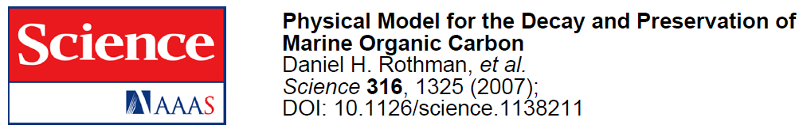
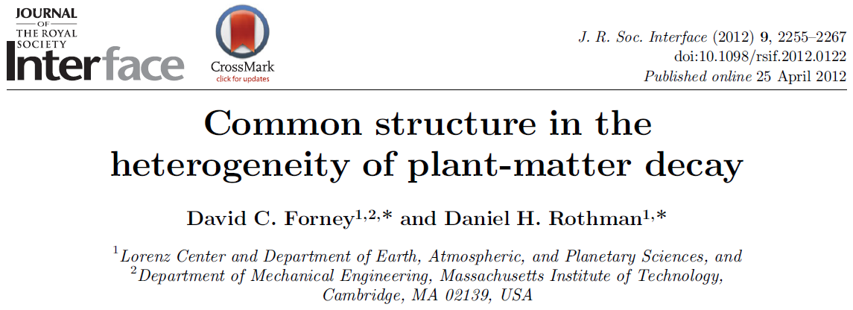
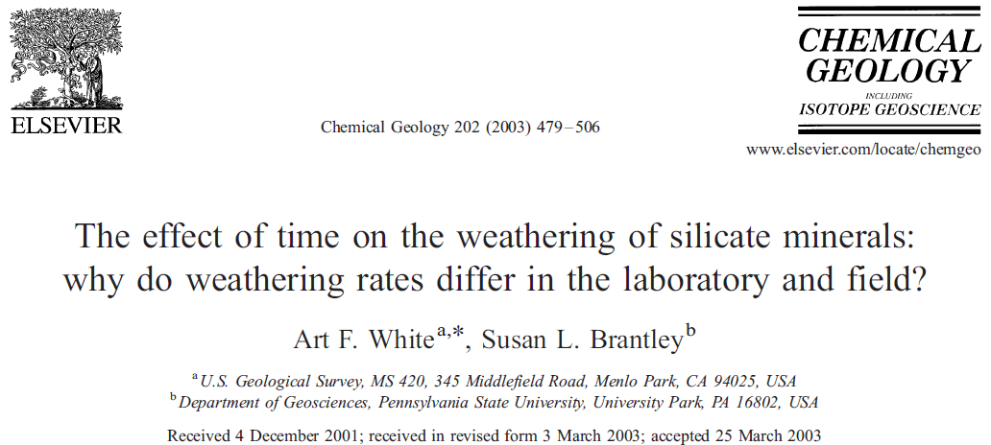
From carbon to minerals…
Motivation
Notes:
Assume:
1. Constant fluid flux from pores (imagine pores as some sort of an “open channel flow”, flowing into and out of the slide)
2. Fluid concentration vanishes at infinity
3. Distance between pores r_{p} >> diffusion length β

Slide 4
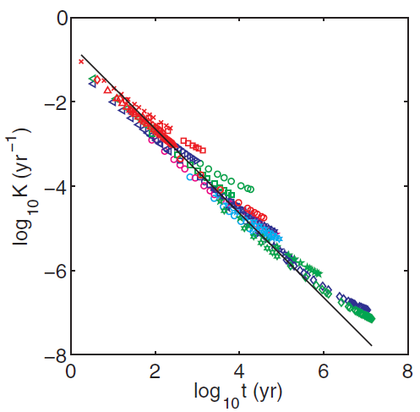
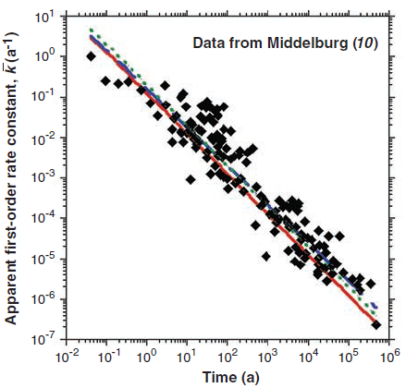


From carbon to minerals…
Motivation
Data from Rothman and Forney (2007)
$$K\left(t\right)≅0.23 t^{−1}$$
$$\overline{k}=0.16 t^{−1}$$
23 published dated sediment cores, from deep ocean to shallow waters
Proposed theory predicts observation
Excellent scaling correspondence

Slide 5
Marine organic carbon
Disordered system
Scaling
Silicate minerals??..

Slide 6
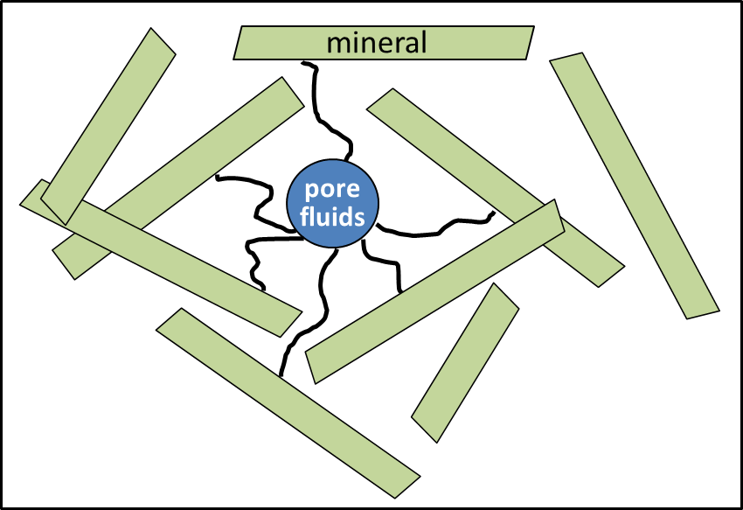

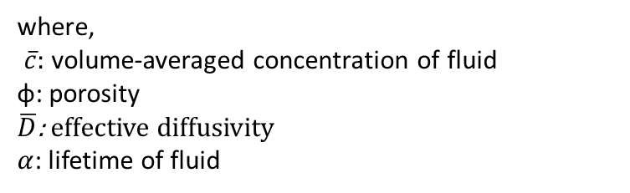


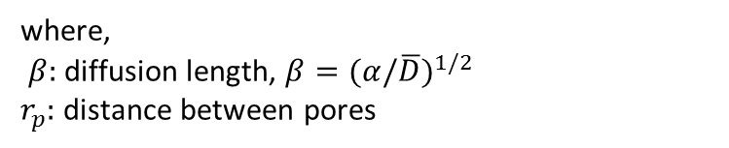
How might reaction-diffusion describe mineral weathering?
Model slide 1 of 5
$$∂_{t}\overline{c}=\overline{D}∇^{2}\overline{c}−α\overline{c}$$
(S1)
$$\overline{c}=ϕc$$
(S2)
where,
$\overline{c}:$volume-averaged concentration of fluid
φ: porosity
$\overline{D}$: effective diffusivity
$α$: lifetime of fluid
Since $k∝f$ and $f∝c$,
$$c\left(r\right)∝e^{−βr_{p}}/r_{p}$$
(S3)
Model central assumption: weathering is rate-limited by hydrolysis. i.e. frequency f with which a mineral is in contact with pore fluids
where,
$β:$diffusion length, $β={(α/\overline{D})}^{1/2}$
$r_{p}:$distance between pores
1
p
p
1
0
. . .
i - 1
i
i + 1
. . .
J
1 - p
1 - p
Notes:
Assume:
1. Constant fluid flux from pores (imagine pores as some sort of an “open channel flow”, flowing into and out of the slide)
2. Fluid concentration vanishes at infinity
3. Distance between pores r_{p} >> diffusion length β

Slide 7

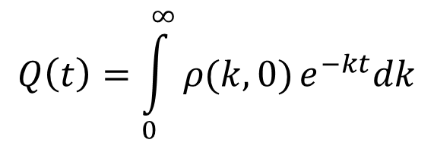
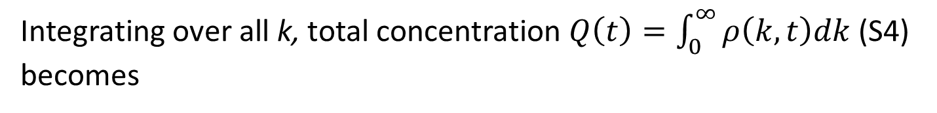

How might reaction-diffusion describe mineral weathering?
Model slide 2 of 5
Reaction-diffusion (S1) predicts a random distribution of rates
Assume random spatial distribution of minerals within domain :
$$ρ\left(k,t\right)dk$$
(S4)
k-dependent concentration, i.e. concentration of mineral at time t associated with rate k and k + dk
Each k-component decays as a first-order process (S3) $∴$
$$ρ\left(k,t\right)=ρ\left(k,0\right)e^{−kt}$$
(S5)
Integrating over all k, total concentration $Q\left(t\right)=\int_{0}^{∞}{ρ\left(k,t\right)dk}$ (S4) becomes
$$Q\left(t\right)=\int_{0}^{∞}{ρ(k,0)}e^{−kt}dk$$
(S6)

Slide 8

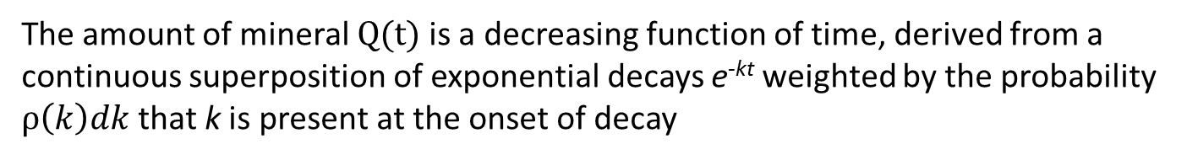
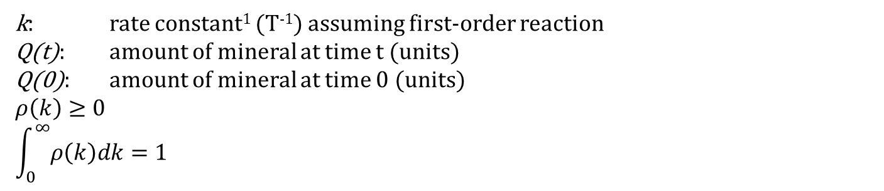
How might reaction-diffusion describe mineral weathering?
Model slide 3 of 5
Or simply that mass fraction $\frac{Q(t)}{Q(0)}$remaining at time t yields
$$\frac{Q(t)}{Q(0)}=\int_{0}^{∞}{ρ(k)e^{−kt}dk}$$
(S7)²
k: rate constant¹ (T⁻¹) assuming first-order reaction
Q(t): amount of mineral at time t (units)
Q(0): amount of mineral at time 0 (units)
$$ρ\left(k\right)≥0$$
$$\int_{0}^{∞}{ρ\left(k\right)dk=1}$$
The amount of mineral Q(t) is a decreasing function of time, derived from a continuous superposition of exponential decays e^{-kt} weighted by the probability $ρ\left(k\right)dk$that k is present at the onset of decay
¹White and Brantley 2003
²Random Rate Model as reviewed by Vlad, Huber, and Ross (1997)
Notes:
Examples of RRM applications: NMR spin decay; protein state relaxation; dielectric, luminescent and mechanical relaxations
Static disorder – the interconversion rates among different conformations are much slower than the reaction rate, such that individual molecules are “frozen” in distinct conformations during their barrier crossing reactions
Dynamic disorder – fluctuations of a reaction rate as a single molecule explores its conformational free-energy landscape

Slide 9
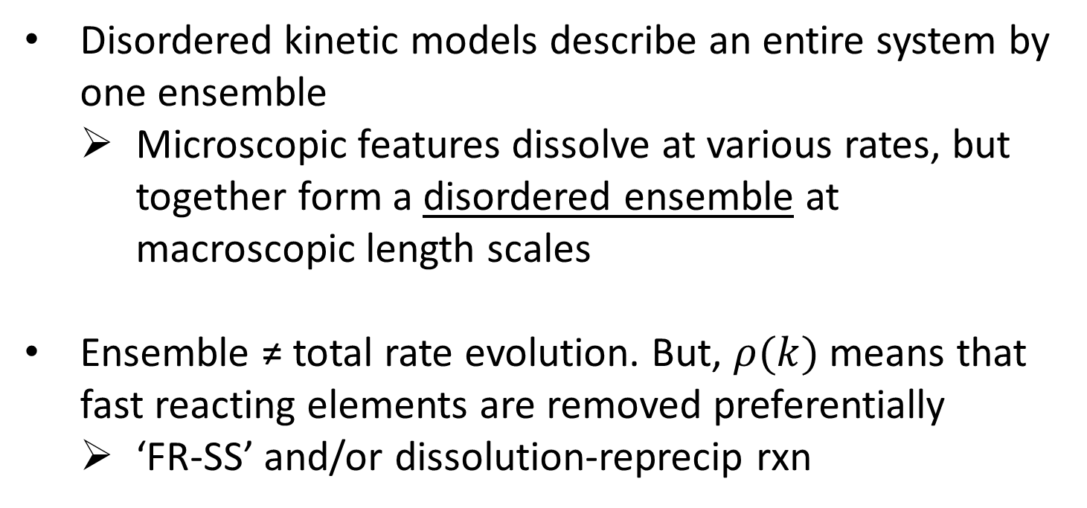
Disordered Kinetics: Random Rate Model
Model slide 4 of 5
Disordered kinetic models describe an entire system by one ensemble
  Microscopic features dissolve at various rates, but together form a disordered ensemble at macroscopic length scales
Ensemble ≠ total rate evolution. But, $ρ(k)$ means that fast reacting elements are removed preferentially
  ‘FR-SS’ and/or dissolution-reprecip rxn

Slide 10
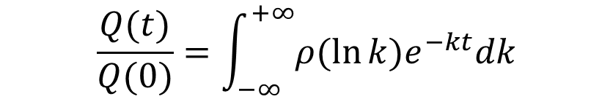
But Eq.7 is ill-posed Laplace transform…
Model slide 5 of 5
So transform $ρ\left(k\right)$ to $ρ\left(x\right)$where $x=\ln{k}$:
$$\frac{Q(t)}{Q(0)}=\int_{−∞}^{+∞}{ρ(\ln{k})e^{−kt}dk}$$
(S8) ¹
Given that we know k, we can then solve for $\frac{Q(t)}{Q(0)}$
¹RRM also commonly used to solve problems involving heterogeneous relaxation in NMR spin decay; protein state relaxation; plant litter decay; dielectric, luminescent, and mechanical relaxations, etc.

Slide 11
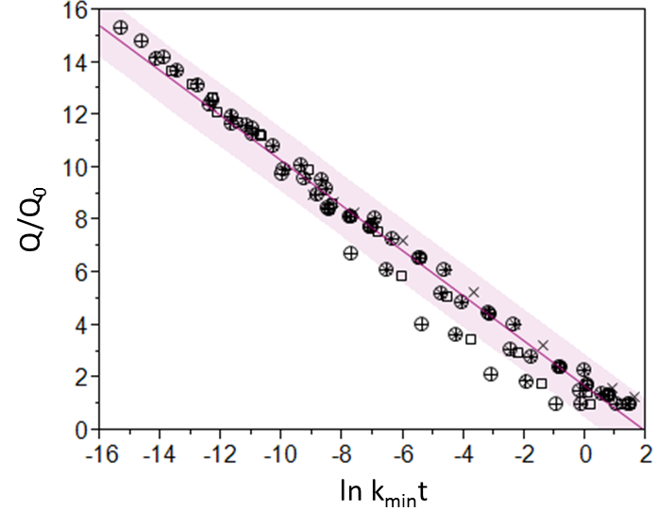
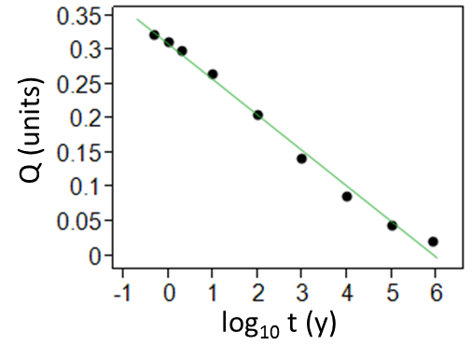
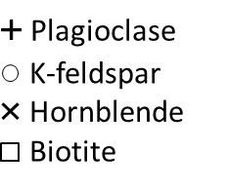
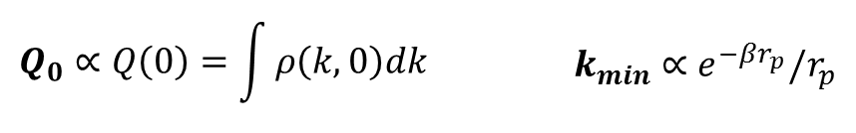
Weathering rate is a function of TIME…
RESULTS
B
A
(A) Amount of albite from Davis Run, VA (White et al. 1996). (B) Rescaling of 30 minerals from literature with respect to dimensionless ln k_{min}t and Q/Q₀

Slide 12
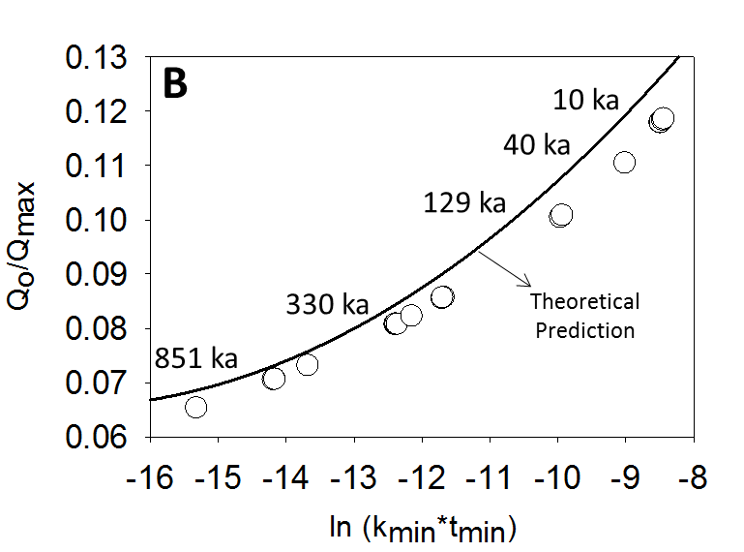
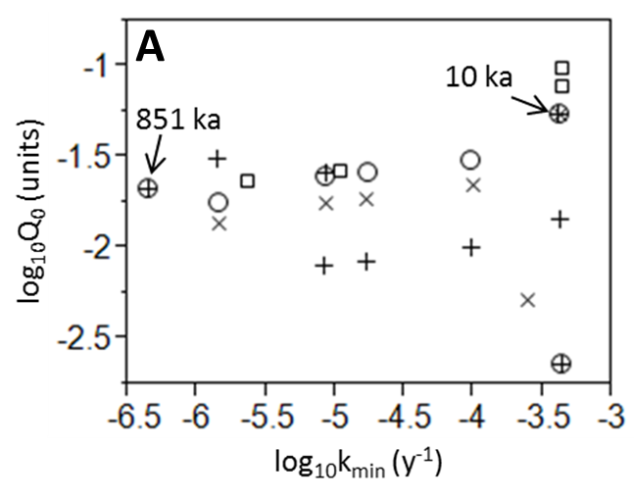
RESULTS
…as well as total mass of minerals in soil
(A) Log-log plot of 30 pairs of Q₀ and k_{min} derived from fits in plot A of previous slide. (B) Rescaling of Q₀ and k_{min} pairs with the initial amount of mineral Q_{max} and initiation of weathering t_{min}.
Note: S.D. << plotted symbols for Plot B

Slide 13
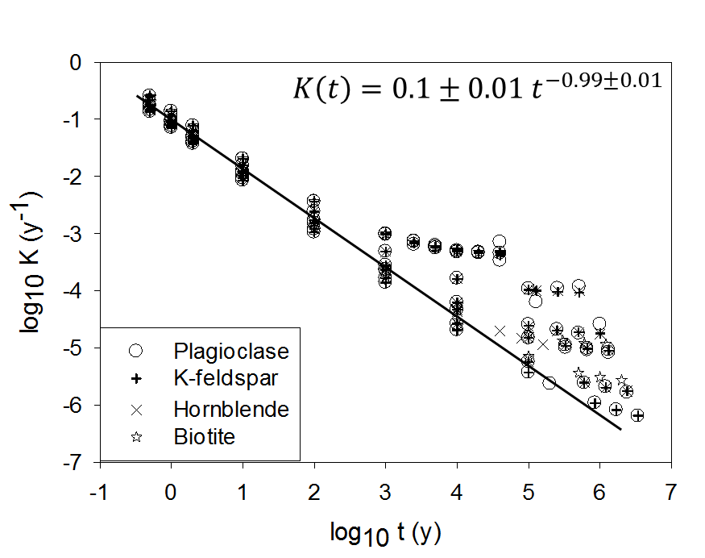



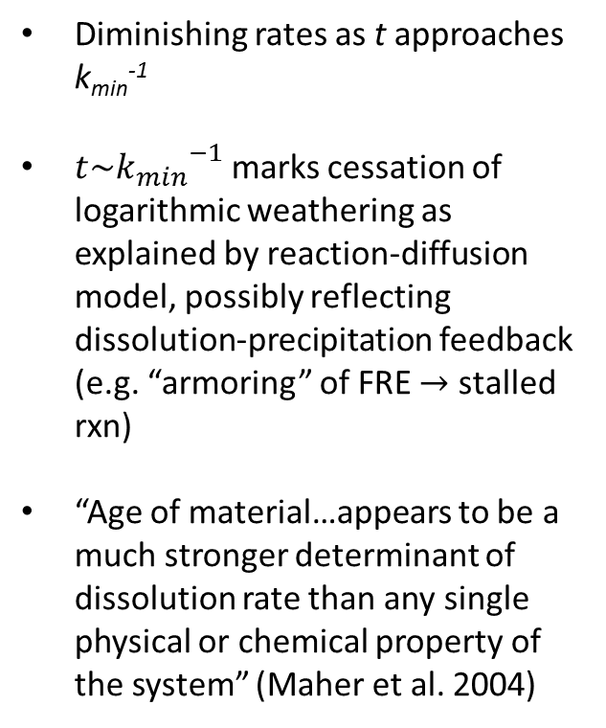
RESULTS
Temporal evolution governed by similar scaling as other systems¹ and earlier study²
Diminishing rates as t approaches k_{min}⁻¹
$t\sim {k_{min}}^{−1}$ marks cessation of logarithmic weathering as explained by reaction-diffusion model, possibly reflecting dissolution-precipitation feedback (e.g. “armoring” of FRE $→$ stalled rxn)
“Age of material…appears to be a much stronger determinant of dissolution rate than any single physical or chemical property of the system” (Maher et al. 2004)
¹Middelburg (1989)
¹Rothman and Forney (2007)
²Maher et al. (2004)
$$K\left(t\right)=0.23t^{−1}$$
$$K\left(t\right)=0.16t^{−0.99}$$
$$R_{d}=0.1{Age}^{−1}$$

Slide 14
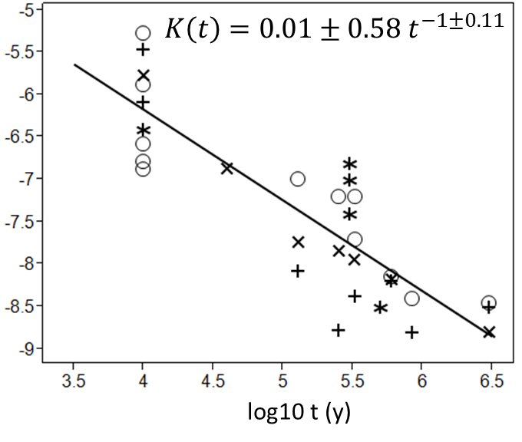
RESULTS
RRM and its relation to the reaction-diffusion model² also agrees with data
²Bender and Orszag (1978). Advanced Mathematical Methods for Scientists and Engineers

Slide 15
Conclusions
Static model of disordered kinetics explains apparent time-dependent and mass-dependent (i.e. mineral residence time) evolution of weathering rates
  Random rate model: explains rates as an ensemble of stochastic reactions that react in parallel, determined by a distribution of rates
  Reaction-diffusion model: provides simple mechanistic understanding of temporal evolution of weathering (sensu ‘mineral residence time’)

Slide 16

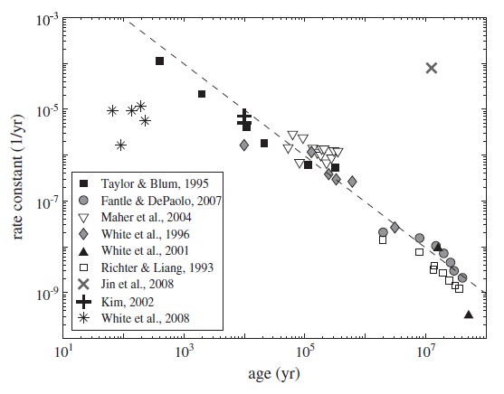
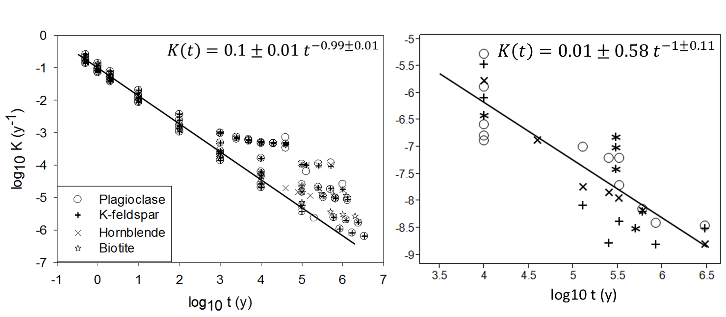

Recently, however…
$$k=0.1 t^{−1}$$
Article first published online: 11 SEP 2013

Slide 17
The model is general…
…and should therefore apply to other transport- and reaction-controlled systems
Question #1: Can RRM describe the serial processes of dissolution-diffusion-precipitation¹ (or permeability recovery) associated with frictional ageing?
¹Manga et al. (2012); Taron and Elsworth (2010)

Slide 18
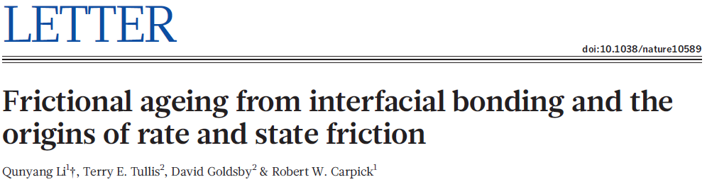
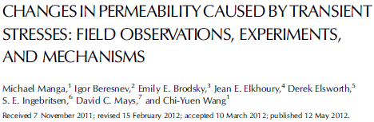
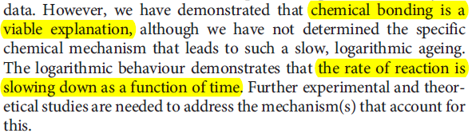
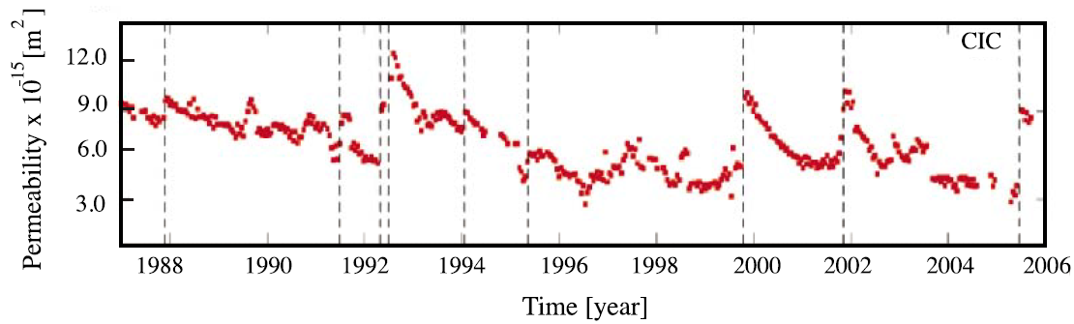
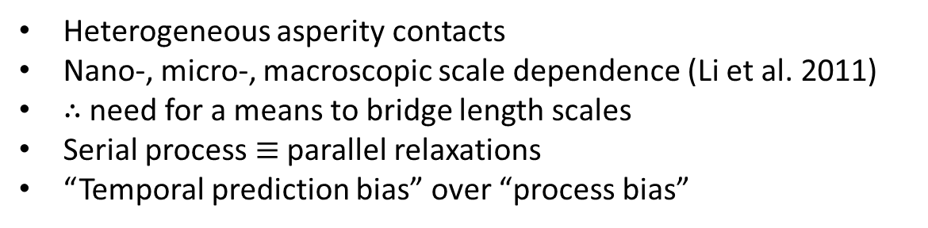
Slow permeability¹ recovery
Why might RRM be able to explain permeability recovery?
Heterogeneous asperity contacts
Nano-, micro-, macroscopic scale dependence (Li et al. 2011)
$∴$ need for a means to bridge length scales
Serial process $≡$ parallel relaxations
“Temporal prediction bias” over “process bias”
Process identification follows after general mathematical classification
¹Also a time-dependent property (White et al. 2005)

Slide 19
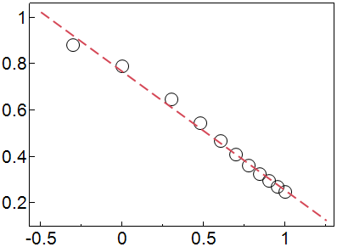


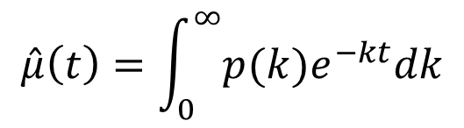
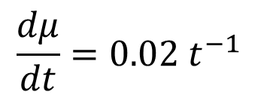
RRM describes observed frictional ‘ageing’
If $∆μ=0.02 log(t)$, then we can take its derivative wrt $t$:
$$\frac{dμ}{dt}=0.02 t^{−1}$$
Then, we call on RRM:
$$\hat{μ}(t)$$
$$\hat{μ}\left(t\right)=\int_{0}^{∞}{p(k)e^{−kt}dk}$$
$$\log_{10} t$$
Contacts lose mass due to dissolution as a slow, logarithmic function of time
Possibly reflects reprecipitation around contacts and hence the ‘healing’
Diffusion is the dominant transport process if we only consider low-permeability fractured rocks as in deep subsurface >10 km

Slide 20

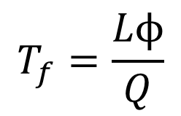


The model is general…
…and should therefore apply to other transport- and reaction-controlled systems
Question #2*: Can we show, experimentally, the heterogeneous, random distribution of reaction rates on reactive surfaces at the nano- and microscale?
$$T_{f}=\frac{Lϕ}{Q}$$
$$∂_{t}\overline{c}=\overline{D}∇^{2}\overline{c}−α\overline{c}$$
$$T^{−1}$$
$$T$$

Slide 21
Thank You

