Slide 1


Flexural Subsidence around Mt. Erebus, Ross Island, Antarctica
Sumant Jha, Derek R. Witt, Dennis L. Harry
Department of Geosciences, Colorado State University

Slide 2
Outline
Introduction – Tectonomagmatic history of Ross Island
Research Objective - Quantify flexure response to volcanic loading
Methods
Identifying flexure subsidence on seismic lines
Correlation of seismic with CIROS-1 and ANDRILL
Flexure Modeling (continuous plate vs. broken plate)
Estimate load magnitude, position and flexural rigidity
Results obtained till now
Future work.

Slide 3
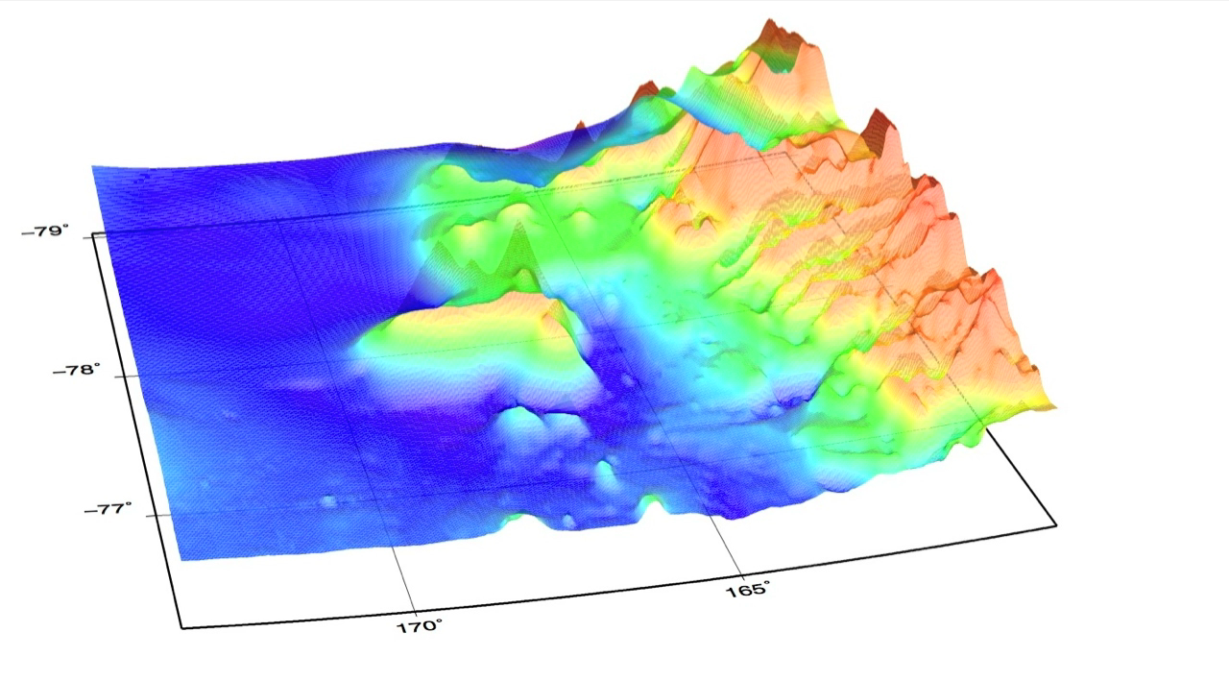
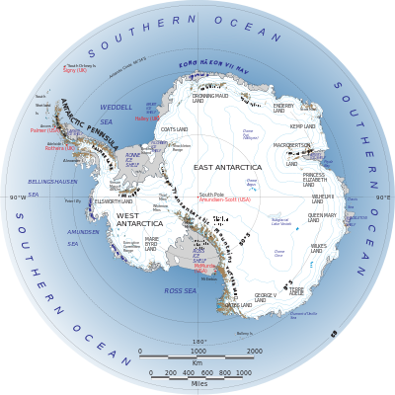
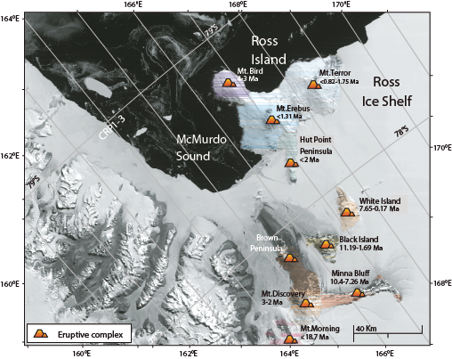
Introduction – Ross Island
Notes:
Ross Island lies at the southern end of the Victoria Land Basin (VLB), a ~350-km-long, half-graben hinged on its western side at the TAM front (Figure 2). Major rifting in the VLB has occurred since the latest Eocene, perhaps having been initiated in the Cretaceous (Cooper and Davey, 1985; Brancolini et al., 1995), and has accommodated up to 10 km of sediment.
Earliest evidence of volcanism 19 Ma, but majority of volcanic rocks have been erupted since ca. 10 Ma. Several volcanos active simultaenously between 5 and 3 Ma. The mass of these volcanoes represent a significant load on the lithosphere that must be isostatically supported by regional flexure of the lithosphere from 1.3 Ma to present

Slide 4
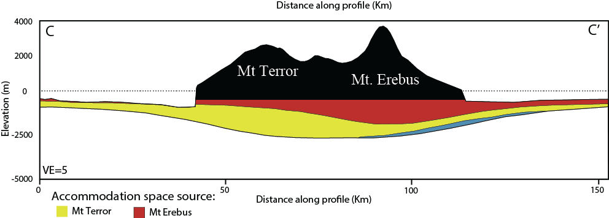
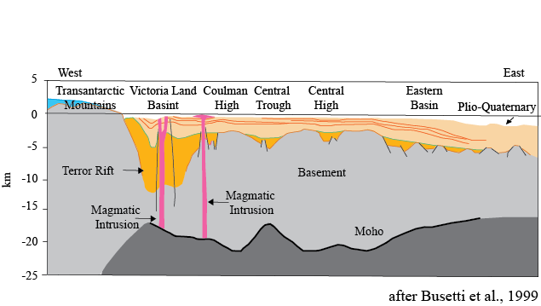
Introduction – Ross Island
Flexure created accommodation space in volcanic moat, and uplift on flexural bulge, where ANDRILL and CIROS drill sites are located
Hypothesis:
Flexural subsidence contributed to cyclic changes between grounded and floating ice at the ANDRILL sites, complicating interpretations of the climatic record
after Aitken et al., 2012
Notes:
Geophysical data show thinned crust throughout the Ross Sea and the West Antarctic Rift System. Basins formed during the Mesozoic, with continued thinning and volcanic activity within the Victoria Land Basin during the Cenozoic, forming the Terror Rift along the boundary between East and West Antarctica.
Magmatism continuous from Eocene (~48 Ma) to present. In southern VLB, volcanism occurred from 19 Ma to the present, although not all the volcanoes were active at the same time. Lithospheric flexure associated with emplacement of these volcanic loads modulates the subsidence history of the southern VLB, complicating recognition of regional extensional (or transtensional) tectonic and
climatic signatures in the stratigraphic record. Waxing and waning of the ice sheet since the Oligocene appears to be dominated by Milankovitch cycles but flexure is recognized to have locally
influenced seafloor depth, particularly in the vicinity of the ANDRILL drill sites, thus complicating interpretation of the climatic signal from the apparent cyclicity in the sediment record
Understanding flexure-induced subsidence and uplift is prerequisite to isolating the regional extensional tectonic and climatic
signatures in the stratigraphic record

Slide 5
Objective
The objectives of this research are –
To identify flexure basin around Ross Island using seismic data.
Identify ages of flexural subsidence by correlating seismic with CIROS and ANDRILL drill holes
Correlate the flexural subsidence episode with volcanic loading events on Ross Island
Model tectonic subsidence due to loading events
Remove tectonic signatures and isolate climatic signatures leading to changes in grounding and floating ice line
Geological Society of America Annual Meeting, Denver, 2013
American Geophysical Union Fall Meeting, San Francisco, 2013

Slide 6
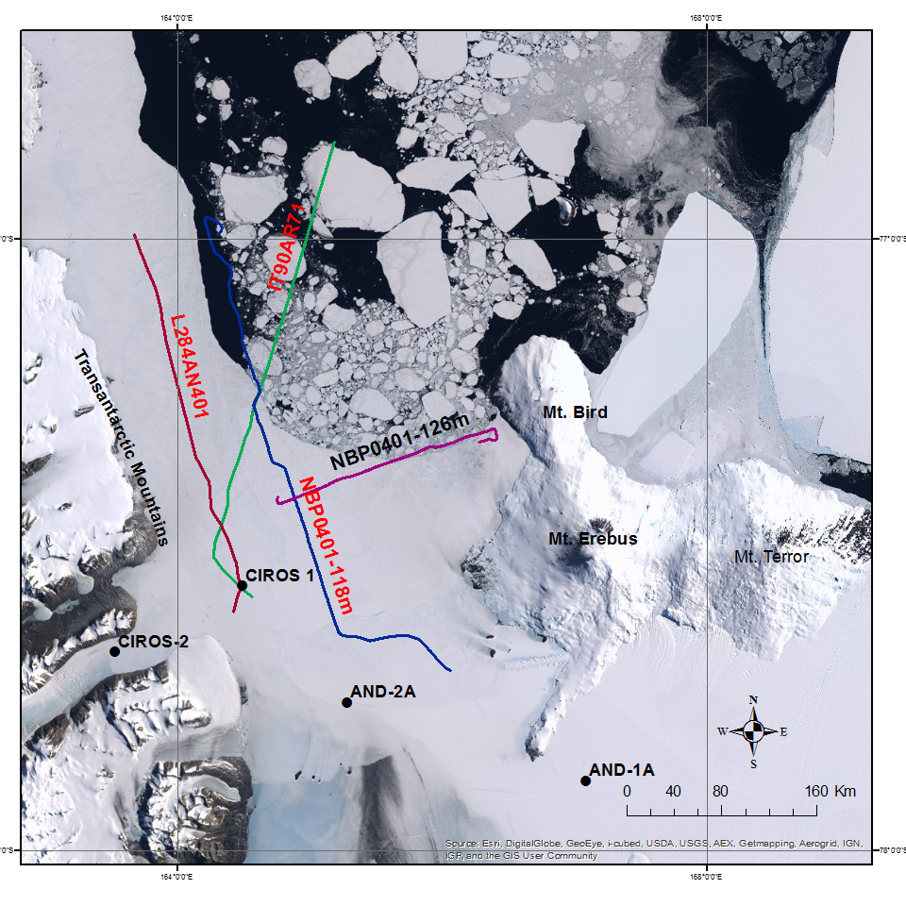
Seismic Evidence of Basin Flexure
Seismic lines, parallel to expected 2-D flexure profile, were identified in Antarctic Seismic Data Library
NBP0401-126m
NBP0401-118m
IT90AR71
L284AN-401
Notes:
AND 1B in Ross Island Flexure moat, and AND 2A, and probably CIROS-1, on Ross Island Flexure Bulge.

Slide 7
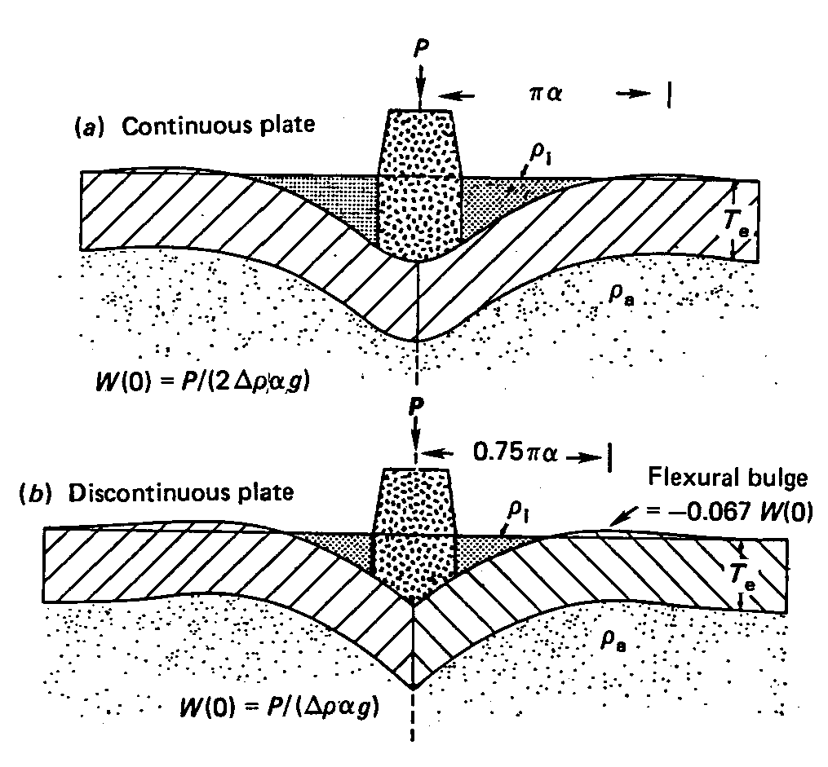
Continuous plate Vs. Broken plate
We used both the broken plate model and continuous plate model in our analysis and found that the broken plate model fits the seismic horizons better than a continuous plate model in the area, which agrees with the discontinuous plate model of Stern et. al, 1991
after Stern et al., 1991
Notes:
Add reference to figure

Slide 8
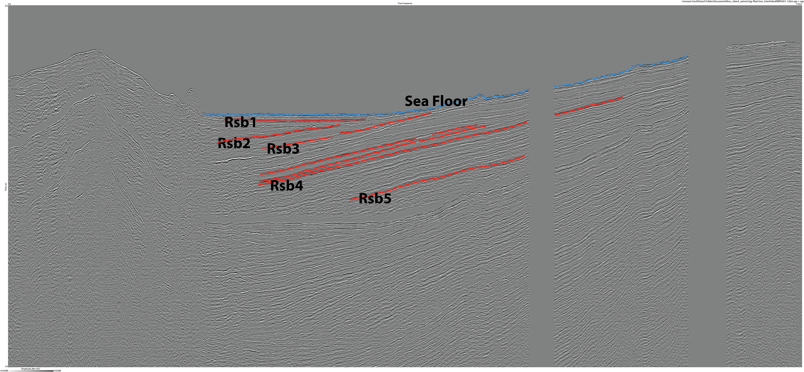
Seismic Profile NBP0401-126m
This Study | Fielding et al. (2008) and Naish et al. (2007)
Rsb1 | Rk
Rsb2 | Rj
Rsb3 | Ri
Rsb4 | Rh
Rsb5 | Rg
Line: NBP0401-126m Shotpoint: 1100-18760
Number of Traces: 1650 Trace Length: 4000 ms
Trace Interval: 80 m
On the seismic data, we have identified 5 seismic horizons which correspond to the seismic horizons from previous authors (Fielding et al., 2008; Naish et al., 2007)

Slide 9
Interpreted Seismic Stratigraphic Horizons
Seismic Stratigraphic Horizon | Age Correlation based on CIROS-1 and ANDRILL (Fielding et al., 2008) | Rifting phase
Rsb1 | >2.0 Ma - Present | Renewed Rifting, upper interval
Rsb2 | ~ 2.0 Ma
Rsb3 | ~4.6 – 4.0 Ma
Rsb4 | ~7.6 Ma | Renewed Rifting, lower interval
Rsb5 | ~13 Ma | End of passive thermal subsidence
Flexural
loading of
lithosphere
around
Ross Island
commenced

Slide 10
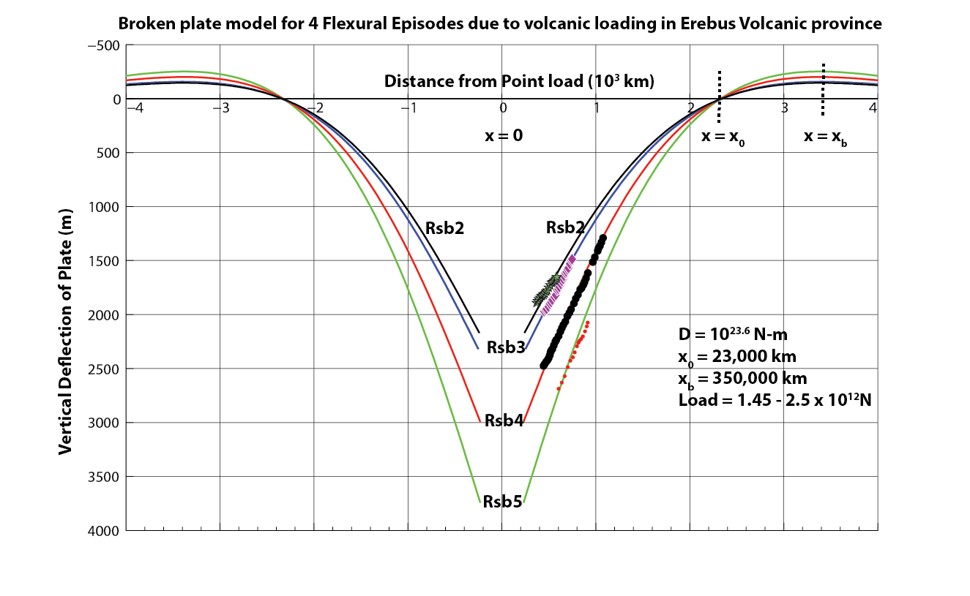
Flexure model
We use dips of seismic horizons in flexure modeling to model the flexure of Ross Sea basin.
Notes:
Add load

Slide 11
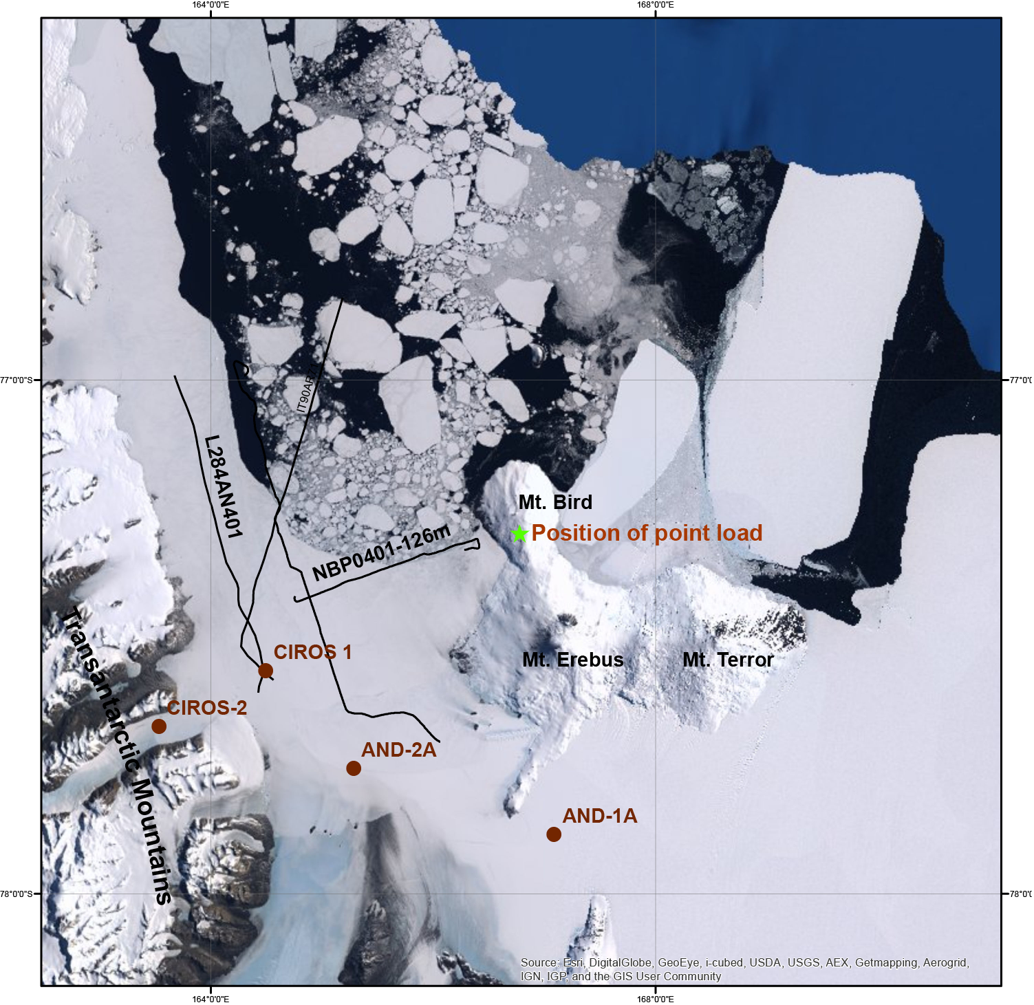
Results
Based on our flexure model, we estimate the flexural rigidity and position of point load.

Slide 12
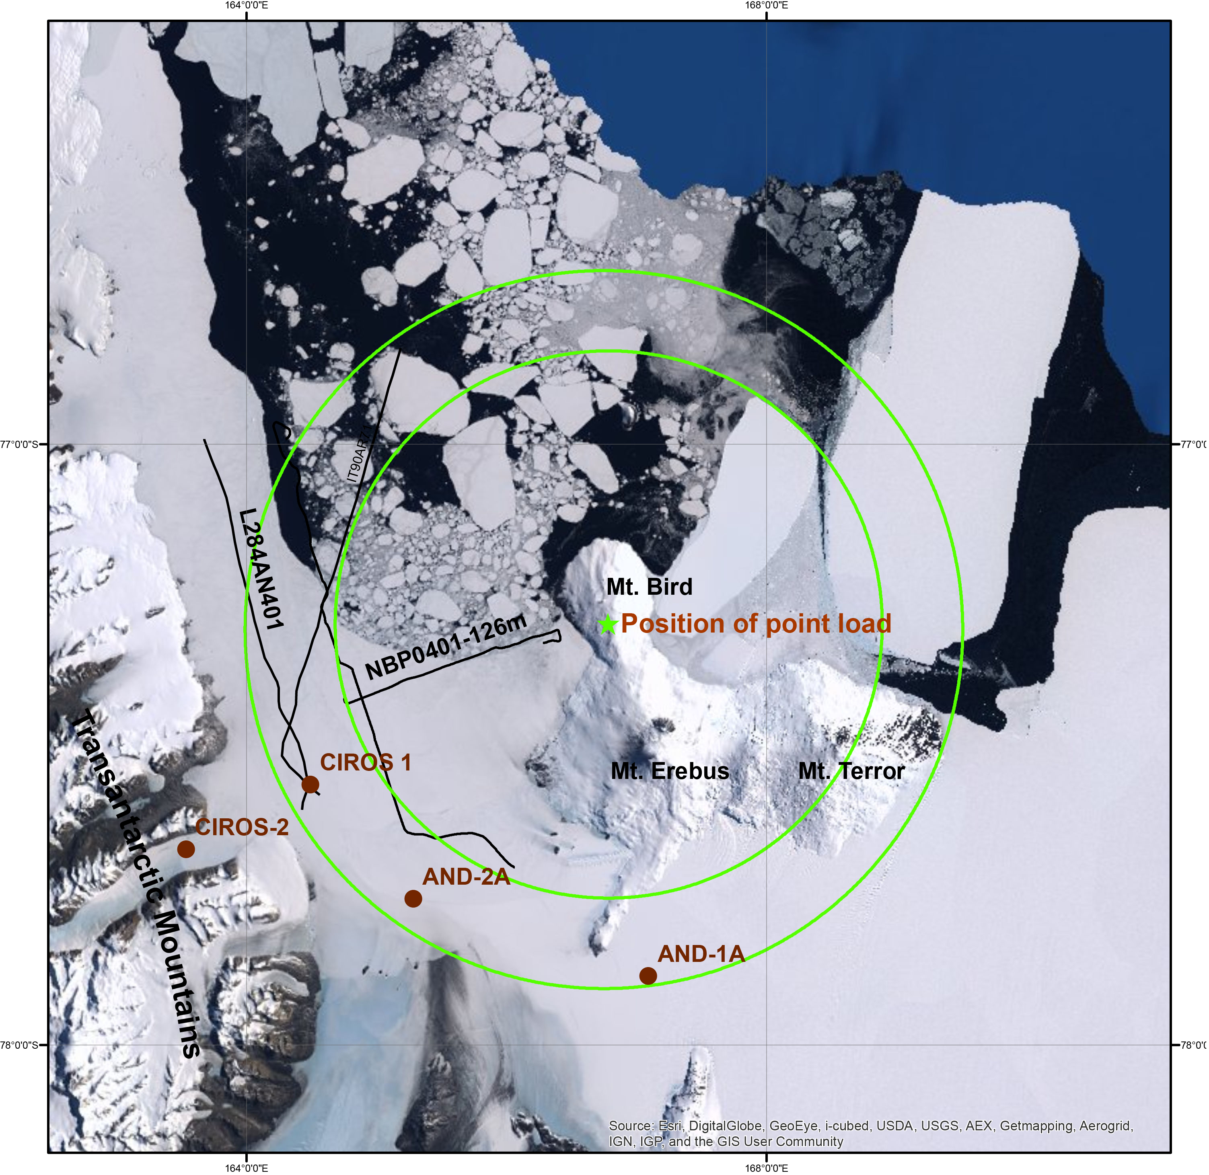
Results
Based on our flexure model, we estimate the flexural rigidity and position of point load.
2-D modeling using NBP0401-126 m, suggests that point load was centered around Mt. Bird, and the flexural bulges extended as far as CIROS-1
Flexure Moat
Flexure Bulge
Notes:
Add 3 slides with three points

Slide 13
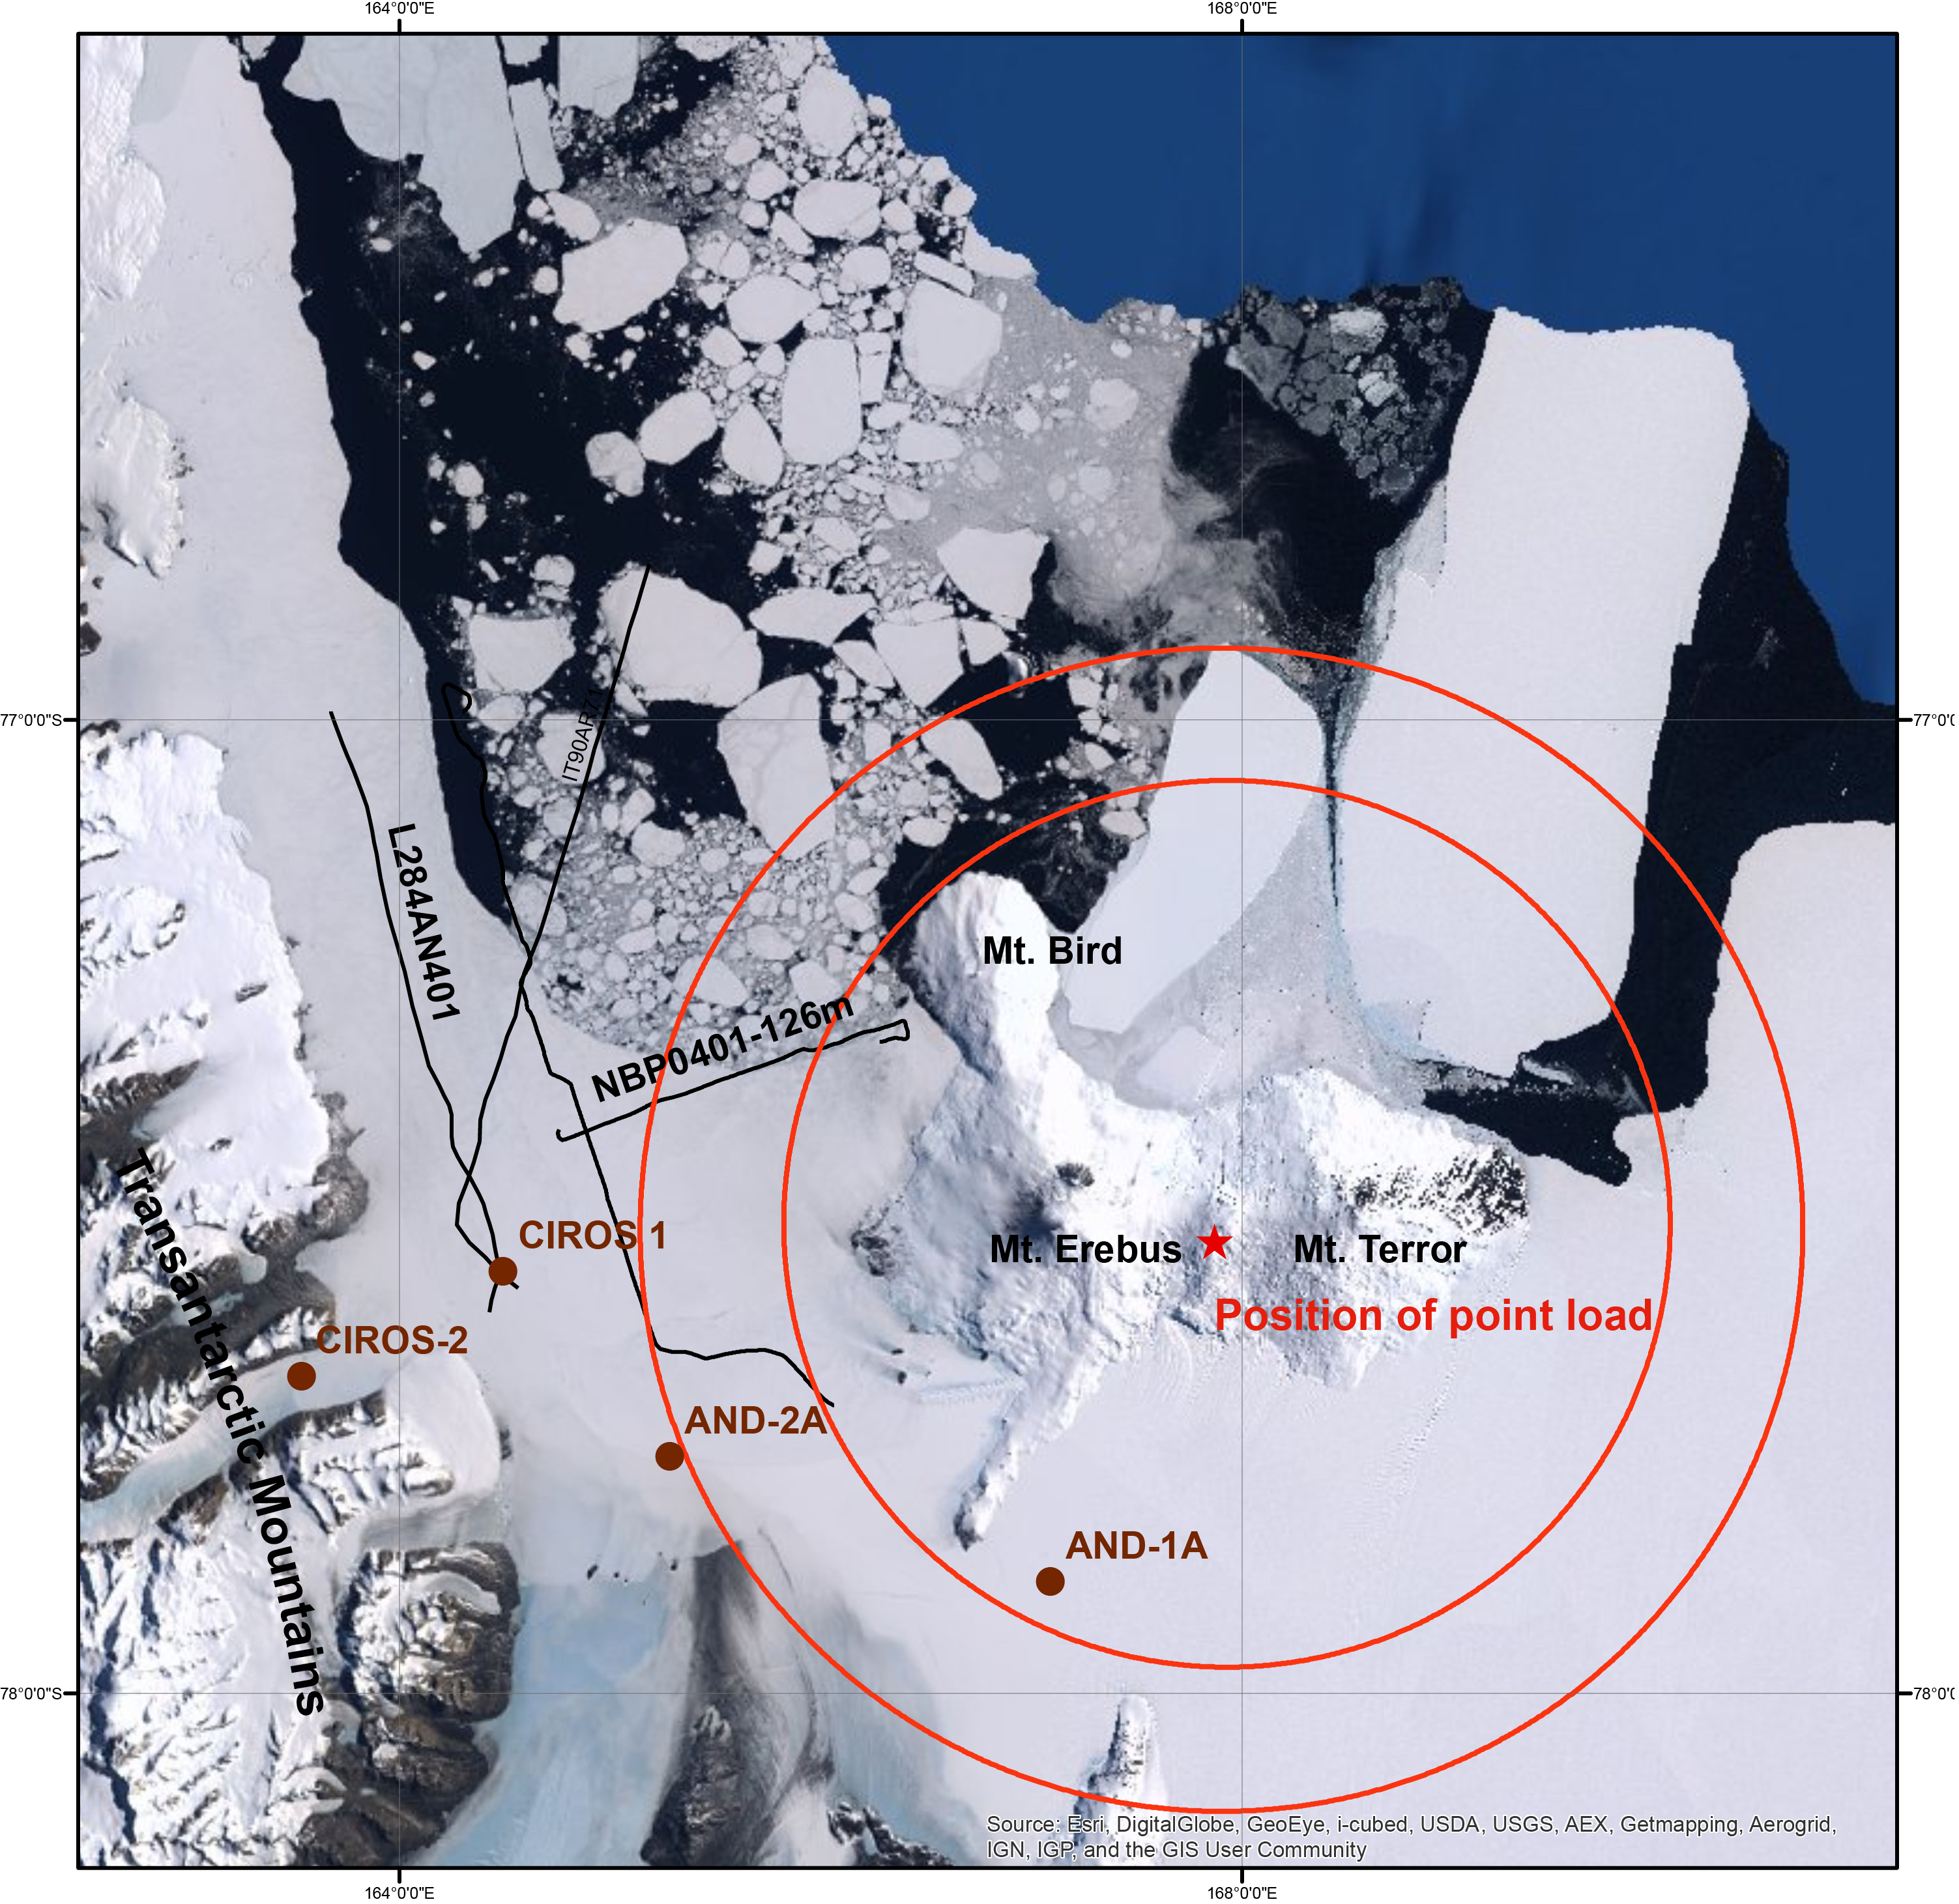
Results
Based on our flexure model, we estimate the flexural rigidity and position of point load.
2-D modeling using NBP0401-126 m, suggests that point load was centered around Mt. Bird, and the flexural bulges extended as far as CIROS-1
Since, we hypothesized that flexure around Ross Island is due to a point load on Ross Island, using the parameters from above result, we infer that AND-1A lies in the moat, and AND-2A, just on the flexural bulge. CIROS-1 is further away
Flexure Moat
Flexure Bulge

Slide 14
Conclusions
Flexural rigidity of lithosphere around Ross Island region is about 10^{23.6} N-m, which suggests presence of weaker lithosphere in the region.
Notes:
Add 4 slides with each point
Weaker lithosphere is expected in rifting areas. Other regions, with such rampant oceanic volcanism like Hawaii to show similarly weakened lithosphere. Some workers have suggested that rifting results in a catastrophic reduction in the strength of the mantle while others have speculated that the mantle recovers its strength but, is somehow de-coupled from the strong uppermost crust.

Slide 15
Conclusions
Flexural rigidity of lithosphere around Ross Island region is about 10^{23.6} N-m, which suggests presence of weaker lithosphere in the region.
Flexural bulge due to point load centered on Ross Island, is located at a distance of ~350 km, which is very close to AND-2A. Additionally, AND-1B lies in the Ross Island Flexure moat. Hence, correlation of seismic data with AND-1B and AND-2A core will yield further results about ages of different volcanic loading episodes.
Notes:
Weaker lithosphere is expected in rifting areas. Other regions, with such rampant oceanic volcanism like Hawaii to show similarly weakened lithosphere. Some workers have suggested that rifting results in a catastrophic reduction in the strength of the mantle while others have speculated that the mantle recovers its strength but, is somehow de-coupled from the strong uppermost crust.

Slide 16
Conclusions
Flexural rigidity of lithosphere around Ross Island region is about 10^{23.6} N-m, which suggests presence of weaker lithosphere in the region.
Flexural bulge due to point load centered on Ross Island, is located at a distance of ~350 km, which is very close to AND-2A. Additionally, AND-1B lies in the Ross Island Flexure moat. Hence, correlation of seismic data with AND-1B and AND-2A core will yield further results about ages of different volcanic loading episodes.
Grounded ice at AND-2A modulated by flexural bulge
Future work will quantify the effect of flexure on grounded vs floating ice
Notes:
Weaker lithosphere is expected in rifting areas. Other regions, with such rampant oceanic volcanism like Hawaii to show similarly weakened lithosphere. Some workers have suggested that rifting results in a catastrophic reduction in the strength of the mantle while others have speculated that the mantle recovers its strength but, is somehow de-coupled from the strong uppermost crust.

Slide 17

Questions?

