Slide 1
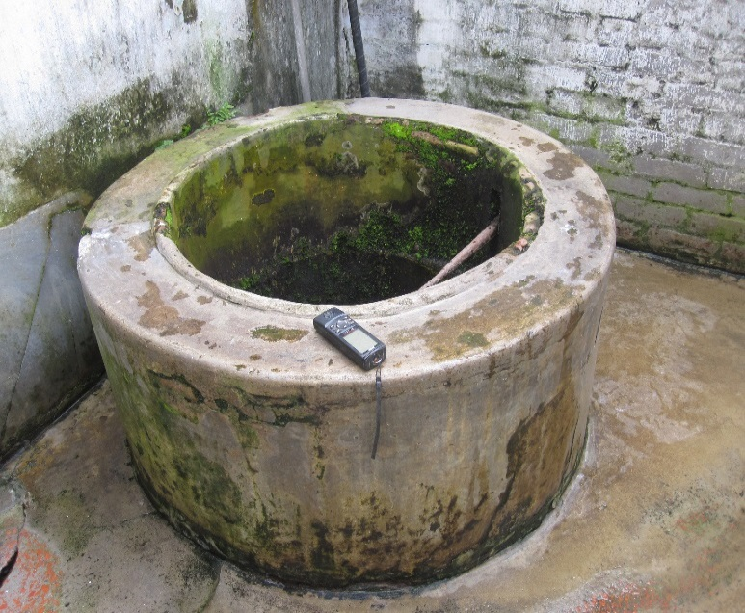


Water quality assessment of Dug Well waters and its adjoining Buriganga river reach, Old Dhaka, Bangladesh
Shovon Barua, M. Saiful Islam, Saugata Datta
University of Dhaka
Kansas State University

Slide 2
Outline
Introduction
Objectives
Methodology
Hydrology
Hydrochemistry
Conclusions

Slide 3
Introduction

Slide 4
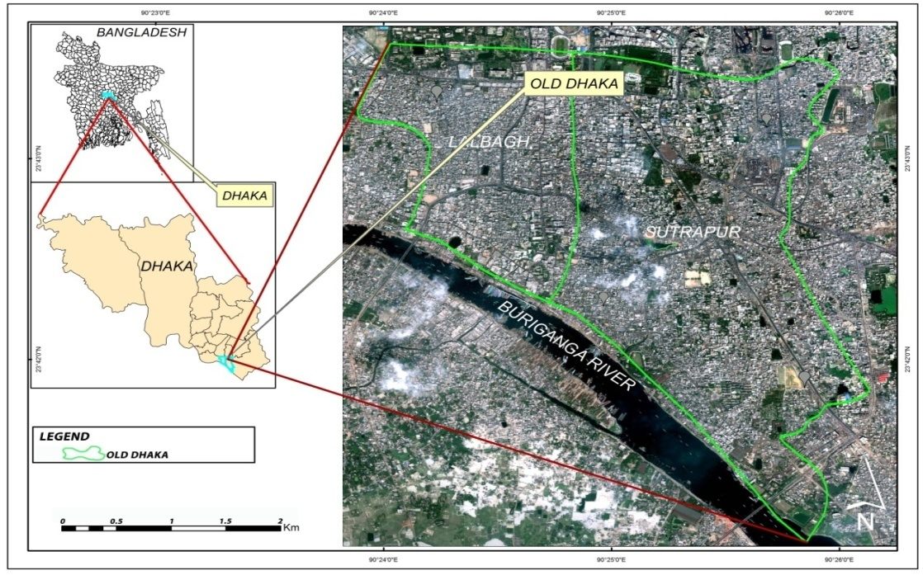
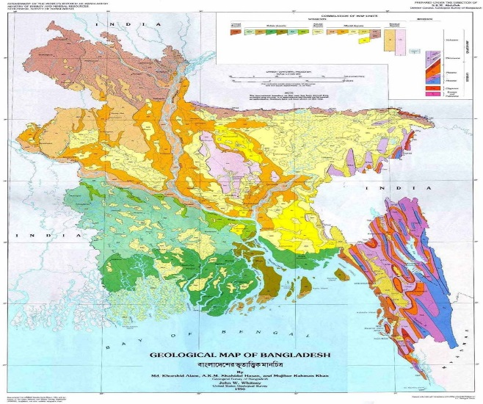
Study area includes Lalbagh and Sutrapur with an area of ̴ 6.8 km² and lies towards the northern bank of Buriganga river
Lat- 23°41'0''N to 23°43'15''N
Long- 90°24'0''E to 90°26'0''E
Geologically- Pleistocene Uplift Block (Madhupur Tract)
Physiographically- Southern half of Madhupur Tract and Floodplain area with river system towards south
Topographically- Elevation around 14m
Geomorphologically- Higher Pleistocene Terrace
Location map of the study area
Strat. age | Strat. name | Lithology | Thickness (m) | Function in aquifer system
Floodplain area
Holocene | Floodplain | Alluvial silt, sand & clay | 6-15 | Up. aquitard
Late Pleistocene to Holocene | Dhamrai fm. | Alluvial sand | 100-200 | Potential aquifer
Pre-Pleistocene | Not Named | Unknown | .
Madhupur Tract area
Recent | Low land alluvium | Swamp, levee and riverbed sediments | 0-5 | Up. aquitard
Holocene | Bashabo fm. | Sand (discontinuous) | 3-25 | Aquifer
Pleistocene | Madhupur Clay fm. | Silty clay member, Fluvio-deltaic sand | 6-25 | Up. aquitard
Plio-Pleistocene | Dupi Tila fm. | Dupi Tila claystones Fluvio-deltaic sands | 100-180 | Potential aquifer
Miocene | Girujan Clay | Bluish clay | 50-100 | Known Lr. AquitarL
Stratigraphy of Dhaka city (Houque, 2004)
Geological Map of Bangladesh (GSB & USGS, 1990)

Slide 5
Dhaka water supply and sewerage authority (DWASA Annual Report, 2011-2012)
Water production/day 1760ML (2007-08)
2180ML (2011-12)
Population, water demand and water supply in Dhaka city (Ahmed et. al. 2011)

Slide 6
-To assess meteorological and hydrological conditions of the study area -Comparing the variation in hydrochemistry and water quality of dug well and Buriganga river waters
Objectives

Slide 7
Methodology

Slide 8
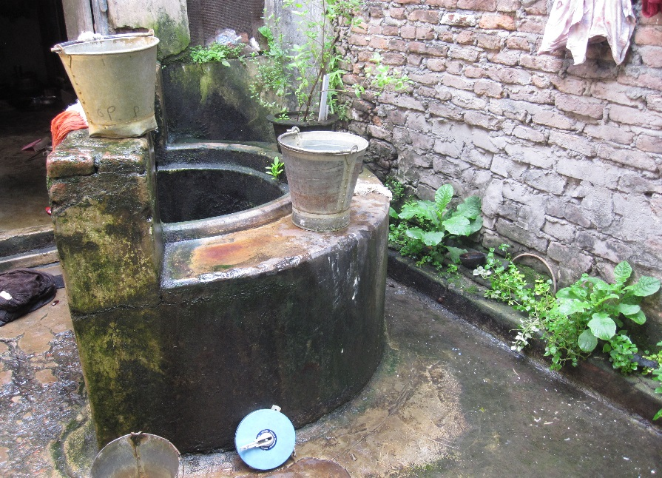
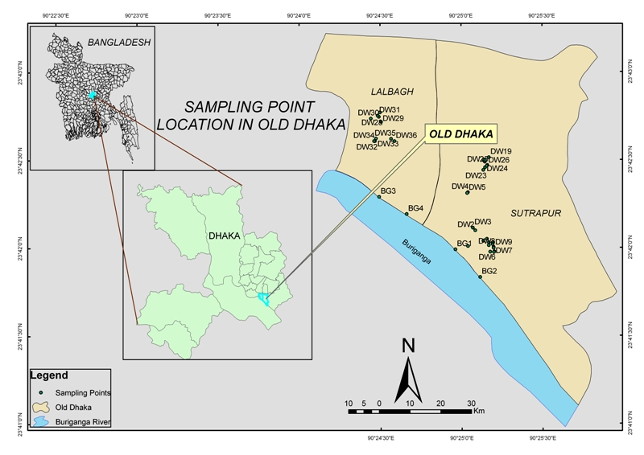
Flow chart for the methodology of the study area
Literature review
Secondary data
Data collection
Field data
Water sampling and on site parameter measurement
Bucket
Hydrochemical analyses
Data processing & analyses
Sampling location map of the study area

Slide 9
Hydrology

Slide 10
Mean monthly rainfall (1998-2007)
max. 402.4 mm (July)
min. 4.9 mm (January)
Mean annual rainfall (1998-2007)
2084 mm
max. 2733.1 mm (2007)
min. 1689.8 mm (2002)
Annual avg. evaporation 769 mm (40% of total annual rainfall of the study area)
max. 95.9 mm (April)
min. 39.4 mm (January)

Slide 11
Mean monthly surface water level (1998-2007)
max. 5.6 mm (Aug)
min. 0.7 mm (Feb)
Ground water level of the study area has been decreased gradually from 1986 to 2007

Slide 12
Hydrochemistry

Slide 13
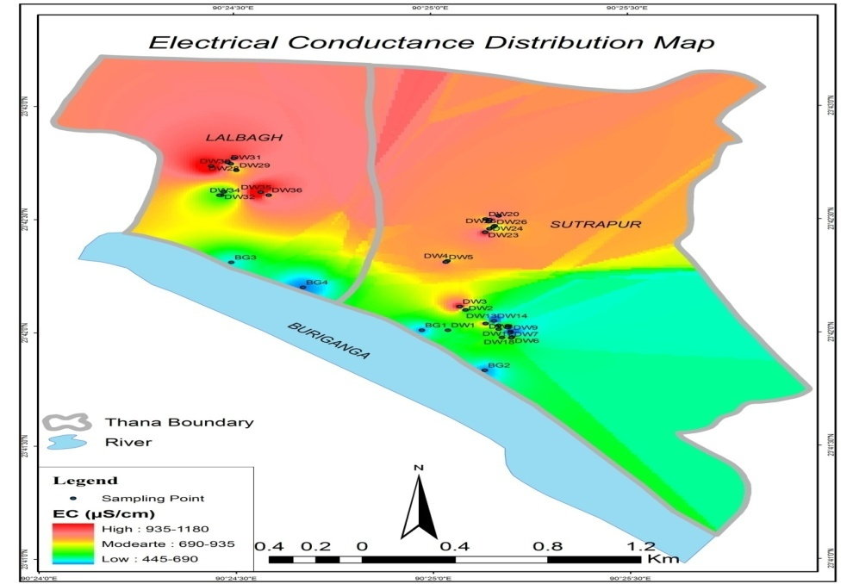
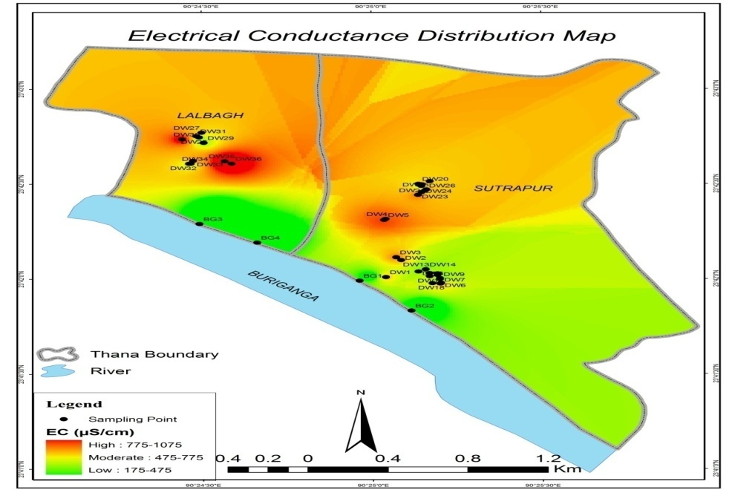
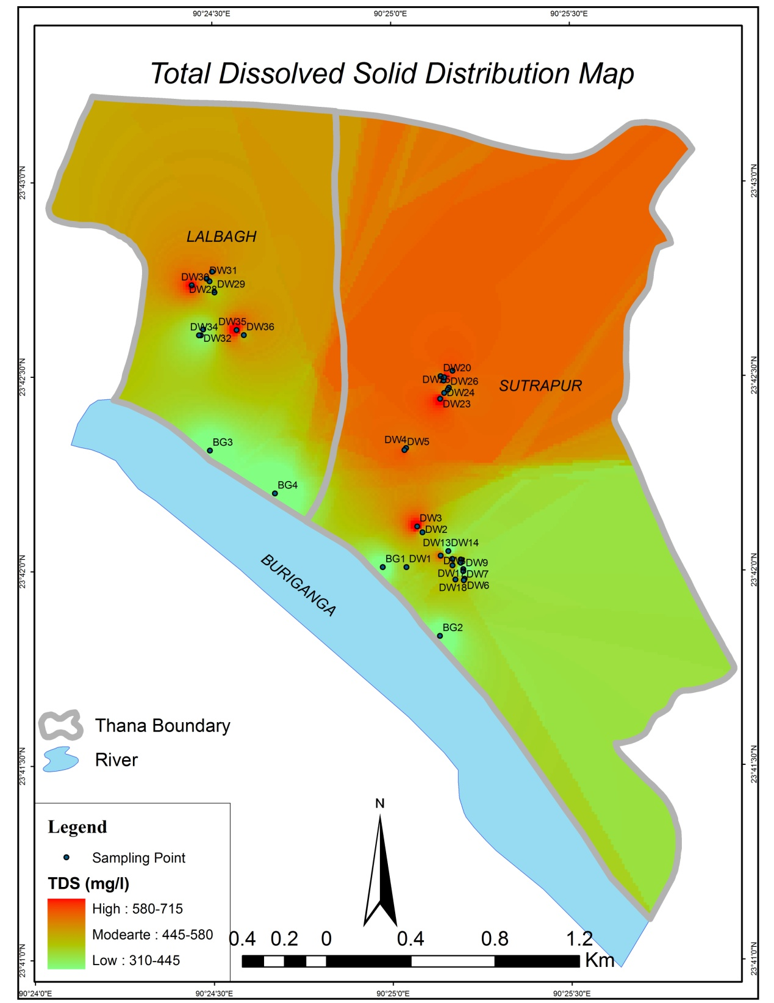
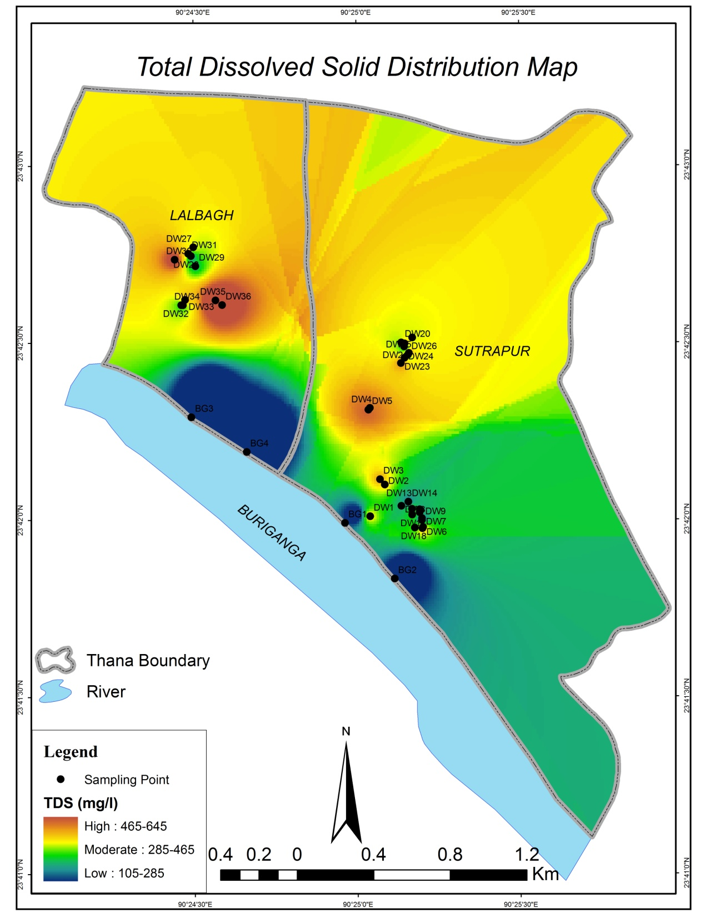
EC during dry period 430 to 1180 μS/cm for DW
593 to 618 µS/cm for BG
EC during wet period 426 to 1068 μS/cm for DW
175.3 to 348 µS/cm for BG
TDS during wet period 256 to 641 mg/l for DW
105.2 to 209 mg/l for BG
TDS during dry period 301 to 733 mg/l for DW
348 to 371 mg/l for BG

Slide 14
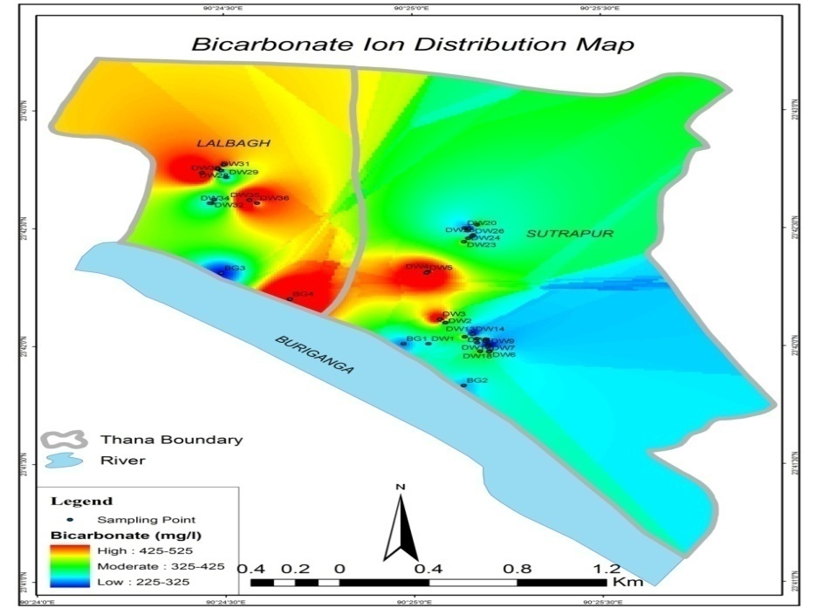
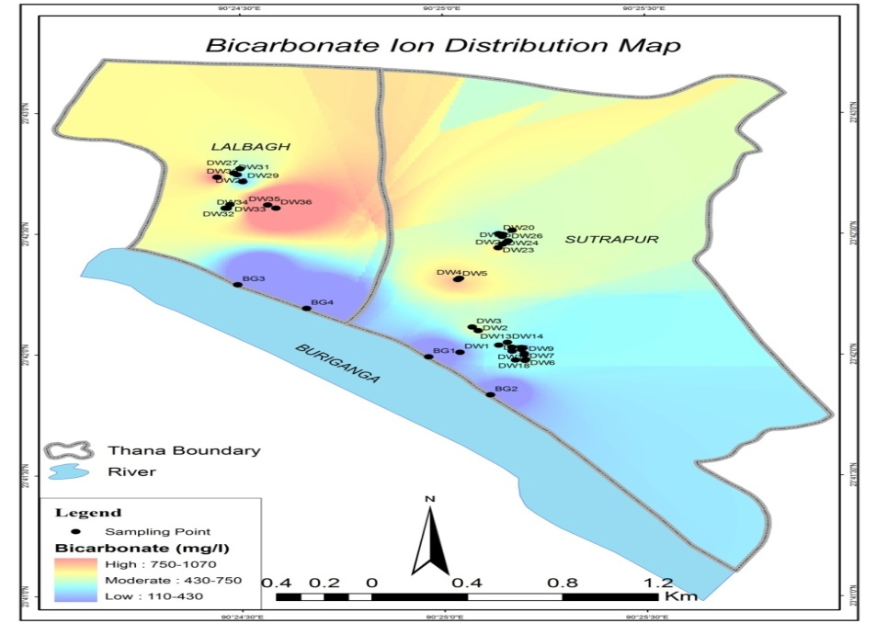
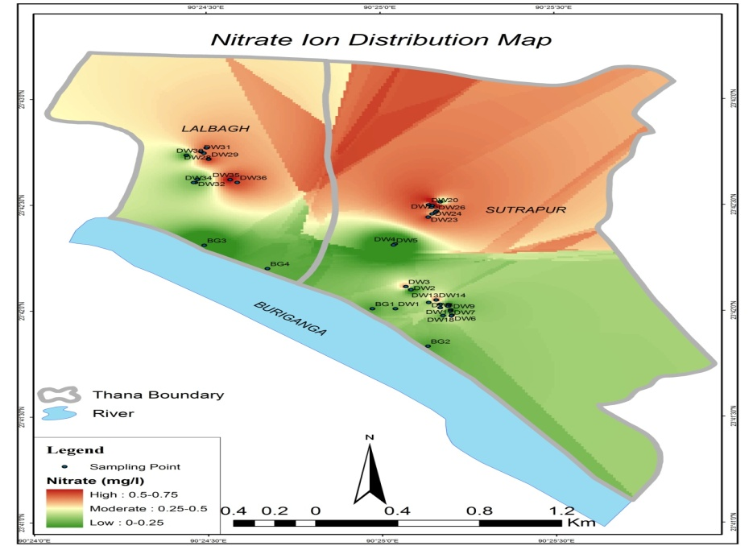
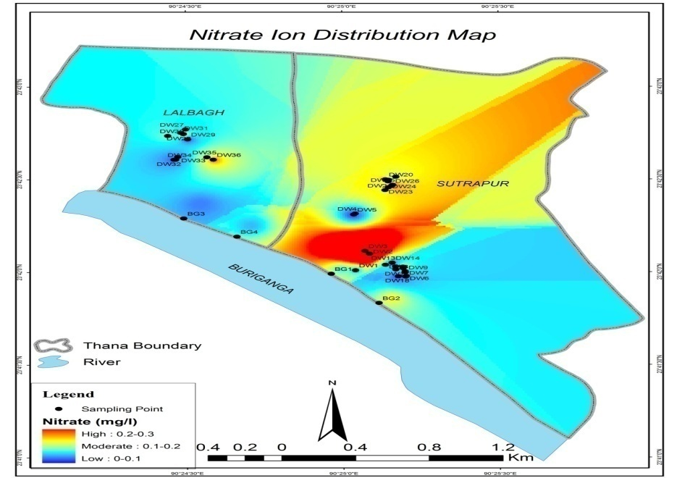
HCO3- during dry period 213.5 to 518.5 mg/l for DW
289.8 to 449.9 mg/l for BG
HCO3- during wet period 228.8 to 1052.3 mg/l for DW
114.4 to 137.3 mg/l for BG
NO3- during wet period 0 to 0.3 mg/l for DW
0 to 0.1 mg/l for BG
NO3- during dry period 0 to 0.8 mg/l for DW
0 to 0.8 mg/l for BG

Slide 15
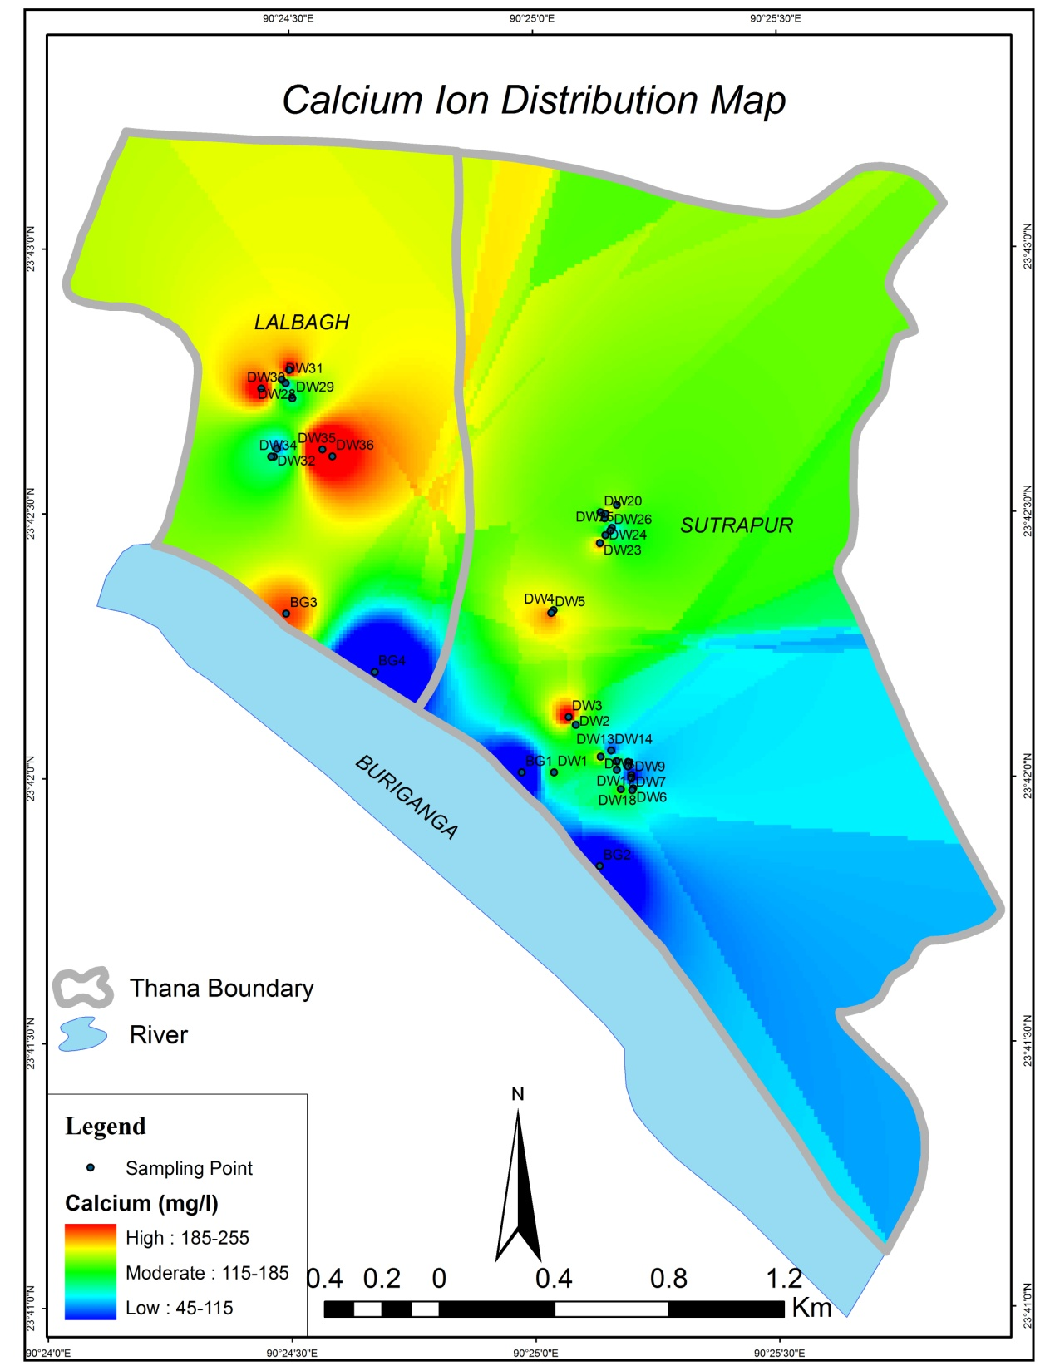
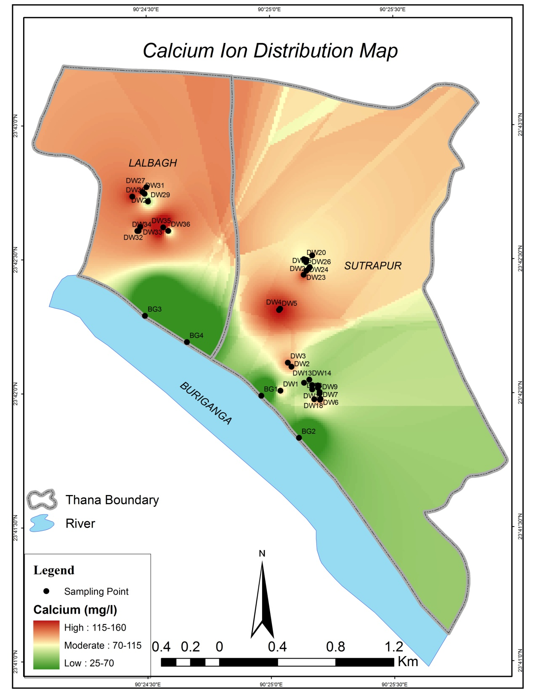
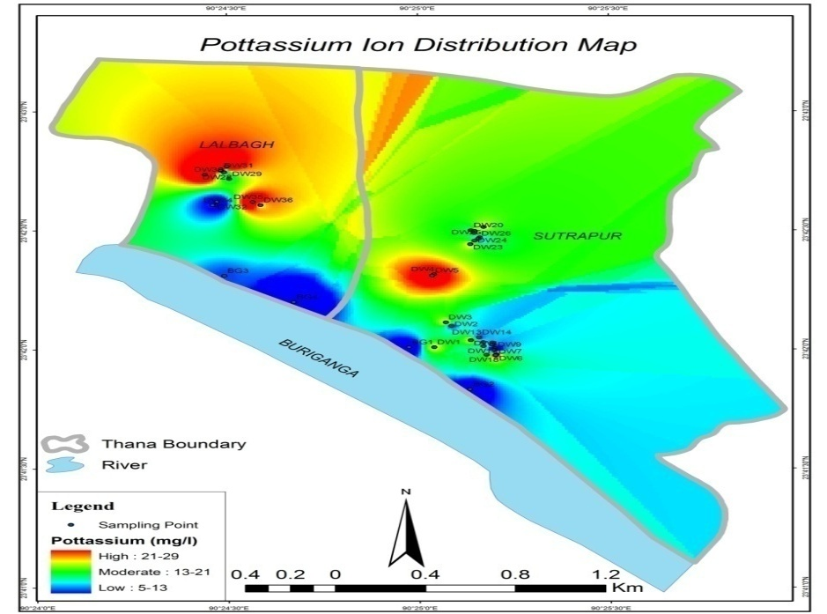
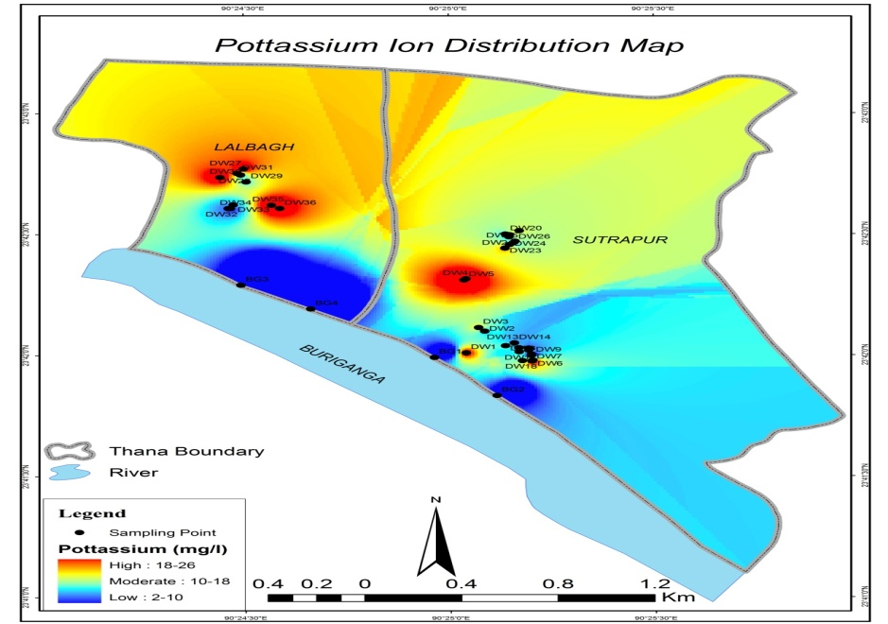
Ca2+ during dry period 91.9 to 251.1 mg/l for DW
47.6 to 188.5 mg/l for BG
Ca2+ during wet period 63.1 to 151.8 mg/l for DW
30.1 to 38.6 mg/l for BG
K+ during wet period 5.4 to 24.6 mg/l for DW
2.8 to 3.2 mg/l for BG
K+ during dry period 4.6 to 26.2 mg/l for DW
3.2 to 6.3 mg/l for BG

Slide 16
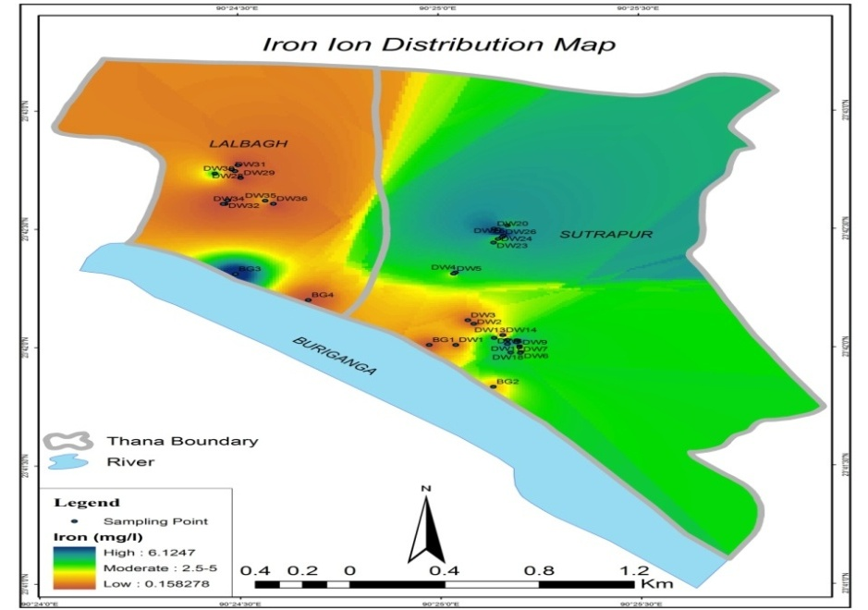
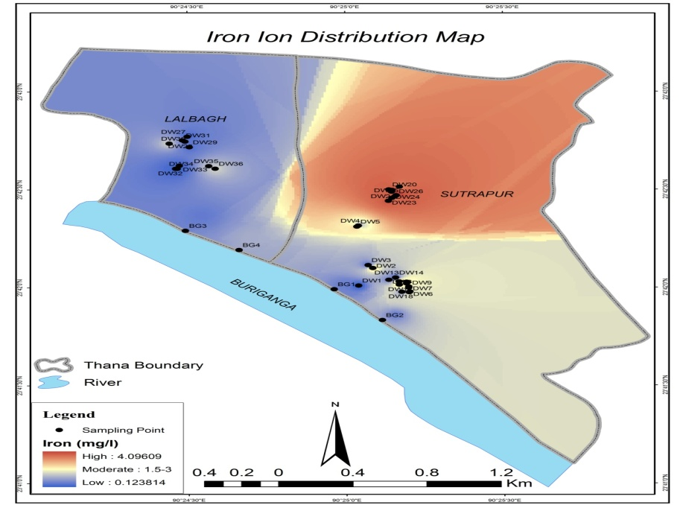
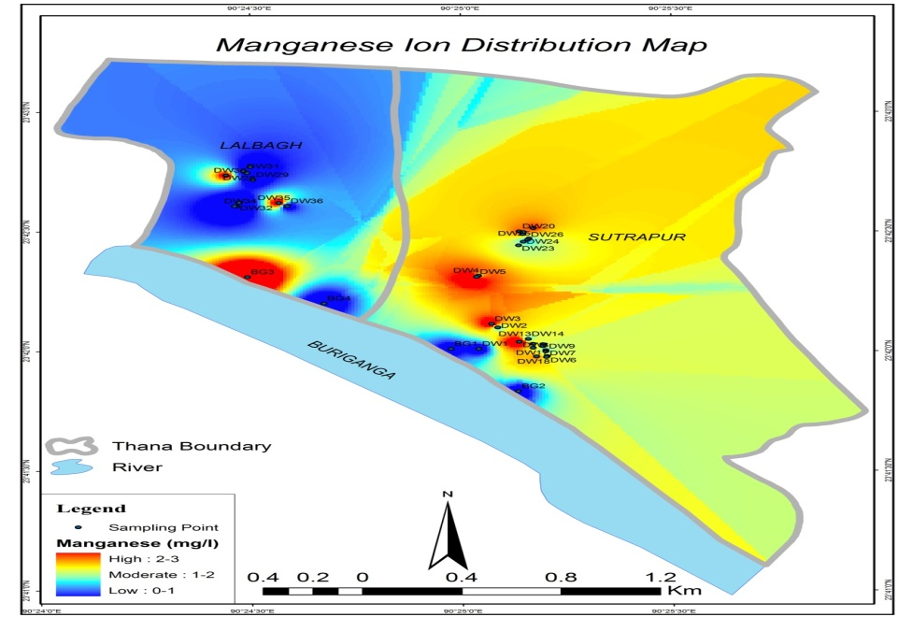
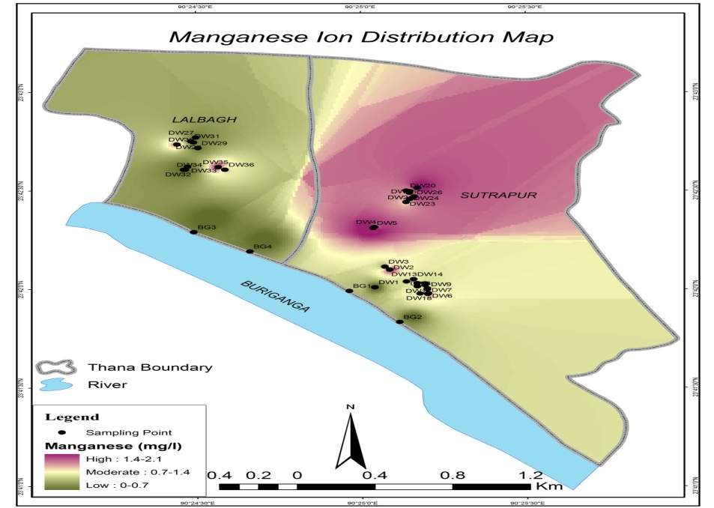
Fe2+ during dry period 0.2 to 6.4 mg/l for DW
0.5 to 4.9 mg/l for BG
Fe2+ during wet period 0.1 to 4.6 mg/l for DW
0.5 to 1.0 mg/l for BG
Mn2+ during dry period 0.1 to 2.4 mg/l for DW
0.2 to 2.1 mg/l for BG
Mn2+ during wet period 0.1 to 2.0 mg/l for DW
0.1 to 0.6 mg/l for BG

Slide 17
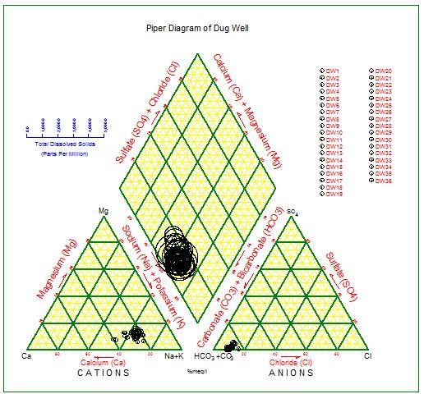
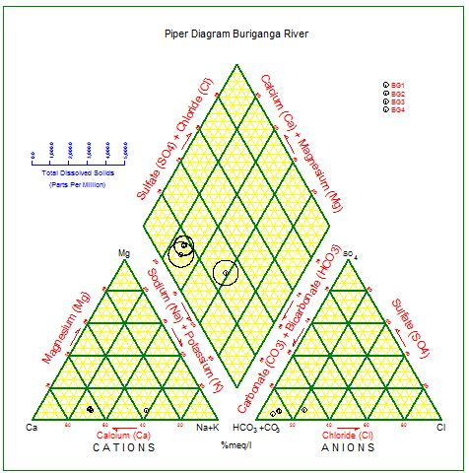
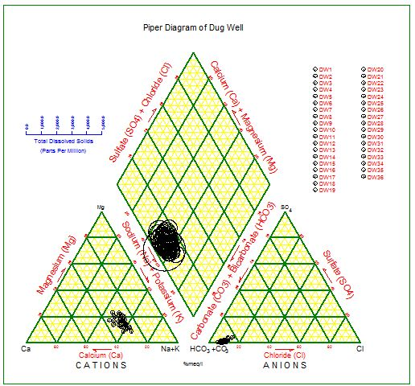
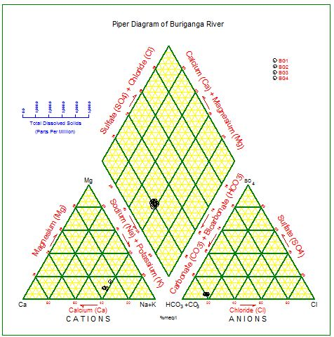
Dug well (dry period)
Buriganga river (dry period)
According to hydrochemical analyses both Dug well and Buriganga river water samples show Ca²⁺-HCO₃⁻ type in both dry and wet periods
Dug well (wet period)
Buriganga river (wet period)

Slide 18
Table: Comparison of dug well and Buriganga river water quality results with
WHO (2004), DOE (1997) and USEPA (1995) standards for drinking purpose
Parameters | WHO Std. 2004 | DOE Std. 1997 | USEPA Std. 1995 | Obtained results for DW (D/W) (mg/l) |  | Obtained results for BG River (D/W) (mg/l) |  | % of DW water sample exceeding DWQSL (D/W) | % of BG River water sample exceeding DWQSL (D/W)
 | DWRL (mg/l) | DWRL (mg/l) | DWRL (mg/l) | Min. | Max. | Min. | Max.
Calcium | - | 75 | - | 91.9/30.1 | 251.1/38.6 | 63.1/47.6 | 151.8/188.5 | 100/75 | 25/0
Magnesium | - | 30-35 | - | 14.2/14.3 | 35.7/15.0 | 17.7/19.6 | 27.6/51.9 | 3/0 | 25/0
Sodium | 200 | 200 | - | 29.6/15.1 | 87.2/16.0 | 26.1/94.3 | 65/100.8 | 0/0 | 0/0
Potassium | - | 12 | - | 4.6/2.8 | 26.2/3.2 | 5.4/5.6 | 24.6/10.9 | 70/61 | 0/0
Iron | 0.3 | 0.3 -1.0 | 0.3 | 0.2/0.5 | 6.4/1.0 | 0.1/0.5 | 4.6/5.0 | 67/58 | 50/0
Manganese | 0.1 | 0.5 | - | 0.1/0.1 | 2.4/2.0 | 0.2/0.1 | 0.3/0.6 | 75/72 | 25/25
Bicarbonate | - | - | - | 213.5/114.4 | 518.5/137.3 | 228.8/274.5 | 1052.3/449.9 | 0/0 | 0/0
Chloride | 250 | 150-600 | 250 | 48.8/22.2 | 248.5/35.5 | 13.3/31.1 | 97.6/39.9 | 0/0 | 0/0
Nitrate | 10 | 15 | 10 | 0/0 | 0.8/0.1 | 0/0 | 0.3/0.1 | 0/0 | 0/0
Total Hardness | - | 200-500 | 200-500 | 287.7/134.1 | 774.3/157.7 | 234/199.2 | 492.5/684.2 | 33/0 | 25/0
TDS | 1500 | 1000 | - | 301.0/105.2 | 733.0/209.0 | 256.0/348.0 | 641.0/371.0 | 0/0 | 0/0
Note: DWRL and DWQSL refer consecutively drinking water recommended limit and drinking water quality standard limits

Slide 19
Conclusions
Sometimes local people do plastering to avoid the caving in and also to keep the wall algae-free
Old Dhaka dwellers are more or less dependent on the dug well water for their daily household activities because of water scarcity especially during dry period; so dug well water was probed to see its viability of alternative drinking water resources
The range of all physical parameters of both dug well and Buriganga river are almost identical in both dry and wet periods; so not much seasonal variation
Dug well and Buriganga river water are to some extent contaminated as almost all the concentration level of different chemical constituents exceeded the standard limits of WHO (2004), DOE (1997) and USEPA (1995)

Slide 20
Thank You
Q?

