Slide 1
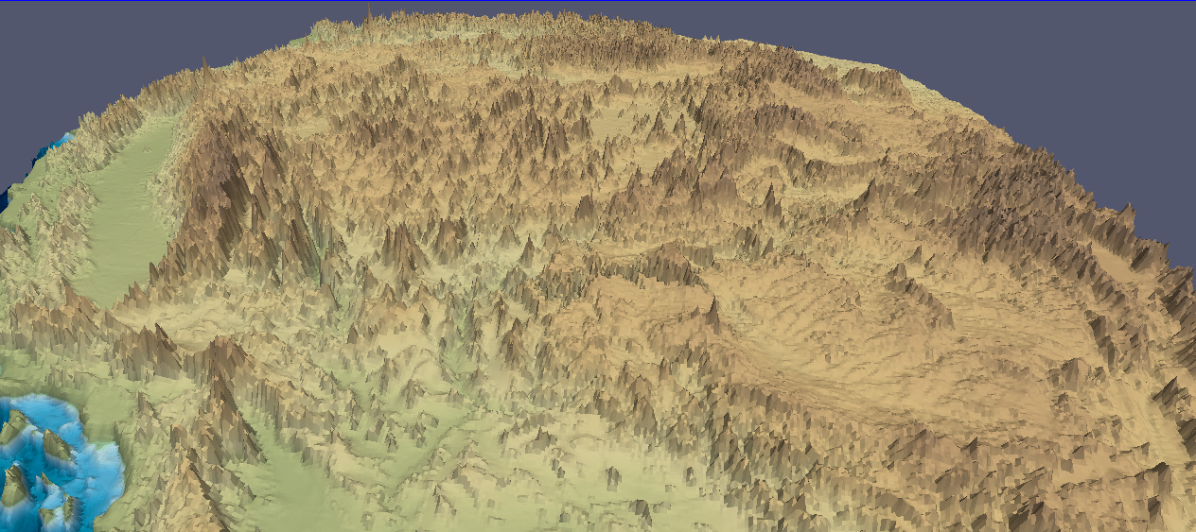
Static and dynamic support of western U.S. topography
Thorsten W Becker
University of Southern California, Los Angeles
Claudio Faccenna (Universita di Roma TRE)
Eugene D Humphreys (U Oregon Eugene)
Anthony R Lowry (Utah State, Logan)
Meghan S Miller (USC)
Acknowledgements: NSF, EarthScope USArray; structural seismologists sharing their models in electronic form, in particular B. Schmandt, W. Chen. Code from CIG and B. Steinberger, GMT
GSA Pardee Symposium: Advances in understanding
Earth structure and process from EarthScope
Denver, October 30, 2013

Slide 2
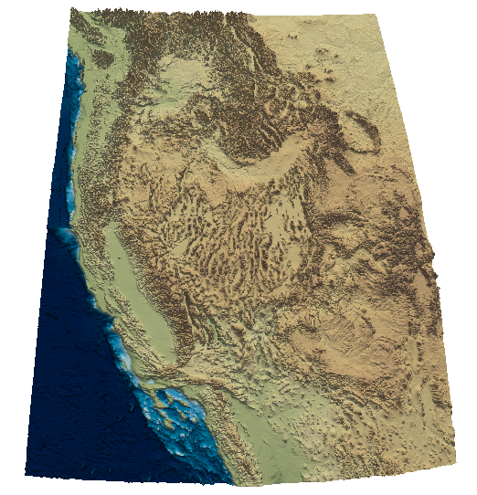
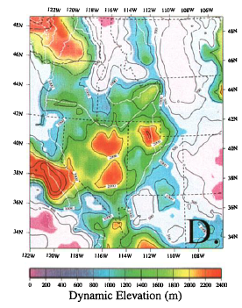
Origin of vertical tectonics?
Lowry et al. (2000)
e.g. Crough and Thompson (1977),
Lachenbruch and Morgan (1990),
Jones et al. (1992), Chase et al. (2002)

Slide 3
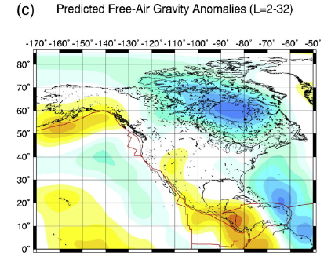
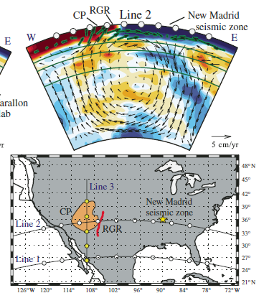
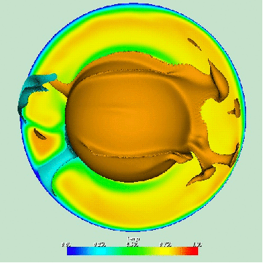
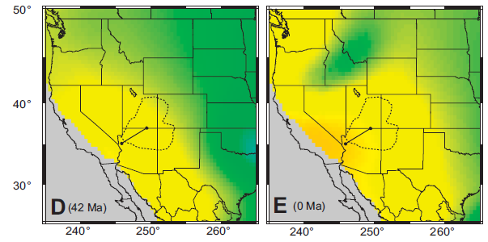

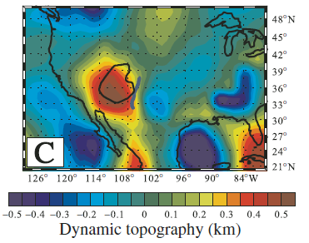
Forte et al. (2009)
Moucha et al. (2008, 2009)
Liu and Gurnis (2010)

Slide 4
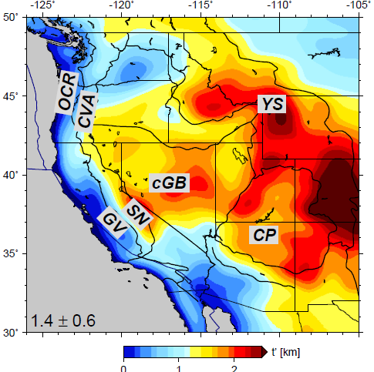
What is the origin of non-flexural topography (in the context of USArray)?
Smoothed (λ > 200 km)
reference topography
CP : Colorado Plateau
CVA : Cascades Volcanic Arc
cGB : central Great Basin
GV : Great Valley
OCR : Oregon Coastal Ranges
SN : Sierra Nevada
YS : Yellowstone
Becker et al. (2013)

Slide 5





Isostatic topography
l_{c}
Isostatic
contributions
crust, ρ_{c}
ridge level
L
mantle
lithosphere, ρ_{l}
l_{l}
asthenosphere
ρ_{a}
crustal layer
mantle
lithosphere
cf. Crough and Thompson (1977), Bird (1979), Lachenbruch and Morgan (1990)

Slide 6
l_{c}
Isostatic
contributions
crust, ρ_{c}
L
mantle
lithosphere, ρ_{l}
l_{l}
asthenosphere
ρ_{a}
+ deflections due to
present-day
asthenospheric flow
(“dynamic topography”)

Slide 7
“Static”
l_{c}
crust, ρ_{c}
L
mantle
lithosphere, ρ_{l}
l_{l}
asthenosphere
ρ_{a}
+ deflections due to present-day
asthenospheric flow
“Dynamic”

Slide 8
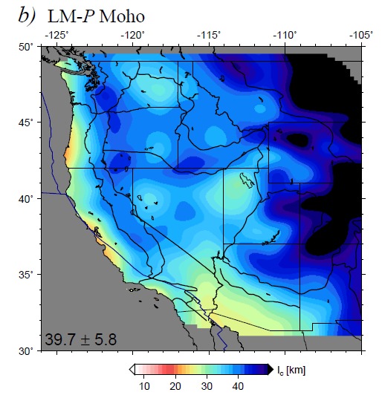
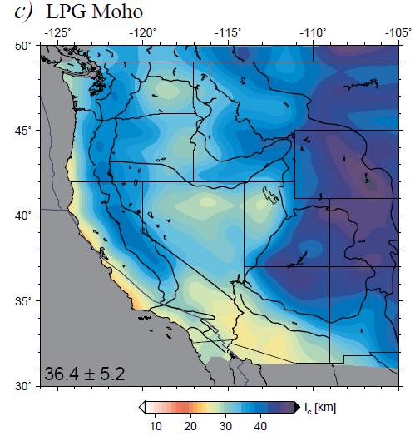
Crustal thickness from receiver function Mohos, based on USArray
Levander and Miller (2012)
Lowry and Perez-Gussinye (2011)
mean and standard
deviation of
all depicted fields
also see Chen et al. (2013)

Slide 9
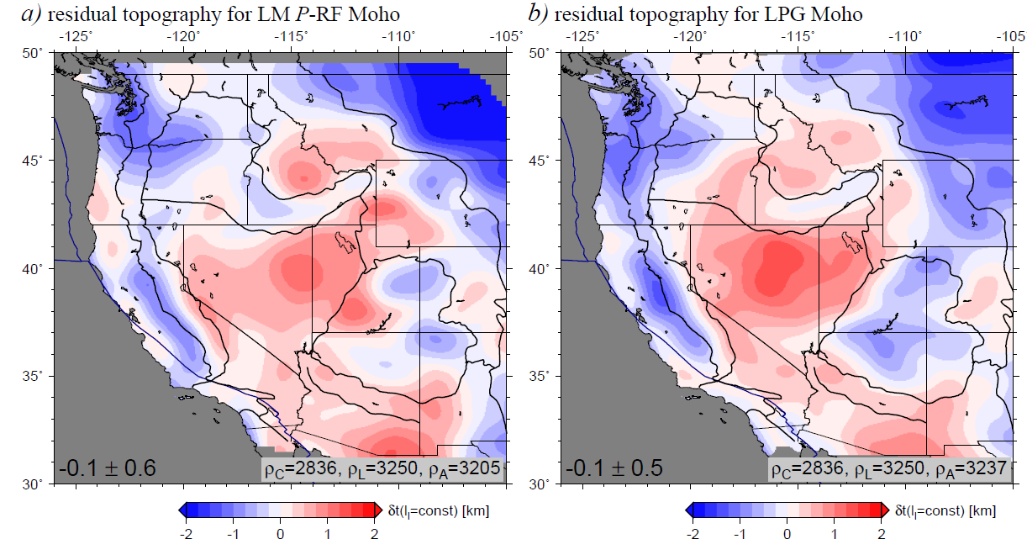
Residual topography for variable crustal thickness
Based on Levander and Miller (2012)
Based on Lowry and Perez-Gussinye (2011)
All residual topography models are minimized by adjusting the asthenospheric
density at fixed crustal and lithospheric density
Becker et al. (2013)

Slide 10
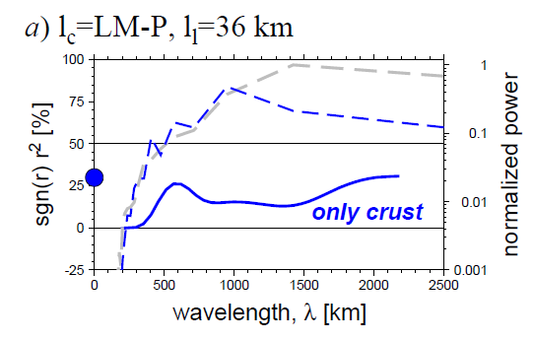
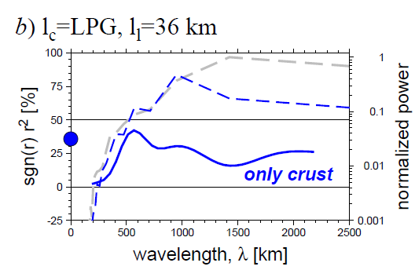
Correlation² for Airy isostasy (solid) and power spectrum (dashed)
Based on Levander and Miller (2012)
observed
total r² (coherence)
Based on Lowry and Perez-Gussinye (2011)
observed
Becker et al. (2013)

Slide 11
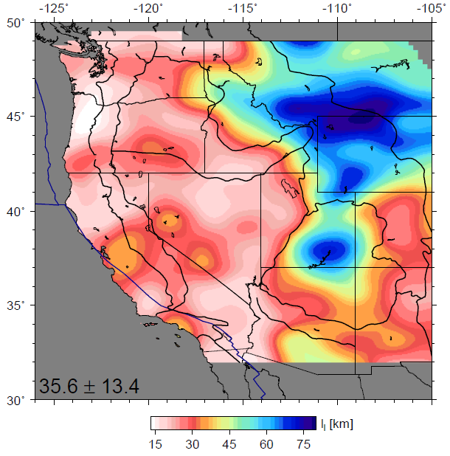
Lithosphere-asthenosphere boundary (?)
Inferred lithospheric
mantle thickness
Simplified, single surface
inferred from PRF from
Levander and Miller (2012)
See also Kumar et al. (2012)

Slide 12
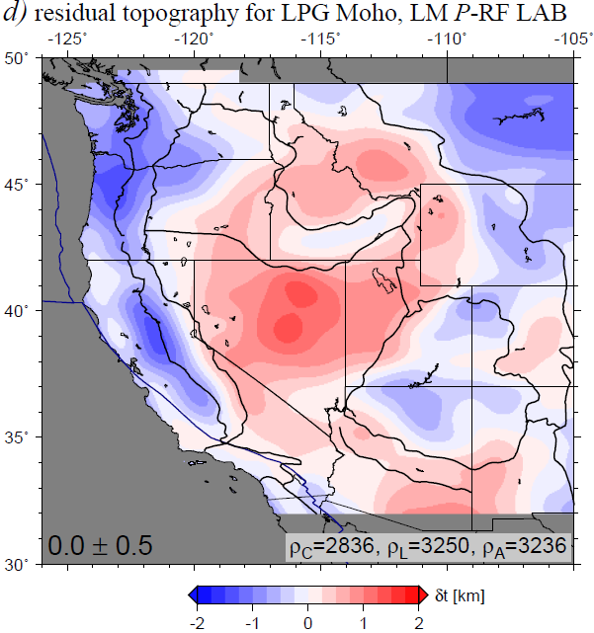
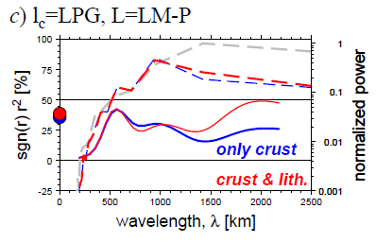
Residual topography for variable crustal and lithospheric thickness
No big improvement
compared to constant
lithospheric thickness
Becker et al. (2013)

Slide 13
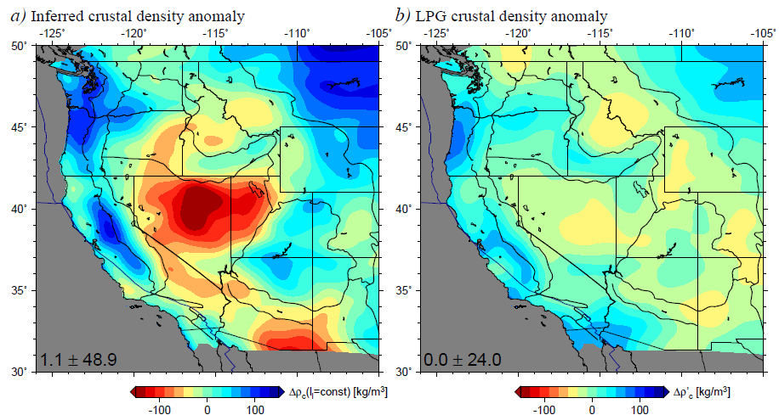
If lithospheric thickness variations don’t work, what about crustal density variations?
Density anomaly for no residual topography
Lowry and Perez-Gussinye (2011)

Slide 14
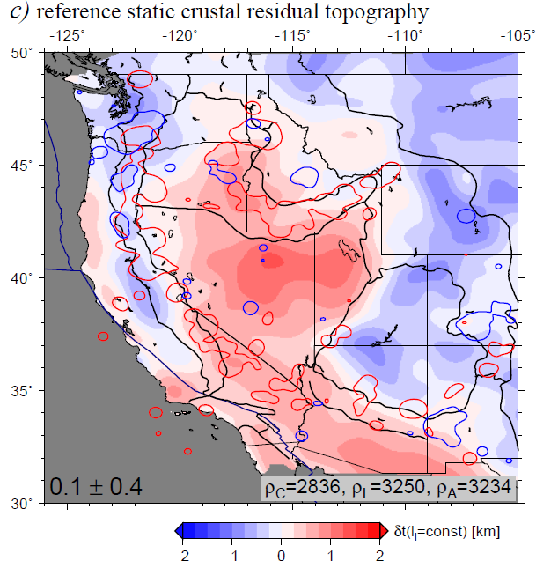
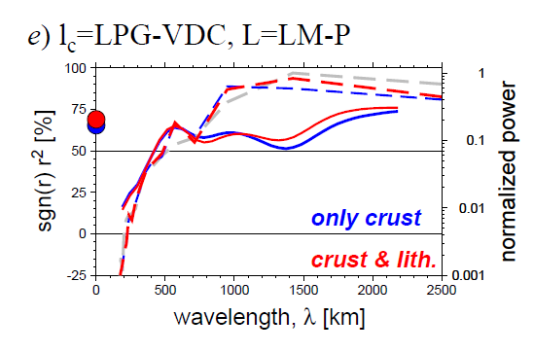
Residual topography including crustal density variations
~60-75% coherence,
but significant RMS
of residual
Red contours: < 20 Ma
Blue contours: > 20 Ma
volcanism from earthchem.org
(cf. McQuarrie and Oskin, 2010; Karlstrom et al. 2012)

Slide 15
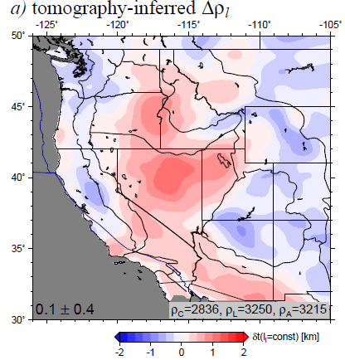
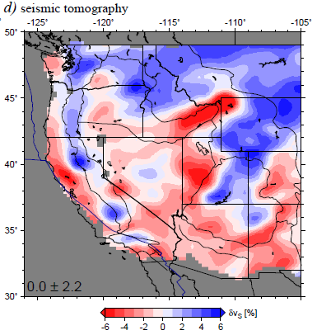
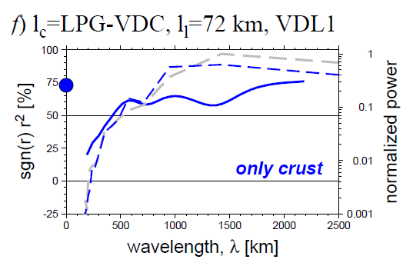
Residual topography including crustal
and lithospheric density variations

Slide 16
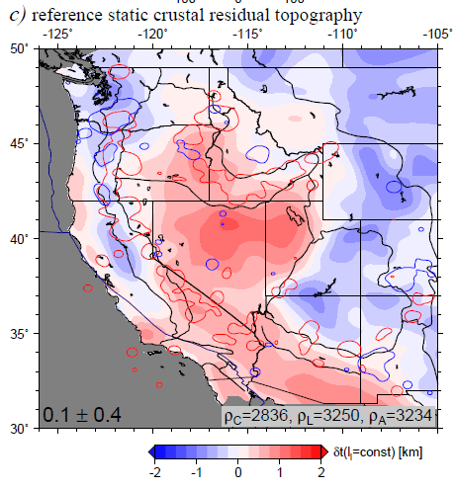
What is the origin of the non-isostatic residual ?

Slide 17
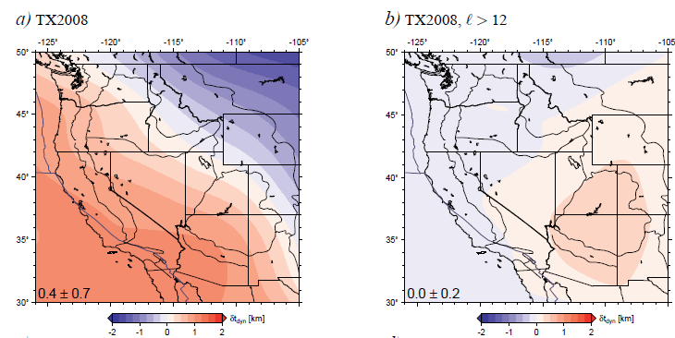
Mantle flow induced topography: Simmons et al. (2007) global tomography
full solution
regional wavelengths
cf. Moucha et al. (2008)
Hager and O’Connell (1981) type computation, topography inferred from radial tractions at surface of spherical mantle circulation model
(results are very similar for FE models with LVVs etc., cf. Ghosh et al., 2013)

Slide 18
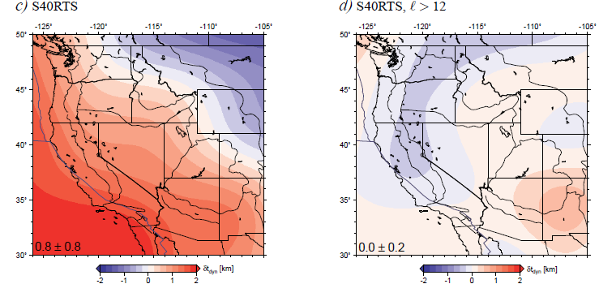
Mantle flow induced topography: Ritsema et al. (2011) global tomography
full solution
regional wavelengths

Slide 19
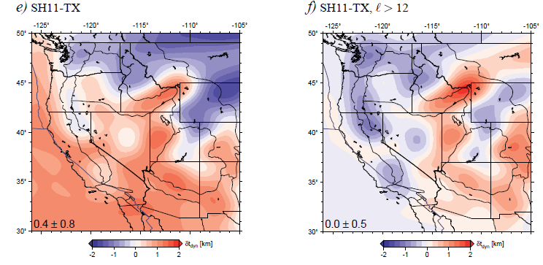
Mantle flow induced topography: Schmandt and Humphreys (2010) regional model
full solution
regional wavelengths
Results very similar for other recent western US tomography models
(cf. Becker, 2012)

Slide 20
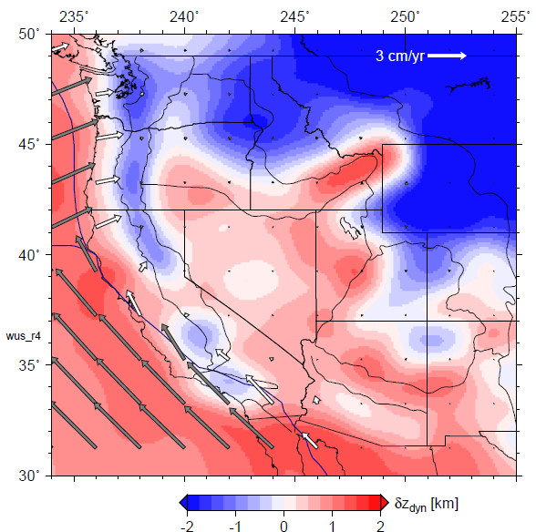
Match between residual and dynamic topography from present-day mantle flow
Correlation ~ 0.6
Becker et al. (2013)

Slide 21
Conclusions
LAB does not seem to scale with simple lithospheric thickness estimates (MLD?)
Colorado plateau at present not dynamically supported, except at edges
Significant residual topography, particular in B&R (+) and along subduction regions (-)
Large fraction of topography residual explained by upper mantle, small scale convective flow
Mismatch indicative of partial melt, radial anisotropy, or chemical heterogeneity

