Slide 1
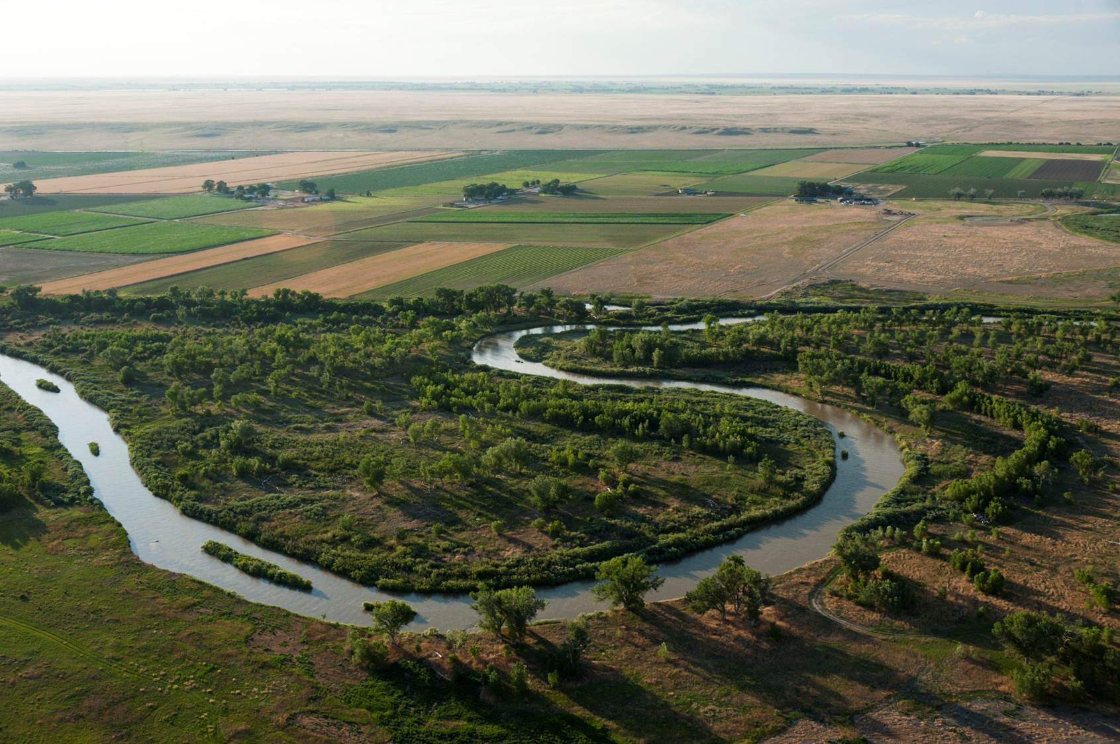
Recent enhancements of the OTIS model to simulate multi-species reactive transport in stream-aquifer systems.
Department of Civil &
Environmental Engineering
Ryan T. Bailey

Slide 2
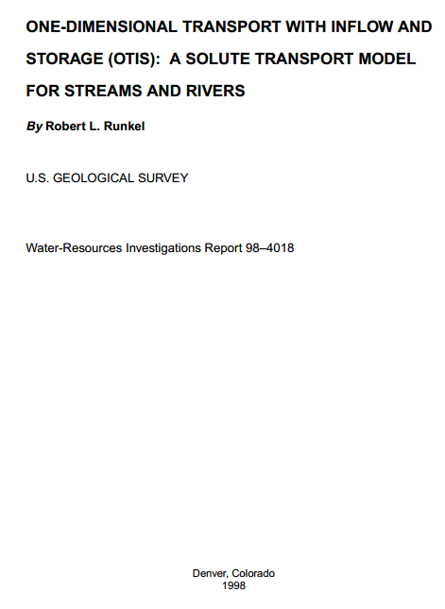
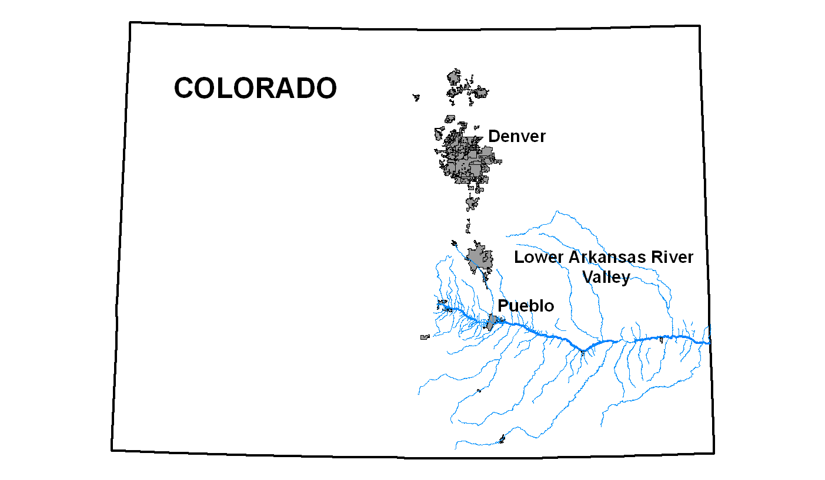
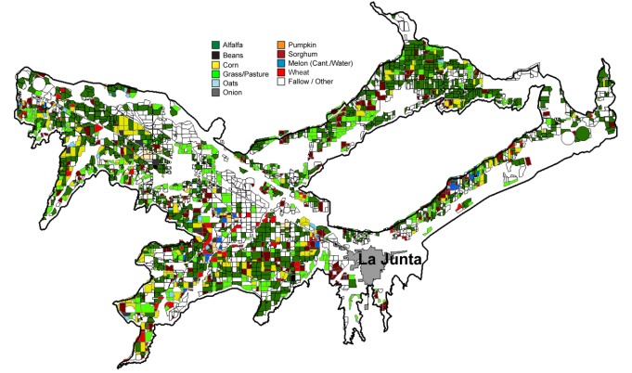
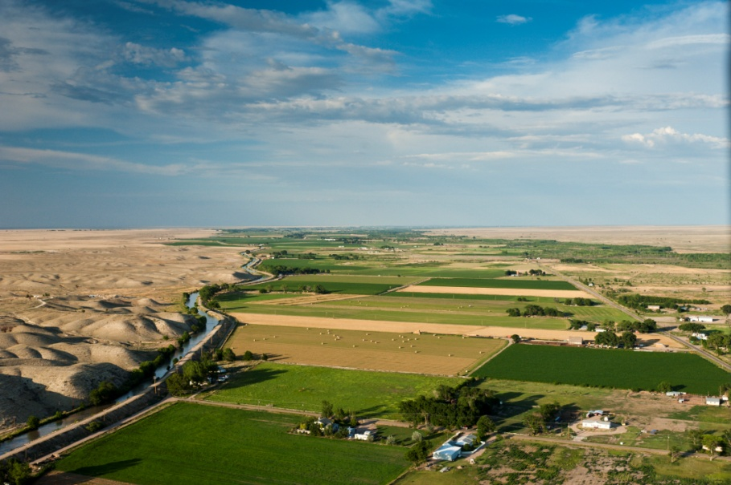
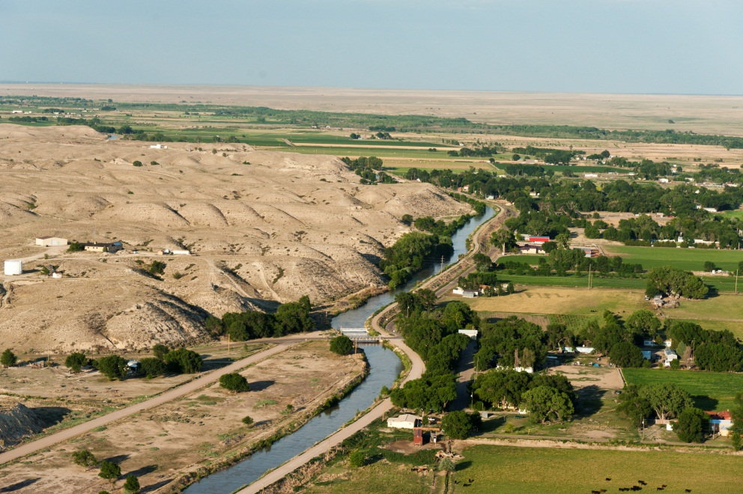
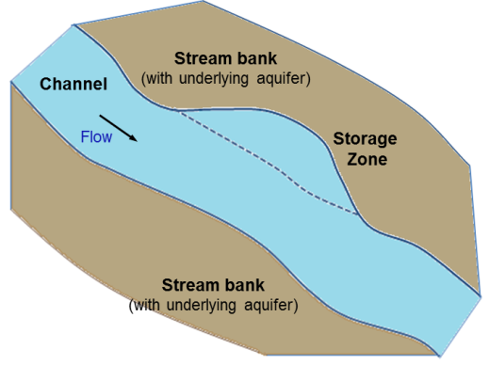
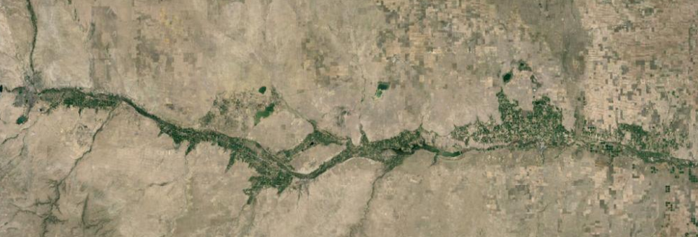
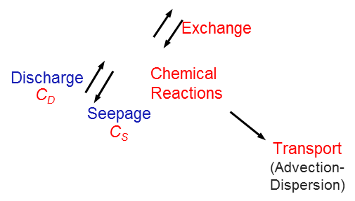
OTIS
Overview of Presentation
Arkansas River Basin, CO
Fertilizer
Shale
Fate and transport of Nitrogen, Selenium species (remediation) in river network.
→Modifications to OTIS code

Slide 3
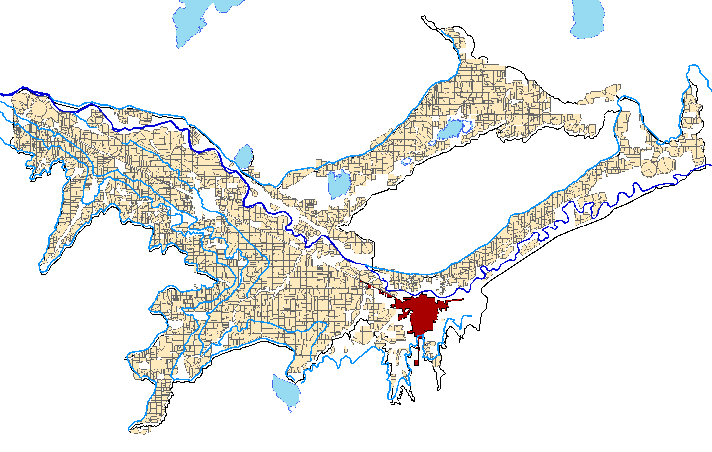

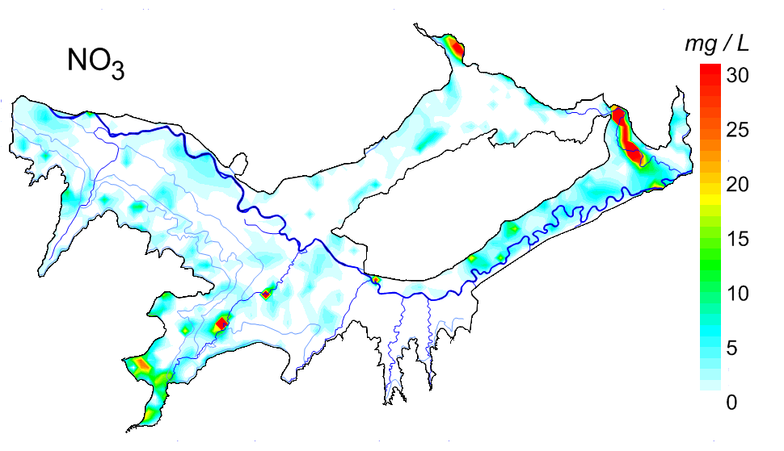
Background & Motivation
Need tool to simulate in-stream solute concentration in groundwater-driven watersheds
Assess influence of remediation strategies (BMPs) on in-stream concentration of NO₃ and Se species
Irrigated
Fields
Groundwater flow model
(MODFLOW-UZF1)
Reactive transport model
(UZF-RT3D)
Selenium
Nitrate
Groundwater solute concentration (NO₃, Se)
Solute mass loadings to Arkansas River
What about in-stream solute concentration?
All river segments impaired for Selenium
(4.6 µg L⁻¹ for Aquatic Life)

Slide 4
Project Objectives
Identify effective regional-scale remediation strategies to decrease in-stream concentrations of Selenium and Nitrate
I. Develop model for Se and N transport in Streams (OTIS)
1. Network of Connected Streams
2. Interaction between Chemical Species
3. Nitrogen Cycling Processes
4. Selenium Cycling and Transformation
5. Apply model to Arkansas River Basin (Testing, Sensitivity Analysis)
II. Couple model with UZF-RT3D (groundwater-surface water)
III. Explore remediation strategies

Slide 5

I. Develop model for Se and N transport in Streams
Model Requirements
- Handle Steady and Unsteady Flow
- Inputs/Outputs (mass loading from aquifer)
- Multiple solutes
Apply to Stream Networks
Chemical reactions / transformations (interacting species)
Nitrogen cycling, Selenium cycling and transformation
Modifications
Model Development
- Base Model: OTIS (One-Dimensional Transport with Inflow & Storage) (Runkel, 1998)

Slide 6
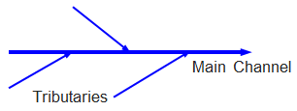
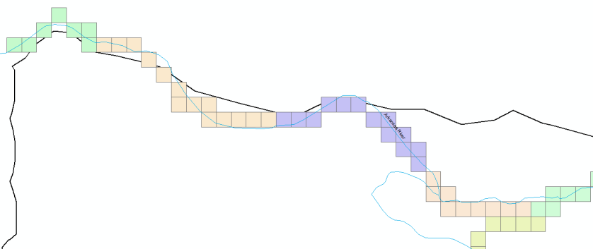
I. Develop model for Se and N transport in Streams
Model Requirements
- Handle Steady and Unsteady Flow
- Inputs/Outputs (mass loading from aquifer)
- Multiple solutes
Apply to Stream Networks
Chemical reactions / transformations (interacting species)
Nitrogen cycling, Selenium cycling and transformation
Stream Network
Mass balance
Input Files: Parameters for each stream
Notes:
Loop through streams in the code.
Mass at the junctions.
Files modified to include parameters for each stream.

Slide 7
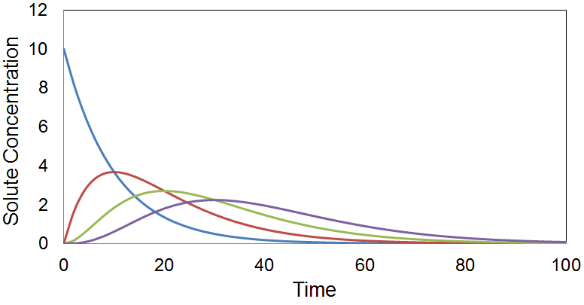
I. Develop model for Se and N transport in Streams
Model Requirements
- Handle Steady and Unsteady Flow
- Inputs/Outputs (mass loading from aquifer)
- Multiple solutes
Apply to Stream Networks
Chemical reactions / transformations (interacting species)
Nitrogen cycling, Selenium cycling and transformation
Concentration of Solute 1 → Affects concentration of Solute 2
→ System of differential equations
→ Solve using 4th-order Runge-Kutta method
Notes:
Loop through streams in the code.
Mass at the junctions.
Files modified to include parameters for each stream.

Slide 8
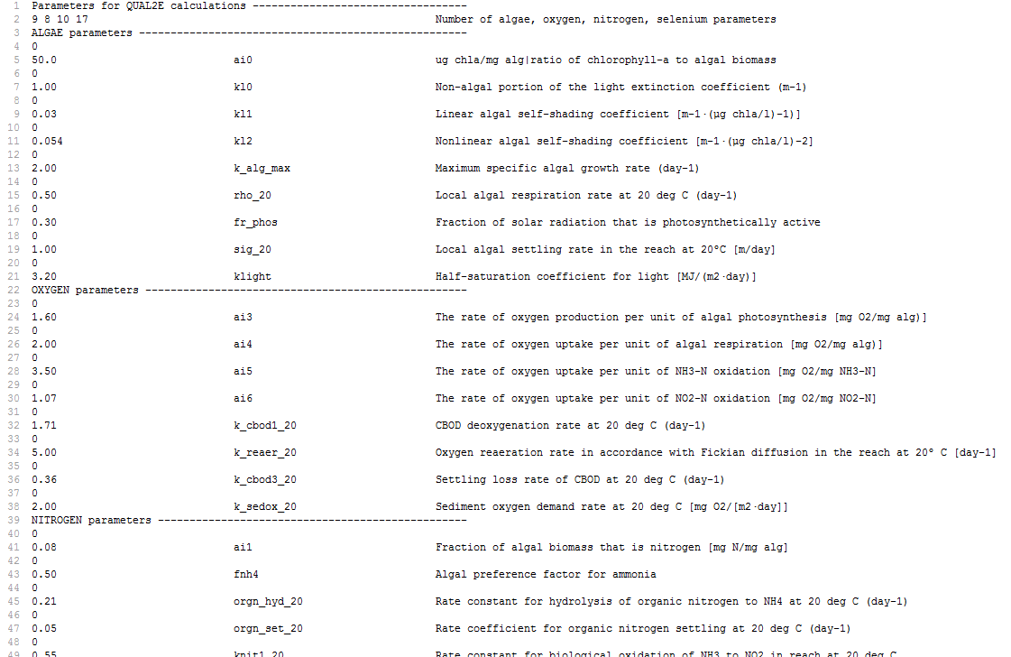
I. Develop model for Se and N transport in Streams
Model Requirements
- Handle Steady and Unsteady Flow
- Inputs/Outputs (mass loading from aquifer)
- Multiple solutes
Apply to Stream Networks
Chemical reactions / transformations (interacting species)
Nitrogen cycling, Selenium cycling and transformation
QUAL2E
Atmospheric
Reaeration
Nitrification of
NH₄, NO₂
OTIS Input File
Decompose organics
Groundwater
Oxygen O₂
Sediment demand
Algal Respiration
Photosynthesis
Algae
Biomass to N
Uptake
Uptake
Organic N
NH₄
NO₂
NO₃
Min.
Nitrif.
Nitrif.
Settling
Diffusion from
Sediments
Groundwater
Denitrification
Notes:
Loop through streams in the code.
Mass at the junctions.
Files modified to include parameters for each stream.

Slide 9
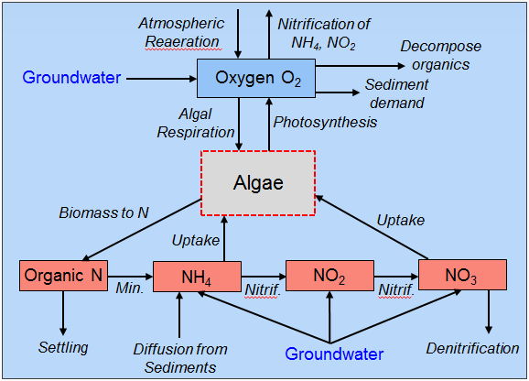
I. Develop model for Se and N transport in Streams
Model Requirements
- Handle Steady and Unsteady Flow
- Inputs/Outputs (mass loading from aquifer)
- Multiple solutes
Apply to Stream Networks
Chemical reactions / transformations (interacting species)
Nitrogen cycling, Selenium cycling and transformation
+
Algae/
Aquatic Plants
Respiration
Uptake
Sorption
Uptake
Org Se
SeO₄
SeO₃
Se
Se²⁻
Min.
Red.
Red.
Red.
SeMet
Groundwater
Settling
Volatiliz.
Volatil.
Notes:
Loop through streams in the code.
Mass at the junctions.
Files modified to include parameters for each stream.

Slide 10
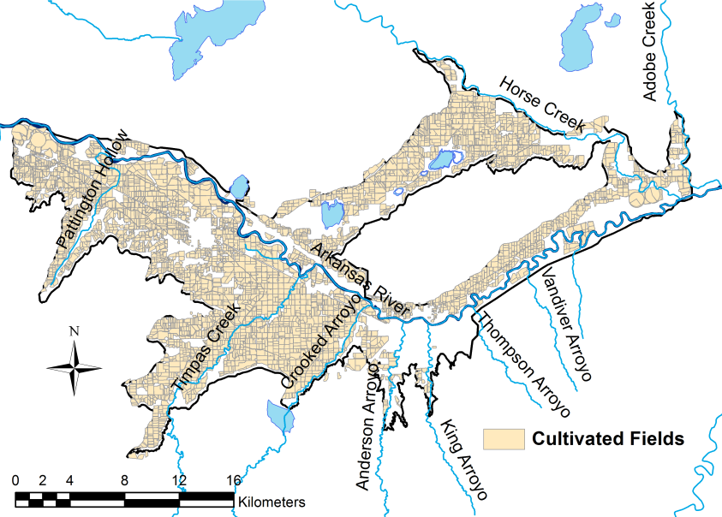
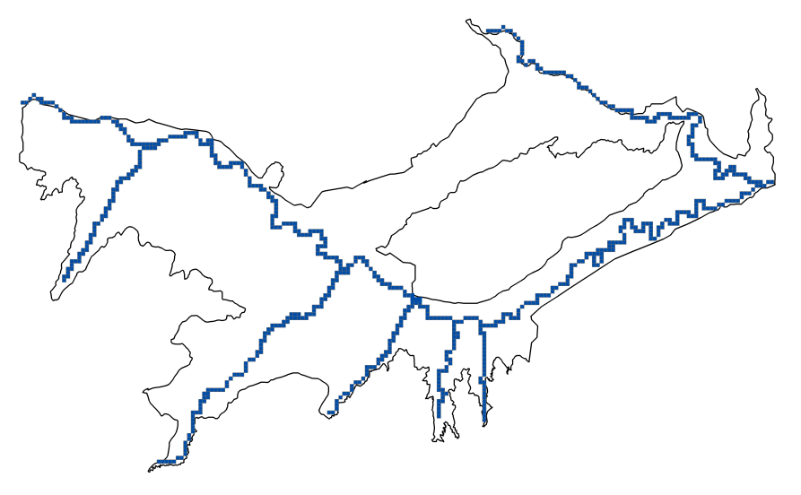
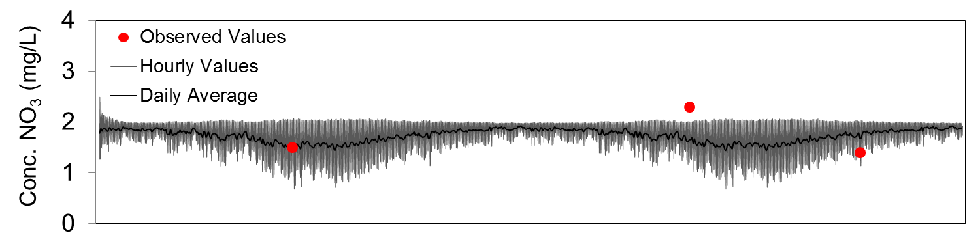
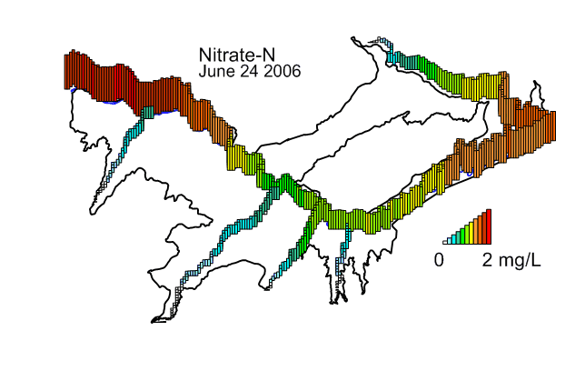
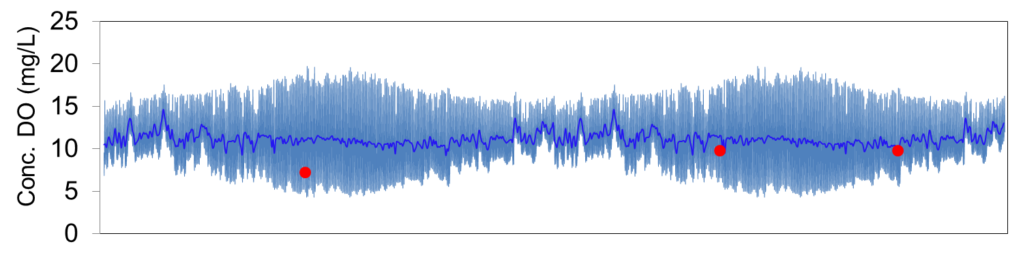
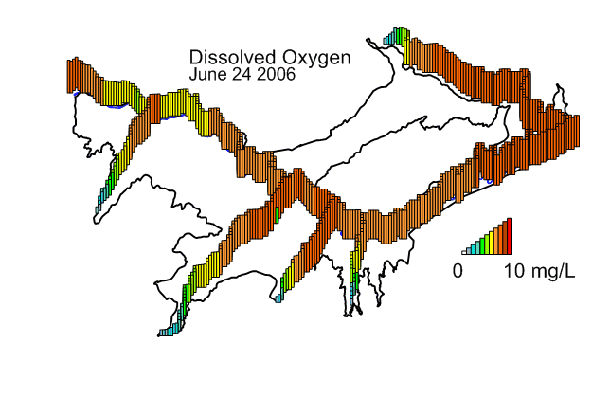
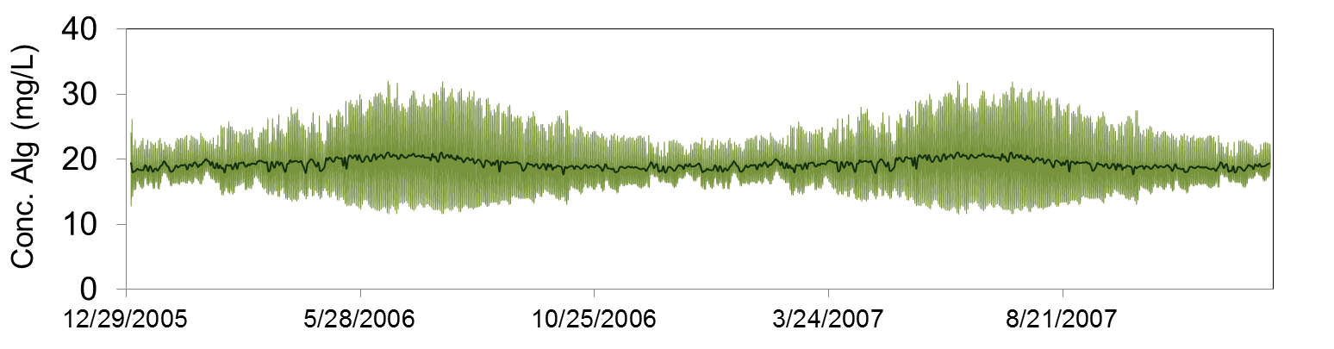
I. Develop model for Se and N transport in Streams
Apply model to Arkansas River Basin
Sensitivity Analysis
OTIS grid
Assess influence of parameters on NO₃ and O₂
34 flow and transport parameters
Steady flow in Arkansas River
6 Tributaries
2006-2008 simulation period
Processing SA Results:
Sensitivity indices
Temporal values of indices
Spatial values of indices

Slide 11

I. Develop model for Se and N transport in Streams
Apply model to Arkansas River Basin
Transient Flows
Flow rates: MODFLOW-SFR
Transient upstream BC for O₂, NO₃, and SeO₄
Field work: sample Se in water, sediments, stream bank
Compare against in-stream O2, NO3, and SeO4
Sampling sites
2006-2010
(12 sampling events)

Slide 12
II. Couple Model with UZF-RT3D
Groundwater-Surface Water Coupling
MODFLOW-UZF
SFR2 Package
Groundwater
discharge
Surface Water
Flow
FLOW
Groundwater
Flow
Stream
Seepage
Linker file
Output (Q, depth, lateral inflow,…)
C_{D}
Groundwater
Solute Transport
Solute
mass loading
Surface Water
Solute Transport
REACTIVE
TRANSPORT
Solute
mass depletion
UZF-RT3D
C_{S}
OTIS*
Imbedded within RT3D
Discharge
C_{D}
Seepage
C_{S}

Slide 13
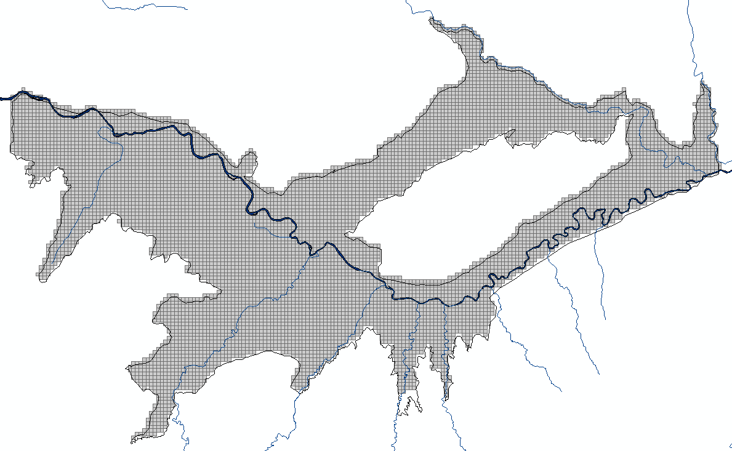
II. Couple Model with UZF-RT3D
Groundwater-Surface Water Coupling
Groundwater flow model
(MODFLOW-UZF1)
(Eric Morway, USGS)
Reactive transport model
(UZF-RT3D)
(N, Se cycling packages)
Stream Network
Flow Model: SFR2 package for River, Tributaries
Divided into stream segments
Transport Model: QUAL2E parameter values
Sampling
Sites
Testing Data: Stream flow, stream depth
In-stream conc. of O₂, NO₃, SeO₄

Slide 14
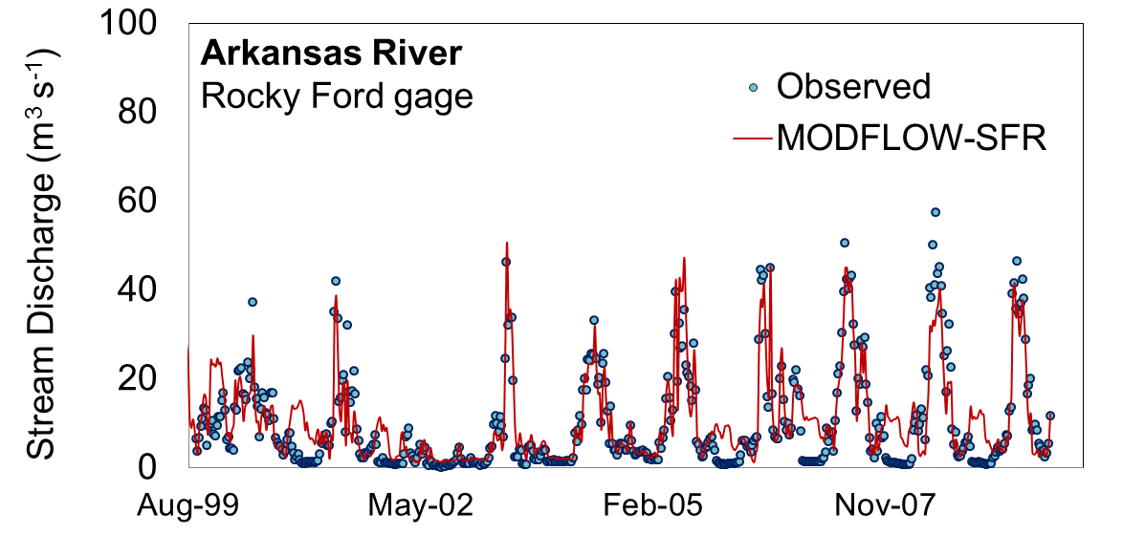
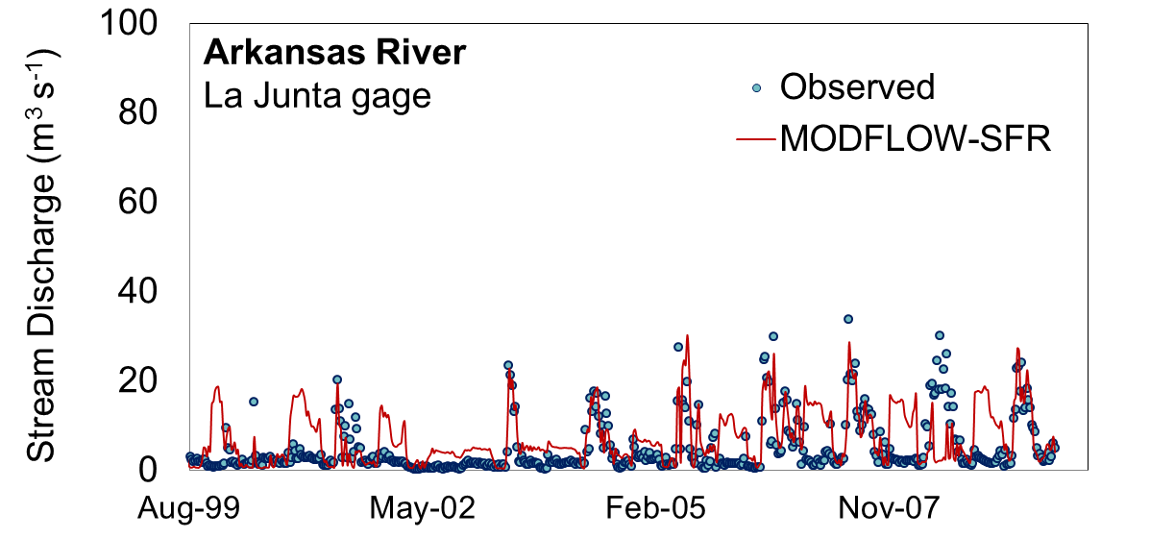
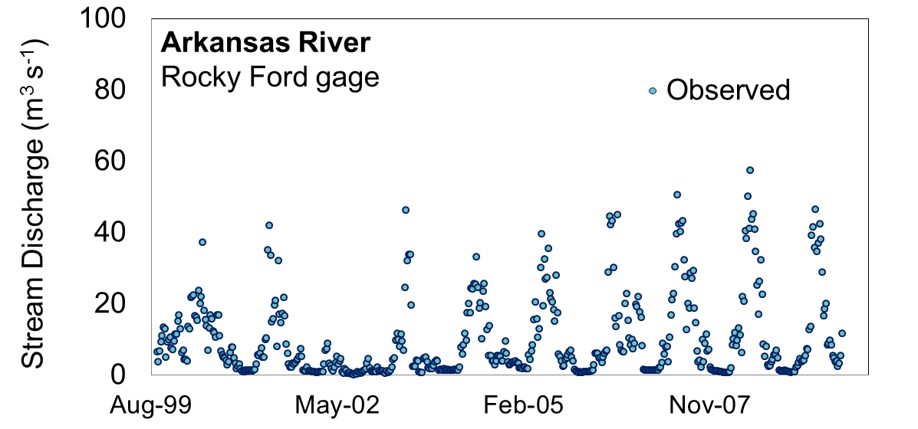
II. Couple Model with UZF-RT3D
Groundwater-Surface Water Coupling
Rocky Ford
gage
La Junta
gage
Preliminary RT3D-OTIS simulations

Slide 15
Next Phases
Further Calibration/Testing of RT3D-OTIS model
Explore Effect of Remediation Strategies
Reduce irrigation
Reduce canal seepage
Reduce Nitrogen fertilizer loading
Implement/Enhance Riparian buffer zones

