Slide 1
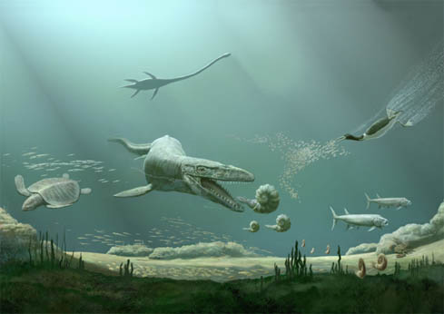
ANTIPREDATORY MORPHOLOGY AND INTENSITY OF SUBLETHAL PREDATION IN MESOZOIC AMMONOIDS
Jim Kerr and Patricia Kelley
University of North Carolina Wilmington
http://www.gambassa.com/public/project/3259/MiaandLaurissa.html

Slide 2
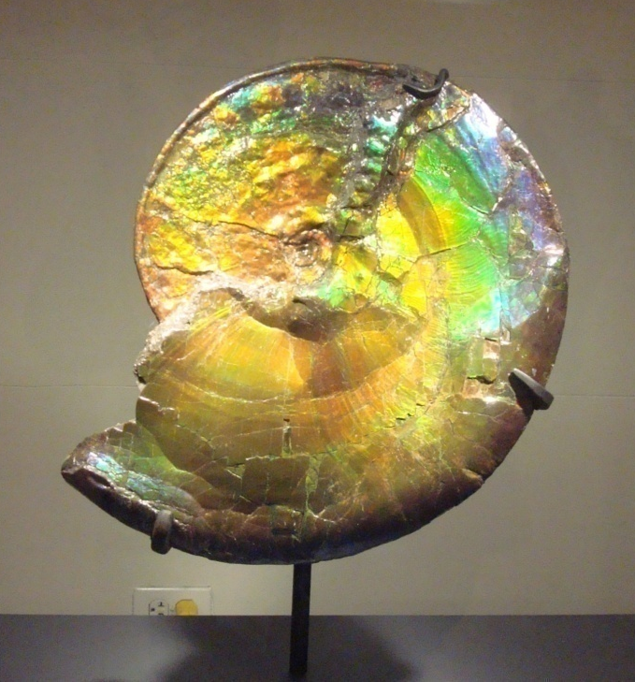
Contents
Introduction
  Escalation
  MMR and Ammonoids
  Repair Scars
Materials and Methods
Results
Conclusions
Future Work

Slide 3
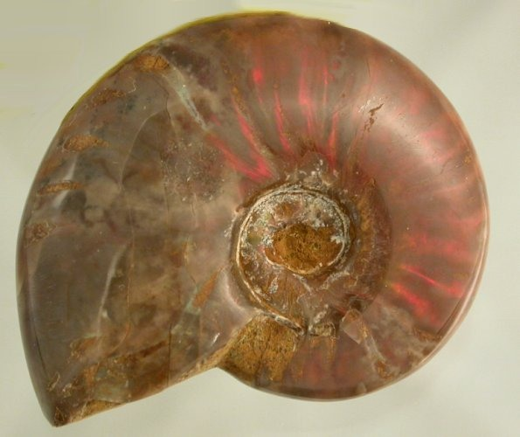
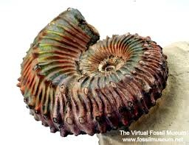
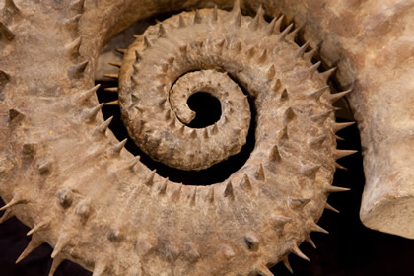
Introduction
Escalation
  Natural selection driven by interactions between individual organisms and their enemies
  Thought to be the primary driver of the MMR
mysticmerchant.com
http://kaijucombat.com/community/index.php?threads/kaiju-sponsor-bogma-the-giant-snail.1379/page-8
dalerogerammonite.com

Slide 4
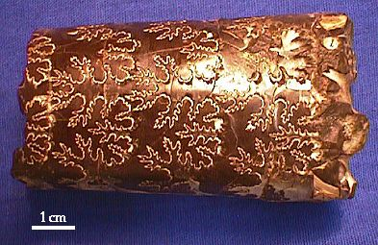
Escalation, the MMR, and Ammonoids
Increase in shell ornament over Mesozoic
  Possibly a result of increased predation
Suture complexity
  May also be related to predation
Little data exist to directly relate increase in ornament or suture complexity to predation frequency
Successful predation destroys shell
Paleo.cortland.edu

Slide 5
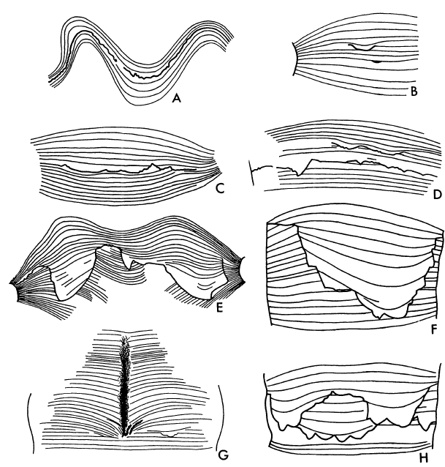
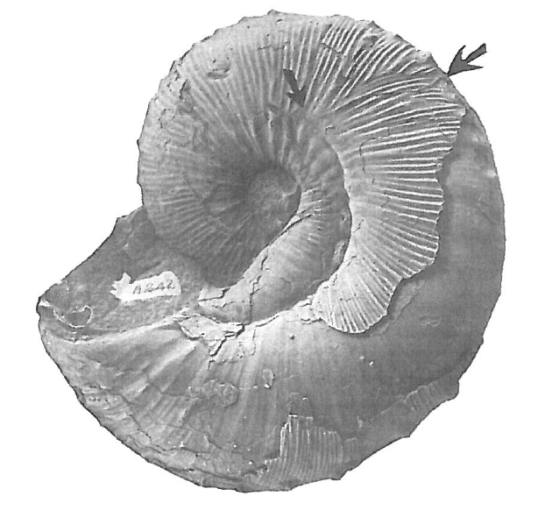
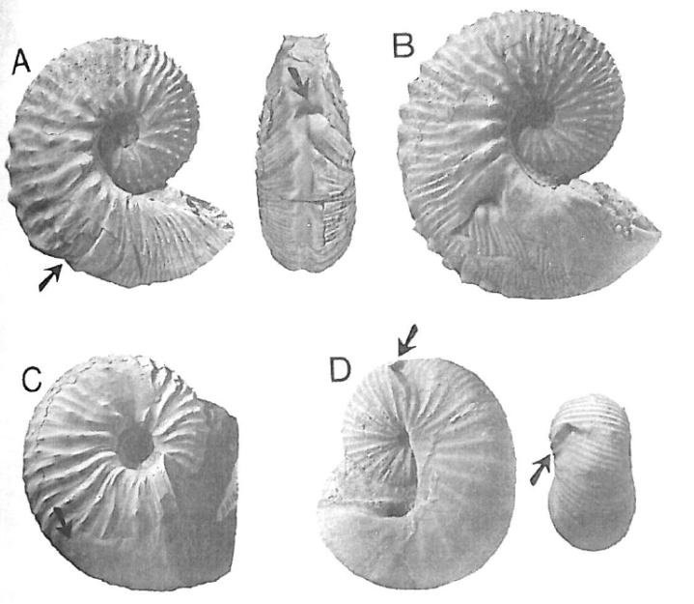
Repair Scars
Fractures that have apparently healed
May represent sublethal predation attempts
Potential proxy for predation frequency
Bond and Saunders 1989
Landman and Waage 1986
Landman and Waage 1986

Slide 6
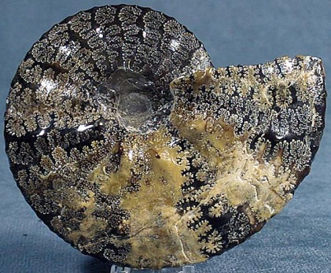
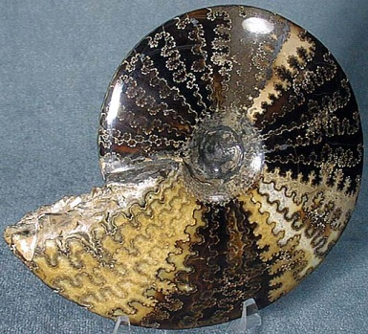
Hypotheses
www.humboldt.edu
www.humboldt.edu
There is a demonstrable relationship between shell ornament and repair scar frequency.
More highly ornamented shells have more repair scars because of increased survivability of predation attempts.
Taxa with more complex sutures have more repair scars because of increased survivability of predation attempts.

Slide 7

Materials and Methods
Mesozoic ammonoid collections from American Museum of Natural History
  341 complete or near-complete shells
  Varying ages throughout Jurassic and Cretaceous
  Varying ornament and suture complexity
Repair scar frequency
  Measured as the proportion of sample exhibiting repair scars
  Evaluate repair scars according to type

Slide 8
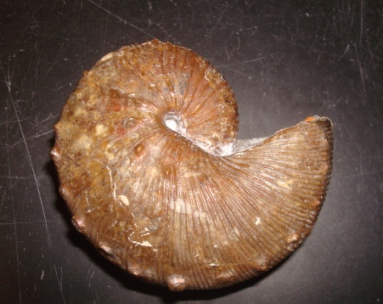
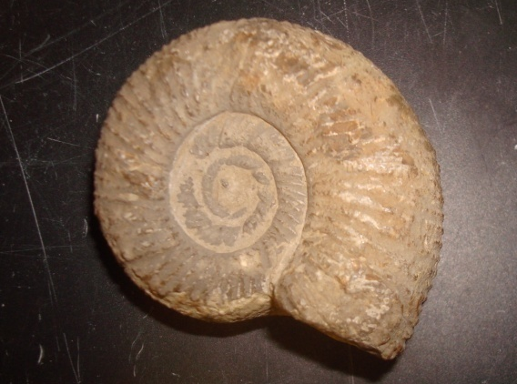
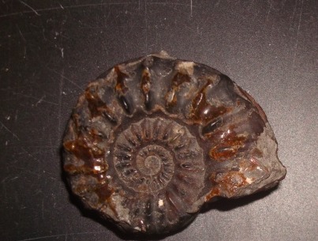
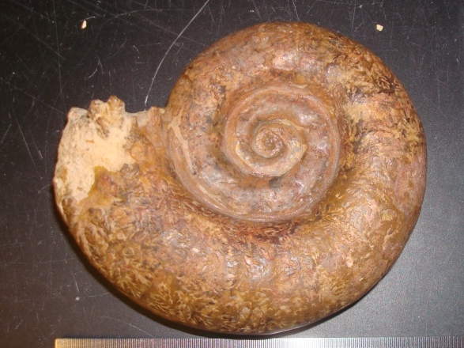
Specimen Collections
1 cm
1 cm
Scaphites (n = 314), Cretaceous – AMNH 74327
Perisphinctes (n = 57), Jurassic – AMNH 27477
1 cm
1 cm
Amaltheus (n = 32), Jurassc – AMNH 14700/1
Lytoceras (n = 11), Jurassic – AMNH 27462

Slide 9
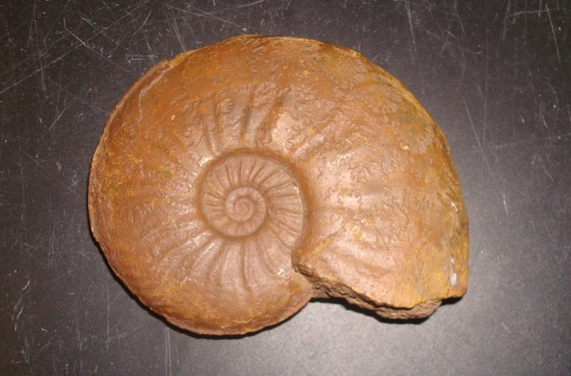
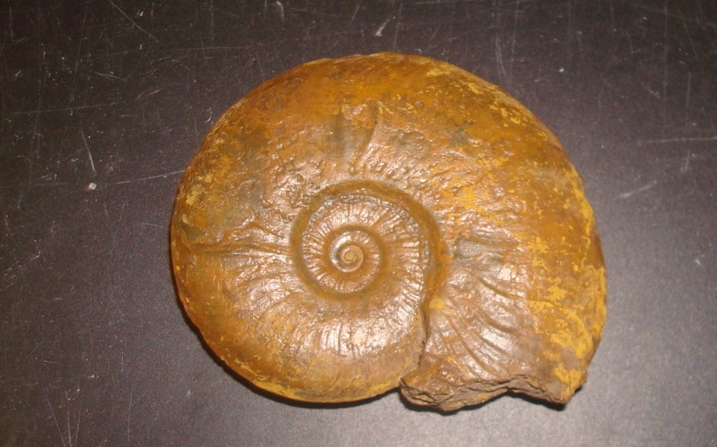
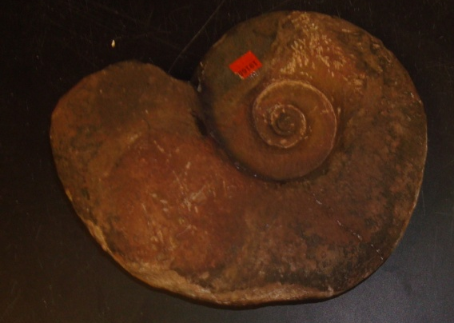
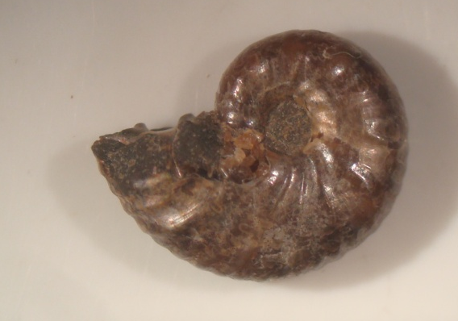
Specimen Collections
1 cm
1 cm
Grammoceras (n = 8), Jurassic – AMNH 27425
Leioceras (n = 36), Jurassic – AMNH 8374
1 cm
1 cm
Phylloceratina (n = 17), Jurassic – AMNH 27477
Rhaeboceras (n =16), Cretaceous – AMNH 72527

Slide 10
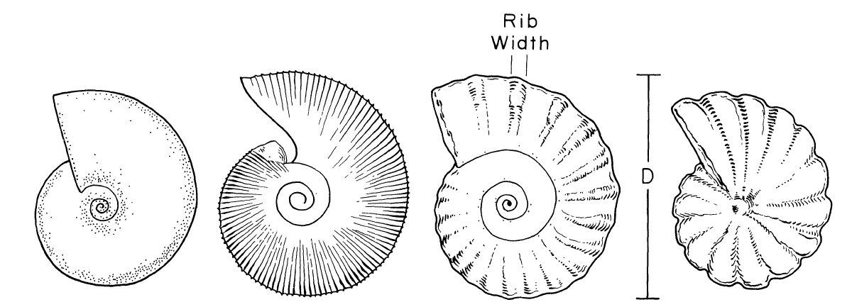
Quantify the Degree of Ornamentation
Ward 1981
Ratio between rib width and shell diameter
Rib should be positioned near aperture and measured at ventral side to measure maximum width of rib

Slide 11
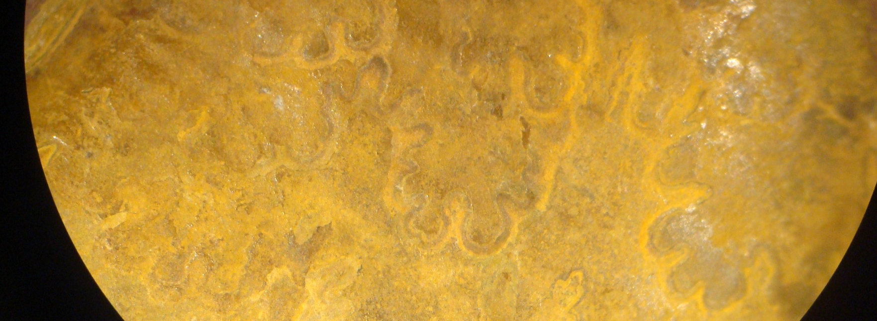
Quantify Suture Complexity
Complexity Factor (CF)
  Summary value of individual primary elements (Saunders 1995)
  Used in this study as a preliminary metric of suture complexity
AMNH 27425

Slide 12
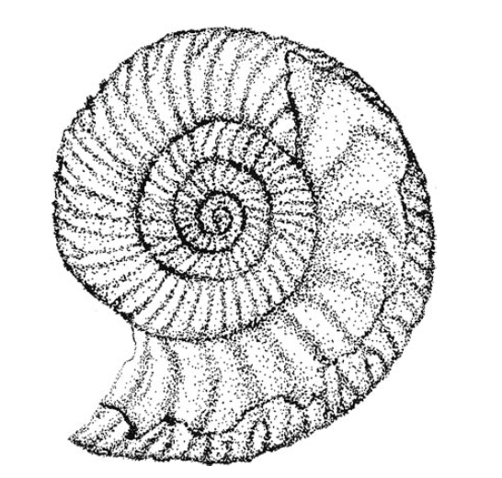
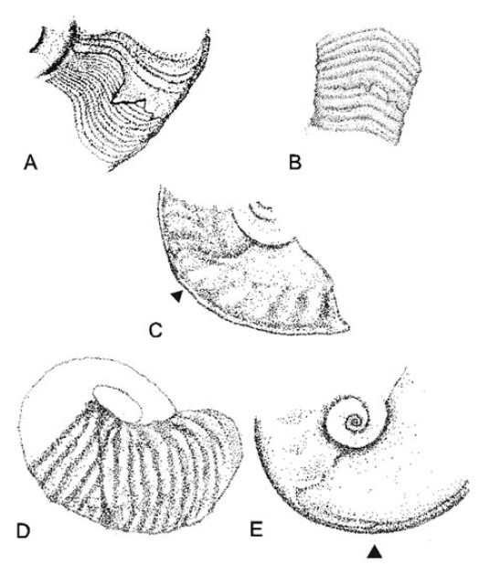
Shell Pathology: Scars
Paleopathies
  Abnormalities expressed on shell surface
  Classified according to forma-type
Scar pathologies
  Forma-types that are interpreted as external injuries
Kröger 2002

Slide 13
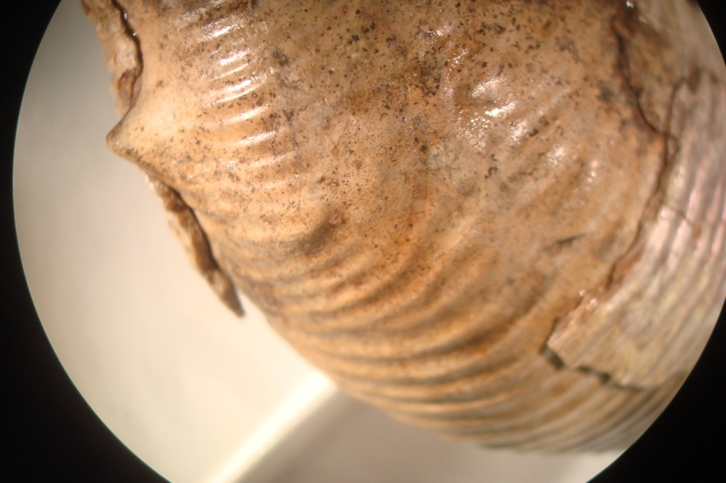
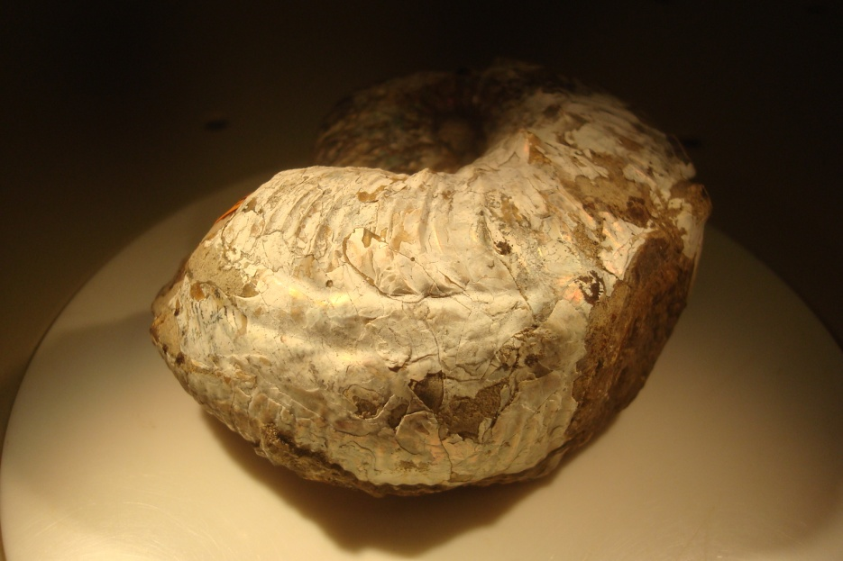
Results: Repair Scars
AMNH 72612
AMNH 72756
Forma Substructa – 95% of scars
Forma Verticata – 5% of scars

Slide 14
Size Standardization

Slide 15
Repair-Scars and Exterior Ornament

Slide 16

Repair-Scars and Exterior Ornament
Results contradict hypothesis that ornamentation and repair scar frequency are positively correlated.
More heavily ornamented ammonoids may have been:
  less likely to suffer breakage
  more successful in escaping predators
  successfully preyed upon more often

Slide 17
Repair-Scars and Suture Complexity

Slide 18
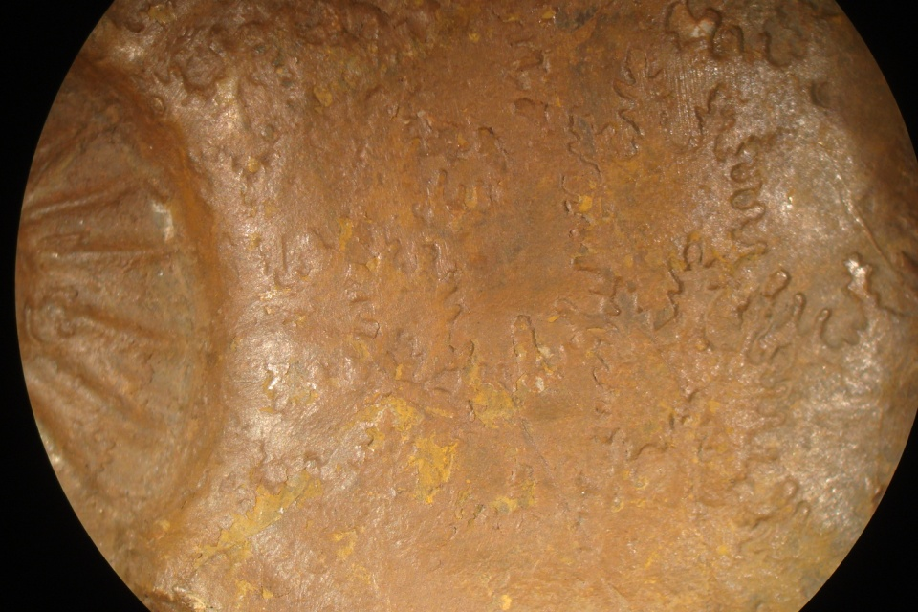
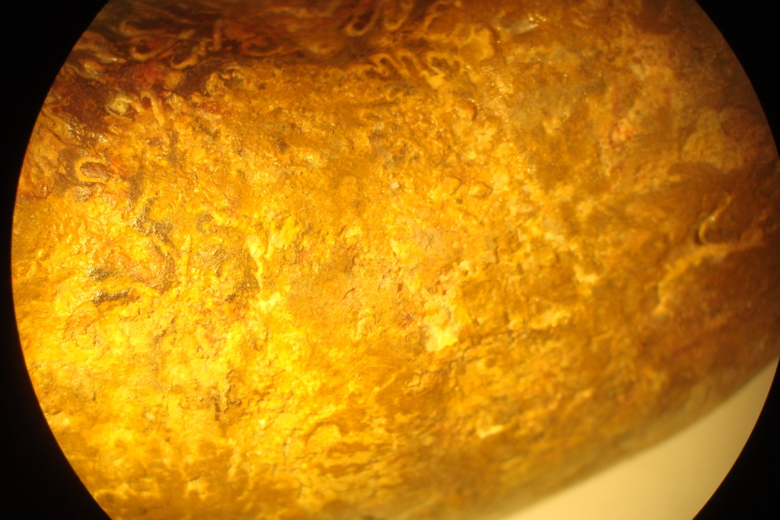
Repair-Scars and Suture Complexity
No relationship between repair scars and suture complexity
Complex sutures do not seem to serve an antipredatory function
AMNH 27425
AMNH 27462

Slide 19
Conclusions
An identifiable relationship between ornamentation and repair scar occurrence does exist.
Less ornamented shells were found to exhibit more repair scarring.
No relationship was found between suture complexity and repair scar occurrence.

Slide 20
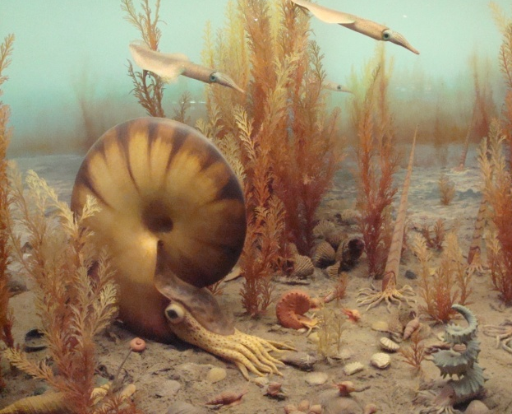
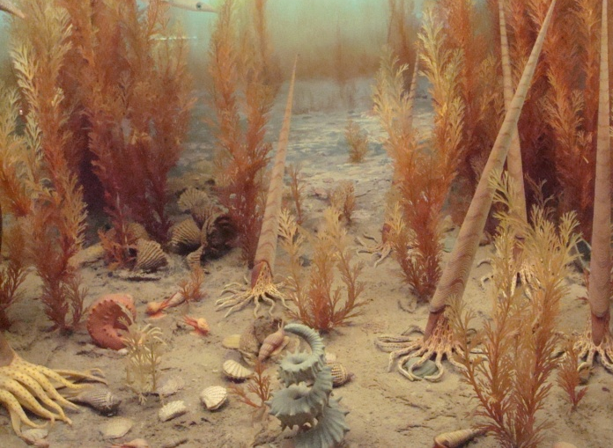
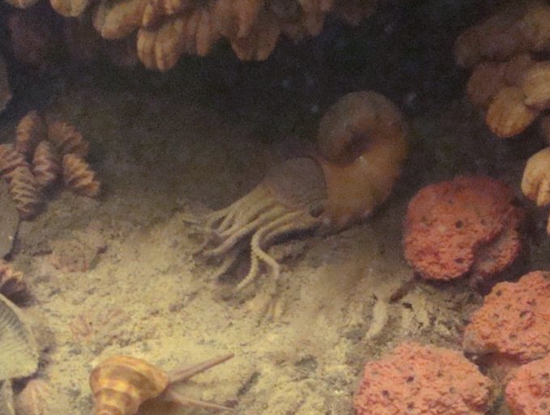
Future Work
Shells with higher frequencies of small apertural scars, which may represent feeding injuries, will also exhibit more robust ribbing.

Slide 21
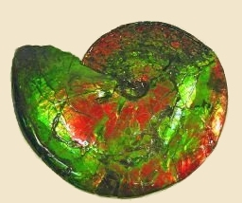
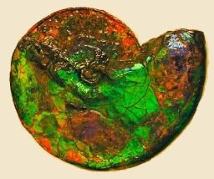
Acknowledgments
We thank Bushra Hussaini and Neil Landman for their assistance with the AMNH fossil collections, and the American Museum of Natural History for making their cephalopod fossil collections available.
Cephalopoda.net

