Slide 1

Exploring Geoscience Participation Opportunities for Elementary-aged Underrepresented Minority (URM) Students: Lessons Learned from a 2-year project
Geeta Verma, Ph.D.
University of Colorado Denver
Jacqueline Leonard, Ph.D.
Ana Houseal, Ph.D.
Karlise Lewis, M.S.
University of Wyoming
This work is supported by National Science Foundation grant # GEO- 1260957

Slide 2
Outline
Background and goals of the Denver, Dinosaur, and Climate Change (D2C2 project) Project and intended audience
Project team and activities
Brief Description of year 1 and year 2 activities
Data/Results
5. Lessons Learned
Questions, comments, and queries

Slide 3
D2C2 background, goals, AND intended audience
NSF funded grant that focuses on proof of concept idea. Here are the goals of the project:
a) using dinosaurs as the hook to learn about geology and climate change; and
b) to develop “green” focused community-based projects to improve public awareness of geoscience
Intended audience: Elementary aged (8-11 yrs. old) underrepresented minority (URM) students and high school and early college students to serve as near-peer mentors (NPM)

Slide 4
Project team and activities
University Professors: Science and mathematics Educators, soil scientist, geologist
Church Pastors: Community based recruitment (Latino and African-American Churches) vs. school based recruitment
Near-Peer mentors (NPM): Project participants as well as team members. High school and early college students (ages 16-22) who became part of the project team in implementing the project activities as well as became study participants (approx. 1 NPM for 4 students)
Pedagogical considerations (hands-on activities in churches and another site [designed as summer camp] complemented with field trips to Dinosaur Ridge, Rocky Mountain National Park, and other sites)
Notes:
Eight NPM worked at the community based sites in fall 2012 for a total of 16 mentors (7 African American, 7 Latina/o, 1 White, and 1 Two or more races). Seven were male and nine
were female. These NPMs attended a training session led by the geologist to learn about their role and responsibilities to assist with the project. Four NPMs from three different areas of
the city were hired in summer 2013 for a total of 12 mentors (8 African American & 4 Latina/o). Nine were male and three were female. Three of these NPMs also participated
in the fall program. All NPMs went through four hours of training that was led by project staff to review logistics and science concepts that would be taught during the camp

Slide 5
Summary of Year 1 and Year 2 Activities
Conceptual Framework: Sociocultural Theory (Vygotsky, 1986) and guided by ideas such as Place-based education and use of academic language in everyday life
Project activities were combination of classroom & field activities
Year 1: Dinosaur Ridge (activities such as what is a dinosaur, making an environmental map, using geological time scale, who lived when) – Field trips to Dinosaur Ridge
Year 2: Community-based activities (soil exploration, composting, germination of seeds, emergency preparedness) – Field trips to Botanical garden, Denver Museum of Nature and Science, Rocky Mountain Park etc.)

Slide 6
WHAT IS A DINOSAUR ?
Dinosaur
Characteristics
Non - Dinosaur
Characteristics

Slide 7
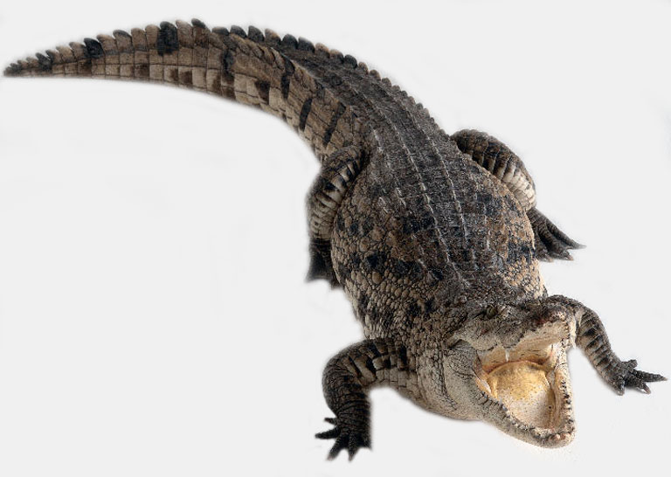
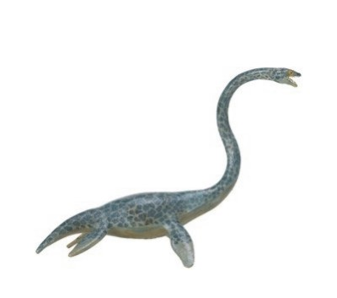
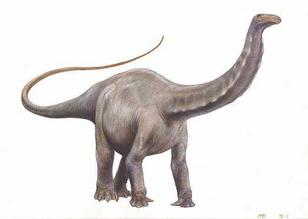
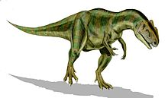
WHAT IS A DINOSAUR ?
Crocodile
Straight Neck
Legs out to Side
Carnivorous Reptile
Elasmosaurus
Lived about 80 Mill Years Ago
Swam in Cretaceous Sea
Maybe ate fish
Apatosaurus
75-90 feet long
25 Tons
Tiny Teeth
Allosaurus
Jurassic Period
Carnivore
Sharp Teeth and Claws
2-3 Tons

Slide 8
Preliminary data/results
Participants:
Year 1: n=33 (9 African American and 34 Latina/o; 1 two or more races)
Year2, n=34 (18 African American, 12 Latina/o; 4 two or more races).
10 Children participated in both years (4 African American and six Latina/o children).
Contextual Findings:
Informal learning opportunities (self-selecting, voluntary, non-sequential activities that may be relevant and meaningful to students)
On a continuum from compulsory to free choice (Rosenfeld, 1996)
Informal setting as alternative sites for data gathering and knowledge production and allows for a contemporary, collaborative, and trans disciplinary science

Slide 9
Representative Project Findings
Year 1
Analysis of quantitative data on the content test demonstrated that students did better on the open-ended items (86% accuracy) on the post-test. As an example, item 15 (List three reasons why it is important to learn science). Students’ responses included:
When you grow up and you are a geologist, it will help you.
You get to learn and do experiments (2 times)
Because it’s cool !!
Data from interviews:
“We also got to do…how to figure out if it was a carnivore, a
meat eater, if it was big or small, and also study about the
footprints”

Slide 10
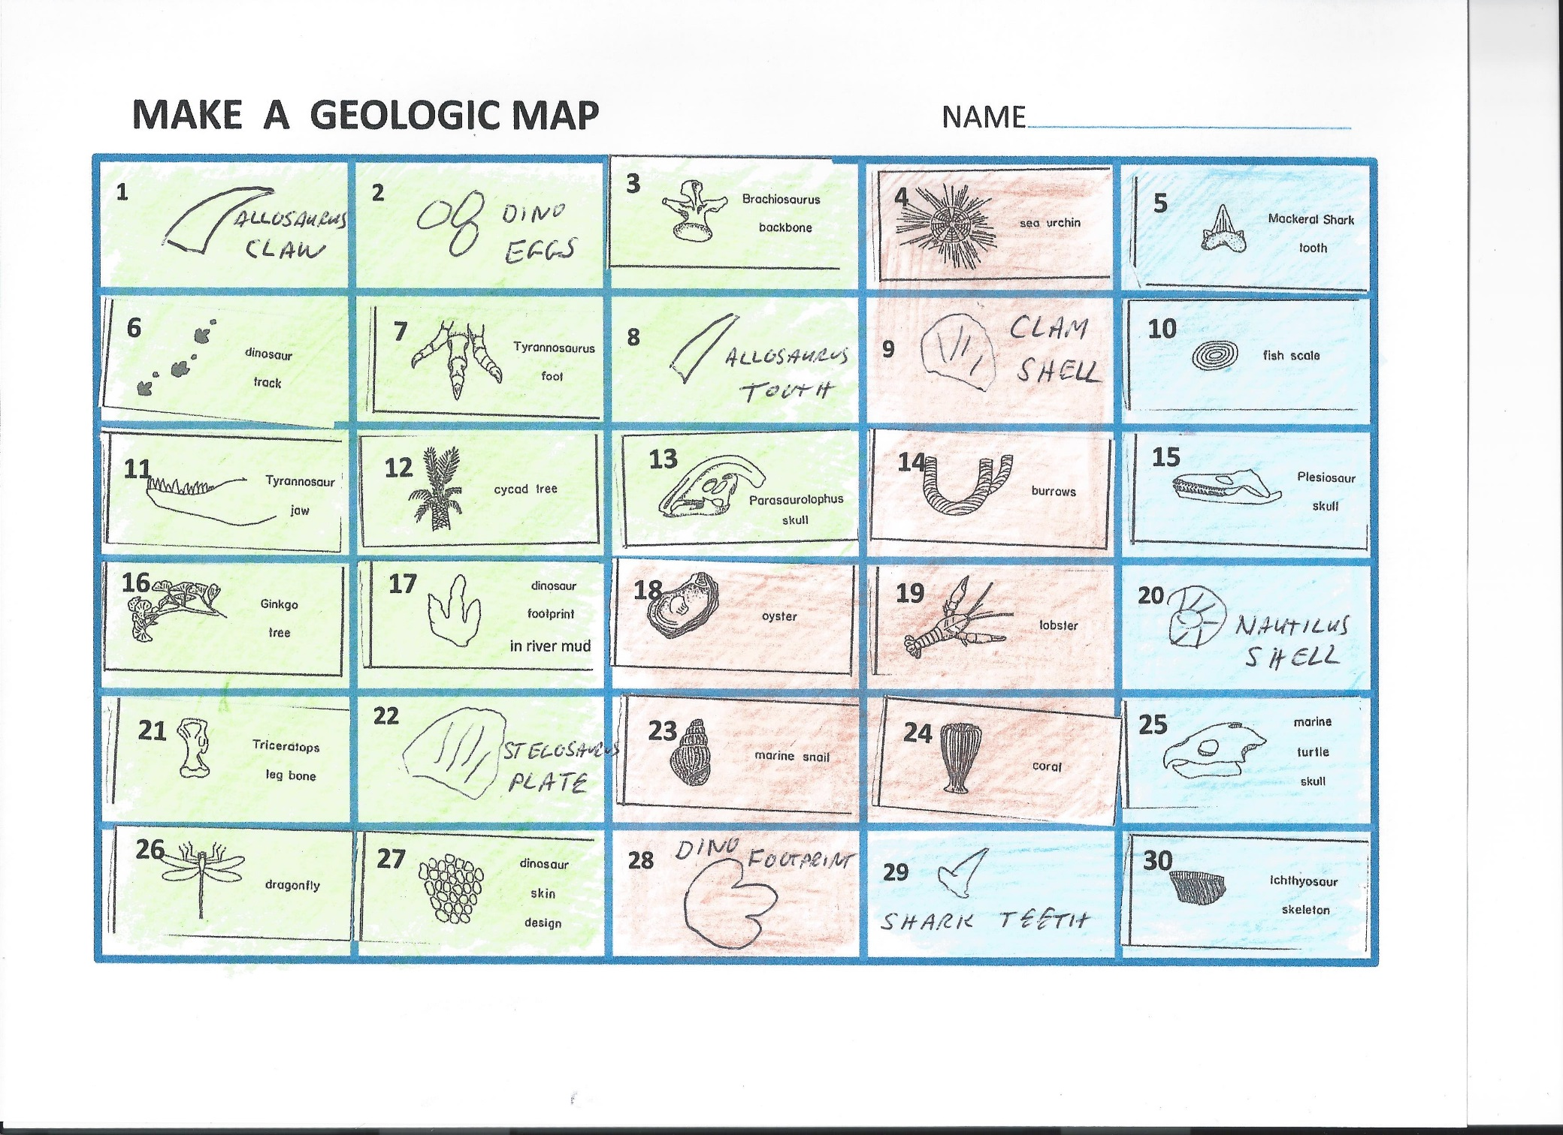
MAKING AN ENVIRONMENTAL MAP
Green = Land Brown = Beach or Near Shore Blue = Deep Water

Slide 11
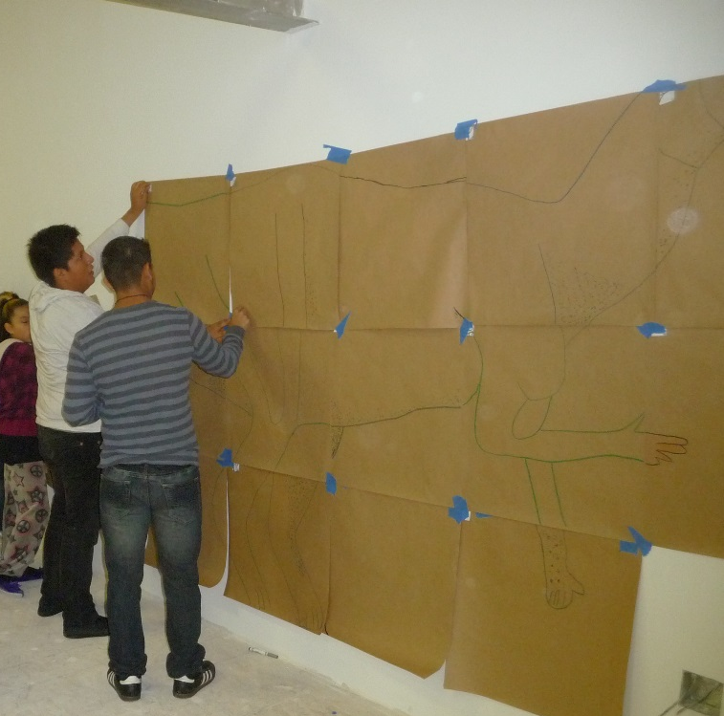
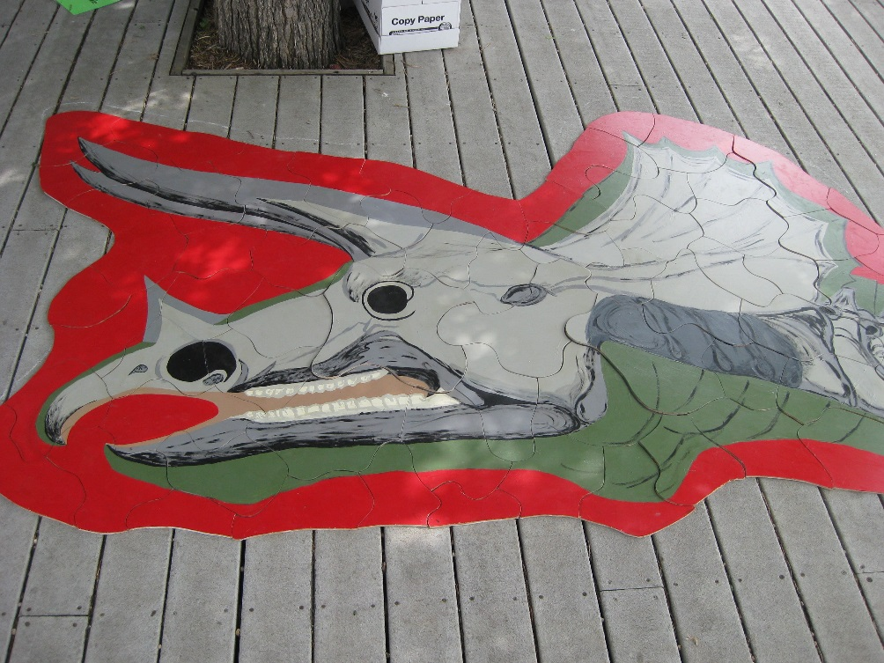
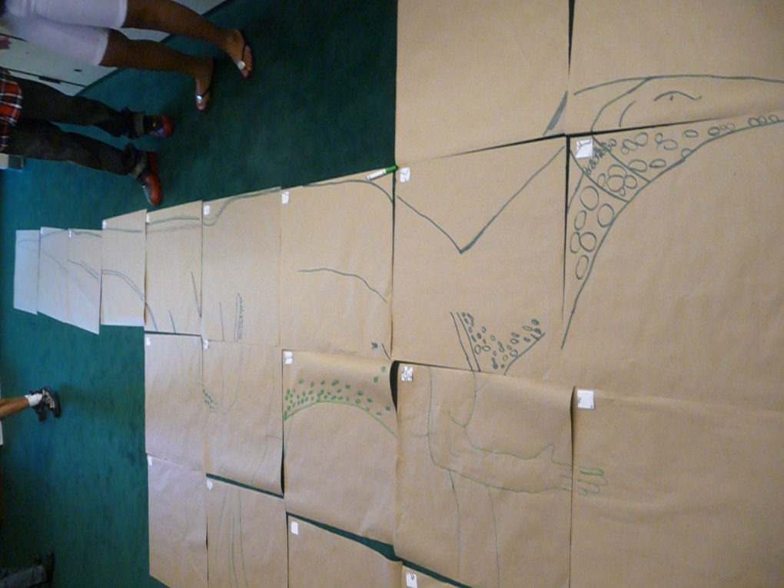
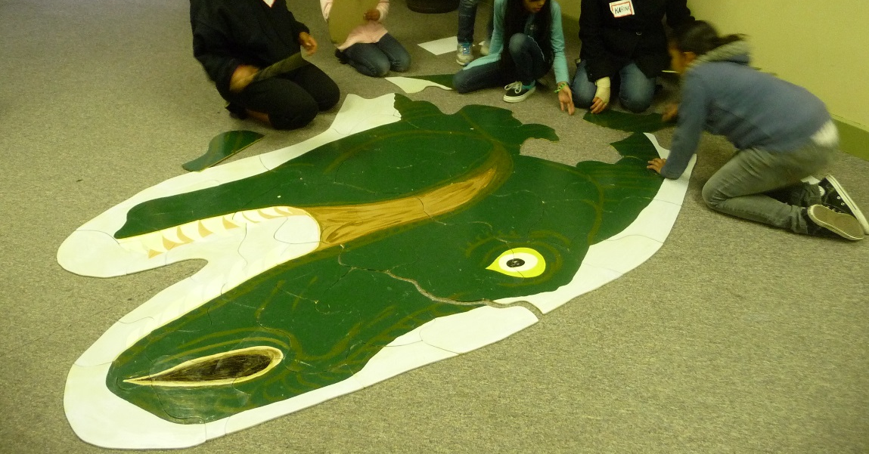

Slide 12
Representative Project Findings
Year 2
Students were given 3 content test (emergency preparedness, composting, and soil tests)
Results of paired t-tests reveal significant improvement on the safety test and composting but not on soil test
Students did well on test-items that were easily interpreted versus items that used academic language
Lesson on geo-detective (the mystery of the valley) based on Climate Change (field trip to Estes Park). Student responses included:
I know if you see a V-[shaped] mountain, it is caused by glaciers
The valley was formed by a glacier

Slide 13
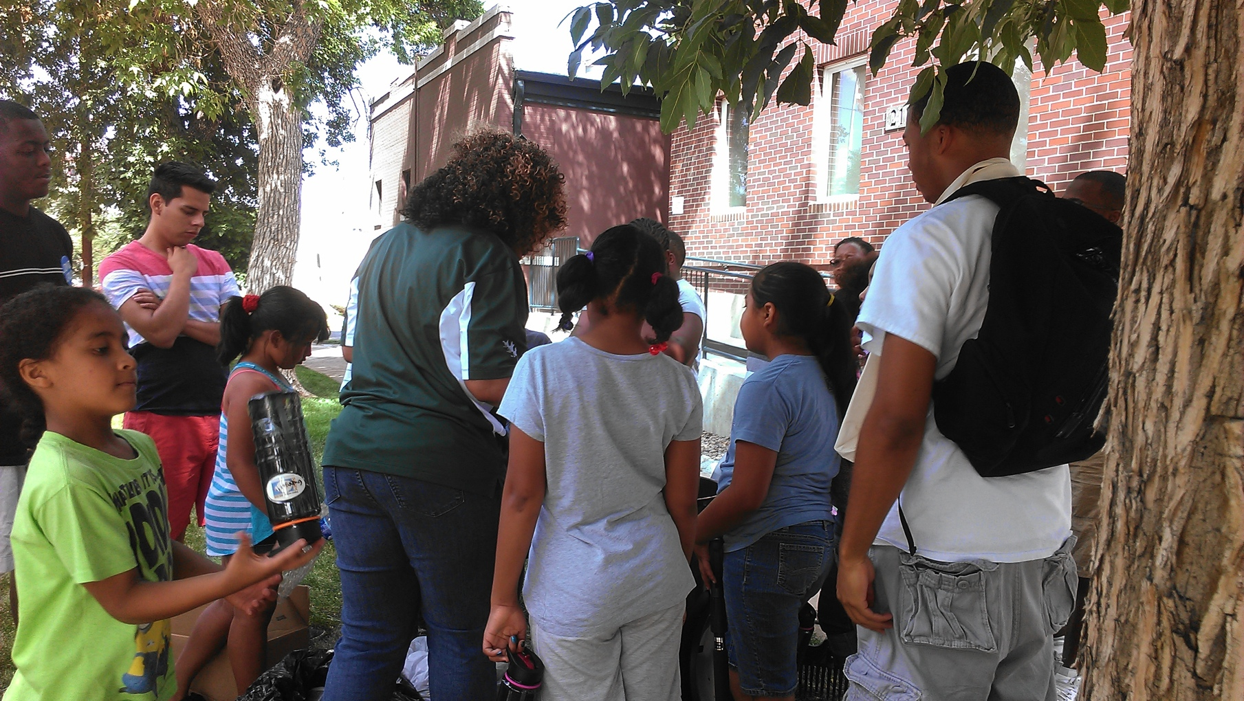
Picture from the composting activity

Slide 14
Lessons learned
Lessons learned related to project effectiveness
Challenges with aligning projects experiences with assessment
Balance between qualitative and quantitative date collection
Lessons learned related to project design
Integrating academic language in project activities to align with students’ background and experiences
Accommodating students and their families in informal learning projects such as this one (e.g., need to be full day-vs. half day to support working parents)

Slide 15
Questions, comments, and queries
Thank you !!
For question, please contact
Geeta Verma
geeta.verma@ucdenver.edu

Slide 16
Resources
“Dinosaurs, Denver and Climate Change Intern Manual” K. Shields, 2012
request from kermit_shields@yahoo.com
“Investigating Science with Dinosaurs” Craig Munsort, 1993
Out of print – but available on amazon.com
“A Field Guide to Dinosaur Ridge” Martin Lockley, 2001.
Many additional references available at Dinosaur Ridge gift shop
“Dinosaur Odyssey: Fossil Threads in the Web of Life” Scott Sampson, 2009
Dr. Scott is now at the Denver Museum of Nature and Science

