Slide 1
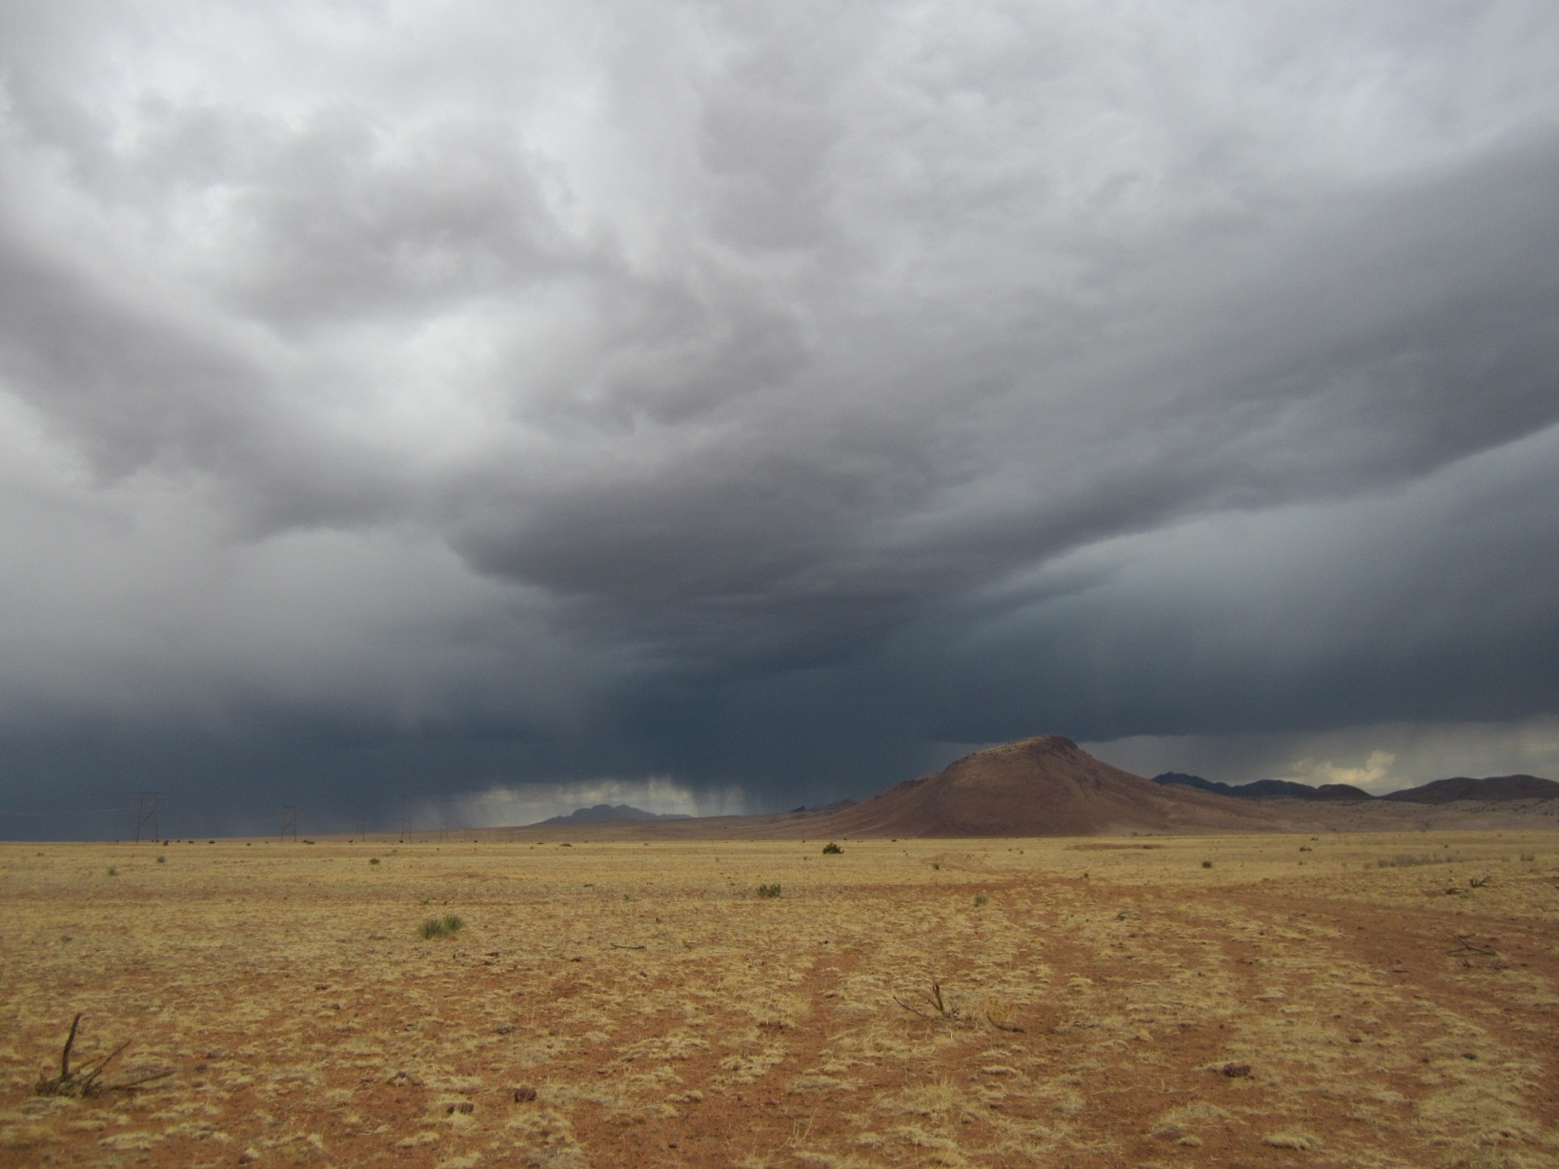
THE WATER CANYON PALEOINDIAN SITE: A Significant Archive of Paleoclimatic Data
for the Early Holocene
in West-Central New Mexico
Robert Dello-Russo, Ph.D.
Office of Archaeological Studies
Museum of New Mexico
Santa Fe, NM
Susan J. Smith
Consulting Archaeo-palynologist
Flagstaff, AZ
T24 Symposium. Climate Change in the Interior Western United States from the Last Glacial Maximum to the Holocene
2013 Geological Society of America Conference
October 27-30, Denver, CO

Slide 2
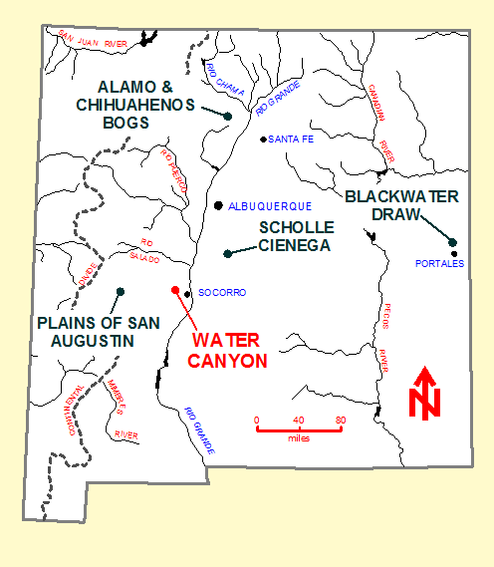
LOCATIONS of SOME PLEISTOCENE-to-HOLOCENE PALEOCLIMATIC RECORDS in NEW MEXICO

Slide 3
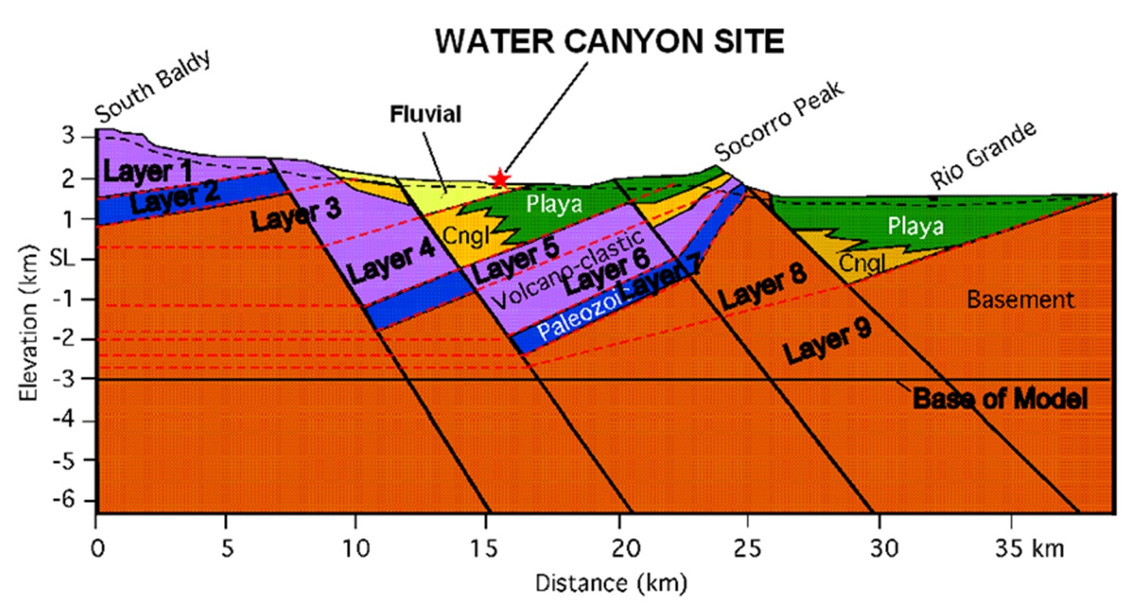
WEST-TO-EAST GEOLOGICAL CROSS-SECTION: MAGDALENA MOUNTAINS TO RIO GRANDE RIFT

Slide 4
3-D Topography Surrounding Water Canyon Site

Slide 5
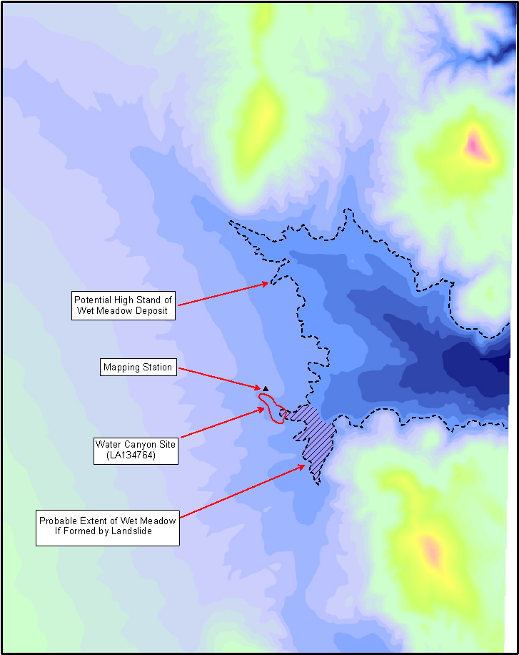
Potential Extent of Wet Meadow During Late Pleistocene – Early Holocene

Slide 6
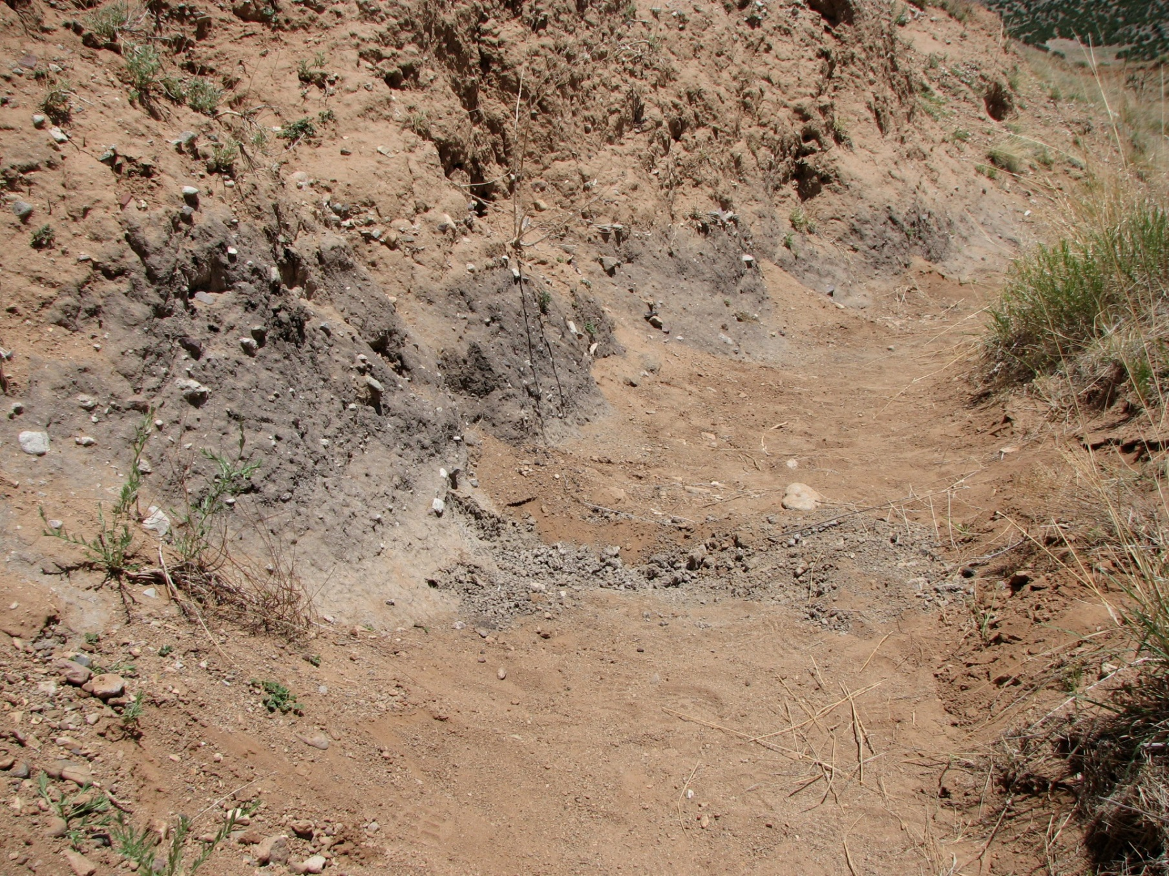
Wet Meadow Deposit in North Arroyo Wall / 2000

Slide 7
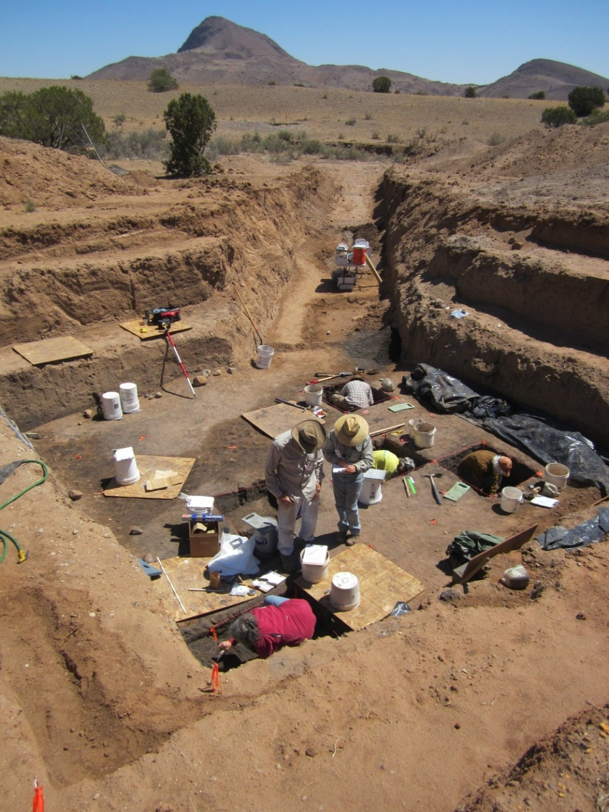
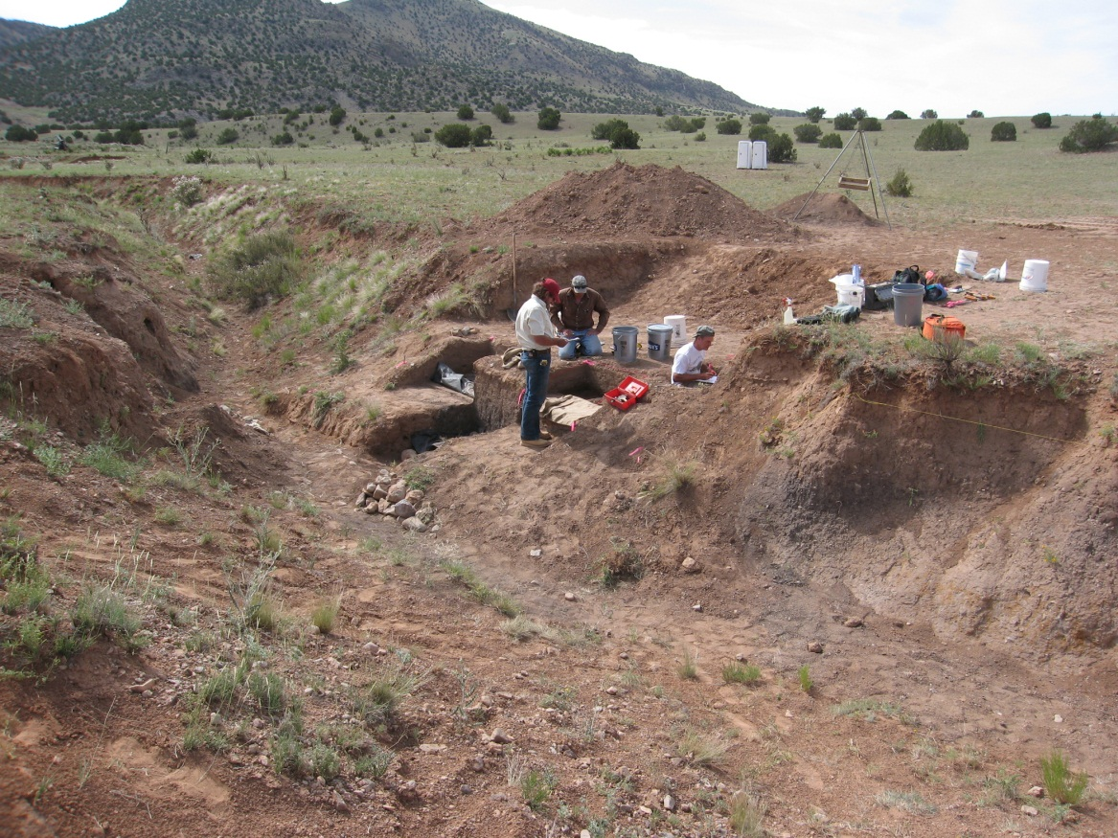
Locations of Hand Excavation Units and Buried Bison Bone Beds
LOCUS 1
No Name Arroyo – View SE
LOCUS 5
View NE

Slide 8
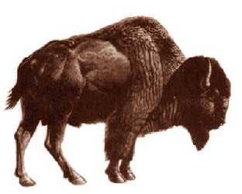
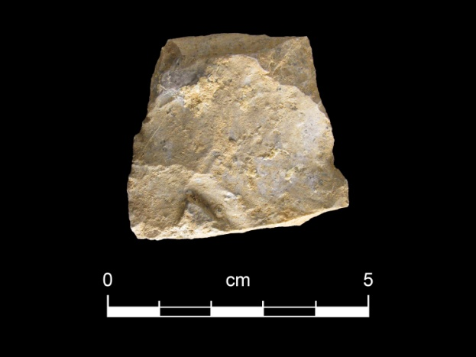
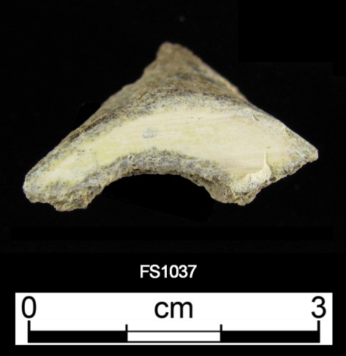
Bison antiquus
Rhyolite biface fragment with bison blood
Bison bone collagen
8200+/-40 rcyrbp (9155+/-135 calyrbp)

Slide 9
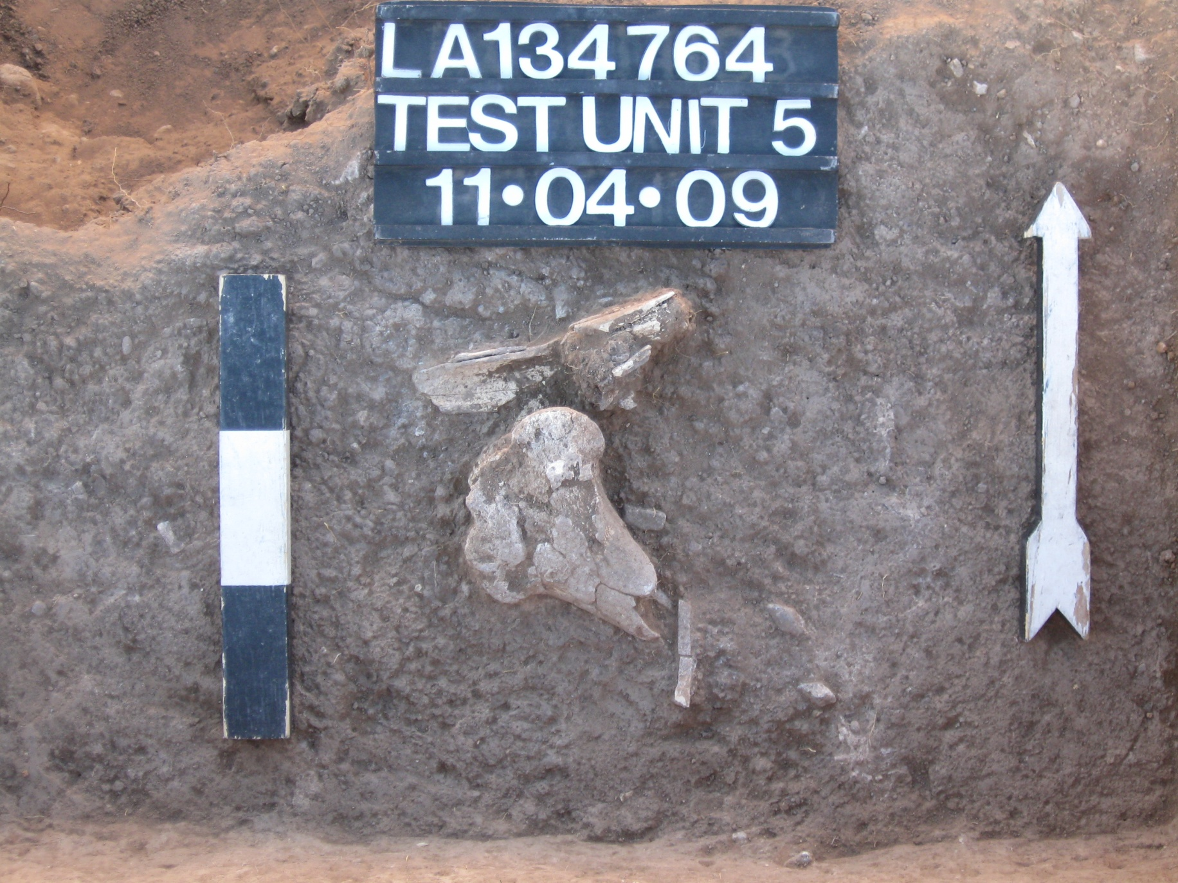
Bison Distal Femur in Wet Meadow Deposit

Slide 10
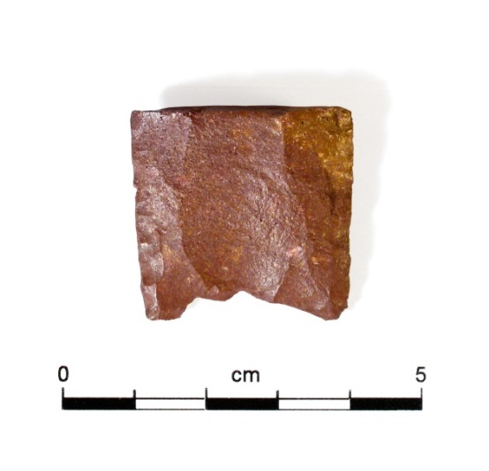
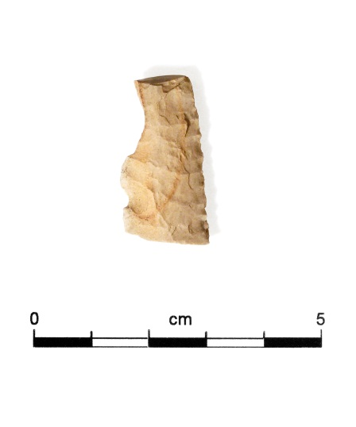
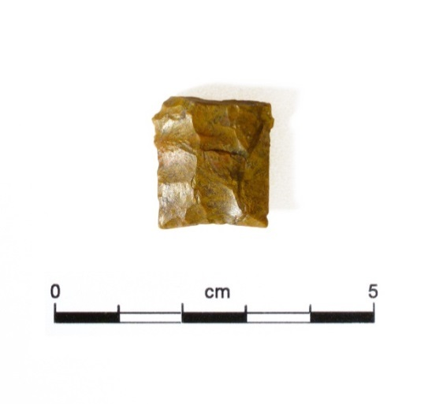
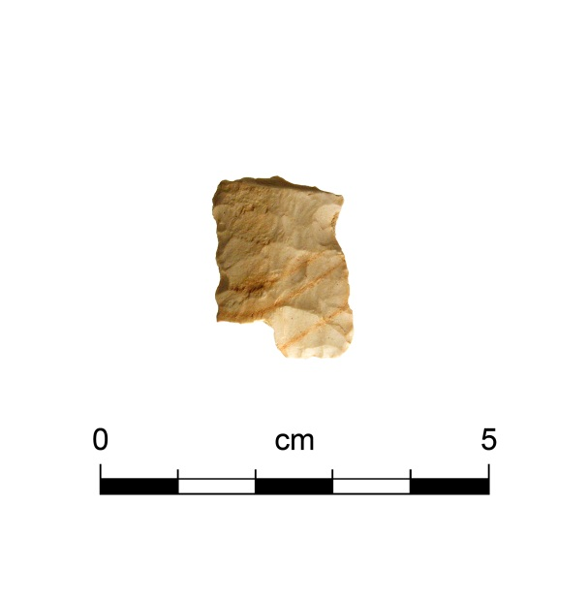
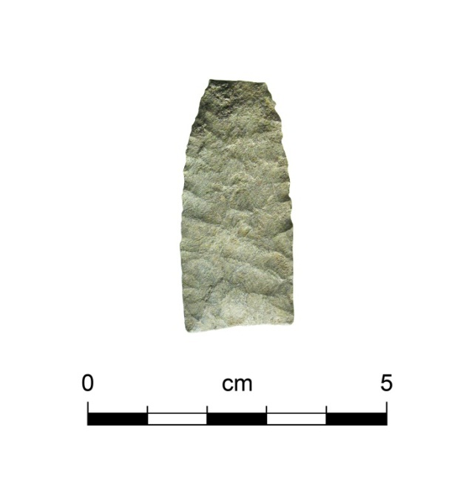
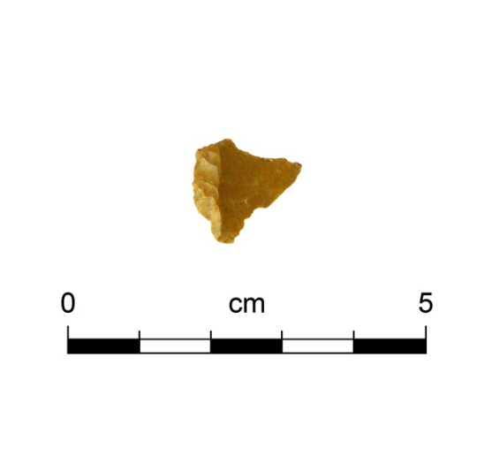
Late Pleistocene – Early Holocene Diagnostic Artifacts
CLOVIS POINT BASE
LATE PALEO POINT BASE
FOLSOM POINT EDGE
LATE PALEO KNIFE
BASE & BLADE
RESHARPENED EDEN POINT

Slide 11
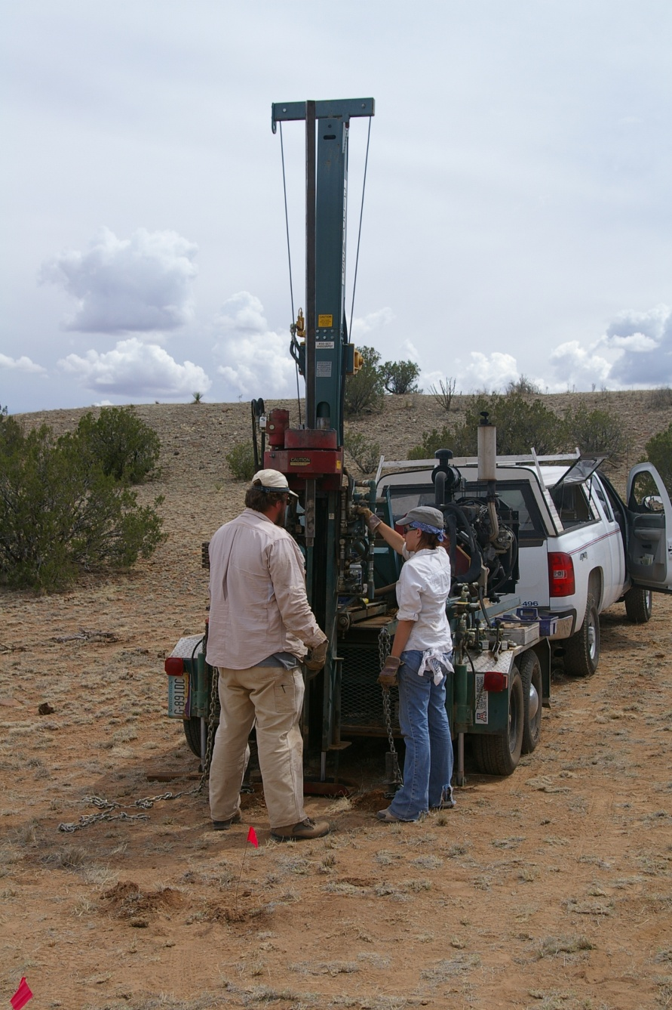
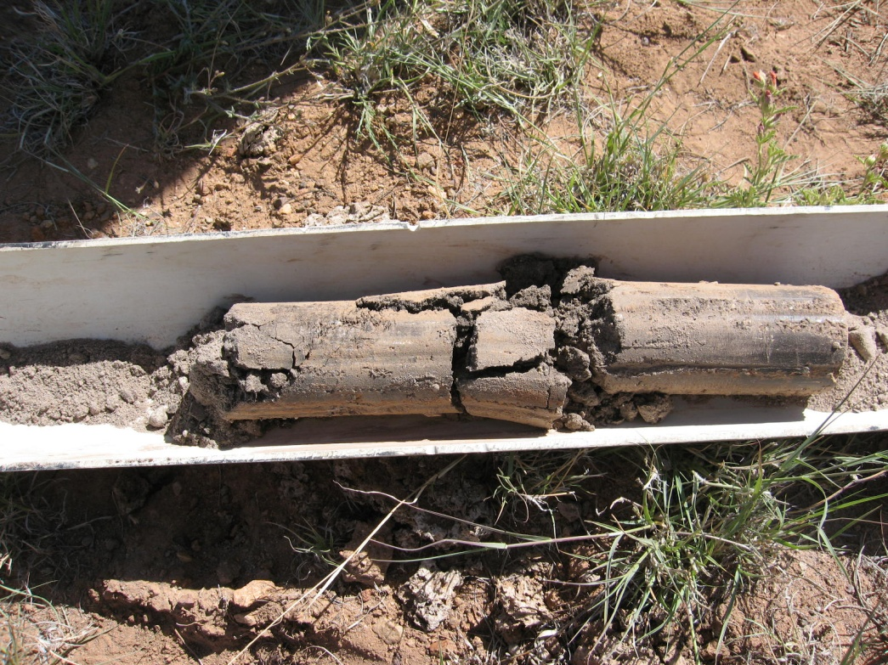
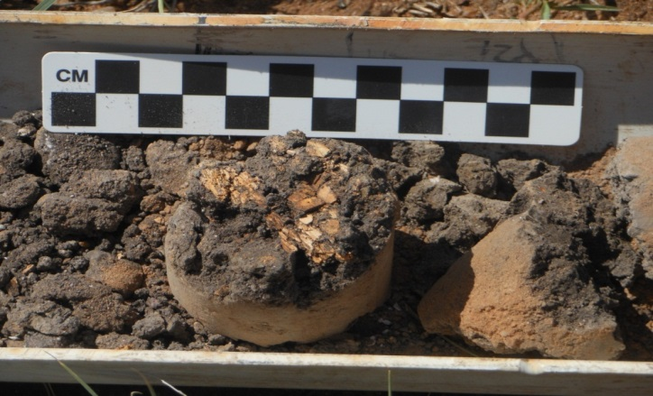
Bulk sediment for pollen & 14C
Bison bone in deep core
Giddings Soil Coring Rig
9887+/-15 rcyrbp (11,100+/-40 calyrbp)

Slide 12
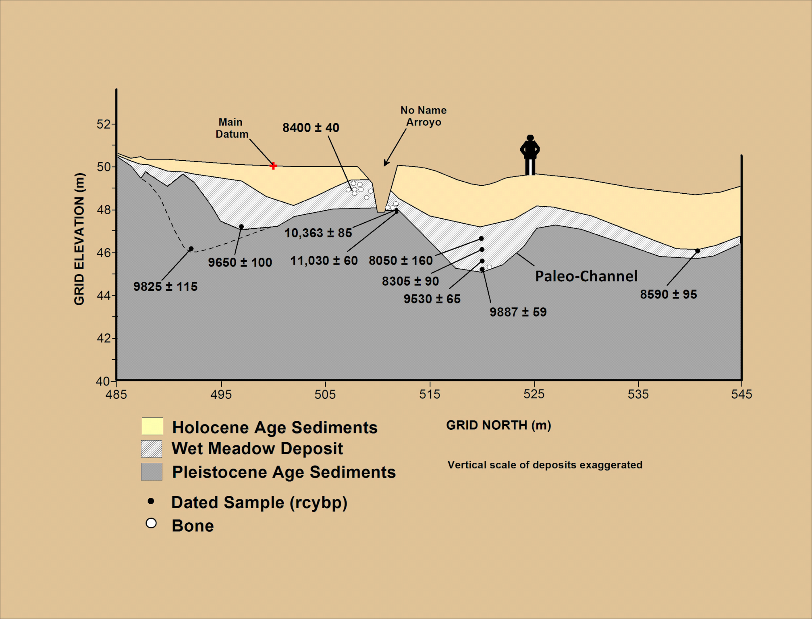
GENERALIZED STRATIGRAPHIC CROSS-SECTION
LOCUS 1
LOCUS 5
Notes:
If you remember our earlier conversation about the south-to-north, stratigraphic cross-section…..where we saw the buried bone in a deep, paleo-channel….
Based on our previous Giddings cores and our original set of 14C dates, we actually encountered Folsom and Clovis-age sediments in L1 in the base of the current active channel of No Name Arroyo.
It seems clear that we have a lot of work to do at WC……

Slide 13
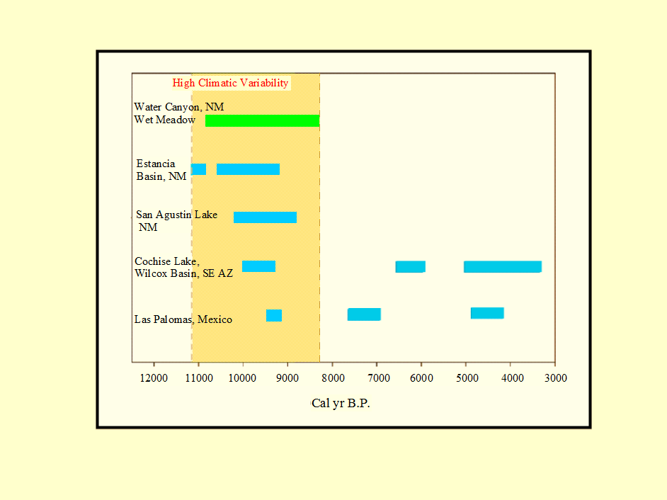
Timing of Regional Lake High Stands & Water Canyon Wet Meadow

Slide 14
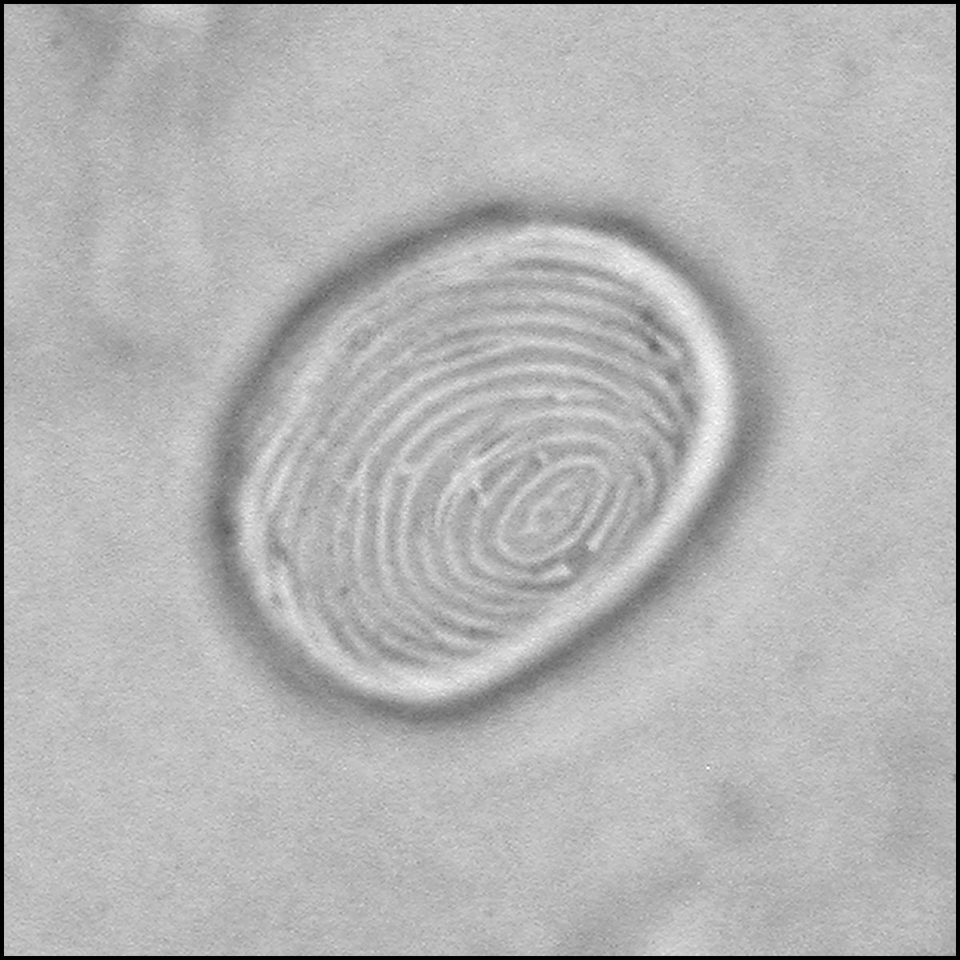
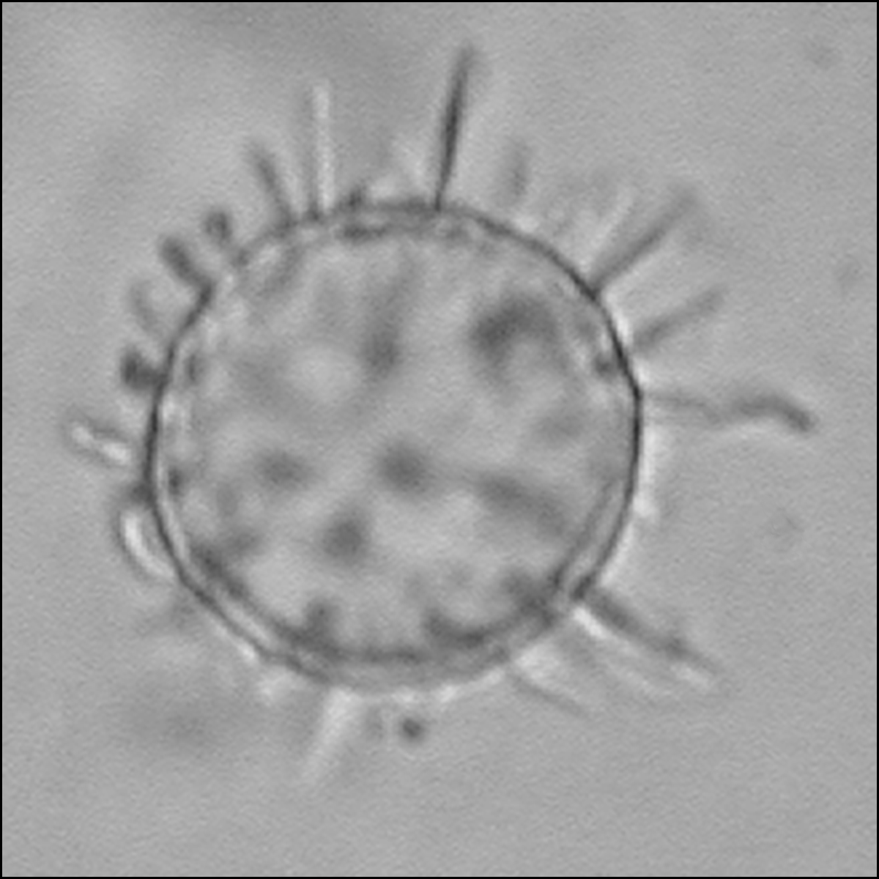
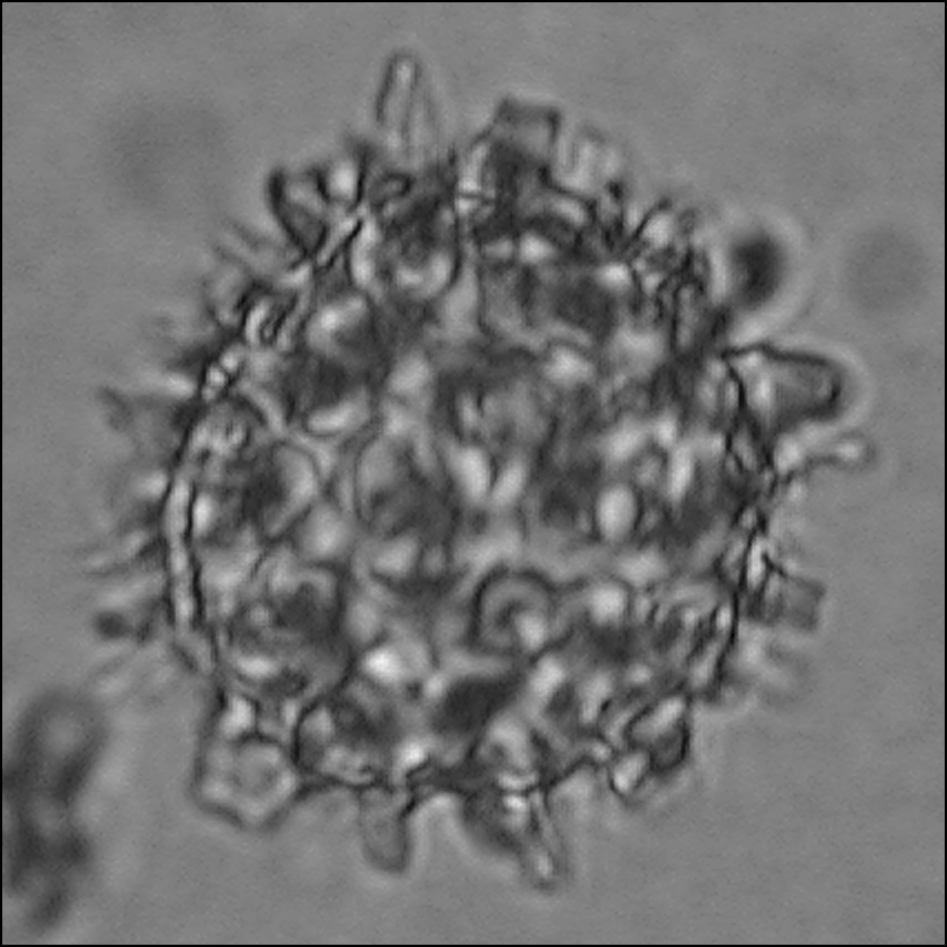
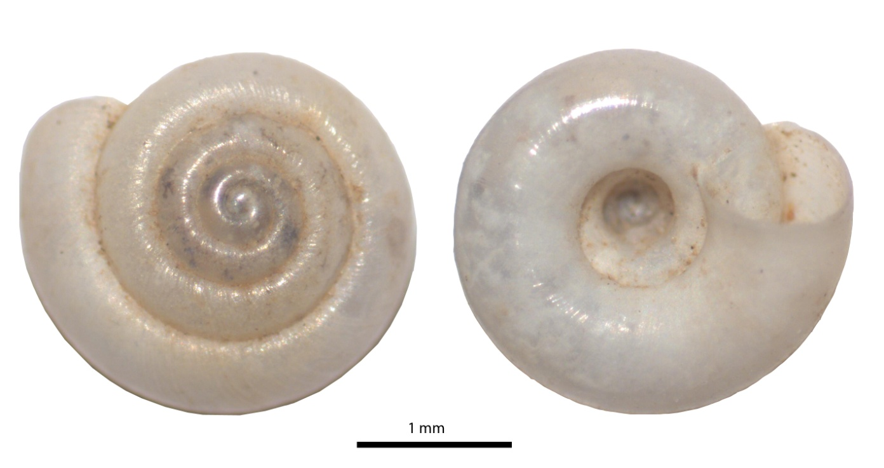
Indicators of Moist Environments
Microfossils
←
Land Snails
→
Hawaiia miniscula

Slide 15
Water Canyon Pollen Results 11,000 - 5,000 cal yr BP

Slide 17
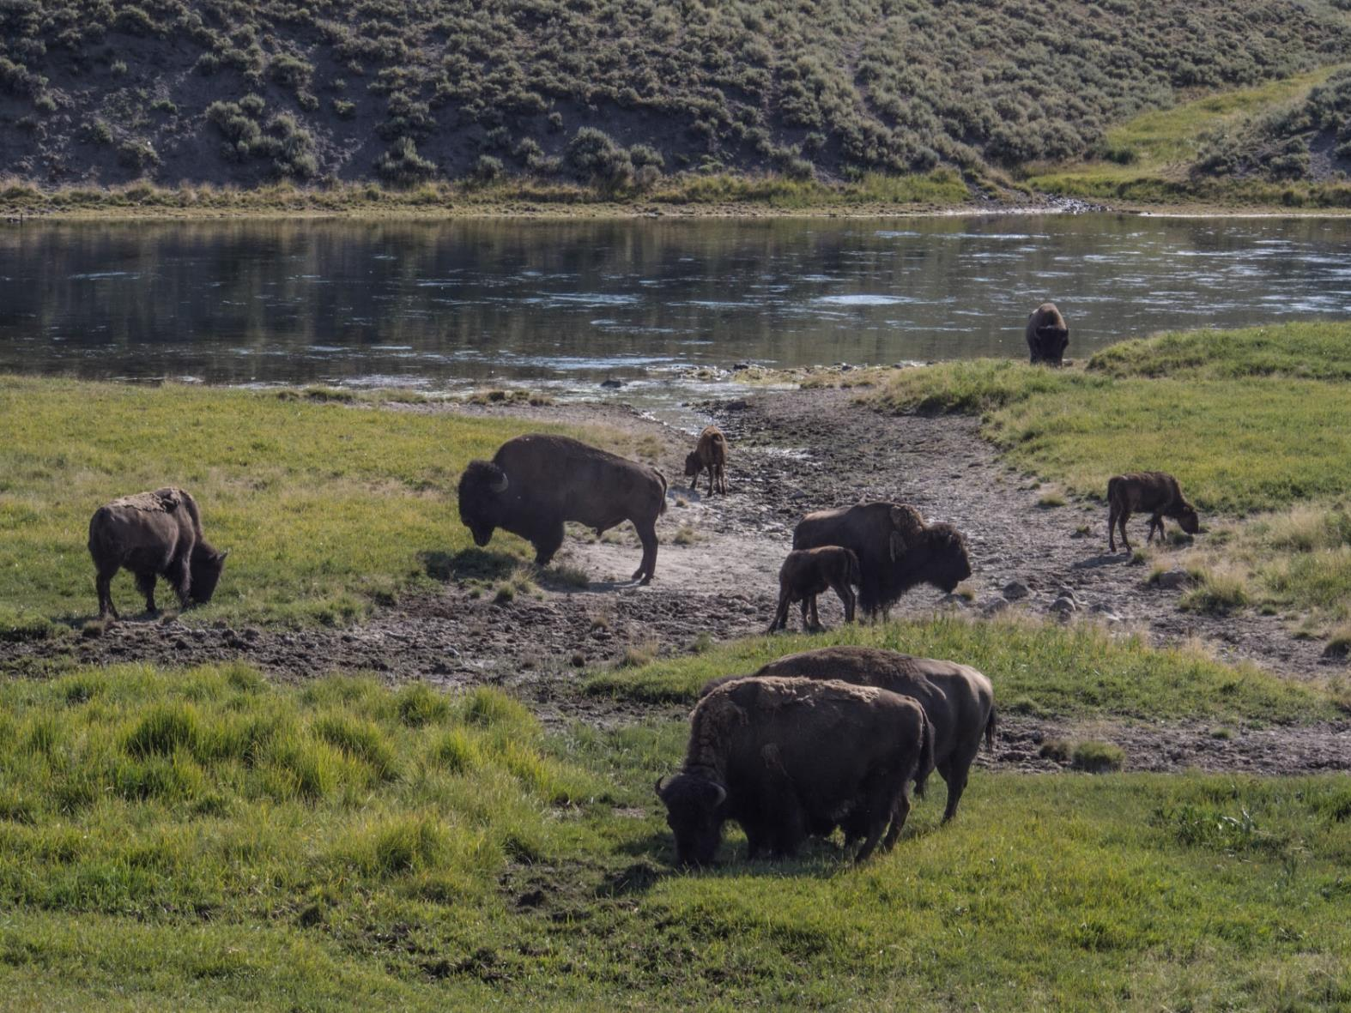
Late Pleistocene Reconstruction
Wet Meadow, Ponded Water, Sagebrush, Bison

Slide 18
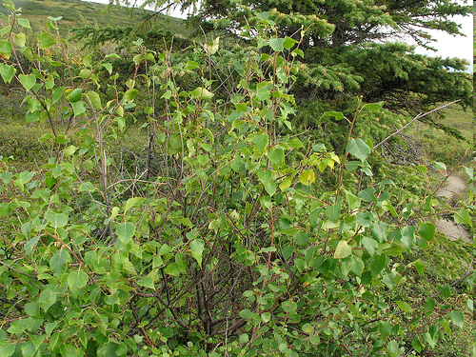
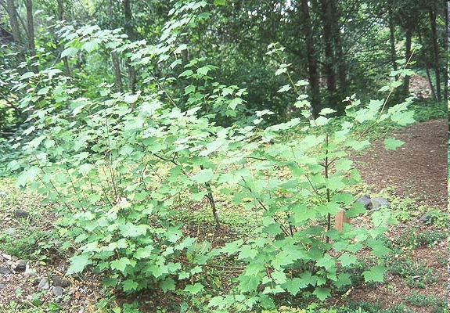
Earliest-to-Early Holocene Reconstruction
Bog Birch / Alamo Bog, 2630 m, Jemez Mts., NM
Rocky Mt. Maple, 2440 m, Magdalena Mts., NM

Slide 19
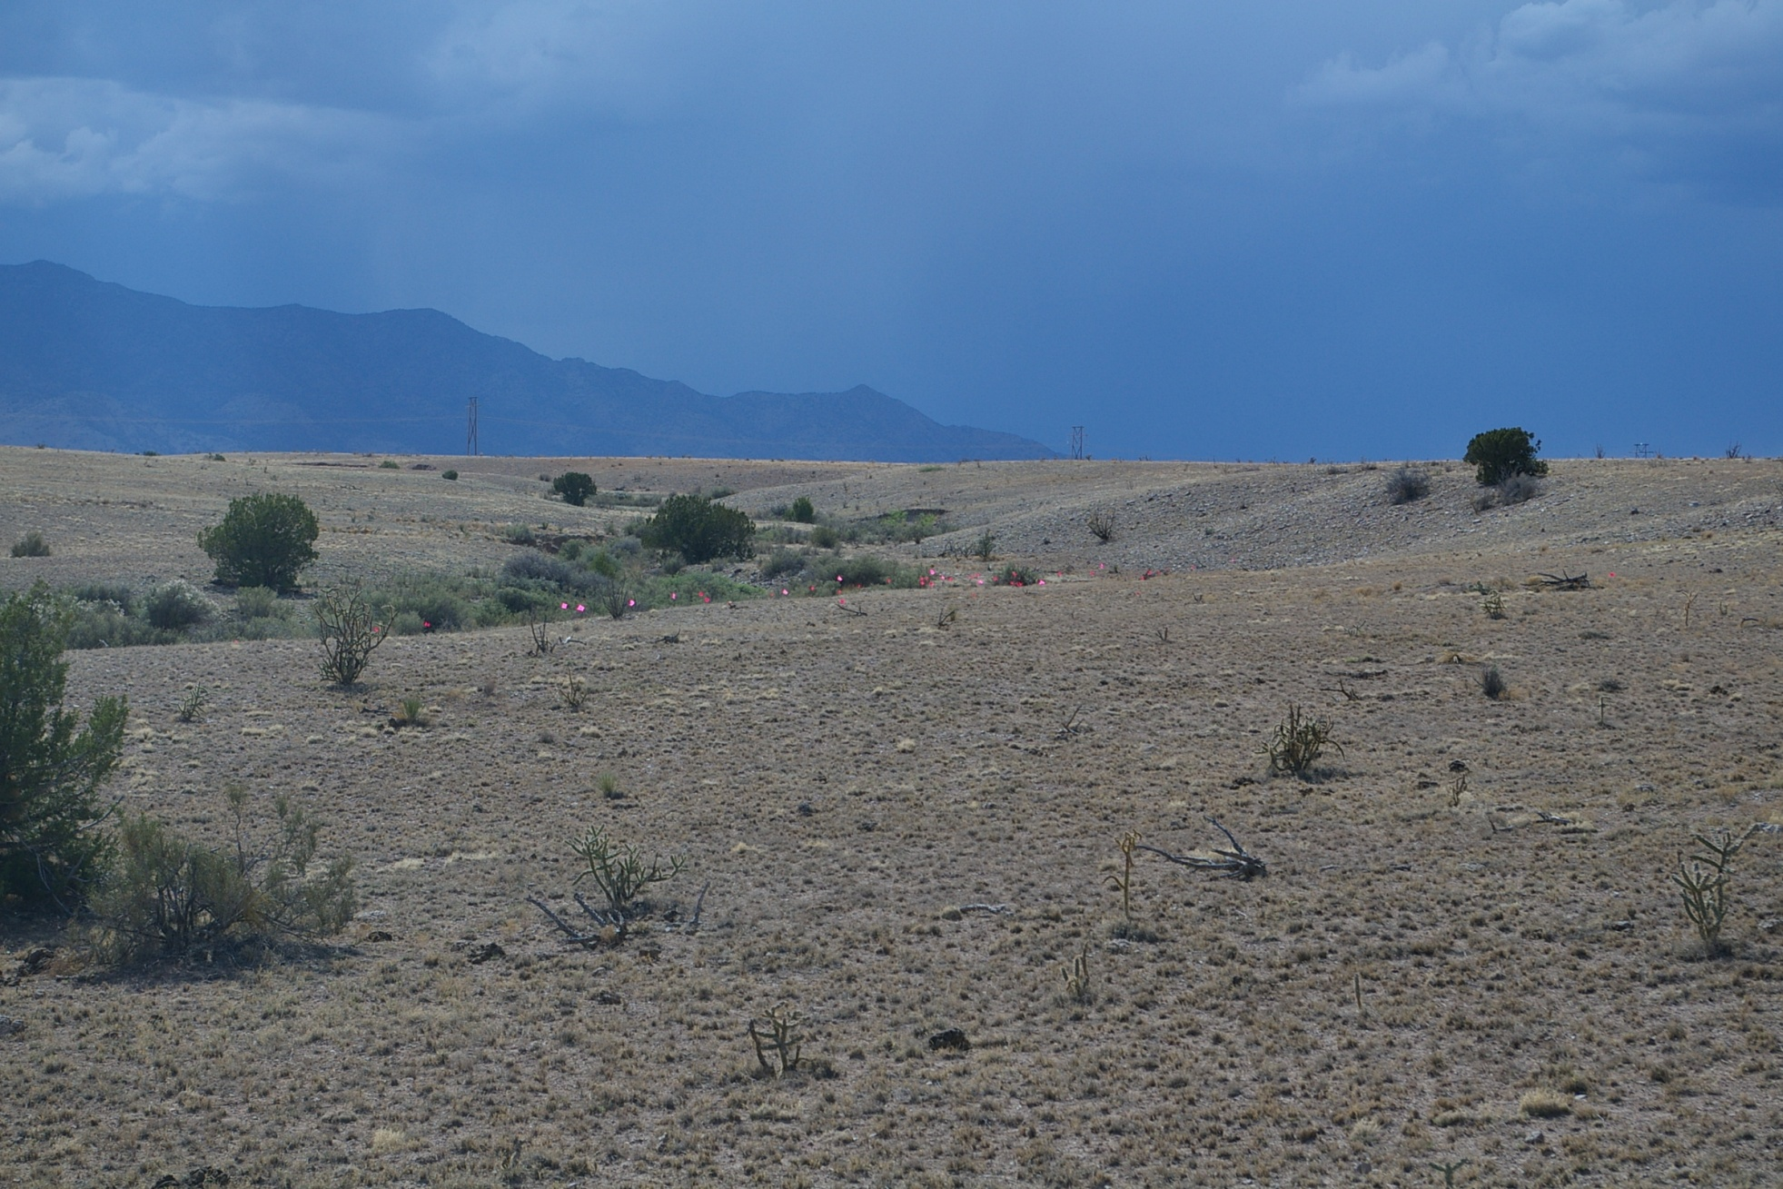
Modern Juniper Savannah 1760 m, Water Canyon Site, NM

Slide 20
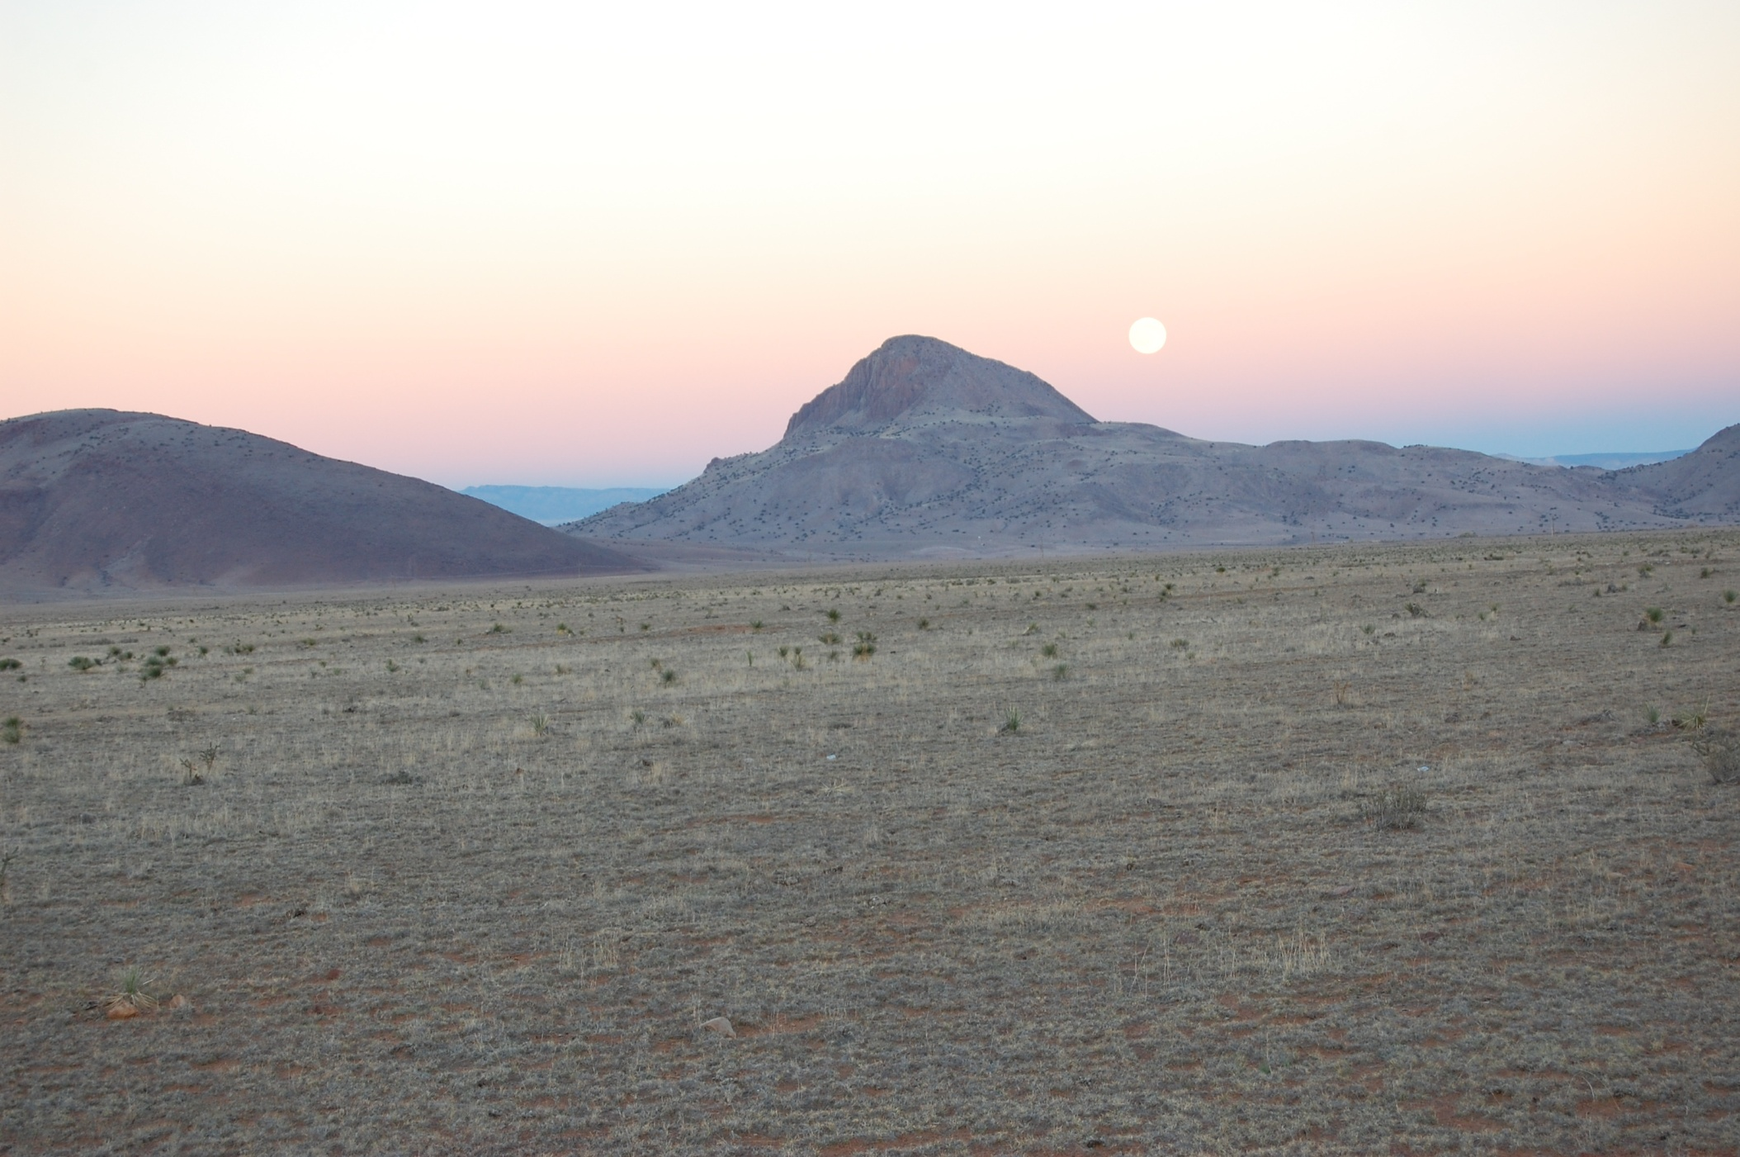
THANKS TO:
Art Hurley
Susan Smith
Gary Morgan
Dr. Steve Hall
Dr. David Kilby
Patricia Walker
George Crawford
Dr. Bruce Huckell
Dr. Vance Holliday
Dr. Russell Greaves
Dr. C. Vance Haynes
Dr. M. Steve Shackley
Roland & Martha Mace
Gary Grief & Dorothy Wells
M. Abernathy & C. Galceran
2008-2013 Volunteers
Museum of NM Foundation
Office of Archaeological Studies
NM Museum of Natural History
NM Institute of Mining & Technology
National Radio Astronomy Observatory
Argonaut Archaeological Research Fund
Curtis T. & Mary G. Brennan Foundation
Energetic Materials Research & Testing Center
THANK-YOU!
Hunter’s Moon Rising Above Water Canyon Paleoindian Site / November 2009

