Slide 1
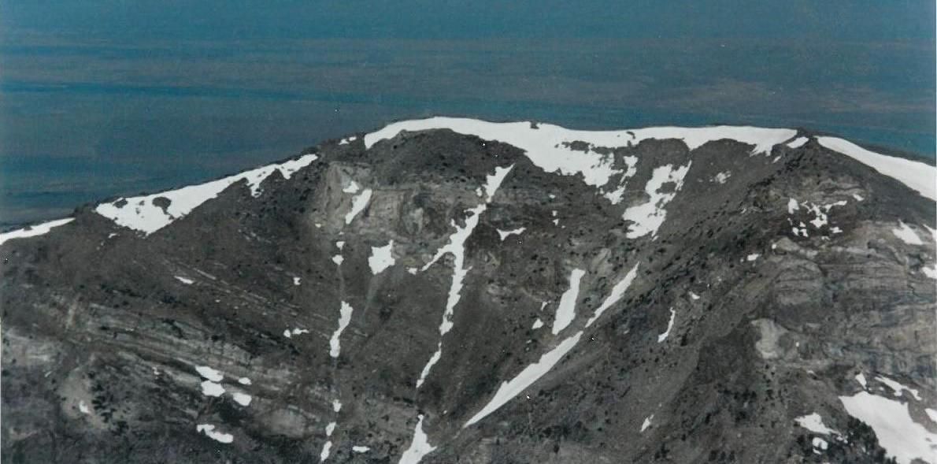
Unfolding the story of Late Cretaceous tectonic inheritance in the Ruby-East Humboldt-Wood Hills Metamorphic core complex, Nevada
Winchell Lake fold-nappe
PHANTOM THRUST BELTS, THINNING FOLD-NAPPES, AND OTHER ENIGMAS
Allen J. McGrew*
University of Dayton
Phyllis Camilleri
Austin Peay State University
Arthur W. Snoke
University of Wyoming
Notes:
I’d like to start by highlighting my two co-authors, Phyllis Camilleri and Art Snoke. Anything that seems to make a bit of sense in this talk undoubtedly reflects vestiges of their influence.
Here is the poster child for this talk – the Winchell Lake fold-nappe as exposed in the cirque wall behind Winchell Lake in the northern part of the East Humboldt Range.

Slide 2
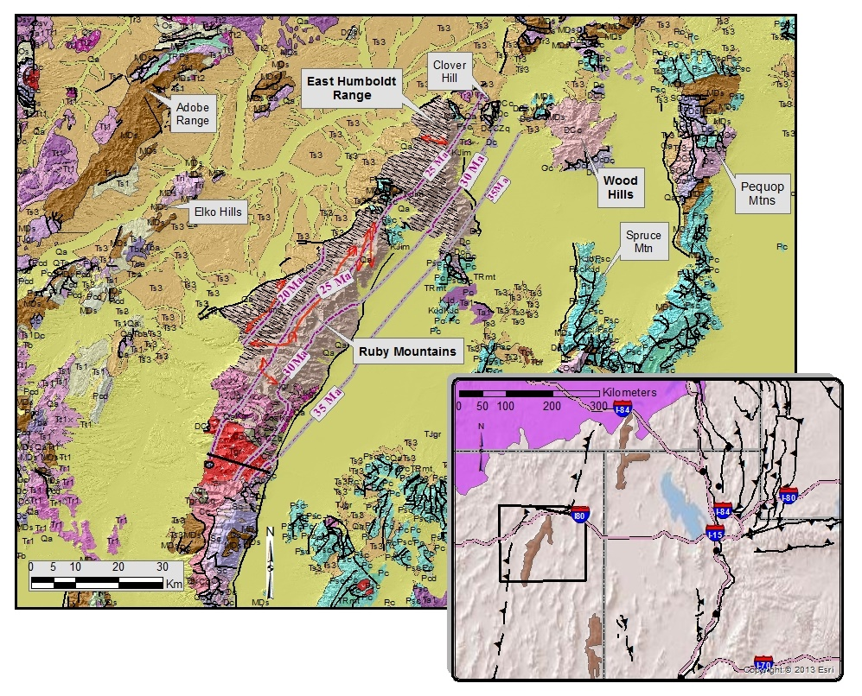
?
?
Roberts Mtn Thurst
Sevier Belt
Notes:
OK, so where are we? The Ruby-East Humboldt-Wood Hills core complex is one three classic metamorphic core complexes in the northeastern Basin and Range Province, the other two being the Snake Range to the SE and the Albion-Raft River – Grouse Creek complex to the NE. Of the three, the RM-EHR-WH complex is deepest into the Hinterland. Also of note, it parallels the trend of the older, supposedly Miss-Dev Roberts Mtn Thrust. I say supposedly because throughout this part of Nevada, this Mississippian-aged feature seems to have an embarrassing propensity for cutting Triassic aged rocks, including conspicuously in the northern Adobe Range approx 60 km WNW of the northern East Humboldt Range. Just north of the RM-EHR-WH complex is an approximately 150 km right-lateral offset in the leading edge of the RMT and a variety of Paleozoic facies trends. Stewart & Poole originally identified this as an oroclinal bend in the MZ orogenic belt; Thorman identified it as a right-lateral tear called the Wells Fault; others have argued that it is simply reflects an original bight in the Cordilleran margin. In any case, it appears to have been exaggerated by Cenozoic deformational history that shifted the Elko Hills and the Adobe Range about 60+ km to the WNW.

Slide 3
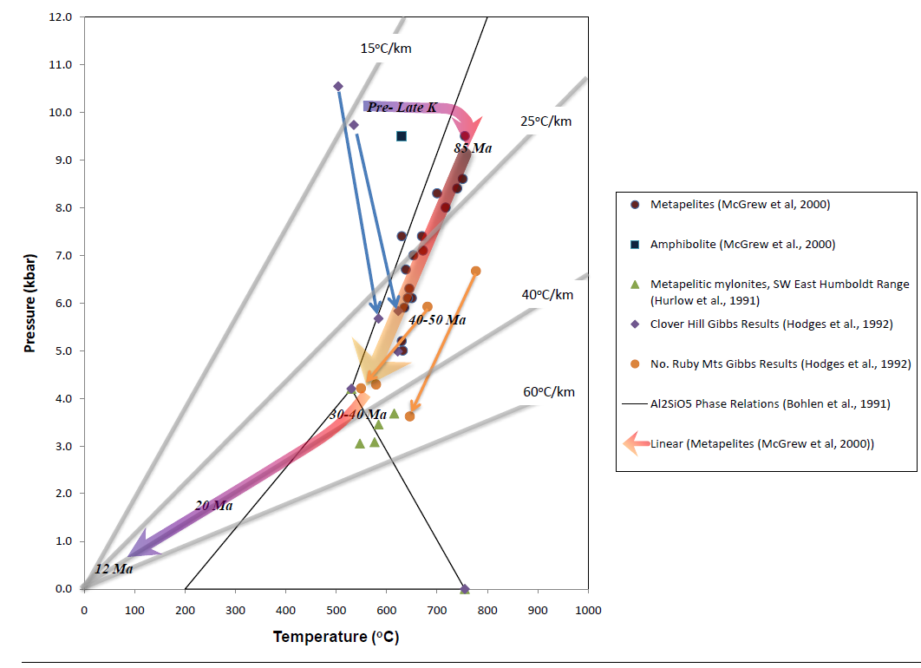
Enigma 1:
Evidence of Late K Deep-seated tectonic burial vs.. . .
Peak Metamorphism to 10 kb in rocks as young as Mississippian
WLN emplacement ~84 Ma early in decompressional path
Notes:
Time to introduce what I think is the most profound enigma of this area, which is that when we take a look in the deeper crust we see evidence of something profound going on, with rocks ranging from Neoproterozoic to Mississippian in age being metamorphosed to pressures as great as 10 kb corresponding to burial depths of 35 km or more depending on what you assume for the density of the overburden. Though the details of timing are still evolving, it is very clear that maximum burial occurred by the Late Cretaceous, 70-90 Ma, with the detailed timing depending where in the core complex you look.

Slide 4
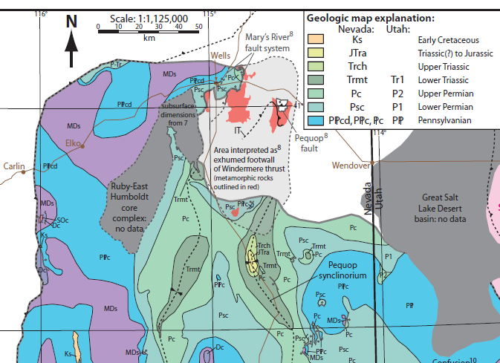
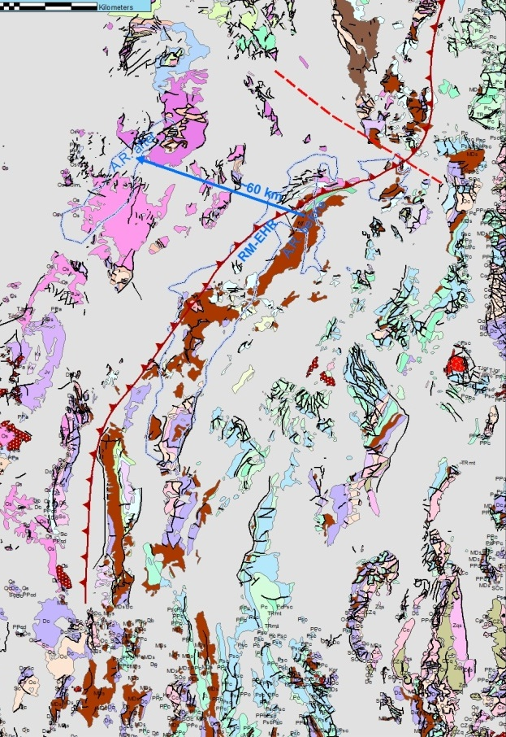
Enigma 1: Limited Upper crustal erosion & little syntectonic sediment
Oops! Roberts Mtn Thrust cuts Triassic strata??
“Roberts Mtn Thrust”
60 km
Notes:
Set against that, the upper crust at the same time suggests a very different story, at least to the SE of the core complex. I captured the image to the left from Sean Long’s important synthesis published just last year in which he re-emphasized a point that Dick Armstrong originally highlighted and that people like Elizabeth Miller have also underscored. If you look throughout East-central Nevada, the basal Tertiary unconformity, which is usually Eocene in age, rests on Upper Mississippian to Triassic strata. In the image at right I have palinspastically restored the bits and pieces assuming 60 km post-Eocene offset of the Adobe Range back on top of the RM-EHR. To restore the probable outcrop belts prior to Cenozoic extension. The basic point is that it is tough to recognize where you could force this hypothetical thrust wedge through unless you hide significant amounts of the shortening within and beneath the Roberts Mtn allochthon. However, even if you do this, you need to propagate significant shortening farther SE into the foreland of the RMT to explain the tectonic burial of the Wood Hills.

Slide 5
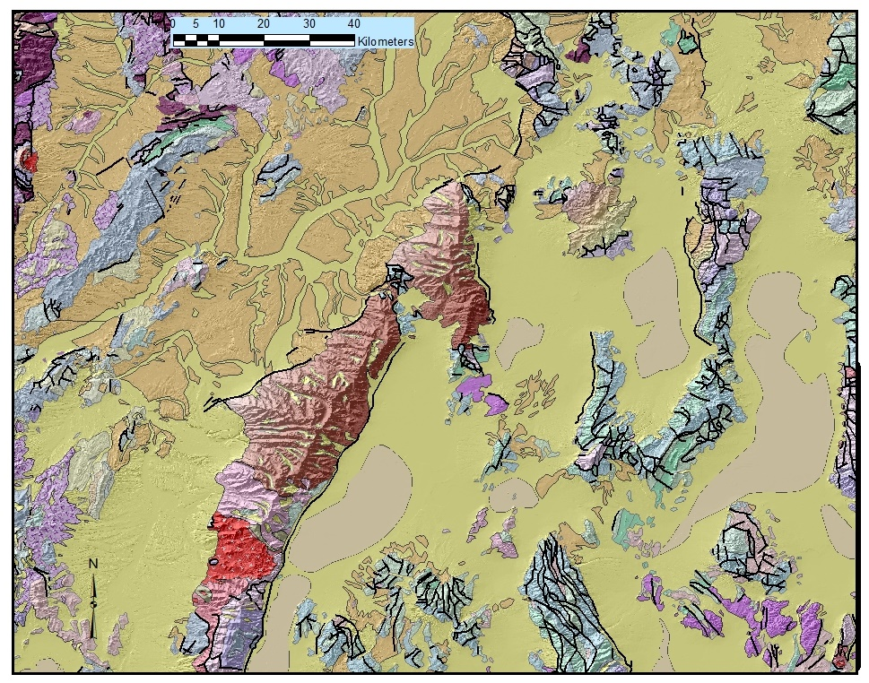
Enigma 1:
Evidence of Late K Deep-seated tectonic burial
(1) ~525°C, 10 kb
(2) ~620°C, 5.8 kb
(Hodges et al., 1991)
625°C, 6.6 kb @ 82.8 Ma
(Wills et al., 2013)
450°C, 4 kb @ 84Ma
700°C, 10 kb @ 78 - 82Ma
WLN (Hallett, 2012)
8 kb
450°C, 4 kb @ 96.5 Ma
750°C, 8 kb @ 85 Ma
LBB (Hallett, 2012)
6 kb
680°C, 5.9 kb
(Hodges et al., 1991)
775°C, 6.6 kb
(Hodges et al., 1991)
Leading edge of Windermere Allochthon
Notes:
My friend and co-author Phyllis Camilleri has looked a lot at this problem, and has invoked the presence of a NW-thickening thrust wedge, the Windermere allochthon, over this area to explain the Late K tectonic burial. The green line in this picture shows where she would “daylight” the basal thrust of this wedge – you certainly could not push it any farther SE because there are unmetamorphosed Triassic strata in the southern Pequops. I want to point out that this structure is significantly oblique to the general trend of the Cordilleran margin, and I am going to raise the hypothesis that it could actually have been a transpressive structure. Interestingly, if you look in detail at the pattern of metamorphism in what would be the exposed lower plate of this allochthon you see a systematic pattern of increasing pressures toward the NW illustrated with proposed paleoisobars shown here. Gibbs method modeling of metamorphic assemblages in the SE East Humboldt Range suggests peak pressures of ~6 kb. Wills and Hoisch last Spring reported peak PT conditionsof 625, 6.6 kb constrained by Lu-Hf dating of garnet at 82.8 Ma. By the time you get to to the central EHR, Hallett has recently documented pressures as high a 8 kb from the same time frame. In the northern East Humboldt Range he found even higher pressures up to 10 kb, but these are from the Winchell Lake fold and so are probably allochthonous. I just want to underscore that the 5.9 kb estimates from the southern EHR and the 8+ Kb estimate in the central EHR come from the SAME CONTINUOUSLY MAPPED STRATIGRAPHIC HORIZOON, the McCOY Creek Group.

Slide 6
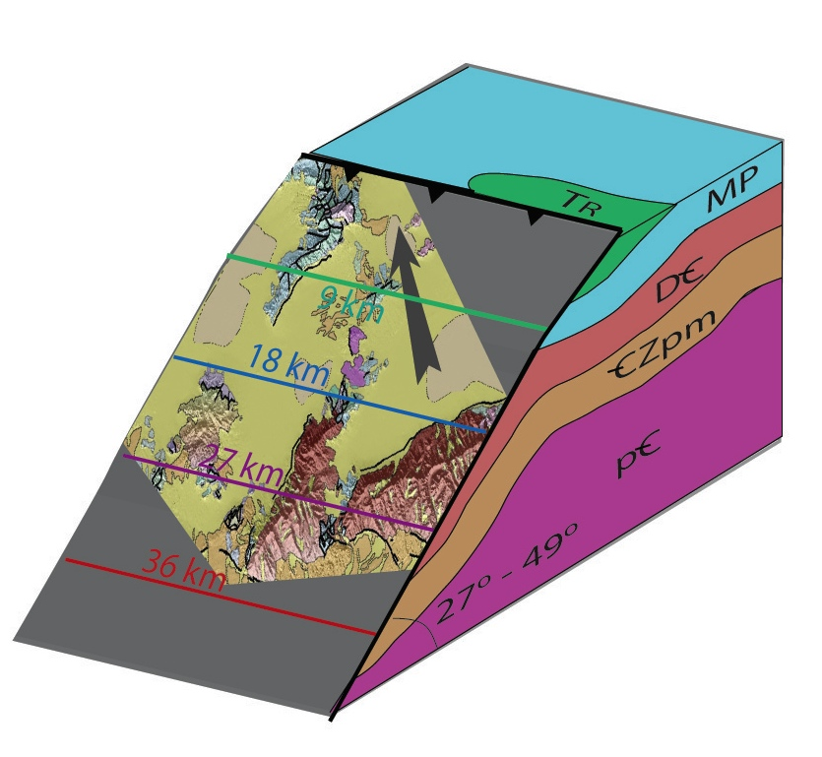
Possibly a Steeper, Oblique-slip system?
Depending on location of leading edge, assumed densities, and amount of post-K extension, dip of base of wedge could range from ~27° to ~50° -- more reverse than thrust.
Higher angle could facilitate reactivation w/ normal-sense
Could also help explain stratigraphic attenuation in ductile regime
N
E
Notes:
So with admittedly a lot of assumptions, you can use the pattern of paleoisobars to try to constrain the geometry of the thrust wedge, and what you see is that it is actually pretty steep, and I think this is actually an important, previously unrecognized point. Just to orient you, this figure attempts to illustrate the footwall geometry as viewed to the SE and so is somewhat “upside down” from our normal perspective. The footwall of this figure shows the Wood Hills, EHR and northern Rubies at their approximately appropriate pre-extensional depths. The minimum dip I was able to get, assuming NO subsequent Cenozoic spreading of the isobars, was 27 degrees. If you take the reasonable assumption that the spacing between isobars was increased by CZ extension, then it is no problem to get the Windermere “transpressive fault” to dips of 40 degrees or more.
We will see that a higher angle tectonic boundary could help with a number of the problems we are wrestling with. (1) You can get more tectonic burial with less shortening on a steeper fault. (2) By bending the stratigraphy to a steeper angle, you can more easily explain the radical attenuation of units that we see in this area – you have rotated the thickness of the units into the shortening field. (3) It also becomes easier to reactivate the fault as a normal fault if there is a subsequent evolution to extensional boundary conditions.

Slide 7
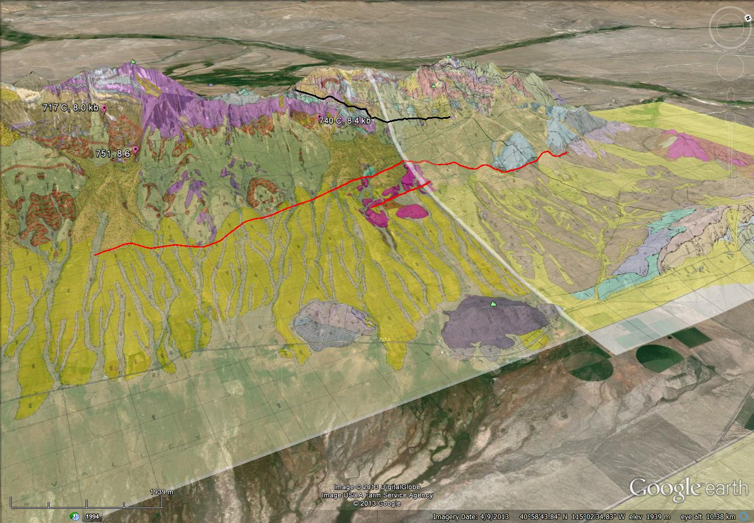
Duplication of section between plates
Dod marble, Migmatitic upper amphibolite
Winchell Lake fold
Range-front fault
Clover Hill – lower grade fault slice
Signal Hill –
upper plate Dod, unmetamorphosed
Clover Hill – upper amphibolite lower plate
Notes:
(Skip this if time limited). This is a Google view facing NW of the northern East Humboldt Range and Clover Hill, and it is here simply to make the point that although we may not have an exposed thrust fault, we DO have duplication of section, albeit sliced and dismembered by younger extensional system. The footwall contains high amphibolite facies Paleozoic metasediments in Clover Hill, overlain by a slice containing intermediate grade marble, which is in turn overlain by the correlative unmetamorphosed sedimentary protolith.

Slide 8
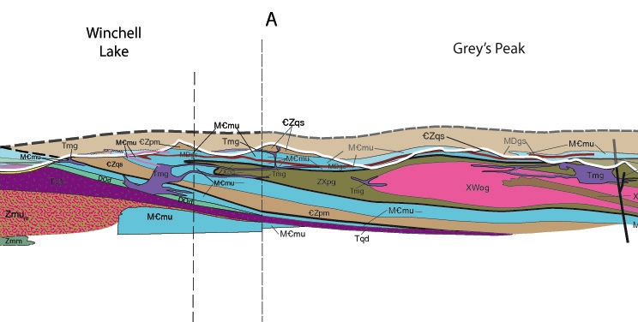
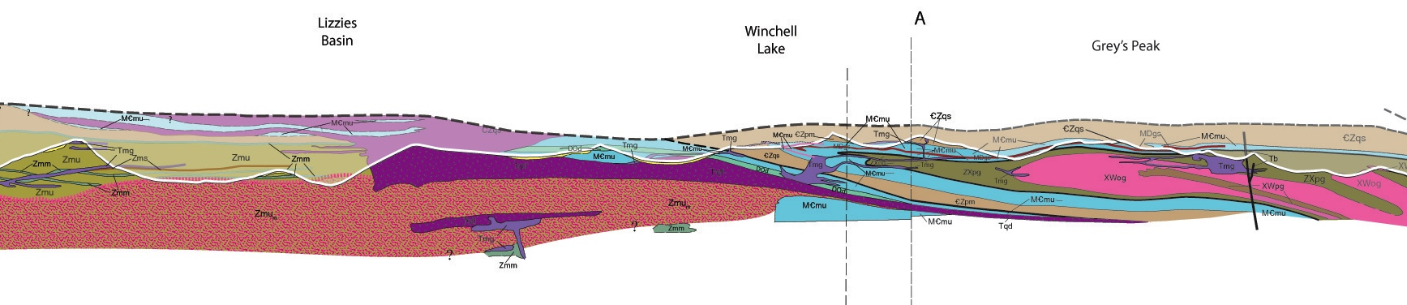
Enigma 2: Bizarre fold-nappe relationships
S
N
4 km
3 km
2 km
Notes:
Onto the next great enigma – what is the significance of these fold-nappes? They truly do have bizarre relationships – at least in modern coordinates, they verge in every which direction; the hingeline of the Lamoille Canyon fold-nappe in the Rubies sweeps through a nearly 90º bend as it is transposed into parallelism with the Cenozoic stretching lineation. In addition, both the Lamoille Canyon fold and, as we will see, the Winchell Lake fold fold older thrust faults. The one feature I think is consistent, is that the lower limbs of most of the fold-nappes appear to be much more migmatized than the upper limbs – at least I know that is the case for the Winchell Lake fold shown here. This strongly suggests to me that the roof zone of this cushion of partially melted material formed a fundamental rheological boundary in the middle crust that served to concentrate large-scale lateral flow. The Winchell Lake fold-nappe is especially unique in a variety of ways:
1. It is the only fold-nappe in the Rubies that includes Neoarchean to Paleoproterozoic gneiss ccomplex in its core.
2. Core of fold-nappe is older younging outward like an anticline whereas metamorphosed miogeoclinal rocks young inward, like a syncline.
3. Plastic attenuation of both limbs and even in the hinge zone is extraordinary – just ~2% of original stratigraphic thickness whereas attenuation of Lizzies Basin block is not so extreme.

Slide 9
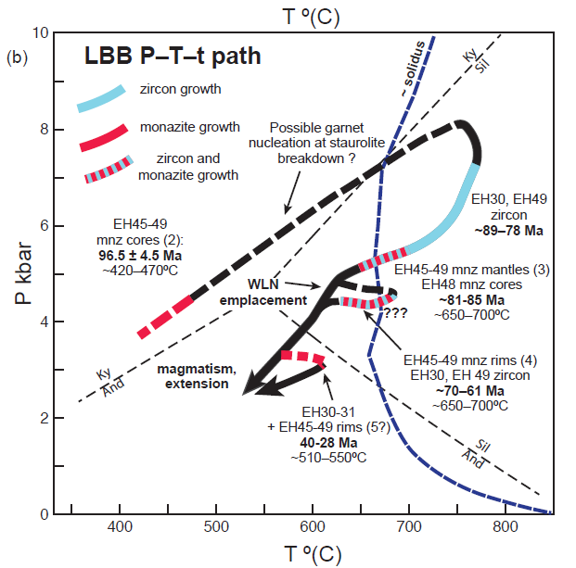
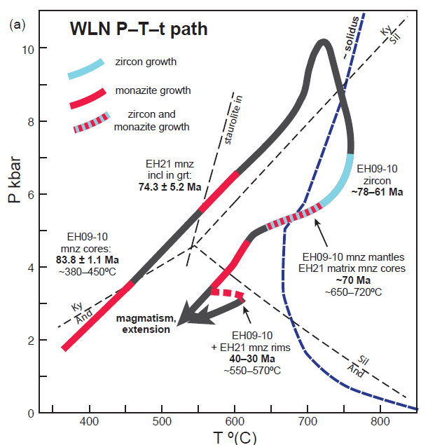
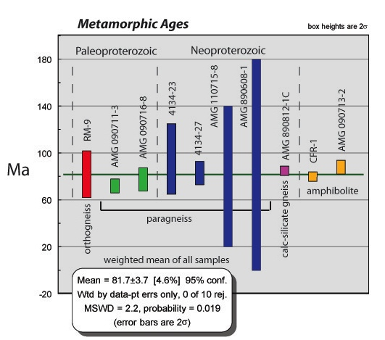
Enigma 2: Bizarre fold-nappe relationships
Mississippian
protolith
Hallett thesis, 2012
Hallett, 2012
Premo, pers. comm.
Ages resemble LBB.
S
N
4 km
3 km
2 km
Notes:
But perhaps the most intriguing thing about the WLN is that it appears to have been emplaced along the decompressional PT-path. I had earlier come to this conclusion from the simple fact that I was able to demonstrate that it was emplaced synkinematically with the replacement of kyanite by sillimanite and the onset of melting, but Ben Hallett has recently quantified this story. In these figures from his recently completed ph.d. thesis working under Frank Spear, he shows that the PT path for the Winchell Lake fold-nappe and that for the underlying Lizzies Basin Block diverge prior to about 75 Ma, from which he infers that the fold-nappe was emplaced about 75 Ma and from then on the LBB and the WLN rode together, with decompression to ~5 kb by 60 Ma. In other words, the rocks had already gotten halfway back to the surface before Late Cenozoic extension had even come into play. Finally, I note that this places the same broad bracket on the timing of emplacement of the Winchell Lake fold (between 85 Ma and 75 Ma) as my friend Phyllis Camilleri reports for the NW-vergent folding in the Wood Hills.
Now I think I can make another point that will extend this story even further. Ben’s PT path for the WLN came from rocks that I would correlate with the Mississippian Pilot formation, near the top of the Paleozoic strat sequence. Meanwhile, Wayne Premo and I have been doing a lot of work on the Precambrian rocks in the core of the fold-nappe, and although we do not have the thermobarometric constraints, the zircon systematics from the Precambrian rocks looks more like the spread of metamorphic zircon ages from the Lizzies Basin block – i.e., a spread of ages from about 90 Ma to 60 Ma. If this holds up as more data comes in, it seems to me that there are two possible interpretations. The less sexy one is simply that the fold grew slowly through the late Cretaceous as the migmatitic front gradually migrated upward, thus migmatizing deeper levels before shallower levels. The more exciting hypothesis is this: not only was the WLN emplaced in this time window, but also the pre-WLN fault placing the Precambrian rocks over the Paleozoic sequence was also likely emplaced prior to being folded by the Winchell Lake fold-nappe, but in the same 90 to 75 Ma time window. Let me say this clearly: I am proposing that the Windermere Thrust is no longer merely a convenient or necessary conceptual construct. The previously unnamed low-angle tectonic contact between the Precambrian gneisses and the Paleozoic metasediments could be the deep-crustal expression of the Windermere Thrust. It could be that the murderer hid the weapon in plain site. It’s been there all along, hidden in the walls of Angel Lake Cirque.
The evidence indicates that the fold-nappe was emplaced along decompressional path – in fact, about half the decompression of the northern EHR appears to have occurred before ~49 Ma

Slide 10
Winchell Lake Fold Summary
Precambrian gneiss complex thrusted upside down on top of Paleozoic Sequence by an earlier F1 fold-nappe – we only see the lower limb of that fold-nappe at Angel Lake.
Extreme plastic attenuation of strata before, during & after fold-nappe emplacement.
Two possible histories for fold-nappe emplacement :
  Rapid deep tectonic burial b/w 84 and 78 Ma during thrusting of XWgn over Paleozoic sequence & extreme plastic attenuation of strata followed by fold-nappe emplacement synchronously with steep decompression with heating.
  More gradual emplacement from 90 to 70 Ma with migmatitic front migrating upward and isopleths of leucogranite abundance cutting fold
Half of decompression occurs before 45 Ma → What caused it?
Notes:
Skip this slide if time running low.

Slide 11
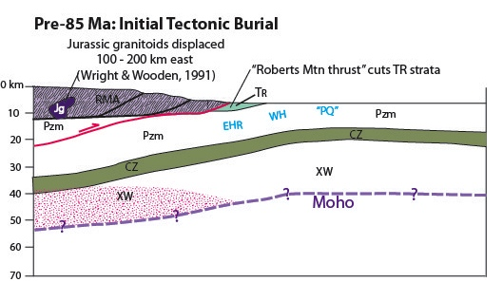
Is earlier thrusting hidden beneath the Roberts Mtn Allochthon?
Hypothetically speaking . . . .
Notes:
OK, let’s go through and look at the story in pictures. First, before 90 Ma we already need significant shortening to get Paleozoic sedimentary rocks such as the Pilot shale to upper mid-crustal conditions. I am advancing the hypothesis that much of this early shortening was cloaked by duplexing beneath and/or Late Cretaceous shortening within the older Roberts Mountains allochthon, serving to transport the RMA over the eastern facies metasedimentary rocks.

Slide 12
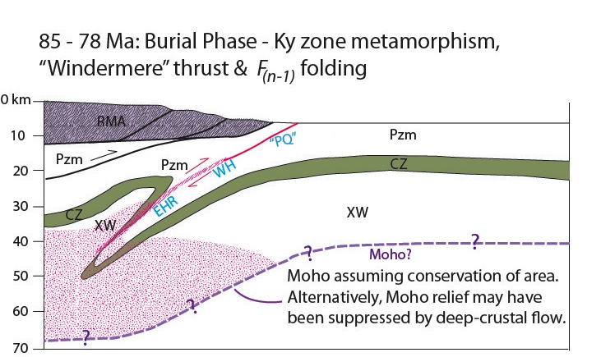
Hypothetically speaking . . . .
Late K Contraction in relatively steeply dipping transpressional system?
Notes:
Secondly, we have a deep tectonic burial phase that I am suggesting was actually transpressional in nature, at least here along the southern edge of the Windermere allochthon – it may well have bent into a more conventional orientation farther north. This had the effect of rapidly and deeply burying the East Humboldt Range some time between ~90 and ~78 Ma. The now steeply dipping footwall rocks were rotated such that the thickness of the units was in the shortening field as they entered the ductile regime resulting in profound plastic attenuation. Finally, I have shown the cartoon at crustal scale to emphasize an important point: if we ignore the possibility of deep-crustal flow, then we wind up with an unsustainable huge step in the Moho. If you believe in the laws of physics, then this thick, soft pillow of low-density material will NOT be able to sustain such large magnitude relief on the Moho. So what is it going to do? Simple, vertical diapiric upwelling WiLL NOT solve the problem that the crust needs to solve here. There may be a density contrast between the partially molten deeper crust and the overlying crustal rocks – but that density contrast will be nothing compared to the lateral density contrast (and therefore the lateral pressure gradient) between the partially molten layer and the mantle. So how is the deeper crust going to respond?

Slide 13
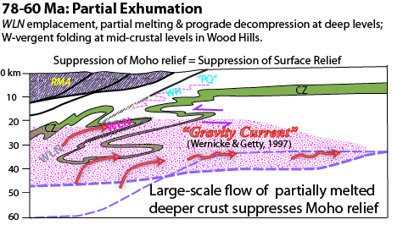
Hypothetically speaking . . . .
Fold-nappe emplacement by “gravity current” or channel flow, suppressing Moho and surface relief?
Notes:
I want to advance the hypothesis that it is likely to respond by large-scale lateral flow, not simply upward, but outward and upward away from the locus of crustal thickening toward the more normal adjacent crust. In 1997, Wernicke and Getty called this kind of response a “gravity current.” In the parlance that has come to the fore in the last decade, I think you could also call this “channel flow,” but rather than expelling the material right back up the fault that brought it down, I am suggesting that it was more likely confined to the deep-crustal layer. This cartoon illustrates the kind of geometries I think we could expect. In this view, the NW-verging folding in the Wood Hills may not be a reflection of fundamental shortening but rather may reflect the underflow of the partially molten gravity “tunneling” southeastward.
There are a couple points to make here.
This process could occur either alongside upper crustal extensional unroofing or even without any upper crustal extension
No Moho relief = No surface relief. By suppressing Moho relief we would also suppress surface relief, and with little surface relief there would be little reason to see surface erosion or surface deposition. Therefore this model helps us to explain the lack of syntectonic erosion and deposition in the hinterland.
While this model provides a convenient way to get the northern East Humboldt Range from 10 kb to 5 kb, without concurrent extension, it does not enable us to explain the exhumation at the structural level of the Wood Hill – i.e., it does not provide a mechanism for us to get rocks from ~5 kb (18 km depths) to the surface.

Slide 14
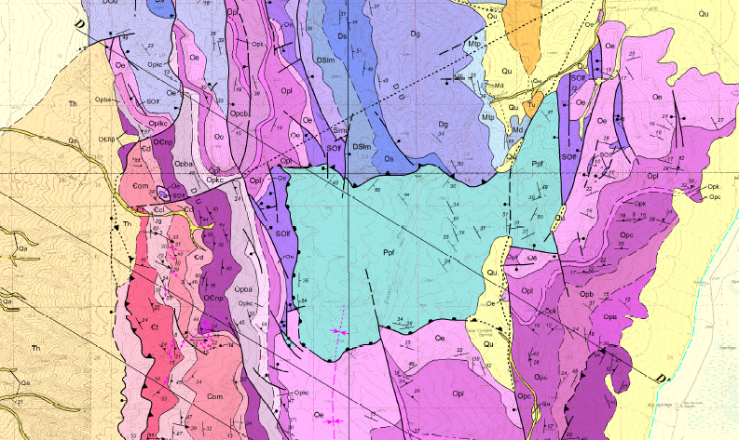
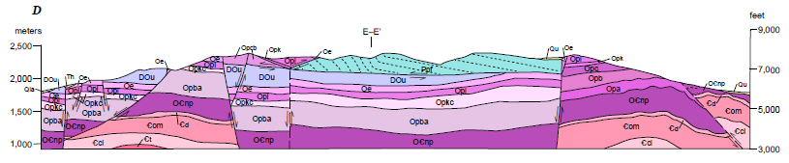
Enigma 3: Late Cretaceous or Early Cenozoic Extension? But where is the syntectonic sediment?
Pequop Fault
Camilleri, 2010
Notes:
So, this provokes the question, is there any evidence for latest Cretaceous or early Cenozoic extension in this area? The only fault I know of that has been attributed to early Cenozoic extension is the Pequop Fault mapped by Phyllis in the Pequop Mts. Here she sees unmetamorphosed upper Permian strata faulted down against low grade rocks as old as Ordovician. The fault cuts the metamorphic fabric and folds that she infers to predate 75 Ma, but she also infers that the fault is also capped by ~40 Ma volcanic rocks.

Slide 15
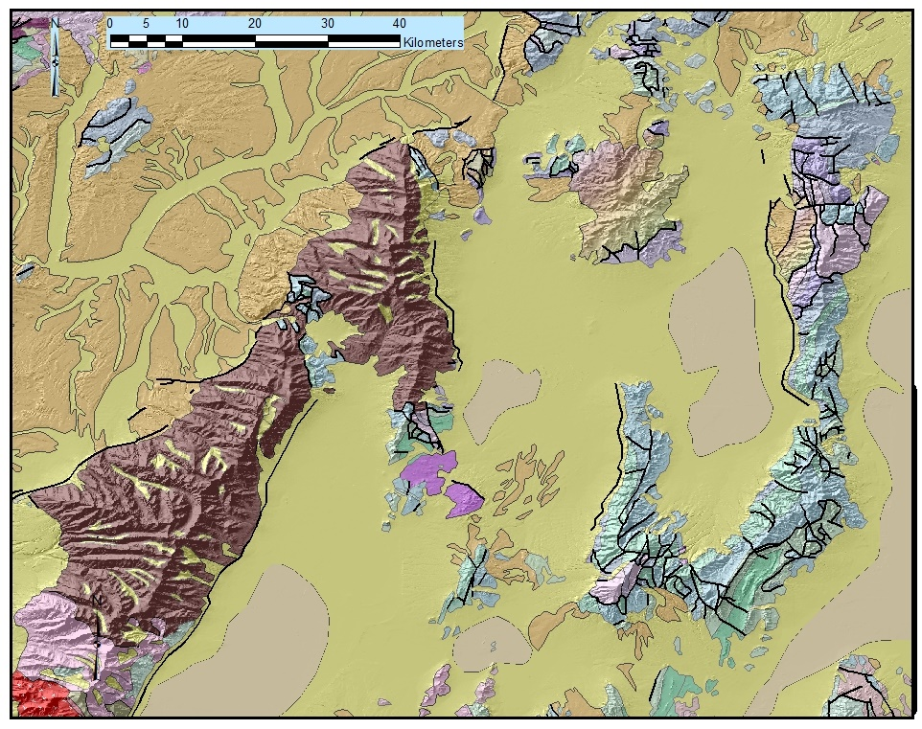
When was Exhumation of the Wood Hills?
61 Ma – 49 Ma ^{40/39}Ar Hbl ages McGrew & Snee
(1994)
46 Ma?
57 Ma?
^{40/39}Ar biot ages Thorman & Snee
(1988)
40 – 45 Ma intrusive suite at P ≈5.5 kb (Al-in-Hb) Snoke et al. (2004)
Notes:
In addition, there’s some rather cryptic geochronological constraints indicating cooling in the 50-60 Ma time-frame. I reported some rather disturbed Ar-hbl age spectra from high structural levels in the EHR during this time frame, and in a 1988 abstract, Thorman and Snee reported but never subsequently published mica cooling ages between 46 and 57 Ma from the Wood Hills. There is a crying need to replicate these analyses and track the cooling history right up to the surface.

Slide 16
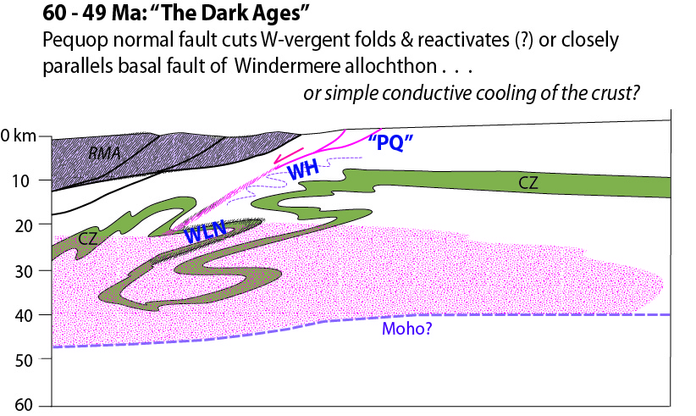
Extensional Reactivation of the
Windermere fault?
Hypothetically speaking . . . .
Notes:
So, my final hypothesis is that the Windermere fault could have been reactivated as a normal fault, or at least that subsequent normal faulting may have followed it so closely as to almost perfectly excise the allochthon that had been emplaced by Late Cretaceous thrusting or transpression.

Slide 17
What next?
Detailed, thermobarometry anchored to U-Pb SIMS chronometry not just to determine P-T-t paths but to map paleoisobars in lower plate, & constrain timing of pre-folding thrusts, plastic attenuation of units, and fold emplacement histories throughout core complex.
Constrain cooling and exhumation history of Wood Hills by applying a range of thermochronometers.

Slide 18





Acknowledgements
Snoke Symposium
Joint Section Meeting
Bozeman 19-21 May, 2013
Cal Barnes
Joe Colgan
Ben Hallett
Chris Henry
Callum Hetherington
Keith Howard
Rod Metcalf
Wayne Premo
Karri Sicard
Countless others who have visited the RM-EHR core complex and shared their insights over the years

