Slide 1
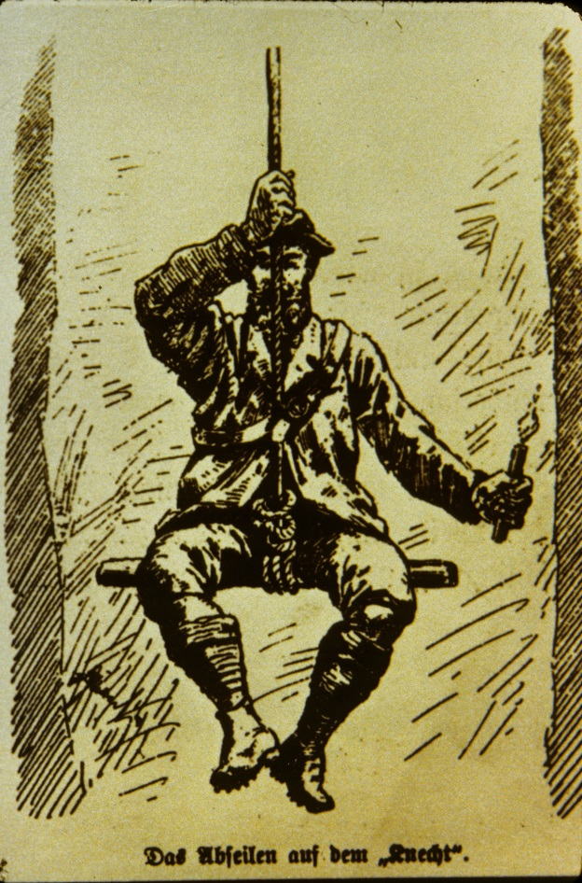
CAVE & KARST RESEARCH:
A BRIEF REVIEW OF THOUGHT
~1880 - ~1960
Derek Ford
McMaster University
Canada

Slide 2
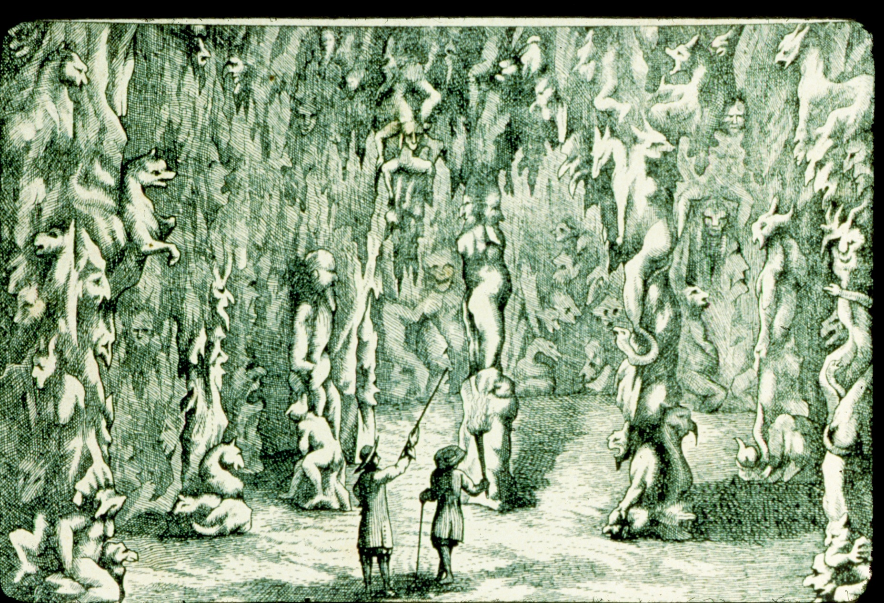
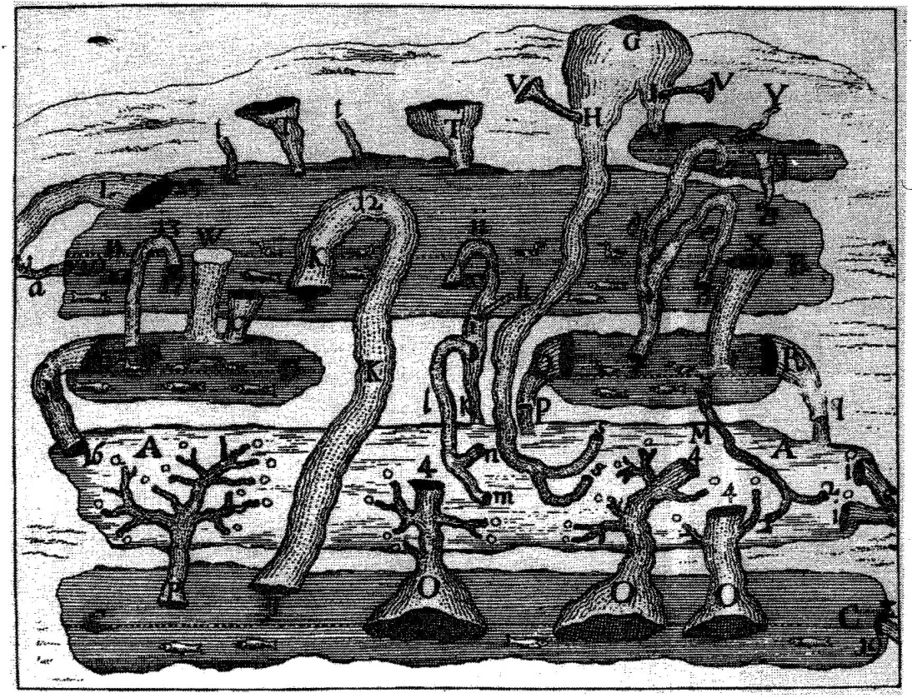
Before the 18th Century ‘Age of
Enlightment’ much was written
about caves and karst in the
Western literature, primarily in the
Mediterranean region because of the
extent of limestone terrains and
economic importance of springs
there.
Two engravings from Janez Valvasor’s
1680-90 studies of karst features in
Slovenia, core area of ‘The Classical
Karst’.
Above: speleothems in Postojna Cave.
On right: Valvasor’s conception of the
relationship between caves and the
seasonal flooding of Cerknica Polje.

Slide 3
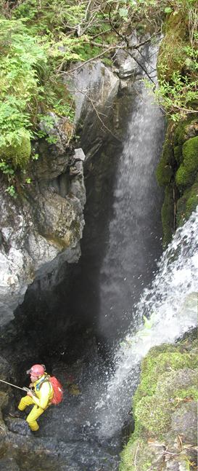
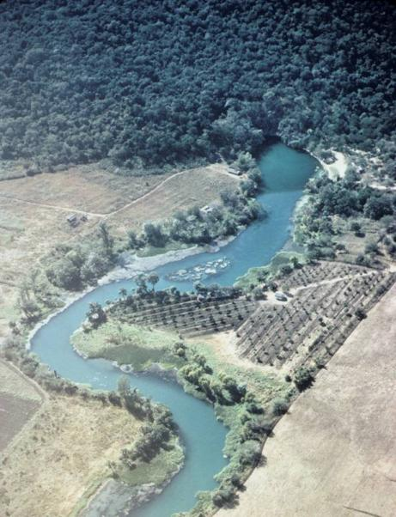
In the thirty years before 1880:-
‘Karst’ was established as the generic term
(versus ‘Causse’ of Edouard Martel)
focus was primarily on karst in limestones
(because of the Mediterranean connection)
sources of most springs are meteoric waters
(passing through stream sinks, dolines, karren, etc.)
sinks, caves and springs are genetically linked
CaCO3 dissolution by carbonic acid is the
essential process
Because caves were known to penetrate long distances
through limestone the solution kinetics must be
favorable and so could be ignored. There was great
Interest in solution rates, however: e.g. Bischof (1854)
found the annual CaCO3 load of the River Rhine was
``… equivalent to 332,539 millions of oysters of the
usual size.`` Spring and Post (1883) in Belgium, Ewing (1885) in
Pennsylvania pioneered more conventional methods of estimation!

Slide 4
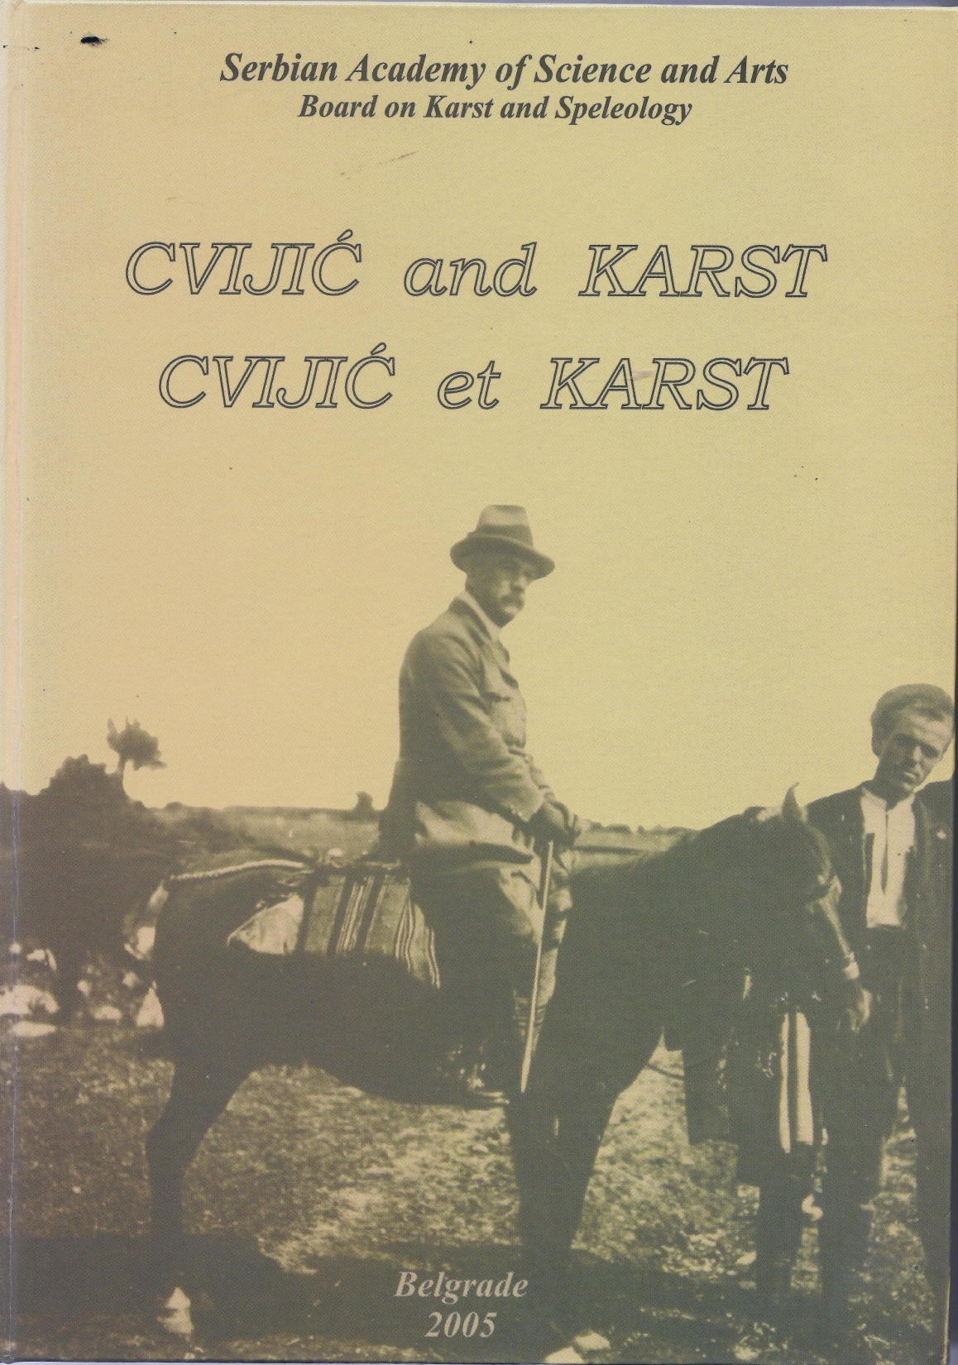
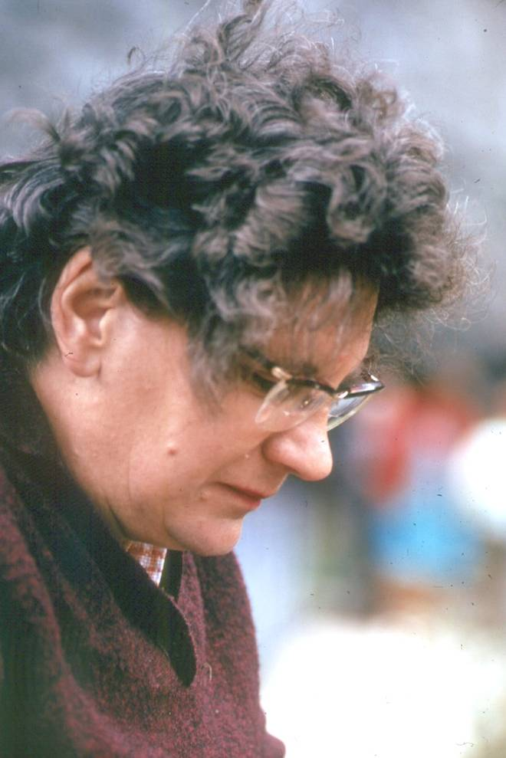
Jovan Cvijić (1865-1927)
Born in Loznica, Serbia, studied in Belgrade and with Albrecht Penck in Vienna.
Professor of Geography, Belgrade. Travelled widely in Europe and taught in France.
Head of the Serbian delegation at the
Versailles peace talks, 1919!!
Major karst publications:-
1893 Das Karstphänomen (PhD thesis with Penck). 1901. Morphologische und glaziale studien Bosnien, der Hercegovina und Montenegro.
1918. Hydrographie souterraine et évolution morphologique du karst.
1924. The evolution of lapies.
La Géographie des Terrains Calcaire.
(courtesy of E. de Martonne; posthumous and
incomplete).
‘Das Karstphänomen’ was “…the beginning of karst studies proper.” Marjorie Sweeting, 1972.

Slide 5
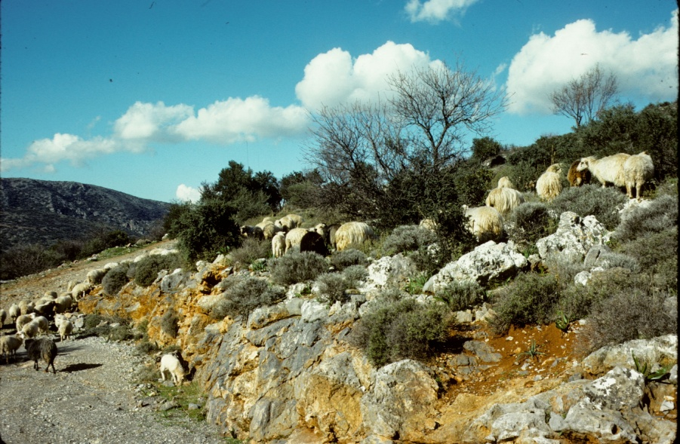
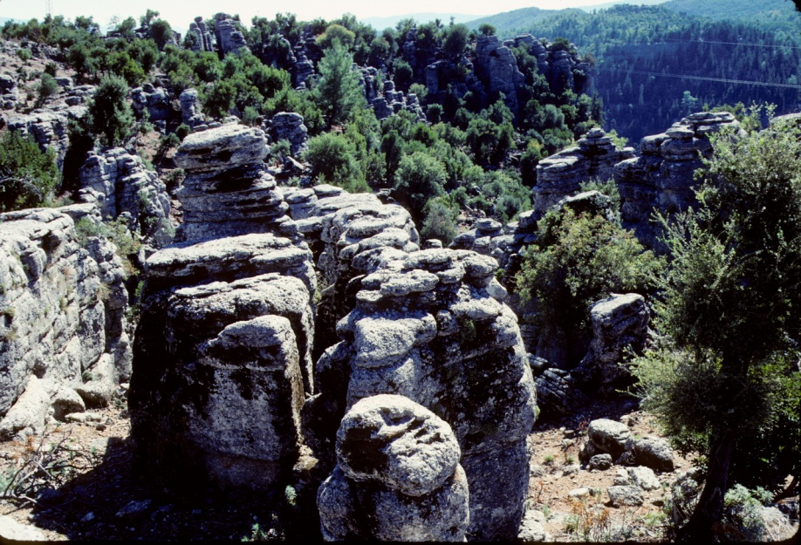
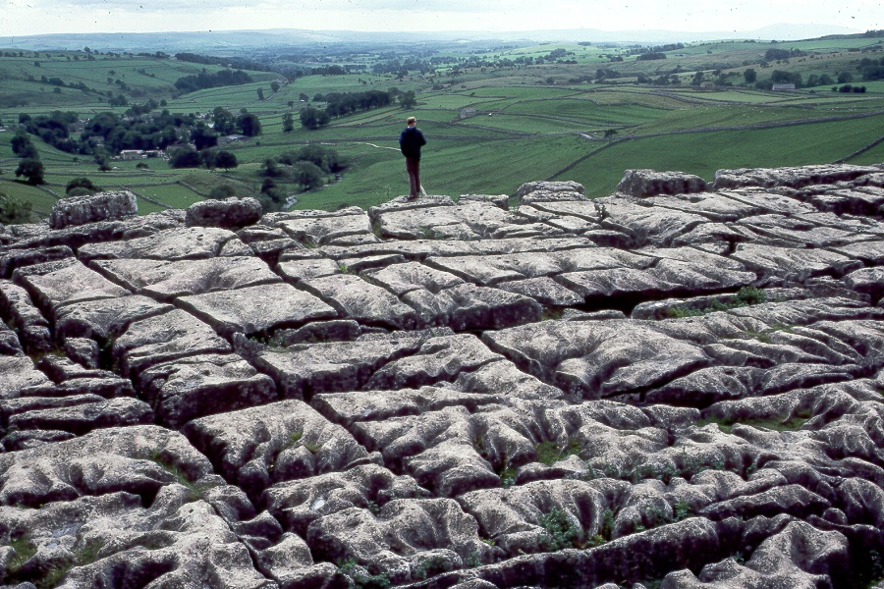
‘Das Karstphänomen` has four principal parts:-
1. Cvijic was fascinated by the many forms of skrape or skripovi (karren or lapies), especially in mountainous regions`.
The description and analysis is mostly
qualitative but his classification
stood until Alfred Bögli`s of 1960.

Slide 6
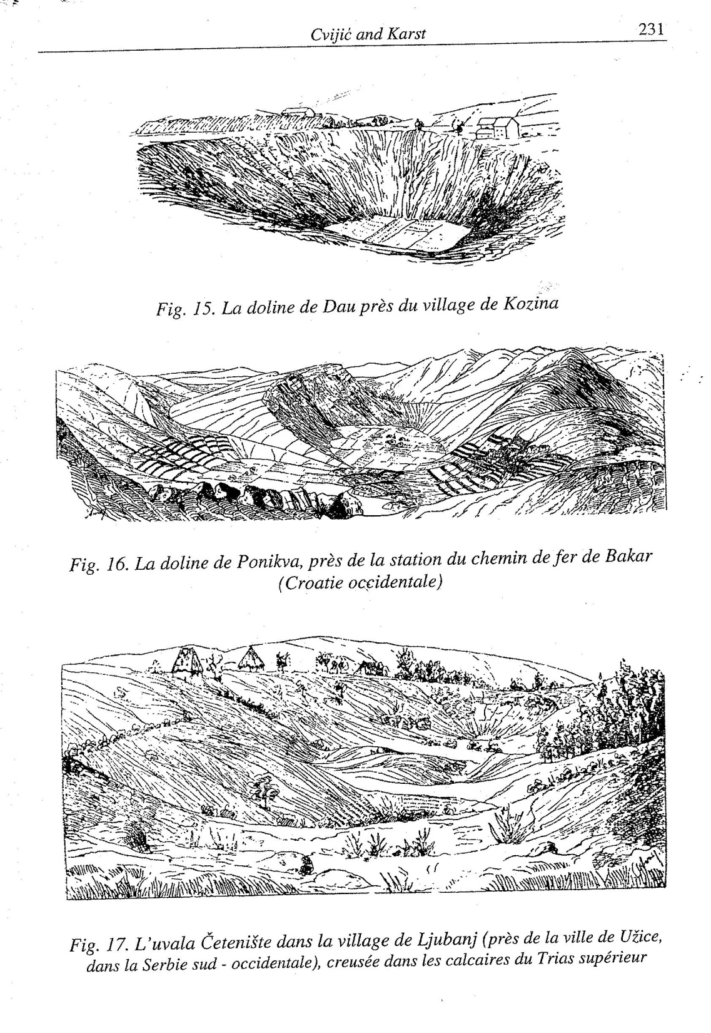
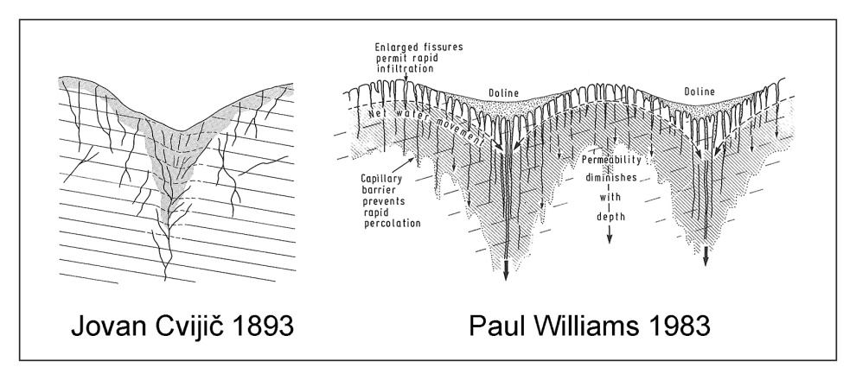
2. Dolines. More pages of Das Karstphänomen are devoted to dolines than to any other topic. He established the term (in competition with ‘sinkhole’) and defined it as ‘the diagnostic karst
landform.’
He showed that true solutional
dolines are more common than
collapse dolines in the karst areas
that he studied.
The work includes some very early
quantitative geomorphology.

Slide 7
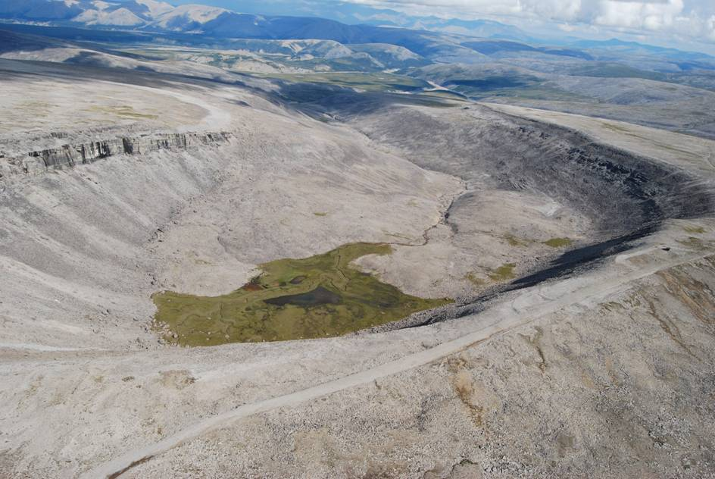
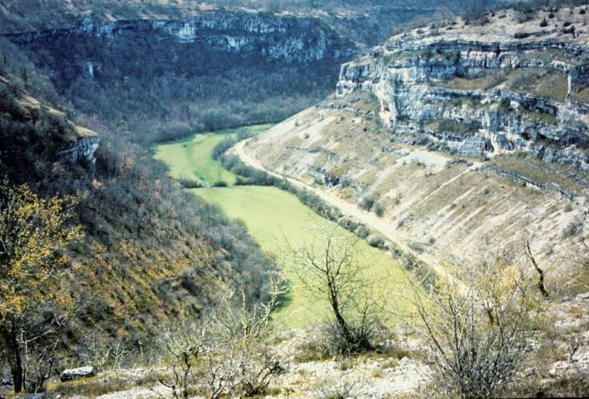
3. Dry valleys and gorges.
‘primary’ – superimposed from
insoluble cover strata.
‘secondary’ – develop in holokarst
sacktäler, cirque-like springhead sap
‘blind’ valley, closed downstream
‘half-blind’ (rare overspill)
‘dry valley (seasonal outflow)

Slide 8
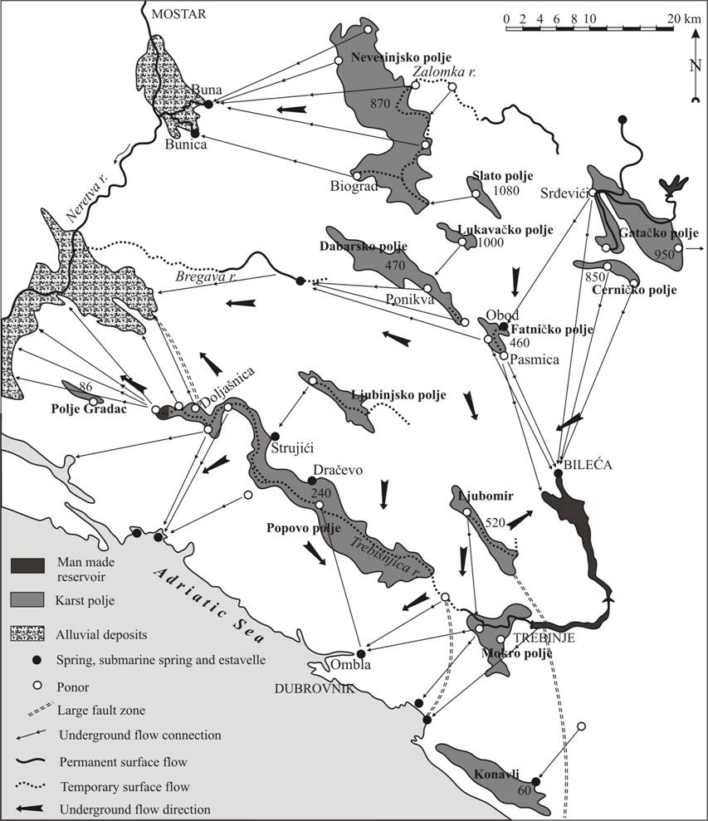
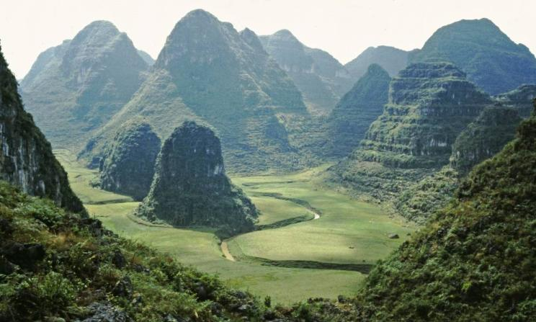
4. Poljes. Cvijić gives thorough descriptions of the geomorphology and seasonal hydrology of the great Dinaric poljes. He understood the role of alluvial infillings but recognised that the basic controls of form and location there were tectonic.

Slide 9
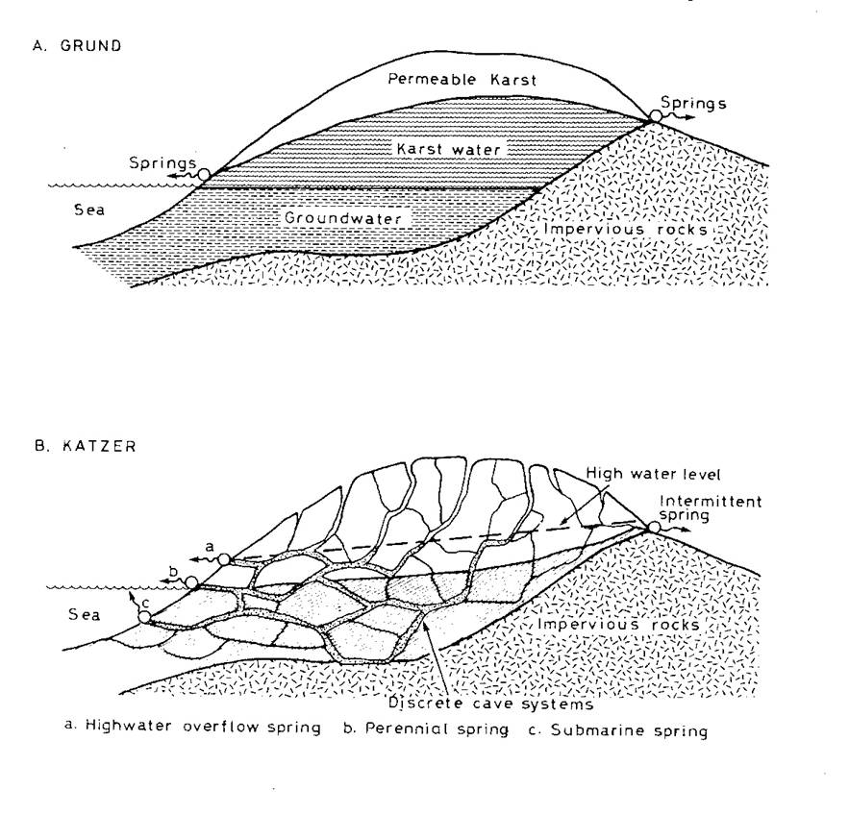
Ideas in Karst Hydrogeology
1900-10, a fundamental
difference in perspective
arose that still bedevils us
today.
Alfred Grund (1903 –’ Die
Karsthydrographie – Westbosnien’)
proposed diffuse flow and
static groundwater zones
beneath a well-defined
watertable.
Friedrich Katzer (1909 – ‘Karst
Und Karsthydrographie – Balkan
halbinsel’) denied the validity
of any watertable concept,
considering that there was only flow through caves and micro-caves.

Slide 10
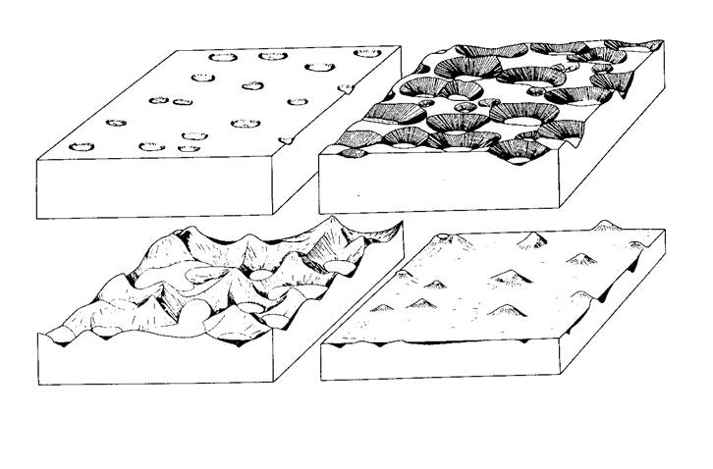
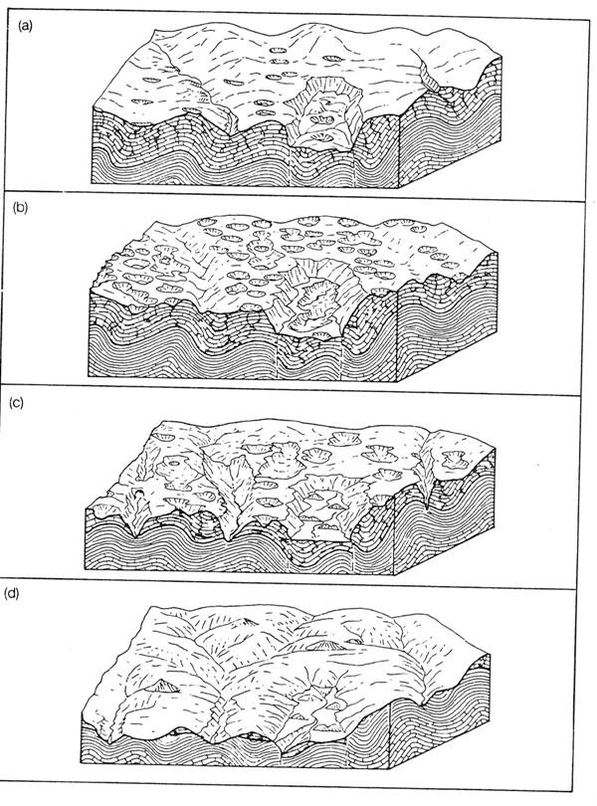
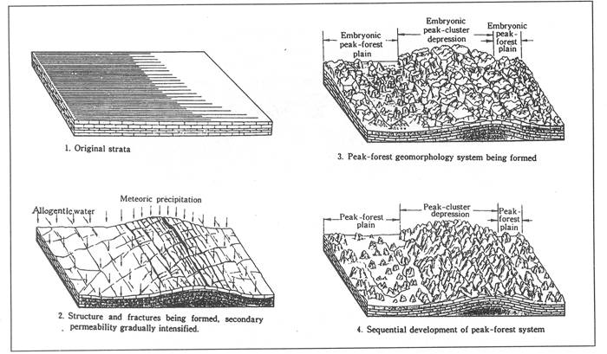
A Cycle of Karst Landform Development? W.M.Davis’ concept of cyclicity in landform development (1893) dominated Western geomorphology at this time. Grund (1903) and Cvijic (1918) proposed the cycles shown here. At bottom left a 1988 conception for the Guilin karst by Zhu Xuewen.
Grund 1903
Cvijic 1918
Zhu 1988

Slide 11
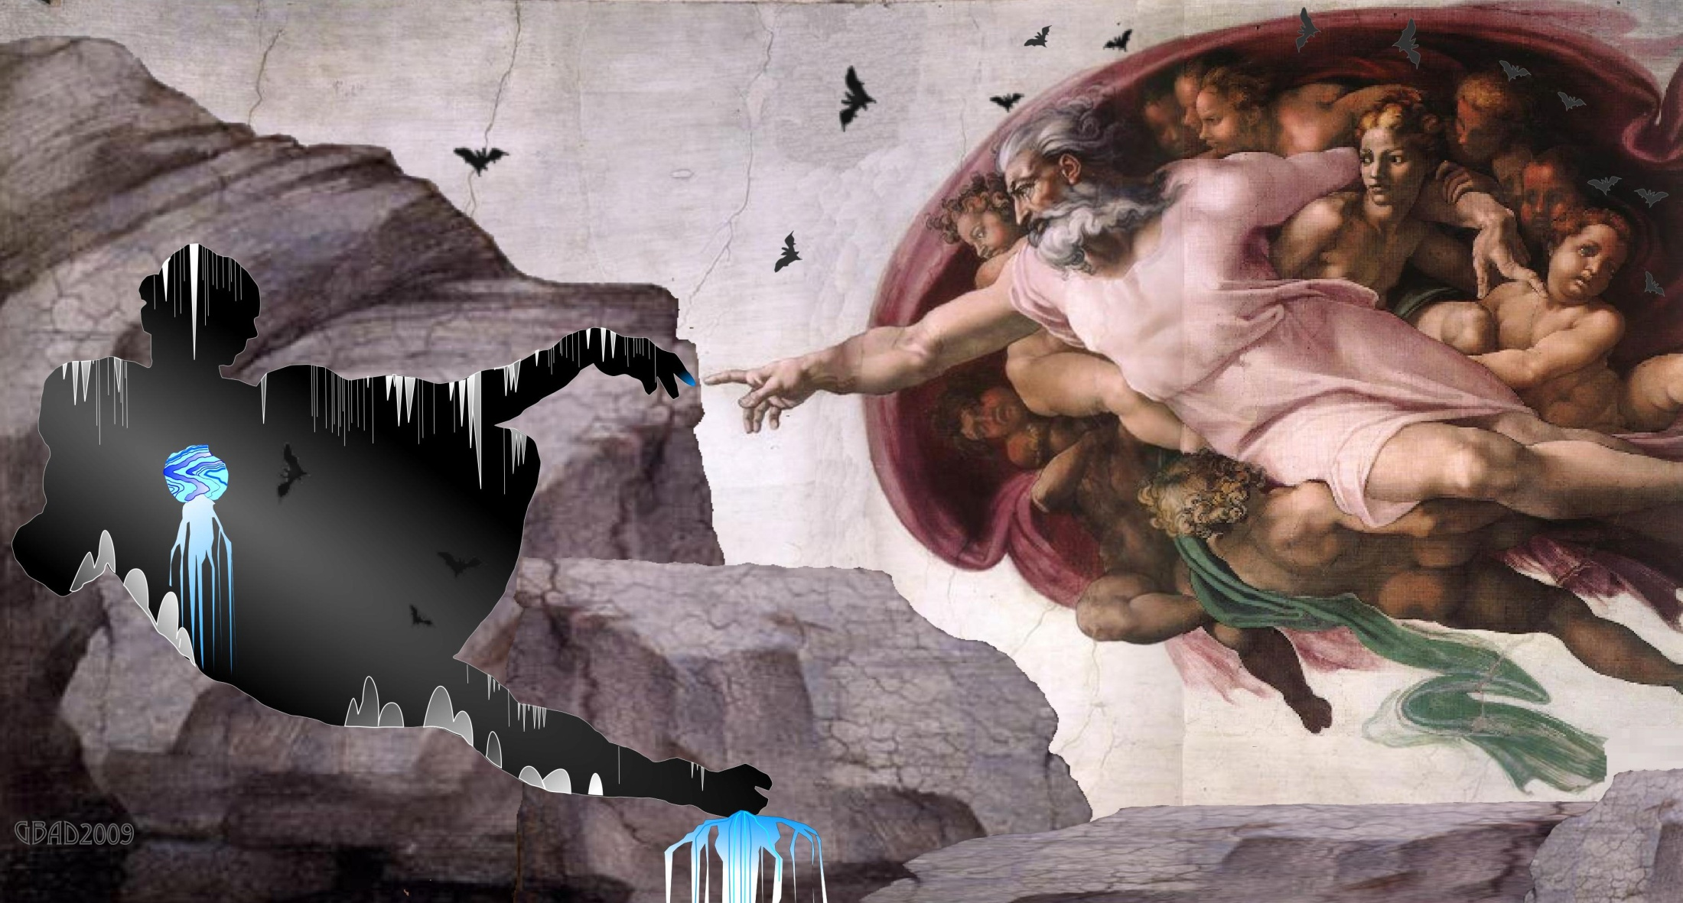
SPELEOGENESIS !
Courtesy – Giovanni Badino

Slide 12
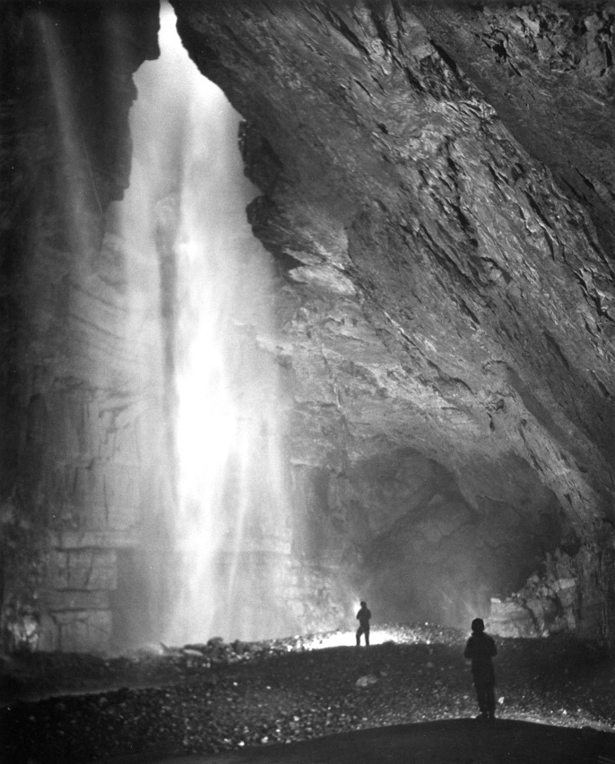
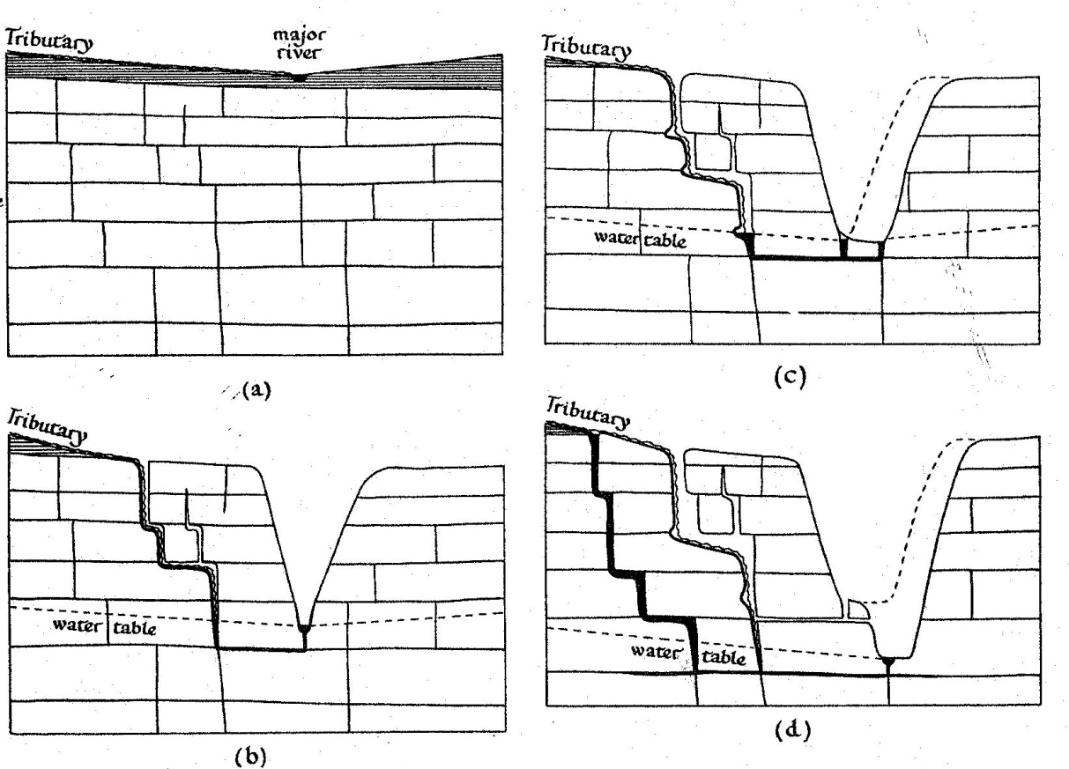
Meteoric Water Cave Development 1: 1880s-1920s.
. Ideas greatly influenced by explorations of Ė.A.Martel (1859-1938)
e.g. Les Abimes (1894, 578 p); Nouveau Traité des Eaux Souterraine (1921, 835 p)
. Caves were being explored under vadose conditions – vadose
processes (especially mechanical corrasion) believed to dominate.
The vadose concept, as drafted by G.T.Warwick (1955)
Gaping Ghyll (Martel 1895)
. There were counter-claims for phreatic development but they
drew much less attention (e.g. Dupont (1894) from studies in Belgium)

Slide 13
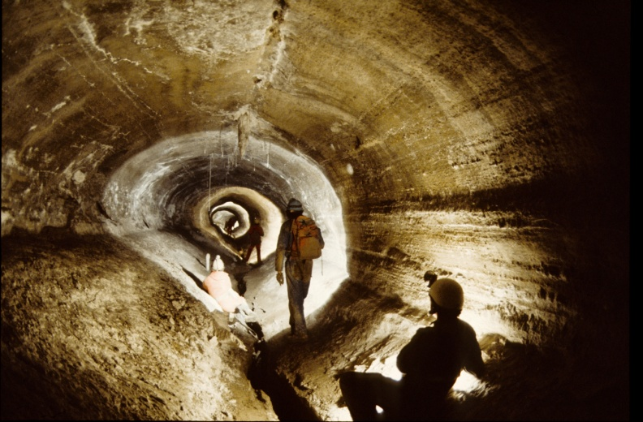
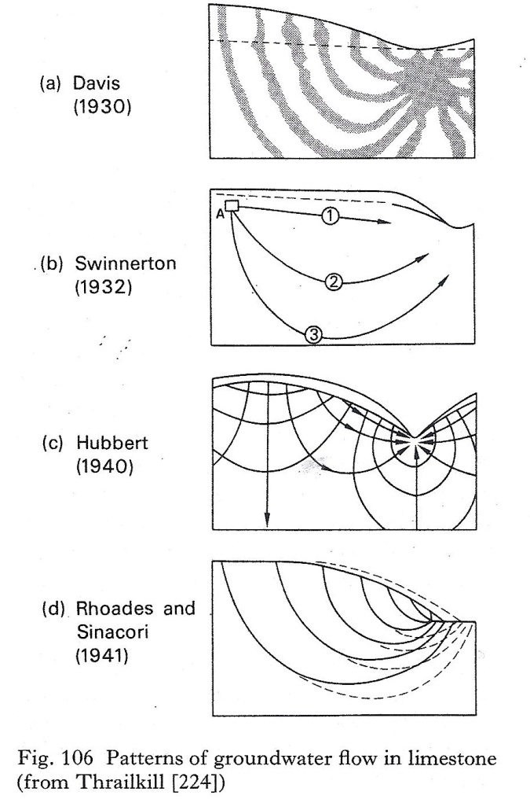
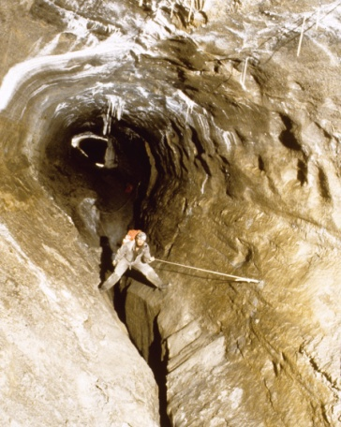
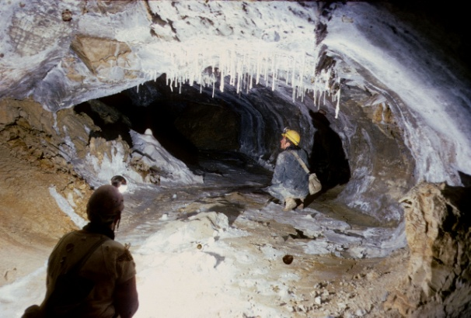
Meteoric Water Cave Development 2: 1930s ~ 40s
- American scientists enter the debate in force!
W.M.Davis (1930) & J.H.Bretz (1943)
development at random depth
in the phreatic zone
A.C. Swinnerton – conduit development close to water
table, generated from the head
M.K.Hubbert attacks Swinnerton’s
argument
Rhoades & Sinacori – conduit development defines the
stable water table, regressively
from the spring outlet

Slide 14
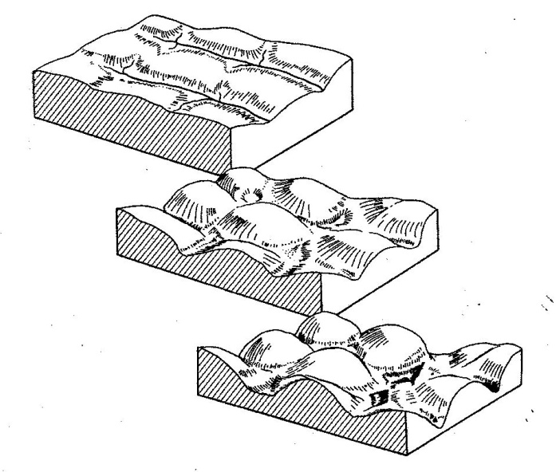

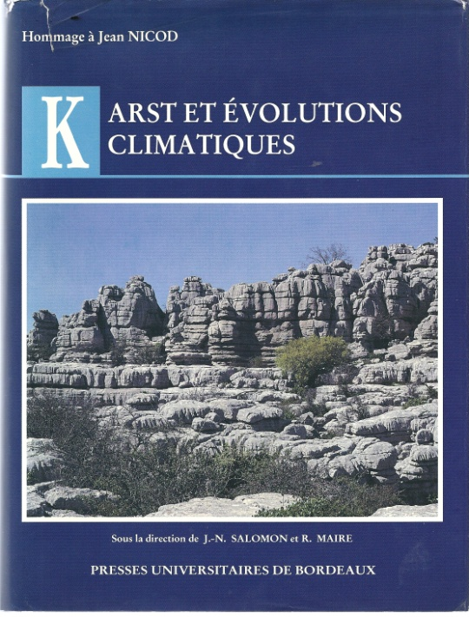
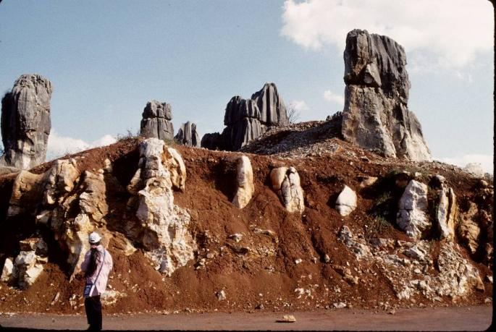
KARST LANDFORMS, 1930s – ’50s
. emphasis shifts to karst
‘climamorphology’
. impact of tropical karst research
(H.Lehmann 1936. Morphologische studien
auf Java; 1954. Das Karst in den
verschiedenen Klimazonen)
. ‘denudation chronology’ assumes
greater prominence, despite lack of
absolute dating methods (e.g. Sweeting
1950. Erosion cycles in limestone caverns in
the Ingleborough district.)
. Introduction of Schwarzenbach
titration methods (1954) renews
solution rate studies; J.Corbel (1957.
Les Karsts du N.-O. de l’Europe) challenges
some long-held rate assumptions.

Slide 15
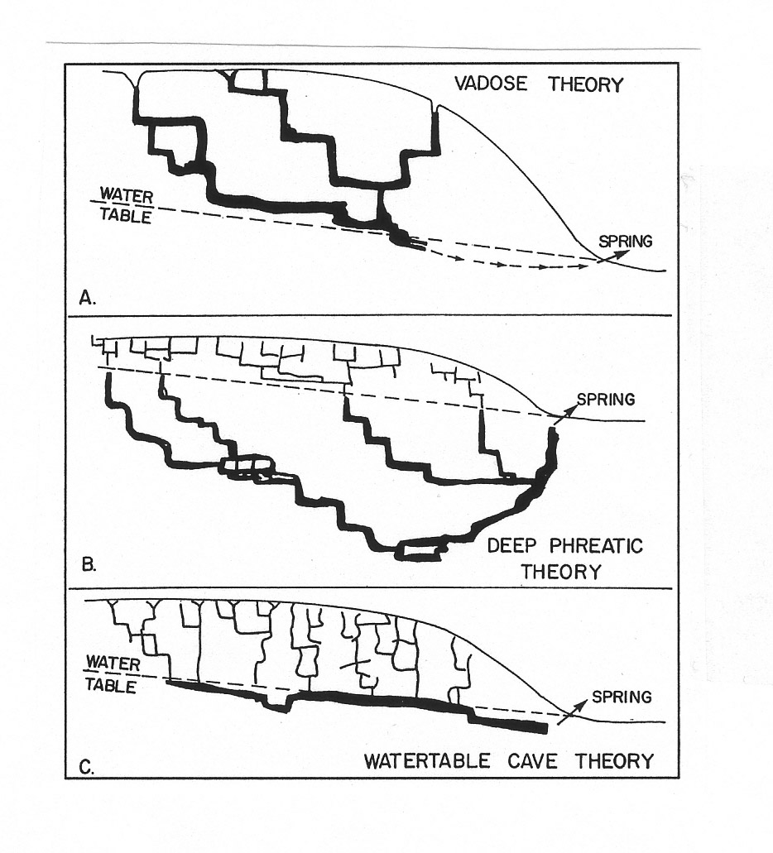
~1960 SOME OPEN QUESTIONS:-
. In limestone solution rates, who was right –
Jean Corbel or Herbert Lehmann?
. What therefore is the extent of climatic control
on karst morphologies, and the validity of
climamorphic models?
. In meteoric speleogenesis, who was right?
. P.K.Weyl (1958. Solution kinetics of calcite) and A.Bögli
(1960 Kalklosung und Karrenbildung) suggested serious problems with our
understanding of the solution kinetics. How could solution caves
form at all?
. And what about the denudation chronology of karst terrains.........?

Slide 16
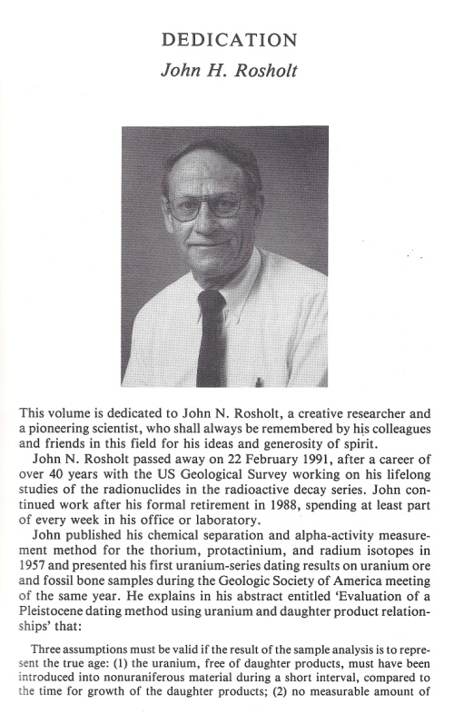
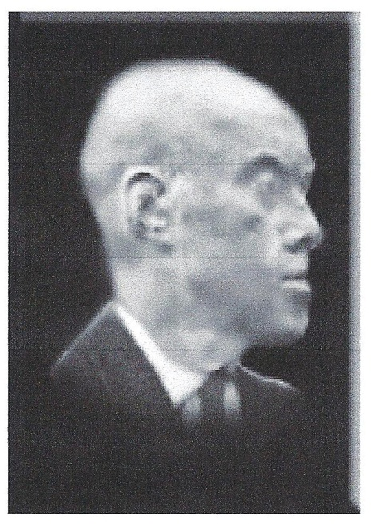
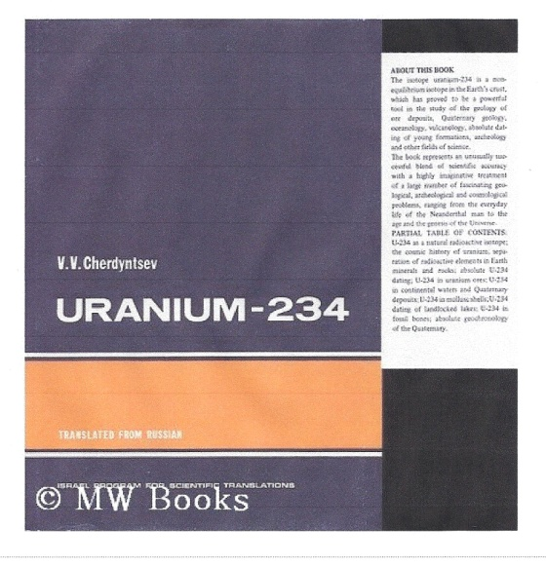
In 1963, when I completed a PhD study of the origin and development of the
cave systems in the central Mendip Hills (southwest England) the standard
means of radio dating cave or other young calcite deposits was 14C: this is
time-limited and has grave problems with dead carbon contamination.
WHAT ABOUT USING U SERIES METHODS ?
Cherdyntsev v Rosholt
In 1962 Rosholt and Antal published findings suggesting that young carbonates could not be dated reliably because 234-U would be preferentially leached after deposition.
In 1963 Cherdyntsev (‘the father of U series dating’), Kazachevsky and Kuzmina reported that they obtained reliable results from young calcites, including speleothems.
This was very exciting because the potential dating range was 350 ka+, a great improvement on 14C.

