Slide 1
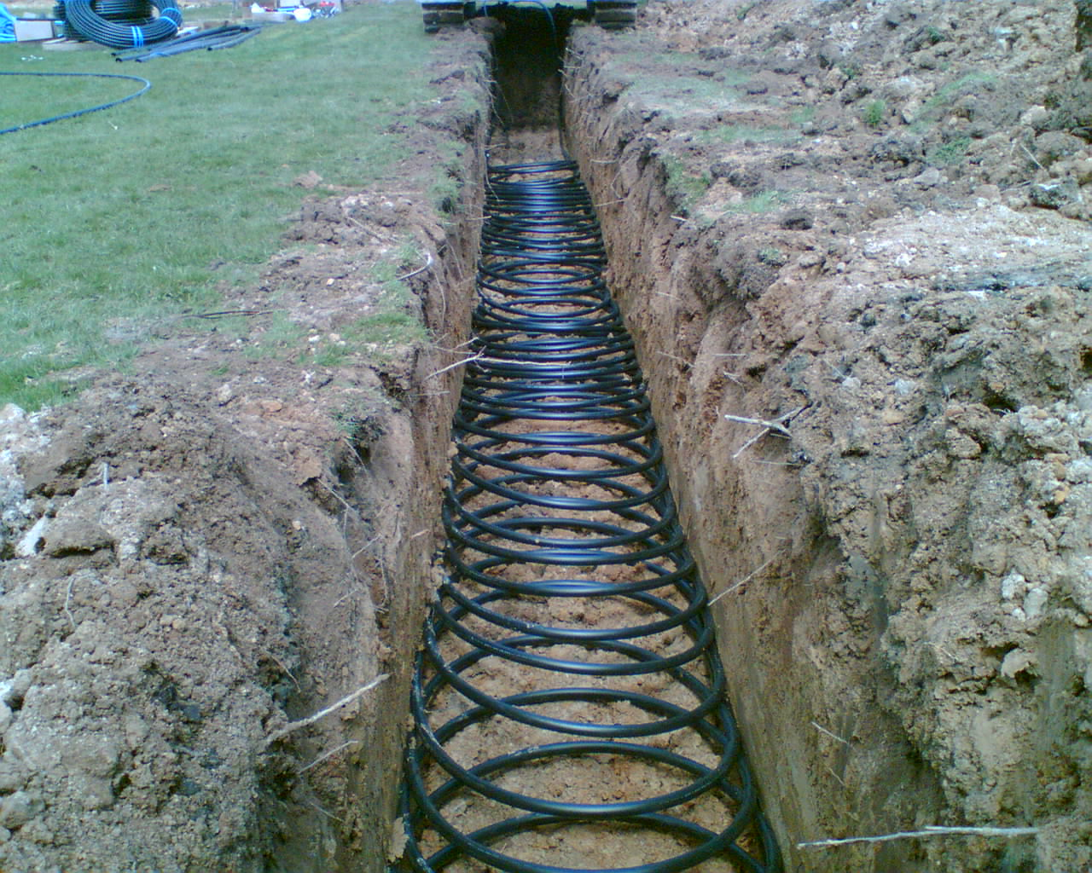







Heat Transfer Controls in Soil:
Recommendations for Improved Ground Source Heat Pump System Design
Andrew Gustin
Kevin Ellett
Shawn Naylor
Connor Waldoch
In Collaboration With:
Research Funding:
The Yoder Farm LLC

Slide 2
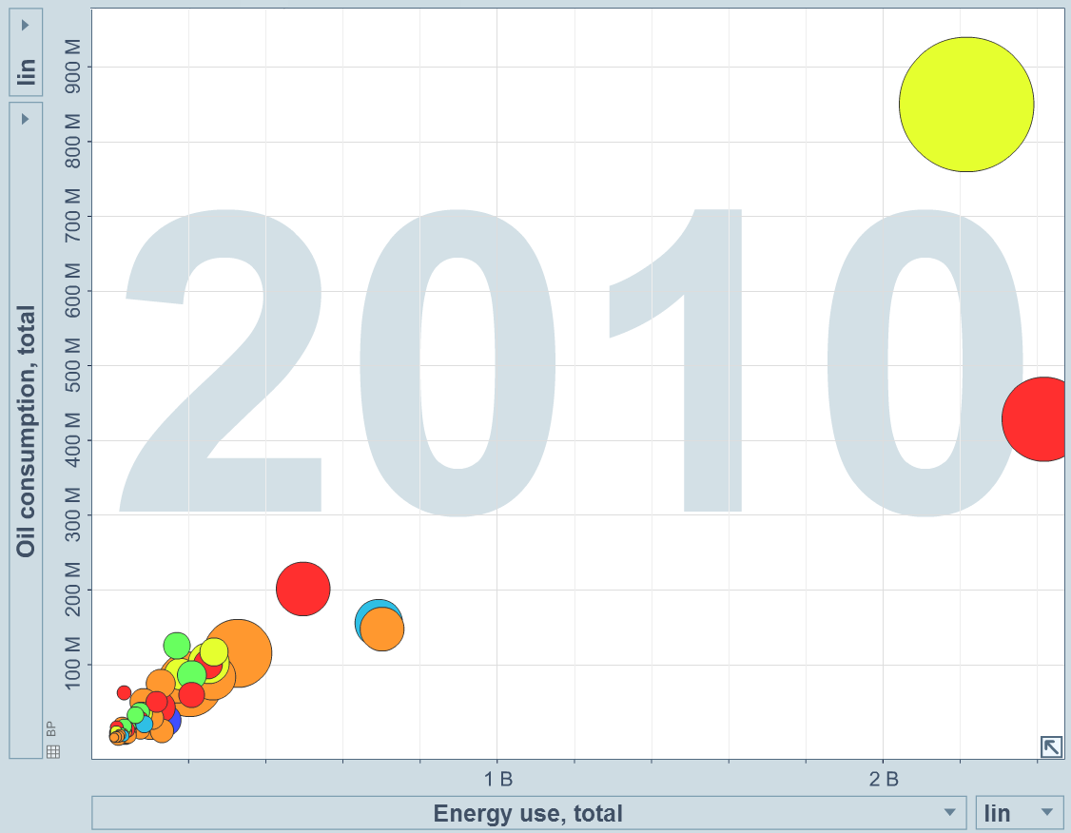
www.gapminder.org
United States of America
(tons)
China
Japan
India
Circle size = Total cumulative CO² emissions since 1751
Russia
Germany
(toe)
Notes:
US consumes twice as much oil as any other country, and is second only to China in total energy use. US and China use over twice as much energy as the rest of the world

Slide 3
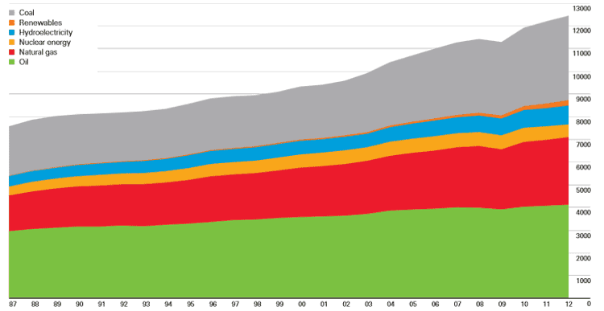

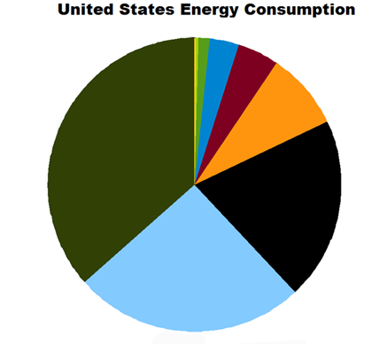
Energy Sources
Progression toward sustainability
World Energy Consumption
(Billions of tons of oil equivalent)
Other Renewables
10
5
0
Coal
Hydroelectric
Nuclear
Natural Gas
Oil
1990 2000 2010
Geothermal / Solar 0.2%
Wind 1.2%
~90% non-renewable
U.S. harnesses more geothermal energy than any country (~3 GW)
Hydro 3.3%
Biomass 4.5%
Oil
36.5%
Nuclear 8.5%
Coal
20.1%
Natural Gas
25.5%
2011
www.eia.gov
Notes:
World Energy consumption has doubled in the last 30 years. Fossil fuels account for approximately 85% of this use. In the US, only 10% of consumed energy is renewable. Although less than ¼ of 1% is geothermal, the US still leads the world in Geothermal energy production

Slide 4
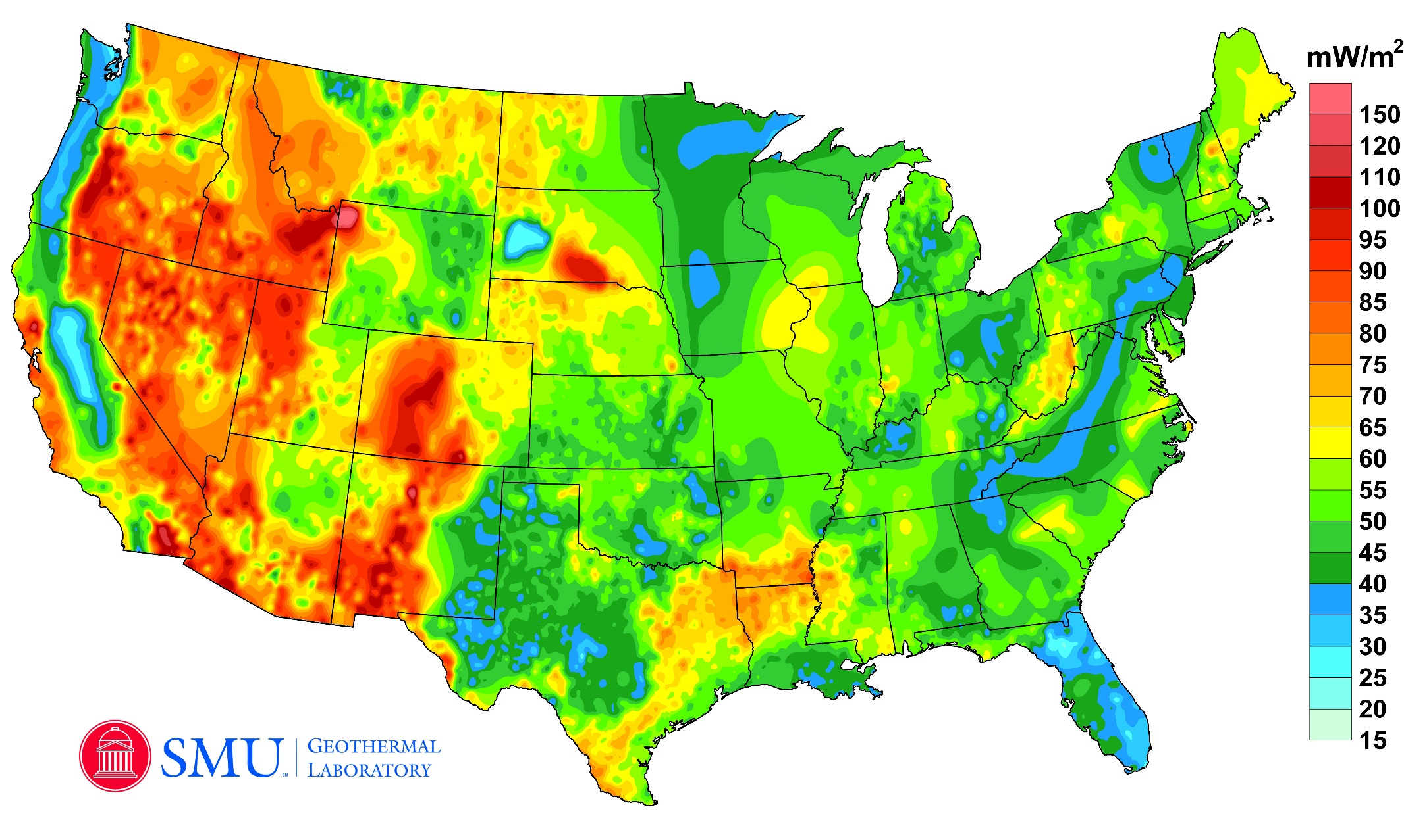
Geothermal Energy Potential
www.google.org, 2011
Notes:
The majority of geothermal energy potential in the US exists in the western states, and is harnessed using deep vertical well installations to generate electricity. In Indiana, many shallow vertical wells already exist and the use of horizontal heat pump systems is growing. These shallow systems are primarily used for HVAC applications (heat exchange systems)

Slide 5
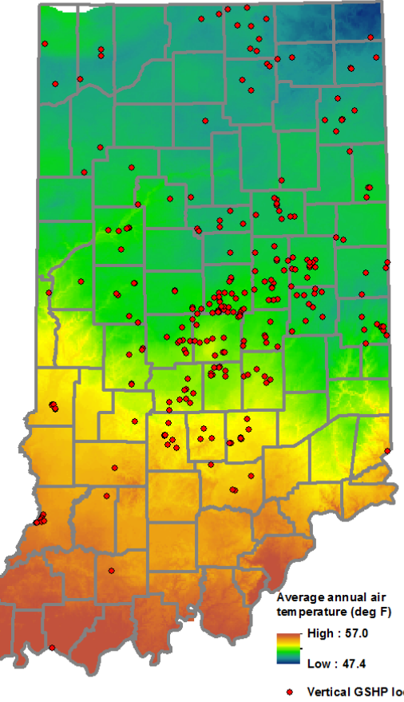
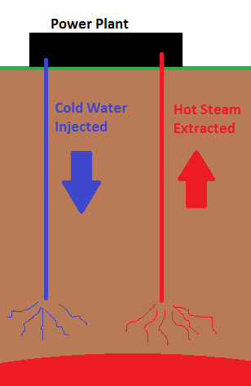
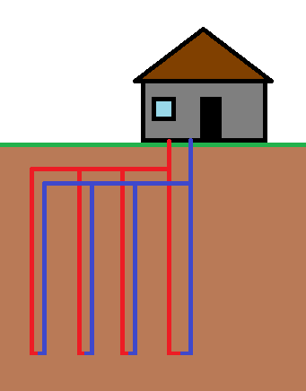
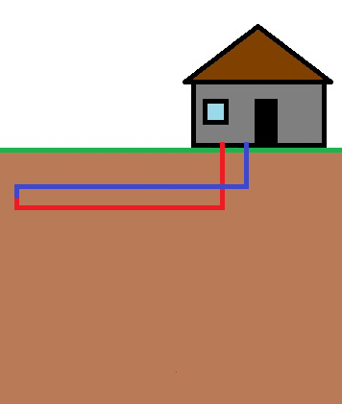
Types of Geothermal Systems
Shallow Vertical Wells
Deep
Heat Extraction
Shallow Heat Exchange
Vertical
Horizontal
1-3m deep
1-5km deep
30-150m deep
Power generation
Heating and Cooling
Notes:
Summarizing the different types of geothermal systems, and indicating the focus of this study.

Slide 6
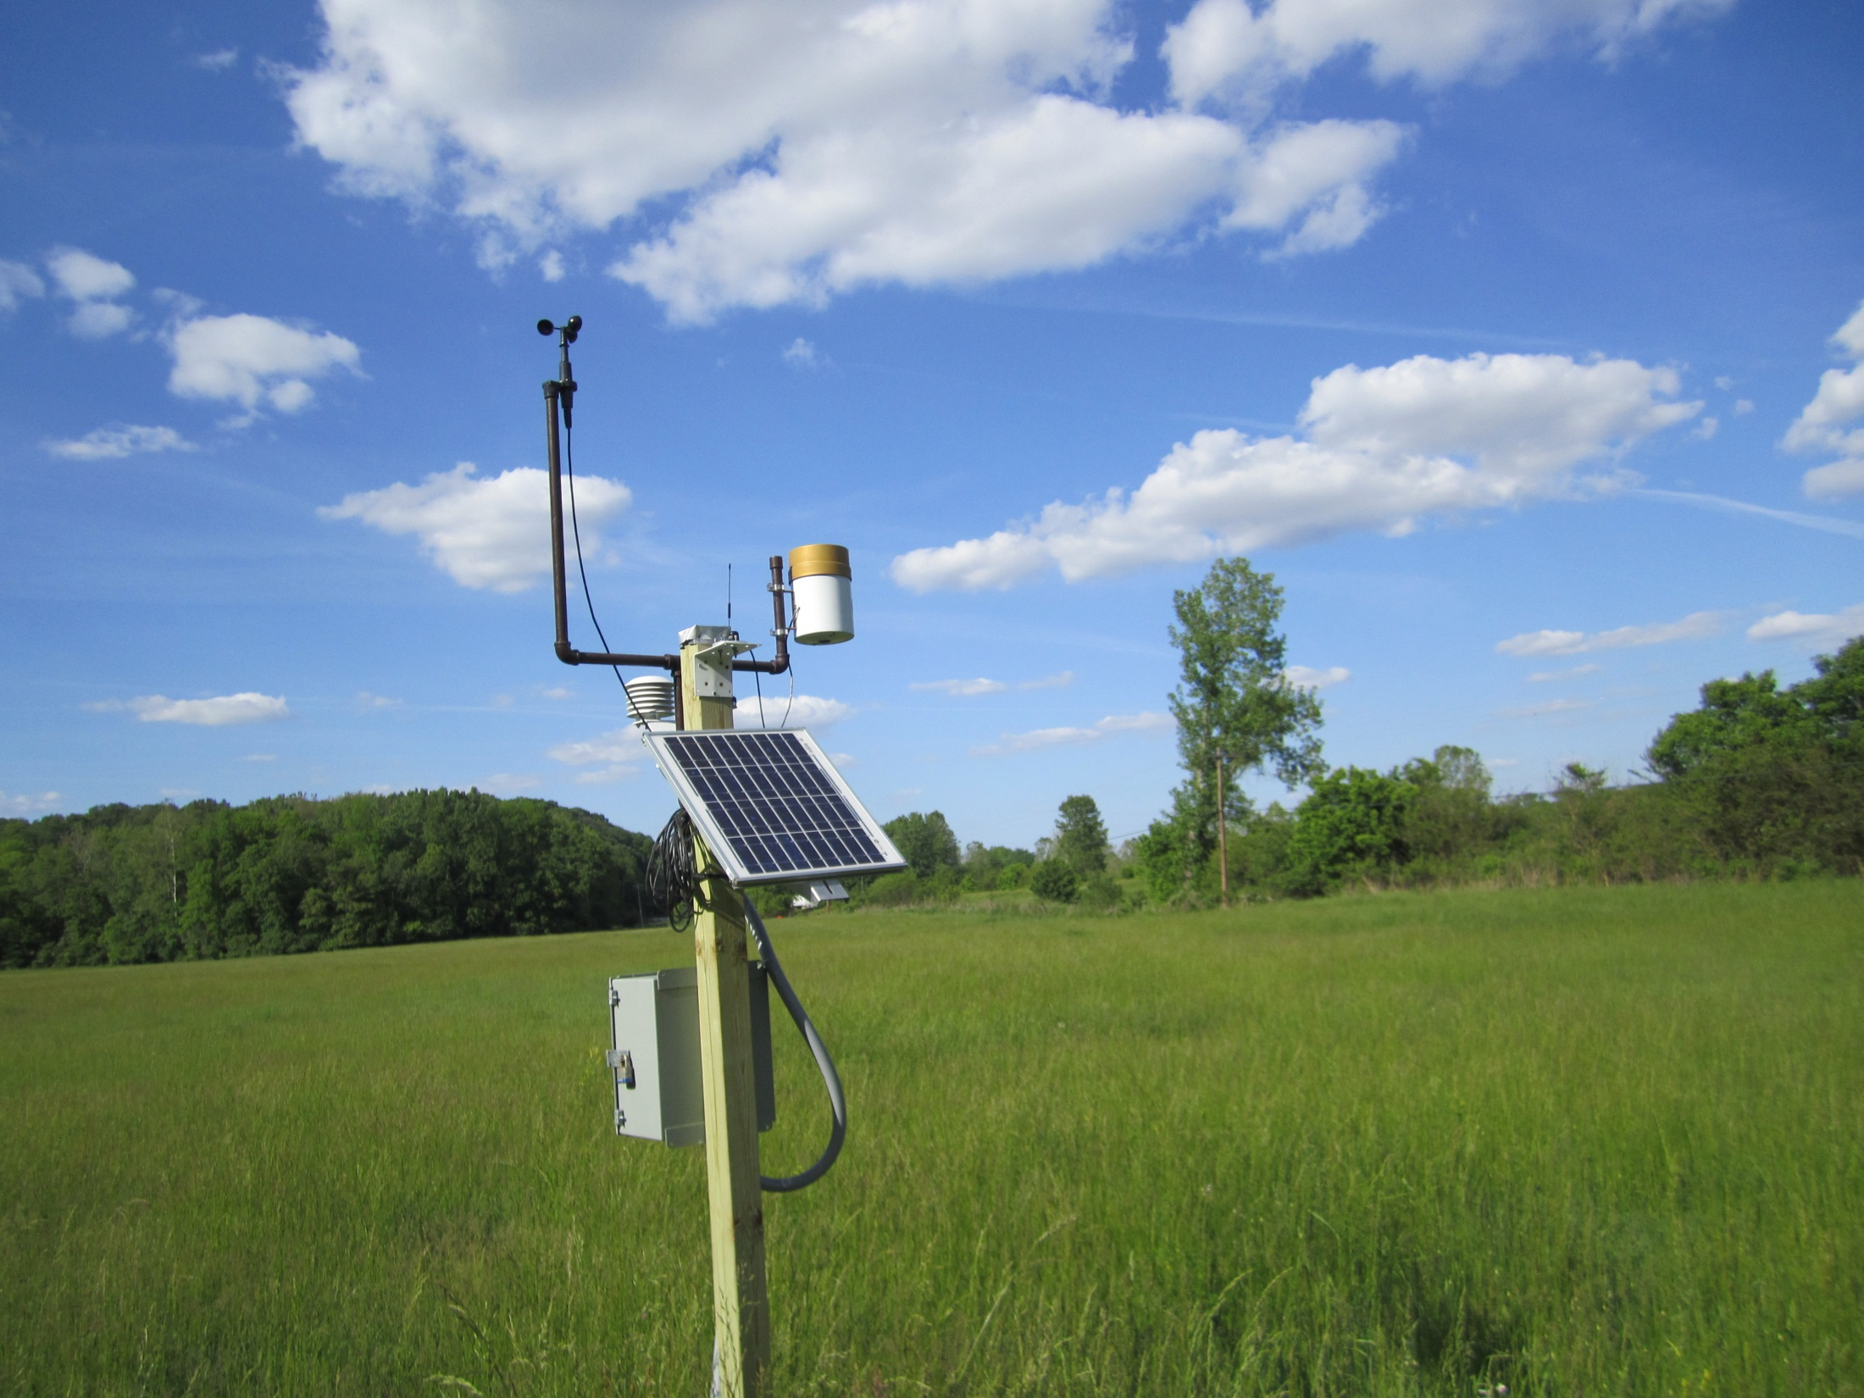
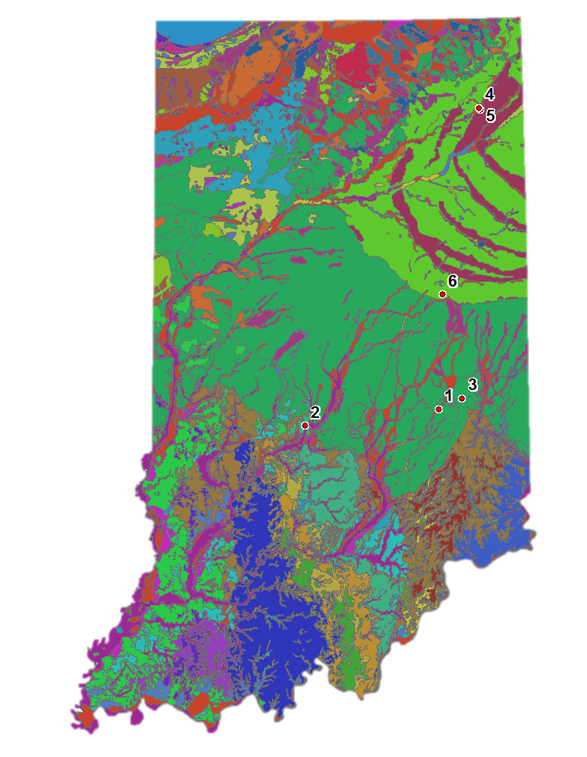
The Indiana Geothermal Monitoring Network
Site | Soil Classification
1 | Sandy Clay Loam
2 | Silt Loam
3 | Clay Loam (Silty)
4 | Sandy Loam
5 | Clay Loam
6 | Clay Loam
4
3
2
Notes:
Focusing on three sites with full datasets and variable soil types: Sand, Silt, and Clay. Brief description of all monitoring sites

Slide 7
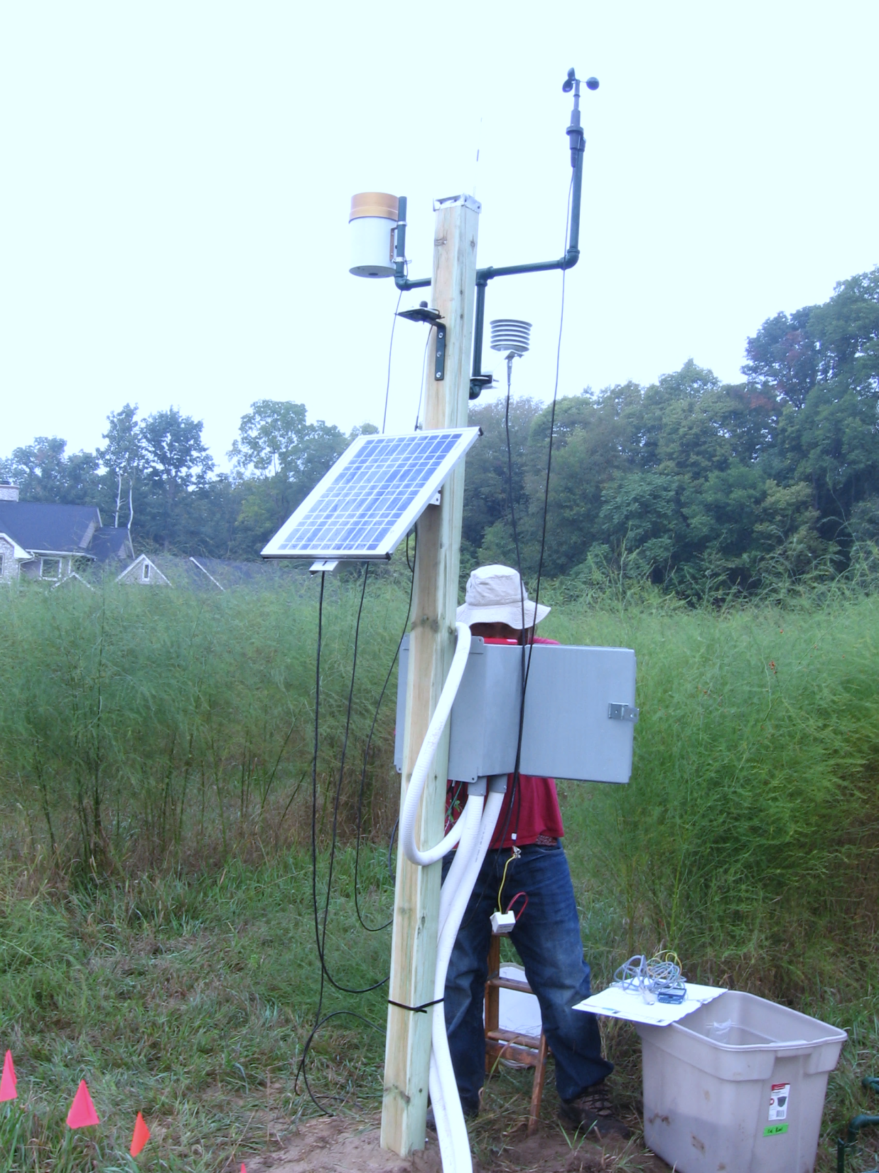
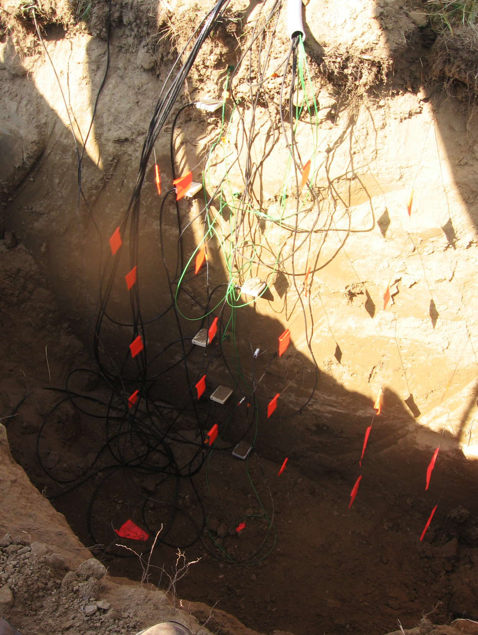


Telemetry
Wind Speed
Precipitation
Temperature & Relative Humidity
Volumetric Water Content
Solar Radiation
Solar Panel
Soil Temperature
Matric Potential
Me
Thermal Conductivity & Diffusivity
Datalogger
& Battery
Energy Flux
$$Thermal Diffusivity=\frac{Thermal Conductivity}{Volumetric Heat Capacity}$$
Notes:
Slide with informative diagrams to discuss the types of instrumentation and data being collected with this network. Also brief description of installation process

Slide 8
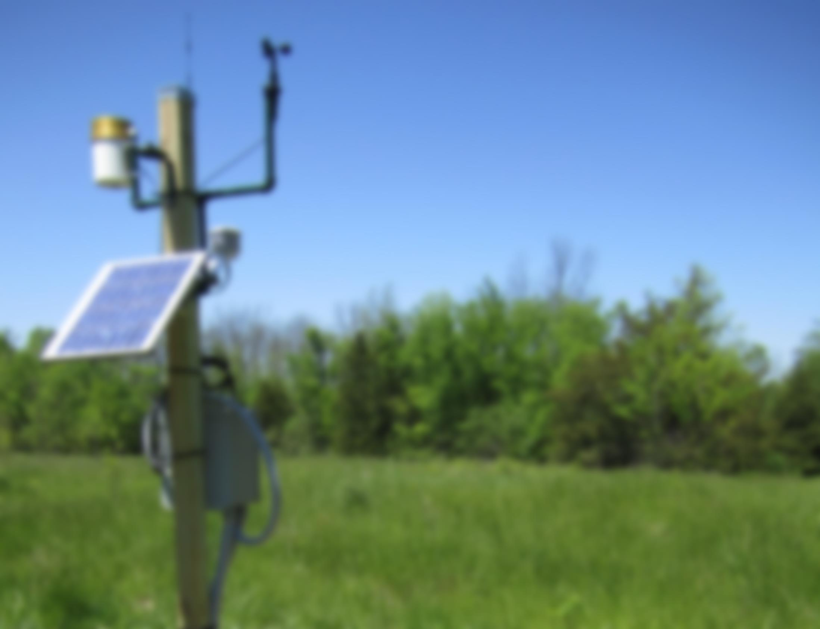
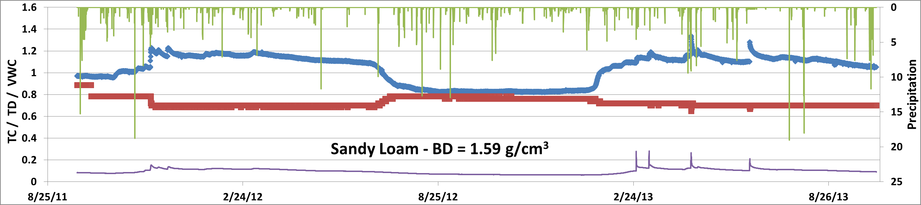
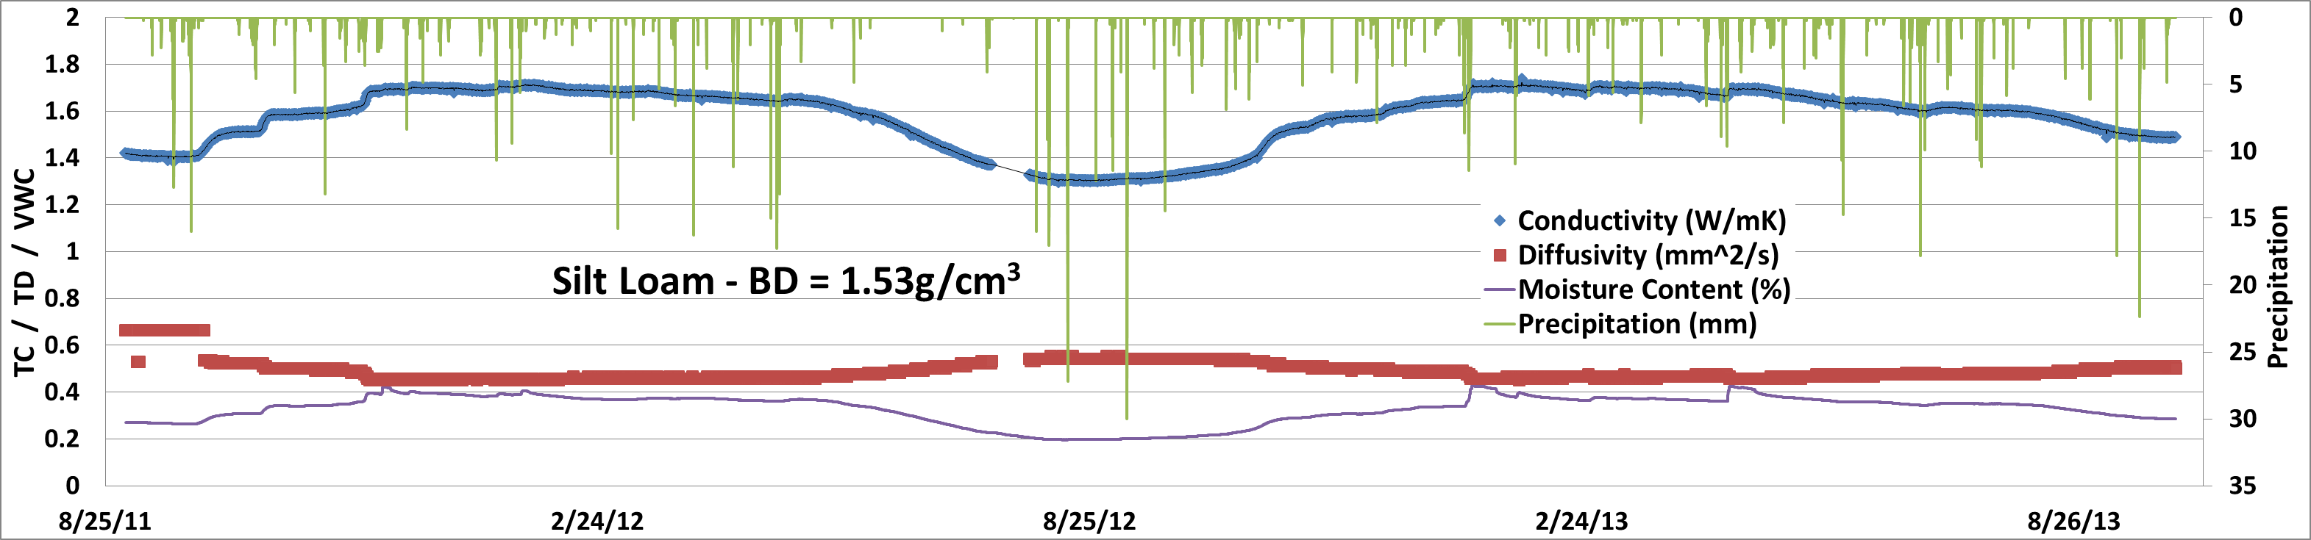
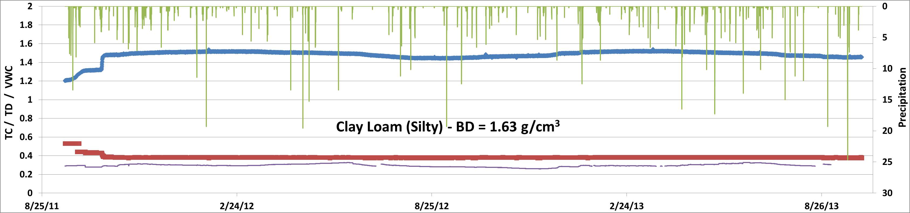
Data @ 1.2m Depth
Drought
Notes:
Comparison of three focus sites over the duration of the study. Note that sandy soils have a lower average moisture content, respond more directly and rapidly to infiltrating wetting fronts, but never reach saturation in field settings (always below 30% moisture). Clay is consistently moist and may reach saturation at some points, but shows less variability than coarser soils and never drops below 25% moisture content.

Slide 9
Thermal Conductivity and Water Content
Silt
Clay
Sand
Notes:
Plot showing the moisture contents and thermal conductivities recorded in-situ at the three focus sites. Notice the lack of variability in both moisture and TC for Clay, wide range of moisture seen by Silt and linear trend of TC fluctuation, and limited moisture variation present in the sand.

Slide 10
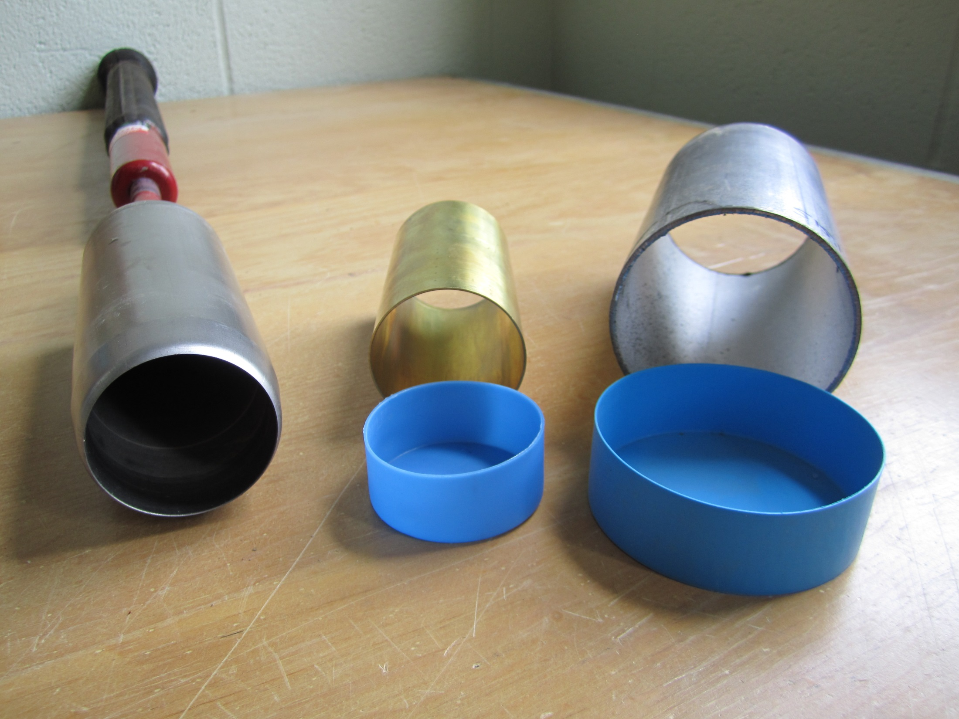
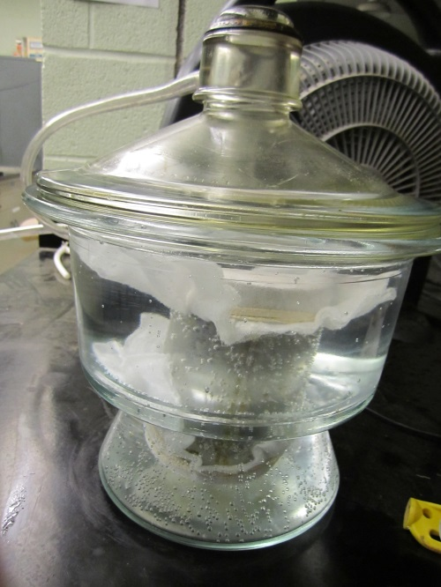
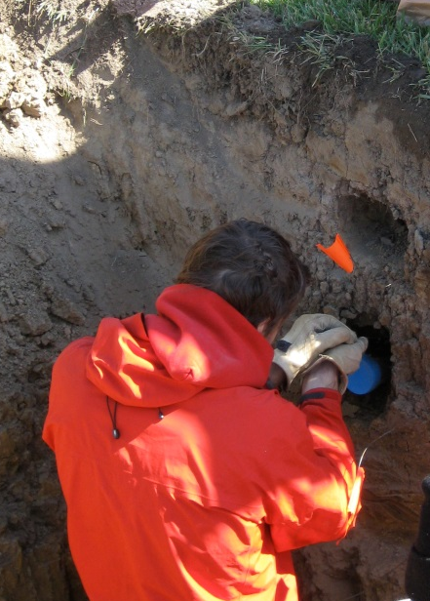
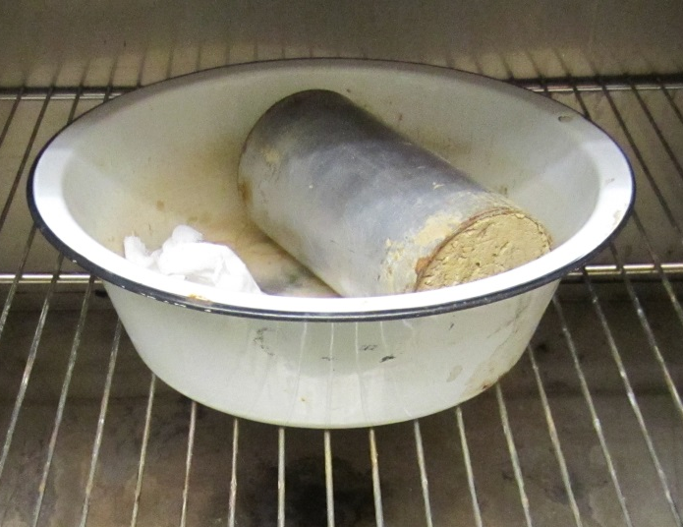
Core Samples
6”
Brass Steel
4”
~3”
~2”
Paul Levy
Notes:
Slide showing the process of core collection, saturation, and drying. Performing these experiments on the cores allows for thermal conductivity to be considered in moisture ranges that are not experienced in the field.

Slide 11
Bulk Density and Saturated Conductivity
Sand
Silt
Clay
Notes:
Showing saturated thermal conductivity against bulk density for all depths at the three focus sites. Notice the clay has a lower TC for a given BD than the silt and sand and a more gradual trend, whereas the silt and sand show similar trends.

Slide 12
All Sites - Bulk Density and Thermal Conductivity
Notes:
Showing variations in thermal conductivity with changes in moisture content and bulk density using data from all sites. Bulk density is positively correlated with TC regardless of moisture content, and moisture content is also positively correlated with TC.

Slide 13
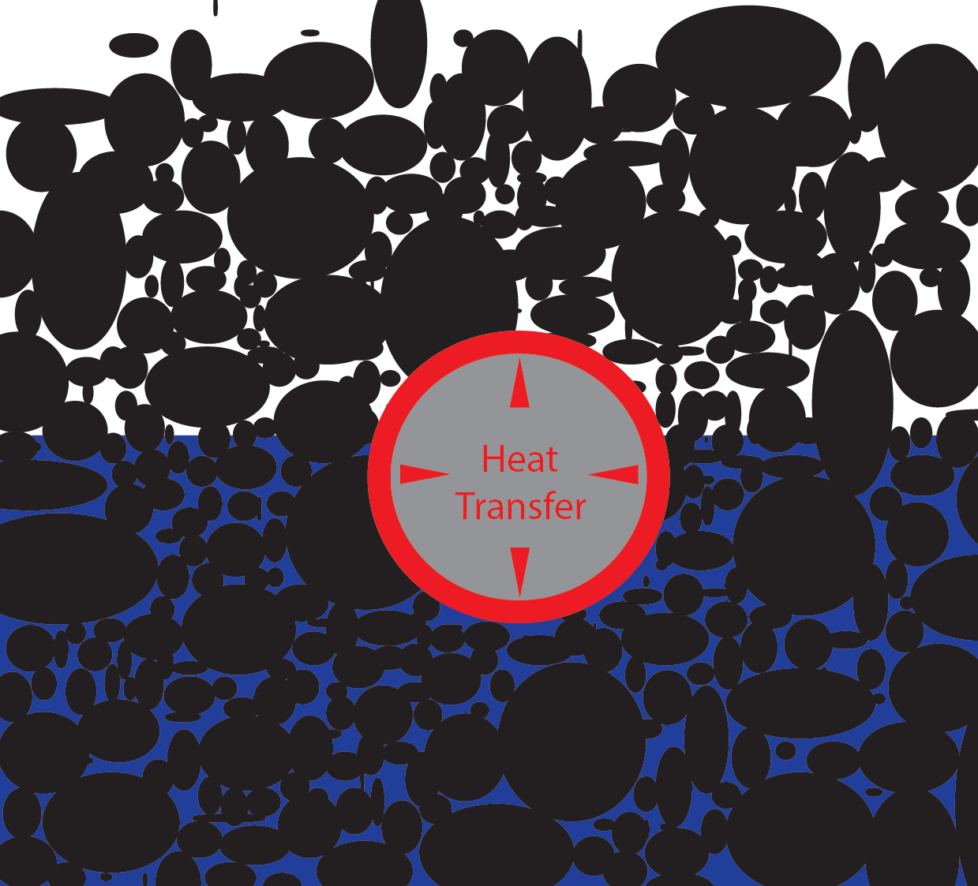
State | Material | Thermal Conductivity (W/mK) | Thermal Diffusivity (mm²/s)
Gas | Air | 0.024 | 19
Liquid | Water | 0.58 | 0.14
Solid | Quartz | 6.2 | 1.4
Dry | Ottawa Sand | 0.3 | 0.19
 | Sand Loam | 0.41 | 0.28
 | Silt Loam | 0.37 | ?
 | Clay Loam | 0.42 | 0.25
Saturated | Ottawa Sand | 3.0 | 0.98
 | Sand Loam | 2.31 | 0.82
 | Silt Loam | 2.25 | 0.74
 | Clay Loam | 2.08 | 0.65
Notes:
Slide illustrating the influence of porosity and substrate material on heat transfer through thermal conductivity and diffusivity. Summarizes three sites of interest, as well as an ideal sand and pure mineral.

Slide 14
Preliminary Modeling Results – Trench Lengths
Heating Season - 2,250 ft² house in Chicago –> 12.22 kWh (USDOE – www.nrel.gov)
Ground Temp=8.8°C ; Groundwater Temp=4.4°C ; GW Flow=3GPM
Single trench with one pipe (out and back)
6%

Slide 15
Conclusions
Dominant Controls of Heat Transfer
INCREASES or DECREASES
Water Content
Bulk Density
Soil Texture
(sand & quartz content)
Thermal Conductivity
Thermal Diffusivity
INCREASING
(Thermal Gradient x Thermal Conductivity) α Heat Flux
Notes:
Summary of the impact of increasing specific variables in regard to whether they increase or decrease thermal conductivity and diffusivity.

Slide 16
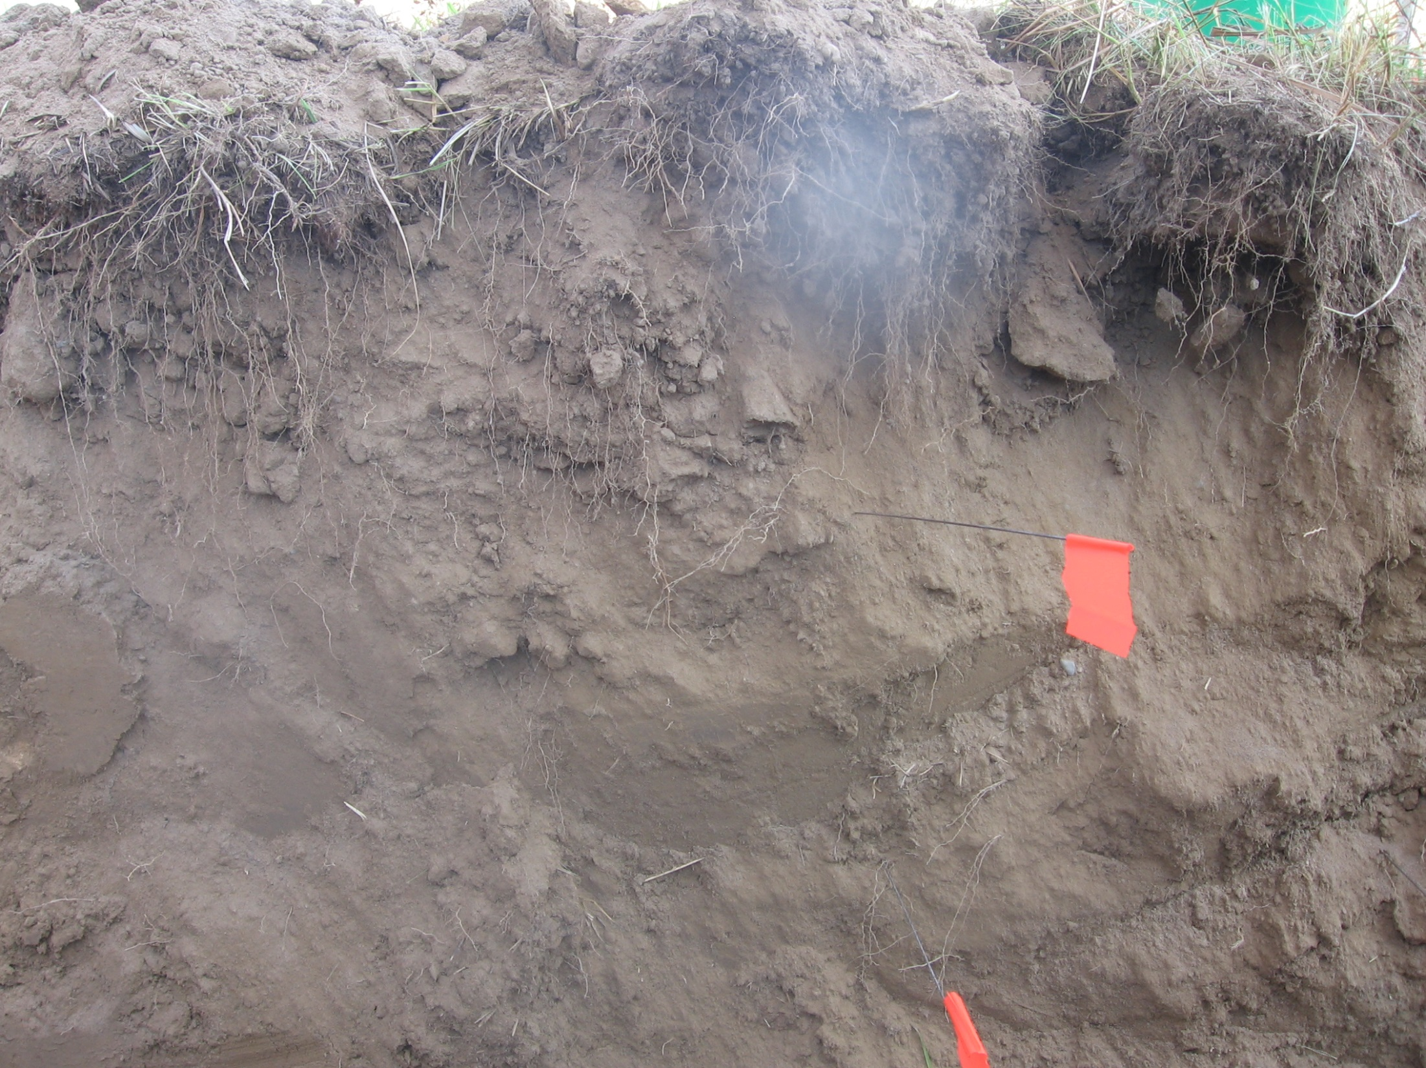
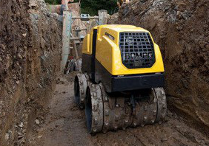
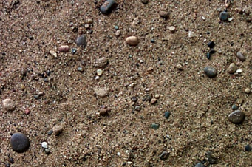
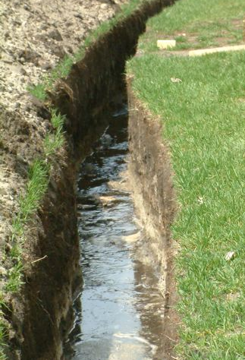
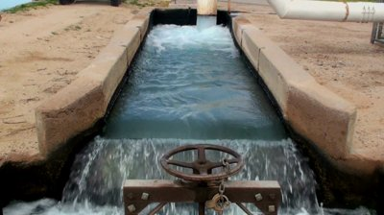
Methods for improving geothermal heat exchange systems
Increase Bulk Density - Trench Compaction
Increase Thermal Conductivity - Mineral Content
Decrease Contact Resistance - Irrigation
Increase Thermal Gradient – Flow Control
Notes:
Slide summarizing ways to increase thermal conductivity and improve the capacity of trench geothermal systems, leading to recommendations for idealized system design

Slide 17
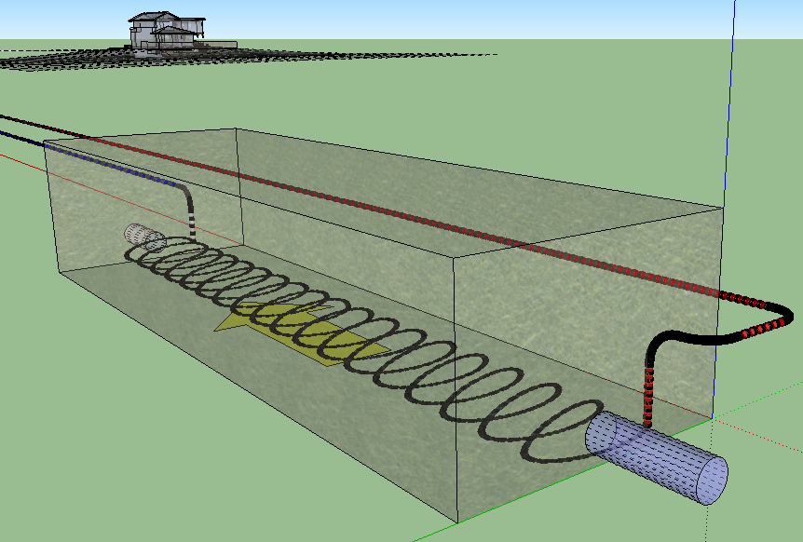
Idealized System Design – Insulated, irrigated subterranean heat bank
Google SketchUp
Outer confining layers:
Impermeable, thermally insulating material
Coiled pipe:
Decreased
trench length
Internal substrate:
Densely compacted, saturated, thermally and hydraulically conductive sediment
Irrigation inlet valve
Notes:
Schematic diagram of trench geothermal system describing ways to improve heat storage and transfer capacity and control overall system efficiency through design. During the summer cooling season, flow valves are left open so that heat can be carried away from system by water. Toward the end of the cooling season, the flow valves are closed and heat is allowed to accumulate in the system for winter extraction.

Slide 18
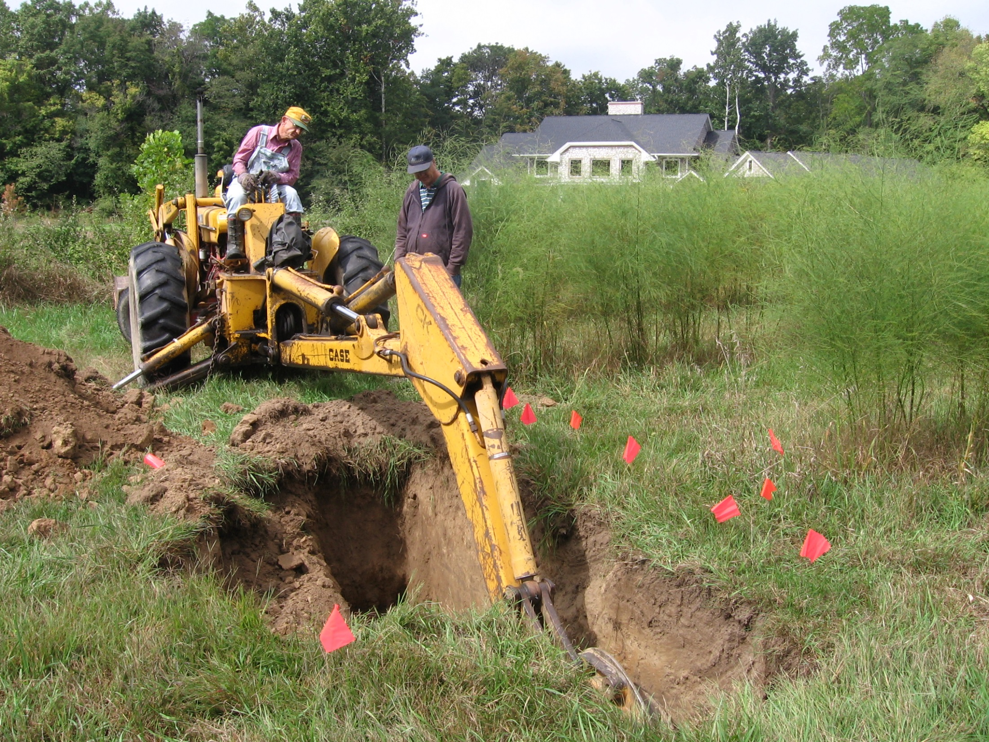
Sources
www.nrel.gov
www.eia.gov
www.gapminder.org
www.wikipedia.org
www.google.org
www.crystran.co.uk
www.engineeringtoolbox.com
www.energyrealist.com
www.shutterstock.com
www.insidemnsoccer.com
www.bomag.com
www.edwclevy.com
www.scdigest.com
Questions?

