Slide 1
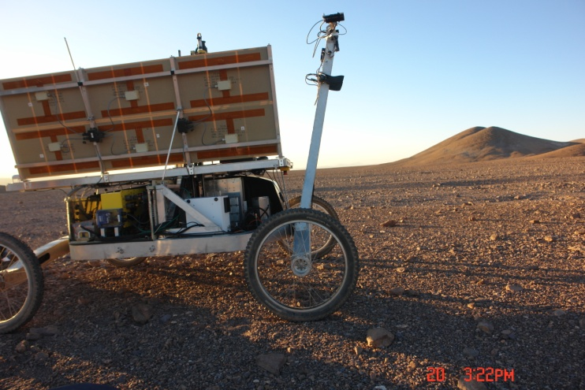
“Life in the Atacama” 2013 Rover Field Campaign in Chile
Autonomous Analysis of Robotic Core Materials by the Mars Microbeam Raman Spectrometer (MMRS)
Jie Wei¹, Alian Wang¹, James L. Lambert², David Wettergreen³, Nathalie Cabrol⁴ and Kimberley Warren-Rhodes⁴
¹Washington University in St. Louis;
²Jet Propulsion Laboratory, CA, 91109,
³Carnegie Mellon University, Pittsburgh PA 15213,
⁴SETI Institute, Carl Sagan Center, NASA Ames Research Center, CA 94035

Slide 2
Outline
Background
Methodology: sampling & measurements
Performance of MMRS (robustness )
Minerals identified
Quantitative analysis: phase distributions
Conclusion

Slide 3
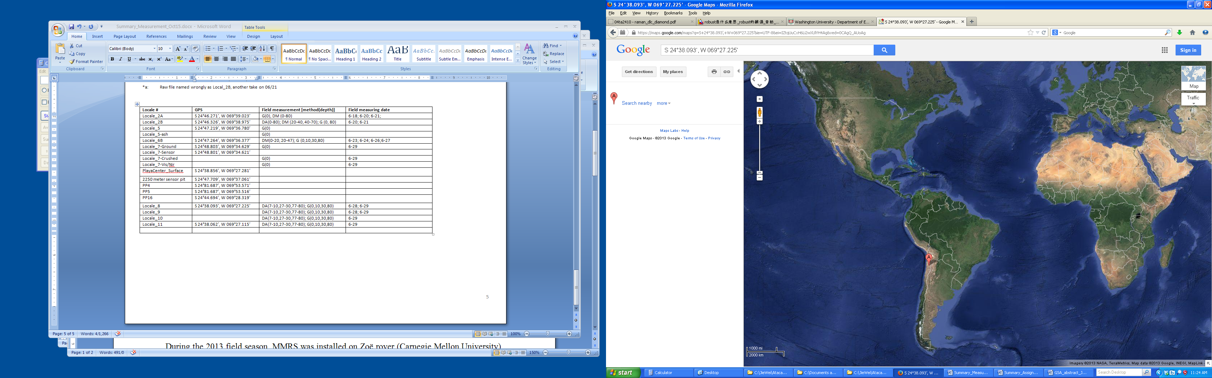
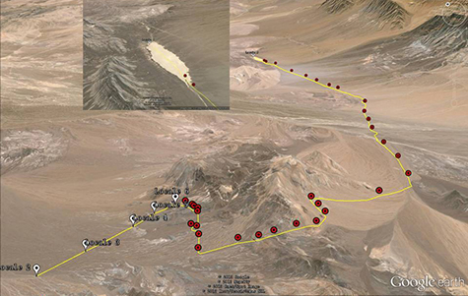
Background
Life in the Atacama (NASA , ASTEP program)
Atacama desert: one of the driest deserts; a terrestrial analog to Mars. Different forms of life were previously identified at Atacama subsurfaces.
LIFA 2013 campaign, rover-based exploration: robotic subsurface sampling, autonomous mineral phase identification.
Operation: Remotely directed
Field team: Rover, Drill, MMRS

Slide 4
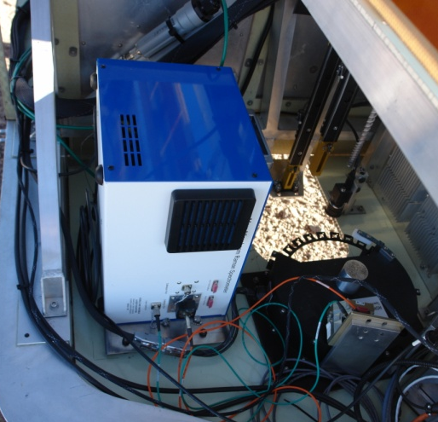
Background
Mars Microbeam Raman Spectrometer (MMRS) for fine-scale mineralogy and biosignature
1996 NASA PIDDP
1997 Athena payload for Mars Exploration Rover mission
2004 MSL payload selection (category one)
2012 LITA project, MMRS stand-alone
2013 LITA project , MMRS on Zöe rover

Slide 5
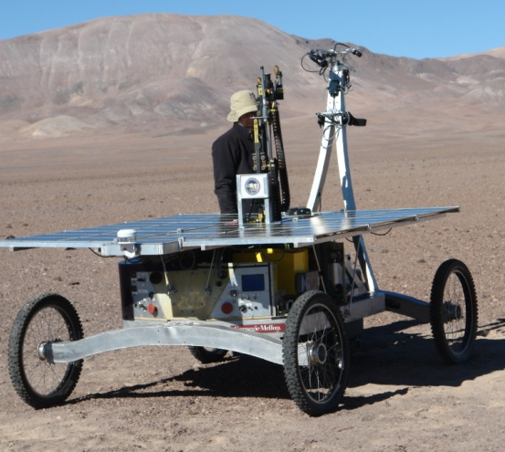
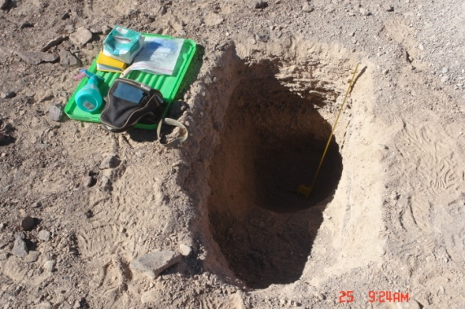
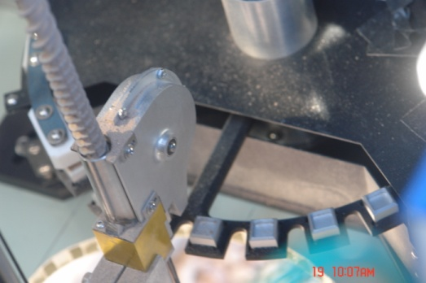
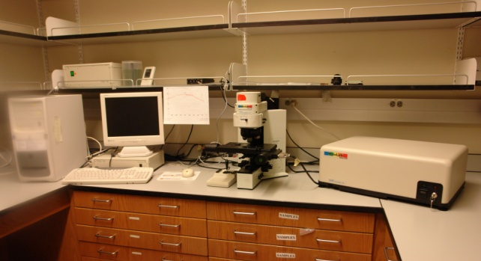
Methodology
Sample collections
Automatically delivered by drill
Manually collected from pit wall
Measurements:
MMRS main box
MMRS probe head
Line-scan of the same samples using HoloLab5000 (similar performance as MMRS)
Autonomous line-scan of samples on carousel

Slide 6
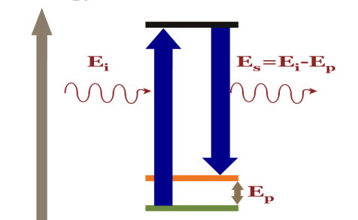
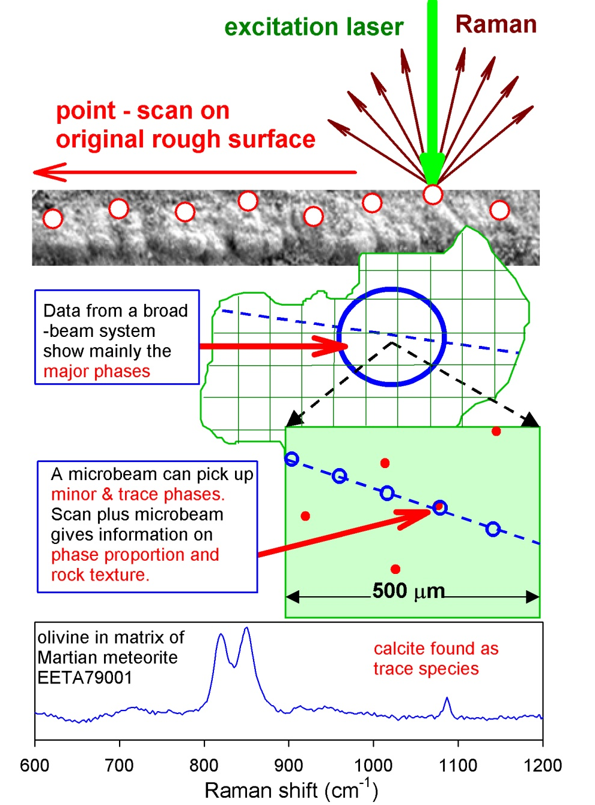
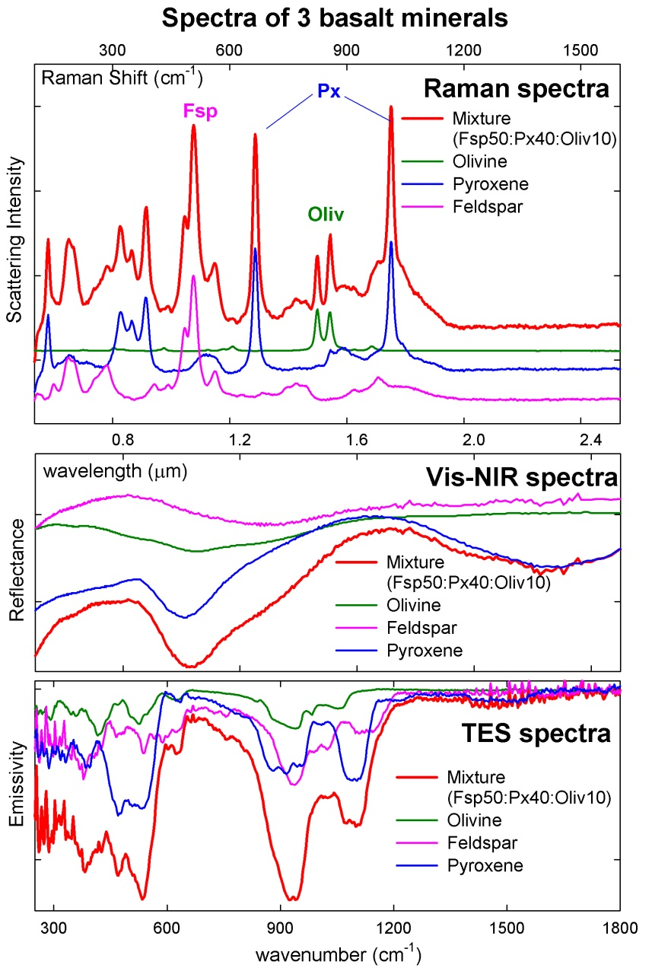
Raman spectroscopy
Micro (focused) beam with line scan
fine grain mineralogy
hν
Point counting method:
Taking spectra from many spots using focused beam
Each assignable spectrum is added to the phase count
Non-invasive
Non-destructive
In situ application

Slide 7
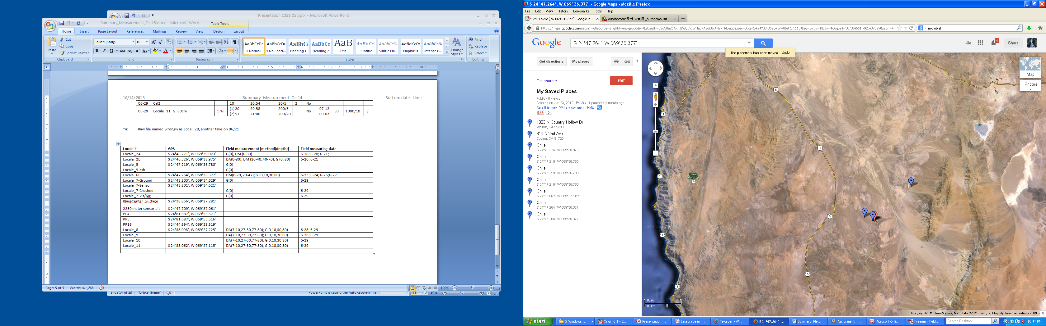
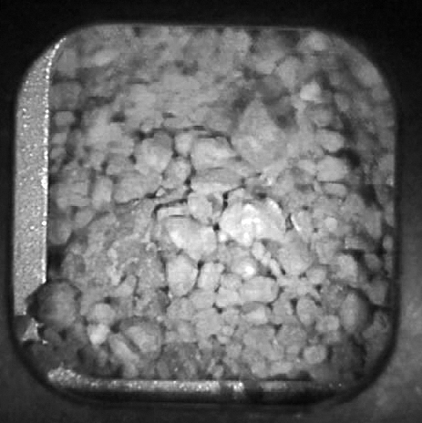
Measurement summary
Locations and depths
7 locations, 31 samples
62 measurements (mmrs, lab)
Total 3230 points (spectra) .
8-11
9 | M | 80 | 50
 |  | 30 | 50
 |  | 10 | 50
 | A | 80 | 50
 |  | 30 | 50
 |  | 10 | 50
8 | M | 80 | 100
 |  | 30 | 20
 | A | 80 | 50
 |  | 30 | 100
6B | M | 80 | 100
 |  | 30 | 100
 |  | 10 | 100
 |  | 0 | 100
5 | M | 30 | 52
 |  | 0 | 50
2B | M | 80 | 50
 |  | 0 | 20
2
L |  | D cm | mmrs points
11 | M | 80 | 50
 |  | 30 | 20
 |  | 10 | 20
 | A | 80 | 100
 |  | 30 | 20
 |  | 10 | 100
10 | M | 80 | 18
 |  | 30 | 20
 |  | 10 | 20
 |  | 0 | 20
 | A | 80 | 50
 |  | 30 | 50
 |  | 10 | 50
5,6B
Linear-scan points

Slide 8
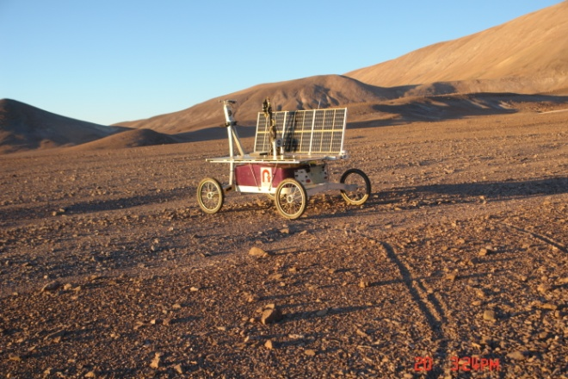
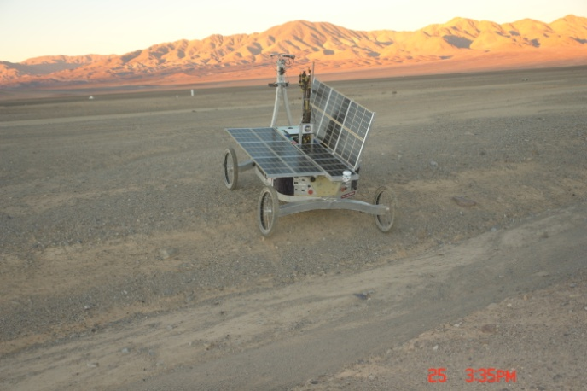
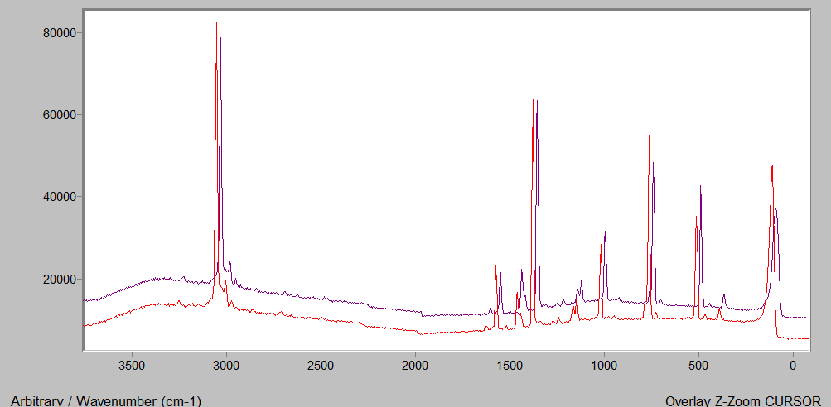
MMRS Robustness
MMRS normal performance remained over 2-week 50 km route
Naphthalene spectra at the beginning and end of the trip
Blue: 06/17 15:09
Red: 06/29 20:54
Peak position
Accounts
Relative peak intensity

Slide 9
Minerals identified -- 3 sulfates
Gypsum (CaSO₄ ∙2H₂O )
For low s/n spectra, single peak at 1008 was assigned to gypsum.

Slide 10
Anhydrite (CaSO₄)
Minerals identified -- 3 sulfates

Slide 11
Minerals identified -- 3 sulfates in Atacama-2013 samples
 | OH str. | A-sym. Str. | Sym. Str. | A-sym. Bend. | Sym. bend.
Gypsum (CaSO₄ ∙2H₂O ) | 3494,3407 | 1135 | 1008 | 670, 620 | 494,415
Anhydrite (CaSO₄ ) |  | 1128 | 1017 | 676,629,612 | 499,416
γ-CaSO₄^{(a)} |  | 1168 | 1025 | 674,632 | 492,422
Bassanite (CaSO₄ ∙0.5H₂O^{(b)}) | 3700,3475 | 1128 | 1015 | 668,628 | 489,427
^{(a)} Only observed in lab. Chio, Sharma and Muenow, American Mineralogist, 89: 390 (2004)
^{(b)} Not certainly identified in this study. From Yang, Wang and Freeman, 40th LPSC (2009): 2128

Slide 12
Minerals identified – K, Na -feldspar
Feldspar group
The Raman spectra slightly vary. The strongest Raman peaks fall within a narrow region of 505 and 515 cm^{-1 (a)}.
Best assigned as ternary feldspar with most albite contribution^{[a]}.
In the MMRS spectra of Atacama samples, only the strongest peaks between 508 - 516 cm⁻¹ show up. They are assigned to the group of feldspar. The peak positions indicate alkali-feldspars, i.e. Na & K-feldspar.
^{[a]}Freeman, Wang, Kuebler, Jolliff and Haskin, The Canadian Mineralogist, 46: 1477 (2008).

Slide 13
Minerals identified – two carbonates
Carbonates have the strongest Raman peak, ν₁, between 1000 – 1100 cm⁻¹ .
Calcite (CaCO₃)
??CO₃
The spectra are weak, only appeared once in the analyzed spectra, might be K₂CO₃ or BaCa(CO₃)_{2.}
Low s/n spectra: Calcite/aragonite

Slide 14
Anatase (TiO₂), quartz (SiO₂) and hematite (Fe₂O₃)
Minerals identified – igneous and graphite
Graphite
Hematite and graphite are only identified in lab-measured spectra.

Slide 15
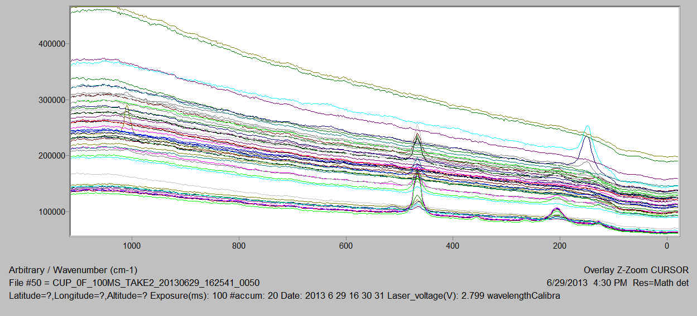
V. Quantitative phase distributions: point counting method
MMRS spectra
Locale: 9, pit
Depth= 10 cm
 | Quartz peak | Gypsum peak | Anatase peaks
50 points | in 19 spectra | in 2 spectra | in 3 spectra
1-phase points | 2+3+4+9+10+5-8+17-22+26+24+25 | 16 | 13+40+38
2-phase points | 23+27 | 23+27
Percentage of Informative spectra = (19+2+3) / 50 = 48 %
Quartz proportion percentage = 19 / 50 = 38%
(To be developed -- weighted with Raman cross section of solid phases)
^{(a)} Haskin, Wang, Rockow, Jolliff, Korotev and Viskupic, J. Geophy. Res. 102: 19293 (1997).

Slide 16
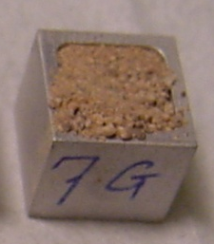
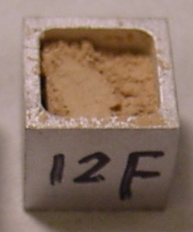
Percentage of informative spectra
Averaged informative percentages: Lab 48%; MMRS 29%.
Exposure time and accumulation numbers:
Lab: 1000 ms x 10acc - 2000 msx10 acc;
MMRS: 100ms x 10 -200ms x 20 .
Laser focus condition.

Slide 17
Phase distributions (Point proportion) 7 sites, 31 samples, 59 measurements (non-informative measurements were removed), 1680 mmrs + 1550 lab points/spectra
Mean proportional percentages
 | Quartz | Gypsum | Anhydrite (+Bassanite) | Fspar | Calcite | TiO₂ | Fe₂O₃
Percentage | 10 | 11 | 8 | 7 | 2 | 1.8 | 0.3
Proportional percentages over depths
Depth (cm) | 0 | 10 | 30 | 80
Number of measurements | 8 | 14 | 19 | 20
Anhydrite/Bassanite | 1 | 0.9 | 2.6 | 21
Gypsum | 23 | 11 | 6.4 | 11
Quartz | 8 | 10 | 12 | 11
Feldspar | 13 | 8 | 6 | 4
The relative distribution of anhydrite/bassanite increases sharply at the depth of 80 cm; Gypsum prefers surface.

Slide 18
V. Phase distributions: anhydrite and gypsum

Slide 19
Conclusion
First time integration of MMRS on a rover and reliable operation over the 50 miles 2-week trip; demonstrated the robustness of its opt-mechanical construction.
Preliminary data analysis results:
Autonomous MMRS spectra of subsurface materials identified 3 sulfates, 2 carbonates, a type of feldspar, quartz and anatase (TiO₂).
Reduced carbon and hematite (Fe₂O₃) are also identified in lab spectra.
The percentage of informative MMRS spectra (29%) is lower than lab’s (48%) (accumulation time and laser focus condition are among the reasons).
Mineral phase distributions as a function of depths show that anhydrite distribution increases abruptly at the depth of 80 cm.
Next trip to Atacama:
1) More calibration;
2) Better sample filling and longer measurement time;
3) More samples and points to decrease statistical uncertainty;
4) Immediate MMRS measurements after sample collection.

Slide 20
Acknowledgement
Jie Wei¹, Alian Wang¹, James L. Lambert², David Wettergreen³, Nathalie Cabrol⁴ and Kimberley Warren-Rhodes⁴
CMU rover team
Greydon Taylor Foil
David Kohanbash
James Peter Teza
Srinivasan
Vijayarangan
Michael Wagner
Honeybee
Drill team
Gale Paulsen
Sean Chulhong Yoon
Local support
Guillermo Chong
Jonathan Bijman
Raul Arias O.
Funding
ASTEP (NASA )
McDonnell Center for the Space Sciences, Washington University in St. Louis

Slide 21
Thanks for your attention! Please visit Poster 227219 and 227240 in Hall D, 2-4 pm, 5-6:60 pm for Raman spectroscopy detection of biomarkers and zeolites

