Slide 1
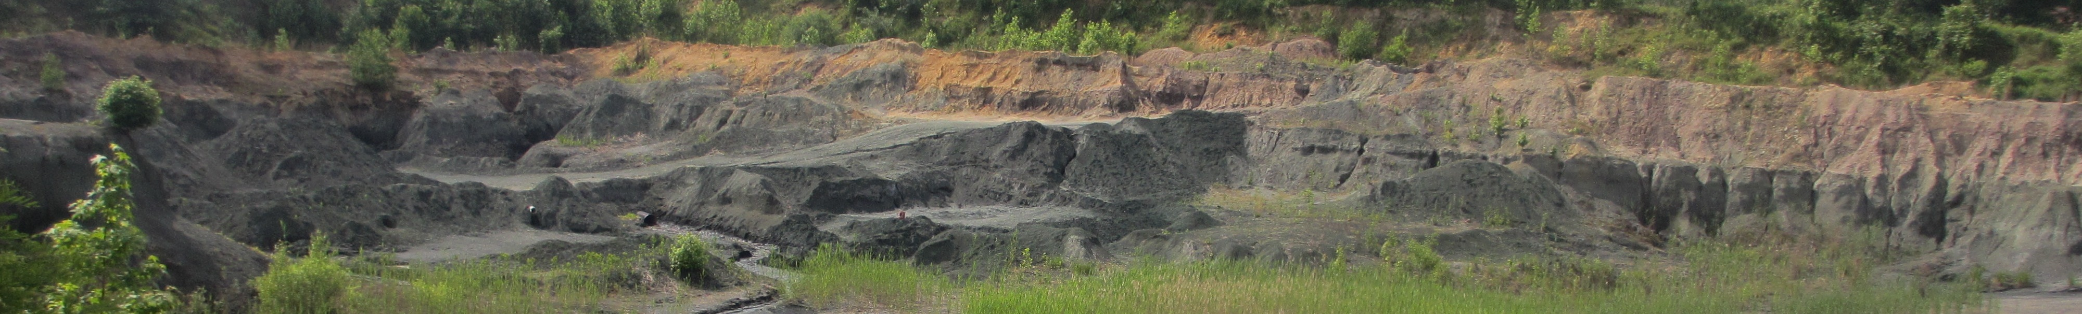

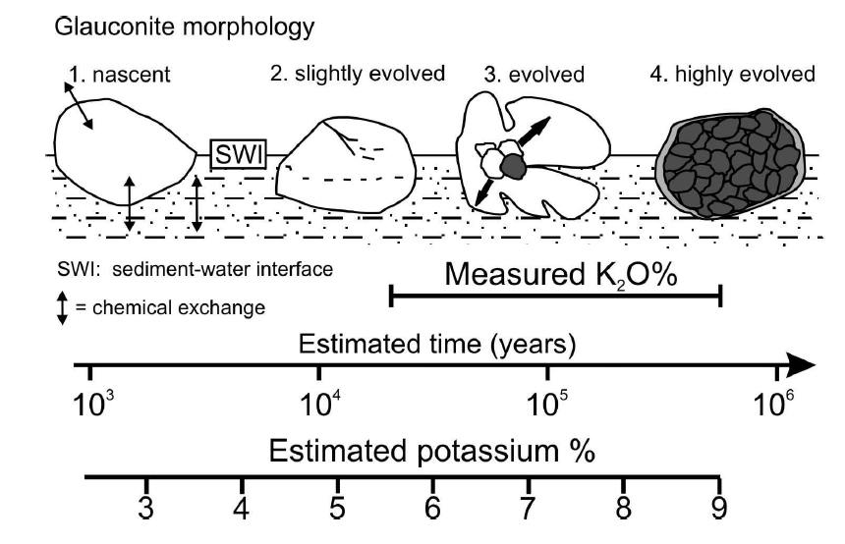
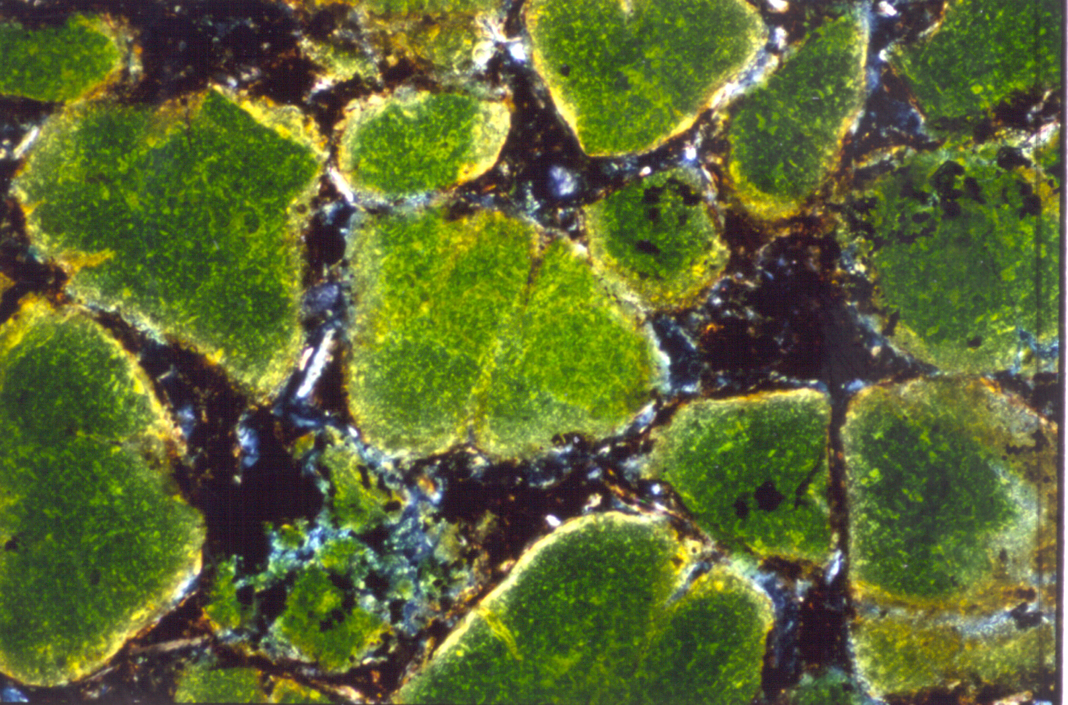
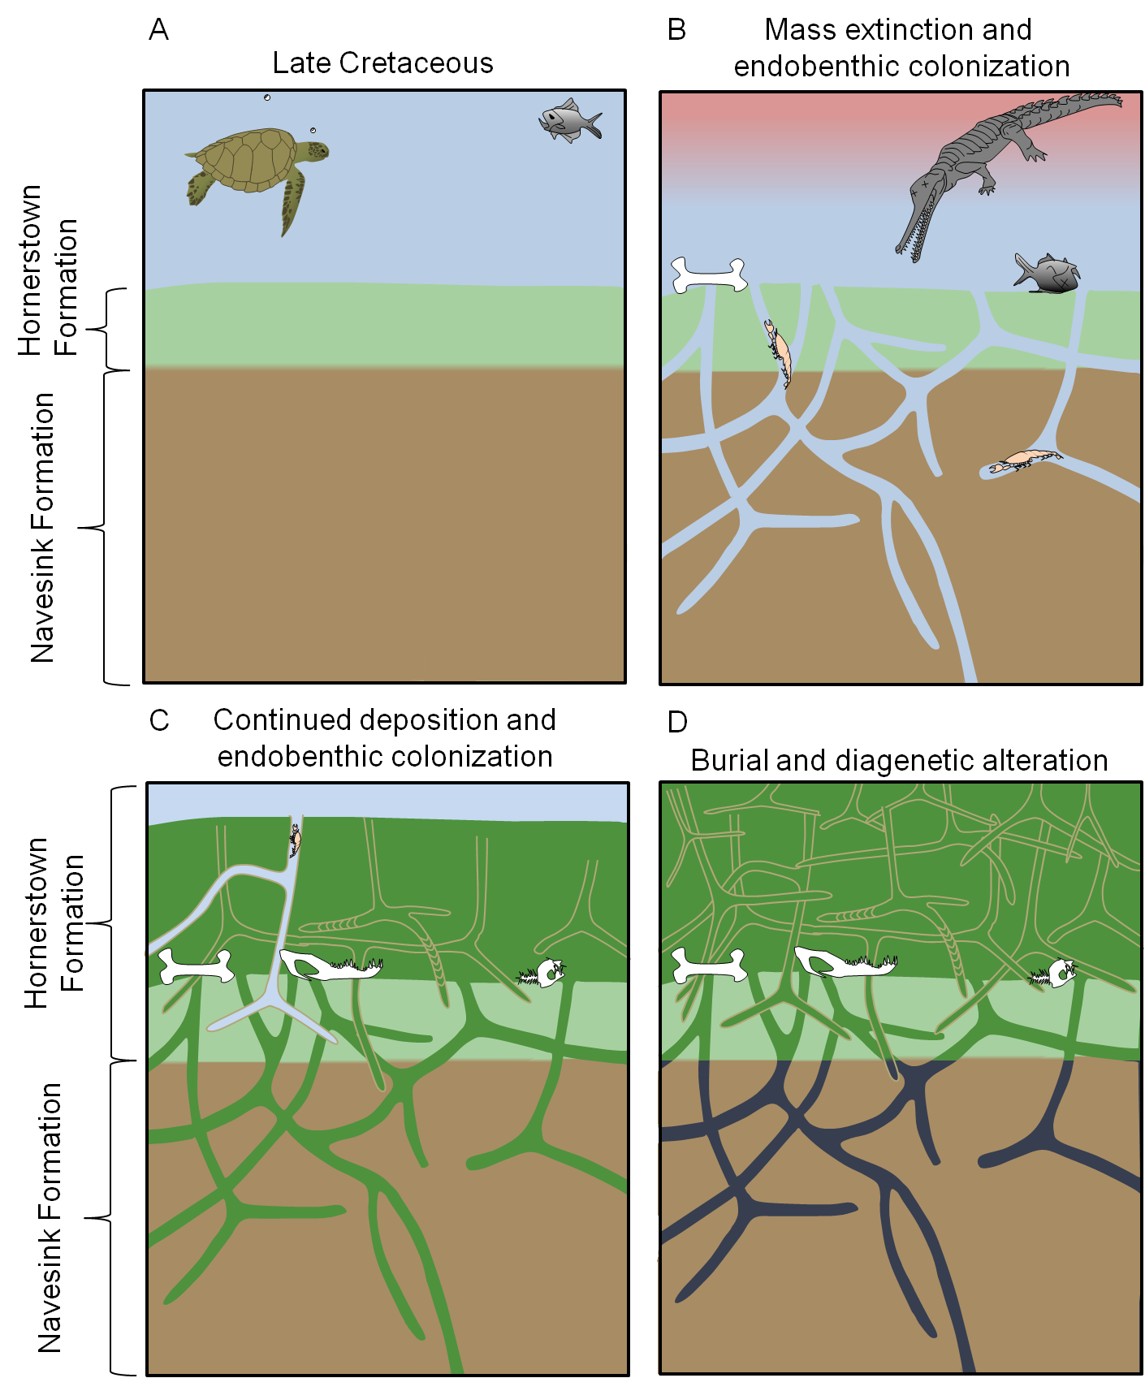
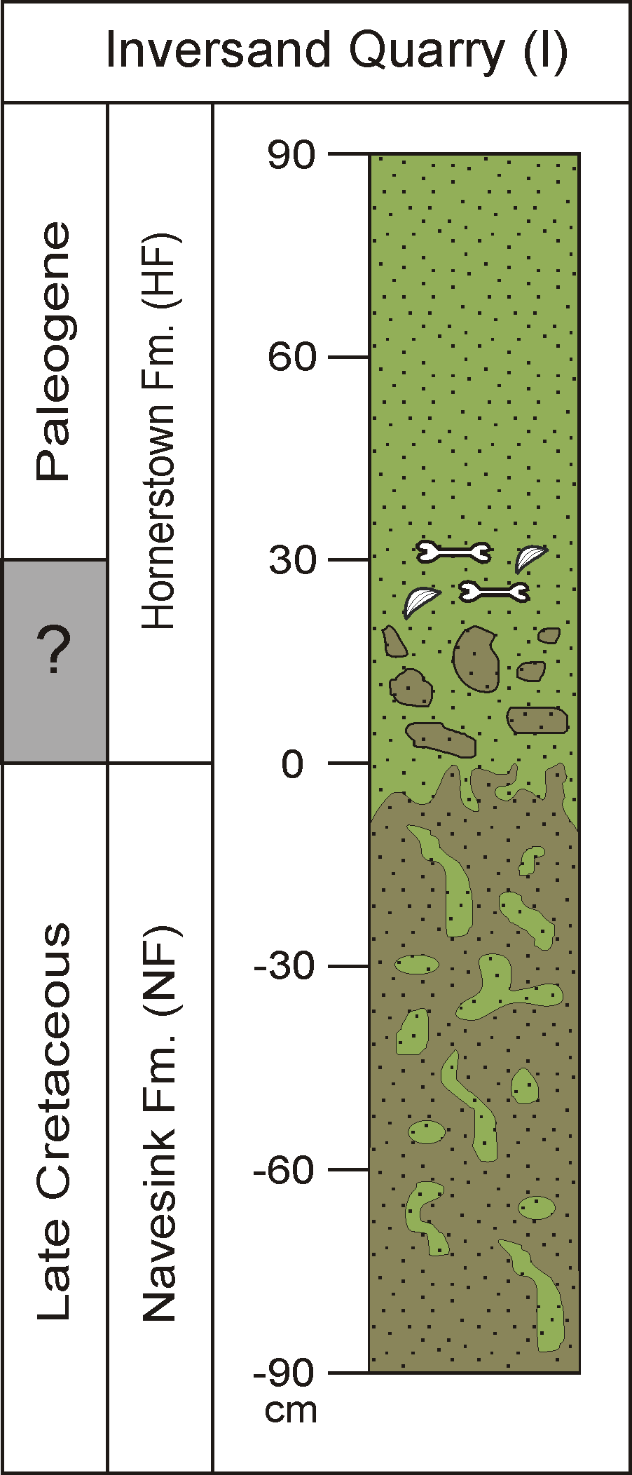
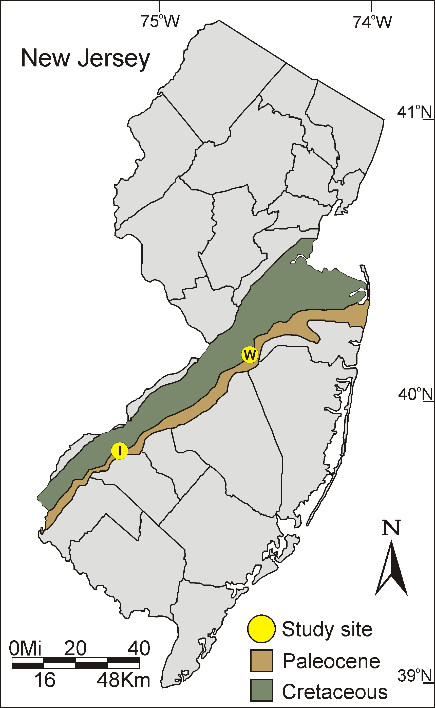
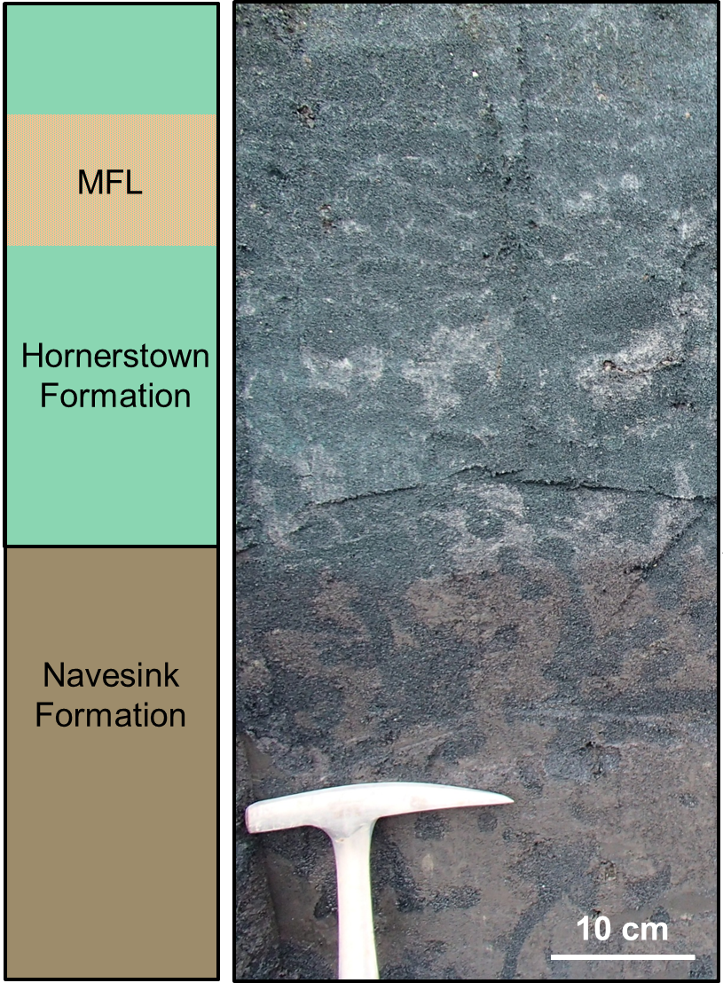
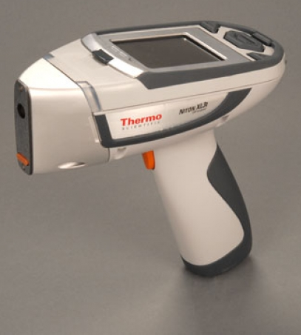
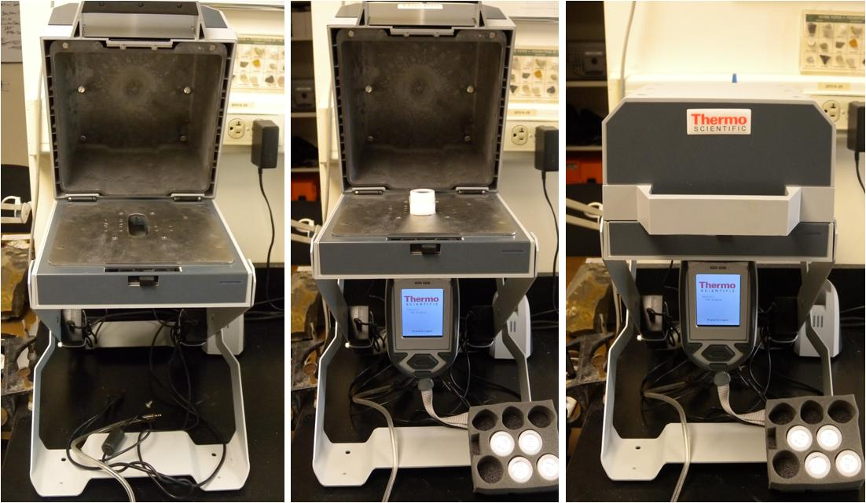
126-22
Shrimp-Trace Elements: Geochemistry of Thalassinoides-Dominated Marine K/Pg Sections of New Jersey
Robert J. Horner ¹, Logan A. Wiest, Ilya V. Buynevich, Dennis O. Terry, Jr., David E. Grandstaff
Department of Earth and Environmental Science, Temple University, Philadelphia, PA 19122 USA ¹ Robbie.Horner@temple.edu
Abstract
Objectives
Results
Glauconite Maturity
We investigated the chemical composition of Thalassinoides isp. burrow fill and surrounding matrix in the unconsolidated Upper Cretaceous Navesink (NVF), New Egypt (NEF), and overlying Cretaceous-Paleogene (K/Pg) Hornerstown Formation (HF) at the Inversand and Meirs Farm sites, New Jersey, using a Niton XL3t XRF analyzer to determine the stratigraphic origin of burrow fill. The laterally equivalent NVF/NEF and overlying HF are glauconite-rich marls deposited during transgression at the end of the Cretaceous and beginning of Paleogene. Near the base of the HF is a renowned bonebed, the Main Fossiliferous Layer (MFL), that contains isolated to articulated Cretaceous marine reptiles, turtles, birds, and crocodiles that has been interpreted as a thanatocoenosis. These formations are heavily bioturbated (ii = 2-5); and well-defined Thalassinoides burrows filled with green glauconite pellets penetrate downward into the chocolate NVF/NEF marl. Above the MFL, these burrows, though more abundant, are ~30% smaller in diameter than those contained within the underlying strata, which is attributed to reduction in crustacean body size resulting from environmental stress associated with the Chicxulub impact. Elemental trends (K, Ti, Zr, Al, and Fe) in the matrix are consistent with marine transgression and increasing glauconite maturity. Concentrations of diagnostic heavy-mineral indicators in the clay-rich NVF matrix (3,000 < Ti < 4,500 ppm; 40 < Zr < 80 ppm) differ from the enclosed burrow fill (1,000 < Ti < 2,000 ppm; 12 < Zr < 30 ppm) and heavily bioturbated HF, suggesting minimal mixing between burrow fill and matrix. Decreases in K suggest that immature glauconite filled burrows below the zone of glauconite formation. Up-section variations in Fe content are generally consistent with bulk magnetic susceptibility trends, with Cr, Mn, and other trace elements indicative of increasing anoxia, particularly at Inversand. The composition of burrow fill below the MFL is different from the surrounding NVF/NEF matrix and similar to the HF sediment above and including the MFL. Therefore burrows originate above the formational contact, penetrate nearly 2 m, and are passively filled with Danian sediments. Diagnostic Danian microfossils, shocked quartz, and Ir may thus be translocated downward, diffusing the K/Pg boundary.
Utilize geochemical analyses to:
  Assess compositional differences in Thalassinoides isp. burrow fill and surrounding matrix
  Refine the stratigraphic context of the endobenthic colonization surfaces
  Determine the effect of bioturbation on the preservation of the K-Pg boundary
Concentrations of elements in Thalassinoides isp. burrow fill are different from the surrounding Navesink/New Egypt Formation matrix
Burrows in Cretaceous formations are filled with Danian sediment from the Hornerstown Formation
Elemental concentrations suggest little to no mixing between burrow fill and matrix
Geochemical analysis is useful in interpreting the depositional history of K/Pg strata in New Jersey
Potassium content and pellet morphology are two measures of glauconite maturity. Mature glauconite has a more bulbous shape and a higher K concentration. Glauconitization depends on diffusion of K and Fe through sediment pore fluids and occurs only near the sediment-water interface. Depth of glauconitization is dependent on sediment texture, composition, porosity, and permeability. This depth ranges from a few centimeters in mud to a few decimeters in sandy mud, and up to a meter in coarse sand. Once a glauconite pellet is buried past the maximum depth of glauconitization, it ceases to mature. Lower concentrations of K in burrows suggest that the fill is composed of less mature glauconite that was buried below this depth.
D
Data
Burrow Diameter
E
F
(E) Glauconite maturity index (from Odin and Fullagar, 1988). (F) Thin section of mature (stage 3 and 4) glauconite grains from the Hornerstown Formation (Betts and Grandstaff, 2001).
Depositional Model
Methods
(A) Following deposition of the Cretaceous Navesink/New Egypt and basal Hornerstown Formation and
(B) the end-Cretaceous mass extinction, Thalassinoides burrows penetrated > 1m into Cretaceous sediments.
(C) These burrows were then passively filled with Danian sediments from the Hornerstown Formation, from at or above the level of the MFL with little mixing between Paleogene fill and Cretaceous matrix (D).
Thalassinoides burrow fills and surrounding matrix were sampled at 5-10 cm stratigraphic intervals across the K/Pg boundary.
Samples were oven-dried at 45°C for at least 24 hours and manually pulverized.
Thermo-Niton XL3t-900 bench top X-ray Fluorescence Analyzer (Mining Cu/Zn mode with He purge) was used to determine elemental concentrations.
Diameter (mm)
Burrow Diameter
A
B
Study Sites
I = Inversand
W = Walnridge
(Meirs Farm)
(Wiest et al., in review)
Conclusions
Along the New Jersey coastal plain, Paleogene Thalassinoides isp. burrows penetrate >1 m into Cretaceous formations. Most of the burrows were passively filled and contain largely Danian sediments of the Hornerstown Formation. Therefore, Danian microfossils, shocked quartz and spherules from the Chicxulub impact could have been introduced into the underlying Cretaceous sediments (e.g. Obasi et al., 2011), so care must be taken in sampling heavily and deeply bioturbated strata to avoid sampling burrows.
C
Diameter (mm)
D) The Meirs Farm (W) field site is proximal and Inversand (I) is distal to the proto-Delaware river sediment source. At W, the MFL is not distinct. The 0 m level marks the lithologic contact at both sites.
Zr and Ti concentrations are greatest in Navesink and New Egypt Formation matrix and decrease upward into the Hornerstown Formation. These elements are likely contained in heavy minerals (e.g., zircon, ilmenite) which decrease up-section as a result of ongoing transgression. Burrow-fill Zr and Ti concentrations are less than in the surrounding matrix and are nearly identical to the Hornerstown Fm.
This indicates that the burrows are filled with predominantly Danian sediments. Error bars = 2σ.
Potassium content and glauconite maturity are lowest in Navesink and New Egypt matrix, indicating faster deposition. Concentrations are highest in Hornerstown burrows. Intermediate K values in Navesink/New Egypt burrows resulted from immature burial of immature glauconite below the glauconitization zone.
Thalassanoides isp. bioturbation increases upward, but burrow diameters abruptly decrease above the MFL (i.e., following the Chicxulub impact; modified from Wiest et al., 2012a, 2012b, in review).
We thank Hungerford and Terry Mining Co. and Dr. Richard Meirs for access to field sites. N.C. Davatzes and Stephen Peterson provided equipment and technical support. Research was funded by Temple University.
A) Map of New Jersey modified from Obasi et al. (2011). B) Section of outcrop at Inversand from Wiest et al. (in review). Note the high density of burrows distinguished by difference in color. C) Niton XRF in hand-held and bench-top configurations.
Bibliography:
Betts, J., and Grandstaff,D.E. 2001. Water Rock Interactions Symposium.11. A.A. Balkema, Rotterdam.
Obasi, C,. et al., 2011. Jour. Sed. Res, 81, 479-494..
Odin, G.S., and Fullagar, P.D., 1988. in: Odin, G.S., ed. Developments in Sedimentology, 45, 292-322.
Wiest, L.A., et al., in review. PALAIOS.
Wiest, L.A.,et al., 2012a. ICHNIA-2012 Program and Abstract Volume, St. John’s, Newfoundland, Canada, p. 97.
Wiest, L.A., et al.,2012b. GSA Abstracts with Programs, Charlotte, NC, v. 44, p. 529.

