Slide 1

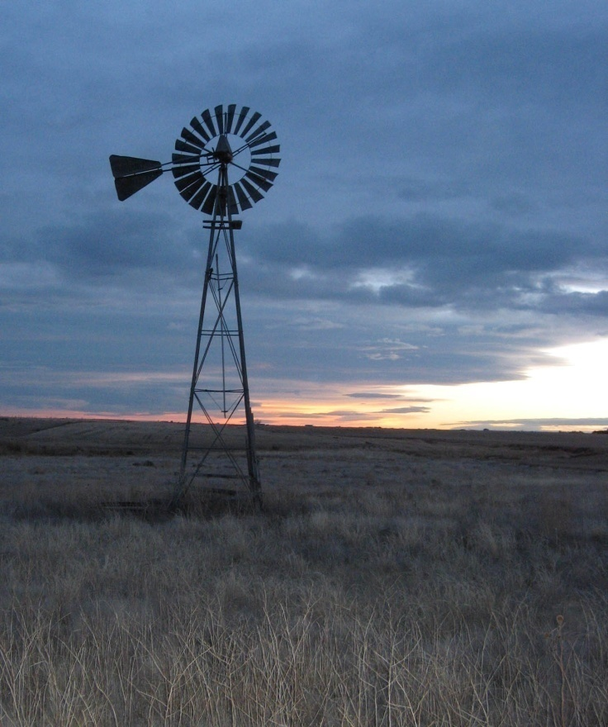
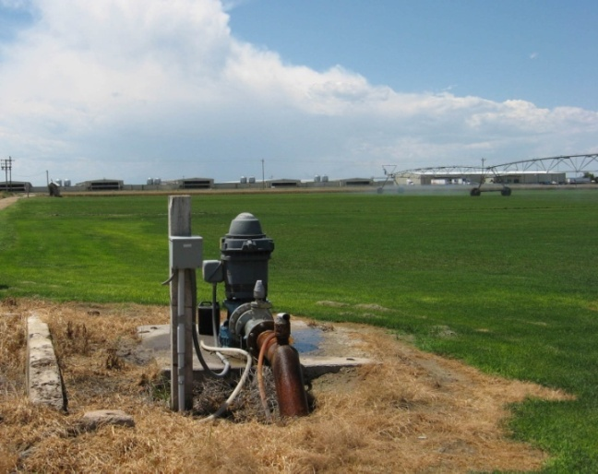
Lost Creek Basin Aquifer Recharge and Storage Study
Ralf Topper
– Colorado Div. of Water Resources
Nick Watterson
– Luhdorff & Scalmamini Consulting Engineers
http://water.state.co.us
Presented to:
2013 GSA Annual National Meeting
October 27, 2013
Notes:
Thank you for the opportunity to present this study at GSA’s 2013 Annual National meeting.
This study was conducted while I was employed by the Colorado Geological Survey.
I’d like to acknowledge my co-author, Nick Watterson, who is currently with Luhdorff & Scalmamini in California.
The Division of Water Resources website, water.state.co.us, is listed on this slide.

Slide 2

Notes:
The State of Colorado and stakeholders in all of it’s river basins have been diligently quantifying water demands and supplies for the past eight years through the Interbasin Compact Committee and Basin Roundtable process.
The population of the South Platte River Basin, which includes the Denver Metropolitan area, is expected to double by 2050, resulting in a supply shortfall of approximately 120,000 acre-feet.
In May of this year, Governor Hickenlooper issued an Executive Order directing the Colorado Water Conservation Board to develop the Colorado Water Plan.
READ ARROW SENTENCE.
Additional storage is one of the primary management strategies to address this shortfall. Though still complicated by Colorado’s water law system, the benefit and potential of storing water underground in alluvial aquifer systems is tremendous.

Slide 3
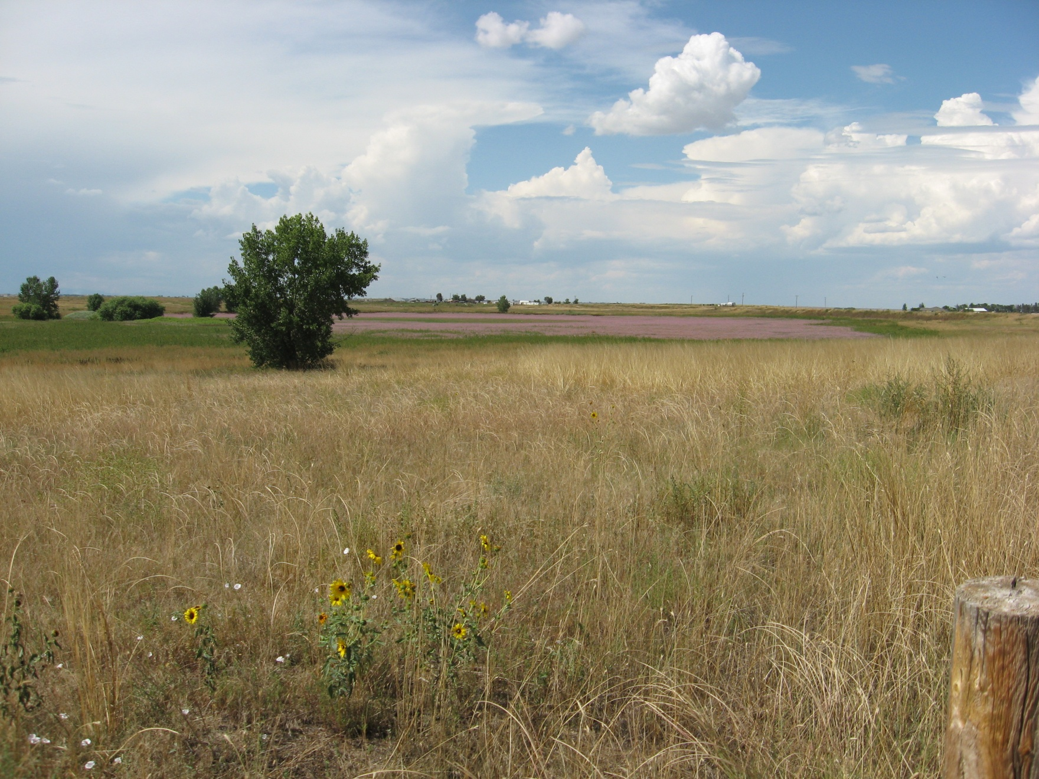
First documented artificial recharge project in South Platte River basin (1930s)
Olds Reservoir – August 2009
Notes:
The possibility of recharging the alluvial aquifer in the Lost Creek basin and storing water underground was recognized and implemented in the late 1930s at Olds Reservoir, a 450 acre-feet leaky storage reservoir in the central portion of the basin. A total of 30,000 acre-feet were recharged during the period from 1939 to 1959.
The primary goals of this study are to quantify the groundwater currently stored in the Lost Creek alluvial aquifer and the additional available storage capacity and also to identify potential sites for aquifer recharge and storage project implementation.
This objective was achieved through compilation and analysis of existing data, new field work and data collection, and utilization of GIS software for spatial analysis and display.

Slide 4
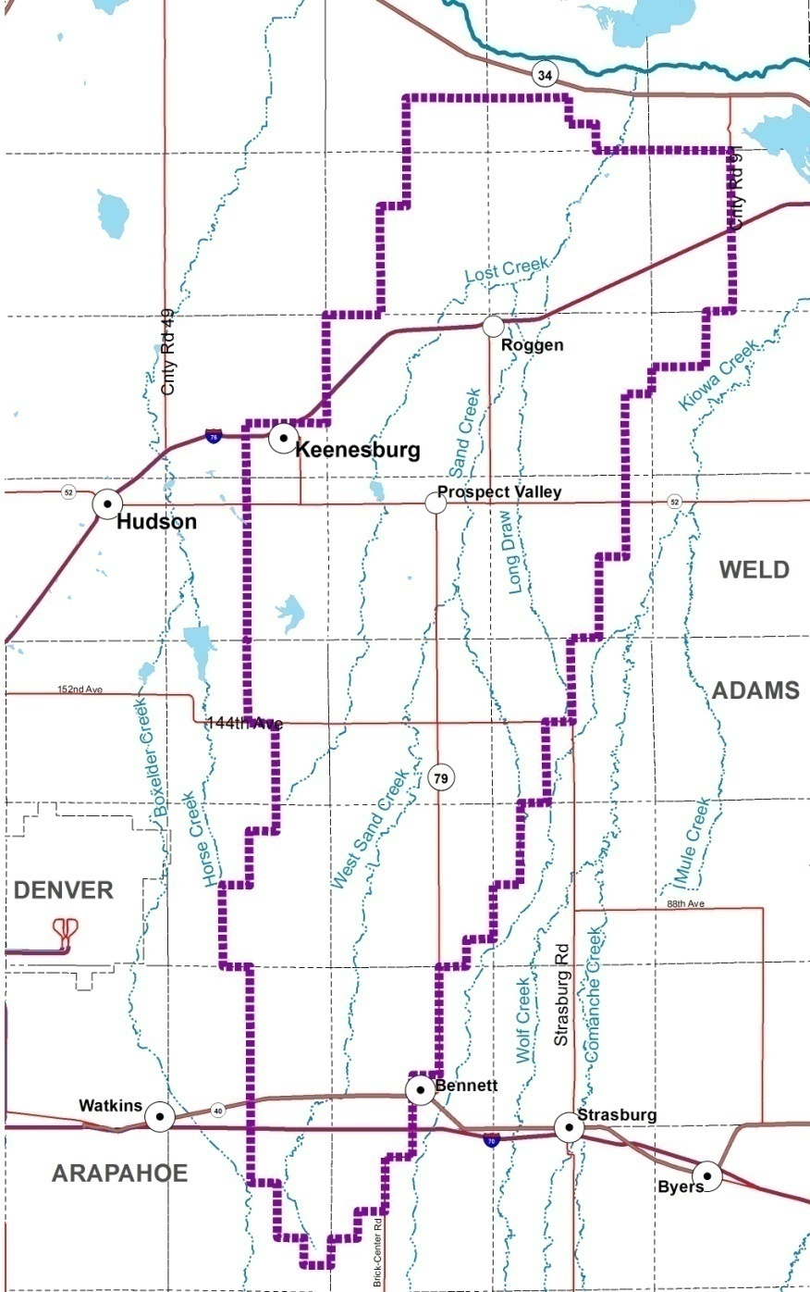
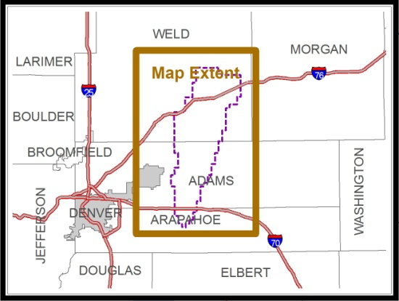
Lost Creek Designated Ground Water Basin
Established as a designated ground water basin in May 1968
Alluvial groundwater used for public water supply (municipal, commercial, domestic), stock watering, and agricultural irrigation.
277,000 acres (433 sq mi)
43 miles long N-S
Up to 14 miles wide (E-W)
Notes:
Water users in the Lost Creek basin rely heavily on groundwater from the alluvial aquifer for agricultural, domestic, and commercial uses. Early groundwater development first began in the 1930s and rapidly increased thereafter.
The climate of the basin is semi-arid, with precipitation ranging between 13-15 inches annually. All streams are ephemeral and flow only in direct response to excess precipitation.
Because the basin has no reliable surface water sources and water users are largely dependent on groundwater, the Colorado Ground Water Commission established the Lost Creek Designated Ground Water Basin in 1968 to enable management of this resource. Recently, the entire basin has been declared over-appropriated.
Aquifer recharge and storage is one mechanism for restoring groundwater levels and managing available water supplies.

Slide 5
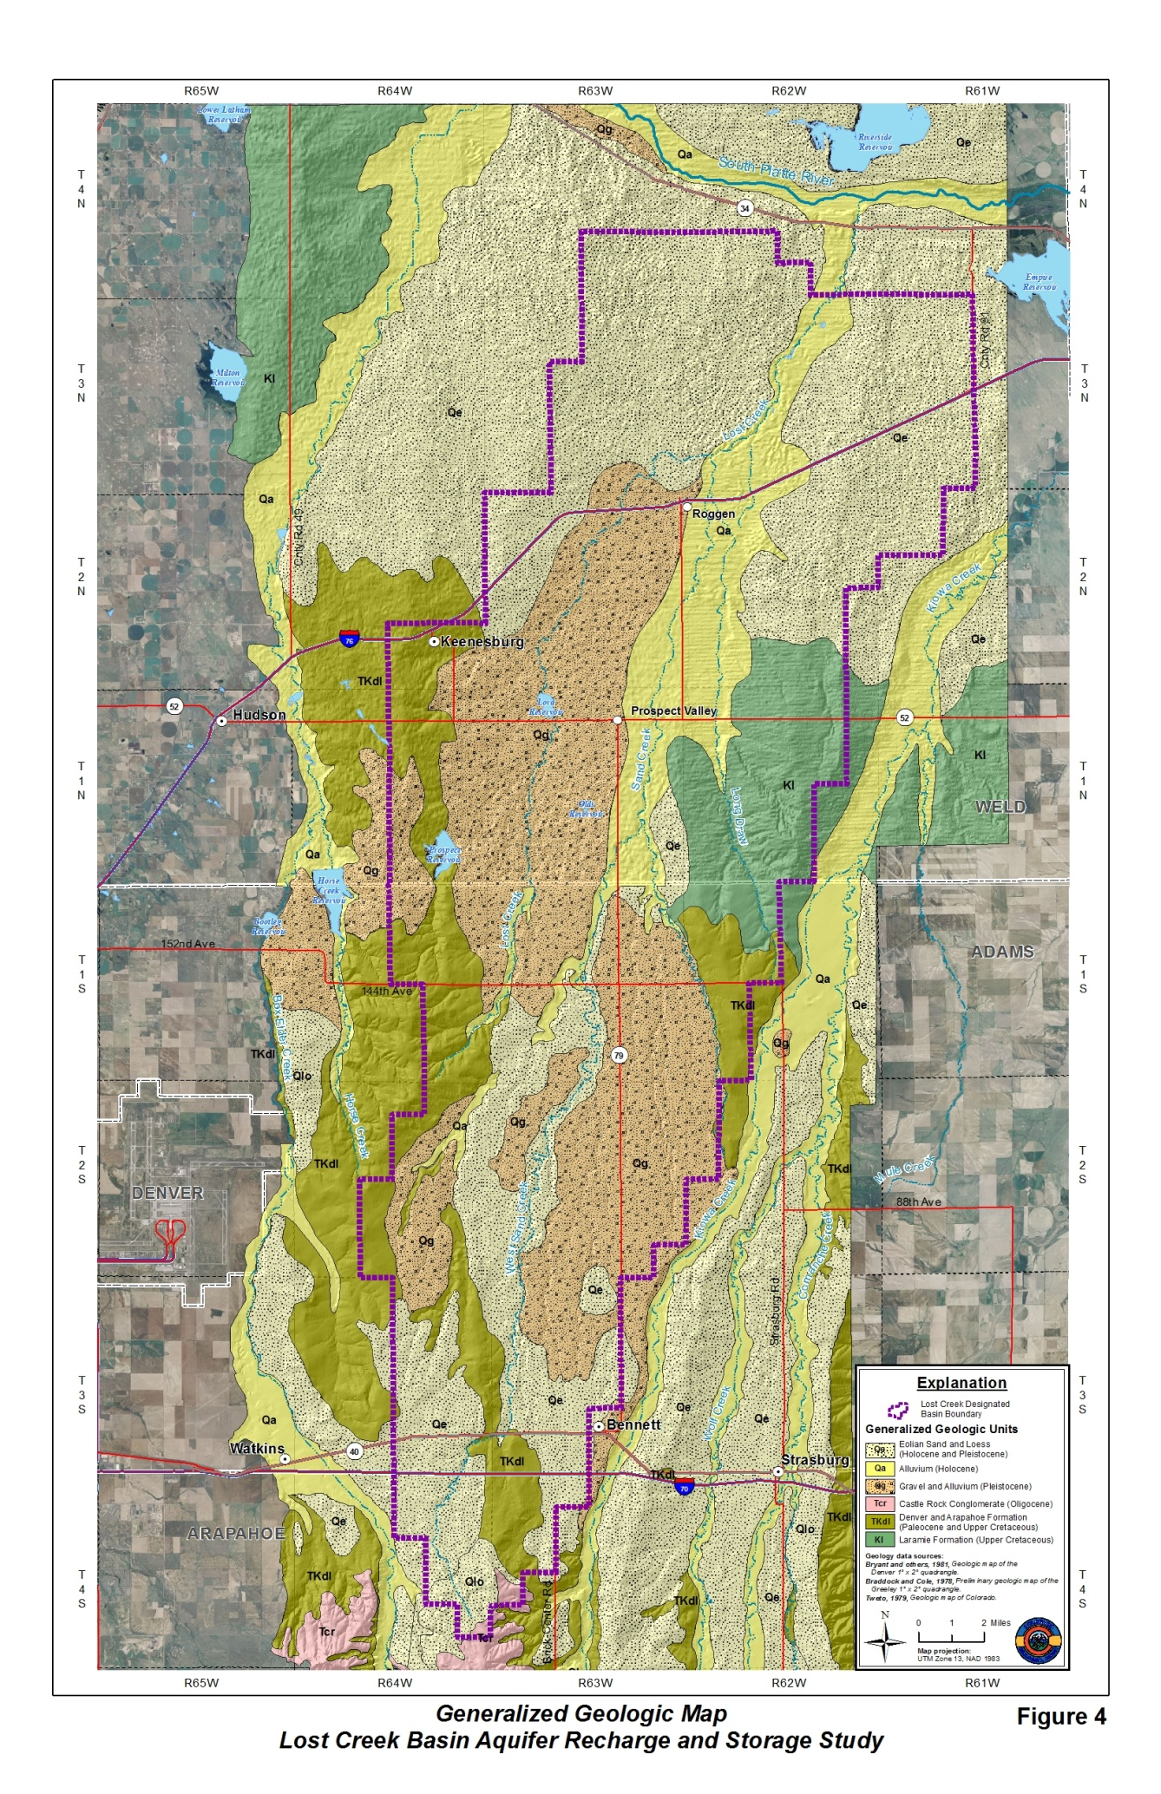
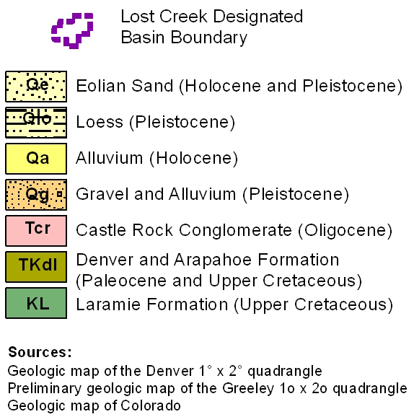
Geology of the Lost Creek Basin
Notes:
The Lost Creek alluvial aquifer consists of unconsolidated sand, gravel, silt, and clay of alluvial (deposited by moving water) and eolian (windblown) origin which overly bedrock sedimentary formations.
The alluvial channel is masked by the overlying older terrace deposits, loess, and eolian sands.

Slide 6
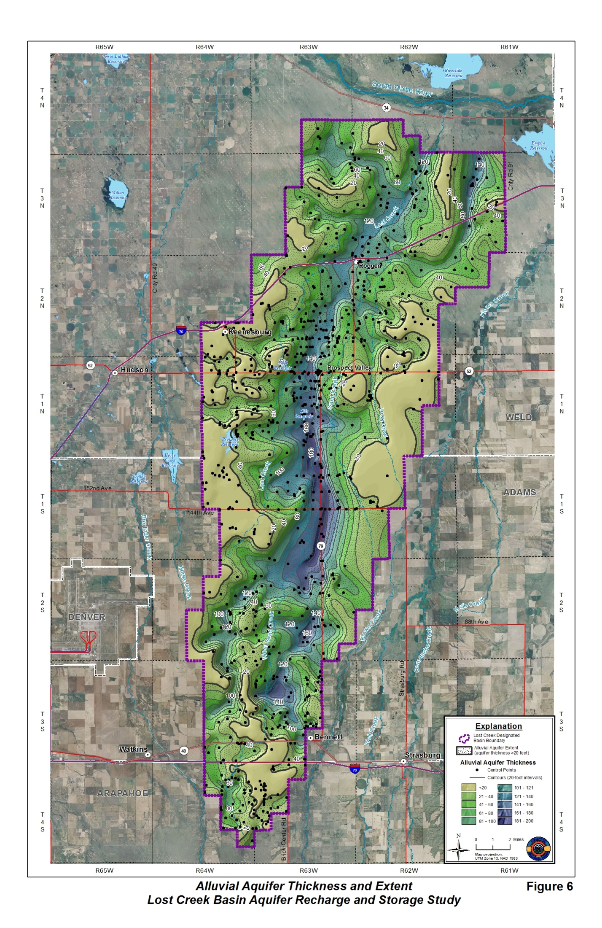
Alluvial thickness
and extent
Based on 1,102 control points, primarily geologic well logs
Interpreted from driller and core logs (DWR, USGS, Amoco, PowerCo, and CGS testholes)
20-foot thickness threshold used to define alluvial extent
Thickness ranging from ~120 to 187 ft along main alluvial aquifer “channel”
Notes:
Methodology from slide text.
The buried erosional surface of the top of the bedrock is characterized by a major north-south trending channel incised into the bedrock by an ancient river network and subsequently filled with alluvial material.
The deposits that make up the aquifer cover about 80 percent of the Lost Creek basin area. The alluvial aquifer is thickest, over 180 feet of material in places, in the central basin along the axis of the incised bedrock channel, and thins to the north and south and along the margins of the basin.

Slide 7
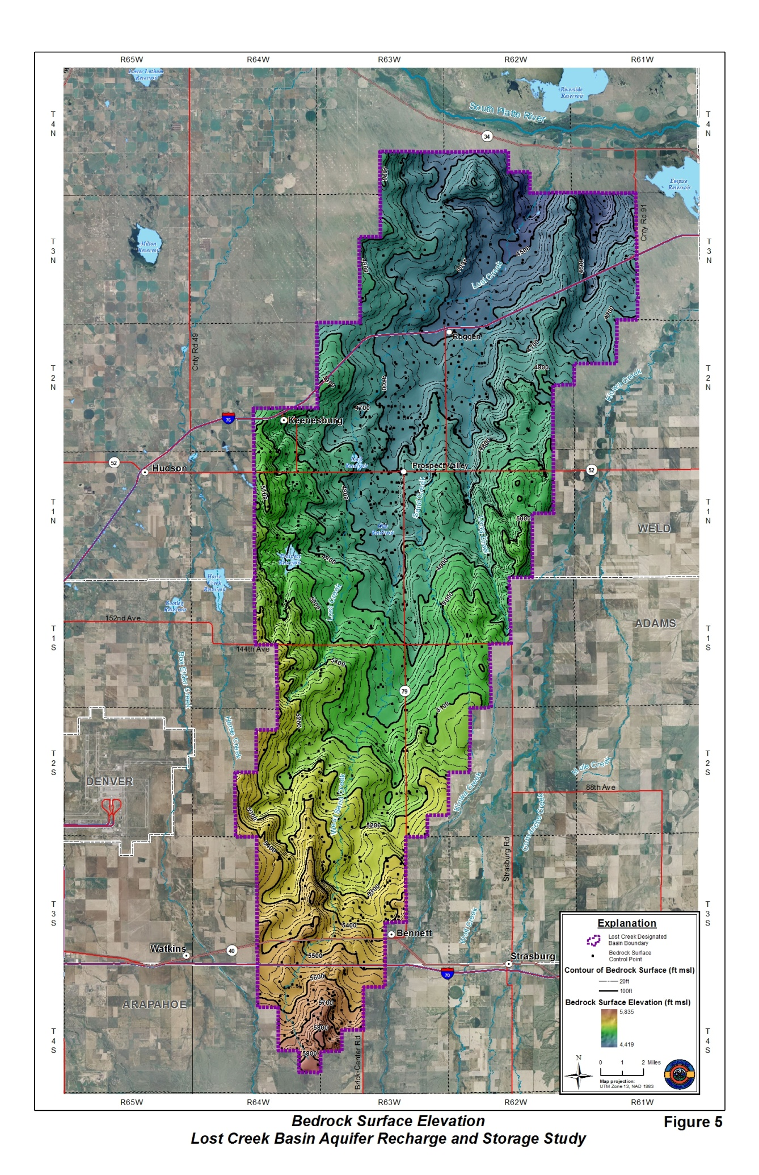
Bedrock structure
Generated by subtracting alluvial thickness from ground surface and re-contouring to the control points
Incised bedrock surface depicting paleo-valley and tributaries
Broader incised “paleo-valley” in central basin
Bedrock elevation range =
4420’ to 5835’; 1,415 feet of relief
Compared to 1,320 feet of relief in the surface topography
Notes:
We mapped the elevation of the bedrock surface in the basin using data from previous investigations and new data developed from corehole logs, test borings, and water well drillers' logs.
Lower elevations are shown in darker blues, while higher ones grade to orange hues.

Slide 8
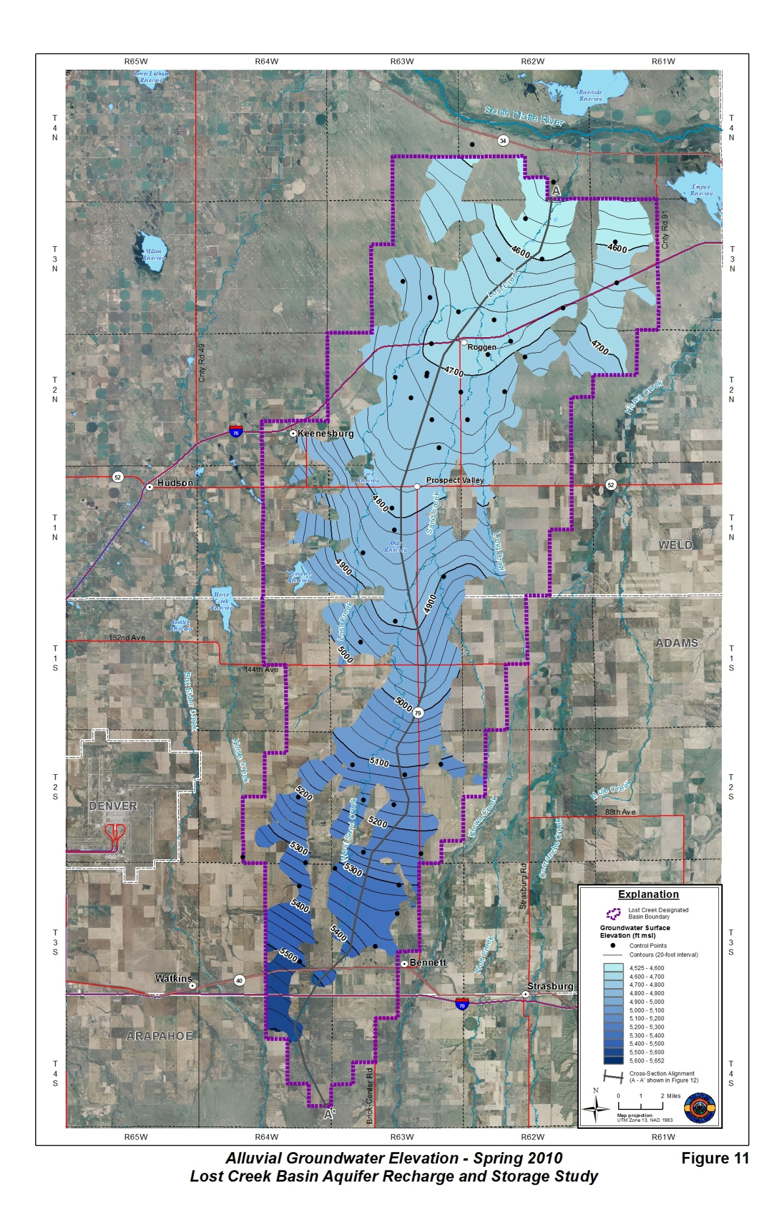
Water table surface
Interpreted for Spring 2010 (Mar-Apr)
Mimics shape of bedrock surface and topographic surface
Surface ranges from 5,600 to 4,540 feet or 1,060 feet of relief
Groundwater gradient varies by location
South – 35 ft/mi
Central – 15 ft/mi
North – 19 ft/mi
Average flow velocity = 0.5 mi/year (k=237ft/d; i=0.005; n=0.17)
Notes:
To better understand the seasonal operating characteristics of the groundwater reservoir, we collected water-level measurements from 45 wells during a 9-month period from July 2009 through April/May 2010.
Spring 2010 high water levels varied from very near the ground surface in the northern part of the basin to greater than 120 feet below ground in parts of the central and southern basin. Seasonal fluctuations between 5-12 feet in the heavily irrigated portions of the basin are not uncommon.
Using this new water level data, we mapped the alluvial water table throughout the basin.
The contour map of the Spring 2010 water surface indicates that groundwater flows from the edges of the basin towards the central alluvial aquifer channel and northward towards the South Platte River at an average flow velocity of between one-third to one-half mile per year.

Slide 9
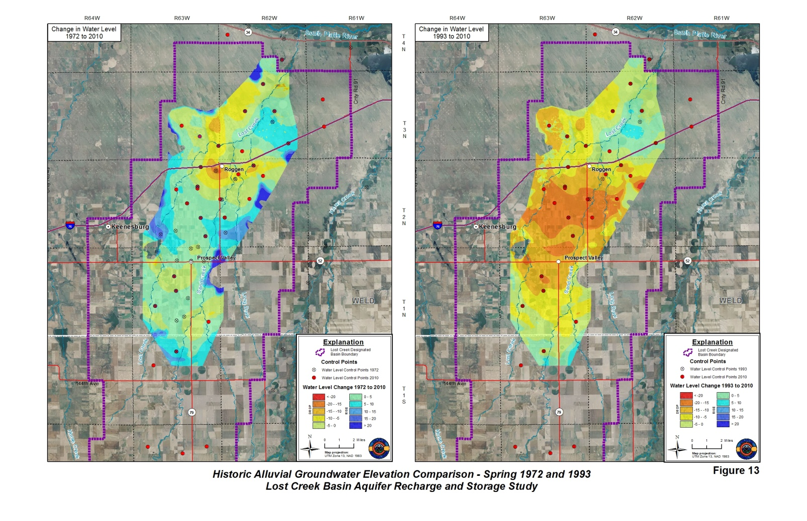
Historic groundwater level analysis
Description | Saturated Aquifer Area (acres) | Water in Storage¹ (acre-feet)
Current Groundwater Storage
Spring 2010 - Total Alluvial Aquifer (Primary + Hay Gulch and S. Platte Subareas) | 147,050 | 1,022,500
Spring 2010 - Primary Alluvial Aquifer | 132,296 | 927,700
Historic Groundwater Storage Comparisons
Spring 2010 - Comparison Subarea² |  | 606,500
Spring 1993 - Comparison Subarea² |  | 703,500
Spring 1972 - Comparison Subarea² |  | 596,300
Change 1972 to 1993 - Comparison Subarea² |  | 107,200
Change 1993 to 2010 - Comparison Subarea² |  | -97,100
Change 1972 to 2010 - Comparison Subarea² |  | 10,100
¹ Calculated using storage coefficient (specific yield) of 0.17 ² Subarea of the basin used to compare historic water level and storage changes
Low water table period (Spring 1972) High water table period (Spring 1993)
Notes:
Historic water level data were also compiled to quantify the changes of water in storage with respect to climate, surface water diversion, and groundwater pumping.
Groundwater levels were generally low in the 1970s and high in the 1990s, with differences of as much as 25 feet. Calculation of the historic saturated thickness, in the central and northern part of the basin, for Spring 1972 versus 1993 indicates that more than 100,000 acre-feet of water was added to storage in the alluvial aquifer during this period.
Clearly, the capacity of the Lost Creek basin alluvial aquifer to take water into or release water from storage has been demonstrated by both “artificial” and natural operations.

Slide 10
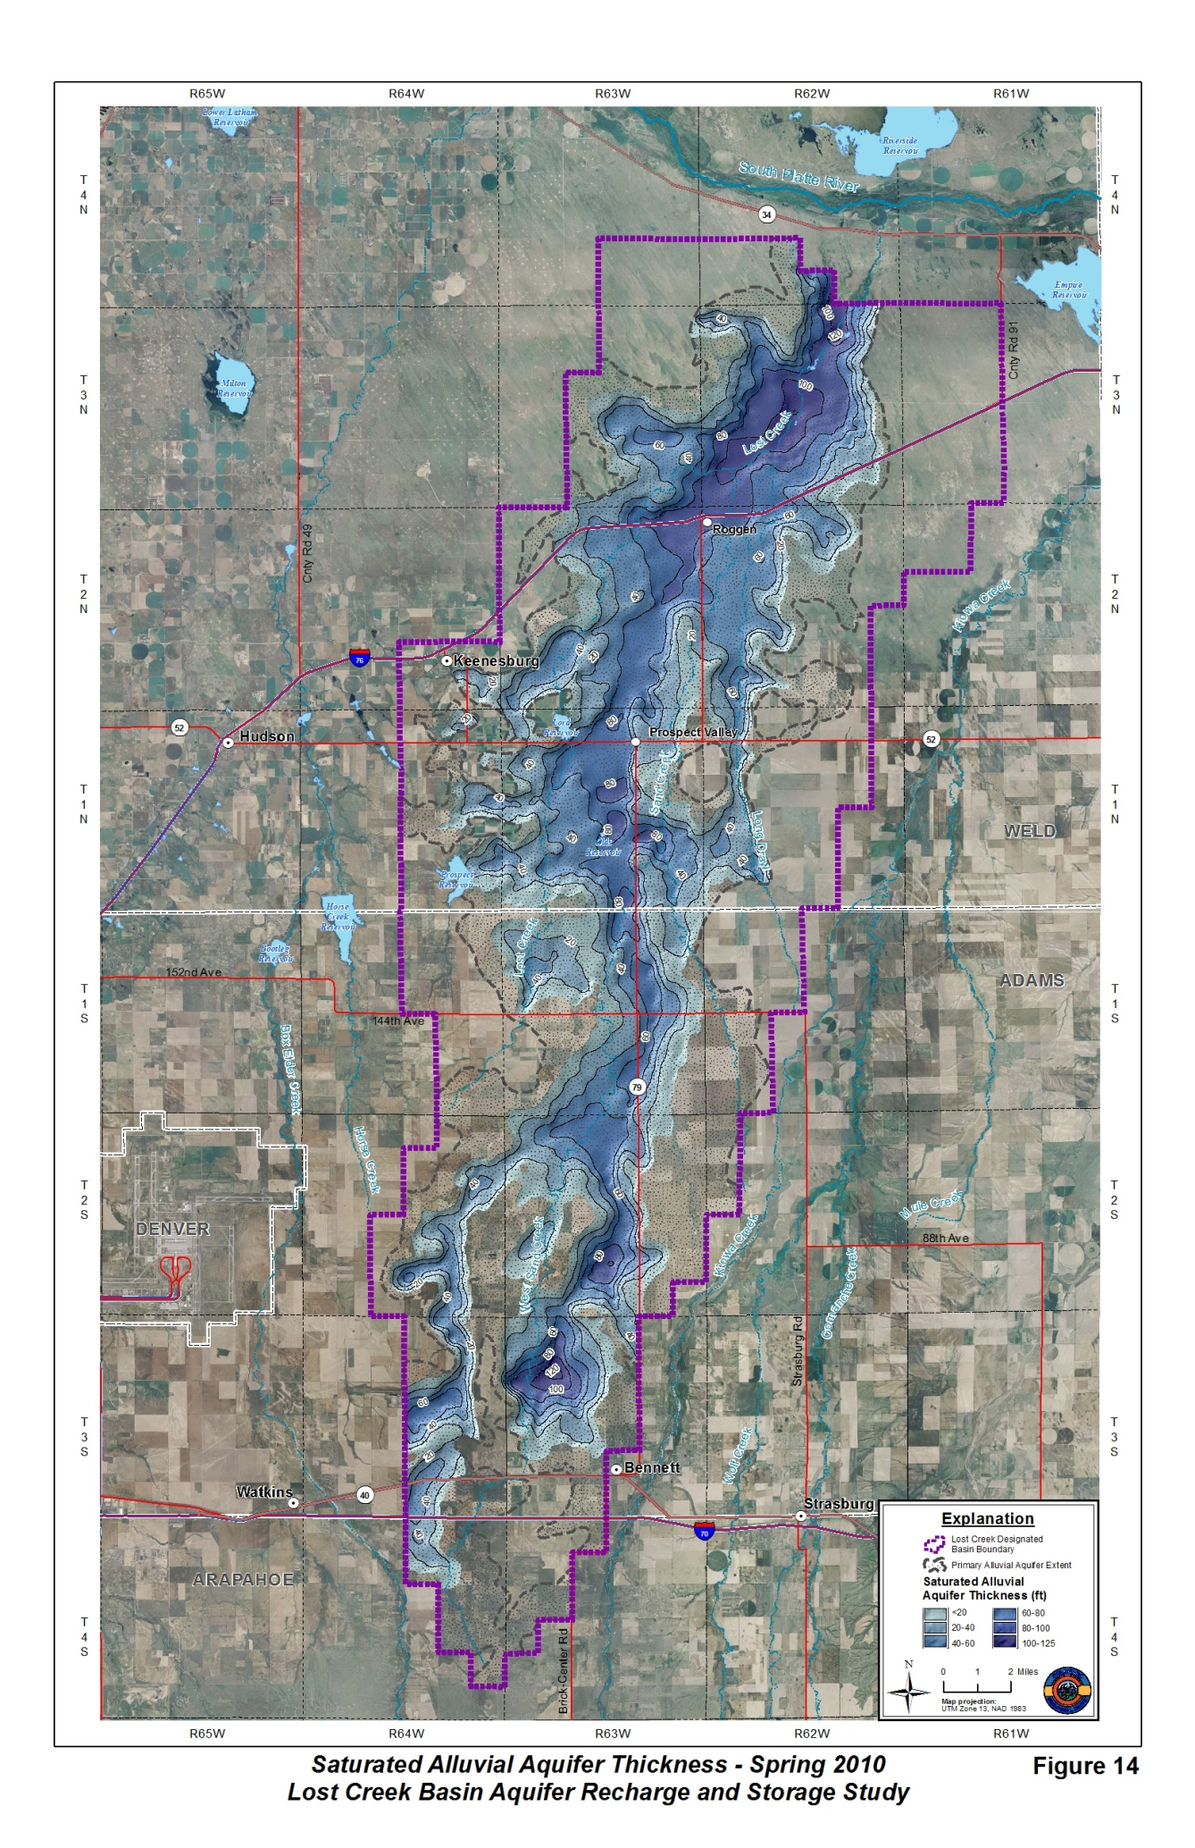
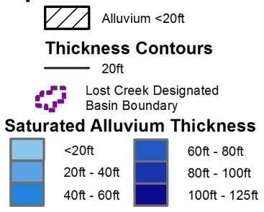
Saturated alluvial thickness
Difference between water table surface and bedrock structure
Notes:
The saturated thickness of the aquifer is the portion of the aquifer below the groundwater surface (water table). With the current water level data, we were able to quantify and map the saturated thickness of the alluvial aquifer, and consequently, estimate the amount of groundwater currently in storage within the aquifer.
The capacity for the aquifer material to store water in its pore space is represented by the specific yield. Using a uniform specific yield of 17% for alluvial aquifer materials throughout the basin, we estimate that 927,700 acre-feet of water is currently stored in the Lost Creek Primary alluvial aquifer.

Slide 11
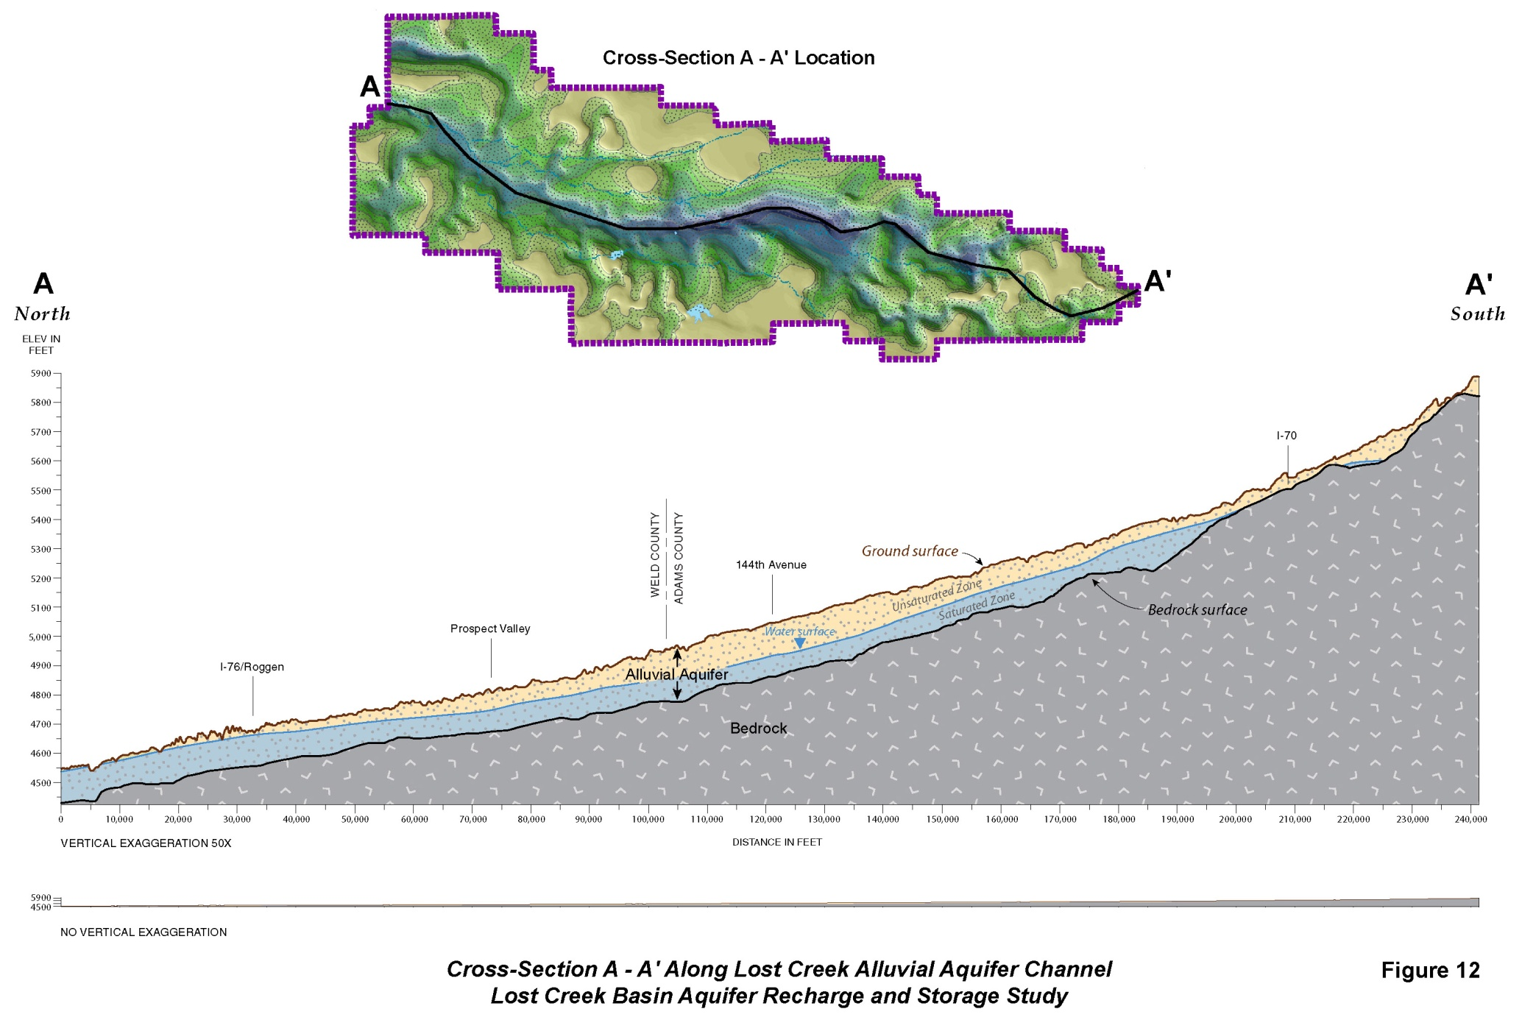
50x
Notes:
This cross-section along the main channel, magnified 50 times, provides a visual understanding of the saturated versus unsaturated portions of the aquifer.

Slide 12
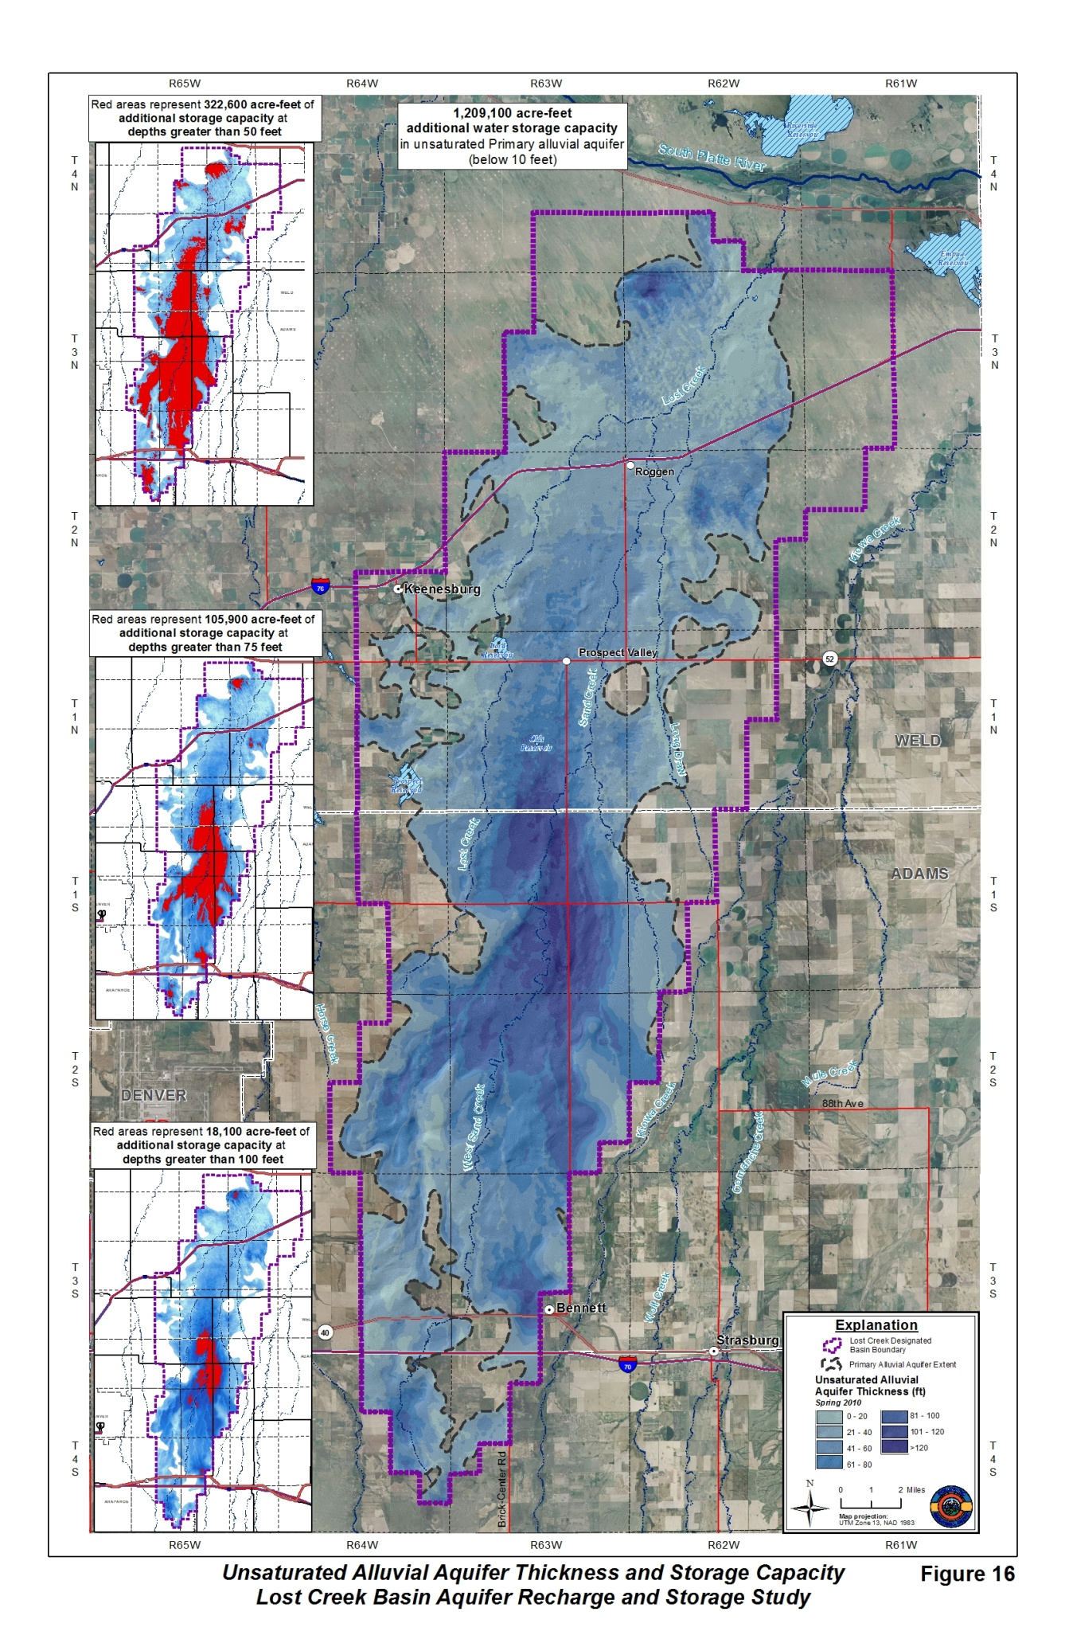
Unsaturated alluvial thickness
Areas that might be available for groundwater storage
Greatest unsaturated thickness in the south-central basin; thick alluvial deposits and low water levels
But where should the water go?
Notes:
The unsaturated portion of the alluvial aquifer provides the reservoir for storage of additional water in the empty aquifer pore space. The thickest area of unsaturated alluvial aquifer material is located in the central and southern part of the main alluvial aquifer channel.
Unsaturated alluvial aquifer thickness values range from zero to more than 120 feet with much of the Primary alluvial aquifer containing at least 40 feet of unsaturated thickness.
Discuss footprint of depth limiting.

Slide 13
Water in storage and available capacity
Notes:
Again, applying a uniform specific yield of 17%, we estimate the total available pore volume in the Primary alluvial aquifer to be 1,524,800 acre-feet.
Practically, however, to avoid basement flooding, surface discharge, and enhanced evapotranspiration, limiting the available storage space to below 10 feet of ground surface results in a potential storage capacity of 1,209,100 acre-feet.
Although in practice, not all of this volume may be used for additional water storage, about 322,600 acre-feet is available if water levels were raised to within 50 feet of the ground surface. Further limiting water level rises to the deeper unsaturated areas at depths greater than 75 feet produces an additional capacity of 105,900 acre-feet.

Slide 14
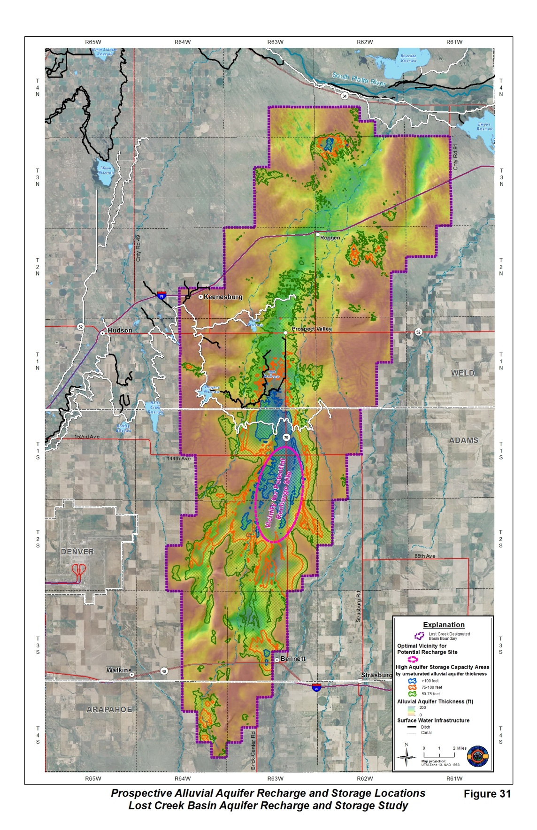
Prospective Recharge Areas
The most advantageous locations are likely in the southern parts of the basin where the unsaturated zone is thickest (>50 feet).
Specifically, areas south of, or in the vicinity of, the intersection of Highway 79 and 144th Avenue.
Here aquifer storage capacity is great, hydraulic conductivity appears high, and recharging in this area will also allow water to flow northward to sustain water levels and well pumping rates.
Notes:
Historic observations and testing indicate effective recharge of the alluvial aquifer is possible, and has been occurring, at Olds Reservoir and Lord Reservoir using surface spreading techniques.
Combined, Olds and Lord reservoirs have a potential to recharge a total of as much as 50 to 95 acre-feet/day of water into the Lost Creek alluvial aquifer (Code, 1945; Skinner, 1963; Arnold, 2010). In fact, observation wells adjacent to Olds Reservoir recorded a water level rise of as much as 45 feet during a 4.5-month recharge test in 1959 and 1960 (Skinner, 1963).
However, areas in the southern and central basin with the greatest unsaturated alluvial aquifer thickness represent areas of highest potential for implementation of aquifer recharge and storage projects.

Slide 15
Conclusions
Water users in the basin are reliant on groundwater from the alluvial aquifer for agricultural, domestic, and commercial uses.
Nearly 670 wells are completed in the alluvium with groundwater withdrawals exceeding natural recharge by 5,700 AF/yr.
The greatest accumulation of alluvial material follows an incised bedrock paleo-channel with thickness up to 180 feet.
Spring 2010 water levels range from near surface in the north to over 120 feet below ground in the south central portion of the basin.
As much as 120 feet of saturated alluvium underlies the northern part of the basin versus 60-80 feet in the south.
Additional storage potential exists, with the thickest unsaturated alluvium located in the central and southern part of the main channel.
An estimated 928,00 AF of groundwater is currently in storage with an additional maximum capacity of 1.2M AF.
Historic observations and artificial recharge tests indicate the aquifer has already experienced 100,000 AF of storage fluctuation.

Slide 16
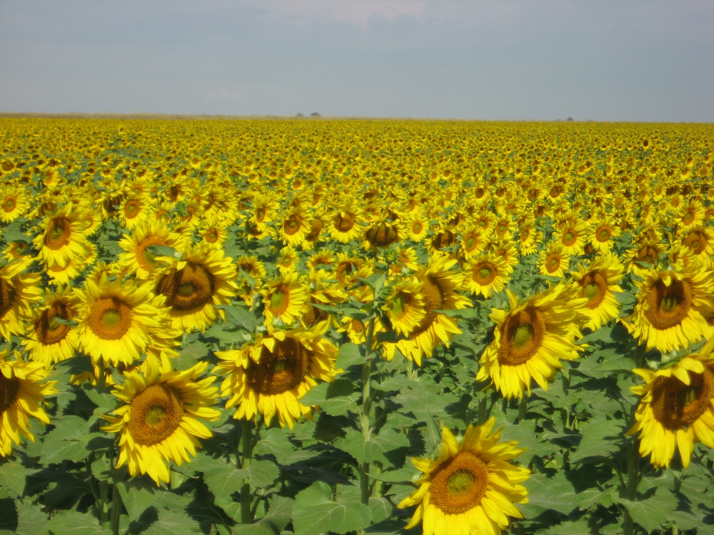
Thanks for Your Time and Attention
Questions?
Nick Watterson, nicholas.watterson@yahoo.com
Ralf Topper, (303) 866-3581, ralf.topper@state.co.us

