Slide 1
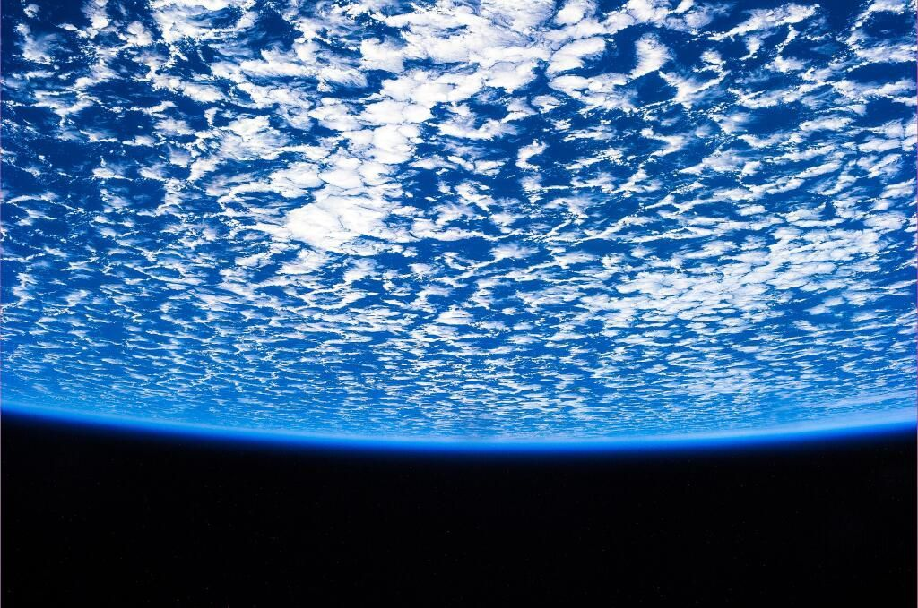
Grappling with Global Change:
The Pedagogical Challenge of the 21st Century
McCaffrey, M., Berbeco, M. (National Center for Science Education),
White, L. (UC Berkeley Museum of Paleontology), Stuhlsatz, M. (BSCS)

Slide 2
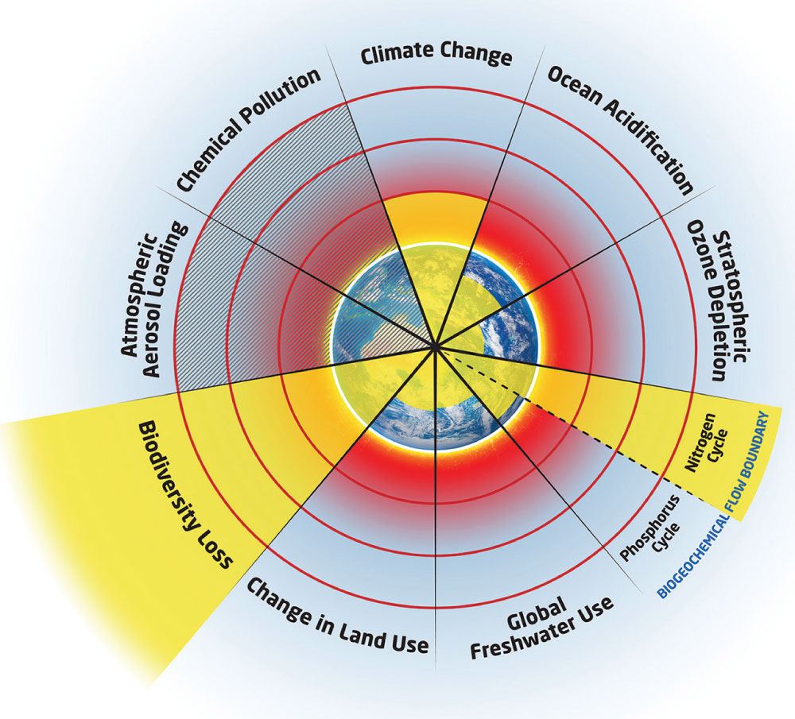
Planetary Boundaries
Source: IGBP-modified from Rockström et al. (2009).
Notes:
As one of the teachers we surveyed noted: “Climate change is only a small part in the big puzzle of global change.“

Slide 3




http://evolution.berkeley.edu/
Launched in 2004 as collaboration between UC Museum of Paleontology and NCSE
Averages 1.3 million page accesses a month during school year
5,000 to 15,000 page requests per month for Evolution in the News
http://undsci.berkeley.edu/
Understanding
Global Change
what we know and how we know it
In development- Launch of 2015
Notes:
QUOTE: I struggle with how to coordinate all of the information. There are so many pieces to the puzzle. What is the best order to teach everything? How does it make the most sense to the students? Also--it is hard to keep up with current data especially since there is so much junk out there. What are the best scientific website that I can trust AND that students can understand? Thank you for your work in this area!

Slide 4
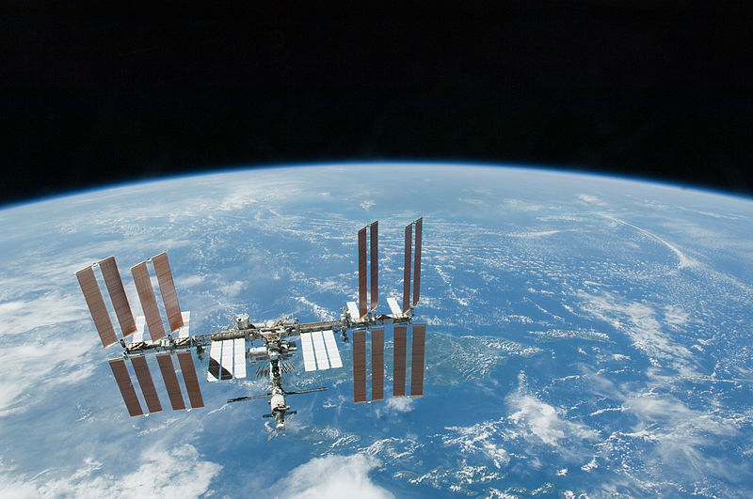
Global Change 101
Defining what is meant by global change
Describing past and present global change
Examine how human activities have become a "force of nature” impacting Earth's spheres and systems.
  Resulting biotic impact and responses
  Measuring and identifying causes of global change.
  A comparison of rates of change through time.
  How we know what we know.
Notes:
QUOTE: “Human records are very limited in the overall history of our planet, teachers should emphasize that the human race has only started to scratch the surface of the complex balance our planet is able to keep. Human impact is also limited.”
I'm disappointed that only one global change theory seems to be presented by the media. I seek to educate my kids about all the theories that are out there because real scientists ask questions from different angles about everything and I don't want my students to become mindless consumers of media.

Slide 5
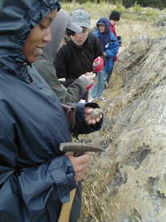
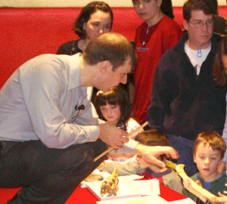
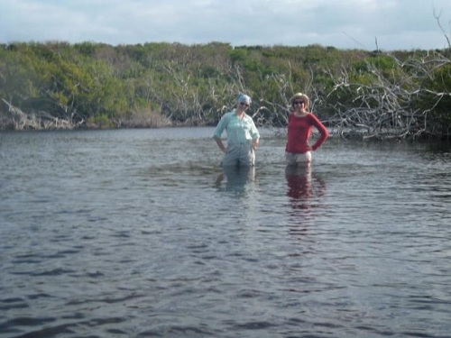
The Resource Library
Engaging interactives for multiple audiences
Research profiles on scientists engaged in global change research
Stories that provide a human dimension and help demystify the research process
SF Rocks
Charles
Marshall
Minda Berbeco

Slide 6
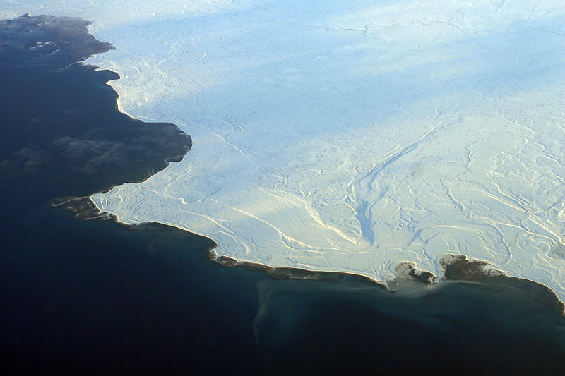
Timeline
Needs assessment (2013)
Advisory board meetings (2013)
Development of website(2013-15)
Workshop- Understanding Global Change (2014)
Summative evaluation (2015)
Dissemination (2015)

Slide 7
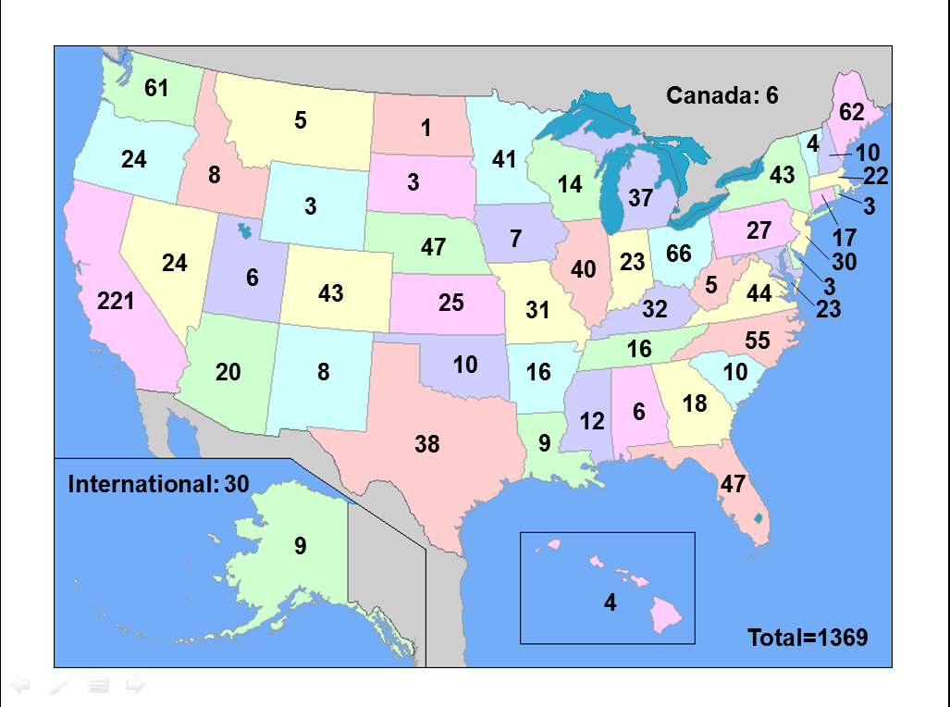
Needs Assessment
Notes:
“In my area of Kansas, climate change is being slowly accepted, but other students, teachers, and community members do NOT believe it is caused by man. They believe it is 'natural' - sun spots, etc. Climate change IS caused by CO2 build up in the atmosphere. The best scientists in the world have superb data to back that.”-
In Kansas climate change is a very difficult thing to "sell" to people . The thought that the same science that allows for blood transfusions, the same science that explains a combustion engine, the same science that explains all the chemical reactions that take place everyday - which is all very good solid science, is the SAME science that explains climate change. They don't LIKE it, so they don't believe it. It is very frustrating.

Slide 8
Notes:
Reported professional level: Two-thirds middle and high school, with a sizeable representation of higher ed and informal.

Slide 9
Notes:
Note: informal education is left out of this figure as this question was only asked of formal educators. Some educators may have answered more than one topic. Biology was strongly represented in high school and 2-year colleges.

Slide 10
Over half +10 years in current position
Notes:
More than half over 10 years!!

Slide 12
Notes:
This is not broken down by age group, as the age group breakdown basically shows same thing (see next slide). Note this is % by responses, not respondents: respondents may have answered more than once.

Slide 13
Notes:
This is broken down by age group.

Slide 14
Notes:
Well over half use the internet one a day or more to access resources.

Slide 15
Did your professional development on
Global Change include the following?
Climate or
Atmosphere
Oceans
Fresh
Water
Terrestrial
Arctic
Urban
Biodiversity
Notes:
Nearly 90% have had PD on climate or atmosphere while fewer than half had PD about fresh water and only about a third about urban enviroments.

Slide 16
Climate or
Atmosphere
Oceans
Fresh
Water
Terrestrial
Arctic
Urban
Biodiversity
Notes:
These are respondents who answered yes (a little and a lot)- around 90 to 95%
QUOTE I find it disappointing that I have colleagues in my own department (mainly meteorologists) who avoid teaching climate change in substantive ways. They tend to broadcast the message that, "since we cannot accurately forecast the weather more than 48 hours out, how can we possibly predict coming climate?" I fear for students who are indoctrinated in their courses

Slide 17
Only 9.8% report being encouraged NOT to teach about climate change
Parents Students Administrators
Other
Teachers
Community
Members
Notes:
Only 9.8% of respondents reported being encouraged to NOT teach about climate change. (Less than 10%)-
QUOTE- The National Center For Science Education is a significant problem to those attempting to teach climate change science because it has politicized the subject. The scientific community's attempts to impose a narrow point of view on science undermines the efforts of teachers to function in the science classroom. The public's declining faith in climate change science and the scientific community's integrity are a direct and appropriate consequence of this politicization. Take this as advice from an environmentalist....cut the political attacks on those who disagree with you or find yourselves removed from the discussion!

Slide 18
Notes:
Broken down by age group, note 2 and 4 year colleges are combined. This is % based on total responses, not # of respondents. Overall there were 194 responses total.-
Middle and high school– about half were parents and students, but in colleges, more than half were other teachers.
QUOTE: I find it disappointing that I have colleagues in my own department (mainly meteorologists) who avoid teaching climate change in substantive ways. They tend to broadcast the message that, "since we cannot accurately forecast the weather more than 48 hours out, how can we possibly predict coming climate?" I fear for students who are indoctrinated in their courses.
I teach at a very conservative school. The kids take my course as an elective and really get to understand climate change. Students who do not take my course see climate change as a political issue. When I wanted to have ACE talk at my school, they felt it would be better targeted at the ECO group than at the whole School. Our director of sustainability does not "believe in" climate change. Very frustrating!

Slide 19
Parents Students Administrators
Other
Teachers
Community
Members
Notes:
We did not ask how many people were encouraged to teach both sides.
QUOTE- After looking at the evidence myself, scientists have not shown a convincing link between human behavior and climate change. The earth has been undergoing climate change for millions of years. A 1.5 degree increase over the last 150 years is nothing to freak out about. 60 million years ago the earth's oceans were almost 20 degrees warmer than they are now.”
“During a conference for students a (supposed scientist was trying to convince [us] that current change has MAINLY natural causes”

Slide 20
Notes:
Broken down by age group. Again based on responses not respondents (for %). Keep in mind survey size is small, only 93 responses overall.
QUOTE: “I feel it is important to look at both sides of the argument so that the overwhelming data behind climate change seems obvious, and correct.”
“I believe learning about both sides and making an educated opinion based on an individuals own gathering of information is something that I try to instill in all of my students!!”
“I believe learning about both sides and making an educated opinion based on an individuals own gathering of information is something that I try to instill in all of my students!!”

Slide 21
Notes:
Did not breakdown by age group, because all age groups were basically the same. This was based on percent of responses overall, not respondents

Slide 22
Notes:
Did not breakdown by age group, because all age groups were basically the same. This was based on percent of responses overall, not respondents. In other words, people checked almost all the boxes, but learning about teaching resources was slightly of more interest than learning teaching strategies.

Slide 23
Notes:
90 to 90% think learning about climate change is important or very important.

Slide 24
Informal
Education
Four-Year
Colleges
Two-Year
Colleges
High School
Middle School
Notes:
Global change about the same, even a little higher…97% in higher education

Slide 25
Informal
Education
Four-Year
Colleges
Two-Year
Colleges
High School
Middle School
Notes:
From high of 75% who agree or strongly agree in informal to about two thirds of middle, high school and two-year colleges

Slide 26
Informal
Education
Four-Year
Colleges
Two-Year
Colleges
High School
Middle School
Notes:
From high of 87% in four-year colleges who agree or strongly agree to 69% and 67% in middle and high school

Slide 27
Observations
Interest is strong in global change topics but content knowledge often lacking.
Presenting “both sides” is less prevalent than prior surveys but still an issue.
Some teachers themselves doubt climate change or are concerned that it is highly politicized.
Plenty of work to be done!
Understanding
Global Change
what we know and how we know it
Notes:
QUOTE:
After looking at the evidence myself, scientists have not shown a convincing link between human behavior and climate change. The earth has been undergoing climate change for millions of years. A 1.5 degree increase over the last 150 years is nothing to freak out about. 60 million years ago the earth's oceans were almost 20 degrees warmer than they are now.
The National Center For Science Education is a significant problem to those attempting to teach climate change science because it has politicized the subject. The scientific community's attempts to impose a narrow point of view on science undermines the efforts of teachers to function in the science classroom. The public's declining faith in climate change science and the scientific community's integrity are a direct and appropriate consequence of this politicization. Take this as advice from an environmentalist....cut the political attacks on those who disagree with you or find yourselves removed from the discussion!

