Slide 1
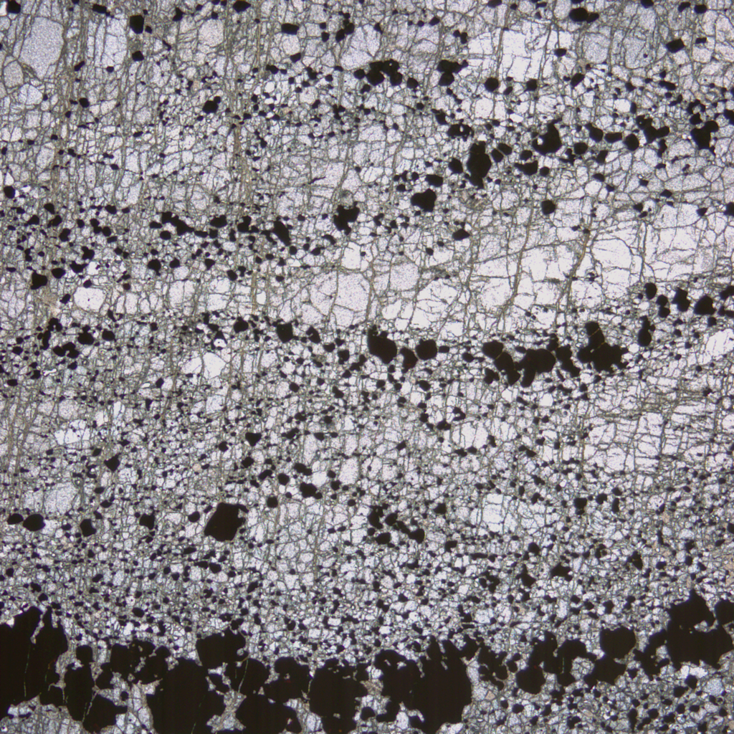

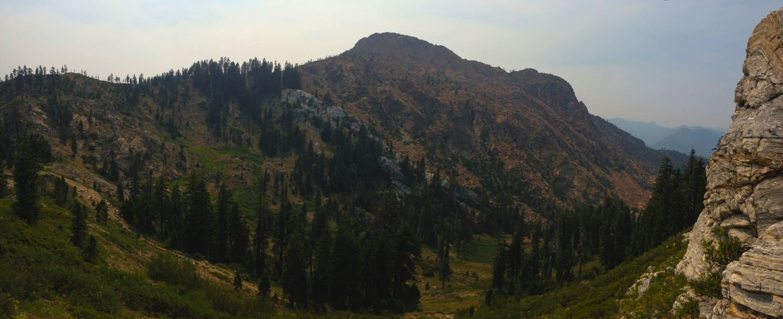
Crustal-scale detachment within an accretionary setting, Seiad complex, Rattlesnake Creek terrane, Klamath Mountains
Z. Michels, B. Tikoff, L. G. Medaris, Jr.
University of Wisconsin – Madison
Notes:
Tell you about a detachment that was active during in the deep crust during construction of the Klamath Mtns geological province and discuss how we plan to exploit the geologic setting to constrain some… (larger scale long term questions)

Slide 2
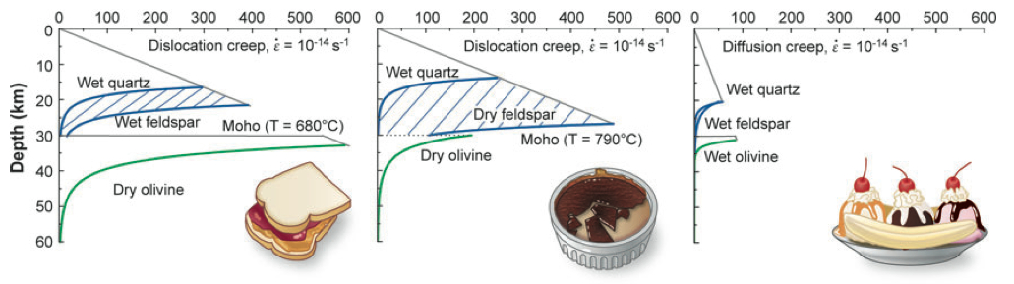
Long-term goals of the research
How variable is the strength architecture of the lower crust in accretionary settings?
How does the relative rheology of mechanically distinct materials at depth influence the development of convergent margins and continental growth?
?
?
?
?
After Bürgmann and Dresen (2008)
Notes:
How heterogeneous is strength in the lower crust in an accretionary margin? At what scales? How do contrasts in strength over different scales potentially relate to bulk mechanics in convergent margins and continental growth?

Slide 3
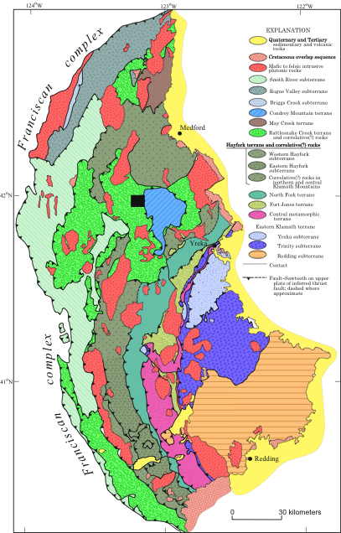
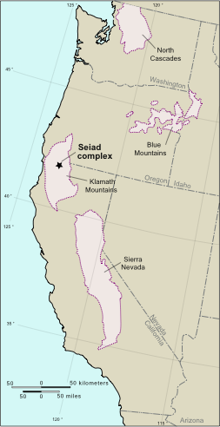
Tectonic Setting
RCT ~164 Ma
younger
older
Western US
Adapted from King (1970)
Klamath Mtns
Modified after Irwin (1994), and Snoke and Barnes (2006)
Notes:
Klamath mtns geological province. Map shows belts of variably metamorphosed and deformed tectonostratigraphic terranes that were successively assembled from East to West, from Early Paleozoic to Jurassic times. 164 Ma = metamorphism in RCT

Slide 4
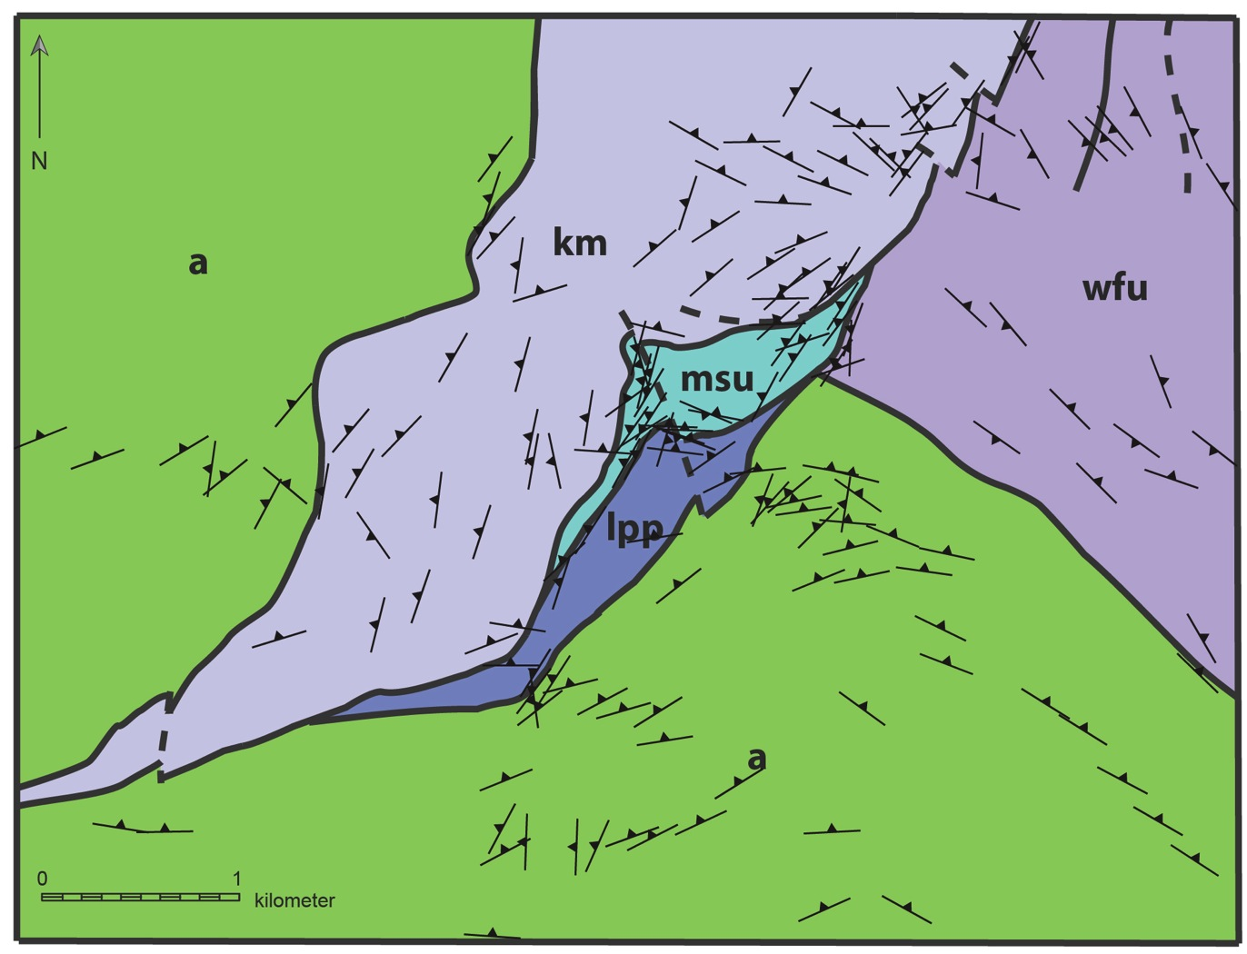
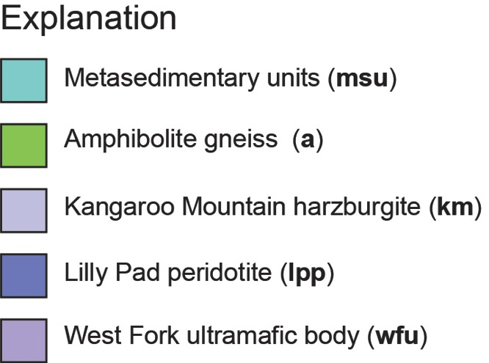
Seiad Complex
Higher T
Lower T
detachment strike
Notes:
Quickly give you some broad context for the rocks and relationships we now understand about the Seiad complex.
TRUNCATED KMP and WFU fabrics at MSU contact.

Slide 5
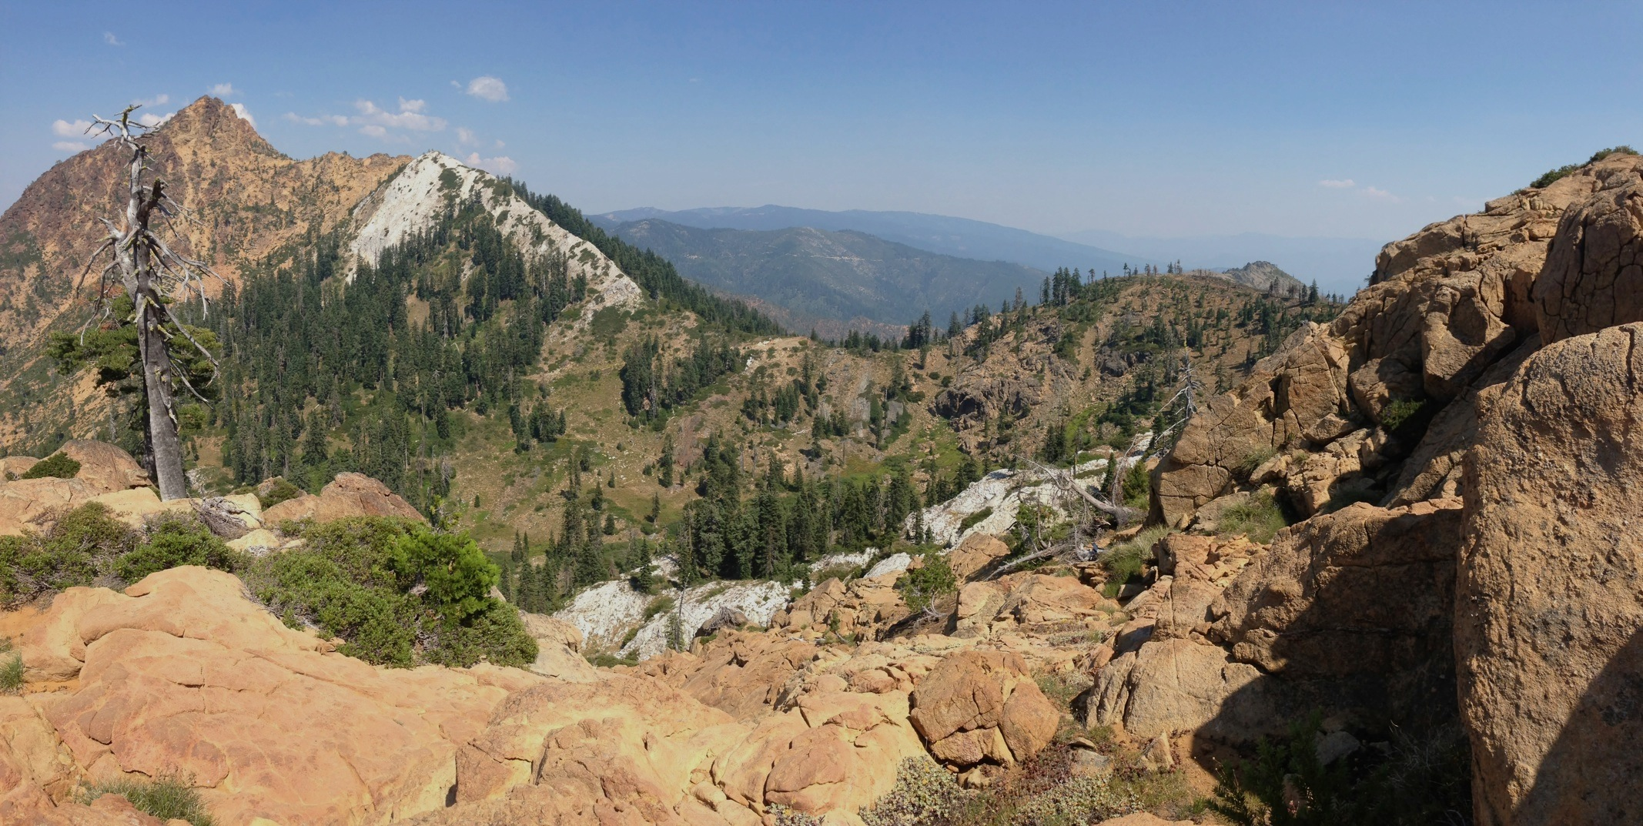
Field Photo
Notes:
Looking Eastish.

Slide 6
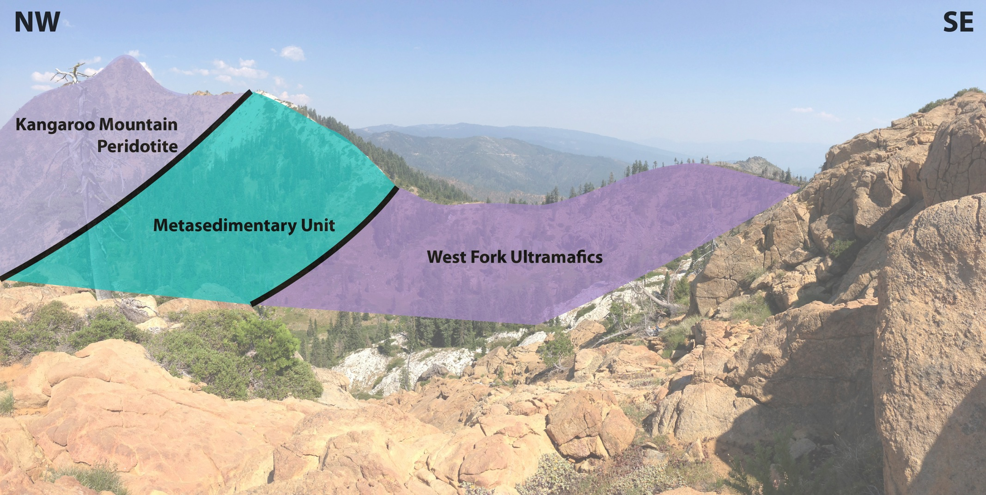
Field Photo
upper detachment surface
Notes:
A couple models have been previously suggested to explain the geometry of contacts and mesoscopic fabrics (foliation, lineation)

Slide 7
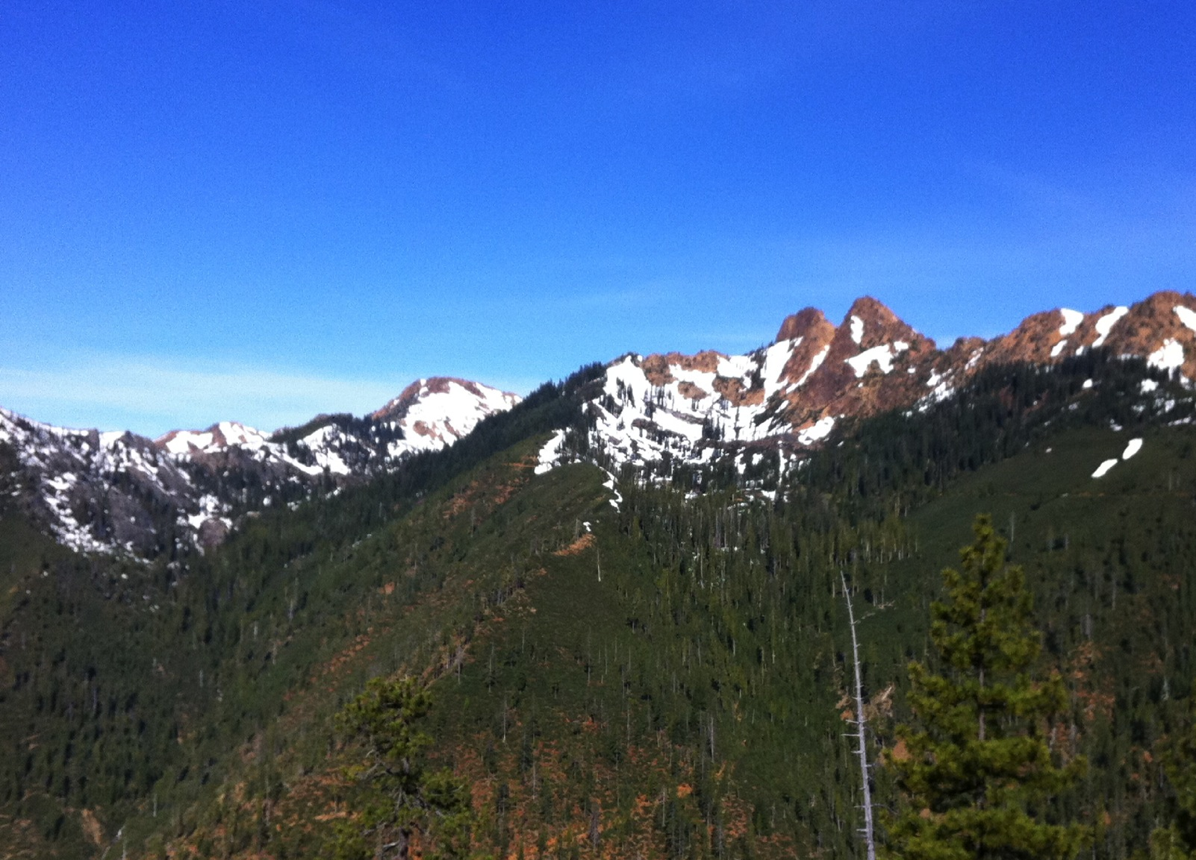
Looking west

Slide 8
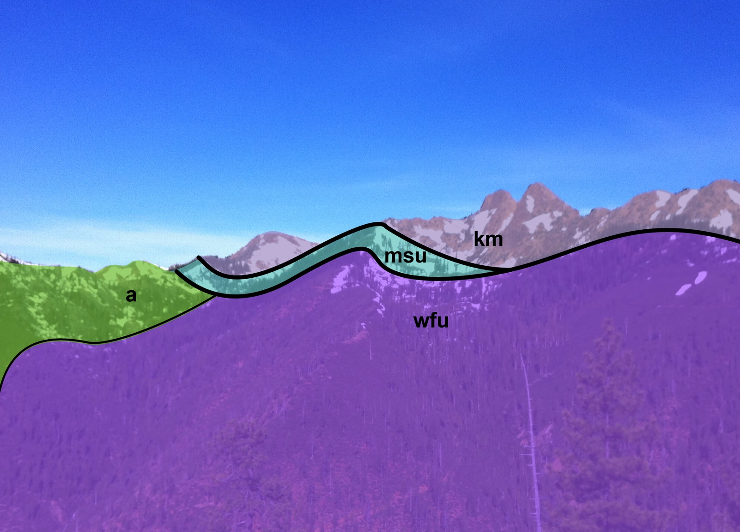
Looking west
upper detachment surface
Notes:
Detachment is partly localized in a lens of metasedimentary unit, but also

Slide 9
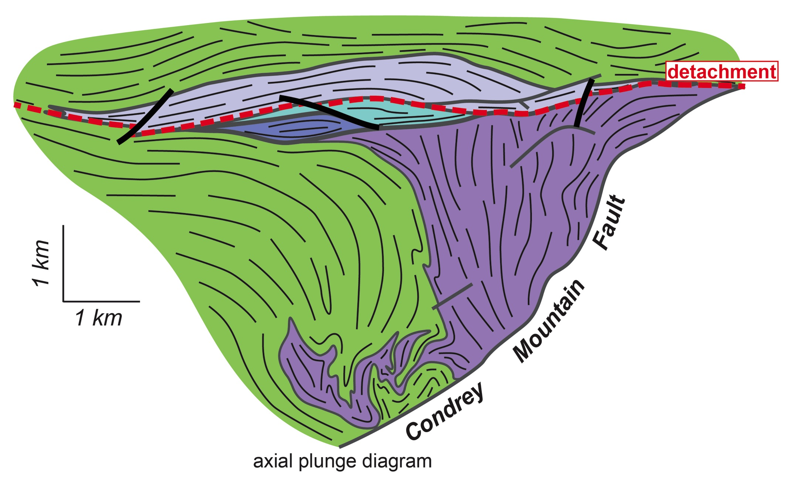
Seiad Architecture
SW
NE
Relict mantle fabrics that survived obduction and burial
km
msu
Highly strained marbles, quartzites, metavolcanics
wfu
a
Ultramafic rocks that were penetratively deformed
Notes:
A more useful perspective into the Seiad ultramafic complex viewed as along the axial plunge of late folds… showing the detachment, and fabric relationships that reflect the different behavior of the rocks during deformation, that I guess I would characterize as domainal rheology over the kilometer scale.
The next few slides attempt to summarize some of the main differences.

Slide 10
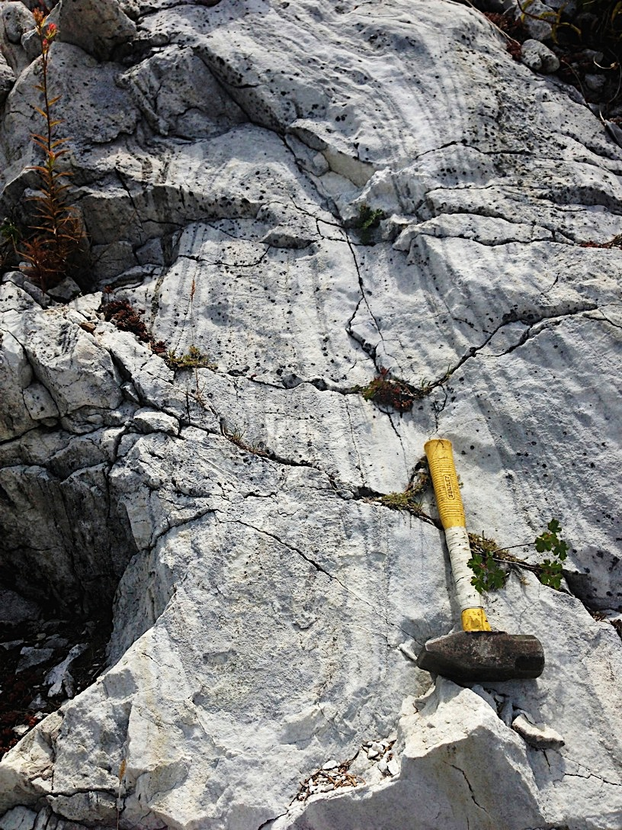
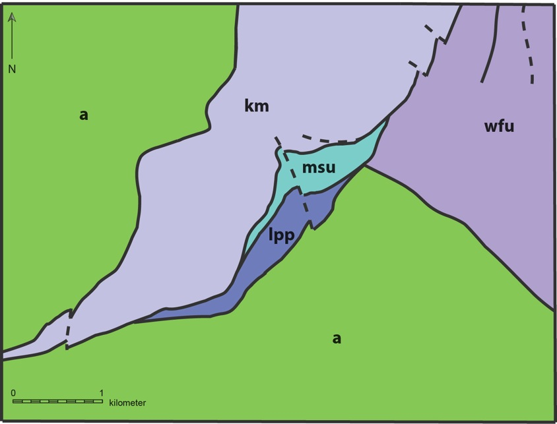
High strain indicators
Sheath folds in marbles
detachment strike
Notes:
The detachment is defined by an approximately 60m-thick high-strain zone, that is locally best recognized by the high-strain fabric features present in the marble and calc-silicate rocks.
With asymmetries that provide good (and fairly consistent) kinematic indicators.

Slide 11
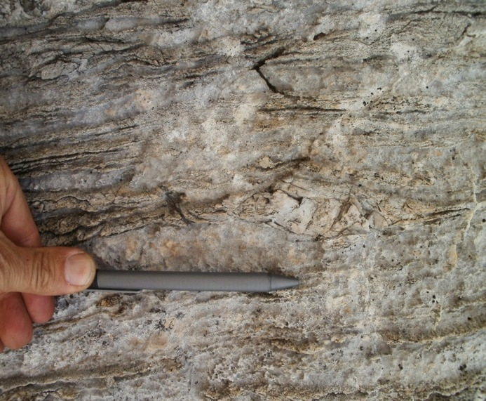
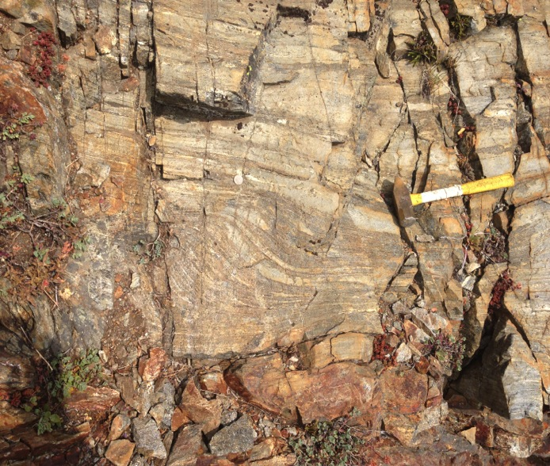
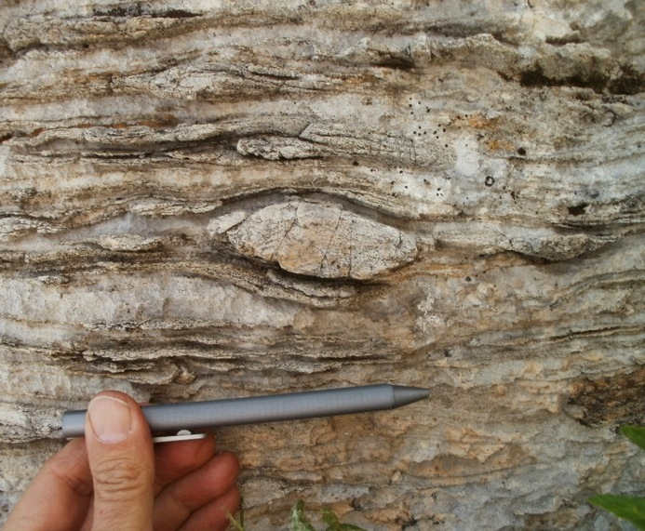
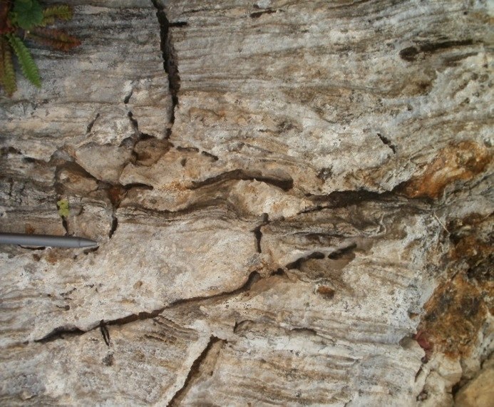
Top-to-SE Kinematic indicators
SE
NW
Notes:
The metasediments contain a wealth of asymmetric features that fairly consistently record Top-to-SE kinematics.

Slide 12
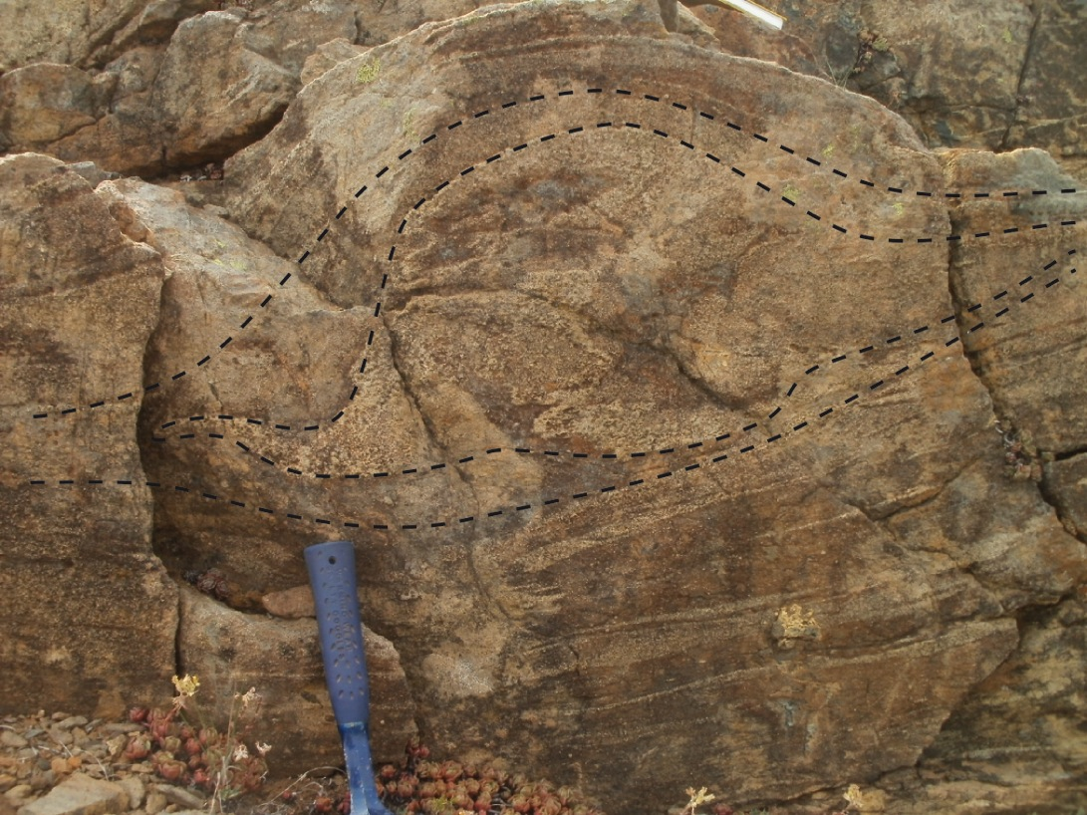
High strain indicators
Elsewhere along strike…
Sheath folds in Peridotites
detachment strike
Pyroxenite bands in peridotite
Notes:
In case

Slide 13
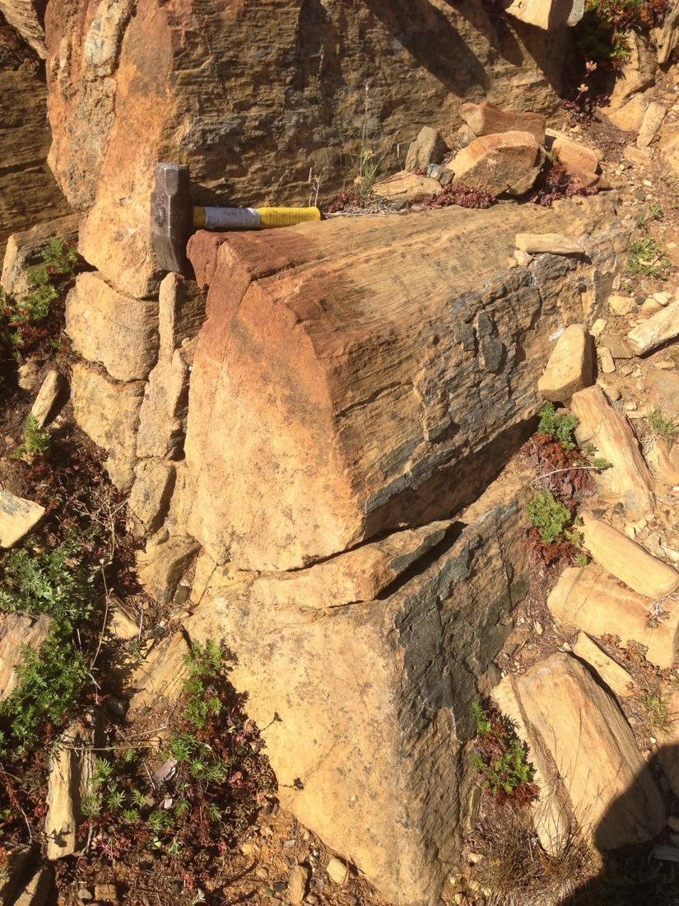
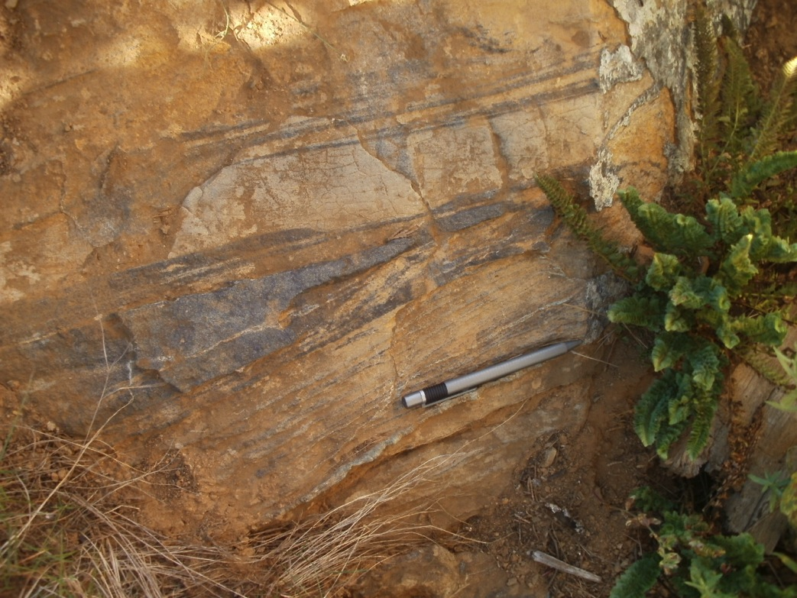
West Fork body
Pre-existing fabrics transposed and obliterated in lower peridotite body
Notes:
And, although we only observed sheath folds in the peridotites along the detachment zone… in general… Any pre-existing fabrics in the lower peridotite body have been highly transposed and obliterated during lower crustal flow.

Slide 14
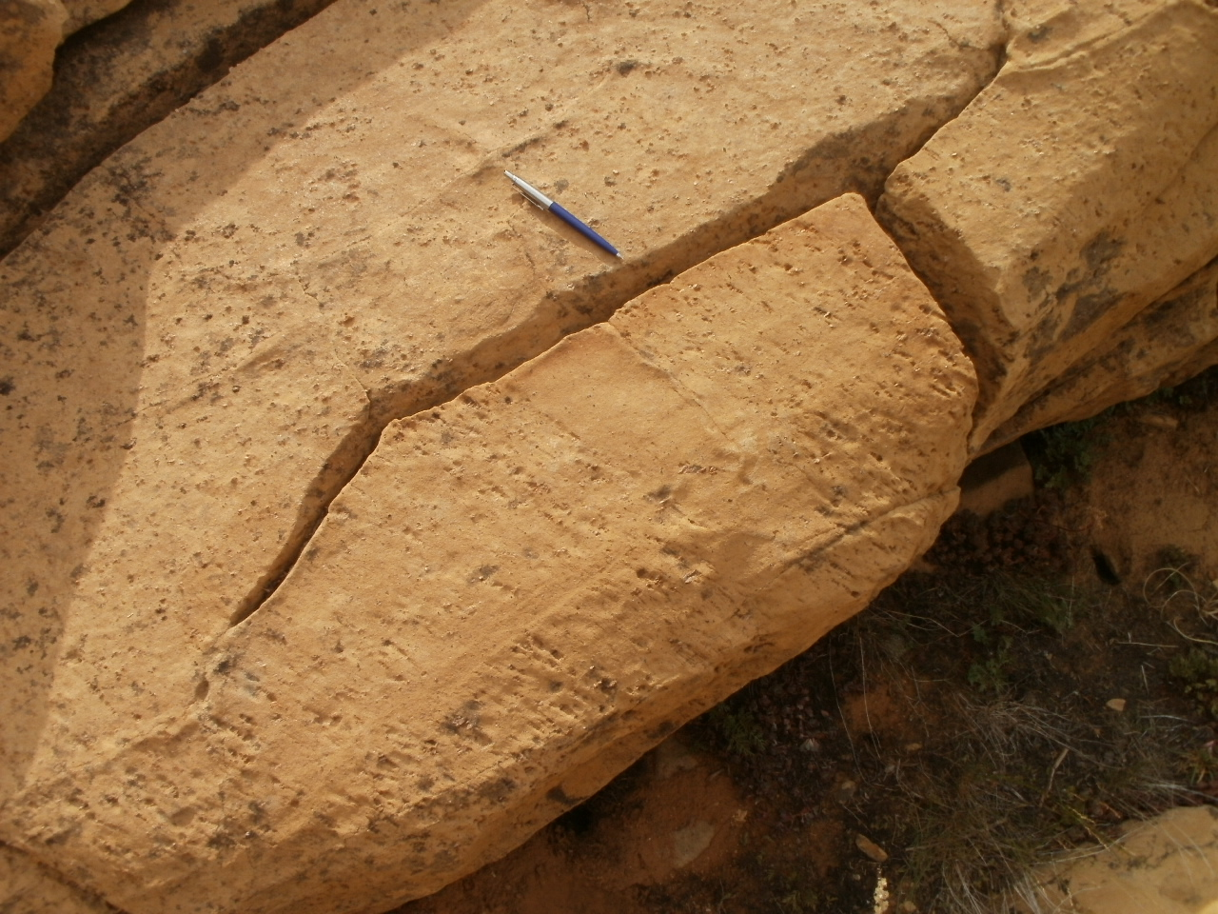
Kangaroo body
Upper mantle fabrics still preserved in the structurally higher peridotite body
Notes:
Conversely, pre-existing rock fabrics in the overlying peridotite body are relatively intact and recognizable. Although these rocks *have* been recrystallized and enjoyed same lower-crustal conditions and events as the West Fork rocks, the pre-existing melt-channels related to mantle-related fabric development have not been transposed to the same degree as those in the WFU.
Mechanically resistant

Slide 15
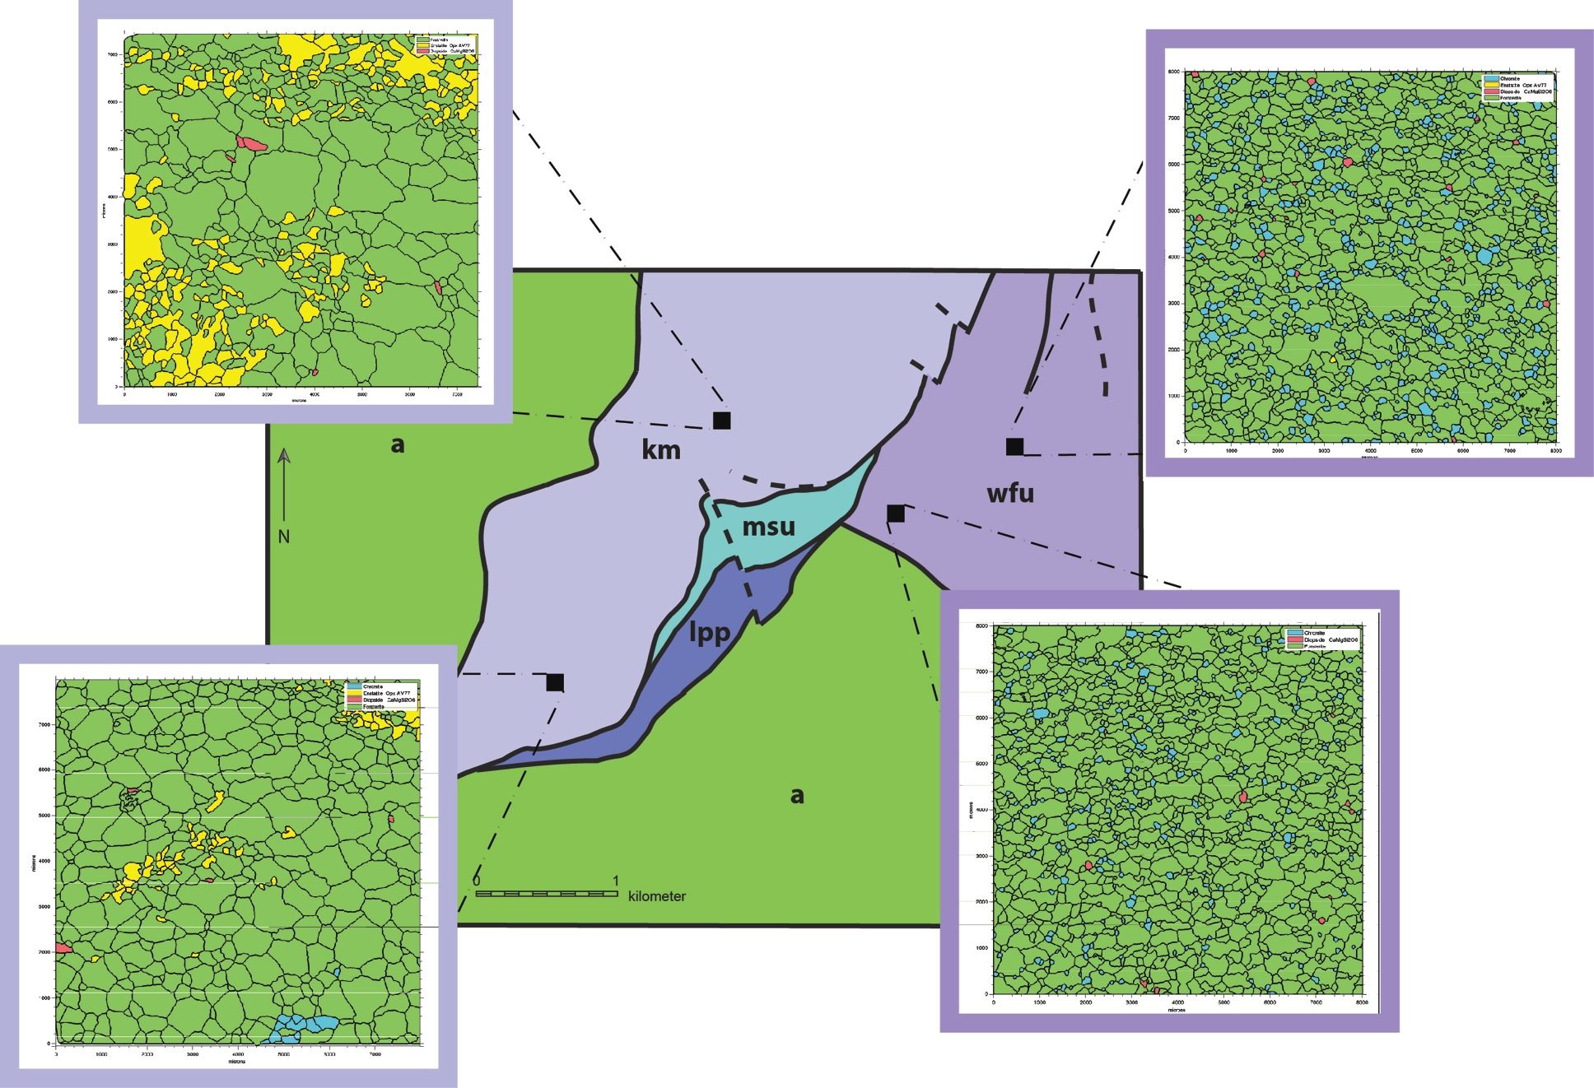
Microstructure
Higher T
Larger grains, weaker fabric
(Lower stress and/or Higher T)
Smaller grains, stronger fabric
(Higher stress and/or Lower T)
Lower T
green = olivine
cyan = chromite
yellow = opx
red = cpx
EBSD maps acquired at Boston College courtesy of Seth Kruckenberg
Notes:
Some of our preliminary data do show notable differences between the peridotite microstructural characteristics. We interpret these differences to illustrate their different stress-strain histories. Previously published temperature data record a general East-to West temperature gradient. New temperature data combined with olivine recrystallized piezometry and constraints from adjacent rocks will provide greater detail for a plausible characterization of temperature-stress distribution in the complex.
8mm x 8mm grain maps reconstructed from EBSD acquired at Boston College courtesy of Seth K!

Slide 16
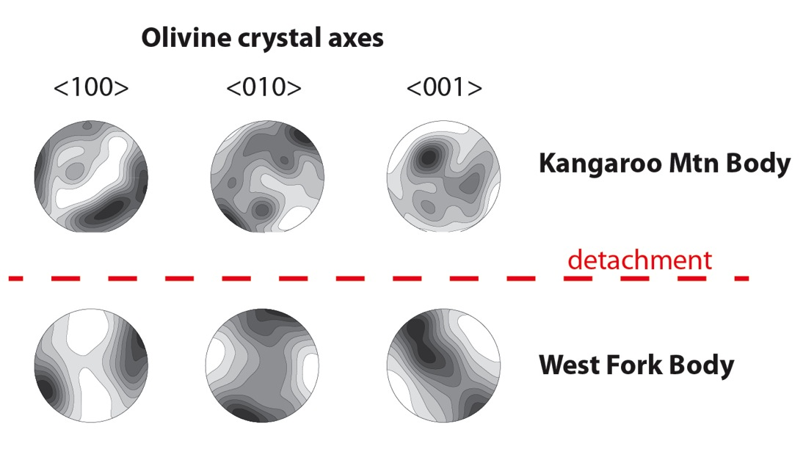
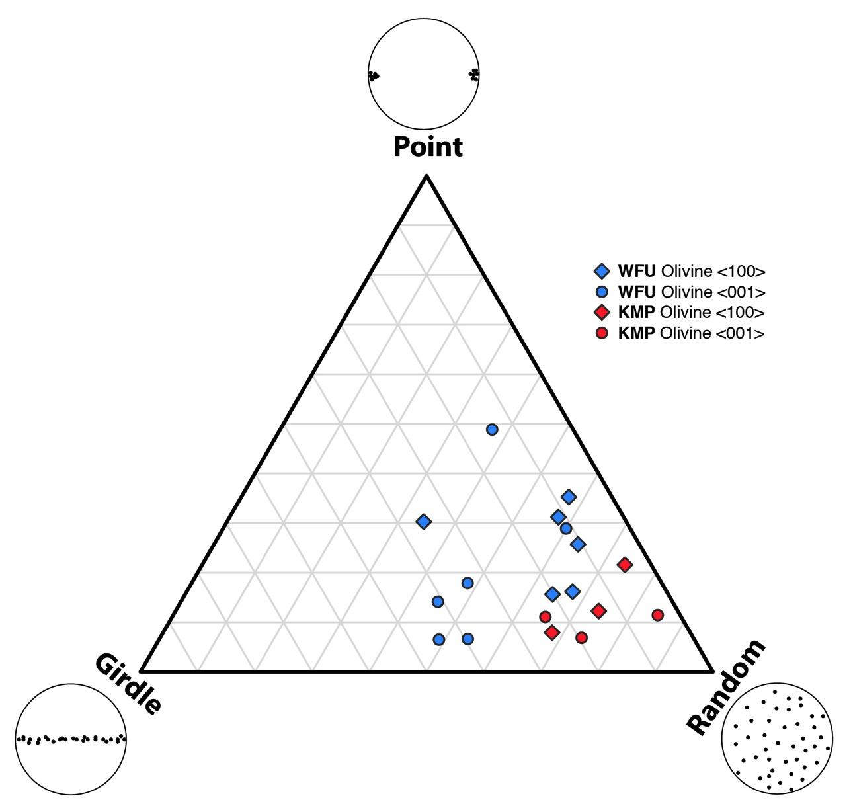
Petrofabric Shapes
-
Eigenvalue analysis
Point: λ₁ > λ₂ ≈ λ₃
Girdle: λ₁ ≈ λ₂ > λ₃
Random: λ₁ ≈ λ₂ ≈ λ₃
PGR eigenvalue analysis, following Vollmer (1990)
Notes:
The difference in intensity of fabric development observed at outcrop and microscopic scales, is also recognizeable in the shape of olivine petrofabrics (and other phases).

Slide 17
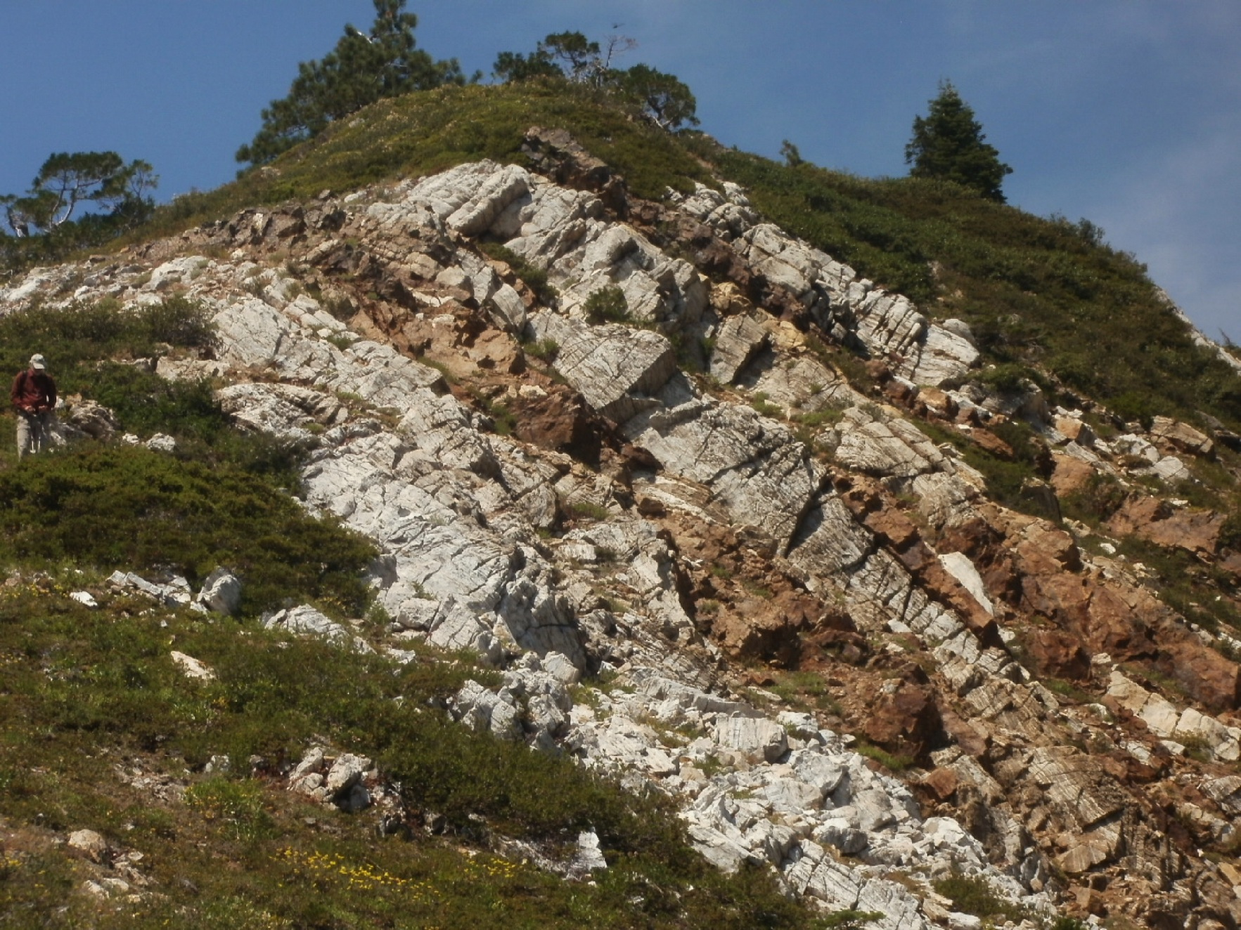
But how to constrain stress architecture?
Notes:
What methods can we use going forward to better constrain the distribution of stress and deformation across the detachment and the complex overall?
Example from metasedimentary rocks where we locally have interlayered quartzitic (metacherts?) lenses and boudins with cacite+dolomite marbles and calc-silicate rocks.

Slide 18
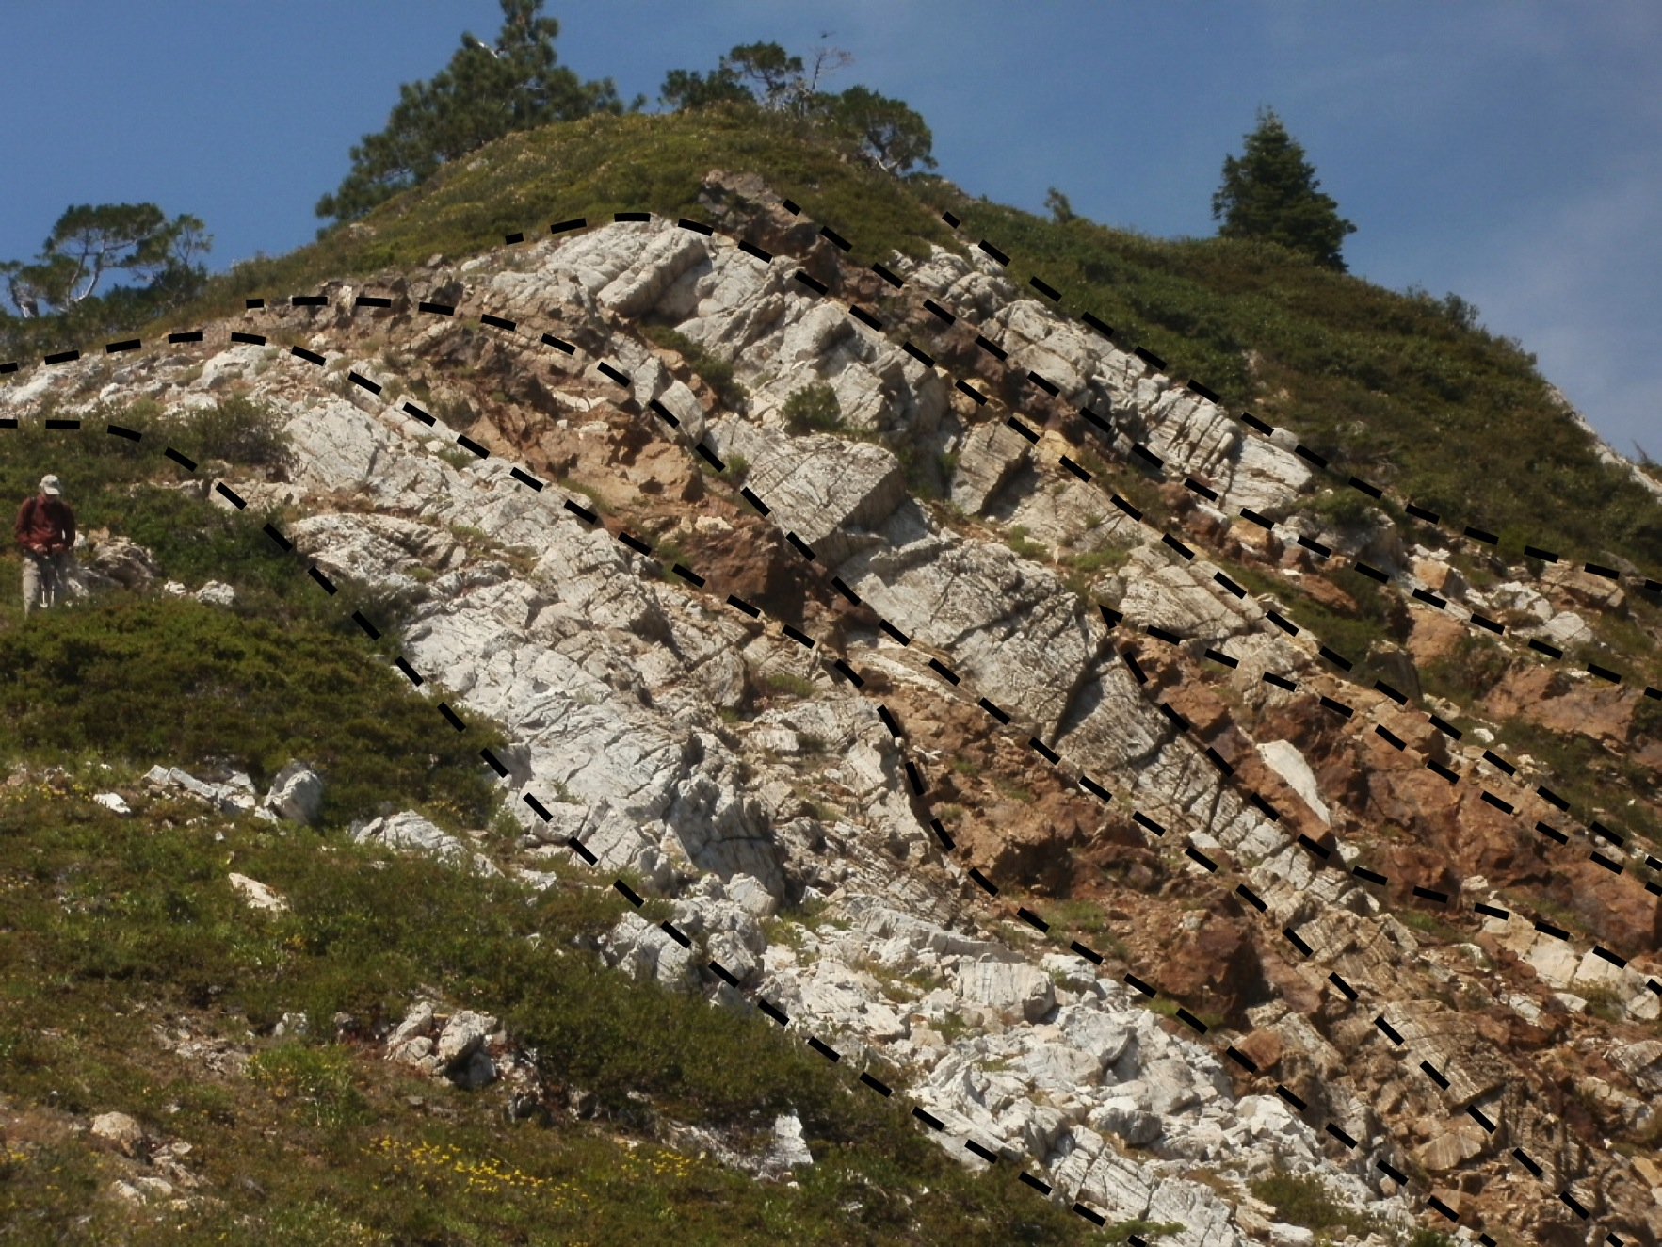
But how to constrain stress architecture?
Quartz recrystallized grain size piezometry, Ti-in-Quartz thermometry, microstructure, kinematics
Calcite piezometry, twin analysis, calcite + dolomite thermometry, microstructure, kinematics
Notes:
What methods can we use going forward to better constrain the distribution of stress and deformation across the detachment and the complex overall?
Example from metasedimentary rocks where we locally have interlayered quartzitic (metacherts?) lenses and boudins with cacite+dolomite marbles and calc-silicate rocks.

Slide 19
Conclusions
Different scales of lower crustal heterogeneity interact to encourage localization and redistribution of stresses and strain-rates.
The Seiad ultramafic complex preserves a deep-crustal detachment architecture characterized by domainal rheology at outcrop- to kilometer-scales, and will be the site for ongoing and future research into the influence of relative rheology in convergent tectonics.
How heterogeneous is strength?
At what scale do strength contrasts have implications for plate margin mechanics?
What is the strength of the mantle-removed?
Notes:
And most importantly:
The Seiad complex is a promising site for our ongoing and future work to investigate the influence of relative rheologies on lithosphere-scale mechanics.
Thank you.
Through this work, we hope to help constrain the answers to such questions as “What is the strength of mantle materials incorporated into the crust, and how do the competency contrasts of different accreted rocks affect
For example:
How strong are mantle-derived materials relative to more-typical crustal materials?
How heterogeneous is the strength of the lower crust in accretionary settings? At what scales do heterogeneities affect tectonic styles?

