Slide 1
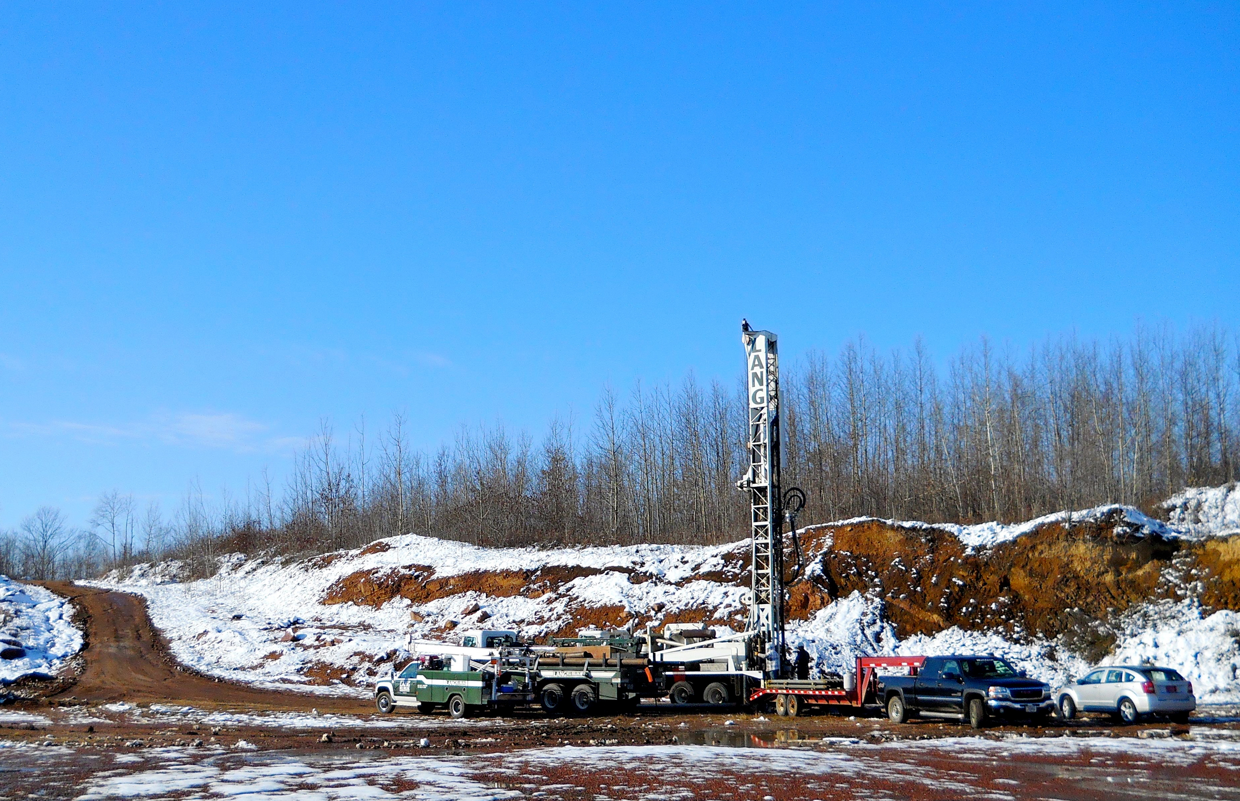
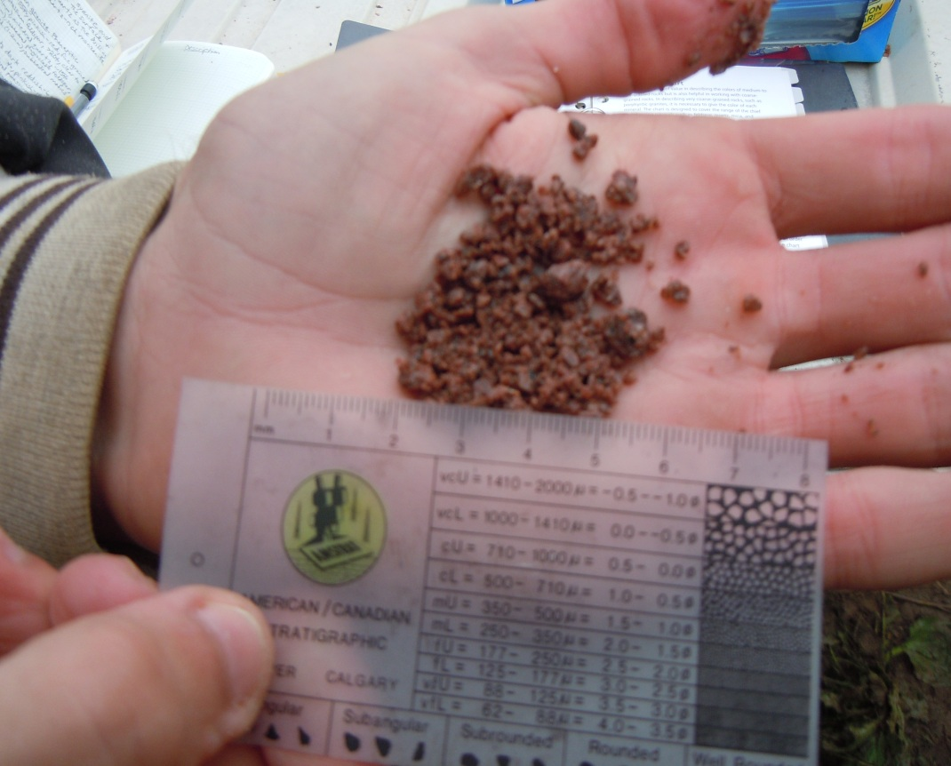


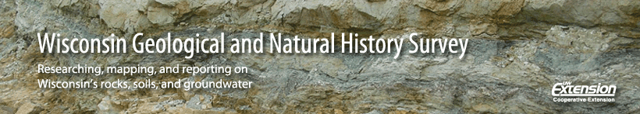
Fracture Transmissivities Before And After Hydrofracturing Water Wells In Granitic Bedrock
David Hart

Slide 2
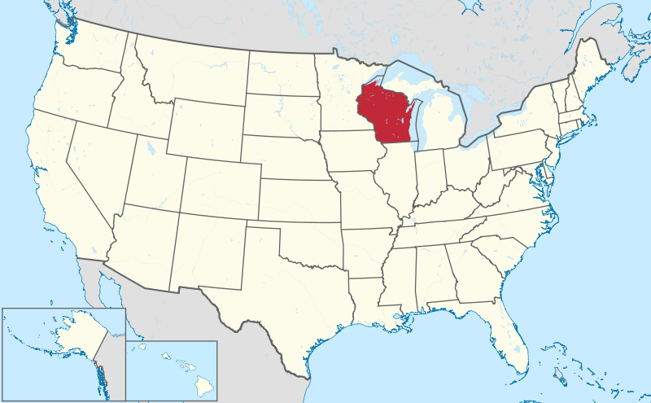
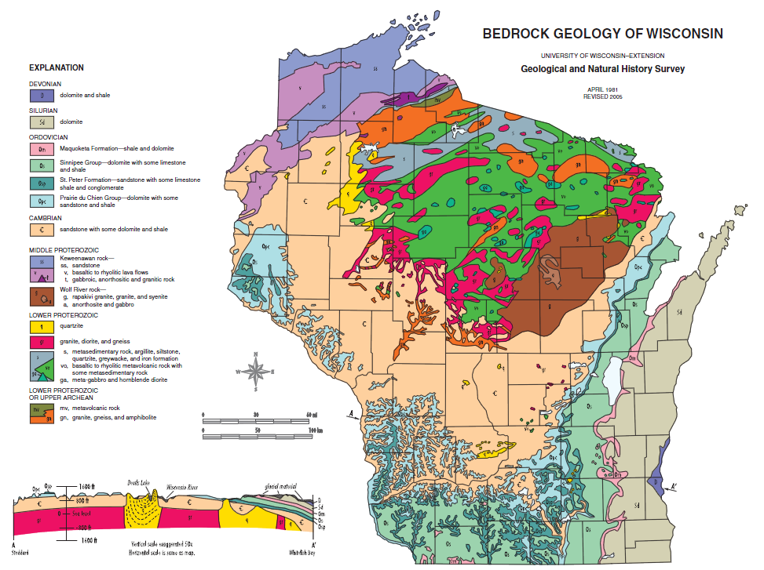
Location
Notes:
Looked to the Granites in Marathon County first.

Slide 3

Motivation
Low yields from crystalline bedrock.
Glacial material thin.
Wells hydrofractured to increase yield
Hydrofracturing done in this region since the 1970s
National Driller (2005) - Haupt
Notes:
Looked to the Granites in Marathon County first.

Slide 4
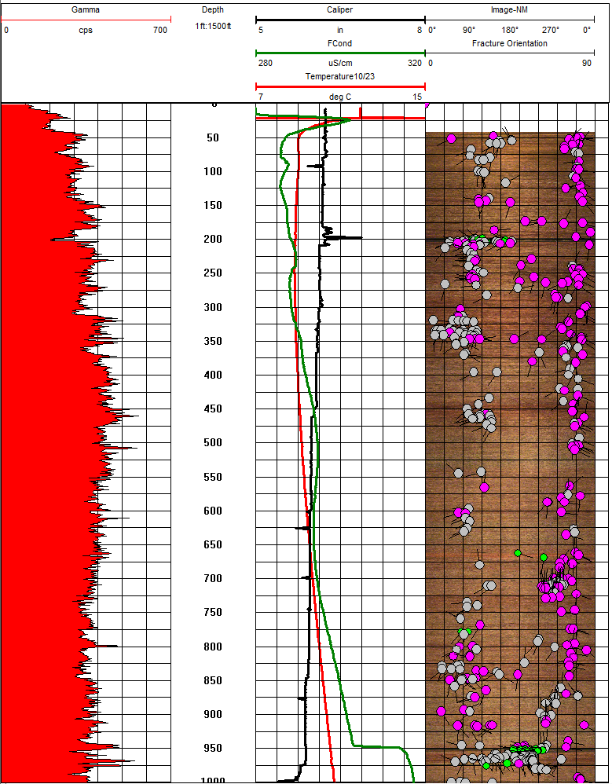
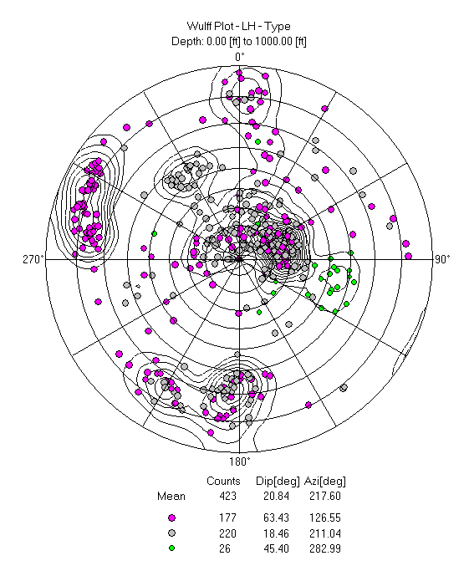
Geothermal 1
Many fractures over entire depth
Gamma spikes correlate (uranium)
Orthogonal fracture sets

Slide 5
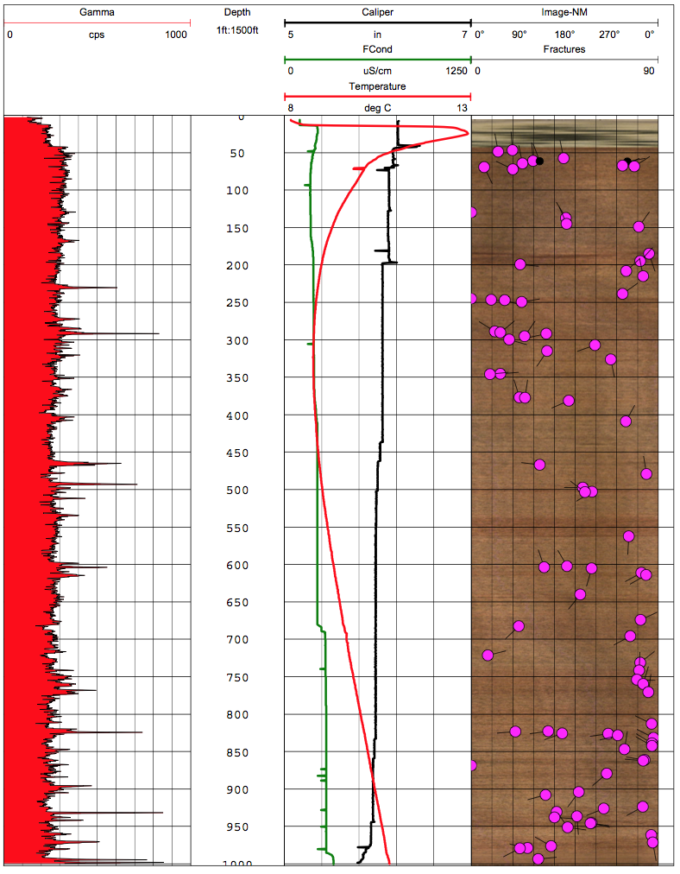
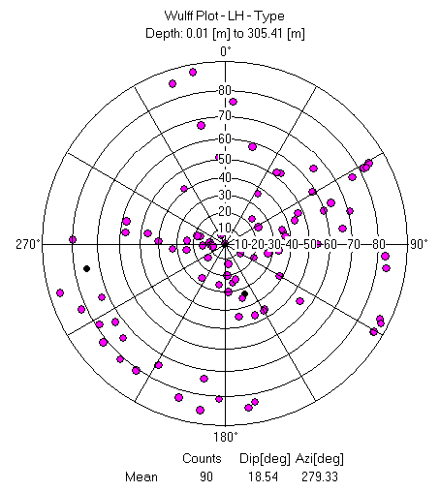
Geothermal 3
Fewer fractures over entire depth
Gamma spikes correlate (uranium)
Homogeneous lithology

Slide 6
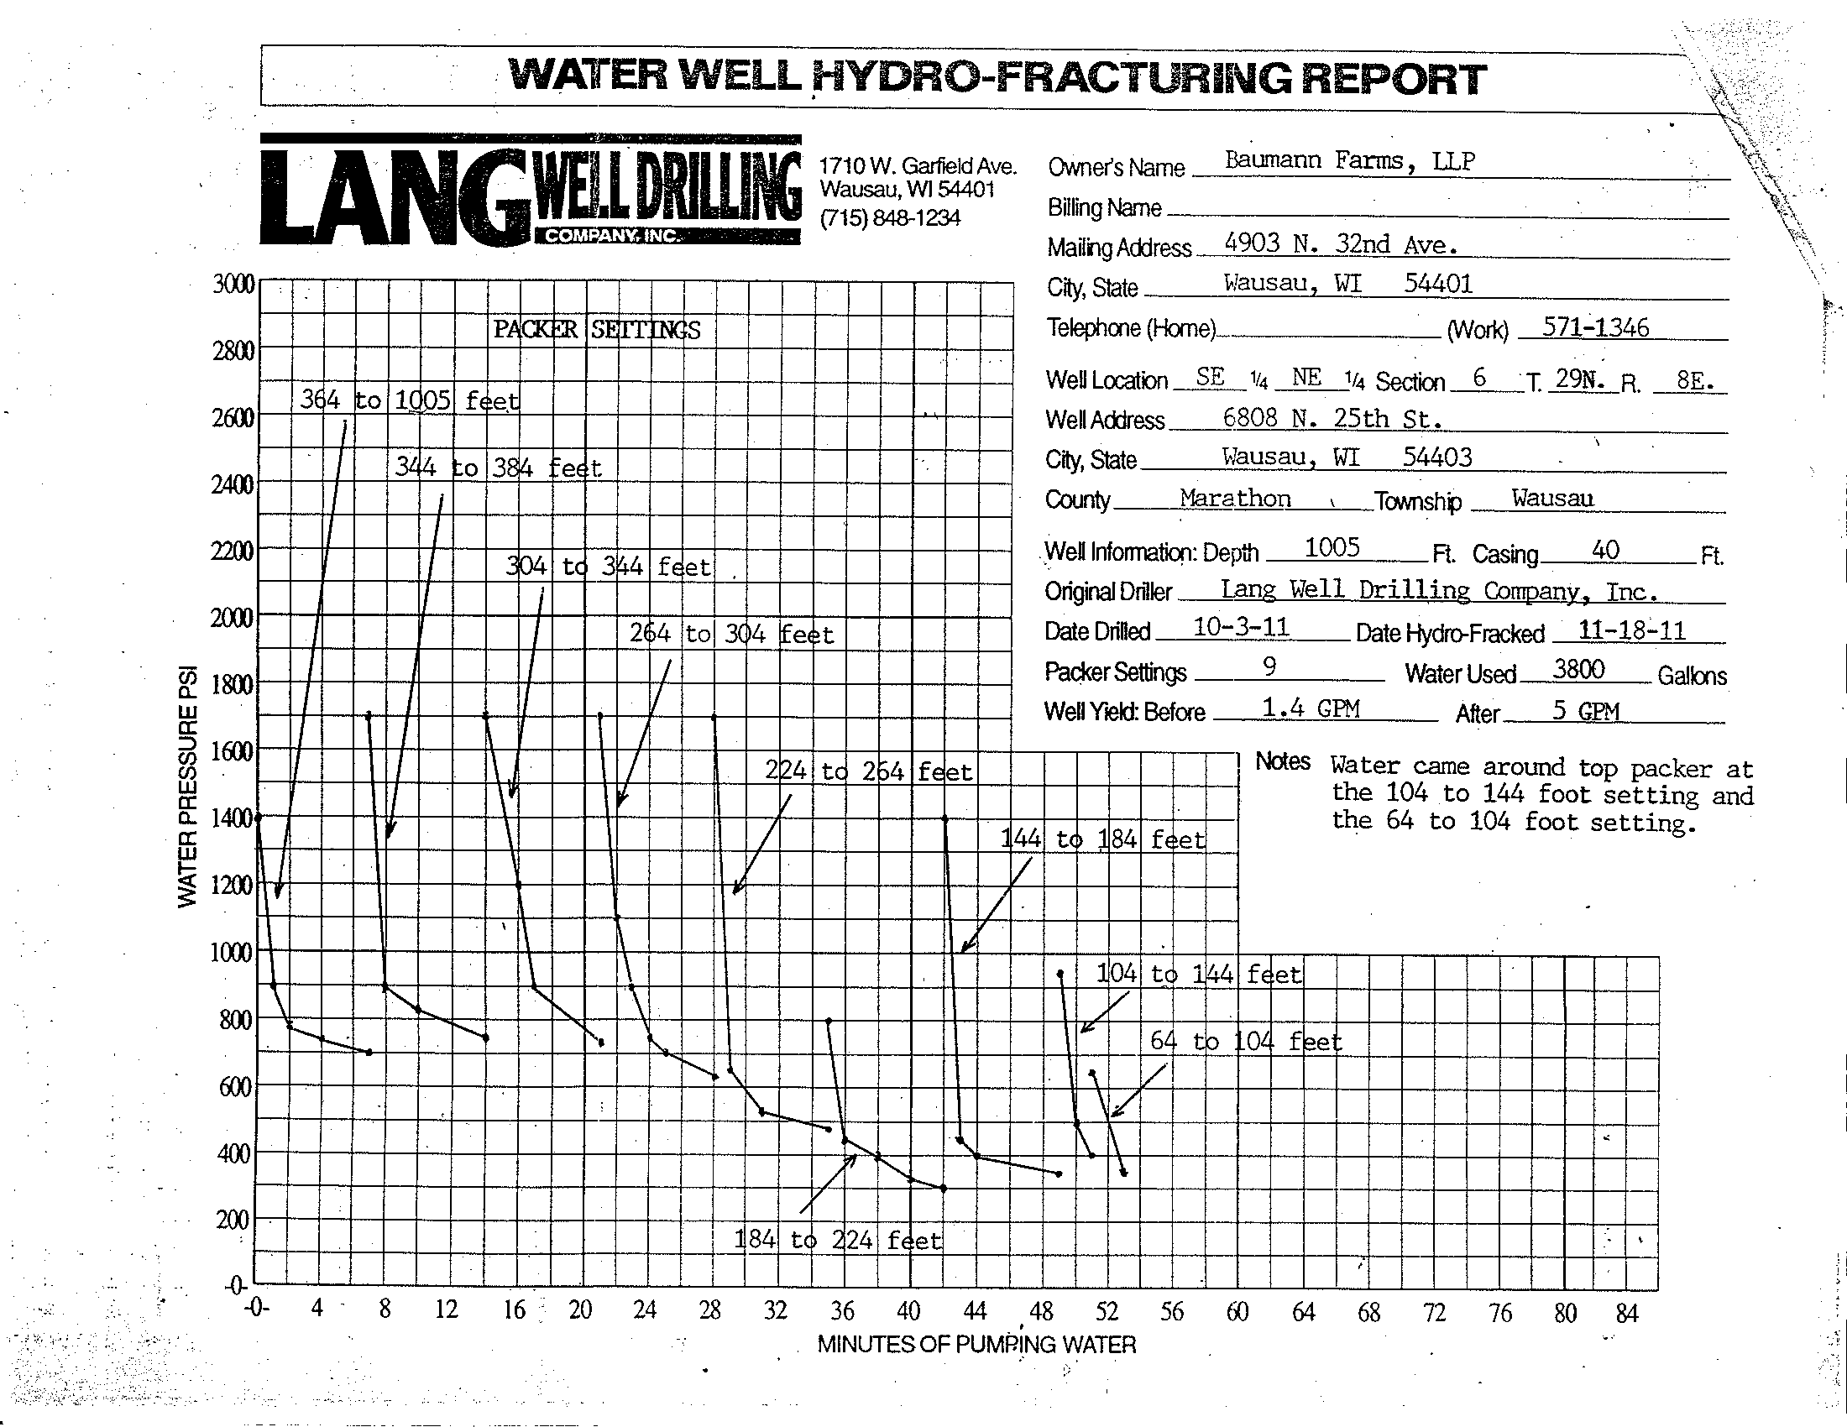
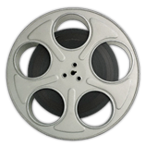
Hydrofracturing Record
Geothermal 1
10 MPa
5 MPa
Lithostatic Stress (psi)

Slide 7
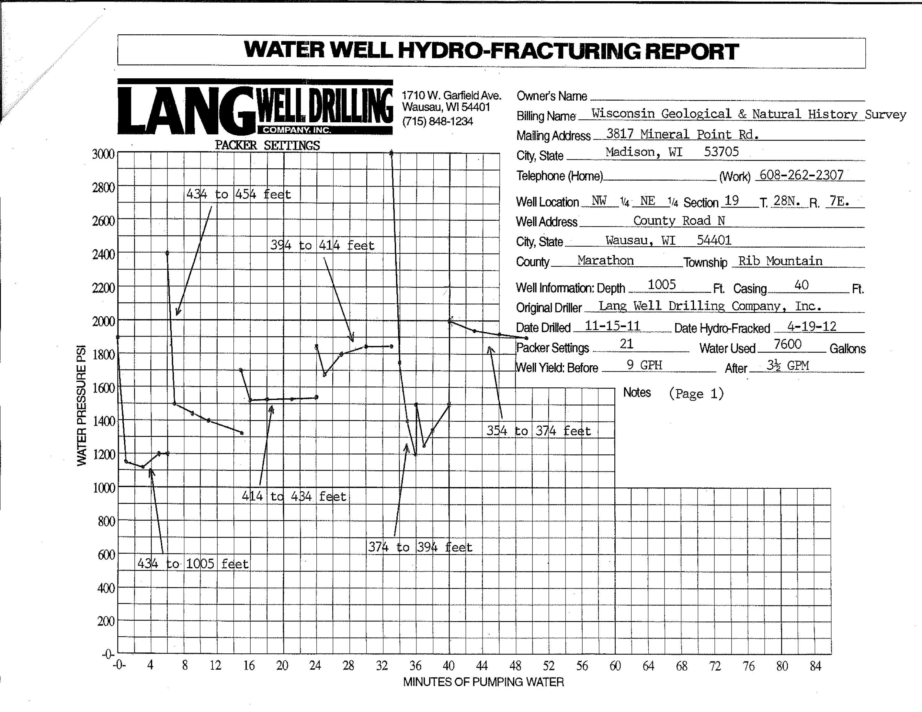
Geothermal 3
10 MPa
5 MPa
Lithostatic Stress (psi)

Slide 8
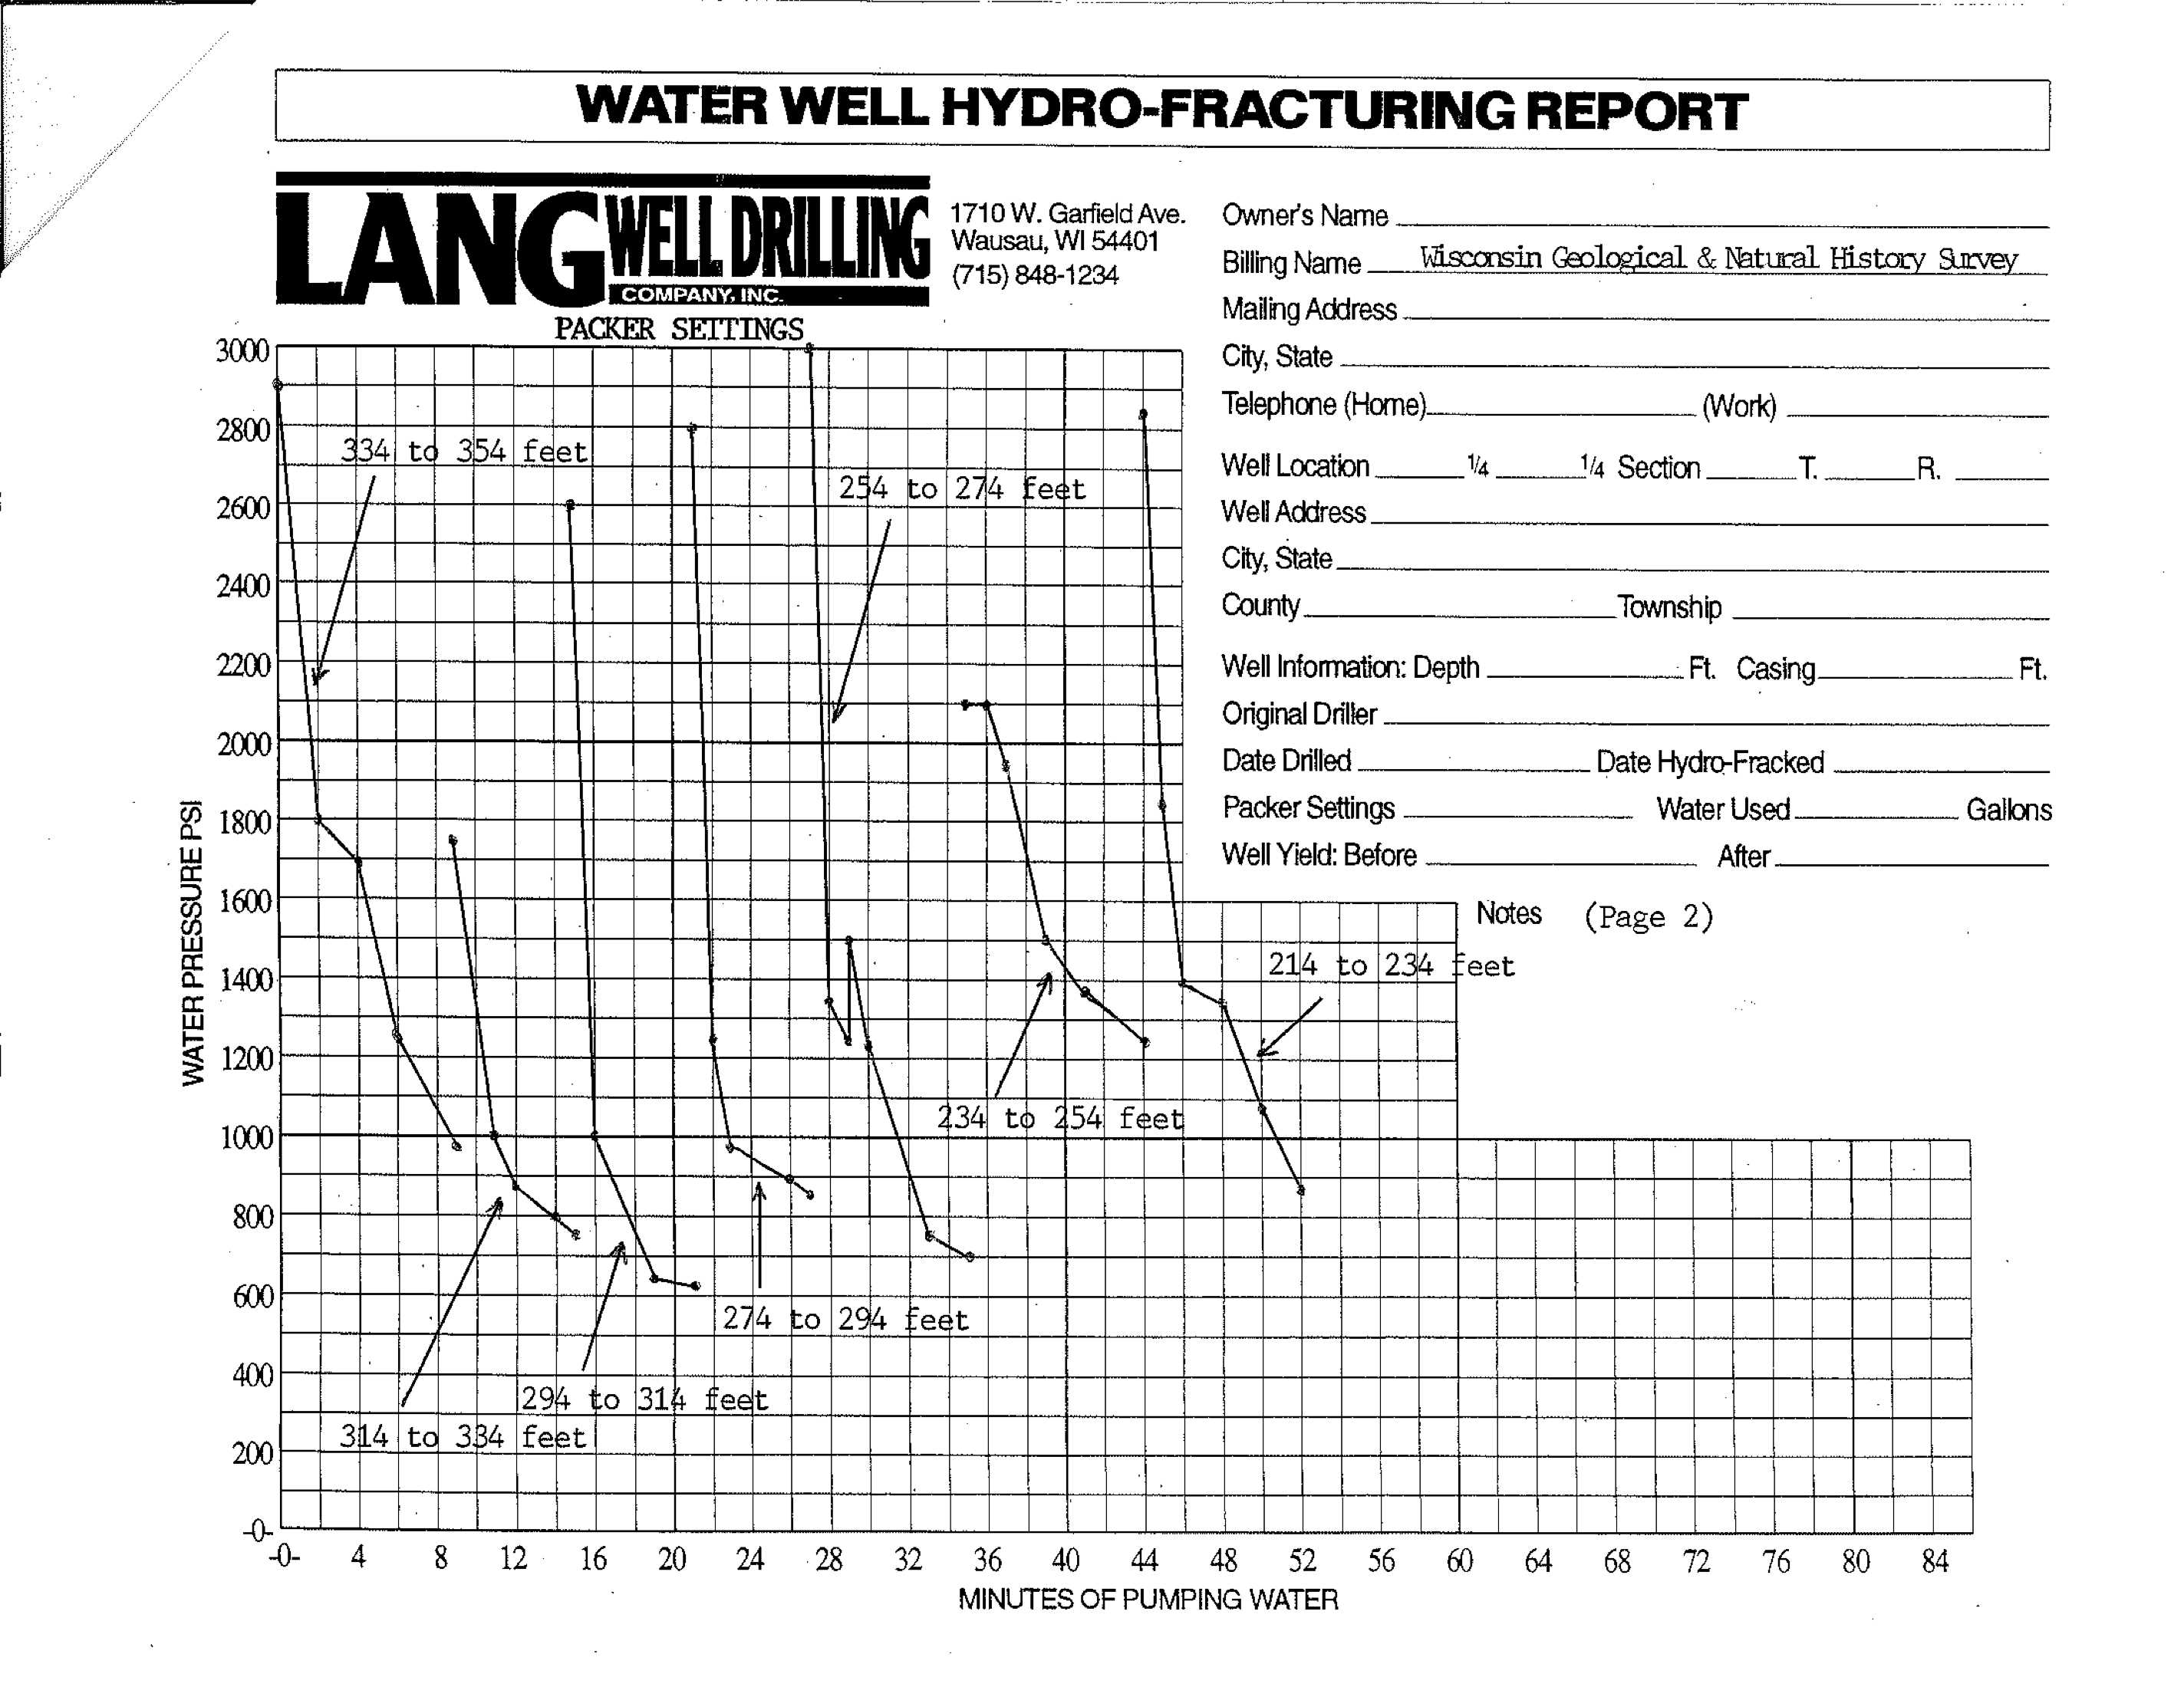
Geothermal 3
10 MPa
5 MPa
Lithostatic Stress (psi)

Slide 9
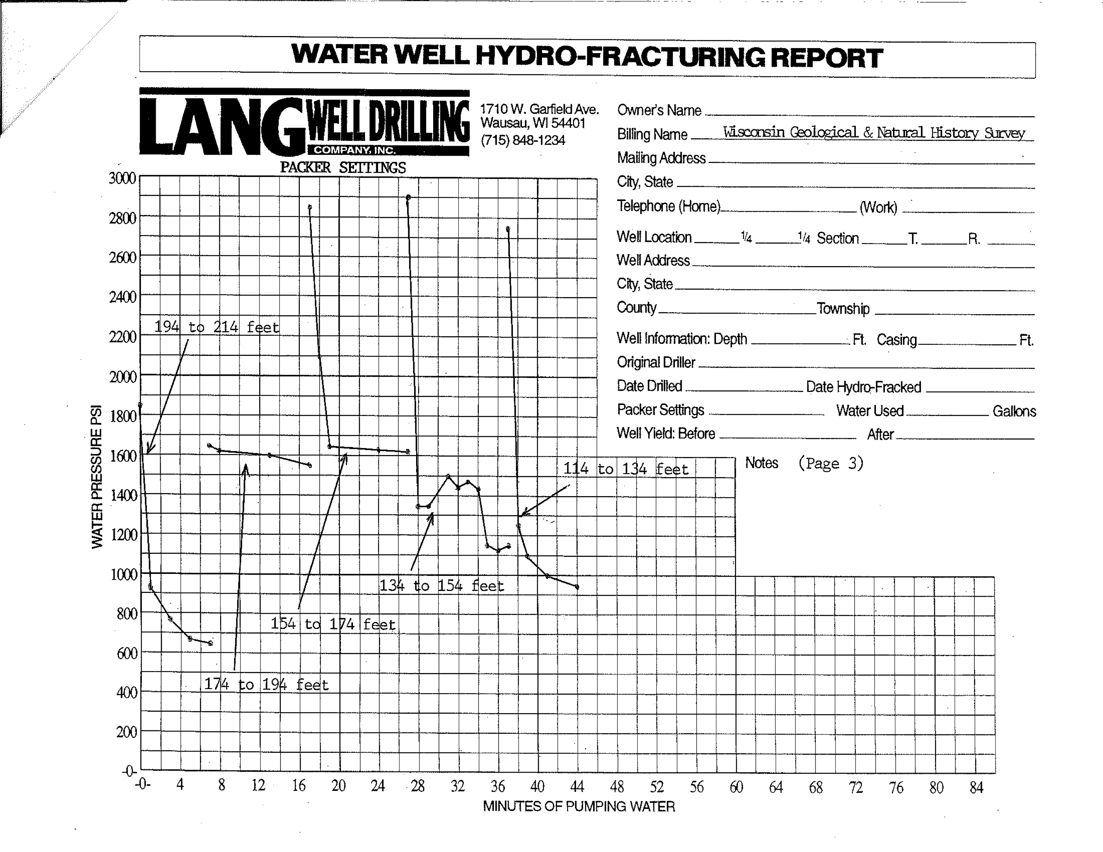
Geothermal 3
10 MPa
5 MPa
Lithostatic Stress (psi)

Slide 10
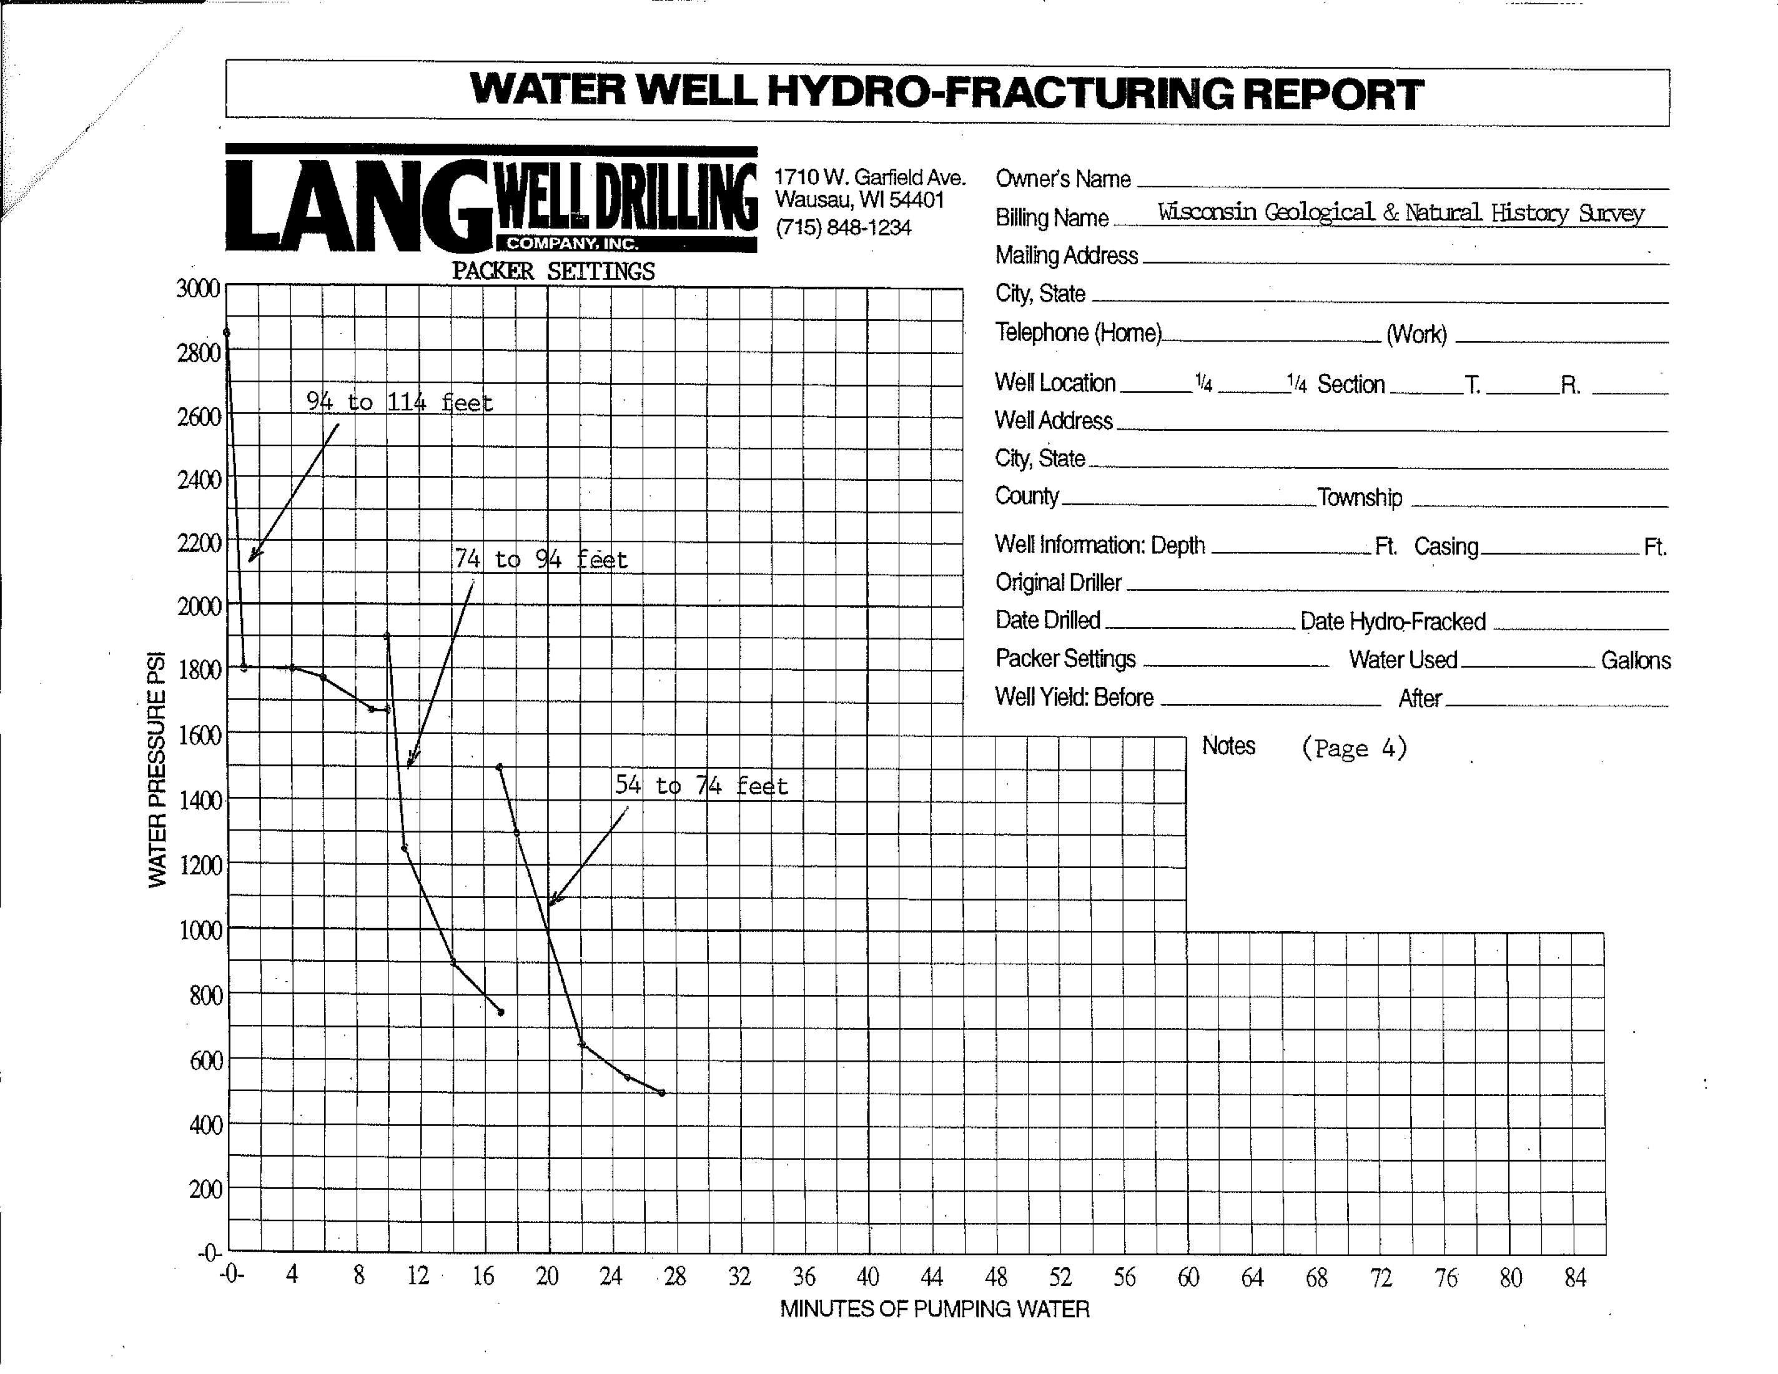
Geothermal 3
10 MPa
5 MPa
Lithostatic Stress (psi)

Slide 11
Hydrofracture Reports
Geothermal 1
More Fractures ( 423 identified)
Lower cracking pressures < 1700 psi (11 MPa)
Unlikely any new fractures formed
Geothermal 3
Fewer Fractures (90 identified)
Higher cracking pressures 3000 psi (21 MPa)
Possibly creating new fractures.
Lab tensile strengths (Goodman, 1989)
Nevada Test Site granite 1700 psi (11.7 MPa)
Pikes Peak granite 1730 psi (11.9 MPa)

Slide 12
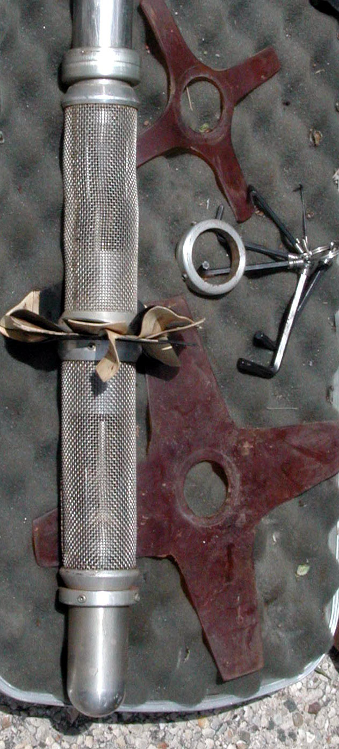
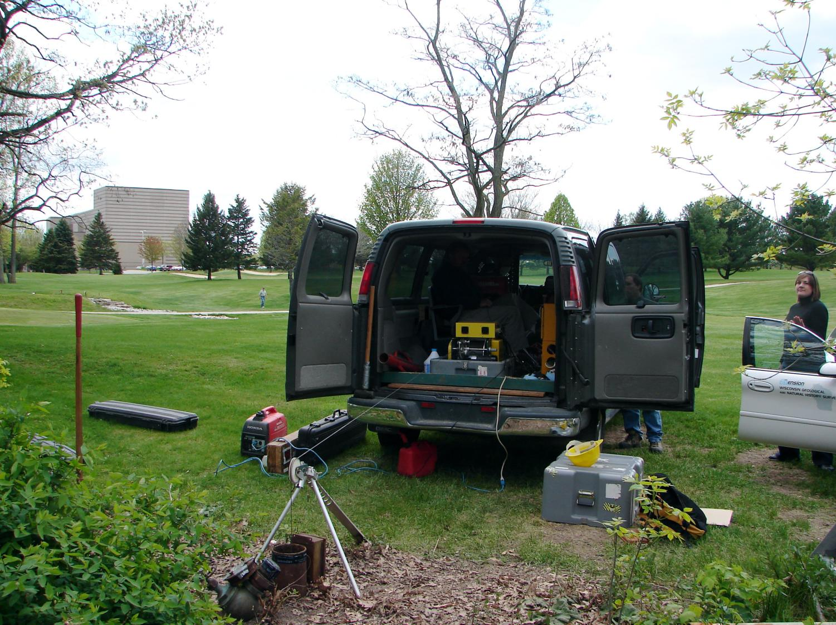
Measuring Transmissivities
Flow Logging - Weighted Transmissivities
assumes: steady state, horizontal flow during pumping, and no ambient flow
Transmissivity of an interval is proportional to the flow from that interval.
Heat Pulse Flow Meter
For more background on flow logging:
http://water.usgs.gov/ogw/bgas/flowmeter/

Slide 13
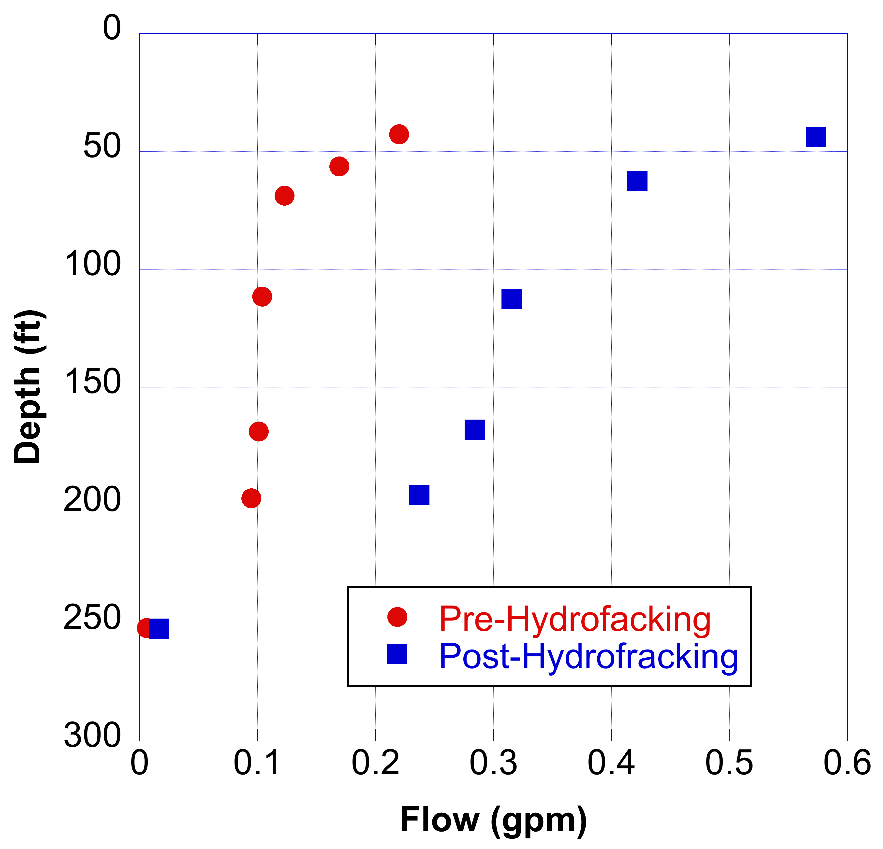
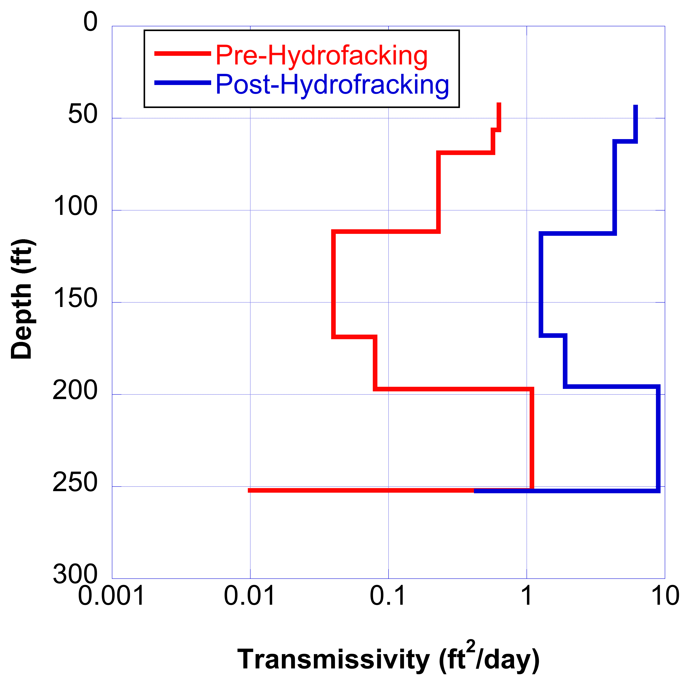
Geothermal 1
 | Pre-Hydrofracture | Post-Hydrofracture
T_{total} (ft²/day) | 2.65 | 23.0
8 x overall increase post-hydrofracture

Slide 14
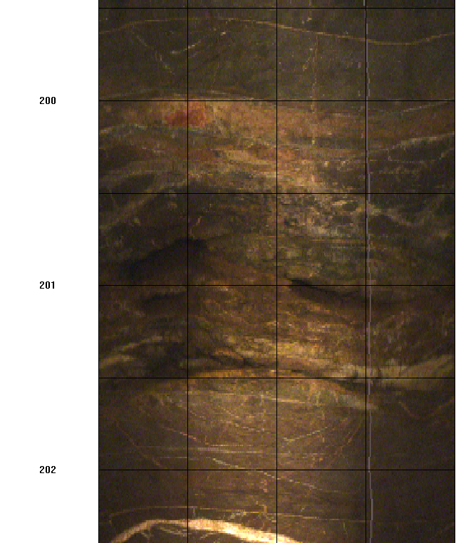
Two fractures at 201 ft
Create provide most of the yield in this well.

Slide 15
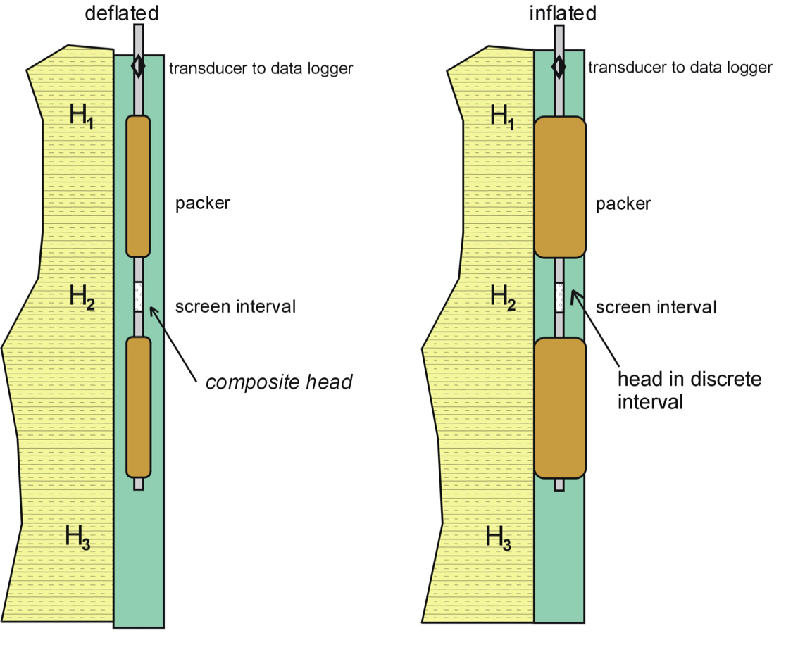
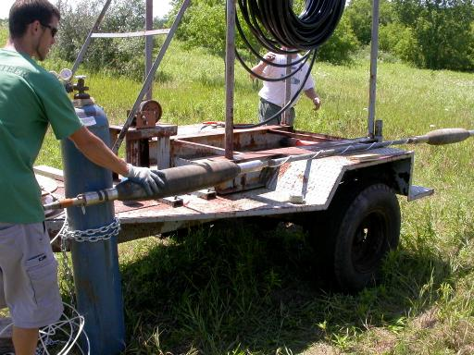
Measuring Transmissivities
Packer Testing
Isolate depth interval of interest (2 feet in this study)
Conduct Slug test

Slide 16
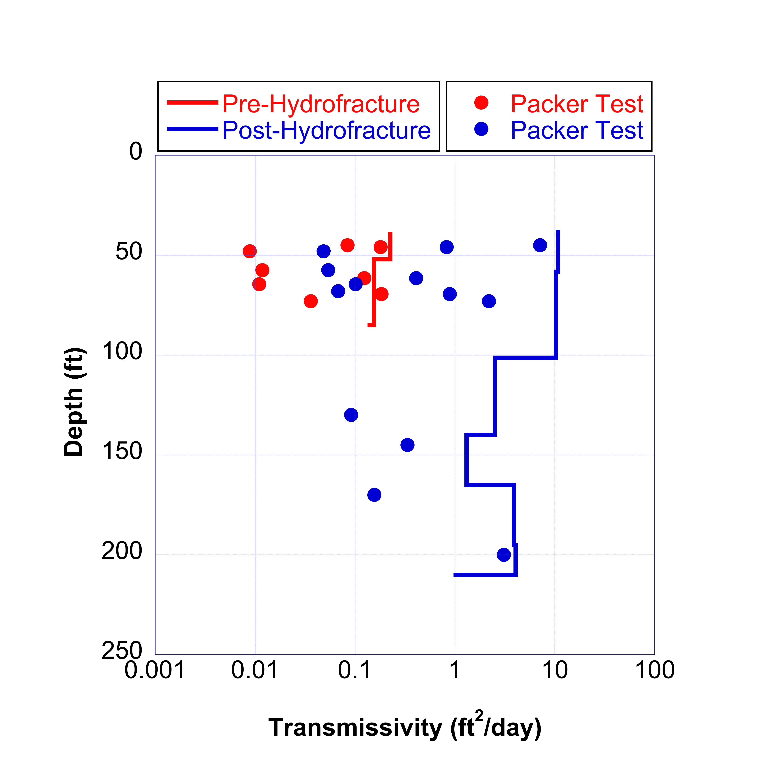
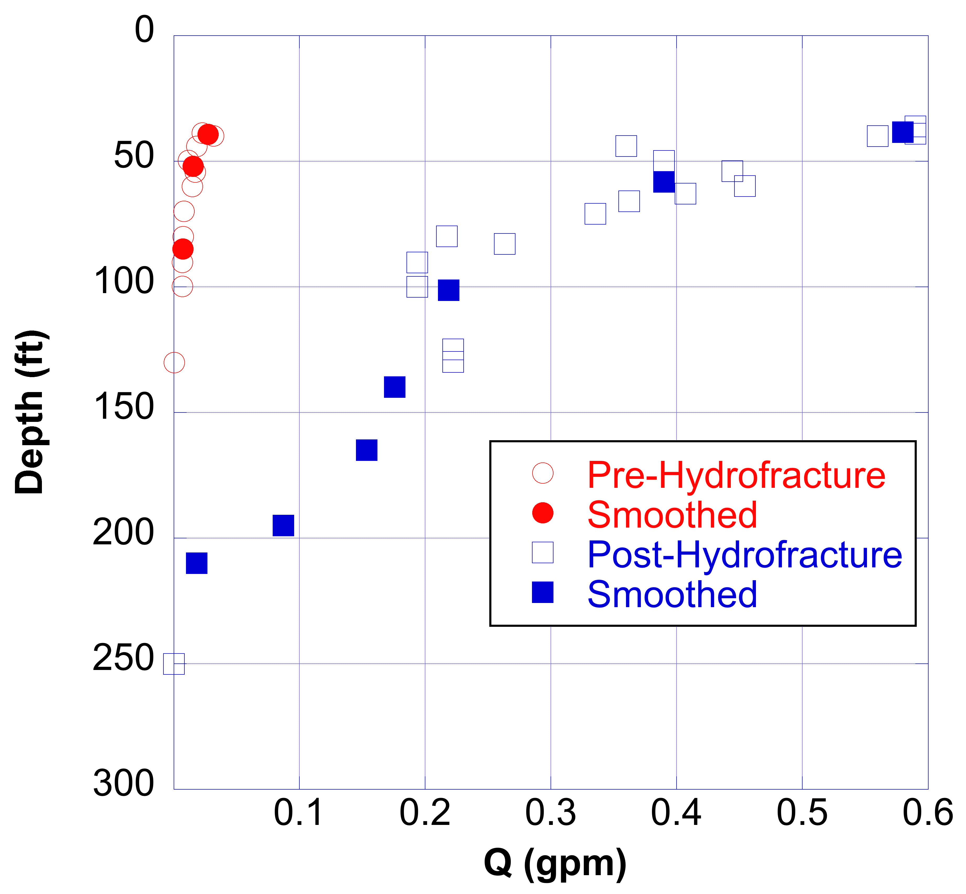
Geothermal 3
 | Pre-Hydrofracture | Post-Hydrofracture
T_{total} (ft²/day) | 0.54 | 34
65 x overall increase post fracture

Slide 17
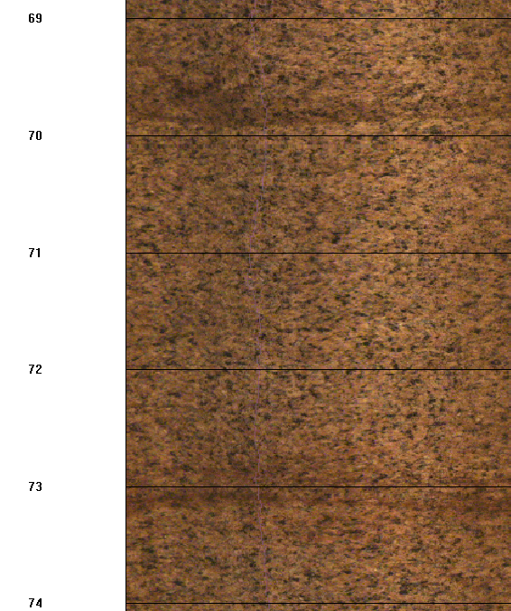
These two fracture are more transmissive than most in this well

Slide 18
Conclusions
Hydrofracturing increased well yields by 1 to 2 orders of magnitude.
Fractures present from surface to 1000 feet.
Lots of fractures (Geothermal 1) – no new fractures generated during hydrofracture process
Few fractures (Geothermal 3) – some new fractures generated but not important for well yield.
Variation or shape of transmissivities with depth remained relatively constant
All the transmissivities shifted or increased.
Low T zones moved higher but remained low T zones relative the high T zones.
Recommendation - Spend time and effort on high T zones in upper part of the well

Slide 19
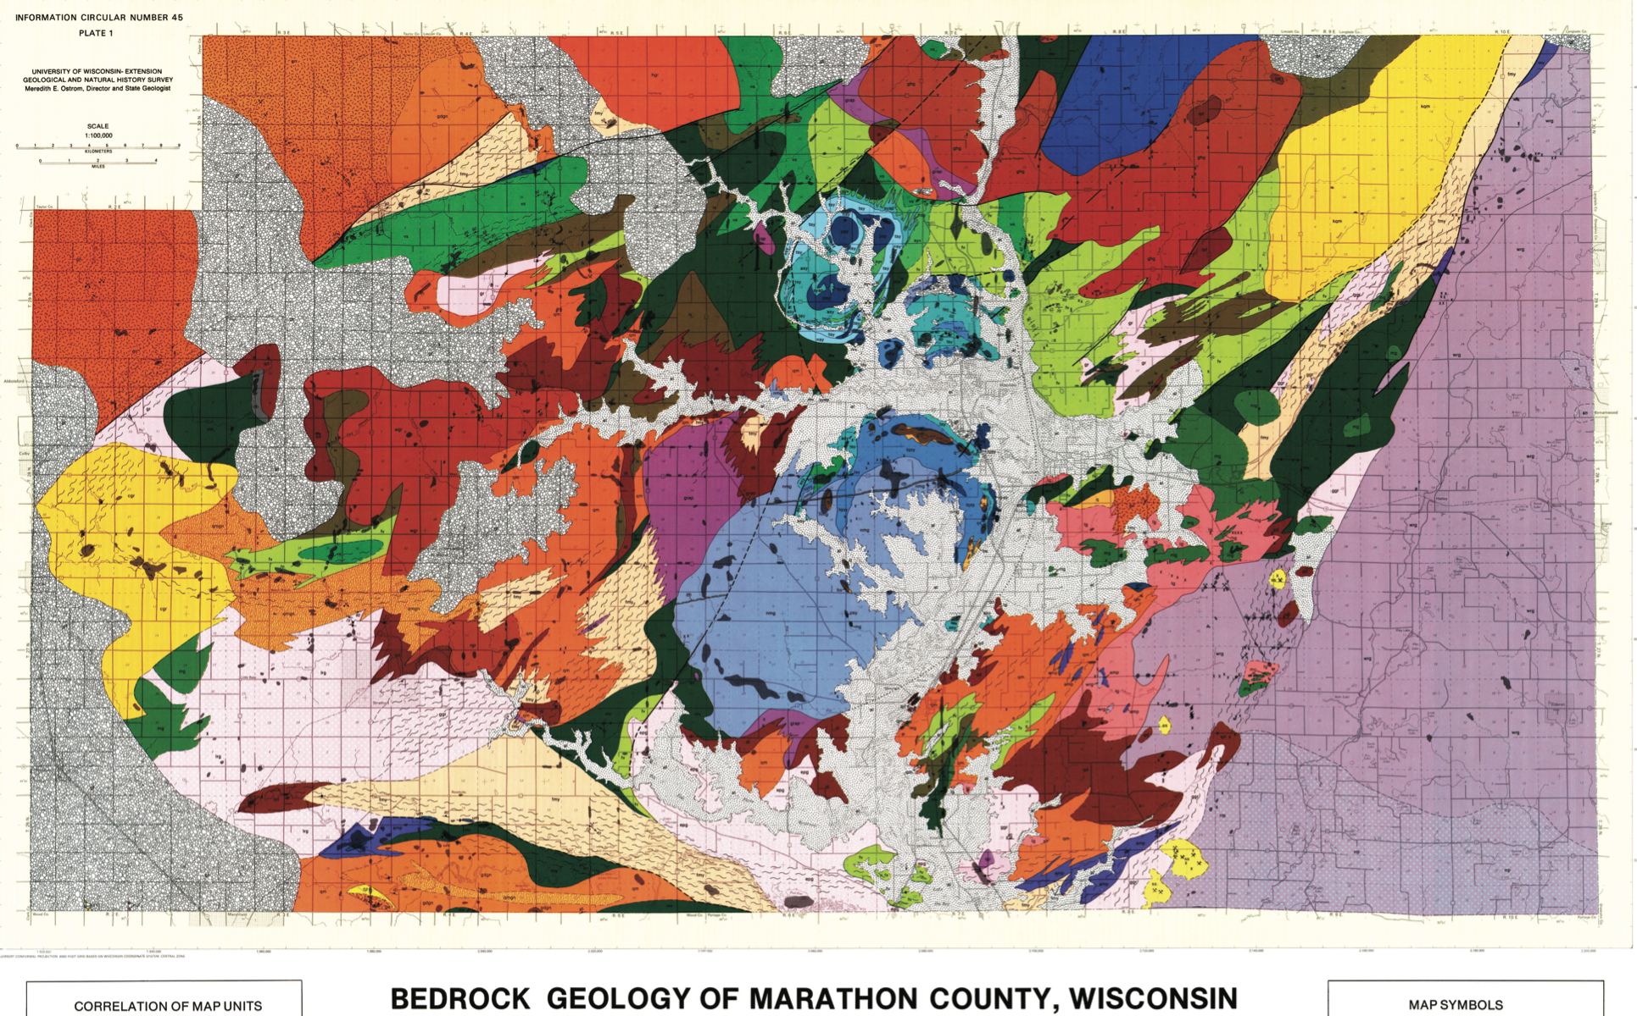
Geology of Boring Locations
Geothermal 1 - Granite
Geothermal 3 – Granite & Quartz Monzonite

