Slide 1
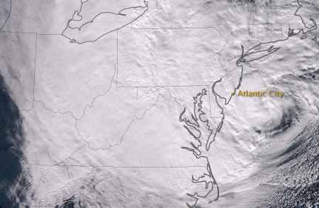
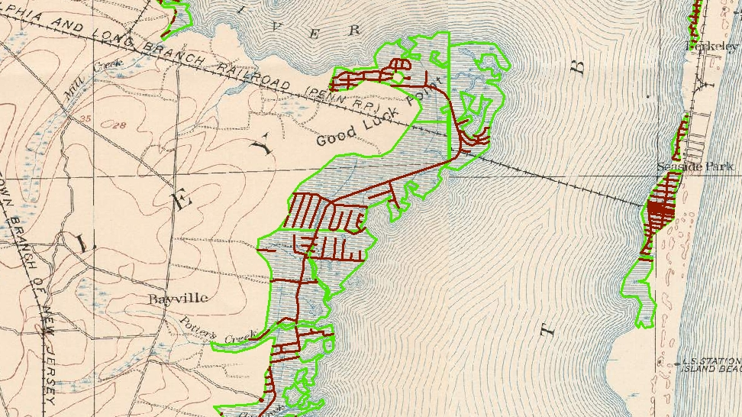

Hurricane Sandy storm surge damage and the legacy of development on historical coastal marshes
earthobservatory.nasa.gov/IOTD
Joshua C. Galster, Lahra Dooner
Diana Flores, Joseph Bernaducci
Earth and Environmental Studies
Montclair State University

Slide 2
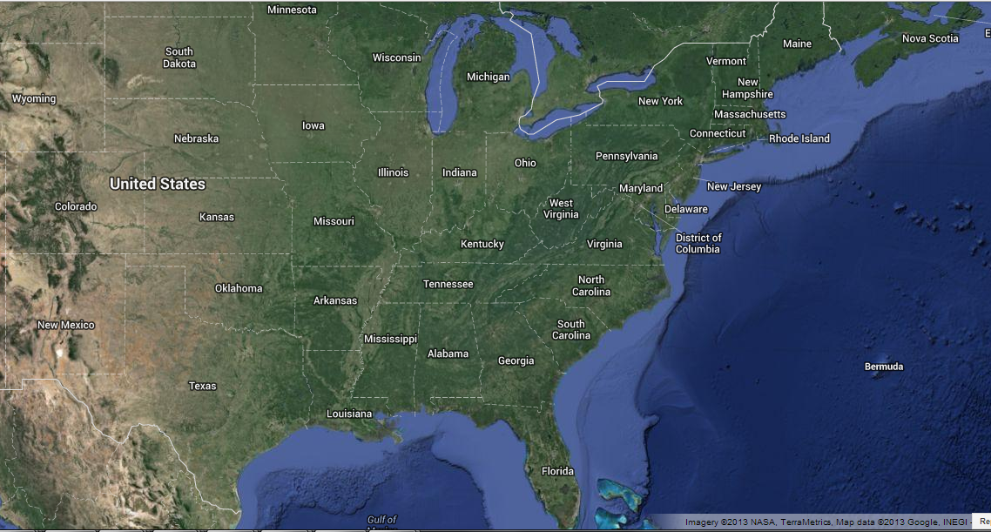
New Jersey Shore

Slide 3
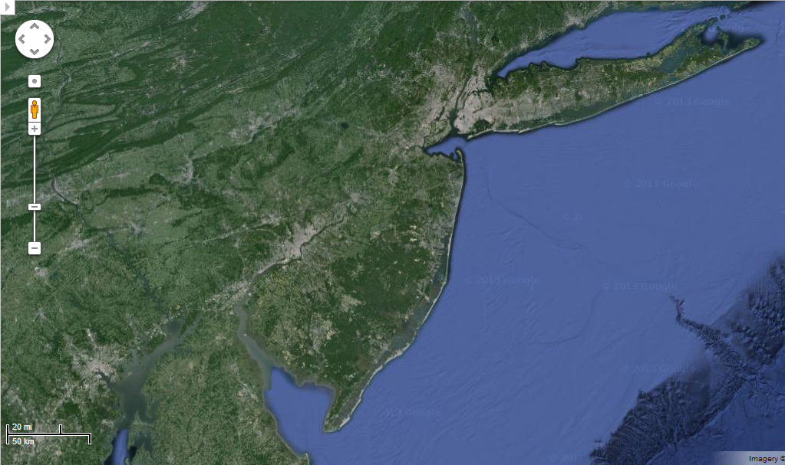
New Jersey Shore
Philadelphia
New York City

Slide 4
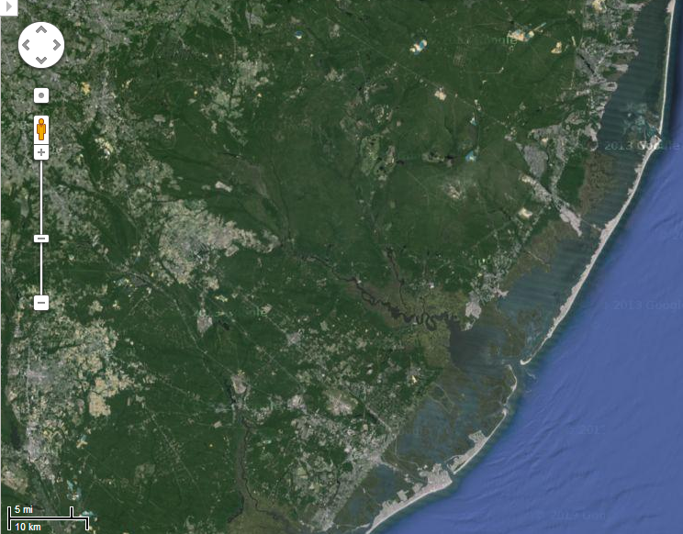
Barrier island system

Slide 5
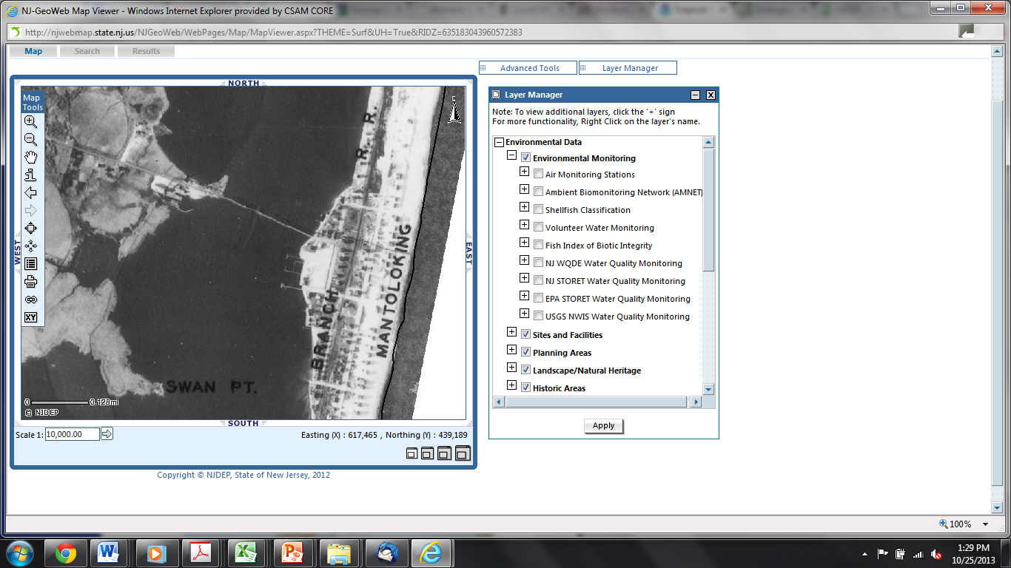
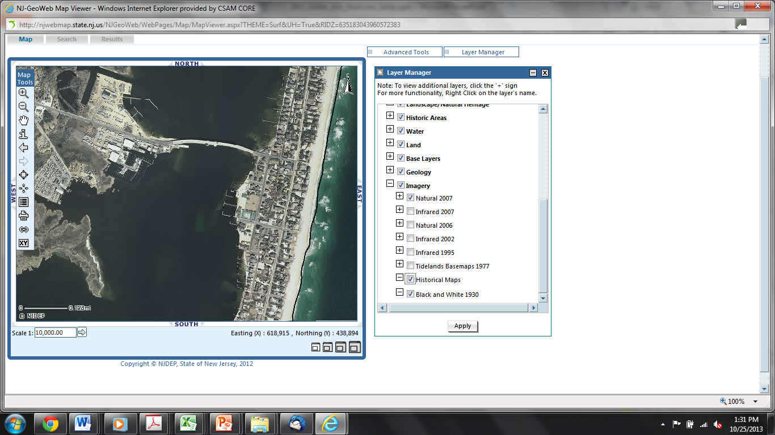
Increased coastal development on barrier islands
1930’s
2007
NJ GeoWeb: http://www.nj.gov/dep/gis/geowebsplash.htm

Slide 6
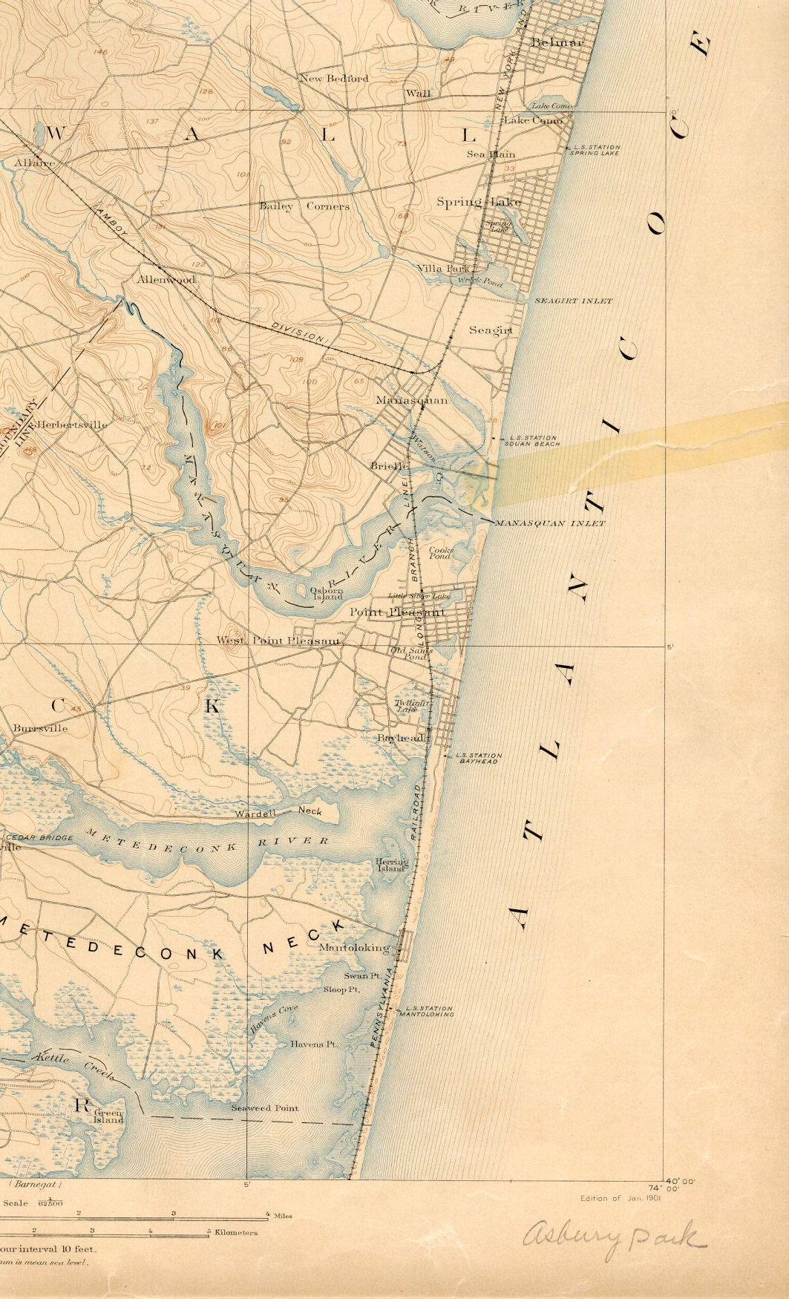
Historical topographic maps
Downloaded from historical.mytopo.com
Georeferenced using modern road networks where they overlapped with historic roads
Digitized “submerged marsh or swamp”

Slide 7
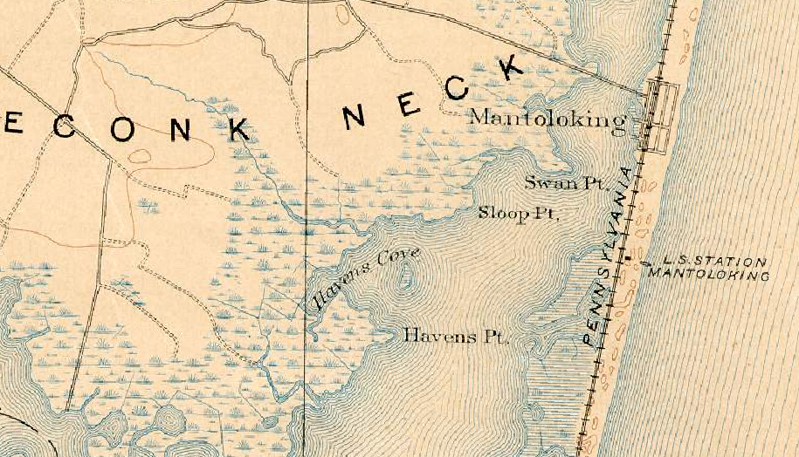
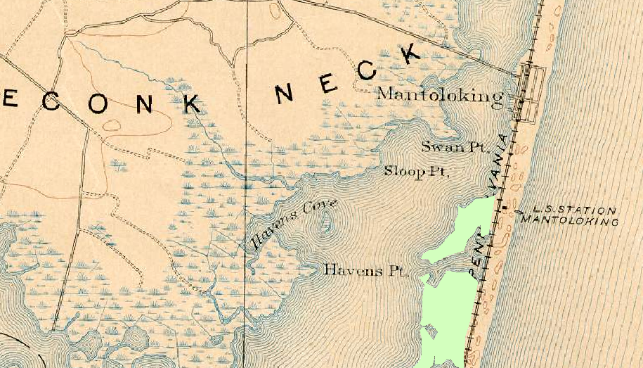
Digitized historical submerged marshes

Slide 8
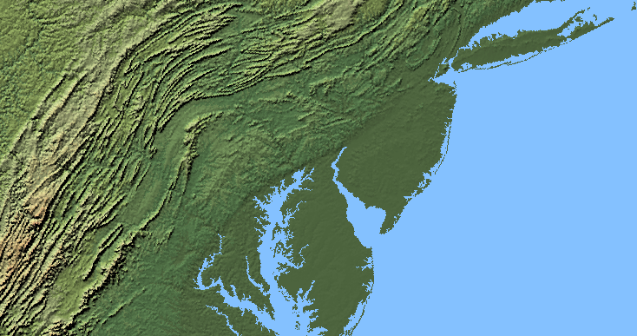
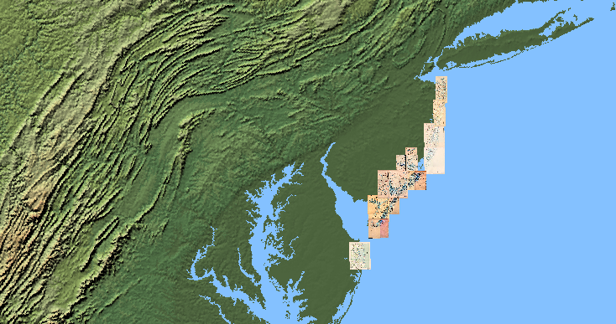
For New Jersey Shore and Delaware

Slide 9
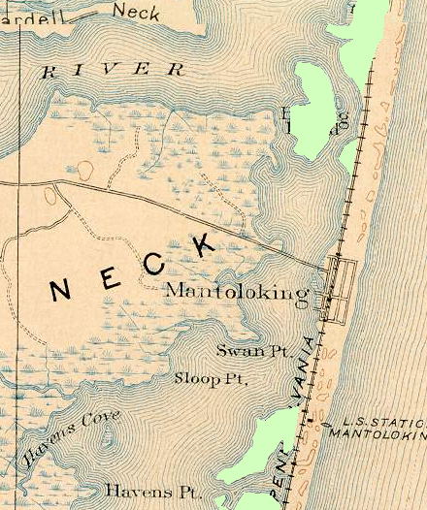
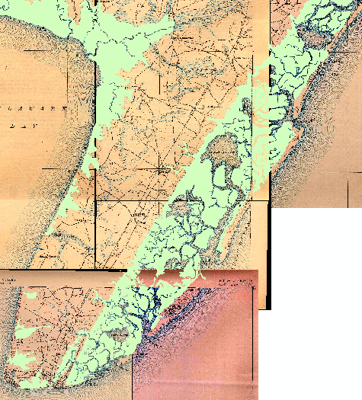
Total area of historic marshes
Twelve historic 15’ USGS topographic maps
Published from 1883 to 1918
Digitized submerged marsh
Produces a conservative estimate of marsh/wetlands
510 km² of marshes in New Jersey & Delaware

Slide 10
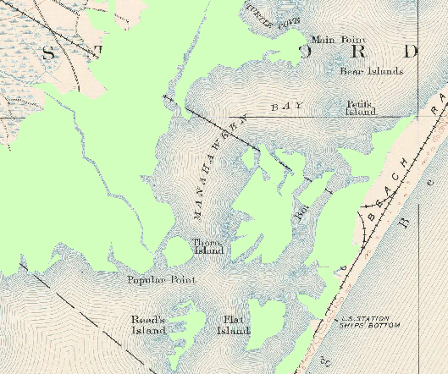
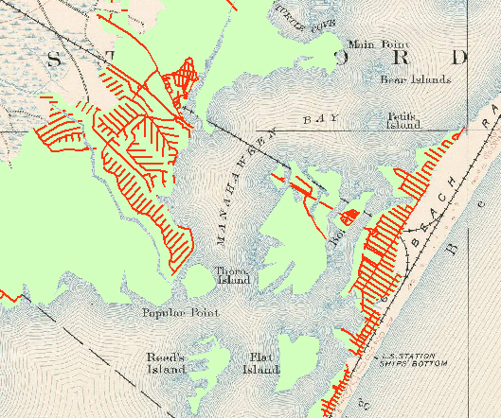
Present-day roads on marshes
In GIS selected current roads built on these marshes
1320 km of roads in New Jersey and Delaware built on submerged marshes

Slide 11
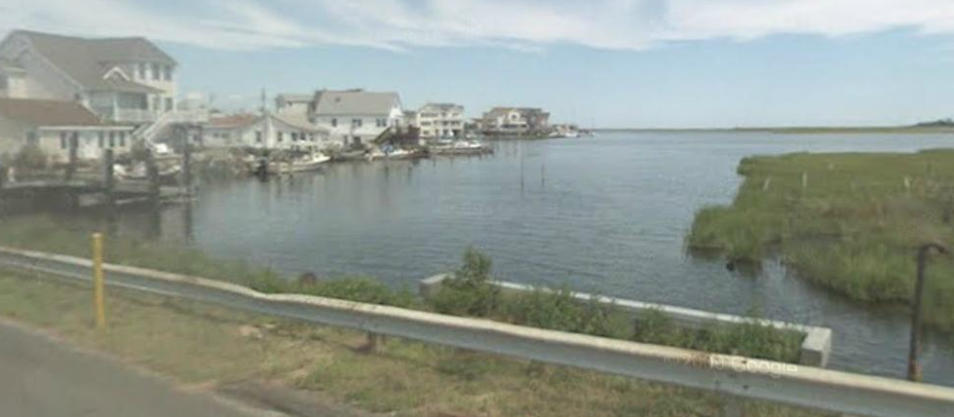
Roads as a proxy for development
Development on historic marsh
Historic marsh
Image from Google Maps Streetview

Slide 12
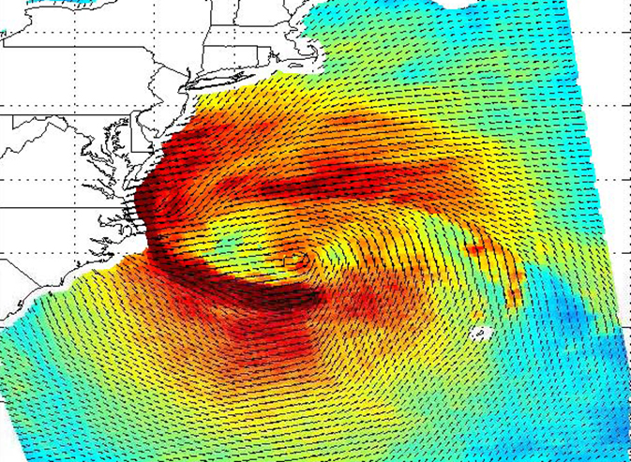
Hurricane Sandy’s rotation and landfall: worst surge in NJ/NY
Image courtesy ISRO/NASA/JPL-Caltech

Slide 13
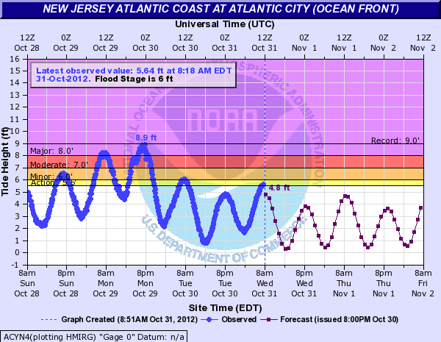
Storm surge and local high tides coincided
water.weather.gov/resources/hydrographs/acyn4_hg.png

Slide 14
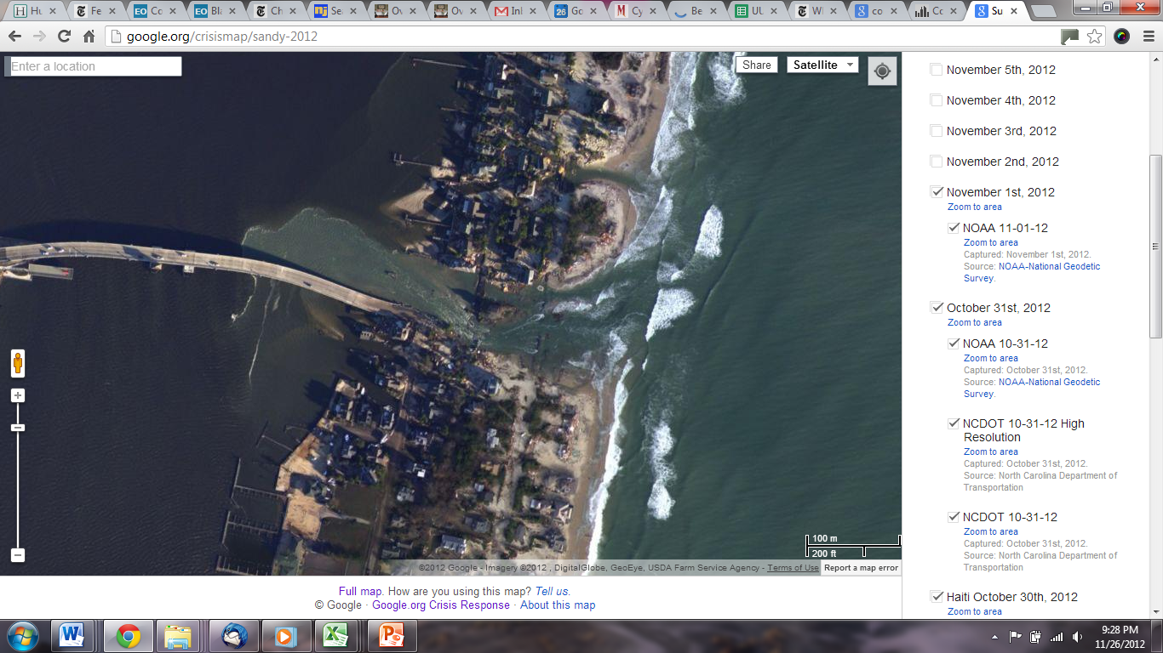
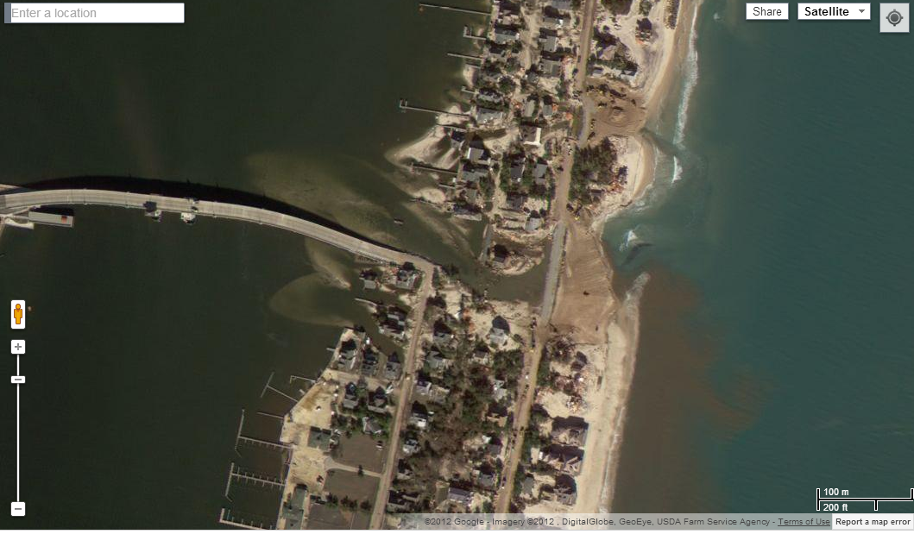
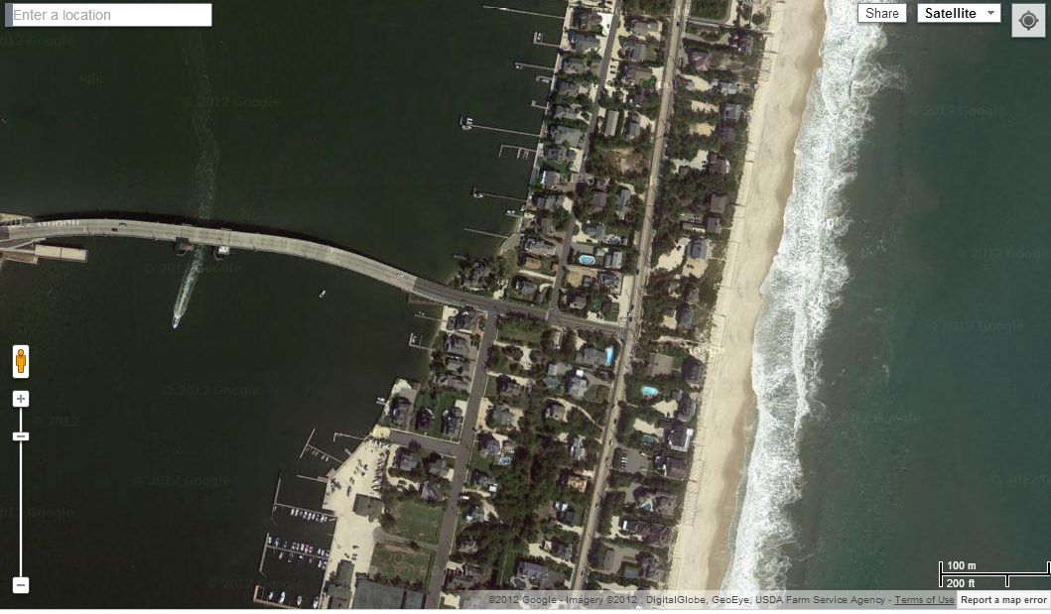
Pre-Sandy
Sandy + 3 days
Sandy + 7 days
google.org/crisismap/sandy-2012

Slide 15
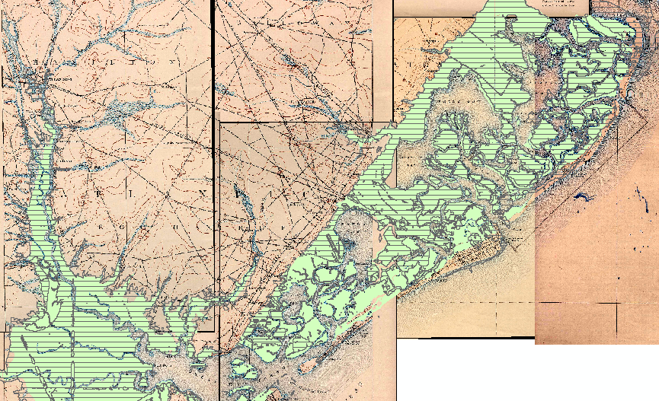
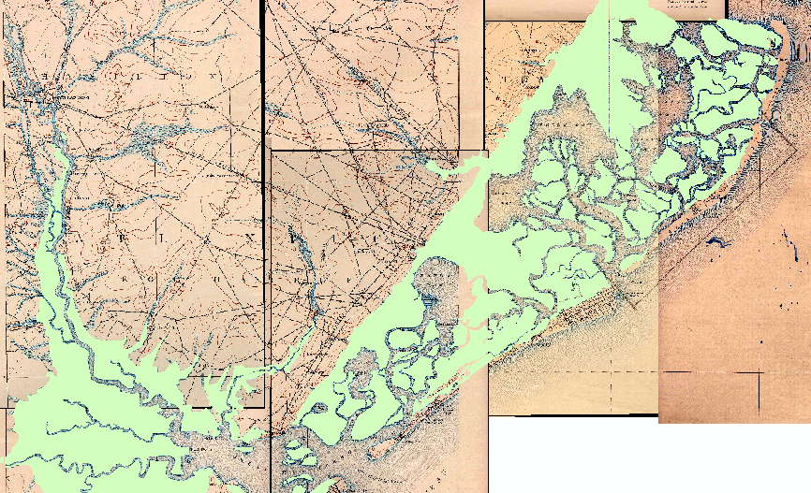
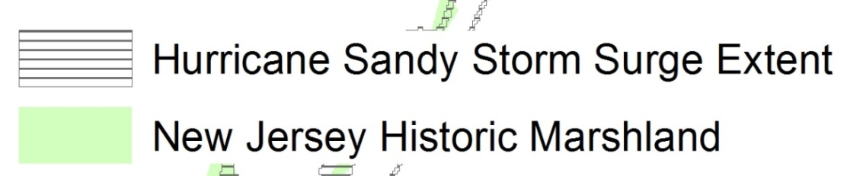
Historic marshes and USGS-mapped Sandy storm surge

Slide 16

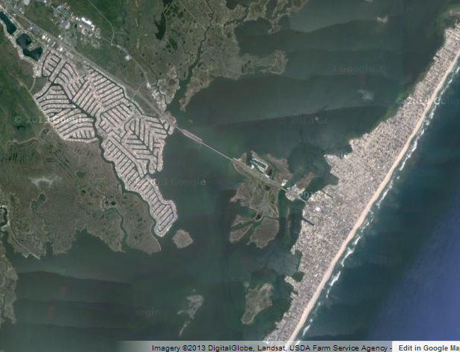
Correlation between storm surge & historic marshes & development
70% of New Jersey historic marshes (mean 1.2 m ASL) were covered by the Sandy storm surge (up to 2.7 m ASL)

Slide 17
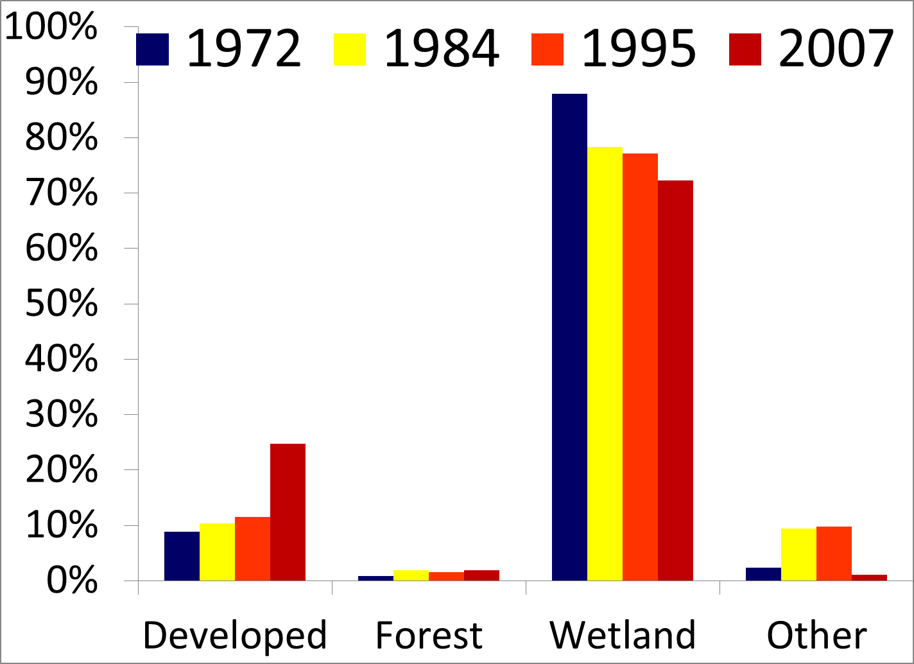
Land use patterns on these historic marshes
1972-1995 data from CRSSA at Rutgers
2007 data from NJDEP

Slide 18
1930’s
2007
1930’s
2007
Hurricane Sandy

Slide 19
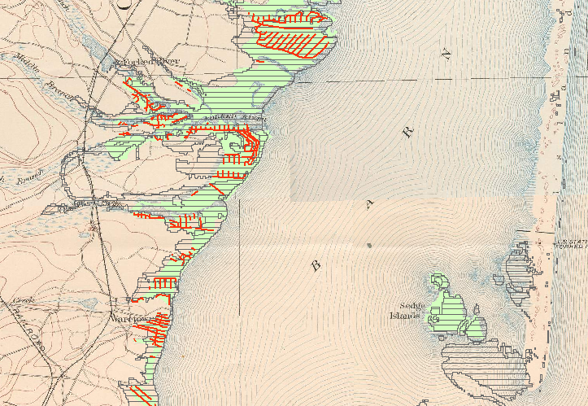
Undeveloped portions still remain
Modern roads
State Park

Slide 20
Conclusions
510 km² of historic marshes on which are now built 1320 km of roads in New Jersey and Delaware
Hurricane Sandy storm surge (up to 2.7 m ASL) covered 70% of these historic submerged marshes (average elevation 1.2 m ASL)
~2/3 of the development on these marshes have occurred since 1995
~30 cm of regional sea level rise

Slide 21
Marshes have the ability to adjust to sea level rise Urban areas static or sinking
Development on historic marsh
Historic marshes

Slide 22
Conclusions
510 km² of historic marshes on which are now built 1320 km of roads in New Jersey and Delaware
Hurricane Sandy storm surge (up to 2.7 m ASL) covered 70% of these historic submerged marshes (average elevation 1.2 m ASL)
~2/3 of the development on these marshes have occurred since 1972
~30 cm of regional sea level rise
Legacy of misguided development patterns leaves us where we are today

