Slide 1
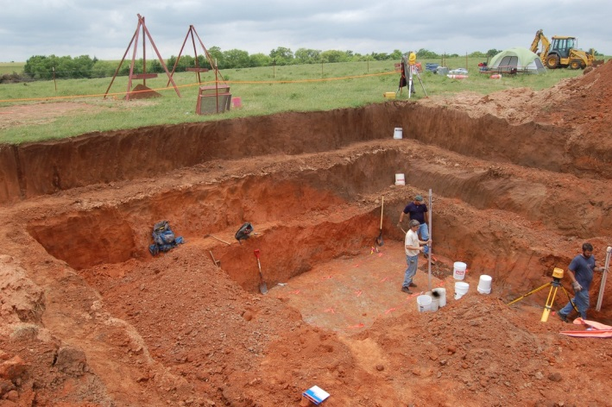
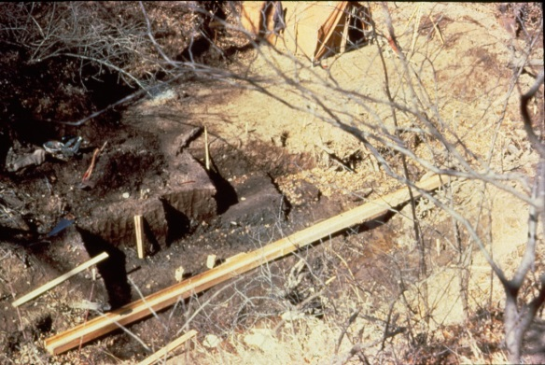
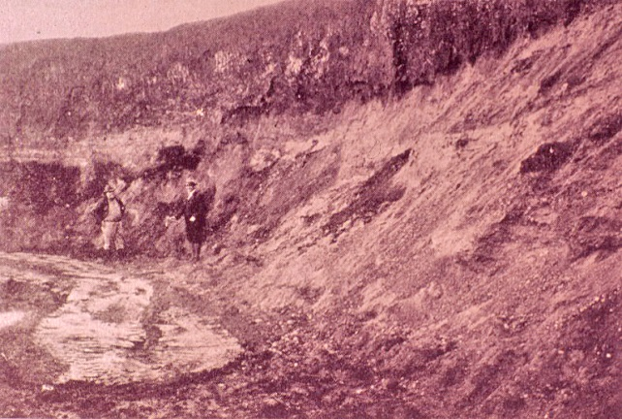
Geoarchaeology in Oklahoma:
A Historical Perspective
2007
1962
Don G. Wyckoff
Curator Emeritus
Sam Noble Oklahoma Museum
of Natural History
Oklahoma University
With the kind assistance of
Lee Bement, Neil Suneson, Brian
Carter, Elsbeth Dowd and Marc
Levine of SNOMNH.
1929
1901

Slide 2
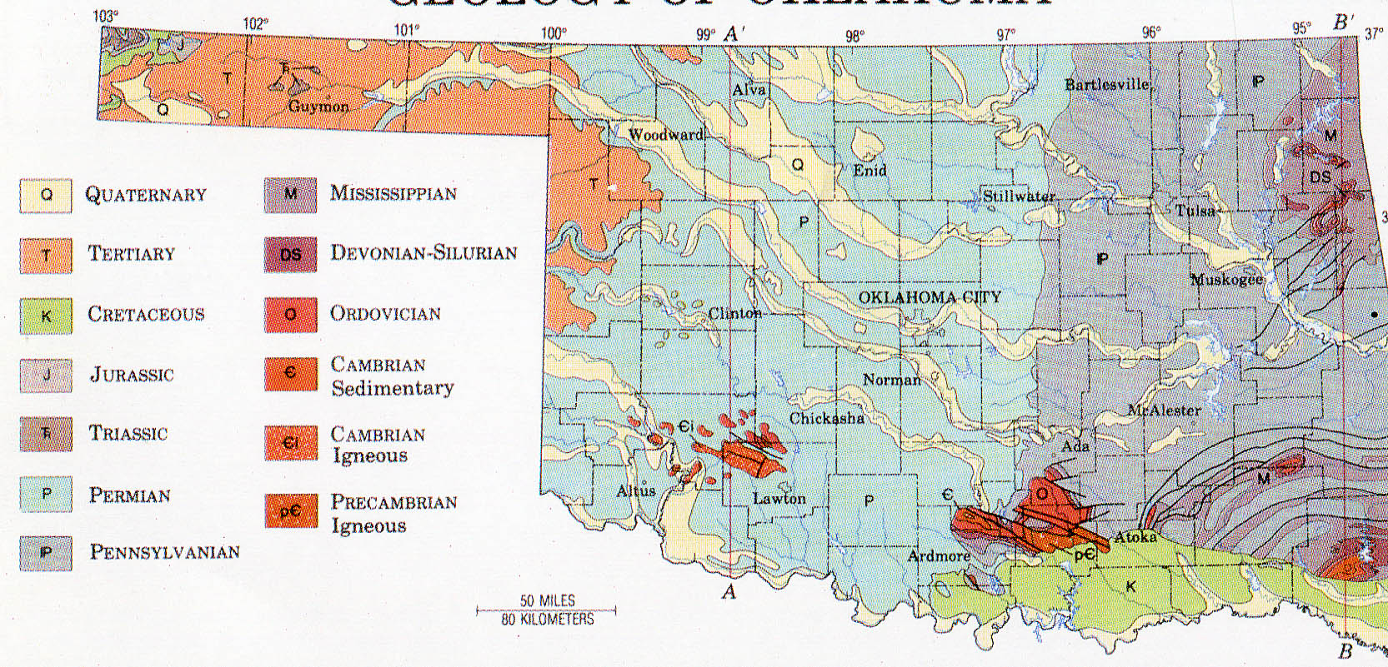
Oklahoma Surface Geology: Exposures and Geological Times
Sporadic research of
valley fills and terraces
in this part of Oklahoma by
Joe Artz, Reid Ferring,
Peggy Guccione, Luther
Leith and Don Wyckoff
Majority of past and current geoarchaeological studies
occur in western 2/3rds of Oklahoma. Permian
sandstones and shales more erodible and help create
deeply stratified exposures of paleosols and gleyed
Pleistocene sediments.

Slide 3
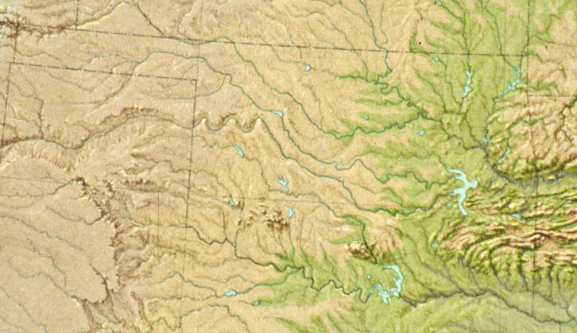
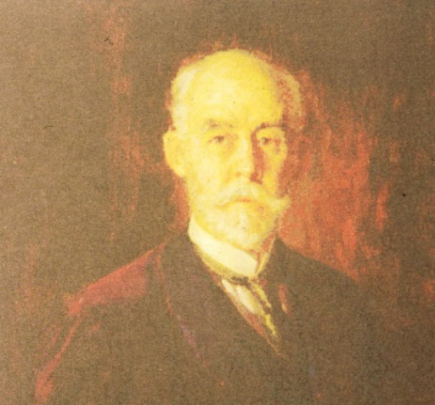
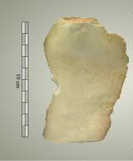
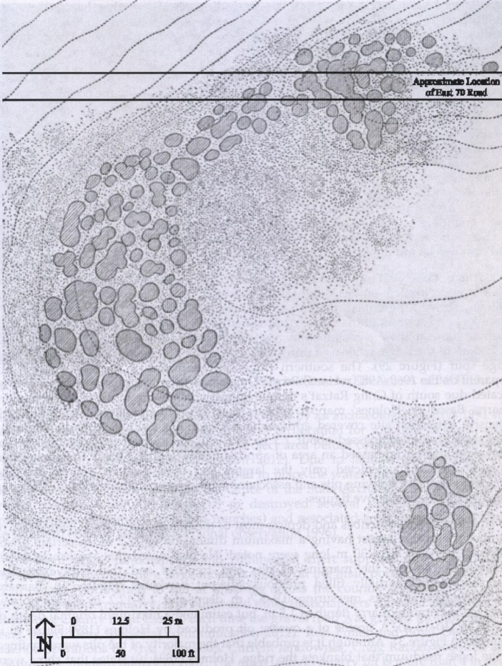
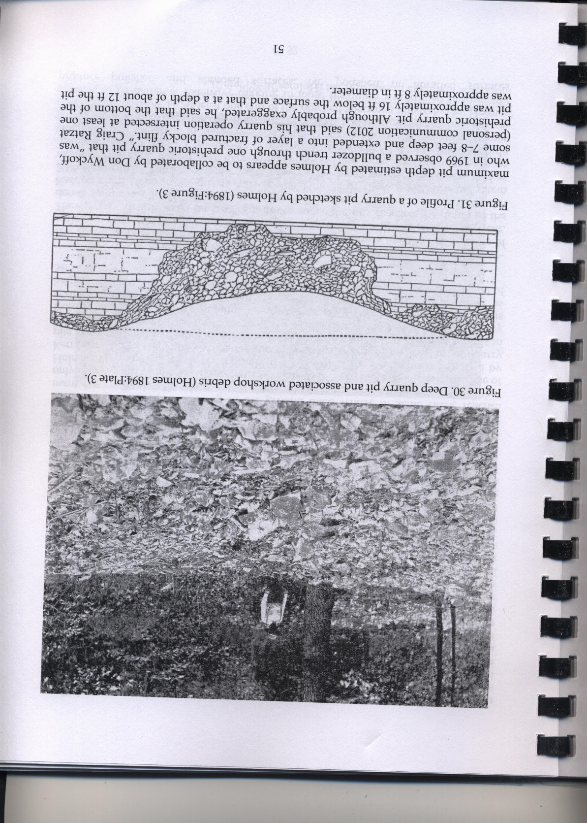

Study of the Peoria Flint Quarries, 1894, by William Henry Holmes, Smithsonian Institution
Peoria x
Quarries

Slide 4
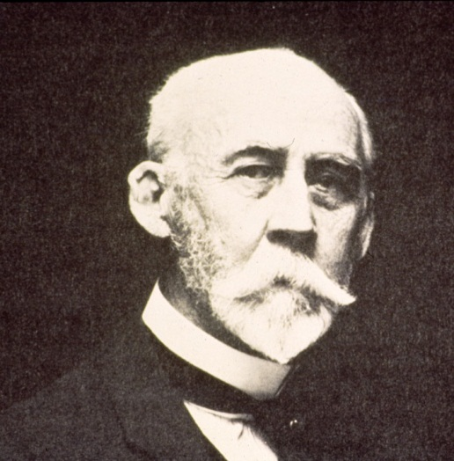
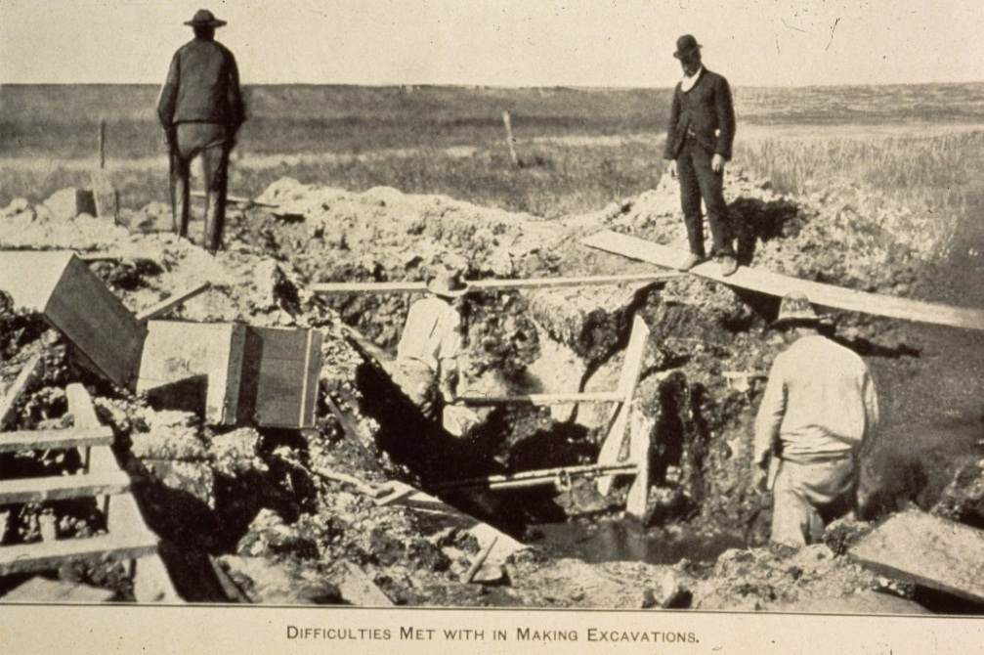
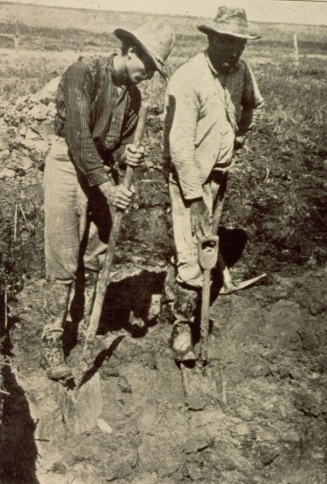
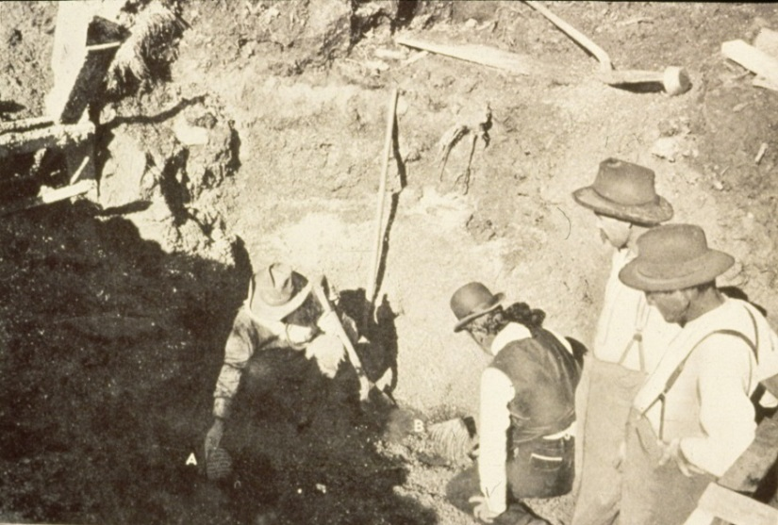
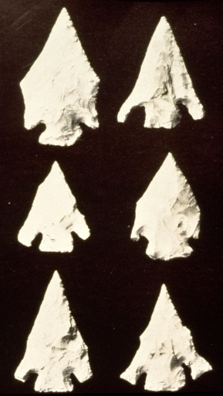
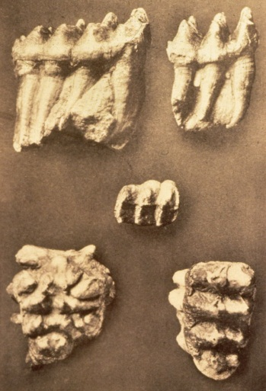
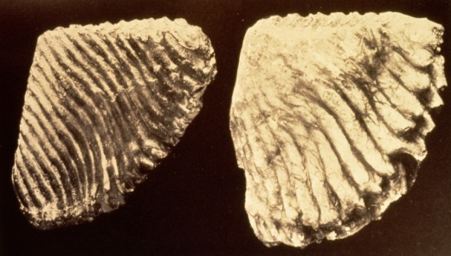
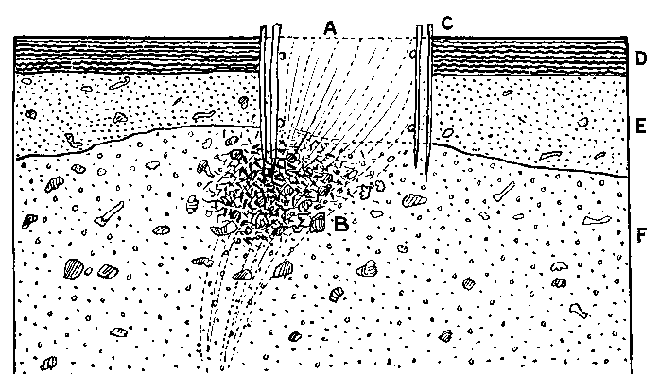
1901, W.H. Holmes of Smithsonian comes to Afton
Springs, Indian Territory to assess artifacts possibly
with ice age animals.
Conclusion: pulses of spring flow mixing ice age
animal bones with prehistoric artifacts being
tossed into spring

Slide 5
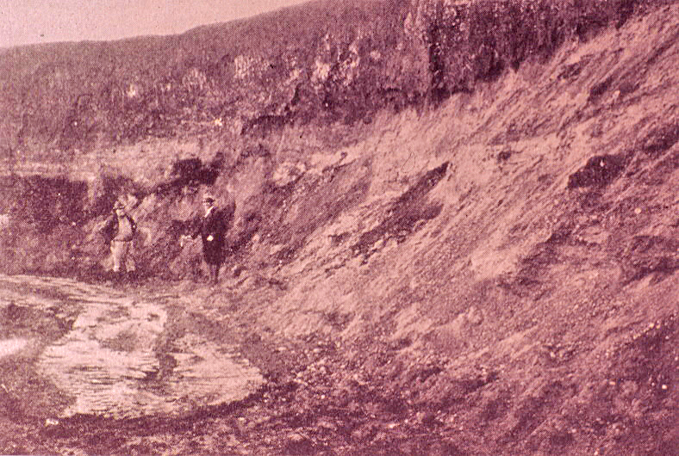
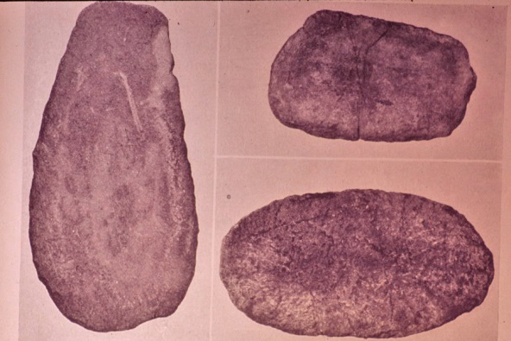
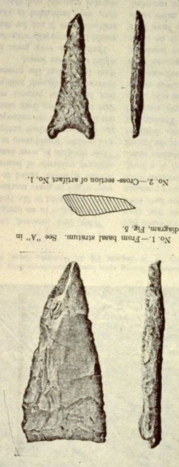
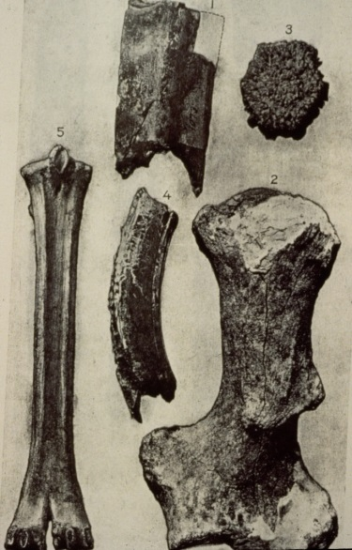
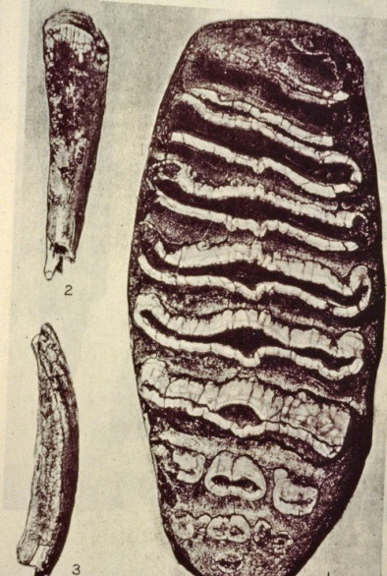
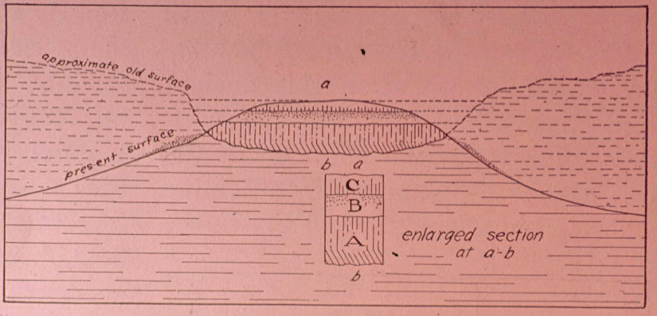
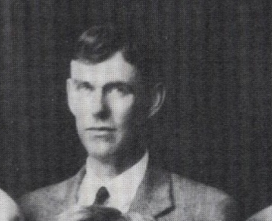
Holloman Gravel Pit,
Tillman County, 1926-1929
Claims of association by H.J. Cook
Interpretation of co-occurrence by
Oren Evans, Geology Department, O.U.
Oren F. Evans
1927 Ph.D.
U. Of Michigan
Oren Evans 1930 reconstruction of setting
(Journal of Washington Academy of Science)
Fossils are forms extant 600,000 bp; W.W. Dalquest

Slide 6
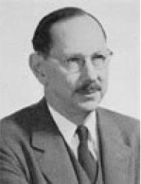
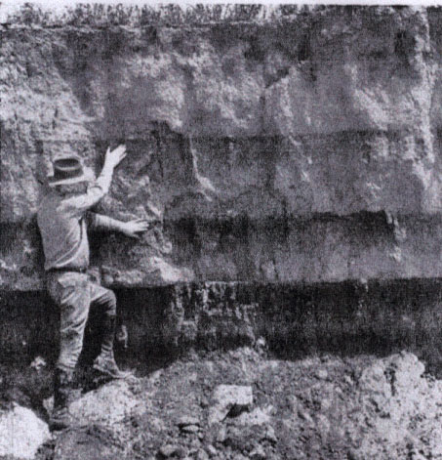
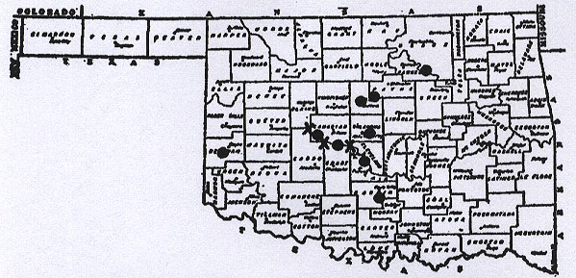
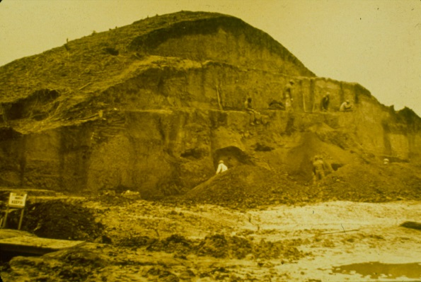
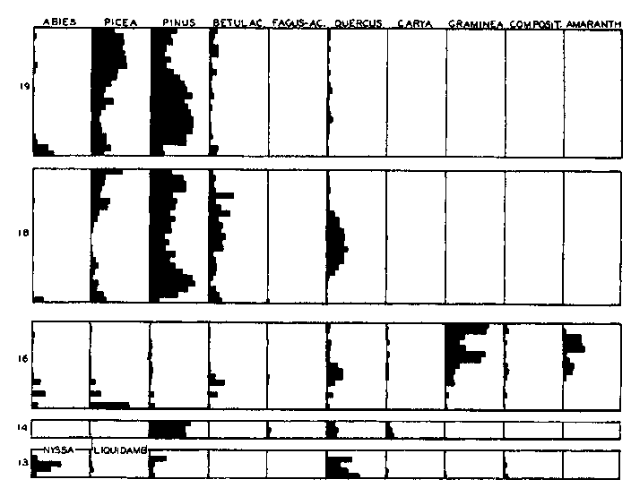
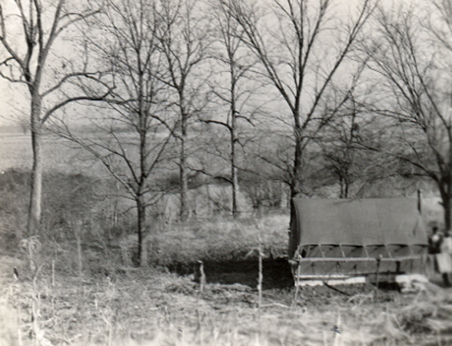
Paul B. Sears, Oklahoma University
1927-1938
Central Oklahoma buried soils and implications of the past:
Palynology at Spiro Mounds

Slide 7
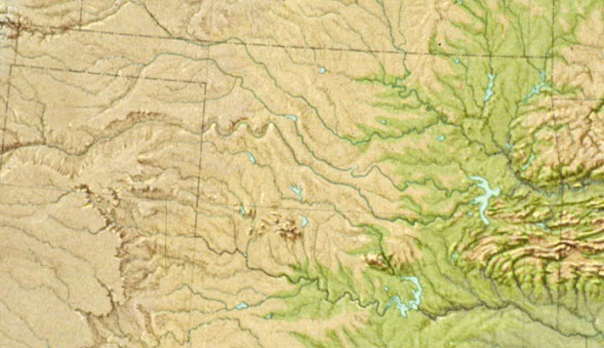
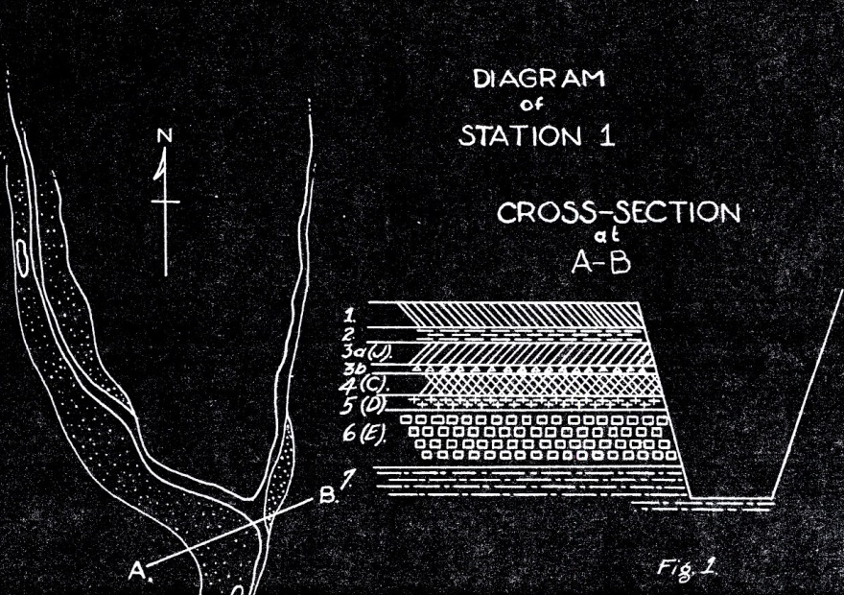
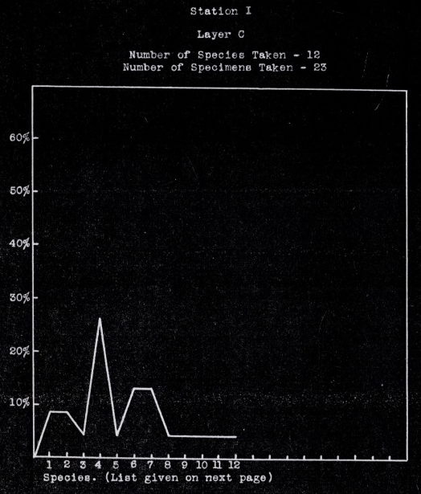
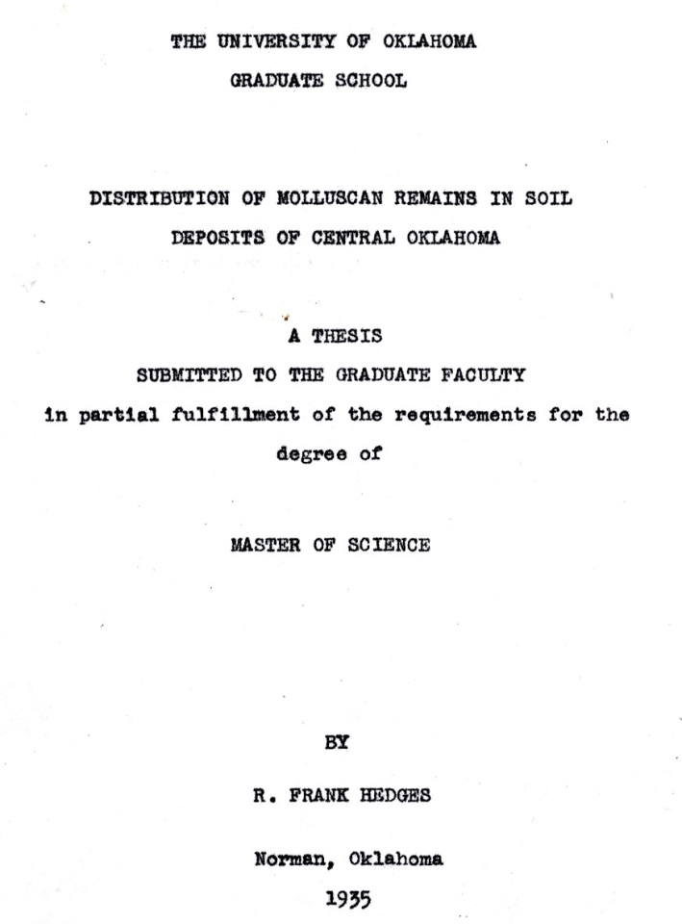
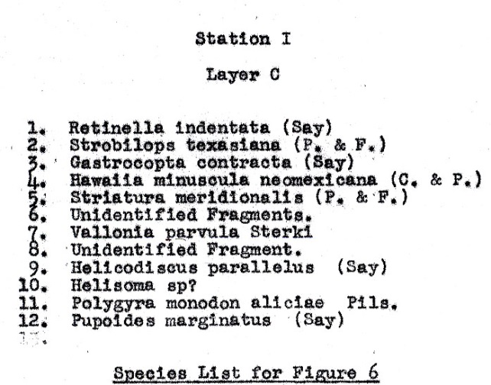
Paul Sears’ influenced research: study of gastropods recovered from stratified buried
soils in Canadian River drainage, McClain County, Oklahoma
R. Frank Hedges M.A. research, 1935

Slide 8
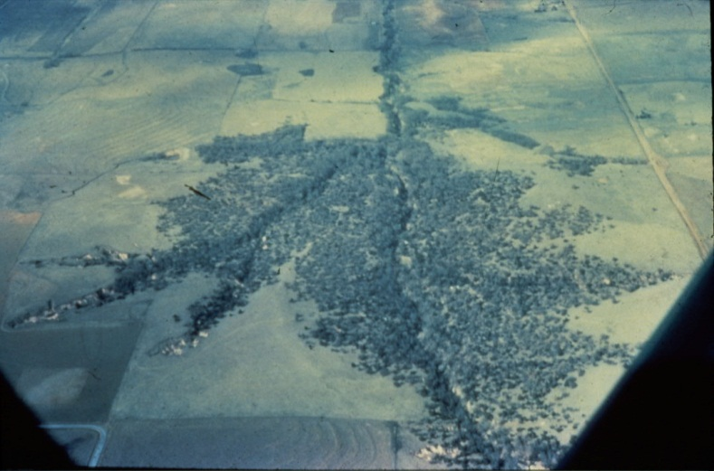
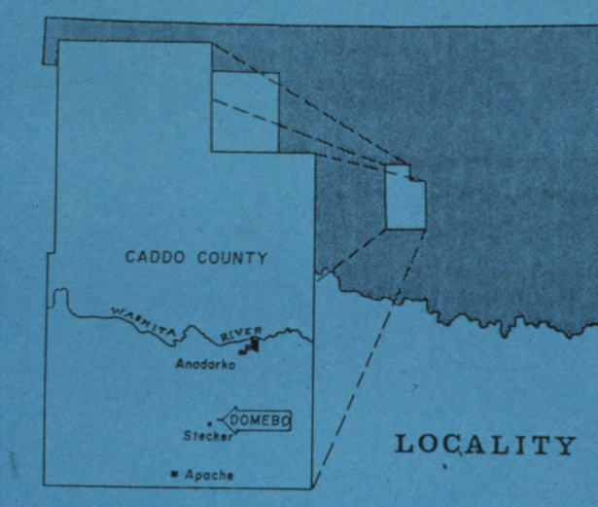
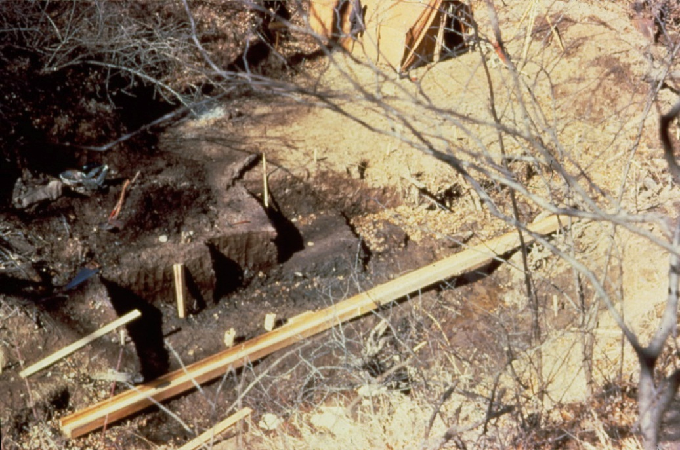
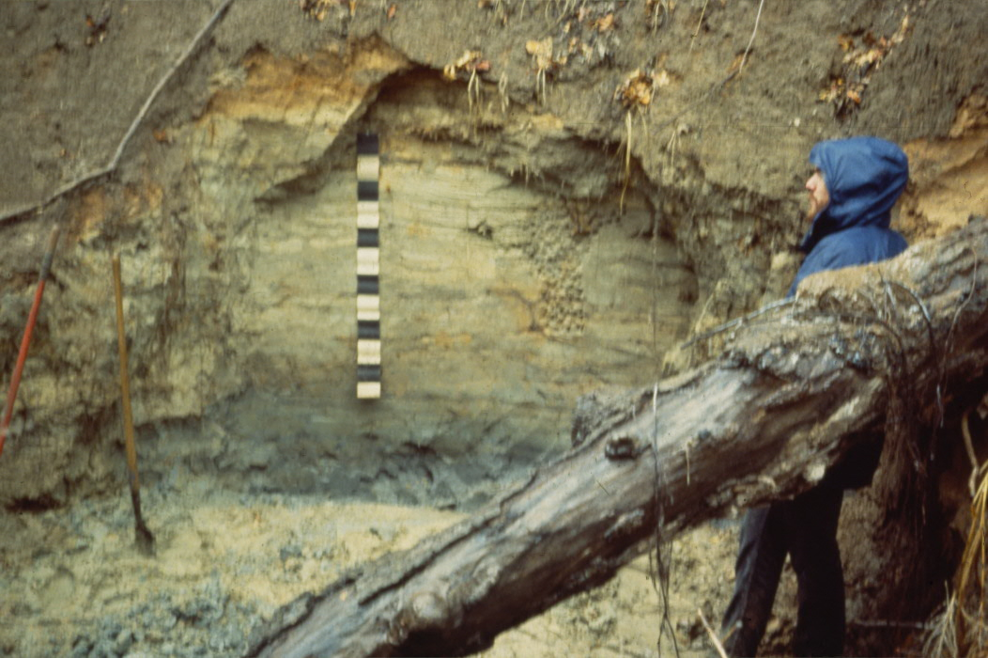
Domebo Site,
Caddo County, Oklahoma
A multidiscipline
project undertaken
in 1962 by the
Museum of the Great Plains
Lawton, Oklahoma
Note stratified alluvial
deposits over the organic
rich “Domebo Formation”
The “Domebo Formation” as it was being excavated 1962.

Slide 9
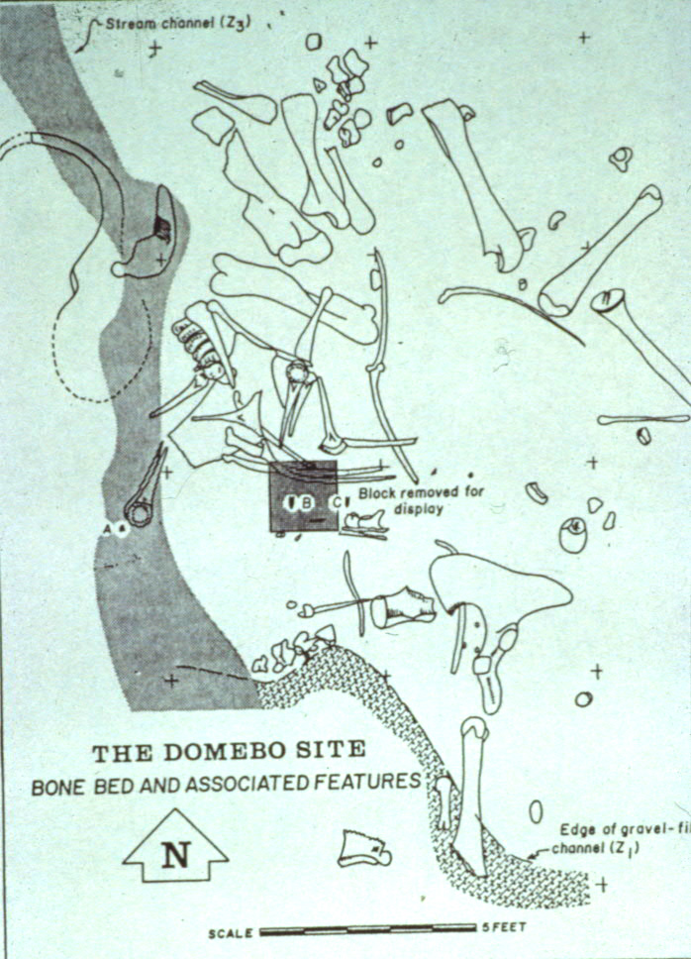
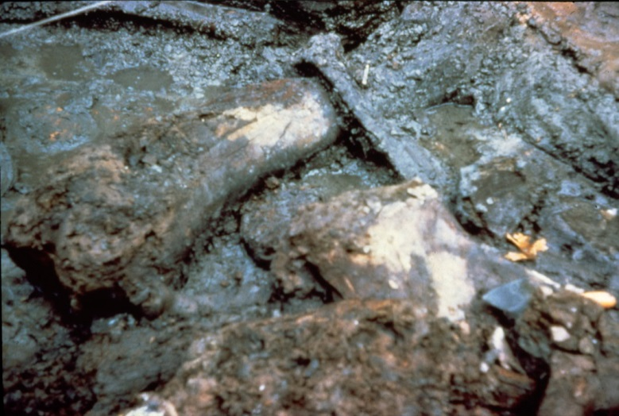
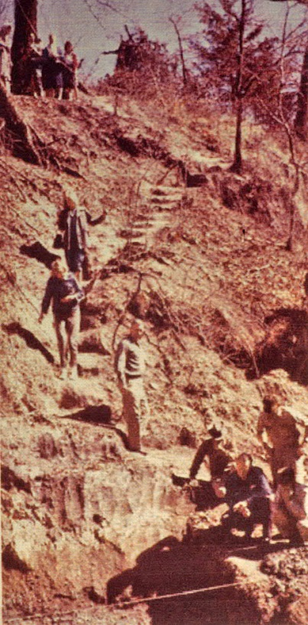
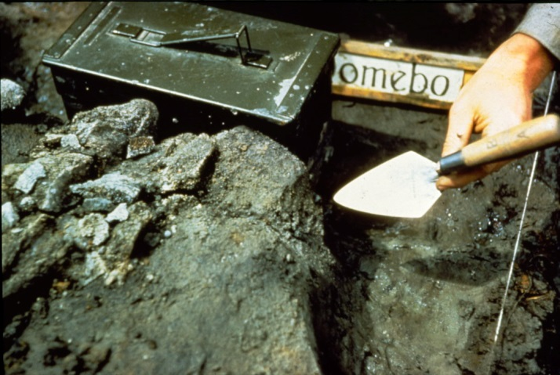
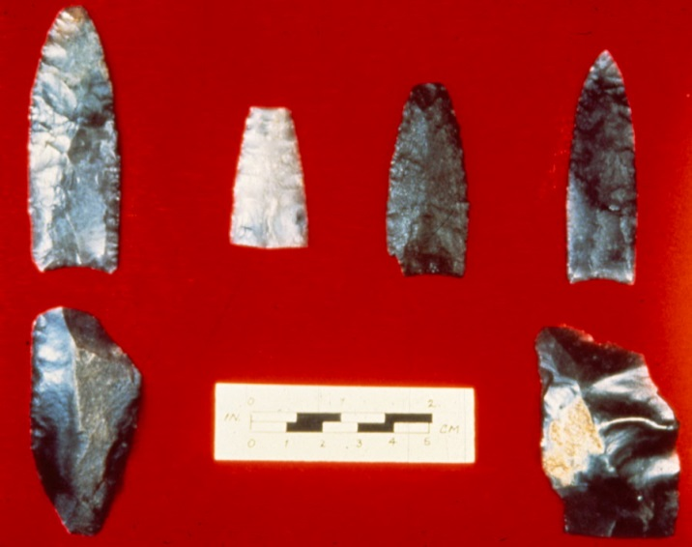
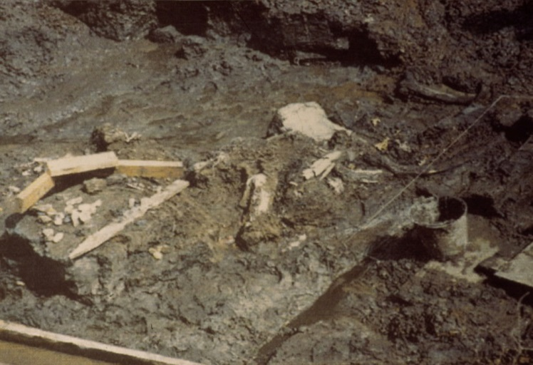
Domebo Site, Oklahoma
January 1962
The associated artifacts
Domebo mammoth bones used
by Tom Stafford to assess
which bone proteins were most
reliable for AMS dating.
He assessed Domebo mammoth
at 11,100 rcybp.

Slide 10
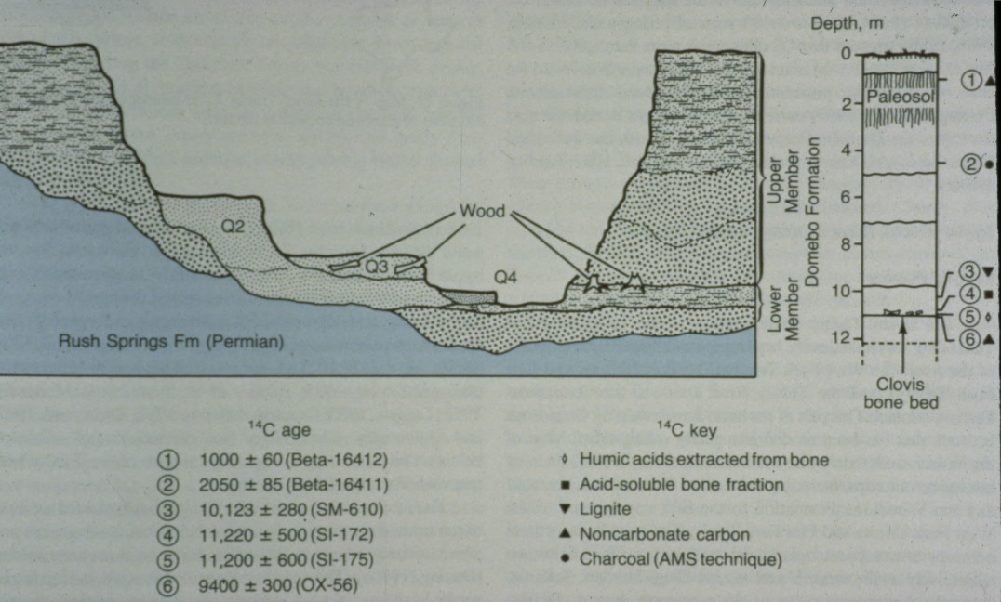
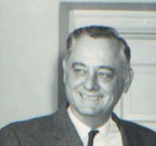
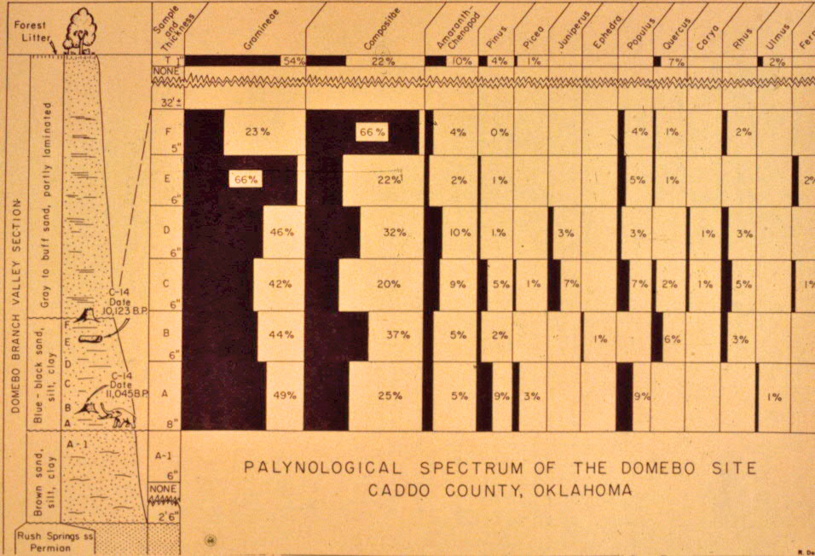
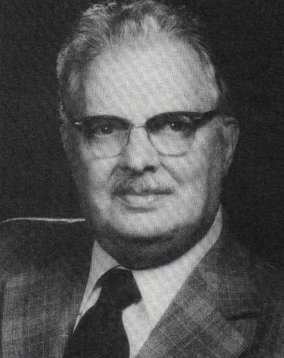
The Domebo site deposits as
recorded and interpreted by
Claude C. Albritton
The pollen record
as extracted and
counted by
L.R. Wilson

Slide 11

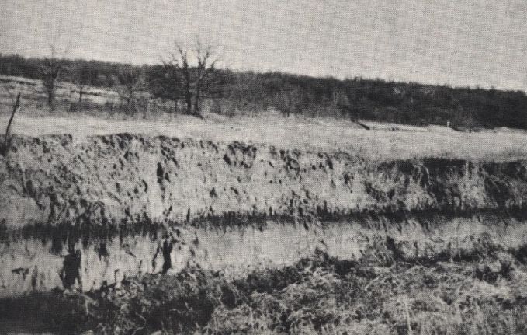



Stephen A. Hall
A Paleosol in Central Oklahoma and Its Archaeological Significance
Bulletin of the Oklahoma Anthropological Society16:151-154.
x Cleveland
County
Paleosol
C. Reid Ferring: 1982, The Late Holocene Prehistory of Delaware Canyon, Oklahoma.
Delaware Creek
paleosol
X Delaware Creek
Delaware Creek Paleosol: 600 rcybp
Caddo County Paleosol: 1325-1025 rcybp
Caddo County paleosol

Slide 12




600 rcybp
1200 rcybp
3000 rcybp
Cut and Fill
Johnson Exposure, Wild Horse Creek, Garvin County
2010 Geoarch Class, University of Oklahoma
3000 rcybp
6500 rcybp

Slide 13




Paleoindian Bison Kills along the Beaver River, Harper County. 1991 to Present
: Lee Bement, Okla. Arch. Survey
Brian Carter, O. S. U.
X Beaver River
Investigations
Although remote sensing equipment did not yield results, systematic coring in
aeolian and colluvial sediments on a
terrace north of the river has found 6 prehistoric gullies, 2 with bison bones and, usually, Folsom or Clovis artifacts.
Cooper Bison Kill (Folsom)
Jake Bluff Bison Kill (Clovis)

Slide 14





Cooper Site, Harper County: Issue of stratified 3 bone beds
Folsom
points
by bone
bed
Trampled painted Bison antiquus
skull in lowest bone bed.
Trampled bones in lowest 2 bone beds

Slide 15






X Hajny Mammoth Site
Hajny Mammoth Site,
Dewey County
1985-1986
Okla. Archeological Survey

Slide 16





Hajny Mammoth Site, 2nd Terrace, Canadian River, Dewey County, Oklahoma
Aerial view of site and excavations
Before excavation, gleyed spring deposits contrast
markedly with surrounding sediments
Spring vent through cross bedded fluvial sands
Uncovering mammoth bones adjacent to and in spring vent.
U/Th dating of teeth: 150,000 bp.

Slide 17




The Burnham Site
Woods County, Oklahoma
1986-1992 (NGS, NSF, OASurvey, and OASociety)
Don G. Wyckoff, Kent Buehler, Brian Carter,
G. Robert Brakenridge, Wakefield Dort, Nick Czaplewski,
Larry Martin, Larry Todd, and Jim Theler
South edge of Fenneman’s “Red Hills”, isolated remnants of the High Plains with Permian
red beds capped by chert-bearing dolomite which is overlain by thin Ogallala Formation
View East
Three exposures of
gleyed lacustrine
sediments with bones
of horse, camel, sloth,
and bison.
1
2
3

Slide 18




October –November 1986
recovery of bison skull and
deposit sampling
2x2 meter grid laid over bison skull and
removed in 10 cm levels and water
screened through 2 mm mesh
Bison
chaneyi
or
alleni

Slide 19




Subsequent sorting of water-screen residue
By June of 1987:
4 flint flakes with flaked
dorsal faces, 3 with platforms.
None larger than 1.5cm in
maximum length.
All from gray sediment around
bison skull.
1cm
1 cm
Biface trimming flake

Slide 20


1986-1992
Manual, Coring &
Backhoe Excavations
1992 Backhoe and Bulldozer Exploration

Slide 21











Some of 54
Flaked objects
from
the Burnham
Site.
All recovered
within 2 m of
bison remains
And in same
stratum
Multi-purpose
flaked tool
Wedge out of
biface
Flaked
Cobble

Slide 22







Lowest Deposit in Broader Stratigraphic Context
Uppermost
Pond deposit
11,000 BP
West Edge
Lowest pond
3nd pond deposit
Calcic horizons
Asimina
triloba, >38,000 BP
34,500 BP
Paleosol, 36,000 to 38,000+ BP

Slide 23


Dating the
Artifact Bearing
Stratum
Charcoal washed in
between 1988 and 1989

Slide 24






Powell Farm Investigations-2007
Canadian County, Oklahoma
Don G. Wyckoff, Nick Czaplewski, and
Brian Carter
X Powell Farm
Artifact Age ?
Mastodon (juv.)
15,000 rcybp
17,000 rcybp
1949
Materials
recovered
by
J. Willis Stovall
investigations
19,000 rcybp
Mammoth
Camel

Slide 25



2007 Field Work at Powell Farm, Canadian County, Okla.
NE Pit
West Pit
Fluvial deposit
with mammoth
15-16,000 BP
Mid-Wisconsinan lacustrine deposit
33,000 to 37,000 rcybp
SE Pit

Slide 26


New Zealand (Rafter Lab)
AMS dating of mammoth
teeth: 16,000 rcybp

