Slide 1
The Effect of Surface Lithology on Arsenic and other Heavy Metals in Surface Water and Groundwater in Mustang Valley, Nepal Himalaya
Steven H. Emerman¹, Janae R. Nelson¹, J. Kade Carlson¹ Tracy Kemp Anderson¹, Anusha Sharma², Basanta Raj Adhikari²
¹Department of Earth Science, Utah Valley University
²Department of Geology, Tri-Chandra Campus, Tribhuvan University

Slide 3
Dominant Paradigm for Arsenic Contamination of Groundwater in South Asia
In strongly reducing conditions of thick sedimentary package, micro-organisms break down iron oxyhydroxides for energy (reductive-dissolution model).
This model assigns no responsibility to any human activity.

Slide 4
Competing Sulfide-Oxidation Model for Arsenic Contamination of Groundwater
Oxidation of sulfide minerals results in release of co-precipitated arsenic.
Sulfide oxidation could result from overpumping of aquifers.

Slide 5
Comparison of Fluvial As between Higher Himalayan and other Zones

Slide 6
Fluvial Recharge Model
All of the existing models are thermodynamically plausible, but the kinetics are too slow.
Groundwater is recharged by losing streams with elevated arsenic due to accelerated erosion caused by monsoon climate, tectonic uplift, deforestation and rangeland degradation.

Slide 7
Why does Accelerated Erosion cause Elevated Arsenic in Surface Water?
Accelerated erosion results in higher concentration of dissolved solids in overland flow.
In rapid overland flow, the large As oxyanion has too much kinetic energy to attach to sorption sites and not enough residence time at a sorption site.

Slide 8
Objectives
Document the occurrence of elevated arsenic in the three major tectonic valleys of Nepal Himalaya (Kathmandu Valley, Pokhara Valley and Mustang Valley) with particular attention to sources of drinking water
Test the fluvial recharge, reductive-dissolution and sulfide-oxidation models in these tectonic valleys

Slide 10
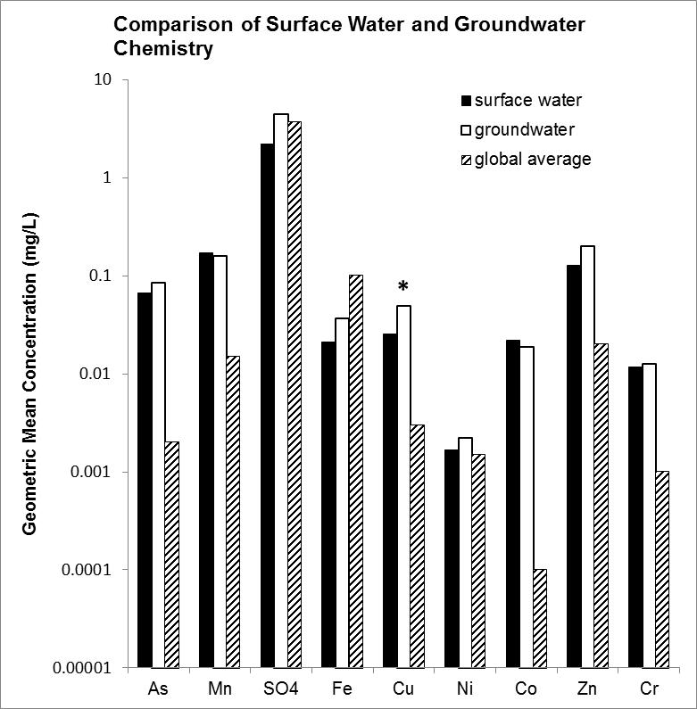

Slide 11
Methods: Mustang Valley
Water samples were collected from 24 streams, four canals or pipes fed by streams, five public faucets fed by streams, 10 springs, and 14 public faucets fed by springs.
There are no wells in Mustang Valley.
pH, electrical conductivity and temperature measured on-site
As, transition elements (Fe, Cu, Ni, Co, Mn, Zn, Cr) and SO₄ measured with Hach DR-2700 Portable Spectrophotometer

Slide 13
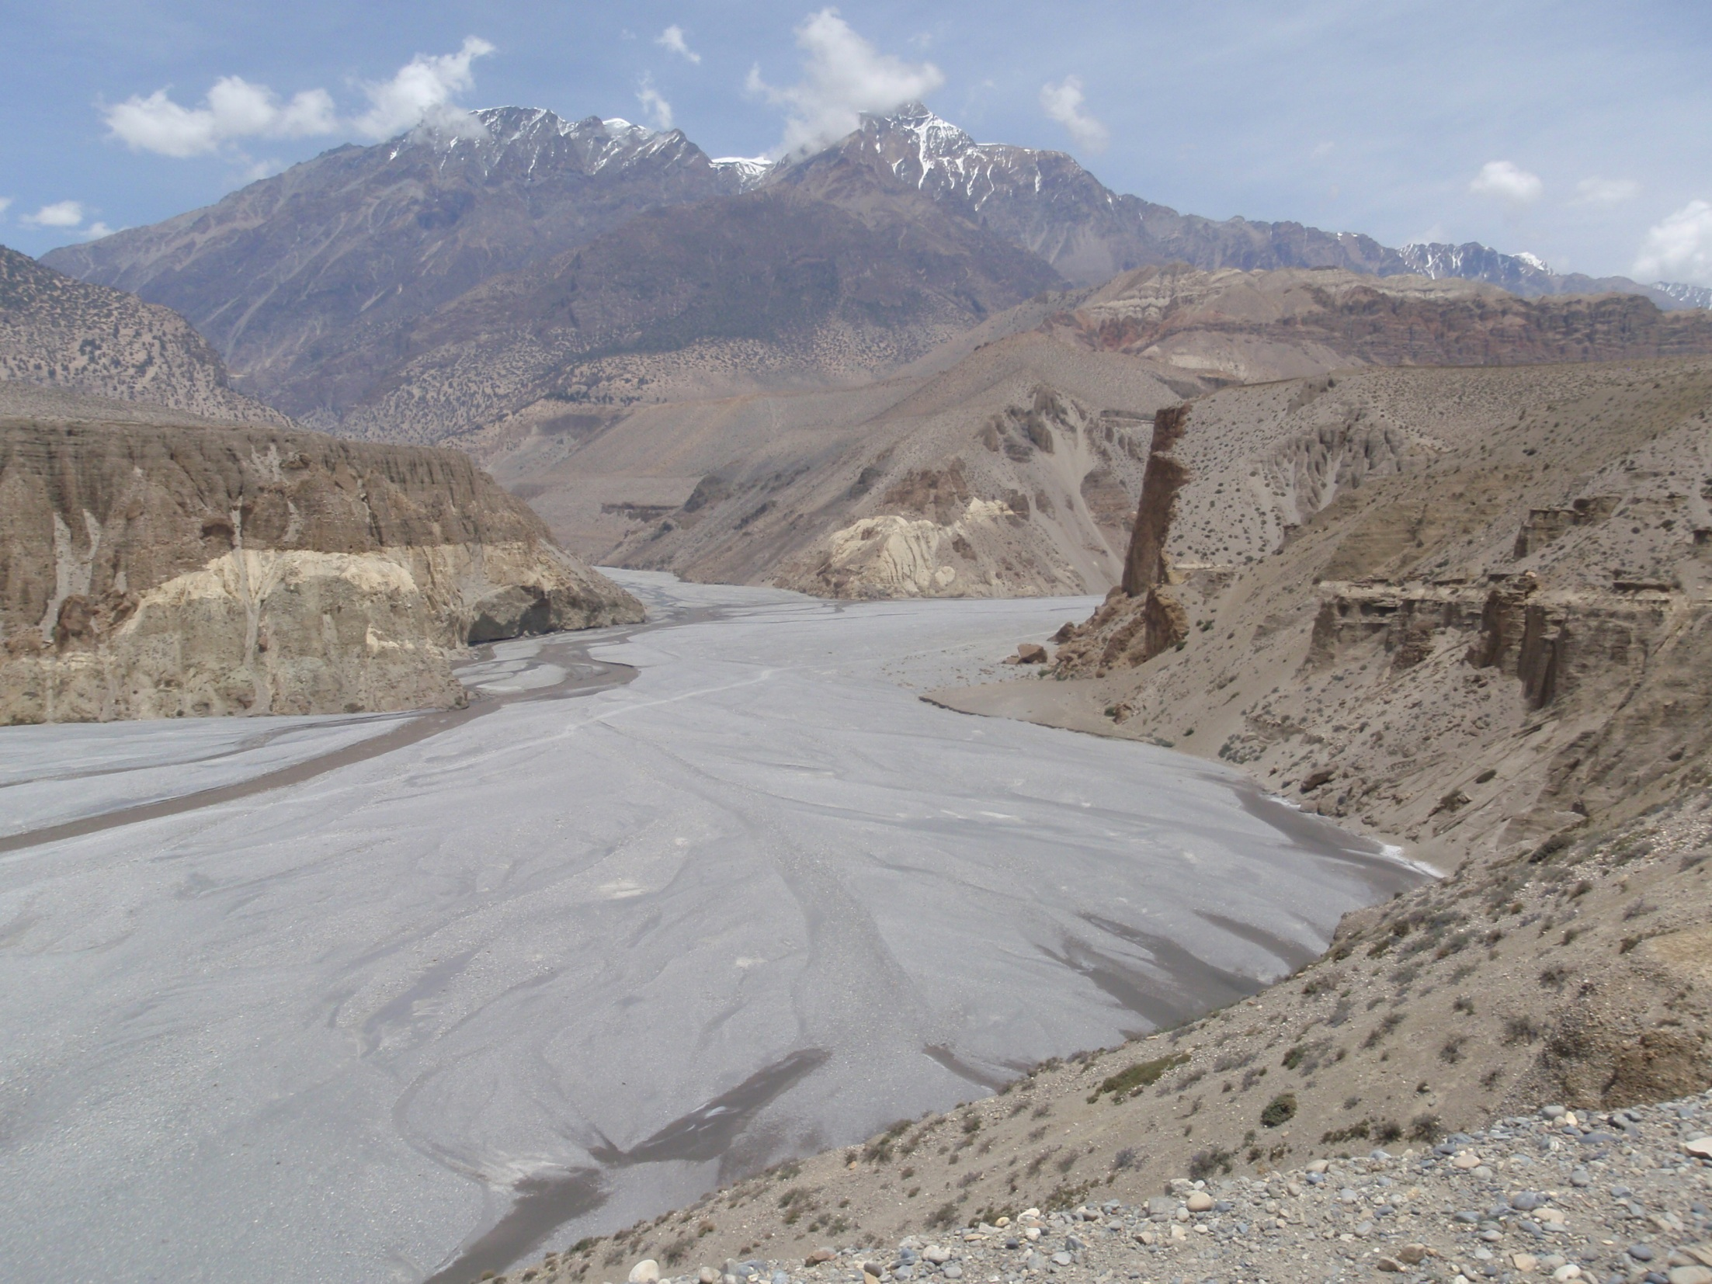

Slide 14
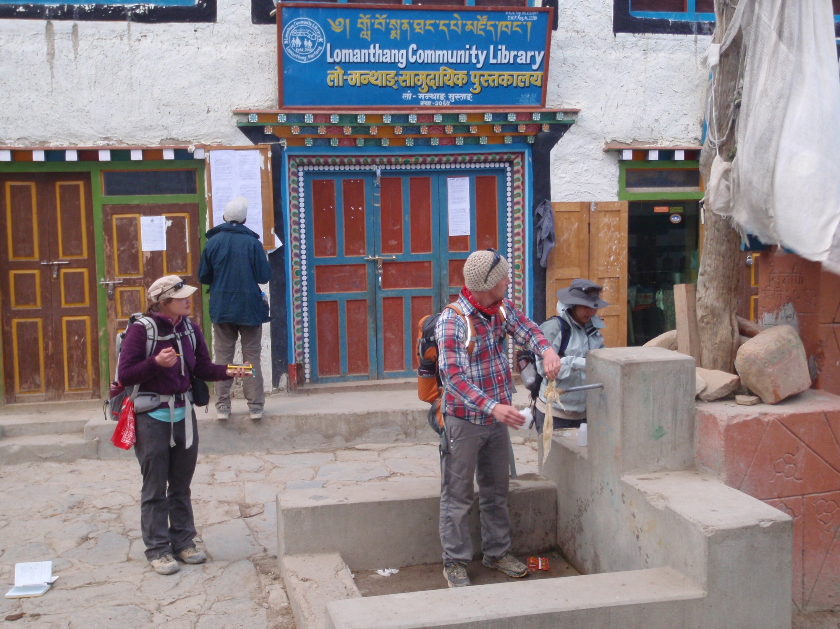

Slide 15
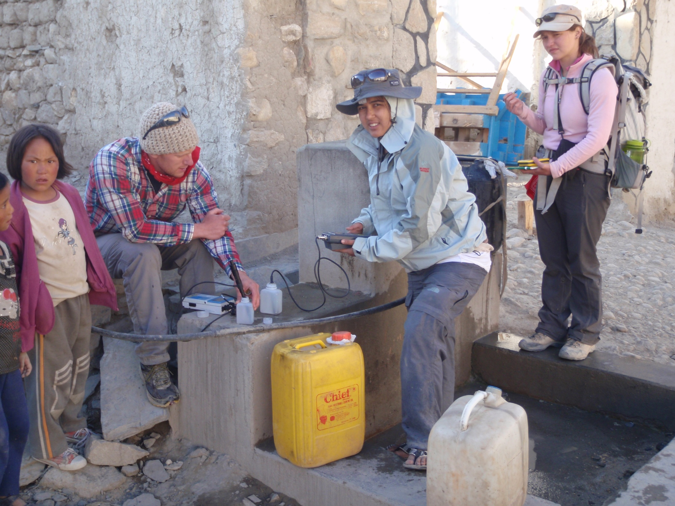

Slide 16
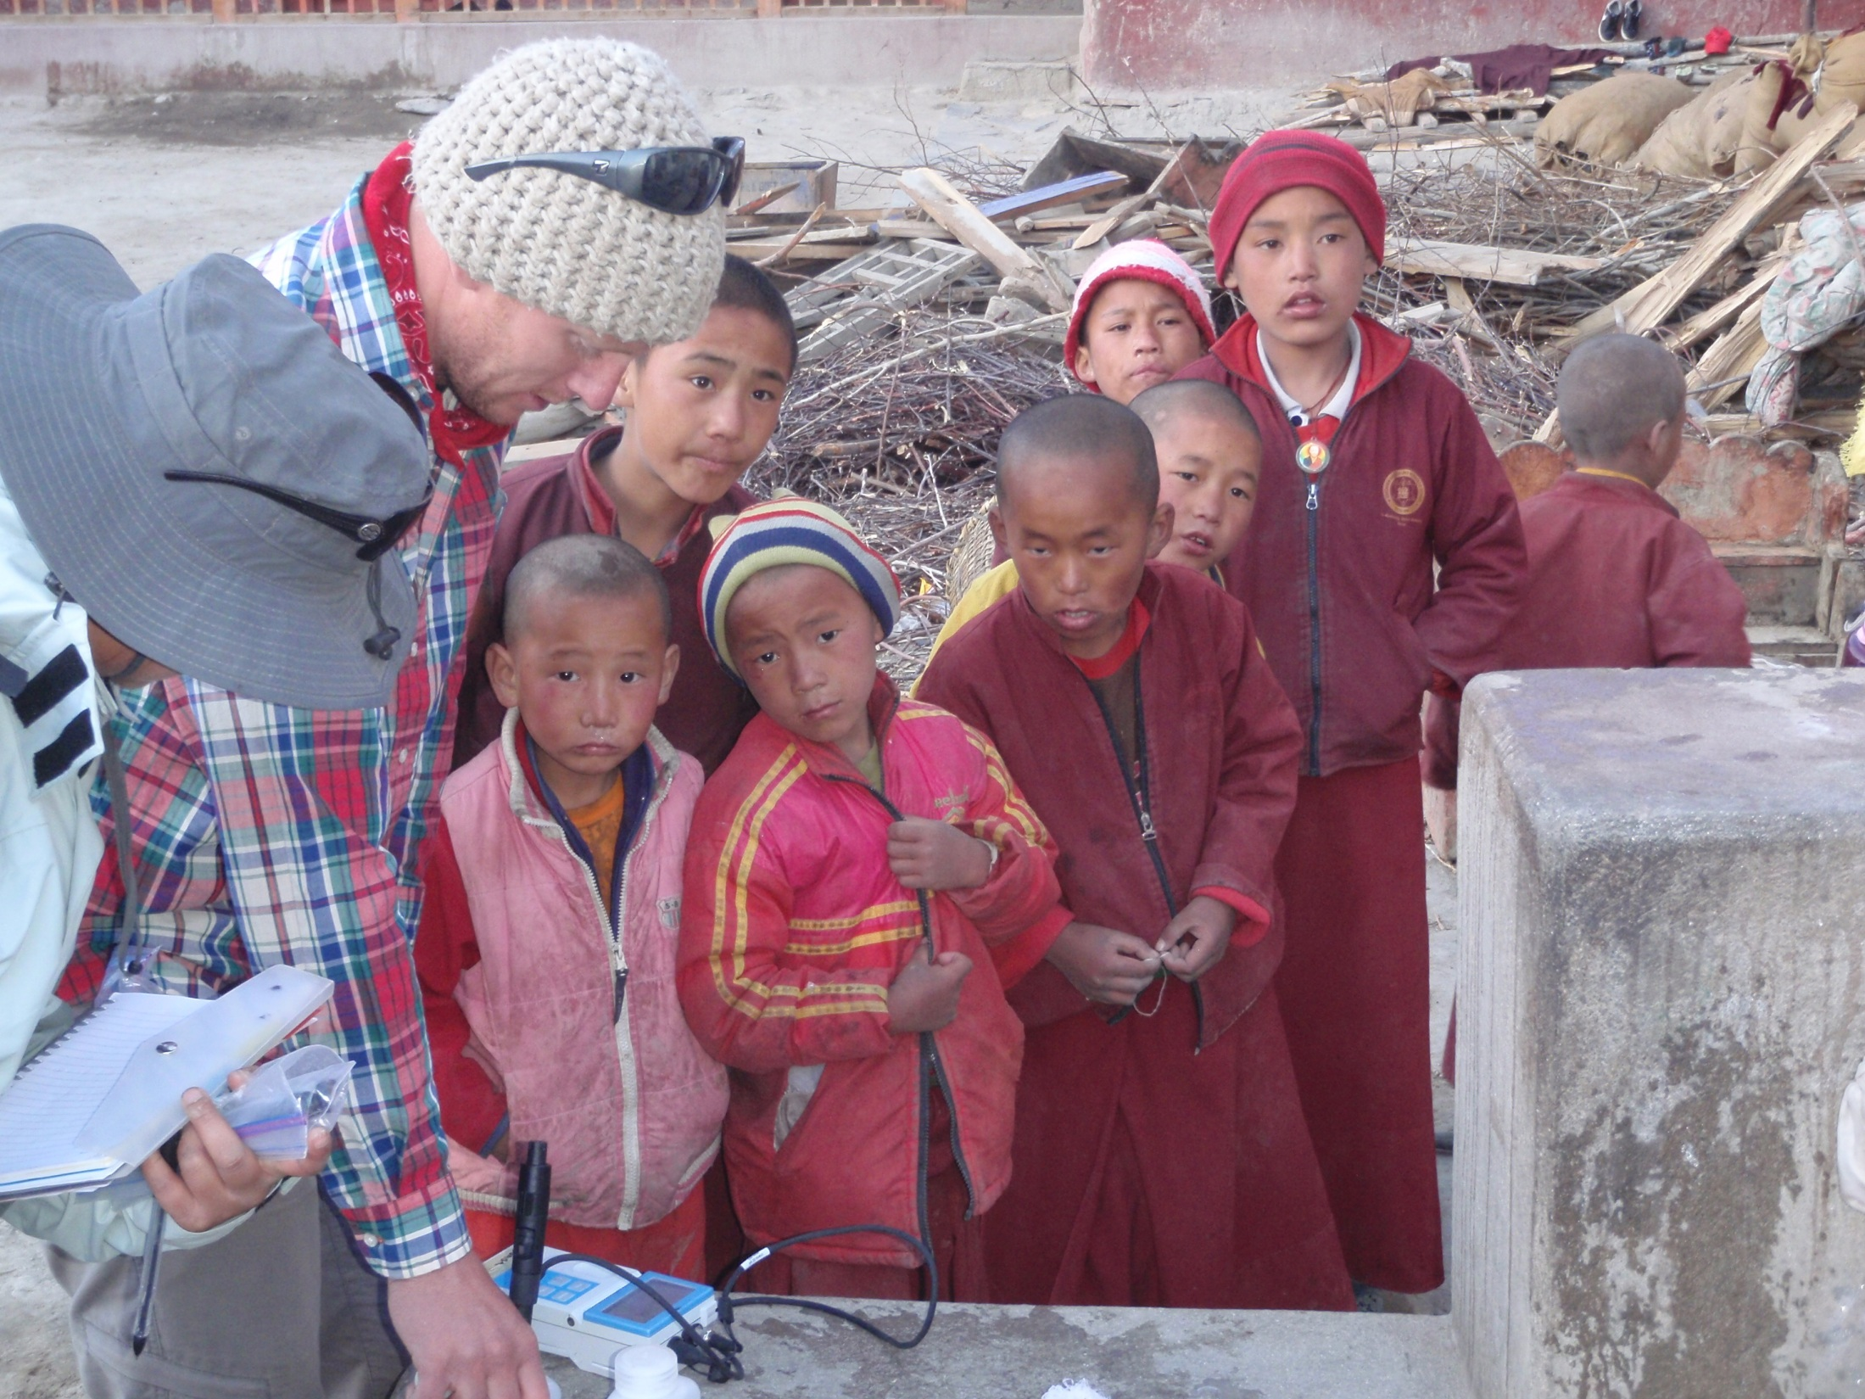

Slide 17
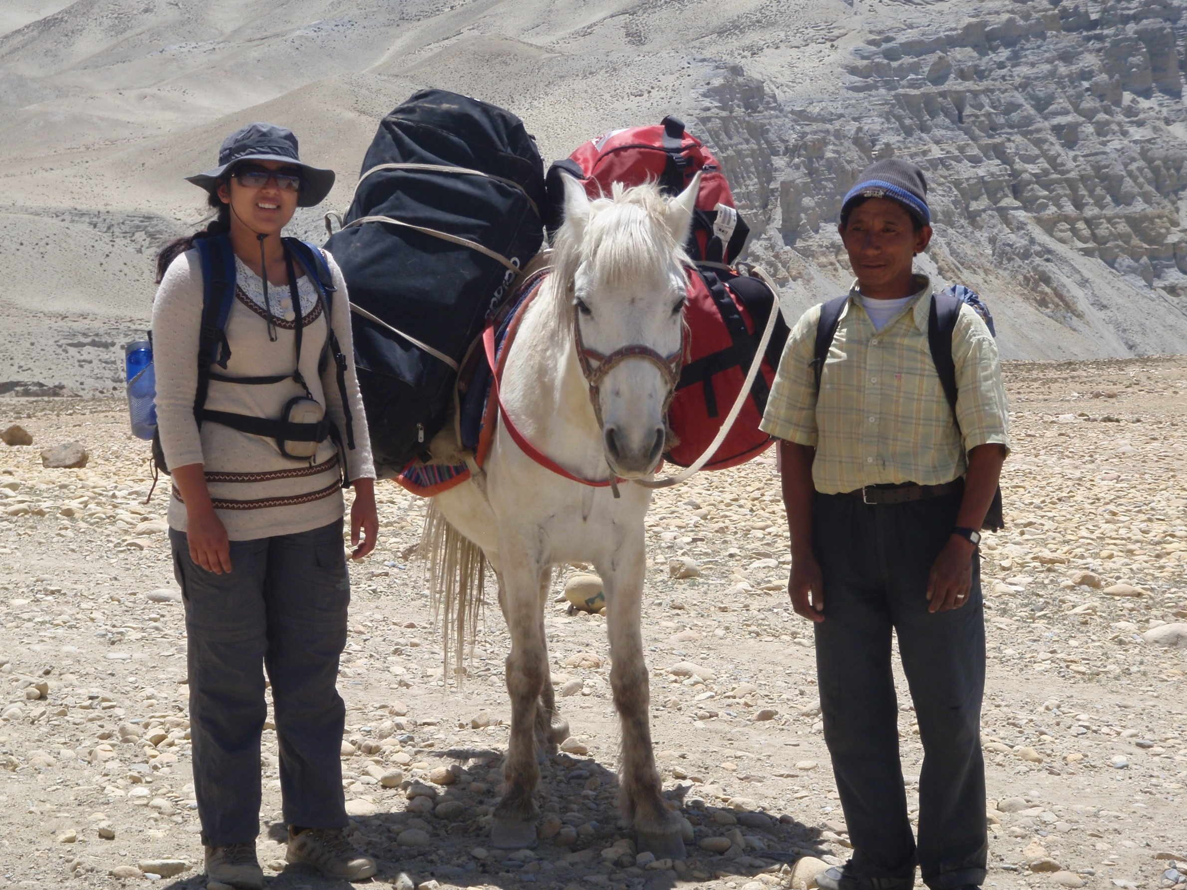

Slide 18
Nepal Interim Arsenic Standard (As = 0.05 mg/L) was exceeded in:
31% of surface water sites
63% of groundwater sites
all nine public faucets in Lo-Manthang
All other public faucets in Mustang Valley did not exceed Nepal Interim Arsenic Standard.

Slide 20
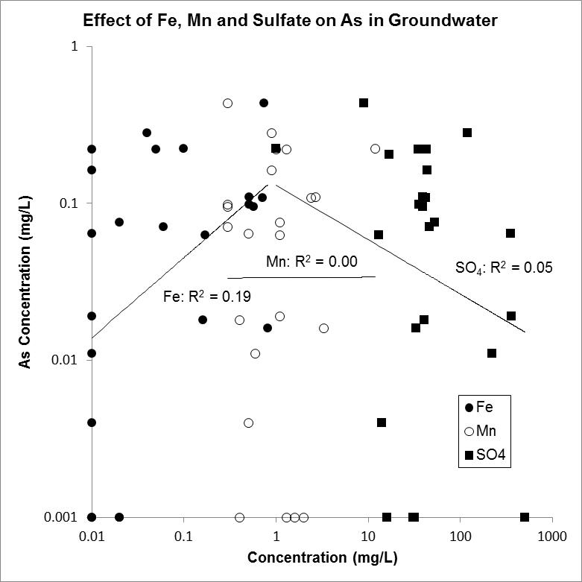

Slide 26
Tentative Conclusions
Arsenic contamination of groundwater in south Asia is not confined to the Ganges-Brahmaputra floodplain.
The dominant reductive-dissolution model is not supported by the geochemical data in the Himalaya.
Arsenic contamination of groundwater in the Himalaya results from accelerated erosion.
Arsenic contamination of groundwater in the Himalaya cannot be addressed without addressing the problems of deforestation and rangeland degradation.

Slide 27
Acknowledgements
Center for Engaged Learning (UVU)
Presidential Faculty Scholarly Activities Award (UVU)
Department of Earth Science (UVU)
Institute for Professional Engagement (UVU)
Student Scholarly and Creative Opportunities (SCOP) Award (UVU)
Student Scholarly Activities Committee (SAC) Award (College of Science and Health, UVU)

Slide 28
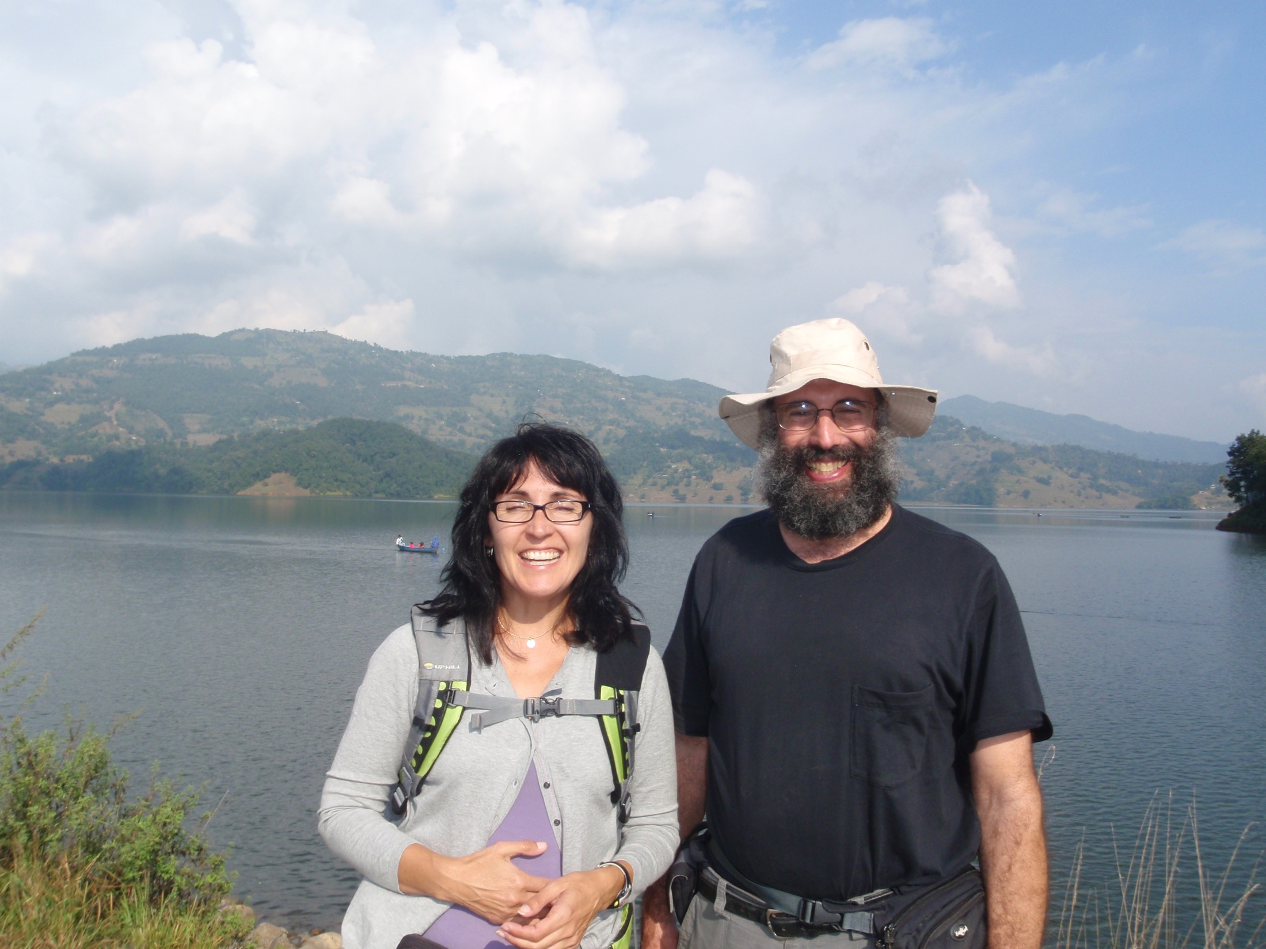
Thanks for listening! Any questions?

