Slide 1
Hydro-Mechanical Properties and Stability Analysis of
Four Landslide-Prone Hillslopes in Western North Carolina
30 October 2013
York W. Lewis¹, Alexandra Wayllace¹, Jonathan W. Godt²,
Richard M. Wooten³, and Ning Lu¹
¹Colorado School of Mines
²U.S. Geological Survey
³North Carolina Geological Survey

Slide 2
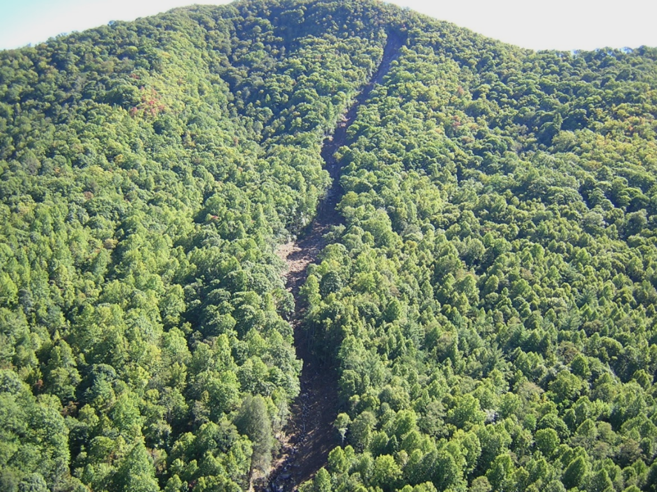
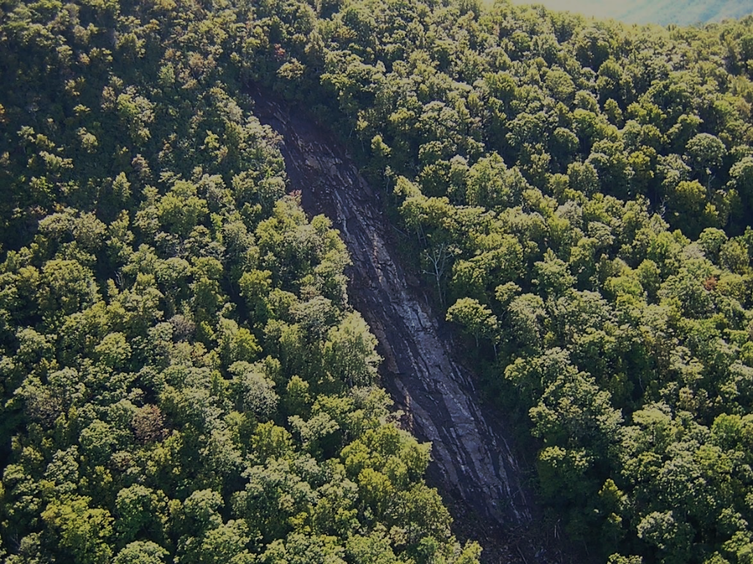
Objectives
Test Hydrological and Geotechnical properties
Calculate Factor of Safety
Determine pore-water pressures needed to cause slope failure.
Photos courtesy of NC Geological Survey
Notes:
Peeks Creek landslide (debris flow) 2004 (Hurricane Ivan)

Slide 3
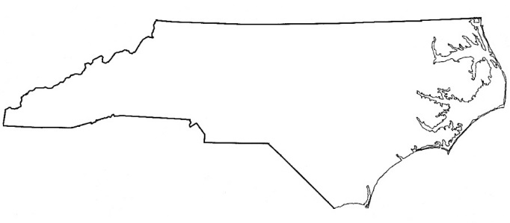
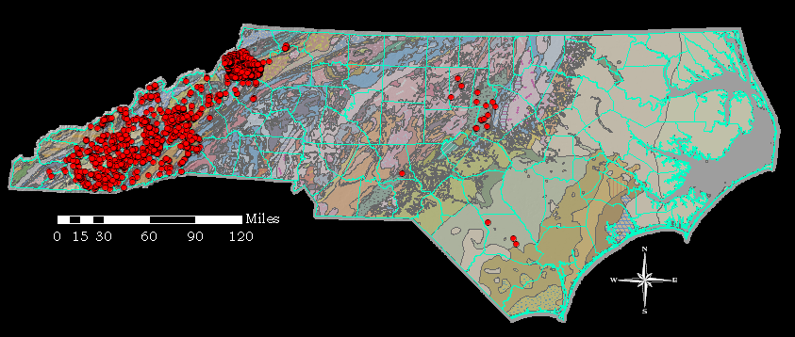
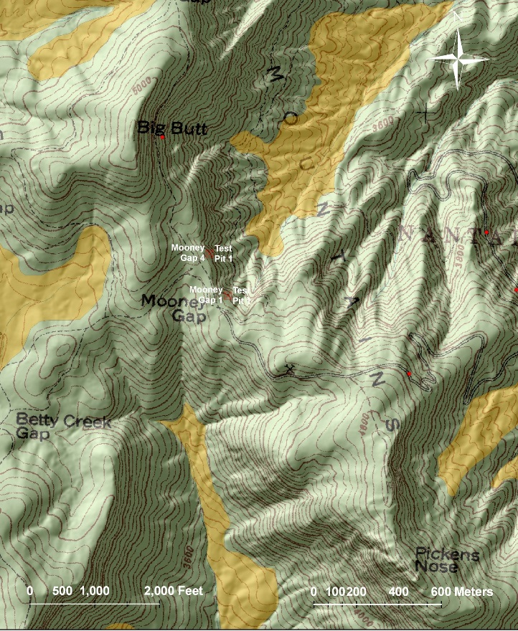
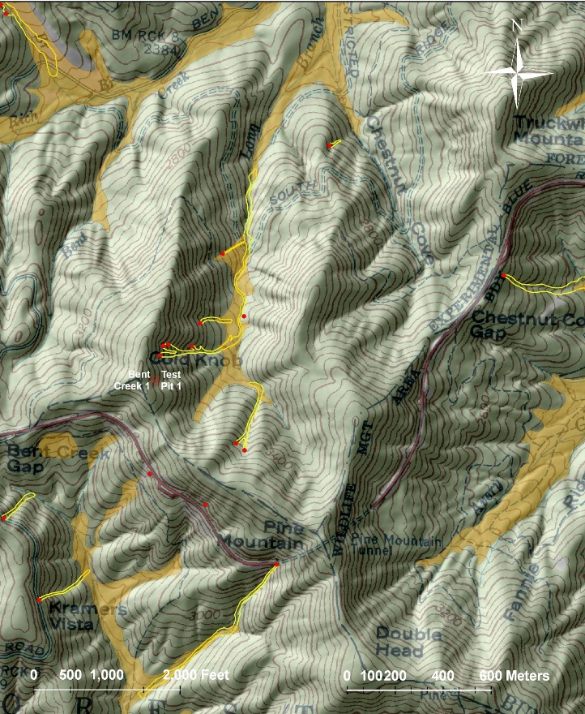
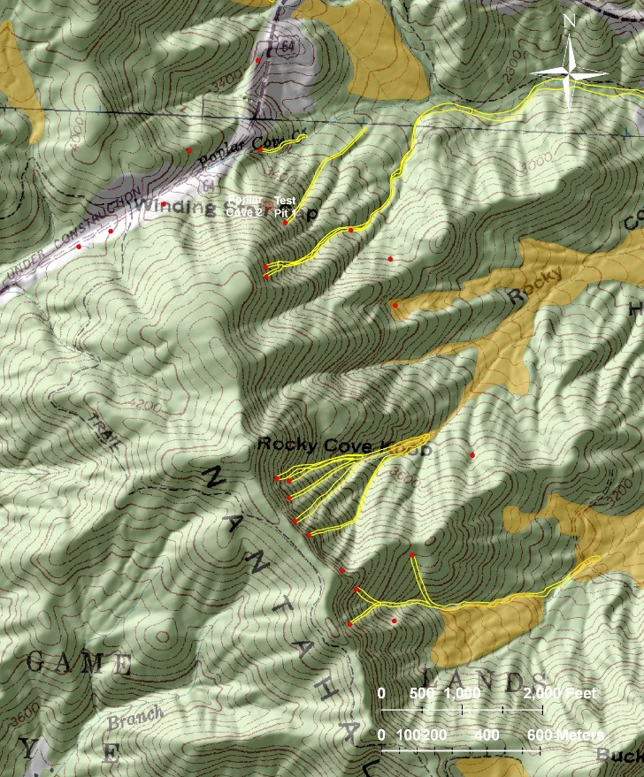
Site Locations
Mooney Gap
Bent Creek
Poplar Cove
Maps courtesy of NC Geological Survey
Slope angles average 31 degrees.
Notes:
Coweeta Experimental Forest, Bent Creek Experimental Forest, and Nantahala National Forest. Steep Slopes Slope aspects and facing to East to NE. Map Explanation: red dots=debris flow initiation zones; yellow outlines=debris flow tracks; tan polygons = debris deposits. Map at upper right: 1985 geologic map of N.C.; red dots = landslide points; mainly in Blue Ridge physiographic province.

Slide 4
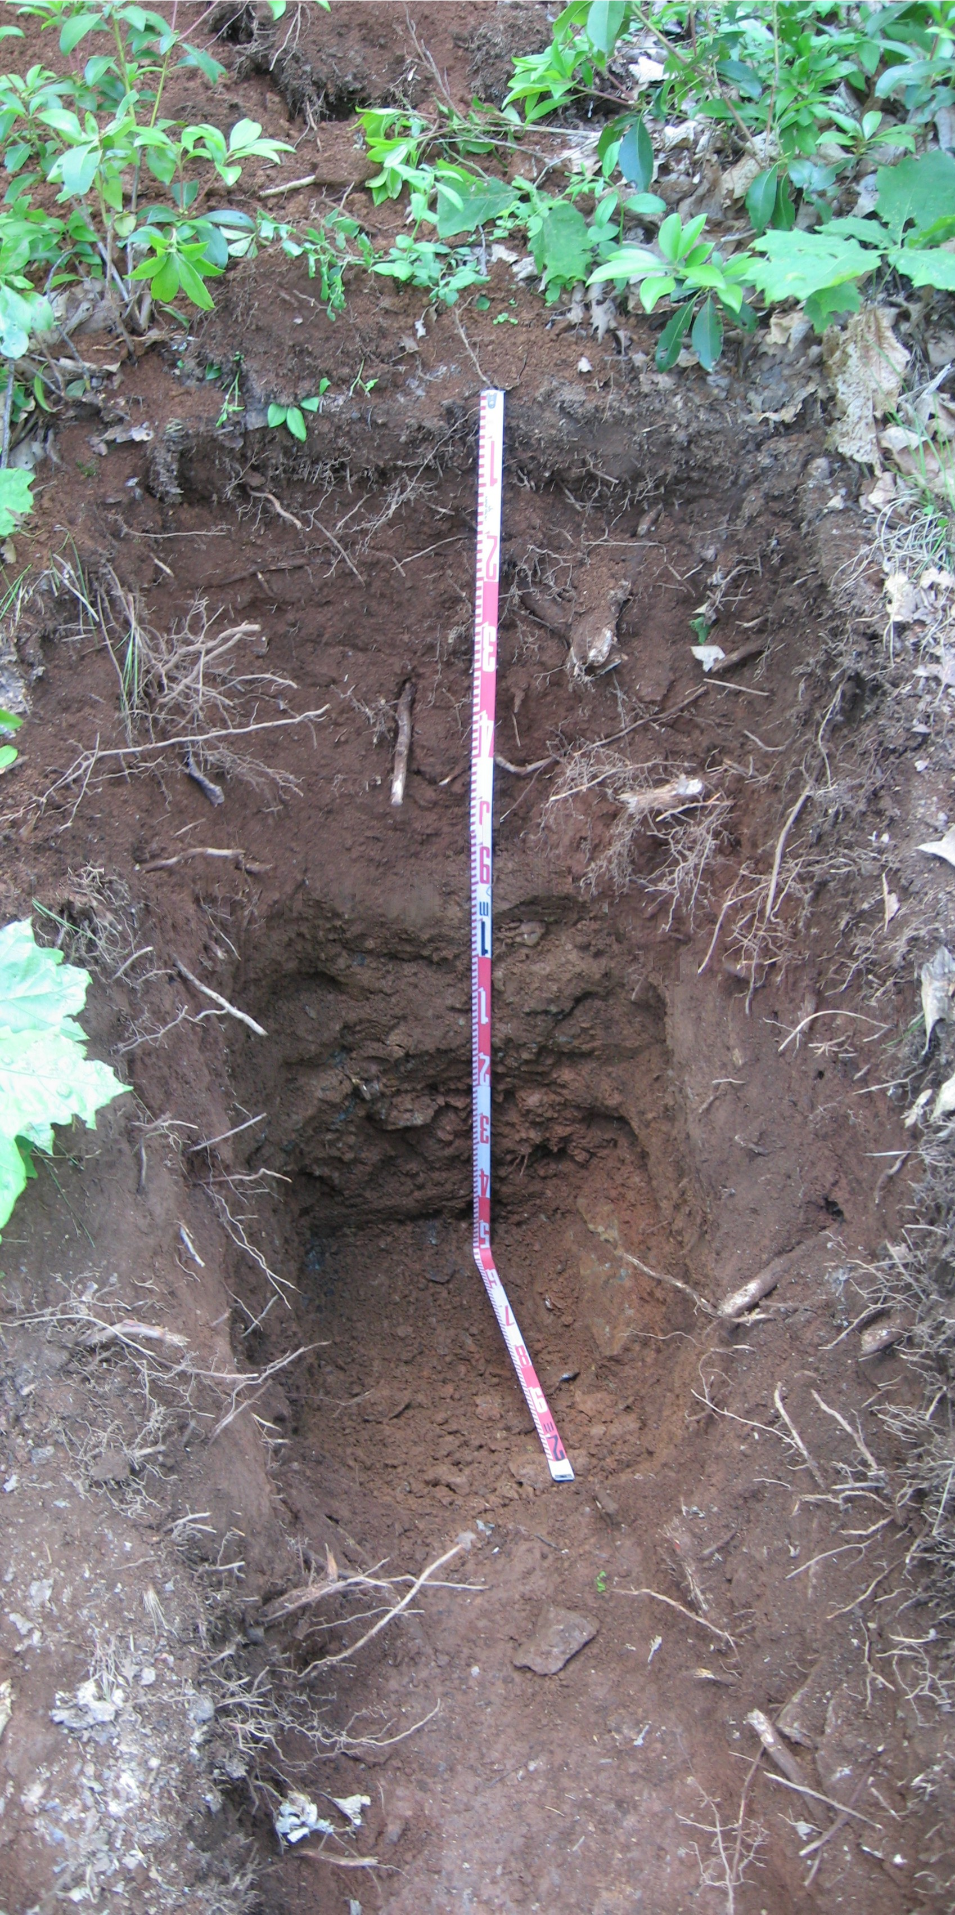
Typical Soil Horizon Thicknesses
O
30 cm
A
60 cm
B
60 cm
C
20 cm
Classification: Silty Sands (SM), Silty Clays (SC)
Notes:
Soils thicknesses were up to 1.8 meters thick to bedrock. Bulk and undisturbed samples taken. Roots ended around 80 cm. Sites are in colluvial hollows. Colluvium is generally matrix supported with gravel- to cobble-sized rock clasts. Generalized bedrock: Late Proterozoic – Early Paleozoic polydeformed, metasedimentary and meta-igneous bedrock. Photo is Bent Creek test pit

Slide 5
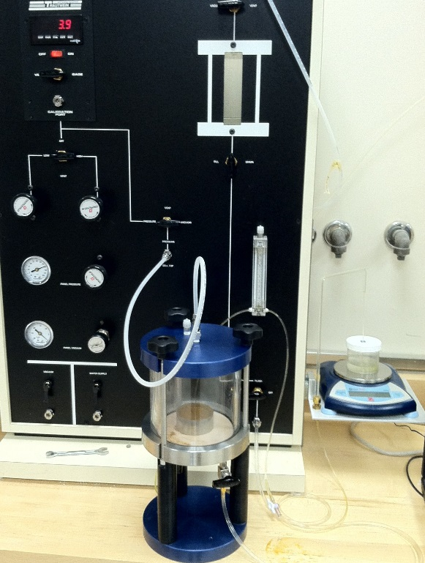

Laboratory Tests
Index Properties for soil classification
Direct Shear (unsaturated & saturated) for shear strength parameters
Transient Release and Imbibition Method (TRIM) for soil-water retention, hydraulic conductivity, and suction stress functions
Notes:
Porosities varies between 0.44 and 0.63.

Slide 6
Test Results
Hydraulic Conductivity Function & Soil Water Retention Curve
Suction Stress Characteristic Curve & Soil Water Retention Curve
Notes:
TRIM fast method (1 week vs months) and gives not only drying but wetting path properties. These graphs are result from Bent Creek. Left - shows how Hyd Conduct and Matric Suction vary with Moisture content. Right - shows how Matric Suction and Suction Stress vary with moisture content. The data can be used to calculate the factor of safety in a soil under varying Moisture Contents.

Slide 7
Infinite-Slope Stability Analysis
                ɸ’ = Effective friction angle (degrees)
                β = Slope angle (degrees)
                c’ = Effective cohesion (kPa)
                σ^{s}= Suction stress (kPa)
                γ = Unit Weight (kN/m³)
                z = Vertical depth (m)
(Lu and Godt, WRR, 2008)
Sample | In situ Factor of Safety | Pore Water Pressure (kPa) for FOS = 1
MG1TP1, 115-125cm | 2.11 | 6.7
MG4Tp1, 70-80 cm | 2.34 | 7.7
PC2TP1, 50-65 cm | 2.72 | 8.15
BC1TP1, 100-105 cm | 2.14 | 13.5
Notes:
Infinite slope model using Suction Stress from TRIM Results, Effective Friction Angle, and Effective Cohesion. FOS calculated for in-situ unsaturated conditions. Back calculated the Pore Water pressures required to cause failure.

Slide 8
Conclusions
Stability calculations indicate modestly stable slopes under field conditions.
Results show that rainfall events need only increase pore water pressures by 6.7 kPa to 13.5 kPa in order to cause landslides in the region.
Use of improved hydrologic/geotechnical testing methods can quantitatively assess regional landslides.
Acknowledgement: NASA (Grant # NNX12AO19G)

