Slide 1
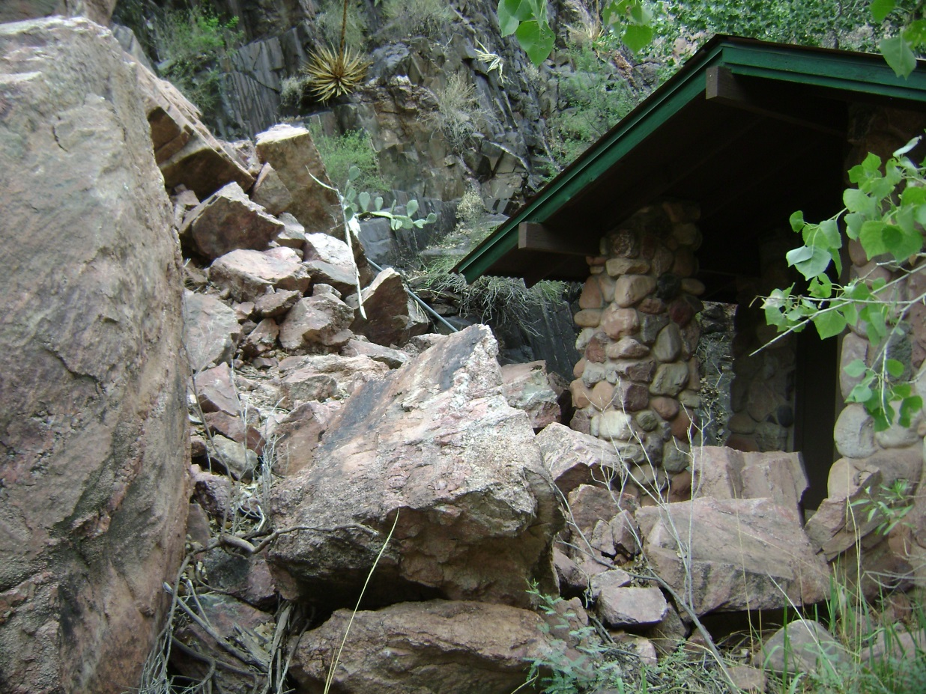
Geohazards Evaluation of Mass Movements in Grand Canyon National Park, Arizona
Kaytan Kelkar
Deanna Greco GRCA 2013

Slide 2
Project Goals
To start the compilation of a database of known documented mass movements.
Identification of damage to park infrastructure.
The acquisition of weather data to pinpoint pertinent causes for events.
To collect GPS coordinates of potential and documented sites for mass movements.
To provide park planning with information on highly active areas.

Slide 3
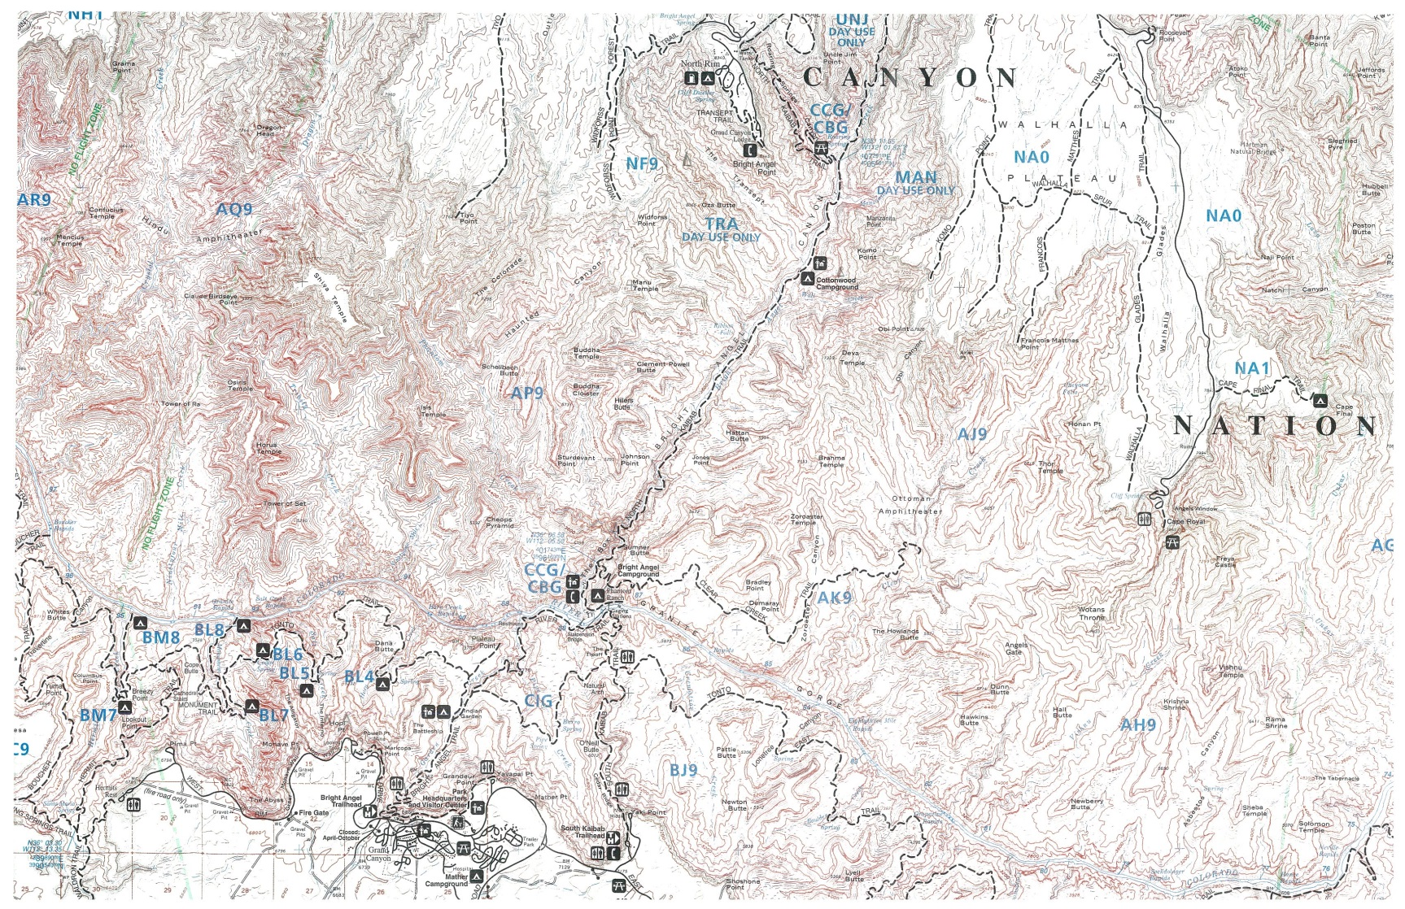
Study Area
North Kaibab Trail
North Rim
National Geographic Maps, 1987.
Bright Angel Trail
South Kaibab Trail
South Rim

Slide 4
Grand Canyon National Park Facts
Was granted national park status in 1919.
Is situated on the Colorado Plateau in northwestern Arizona.
Encompasses an area of 1.2 million acres.
Is 1 mile deep and on average is 10 miles wide.
Is home to highly diverse ecosystems.
Can be experienced through various outdoor activities.

Slide 5
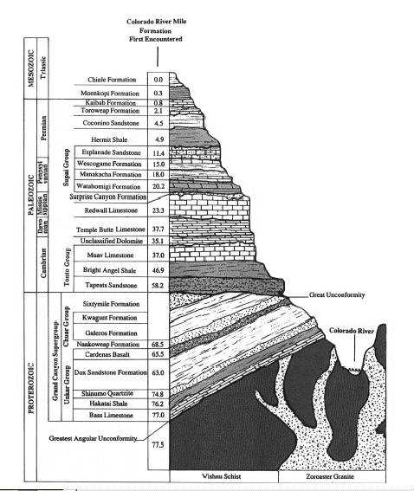
Grand Canyon Geology
Successive chain of events led to the formation of the canyon.
The stratigraphy has been classified under 3 sets of rock layers.
The rock units do not provide the
complete picture.
The Grand Canyon is a constantly
eroding entity.
Griffiths et al.

Slide 6
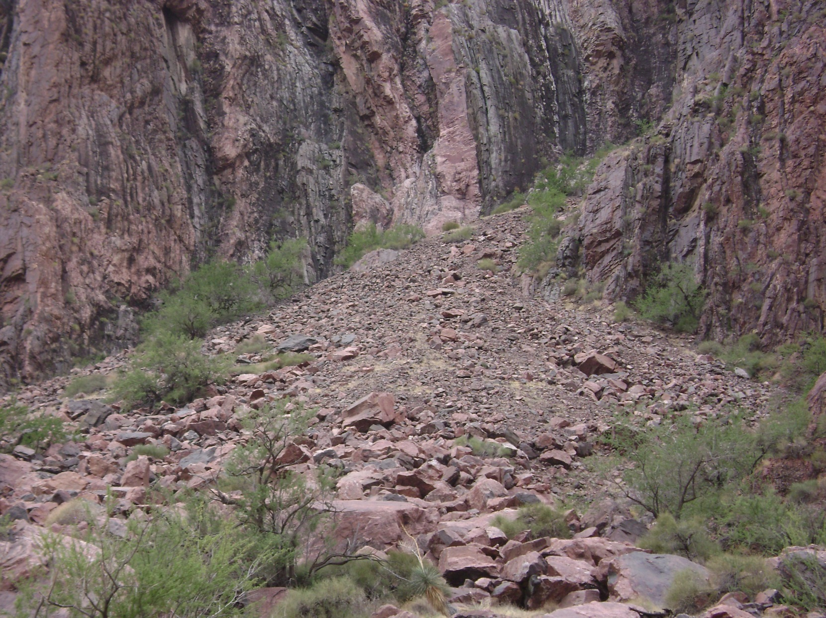
Mass Movements
July 30th- August 1st, 2006, River Trail
Scarp
Impact Zone
Foot
Toe

Slide 7
Background Research
Initial locations for documented mass movements were plotted in Garmin Basemap.
Analyzed the number of large events per trail.
Accurate trail locations for photos of events were pointed out by trail crew.
Weather data was obtained from the National Climatic Data Center for specific dates of events.
Historic photos of events were identified for active sites.
GPS coordinates were collected for documented and potential sites.

Slide 8
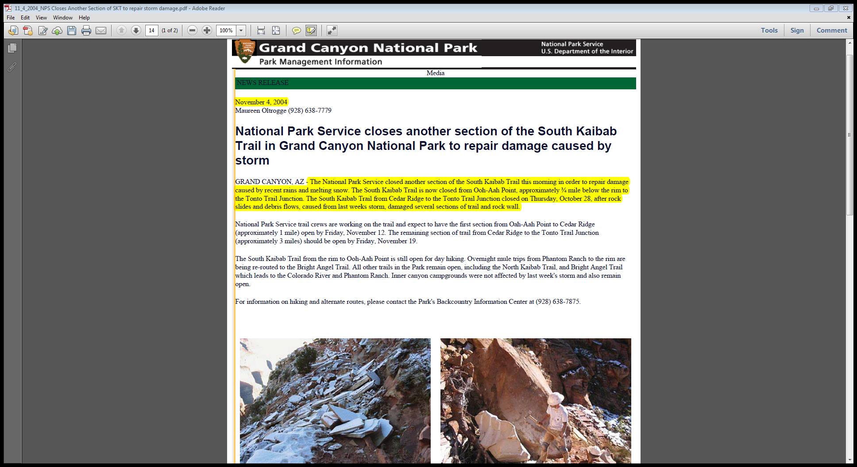
Press Releases
Provided organization to the compilation of database.
Significant source of information.
Provided vital clues regarding specific events.
Lacked specific geologic data.
NPS Press Release South Kaibab Trail November 4, 2004.

Slide 9
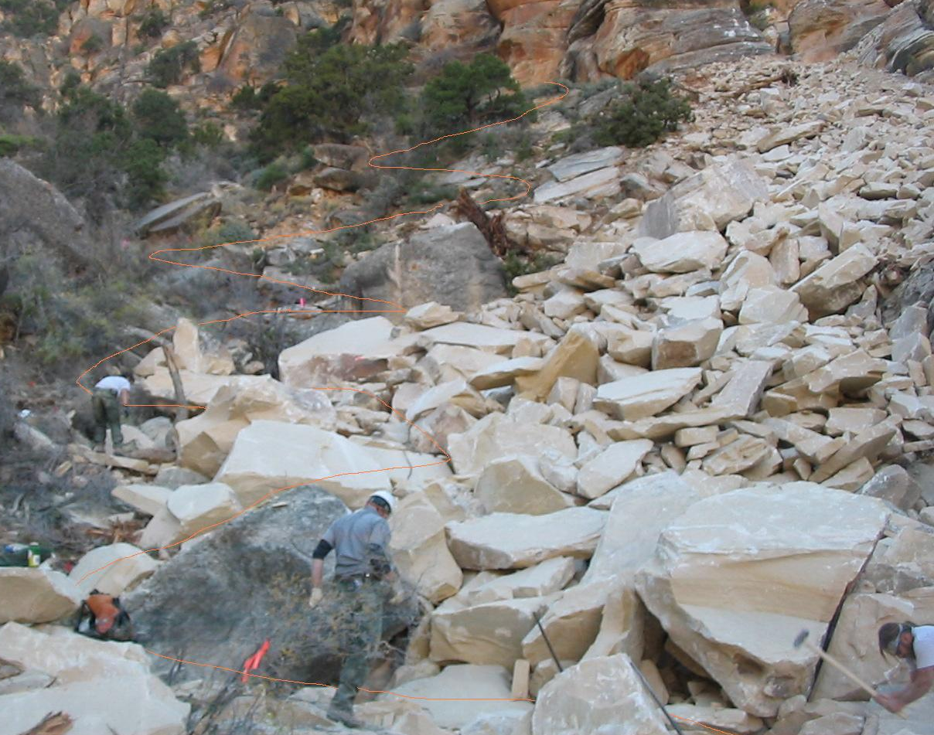
Photos and Photo Interpretation
Photos obtained from various sources within park.
Accurate location of event.
Possible identification of cause for event.
Chris Brothers (trail crew) Tanner Trail slide October 27th, 2007.
Use of photo interpretation for additional data.

Slide 10
Challenges
Structuring gathered data from various sources to establish specific events.
No set template or previous database to refer for the organization of the database.
Vague verbal descriptions of events.
Inadequate information from photographs.
Inconsistencies in weather data.

Slide 11
Challenges in the Field
Identification of unit contacts and distinguishing rock units.
Classifying potential hazards of small mass movements.
Recognizing former sites of documented mass movements.
Familiarization with trail locality names on corridor trails.
The loss of GPS signal during data collection.

Slide 12
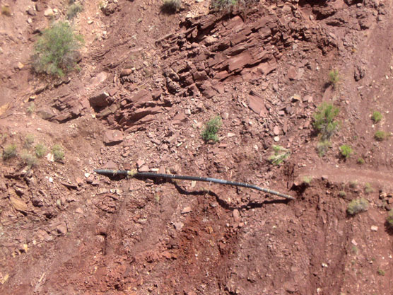
Issues with photographs
No indication of location with respect to trail.
No conclusive photo interpretation.
NPS press release North Kaibab Trail May 31st, 2012

Slide 13
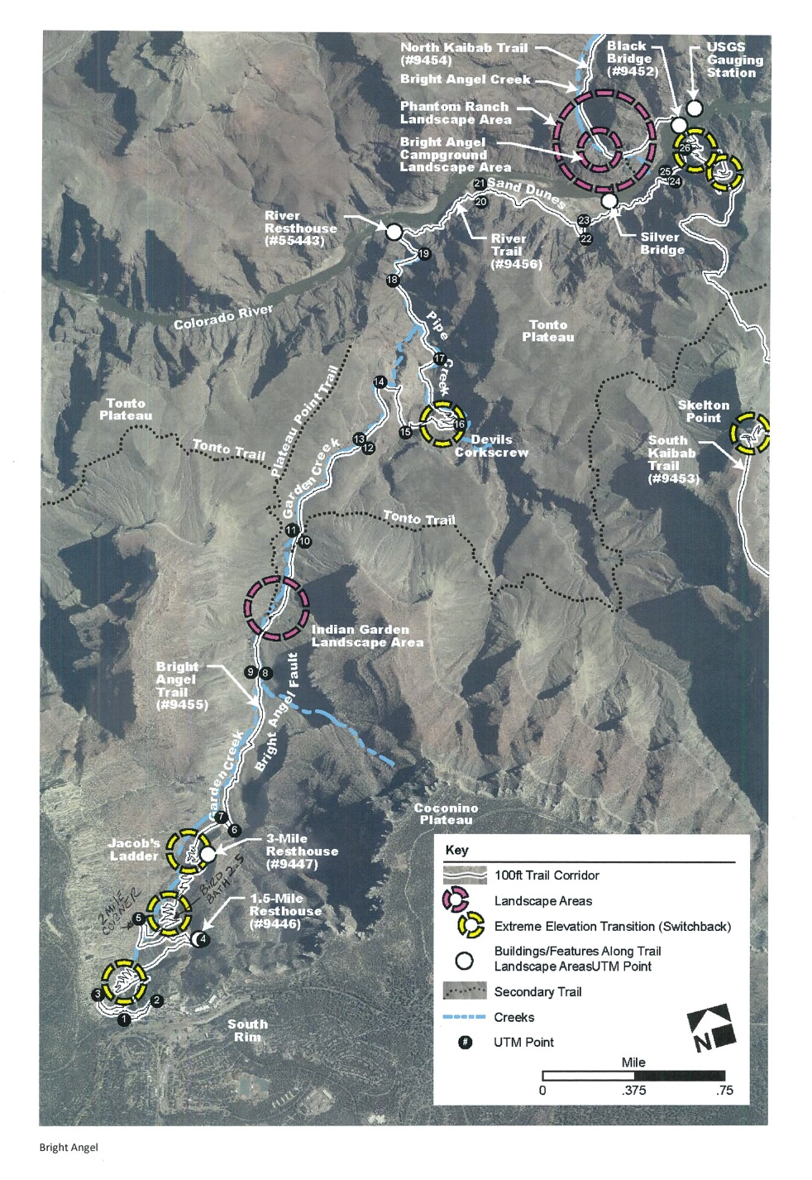
Trail Localities
Locality maps an added bonus.
Helped in the identification of active sites.
Hiking with rangers for field descriptions of localities.
Ellen Brennan Cultural Resources Supervisor.

Slide 14
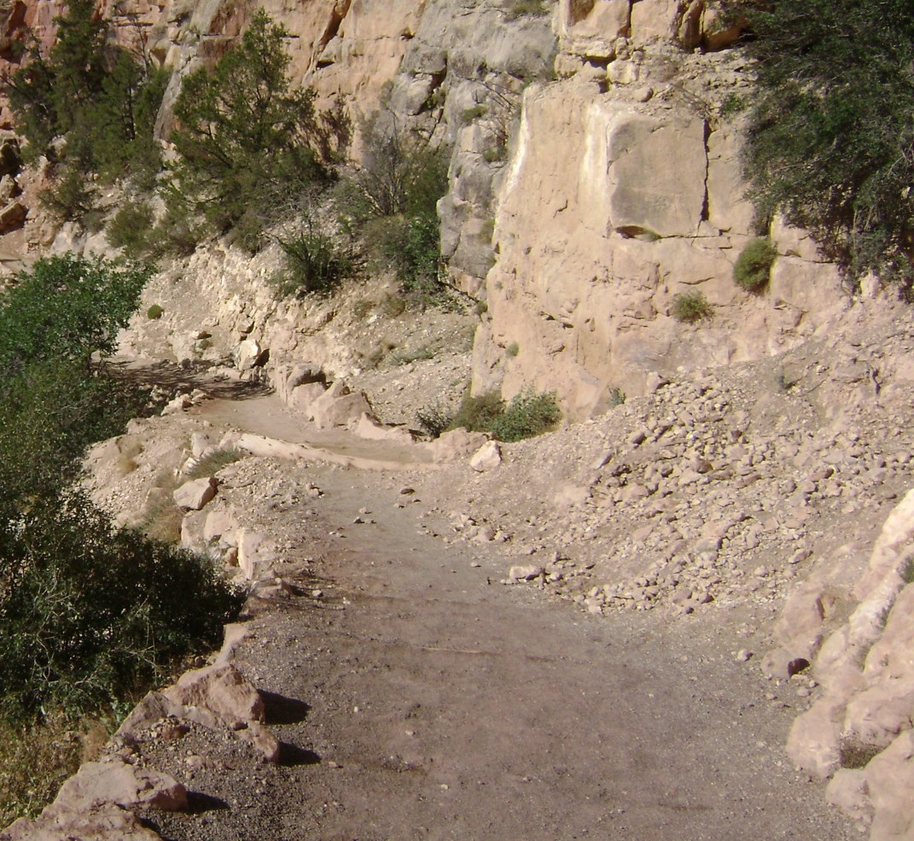
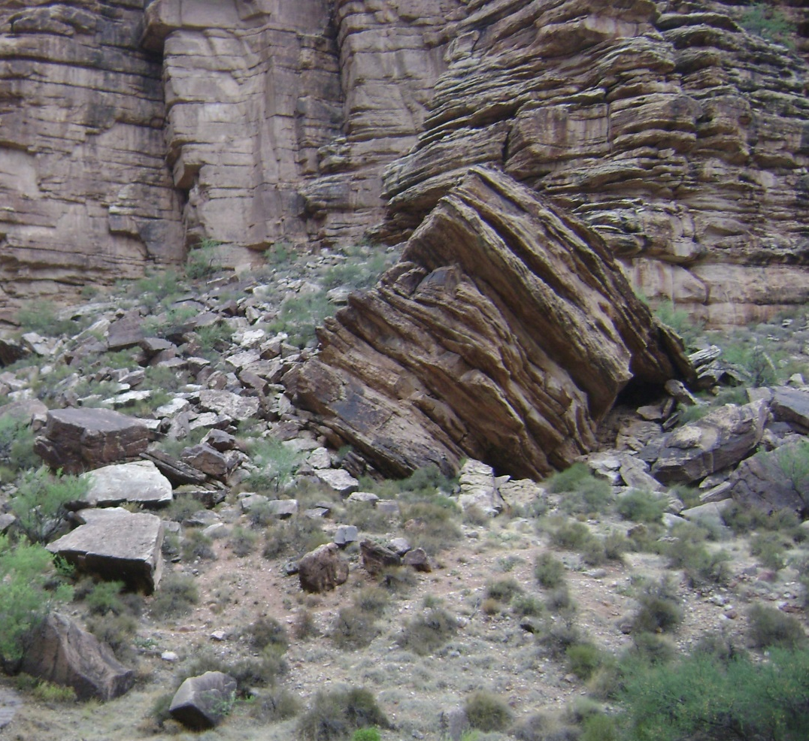
Issues in the Field
South Kaibab Trail
Bright Angel Trail

Slide 15
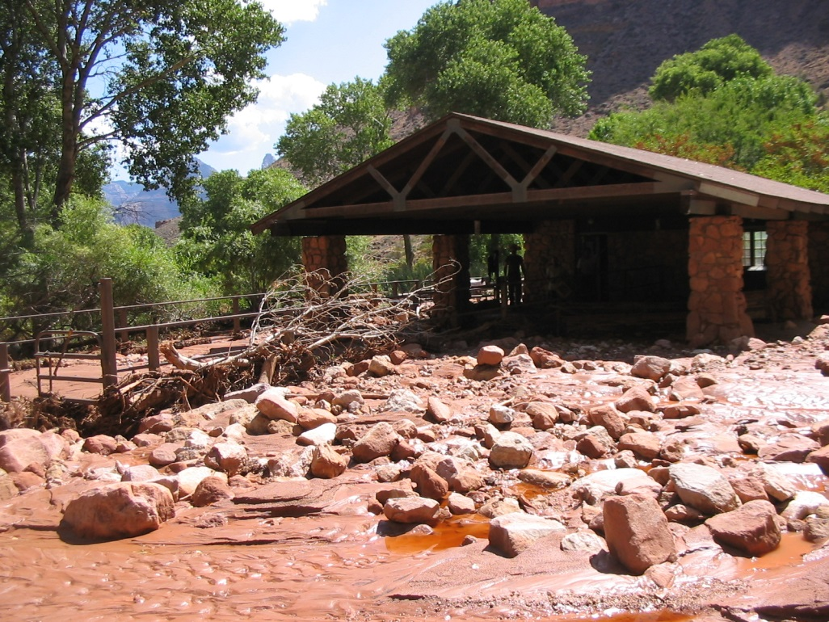
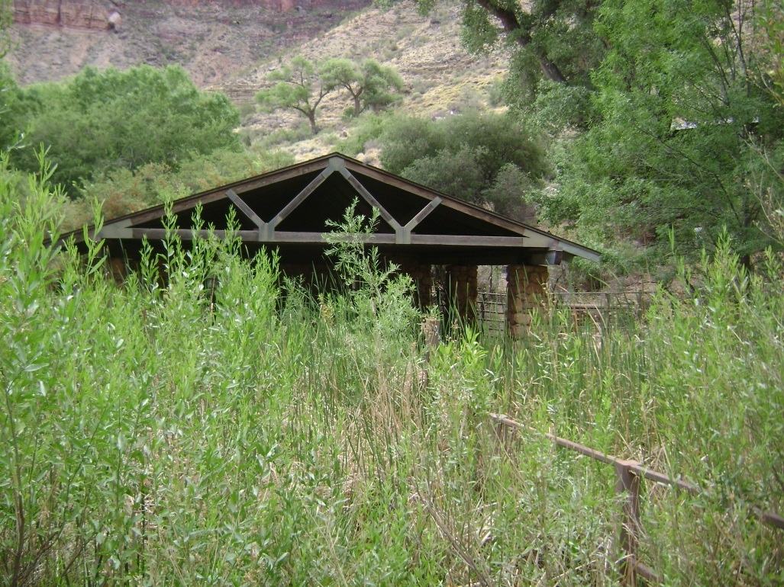
Former Sites of Events
Bright Angel Trail flashflood damage at Indian Gardens mule corral July 14th, 2004.
2004
2013
Chris Brothers (trail crew)

Slide 16
Observations
Total number of documented events: 45
Monsoon season spans from mid July to early September.

Slide 17
Documented Events by Trail

Slide 18
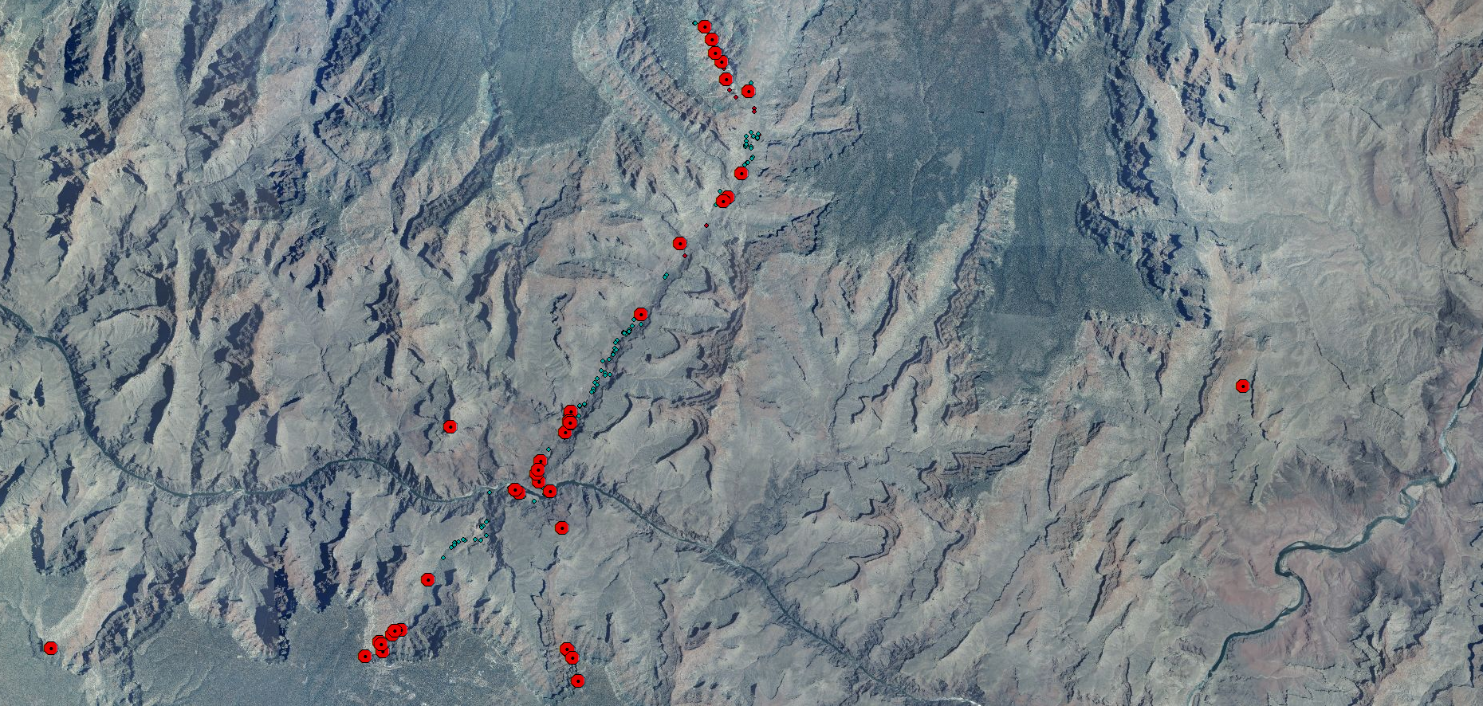
Mapping Documented Events
The locations for documented events were plotted in ArcGIS.

Slide 19
Documented Events Per Year
Year | 92 | 93 | 01 | 03 | 04 | 05 | 06 | 07 | 08 | 09 | 11 | 12 | 13
AP | 11.5 | 10.9 | 9.27 | 9.21 | 15.4 | 12.9 | 11.3 | 8.14 | 8.52 | 6.33 | 8.63 | 9.55 | 4.19
AS | 46 | 51.5 | 82.8 | 43 | 39 | 29.3 | 22.8 | 17.4 | 52.8 | 43.2 | 52.8 | 50.7 | 21.2
AP: Annual Precipitation (in), AS: Annual Snowfall (in)

Slide 20
Conclusion
Unstable lithologic contacts are Coconino Sandstone-Hermit Shale and Redwall/Muav Limestone- Bright Angel Shale.
Numerous unstable units responsible for propagating mass movements.
Several active areas identified on corridor trails.
Fluctuations in temperature preceding events were observed.
Three very interesting finds.

Slide 21
Acknowledgments
I am grateful to the Geological Society of America and the National Park Service for giving me this excellent opportunity.
I would like to thank Deanna Greco for her support and expertise towards this project.
I would like to thank Russell Rosenberg, Bil Vandergraff, Brian Gatlin, Chris Brothers and the Museum Collection at GRCA for their guidance.

Slide 22
Works Cited
Griffiths, Peter G., Robert H. Webb, and Theodore S. Melis. Initiation and frequency of debris flows in Grand Canyon, Arizona. No. USGS-OFR-96-491. DEPARTMENT OF THE INTERIOR WASHINGTON DC, 1996.
  National Geographic Maps. Grand Canyon National Park Trails Illustrated. [ca. 1: 73,530]. Evergreen, CO: National Geographic Maps, 1987. Print.
Oltrogge, Maureen. “National Park Service closes another section of the South Kaibab Trail in Grand Canyon National Park to repair damage caused by storm.” GRCA Park Management Information 4 November, 2004. NPS Press Release. nps.gov. 25 July 2013.
Oltrogge, Maureen. “Third Pipeline Break in Grand Canyon Closes Section of North Kaibab Trail.” GRCA Park Management Information 31 May, 2012. NPS Press Release. nps.gov. 25 July 2013.
Photos of the Tanner Trail slide and Indian Gardens flash flood damage were provided by Chris Brothers of trail crew.
Trail locality maps were provided by Ellen Brennan of Cultural Resources.

