Slide 1
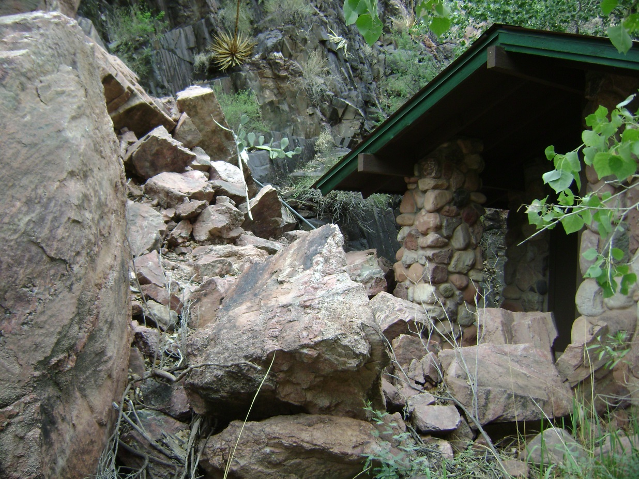

Geohazards Evaluation of Mass Movements in Grand Canyon National Park, Arizona
Kaytan Kelkar
Mosaics in Science Program 2013

Slide 2
Project Goals
To start the compilation of a database of known documented mass movements.
Identification of damage to park infrastructure.
The acquisition of weather data to pinpoint pertinent causes for events.
To collect GPS coordinates of potential and documented sites for mass movements.
To provide park planning with information on highly active areas.

Slide 3
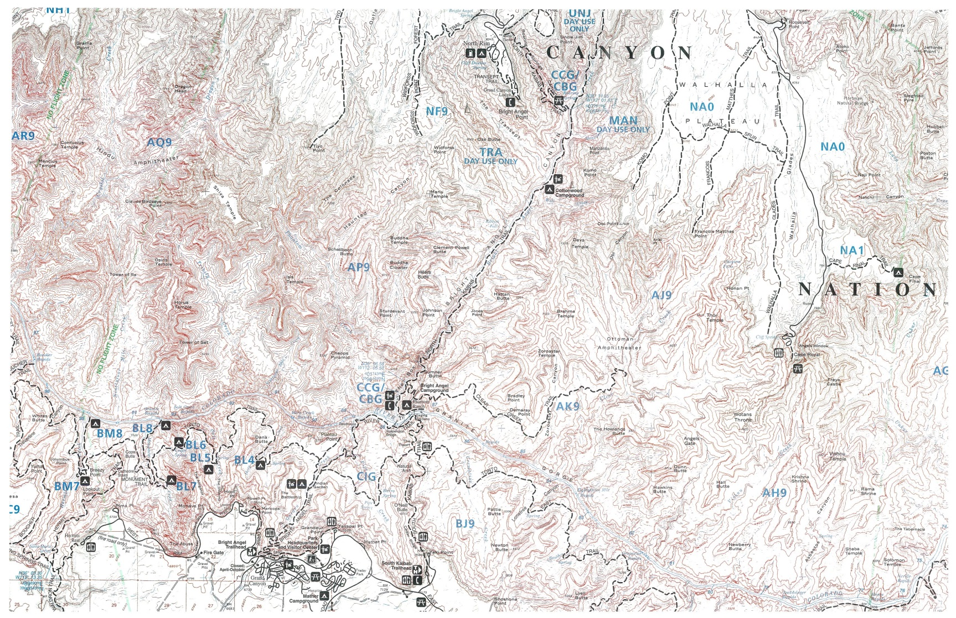
Study Area
North Kaibab Trail
North Rim
National Geographic Maps, 1987.
Bright Angel Trail
South Kaibab Trail
South Rim

Slide 4
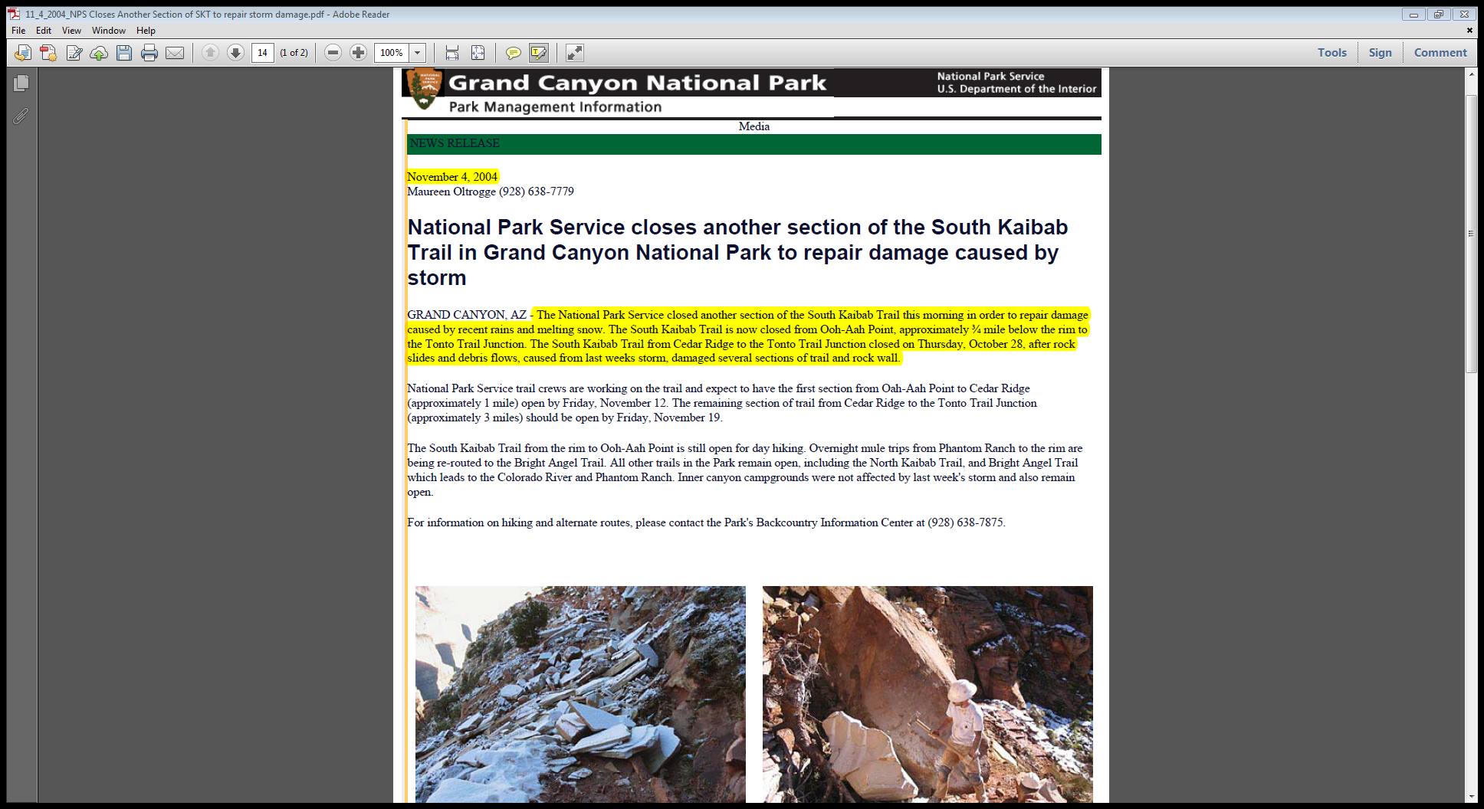
Background Research
Provided organization to the compilation of database.
Significant source of information.
Provided vital clues regarding specific events.
Lacked specific geologic data.
NPS Press Release South Kaibab Trail November 4, 2004.

Slide 5
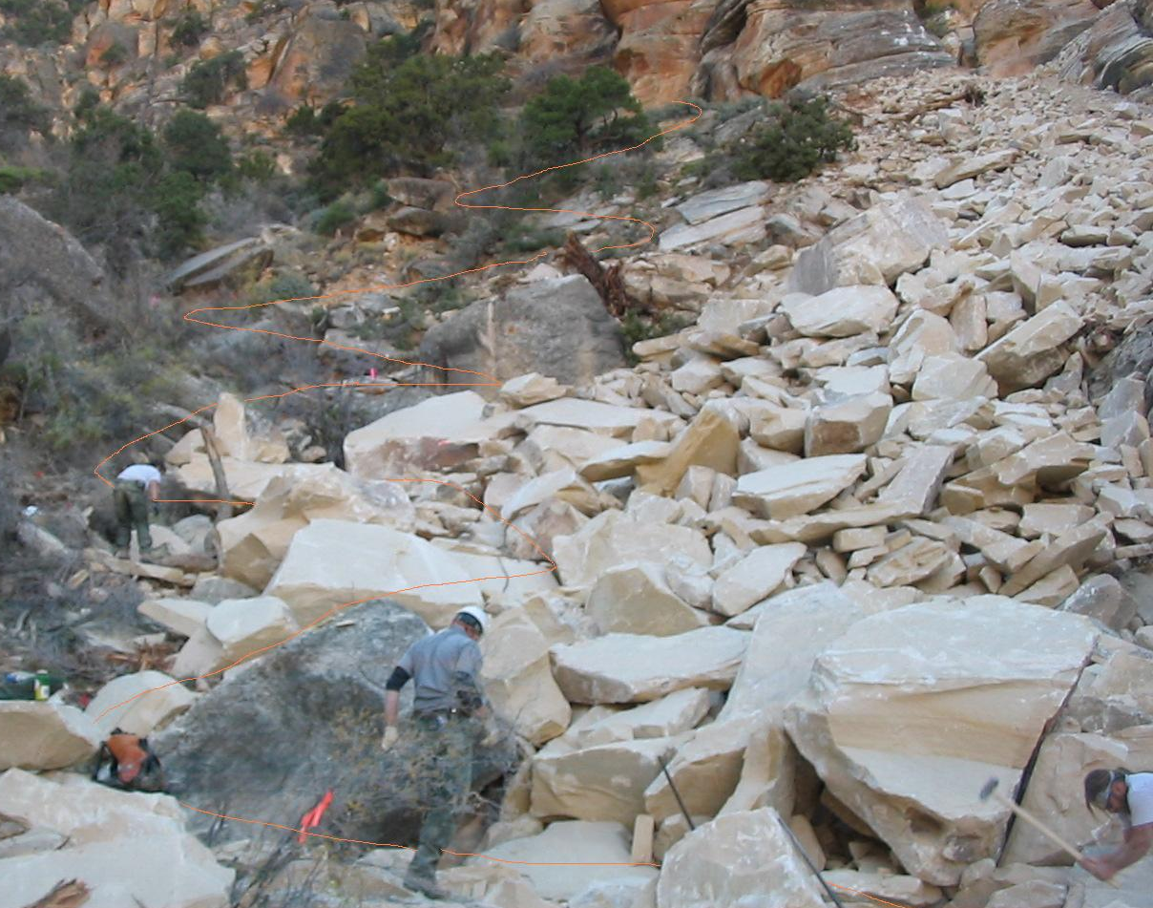
Photos and Photo Interpretation
Photos obtained from various sources within park.
Accurate location of event.
Possible identification of cause for event.
Chris Brothers (trail crew) Tanner Trail slide October 27th, 2007.
Use of photo interpretation for additional data.

Slide 6
Challenges
Structuring gathered data from various sources to establish specific events.
No set template or previous database to refer for the organization of the database.
Vague verbal descriptions of events.
Inadequate information from photographs.
Inconsistencies in weather data.

Slide 7
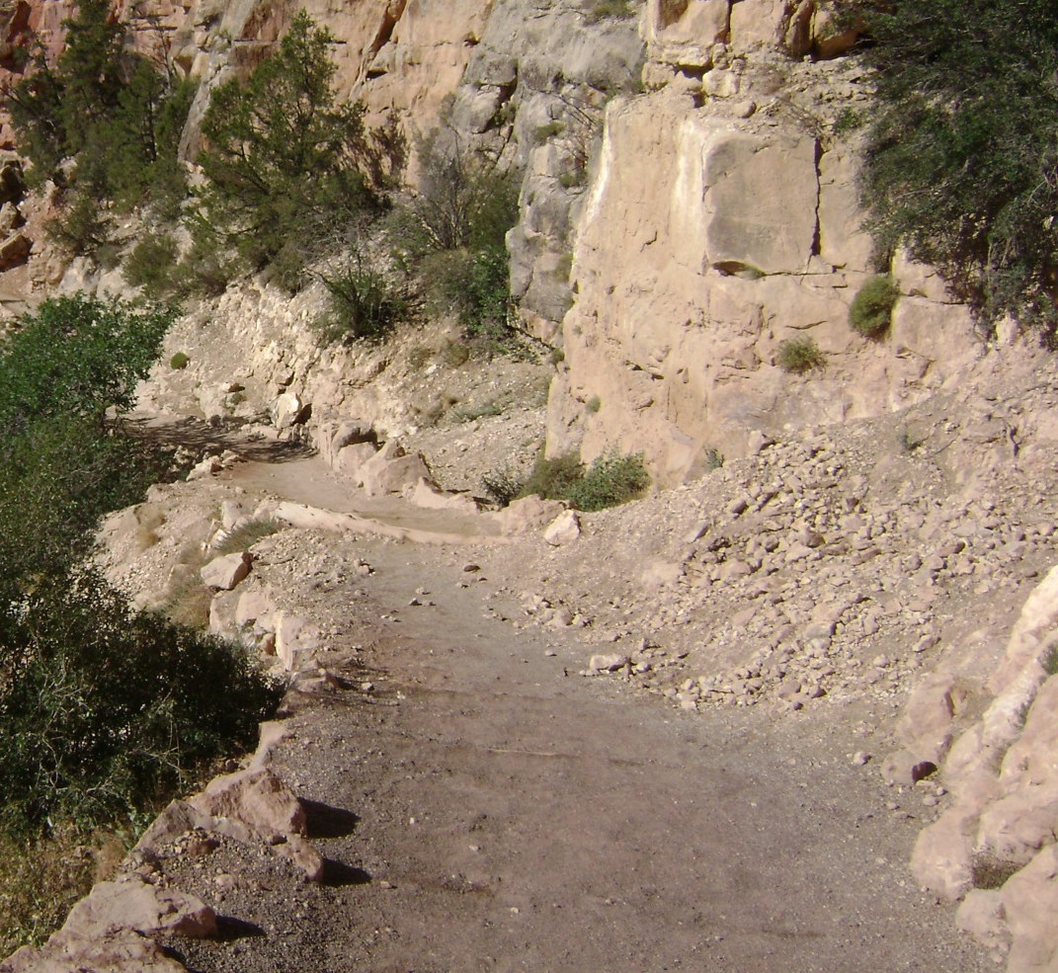
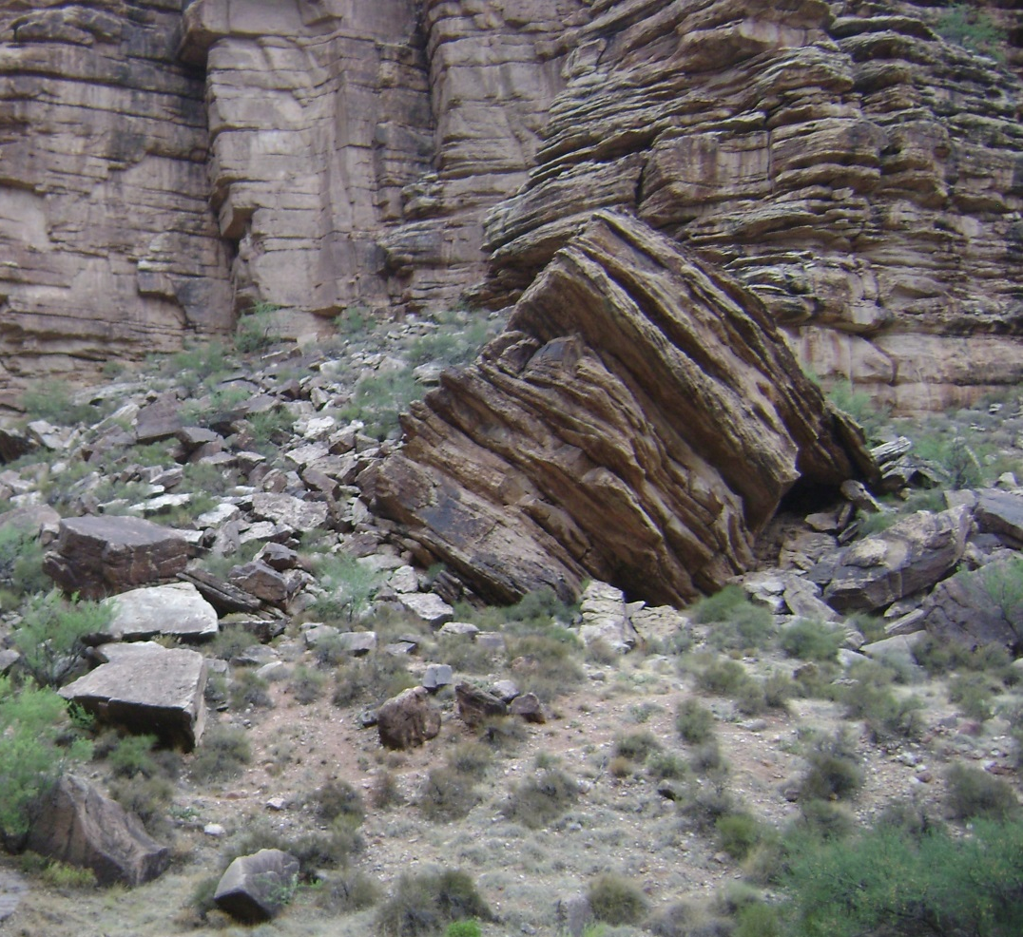
Issues in the Field
South Kaibab Trail
Bright Angel Trail

Slide 8
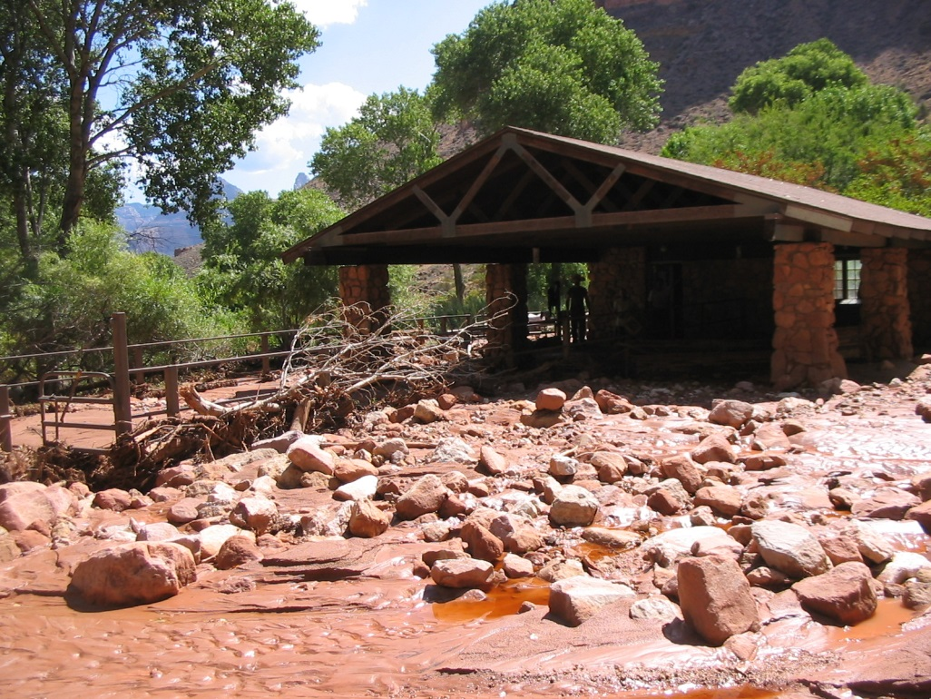
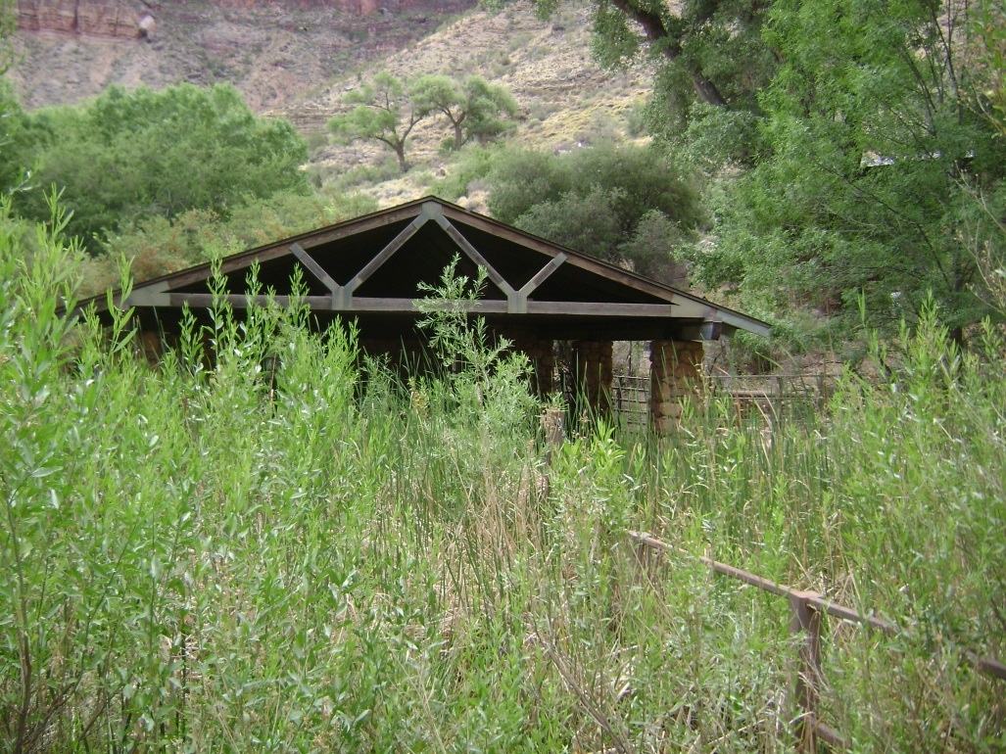
Former Sites of Events
Bright Angel Trail debris flow damage at Indian Gardens mule corral July 14th, 2004.
2004
2013
Chris Brothers (trail crew)

Slide 9
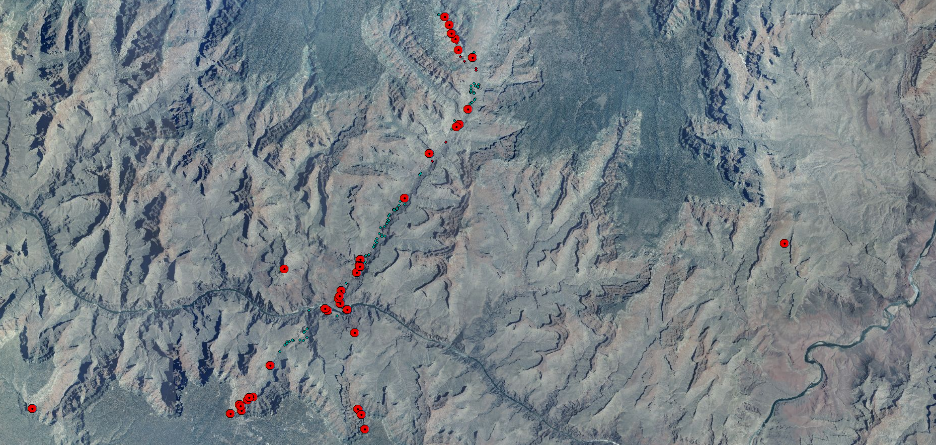
Mapping Documented Events
The locations for documented events were plotted in ArcGIS.

Slide 10
Observations
Total number of documented events: 45
Monsoon season spans from mid July to early September.

Slide 11
Documented Events by Trail

Slide 12
Documented Events Per Year
Year | 92 | 93 | 01 | 03 | 04 | 05 | 06 | 07 | 08 | 09 | 11 | 12 | 13
AP | 11.5 | 10.9 | 9.27 | 9.21 | 15.4 | 12.9 | 11.3 | 8.14 | 8.52 | 6.33 | 8.63 | 9.55 | 4.19
AS | 46 | 51.5 | 82.8 | 43 | 39 | 29.3 | 22.8 | 17.4 | 52.8 | 43.2 | 52.8 | 50.7 | 21.2
AP: Annual Precipitation (in), AS: Annual Snowfall (in)

Slide 13
Conclusions
Unstable lithologic contacts are Coconino Sandstone-Hermit Shale and Redwall/Muav Limestone- Bright Angel Shale.
Numerous unstable units responsible for propagating mass movements.
Several active areas identified on corridor trails.
Fluctuations in temperature preceding events were observed.
Three very interesting finds.

Slide 14
Future Work
Continued research required to consolidate database.
Acquiring data from more sources within the national park.
Trans-canyon pipeline work orders need to be examined closely.
Investigation of earthquake records to pin point possible propagation.
Additional data collection on the South Kaibab Trail.
Digital mapping of satellite imagery.

Slide 15
Acknowledgments
I am grateful to the Geological Society of America and the National Park Service for giving me this excellent opportunity.
I would like to thank Deanna Greco for her support and expertise towards this project.
I would like to thank Russell Rosenberg, Bil Vandergraff, Brian Gatlin, Chris Brothers and the Museum Collection at GRCA for their guidance.

Slide 16
Works Cited
Griffiths, Peter G., Robert H. Webb, and Theodore S. Melis. Initiation and frequency of debris flows in Grand Canyon, Arizona. No. USGS-OFR-96-491. DEPARTMENT OF THE INTERIOR WASHINGTON DC, 1996.
  National Geographic Maps. Grand Canyon National Park Trails Illustrated. [ca. 1: 73,530]. Evergreen, CO: National Geographic Maps, 1987. Print.
Oltrogge, Maureen. “National Park Service closes another section of the South Kaibab Trail in Grand Canyon National Park to repair damage caused by storm.” GRCA Park Management Information 4 November, 2004. NPS Press Release. nps.gov. 25 July 2013.
Oltrogge, Maureen. “Third Pipeline Break in Grand Canyon Closes Section of North Kaibab Trail.” GRCA Park Management Information 31 May, 2012. NPS Press Release. nps.gov. 25 July 2013.
Photos of the Tanner Trail slide and Indian Gardens flash flood damage were provided by Chris Brothers of trail crew.
Trail locality maps were provided by Ellen Brennan of Cultural Resources.

