Slide 1
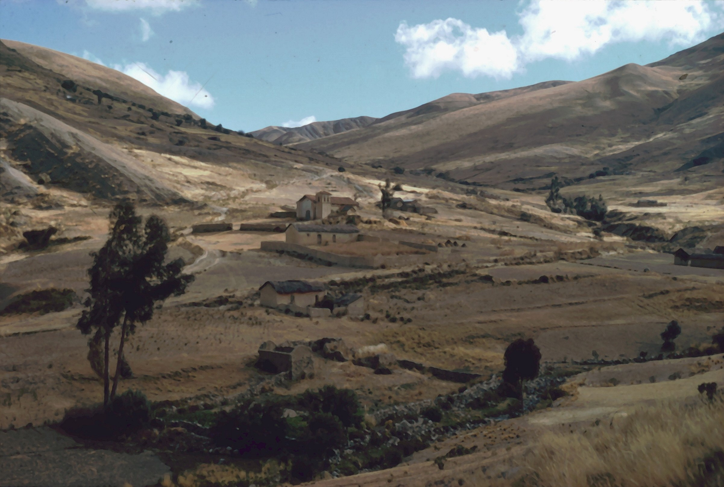
DEVONIAN , CARBONIFEROUS and PERMIAN of WESTERN GONDWANA
A story of glacials, rebound, and carbonates
Peter Isaacson, University of Idaho
Mercedes diPasquo, UAER, Argentina
George Grader, PRISEM Consulting
Enrique Díaz-Martínez, IGME, España
Heidi Anderson, University of Western Montana

Slide 2
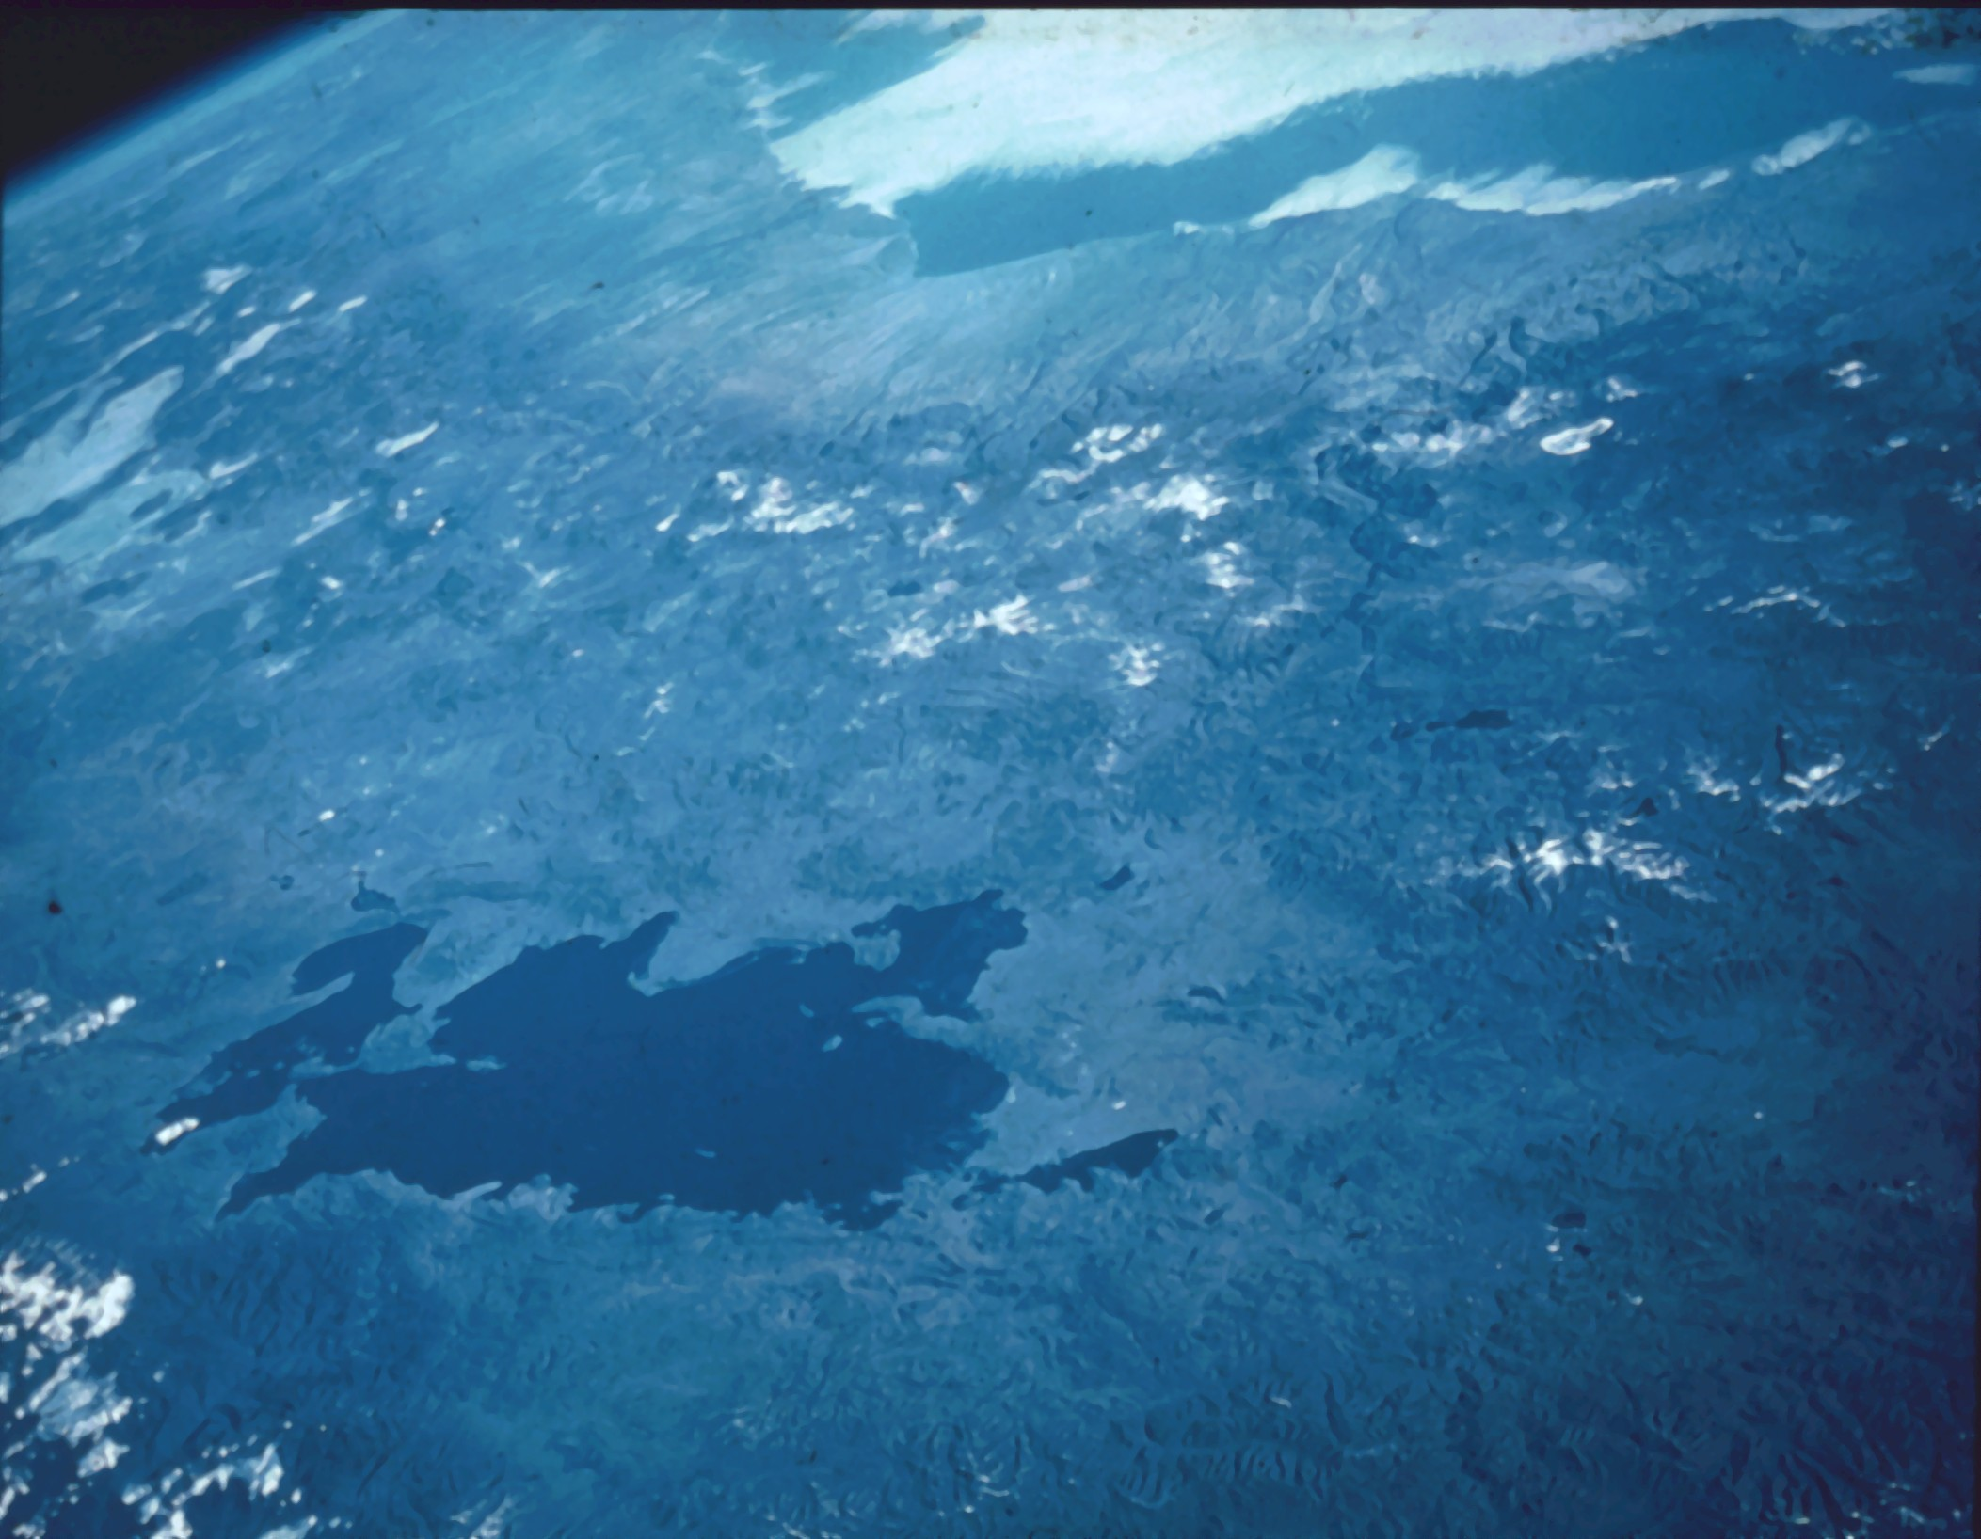
Océano Pacífico
ARGENTINA
CHILE
Cordillera
Occidental
PERÚ
altiplano
Peninsula de Copacabana
L. Titicaca
yungas

Slide 3
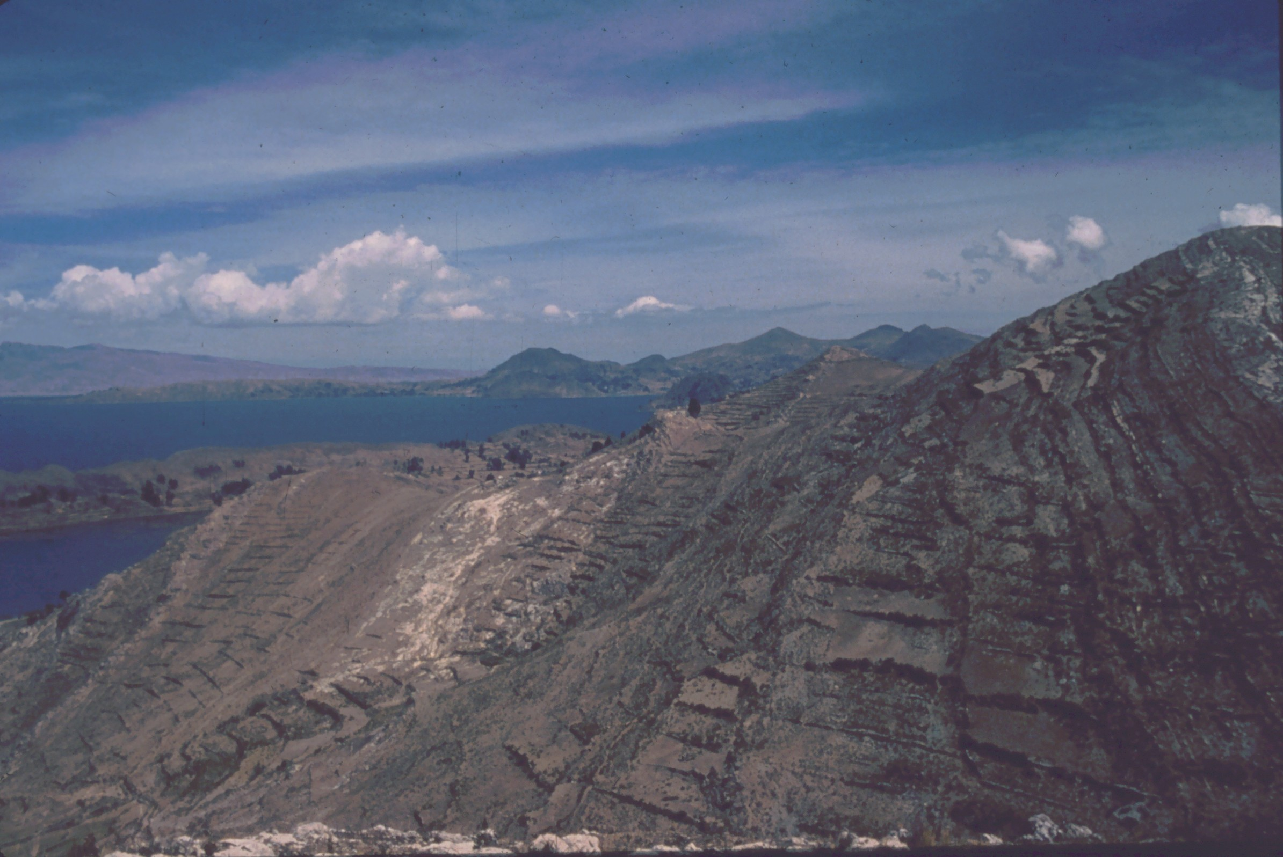

Slide 4
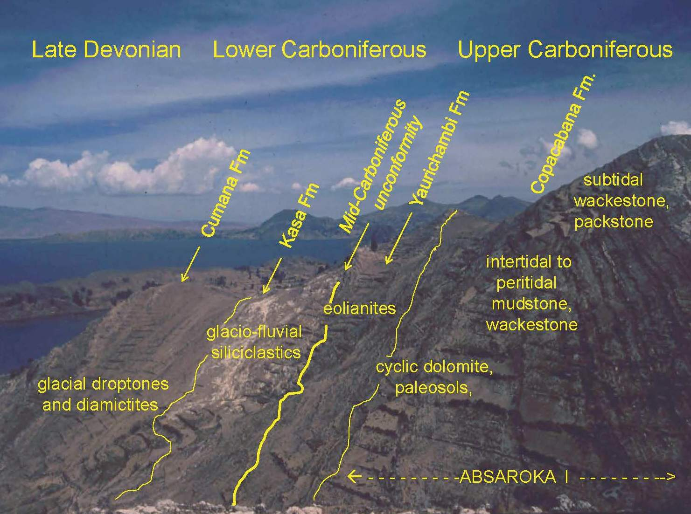

Slide 5
DEVONIAN
Western land source - foreland (Isaacson, 1975)
Siliciclastics (Kozlowski, 1923; Ahlfeld and Braniša, 1960; Chamot, 1965)

Slide 6
Early Devonian convergence central Andes
San Nicolás batholiths
(Mukasa and Henry, 1990)
Isaacson et al., 1995

Slide 7
DEVONIAN
Western land source - foreland (Isaacson, 1975)
Siliciclastics (Kozlowski, 1923; Ahlfeld and Braniša, 1960; Chamot, 1965)
Early Devonian endemic, cold water faunas (d’Orbigny, 1843; Clarke, 1913; Boucot et al., 1969; Isaacson, 1977)
~50-60º S paleolatitude (Smith et al., 1973)
Middle Devonian immigrants from Africa (Isaacson, 1974, 1977)

Slide 8
Early Devonian in the Central Andes
Bolivia Basin and maximum Malvinokaffric Realm
brachiopod diversity
Isaacson, 1974, 1977

Slide 9
DEVONIAN
Western land source - foreland (Isaacson, 1975)
Siliciclastics (Kozlowski, 1923; Ahlfeld and Braniša, 1960; Chamot, 1965)
Early Devonian endemic, cold water faunas (d’Orbigny, 1843; Clarke, 1913; Boucot et al., 1969; Isaacson, 1977)
~50-60º S paleolatitude (Smith et al., 1973)
Middle Devonian immigrants from Africa (Isaacson, 1974, 1977)
Gondwana glaciation begins in Late Devonian (Brasil: Caputo, 1985; Andes: Isaacson et al., 1999,
2008; Appalachians: Brezinski et al., 2010)

Slide 10
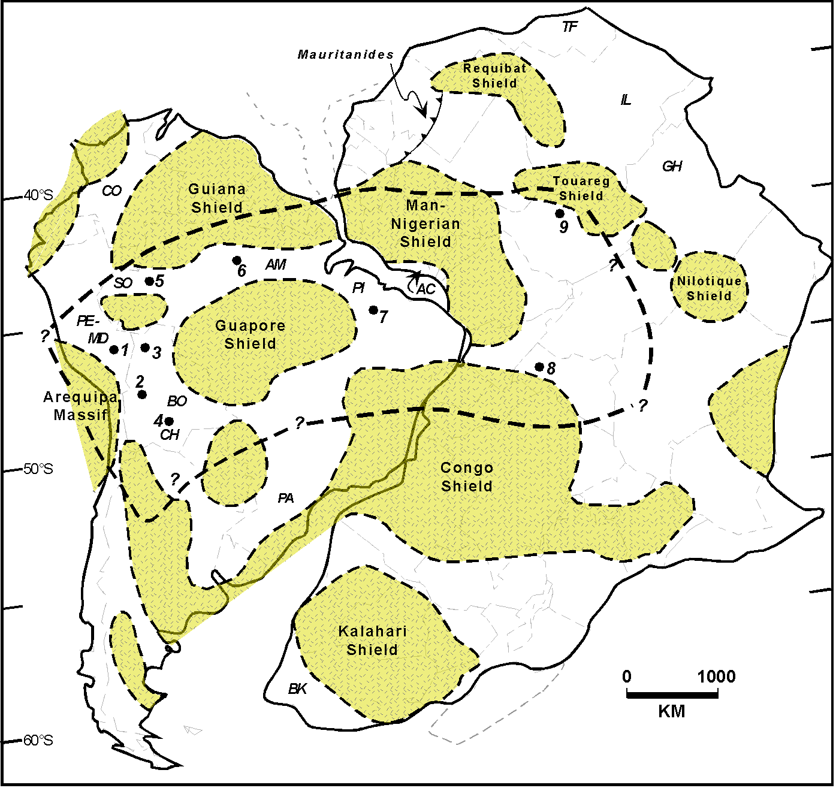
Preliminary estimate of ice extent
1,600,000 km
2
minimum
Isaacson et al., 2008

Slide 11
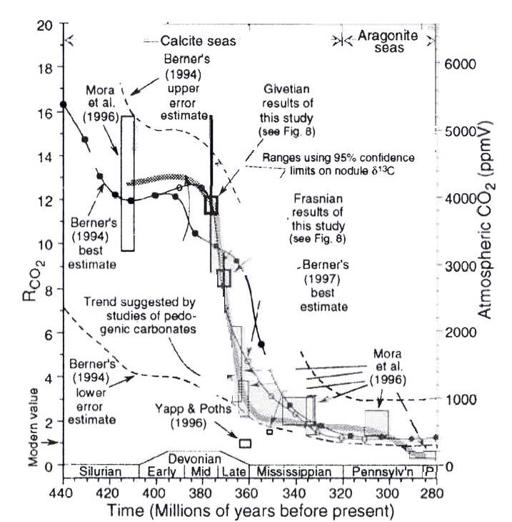
Late Devonian carbon dioxide drop
Cox et al., 2001

Slide 12
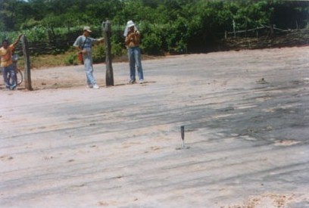
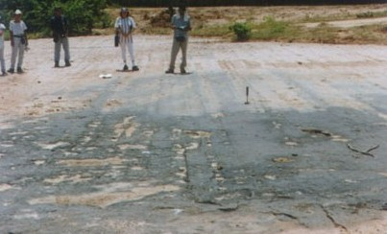
FIRST DESCRIPTION: DEVONIAN GLACIATION
Brasil
Amazonás and Solimöes basins’ subsurface
and
Devonian Glacial Grooves
Parnaíba Basin
Caputo, 1985, and unpub. photos

Slide 13
Glacial clasts: Cumaná Fm., Bolivia
fractured siliciclastic clasts
striated argillite
quartz monzonite

Slide 14
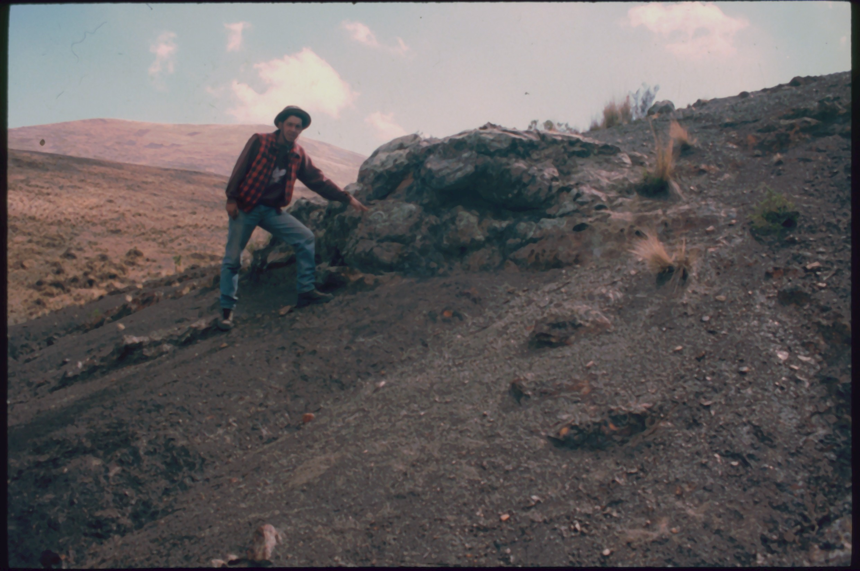
Bedded quartz arenite clast
smaller clasts, mostly quartzite

Slide 15
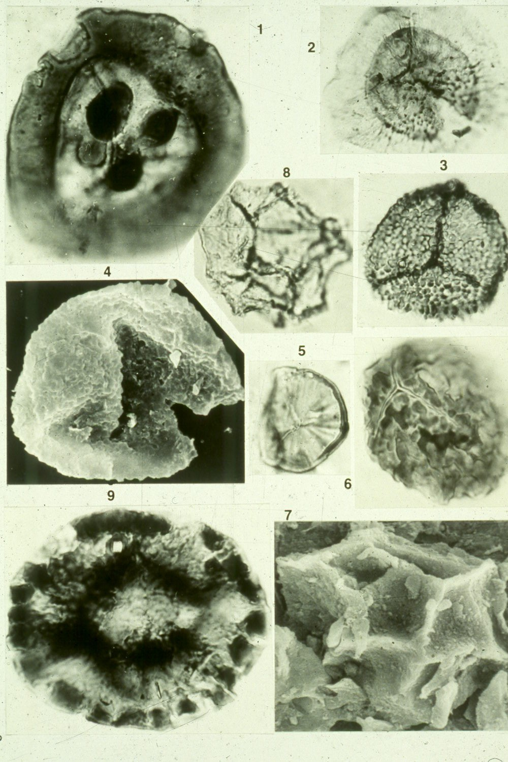
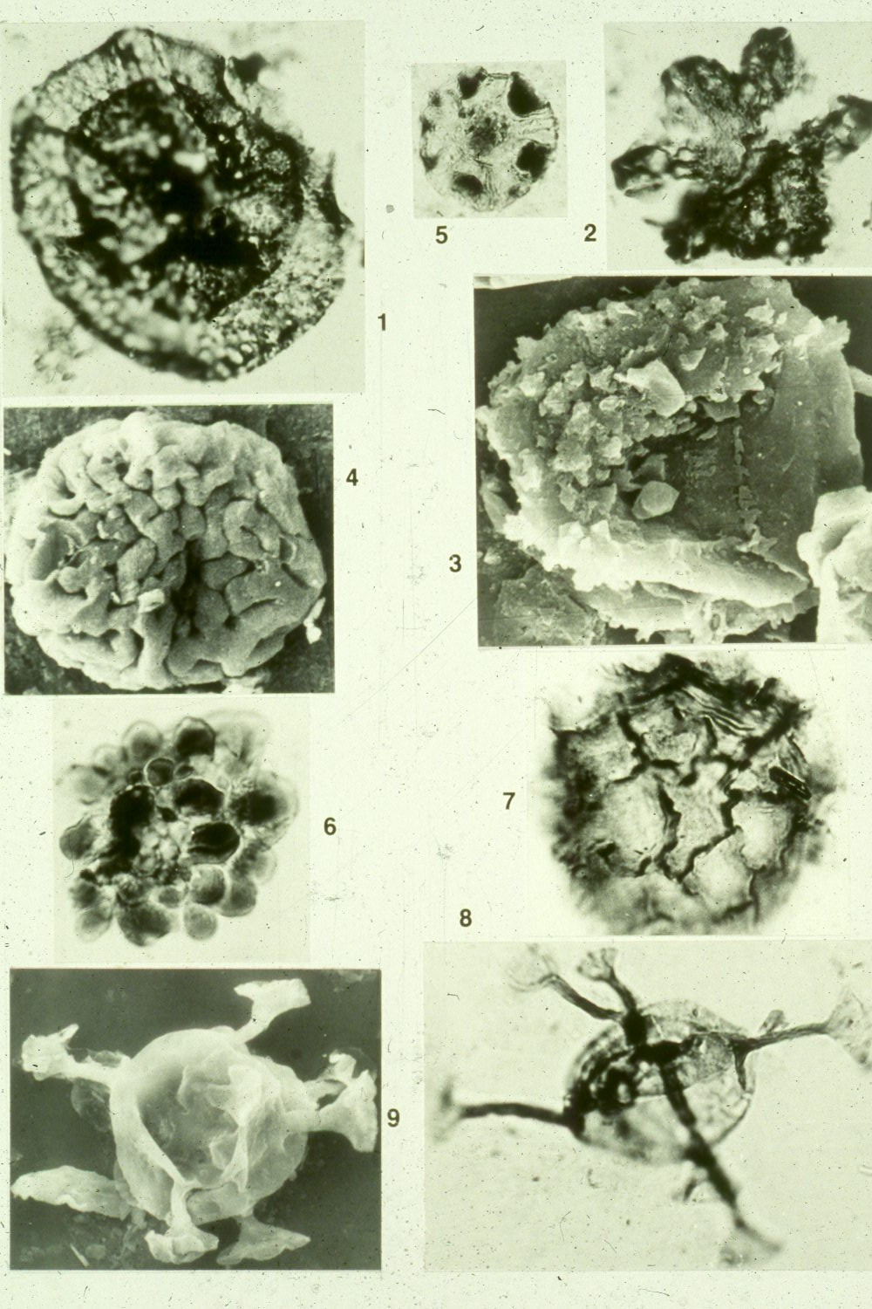
Famennian palynology Cumaná Fm.
Vavrdová et al., 1993
R. lepidophyta
M. brasiliensis
U. saharicum

Slide 16
Comparisons of wt% TOC values from world-class Devonian-Carboniferous boundary source rocks
Peters et al., 1996
Hui Jin and Sonnenberg,
ca. 2011
Nuttall et al., 2005
Cardott, 2013
Marynowski et al., 2012

Slide 17
CARBONIFEROUS
Lower Carboniferous peri-glacial marine and terrestrial siliciclastics
Mid-Carboniferous hiatus (global) = REBOUND?

Slide 18
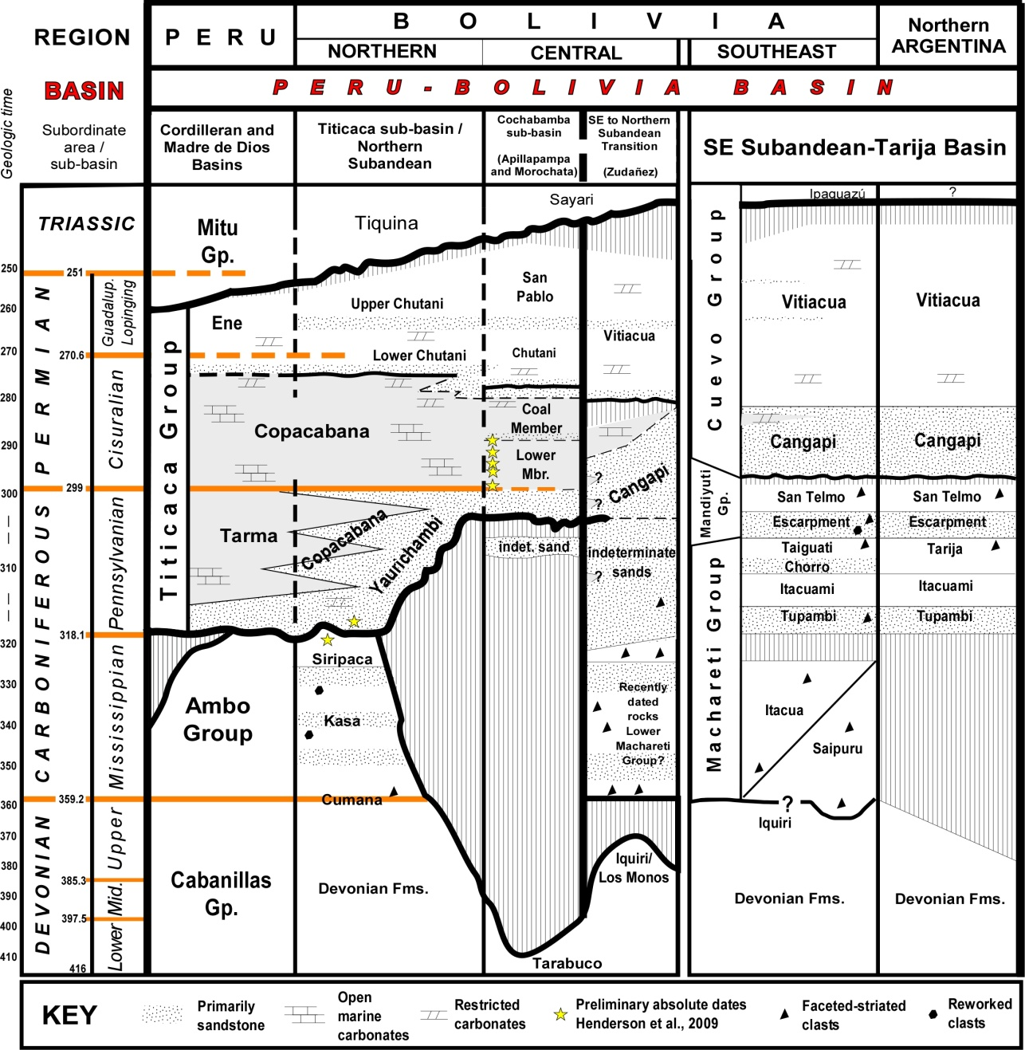
Late Paleozoic stratigraphy
Siliciclastics, southern Bolivia and northern Argentina, with recycled Retispora lepidophyta
Northern and western Bolivia, Perú, Brasil, Ecuador and Colombia carbonates
Mid-Carboniferous erosion
diamictites
REBOUND?
Mississippian erosion
REBOUND?
Stratigraphy from Díaz-Martínez, 1999; Southern Bolivia palynology ages from di Pasquo, 2003, 2007, 2009; diamictites reported by Anderson, 2011, Starck and del Papa, 2006

Slide 19
CARBONIFEROUS
Lower Carboniferous peri-glacial marine and terrestrial siliciclastics
Mid-Carboniferous hiatus (global) = REBOUND?
Late Carboniferous coal, carbonates, silcretes and calcretes

Slide 20
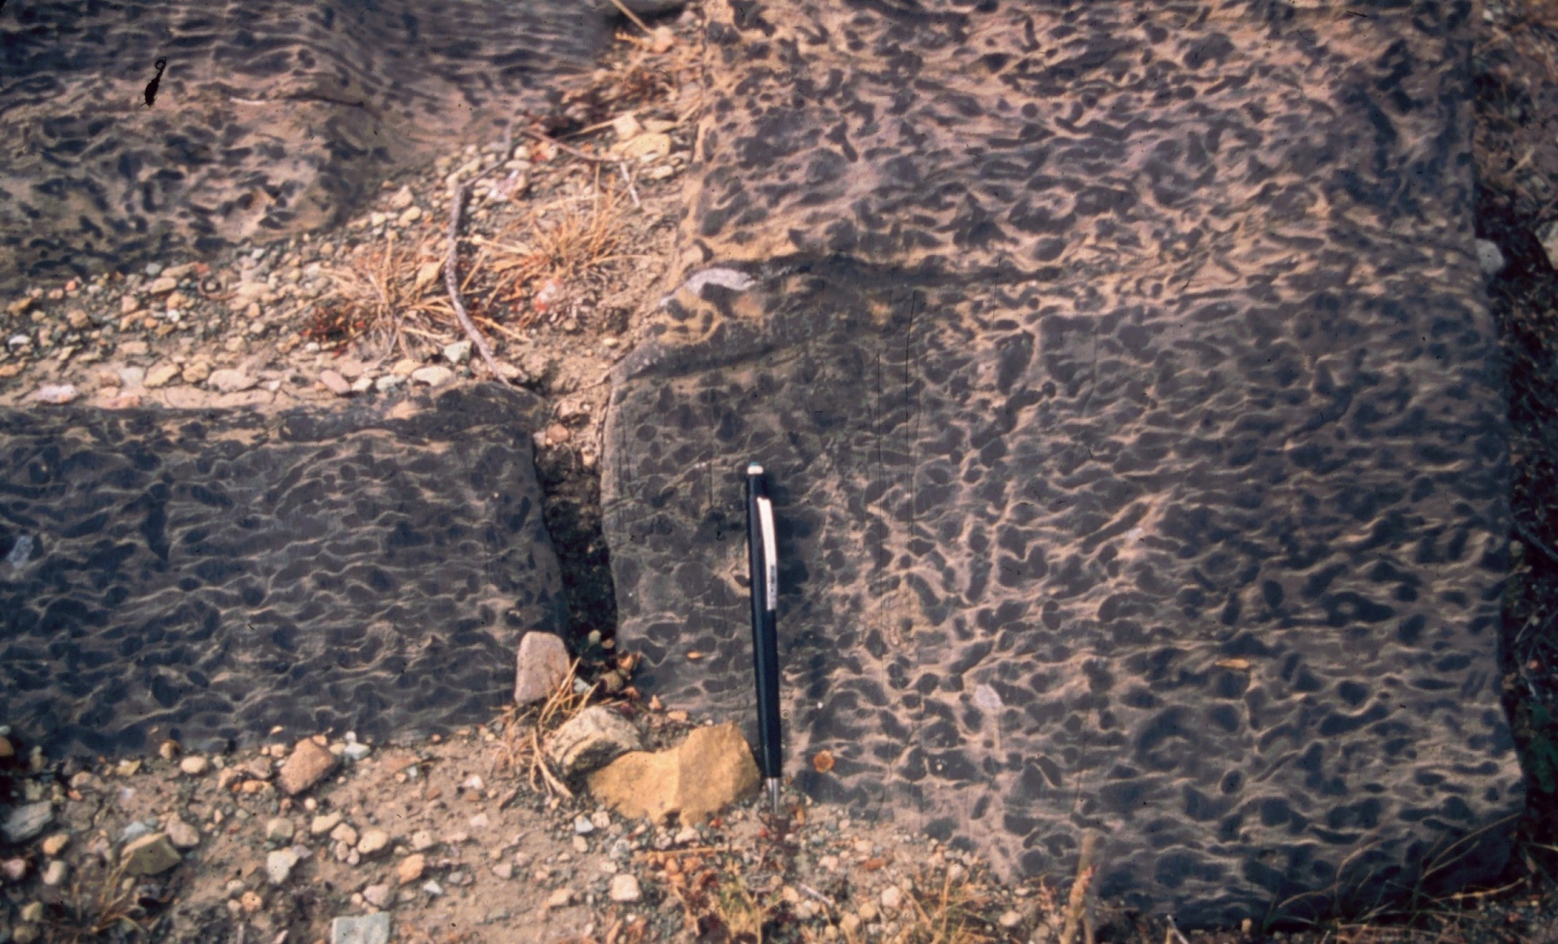
Copacabana Formation Pennsylvanian - Permian

Slide 21
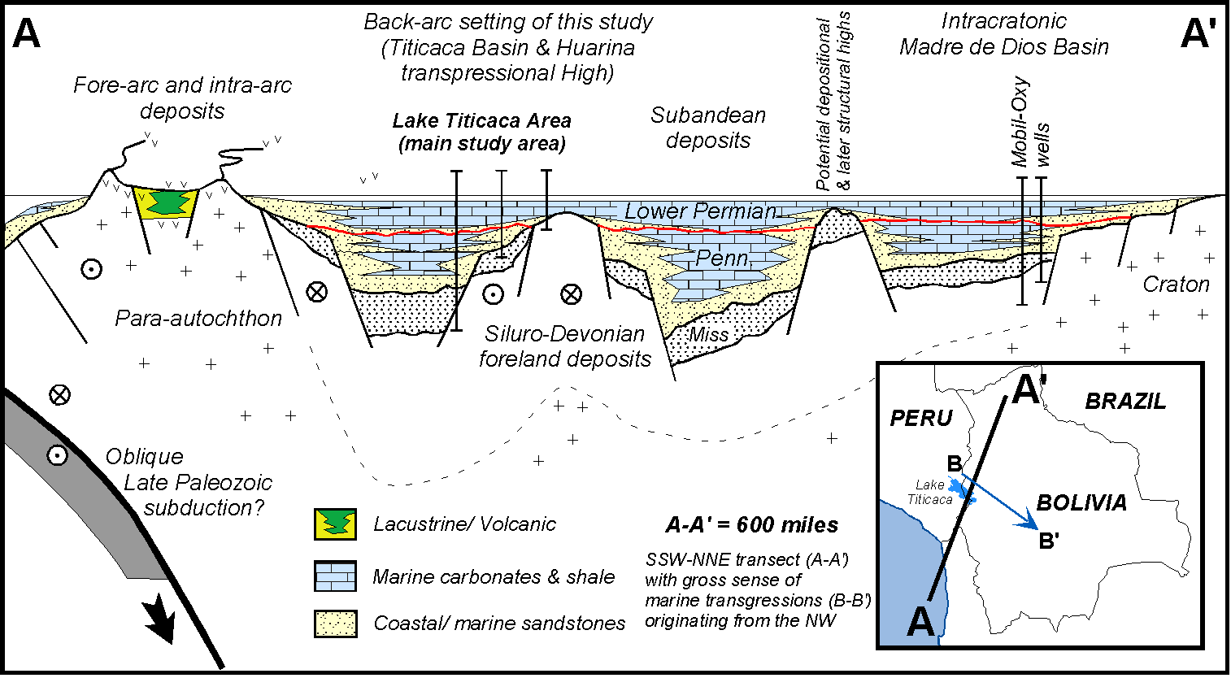
Grader et al., 2007

Slide 22
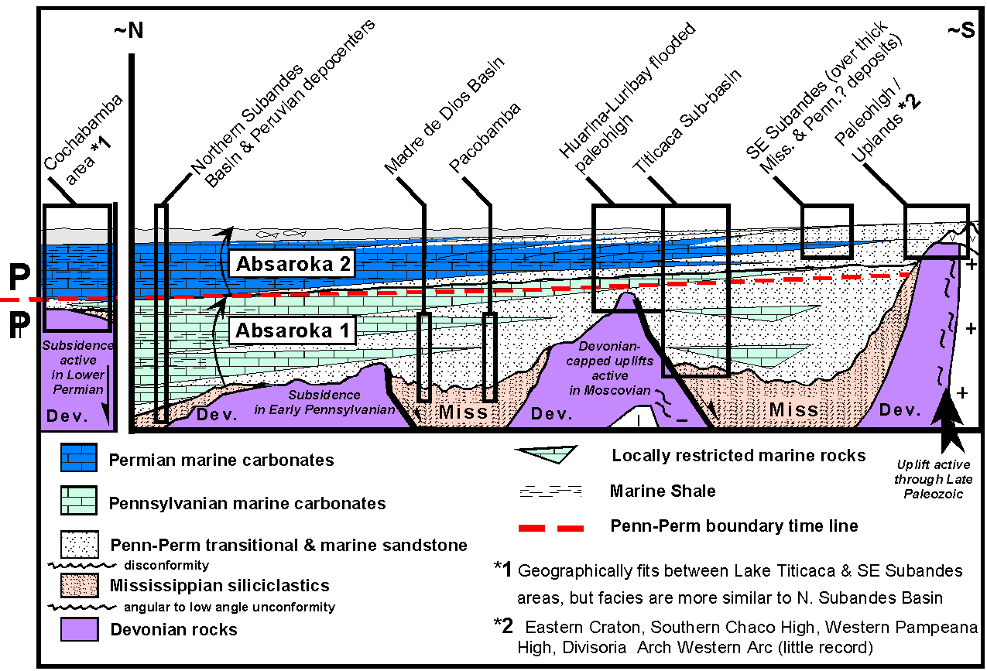
Grader, et al., 2007

Slide 24
Proxies for Late Pz Glaciation sequence boundaries
Five Pennsylvanian sequence boundaries: 318, 311, 308, 308, 306.5 Mya
Three Permian sequence boundaries: 299, approx. 293, 283 Mya

Slide 25
Bolivia: Important Points
Early Devonian highly endemic, cold-water faunas replaced by cosmopolitan immigrants (M Devonian)

Slide 26
Bolivia: Important Points
Early Devonian highly endemic, cold-water faunas replaced by cosmopolitan immigrants (M Devonian)
Western Land Source (Arequipa massif)

Slide 27
Bolivia: Important Points
Early Devonian highly endemic, cold-water faunas replaced by cosmopolitan immigrants (M Devonian)
Western Land Source (Arequipa massif)
Late Devonian glaciation, debate over duration

Slide 28
Bolivia: Important Points
Early Devonian highly endemic, cold-water faunas replaced by cosmopolitan immigrants (M Devonian)
Western Land Source (Arequipa massif)
Late Devonian glaciation, debate over duration
Very thick siliciclastic succession (D-C), followed by carbonates in altiplano and peri-glacial clastics in south (C-P)

Slide 29
Bolivia: Important Points
Early Devonian highly endemic, cold-water faunas replaced by cosmopolitan immigrants (M Devonian)
Western Land Source (Arequipa massif)
Late Devonian glaciation, debate over duration
Very thick siliciclastic succession (D-C), followed by carbonates in altiplano and peri-glacial clastics in south (C-P)
High to lower paleolatitude shift?

Slide 30
Bolivia: Important Points
Early Devonian highly endemic, cold-water faunas replaced by cosmopolitan immigrants (M Devonian)
Western Land Source (Arequipa massif)
Late Devonian glaciation, debate over duration
Very thick siliciclastic succession (D-C), followed by carbonates in altiplano and peri-glacial clastics in south (C-P)
High to lower paleolatitude shift?
Carboniferous subaerial exposure, glacio-fluvial systems and periglacial deposits = rebound?

Slide 31
Bolivia: Important Points
Early Devonian highly endemic, cold-water faunas replaced by cosmopolitan immigrants (M Devonian)
Western Land Source (Arequipa massif)
Late Devonian glaciation, debate over duration
Very thick siliciclastic succession (D-C), followed by carbonates in altiplano and peri-glacial clastics in south (C-P)
High to lower paleolatitude shift?
Carboniferous subaerial exposure, glacio-fluvial systems and periglacial deposits = rebound?
Penn/Perm carbonates: sequence boundaries as proxies for glaciations

Slide 32
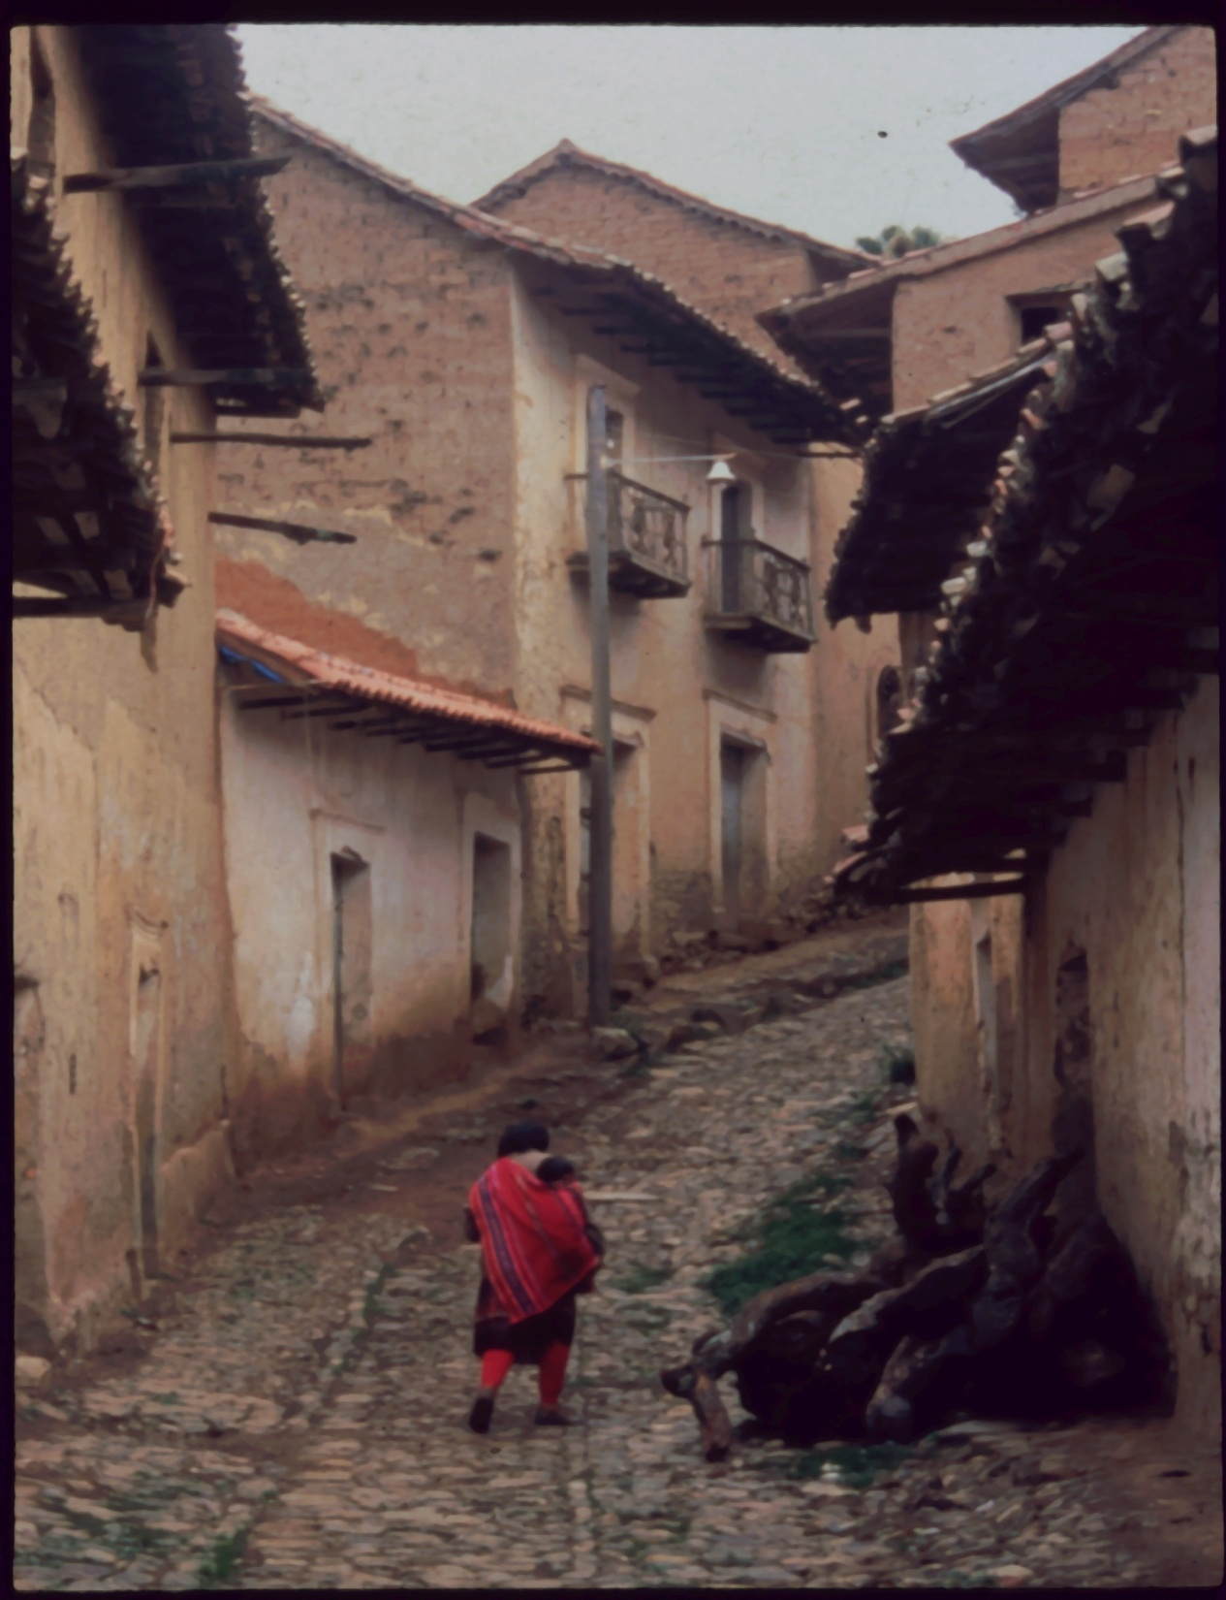
“I know one thing, and that is I know nothing.”
Socrates, ca 410 BC

