Slide 1


Using Role-play to Improve Science Communication Efficacy in Students
Jacqueline Dohaney
Postdoctoral Fellow
jdohaney@gmail.com
& Erik Brogt, Ben Kennedy, and Thomas Wilson

Slide 2
Using Role-play to Improve Science Communication Efficacy in Students
Why teach communication skills?
What are the attributes of ‘good’ communication?
Risk Communication
Using Role-play
Communication Performance
Communication Efficacy
Results

Slide 3


Why should we teach communication?
PROFESSIONAL GEOLOGISTS INTERVIEWS (n = 21)
geologists, geophysicists, geochemists, volcanologists, emergency managers, consenting managers, project managers, R&D managers
Geothermal Sector n = 10; Volcanology Sector n = 11
Communication Skills:
“Social skills are really important in the job. You’ve got to be able to communicate with people. And that’s not just like at a professional level, it’s at a social level too. You’ve got to be able to sit down and have a drink with someone, and talk to them about not just what’s been going on at work, but what’s going on with them, personally as well. And form relationships with people. It’s important.”
Notes:
Student Feedback
Learning Gains
Expert Interviews

Slide 4
Fundamentals of Risk Communication
(DRR, Disaster Risk Reduction)
7 C’s of Science Communication:
Comprehensible – simple, clear, jargon-free
Contextualized – diversity, cultures, differences
Captivating – engaging, relevant
Credible – open, frank, acknowledges uncertainty
Consistent – backed by evidence, confirmable
Courteous – compassionate, empathetic, respectful
(Addresses ) Concerns – empowers action/response
Vivienne Bryner, PhD at University of Otago
http://www.youtube.com/watch?v=grhrLT8tfjg

Slide 5
What variables contribute to communication?
Communication Performance
Communication Efficacy
Perceptions of Science Communication
Geology Knowledge
Communication Experience

Slide 6
How can we assess communication performance?
Variables (i.e., proxys)
Communication Experience
Communication Apprehension
or Efficacy (i.e., confidence)
Perceptions of Science Communication
Geology Content Knowledge
Measures (Self-reported)
-> Self-reported Questionnaire
-> PRCA-24, SPCC Communication Apprehension Instruments
-> Science Communication Perceptions Questionnaire
-> Content Knowledge questionnaire

Slide 7
How can we assess communication performance?
Communication Performance
“Classroom” Observations
Pre-post communication interviews (videotaped)
Assessed through qualitative coding, informed by…
Communication Performance Rubric (** 2PS ** Instrument)

Slide 8
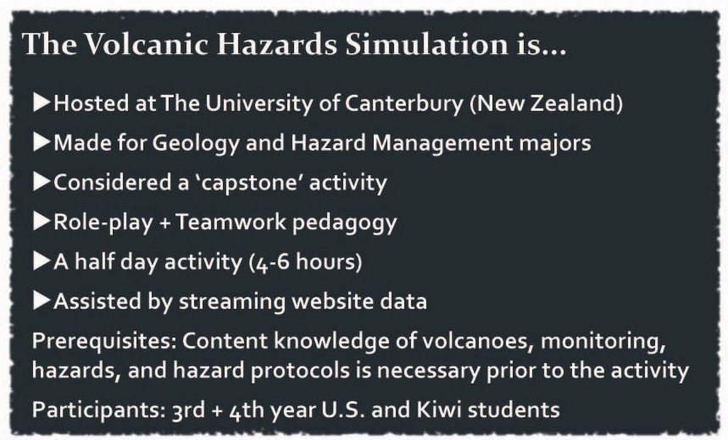

Slide 9
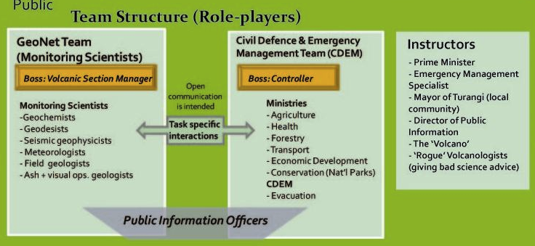
Students play realistic roles, within a complex professional structure

Slide 10
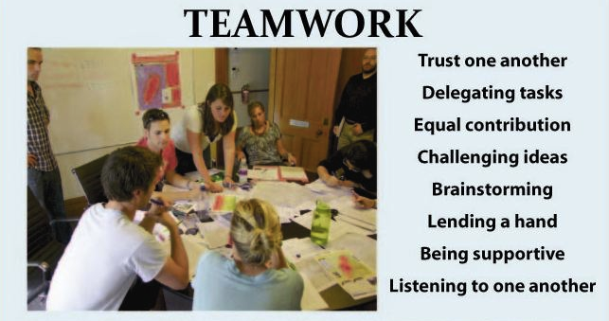
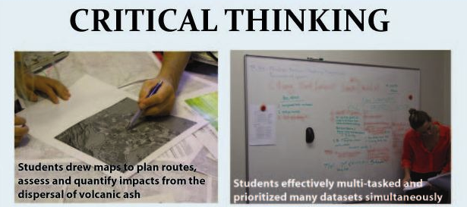
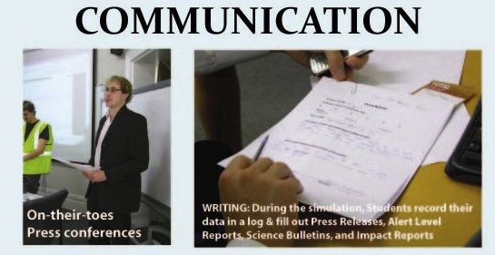

Slide 11
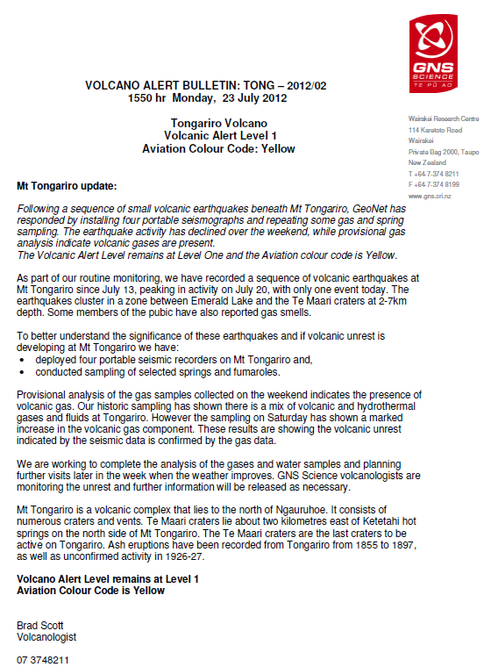
Students practice several forms of communication:
Media Releases & Bulletins
Press Conferences
Meetings Discussions
Townhall
& monitoring of Social Media

Slide 12
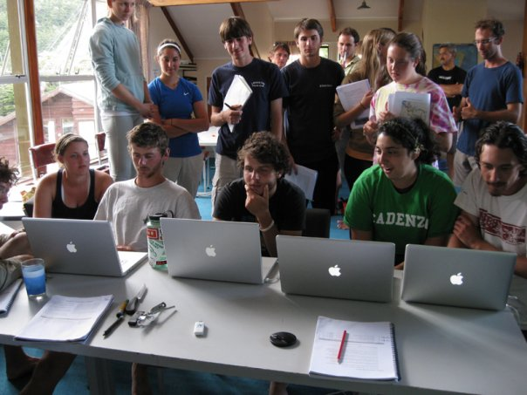
Communication Apprehension: PRCA-24
Definition: An individual’s level of fear or anxiety associated with either real or perceived communication with another person or persons in given communication settings (McCroskey, 1982b; 1984)
High CA = low confidence (i.e., efficacy) in communication scenarios;
Low CA = high confidence
CA is strong predictor of/proxy to (but is not proven relationship with) communication performance (Rubin 1985; Morreale et al 2007).
E.g., student who believes they are an excellent speaker, but deliver poor performances
New research indicates a statistically significant negative correlation between CA and cognitive performance

Slide 13
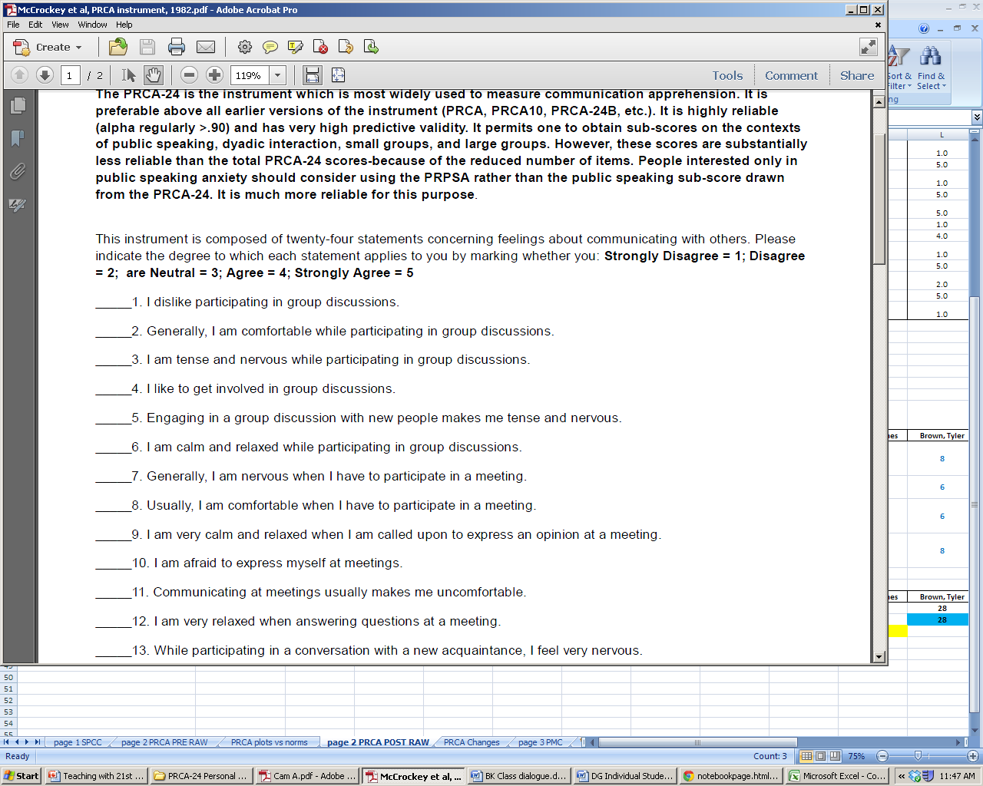
The Instrument: PRCA-24
Communication in different settings. E.g., Group discussions

Slide 14
Where did the students plot?
n = 20 students
3
HIGH score of >80
LOW score of <51
These students would exhibit: ‘stage’ fright or audience anxiety
=> linked to difficulties with group work, cognitive development and inter-social skills
10
7
Mean score:
65.6 ± 15.3
Descriptive Statistics of CA Pre-tests
 | Group | Meeting | Interpersonal | Public | Overall
Minimum | 6 | 6 | 6 | 6 | 24
Maximum | 26 | 25 | 20 | 27 | 96
Mean | 14.3 | 16.2 | 13.7 | 16.7 | 61.0
St Dev | 4.8 | 6.0 | 4.8 | 6.3 | 19.8
Notes:
Based on averages obtained by the author:
Norms: avg = 65.6 + 15.3
Group – 15.4 +/ 4.8
Meeting – 16.4 +/ 4.5
Interpersonal – 14.5 +/ 4.2
Public – 19.3 +/ 5.1

Slide 15
n=20
 | Group | Meeting | Interpersonal | Public | Overall
n of people who's communication changed for the better | 12 | 12 | 8 | 11 | 12
n of people who's communication changed negatively | 6 | 4 | 9 | 8 | 6
n of same/no change | 2 | 4 | 3 | 1 | 2
avg positive change (+/ stdev) | 1.92 +/ 1.33 | 3.33 +/ 1.78 | 2.5 +/ 2 | 2.36 +/ 1.87 | 7.375 +/ 7.01
avg negative change (+/) | 1.60 +/ 0.89 | 4.38 +/ 1.80 | 2.28 +/ 1.3 | 2.31 +/ 1.44 | 8.33 +/ 5.28
Significant changes, when compared to semester long communication therapy
Need for more comparable index, McCroskey, 1998 & correlation to communication performance

Slide 16
Future Work: Compare measures to actual performances
Use qualitative coding and rubric-based assessment of pre-post scenario ‘interviews’.
Assess variables the impact communication performance -> compare to proxys
Look for whether the curricula is successful at some communication attributes and/or scenarios more than others
Package for spin-off exercises

Slide 17
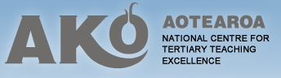


Thank you!
Contact: Jackie Dohaney
jdohaney@gmail.com
Funding
Collaborators
Colleagues
& Students

