Slide 1
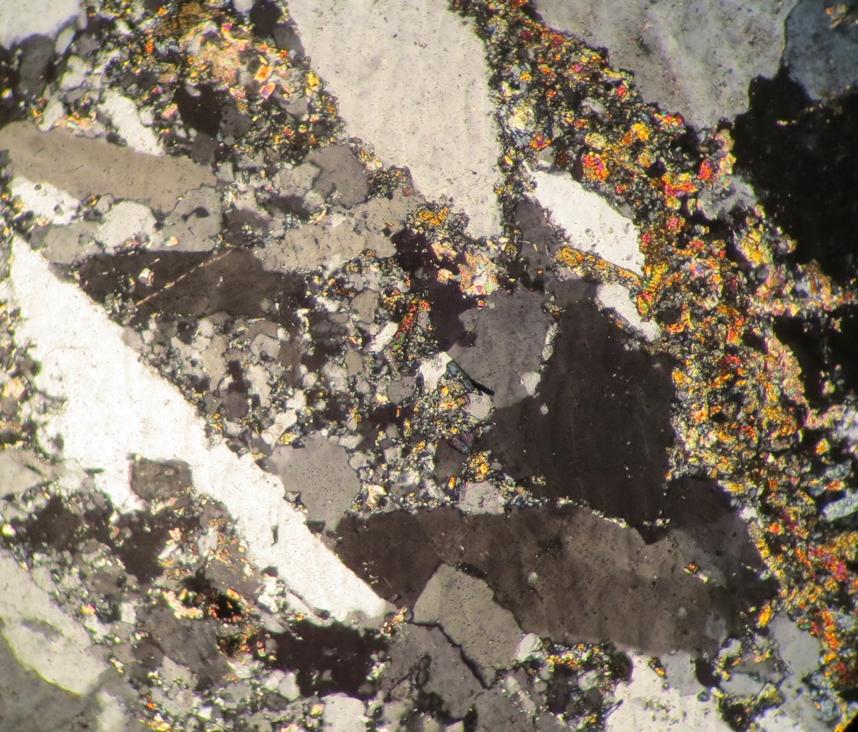

Undergraduate Research on the Bayside Core
of the Chesapeake Bay Impact Structure:
Past, Present, and Future Studies
Mercer Parker, Robin Rohrback-Schiavone,
and Shelley Jaye

Slide 2
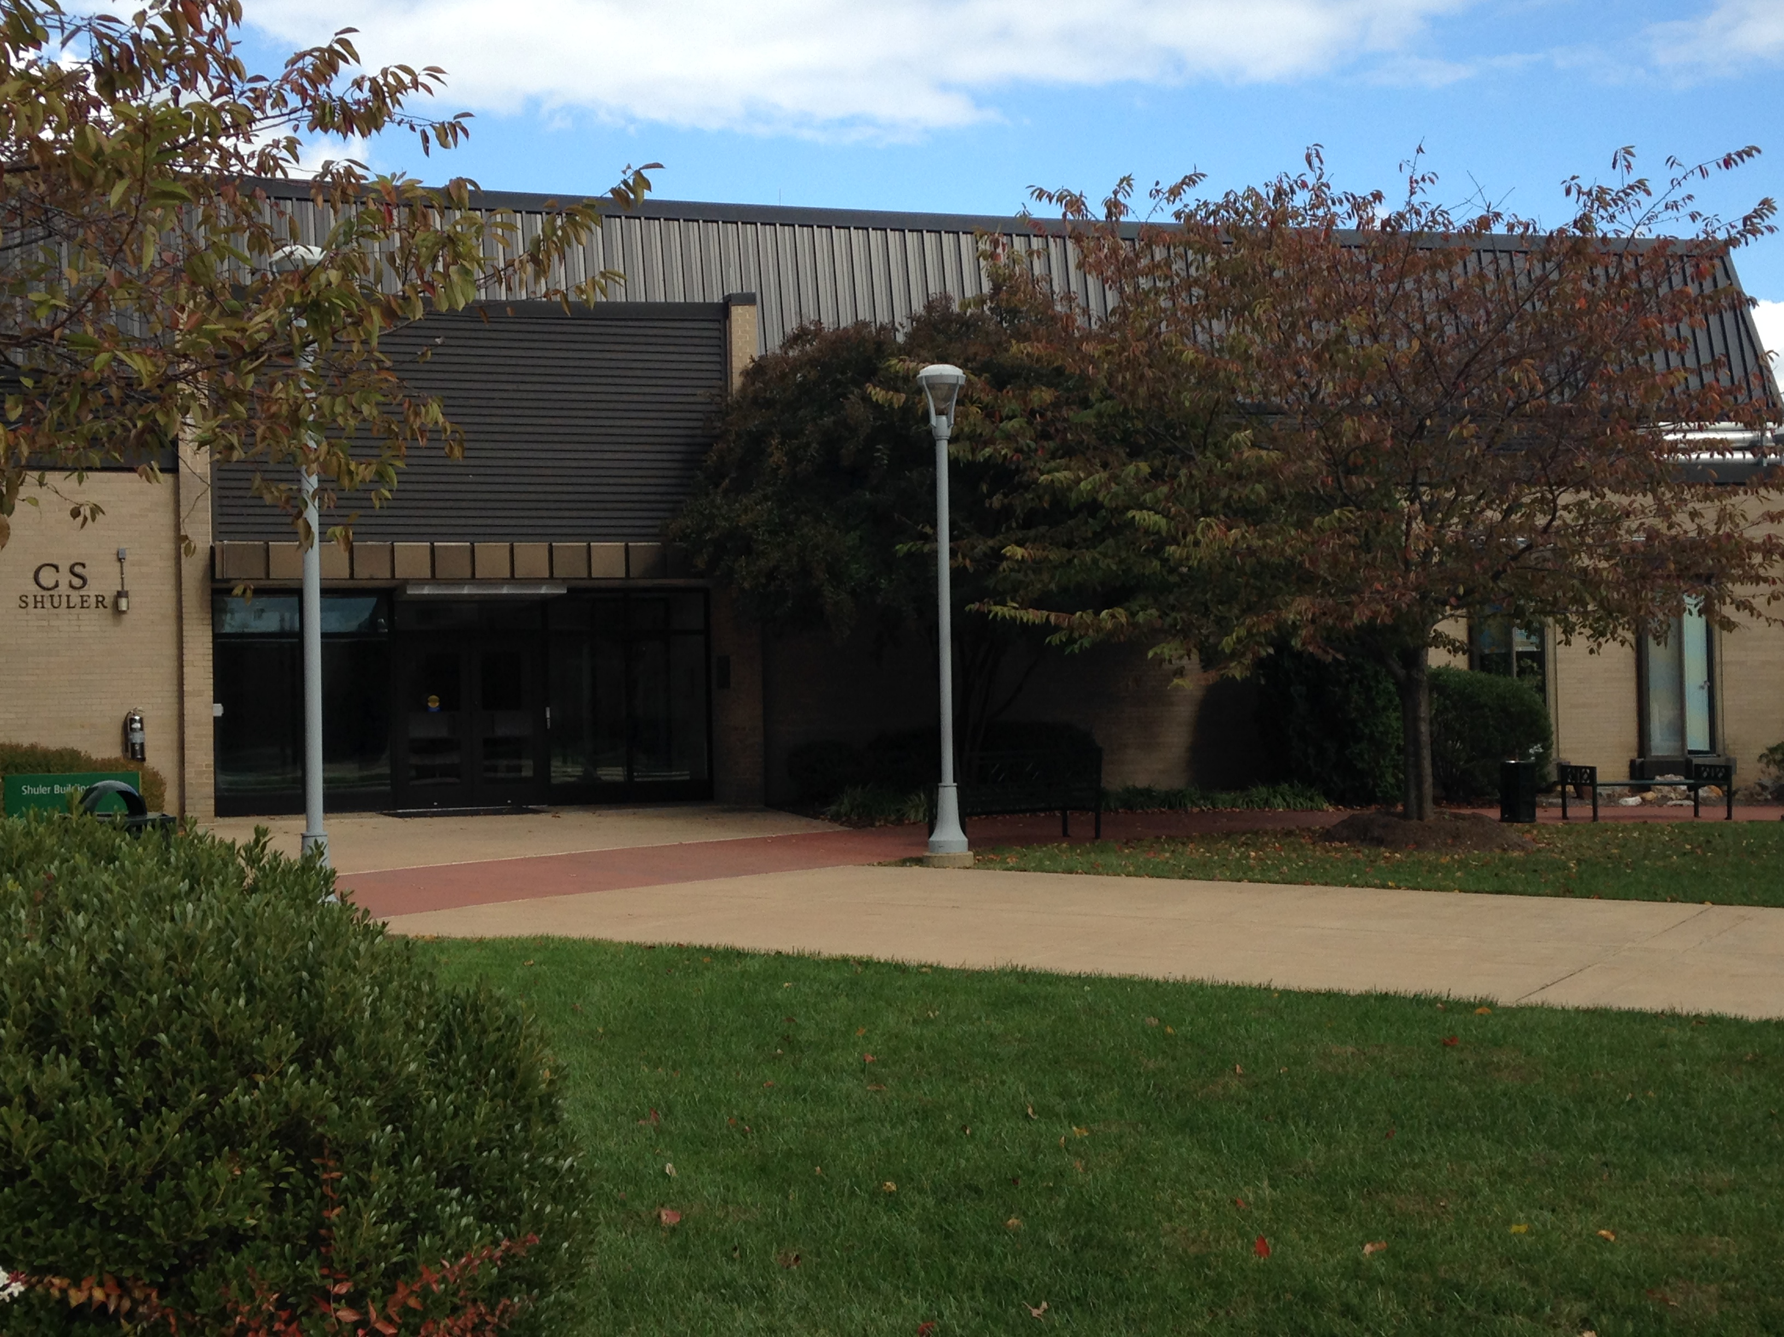



Slide 3


Slide 4
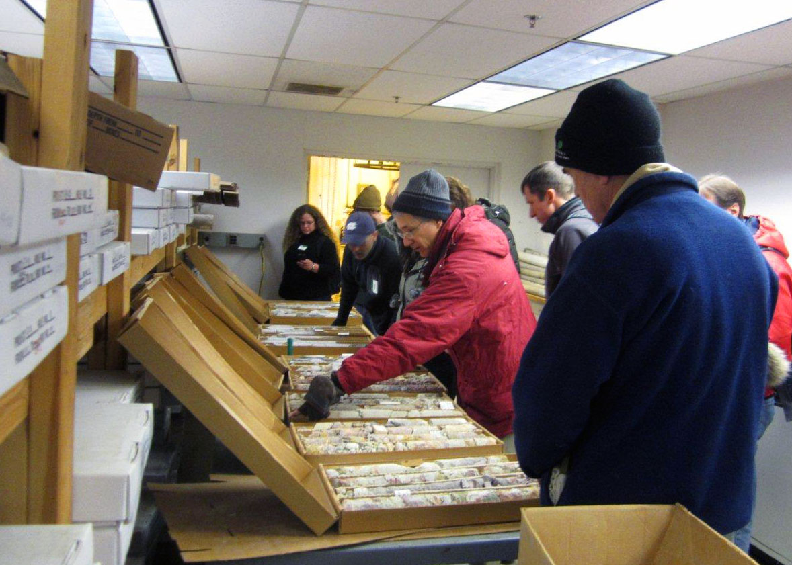

Slide 5
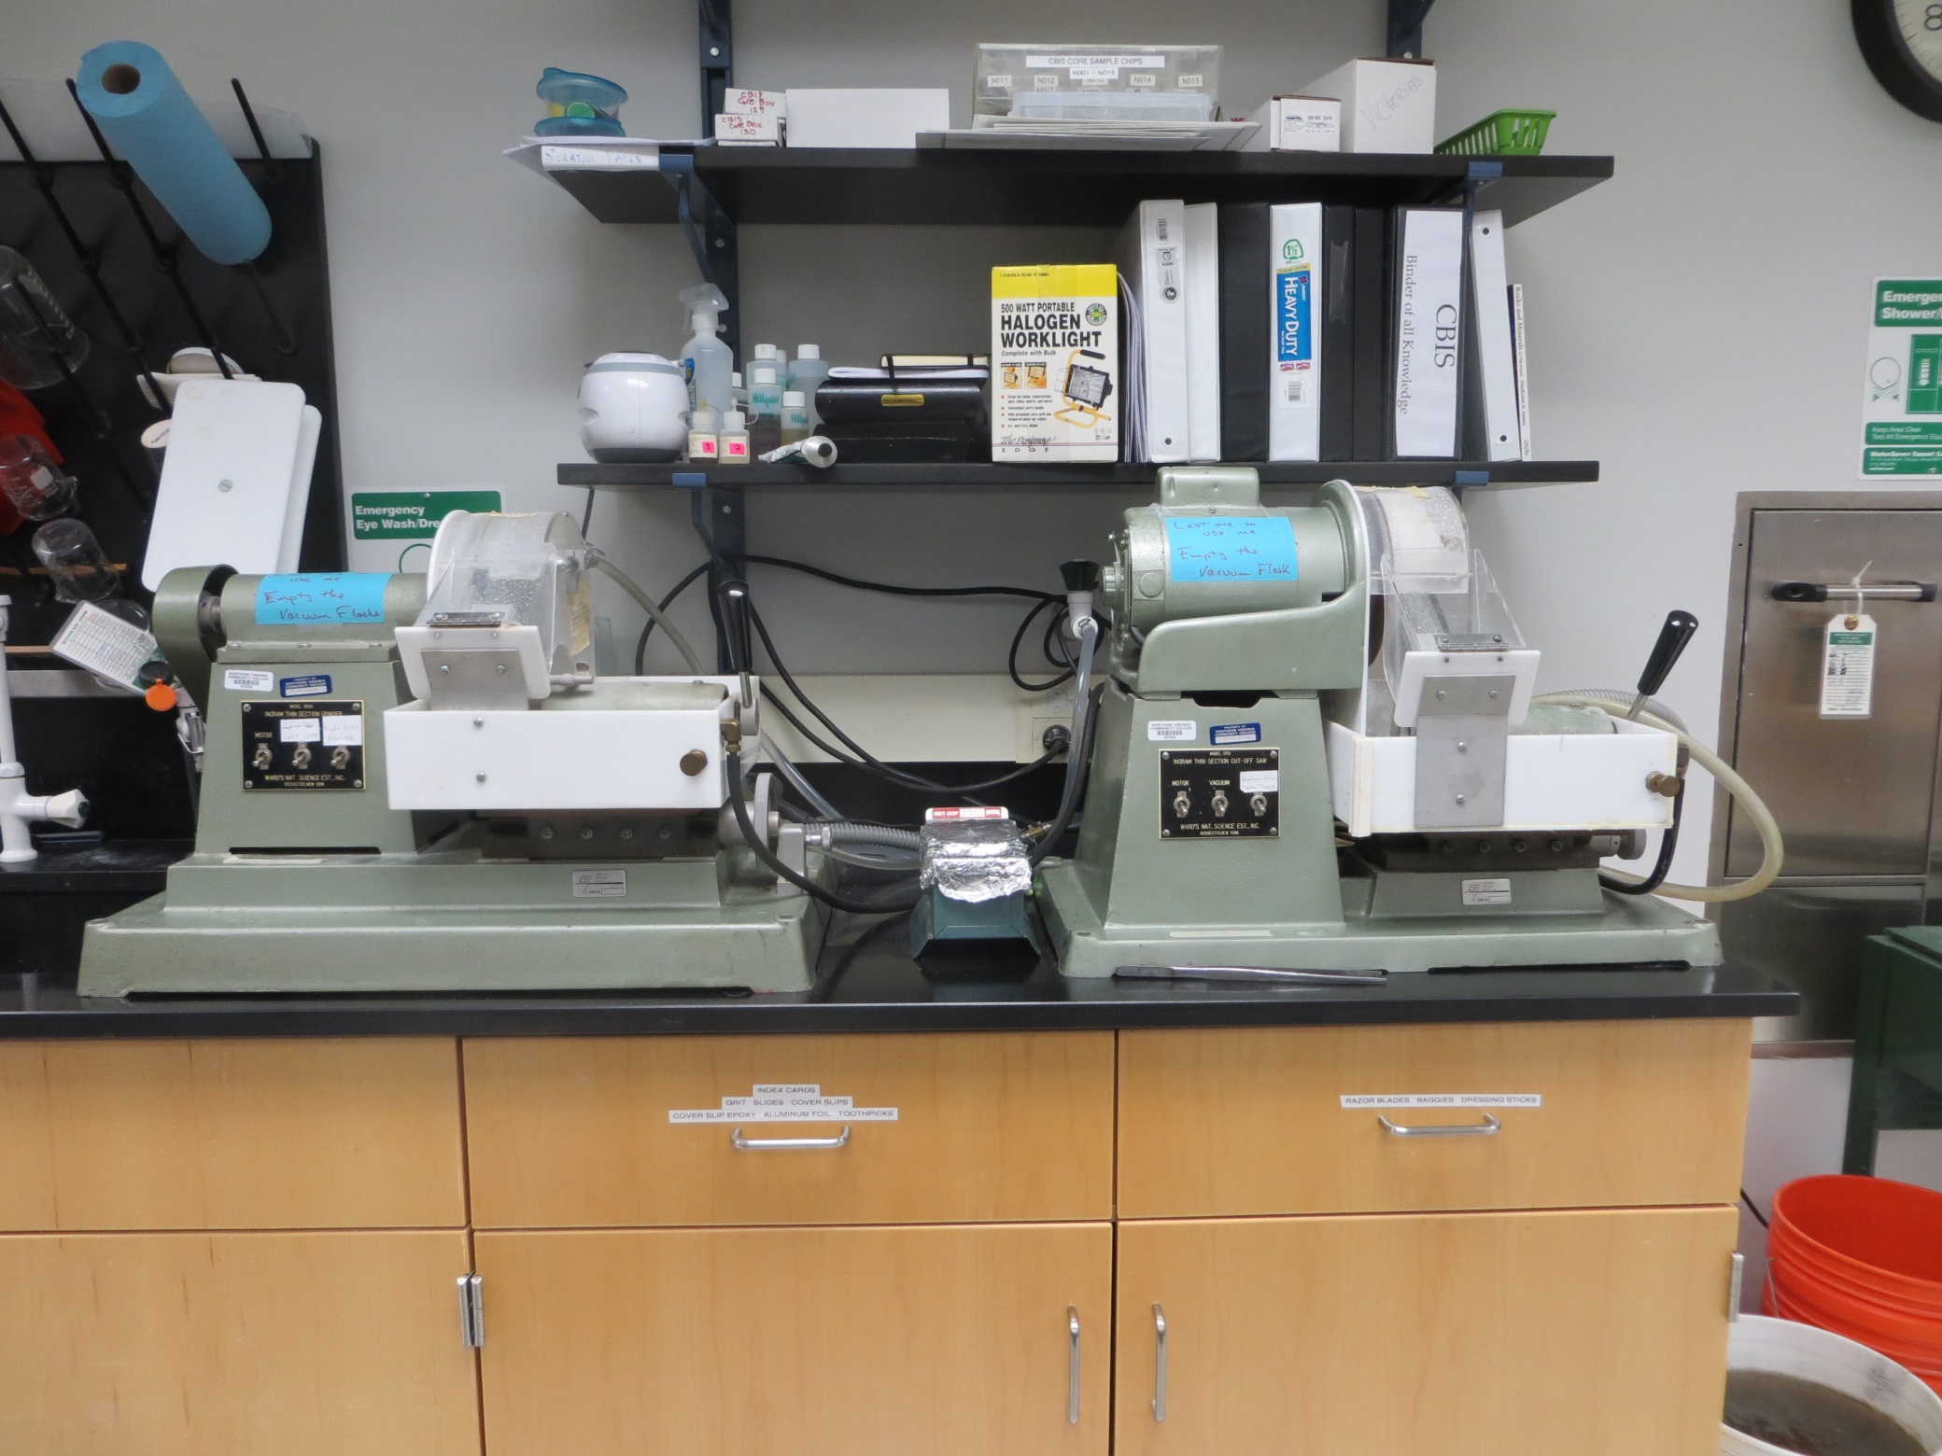

Slide 6
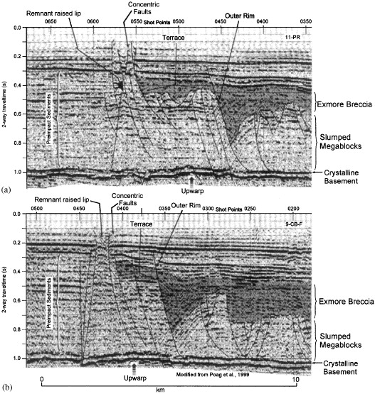
Subsurface mapping

Slide 7
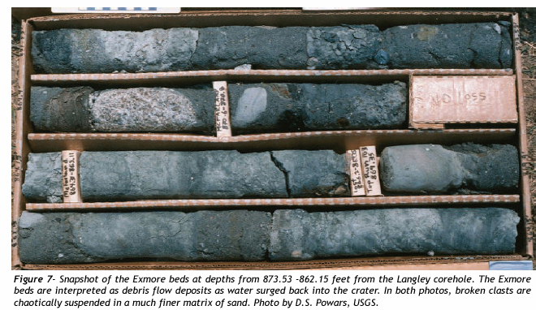
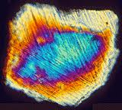

Slide 8

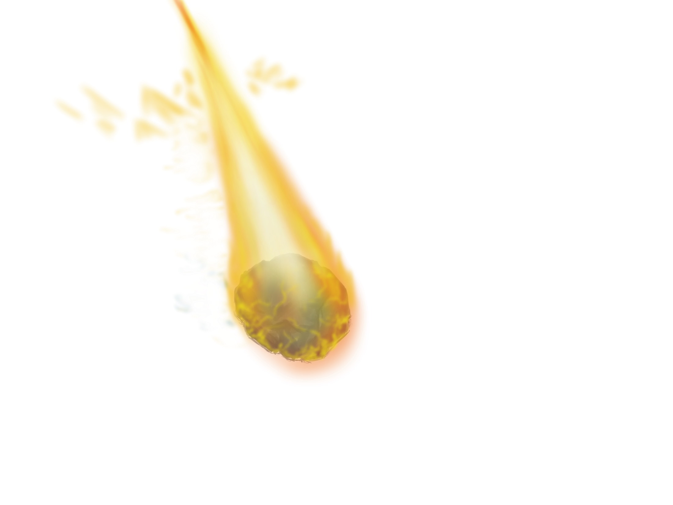
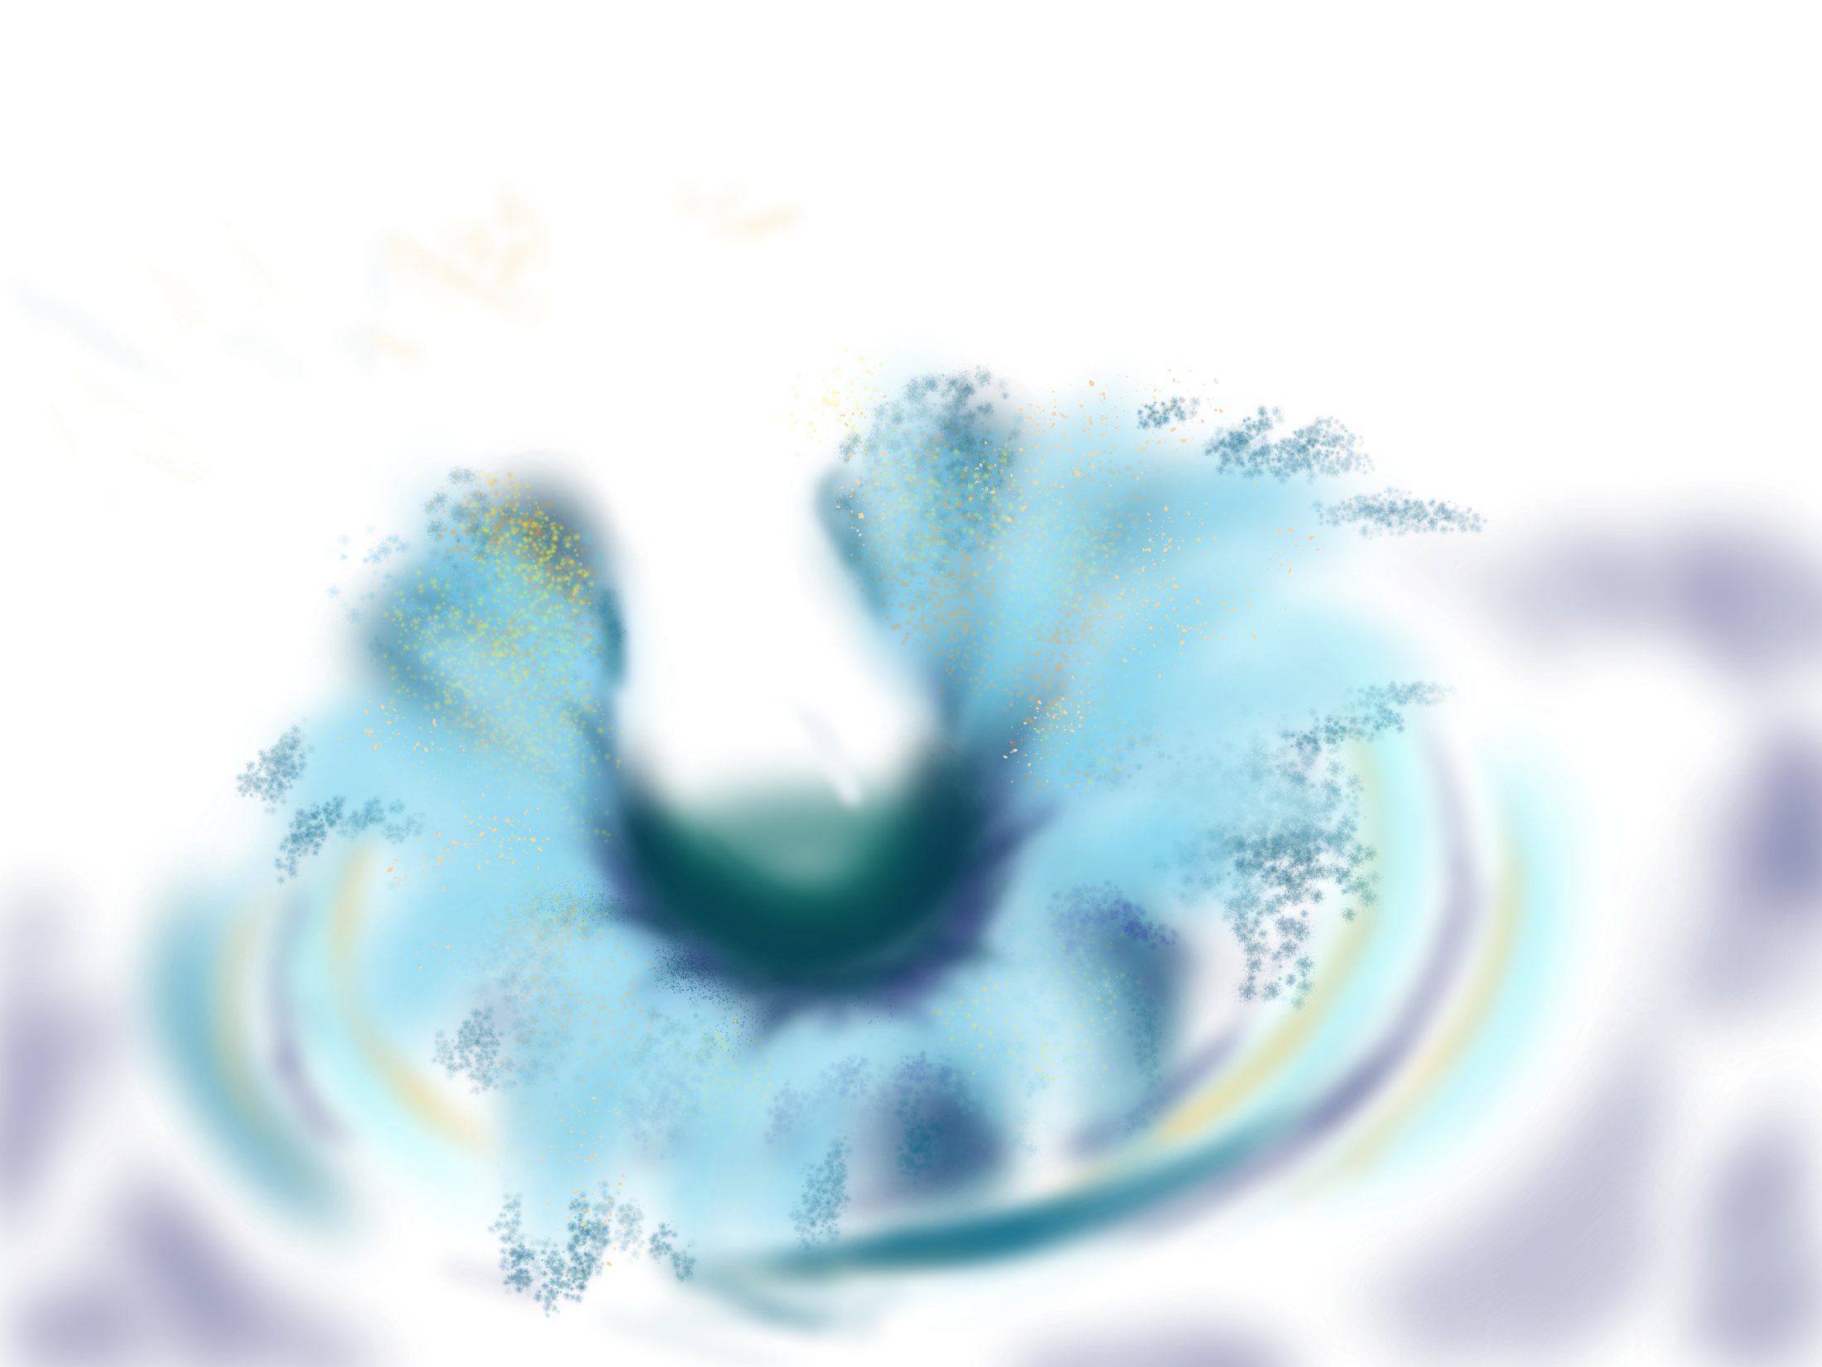


Slide 9
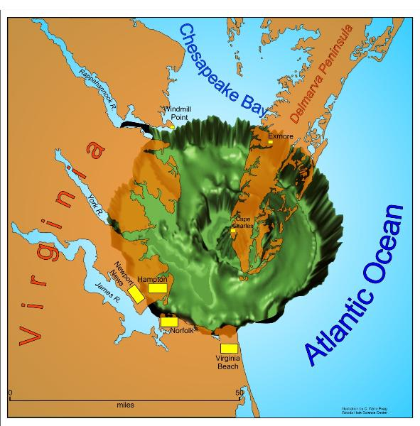
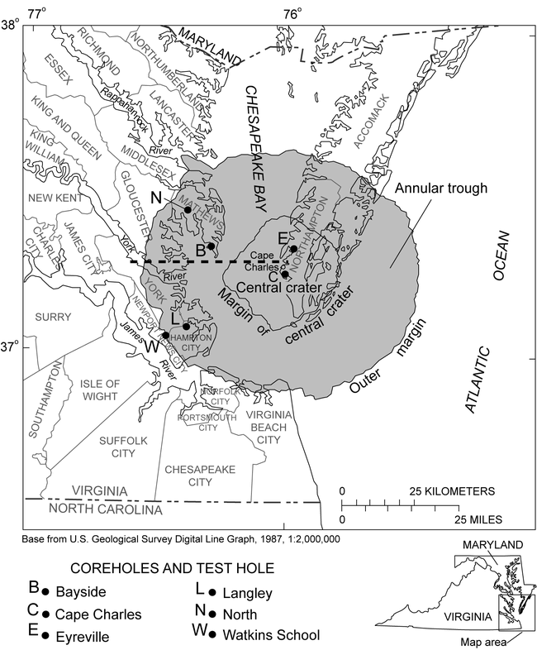

Slide 11
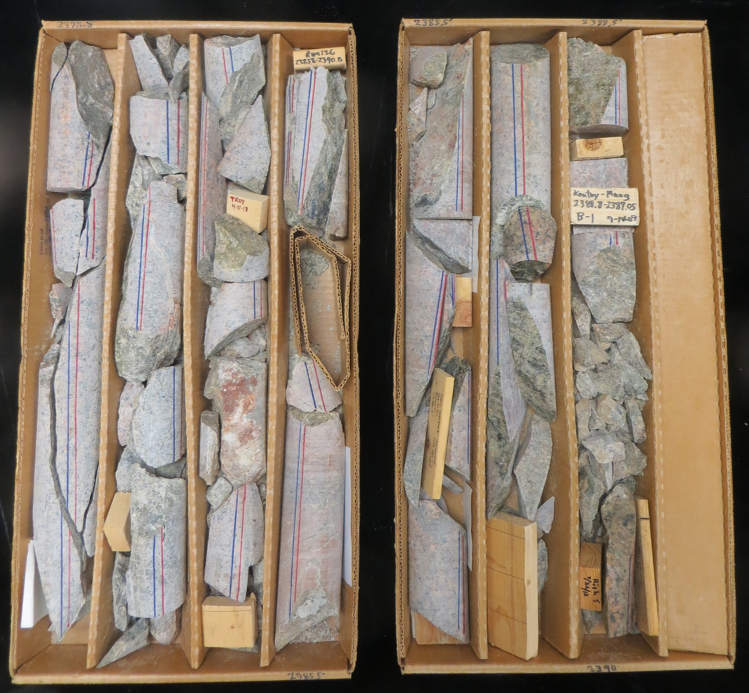
Bayside Core
Depths
2378.8 – 2390.0 feet

Slide 12
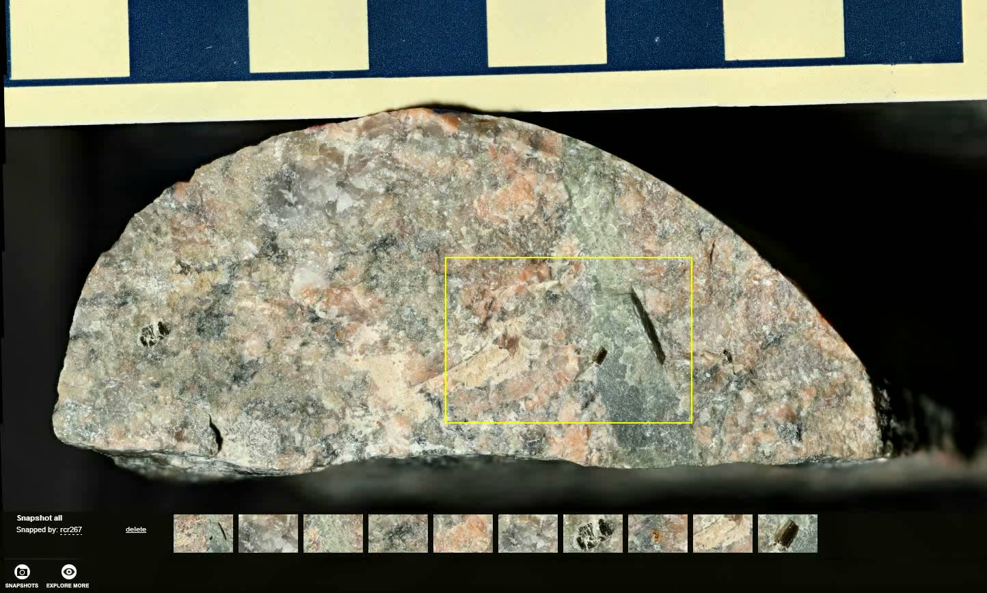

Slide 13
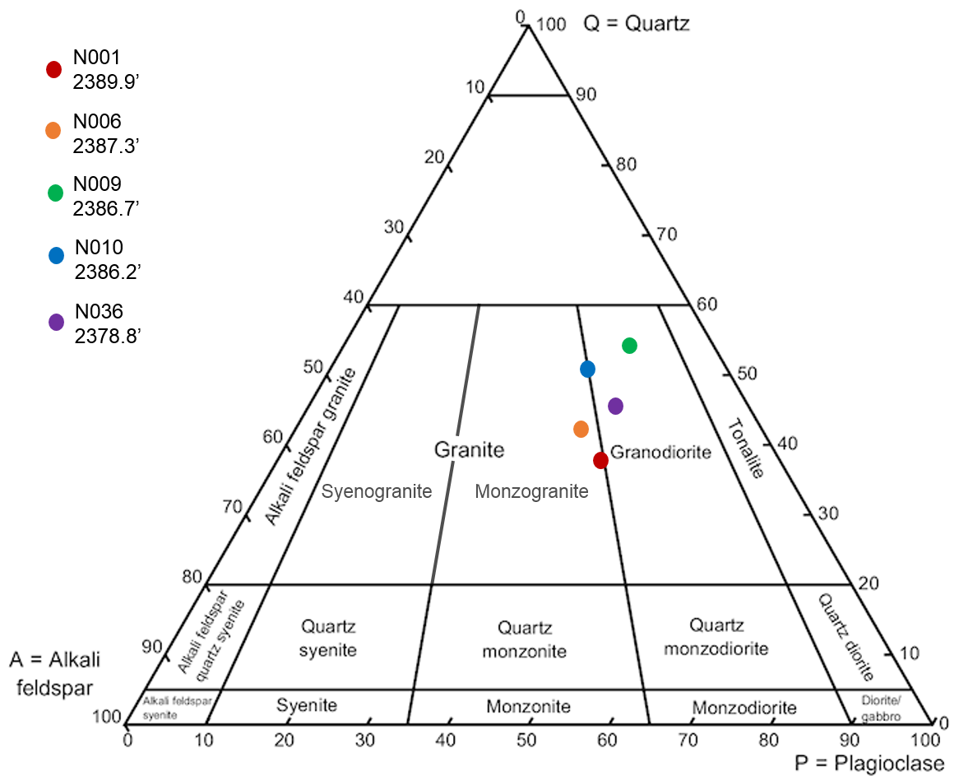

Slide 14
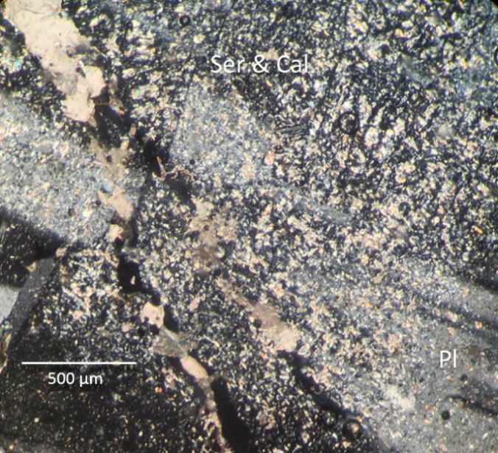
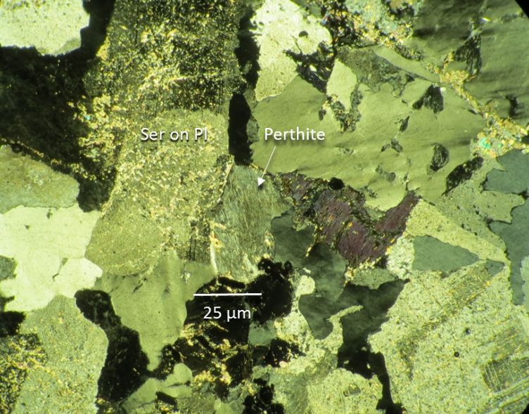
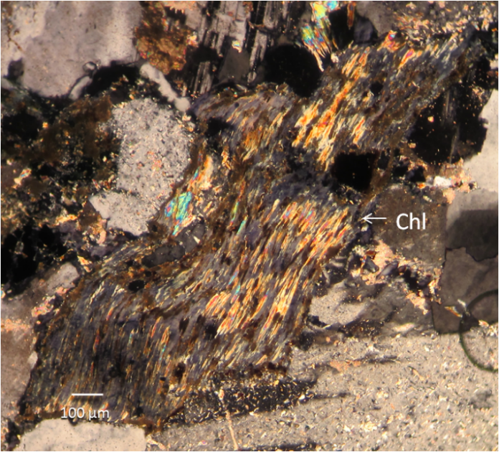
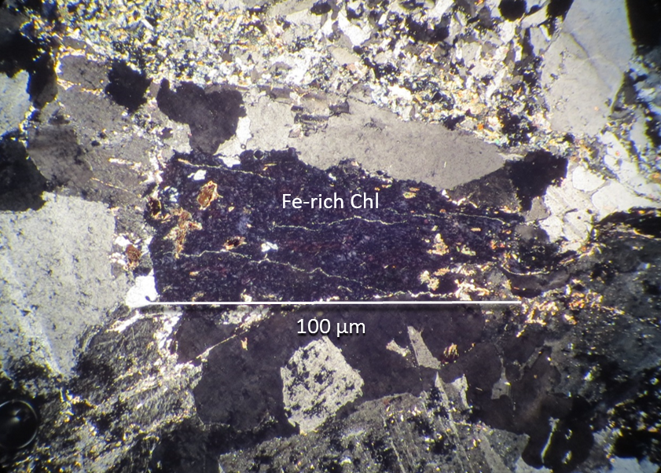
Sericitized plagioclase with calcite vein
Perthite with no sericite present
Chlorite replacing biotite
Fe-rich chlorite (anomalous blue-purple color)

Slide 15
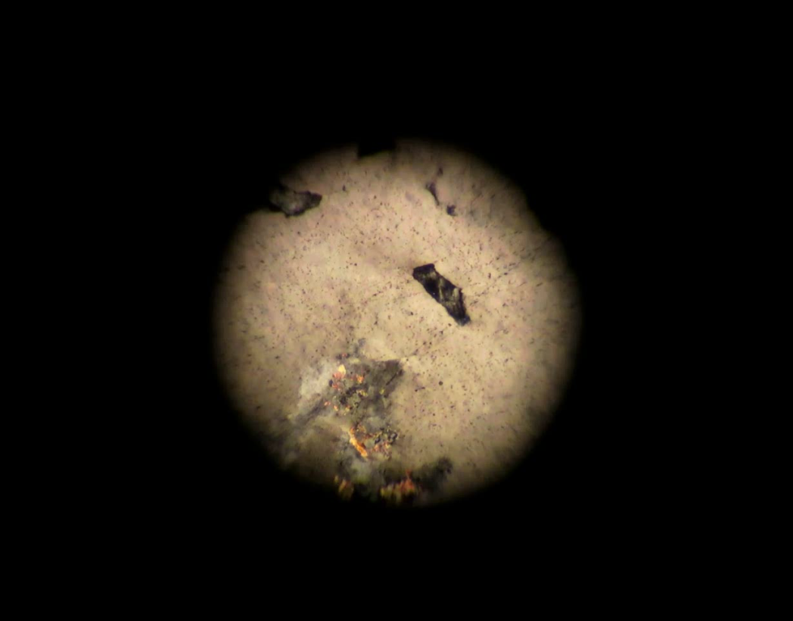
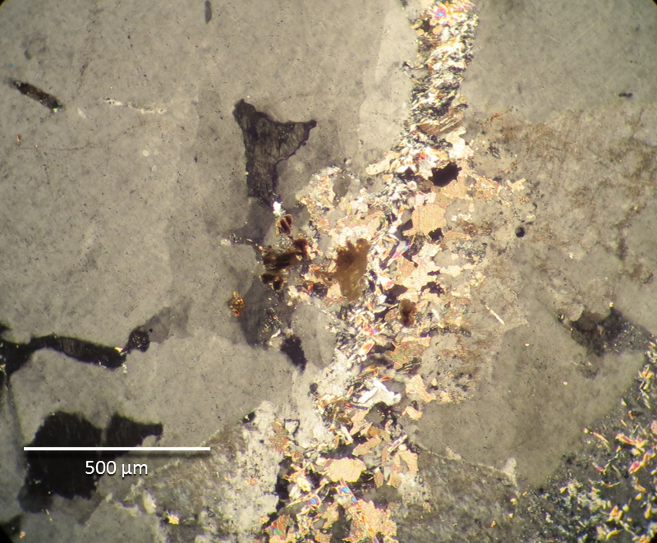
Video – strained quartz
Vein containing epidote group, albite, calcite, and microcrystalline quartz.

Slide 16
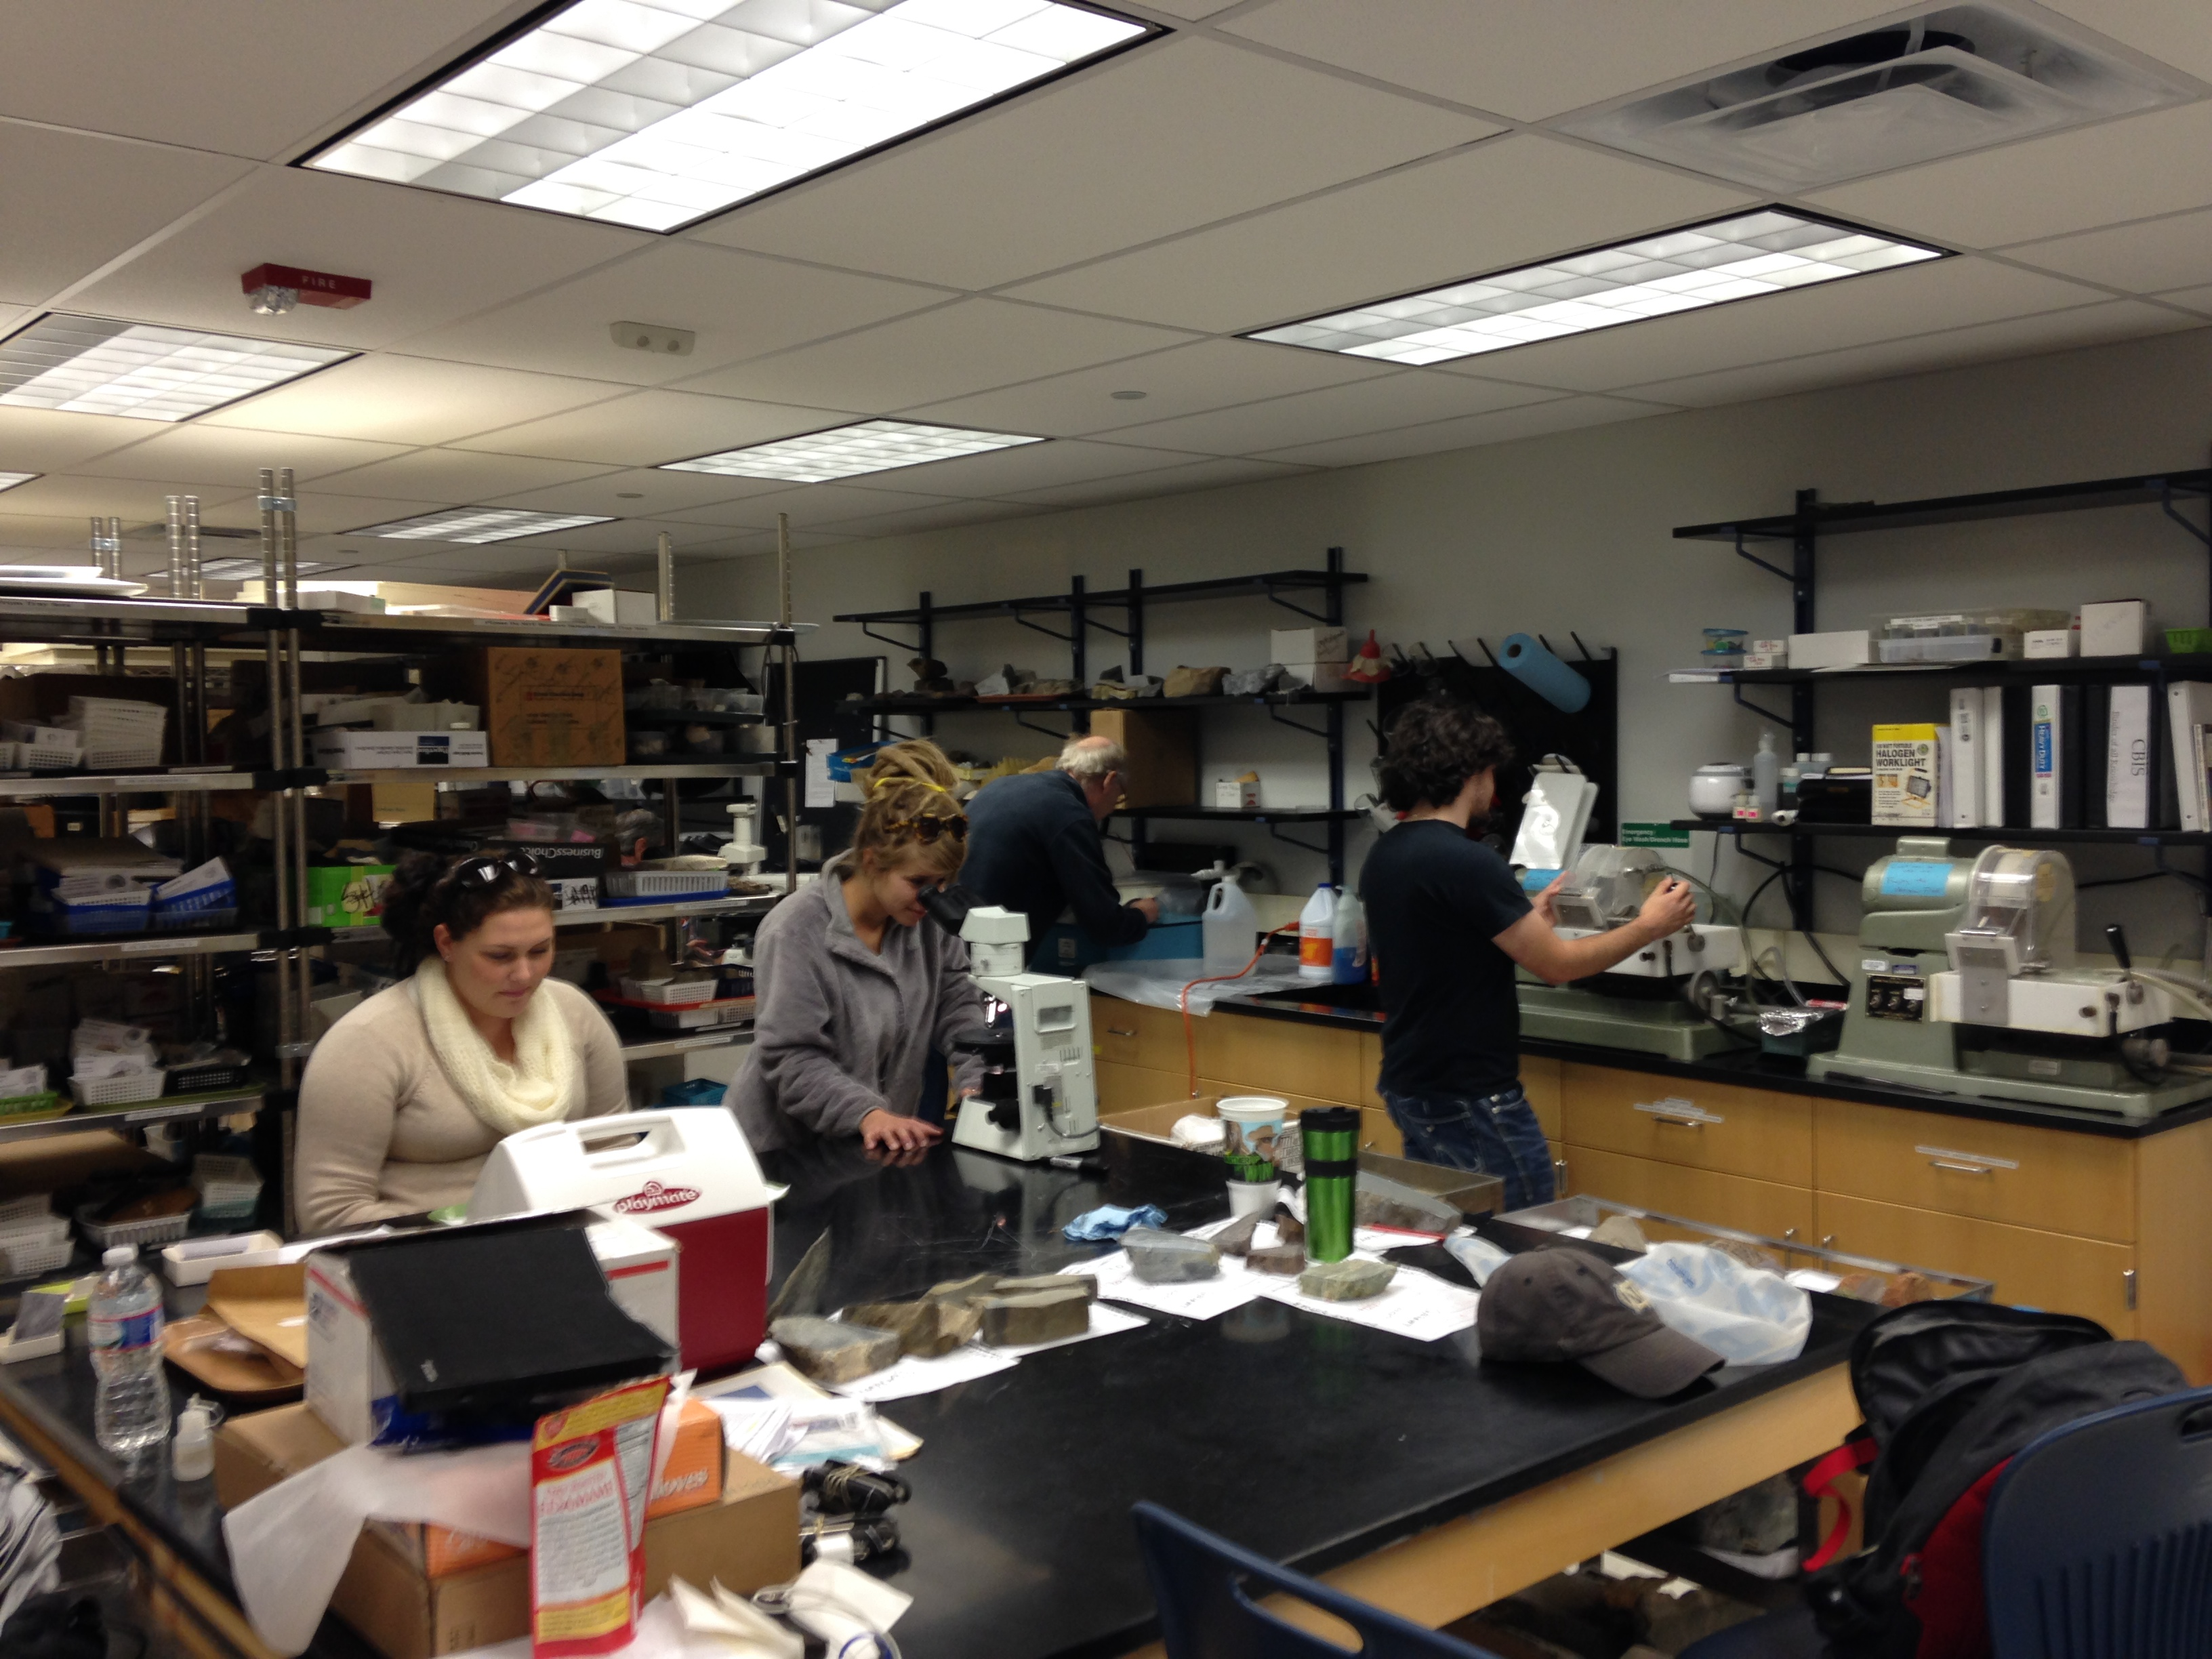
Honors - Mineralogy
Continue to work up through the core
Contributions to a USGS paper classifying the bedrock of the Atlantic Coastal Plain

Slide 17
References
Dixon, D. Bolide animation. 23 Oct 2013. www.ddxdesign.com.
Gohn, G.S., Horton, J.W., Powars, D. Studies of the Chesapeake Bay Impact Structure – Introduction and Discussion. Professional Paper 1688 Chapter A. United States Geological Survey. 2005.
Pascua, A., Powars, D., Robertson, L.,Robinson, E. Snapshots of a violent I mpact. Retrieved from http://web.wm.edu/geology/virginia/whats_new/snapshotsviolence.
Poag, C.W., Plescia, J., Molzer, P. Ancient Impact Structures on the Continental Shelf: Original Research article Deep Sea Research part II: Topical Studies in Oceanograhy , Volume 49, Issue 6, 2002, Pages 1081-1102. Retrieved from http://www.sciencedirect.com/science/article/pii/S096706450100144

