Slide 1



An overview of past depositional environments explored by the Curiosity rover at Bradbury Landing and Yellowknife Bay
Gale Crater, Mars
Kathryn M. Stack and the MSL Team
GSA
October 27, 2013
NASA/JPL-Caltech/MSSS

Slide 2
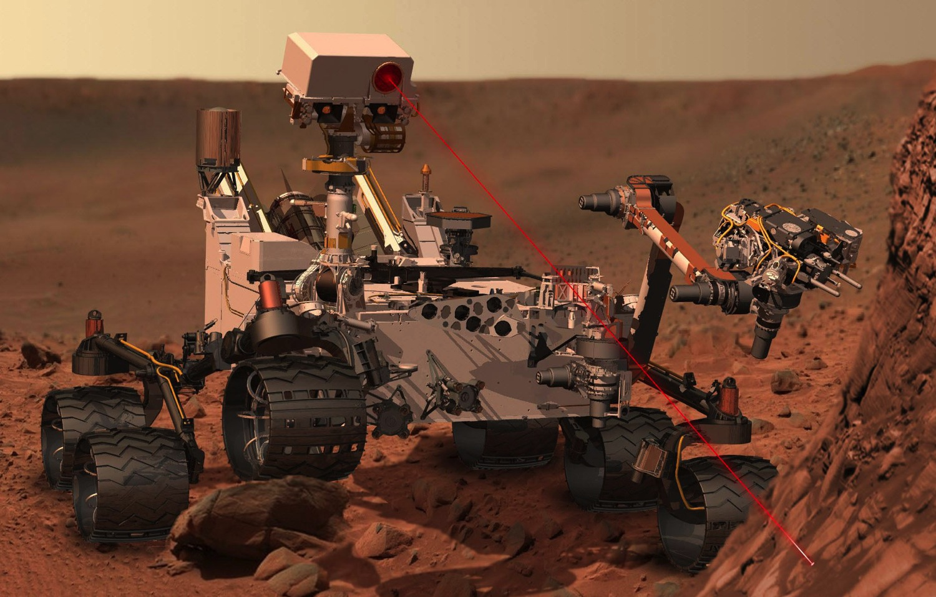
ChemCam
(Chemistry)
Mastcam
(Imaging)
MAHLI
(Imaging)
APXS
(Chemistry)
CheMin
(Mineralogy)
NASA/JPL-Caltech
Curiosity’s Science Payload

Slide 3
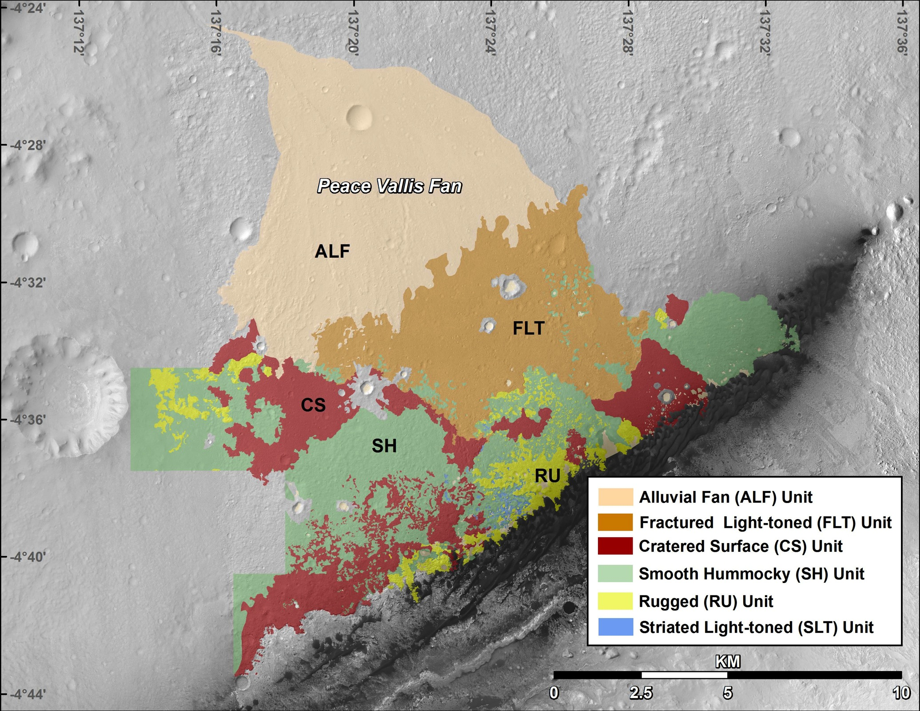
Fred Calef, Dawn Sumner, and the MSL Mapping Group

Slide 4
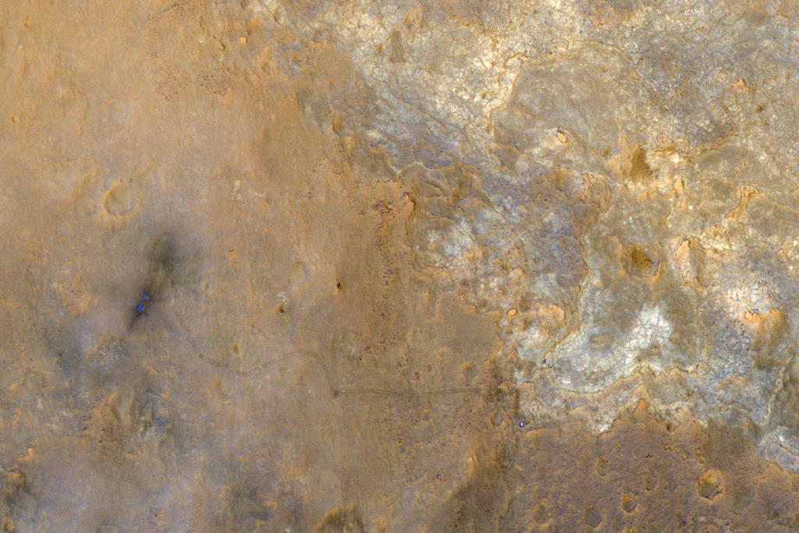
40 m
Bedded Fractured unit
Hummocky Plains
Yellowknife Bay
Cratered Surface
NASA/JPL-Caltech/Univ. of Arizona

Slide 5
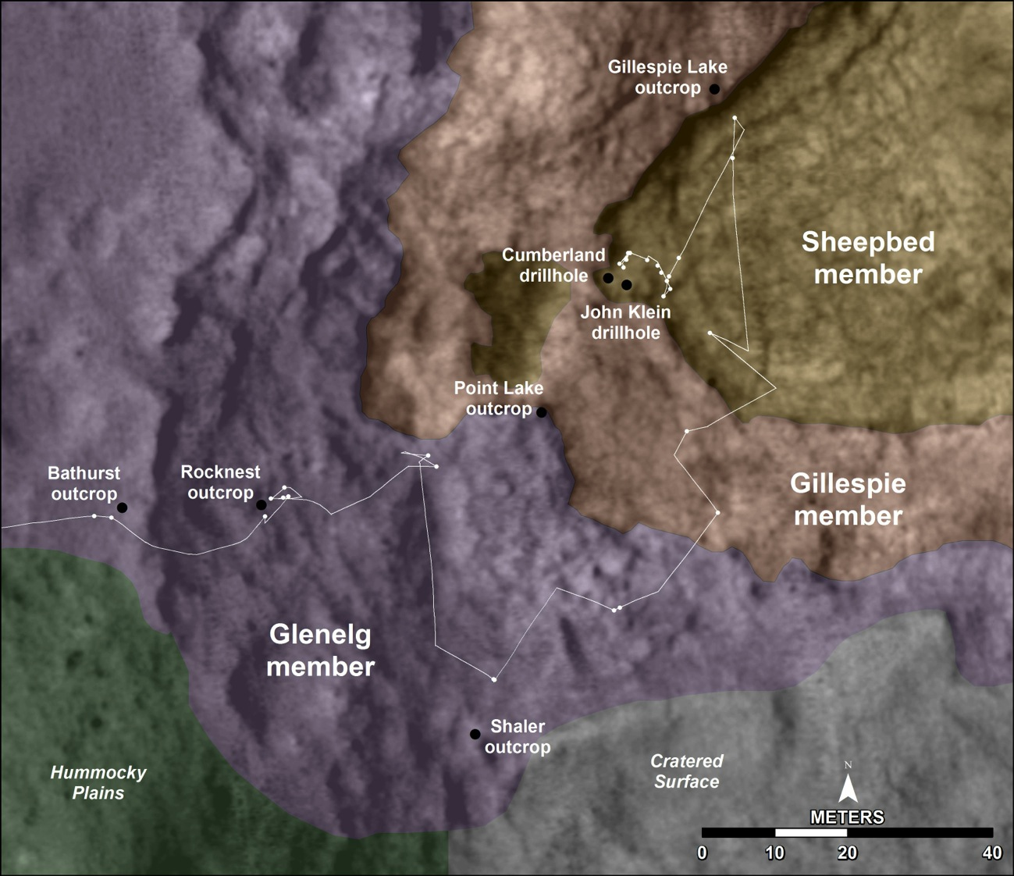
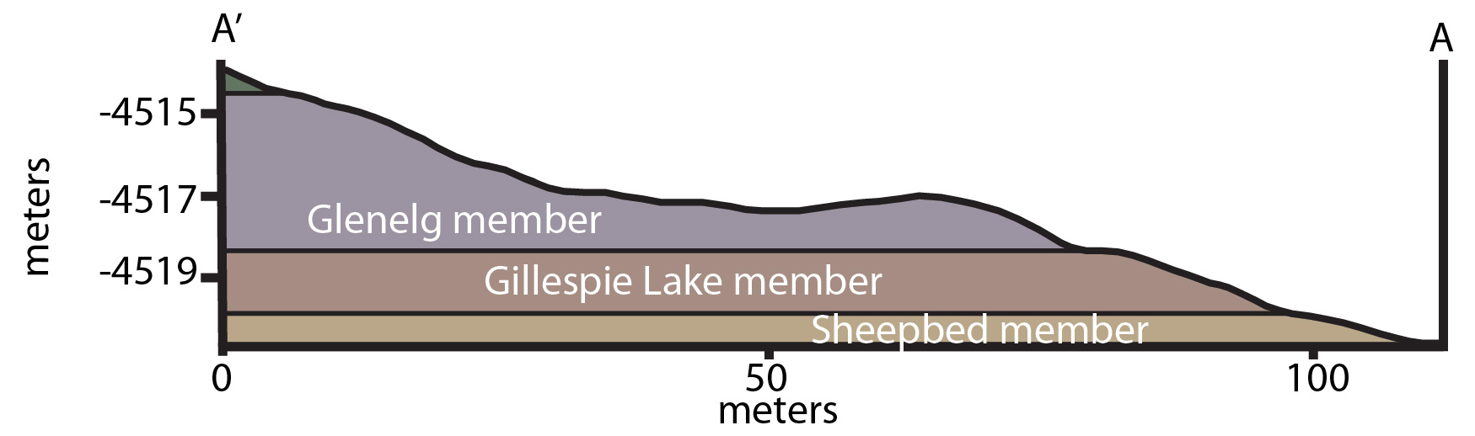
Yellowknife Bay
A’
A
Dawn Sumner and Fred Calef
A’
A
’

Slide 6
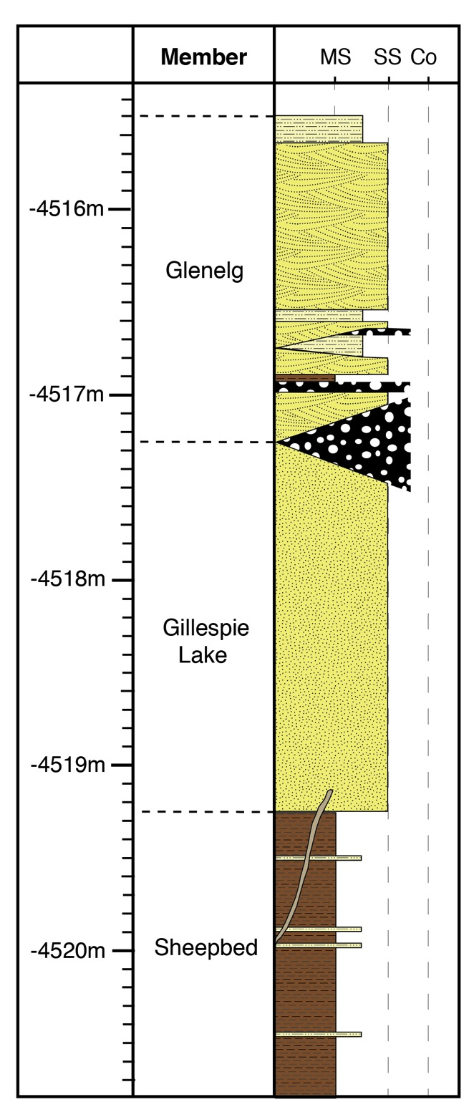
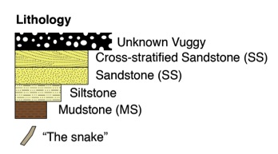
Yellowknife Bay formation
Detrital siliciclastic sedimentary assemblage
Fine, medium, and coarse-grained sandstones
Bulk basaltic composition

Slide 7
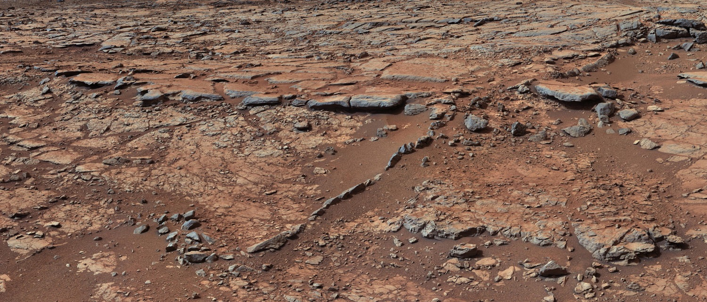
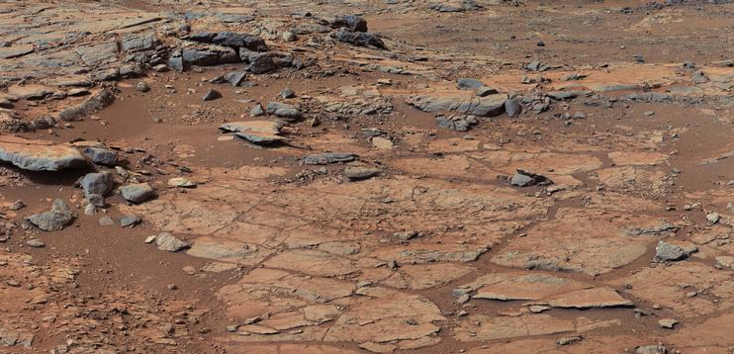
Sheepbed member
GL
Sb
The “snake”
10 cm
GL
Sb
40 cm
Image Credits: NASA/JPL-Caltech/MSSS
Notes:
Mcam00819 (lower image)
Mcam00817 (upper image)

Slide 8
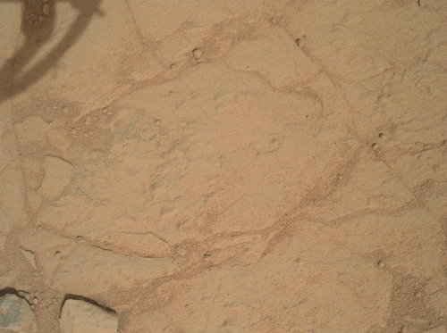
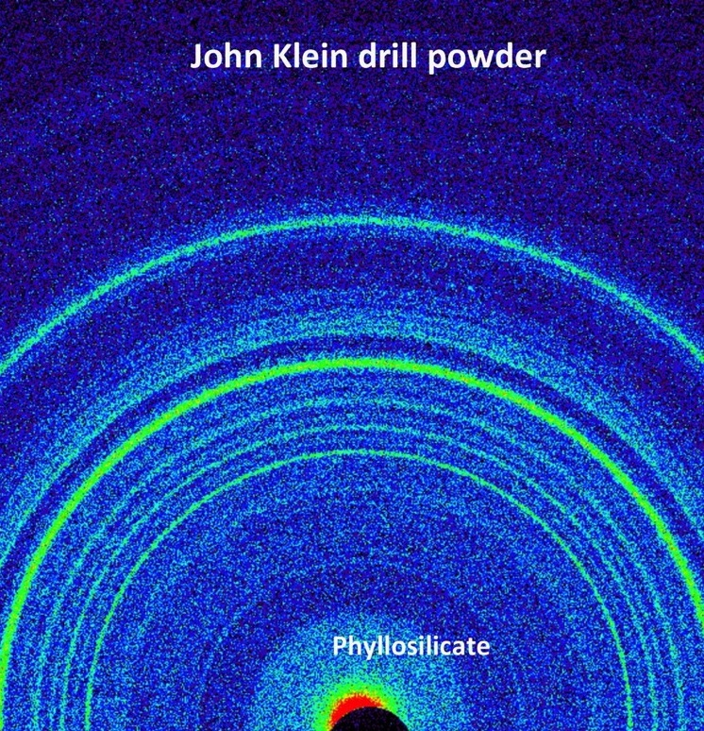
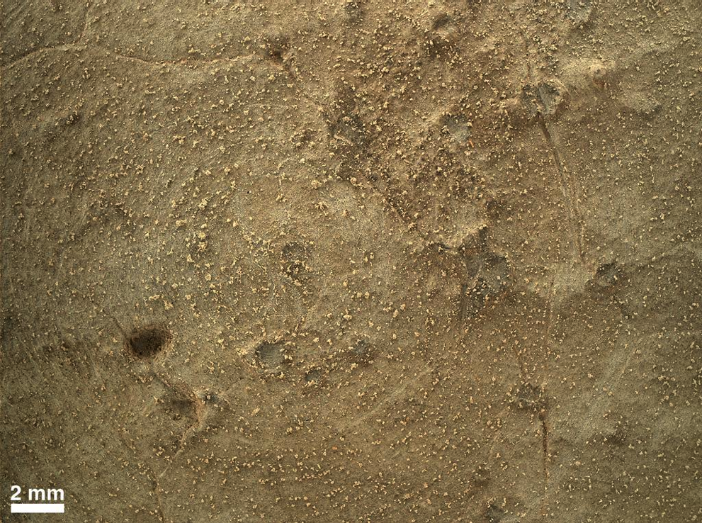
2 cm
Sheepbed member
Phyllosilicate-bearing, gray mudstone
Provenance of Sheepbed mudstone is similar in composition to average martian crust
NASA/JPL-Caltech/MSSS
NASA/JPL-Caltech/MSSS
NASA/JPL-Caltech/Ames

Slide 9
Sheepbed Depositional Environment
Suspension settling from water column or atmosphere
Volcanic ash, eolian dust, distal impact fallout, extensive overbank flood deposits are possibilities
Interpretation: deposition in distal alluvial fan or proximal lacustrine setting

Slide 10
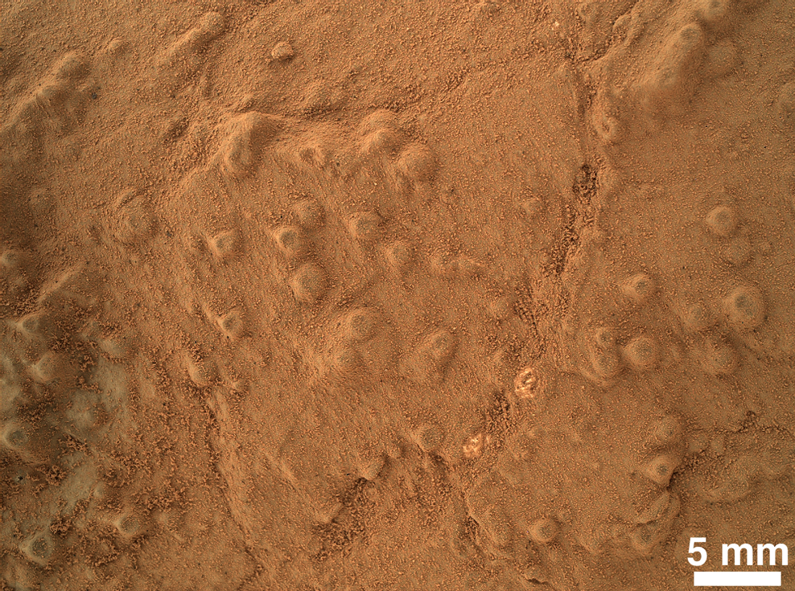
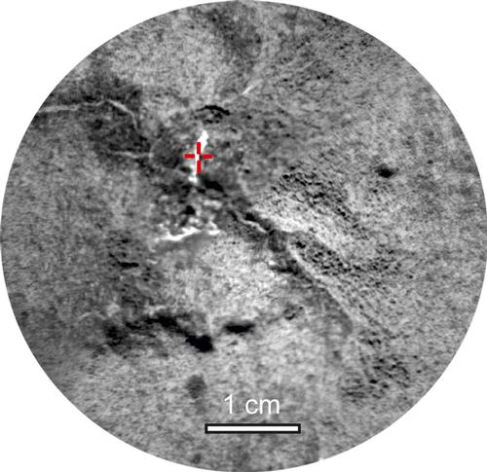
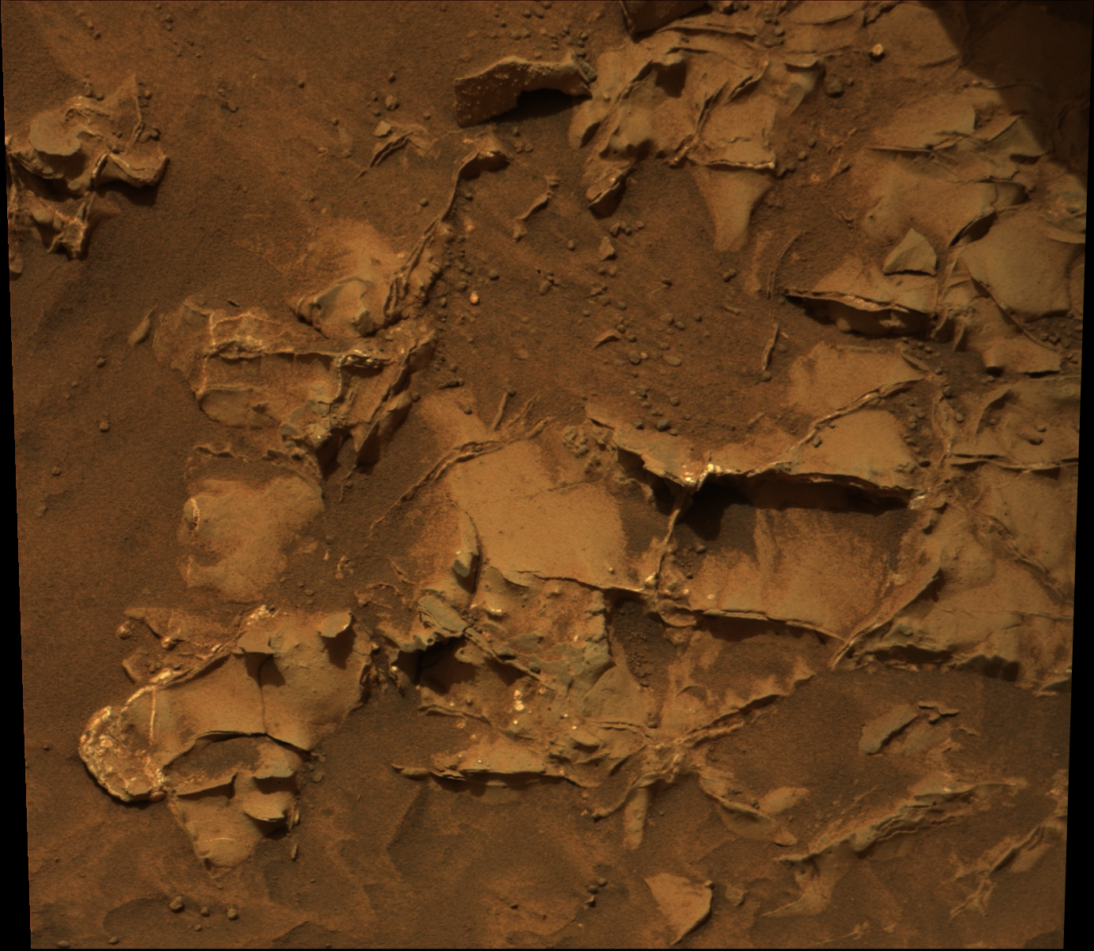
Hollow nodules
Diagenesis of the Sheepbed member
See talk by Josh Williams, this session
“Mapping of light-toned veins and nodules of the John Klein borehole wall in Gale Crater, Mars”
And poster by Katie Stack, Curiosity poster session
“The distribution of nodules within the Sheepbed member”
NASA/JPL-Caltech/MSSS
Sulfate-filled veins
Raised ridges
2 cm
NASA/JPLCaltech/LANL/CNES/IRAP/LPGNantes/CNRS
NASA/JPL-Caltech/MSSS
Notes:
mcam00811

Slide 11
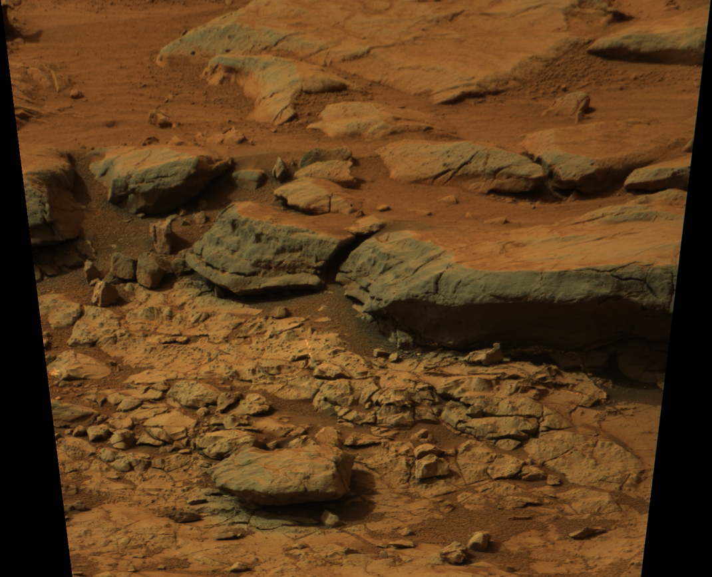
Gillespie Lake member
GL
Sb
10 cm
NASA/JPL-Caltech/MSSS

Slide 12
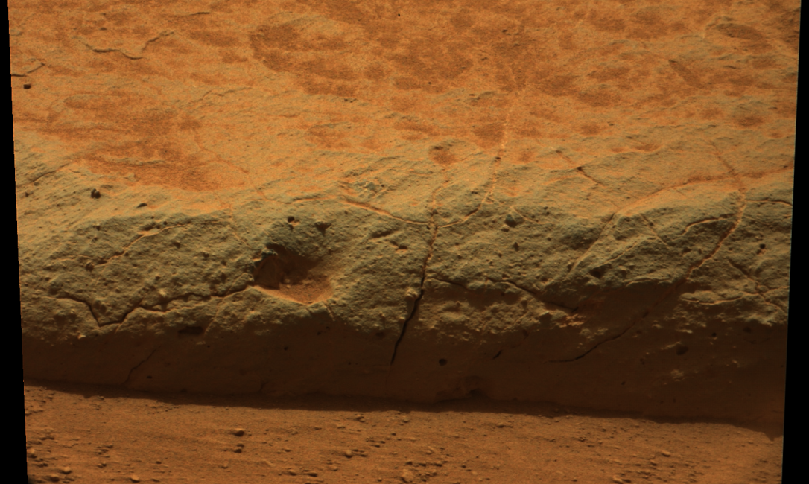
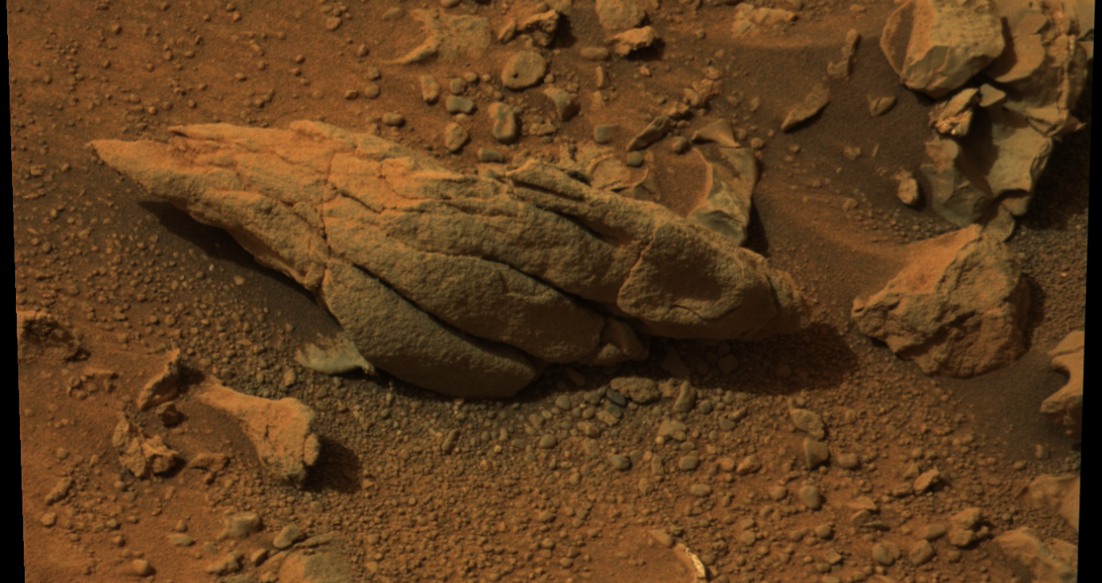
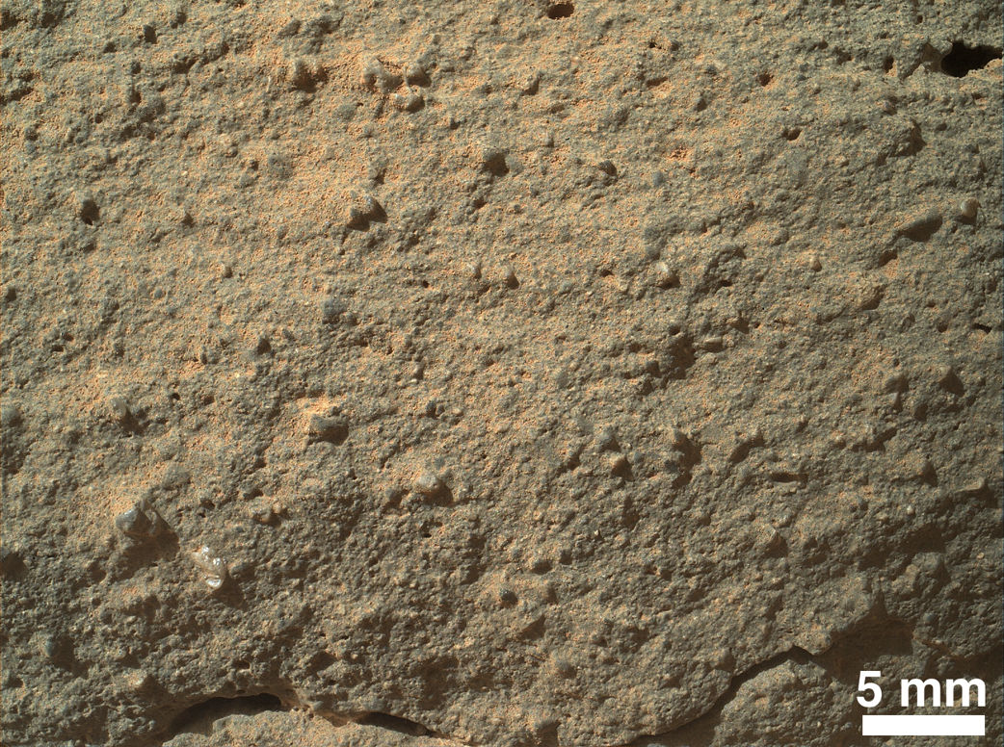
2 cm
5 cm
Amalgamated sheet-like sandstones
Coarse cross-bedding
Medium to very coarse sand
Variable rounding and angularity
Bulk basaltic composition
Interpretation: Fluvial transport and deposition, perhaps as distal fan lobe
Image Credits: NASA/JPL-Caltech/MSSS
Notes:
Mcam00856 (left image)
Mcam00886 (right image)

Slide 13
Glenelg member
Lateral facies variations:
Platy, coarse-grained, cross-bedded sandstone and pebble beds
Recessive fine-grained intervals containing cracks
Dark rocks of unknown grain size with pervasive mm to cm-scale voids

Slide 14
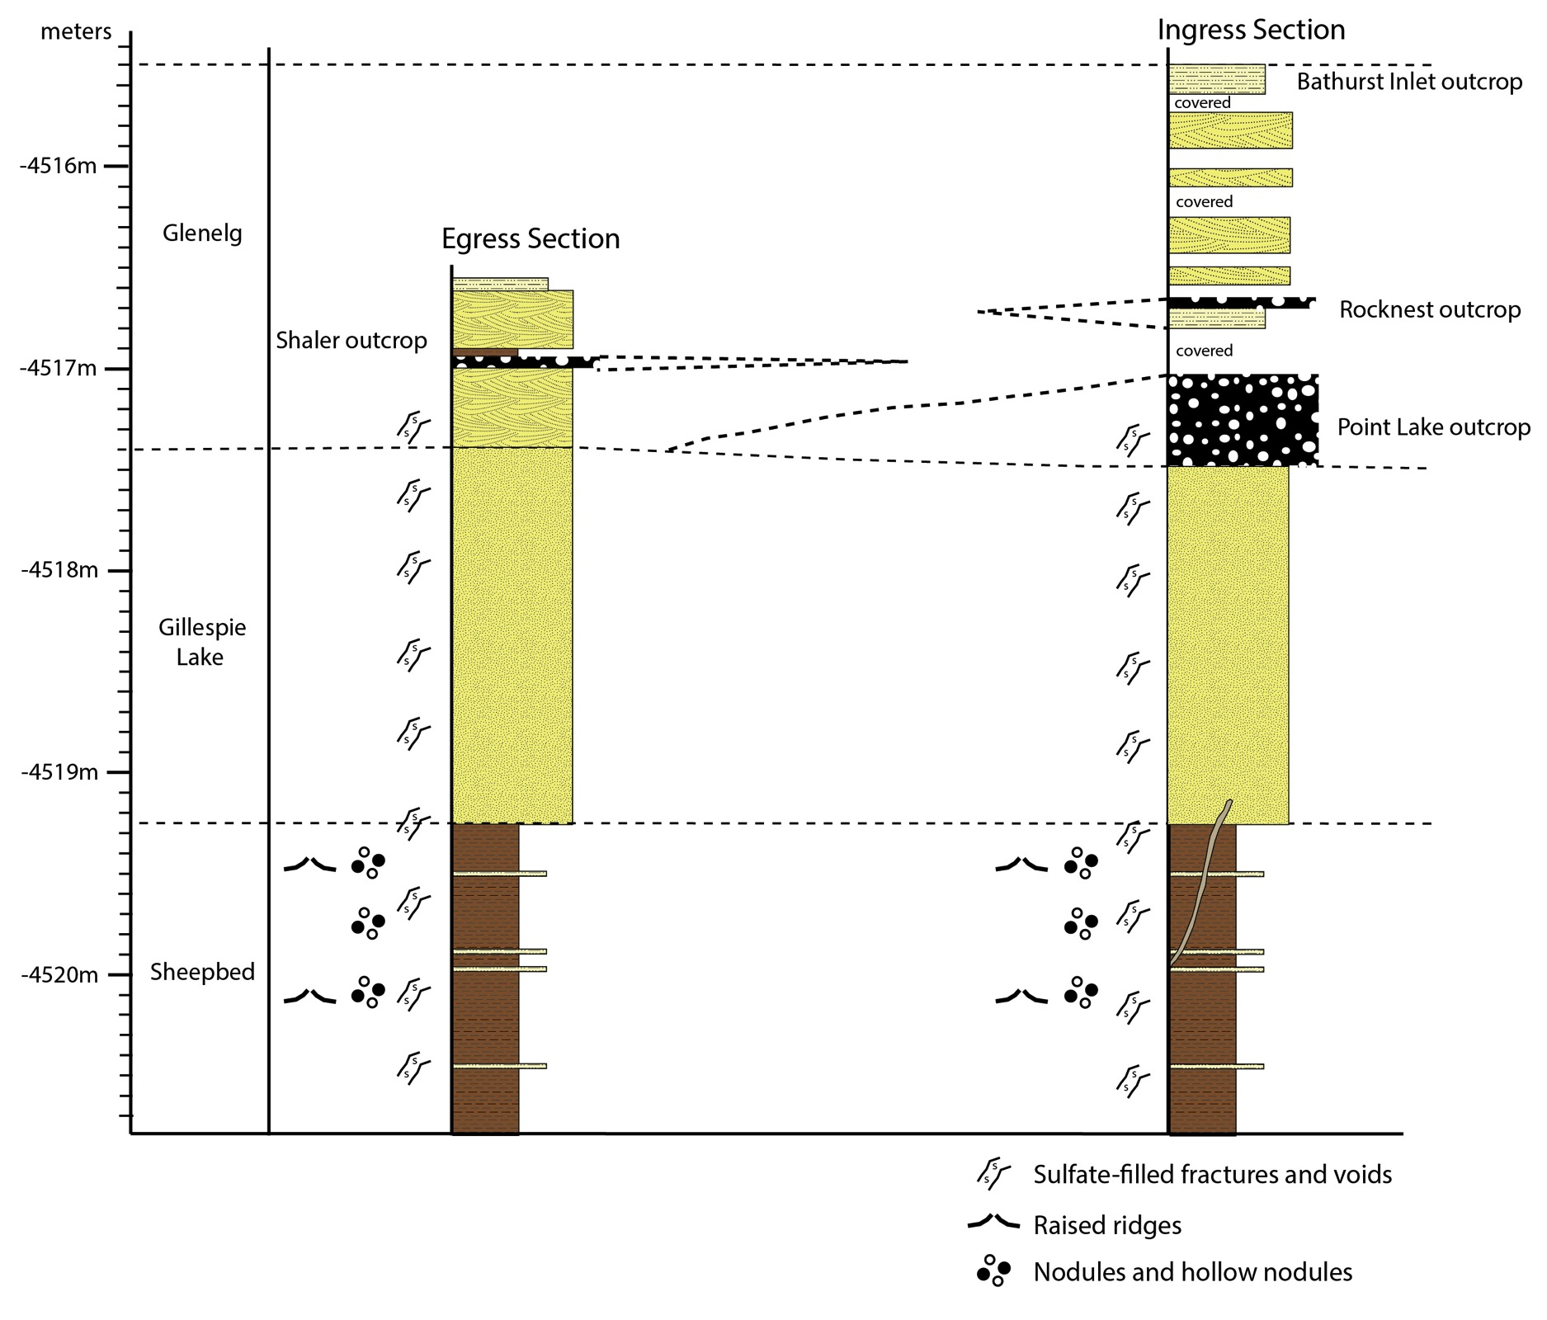

Slide 15
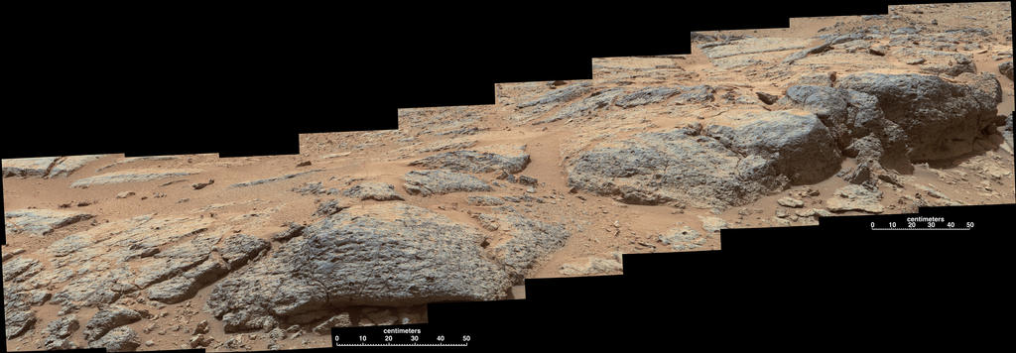
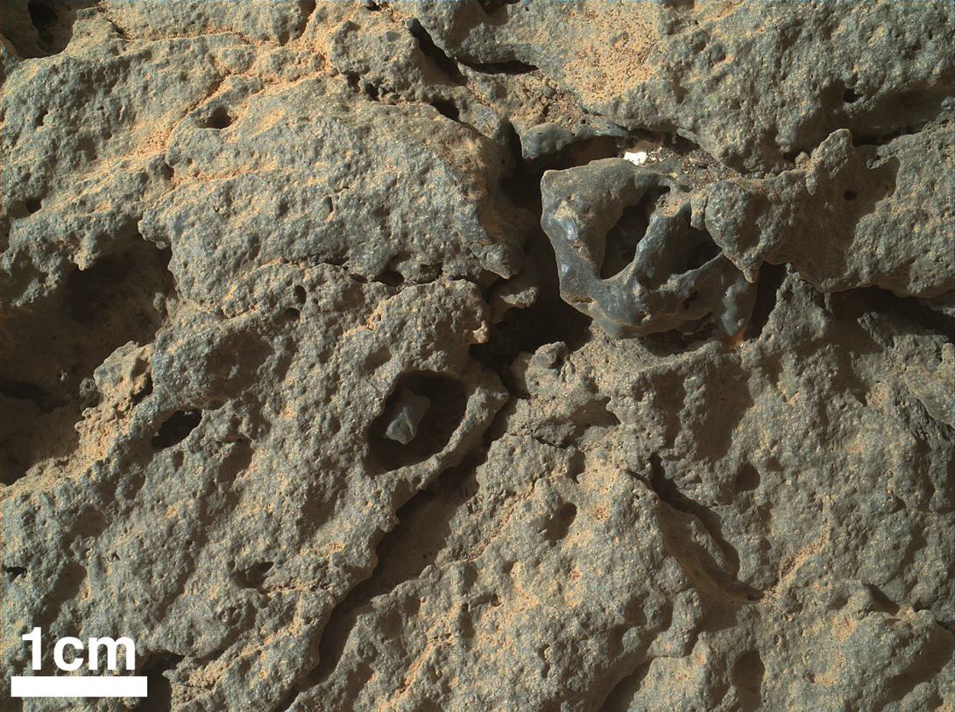
Point Lake outcrop
Glenelg member
Proposed origins:
Vesicular lava flow
Pebbly debris flow
Gas-charged intrusive sedimentary sill
Sandstone with leached evaporites
Image Credits: NASA/JPL-Caltech/MSSS

Slide 16
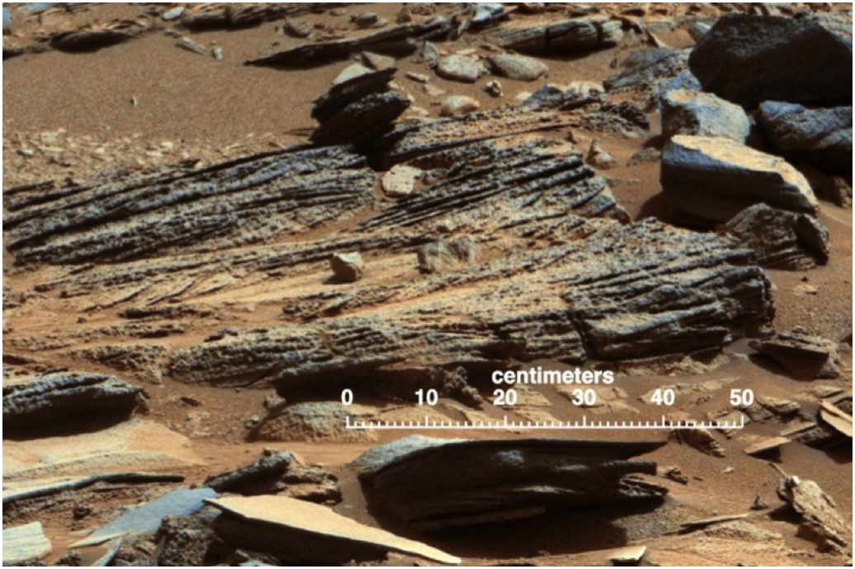
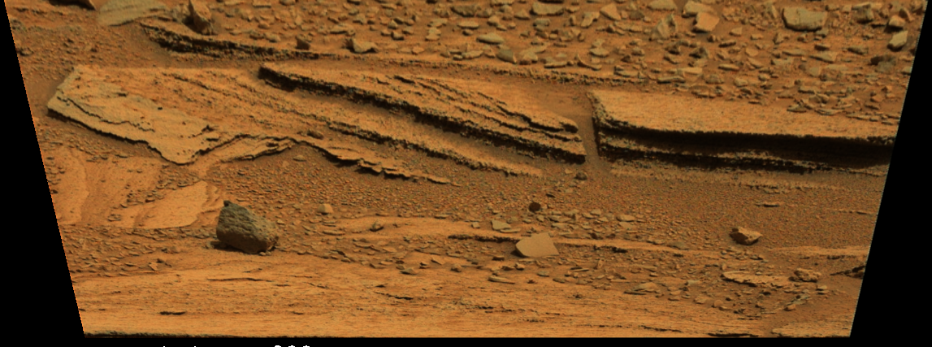
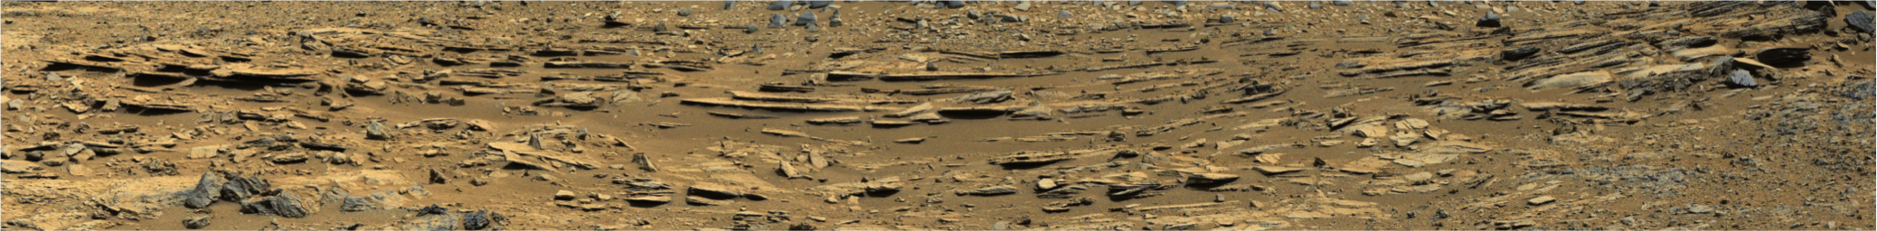
Shaler outcrop
Glenelg member
Fluvial environment characterized by bedload and suspended load transport
Pinstripe laminae suggest minor eolian bedload transport
Recessive beds may represent overbank deposits, slack-water deposits, or proximal lacustrine facies
Transport direction is variable, but consistent with origin at the Gale crater rim
NASA/JPL-Caltech/MSSS
2 cm
1 m
Image Credits: NASA/JPL-Caltech/MSSS
Notes:
Mcam00752 (bottom image)
Mcam00756
mcam00757

Slide 17
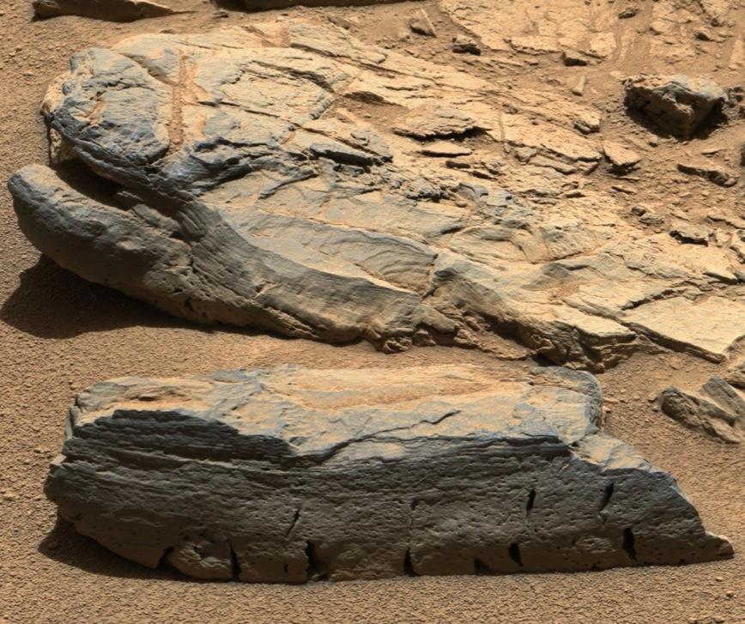
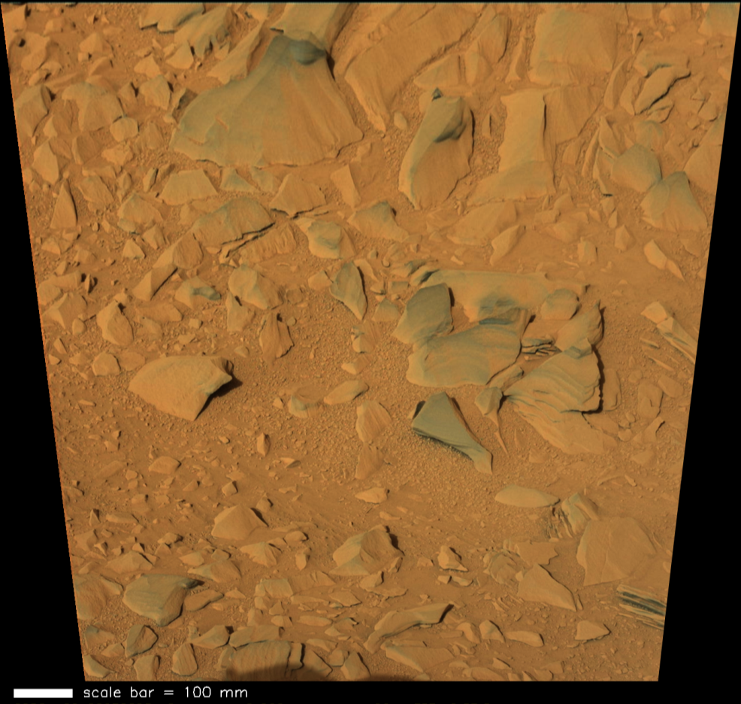
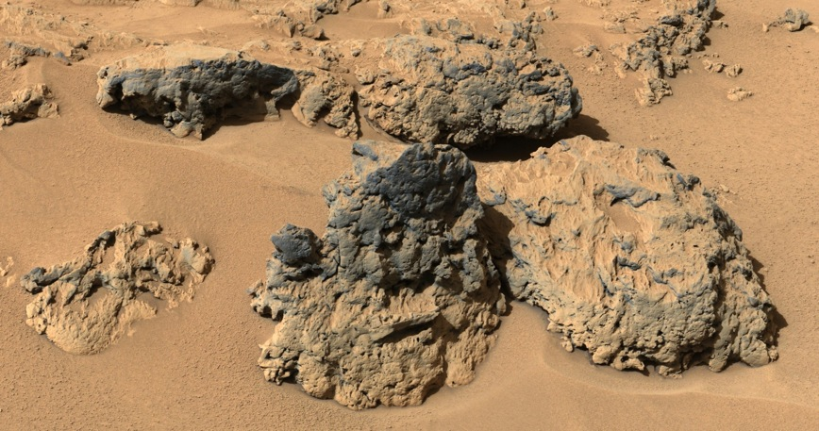
Rocknest and Bathurst Inlet outcrops
Glenelg member
Rocknest _3 and Peg
Bathurst Inlet and Cowles
5 cm
Rocknest Crest
2 cm
1 cm
Image Credits: NASA/JPL-Caltech/MSSS
Notes:
Mcam00240
Mcam00270
Mcam00571

Slide 18
Outcrop and member ChemCam compositions
See talk by Suzanne Gordon, this session
“Stratigraphy of Yellowknife Bay, Mars: ChemCam observations of chemical variability between members”
85 points
Composition ratio’d to average Sheepbed
126 points
269 points
130 points
5 points
Nicolas Mangold

Slide 19
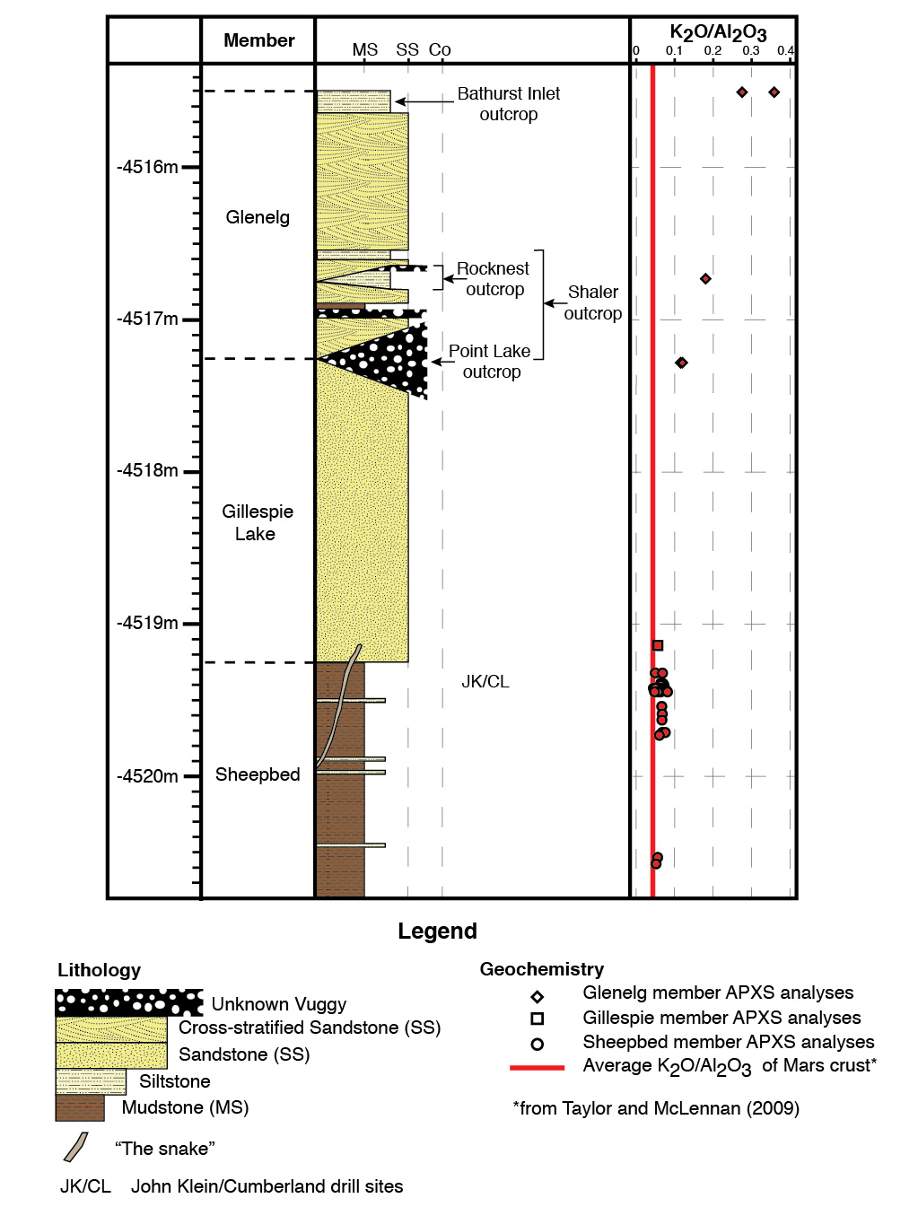
Yellowknife Bay formation: a fluvio-lacustrine sedimentary assemblage of bulk basaltic composition

Slide 20
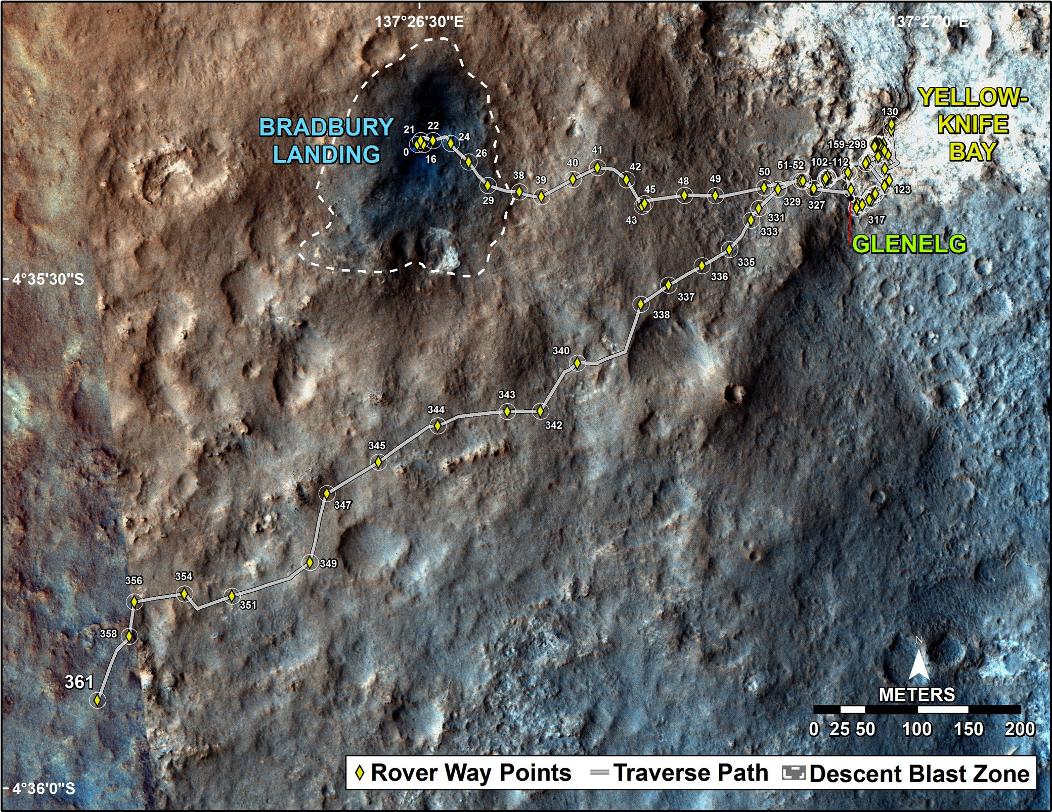
Fred Calef
NASA/JPL-Caltech/MSSS

Slide 21
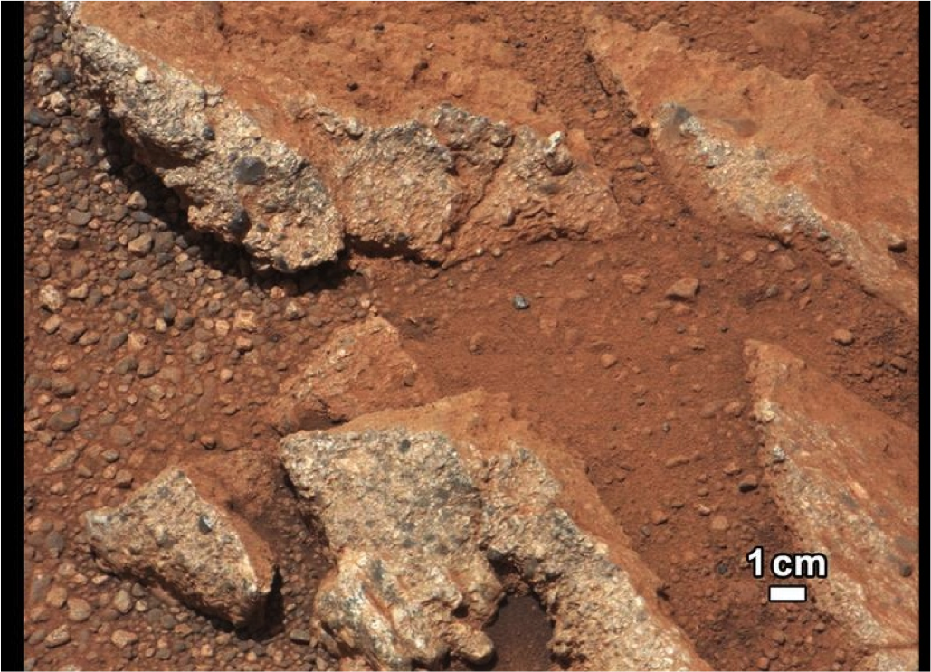
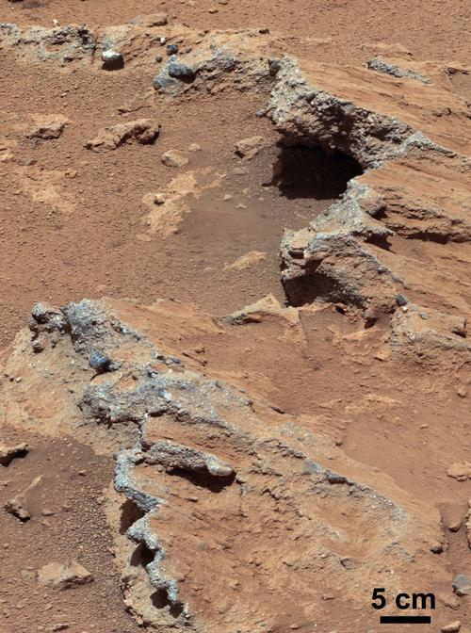
Link
Sol 27
Hottah
Sol 39
The conglomerates “Link” and “Hottah” contain rounded pebbles and very course sand-sized matrix
Interpretion: ancient streambed likely originating at crater rim
Image Credits: NASA/JPL-Caltech/MSSS

Slide 22
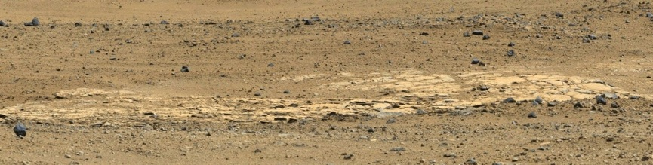
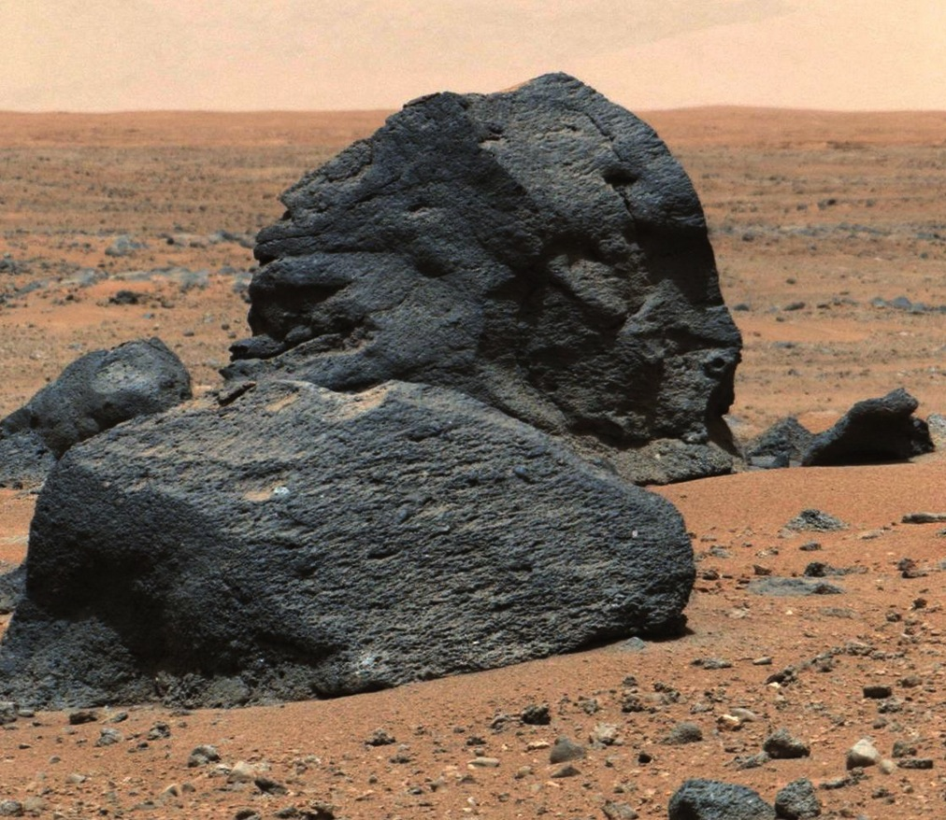
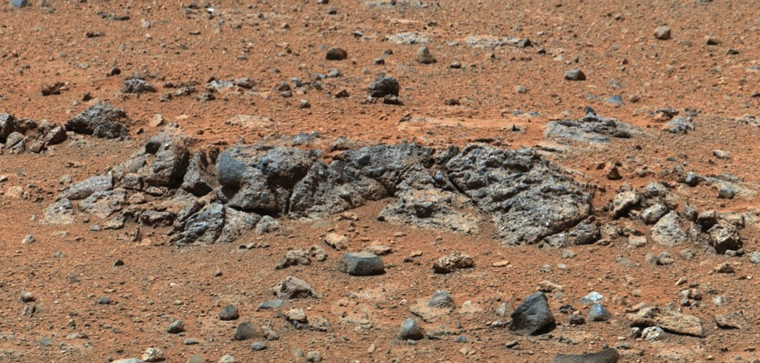
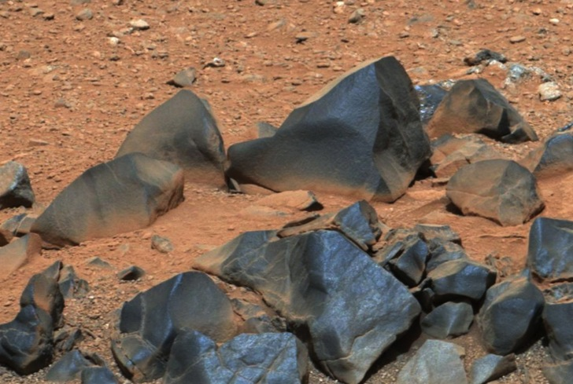
M100 Mosaic
Sol 37
5 m
Elsie Mountain
Sol 349
Hoyle
Sol 356
10 cm
Hardrock
Sol 345
50 cm
5 cm
Image Credits: NASA/JPL-Caltech/MSSS
Notes:
Mcam01451
Mcam01420
Mcam01401
mcam00157

Slide 23
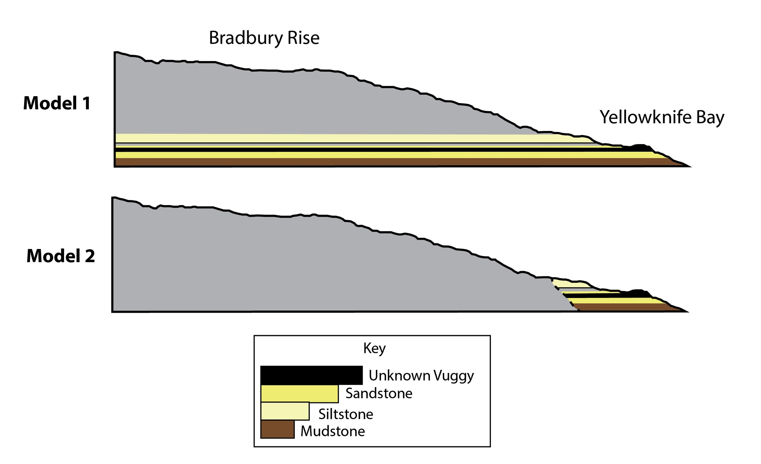
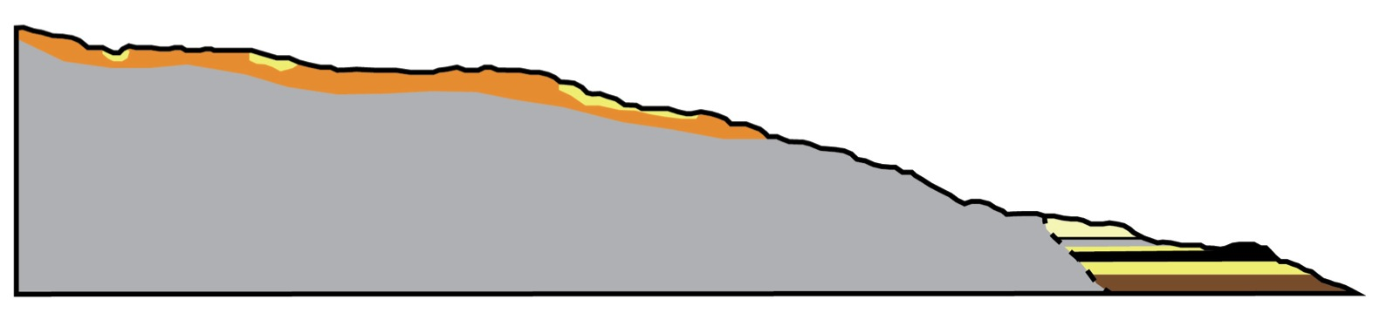
Relationship of Yellowknife Bay section to Bradbury Rise (Hummocky Plains)
Younger
Older

Slide 24
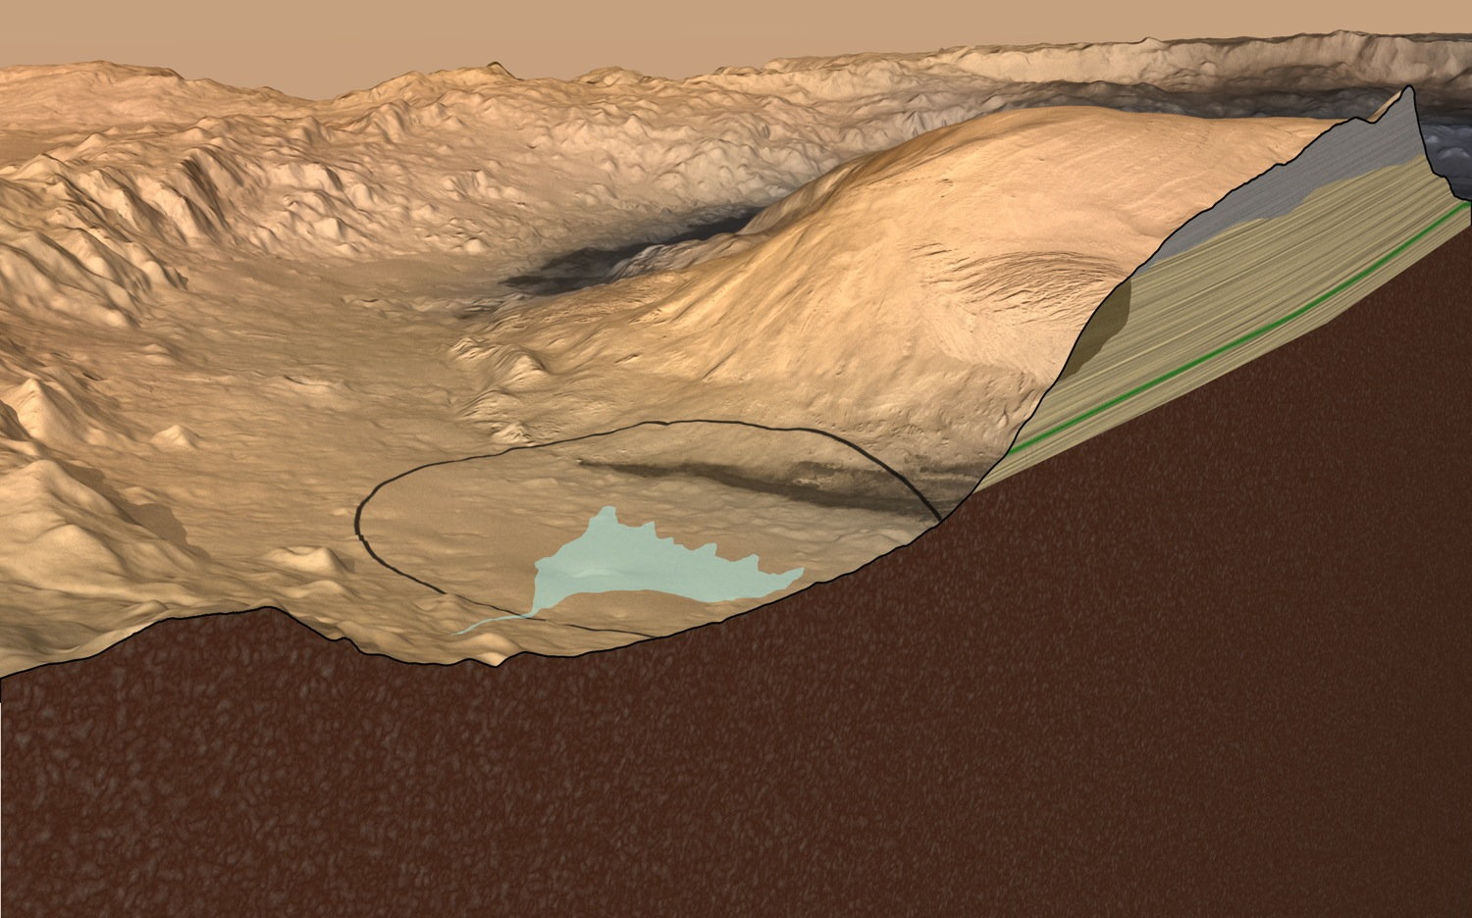
?
Strata in the lower section of the Gale Crater mound vary in mineralogy and texture, suggesting that they may have recorded environmental changes over time. Relationship between Yellowknife Bay and Bradbury Rise rocks to lower Mt. Sharp is still uncertain.
NASA/JPL-Caltech/ESA/DLR/FU Berlin/MSSS
NASA/JPL-Caltech

Slide 25
Summary
Since landing in Gale Crater in August of 2012, the Curiosity rover has been exploring rocks consistent with fluvio-lacustrine depositional environments
In situ rover observations of these facies are consistent with orbital mapping which places the rover at the distal end of an alluvial fan system
Understanding and interpreting the rock record is key to helping Curiosity achieve its mission goal of exploring habitable environments

Slide 26
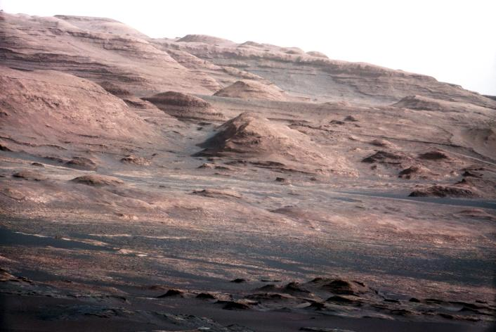
On to Mount Sharp!

