Slide 1
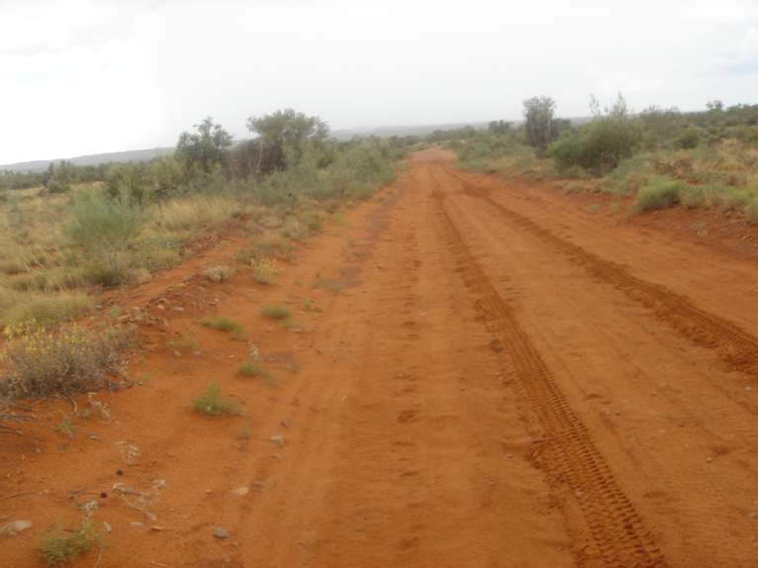
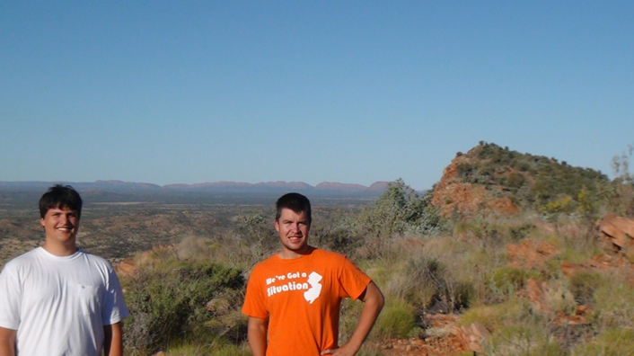
LIPS and Impact Events: A Connection Between Kalkarindji LIP, Mooracoochie Volcanics and MAPCIS?
Daniel P. Connelly
2013
Expedition assistants David & Ken, near Alice Springs
Road to Gosse bluff

Slide 2
Abstract
Presentation Time: 4:15 PM
LIPS AND IMPACT EVENTS: A CONNECTION BETWEEN KALKARINDJI LIP, MOORACOOCHIE VOLCANICS AND MAPCIS?
Connelly Daniel P.., 4815 Covered Bridge Rd, Millville, NJ 08332, danielconnelly@comcast.net
A connection between large igneous provinces and impact events has been a long sought after goal to explain the association of both, with extinction events. Many have considered the association between IEs and LIPs to be tenuous. From this a dichotomy developed often separating scientists into opposing camps supporting either LIPs or IEs as the cause of extinction events. This presentation introduces the spatial and temporal relationship between the end Ediacaran, MAPCIS, and the annular early Cambrian Kalkarindji LIP. The coeval Mooracoochie volcanics within the spreading Cambrian rift separating the North Australia Craton from the Gawler Craton gives a clue to a possible cause and effect between impacts and subsequent volcanics.

Slide 3
Connecting LIPS & Impacts
Shiva & Chicxulub with the Deccan Traps ~65Ma & the K/T Boundary
Wilkes Land Crater with the Siberian Traps ~250Ma & the P/T Boundary
Problems
No easy connections
Antipodal impact mantle plumes?
Impact mantle plumes erasing crustal piercing impacts?
Are they impact mantle plumes or just hot spot mantle plumes?
Notes:
Shiva although in proximity to the Deccan Traps has yet to be verified as an impact.
Chicxulub and Wilkes Land Crater might have been antipodal to mantle plumes at the time of impact. The key phrase here is “might have been”. The evidence is weak.
How to differentiate between an impact mantle plume and a hot spot mantle plume?

Slide 4
Another possibility?
A large impact that did not pierce a strong thick continental crust
An impact mantle plume that finds its way to the surface around the MASCON to form radial and/or annular deposits
Notes:
There is the remote possibility that a spontaneous mantle plume in central Australia caused the Petermann Orogeny violently uplifting Central Australia without any evidence for volcanic activity.

Slide 5
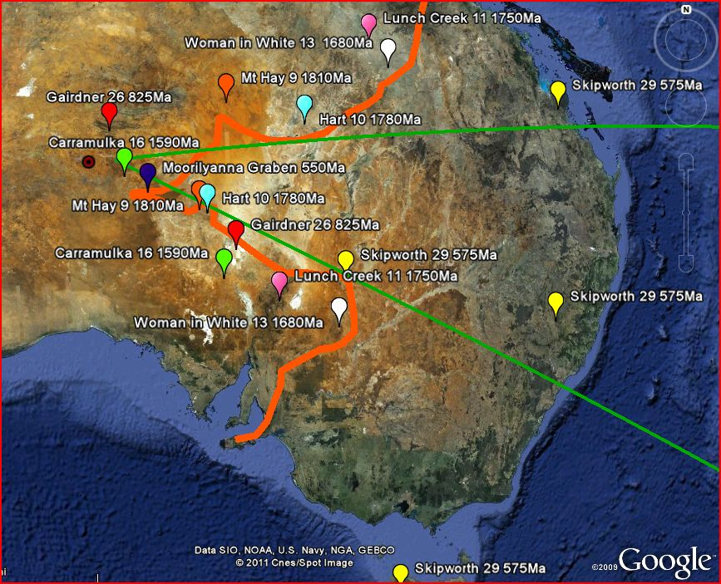

Timing of the Rift Initiation between the NAC & SAC
MAPCIS ~542 Ma or
Petermann Orogeny ~550-530Ma
Beginning ?
Where & When was the lava within the rift ? ? ?
Delamerian orogeny ~515-500ma
Ending?
DPC 2011
Notes:
This slide is modified from the following presentation. Northeastern (46th Annual) and North-Central (45th Annual) Joint Meeting (20–22 March 2011) Paper No. 14-14 Presentation Time: 5:00 PM-5:15 PM THE TIMING OF RIFT INITIATION BETWEEN THE NORTH AUSTRALIA AND GAWLER/ SOUTH AUSTRALIA CRATONS D.P.Connelly
The locations of the magmatic events are from: Hoatson, D.M., Claoue-Long, J.C., Jaireth, S,.2008 Australian Proterozoic Mafic-Ultramafic Magmatic Events: Sheet 1, Geoscience Australia, Canberra
Two published papers suggest a much earlier opening of the rift but don’t account for the division of magmatic events or the Mooracoochie Volcanics.
Zheng-Xiang Li and David Evans. 2011-Late Neoproterozoic 40deg intraplate rotation within Australia allows for a tighter fitting and longer lasting Rodinia, Geology , January 2011, Vol 39, #1, Pg 39-42
David Giles, Peter G. Betts, and Gordon S. Lister. 2004 1.8-1.5-Ga links between the North and South Australian Cratons and the Early-Middle Proterozoic configuration of Australia. Technophysics 380 (2004) 27-41
Magmatic events split. There should be lava fill somewhere in the rift of the appropriate age.
February 2013 Andrew Glikson announced the finding of evidence for a 300 million year old, 200km wide impact crater in the Warburton Basin.

Slide 6
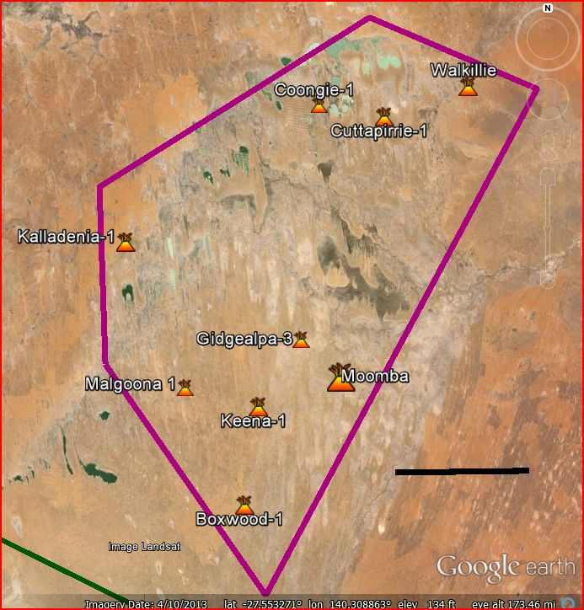
Mooracoochie volcanics early Cambrian (517Ma +/- 9 Ma)
~960m thick at Gidgealpa-3
Area ~ New Jersey
50 km
DPC 2013
2013
Notes:
Mooracoochie mislabeled lacking the dating.
Definition card for: Mooracoochie Volcanics
State(s): SA,
Status of unit: Formal
Usage: Defined
Stratno: 27294
Reserved by: C.G.Gatehouse on: 05-OCT-82
Approved: Y
Approved by: Moore, P.S. on: 07-JUN-83
Name source: Mooracoochie Hill, latitude 27o48'S, longitude 139o41'E on the Pastoral Plan 15.
Type section locality: Gidgealpa-3 from 2373 m to 3333 m.
Extent: Subsurface on Gidgealpa-1, -14, Spencer-1, Kalladeina-1. Possibly also Cuttapirrie-1, Coongie-1, Paning-1, and Pinna-1 where the volcanics should be regarded as Mooracoochie Volcanics equivalent. Andesites intersected at Murteree A-1 which are lithologically different from the Mooracoochie Volcanics may be equivalent.
Thickness range: In the type section it is 960 m (3149 ft) thick. The range is unknown as the base has not been penetrated.
Lithology: Gidgealpa-3 contains tuff, lapillituff, trachyte, crystal tuff, sodic trachyte, and rhyolite. Conglomerate, and shale also occur within the section. Sericitisation, and chloritisation, with dolomite and calcite veins, are common. Spherulitic agglomerate blocks occur in Gidgealpa-1, obsidian and vitric rock fragments are also common.
Relationships and boundaries: The base has not been penetrated, the top is erosional, though in the type section there are interbeds of dolomite and limestone.
Age reasons: The volcanics are overlain by early Middle Cambrian carbonates of the Kalladeina Beds, the oldest of which are dated as Templetonian. The volcanics are therefore no younger than Templetonian, they are thought to be Early Cambrian but may be older.
Proposed publication: Quarterly geol Notes, Geological Survey of SA, No. 86, March 1983
Proposer: Gatehouse C.G.
517 +- (Ma U/Pb ion microprobe

Slide 7
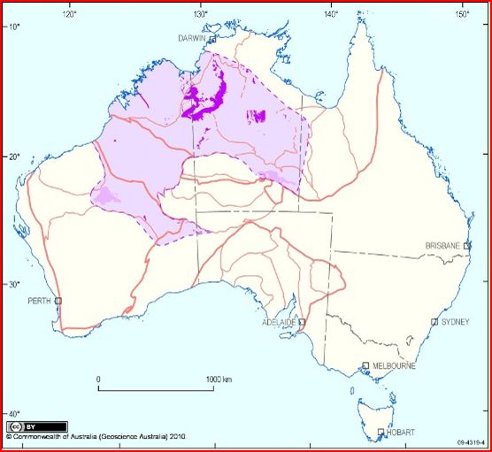
Kalkarindji LIP
Stratigraphically early Cambrian
~545Ma-500Ma
Ar-Ar dating ~510Ma
2008 center of impact published. DPC
2010 Kalkarindji Map published
Mooracoochie
2013
This map is based on the GA 2010 Map of the Kalkarindji LIP
The Star for MAPCIS, the Mooracoochie Volcanics and the orange outline of the Tasman Line have been added.
GA 2010

Slide 8
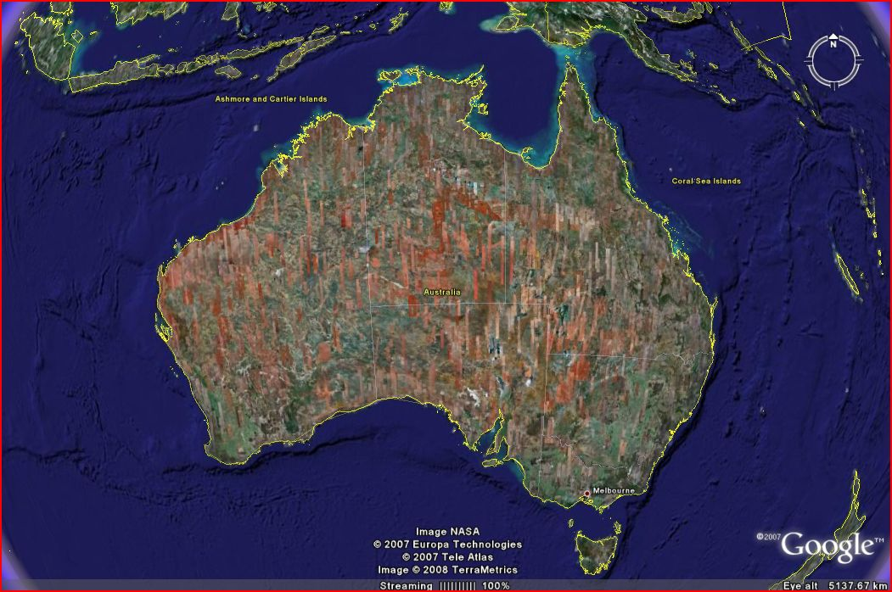
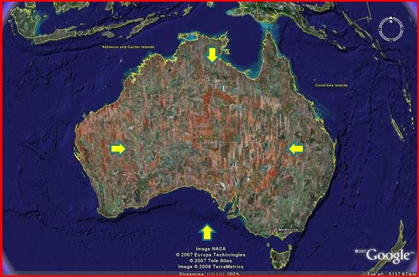
Transverse lines were marked across the ring and the altitude was measured at intervals of 10 km
DPC2008
Bisects located the approximate center of the ring.
Spencer Gulf

Slide 9
640km
North
D. P Connelly 2008, update 2013
Notes:
More transects can be shown if requested – danielconnelly@comcast.net - This transect clearly shows the width and the height of the outer ring on the left hand side and the central ridges

Slide 10
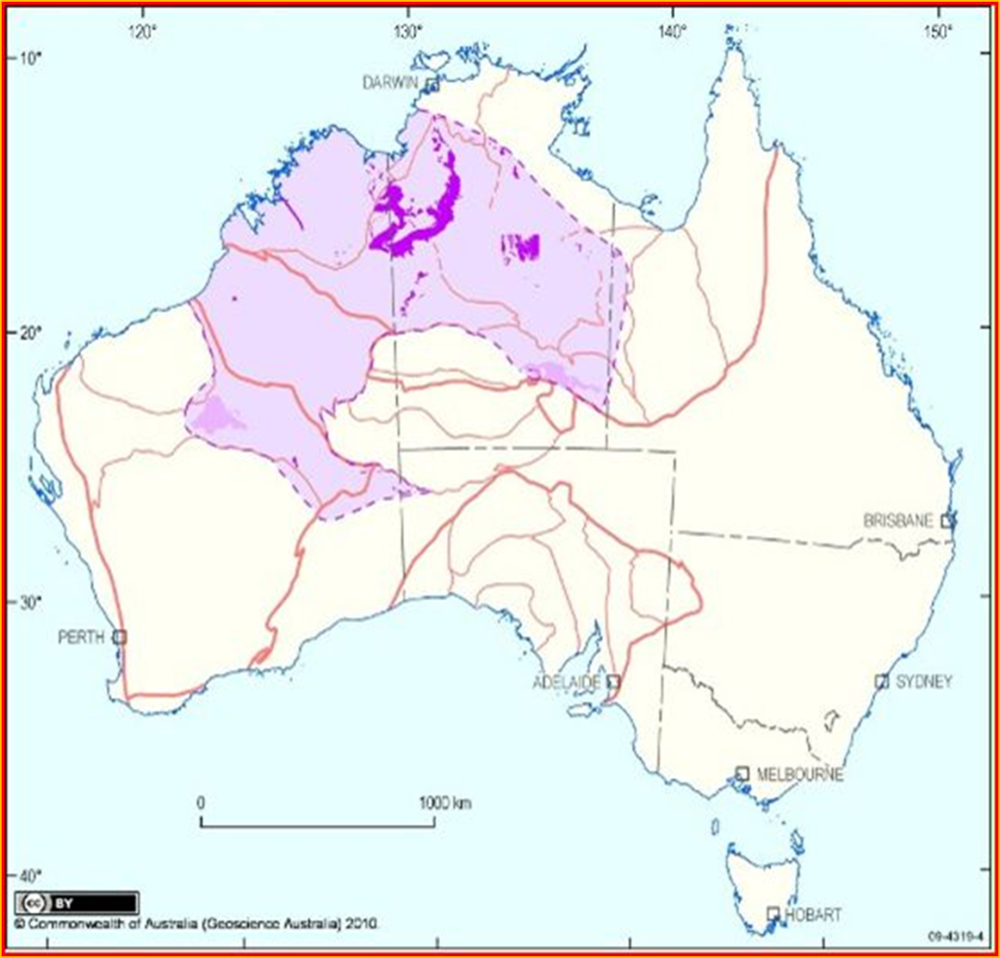
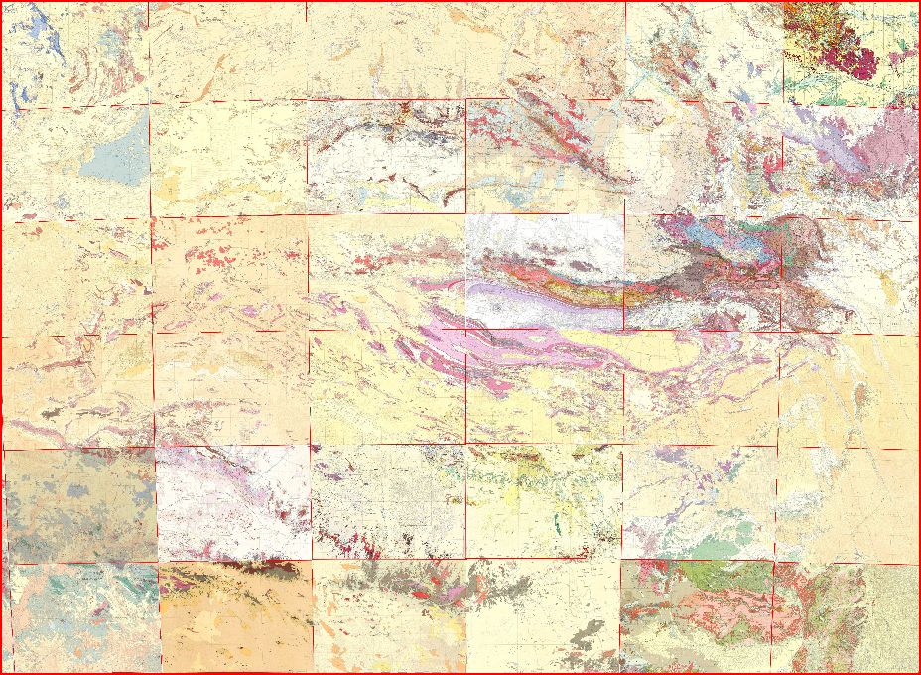
The MAPCIS inner ring fits nicely within the annular Kalkarindji LIP
Mosaic map based on 1:250,000 GA Surface Geology Maps shows inner ring
~500km across North to South
2011 D. Connelly

Slide 11
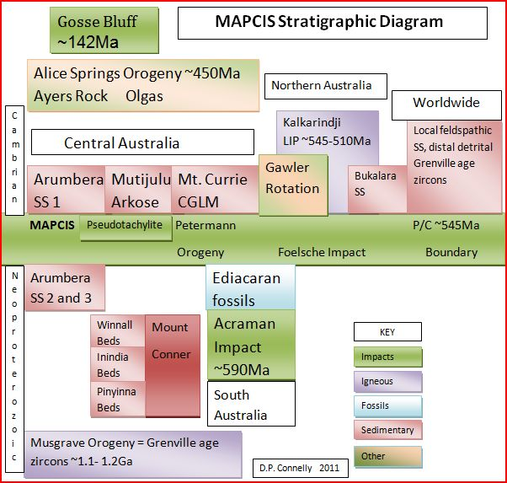
2013
Annular
Kalkarindji Surrounding the Central Highlands
Winnall 3&4
SAC
1 & 2
Updated 2013

Slide 12
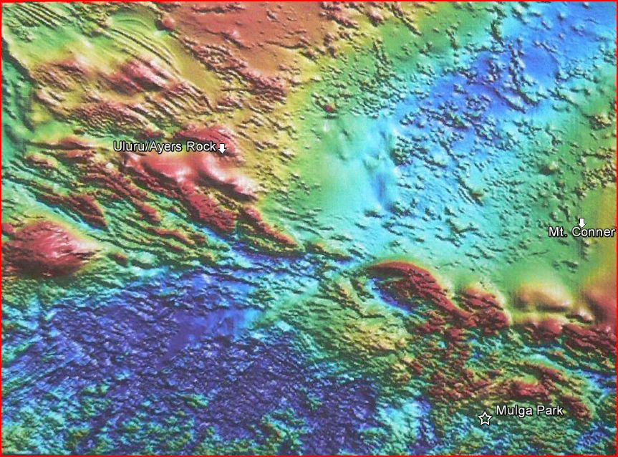
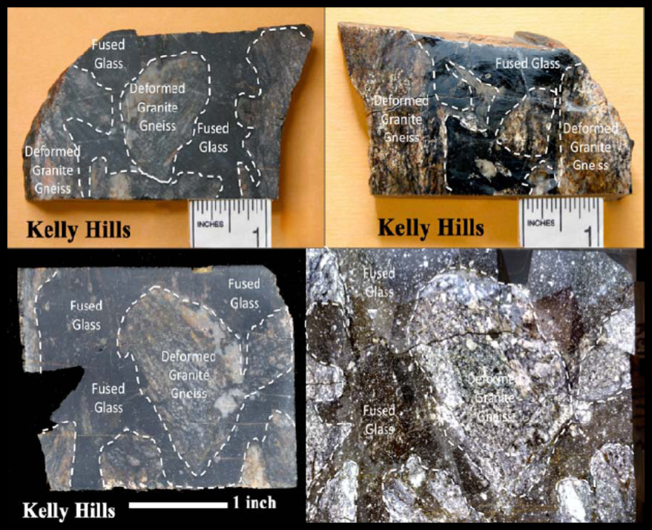
MAPCIS is the Star at the center
This is the same location as shown on the Kalkarindji Map.
GA Magnetic Intensity Map 2002
Around which are the largest known deposits of pseudotachylite breccia
2011 Expedition
Notes:
PSEUDOTACHYLITE BRECCIA OF THE MUSGRAVE PROVINCE, AUSTRALIA
GSA 2012 presentation by Daniel Connelly
As of 2013, Musgrave pseudotachylite is the only large deposit not associated with a large impact.

Slide 13
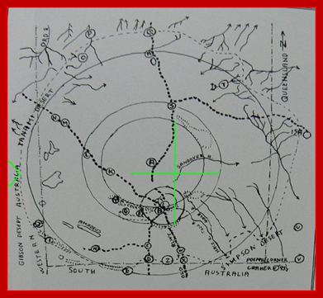
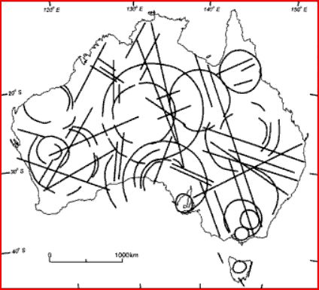
1993 Bert Cramer
considers impact origin of Central Australia Ring structure
1997 E.S.T. O’Driscoll &
I. B. Campbell
consider impact origin of CAR.
Meets “square root of 2 rule” for multi-ring impact basins.
(CAR) Central Australia Ring
Notes:
Bert Cramer and E.S.T. O’Driscoll are deceased.

Slide 14
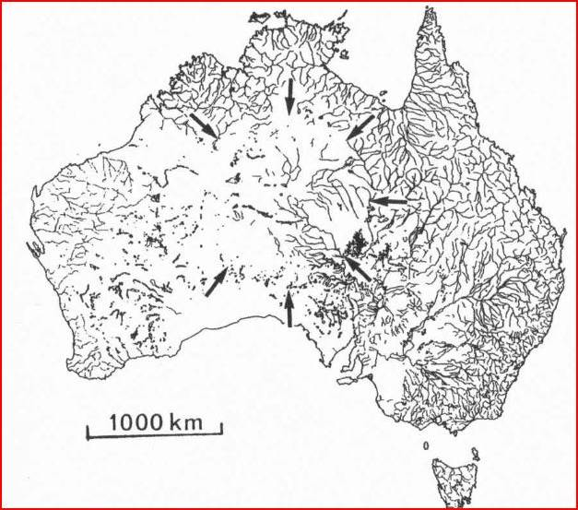
1969 Drainage Map
1969 Div. Nat. Map noted by O'Driscoll & Campbell 1997

Slide 15
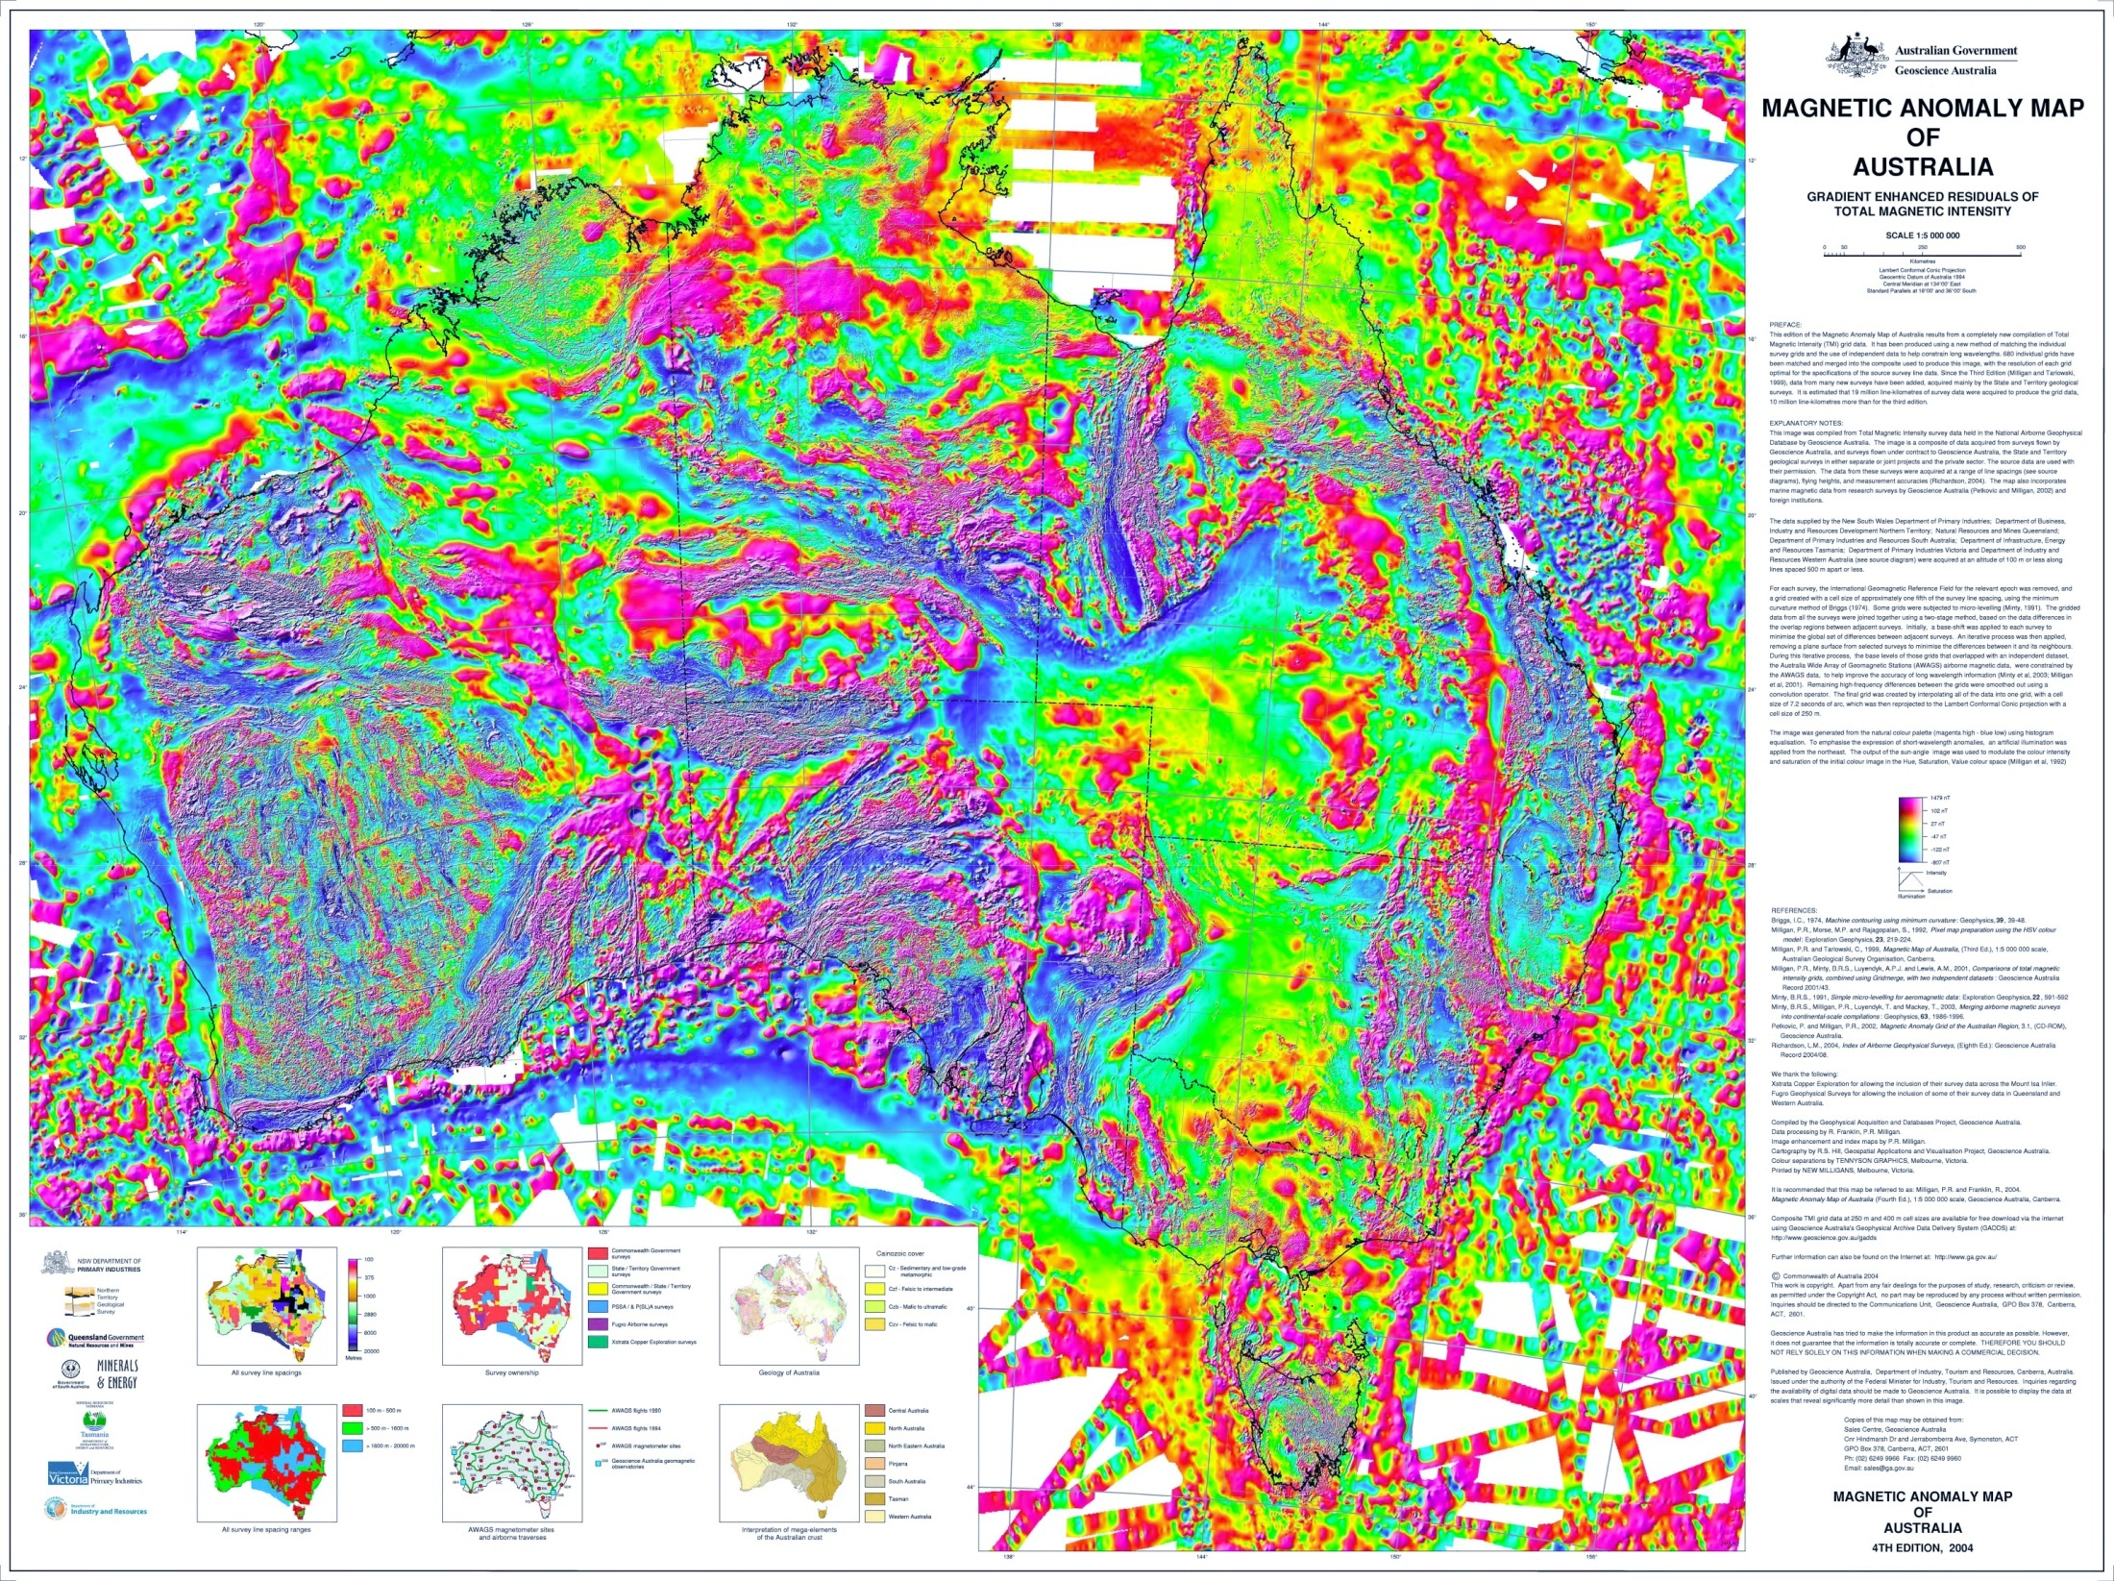
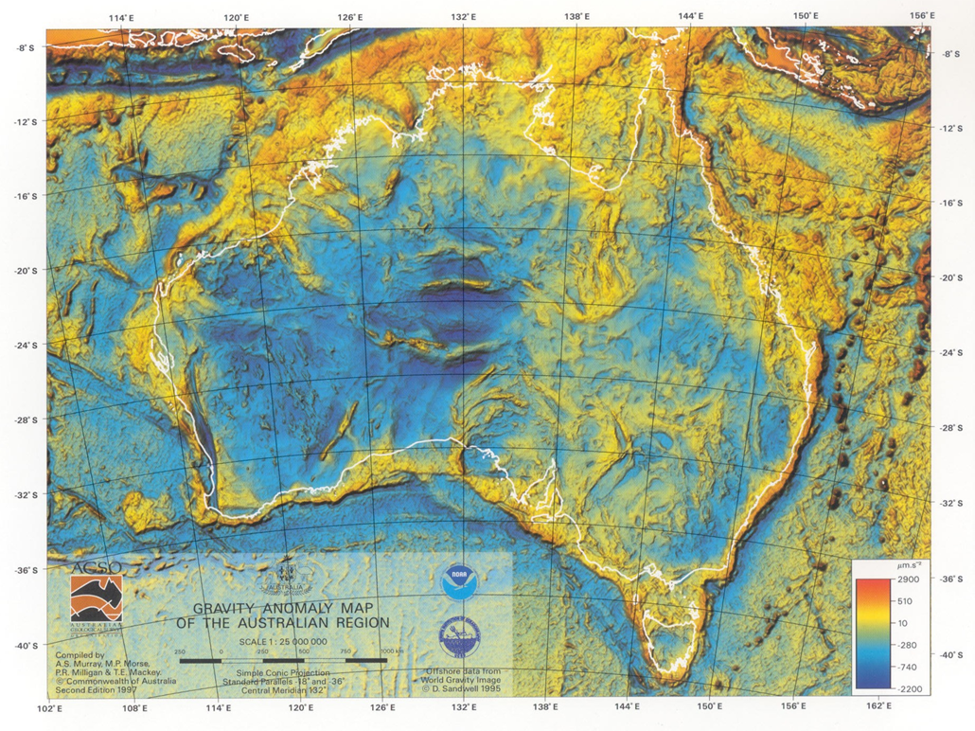
Central region well defined subsurface geology
2004 GA Magnetic Anomaly Map
1997 GA Gravity Anomaly Map
Notes:
Points out that the surface and subsurface concur.

Slide 16
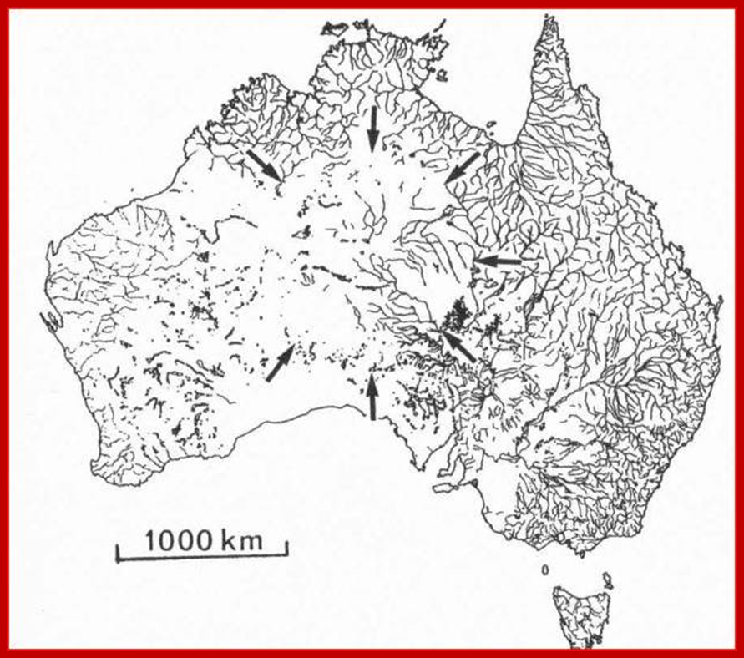

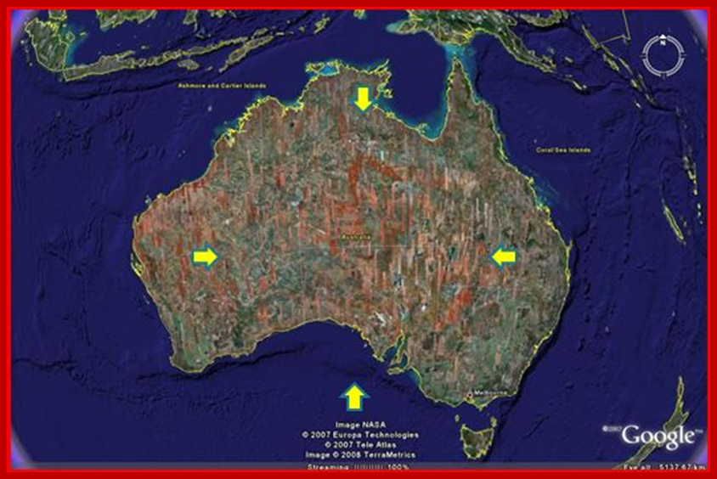

Independent cartographers with similar results
1993 & 19973
1969
2008, 2010 & 2013
2011
2006 & 2007
Notes:
Until I compiled these maps, the cartographers were unaware of the others work. Cramer in 1993 and O’Driscoll in 1997 could not have seen the Google Earth satellite image. Daniel Connelly of New Jersey, fixing the impact center in 2008 could not know of the Kalkarindji Map of 2010.
The 2011 geology mosaic map (DPC) made from 1:250,000 GA geology maps has fixed coordinates and fits within the inner ring of the Kalkarindji LIP.

Slide 17
Conclusions and Implications
I found that this multi-ringed circular anomaly has been rediscovered several times and will continue to be rediscovered . The juxtaposition in time and space of the Kalkarindji LIP and Mooracoochie volcanics with the proposed impact known as MAPCIS raises challenging questions .
Did this impact cause the formation of a mantle plume and LIP?
Did this impact cause the uplift of central Australia prior to the Kalkarindji LIP?
Did this impact cause the rifting between the North Australia Craton and the South Australia Craton?
By implication , through mantle plumes and rifting did this impact stimulate plate tectonics?
These are not easy questions . If answered in the affirmative, it writes a new chapter in the middle history of Earth
danielconnelly@comcast.net
MAPCIS can be found on facebook

