Slide 1
VALIDITY OF TAXON-SPECIFIC SAMPLING FOR STUDIES OF DRILLING PREDATION: CONFIRMATION FROM FOUR BIVALVE SPECIES IN THE PLEISTOCENE OF NORTH CAROLINA
Kelly E. Hattori
with Patricia H. Kelley, Kristina Ottens, Nicholas O. Moore, Sarah L. Simpson, Anna M. Zappulla, Gregory P. Dietl, and Christy C. Visaggi

Slide 2
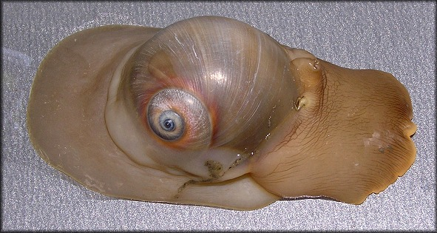
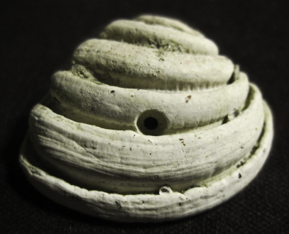
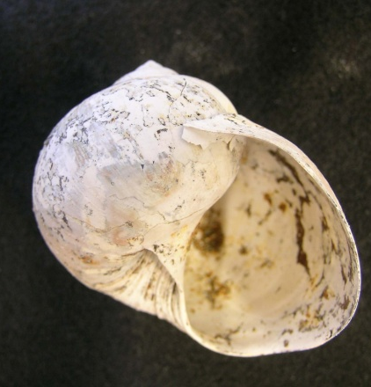
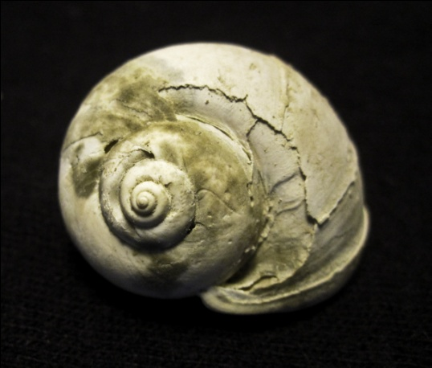
BACKGROUND
Predatory gastropods frequently feed upon bivalves
Predation trace fossils
occur in fossil record
Drilling predation studies useful for
examining community composition and
interactions
Many sampling method options, including:
Bulk
Taxon-specific (targeted)
Surveys (museum, monograph,
outcrop)
Notes:
Talk about how drilling evidence can be correlated to amount of predation (and thus presence/amount/percentage of gastropod predators)
Talk about how gastropods drill into bivalves and suck out the insides
Talk about how these studies are useful for determining ecology when not everything has been preserved – long history of studying invertebrate benthic communities

Slide 3
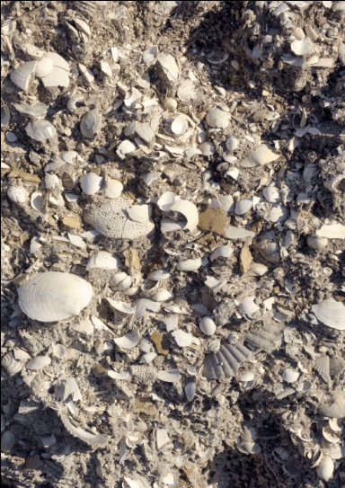
RESEARCH GOALS
Investigate:
Validity of taxon-specific (targeted) sampling as an alternative to bulk sampling when select taxa are needed for drilling predation studies
Based on preliminary study conducted by Ottens et al. (2012)
Effects of collector expertise on bias
in targeted samples
Effects of size variability of specimens
on bias in targeted samples
Notes:
Briefly state research goals (“These are my goals, now let me tell you the background information…”)

Slide 4
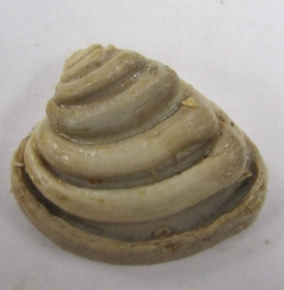
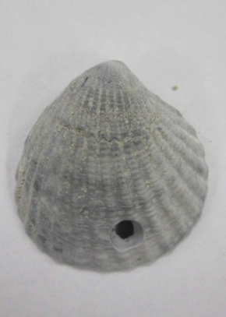
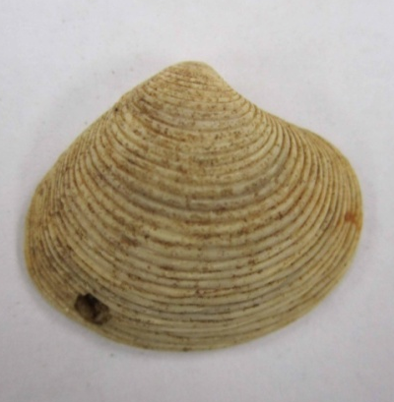
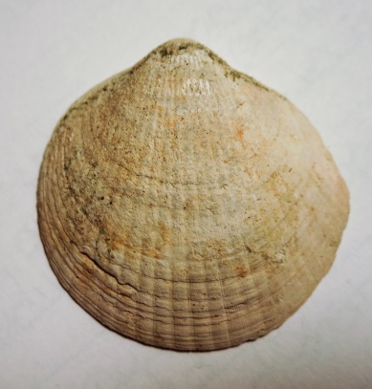
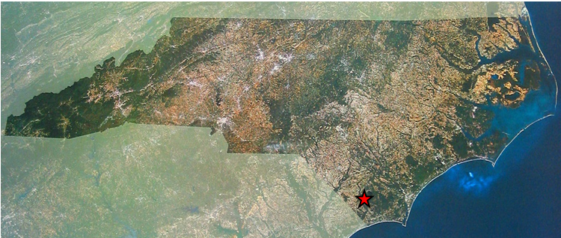
GENERA STUDIED / LOCALITY
A
B
C
D
Lirophora latilirata (A)
Cyclocardia granulata (B)
Astarte concentrica (C)
Glycymeris americana (D)
Location of Register Quarry in NC
Notes:
List genera studied
Also talk about Glycymeris and why it wasn’t used

Slide 5
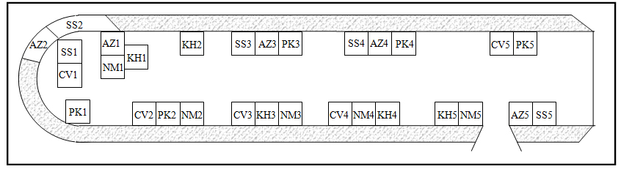
COLLECTION METHODS
Six bulk sample replicates taken during a Research Experiences for Undergraduates project in June 2008
Sieved using 5mm mesh
~ 2 liters of material per sample
Each collector took five replicate targeted samples
1m² quadrat size
25 specimen minimum per sample
Layout of Register Quarry with location of targeted replicates
Notes:
Talk about bulk samples and where they came from
Talk about collection methods – how no replicates overlapped, how quadrat was expanded for sample size, chart

Slide 6
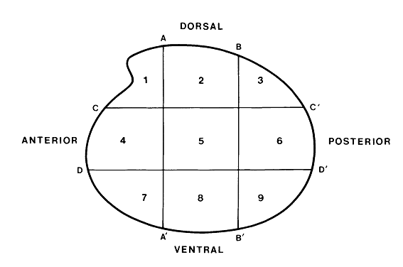
MEASUREMENTS & CALCULATIONS
Measured:
Length and thickness
Valve frequency (left versus right)
Drillhole presence, location, and outer borehole diameter
Calculated:
Drilling frequency (DF)
Prey effectiveness (PE)
Size and site selectivity
Diagram of drillhole location sectors from Kelley (1988)
Size-standardize data using parameters used by Ottens et al. (2012)
Notes:
Talk about who did measurements
Talk about calculations, drillhole identification, definition of prey effectiveness
Talk about size parameters used (5-15 for Cyc, 15-25 for Ast, 20-30 for Lir) and how they were determined by Ottens?

Slide 7
STATISTICAL TESTS & ANALYSIS
Methods and collector experience for both standardized and unstandardized data
Replicates analyzed in four groups:
All replicates separate
All replicates with a minimum of 10 specimens
All replicates with a minimum of 20 specimens
All replicates combined
Mann-Whitney U tests, chi-squared tests, Kolmogorov-Smirnov one-sample tests, covariance tests

Slide 8
RESULTS –Drilling Predation Metric
Total specimens
collected: 6826
Number of tests
conducted: 1090
Size-standardized data show fewer significant differences than unstandardized data
Taxon-specific sampling minimally significantly different from bulk sampling results
Notes:
Explain how tests were broken up based on standardization and test type (collector vs method)
Explain significance (obviously)

Slide 9
RESULTS - Taxon
Size variability of Glycymeris americana did not cause additional bias in collected targeted samples
Bulk samples frequently had inadequate sample sizes, especially in less common taxa
Notes:
Explain graph and how it shows % of significant tests based on genus – lots in method unstd but very little in method std and little to none at all in collector tests

Slide 10
RESULTS – Collectors
Novice collectors did not differ significantly from veteran collectors
Notes:
Explain how graph breaks up into novice (top) and veterans (bottom)
Explain why veterans are not compared with collector std/unstd
Explain numbers (obviously)

Slide 11
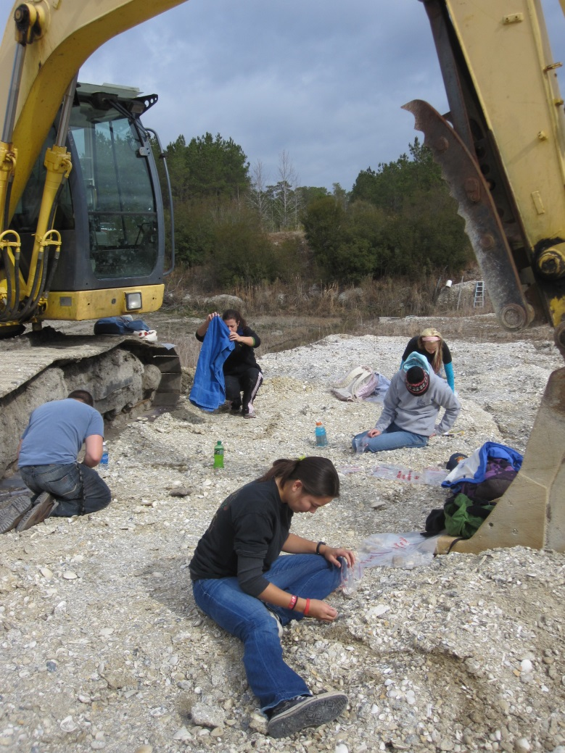
CONCLUSIONS
Taxon-specific sampling is a viable collection method for drilling predation studies in targeted species
Limitations must be fully
understood
Care must be taken to avoid bias
Sample size can be controlled
More efficient
Notes:
Very straightforward

Slide 12
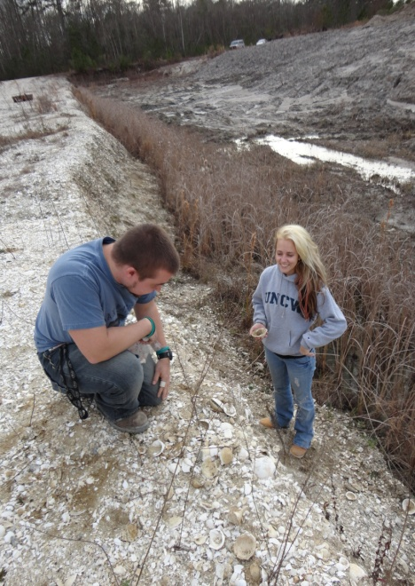
CONCLUSIONS
Novices are able to collect samples of the same caliber as those collected by veteran collectors.
Must be properly trained in identification, collection, and measurement techniques
More efficient
Larger pool of people to assist with studies
Notes:
Talk about how adding extra novices (read: undergrads) is more efficient, allows larger sample sizes, more sampling in general and does not introduce bias or error
Warn about how novices must be properly trained in collection techniques and perhaps supervised for an initial trial to make sure they have the hang of things
Talk about how taxon specific sampling is more efficient, always has large enough sample size
Warn of drawbacks – does not give community overview and is useful to other researchers only if they are studying the exact taxa you collected
Talk about future research that should be done to further verify this – incorporation of Glycymeris, studying a wider range of fossil localities

Slide 13
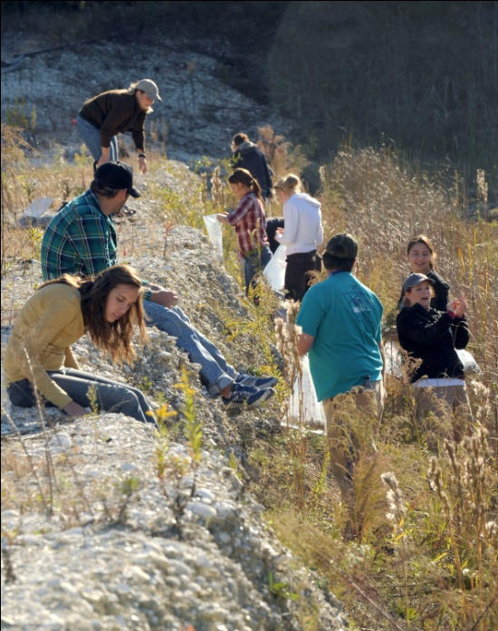
Thank You!

