Slide 1
THE FALSE POSITIVE CONUNDRUM: IDENTIFYING FALSE POSITIVES OF
CONTAMINATION FROM LANDFILLS IN SEMI-ARID TO ARID WESTERN
WATERSHEDS
Maxwell Gade
Graduate Student
Syracuse University
Dr. Donald Siegel
Professor, Earth Science
Syracuse University

Slide 2
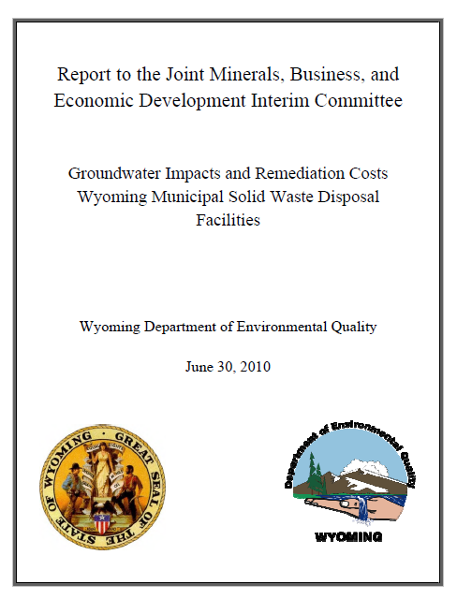
Notes:
In a 2010 report by the WYDEQ 114 municipal solid waste facilities were investigated for groundwater contamination. Of those landfills 76 had sufficient monitoring wells to detect a leachate plume release. 73 (96%) of those landfills had evidence of contamination and 69 (91%) of those landfills had contamination concentrations exceeding Groundwater Protection Standards. The WYDEQ determined that 51 landfills required further monitoring and 18 landfills required active remediation. The total cost for corrective action and remediation for the 76 landfills is $164.4 million from local governments. The total statewide cost for all landfills, including sites with insufficient monitoring wells, was estimated to be $226 million.

Slide 3
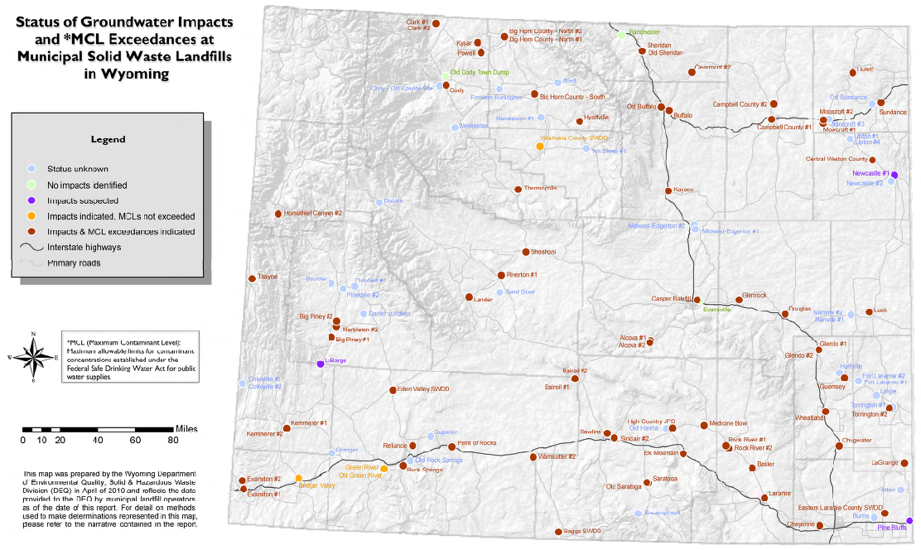
Wyoming Department of Environmental Quality, 2010
Notes:
A majority of the 114 landfills included in the report are in semi-arid and arid basins across Wyoming. MCL exceedances were based on both typical organic contaminants, like benzene, and inorganic exceedences. When an EPA MCL for a contaminant was unavailable a Groundwater Protection Standard was based on secondary MCLs or constituent increases above background levels. If background water naturally exceeds EPA and other standards then false positives of contamination can occur because of water-rock interactions.

Slide 4
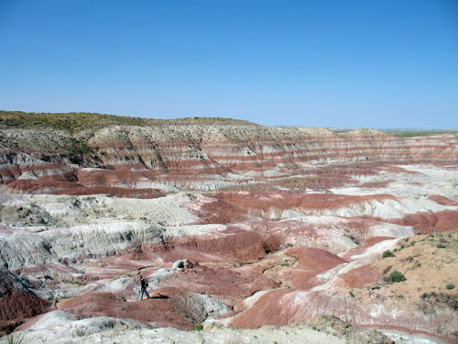
Wind River Formation
Notes:
A majority of landfill water samples are taken from shallow ground waters in iron rich claystone and siltstone layers. These waters would be naturally high in iron and sampled water would contain clay and silt colloids. Unless the pH or a sample is lower than 4, indicating leachate presence, high concentrations metals are likely caused by colloid matter in samples.

Slide 5
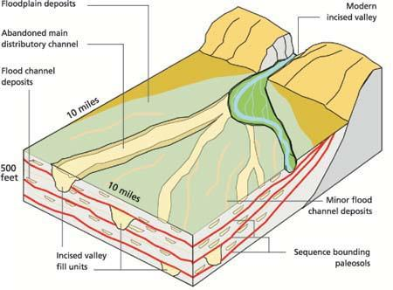
Valley Fill
Notes:
The landfills are on valley fill, underlain by deep layered aquifers and confining units within unconsolidated alluvium and glacial deposit aquifers, as well as shallower perched lenticular sandstone aquifers (Taucher et al. 2012).

Slide 6
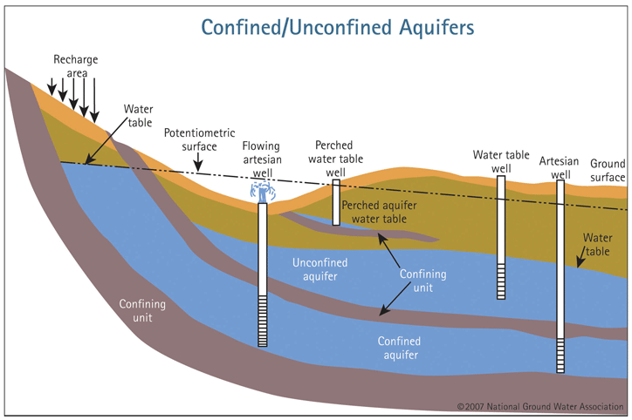
Notes:
The aridity of the eastern United States causes evapoconcentration of natural solutes in perched aquifers resulting in naturally high solute concentrations (Gurdak and Roe, 2010). High solute concentrations may be a result of natural evapoconcentration and not contamination, causing waters uncontaminated by landfills to be falsely identified.

Slide 7
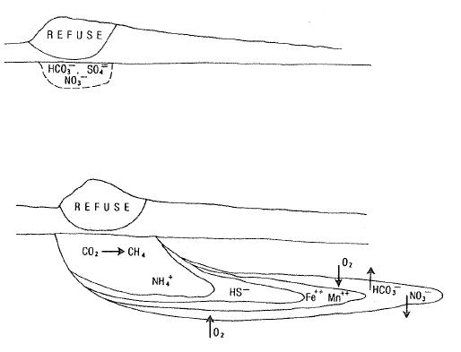
Landfill contamination has a unique fingerprint
Baedecker and Back, 1979
Notes:
As precipitation percolates through waste, leachate forms and migrates downward in a plume below the landfill. A sequence of oxidation-reduction reactions occurs as organics are transported via leachate, they are methanogenesis, sulfate reduction, iron and manganese reduction, denitrification, and oxidation.

Slide 8
Major Reactions
Organic matter oxidation
Carbonate mineral dissolution
Ion exchange
Sulfate reduction
Iron oxide reduction
Ammonium generation under anoxia

Slide 9
Landfill Leachate Indicators
Alkalinity
Sodium
Chloride
Absence of Sulfate
Dissolved Organic Carbon
Notes:
22
These should occur as together to indicate leachate

Slide 10
As an assemblage natural variability is very large and has no logical trends
Notes:
TOC, Ammonia, Iron, and manganese are expected to positively correlate with chloride concentrations in groundwater contaminated with leachate. These four plots show that state wide, for both contaminated (red) and uncontaminated (blue) landfills these constituents do not correlate as expected.

Slide 11
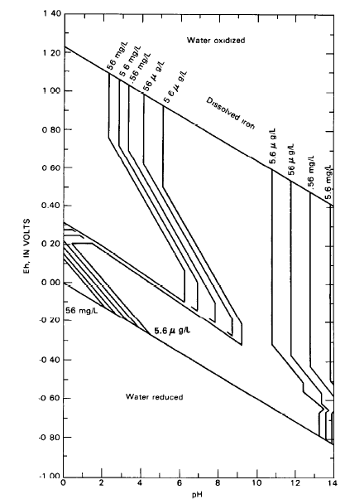
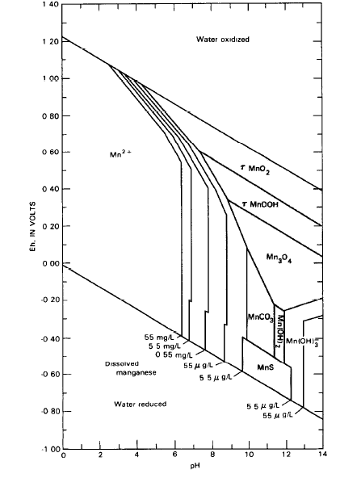
Highest Possible
Concentration

Slide 12
Total Iron is not thermodynamically reasonable
Orders of
Magnitude
Higher
Orders of
Magnitude
Higher
Maximum Possible
Maximum Possible
Total metal analyses cause false positives
Plausible
Plausible

Slide 13
Wyoming Department of Environmental Quality, 2010
Notes:
The focus of future geochemical modeling with PHREEQC will be on four landfills in Fremont County in the Wind River basin – the Lander, Shoshoni, Sand Draw, and Riverton landfills.

Slide 14
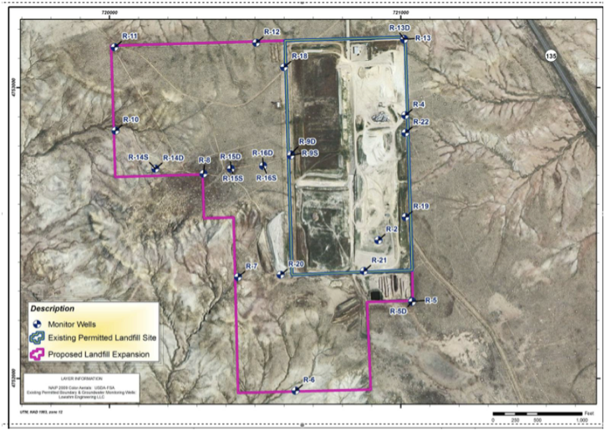
Sand Draw Case Study
Notes:
I am able to couple high quality data from the Sand Draw landfill, including isotopic measurements, collected for a past litigation. I can use this data to constrain PHREEQC model results as a case study for other arid-region landfills.

Slide 15
Water levels in wells have not varied in years
Notes:
The water levels in wells have not varied significantly in the last decade, suggesting poor or no connectivity with local groundwater nor response to recharge from precipitation

Slide 16
Sodium-sulfate Water
Figure 4
Notes:
Sand Draw has consistently higher sulfate and sodium levels relative to bicarbonate, chloride, magnesium, and calcium

Slide 17
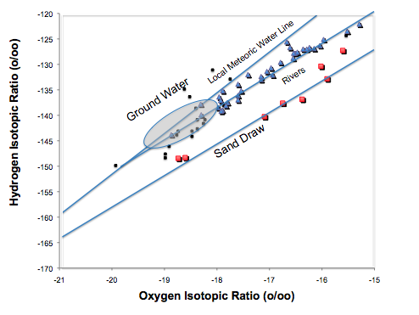
Water isotopes Fall on Completely Different Line than Modern Water
Siegel, 2009
Notes:
Hydrogen and Oxygen isotope data show that the sampled Sand Draw groundwater has an evaporative trend, along with river water samples from the Wind and Yellowstone rivers. The Sand Draw water intersects the meteoric water line at -24 permil which is consistent to glacial ice or rain that recharged under in a colder climate thousands of years ago.

Slide 18
Some Water is Thousands of Years Old
Well | Depth (ft) | C-14 Age | C-13
R-10 | 50
R-11 | 50
R-12 | 50 | 4550 | -21.0
R-18 | 52 | 17180 | -7.7
R-20 | 55 | 3650 | -19.3
R-7 | 50
R-8 | 50
R-9D | 60 | 22130 | -10.8
R-13D |  | 9029 | -16.7
R-19D |  | 19120 | -14.6
R-21 |  | 6600 | -17.3
Wash well | ~200 | 6020 | -11.1
Notes:
Carbon-14 dating puts shallow Sand Draw groundwater samples at ages between four and a half thousand and twenty two thousand years old

Slide 19
Sand Draw Sample Comparison
Notes:
These four plots compare TOC, Ammonia, Iron, and Manganese to chloride for multiple samples from the Sand Draw landfill and other local groundwater. The NAWQA groundwater was taken from a well North West of Riverton. The green filtered samples were Sand Draw water samples taken as part of a litigation in 2008. The blue and red samples are from the DEQ dataset, uncontaminated (blue) samples are waters that contained no organics and contaminated (red) samples are waters that did contains organics.
Uncontamianted (blue) samples have higher concentrations of all constituents while having lower concentrations of chloride than the contamianted (red) samples. The NAWQA water samples show high TOC and higher Manganese concentraitons that contamianted DEQ samples.
On the Iron – Chloride plot filtered samples have much lower iron concentrations than the DEQ samples.

Slide 20
Sand Draw Sample Comparison

Slide 21
Conclusions
The chemistry in ground waters contaminated with leachate must be consistent with landfill geochemical processes
The local variability of constituents needs to be assessed in a hydrological context
To avoid false positives samples should be filtered, using only dissolved constituent values

