Slide 1
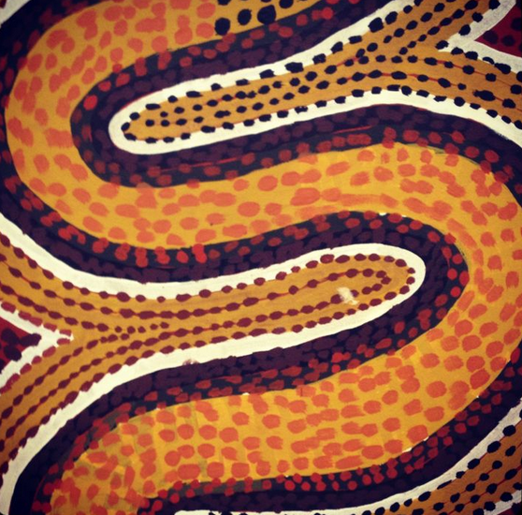
O
Coupled Oroclines of the Svecofennian Orogen:
A Paleoproterozoic Terrane Wreck
and its implications for continental construction
Stephen T. Johnston
Univ. of Victoria
Raimo Lahtinen <raimo.lahtinen@gtk.fi>
Mikko Nironen <mikko.nironen@gtk.fi>
Geological Survey of Finland

Slide 2
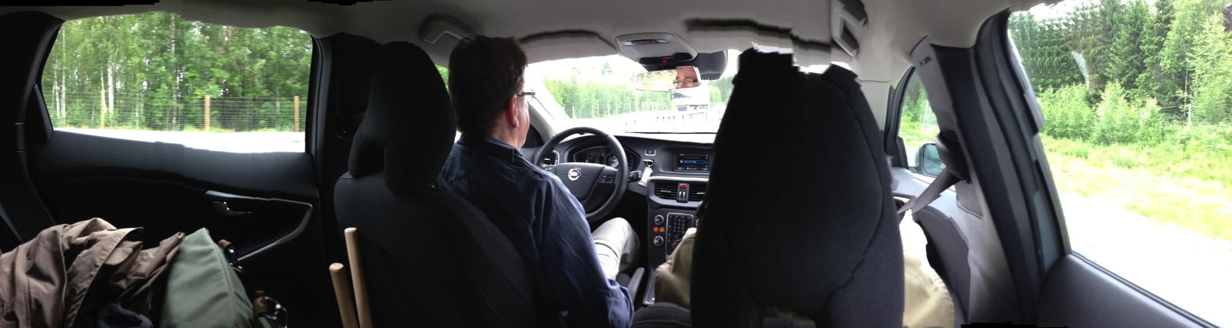

Slide 3
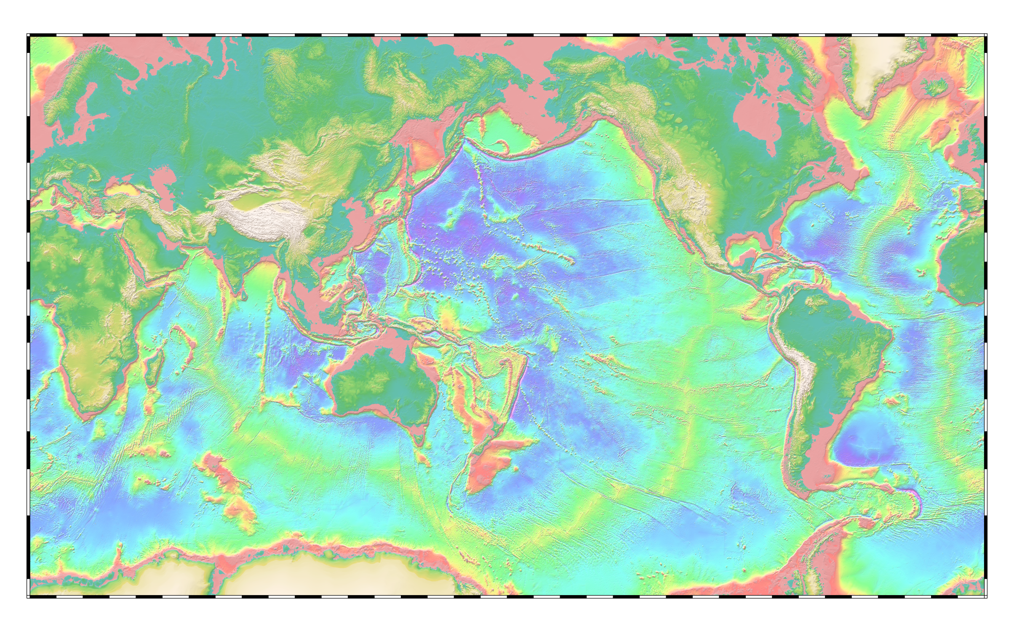
How do we get from magmatic arcs to continents?
Passive
© 1997, David T. Sandwell

Slide 4
Sequential accretion?
Parallel arcs
Implies high rates of crustal growth
Requires extreme translation rates
© 1997, David T. Sandwell

Slide 5
Terrane Wrecks?
- Buckling of elongate arcs / orogens about two or more coupled oroclines

Slide 6
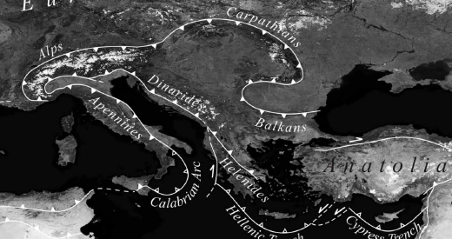

Slide 7
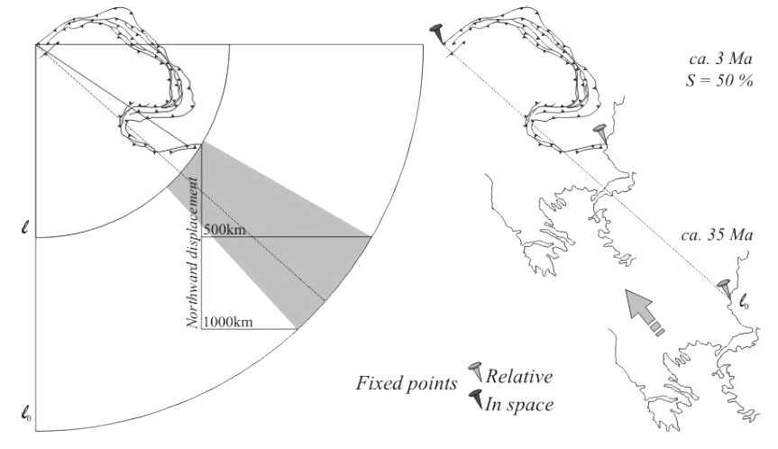
= 1050 km
= 2100 km
Shaw & Johnston, 2012

Slide 8
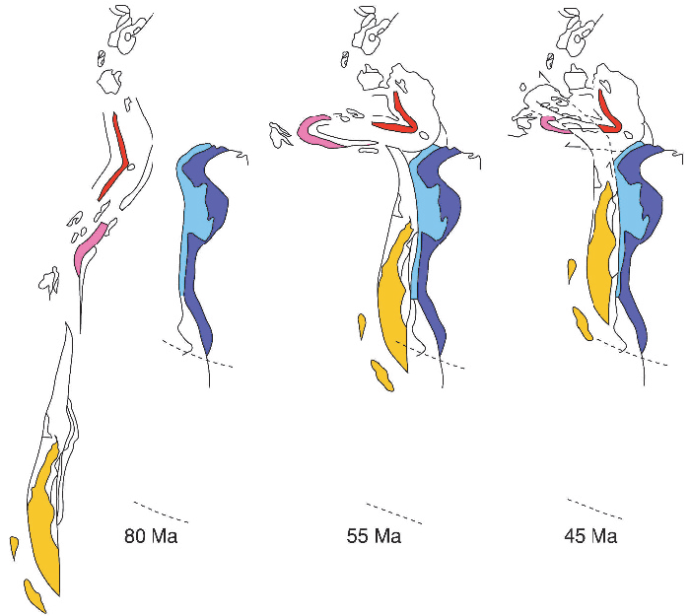
Van der Voo, 2004

Slide 9
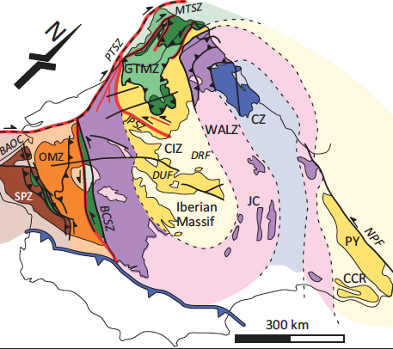
Johnston et al., 2013, after Shaw et al., 2012

Slide 10
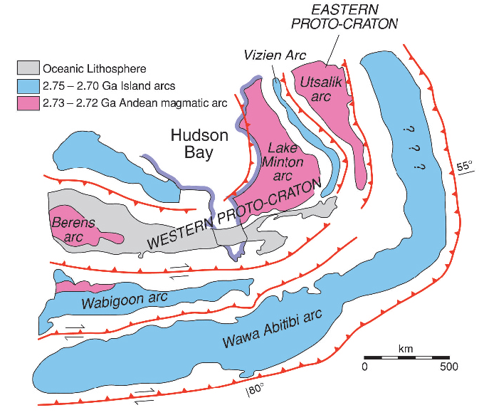
“… perhaps this is something to be pursued in
future paleomagnetic studies.”
Van der Voo, 2004

Slide 11
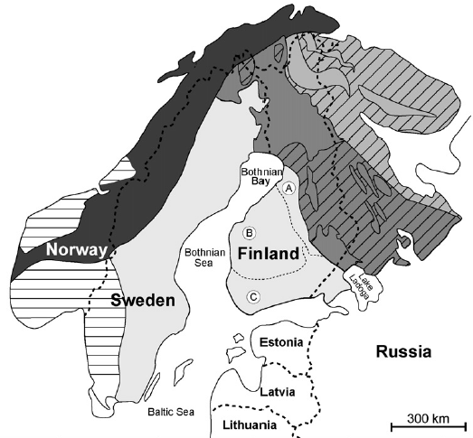
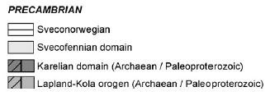
Cagnard et al., 07

Slide 12
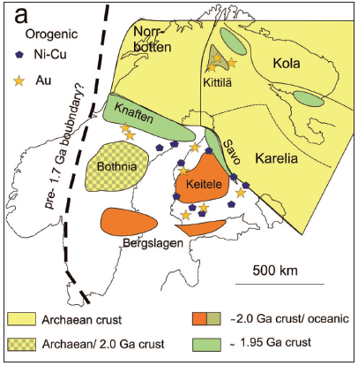
Lahtinen et al., 2011

Slide 13
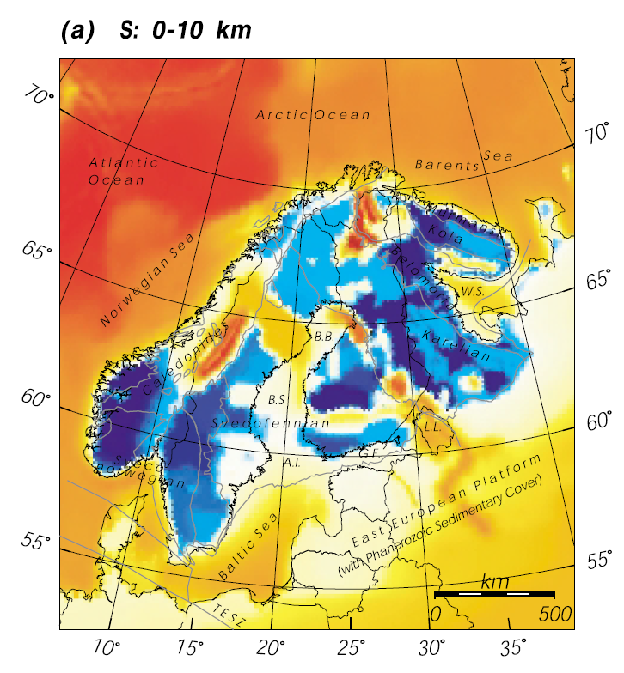
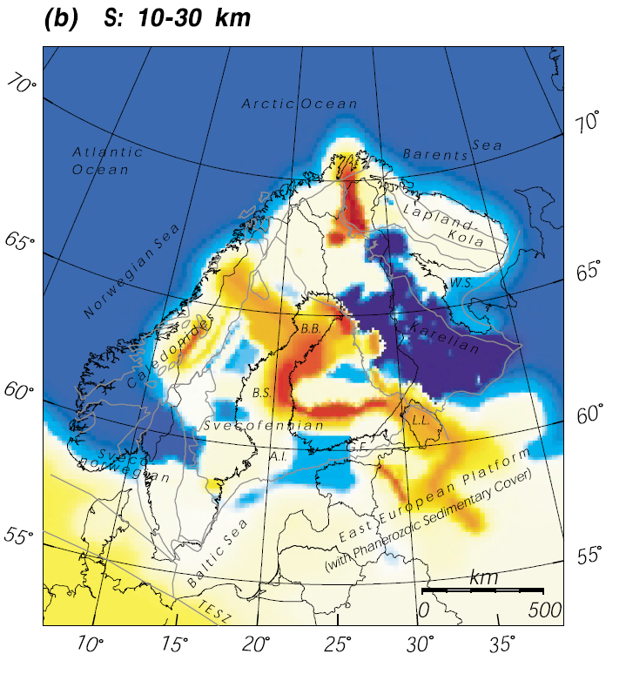
Korja et al., 2002
“conductivity anomalies related to 2.1-2.0 Ga passive margin”
Notes:
Slide 1. If we assume that the high conductance is due to early passive margin graphite-sulfide rocks, which are common and often related with the 1.91 Ga rift-volcanism (EMORB-MORB pillow lavas). This sequence has then formed lowermost part of the accretionary wedge and then during collision thrust under the island arc rocks. In the belt south of Tampere the tectonic shortening has been more severe than seen in the northern Bothnia orocline, where the rocks of high conductance are seen also in over 30km depths (30-60 km). Anyhow this is a very strong argument for the northern and southern Bothnia oroclines

Slide 14
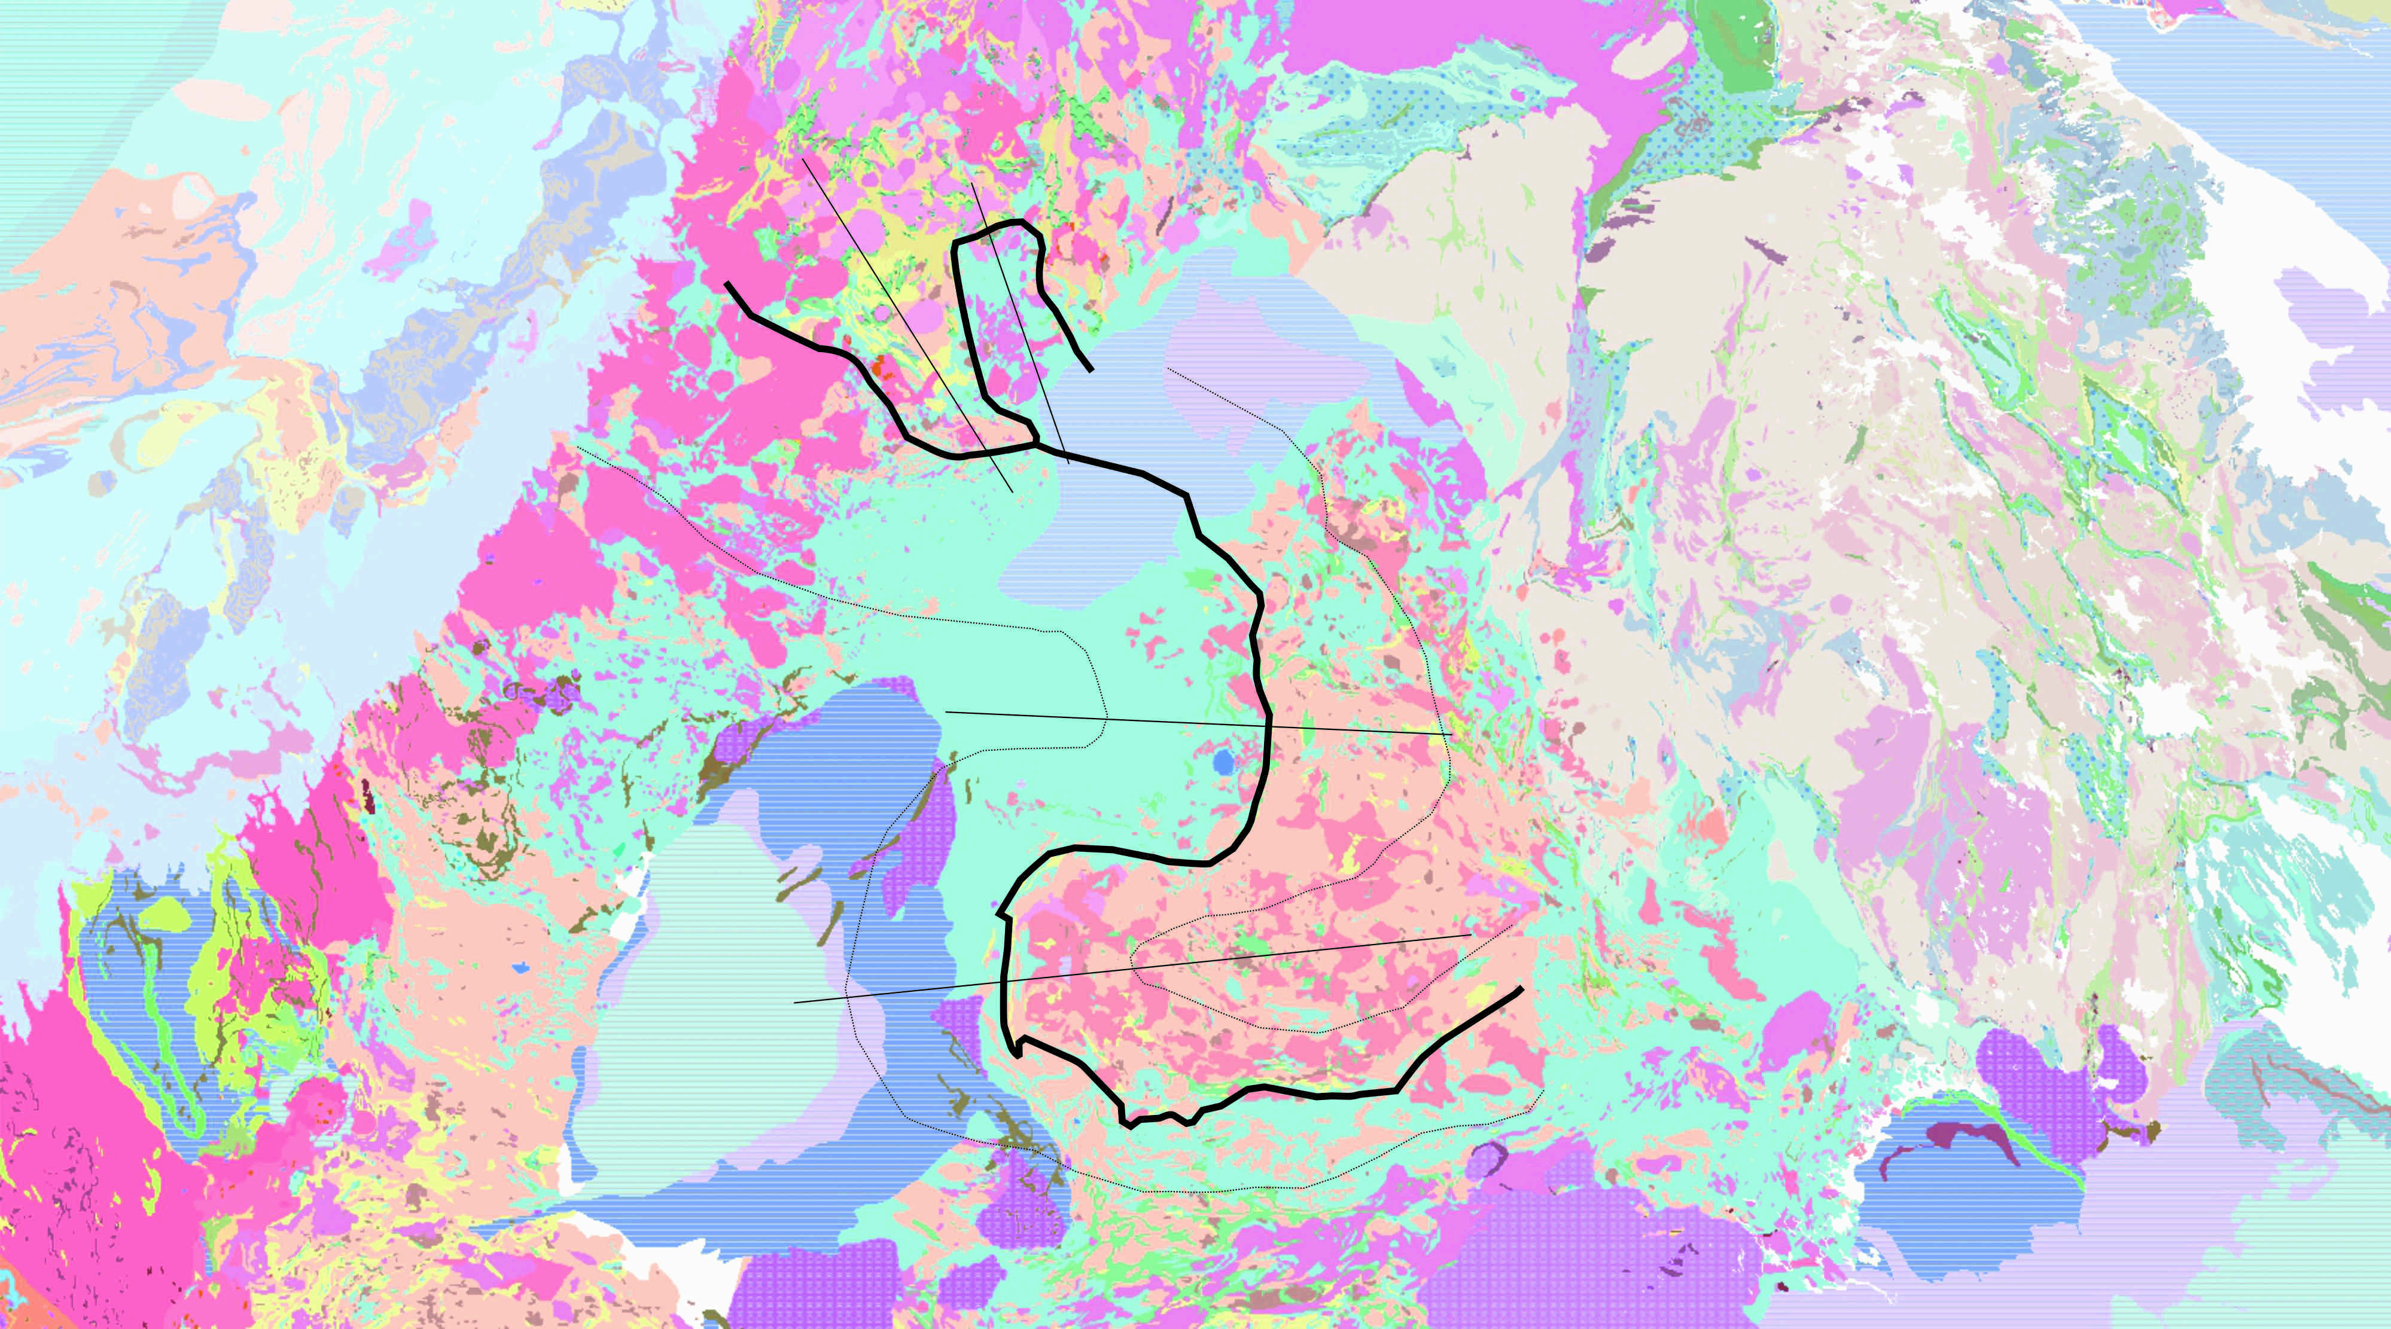
P – Pirkanmaa Metasediments
1.88 – 1.92 Ga
turbidite & e-MORB basalt
Vammala Ni-zone
Granulite facies
thrust north over Tampere
T – Tampere Volcanosedimentary
1.88 – 1.92 Ma
Intermediate volcanics
VMS deposits
Amphibolite facies
Less strained footwall to P
K – Keitele (CFGC)
1.87 – 1.89
voluminous granitic
magmatism
Granulites
1.88 Ga Orogeny
Tectonic Vectors
K
T
P
Notes:
Slides 3 and 4. New proposal for the orocline-configuration. The idea could be that first formed these small Jörn (western) and Fällfors (eastern) oroclines. This should have happened very rapidly after accretion at 1.87 Ga and would be responsible for the sinistral strike-slip shearing in A. This buckling would have happened in rather juvenile island arc rocks within a narrow arc. Buckling would continue and the stiffened small-scale buckle would then be part of the large-scale oroclines. These have a wider arc system and partly a more mature basement (2.0 Ga proto-Keitele) leading to larger amplitude. Younger dextral shearing in A could be explained with this as well as the shearing in B, dated at 1.86 Ga. Does this work or should we stop before Sweden???

Slide 15
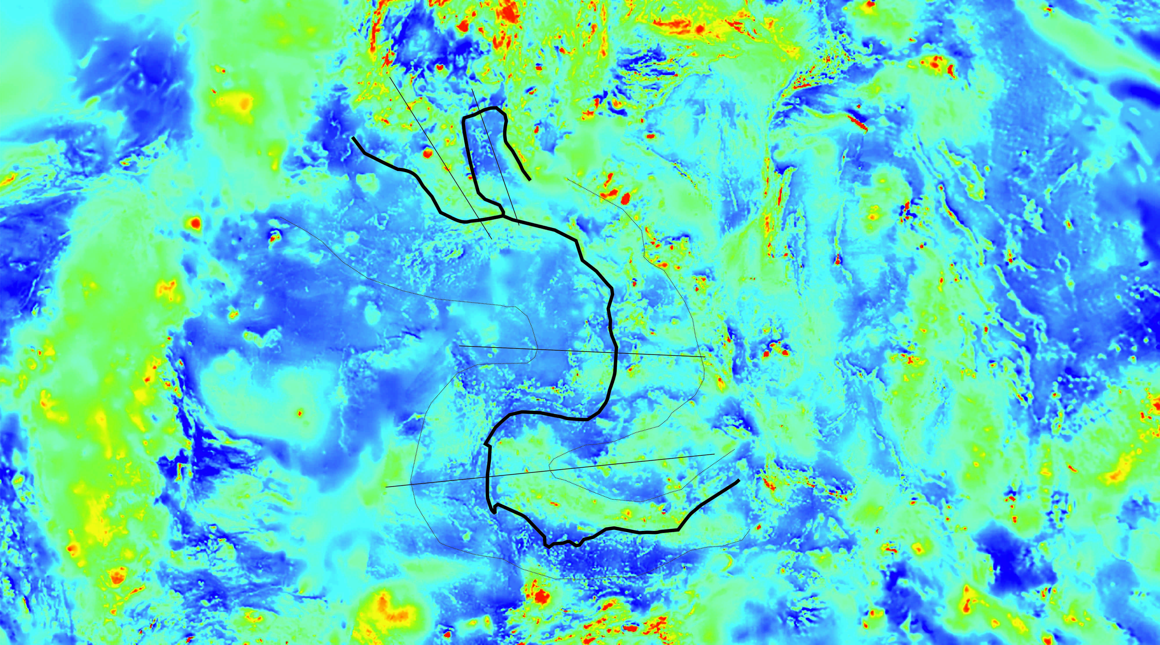
Notes:
Slides 3 and 4. New proposal for the orocline-configuration. The idea could be that first formed these small Jörn (western) and Fällfors (eastern) oroclines. This should have happened very rapidly after accretion at 1.87 Ga and would be responsible for the sinistral strike-slip shearing in A. This buckling would have happened in rather juvenile island arc rocks within a narrow arc. Buckling would continue and the stiffened small-scale buckle would then be part of the large-scale oroclines. These have a wider arc system and partly a more mature basement (2.0 Ga proto-Keitele) leading to larger amplitude. Younger dextral shearing in A could be explained with this as well as the shearing in B, dated at 1.86 Ga. Does this work or should we stop before Sweden???

Slide 16
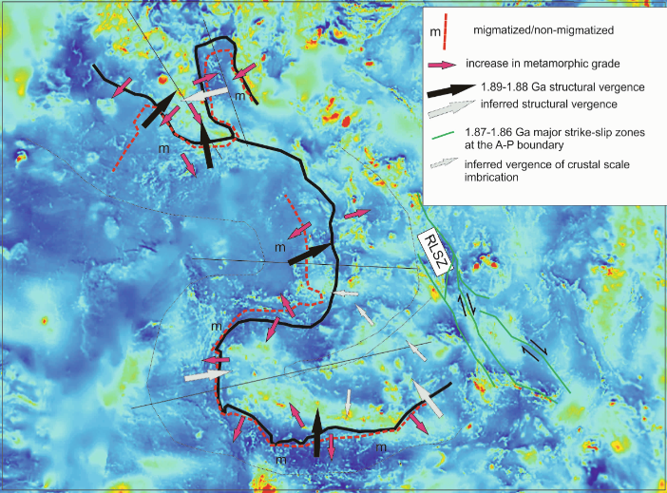

Slide 17
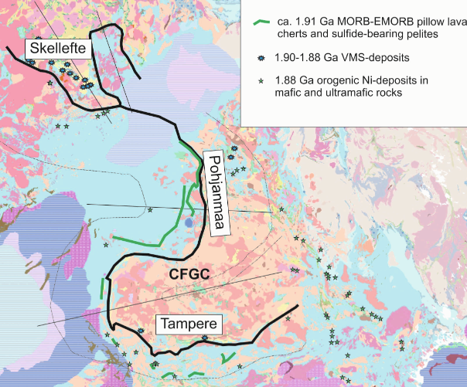

Slide 18
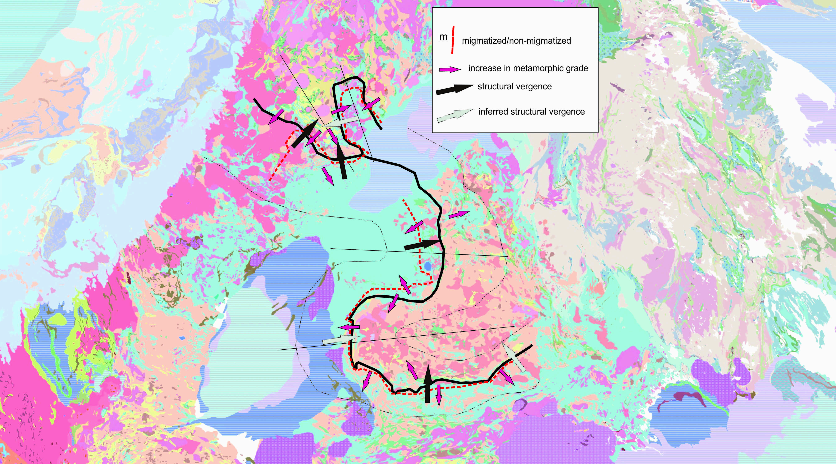
m
m
m
m
m
m
Notes:
Slides 5 and 6. As you see this data is very much in line with our ideas. Interesting is that the center line of the Bothian oroclines seems to be composed of low grade rocks and the metamorphic grade then increases also towards the thickened core. It seems also that the metamorphic peak in the migmatites is “syntectonic” and varies from 1.88-1.87 Ga whereas in the low grade centerline rocks the metamorphism, at least in the Bothnia and Skellefte area is much younger at ca. 1.80 Ga (due to the Nordic orogeny ? slide 2). If so it would imply that the centerline has been in “very high position” during orocline formation.

Slide 19
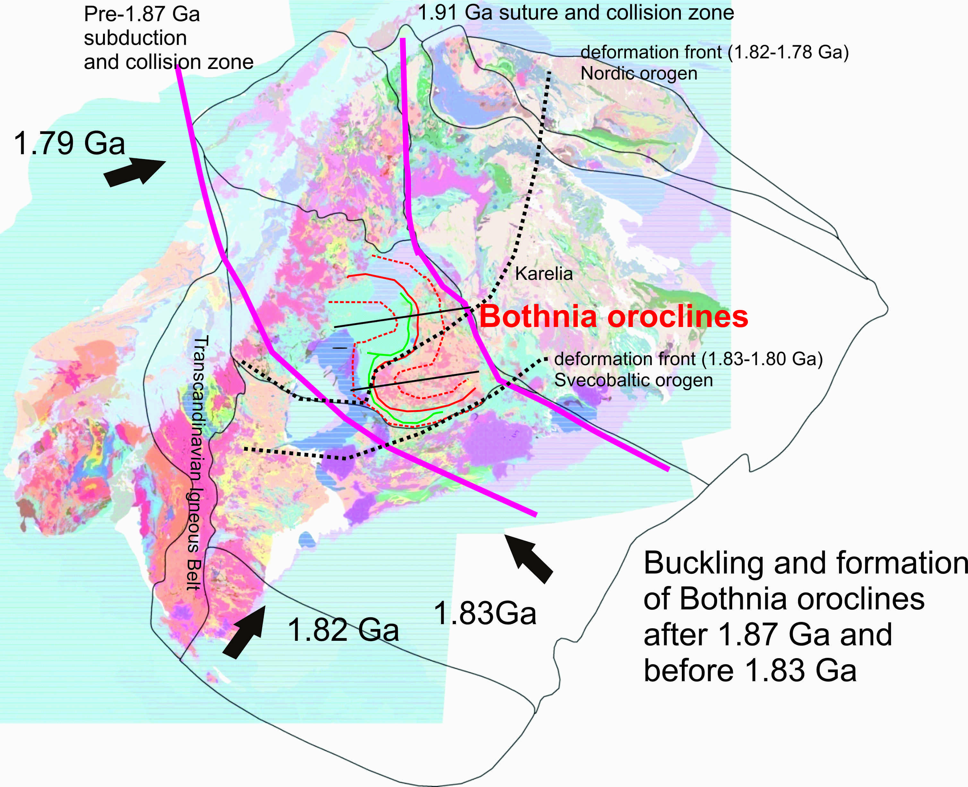
Notes:
Slide 2. This shows how after continent-arc collision (forming the Lappland-savo orogen) subduction reversal occurred and a new subduction zone started to operate leading arc magmatism in Tampere, Central Finland and Skellefte areas. Also are shown the younger deformation fronts, which should have been active after the orocline formation.

Slide 20
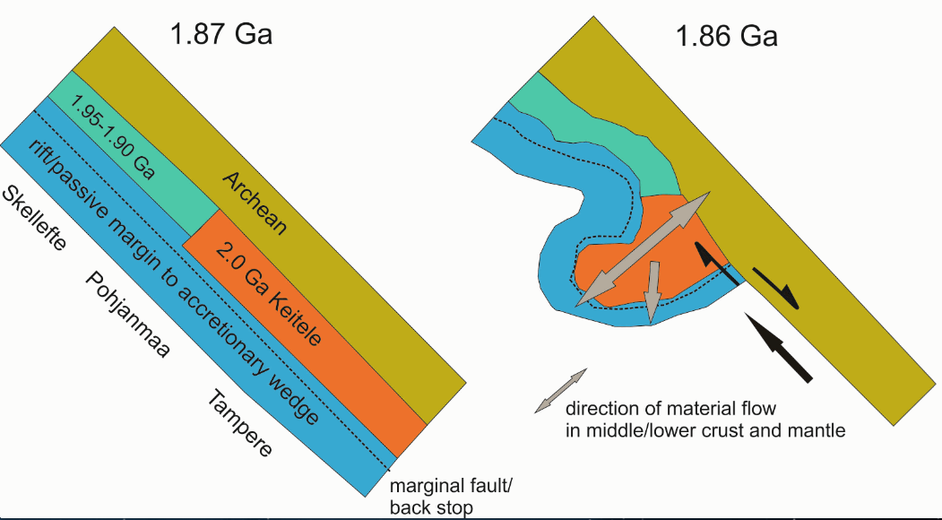
~750 km translation in 10 Ma (7.5 mm/a)
?driven by subduction?
- Crustal scale! Lithospheric scale?
Two stage process:
1.88 orogeny
1.88 – 1.87 oroclinal buckling

Slide 21
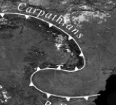
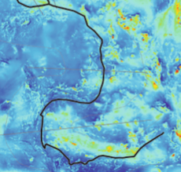

Slide 22
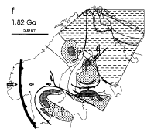
Nironnen, 1997

Slide 23
Nironnen, 1997

