Slide 1
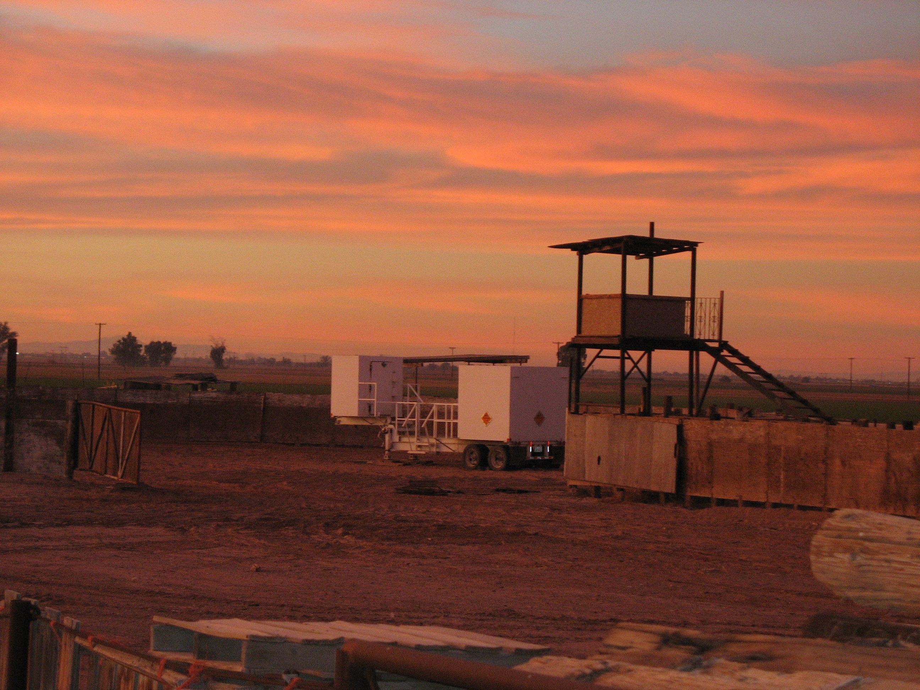
GEOMETRY OF THE SAN ANDREAS FAULT
IN THE SALTON TROUGH
AND ITS EFFECT ON SIMULATED SHAKING
FOR A RUPTURE SIMILAR TO THAT OF
THE GREAT CALIFORNIA SHAKEOUT OF 2008
Gary S. Fuis, Klaus Bauer, Robert W. Graves,
Brad Aagaard, Rufus D. Catchings, Mark R. Goldman,
John A. Hole, Victoria E. Langenheim, Trond Ryberg,
Michael J. Rymer, Daniel S. Scheirer, and Joann M. Stock

Slide 2
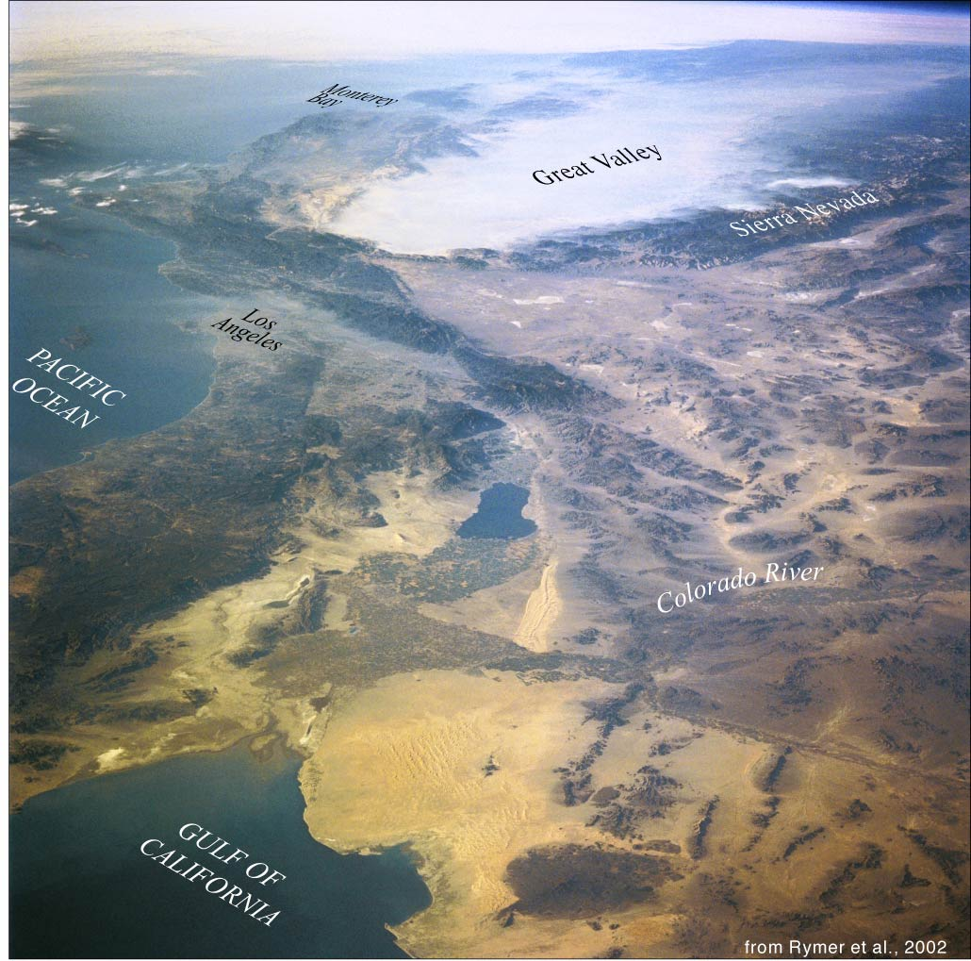

Slide 3
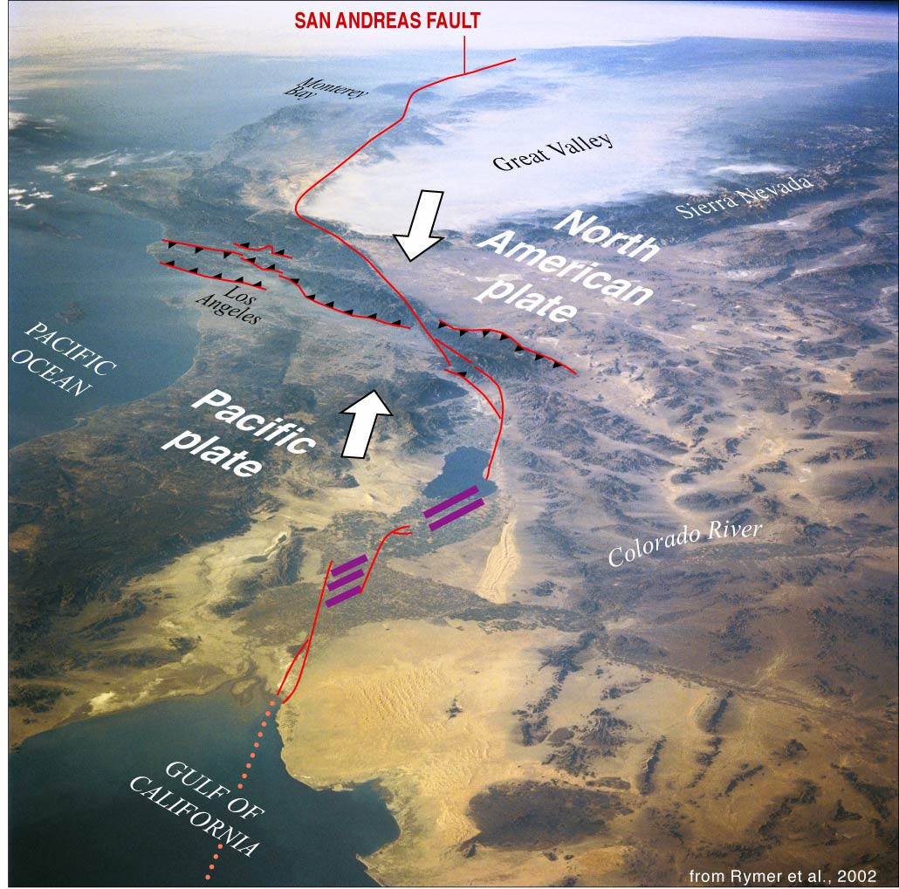

Slide 4
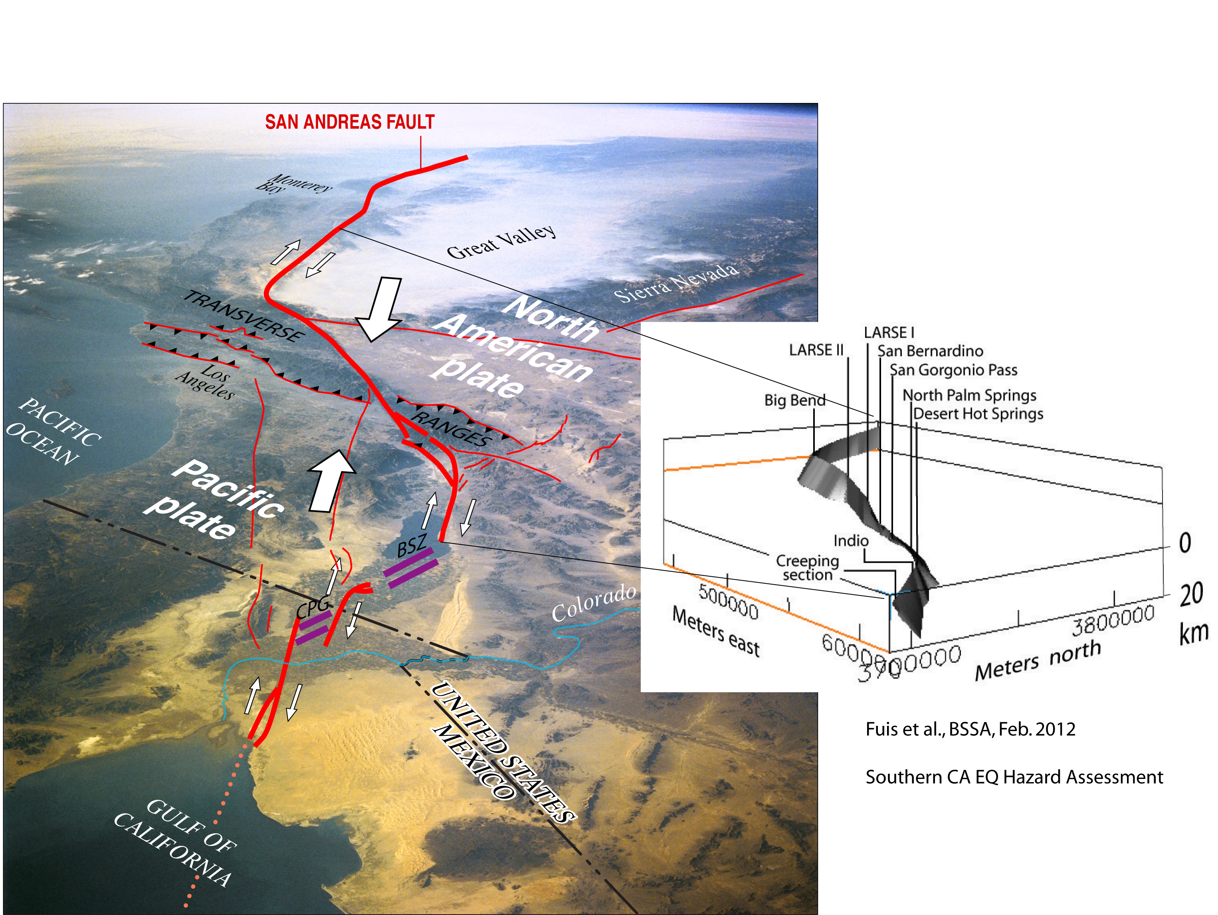

Slide 5

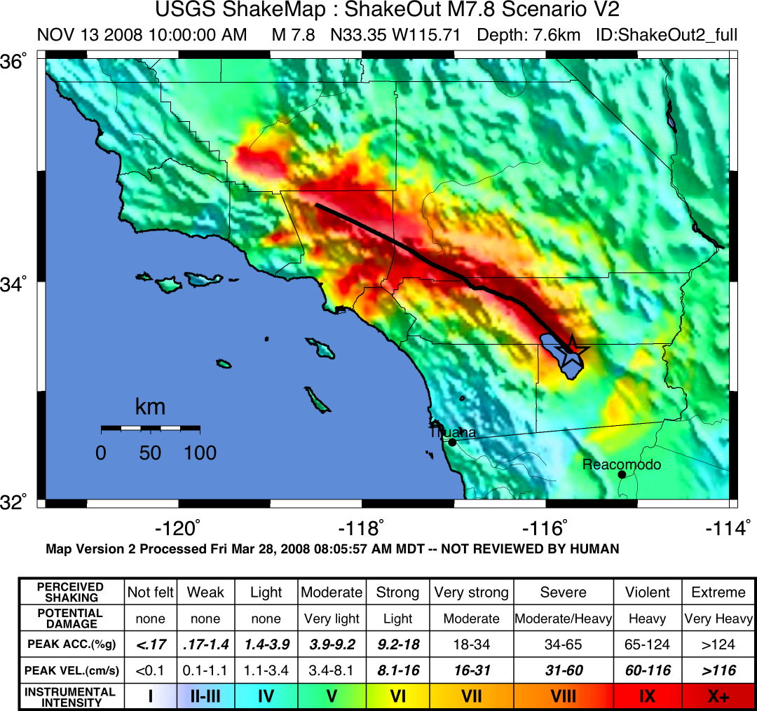
Earthquake Hazards:
1685 earthquake,
ShakeOut Scenario
Notes:
Delete map. Add 2 photos of drill rigs.. And then the same points …… use all the Seismic line and SAF lines of the same color…

Slide 6
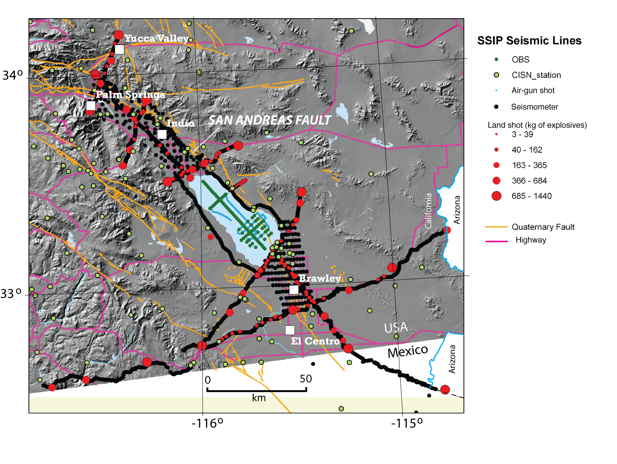

Slide 7


Slide 8
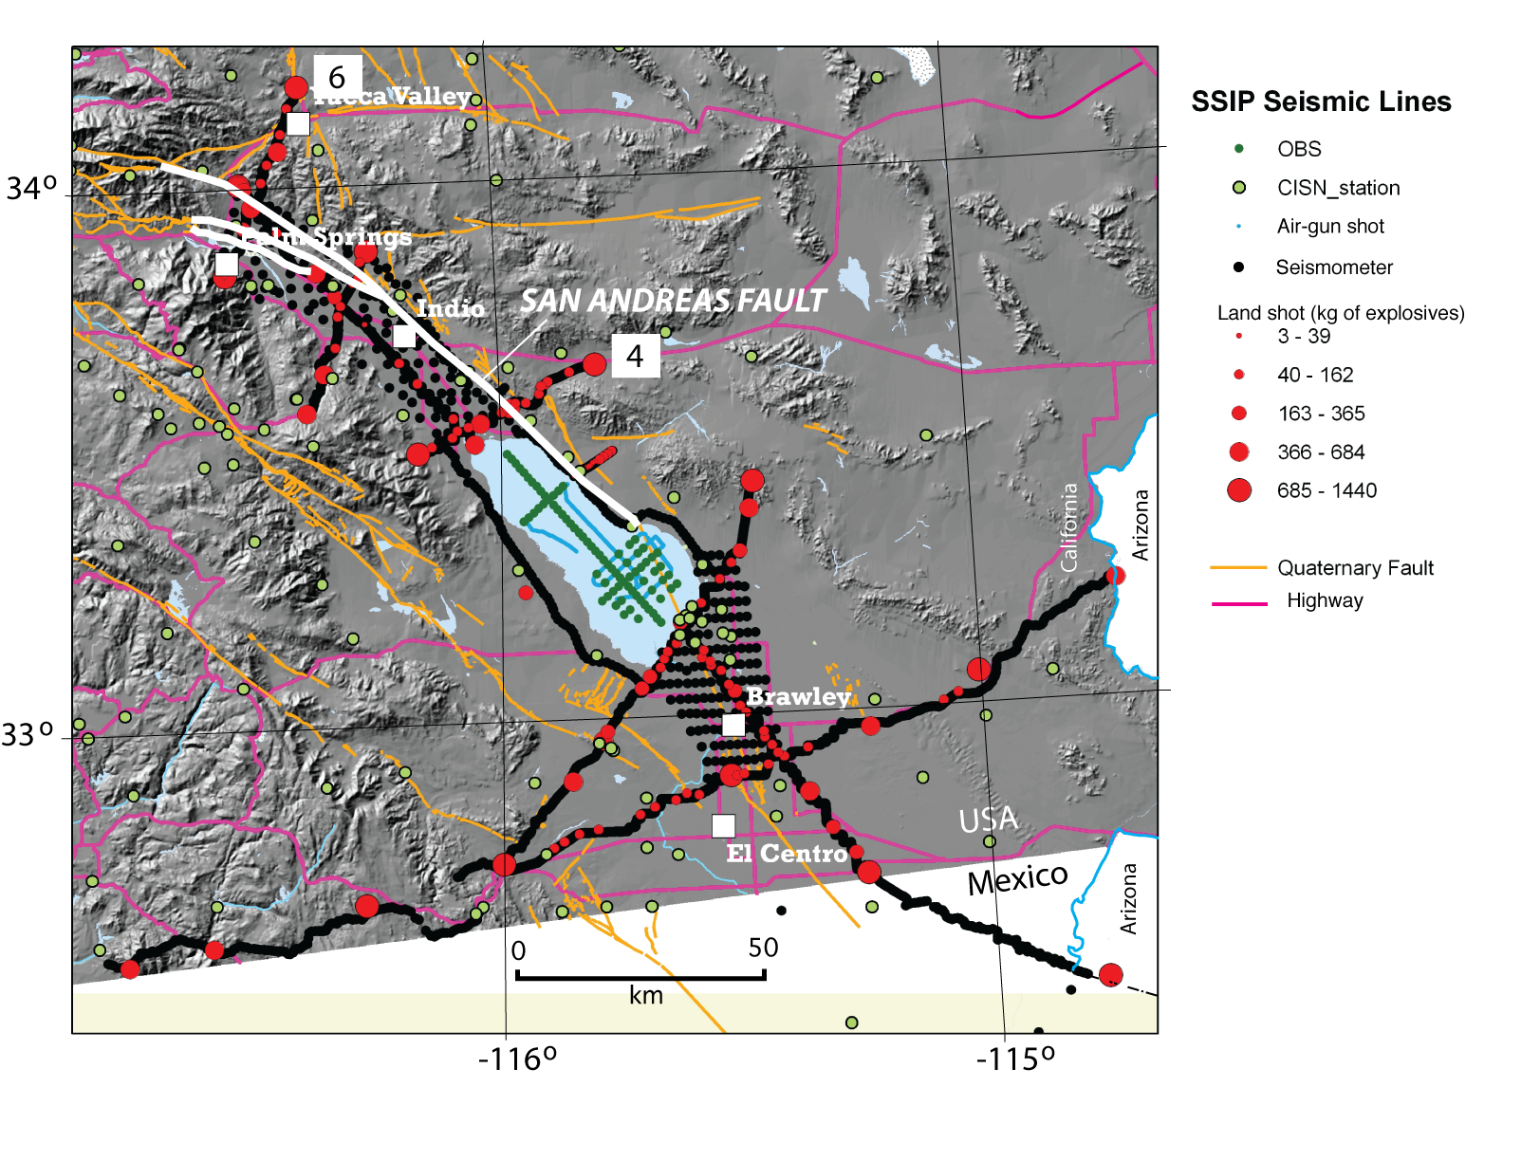

Slide 9
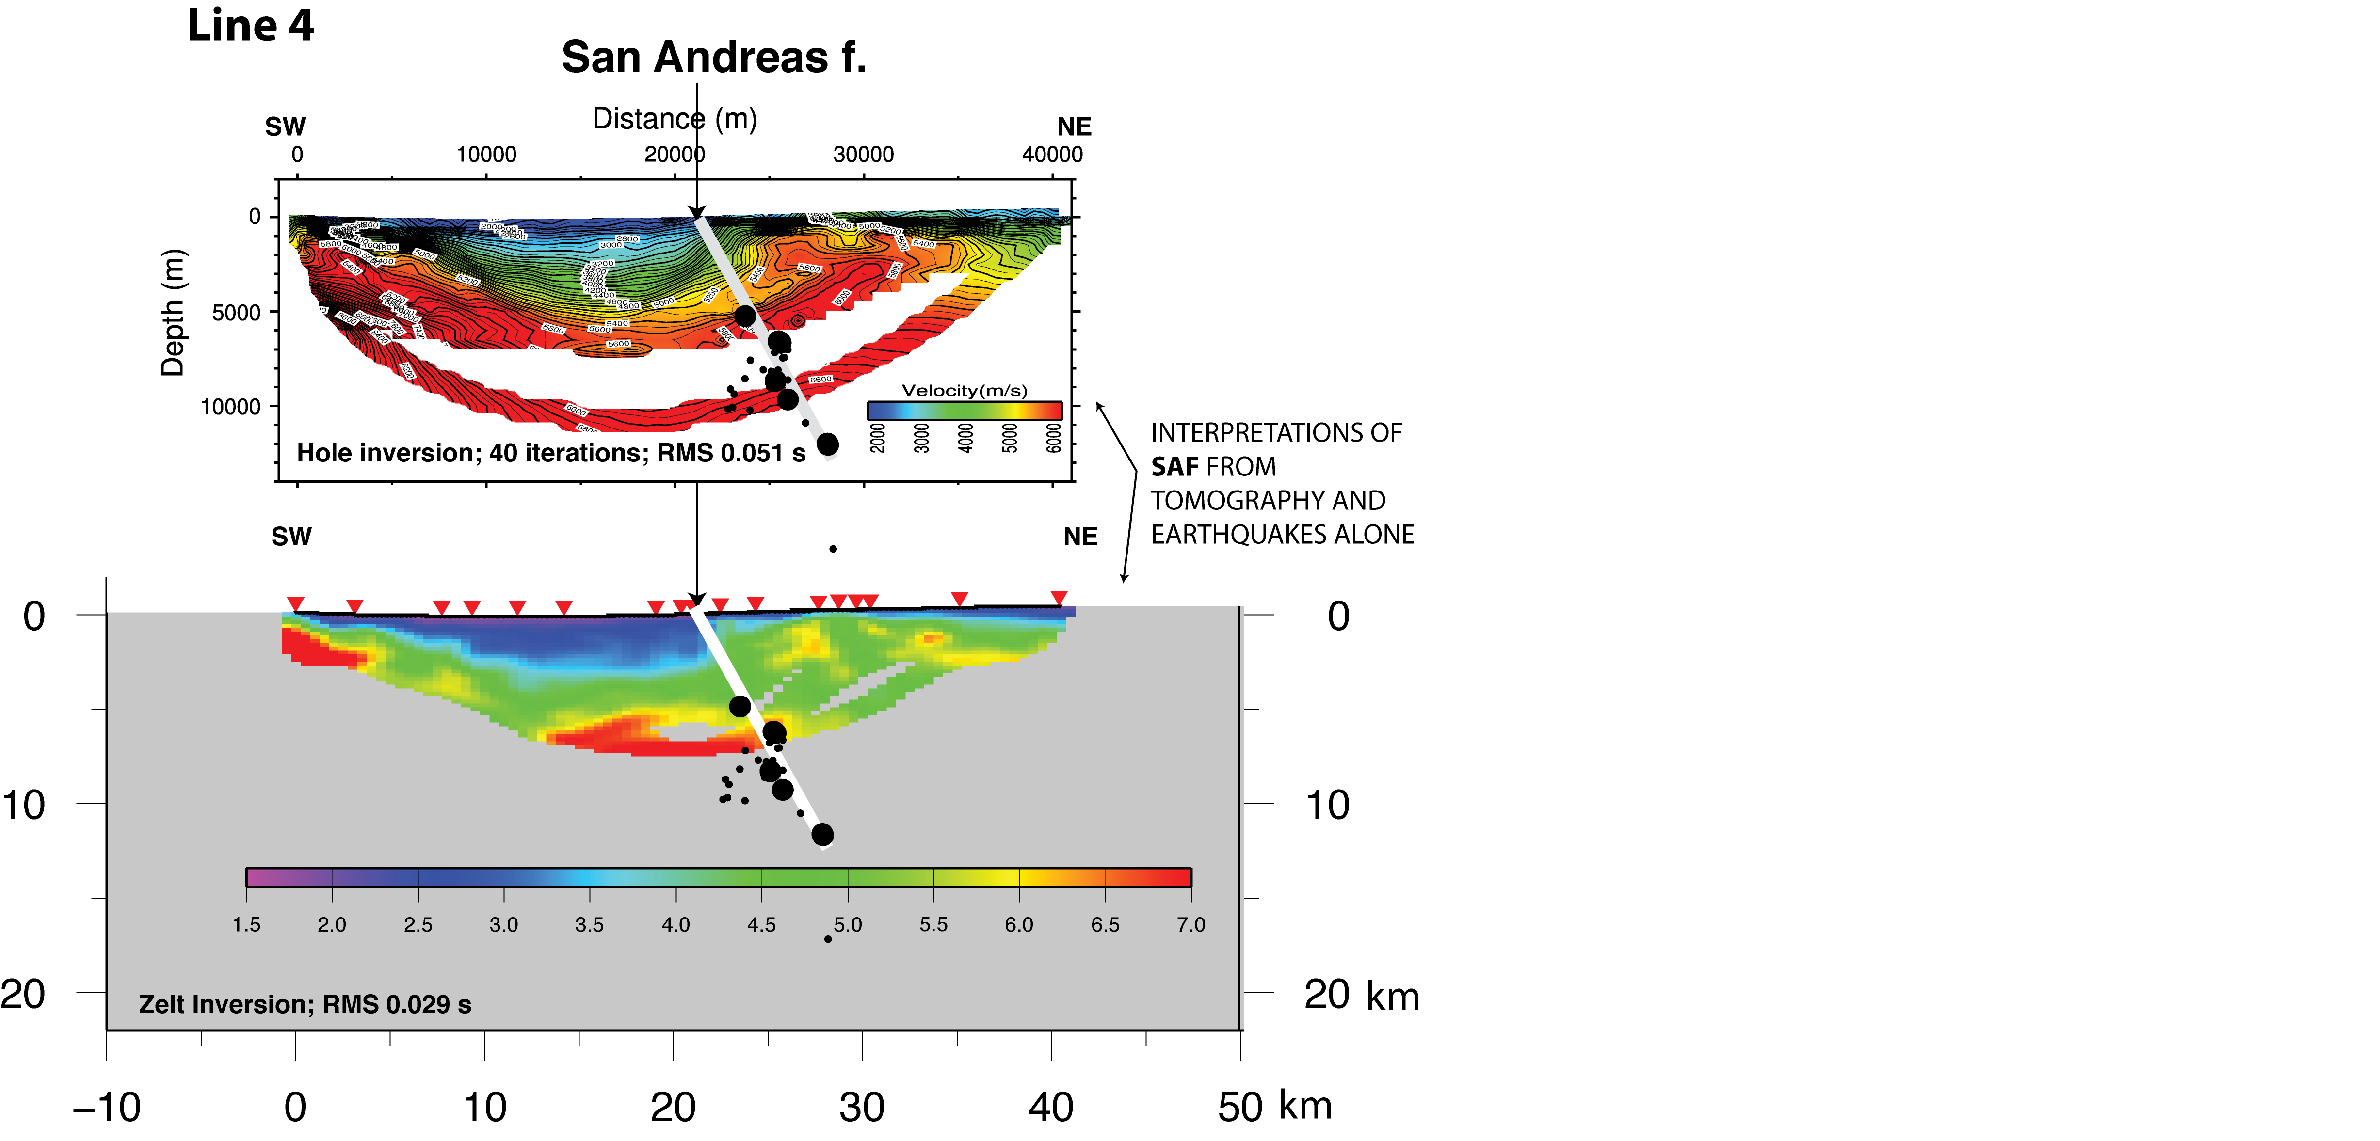

Slide 10
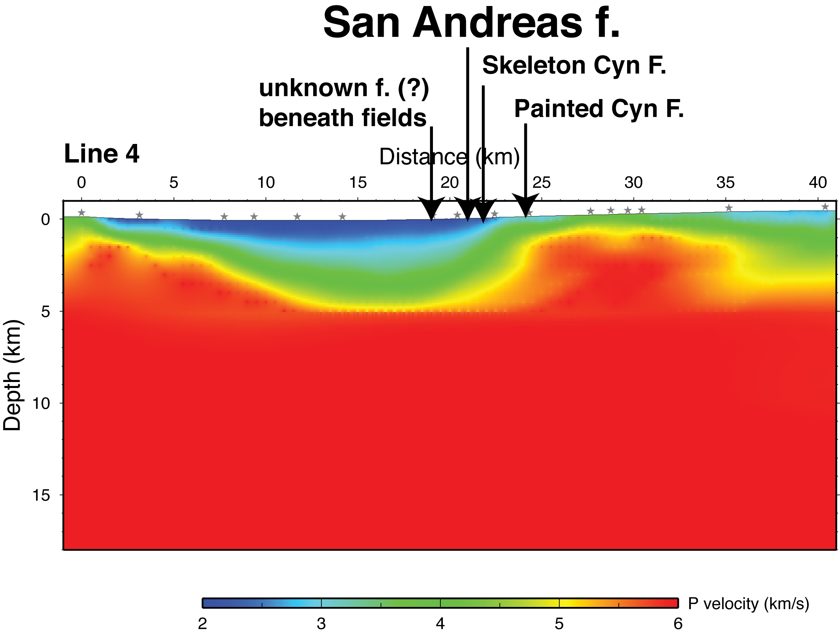

Slide 11
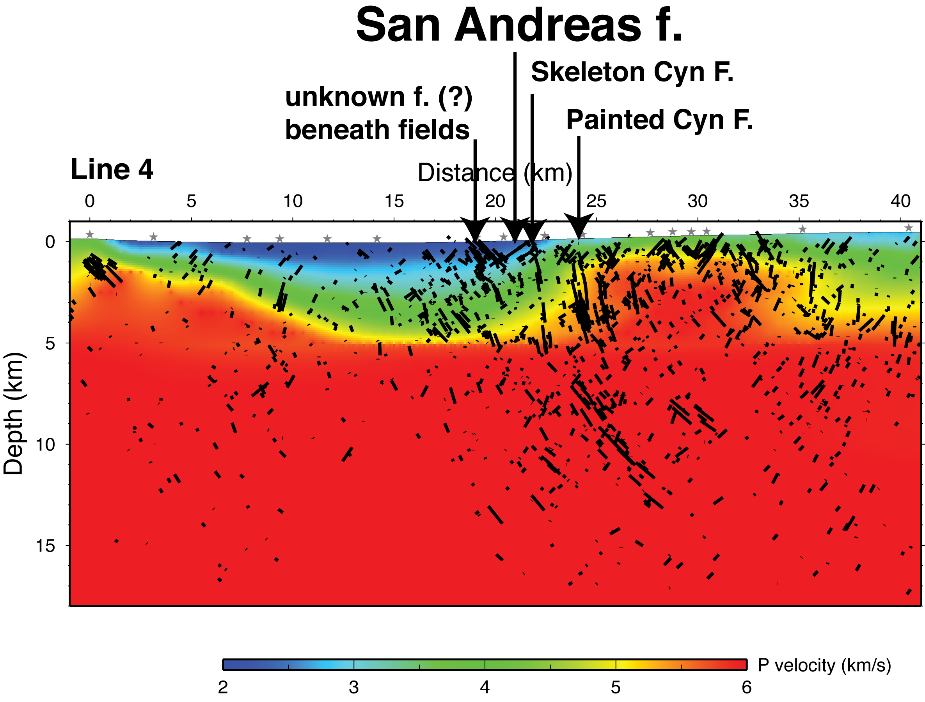

Slide 12
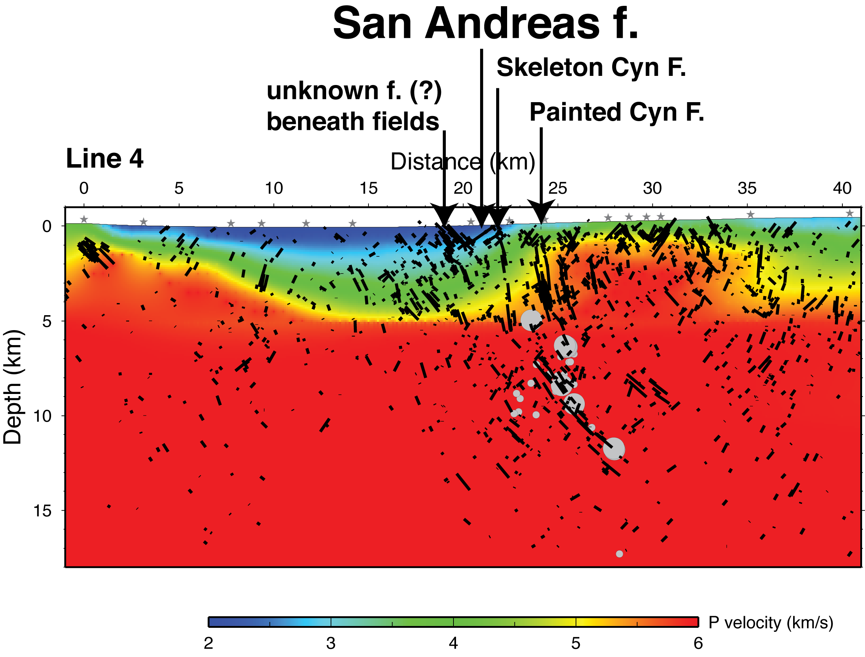

Slide 13
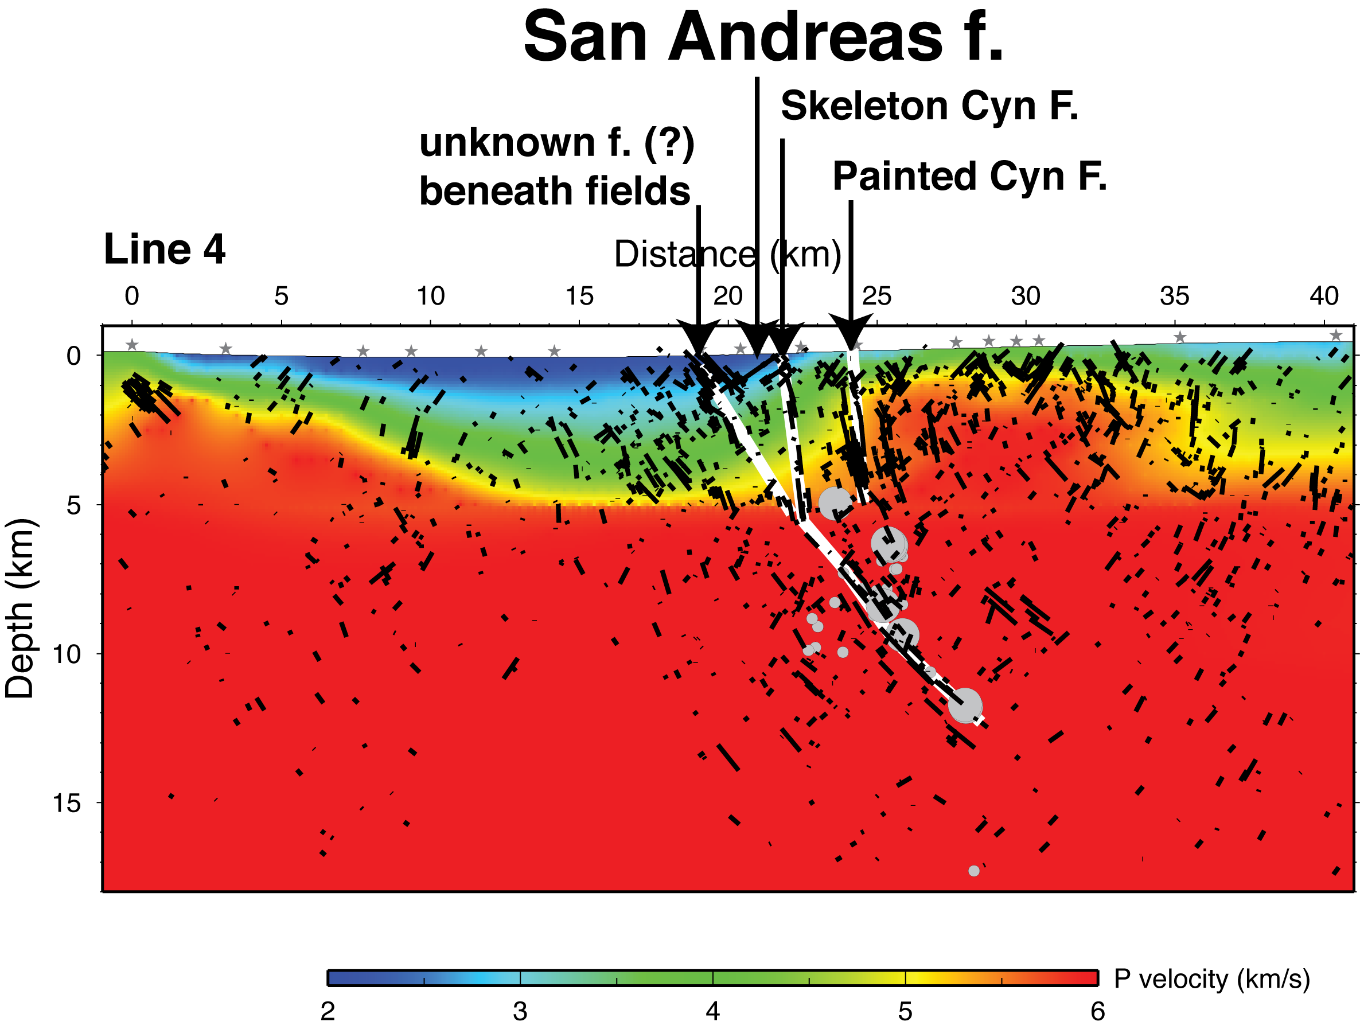

Slide 14
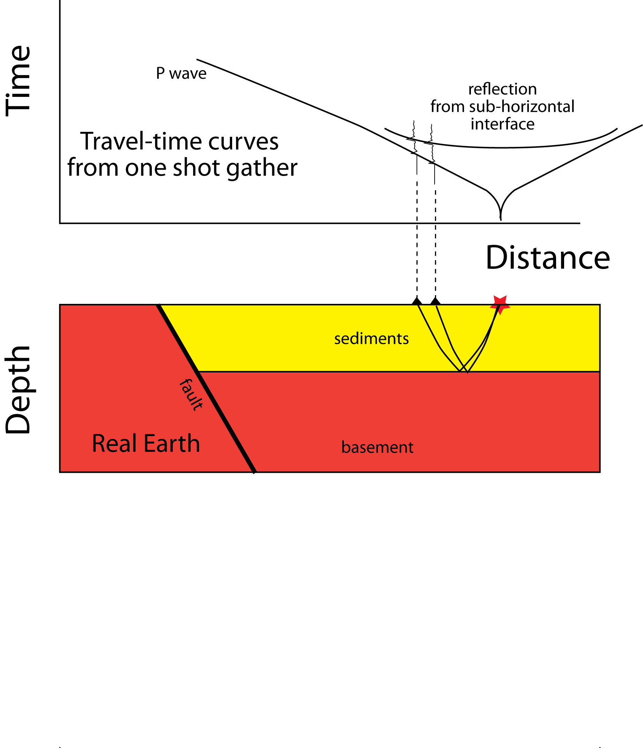

Slide 15
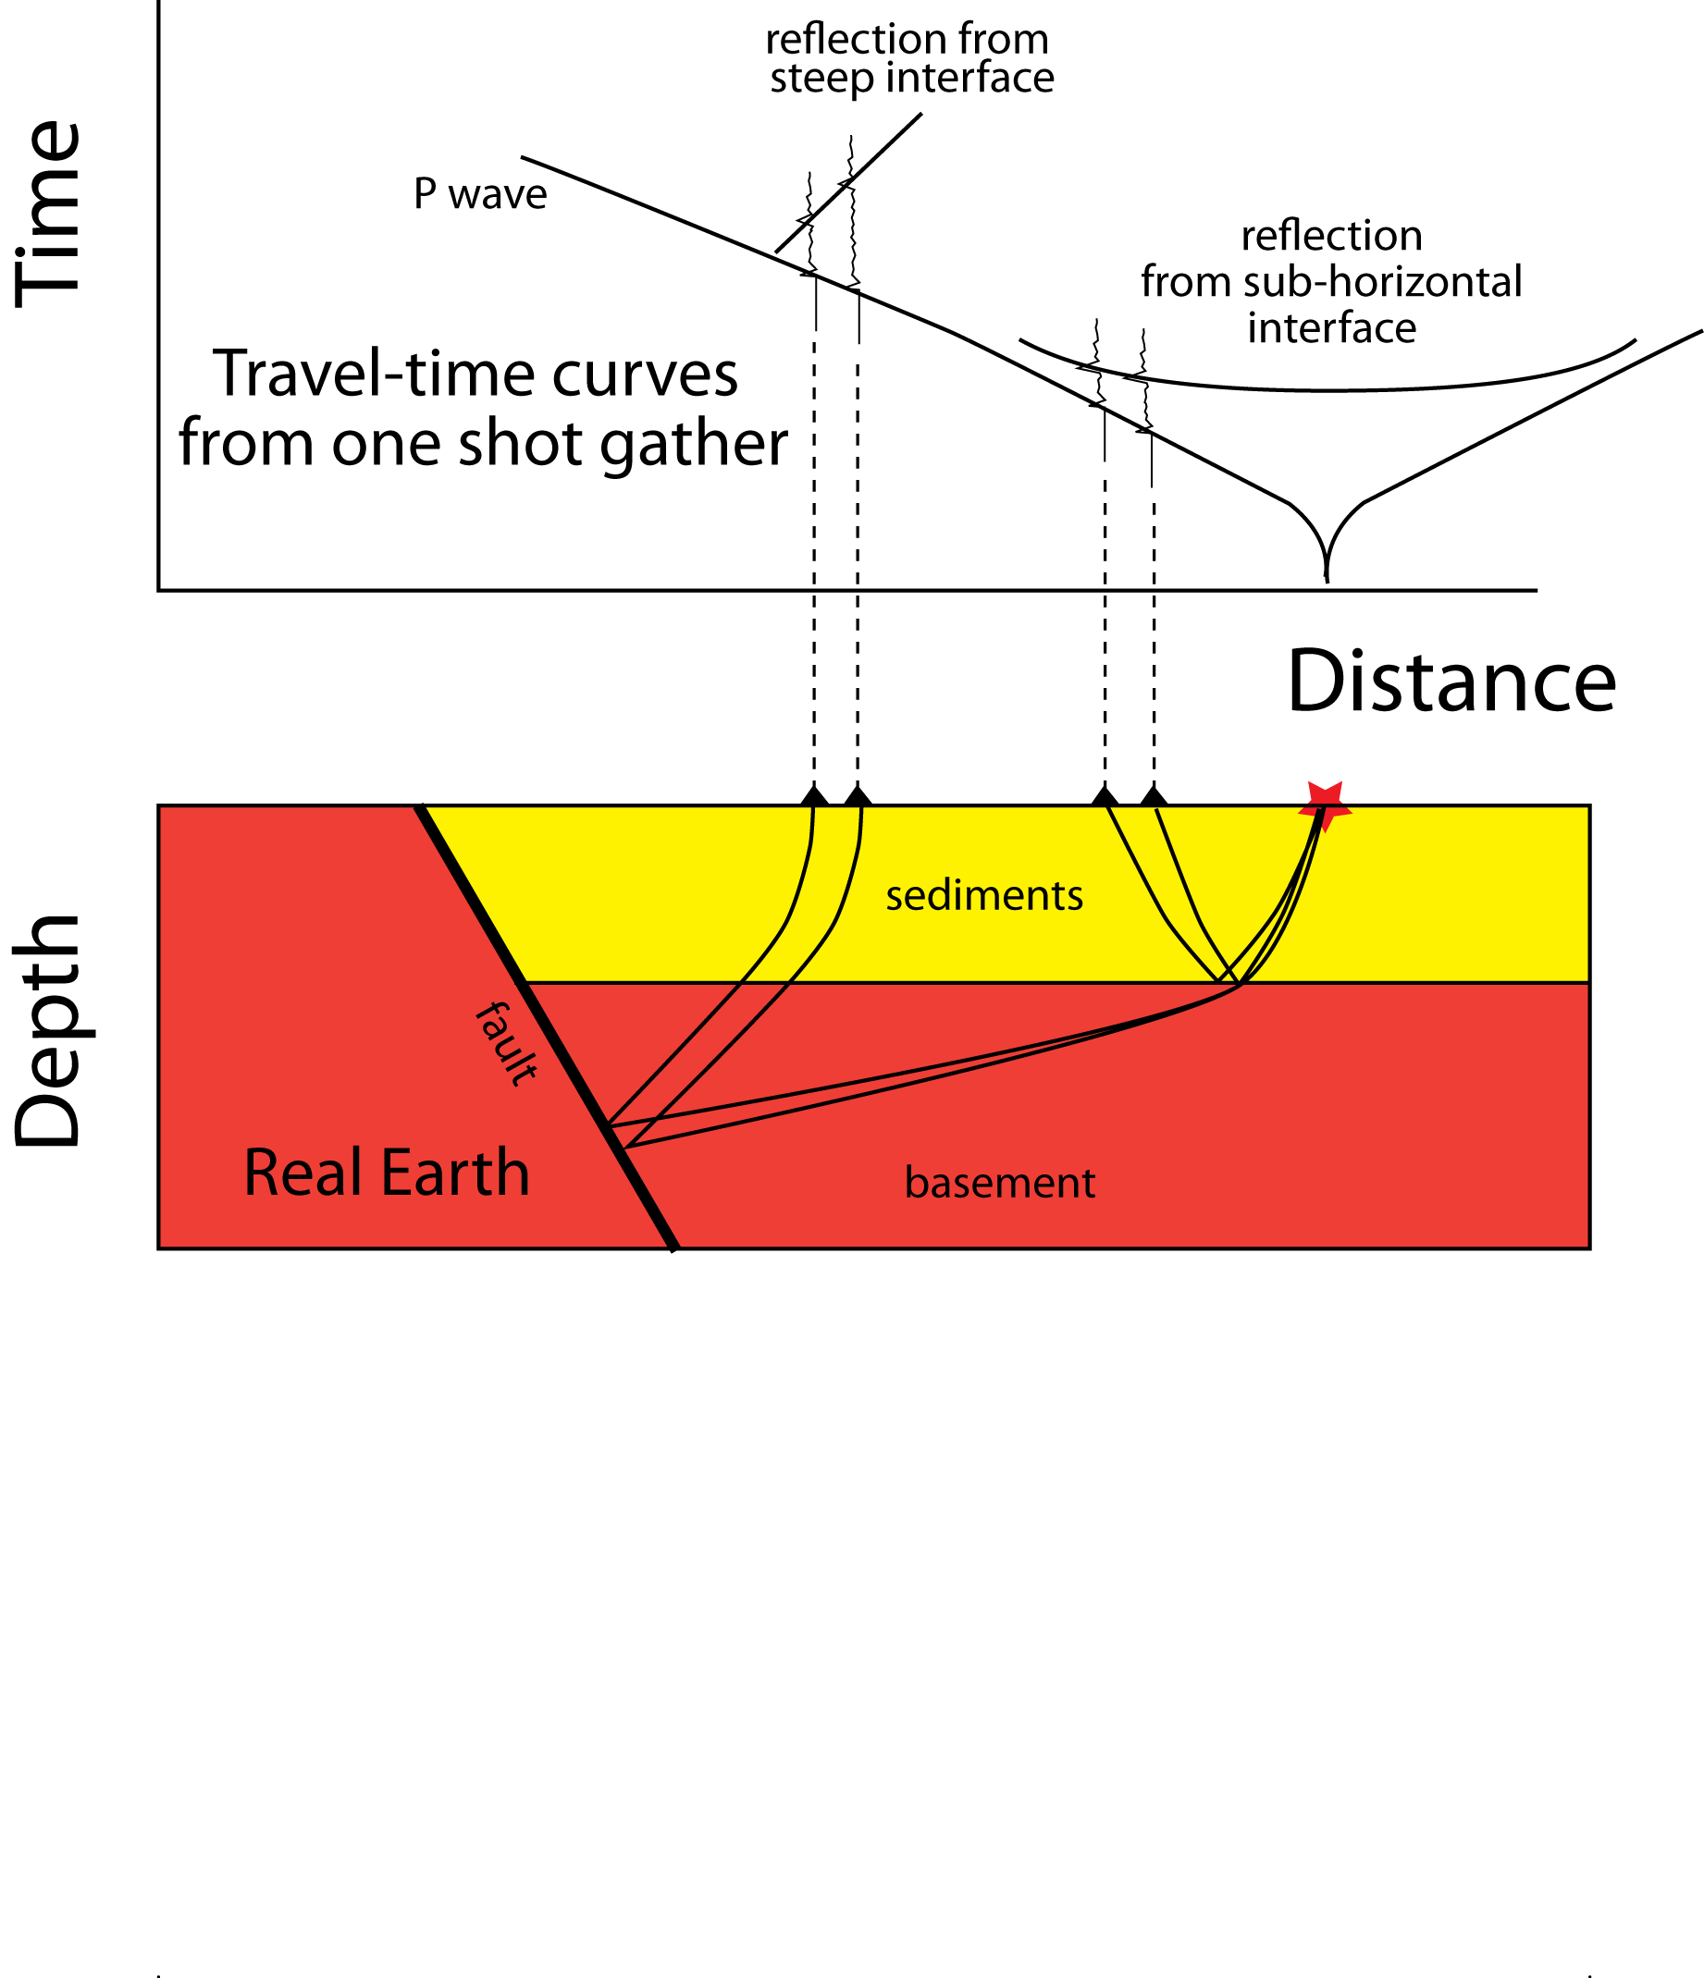

Slide 16


Slide 17
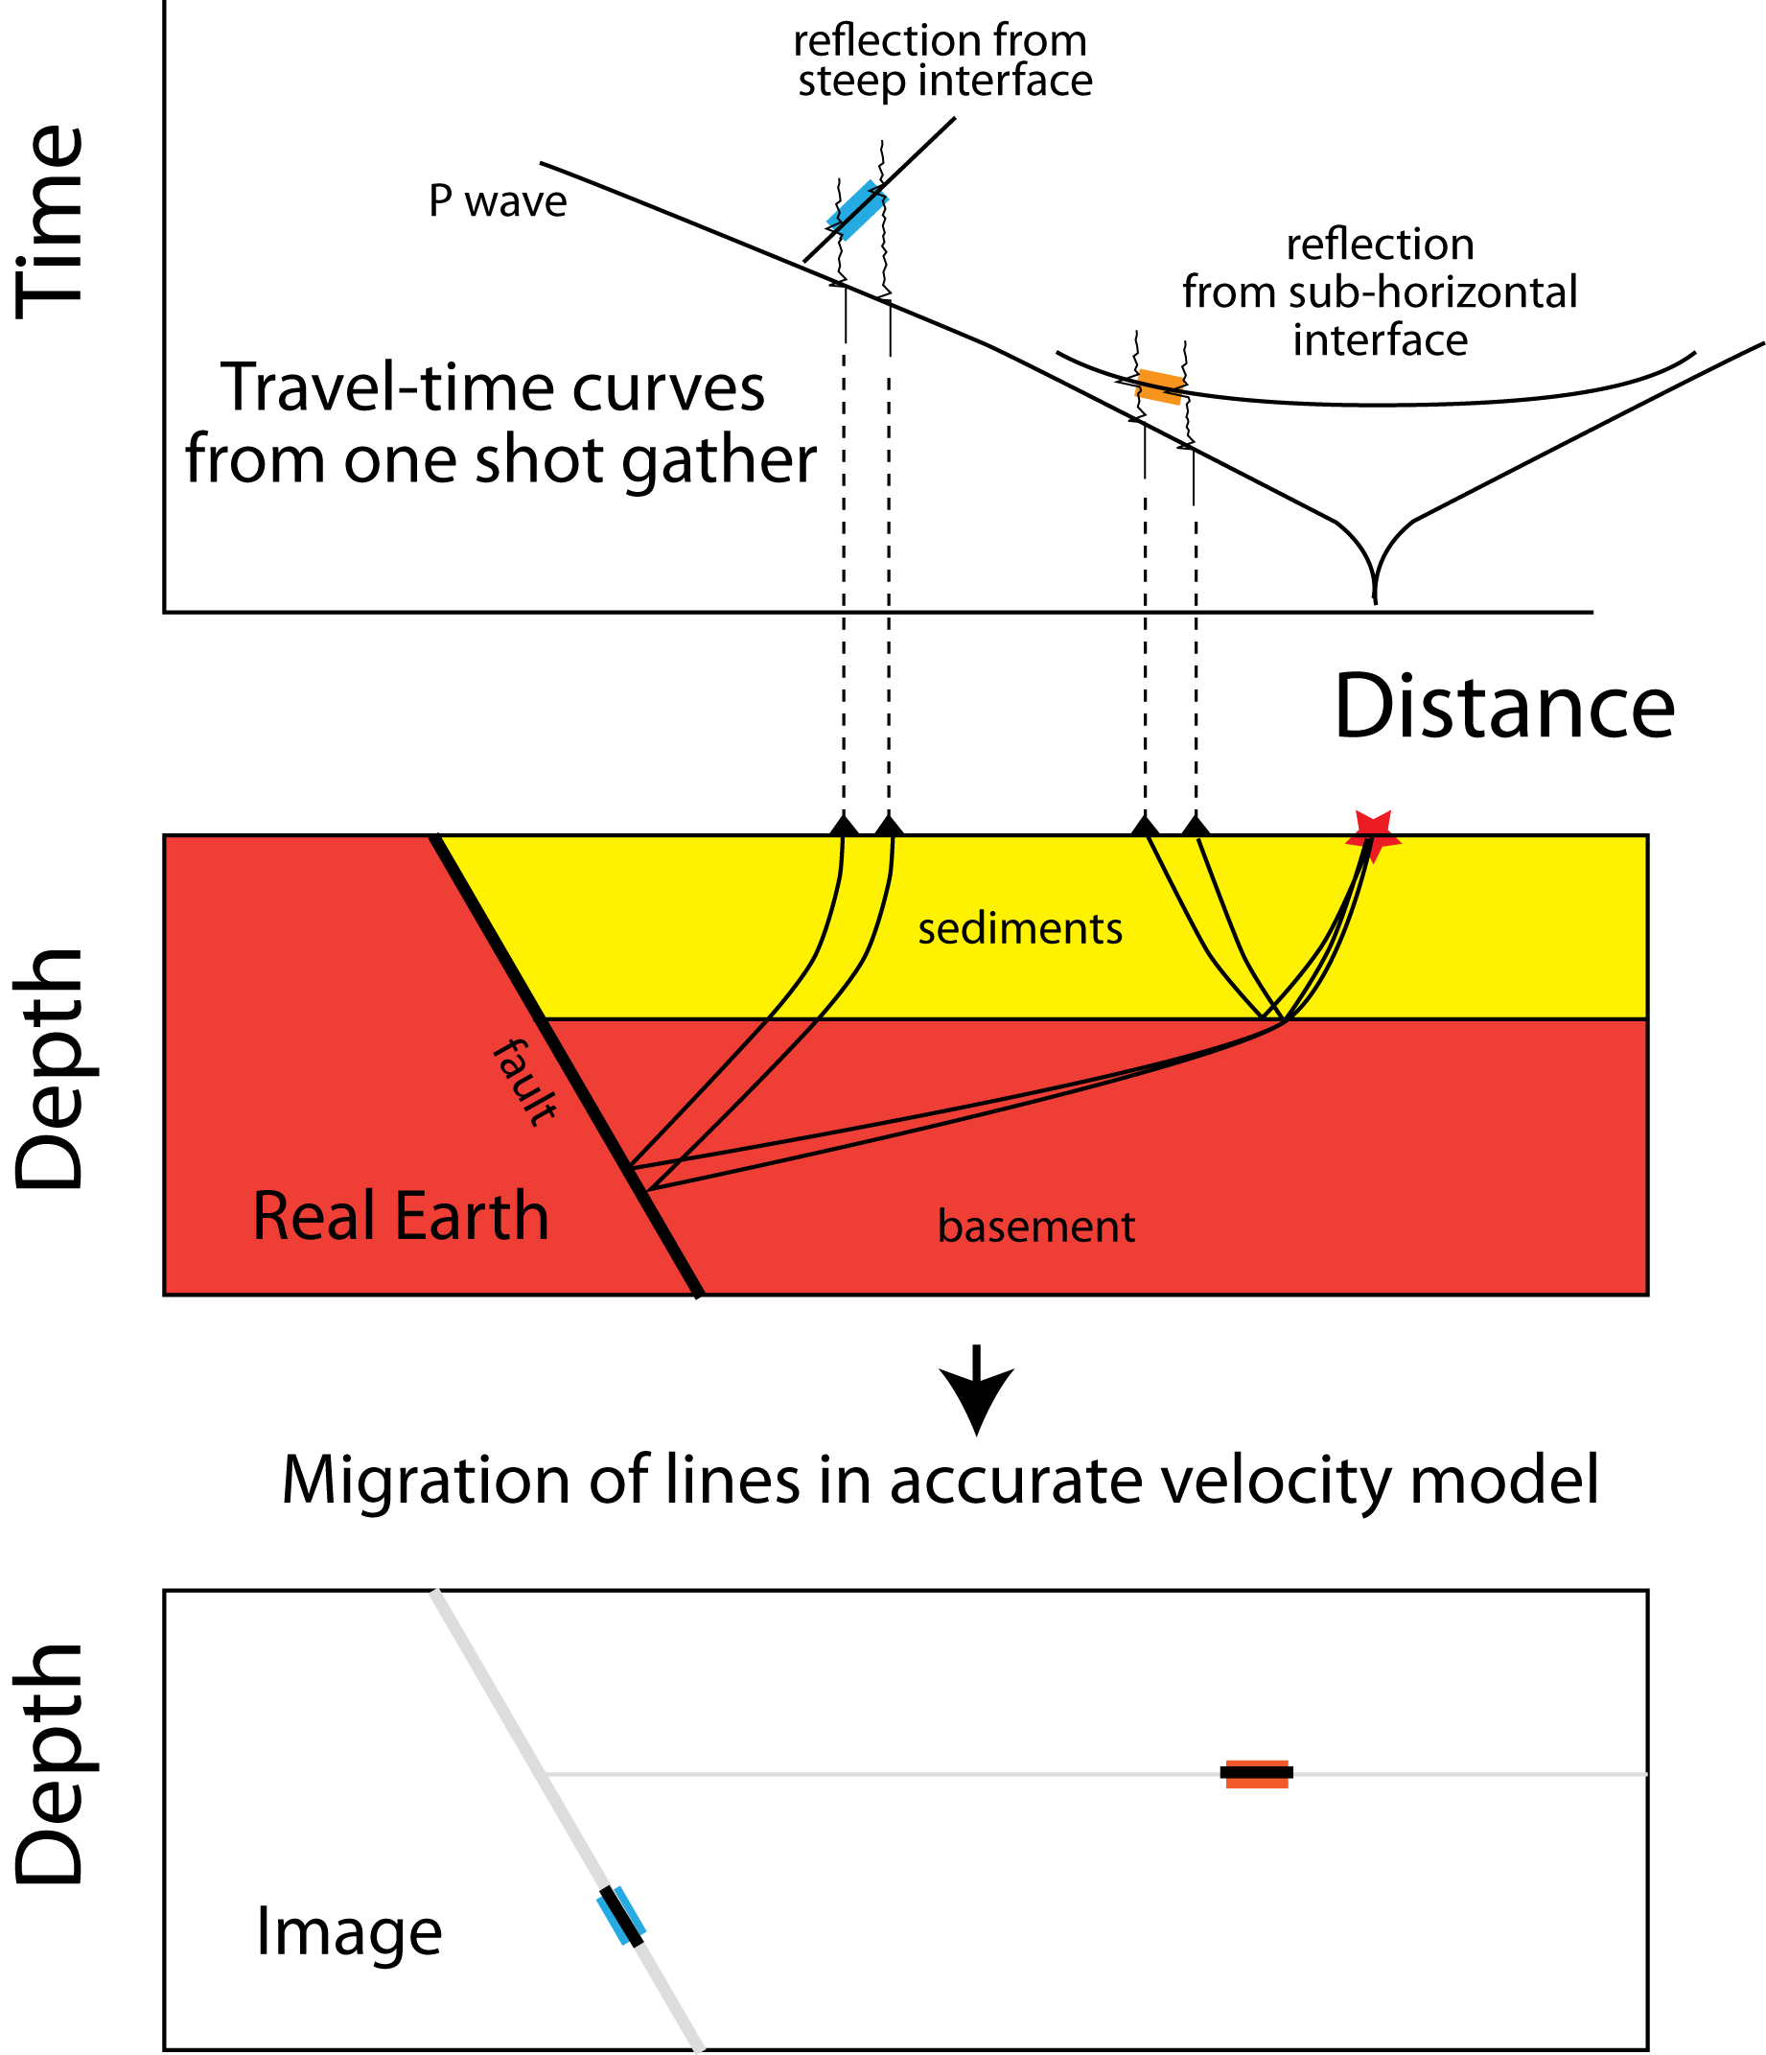

Slide 19
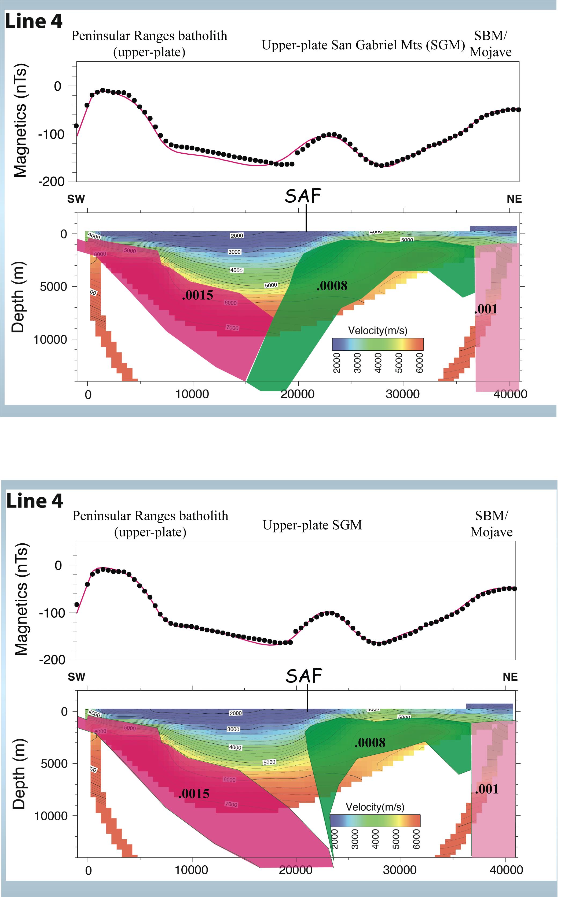

Slide 20
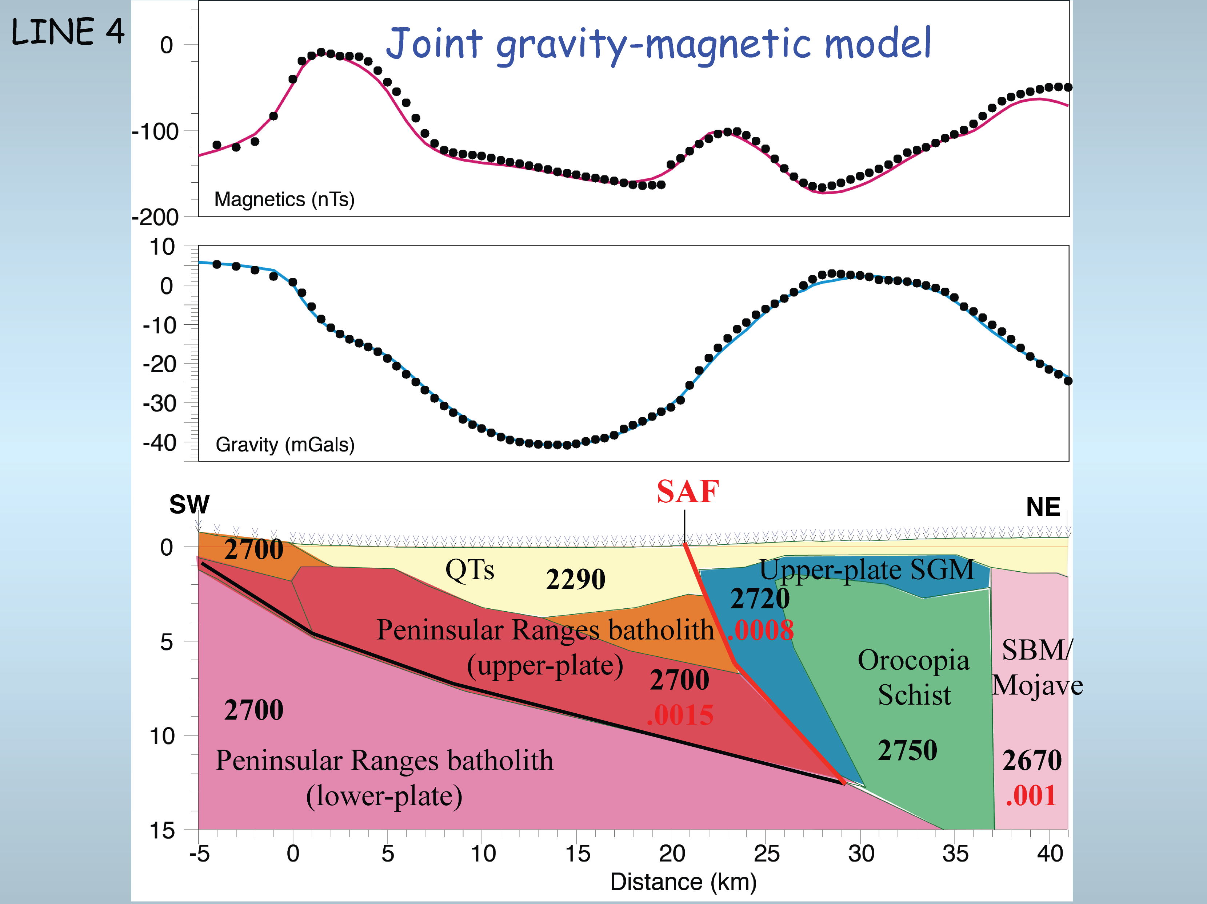

Slide 21
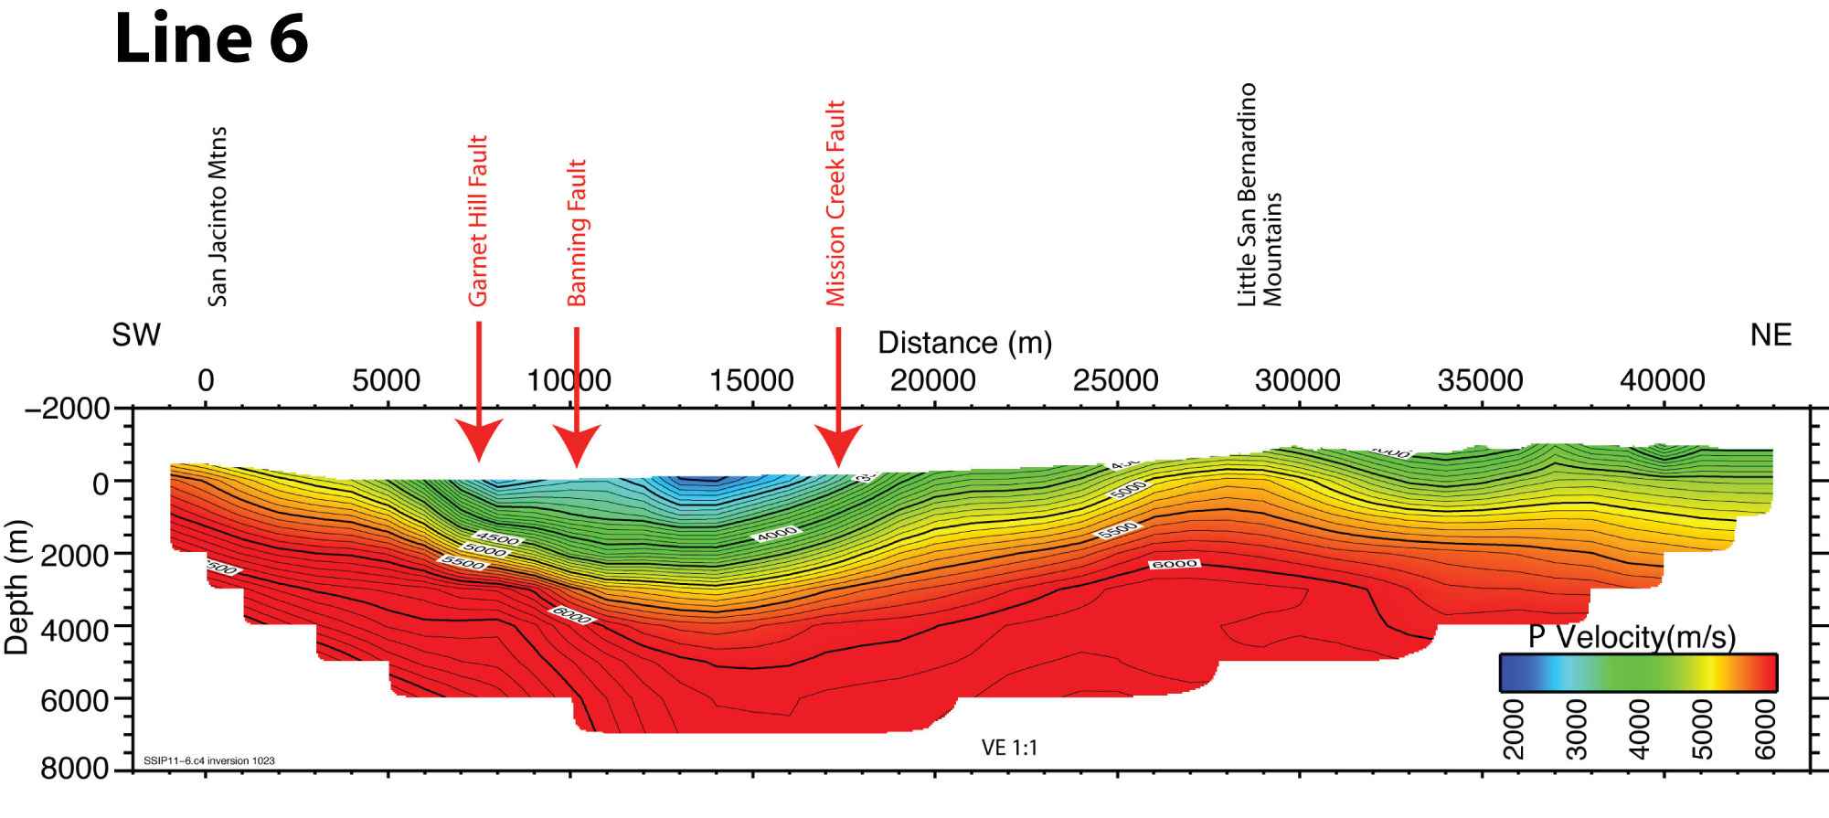

Slide 22
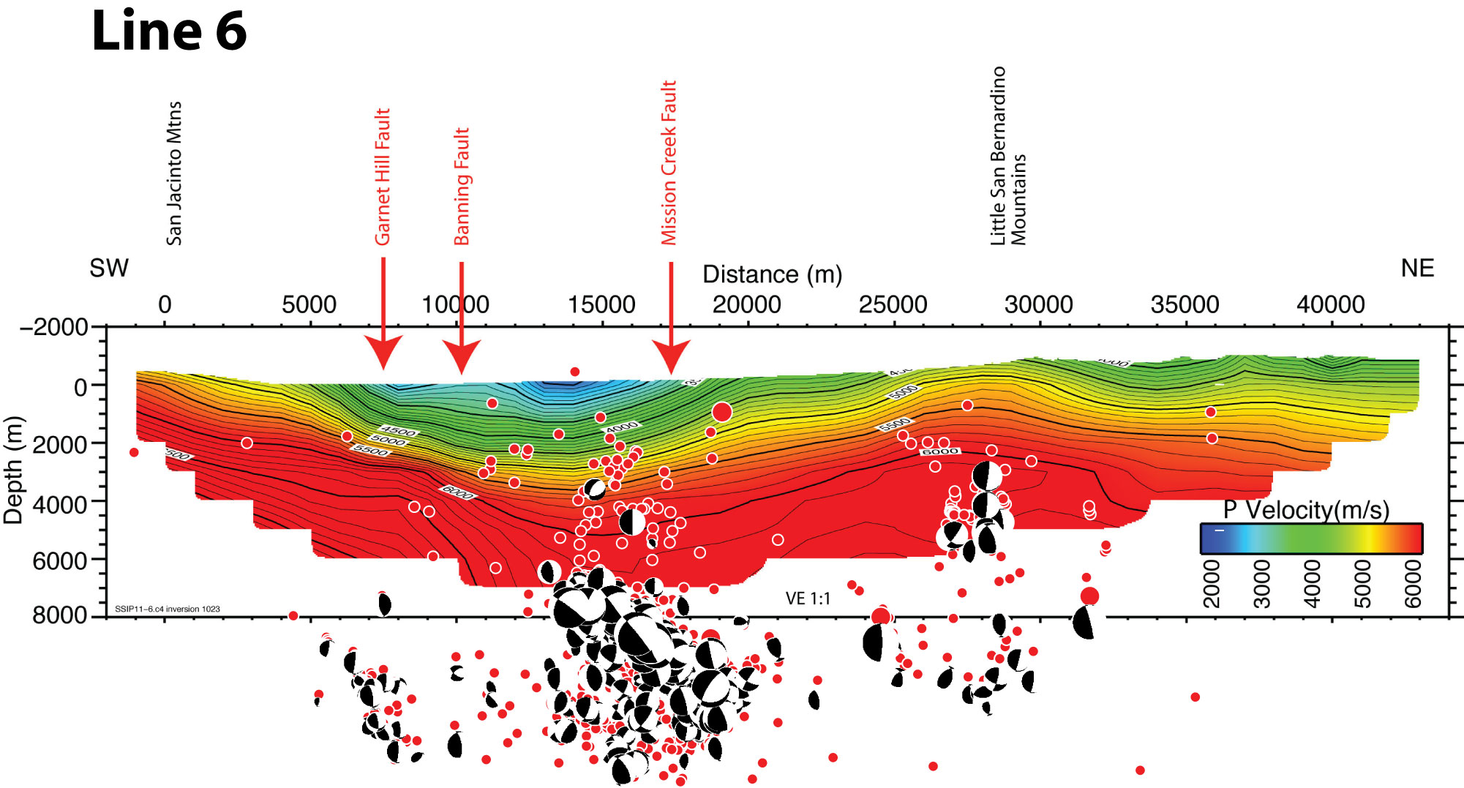

Slide 24
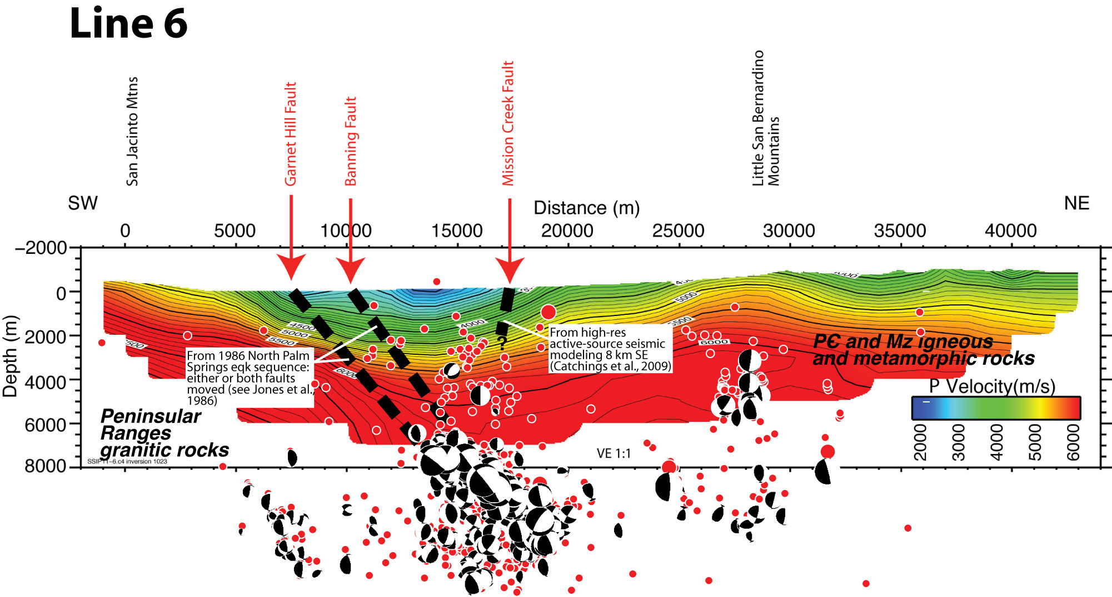

Slide 25
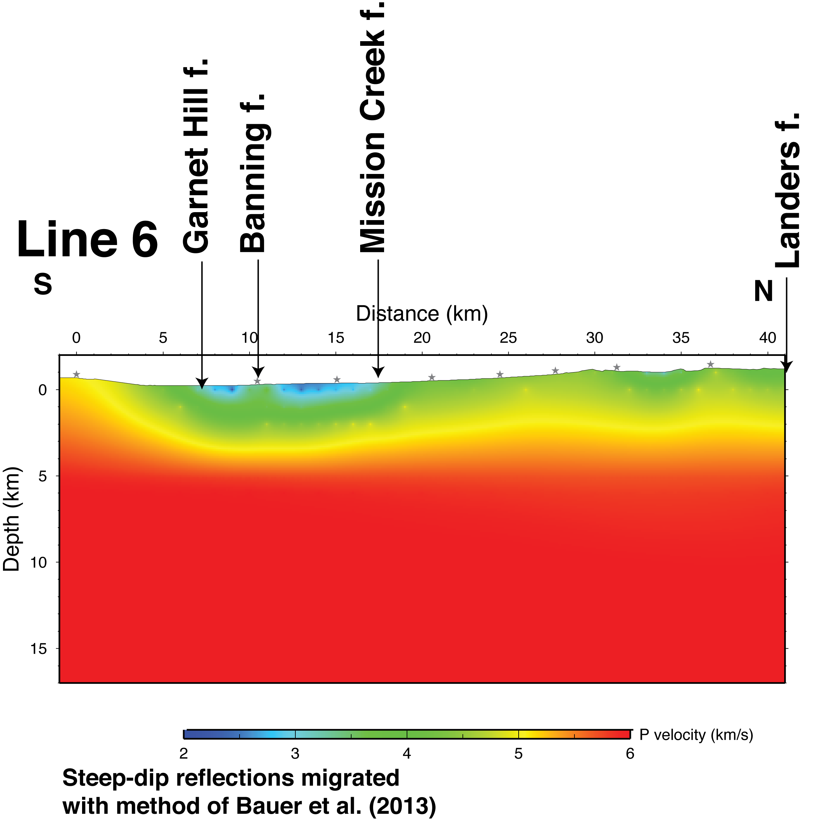

Slide 26
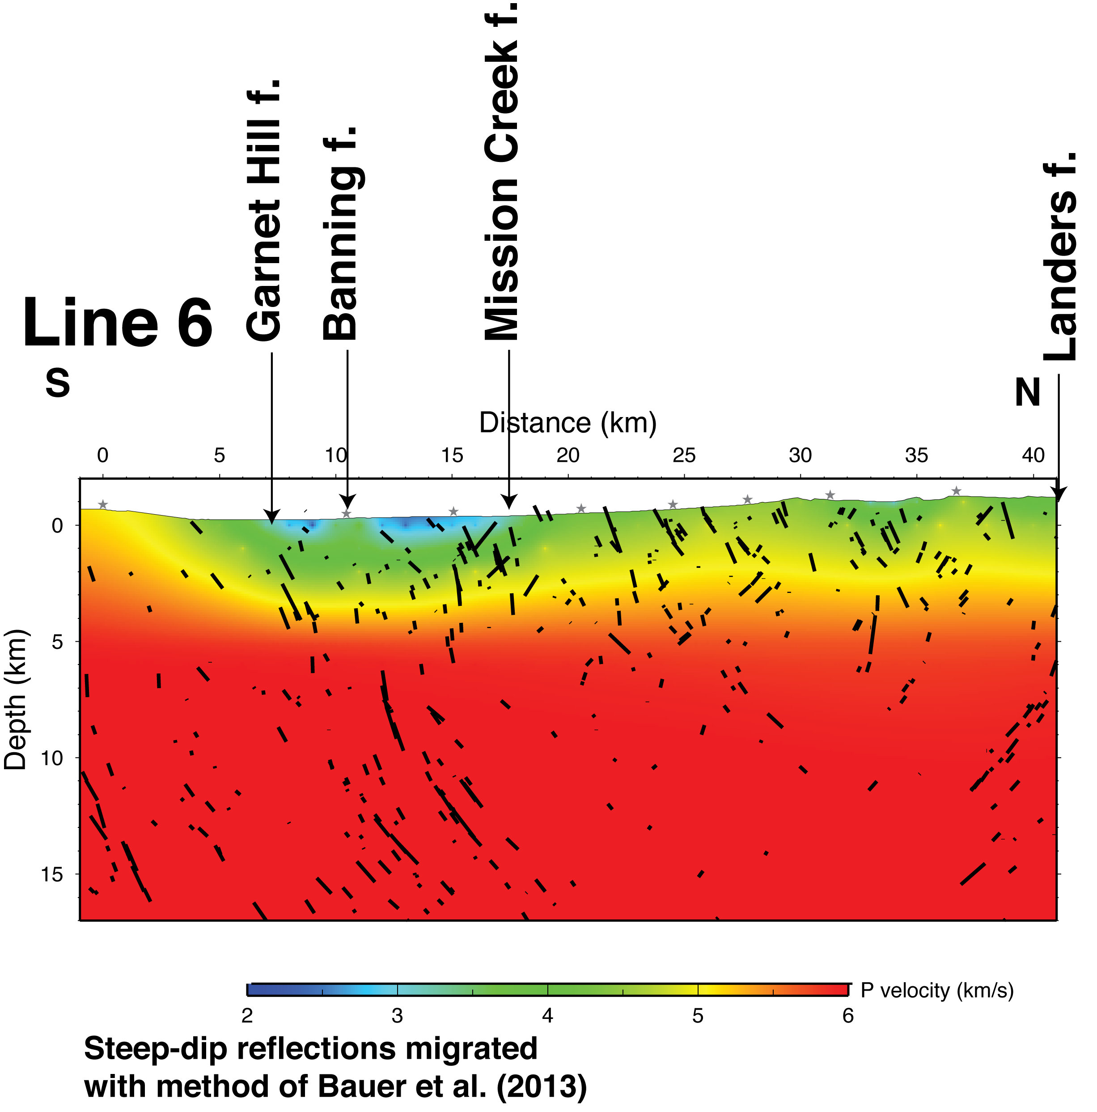

Slide 27
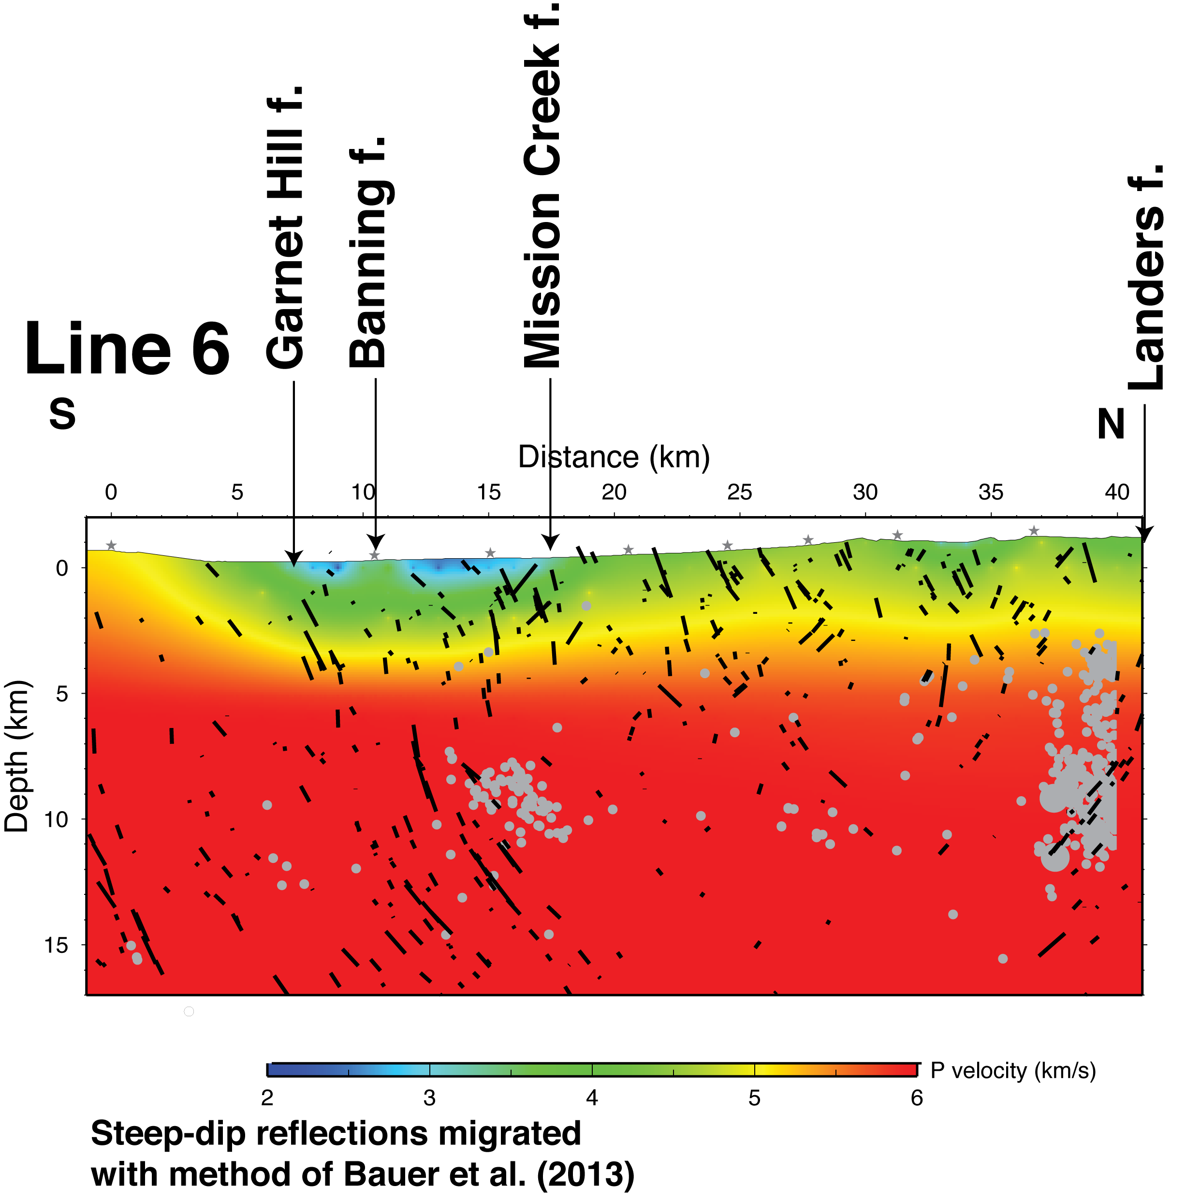

Slide 28
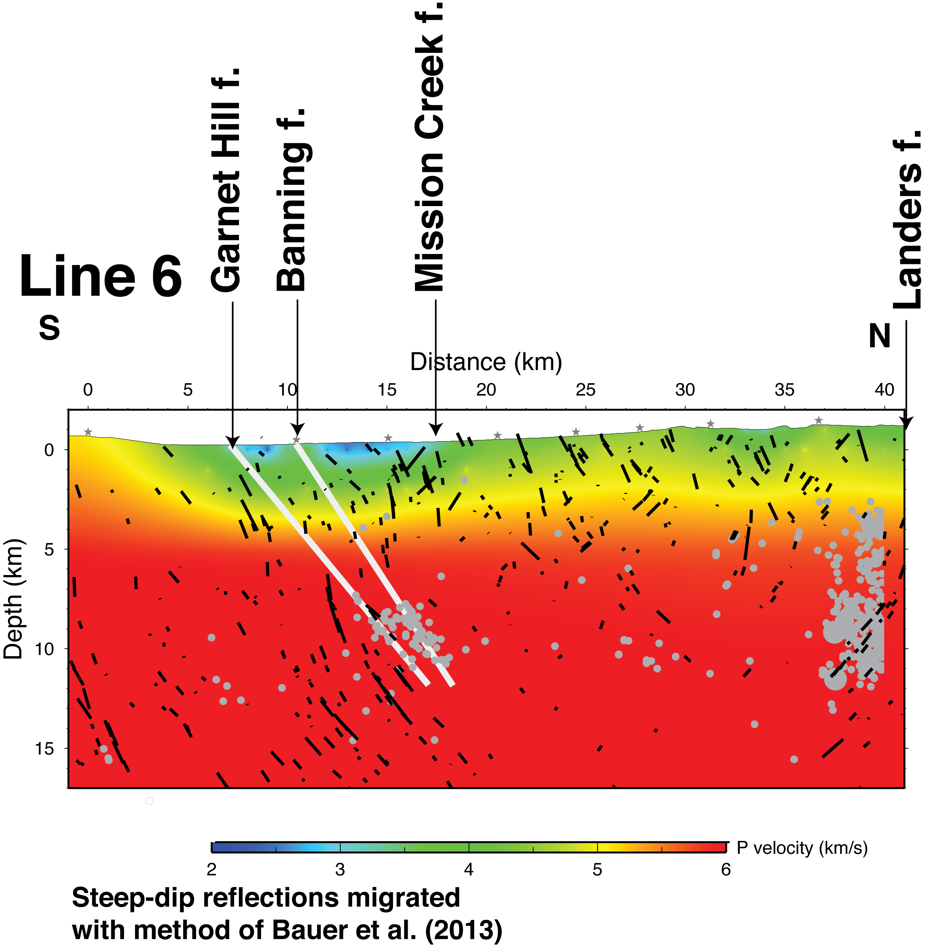

Slide 29
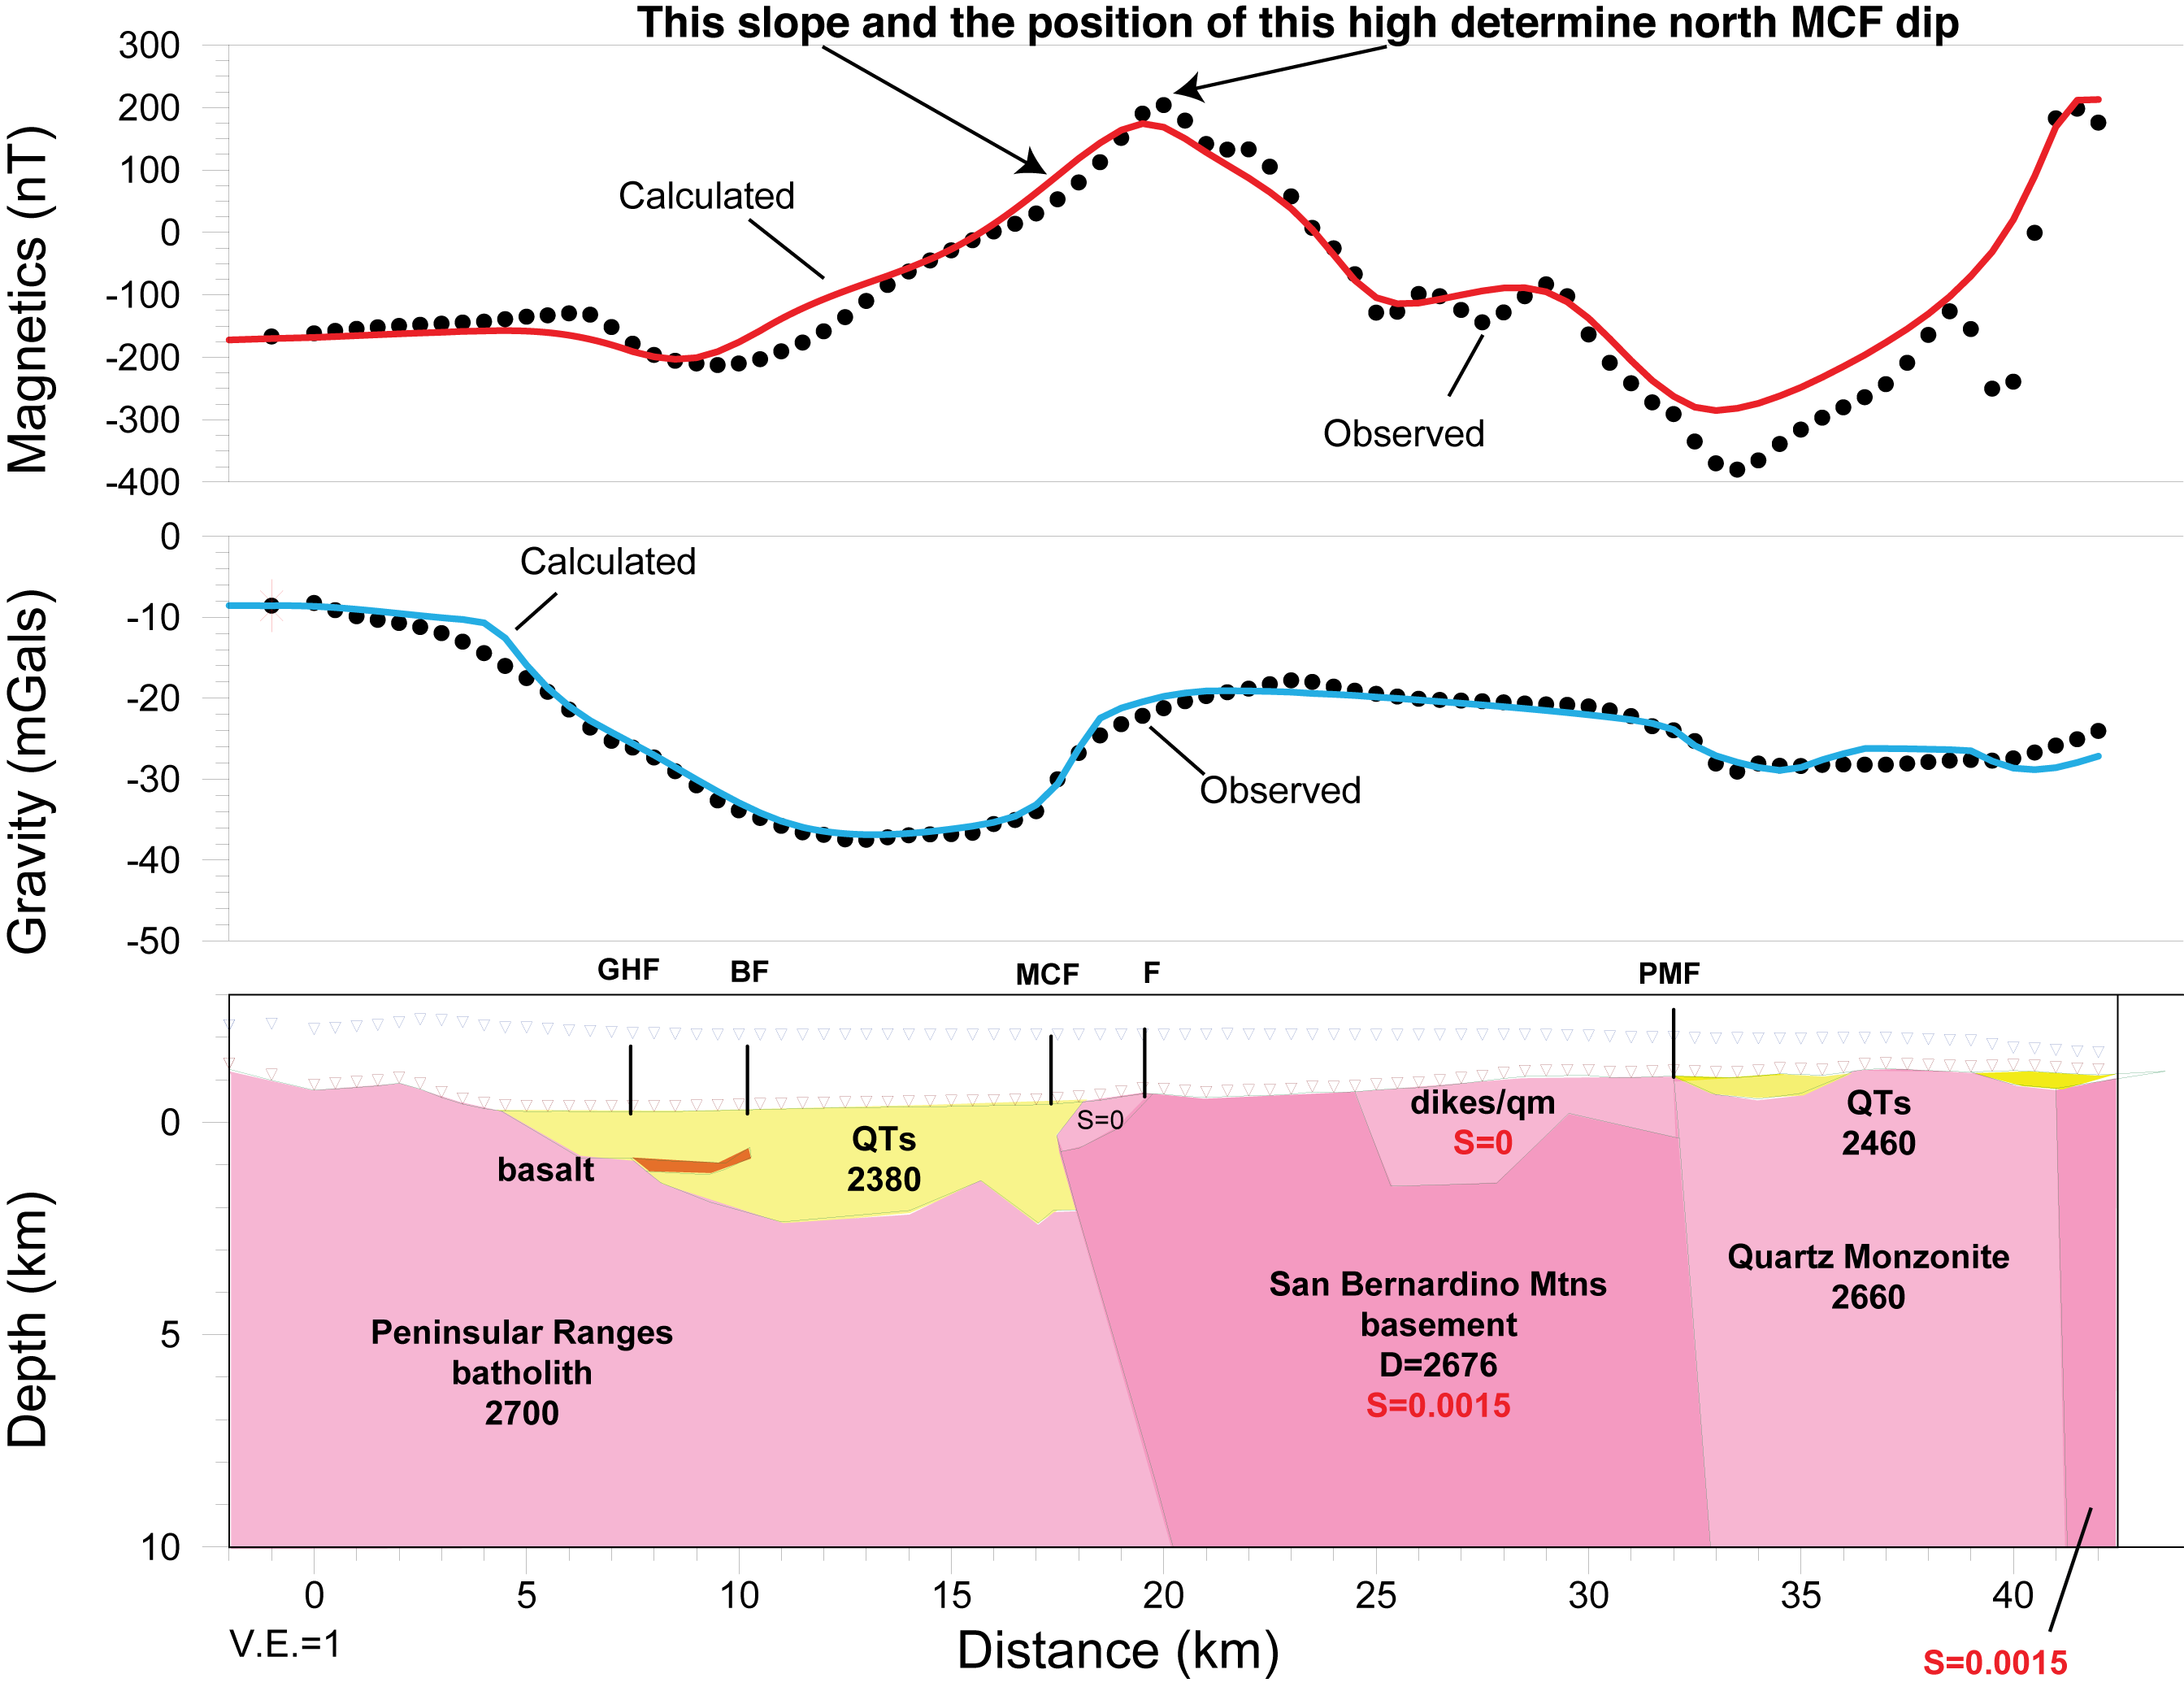

Slide 30
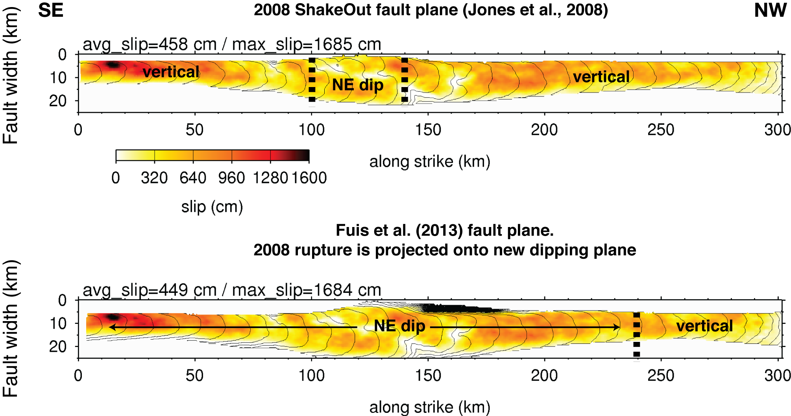

Slide 31
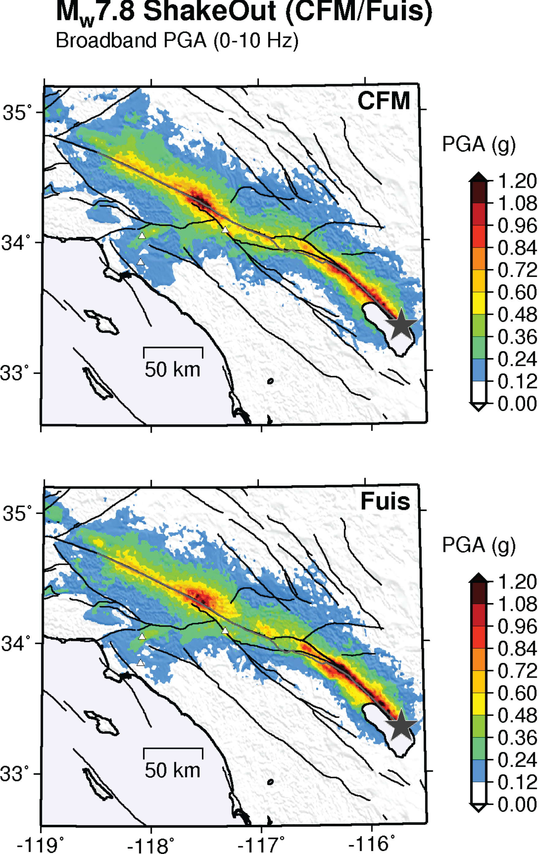
Shaking
comparison

Slide 32
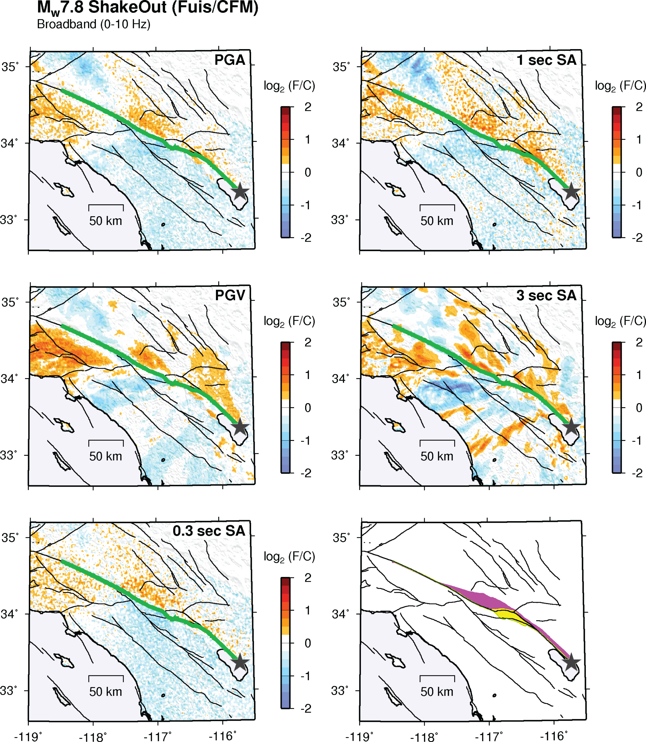
Shaking ratio
comparison

Slide 33
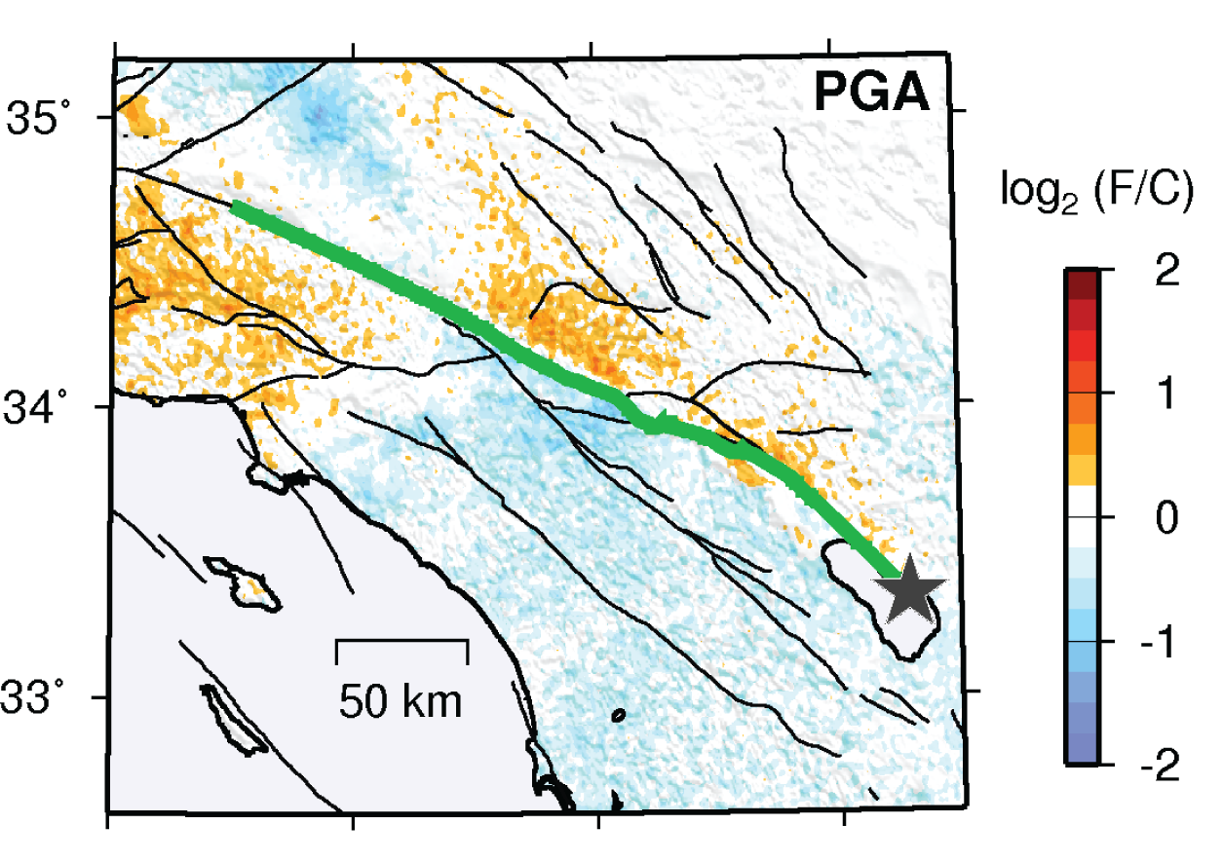

Slide 34
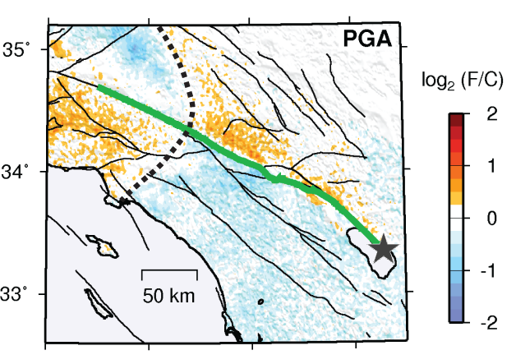

Slide 35
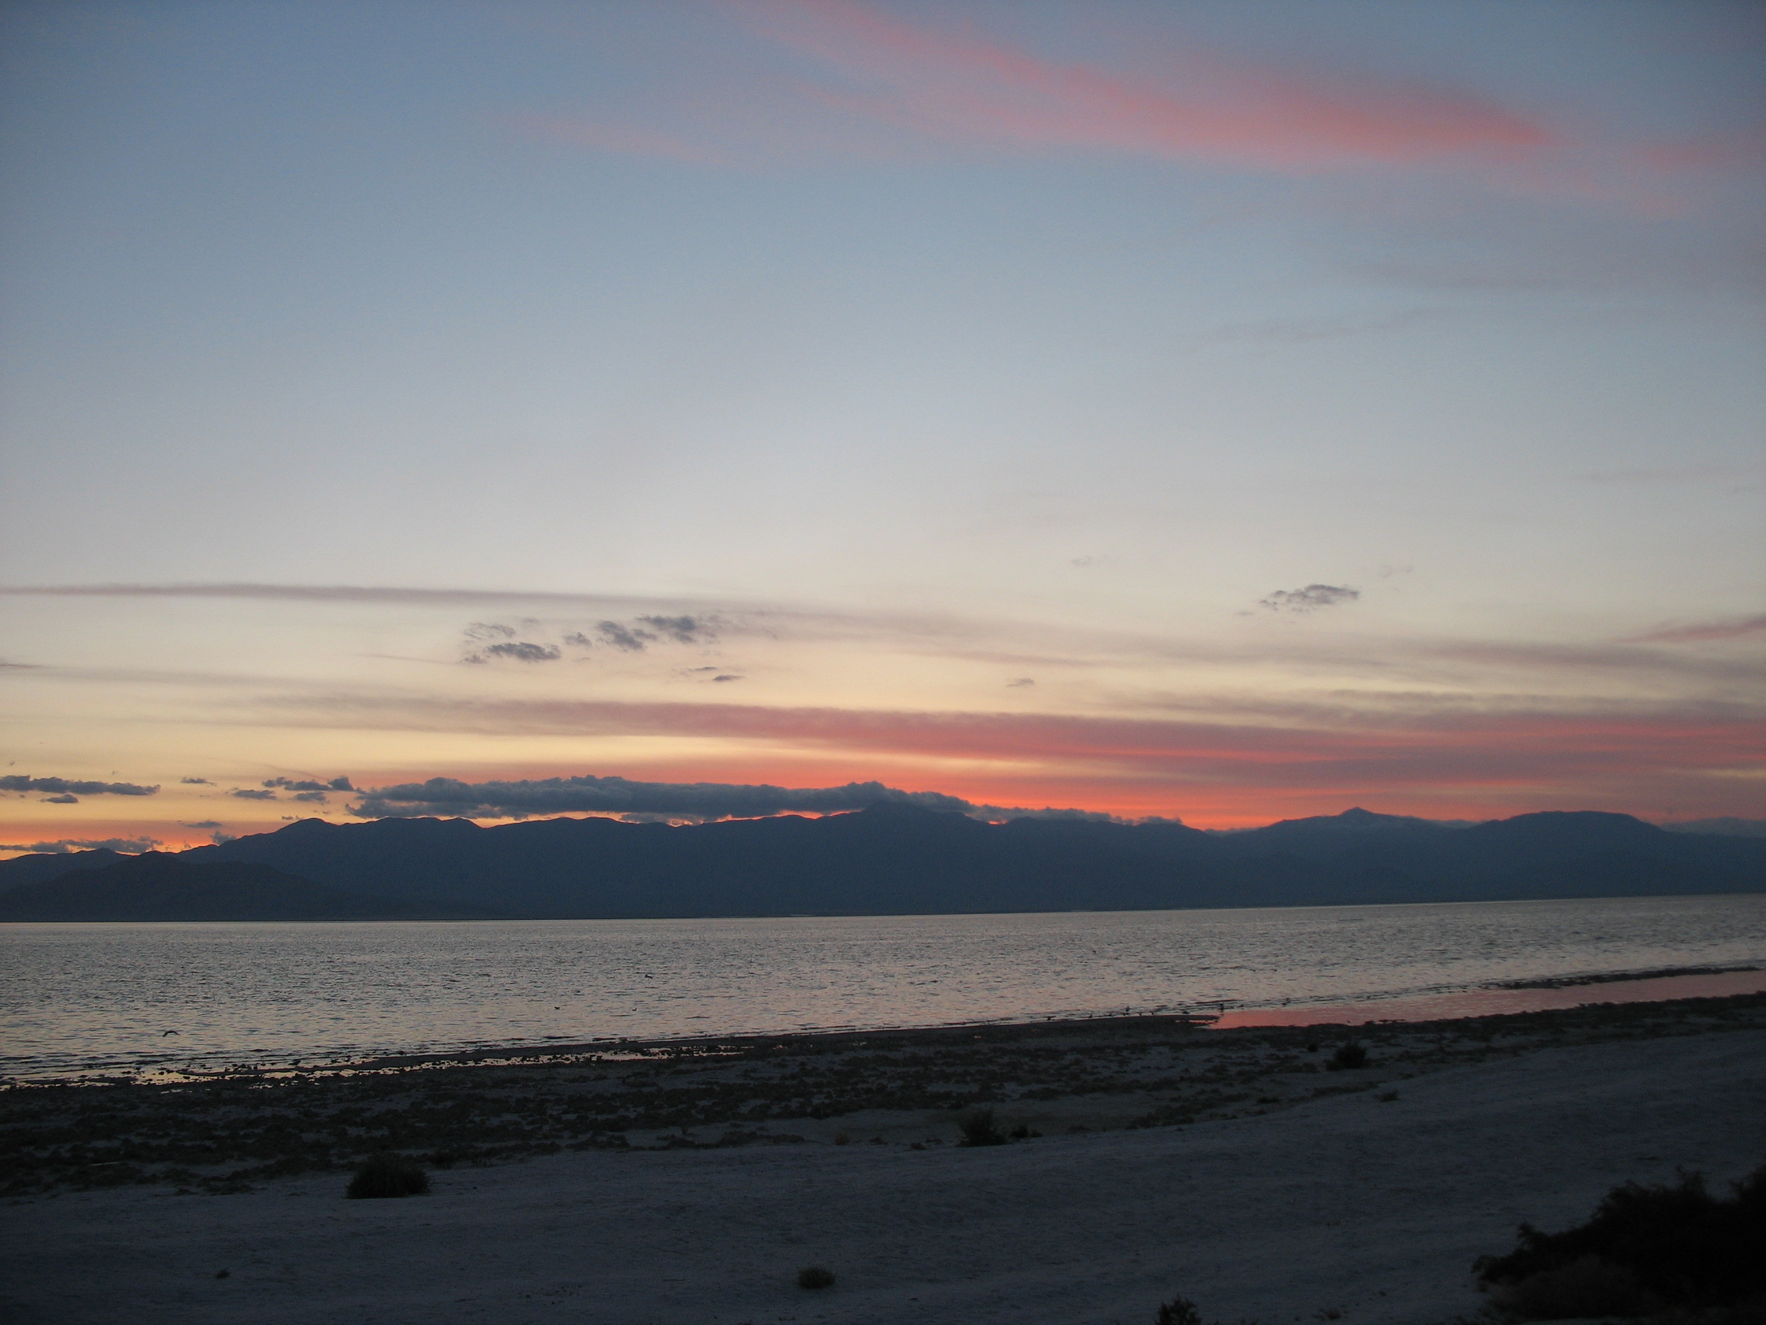
SUMMARY
1. We have imaged NE dipping reflections that we believe belong to the SAF in the depth range of 5-10 km. Above that depth, reflections diverge to known faults that we interpret as flower structures.
2. We have recalculated shaking from our new interpreted geometry of the SAF and have found, not unexpectedly, that higher shaking would be seen on the hanging wall and lower shaking on the footwall compared to a largely vertical SAF.

Slide 36
END

