Slide 1




The false sense of chronostratigraphic
certainty in the Devonian
“Revising the accuracy and precision of the Devonian time-scale”
David De Vleeschouwer and Philippe Claeys
Notes:
Good afternoon.
As most of you know, I am doing my PhD research at the University of Brussels on the detection of astronomical cycles in the geological record of the Devonian.
When I tell to colleagues in cyclostratigraphy that I am studying the Devonian, most of the time, they look very surprised and they ask me:
If you want to understand the role of astronomical forcing in a warm, ice-free greenhouse world, why aren’t you looking at the Cretaceous or the early Cenozoic?
You can use magnetostratigraphy, a very detailed biostratigraphy, outcrops are usually better and there are even IODP core available, which are perfect for the detection of astronomical forcing.

Slide 2
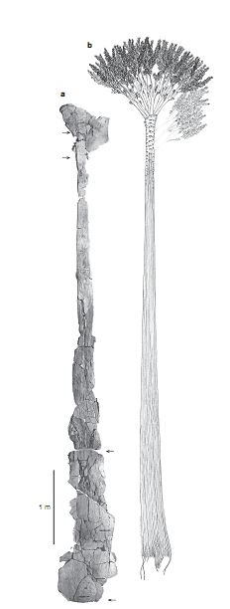
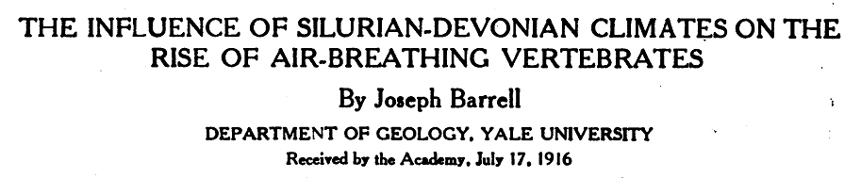
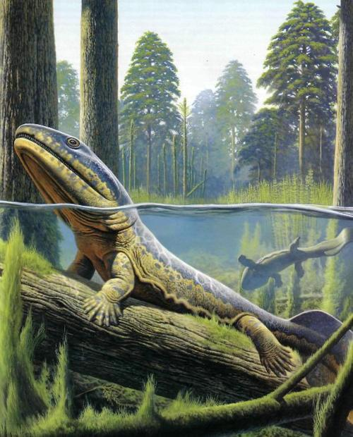
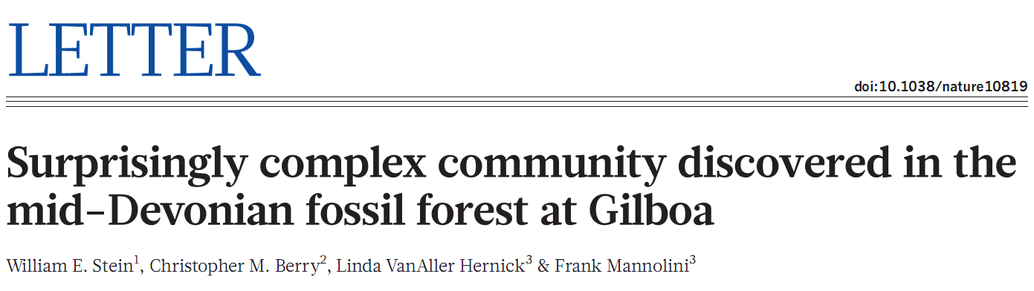

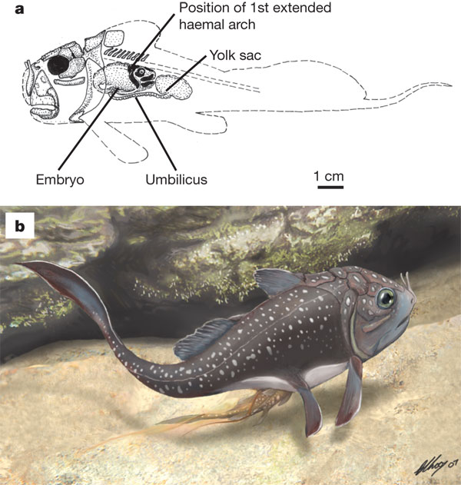
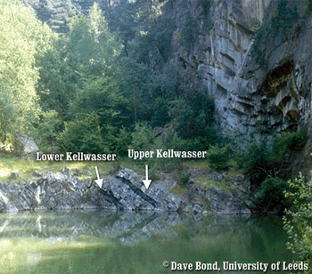
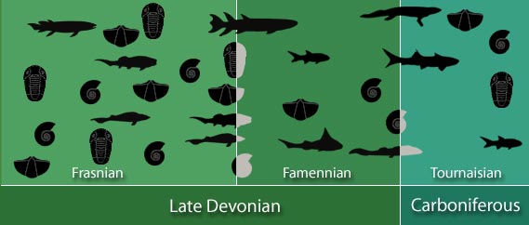
Notes:
Well, than I answer them that the Devonian actually is a very interesting period to study.

Slide 3
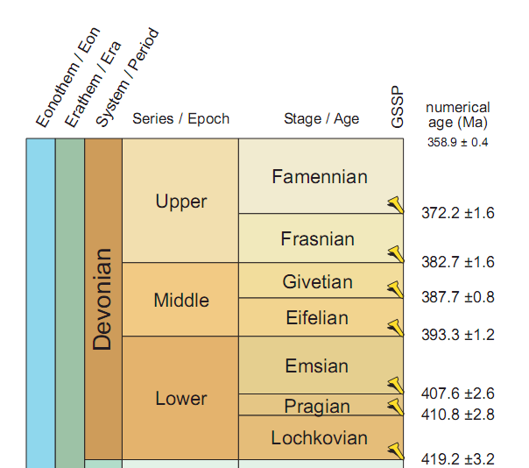
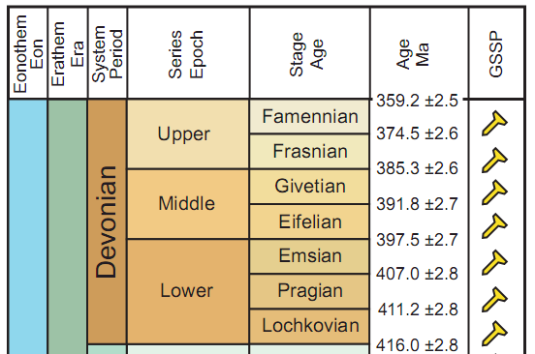
Understanding the rates of Devonian change
and evolution is crucial
GTS2012 seems to offer an unprecedented precision for the Devonian.
v 2010
v 2013

Slide 4
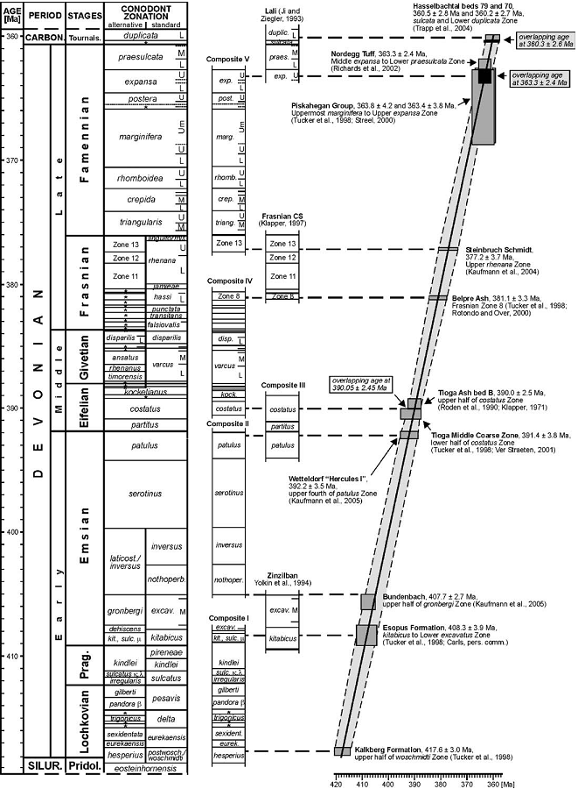
Understanding the rates of Devonian change
and evolution is crucial
Therefore a high-resolution, precise chronology is needed.
Until 2010, uncertainties on stage boundaries are ±2 to ±3 Myr
Kaufmann, 2006
360.7 ± 2.7
376.1 ± 3.6
v 2010
383.7 ± 3.1
388.1 ± 2.6
391.9 ± 3.4
409.1 ± 3.8
412.3 ± 3.5
418.1 ± 3.0

Slide 5


Slide 6
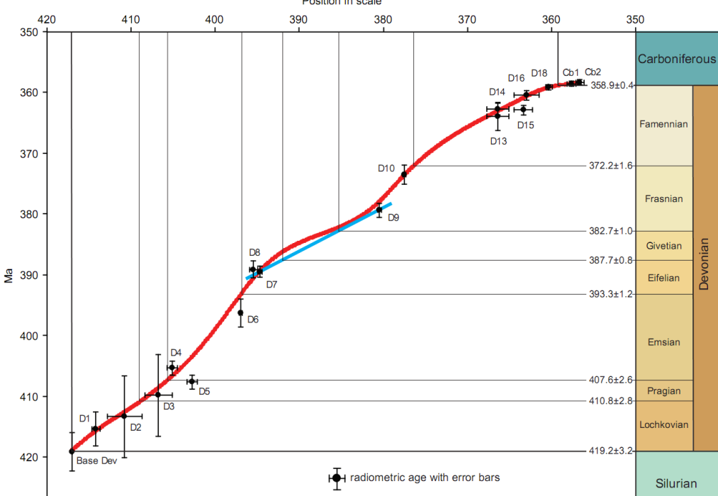
Understanding the rates of Devonian change
and evolution is crucial
GTS2012 seems to offer an unprecedented precision for the Devonian.
Kaufmann, 2006
360.7 ± 2.7
376.1 ± 3.6
v 2013
Davydov et al., 2011
383.7 ± 3.1
Recalculated using the
U decay constant ratio
of Mattinson, 2010
388.1 ± 2.6
391.9 ± 3.4
409.1 ± 3.8
412.3 ± 3.5
418.1 ± 3.0
Notes:
Recalculated using the U decay constant ratio of Mattinson, 2010

Slide 7

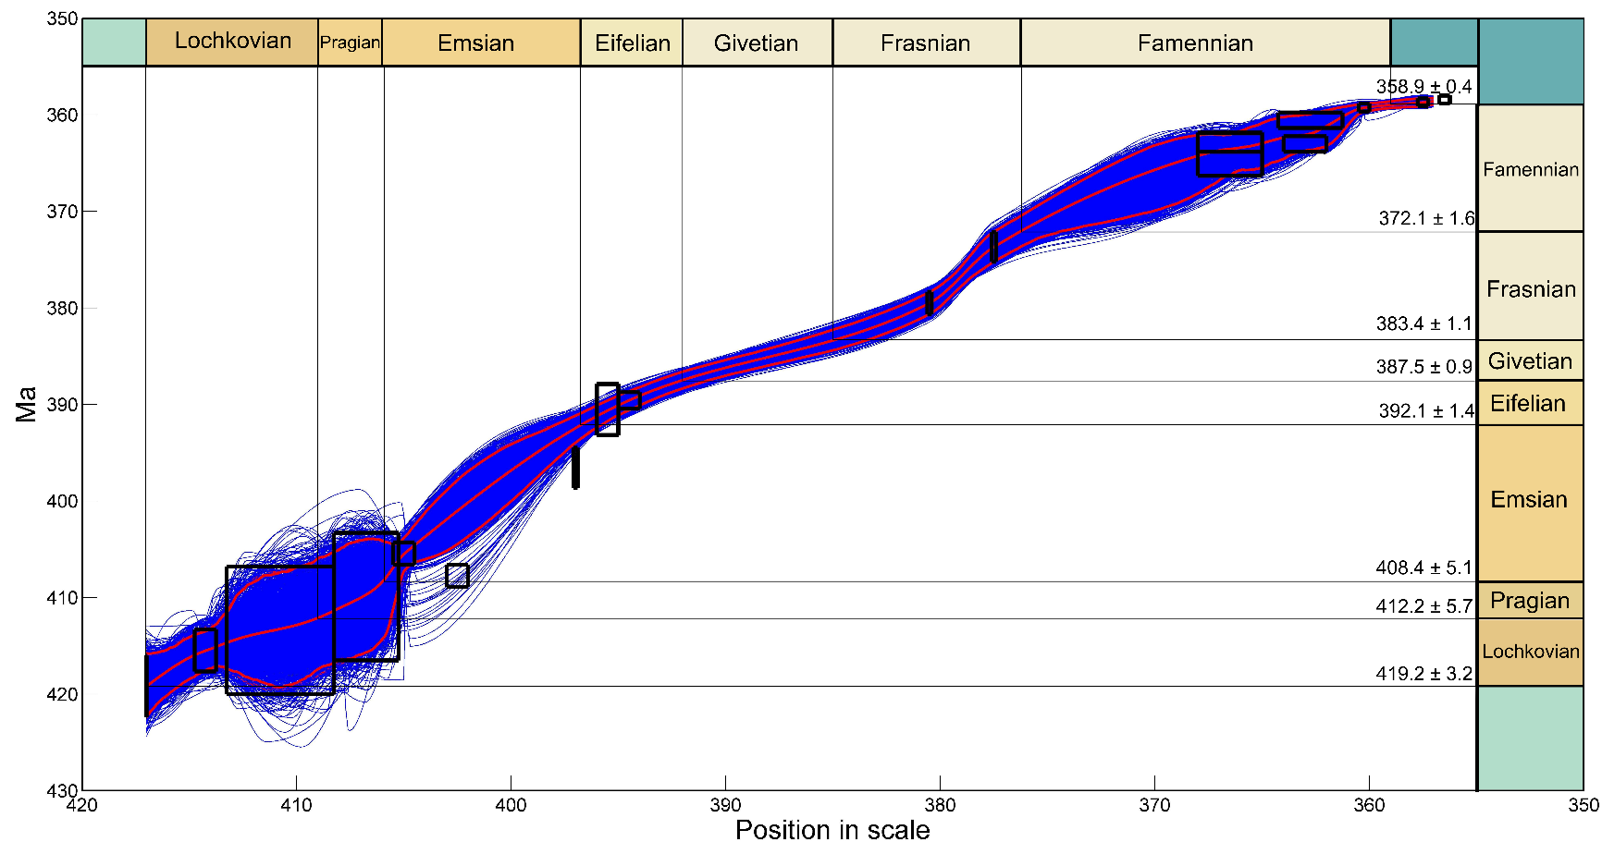
Reproducing the GTS2012 confirms the small uncertainties.
This study
GTS2012
358.9 ± 0.4
372.2 ± 1.6
382.7 ± 1.0
387.7 ± 0.8
393.3 ± 1.2
407.6± 2.6
410.8± 2.8
419.2± 3.2
Notes:
Recalculated using the U decay constant ratio of Mattinson, 2010

Slide 8
Reproducing the GTS2012 confirms the small uncertainties,
BUT…uncertainties are implausible
Tioga ash B, PA, USA
389.58 ± 0.86 Ma
Chattanooga Shale, Tennessee, USA
379.5 ± 1.17 Ma
GTS2012
358.9 ± 0.4
372.2 ± 1.6
382.7 ± 1.0
387.7 ± 0.8
393.3 ± 1.2
407.6± 2.6
410.8± 2.8
419.2± 3.2
Notes:
Recalculated using the U decay constant ratio of Mattinson, 2010

Slide 9

Cubic Spline Interpolation in Devonian GTS2012 poses some serious problems
Uncertainties are implausible
How to choose which interpolation-model
No outlier detection (except by eye)
Age-depth models can be implausible
Ignores lots of information
GTS2012
358.9 ± 0.4
372.2 ± 1.6
382.7 ± 1.0
387.7 ± 0.8
393.3 ± 1.2
407.6± 2.6
410.8± 2.8
419.2± 3.2
Notes:
Recalculated using the U decay constant ratio of Mattinson, 2010

Slide 10
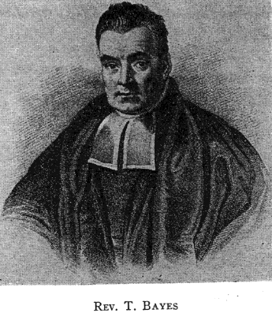
Bayesian age models can overcome most of these problems
Stratigraphy (m)
Bayesian age models incorporate prior information:
Any stratigraphic position in a succession of rock between two dated ash layers must be younger than the lower ash layer and older than the top ash layer
Age (Ma)
Notes:
Recalculated using the U decay constant ratio of Mattinson, 2010

Slide 11
Bayesian age models can overcome most of these problems
Stratigraphy (m)
Age (Ma)
Notes:
Recalculated using the U decay constant ratio of Mattinson, 2010

Slide 12
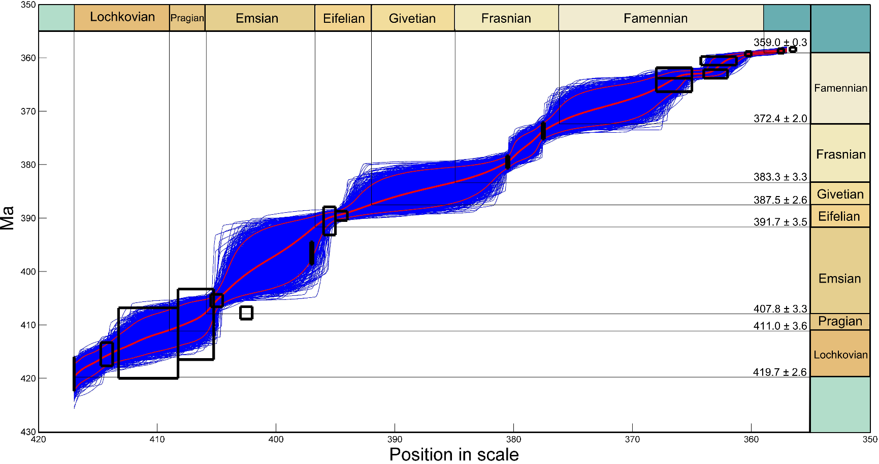
The Bayesian approach leaves us again with huge uncertainties
BUT…these uncertainties are plausible
This study
GTS2012
358.9 ± 0.4
372.2 ± 1.6
382.7 ± 1.0
387.7 ± 0.8
393.3 ± 1.2
407.6± 2.6
410.8± 2.8
419.2± 3.2
Notes:
Recalculated using the U decay constant ratio of Mattinson, 2010

Slide 13
The Bayesian approach leaves us again with huge uncertainties
BUT…these uncertainties are plausible
This study
GTS2012
Bayesian age models incorporate prior information…
Cyclostratigraphy
Frasnian: 6.7 ± 0.6 Myr
(De Vleeschouwer et al., 2012, GSA Bulletin, v.124)
Givetian: 4.35 ± 0.5 Myr
(De Vleeschouwer et al., submitted to GSL Special Publications)
358.9 ± 0.4
372.2 ± 1.6
382.7 ± 1.0
387.7 ± 0.8
393.3 ± 1.2
407.6± 2.6
410.8± 2.8
419.2± 3.2
Notes:
Recalculated using the U decay constant ratio of Mattinson, 2010

Slide 14
Cyclostratigraphy estimates duration of Devonian stages
16.5 405-kyr eccentricity cycles:
= 6.7 ± 0.6 Myr

Slide 15
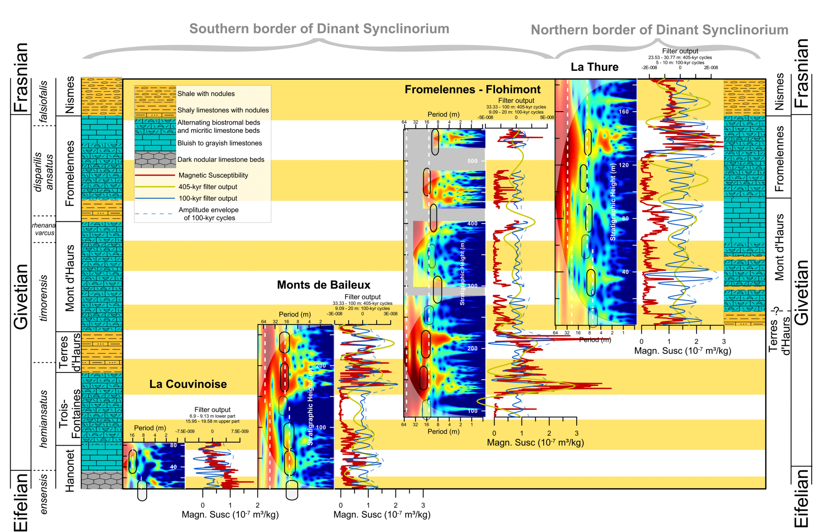
Cyclostratigraphy estimates duration of Devonian stages
10.75 405-kyr eccentricity cycles:
= 4.35 ± 0.5 Myr

Slide 16
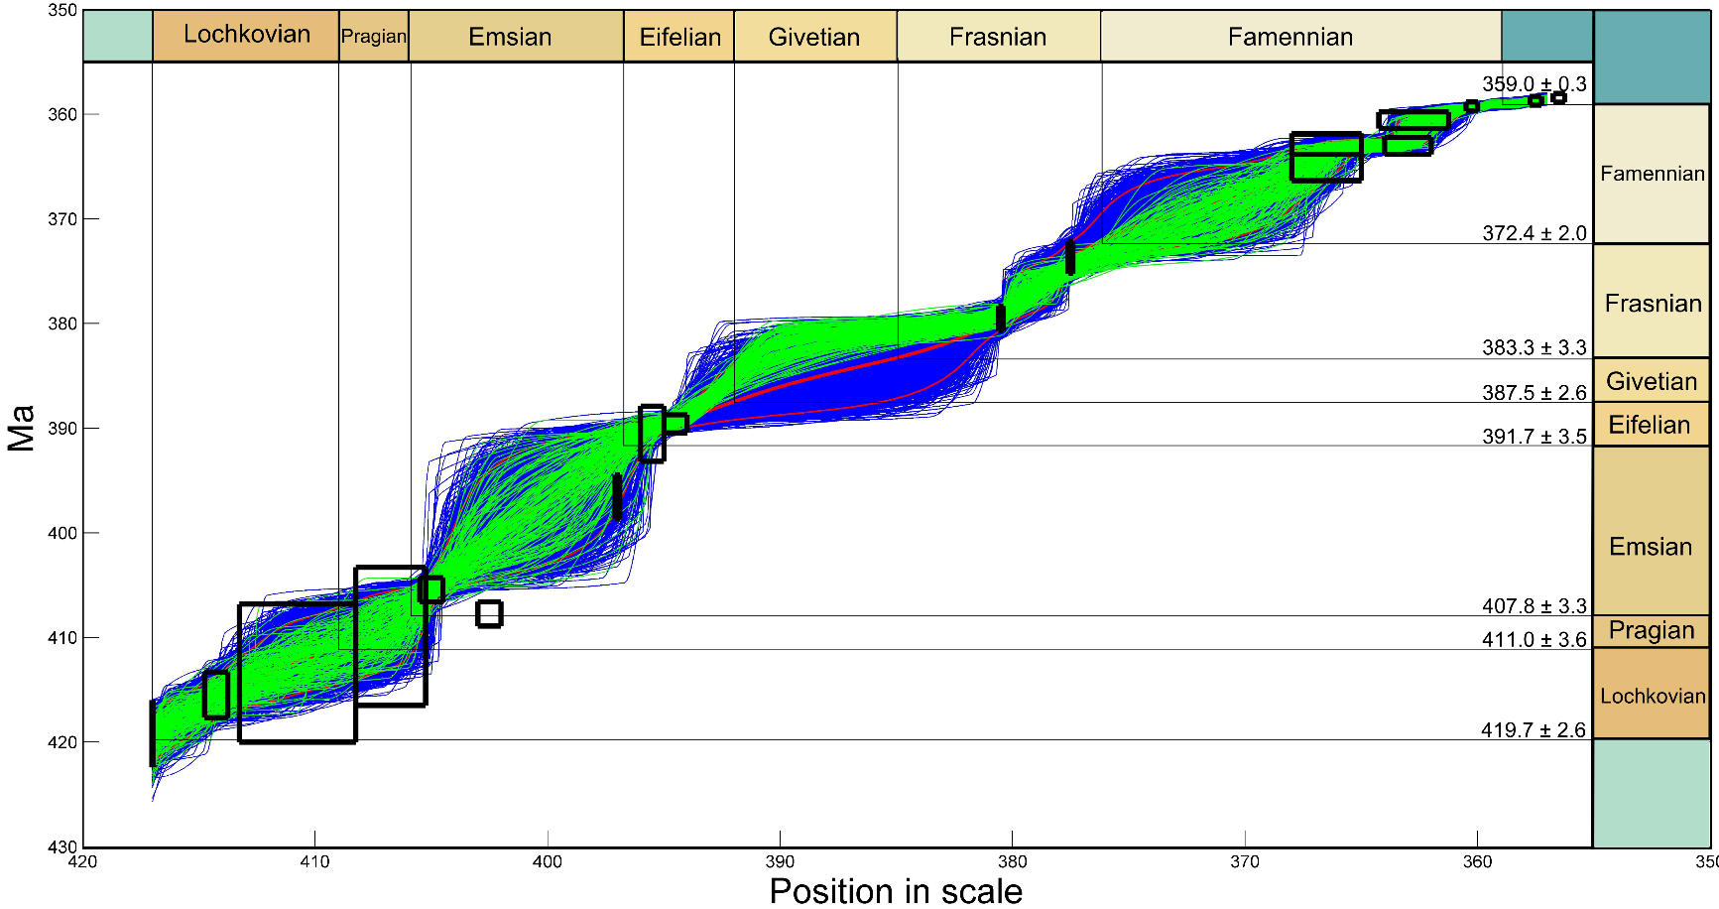
Bayesian age models can incorporate information from cyclostratigraphy
Frasnian: 6.7 ± 0.6 Myr
(De Vleeschouwer et al., 2012, GSA Bulletin, v.124)
Givetian: 4.35 ± 0.5 Myr
(De Vleeschouwer et al., submitted to GSL Special Publications)
This study
GTS2012
358.9 ± 0.4
372.2 ± 1.6
382.7 ± 1.0
387.7 ± 0.8
393.3 ± 1.2
407.6± 2.6
410.8± 2.8
419.2± 3.2
Notes:
Recalculated using the U decay constant ratio of Mattinson, 2010

Slide 17
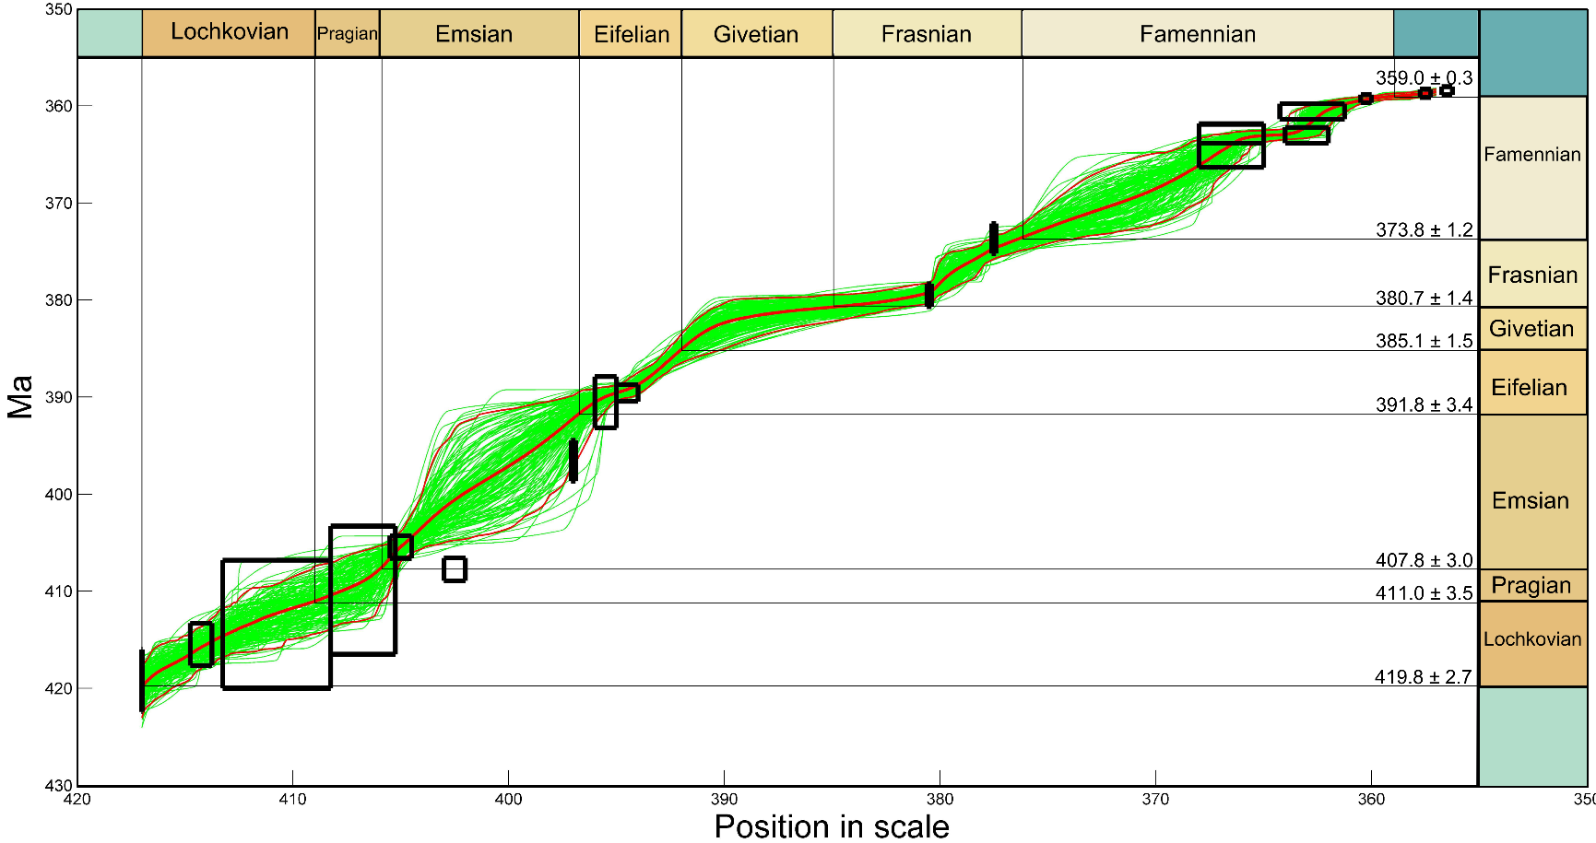
Cyclostratigraphy reduces uncertainties on the Middle- and Upper-Devonian stage boundaries
This study
GTS201X?
GTS2012
358.9 ± 0.4
372.2 ± 1.6
382.7 ± 1.0
387.7 ± 0.8
393.3 ± 1.2
407.6± 2.6
410.8± 2.8
419.2± 3.2
Notes:
Recalculated using the U decay constant ratio of Mattinson, 2010

Slide 18
Cyclostratigraphy reduces uncertainties on the Middle- and Upper-Devonian stage boundaries
Take Home #1:
GTS2012 has too optimistic uncertainties
This study
GTS201X?
GTS2012
358.9 ± 0.4
372.2 ± 1.6
382.7 ± 1.0
387.7 ± 0.8
393.3 ± 1.2
407.6± 2.6
410.8± 2.8
419.2± 3.2
Notes:
Recalculated using the U decay constant ratio of Mattinson, 2010

Slide 19
Cyclostratigraphy reduces uncertainties on the Middle- and Upper-Devonian stage boundaries
Take Home #1:
GTS2012 has too optimistic uncertainties
This study
GTS201X?
Take Home #2:
More numerical ages are needed for the Devonian!
GTS2012
358.9 ± 0.4
372.2 ± 1.6
382.7 ± 1.0
387.7 ± 0.8
393.3 ± 1.2
407.6± 2.6
410.8± 2.8
419.2± 3.2
Notes:
Recalculated using the U decay constant ratio of Mattinson, 2010

Slide 20
Cyclostratigraphy reduces uncertainties on the Middle- and Upper-Devonian stage boundaries
Take Home #1:
GTS2012 has too optimistic uncertainties
This study
GTS201X?
Take Home #2:
More numerical ages are needed for the Devonian!
GTS2012
358.9 ± 0.4
372.2 ± 1.6
382.7 ± 1.0
387.7 ± 0.8
Take Home #3:
Confirmation of cyclostratigraphic results would be good
393.3 ± 1.2
407.6± 2.6
410.8± 2.8
419.2± 3.2
Notes:
Recalculated using the U decay constant ratio of Mattinson, 2010

Slide 21
Questions?
David De Vleeschouwer and Philippe Claeys
Notes:
Good afternoon.
As most of you know, I am doing my PhD research at the University of Brussels on the detection of astronomical cycles in the geological record of the Devonian.
When I tell to colleagues in cyclostratigraphy that I am studying the Devonian, most of the time, they look very surprised and they ask me:
If you want to understand the role of astronomical forcing in a warm, ice-free greenhouse world, why aren’t you looking at the Cretaceous or the early Cenozoic?
You can use magnetostratigraphy, a very detailed biostratigraphy, outcrops are usually better and there are even IODP core available, which are perfect for the detection of astronomical forcing.

