Slide 1
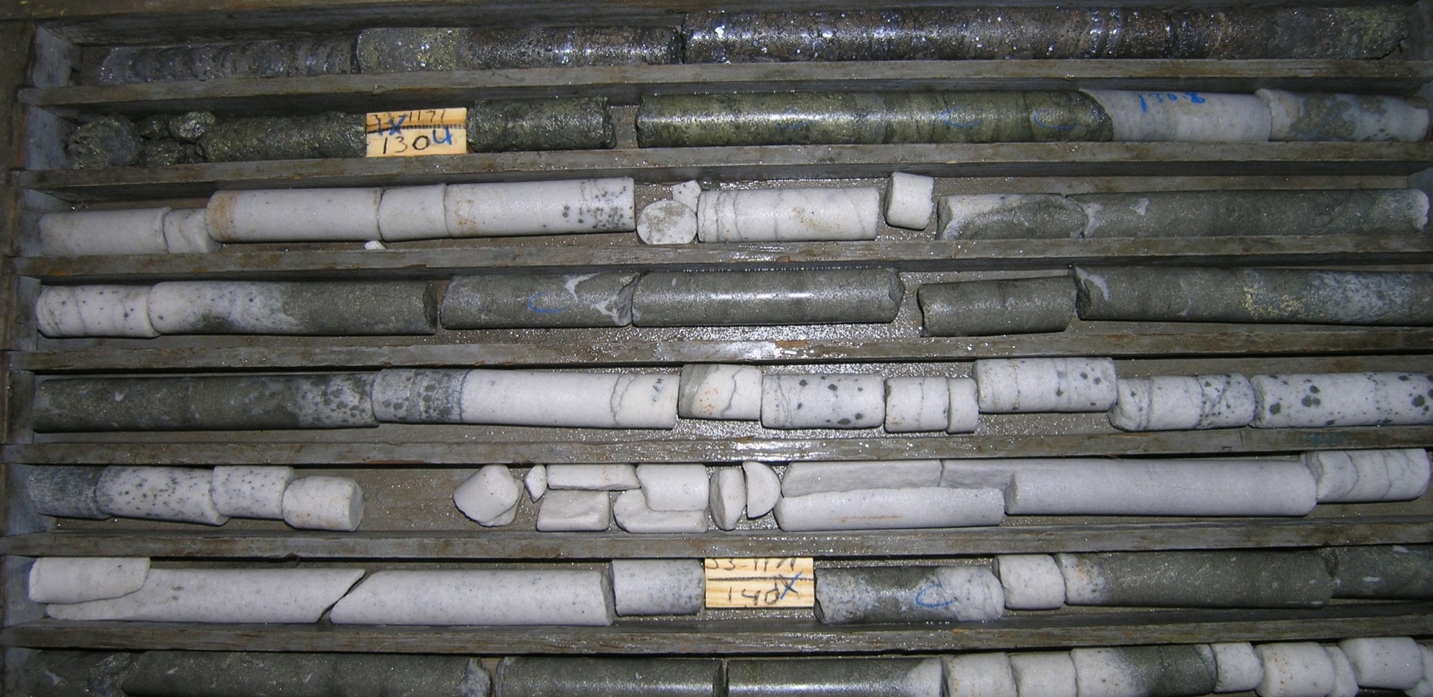
Unusual MVT, Zn-Pb-Cu mineralization in the lower portion of the Bonneterre Dolomite, Viburnum Trend, Southeast Missouri
BT
LM
B. Danielle Cavender* Kevin L. Shelton* Jim Husman**
* Department of Geological Sciences, University of Missouri ** Exploration and Development Division, The Doe Run Company
Notes:
-Introduce yourself and your advisor
-Address Jim as source of the idea
-”This talk serves as an introduction to an ongoing research project concerning a more Zn and Cu-rich, atypical sulfide mineralization occurring in the lower Bonneterre Dolomite unit in the Viburnum Trend. The normal ore mineralization occurs almost exclusively in the upper Bonneterre, but recent drilling in the district has uncovered these ore reserves. As you can see, the mineralization replaces almost the entire carbonate host rock all the way to BTD-Lamotte sandstone contact, with significant sulfide precipitation continuing well into the white sandstone. Mineralization of this magnitude at this depth had not been encountered prior.

Slide 2
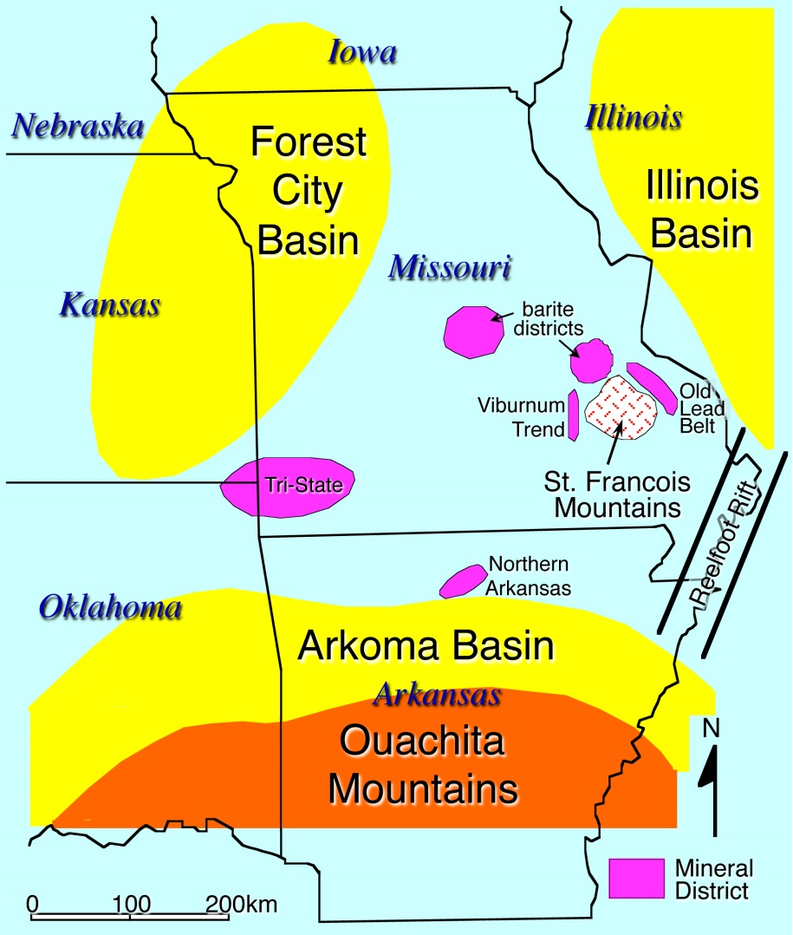
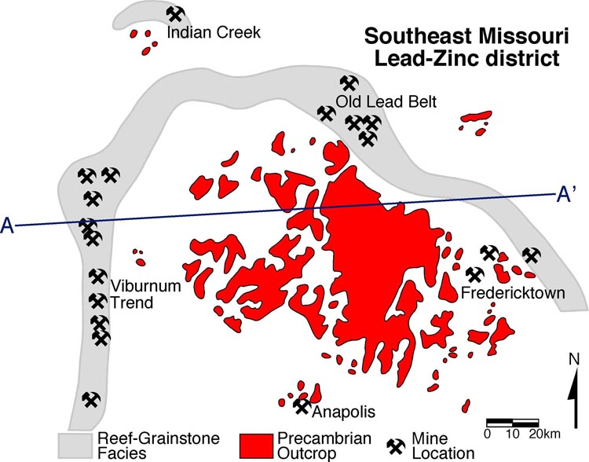
Geology of the Viburnum Trend
(after Gregg and Shelton, 1989, 2012)
Production began in the Viburnum Trend in 1960
United States’ largest lead-mining district-- >300 million tons Pb to date
Also mined for Zn and Cu
Notes:
So, the VT is located in the SE Missouri Pb-mining district with proximity to the barite districts to the north and the tri-state and N. AR districts to the SW. Proposed basinal fluid sources are the Arkoma and Illinois basin; the Forest City Basin is essentially not considered a source for the VT district. More closely, the mining district is the only active district and is to the east of the St. Francois mountains, a part of a horse-shoe shape of Pb mineralization surrounding the igneous outcrops.

Slide 3
Key Stratigraphy of the Viburnum Trend
A
A’
Davis Formation
Bonneterre Dolomite
Platform Edge
Grainstones
“Back
Reef”
Open Shelf Facies
Interbedded Limestone & Shale
Basal
Dolomite
“Reef”
Lamotte Sandstone
Precambrian
Dolomitized laminates & partially dolomitized mudstones
0
10
20km
Dolomite (undifferentiated)
Dolomitized grainstones
30m
Quartzic sandstone
Dolomitized stromatolites
Igneous complex
Interbedded limestone & shale
0
(from Gregg and Shelton, 1989, 2012)
Notes:
The Pre-Cambrian basement has a topography of “knobs” that is unconformably overlain by Cambrian units. The Lamotte sandstone is the main aquifer of the area, in which fluids would’ve flowed and been influenced by the underlying basement topography. As fluids migrated upward through fractures or brecciation, they are believed to have mixed with another fluid, resulting in deposition in the porous grainstone facies above the dense digitate stromatolite reef of the Upper BT. The Davis Fm, a dolomitic shale, served as an aquitard and the back reef is a bleached, ore-barren, white rock suggested to have been the exit pathway for spent fluids. Ore up here-ore down there.

Slide 4
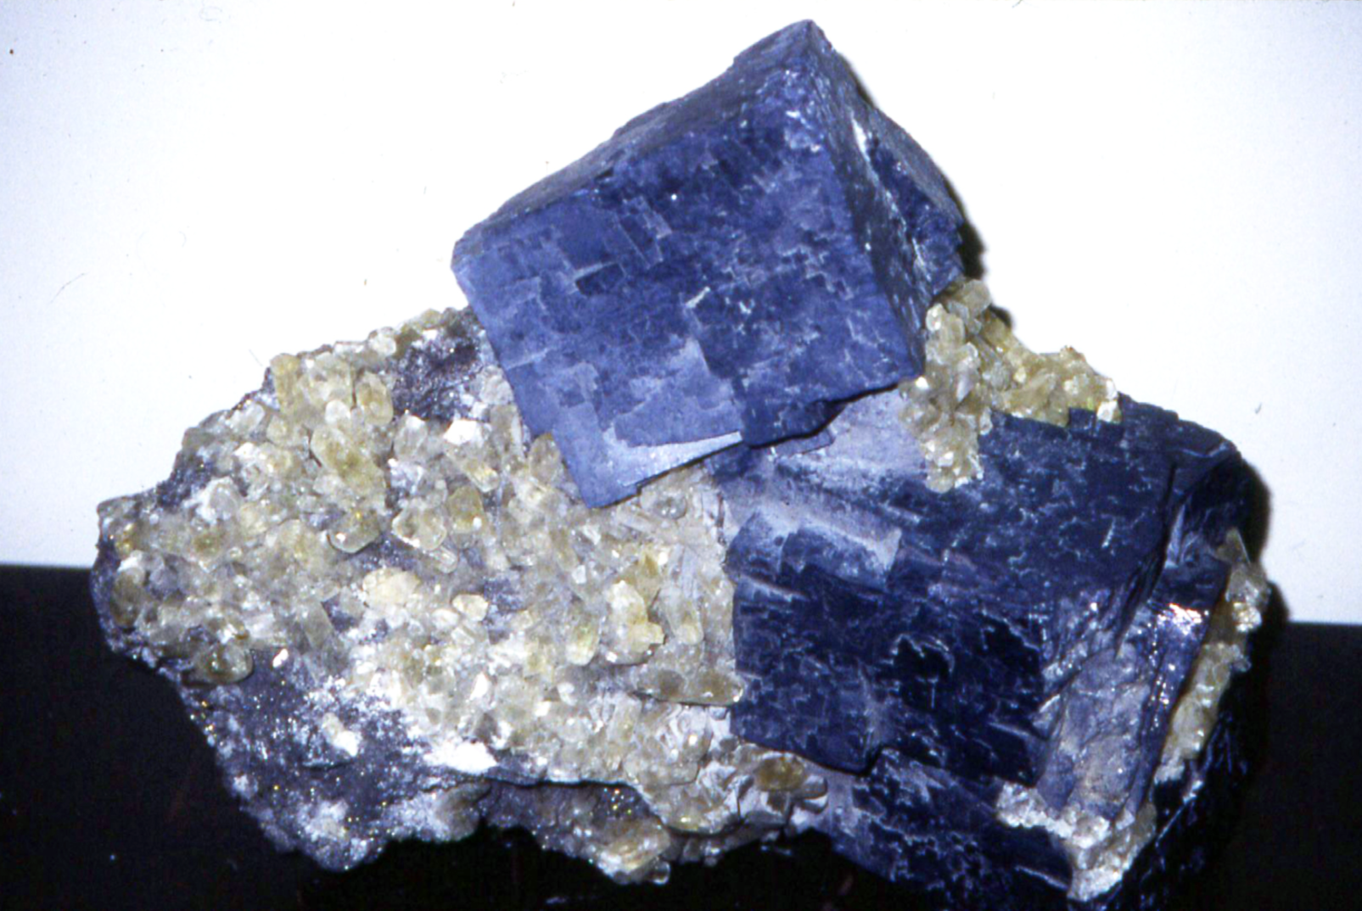
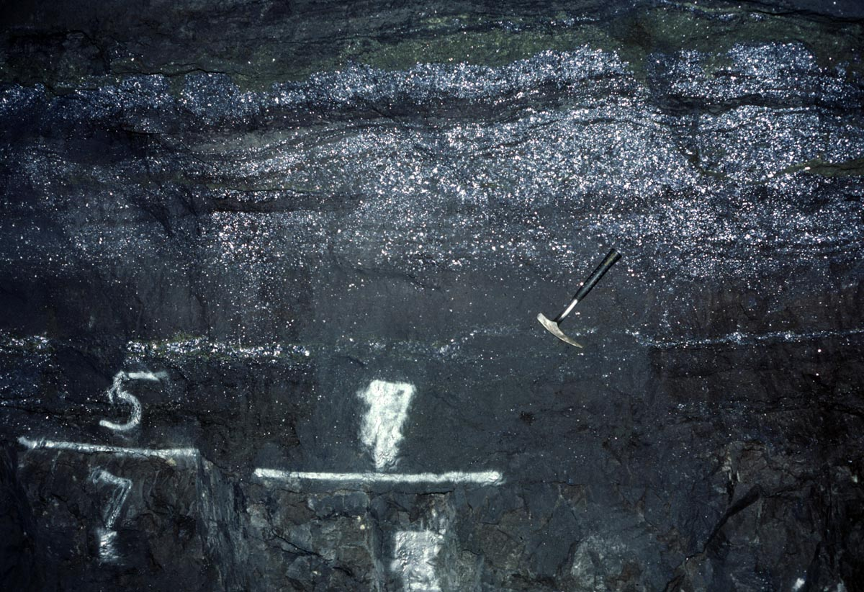
Viburnum Trend Mineralization
Lead-dominant (5:1 Pb/Zn), with some “Cu specials,” rare Ag-Co-Ni enrichments
Structural controls: Stratigraphic pinchouts, Precambrian knobs, facies changes, dissolution brecciation
Mined horizon = Upper Bonneterre Dolomite
Lower section mineralization has not been previously considered a resource
5 cm
0.5 m

Slide 5
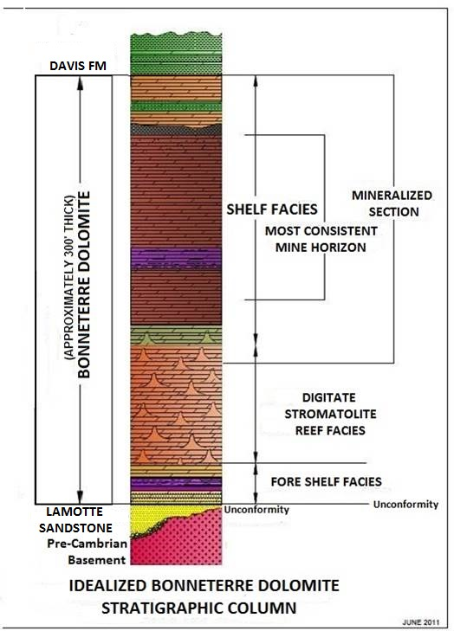
Features of the Lower Section Mineralization
100 ft (30 m) or more below the typical ore horizon
Cu- and Zn-rich, typically Zn-dominant
Assay ranges:
11 to 29% Zn,
6 to 15% Pb, and
< 1 to 8% Cu
In one area, > 250,000 tons of
14 % Pb+Zn, 2% Cu
Notable enrichments of Ag, Co, Ni

Slide 6
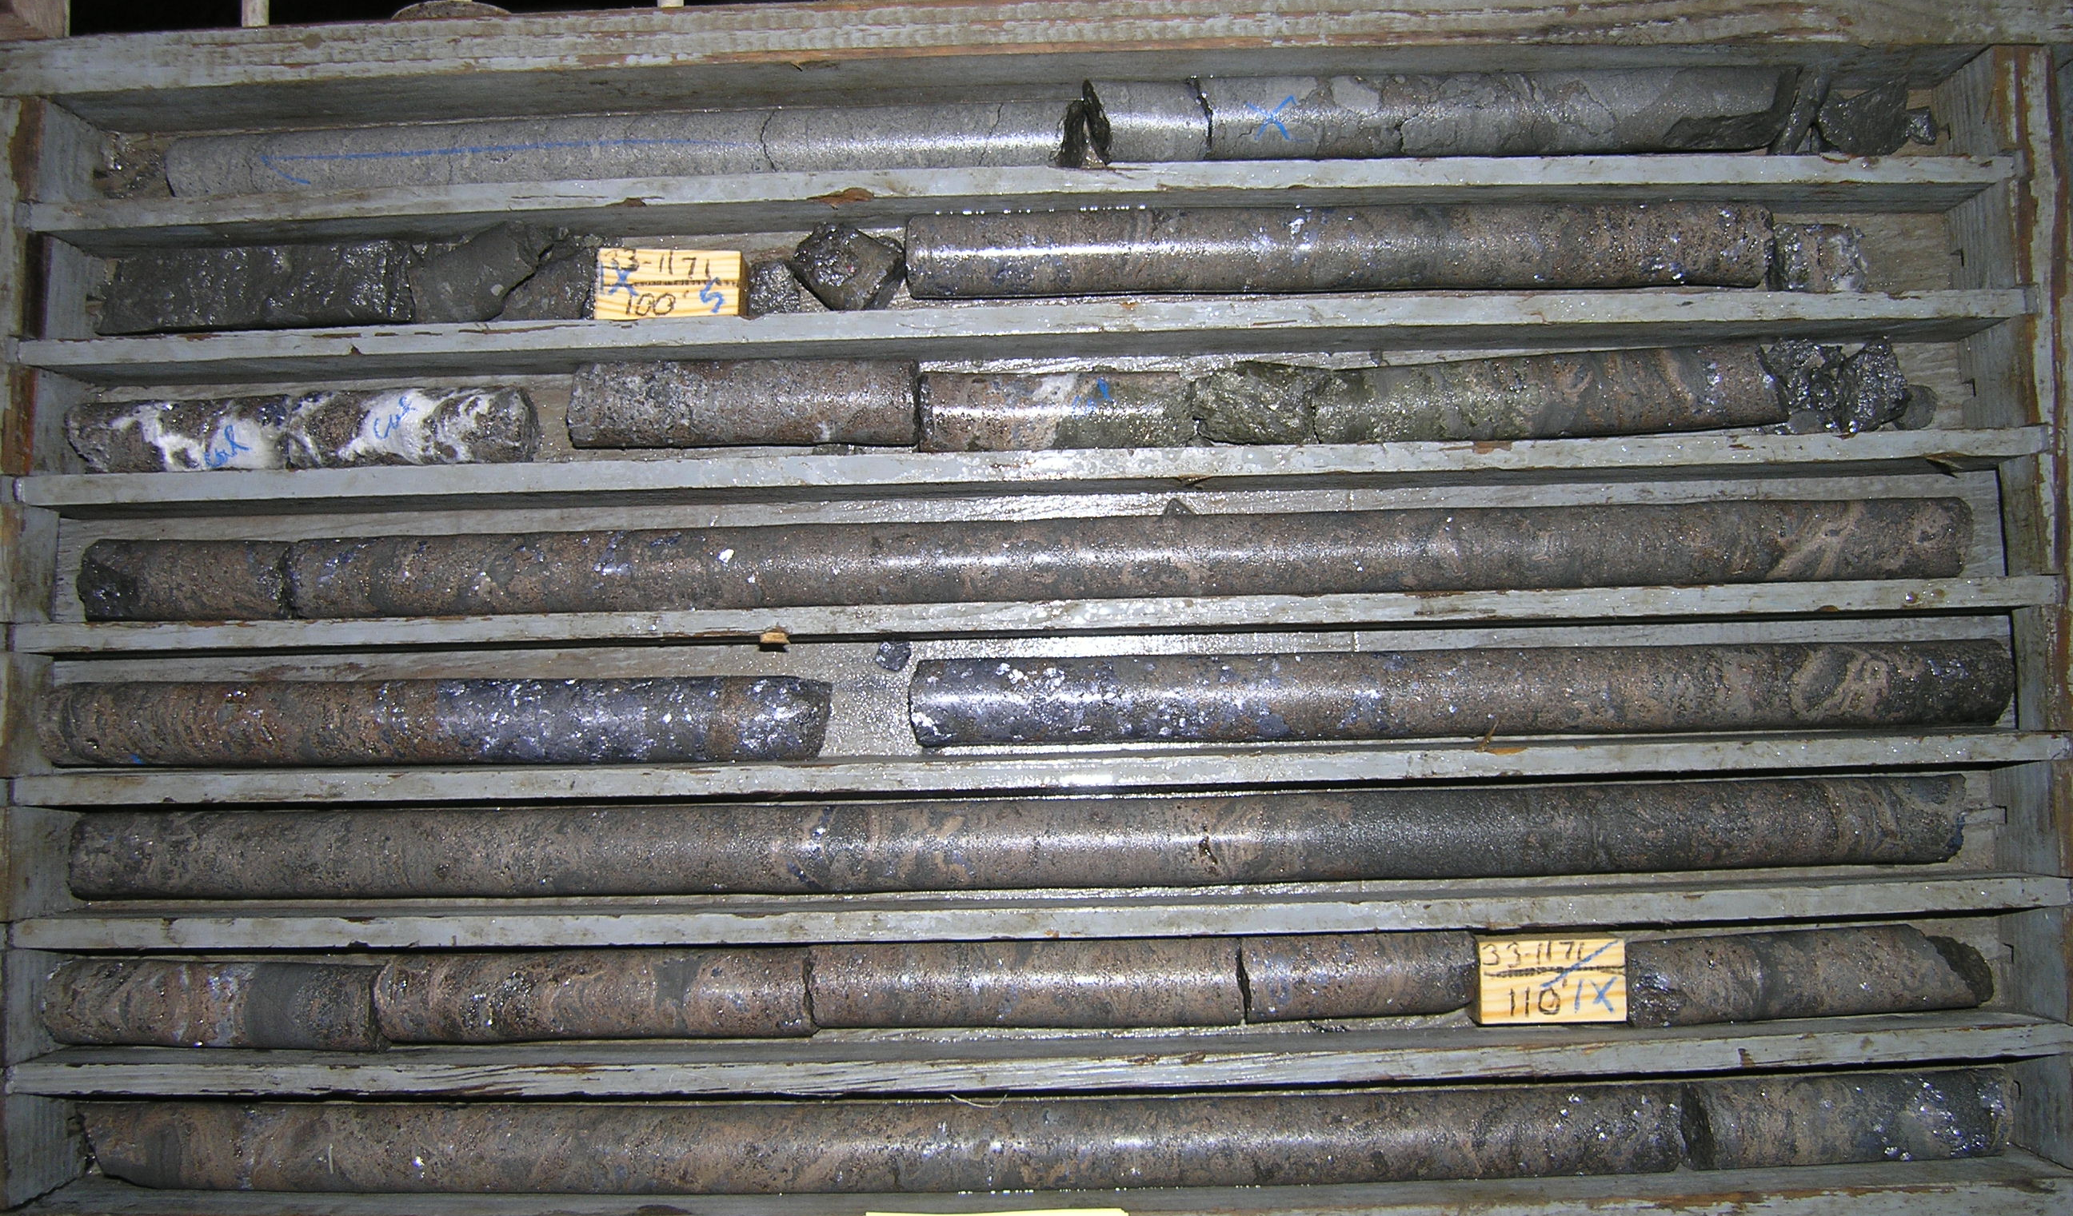
Ag ppm
From
To
Vert. Thick
Pb %
Zn %
Cu %
Fe %
Co %
Ni %
100
110
10
13.7
33.4
0.03
1.2
0.028
0.035
2.8

Slide 7
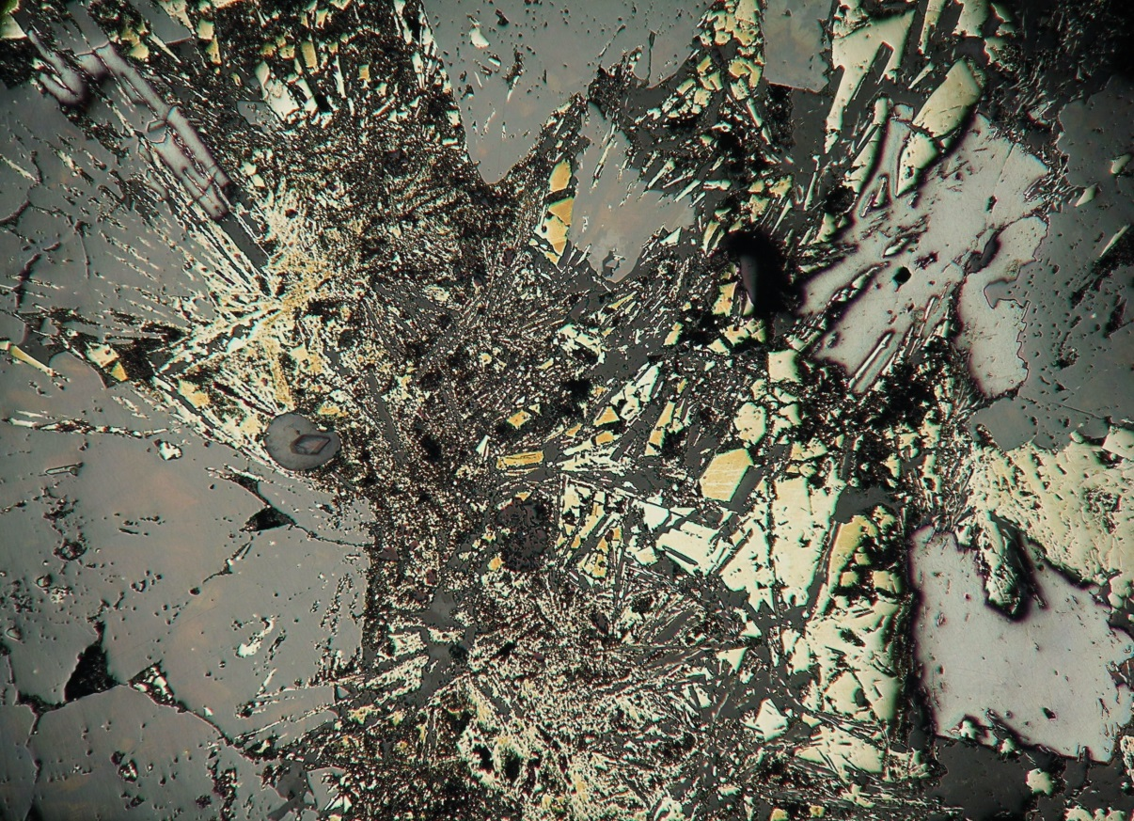
1 mm
Notes:
Repeated fracturing throughout the paragenesis.

Slide 8
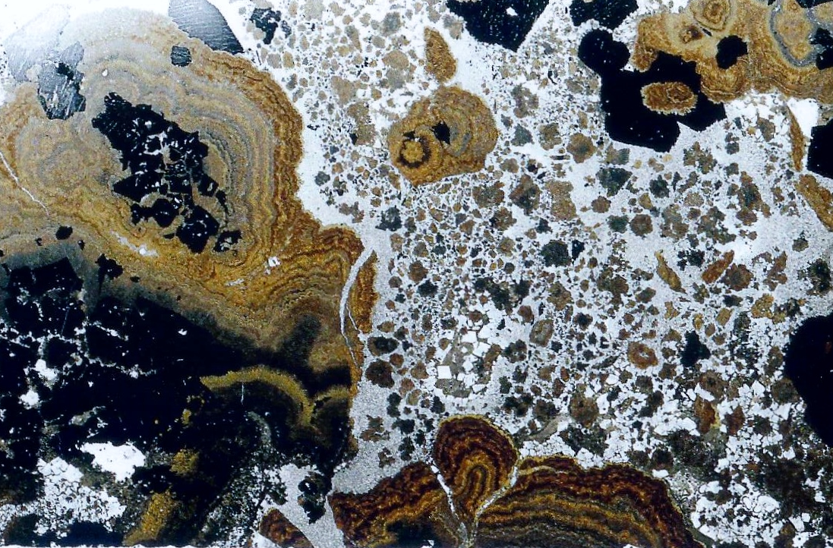
5 mm
Open-space-filling, banded sphalerite (schalenblende) → fragmentation and fracturing → cuboctahedral galena and dolomite

Slide 9
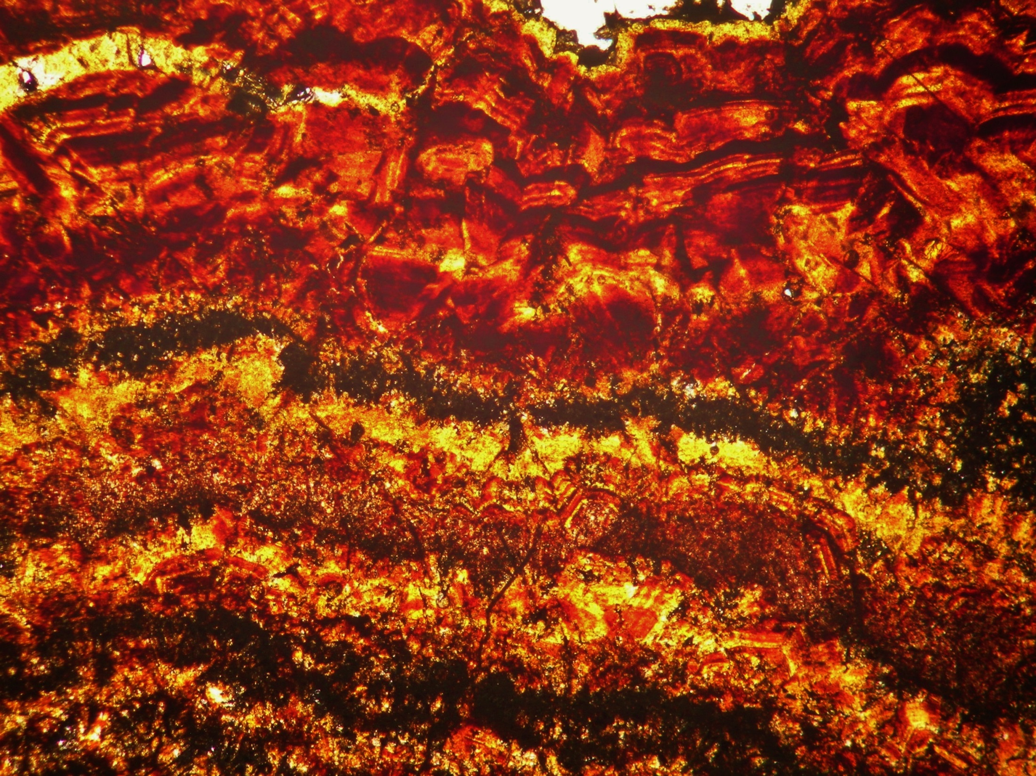
1 mm
Notes:
Open-space filling
Schalenblend sphalerites with mesoscopic color banding and nanometric, acicular texture

Slide 10
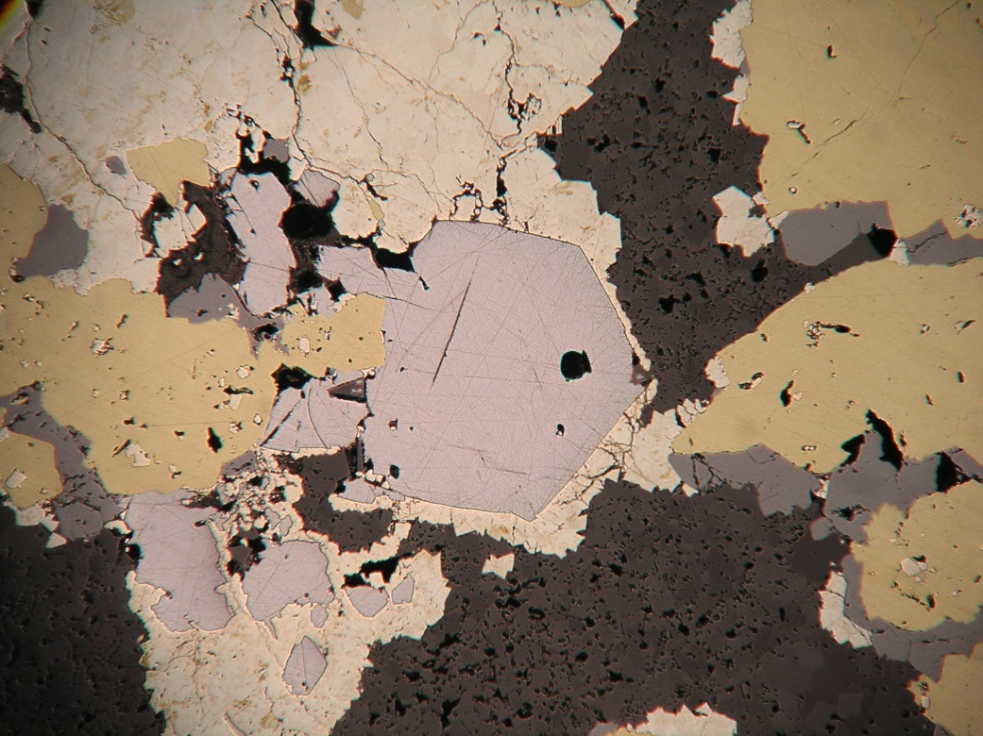
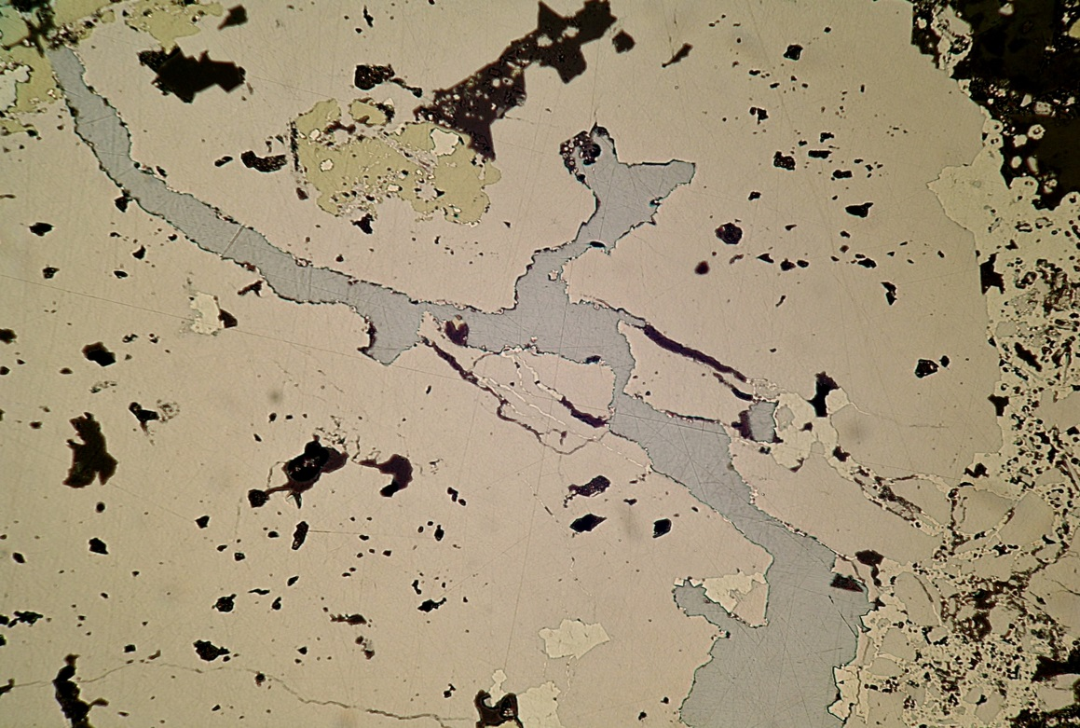
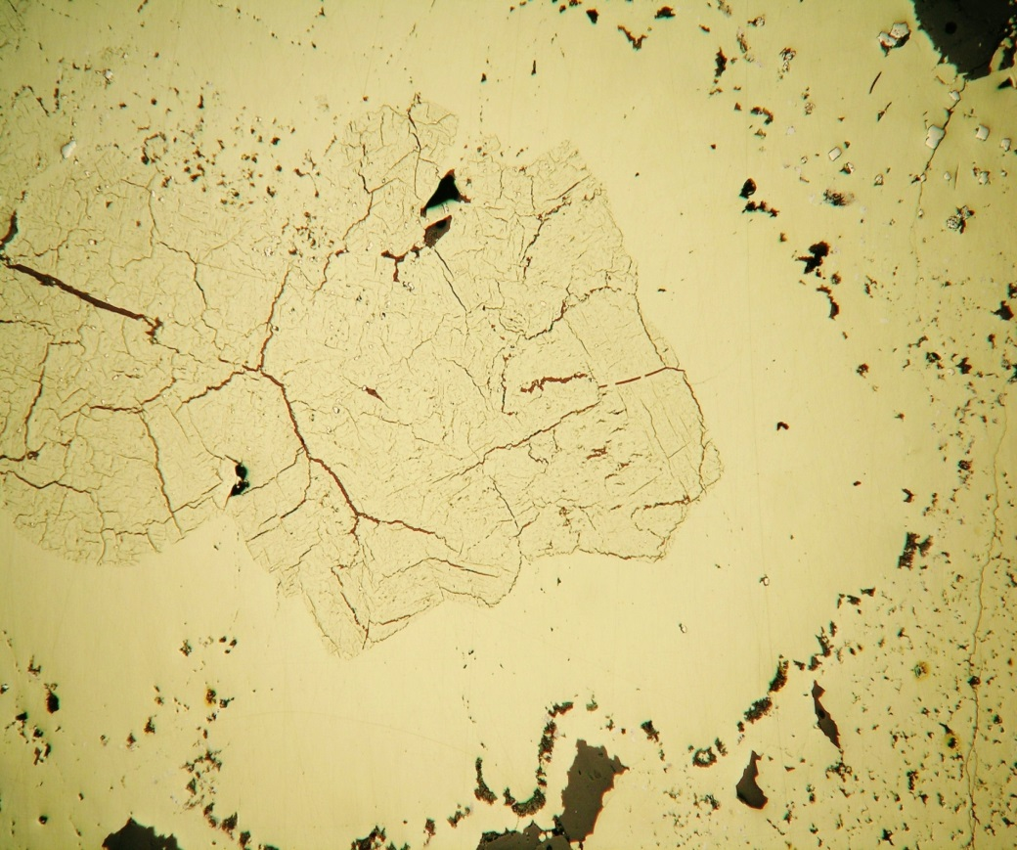
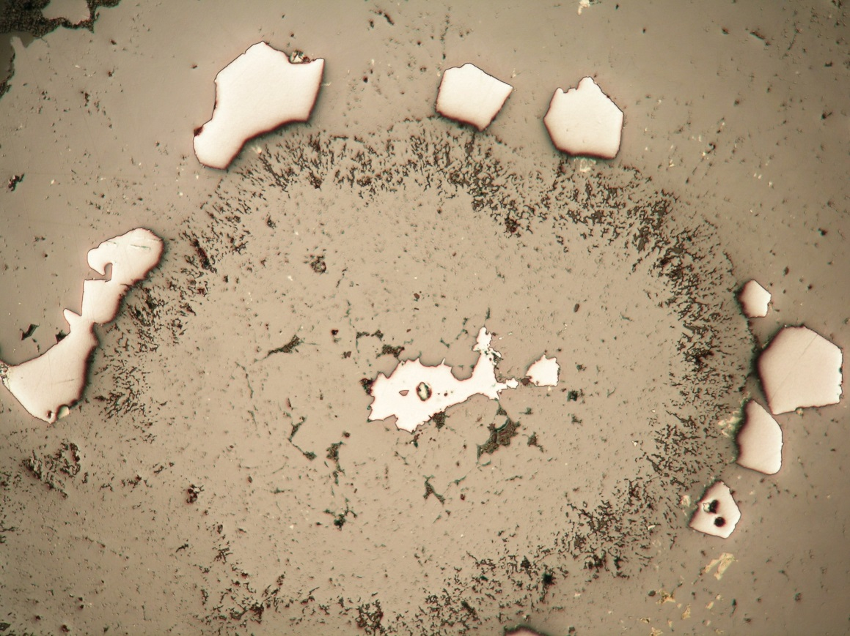
cpy
mrc
cpy
pyr
gal
sgn
gal
sph
1 mm
0.5 mm
gal
sph 2
sph 1
cpy 1
cpy 2
cpy 3
pyr
1 mm
1 mm
Notes:
Multiple generations
2 generations of cpy
2 generations of sph (supersaturated, then saturated) with intermission of low saturation of galena
Early mineralization
Replacement textures

Slide 11
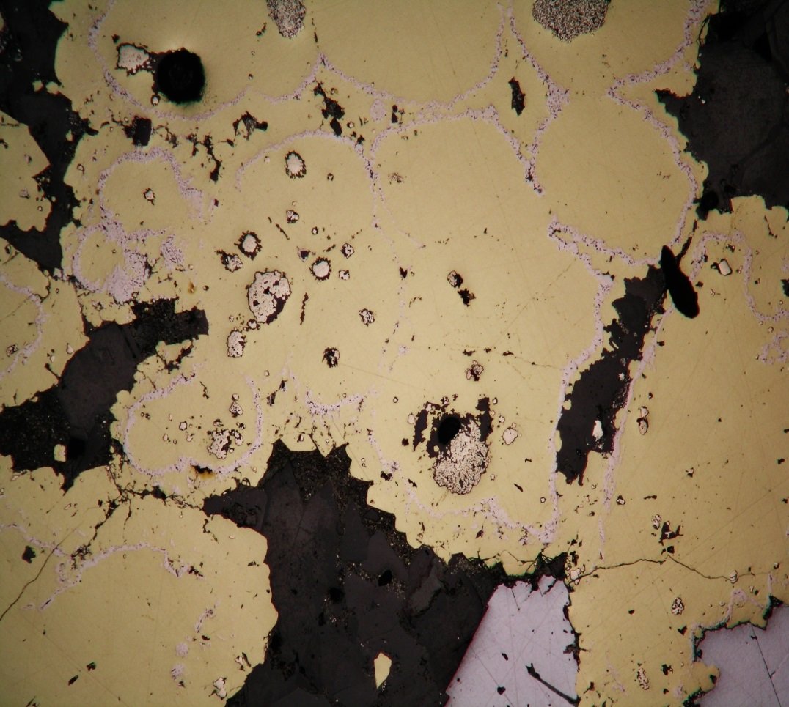
SEM-EDS analysis reveals diagenetic pyrite as nuclei for colloform and reniform cpy, as well as for Co-Ni minerals
1 mm
Center is recrystallized, diagenetic pyrite(framboidal) → overgrown by later cpy → mantled by an intervening band of an altering nickel-cobalt-bearing sulfide→ finally mantled by euhedral chalcopyrite
Notes:
Di-py may indicate bacterial or abiological sulphate reduction in the mudstones of the basal dolomite

Slide 12
Dolomite Cmnt.
1
?
?
Pyrite
2
3a
3b
4
Bravoite
1
2
3
4
5
6
7
Marcasite
1
2
3
Fletcherite
1
2
3
4
Ni Carrollite
Chalcopyrite
Bornite
1
2
3
4
5
6
7
8
9
Sphalerite
1
2
3
4
Gersdorffite
1
2
3
4
5
Tennantite
Enargite
Vaesite
Digenite
1
2
Anilite
Chalcocite
Djurleite
Blaubeibender Covellite
2
Covellite
1
Siegenite
1
2
Galena
1
2
3
4
Galena
Pyrrhotite
1
2
3
4
5
6
7
Magnetite
?
Anhydrite
Quartz
Millerite
1
2
Polydymite
Luzonite
Calcite
Dickite
= Dissolution
(modified from Hagni, 1986)
1
2
Bitumen
VEINS
MAIN Pb-Zn ORES
EARLY MINERALIZATION
LATE VUG-FILLING CRYSTALS

Slide 13
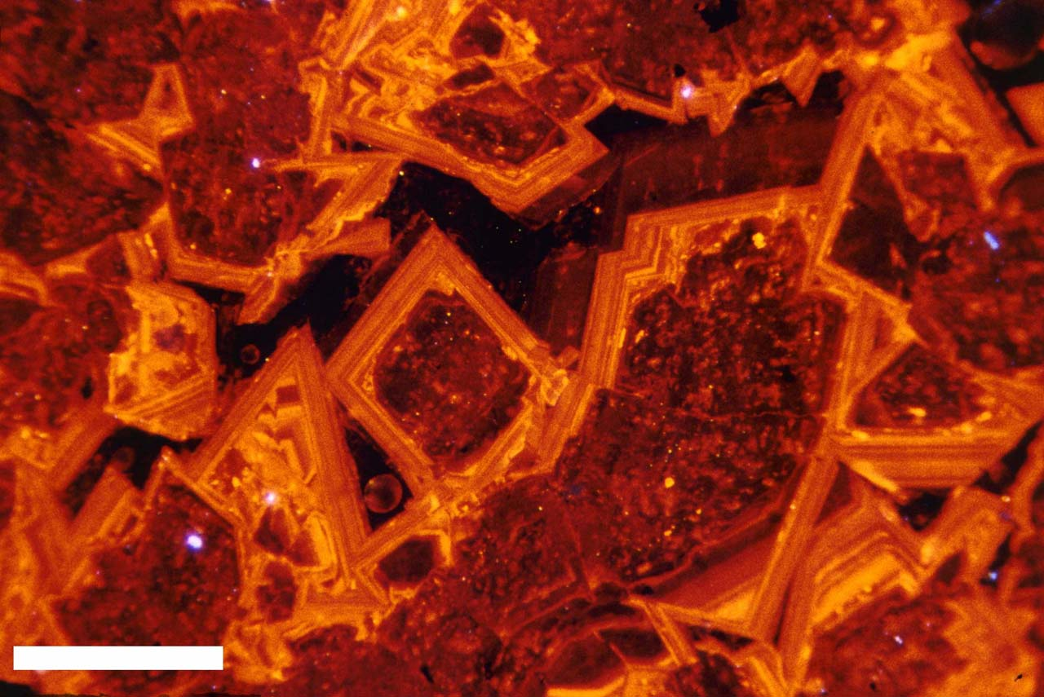
This is the typical, four-zone dolomite CL stratigraphy recognized throughout the Viburnum Trend and SEMO
4
3
2
1
0.5 mm
Notes:
MnCO3-excitor; FeCO3-inhibitor. ZONE 1: mottled texture without banding, ZONE 2: dull to non-luminescent band, ZONE 3: 2 sections of alternating fine bands of bright and non-luminescent dolomite separated by a dissolution zone, ZONE 4: non-luminescent band

Slide 14
The dolomite CL zoning in the lower section mineralization is different.
116.5 ft ( 35.5 m) beneath the mine floor
1 mm
Notes:
Much brighter to moderate and dull luminescent zones occurring early, followed by later dull to non luminescent banding zones. Also, a final, non-luminescent zone possibly correlatable to the 4 zone of the previous slide. Otherwise, this CL is very different from the typical regional stratigraphy and is divisible into more than four zones.

Slide 15
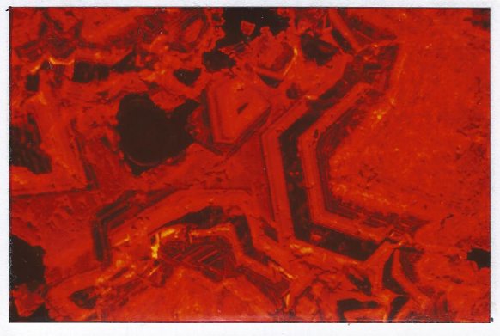
The only other place in which a similar dolomite CL stratigraphy has been observed is on the carbonate platform near the Reelfoot Rift.
1 mm
Lower Brushy Creek
0.5 mm
Western Platform
(from Keller et al. 2000)
Notes:
Keller observed and documented dolomite stratigraphies from the Marr and Oliver wells of the western platform. The trend of the WP-VT represents the evolution of fluids from high temp, low salinity, lower delta O18 values towards low temp, high salinity, higher delta O18 values in a rock-dominated system. Keller postulated that early dolomite cement of the WP and the RR were formed by similar fluids to those in the VT. However, he believed these fluids to have been separated later and consequently not responsible for ore deposition in the the trend.

Slide 16
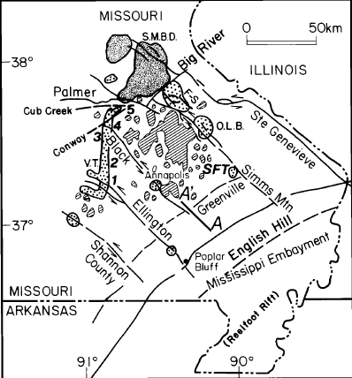
Current Hypothesis
New Bloomfield
mafic pluton
(from Clendenin et al., 1994)
Notes:
The fluids would have to migrate along the traverse faults and deviate either through fault splays or deep-penetrating fractures. Fluid migration by this means is supported by strontium isotope data and patterns of kspar leaching.

Slide 17
Summary
Typical VT Mineralization
Lower Section Mineralization
Mostly disseminated replacement textures
Stratigraphic pinch-outs, Precambrian knobs, facies changes, brecciation
Pb-dominant, main-stage mineralization
Four-zone dolomite CL stratigraphy bracketing the ore-forming events
Mostly open-space filling textures
Fault-related enhancement of porosity & permeability, and brecciation
Dominantly early, Zn, Cu, Co, Ni minerals with minor, main-stage mineralization
New dolomite CL zoning not seen previously in the Viburnum Trend

Slide 18
Acknowledgements
The authors would like to thank:
The Doe Run Company: Dillon Bailey, Terry Peppers, Andy Childers, Ross Conner, Tom Schott, Bruce Ahler (retired), and Bob Dunn (retired)
MU: James Schiffbauer; Midas Ore Research Fund; Keller Opportunities for Excellence Fund

