Slide 1
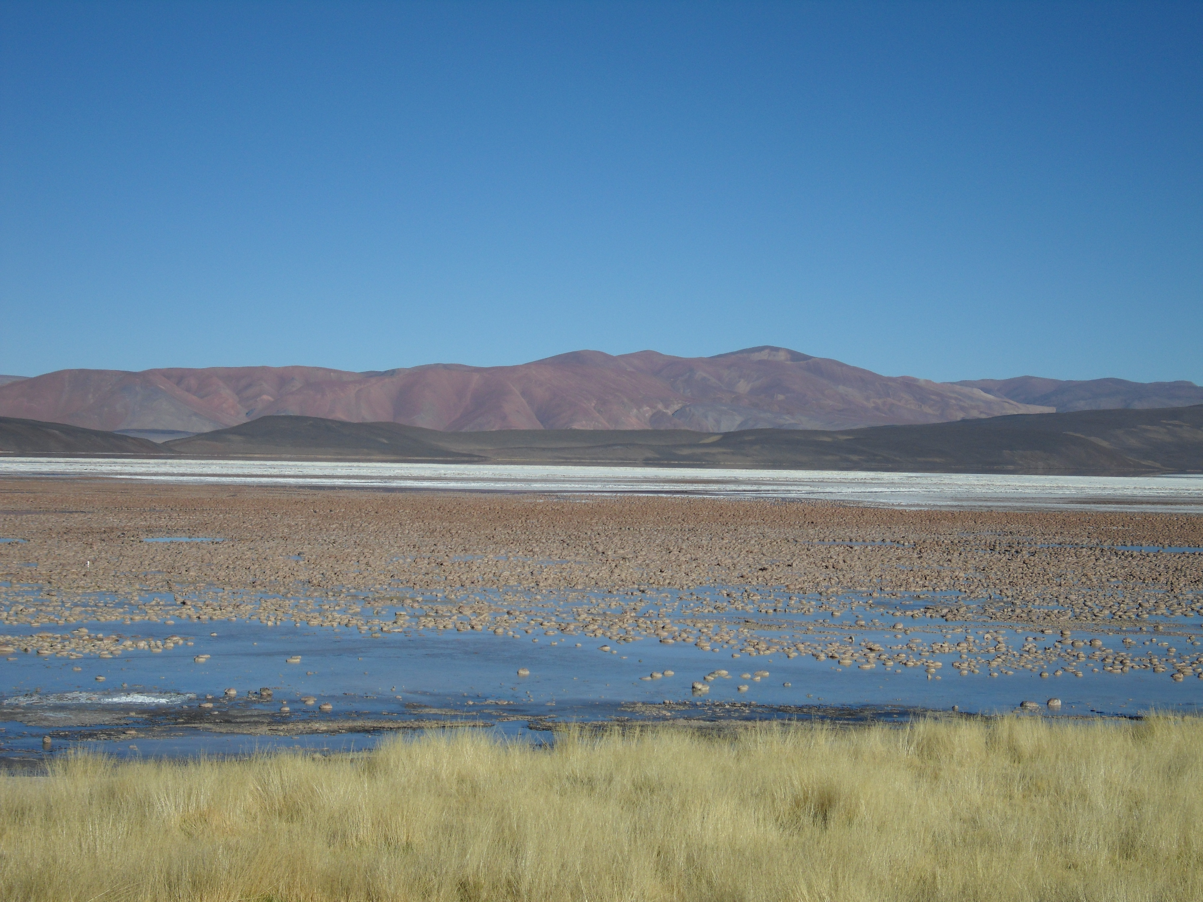

TIME-SERIES ISOTOPIC AND ELEMENTAL COMPOSITIONS OF MINERALIZED MICROBIALITES WITHIN A HIGH-ALTITUDE ANDEAN LAKE (LAGUNA NEGRA, CATAMARCA PROVINCE, NW ARGENTINA)
Joy Buongiorno, University of Tennessee
Linda C. Kah, University of Tennessee
Fernando J. Gomez, Universidad Nácional de Córdoba

Slide 2
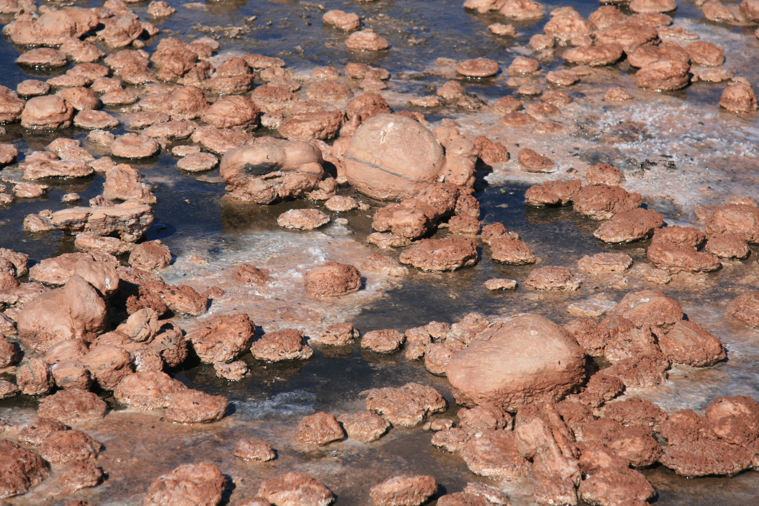
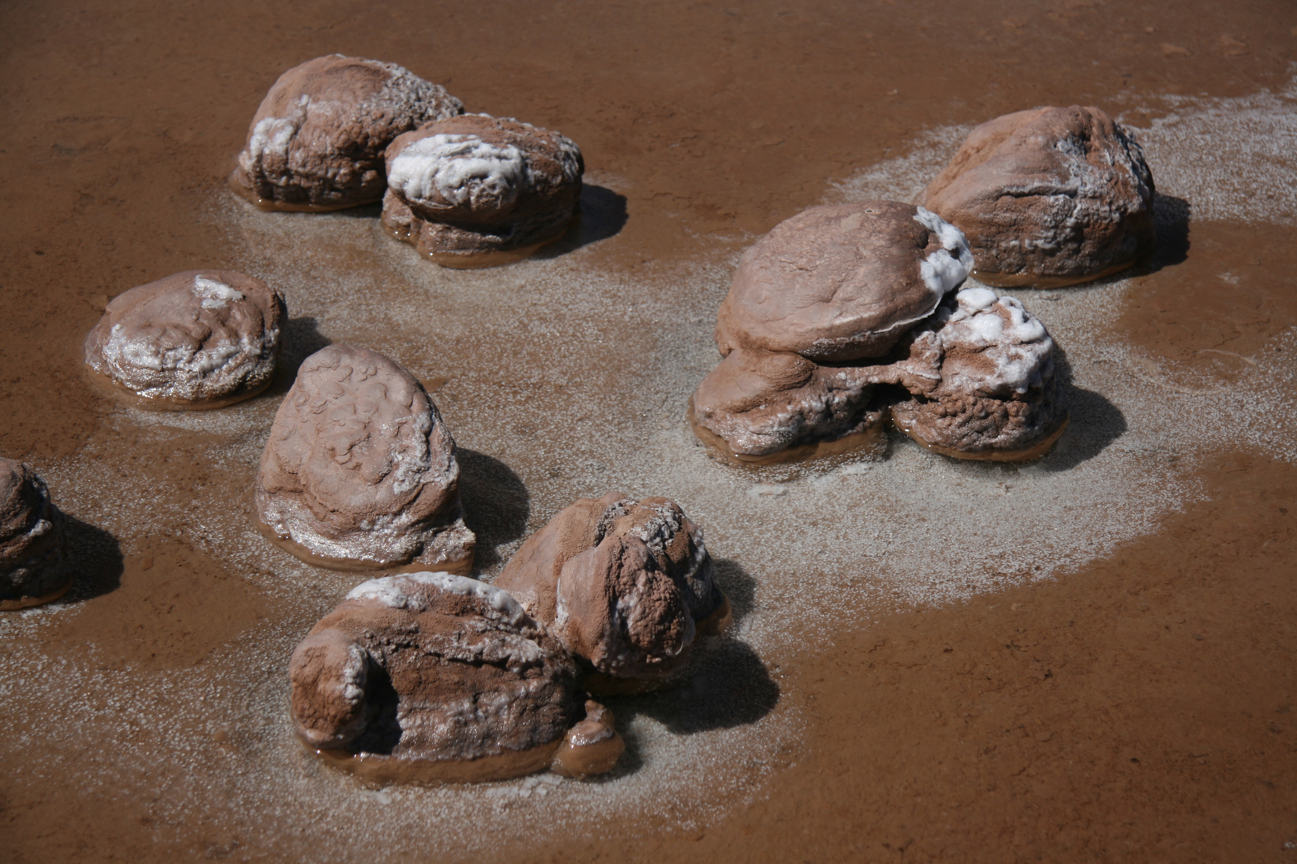
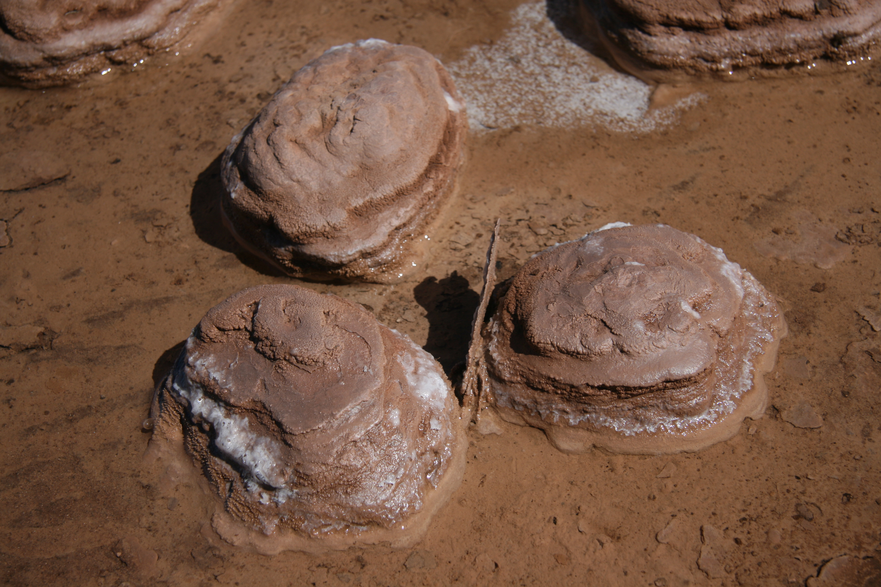
Mineralized Microbialites as Recorders of Paleoenvironmental Information
Environmental fluctuations, such as those related to climate, biological productivity, and evaporation can be recorded by lacustrine carbonates.
Terminal, closed-basin lakes are especially sensitive to envionmental change, and have potential for preserving both spatial and temporal records of these changes.

Slide 3
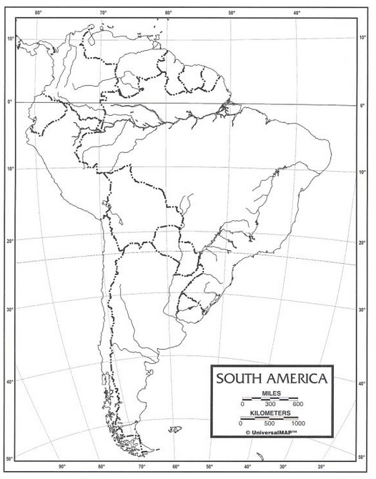
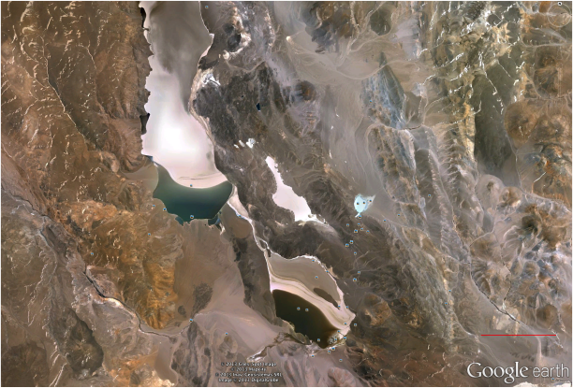
Puna region, Catamarca Province,
NW Argentina
Laguna Negra
5 km
Notes:
A series of closed-basin, high-altitude lakes are located in the Andean Altiplano. The basement is composed of andesite, dacite and basalt. The climate of the region dry and cold, with larger daily temperature variations (up to 40 degrees celsius). The largest source of freshwater is seasonal snow melt.

Slide 4
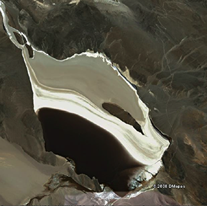
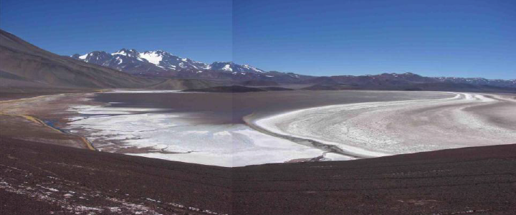
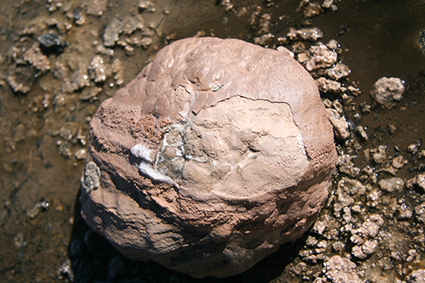
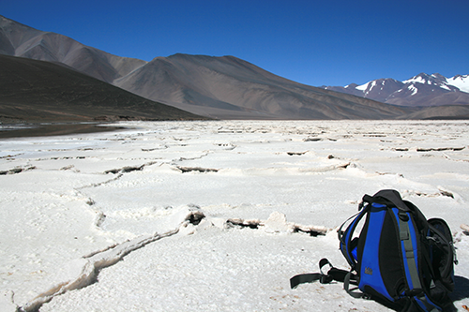
The Laguna Negra Saline Complex
Photo credit: Gomez et al., 2012
OpenWater
Avg. pH 5.7
Oncolite belt
Avg. pH 7.1
Saline plain
Lake salinity to >300 ppt, alkalinity to >833 mg/L
Notes:
A profile view along the south eastern edge shows the modern stromatolite belt in the southernmost edge, the extensive salt flat toward the north east, and the lake in between. Lake area is approximately 9 km and depth is very shallow, at 2 meters. Geochemical measurements made in situ during a previous field season. Age range determined via U-Th dating has at around 1,000 years at the outer rind, and up to 2,500 years at the innermost layer.

Slide 5
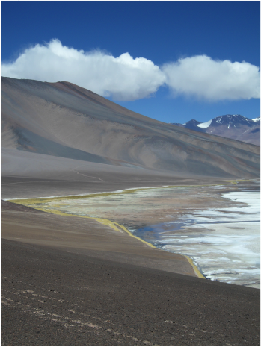
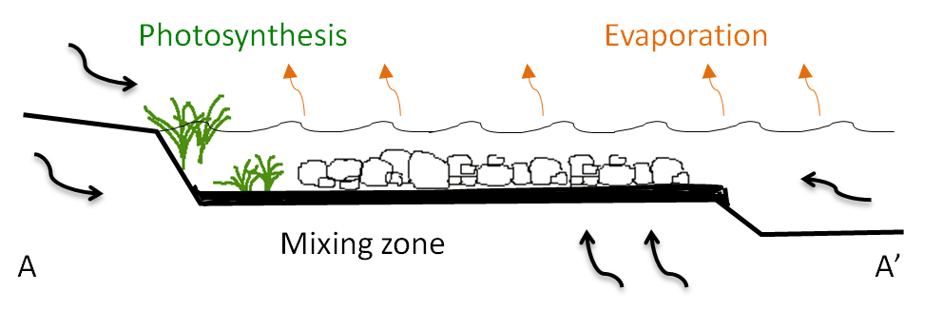
Drivers for Mineral Precipitation
Mixing of dissimilar fluids results in a spatial increase in carbonate saturation
Acidic hypersaline lake fluids provide abundance of ions
Hypersaline
Lake
Photosynthesis within microbial mats may aid in the biological drawdown of CO2
A
Low Salinity Influx
Gomez et al., 2012
Notes:
Precipitation of oncolites is thought to be driven by carbonate oversaturation due to mixing of hypersaline lake waters with low salinity ground waters that enter the basin seasonally or perennially due to snowmelt. The regions within the lake containing these oncolites have higher pH values than average lake waters, which induces increased carbonate ion activity and calcite saturation index. Gomez et al. 2013 performed geochemical modeling using PHREEQC-I and determined that the greatest saturation index of calcite was seen in mixed waters with a lake to inlet water ratio of 1:1 to 1:3. In addition to mixing of dissimilar fluids, biological drawdown of CO2 within microbial communities aid in calcite precipitation of these carbonates.

Slide 6
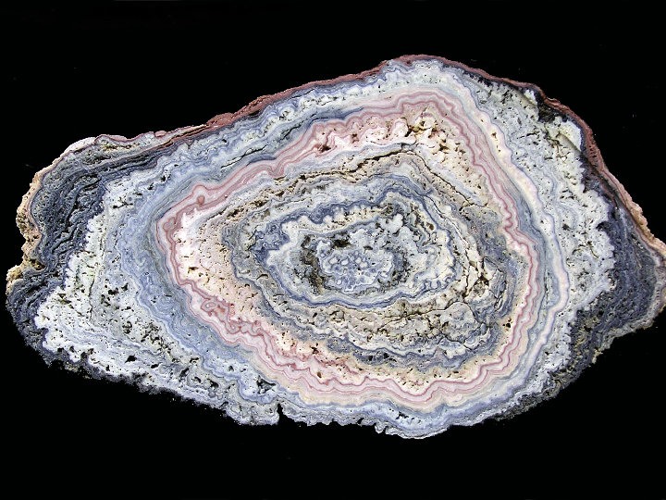
Laguna Negra Microbialite
LN-13-1
1 cm
Notes:
In hand sample, we see concentrically banded, alternating light and dark laminae. Deposition of layers is likely seasonal, with darker layers representing periods of salinity stress decrease, possibly due to seasonal snowmelt. The successive nature of these carbonates permits the unique reconstruction of geochemical and isotopic evolution of the lake.

Slide 7
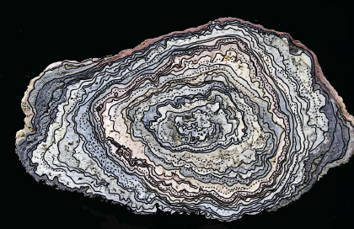
Geochemical Analyses
Sample
LN-13-1
LN-13-5
LN-13-10
LN-13-13
LN-13-20
LN-13-28
# Laminae
46
32
31
44
45
30
Trace discrete visible laminae in hand sample and thin section
Microdrill powders with <0.5 mm drill bits along laminae
Measure major and minor elements (Ca, Mg, Sr, Mn, Fe) via ICP-OES
Measure C- and O-isotopes of carbonate via IRMS
Notes:
Discrete laminae were identified both in hand sample and in thin section. These layers were then microdrilled by using dental drill bits attached to a drill press. Powerdered samples were logged and prepared for elemental analyses at the University of Tennessee and carbon and oxygen isotopes at Washington University in St. Louis. The colors here represent the colors that represent each rock sample in the upcoming graphs

Slide 8
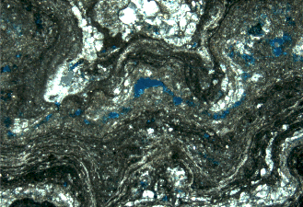
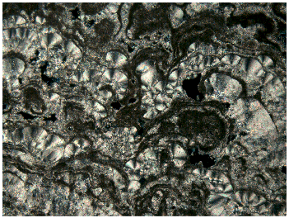
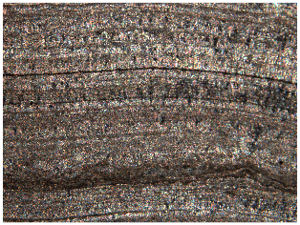
Petrographic Microfabrics
B – crystalline botryoids
M – irregular microsparitic laminae
I – isopachous crystalline to micritic laminae
M
1 mm
B
0.5 mm
XPL
I
0.25 mm
XPL
XPL
Notes:
Microfabrics currently identified primarily consist of abiotic, isopachous calcium carbonate, connected, sometimes laterally-discontinuous, botryoidal fan cements, dark, irregular micritic layers, often associated with microbial elements such as sheaths, and finally a complex sparry, diatom-rich siliceous ooze containing weak-walled microbial filaments and diatom tests.

Slide 9
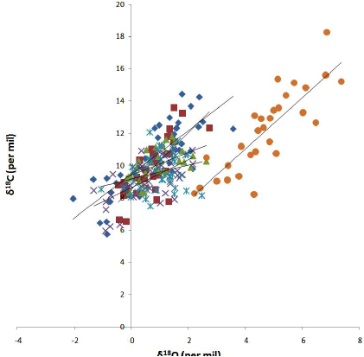












Oxygen and Carbon covariance
δ¹³C (PDB)
δ¹⁸O (PDB)
Carbon and oxygen covariance
Heavy δ¹³C suggests increased CO₂ degassing and productivity
Spatial position in lake reflected in δ¹⁸O values
Notes:
As a closed-basin lake, Laguna Negra very sensitive to hydrological fluctuations, such as those related to groundwater influx or evaporation. Oxygen and carbon isotope covariance is displayed by Laguna Negra oncolites, with varying degrees of significance among samples. Covariance with respect to oxygen and carbon isotopes may reflect a combination of abiotic and biotic geochemical effects. For example, enriched oxygen isotopes are likely attributed to kinetic fractionation through evaporation. This not only increases surface productivity and thus biological drawdown of CO2, but also plays a role in increasing CO2 degassing, leaving the DIC pool enriched.
Strong covariance of C-O, typical of closed-basin
Heavy δ¹³C suggests increased productivity and CO₂ degassing
Spatial position in lake reflected in δ¹⁸O values

Slide 10
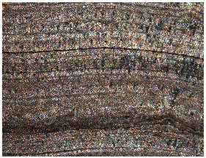
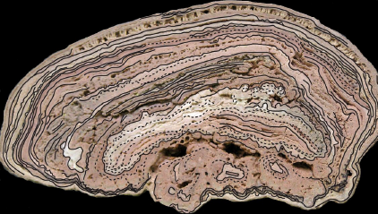
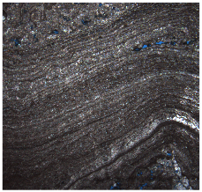
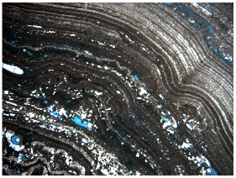
LN-13-28
1 cm
XPL
0.25 mm
XPL
1 mm
XPL
1 mm

Slide 11
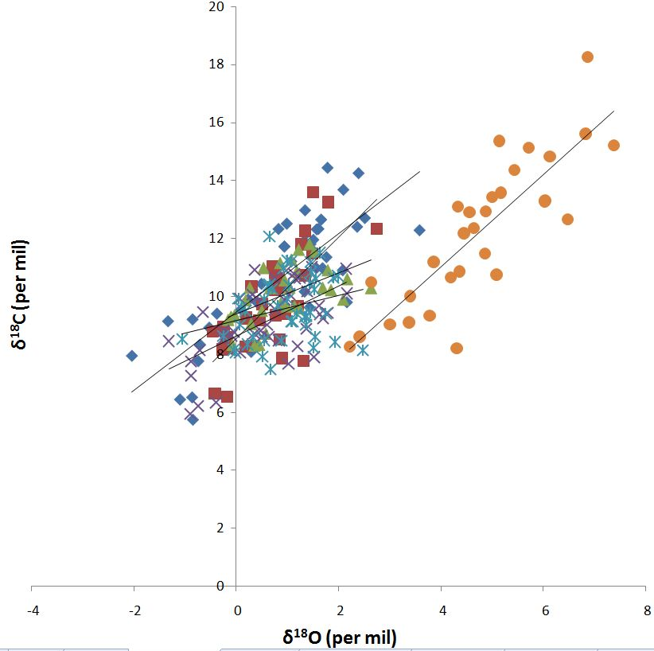
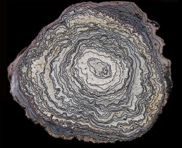
Oxygen and Carbon covariance
δ¹³C (PDB)
δ¹⁸O (PDB)

Slide 12
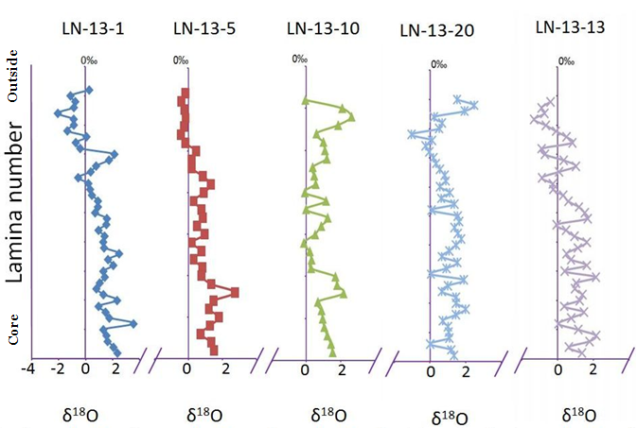
Oxygen isotopes
Samples associated with microbial mats show uniformity in trends
Time-wise progression toward lighter values (freshening)
High variability in values tied to spatial position within lake

Slide 13
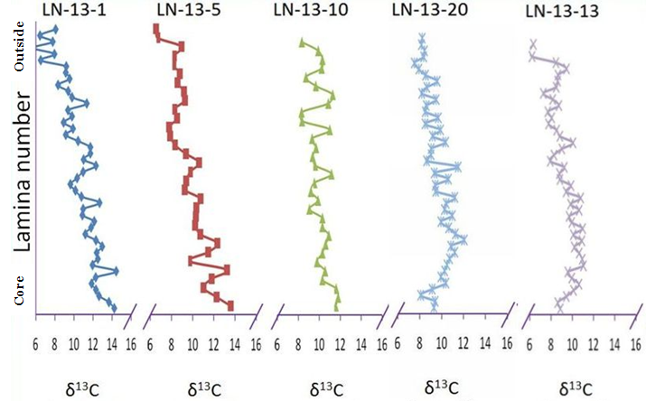
Carbon isotopes
Similar trends as δ¹⁸O (lighter isotope values)
Suggests dominant influence is decreased evaporation (freshening)
Small changes from productivity

Slide 14
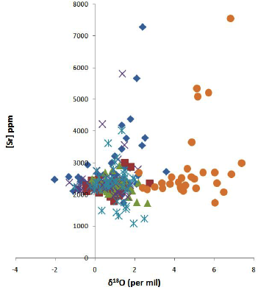
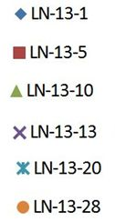
δ¹⁸O and [Sr]
Trends suggest times of evaporation decoupled from salinity increases, until threshold reached.
Notes:
Here, a pattern in the data suggests that increased evaporation, as indicated by enriched oxygen values, is decoupled from salinity changes, as indicated by increasing Sr incorporation. In cases of samples collected bothwiht and without microbial mats, see a marked increase in strontium incorporation after 3 percent per mil oxygen isotope values.

Slide 15
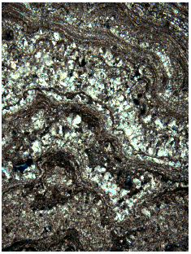
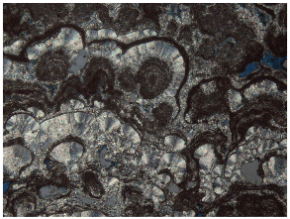
Microfabric relationships to geochemistry
Strontium and oxygen enrichment
LN-13-1
  7285 ppm strontium
2.39 ‰ δ¹⁸O
XPL
1mm
XPL
0.5 mm
Notes:
Not uniformly true, but botryoidal fabrics seem to be associated with increased evaporation, as suggested by enrichment in heavy oxygen isotopes, and increased strontium. Botryoids could be aragonite, will follow up with XRD to confirm.

Slide 16
Conclusions
Isotopic signals of Laguna Negra microbialites driven mainly by basin dynamics.
  δ¹³C_{org} will permit identification of roles of productivity.
  Laminae microfabrics associations suggest correlation between specific fabrics and oxygen isotopes and strontium abundance.
Geochemical compositions and fluctuations are reflective of microbialite spatial position within the lake.
Notes:
Further geochemical analyses may permit the reconstruction of LN lake dynamics. Spatial distribution of microbialites of Laguna Negra is indicated by geochemical compositions of laminae.
Isotopic values and elemental abundance are reflected in microfabrics.

Slide 17




Acknowledgements
Continuing investigation is funded in part by:
University of Tennessee
The Society for Organic Petrology
Geological Society of America
SE Section, Geological Society of America
SEPM, The Society for Sedimentary Geology

