Slide 1

Direct Landslide Costs in the United States: Who Bears the Burden?
A Pilot Landslide Loss Study for the States of Washington and Oregon With an Application to the 50 United States
Lynn Highland, Geographer
USGS Landslide Program
Golden, Colorado

Slide 2

The Colorado Flooding of September is costing homeowners, businesses and local governments nearly $2 billion, much of it uninsured
Special GSA Session,
The 2013 Colorado Flood Event:
A Perfect Storm Hits a Dynamic
Landscape —
Causes, Processes, and Effects.
8:00 AM Tuesday, October 29 –Ballroom 2AB and 3AB

Slide 3

Arapahoe Ave. in Boulder, CO
Photo by Jonathan Godt, USGS
Notes:
Split office building in two

Slide 4
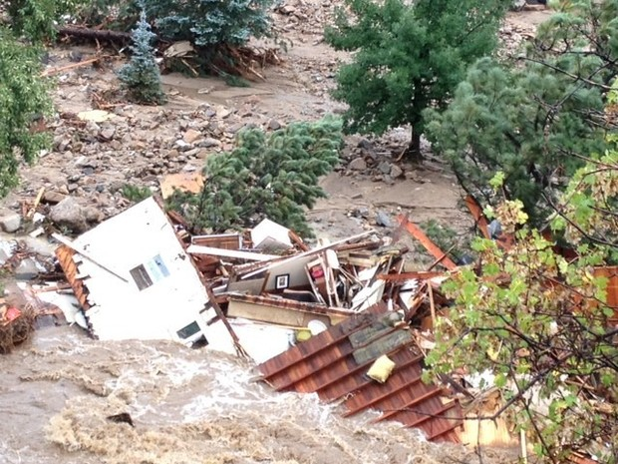
Jamestown, CO (north and west of Boulder)
Photo credit: The Denver Post, Brandon Jacobs

Slide 5
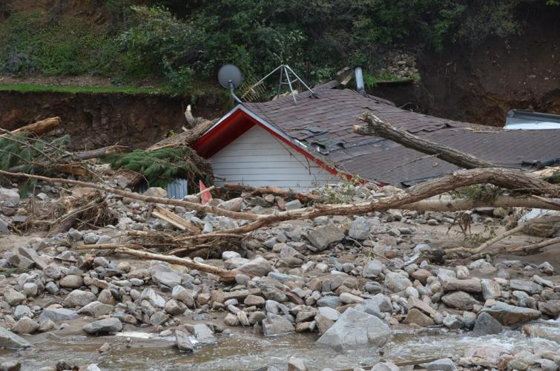

Jamestown, CO – Sept. 16 – photo by Jason Kean, USGS

Slide 6
Big Thompson Canyon, west of Estes Park
Photo by Jonathan Godt,
USGS
Notes:
Big Thompson Canyon, west of Estes Park – USGS Photograph by Jonathan Godt, September 20, 2013

Slide 7
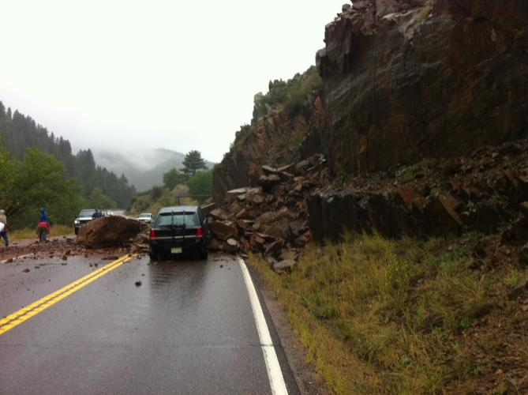
Rockslide in Golden Gate Canyon
near Golden, CO
Photo by Dennis Staley, USGS

Slide 8
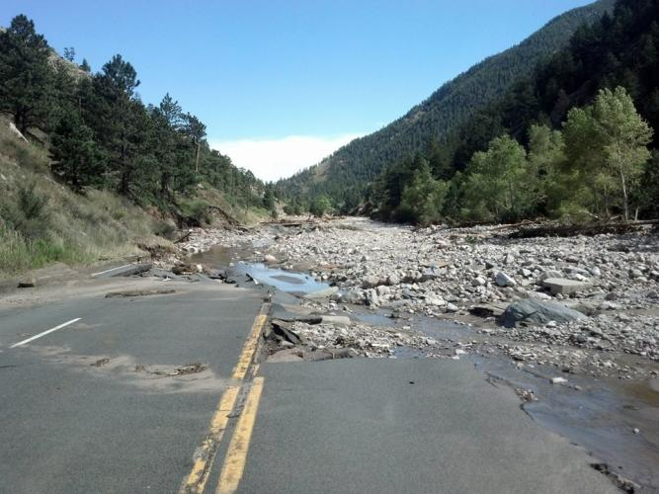
Larimer County, Highway 34 (north of Boulder)
– photo by Justin Smith, Larimer County Sheriff

Slide 9
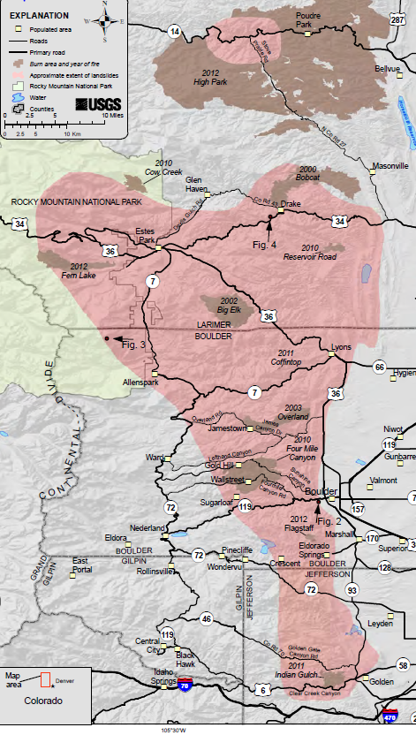

Extent of landsliding
Caused by heavy rainfall
And flooding
Jamestown
Boulder
Golden

Slide 10
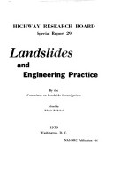

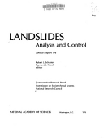
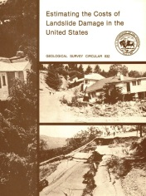
From a global perspective the U.S. has the longest history of landslide loss studies
Fleming & Taylor (1980)
USGS Publication
Estimating the Costs of Landslide Damage in the United States
Smith (1958)
„hundreds of millions of annual monetary losses“
Krohn & Slosson (1976)
Systematic cost extrapolation
Schuster (1978)
Annual costs of > $1bn
The focus was on case study regions and years of increased landslide activity
Data based on expert interviews and archive information
Cost figures start at city or county level and end up as regional and national extrapolations
Notes:
One of the things that I hope to accomplish in the next 2 years is to produce an updated, national cost estimate for
The United states. First, a history of cost studies for the United States, why a new one is needed, and some of the pros and cons of attempting this type of assessment.

Slide 11
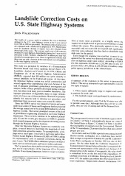
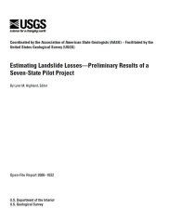
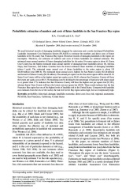
After 2000 several studies covering
a broad spectrum of topics
Walkinshaw (1992)
Landslide Costs for the U.S. Highway System
Highland (2006)
U.S. Landslide losses – Seven-State Pilot Project
Crovelli & Coe (2009)
Probablistic Cost Estimation for the San Francisco Bay Area
In Future
A new cost estimate for the U.S.
Cross-sector studies and additional key focus on transportation
Cost assessment, socioeconomic evaluation and probabilistic loss modeling
Strategies for compiling cost data more systematically

Slide 12
Why do we need an up-to-date
National Cost Estimate
for Landslides, that
includes casualties?
Notes:
Because it’s an obsolete estimate

Slide 13
Today‘s global disaster databases
A reliable data source?
Global landslide loss record 1900-2013
Africa | Very little data
Americas | $2.7 billion
Asia | $2.8 billion
Europe | $4.9 million
Oceania | $2.5 million
EM-DAT: The CRED/OFDA International Disaster Database
Notes:
CRED – Centre for the Research of epidemiology of Disasters – A University in Brussels, Belgium – database of disasters from 1900 to present – 10 or more killed; 100 or more affected; declaration of state of emergency; Call for International assistance – in US$
You can see that one of the international databases is tracking the Americas at a lower rate than our studies show.

Slide 14

United States estimate dates from the 1985 National Research Council, Committee on Ground Failure report--still referring to this cost figure:
$1 – $2 Billion per year (average)
25 – 50 Casualties per year
( *$2.1 – $4.3 Billion modified
to reflect inflation, 2013 Dollars)
*

Slide 15


Why Study Washington and Oregon first?
Good solid data in the form of
maps, reports, cost studies
Have a focused, sustained interest in mitigating their landslide hazard
A willingness to share data and cooperate

Slide 16
POSITIVE DEVELOPMENTS for a new cost figure
Since 1985, the explosion of available digital data
has made landslide costs easier to obtain and
hopefully more accurate
We won’t have to rely on extrapolation and
unreliable estimates, as much as we did in the past.
The data is better itemized as to who bears brunt of
the cost – Private, State and local, or Federal entities

Slide 17
CHALLENGES
There are still areas of the U.S. with little or no data
Problems remain for extracting landslide data from other associated hazards, such as earthquakes and floods
Still no insurance for landslides which if existed, would be a great help in tracking costs

Slide 18
WHO BEARS THE COSTS OF LANDSLIDES?
#1
The Federal Government?
Taxpayers
#2
State and Local?
Taxpayers
#3
Private Sector?
Private Funds

Slide 19
Landslides are notorious for causing skyrocketing indirect costs
such as:
Consequences of no private insurance
Loss of business activity
Costly detours for commercial traffic on highways
Environmental
Regulatory Issues
Notes:
Environmental includes loss of ag land, grazing, forest changes, stream and water quality – therefore, involve a whole additional study for these types of losses -

Slide 20
HOW WILL THESE COSTS BE PRESENTED?
1.
Average annual costs, calculated over a period of years?
2.
Aggregate costs for a period of years, for example, 1980s to the present?
3.
Some costs studies in the past, were costs per capita. Is this a better approach?

Slide 21
Thanks for your
Attention!

