Slide 1

Learning from evidence in the context of global climate change
Jenny Dauer and Andy Anderson

Slide 2

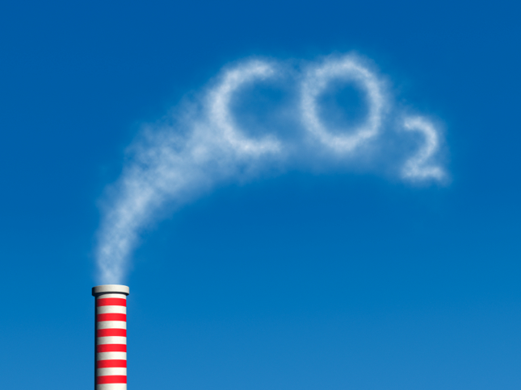
Science literacy involves learning from evidence
Analyzing and interpreting data
Constructing explanations
Engaging in argument from evidence
In context of climate change?
Evidence is situated in complex interdisciplinary models of earth systems
Notes:
NGSS recommends three key student practices for scientific literacy:
In the context of climate change, this evidence is situated in complex interdisciplinary models of earth systems. How do students “learn from evidence” in this situation? What becomes meaningful, and what becomes challenging?

Slide 3
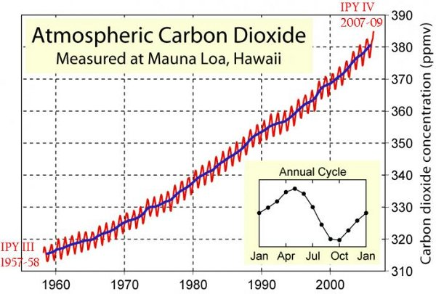
Iconic representation of evidence for carbon dioxide emissions
What does it mean to understand the Keeling Curve?
Notes:
Keeling Curve– famously used as self-evident evidence for human greenhouse gas emissions. In our classes we would want students to use this graph to: Interpreting and analyzing data as evidence that CO2 in the atmosphere has increased over the last 50 years.
Constructing explanations about the reason for the overall trend (combustion) and the reason for the annual cycle (PS in the summer in the N hemis)
Engaging in arguments from evidence about the best way to mitigate CO2 emissions by tracing to the source of CO2.
What does it mean to understand the Keeling Curve?

Slide 4
Qualitative research methods
Preliminary interviews and analysis
28 middle and high school students in science classes in rural Michigan, no common instruction
Keeling Curve was one segment of larger interview on evidence for global climate change
Coding using grounded theory with a team at MSU

Slide 5
Interview Protocol
Q’s to check for reading graph correctly.
Do you have any idea why Charles Keeling went there to collect these data?
Do you think we could use these data to estimate CO₂ concentrations in Michigan during this period? Why or why not?
Do you see a pattern? If so, what pattern do you see?
What do you think could be the cause of this pattern of the line in blue? … line in red?
Could we use this graph to make predictions about carbon dioxide concentrations at Mauna Loa in 2015? What predictions could you make?
Notes:
Here are the basics of the questions we asked
In case asked… here are the questions associated with #1
This graph shows levels of carbon dioxide concentrations in the atmosphere in the past 50 years. Mauna Loa is a tall mountain on the island of Hawaii in the middle of the Pacific Ocean. These data were collected by a scientist named Charles Keeling.
Check their interpretation of this graph by saying “First a few questions to give you some more time exploring the graph.”
Can you find the point on the graph that shows 2000?
What does that point tell you about CO₂ at Mauna Loa in 2000?
Now look at the box that says “Annual Cycle.” The line in this box, is like the red line on the graph, and it shows you what is happening to CO₂ concentrations within one year.
So looking at this box, how do CO₂ concentrations compare between April and October?

Slide 6
Research Question
What are students’ interpretations of the Keeling Curve graph?
Two challenges for students:
Generalizability of the data to other places on Earth
2) Mechanisms that explain the data A) Overall Upward Trend (blue line) B) Annual Cycle (red line)
Notes:
We saw two issues that led to misunderstandings about how to mitigate climate change.

Slide 7
1) Student challenges with generalizability
Do you think we could use these data to estimate CO₂ concentrations in Michigan during this period?
Across all 28 interviews:
26% said yes for the overall trend but uncertain about the actual numbers
“You could get the same trend in general, but the data points themselves, probably not, because [the two places] have different conditions.” ~Tom, HS Bio
Notes:
Huge range in types of responses. About 1/3rd were able to say something that we might interpret to be close to how a geoscientist might answer it….. to the effect of yes for the overall trend, but can’t predict the actual numbers. Range in how articulate they were about this point

Slide 8
1) Student challenges with generalizability
Do you think we could use these data to estimate CO₂ concentrations in Michigan during this period?
Across all 28 interviews:
No (39%) because:
“atmospheres of HI and MI are not connected” “HI and MI are different”
Yes (32%) because:
“atmospheres of HI and MI are connected” “HI and MI are alike”
Notes:
40% said no! Not relevant to their state! MI and HI do not have connected atmospheres. Or, they are different in terms of climate, plants, animals # of humans.
Yes—because atm connected (but without reasoning about the overall upward trend). Or, alike, same # of people, # of plants, driving more in the summer and heating homes in winter.
Lots of confusion here. Some of this confusion probably relates to students fundamentally not understanding the purpose of this data– to represent global CO2.

Slide 9
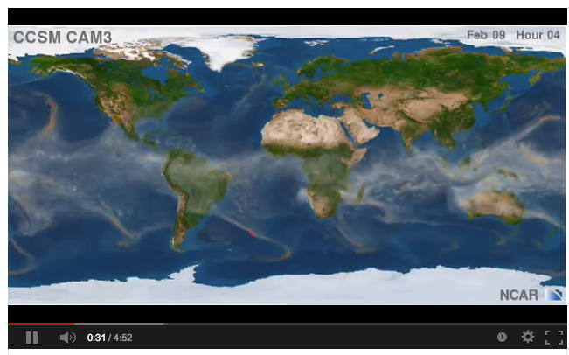
Scaffolding ideas about generalizability of the Mauna Loa data to other places on Earth
- global atmosphere circulation
Video of global air circulation
http://www.youtube.com/watch?v=qh011eAYjAA

Slide 10
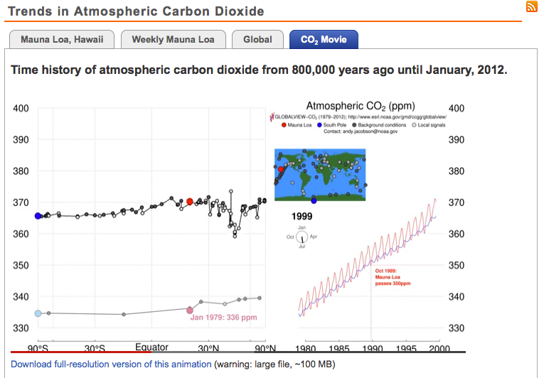
Scaffolding ideas about generalizability of the Mauna Loa data to other places on Earth
how Mauna Loa is removed from local sources of CO₂
how CO₂ concentrations have change in other parts of the globe
“History of CO₂“ or “Pumphandle” Video
http://www.esrl.noaa.gov/gmd/ccgg/trends/history.html

Slide 11
2) Student challenges with mechanisms that explain the data
What do you think could be the cause of this pattern of the line in blue?
Across all 28 interviews:
18% clearly articulate that combustion of fossil fuels releases CO₂
The remaining students said things like: “Most likely global warming… and ozone depletion” ~Logan, HS Bio “Industries are responsible for pollution” ~Sarah, AP Bio “Volcanoes… plants and animals dying off” ~Pat, HS Bio
Notes:
Blue: many say “industries” “pollution” or even “emissions of CO2” without pointing to combustion of fossil fuels…global warming is causing CO2 increase
Logan & Sarah– *Vague way association with global warming and other problems

Slide 12
2) Student challenges with mechanisms that explain the data
What do you think could be the cause of this pattern of the line in red?
Across all 28 interviews:
14% say anything about photosynthesis
The remaining students said things like:
“Less factories are releasing gases in Oct than April” ~Logan, HS Bio “When it’s colder, gases freeze in the ice” ~Tessa, MS Bio “More people drive in the summer” ~Peter, HS Bio
Notes:
many say “more driving, more industry or more lights” in one of the seasons, temperature changes
Peter = *Vague way of reading the graph

Slide 13
2) Student challenges with mechanisms that explain the data
Vague association with global warming without understanding the mechanism:
confusion about global warming & ozone
many talk about “global warming” as a cause of the data, rather than an effect of CO₂ emissions
vague reading of the graph
notion of association with factories, plants and volcanoes
Notes:
Students seem to be more attuned to a story about how global climate change is loosely associated with CO₂, factories and plants than to making sense of data. See graph as a visualization of how people are doing bad things to the atmosphere, but not linked to CO2 emissions.

Slide 14
These challenges lead to problems understanding mitigation
Many people indicate that mitigation for climate change should include:
increasing gas mileage
decreasing coal burning
cleaning up toxic wastes
fixing the hole in the ozone layer
decreasing use of nuclear power
(Bostrom, 1994; Kempton, et al. 1996; Leiserowitz & Smith, 2010)

Slide 15
Conclusions
If we want students to use and learn from evidence:
Analyzing and interpreting data about CO₂ emissions
Constructing explanations about the source of increasing CO₂ emissions
Engaging in argument from evidence about best ways to mitigate CO₂ emissions
…we need to build a coherent model and story for students by providing scaffolds for understanding earth systems.
Notes:
If we want students to be able to do these practices Learning about Earth systems including:
Greenhouse effect (work by Shepardson et al 2011 shows student difficult)
Carbon transforming processes across scales Photosynthesis Cellular respiration Combustion
Human energy systems

