Slide 1
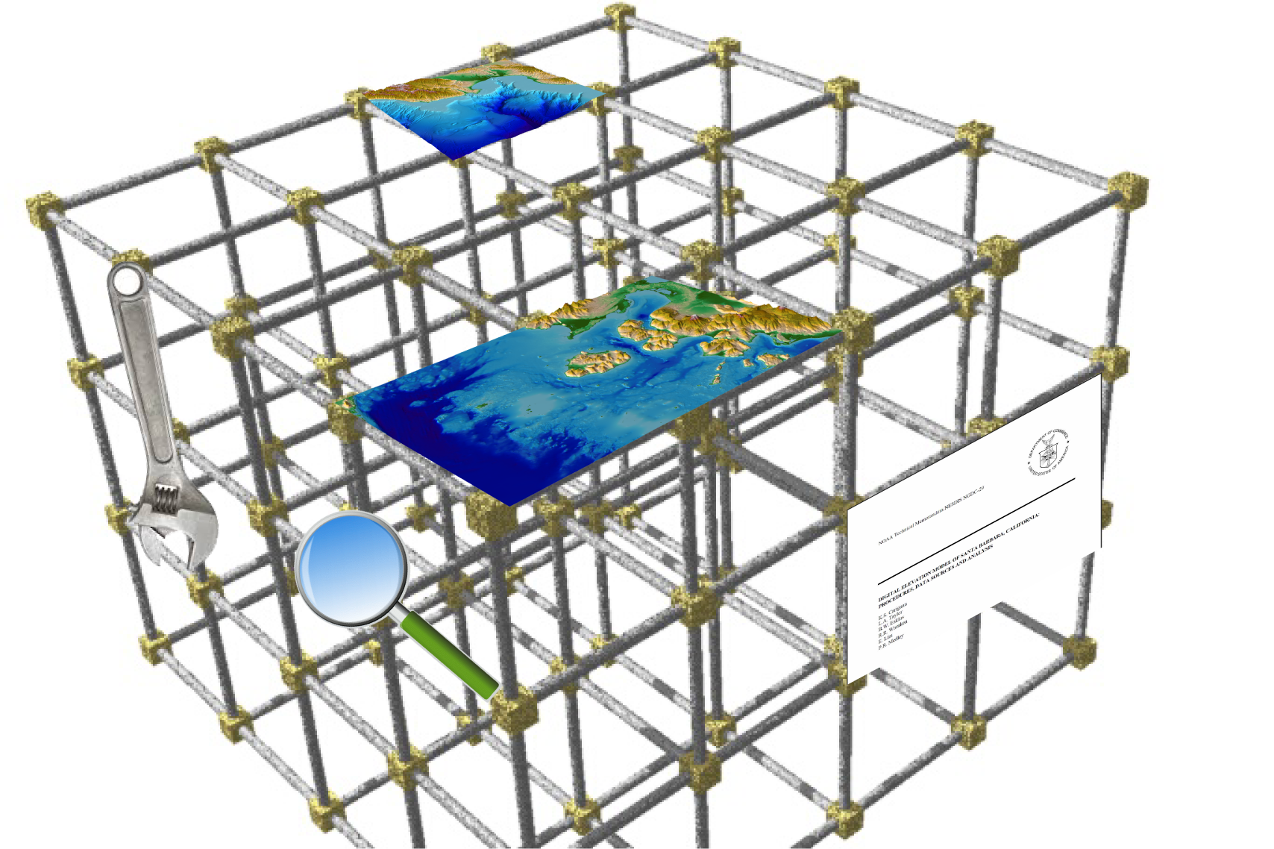



Creating a framework for integrated U.S. digital elevation models
Barry Eakins,
Jeff Danielson
John Brock,
Michael Sutherland, and Sue McLean
1
2
2
1
3
University of Colorado at Boulder
U.S. Geological Survey
National Oceanic and Atmospheric Administration
Notes:
Specifically square-cell / raster DEMs.

Slide 2
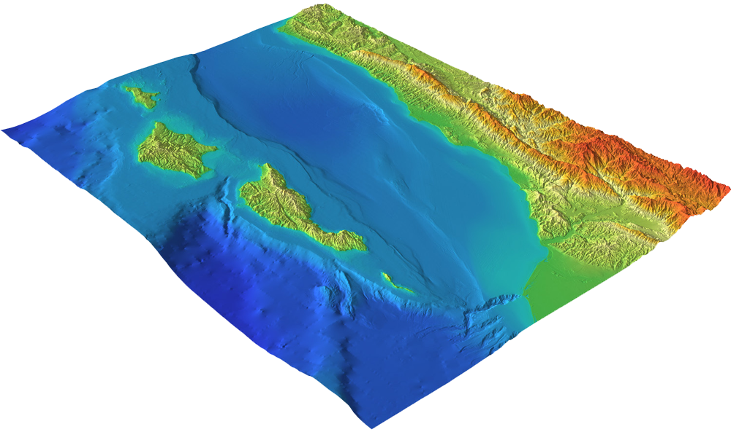
Coastal DEM Framework Goal
Goal: For users to discover and access publicly available integrated bathymetric-topographic DEMs and color, shaded-relief hillshade images (e.g., geotiffs) of U.S. coasts and Great Lakes
At a range of pre-determined cell sizes (e.g., ⅓ arc-seconds, 3 arc-seconds)
In different vertical datums (e.g., NAVD 88, MHW) and coordinate systems (e.g., geographic, UTM zone)
Models built by different Federal / State agencies, universities, private sector
Models covering different temporal ranges (e.g., morphologic change analysis)
Santa Barbara, CA
coastal DEM

Slide 3
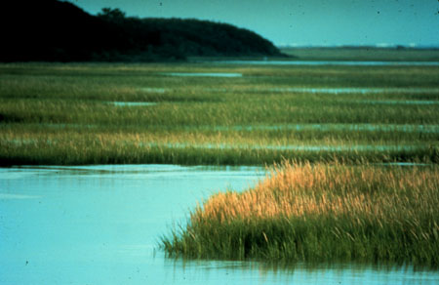
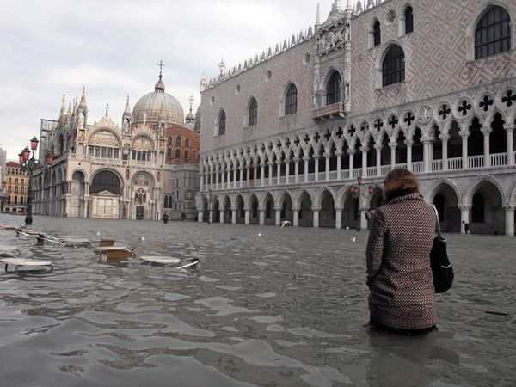
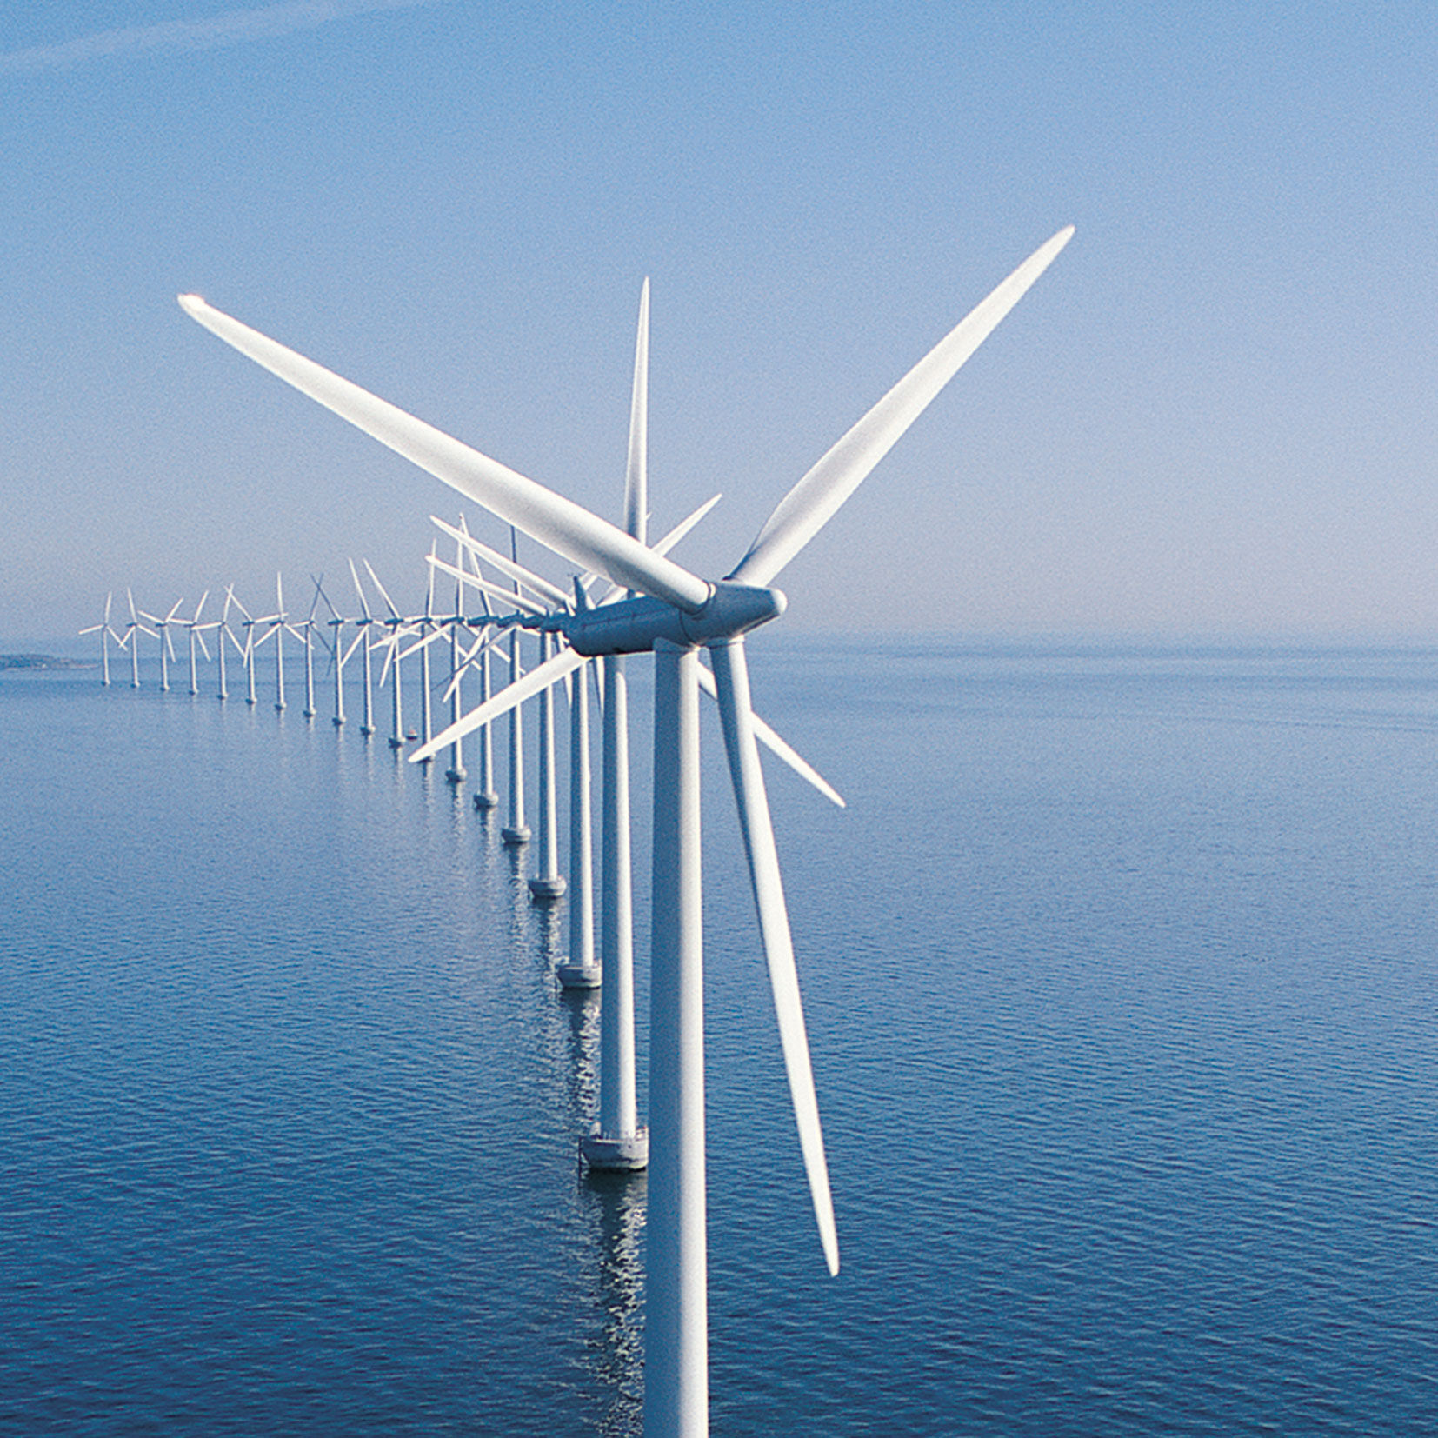
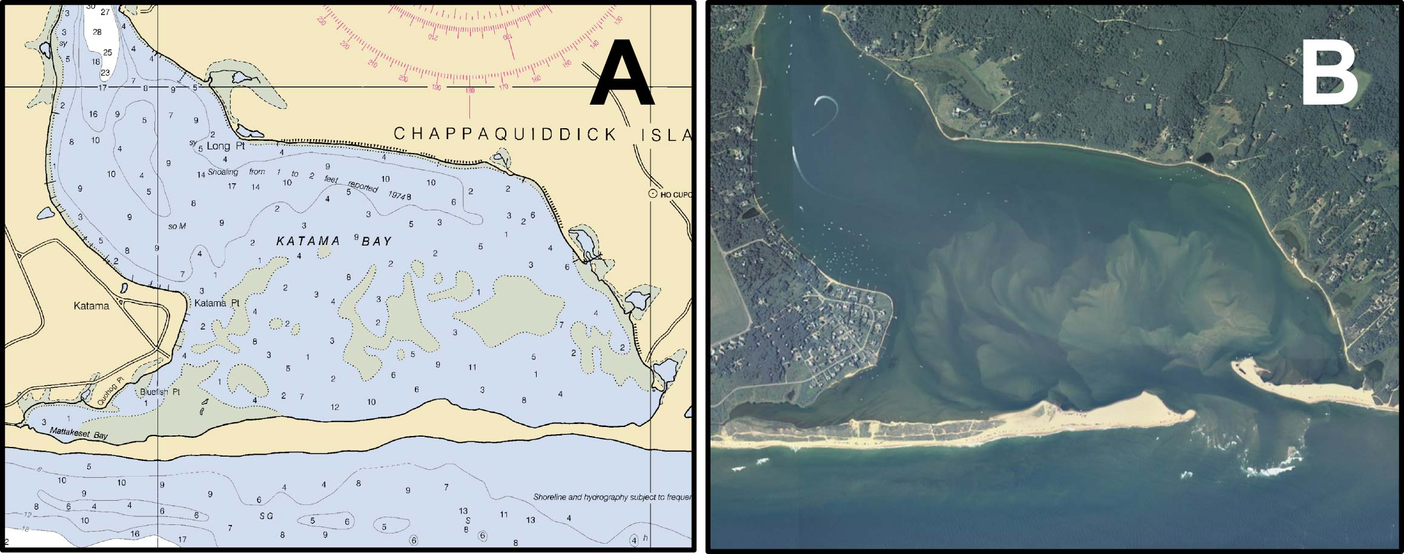

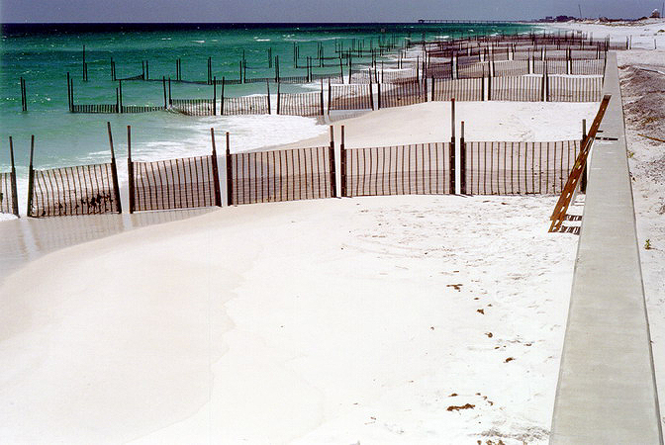
Coastal Zone
Sea-level rise
Ecosystem management
and habitat research
Spatial planning
Morphologic change
Shoreline mapping
Hazard mitigation and
Community preparedness
Notes:
Modeling of long-shore currents, tides; Earth visualization

Slide 4

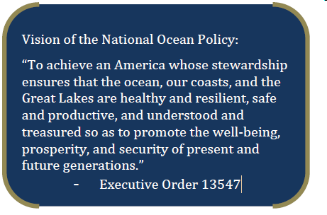

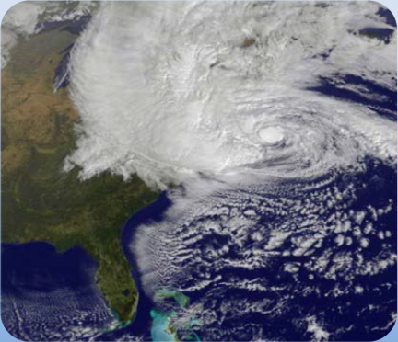
U.S. National Ocean Policy
National Ocean Policy
Implementation Plan
The National Ocean Policy Implementation Plan translates the National Ocean Policy into on-the-ground actions that will help Americans all across the Nation sustain and enjoy our ocean resources.
I. The Ocean Economy: Supporting Economic Growth (Appendix p. 2)
Advance our mapping and charting capabilities and products to support a range of economic activities.
2017
Improve and implement coastal change analysis products and a sustained and seamless description of coastal and marine elevation extending from on-shore coastal areas (Coastal National Elevation Dataset) through the U.S. Exclusive Economic Zone (EEZ) and extended continental shelf, including elevation models and derived map products, for local, State, and Federal managers. [IWG-OCM, DOI (USGS), USACE, NOAA] [OMI]

Slide 5
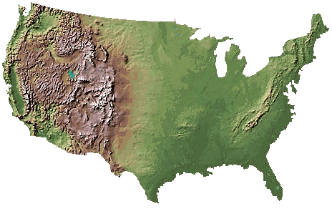
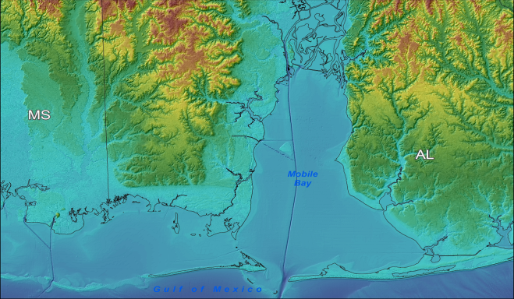
USGS EROS Data Center
National Elevation Dataset
Topography only
1, 1/3 and 1/9 arc-second
NAD 83 geographic
NAVD 88
Updated bi-monthly
USGS NED
Coastal NED
Integrated bathy-topo
1/9 arc-second and 2 meter
NAD 83 geographic and UTM
NAVD 88
Limited coverage
Mobile Bay, AL
coastal DEM
Notes:
Jeff will discuss the USGS San Fran Bay CoNED DEM project in the next session.

Slide 6
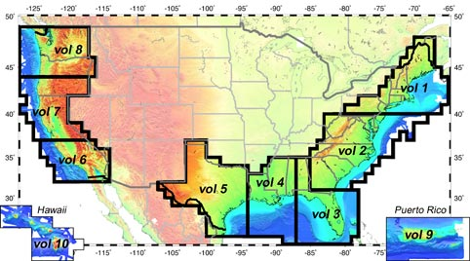
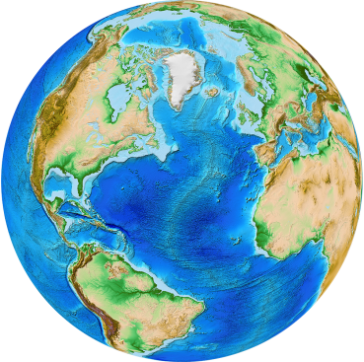
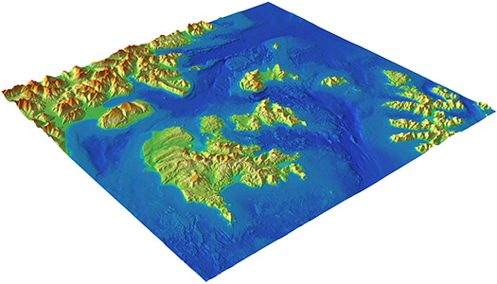
NOAA NGDC
US Coastal Relief Model
Integrated bathy-topo
3 arc-second
NAD 83 geographic
“sea level”
1999-2005
US CRM
ETOPO1
Tsunami inundation DEMs
Integrated bathy-topo
1/3 arc-second
WGS 84 geographic
NAVD 88, MHW
Global relief
Integrated bathy-topo
1 arc-minute
WGS 84 geographic
“sea level”
Sand Point, AK
coastal DEM
Notes:
Tsunami propagation and inundation for forecast, warning and preparedness.

Slide 7
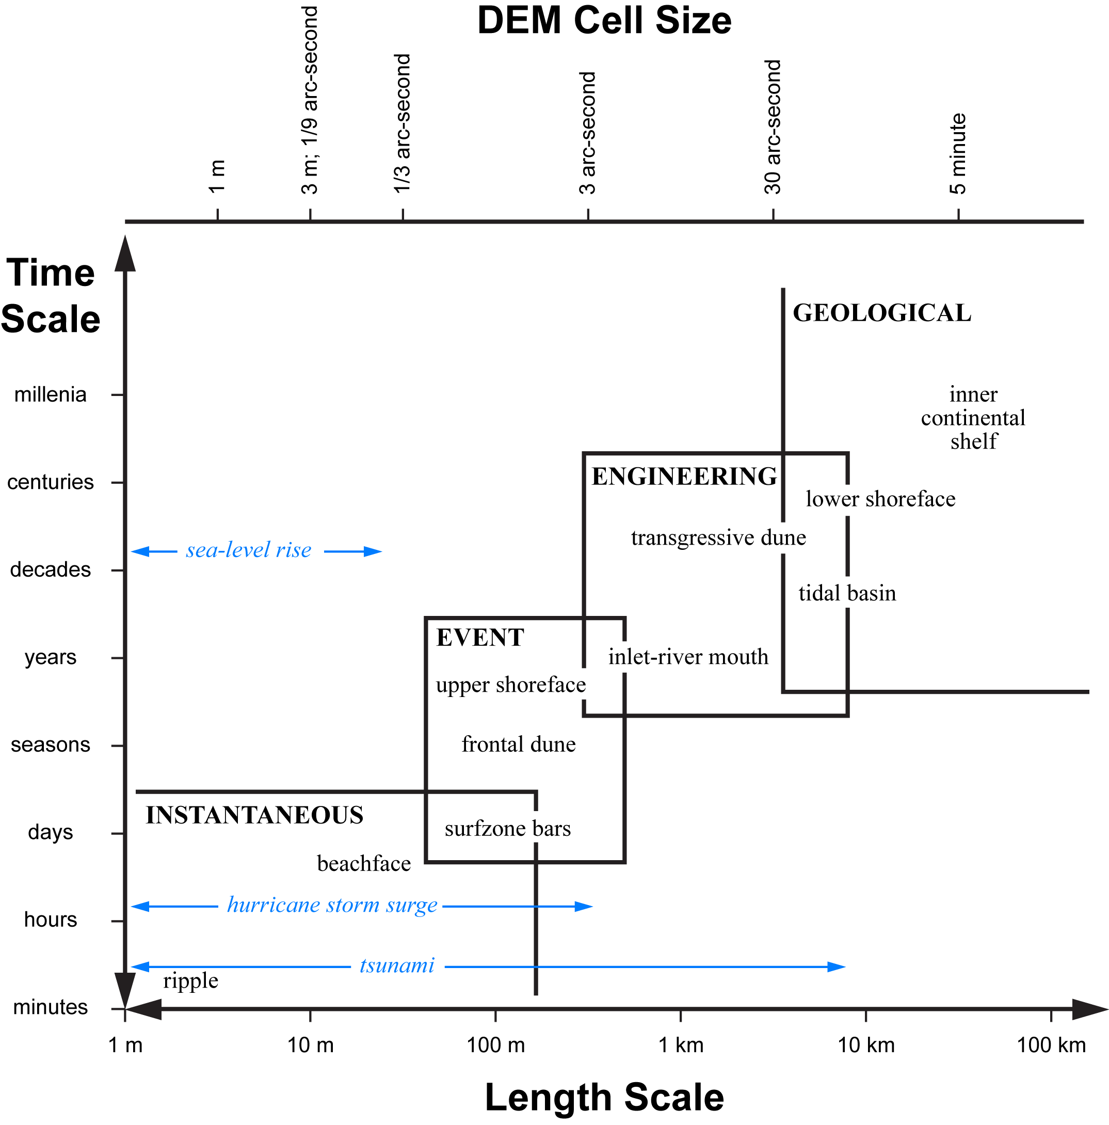
DEM Time-Length Scales
Modified after
Cowell and Thom [1997].
DEM cell size needs to be three times smaller than the features they can resolve.
Notes:
DEMs need to have a cell size three times smaller than the features they can resolve.

Slide 8
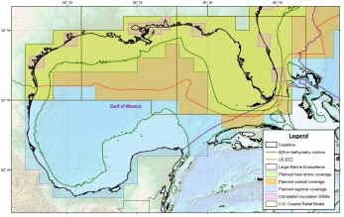
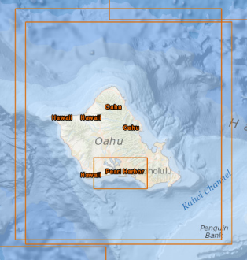
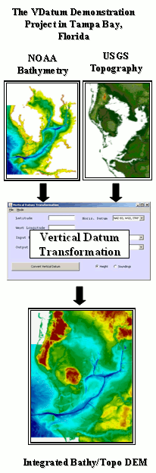
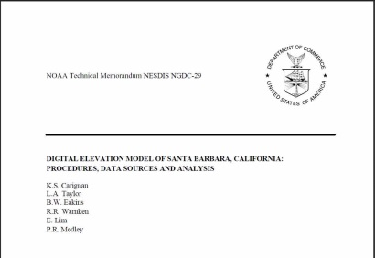
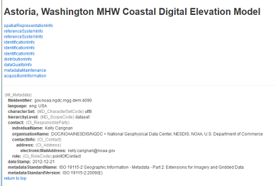


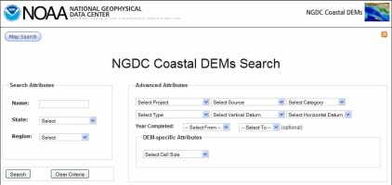
Coastal DEM Framework
Components
Comprehensive suite of seamless, integrated, consistent, and regularly updated bathymetric-topographic models of all U.S. coastal and marine areas
  Topobathy digital elevation models
  Color images for map visualization
Standardized, robust procedures and tools
  Data processing
  DEM development and evaluation
  DEM updating as new data are collected
Thorough documentation on source data and model development
  Spatially referenced metadata
  ISO/FGDC-compliant xml
  Technical reports
Online tools for public search, discovery, transformation, and retrieval

Slide 9
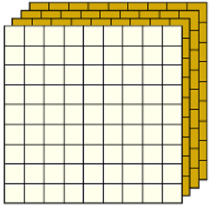
Tentative Specifications and Plans
Develop Standardized Procedures (Jan 2014)
Data processing
Coastal DEM development and assessment – specifications, interpolation, resampling
Coastal DEM updating as new data collected
Metadata documentation
Common access
Tentative Specifications: UTM Zone Suite
1 and 3 meter cell sizes
Near-shore, Lidar based, hydro-enforced
NAVD 88 vertical datum (MHW via online tools)
NAD 83
Nesting – Consistent resampling
Cell alignment (pixel edge)
Multi-temporal (pre- and post-event)

Slide 10
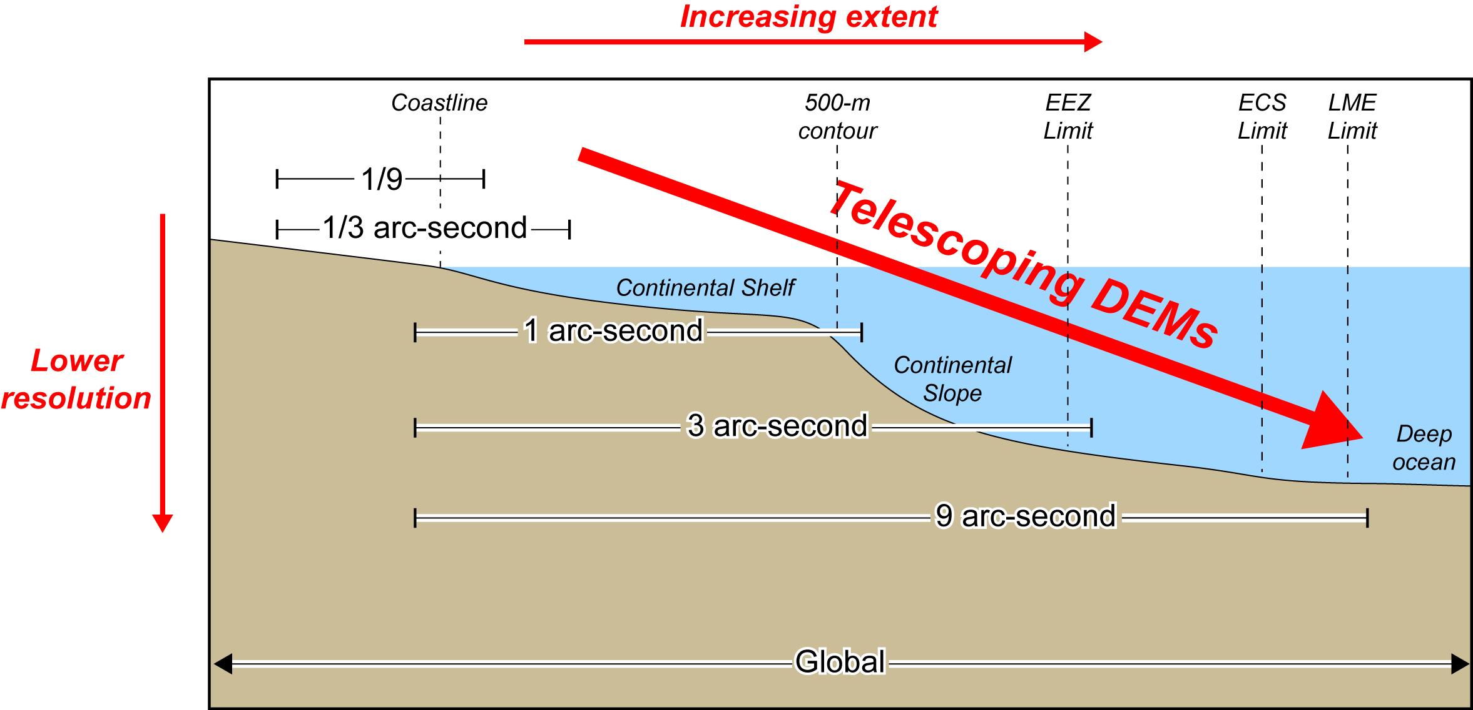
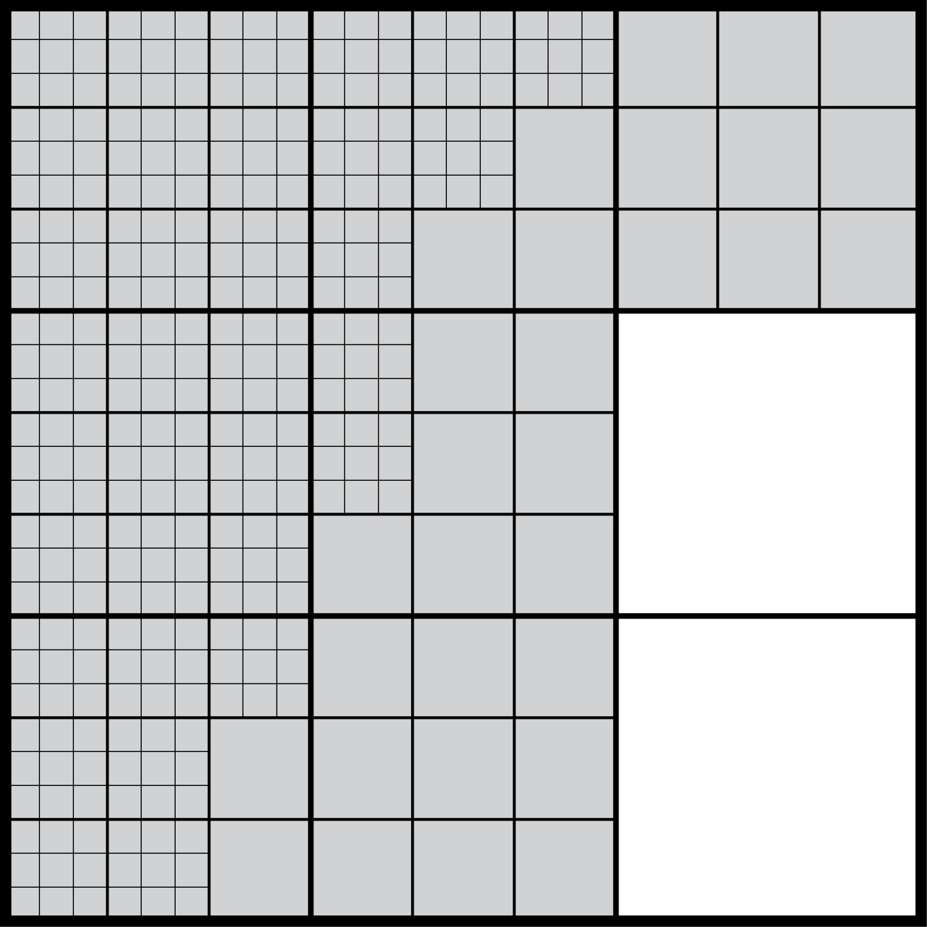
Tentative Specifications and Plans
Geographic Suite
1/9, 1/3, 1, 3, and 9 arc-seconds
Shoreline to deep ocean
Lidar, hydrographic soundings, and single-beam and multibeam sonar
NAVD 88
Nesting, telescoping
Grid-node alignment
DEMs telescoping offshore
DEM cell nesting

Slide 11
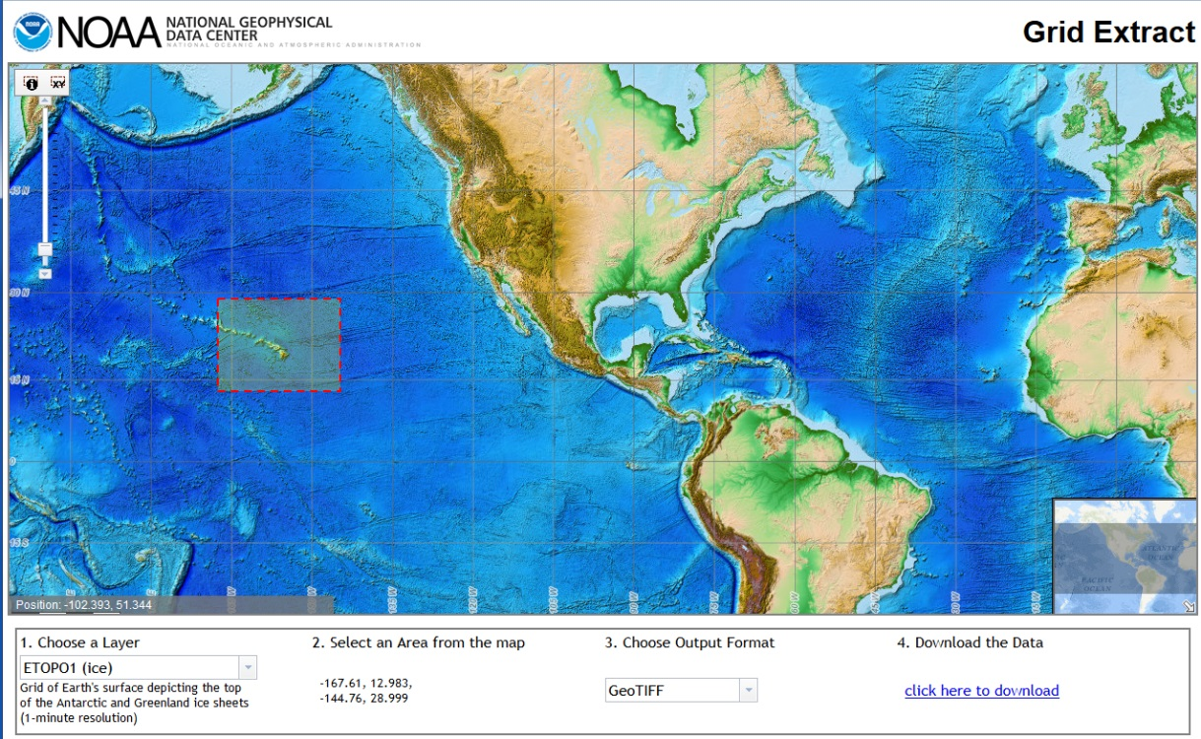
Web Access Tools
Common Tools
On-demand conversion to common vertical datums and coordinate systems, and common file formats
Extraction of coastal DEMs and/or spatially referenced, color hillshade images (e.g., geotiffs)
Merging of adjacent coastal DEMs in a user’s area of interest
Select by temporal coverage (e.g., 2005-2011)
Screen capture of current
NGDC grid extract tool
We seek your input on what you require in coastal DEMs.

Slide 12
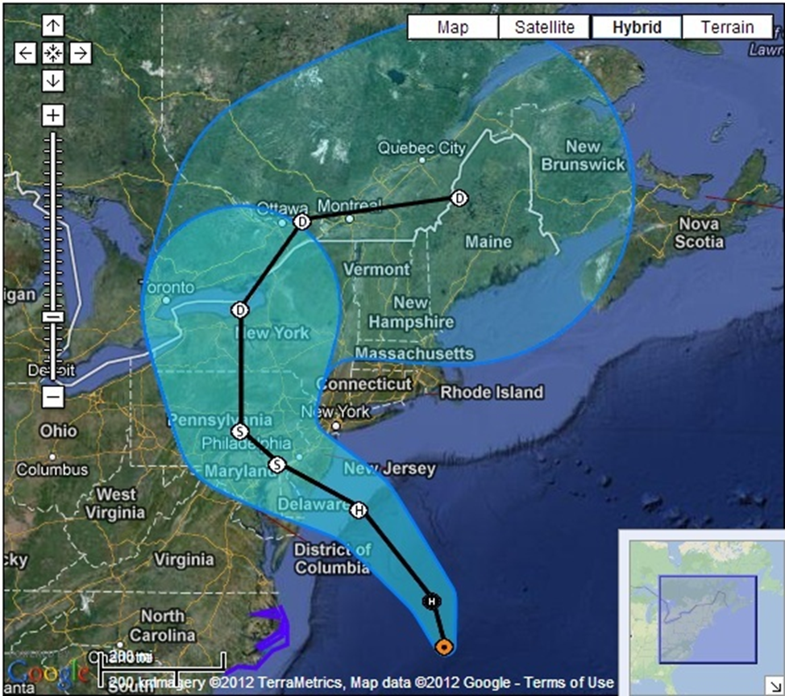
Test Case: Sandy-Impacted Coasts
NOAA funded to test procedures and produce integrated models along Sandy-impacted NY-NJ coast.

Slide 13
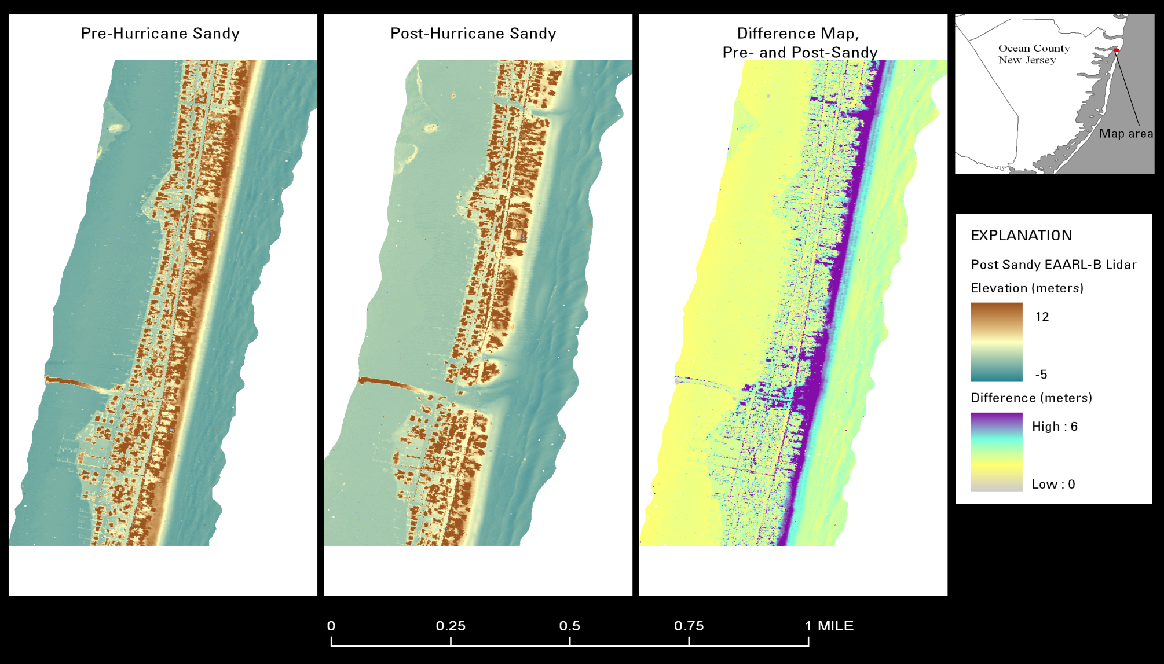
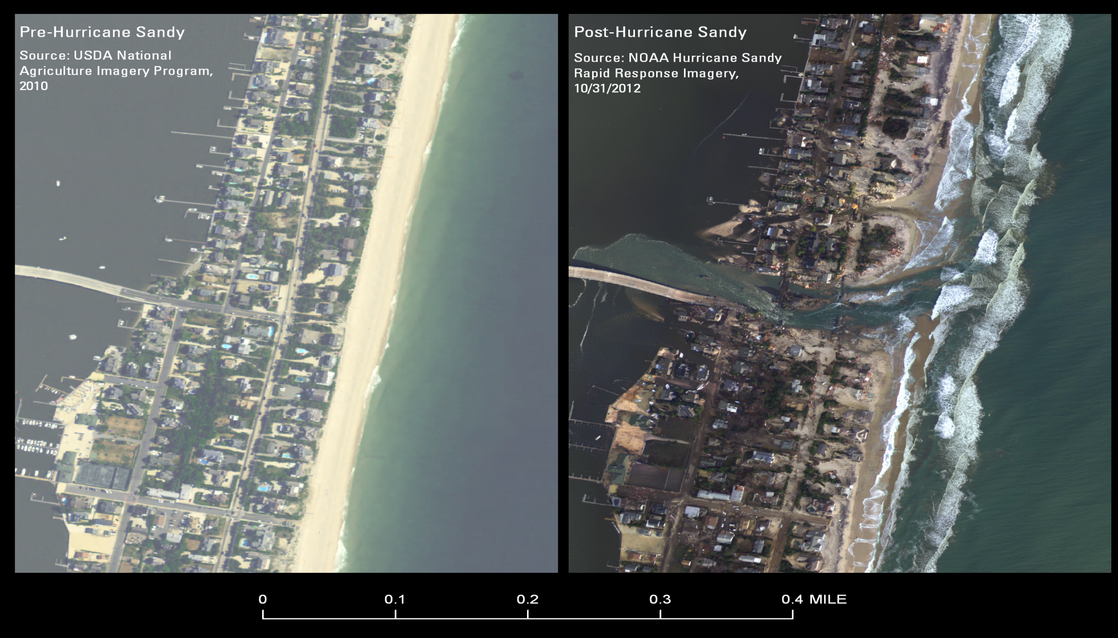
Pre and Post Hurricane Sandy
Mantoloking, New Jersey (Barnegat Peninsula) (USGS EAARL-B)
Courtesy Wayne Wright and John Brock, USGS

Slide 14
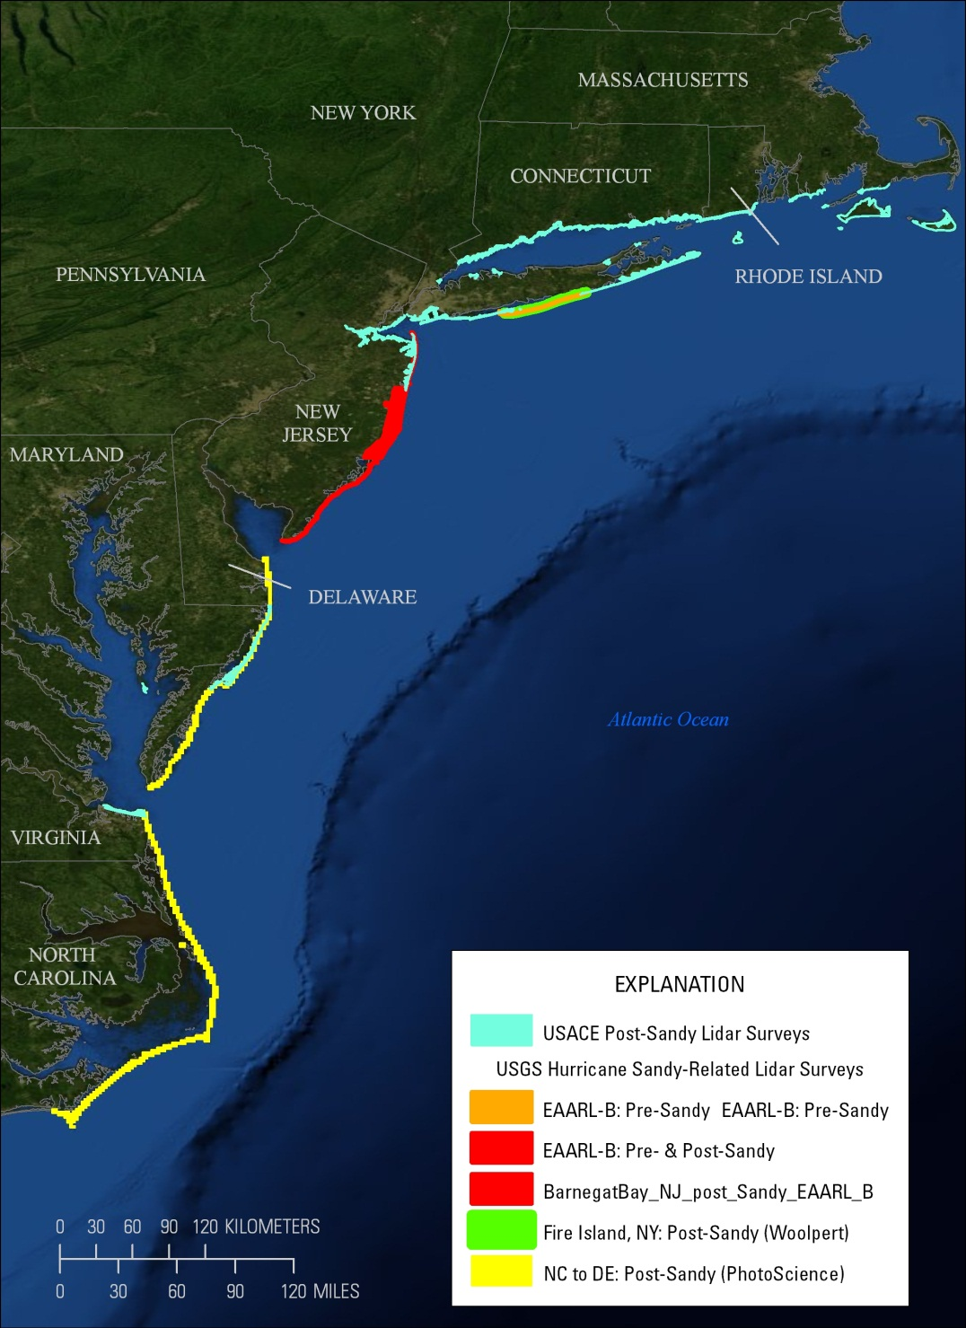
Pre- and Post-Sandy Lidar Surveys

Slide 15
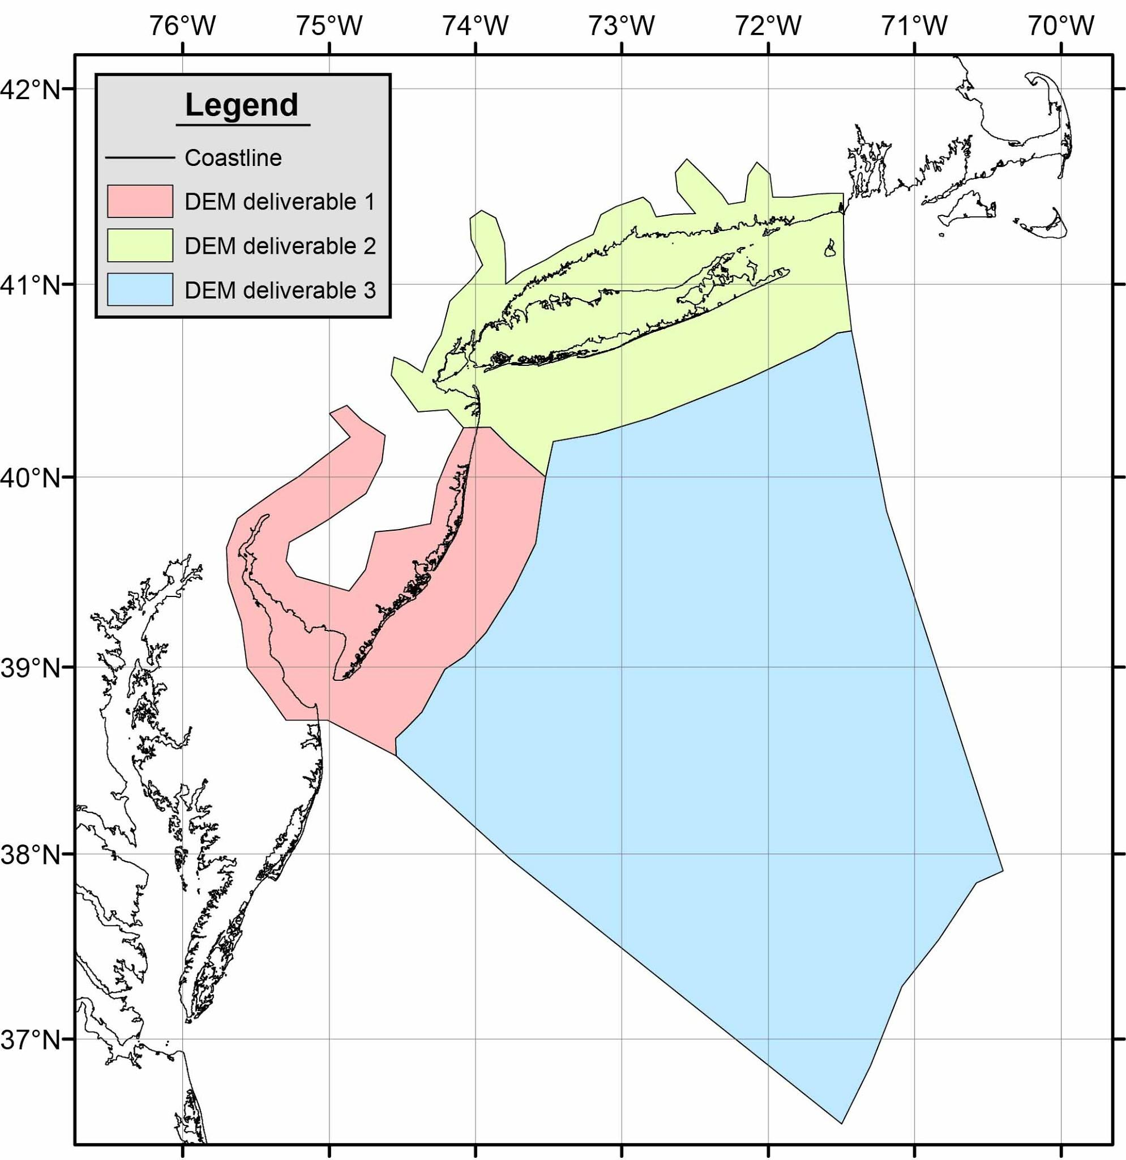
Test Case: DEMs of NY-NJ Coasts
NOAA’s National Geophysical Data Center (NGDC) will work collaboratively with USGS’s Earth Resources Observation & Science (EROS) Center to develop draft procedures for building seamless bathymetric-topographic digital elevation models (DEMs) of the Nation. These procedures will be tested and implemented by building DEMs of the New York-New Jersey shoreline that were impacted by storm-surge from Hurricane Sandy in 2012 that accurately reflect the post-storm morphology.
NOAA Project deliverables
Product | Date
Draft procedures | Q1 FY14
First set of DEMs | Q3 FY14
Second set of DEMs | Q2 FY15
Third set of DEMs | Q4 FY15
Coverage of coastal DEMs for each deliverable date
Separate web discovery and access.

Slide 16
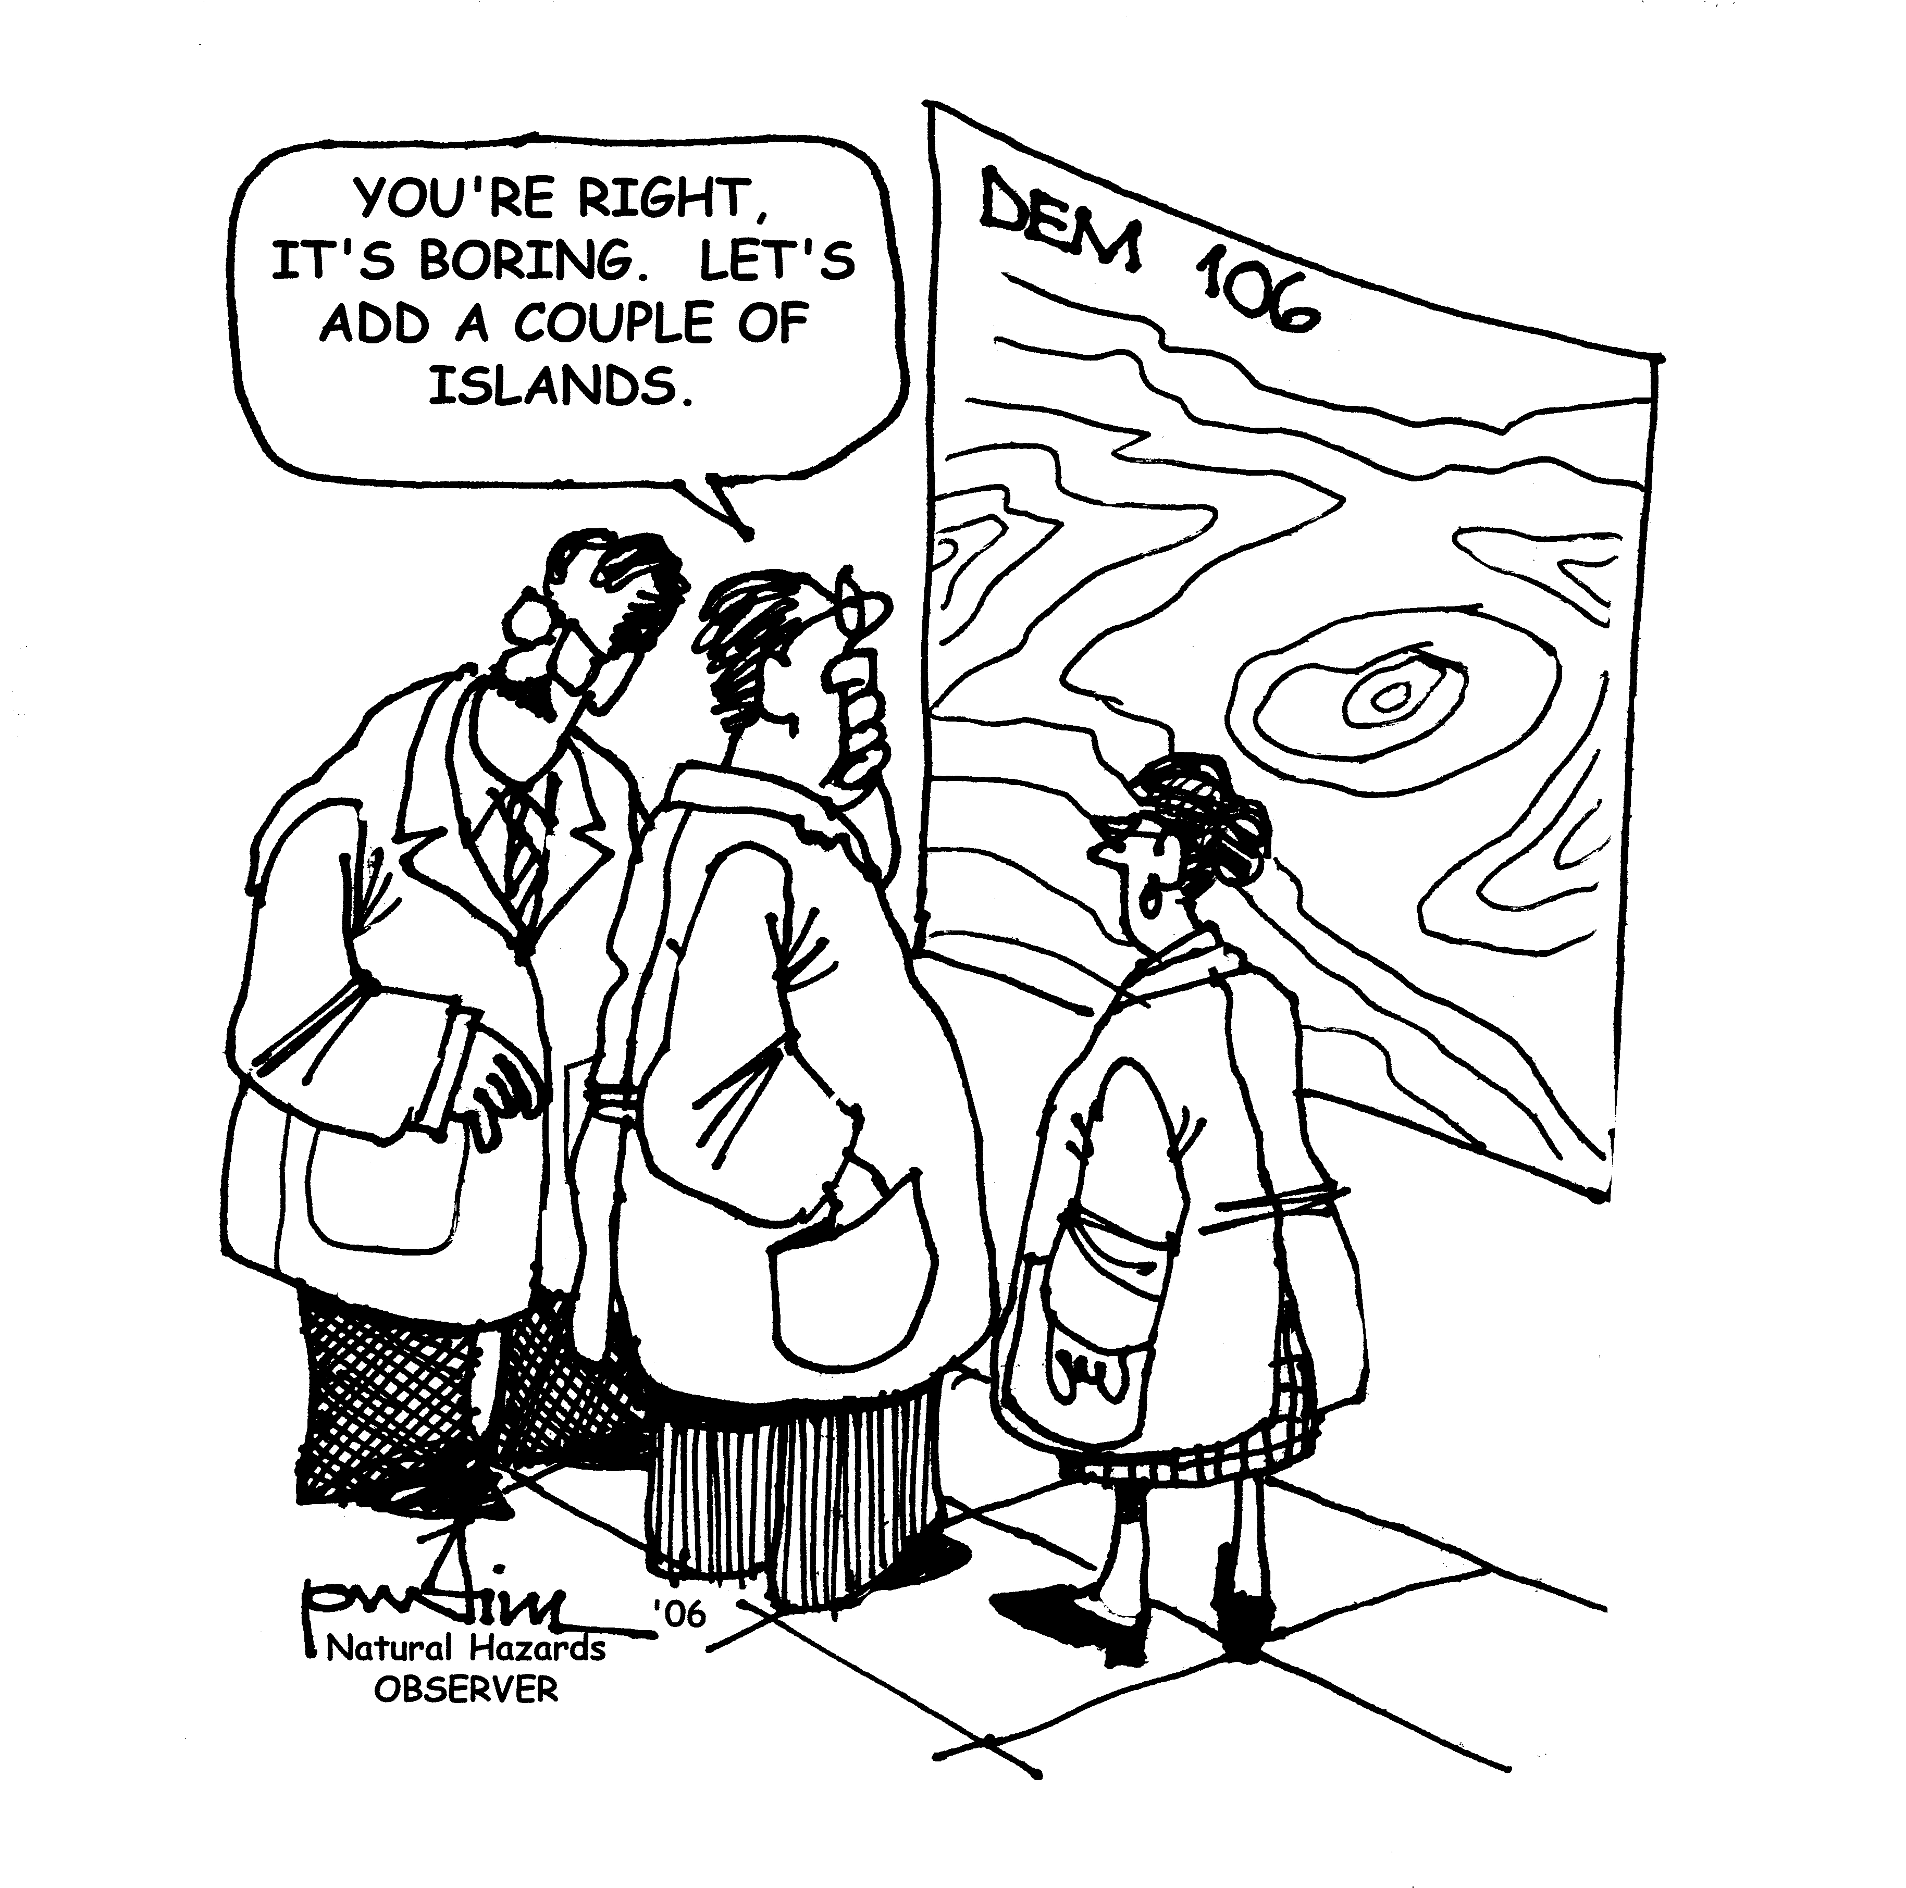
Questions?
barry.eakins@noaa.gov
daniels@usgs.gov

