Slide 1

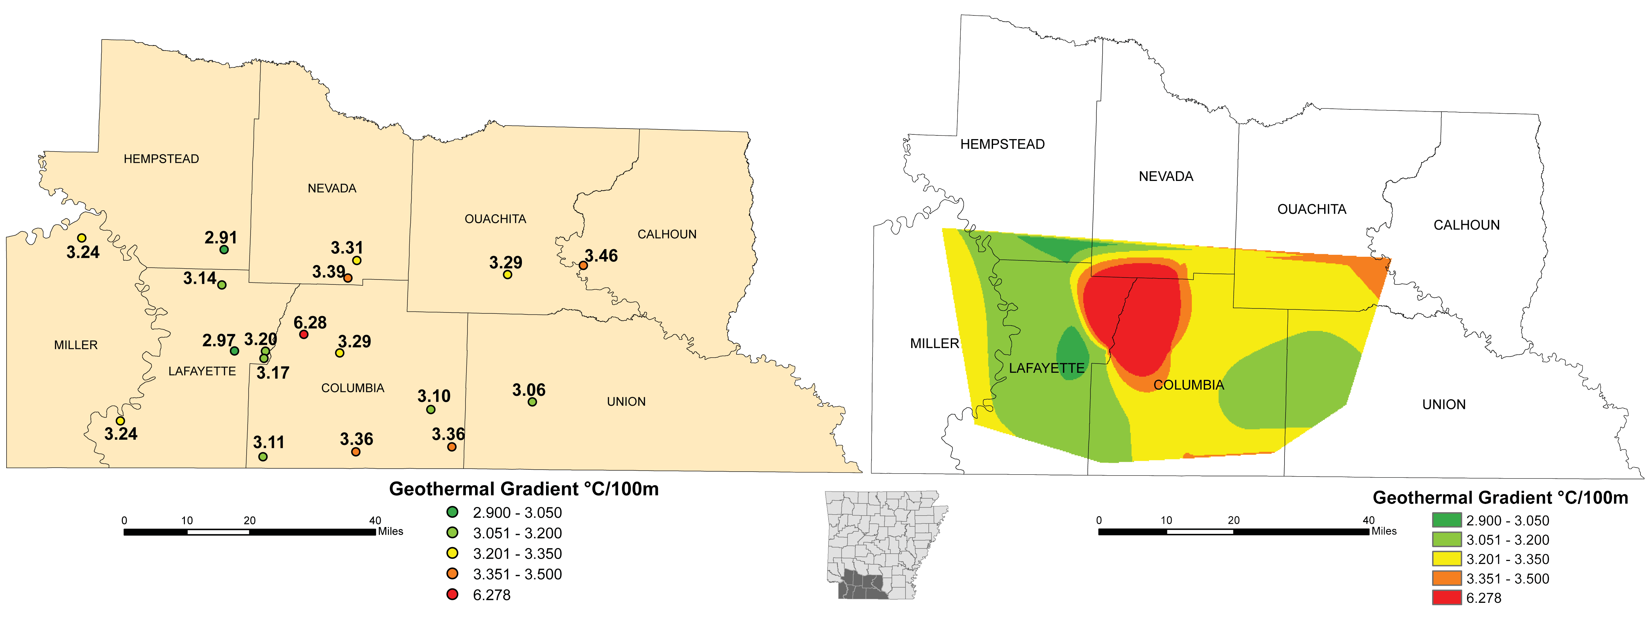
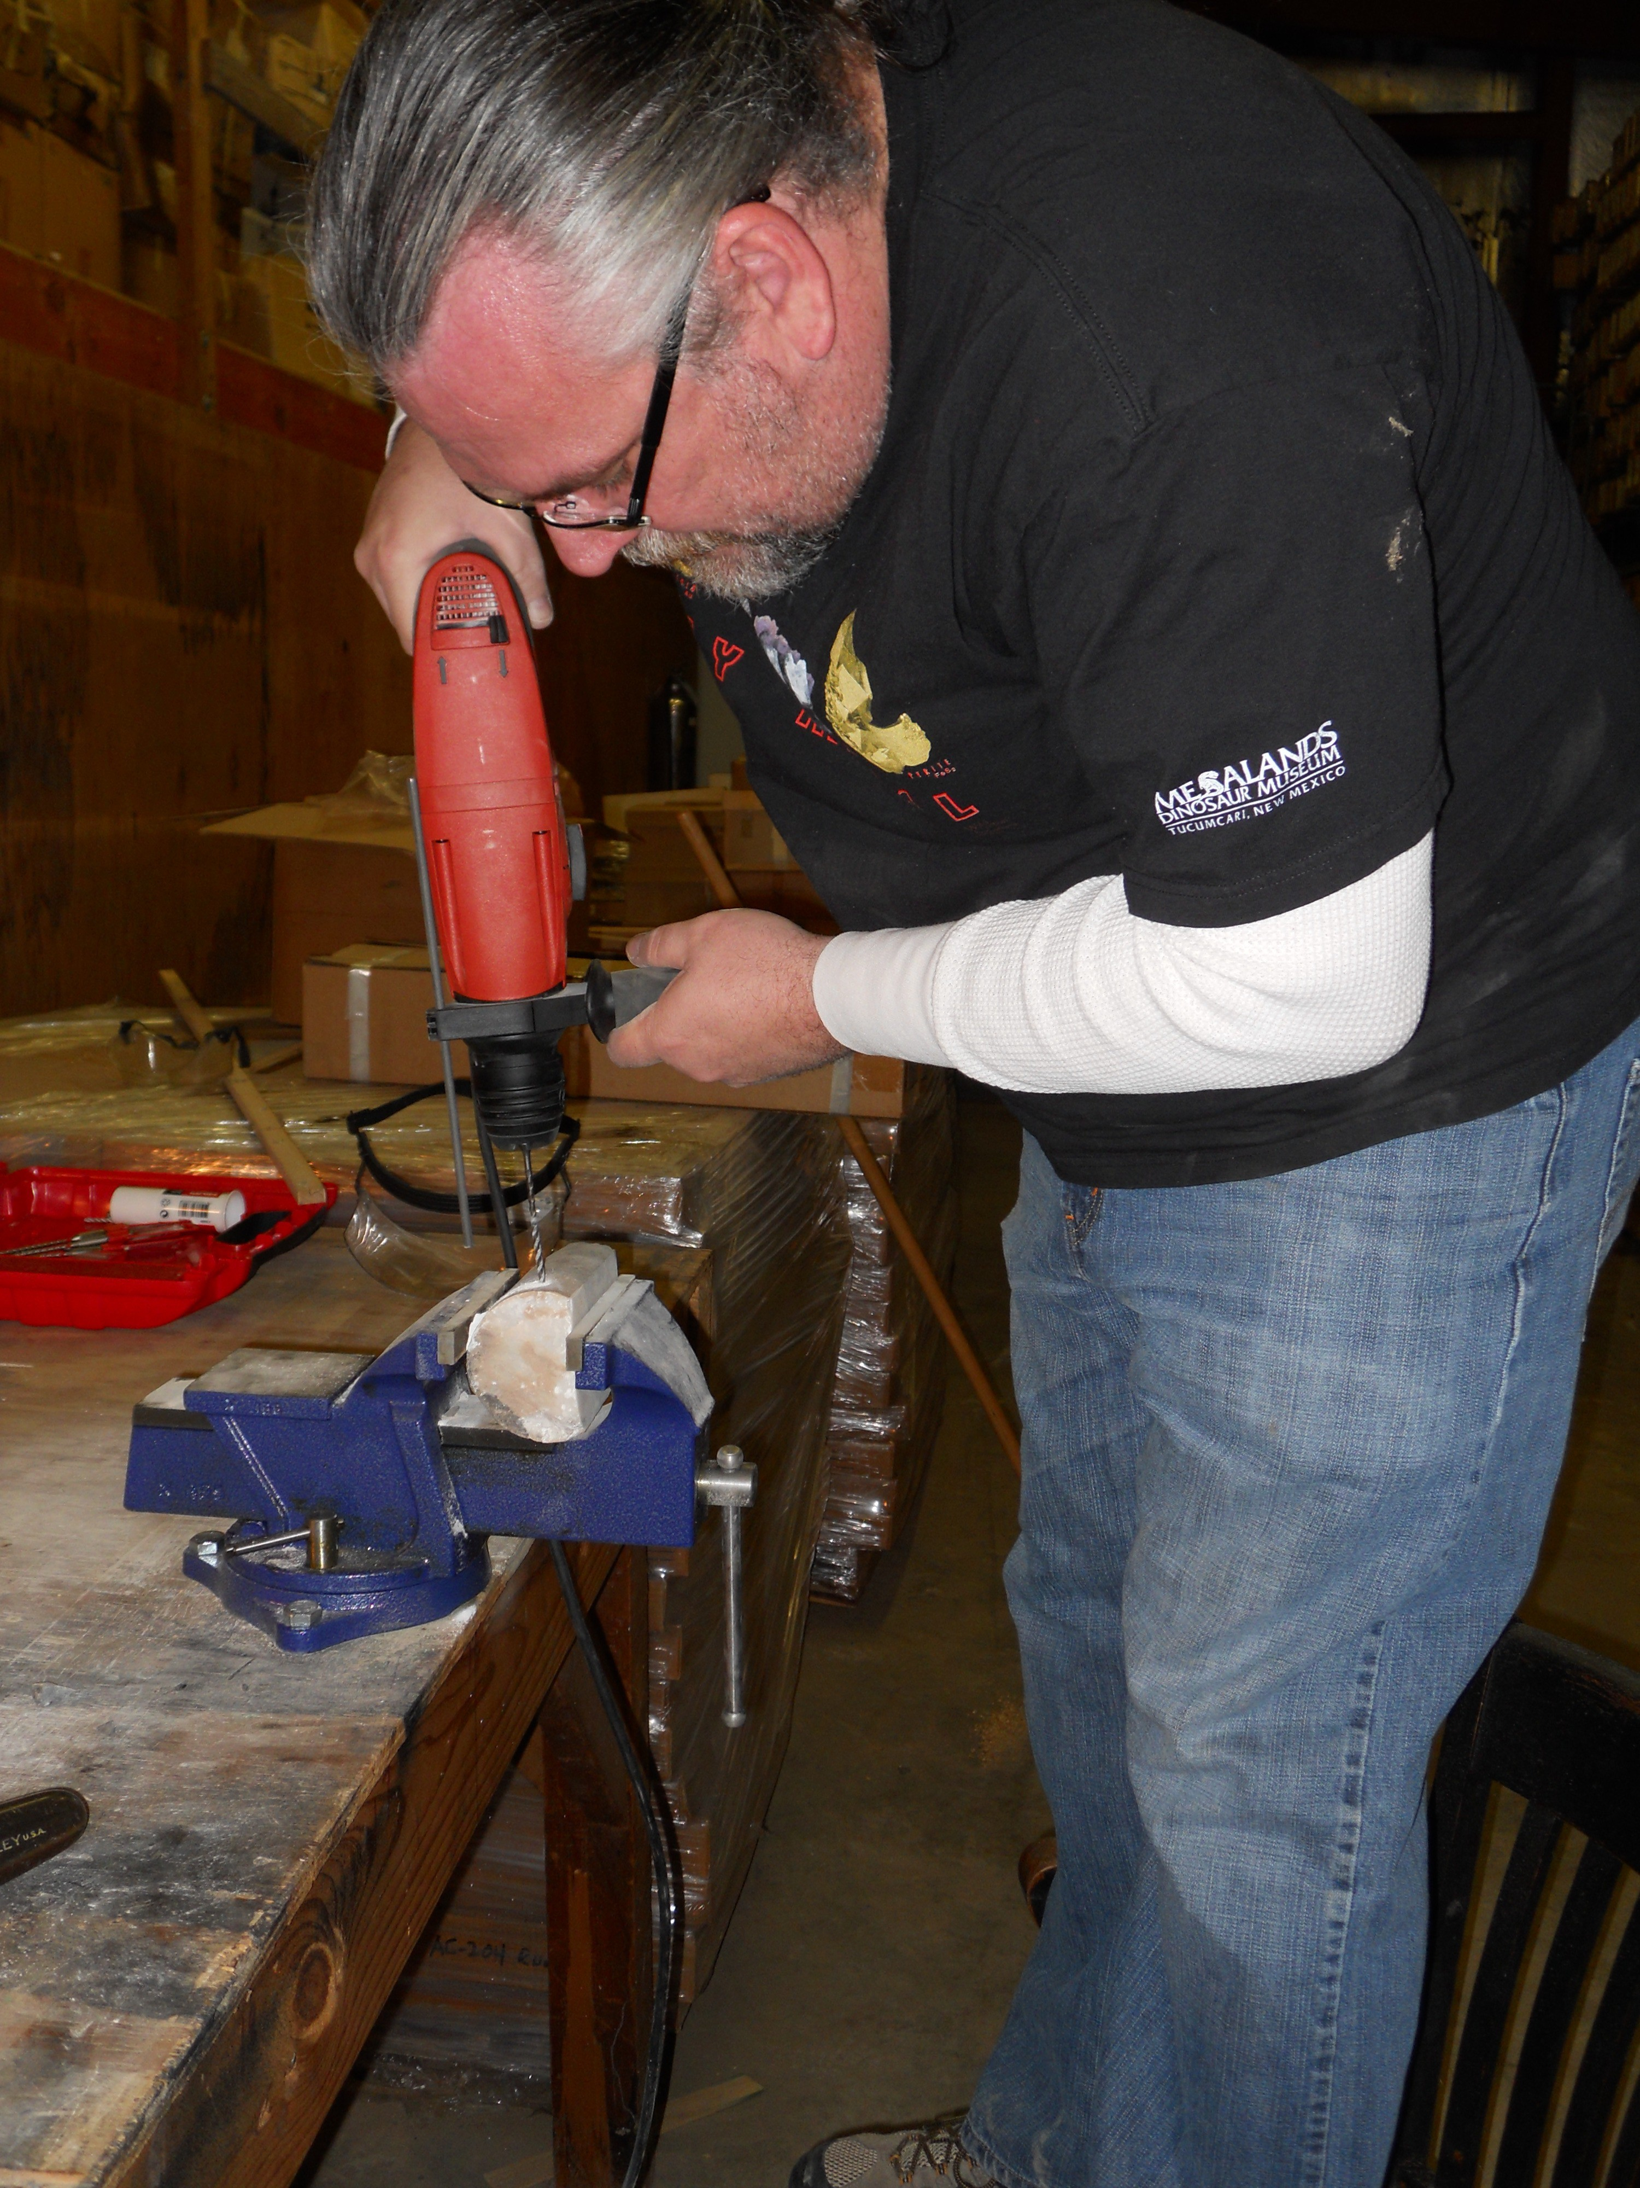
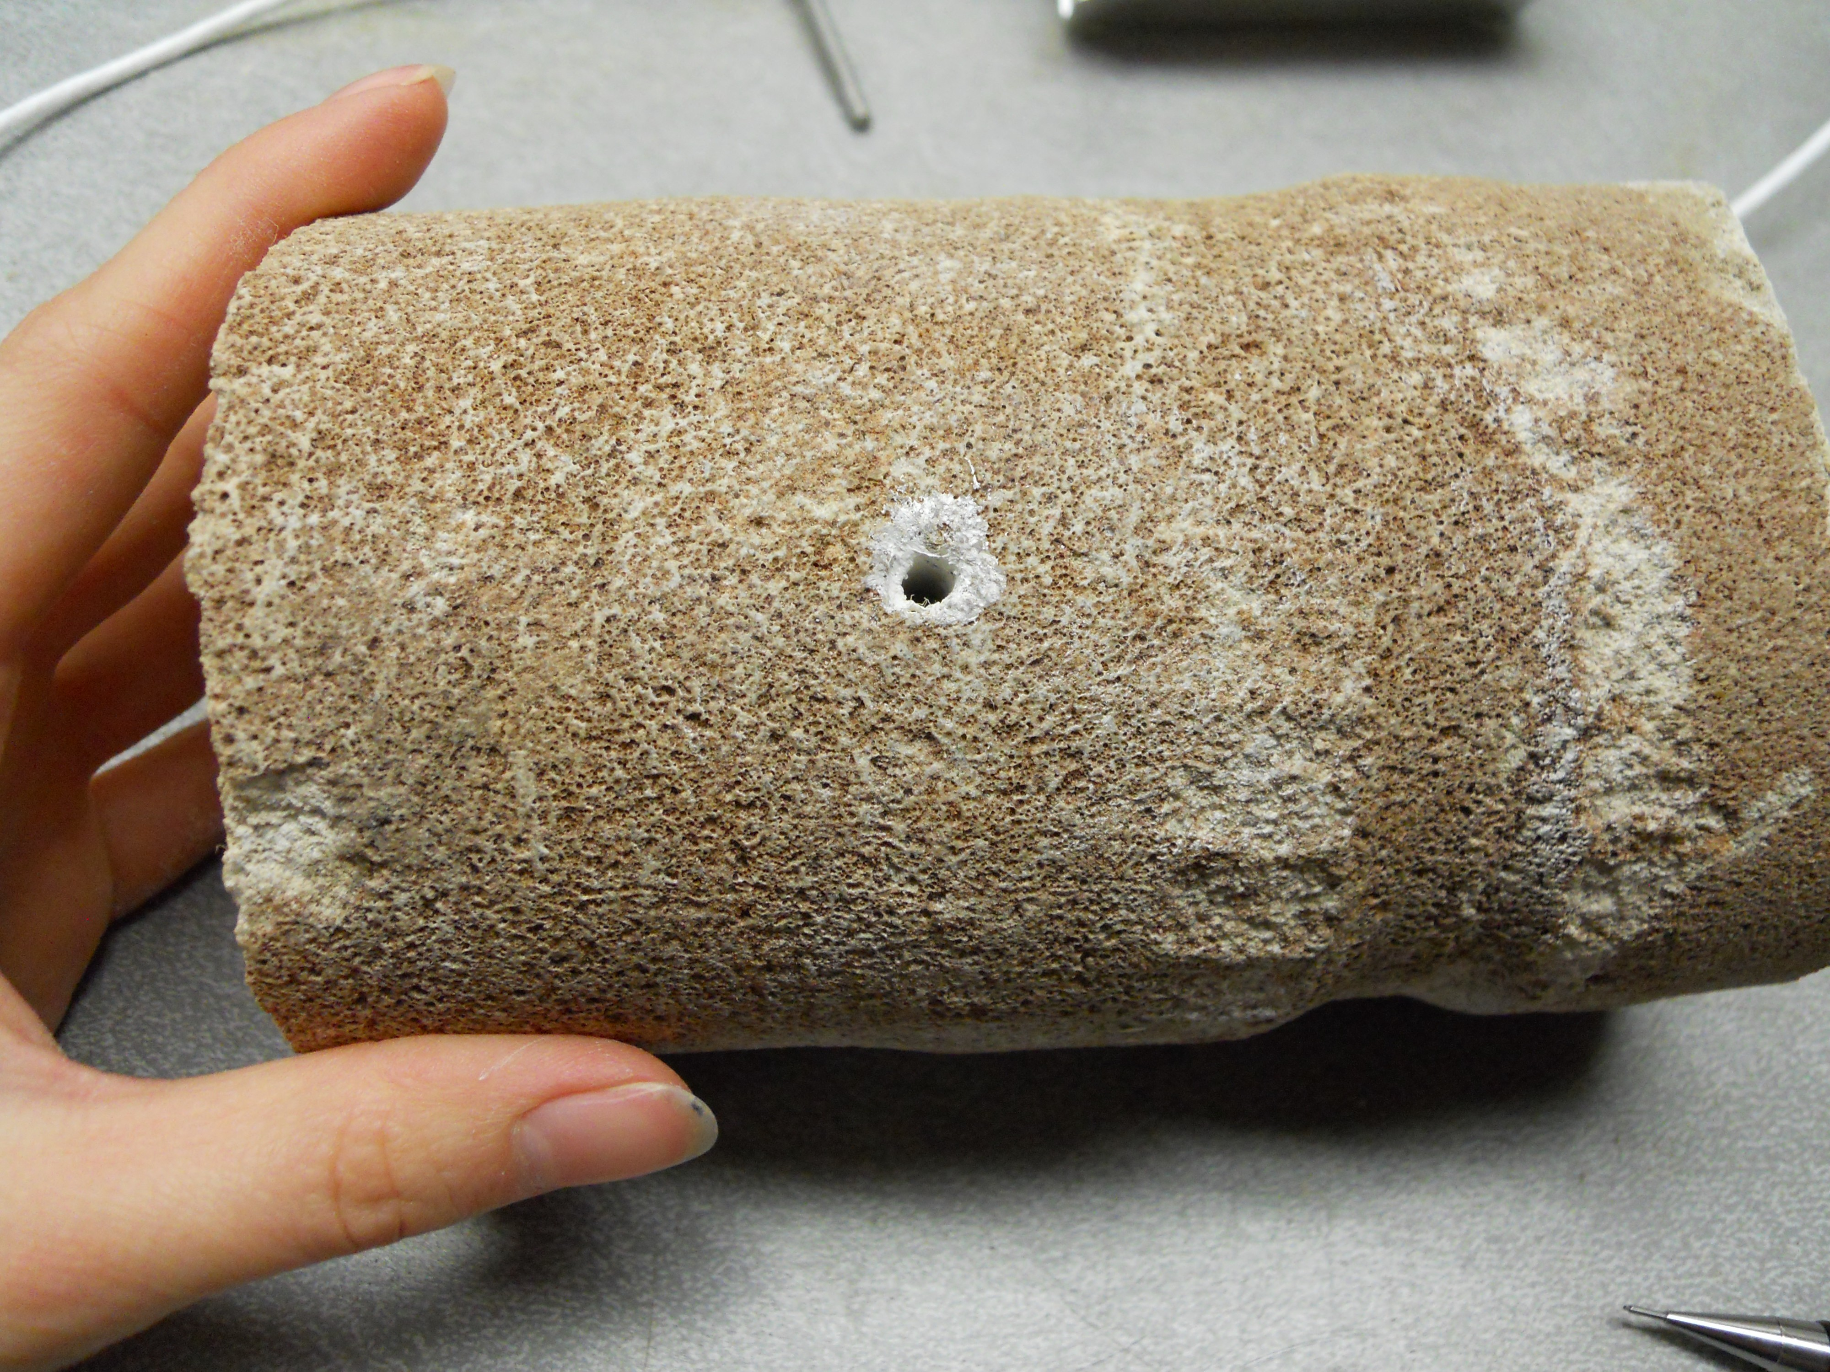
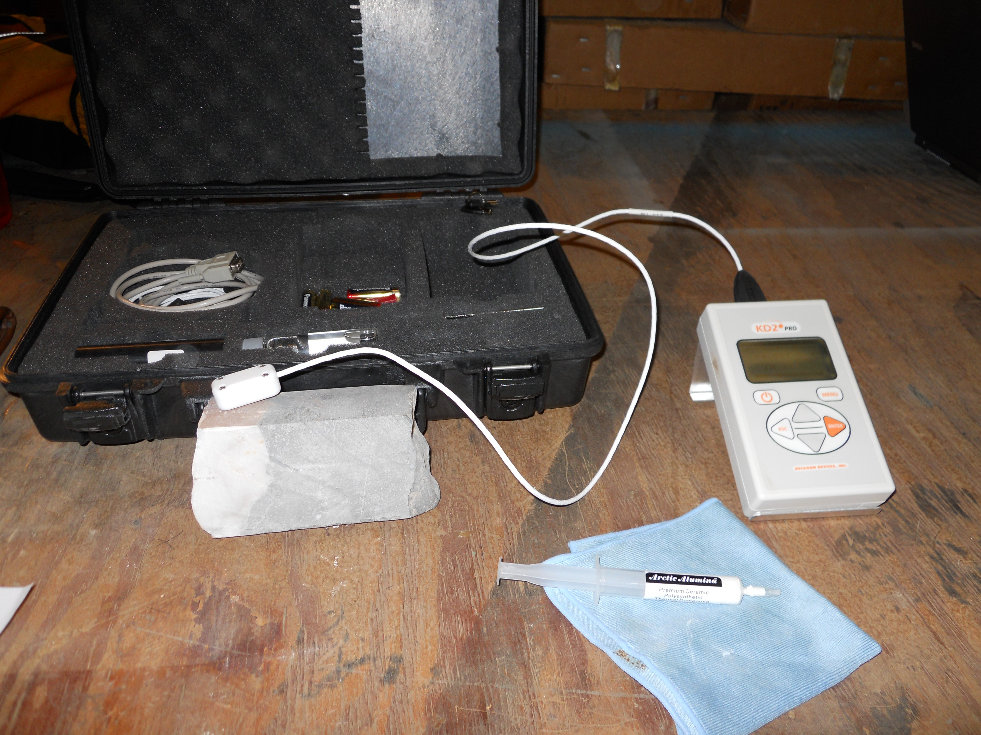
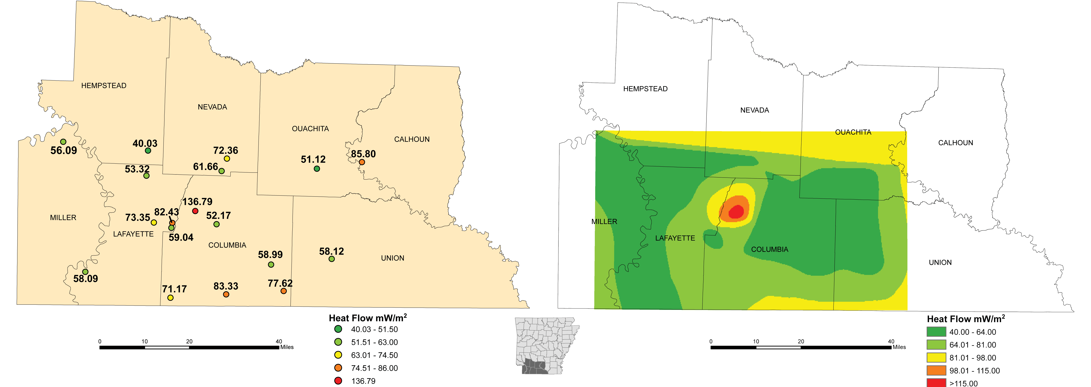
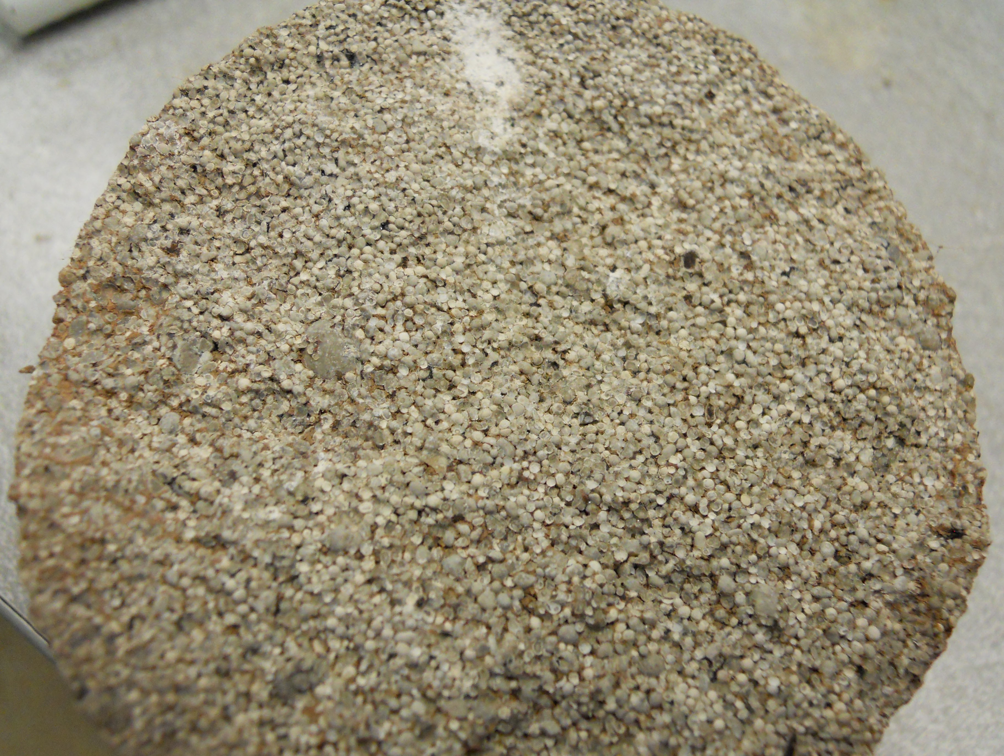
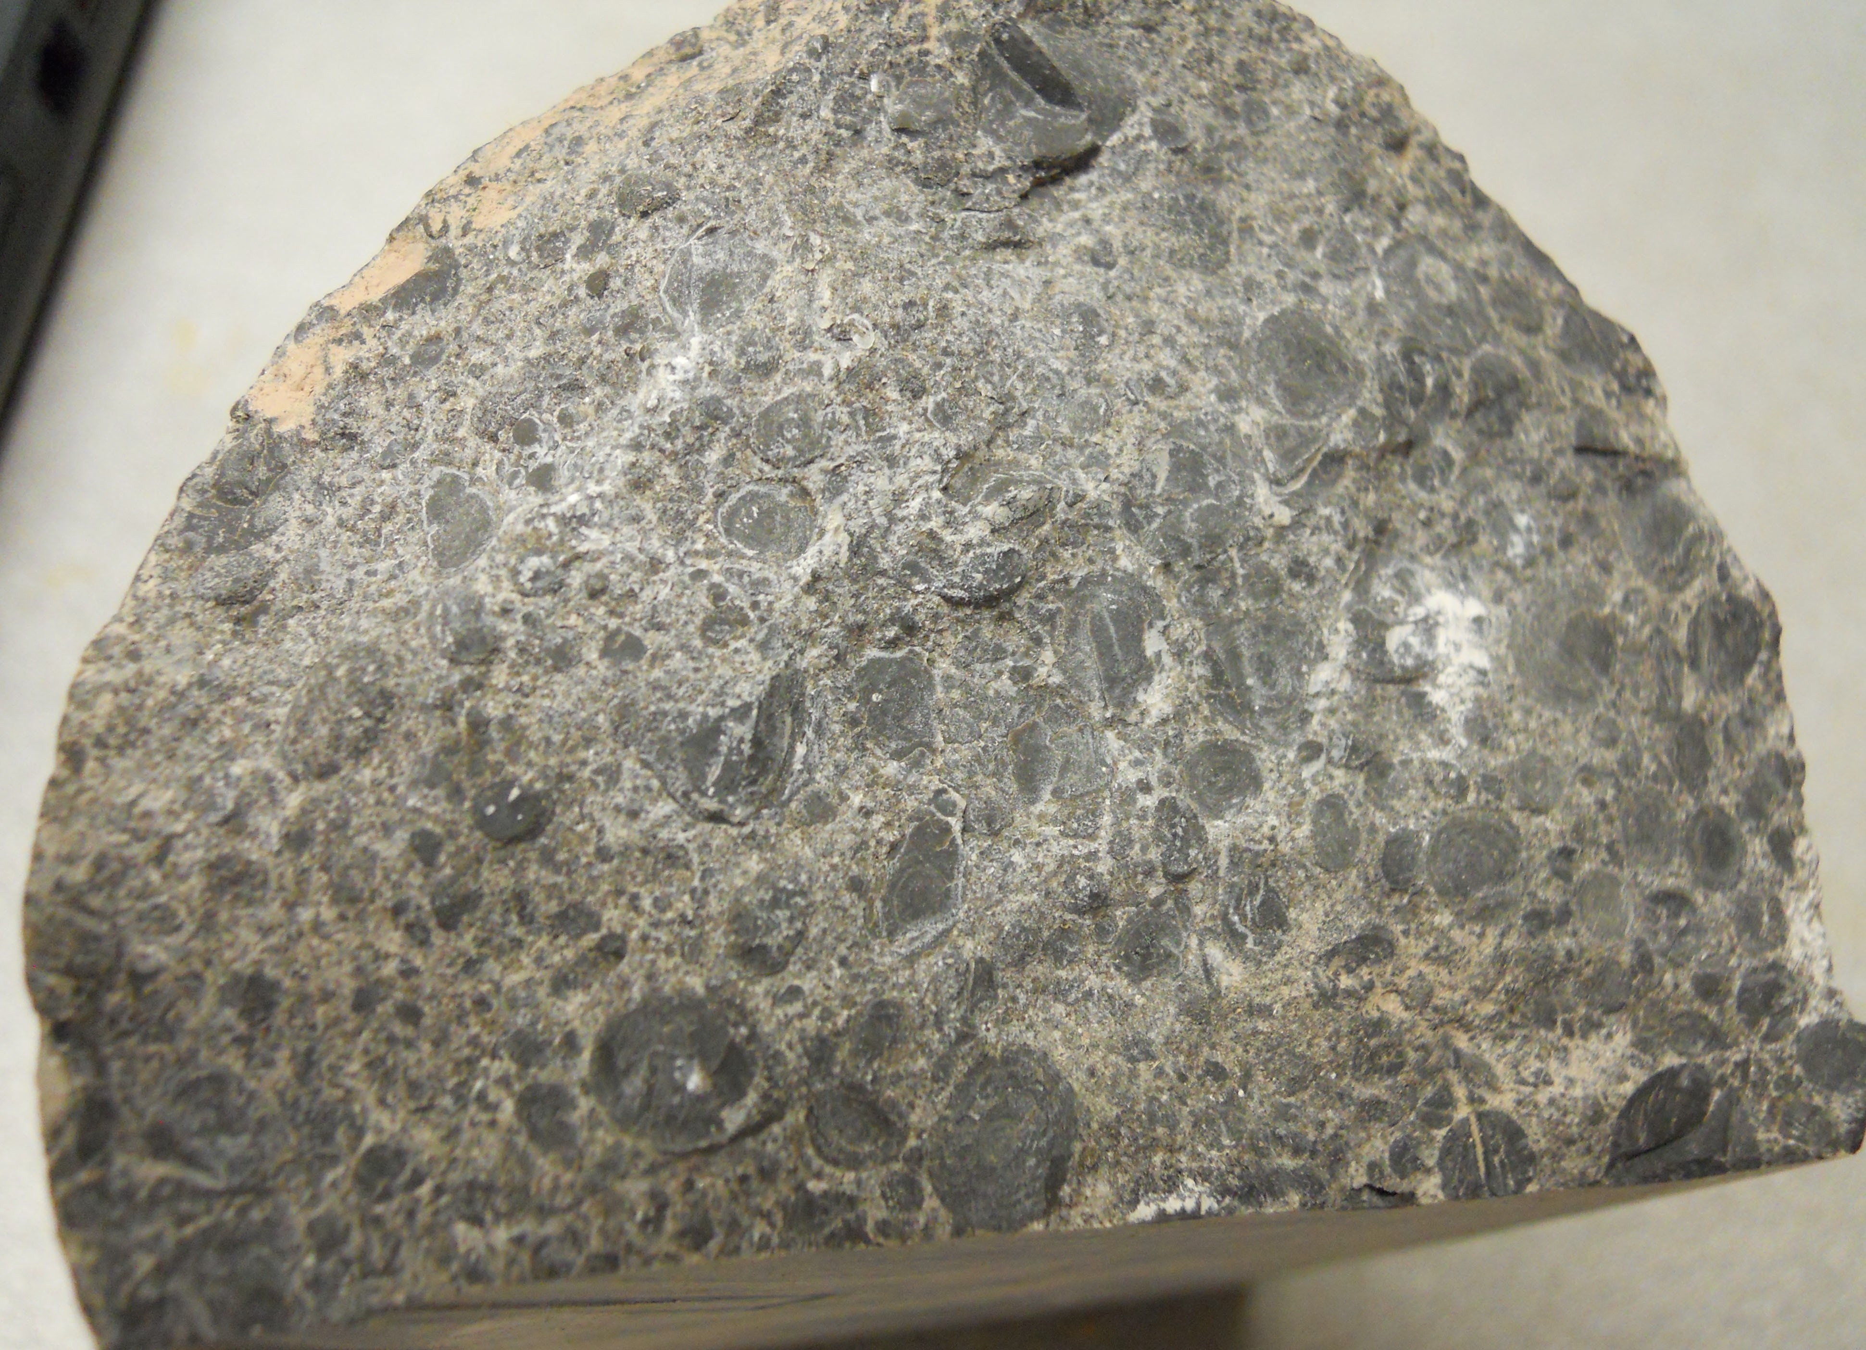
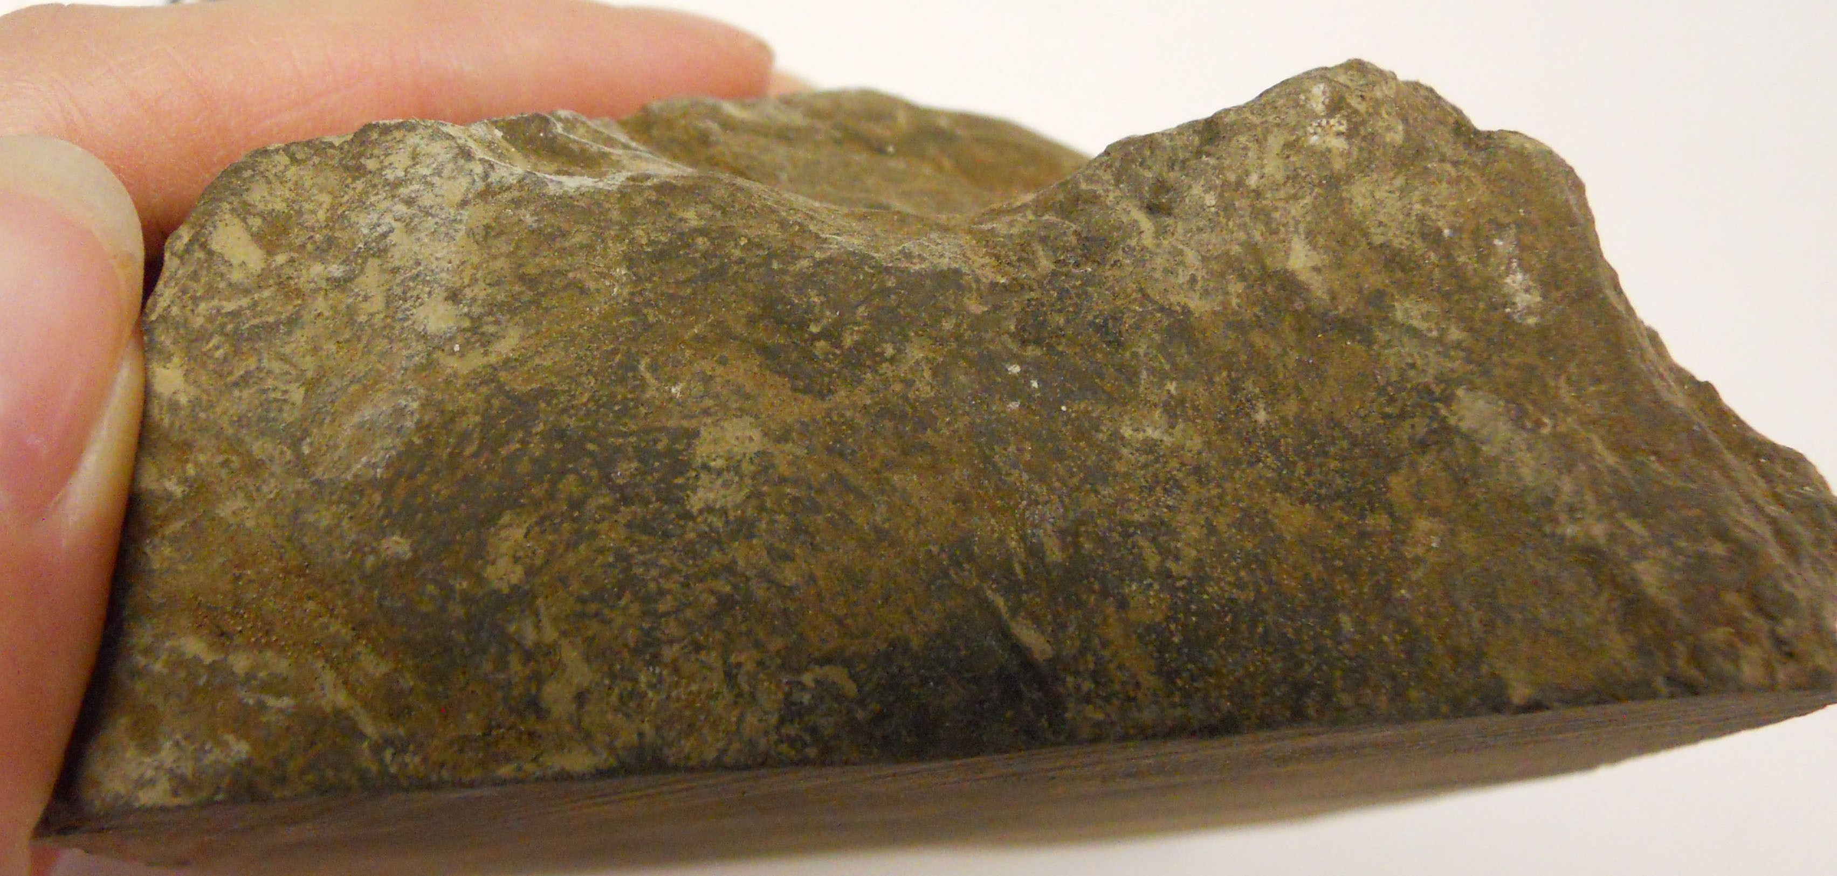
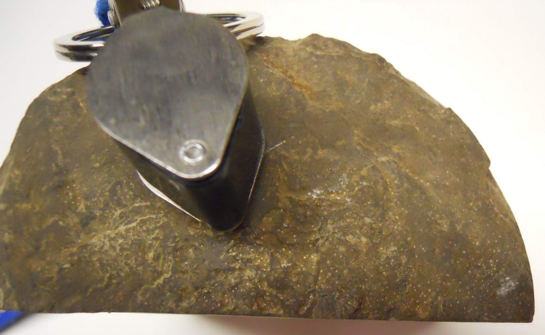
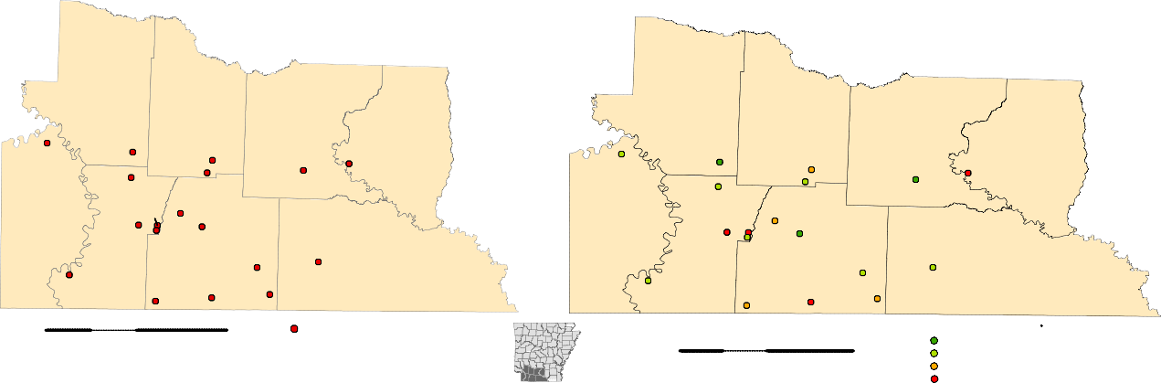
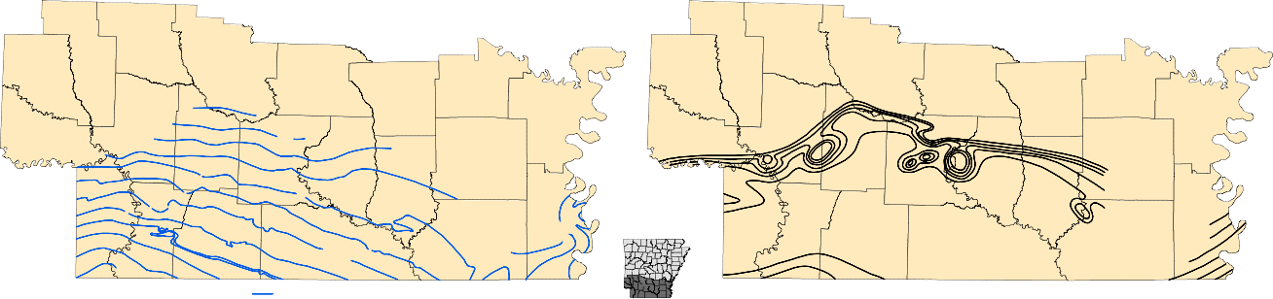
THERMAL CONDUCTIVITY, THERMAL GRADIENT, AND HEAT FLOW ESTIMATIONS FOR THE SMACKOVER FORMATION, SOUTHWEST ARKANSAS
Lea Nondorf, Arkansas Geological Survey, Little Rock, AR
Bekki White, State Director and Geologist
Abstract
Subsurface thermal conductivity, thermal gradient, and heat flow are significant parameters when determining the feasibility of utilizing a geologic unit to generate industrial geothermal power. Core samples from 18 wells of the subsurface Jurassic Smackover Formation in southwest Arkansas were analyzed at the Arkansas Geological Survey where estimated thermal conductivity, thermal gradient, and heat flow values were determined. Thermal conductance of several samples was obtained using a KD2 Pro Thermal Analyzer at room temperature. Thermal gradients were estimated from Smackover borehole temperatures, and estimated heat flow was calculated from thermal conductance and thermal gradient values. Average estimated thermal conductance values for the Smackover Formation are greatest in northeastern Lafayette County at 2.57 Watts per meter Kelvin, or W/m•K, followed by south- ern Columbia and western Calhoun Counties at 2.47 W/m•K each. Northwestern Columbia and northeastern Lafayette Counties exhibit the highest estimated thermal gradient and heat flow with values averaging 3.29°C/100m and 63.8 milliWatts per meter per meter, or mW/m², respectively. Interpretation of these parameters suggests that this area exhibits the highest geothermal potential for the Smackover Formation in southwest Arkansas. Investigations further characterizing the Smackover Formation, including in situ thermal properties and borehole temperature measurements, are recommended for future geothermal feasibility studies.
Introduction
Worldwide interest in renewable energy resources has created a need for more data to help determine the feasibility of develop- ing these energy alternatives. Geothermal energy is one potential resource which is currently being evaluated by each state in par- ticipation with the State Geothermal Data Project, a collaborative project organized by the Association of American State Geolo- gists (AASG) and funded by the Department of Energy (DOE). The Arizona Geological Survey, under the direction of Lee Allison, was designated by the AASG to collect and contribute digitized legacy geothermal data from all 50 states to the National Geother- mal Data System (NGDS), a publicly available database network. The Arkansas Geological Survey (AGS) contributed geothermal data primarily from the Smackover Formation in southern Arkansas in the form of borehole temperatures (BHT’s), driller logs, and thermal conductance measurements (available at http://services.usgin.org/track/report/AR). Observed high temperature data of the Smackover Formation prompted further investigation into its potential as a geothermal reservoir for the state.
The purpose of this research is to characterize the subsurface thermal conductivity, thermal gradient, and heat flow of the Smackover Formation as a potential geothermal energy resource in southwest Arkansas. Thermal data was collected over a two- year period starting in 2010.
Smackover Formation in South Arkansas
Thermal Conductivity of the Smackover Formation
Thermal conductivity is a measure of the ability of heat to flow through a particular material, and is a function of temperature in Watts per meter•Kelvin, (W/m•K). A total of 83 Smackover core samples from 18 wells in southwest Arkansas were measured for thermal conductance at the AGS owned Norman F. Williams Core Sample Library in Little Rock, Arkansas. Some samples in- clude lower sections of the overlying Buckner Formation, typically a red to gray shale (Figure 1). Core samples selected for analy- ses were chosen based on (1) even distribution of well locations across southwest Arkansas, and (2) competency for drilling and thermal testing. Thermal measurements took place over a three month period beginning in mid-February 2012.
Equipment Used for Thermal Measurements
KD2 Pro Thermal Analyzer (version 1.08) using beta probe for conducting thermal measurements
Probe dimensions are 6.4 cm (2.5 in.) long by 0.40 cm (5/32 in.) in diameter
After cooling to room temperature, thermal measurements were set to run for 10 minutes on high power mode
Results were downloaded into a Microsoft Excel® spreadsheet
Hilti Rotary Hammer for drilling holes, drilled to depth equal to length of beta probe
Arctic Alumina thermal grease applied to drilled hole to improve thermal contact between thermal probe and core
Thermal Gradient of the Smackover Formation
Thermal gradient is a vector dependent on temperature distributed in three dimensions with the maximum thermal gradient in the vertical direction within the upper crust of the Earth; therefore, thermal gradient is simplified to ∆T=∂T/∂z, or change in tem- perature per change in depth (Kelvin/meters). Thermal gradients were determined for each well by first correcting BHT data for in situ borehole conditions using the Harrison Correction Equation (Harrison et al., 1983). Then, ∂T was calculated by the difference between the corrected BHT’s and the average surface temperature in south Arkansas at 17.2˚C (63.1˚F). ∂z is the depth, in meters, in which maximum BHT’s were recorded. For logs in which several runs were recorded, consecutive corrected BHT’s and depth values were used to find ∂T and ∂z values, respectively, where ∂T/∂z was averaged to find ∆T for each well. The (harmonic) aver- age thermal gradient estimated for southwest Arkansas is 0.033 K/m (Table 2).
Table 2. Harrison correction (T ), corrected temperature, estimated
average thermal gradient, and estimated heat flow values (described
below) for the 18 Smackover wells in southwest Arkansas.
Figure 11. Geothermal gradient values for each well of the Smackover Formation. Refer to Figure 9 for permit numbers and well locations.
Figure 12. Estimated geothermal gradient raster image of the Smackover Formation. Generated using the Natural Neighbor method in Spatial Analyst, ArcGIS 10.1
Heat Flow of the Smackover Formation
Heat flow (milliWatts per meter per meter, or mW/m²), is the transfer of thermal energy from one body to another. Heat within the crust is generated by either radioactive decay, primarily from uranium, thorium, and potassium, or through conduction and con- vection from the Earth’s interior. The conveyance of heat through the crust is primarily related to rock type and structure (Smith and Fishkin, 1988). Heat flow (Q) is the product of the average thermal conductivity (λ_{avg}) (Table 1) and the average thermal gradient (∆T) (Table 2). For southwest Arkansas, the (harmonic) average heat flow is around 64 mW/m² (Table 2).
Figure 7. Drilled sample, hole filled with Arctic Alumina compound for improved thermal contact between probe and sample.
Figure 8. KD2 Pro Thermal Analyzer with beta probe in sample. Arctic Alumina grease shown in lower right.
Figure 6. Drilling of core sample with Hilti Rotary Hammer.
Thermal conductance values were corrected for in situ conditions using the Sekiguchi Empirical Correction Equation (1984)
λ= ( ^{T0Tm} )(λ – λ ) (¹ – ¹ ₎+ λ
T – T
0 m
T
T
m
m
where
m 0
λ = Corrected Thermal Conductivity
λ = Thermal Conductivity at Laboratory Temperature, T
λ = 1.05 W/m•K, Calibration Coefficient
0
0
m
T = Temperature (K) at which λ was measured (equal to initial temperature of core sample recorded by analyzer)
0 0
Figure 2^{A}. (A) Oolitic grainstone sample and (B) crys^{B}talline pisolitic sample of the upper Smackover Formation, or Reynolds oolite, southwest Arkansas.
T = 1473 K (Calibration Coefficient)
m
T = Borehole Temperature
A
Figure 3. Informal lower Smackover Formation samples, or Brown dense, southwest Arkansas.
HEMPSTEAD
NEVADA
OUACHITA
HEMPSTEAD
NEVADA
27575
24087
28258
28301
26677
26424
CALHOUN
1.73
1.37
2.18
OUACHITA
2.47
CALHOUN
18345
24227
29667
29766
COLUMBIA
28603
1.69
1.81
1.55
Figure 13. Estimated heat flow for each Smackover Formation well in mW/m². Labeled according to actual heat flow values. Refer to Figure 9 for permit numbers and well locations.
Figure 14. Estimated heat flow raster image of the Smackover Formation. Generated using the Natural Neighbor method in Spatial Analyst, ArcGIS 10.1
Figure 1. General stratigraphic chart of the subsurface Jurassic section indicating relative stratigraphic position of the Smackover Formation in south Arkansas.
In southern Arkansas, the Upper Jurassic (Oxfordian, 161-156 Ma) Smackover Formation, named after the Smackover Field, Union County, Arkansas (Figure 1), was one of the first major oil producing units in the state contributing hundreds of millions of barrels of oil and condensate during the 1930s and 1940s (Vestal, 1950). The Smackover Formation is informally divided into the upper and lower Smackover.
The upper Smackover Formation was the major hydrocarbon producer in southern Arkansas, primarily from the Reynolds oolite (where present). The upper section consists mostly of a white to brown, porous oolitic to pisolitic grainstone with local inclusions of calcite, pyrite, anhydrite, gypsum, and lignite (Figure 2). Sucrosic texture is also common as a secondary feature generated from the weathering of oolites and/or pisolites (Vestal, 1950). Bromine brines are associated with the upper Smackover in south Arkan- sas.
The informal lower Smackover is the source rock for petroleum present in the informal upper Smackover as well as some Creta- ceous reservoirs (Figure 3). Due to the development of new drilling technologies, several oil and gas companies are currently ex- ploring the economic potential of the lower Smackover, or Brown dense, as a commercial and unconventional reservoir. The lower section is described as an organic-rich, very dense, dark brown, very fine-grained, calcareous mudstone (Weeks, 1938).
MILLER
28591
26150
26489
MILLER
_{2.47} 2.57
LAFAYETTE 1.86
2.17
1.58
Discussion and Conclusion
For comparison of thermal conductance results measured at the AGS, samples from 2 Smackover wells, permit numbers 21661, an oolitic to pisolitic crystalline limestone at a depth of 10,839 ft (southwest Lafayette County), and 25774, a fine-grained grain- stone at a depth of 9,441 ft (southeast Columbia County), were sent to the University of North Dakota (UND), Harold Hamm School of Geology and Geological Engineering Laboratory, for thermal conductance testing. The UND samples were measured using a Portable Electronic Divided Bar (PEDB) in an isolated system with vertical heat flow at a constant temperature of 20˚C (68˚F). Each sample was measured twice and averaged.
UND results for permit numbers 21661 and 25774 are 2.91 and 2.47 W/m•K, respectively (±3.5% accuracy). For these wells, Table 1 shows that UND results are comparable to the results measured at the AGS at similar depths, helping to verify the AGS re- sults (corrected) as reasonable estimations of in situ thermal conductivity of the Smackover Formation.
For the Smackover Formation, northwestern Columbia and northeastern Lafayette Counties demonstrate high geothermal po- tential exhibiting the greatest heat flow for southwest Arkansas, as evidenced by the estimated thermal properties of existing wells for this area. Permit number 24227 has the highest thermal gradient (6.3°C/100m) along with a moderate thermal conductivity (2.2 W/m•K), producing the highest heat flow value near 137 mW/m².
Based on these thermal estimations for southwest Arkansas, utilizing thermal resources from the Smackover Formation in north- western Columbia and northeastern Lafayette Counties is the most feasible location for future industrial geothermal power plants. Only a small set of wells were sampled in this area; therefore, further in-depth investigations characterizing in situ BHT’s and ther- mal properties of the Smackover Formation are recommended for future geothermal feasibility studies.
Acknowledgments
This publication was written to provide geothermal results generated by the Arkansas Geological Survey for the State Geothermal Data Project, sponsored by the U.S. Department of Energy under prime award number DE-EE0002850, awarded to the State of Arkansas under sub award number AR-EE002850. I would like to thank Corbin Cannon for helping to collect, drill, and measure core samples, Jason Tipton for providing well log and core information and for assisting me in generating the raster maps, and the AGS staff for the editing of this content.
References
Harrison, W.E., K.V. Luza, M.L Prater, and P.K Cheung, 1983. Geothermal Resource Assessment in Oklahoma. Special Publications 83-1. Oklahoma Geological Survey.
Nondorf, L. Thermal Conductivity, Thermal Gradient, and Heat Flow Estimations for the Smackover Formation, Southwest Arkansas. Misc. Pub 23. Arkansas Geological Survey. Sekiguchi, K., 1984. A Method for Determining Terrestrial Heat Flow in Oil Basinal Areas. Tectonophysics, Vol. 103, Issue 1-4, p. 67-79.
Smith, D.L. and L. Fishkin. 1988. New Heat Flow Investigations in Arkansas. Contributions to the Geology of Arkansas. Arkansas Geological Commission. Misc. Pub 18-C, V. III, p. 79-84. Vestal, J.H., 1950. Petroleum Geology of the Smackover Formation of Southern Arkansas. Information Circular 14, Arkansas Geological Commission. 37 p.
Weeks, W.B., 1938. South Arkansas Stratigraphy with Emphasis in the Older Coastal Plain Beds. Am Assoc Pet Geol Bull, Vol. 22, No. 8, p. 953-983.
21661
LAFAYETTE
25774
UNION
COLUMBIA
1.90
1.86
UNION
0
10
20
30929 ²¹⁸⁰⁷
1.79
2.28
2.47
2.31
Average Thermal Conductivity (W/m K)
40
Miles
Smackover Sampled Core
0
10
20
40
Miles
1.370 - 1.580
1.581 - 1.900
1.901 - 2.310
2.311 - 2.570
Figure 9. Well locations of measured core samples, labeled according to permit number. A permit number is a numeric identifier assigned to each drilled well in the state by the Arkansas Oil and Gas Commission.
Figure 10. Corrected thermal conductivity values per well. Refer to Figure 9 for permit numbers and well locations.
Corrected Thermal Conductivity Values for the 18 Smackover Wells (W/m•K)
SEVIER
HOWARD
PIKE
CLARK
DALLAS
LINCOLN
SEVIER
HOWARD
PIKE
CLARK
DALLAS
LINCOLN
HEMPSTEAD
2000
1000
CLEVELAND
DESHA
HEMPSTEAD
NEVADA
400
OUACHITA
CLEVELAND
DESHA
LITTLE RIVER
3000
2000
LITTLE RIVER
100
CALHOUN
6000
5000
NEVADA
OUACHITA
CALHOUN
4000
DREW
200
0
300
100
0
300
0
BRADLEY
0
DREW
7000
5000
BRADLEY
MILLER
600
200
8000
LAFAYETTE
6000
300
500
LAFAYETTE
700
300
CHICOT
9000
COLUMBIA
6000
CHICOT
6000
5000
800
400
300
MILLER
10000
7000
UNION
6000
5000
ASHLEY
4000
1000
COLUMBIA
900
UNION
ASHLEY
400
11000
11000
9000
9000
8000
7000
4000
5000
6000
1200
1100
600
800
Structural Contours Contour Interval = 1,000 ft
0
10
20
40
Isopach Contours Contour Interval = 100 ft
Figure 4. Structural contours of top of Smackover Formation (modified from Vestal, 1950). Contour digitization by Jason Tipton, AGS.
Miles
Figure 5. Isopach contours of top of Smackover Formation (modified from Vestal, 1950). Contour digitization by Jason Tipton, AGS.
Table 1. Smackover thermal conductance results showing measurement ID number, permit number of core, depth measured (ft), thermal conductance, or λ (initial, corrected, and average per well), error value recorded by analyzer, measurement direction with respect to bedding (perp = perpendicular, para = parallel), and lithologic description of each sample. In order of increasing depth per well.

