Slide 1
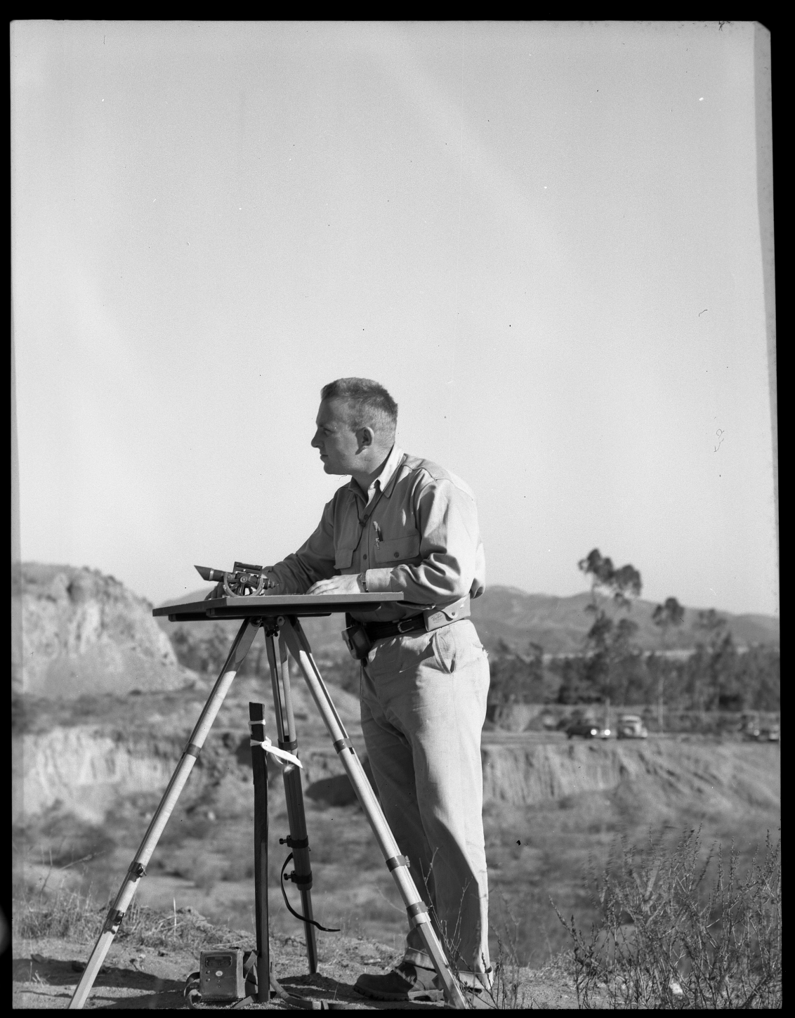
Mark F. Meier

Slide 2
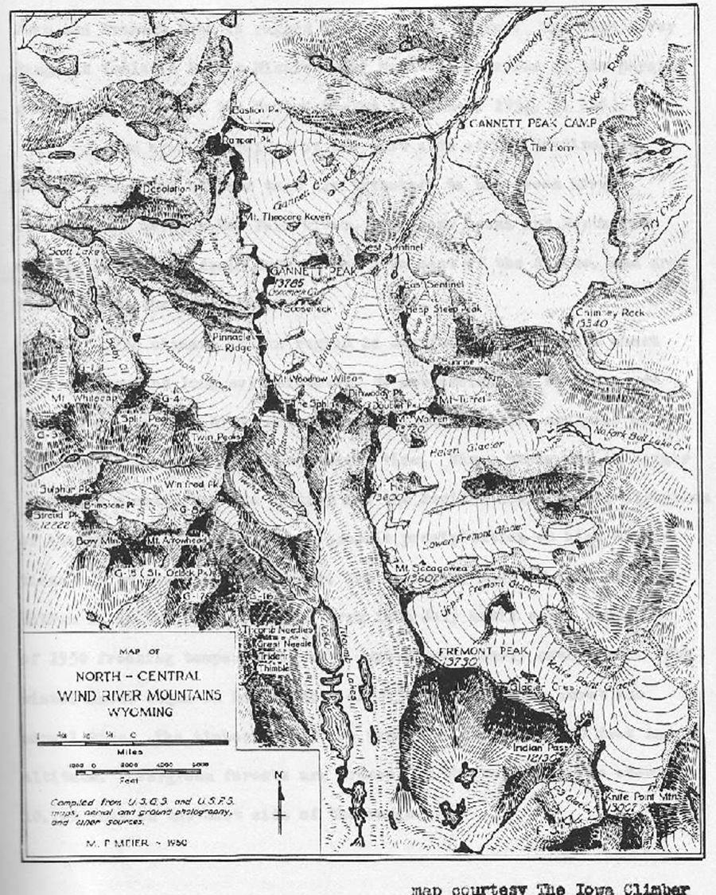

Slide 3
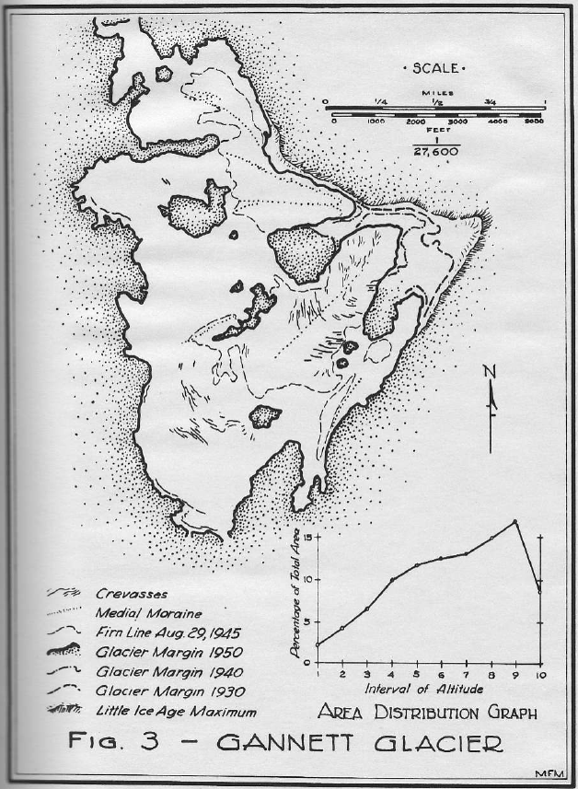

Slide 4
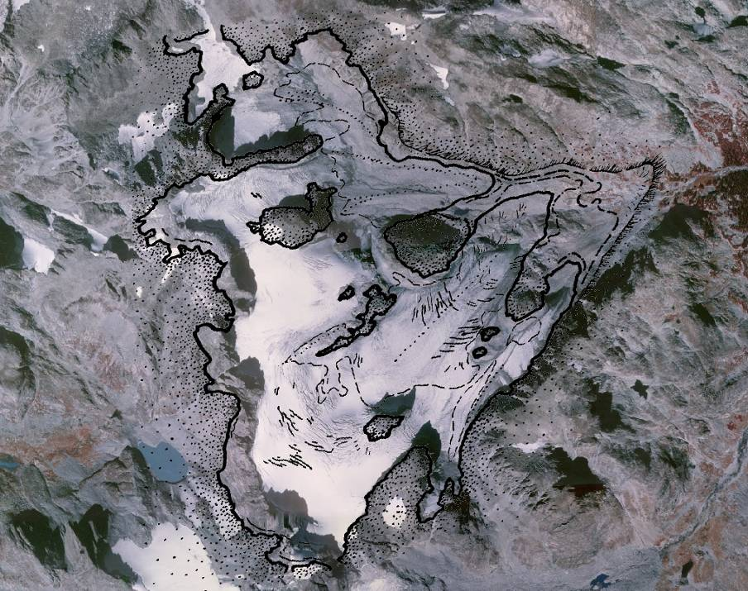
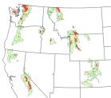
Gannett Glacier, WY
Meier, 1951

Slide 5
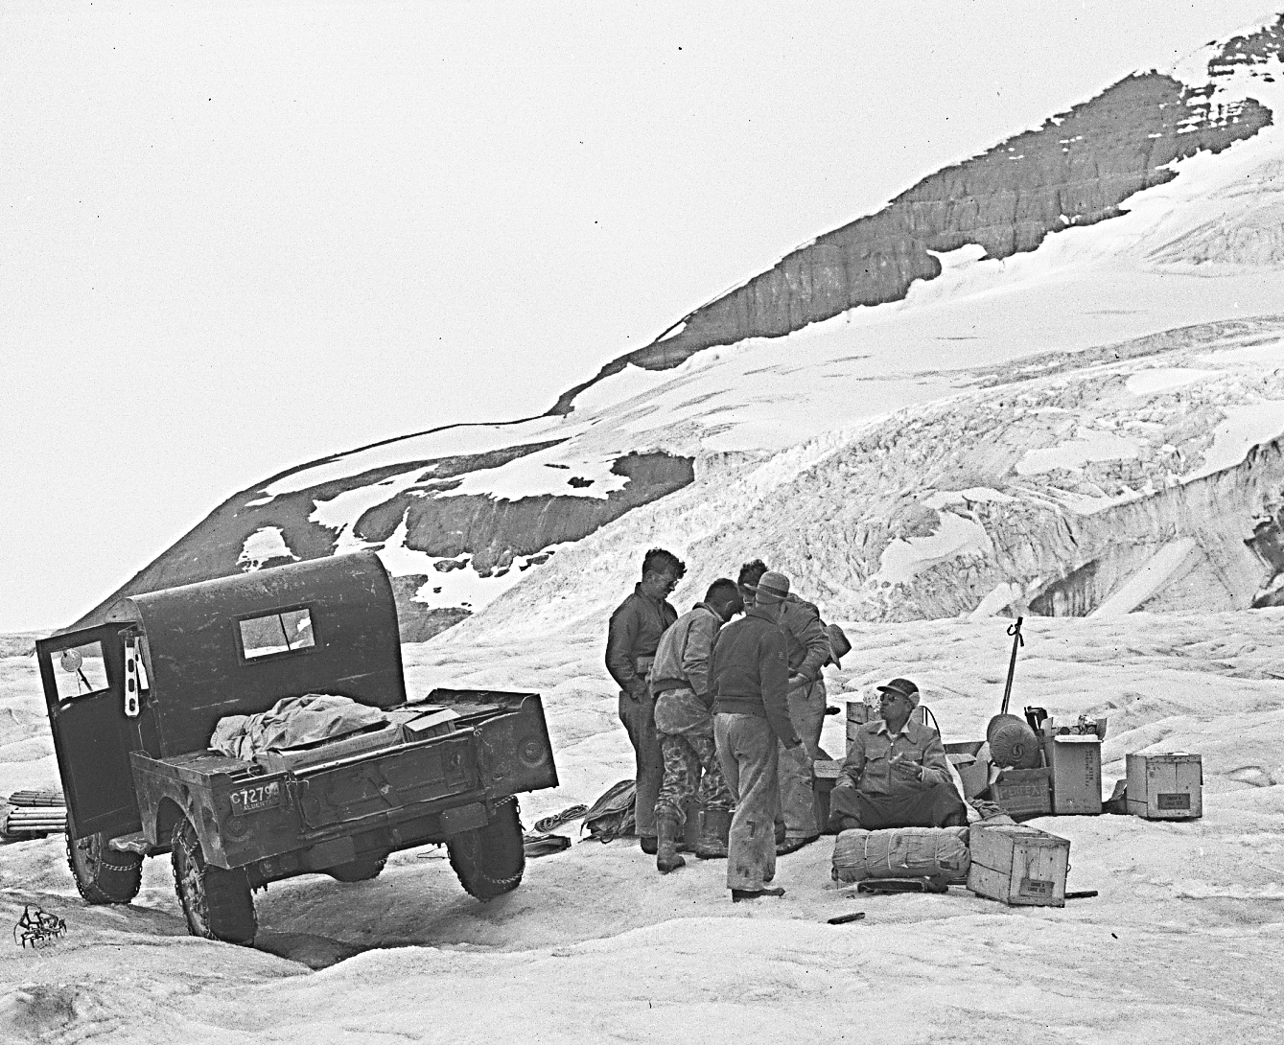

Slide 6
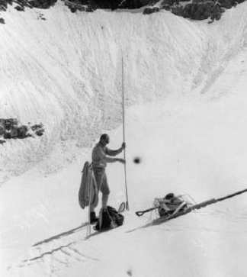
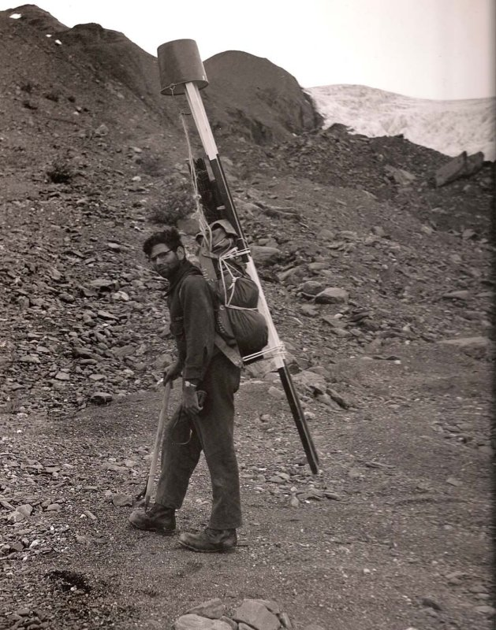
The early Meier Glaciological Team
Wendell Tangborn Austin Post

Slide 7
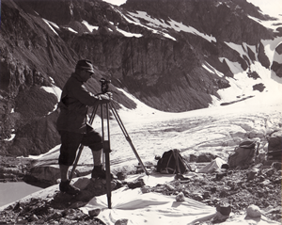
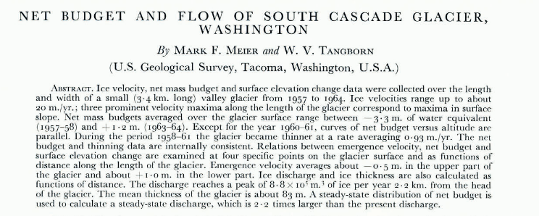
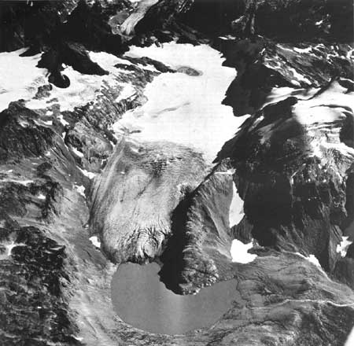
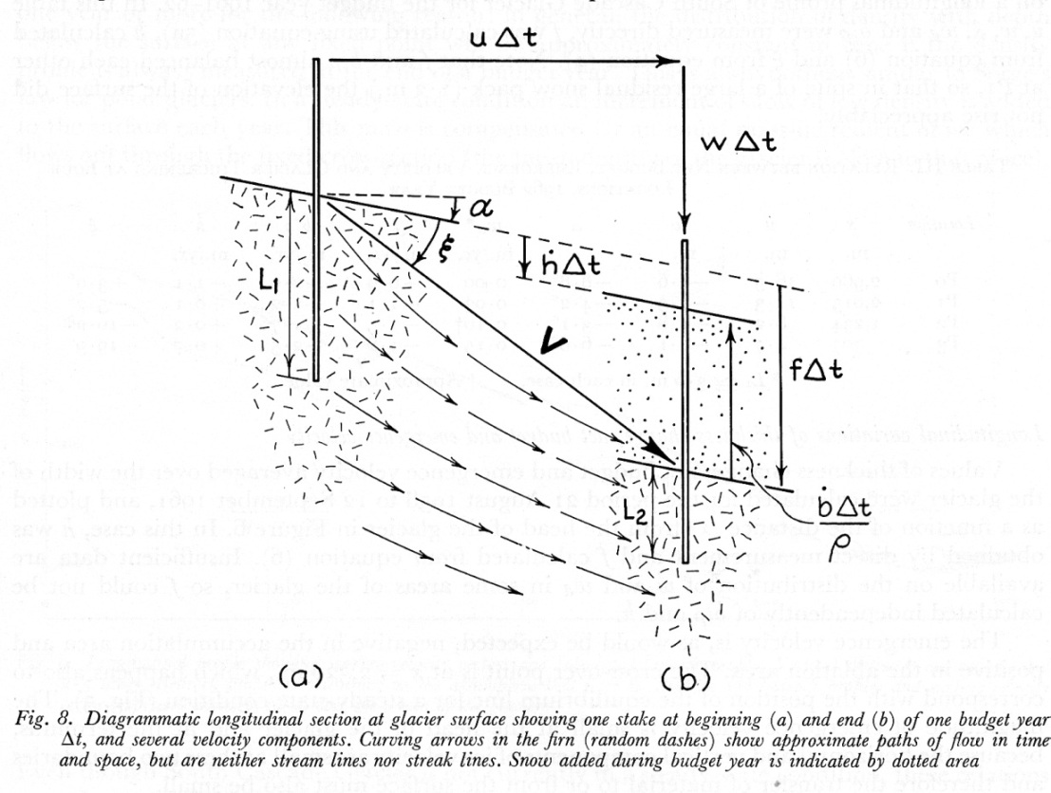
Glacier Flow
Journal of Glaciology 1965
Photo: Wendell Tangborn
Mark F. Meier 1926 - 2012
South Cascade Glacier 1967

Slide 8
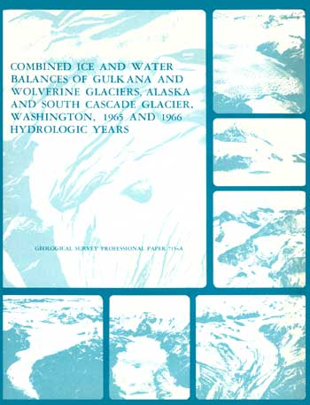
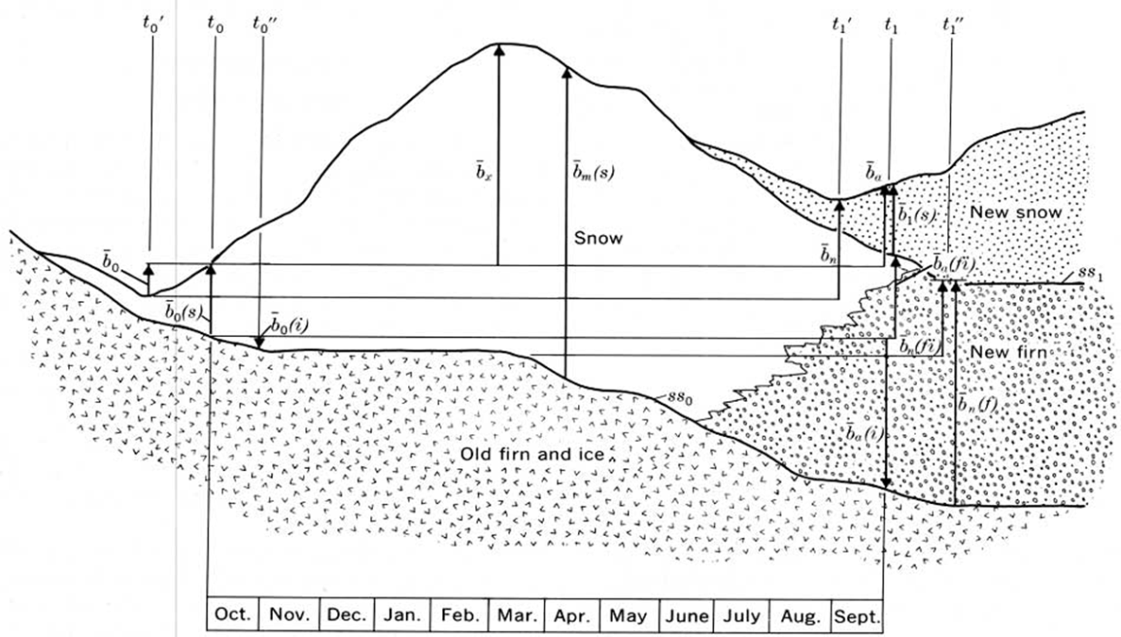
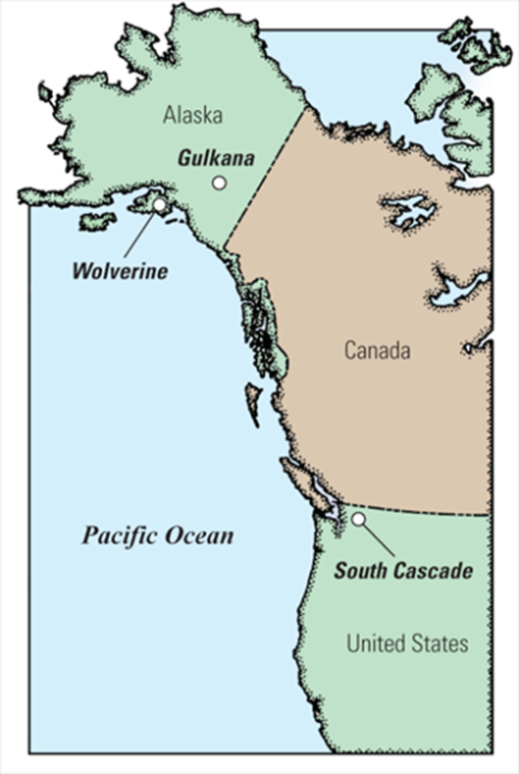
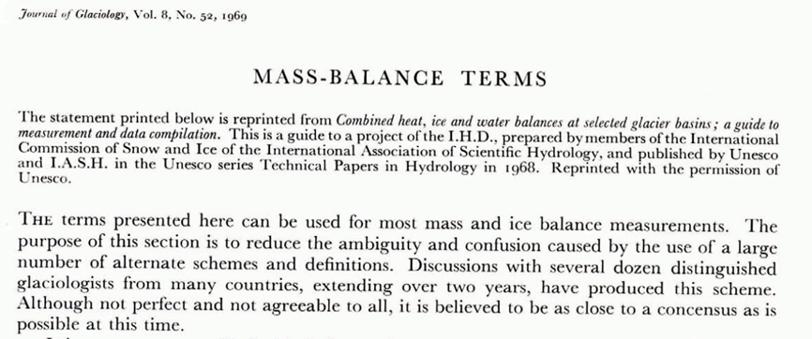
Mass Balance
Anonymous
Notes:
Mass Balance, 715A only report I know of where Meier Tangborn and Post appear together, 4th author Mayo.
Anonymous

Slide 9
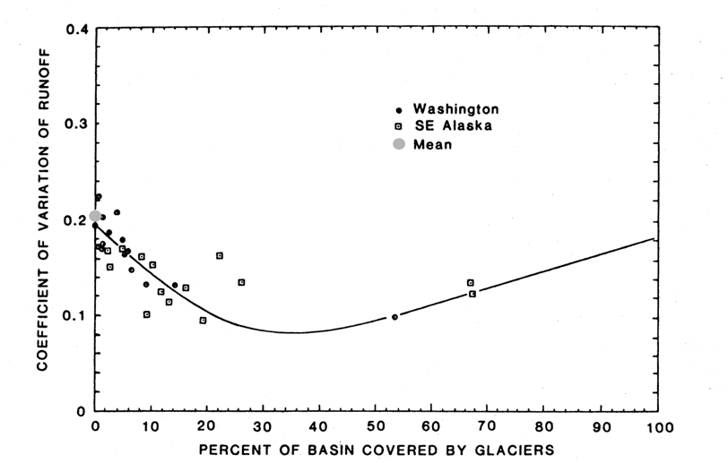
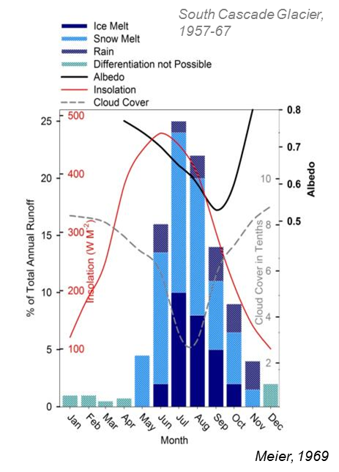
Hydrology
Tangborn W V, Krimmel R M and Meier M F 1975 A comparison of glacier mass balance by glaciological, hydrological and mapping methods, South Cascade Glacier, Washington Snow and Ice Symp. (Moscow: IAHS-AISH) pp 185–96
Meier, M. F., Tangborn, W. V., Mayo, L. R., Post, A., 1971: Combined ice and water balances of Gulkana and Wolverine Glaciers, Alaska, and South Cascade Glacier, Washington, 1965 and 1966 hydrologic years. U.S. Geological Survey Professional Paper 715A.
Meier, M. F., 1970: Combined heat, ice and water balances at selected glacier basins. UNESCO Technical Papers in Hydrology, 5, 20 pp.
Meier, M. F., 1969: Glaciers and water supply. Journal of the American Water Works Association, 61(1).

Slide 10
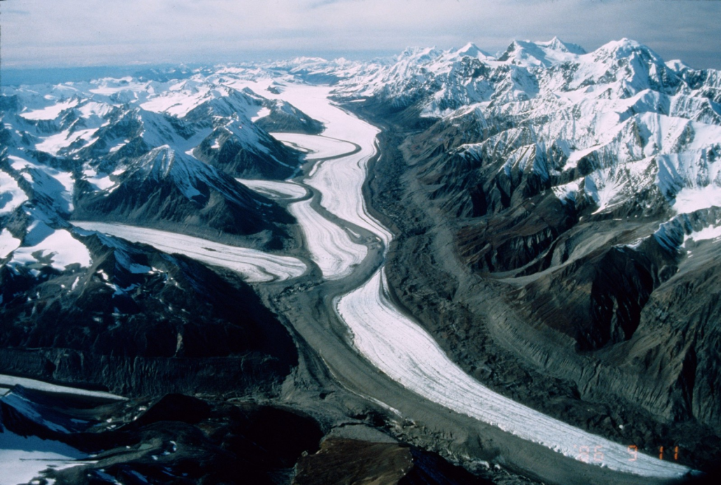
Glacier Surges
Meier, M. F., Post, A., 1969: What are glacier surges? Canadian Journal of Earth Sciences, 6(4P2): 807+.
Lliboutr., L., Meier, M. F., Weeks, W. F., Robin, G. D. Q., Weertman, J., Budd, W., 1969: Discussions of What are glacier surges? Canadian Journal of Earth Sciences, 6(4P2): 816+.
Meier, M. F., 1969: Seminar on causes and mechanics of glacier surges, St. Hilaire, Canada, September 10-11, 1968: A summary. Canadian Journal of Earth Sciences, 6(4P2): 987+.
Meier, M. F., Field, W. O., 1969: Discussion of Current observations on 3 surges in Glacier Bay, Alaska, 1965-1968. Canadian Journal of Earth Sciences, 6(4P2): 839+.
Meier, M. F., Roots, E. F., Goldthwait, R. P., Field, W. O., 1969: Discussion of Glacier surges in Iceland, with special reference to surges of Bruarjokull. Canadian Journal of Earth Sciences, 6(4P2): 882+.
Nye, J., Weertman, J., Lliboutr., L., Meier, M. F., Rothlisb., H., Weeks, W. F., 1969: Discussion of Water lubrication mechanism of glacier surges. Canadian Journal of Earth Sciences, 6(4P2): 939+.
Roots, E. F., Hattersl., Blake, W., Meier, M. F., Lliboutr., L., 1969: Discussion of Recent observations of surging Otto Glacier, Ellesmere Island. Canadian Journal of Earth Sciences, 6(4P2): 888+.
Taylor, L. D., Stanley, A. D., Meier, M. F., Lliboutr., L., Collins, S. G., 1969: Discussion of Observations of surge of Steele Glacier, Yukon Territory, Canada. Canadian Journal of Earth Sciences, 6(4P2): 829+.
Black Rapids Glacier Rod March
Notes:
Based on Post 1960-muldrow, black rapids, susitna; 1965 – no earthquake effects Setting the stage for the investigations in the 1970s by Charlie Raymond, Will Harrison, and Barclay Kamb

Slide 11
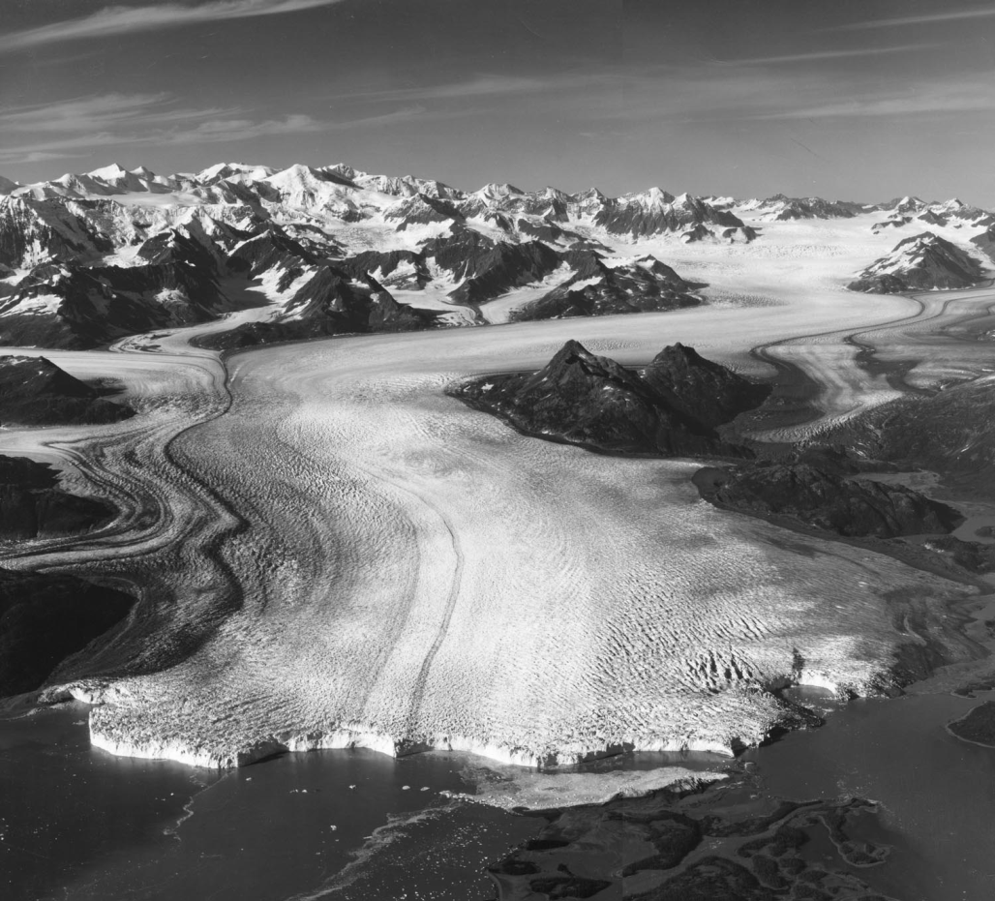
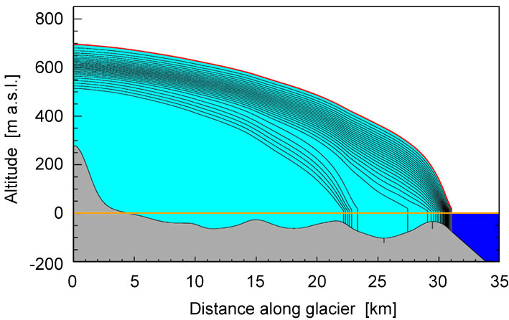
Calving Glaciers
Meier, M. F., Lundstrom, S., Stone, D., Kamb, B., Engelhardt, H., Humphrey, N., Dunlap, W., Fahnestock, M., Krimmel, R., Walters, R., 1994: Mechanical and hydrologic basis for the rapid motion of a large tidewater glacier, 1. Observations. Journal of Geophysical Research, 99(B8): 15,219-15,229.
Meier, M. F., Post, A., 1987: Fast tidewater glaciers. Journal of Geophysical Research, 92(B9): 9051-9058
Brown, C. S., Meier, M. F., Post, A., 1982: Calving speed of Alaska tidewater glaciers, with application to Columbia Glacier. U. S. Geological Survey Professional Paper 1258-C.
Rasmussen, L. A., Meier, M. F., 1982: Continuity equation model of the predicted drastic retreat of Columbia Glacier, Alaska. U. S. Geological Survey Professional Paper 1258-A.
Meier, M. F., 1979: Variations in time and space of the velocity of the lower Columbia Glacier, Alaska. Journal of Glaciology, 23(89): 408.
Meier, M. F., Post, A., Brown, C. S., Frank, D., Hodge, S. M., Mayo, L. R., Rasmussen, L. A., Senear, E. A., Sikonia, W. G., Trabant, D. C., Watts, R. D., 1978: Columbia Glacier progress report, December 1977. U. S. Geological Survey Open-File Report 78-264.
Vieli
Notes:
March 24, 1989, when Exxon Valdez ran aground Vieli

Slide 12
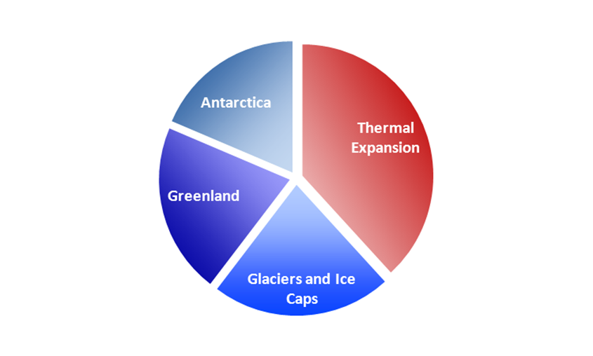
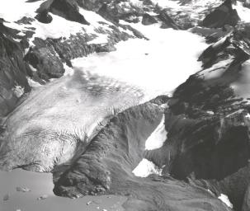
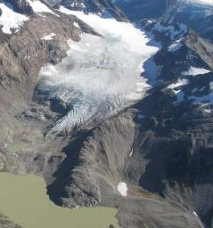
Sea Level Rise
Mark F. M., Dyurgerov, M. B., Rick, U. K., O’Neel, S. Pfeffer, W.T., Anderson, R.S., Anderson, S., Glazovsky, A. F., 2007: Glaciers dominate eustatic sea-level rise in the 21st century. Science, 317: 1064-1067.
Dyurgerov, M.B., Meier, M. F., 2000: Twentieth century climate change: Evidence from small glaciers. Proceedings of the National Academy of Science ,97(4): 1406-1411.
Trupin, A.S., Meier, M. F., Wahr, J.M., 1992: Effect of melting glaciers on the Earth's rotation and gravitational field: 1965-1984. Geophysical Journal International, 108(1): 1-15.
Pfeffer, W. T., Meier, M. F., 1991: Retention of Greenland runoff by refreezing: Implications for projected future sea level change. Journal of Geophysical Research, 96(C12): 22,117-22,124.
Meier, M. F., 1984: Contribution of small glaciers to global sea level. Science, 226(4681): 1418-1421.
Pfeffer, et al., 2008
Notes:
Pfeffer, 2009

Slide 13
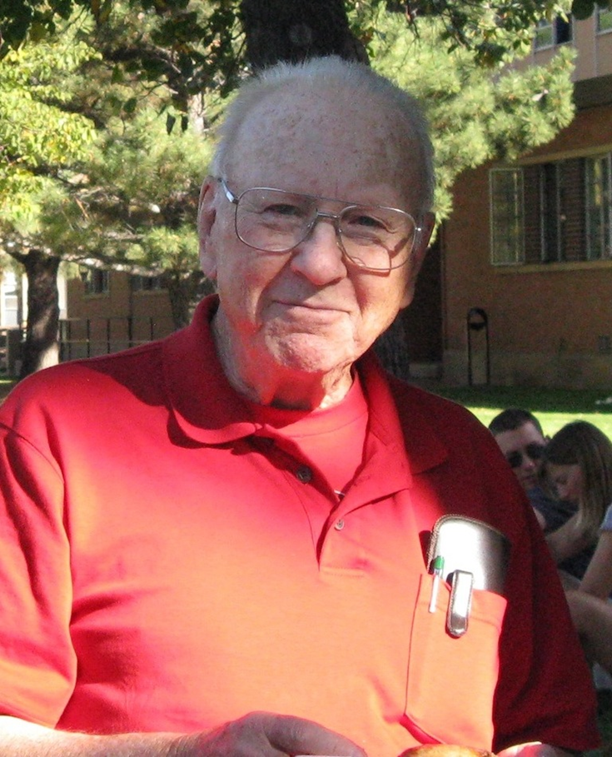
Lessons from a career
Work with talented people
Be lucky – Chance favors the prepared mind
Keep the big picture in mind
Proceed with humor
Notes:
When we reflect on the sweep of a professional life there is a joy in seeing all the processes discovered and the advance in our understanding. And there is some frustration, perhaps as we compare our own career and contributions. But are there any lessons or reminders for us?
Chance favors the prepared mind (pasteur)

