Slide 1
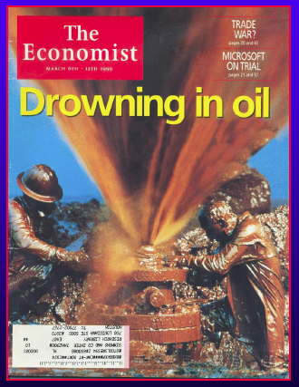
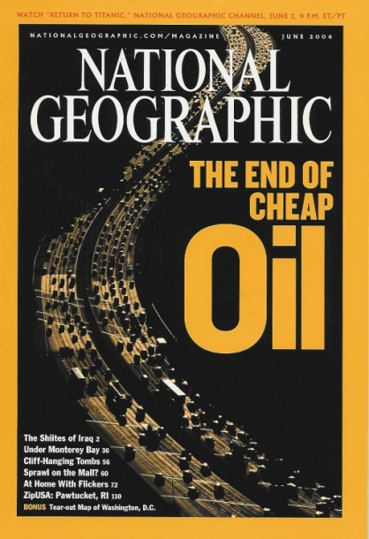
OIL PRODUCTION.
ECONOMIC GROWTH
AND
CLIMATE CHANGE
GSA Meeting
October 2013
James W. Murray
School of Oceanography
University of Washington
1999
2004
"We like to think that the reason we enjoy our high standards of living is because we have been so clever at figuring out how to use the world's available resources. But we should not dismiss the possibility that there may also have been a nontrivial contribution of simply having been quite lucky to have found an incredibly valuable raw material that for a century and a half or so was relatively easy to obtain."
- James D. Hamilton

Slide 2
Pardee Keynote Session (P8): Fossil Fuel Production, Economic Growth and Climate Change
Session Chair: James W. Murray
1:00 Murray, James W. (University of Washington, Seattle, WA, USA)
INTRODUCTION
OIL PRODUCTION, ECONOMIC GROWTH AND CLIMATE CHANGE
1:30 Aleklett, Kjell (Uppsala University, Uppsala, Sweden)
DARCY’S LAW AND FUTURE FLOW OF CRUSE OIL
1:55 Berman, Art E.( by Jim Hansen and David Hughes)
LETS BE HONEST ABOUT SHALE GAS
2:20 Hughes, David (Global Sustainability Research, Whaletown, BC, Canada)
TIGHT OIL: A SOLUTION TO US IMPORT DEPENDENCE?
2:45 Hall, Charles A.S. (SUNY Syracuse, Syracuse, NY, USA)
ARE WE ENTERING THE SECOND HALF OF THE AGE OF OIL? SOME
EMPIRICAL CONSTRAINTS ON OPTIMISTS’ PREDICTIONS OF AN OIL-RICH
FUTURE
3:10 Hansen, Jim (Ravenna Capital Management, Seattle, WA, USA)
IT IS MORE THAN A SIMPLE BELL CURVE
3:35 Rutledge, David B. (California Institute of Technology, Pasadena, CA, USA)
PROJECTIONS FOR ULTIMATE COAL PRODUCTION FROM PRODUCTION
HISTORIES THROUGH 2012
4:00 Tans, Pieter (NOAA NCAR, Boulder, CO, USA)
WILL REALISTIC FOSSIL FUEL BURNING SCENARIOS PREVENT
CATASTROPHIC CLIMATE CHANGE?
4:30 Panel Discussion: Questions and Answers

Slide 3
There is an ongoing Energy Policy Debate
The notion of that fossil fuel supply may be constrained has gone from
being dismissed, to be partially accepted, to being vociferously dismissed.
The Teams:
Cornucopians – the oil and gas industry, its public relations, its bankers,
official agencies (EIA and IEA) that tend to parrot industry data.
Respected, get lots of press and are well funded.
Oil production will continue to increase to meet rising demand
Vs
Peakists – retired and independent petroleum geologists
and energy analysts
Geological evidence suggests that rates of global oil production
will soon reach a maximum then decline.

Slide 4
Economic and Climate Change Impacts
Oil has been the linchpin of industrial life and growth of the
global economy.
It allowed expanded extractive and productive process
Transportation
Trade
But these benefits come at a cost
Depletion
Waste
CO₂ production
For simple reference call this “peak oil” but its:
Complex
Mischaracterized
Oversimplified
Not decades away but
unfolding in real time

Slide 5
The “peak” issue is not limited to oil (Aleklett, Hughes, Hall)
Natural gas (e.g., Berman, Hansen, Hughes)
Coal (e.g., Rutledge)

Slide 6
What is Peak Oil? Its not a theory!
Often misrepresented by critics.
It’s not about Reserves!
It’s all about maximum in Production Rate!
Price ∝ supply/demand
We are not close to running out of oil.
It doesn’t mean we won’t find more oil.
It does not mean the immediate collapse
of modern civilization!

Slide 7
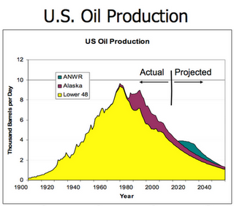
What is Peak Oil?
Geological Peak Oil – supply side view
Conventional oil production will reach a maximum when
half the ultimate recoverable resource (URR) has been
produced
US reached peak oil
in 1970

Slide 8
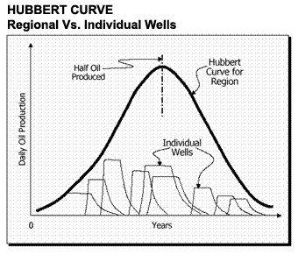
A model
logistic
distribution
Oil Wells and Fields Peak --- Regions Peak --- The World will peak
Everyone agrees that world oil will peak – controversy on the date

Slide 9
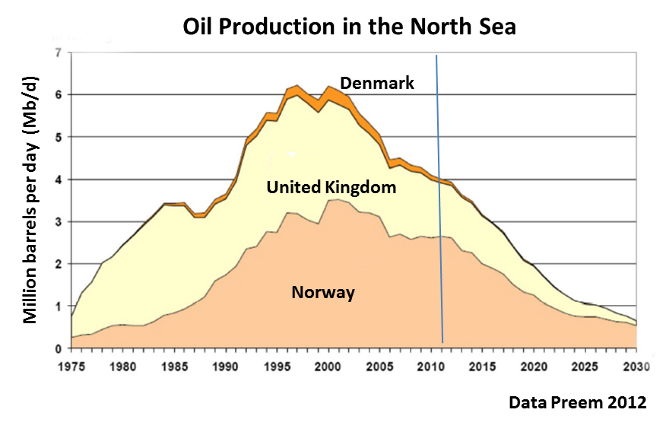
Example: Peak and Depletion are normal
Q. When will the world peak??

Slide 10
Confusing Factors
Definitions of oil
Resources vs Reserves vs Supply
“Proven” Reserves
Discoveries vs Production
Existing oil fields in decline
Net Exports
Energy Return on Energy Invested
Wild Cards
Technology
Politics
Economy

Slide 11
1
Definitions of Oil and Price
IEA – International Energy Agency (International, Paris)
EIA – Energy Information Agency in US Department of
Energy (US DOE)
Definitions of Oil
IEA reports Crude + condensates + natural gas
liquids + biofuels + processing gains = 91 mb/d
EIA reports Crude + condensates = crude oil
= 76 mb/d
NGL = propane, butane
Condensates = low density HC liquids (C5 to C9)
(drip gas)
Oil Price
Brent = $108
NyMeX (WTI) = $102

Slide 12
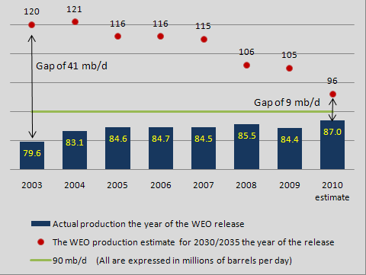
IEA Predictions

Slide 13
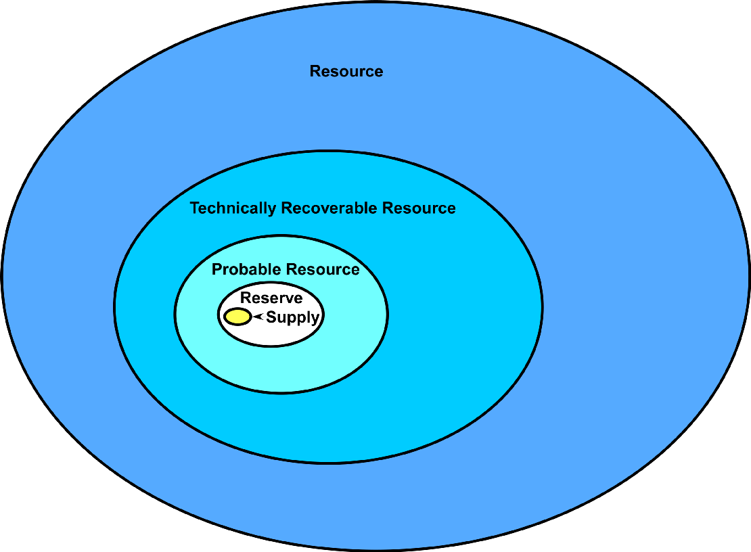
2
Modified from Medlock (2010)
Reserves are a very small sub-set of resources (oil in place).
Reserves take years of development drilling to become supply.
Proved undeveloped reserves may never be developed.

Slide 14
OPEC Oil “Proven” Reserves!
3
Not proven
by anybody!
Accurate reserve estimates for OPEC countries are state secrets
Values for 1983 are accurate
No adjustment for 193Gb produced since 1980
Kuwait Example: A recent leak of Kuwait Petroleum Company documents showed the actual reserves are only 48Gb (official reserves are 102Gb). 1980 Kuwait reserves adjusted for production since then are 55Gb
From BP Statistical Review
Gb = billions of barrels
From D. Rutledge
Notes:
Oil and Gas Journal July 28, 2003, Rafael Sandrea, “OPECs next challenge, rethinking their quota system”. There was a discussion of a new quota system, and countries increased their reserves, presumably thinking that it would help them get higher quotas
Proved Reserves from the BP Statistical Review http://www.bp.com/productlanding.do?categoryId=6842&contentId=7021390 They start in 1980 EIA production data at http://www.eia.doe.gov/emeu/international/oilproduction.html
Kuwait leak January 2007 of 2001 documents
http://today.reuters.com/news/articlebusiness.aspx?type=tnBusinessNews&storyID=nL20548125&imageid=&cap&from=business
24 billion proved, 48 billion probable
Estimate of 2 billion barrels loss for Kuwait in the first Gulf War in the World Energy Council 2007 Survey of Energy Resources page 59
http://www.worldenergy.org/publications/survey_of_energy_resources_2007/default.asp
I include 2 billion barrels for oil burned in the first Gulf War, estimated in

Slide 15
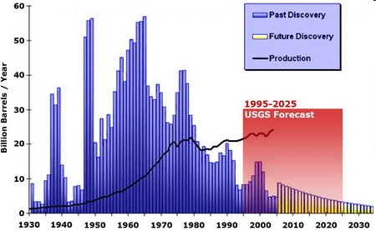
Oil discoveries have been declining since 1964.
USGS Forecast is way off base.
4
Middle
East
US
The red box shows the average amount estimated to be discovered by the USGS each year between 1995 and 2025.

Slide 16
Existing Oil Fields are in Decline
5
Existing oil fields are declining at 5% per year
(IEA 2008; Exxon, CERA, ASPO)
For 2010 to 2030 the world needs 46 mb/d of new production
– just to maintain flat production
The IEA forecasts in 2008 projects a 10% increase in
oil production between now and 2030 (from 87 to 96 mb/d)
(Δ = +9 mb/d).
The projected growth requires discovery and
production of 46 + 9 = 55 mb/d of new oil!
55 mb/d ÷ 9 mb/d = ~6 new Saudi Arabias

Slide 17
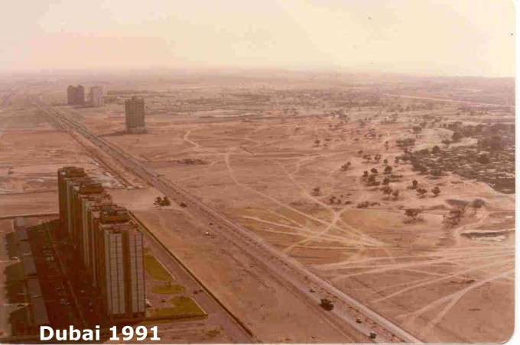
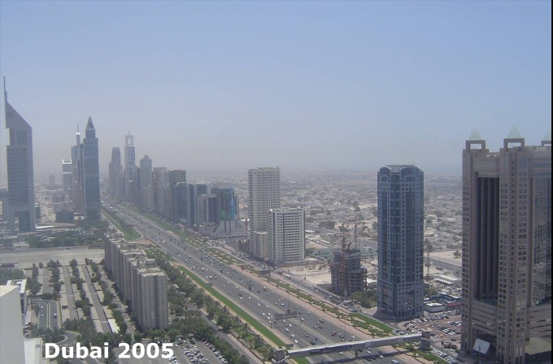
Net Exports are going down
6
Over the last three years, consumption inside of OPEC has grown at an astounding >5% average annual rate.

Slide 18
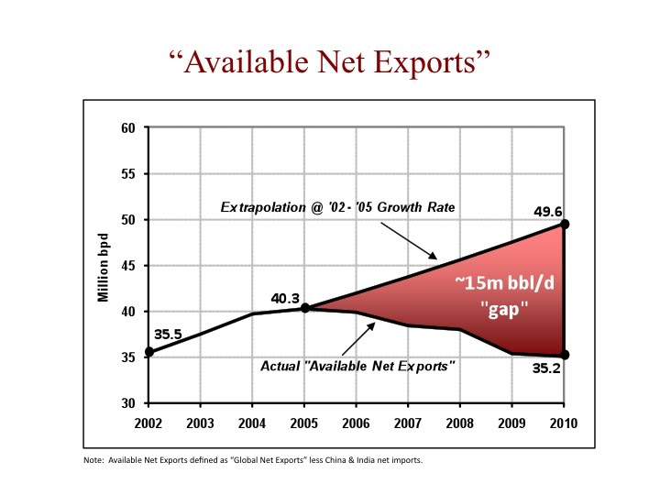
Peak Oil has come to the export market
Citigroup (2012) – Saudi Arabia will become
an oil importer in 2030
Brown and Foucher, 2007

Slide 19
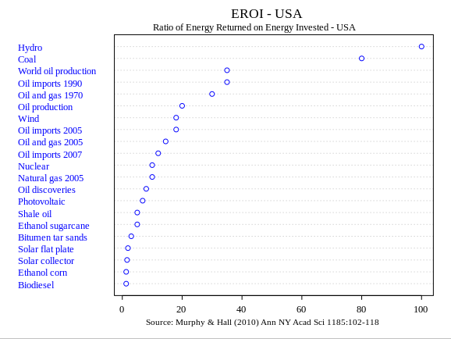
EROI = Energy Return on Invested
7
Net Energy = Eout – Ein EROI = Eout/Ein

Slide 20
8
Wild cards
Technology (e.g., fracking and tight oil)
Politics (e.g., Middle East today)
Economy – price ⬆ production ⬆ but economy ⬇ demand ⬇ price⬇
A production – price buffer

Slide 21
When will the World Peak??
What has actually happened?

Slide 22
Global oil production and price
EIA data
Oil Production has been
on a plateau since 2005
Murray and King (2012) Nature
Murray and Hansen (2013) EOS

Slide 23
A Phase Shift

Slide 24
No Peak yet but …
Global Oil Production has been on a plateau since 2005
in spite of a large increase in the price of oil.
Why the plateau?
1. Existing oil fields are in decline.
2. New discoveries are just keeping pace (so far).
3. No increase in production.

Slide 25
So if conventional oil is on a plateau,
the debate about “peak oil” comes down to what are the prospects for production rates from low EROI, expensive, unconventional sources.

Slide 26
Conventional Oil = production from reservoirs that have sufficient pressure, porosity and permeability to flow freely.
Higher EROI.
Unconventional Oil = is that which does not flow freely or requires special technologies. More expensive to produce.
Lower EROI.
Includes: deep-water oil, tar sands, tight oil
(improperly called shale oil) heavy oil, biofuels, synthetic oil

Slide 27
The prospects for crude oil production
to exceed 75 mb/d are not good.

Slide 28
Can there be economic growth
without growth in energy?

Slide 29
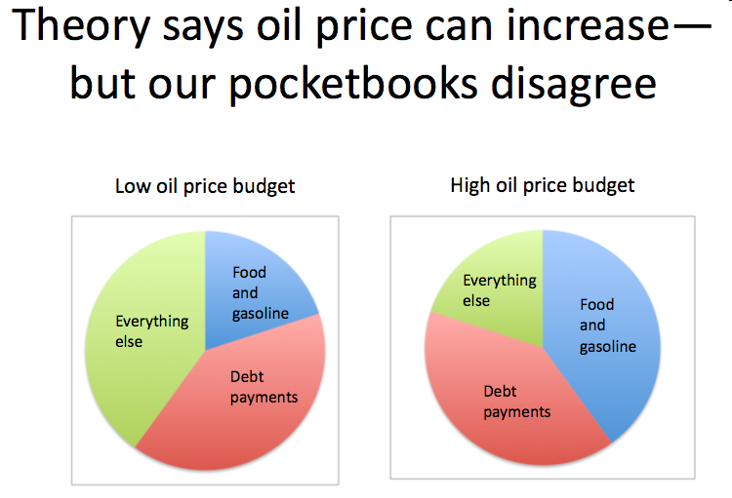
There is a connection between debt, oil prices and personal income

Slide 30
What is Peak Oil?
Economic Peak Oil
If the price of oil is too high, oil consumption will decline. If the price is too low, more costly reserves (mostly unconventional oil) will not be produced.
The net result is that peak production will occur when the marginal consumer (the consumer who will buy the most expensive barrel of oil) is no longer willing to pay the price of the marginal barrel (the most expensive barrel to produce)

Slide 31
Peak Oil and Climate Change

Slide 32
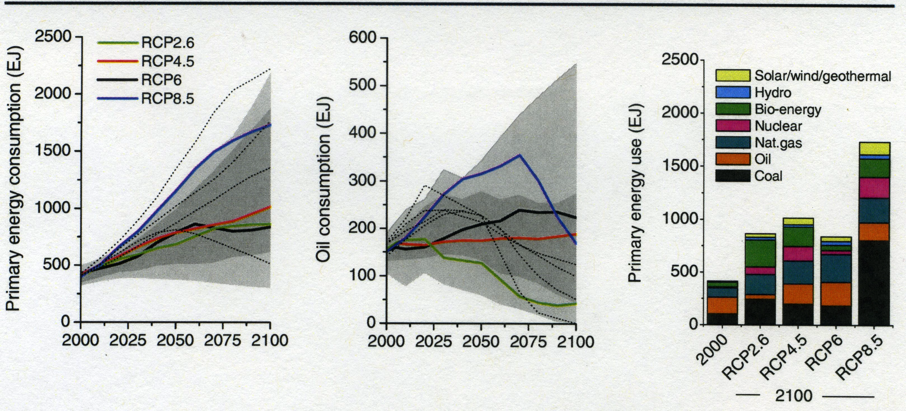

Slide 33
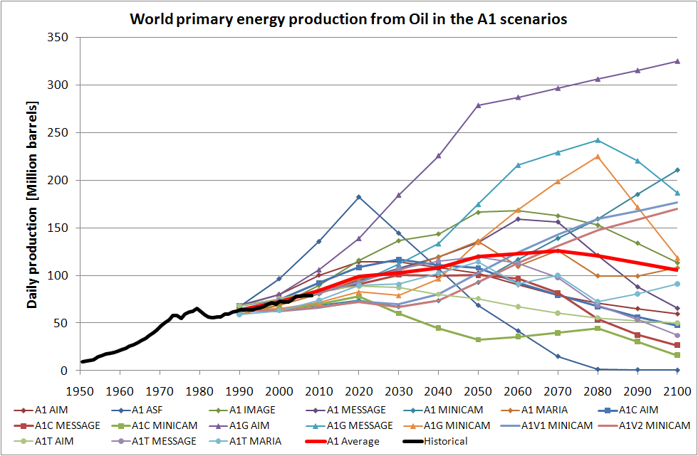
Oil consumed by the SRES emission scenarios range up to 325 mb/d (for A1G AIM) in 2100 with an average maximum of 126 mb/d (Hook et al., 2010).
With present oil production on a plateau of 75 mb/d it is very unlikely that such production rates would ever be reached.

Slide 34
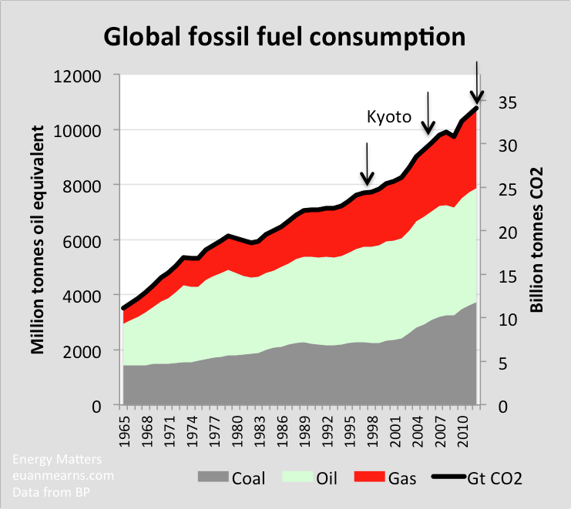
Effect of Kyoto on CO2 emissions.

Slide 35
Conclusions: A slow-motion train wreck
1) Global Oil Production is on a Plateau.
2) Unconventional Oil has is expensive,
has high EROI and production will be
limited.
3) The economic impacts of the high price
of oil are a drain on the economy.
4) It is very unlikely that the higher range of
IPCC scenarios for CO₂ production will
ever be reached.

Slide 39
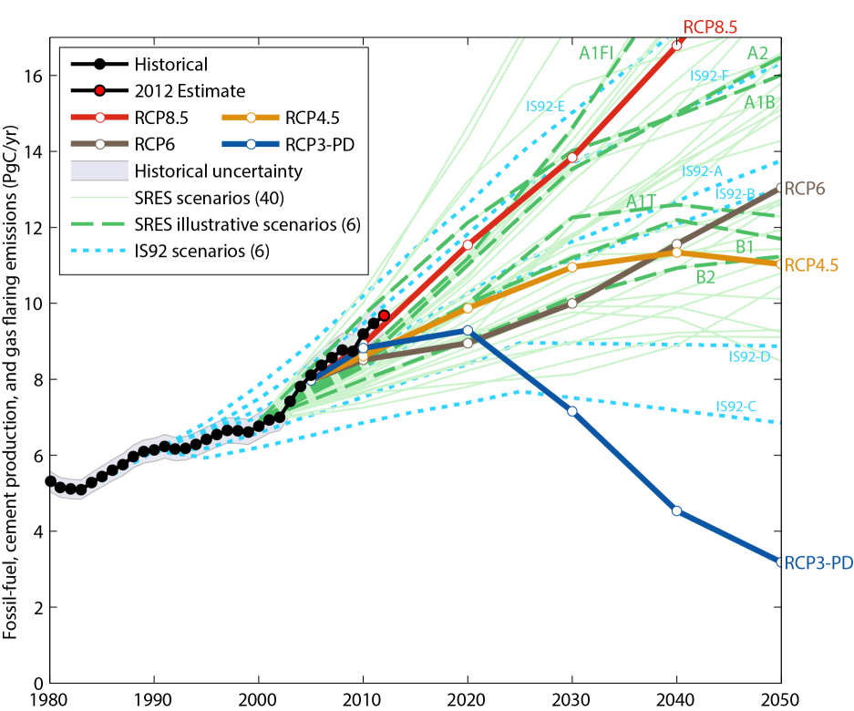
We learned from Le Quere that atmospheric CO₂ is increasing along the path of the highest scenarios.
Source: Peters et al. 2012a; Global Carbon Project 2012

Slide 40
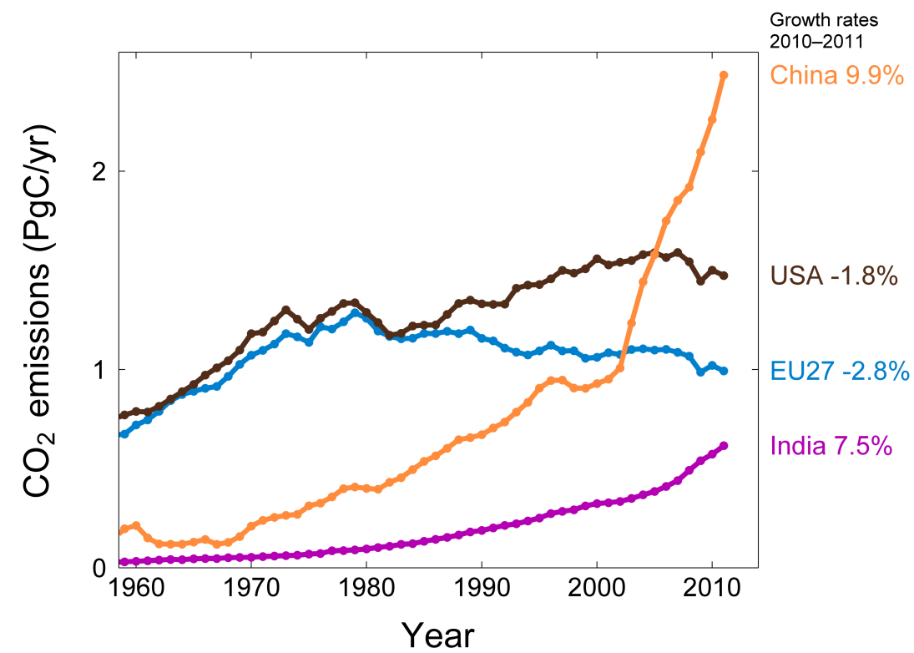
This is mostly due to increases in emissions from China and India
Source: CDIAC Data; Le Quéré et al. 2012; Global Carbon Project 2012

Slide 41
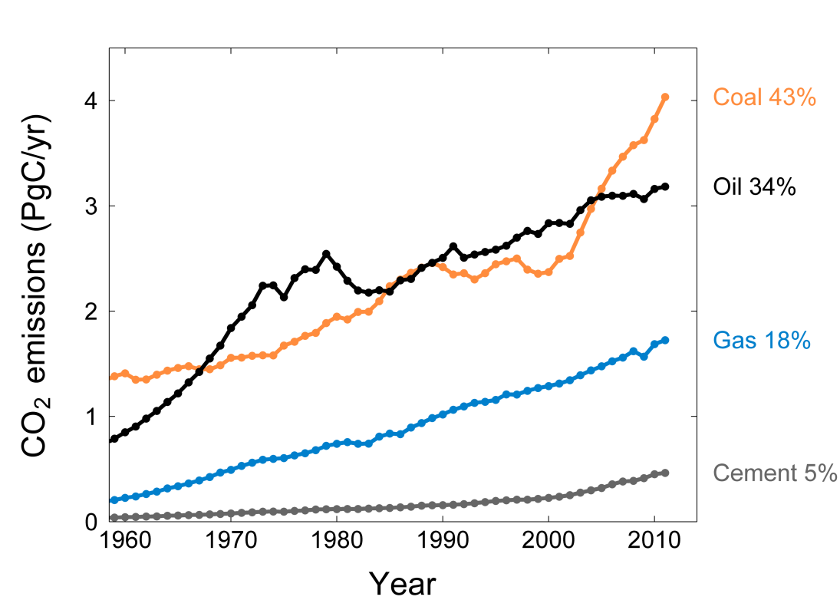
This is mostly due to increases in emissions from coal
Share of global emissions in 2011
Source: CDIAC Data; Le Quéré et al. 2012; Global Carbon Project 2012

Slide 42
Unconventional Oil – ethanol and biodiesel
Problem of scale is unsolvable.
To run the US car fleet on ethanol
– need 1.8 billion acres of cultivation.
Present US cultivation (total) = 0.44 billion acres
Negative impacts on the cost of food
EROI = 2:1 Even with government subsidies
doesn’t make money

Slide 43
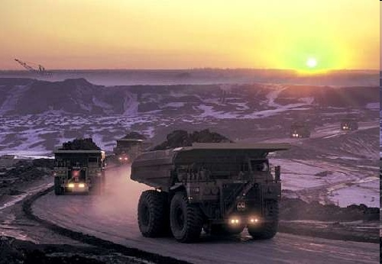
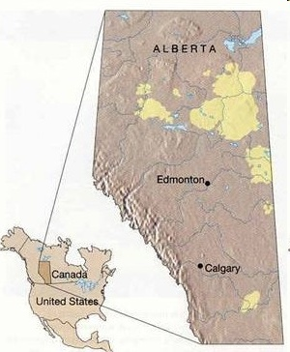
Unconventional Oil - Canadian Tar Sands
Hugh resource
= 1.7 trillion barrels
surface mining (~20%)
in-situ (~80%)
1.7 mbd in 2013;
projected 2.5 (most) to 6.6 mb/d in 2035 (EIA)
4 barrels of water for each barrel of oil
2 tons tar sands = 1 barrel
EROI = ~5:1 gold (natural gas) to lead (oil)
Neither scalable nor timely
Production Rate is the key metric
Keystone Pipeline

Slide 44
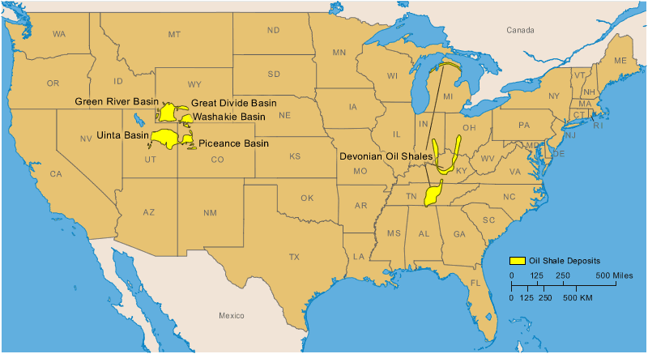
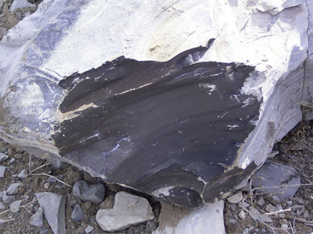
Unconventional Oil – oil shale
Oil shale is neither shale, nor does it contain oil. It is better characterized as organic marlstone. It contains kerogen, a waxy, long-chain hydrocarbon that must be extensively processed to make it into a synthetic form of crude oil.
Needs energy
Needs water
Where is it? : Eocene fresh water lakes
What it looks like
Exxon Mobile has pulled out
Chevron has pulled out
Shell has pulled out

Slide 45
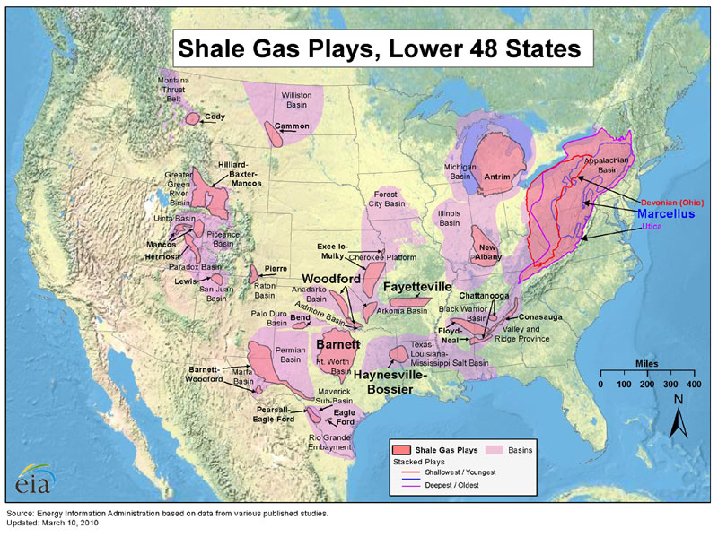
The Miracle of Tight Oil
What is shale?
= organic rich mud to fine grained source rock
= with low permeability
As of October 2014 = 7.9 mb/d

Slide 46
The shale revolution did not begin because it was a good idea but
1. because more attractive opportunities were exhausted and
2. because the market price climbed to support the cost of extraction

