Slide 1
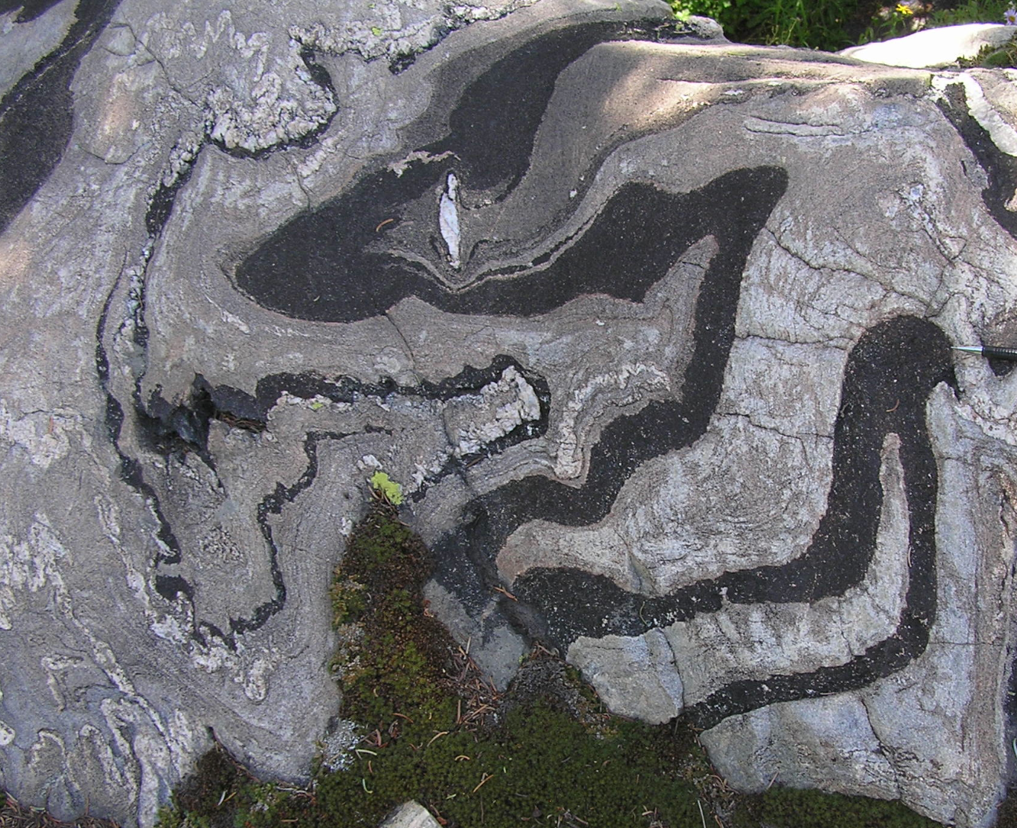
Tectonic significance of ca. 1.6 Ga deformation in southwestern Laurentia - protracted Mazatzal orogeny or previously unrecognized event? A progress report
Ernie Duebendorfer, Northern Arizona University
Kevin Chamberlain, University of Wyoming
Michael Williams, University of Massachusetts, Amherst
Jeffre Hamlin, Northern Arizona University
Notes:
Tectonic significance of ca. 1.6 Ga deformation in southwestern Laurentia - protracted Mazatzal orogeny or previously unrecognized event? A progress report.

Slide 2
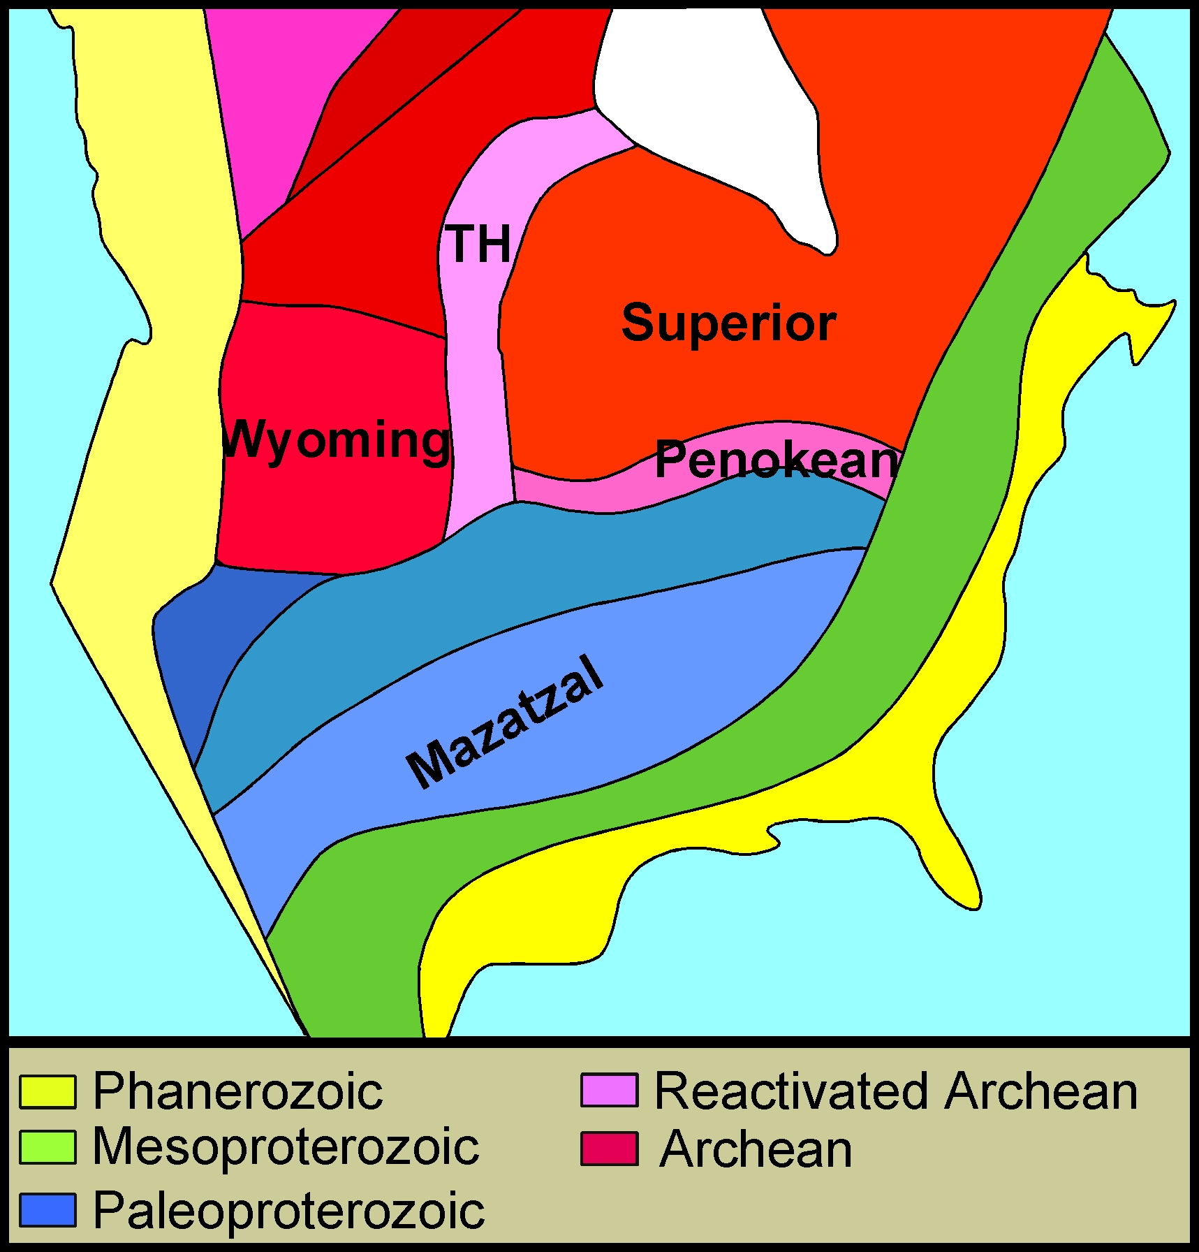
Crustal Provinces and Orogens
Rae
Wopmay
Hearne
Cordilleran
Cheyenne belt
Mojave
Yavapai
Grenville
Appalachian
1000 km
Notes:
Period between 1.78 and 1.63 Ga was one of major crustal growth and assembly in SW Laurentia. Mazatzal orogeny generally considered to be the culmination; over by 1630 Ma.

Slide 3
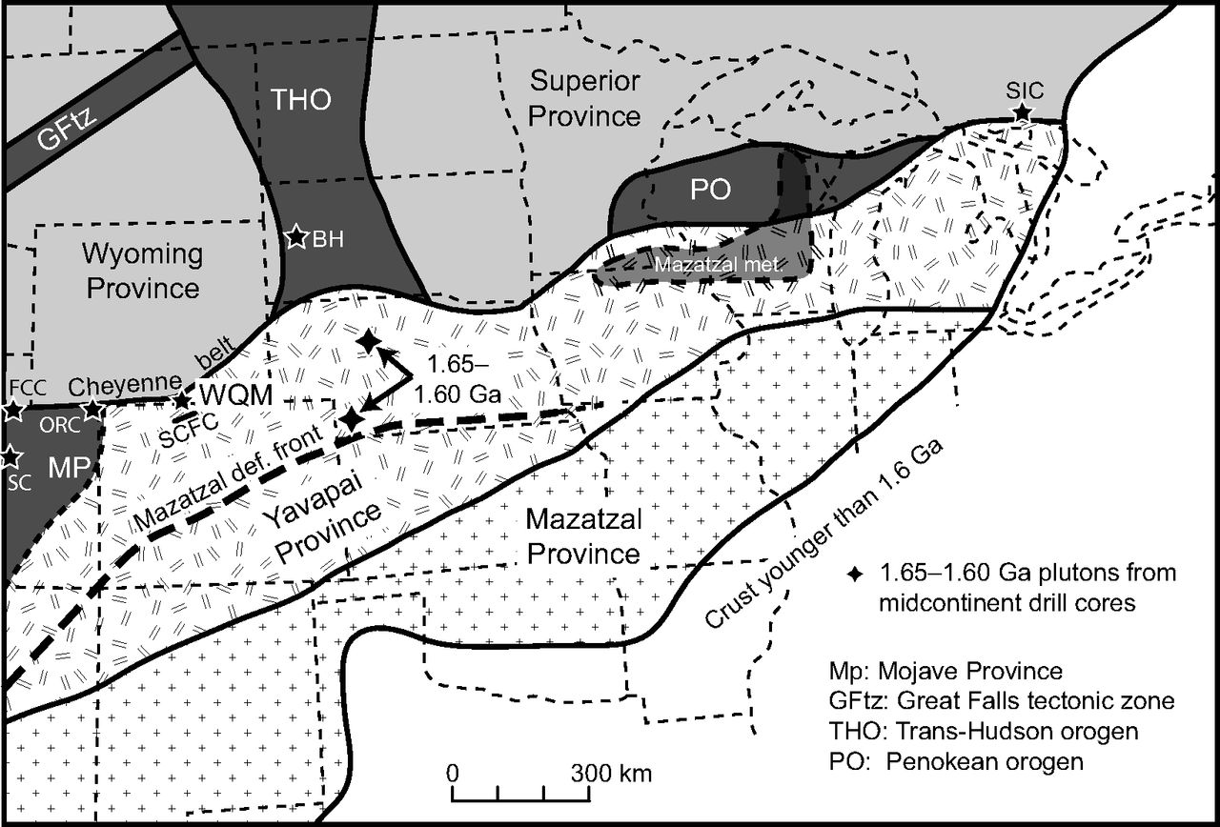
Location of possible Mazatzal-age deformation and magmatism north
of the Mazatzal deformational front
Holm and coworkers
Jones et al.
Mazatzal deformational front
Modified from Jones, D.S. et al. 2012; Geological Society of America Bulletin
Notes:
Mazatzal front. Holm and Jones documented Mazatzal deformation 200-300 km north of MF.

Slide 4
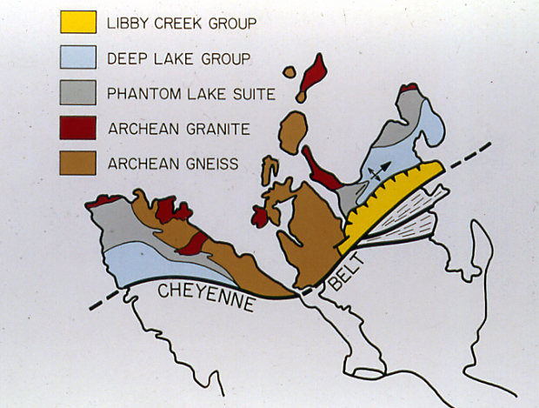
Cheyenne Belt - 1.78-1.75 Ga Archean-Proterozoic Suture
The Old Version
Medicine
Bow Mts.
Archean
Sierra
Madre
Proterozoic
Notes:
Start of period of Paleoproterozoic crustal growth – Medicine Bow orogeny. The CB is commonly depicted with a pronounced bend.

Slide 5
Truncation of Cheyenne belt suture by brittle thrust-tear fault system:
the ca. 1.6 Ga Battle Lake fault
1.63 Ga
qz. monz.
1.57 Ga
epidote
1.61 Ga
zirc. rims
Notes:
Apparent bend Is actually truncation of the CB by a NW-striking, right-lateral cataclastic fault zone that zone curves into an east-striking reverse-sense cataclastic shear zone.

Slide 6
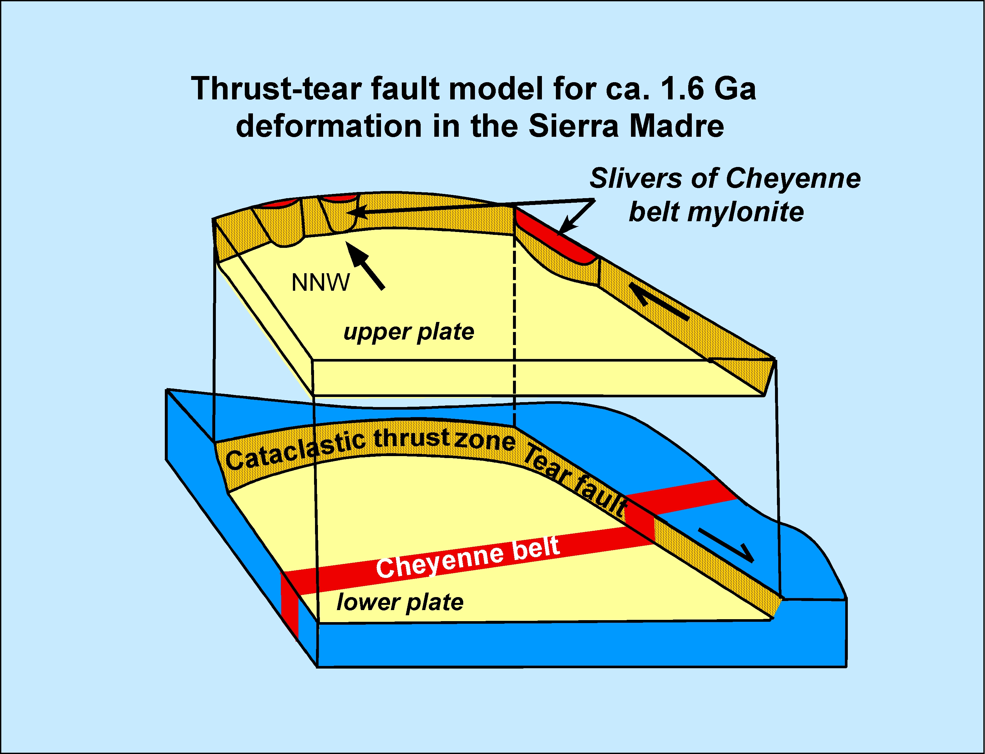
Battle Lake
fault zone
Notes:
Block diagram showing relation between the Battle Lake fault zone and Cheyenne belt. At least 30 km movement on BLFZ.

Slide 7
⁴⁰Ar/³⁹Ar dates on synkinematic muscovite from the
Battle Lake fault zone
Coarse muscovite defines foliation and lineation in cataclastic amphibolite
Courtesy of Matt Heizler. Cited in Duebendorfer, Chamberlain, and Heizler (2006)
Notes:
Ar/Ar dates of three synkinematic muscovites are 1579, 1592, and 1596 Ma.

Slide 8
Ca. 1.6 Ga Deformation, Magmatism, and Thermal Events
Sierra Madre
1.63 Ga plutonism
(Premo and Van Schmus,
1989; Jones et. al., 2012)
Farwell Mt.
1.6 Ga folds,
1.6-1.57 Ga
zircon, titanite,
monazite
(Chamberlain, unpub.)
Virgin Mts.
1.60-1.55 Ga
monazite
(Quigley et. al.,2002)
SE of Yuma
1.60-1.55 Ga
folding and
mineral growth
(Nourse et al., 2005)
Cheyenne belt
1.60 Ga deformation
(Strickland, 2004)
*
Gore R., Idaho
Spgs. shear zones
1.62 deformation
(McCoy et al., 2005)
Mazatzal def. frt.
Wet Mts.
1.62–1.615 Ga
plutonism
(Bickford et al., 1989)
Manzano Mts.
1.60 Ga volcanism,
deformation
(Luther et al., 2006)
Burro Mts.
1.63 magmatism
(Rämö et al., 2003;
Amato et al., 2008)
*
SE AZ deformation/magmatism 1.63-1.615 Ga (Eisele and Isachsen, 2001)
Notes:
The 1.6 Ga deformational event is not restricted to southern Wyoming. Briefly discuss other localities that show evidence for ca. 1.6 Ga tectonism. Bottom line: deformation, thermal effects, and magmatism younger than the Mazatzal orogeny documented over a broad area throughout SW Laurentia. Last phase of Mazatzal orogeny or completely different event? Not known.

Slide 9
Hypotheses for ca. 1.6 Ga tectonism in southwestern Laurentia
Intracratonic deformation
Southern margin of Laurentia
Tibetan Plateau
Laramide
Implies stabilized crust not long after accretion
Notes:
If last gasp of a protracted Mazatzal orogeny - would imply deformation of accreted crust far inboard of a convergent plate margin, perhaps analogous to the Laramide orogeny in the U.S., or the Tibetan plateau. Suggests lithosphere strong enough to transmit stress, implying stabilization of new crust not long after accretion.

Slide 10
Tomographic image of P- and S-wave velocity variations
beneath CD-ROM transects
South
North
P wave
Cheyenne belt
200+ km-long high-velocity zone
Interpreted as a fossil
oceanic slab
Blue = high velocity
Red = low velocity
S wave
Dueker et al. (2001)
Notes:
Alternative model incorporates data from a tomographic study. Discuss Cheyenne slab.

Slide 11
Hypotheses for ca. 1.6 Ga tectonism in southwestern Laurentia
Delayed subduction of remnant ocean basin
Closure of remnant ocean
basin could explain 1.6 Ga
tectonism in southern
Wyoming
Model requires regional-scale
strike-slip shear zone
Notes:
Alternative model “delayed subduction” implies Paleoproterozoic crustal assembly was not completed, and therefore newly accreted crust could not have been stabilized, before 1.6 Ga. Requires existence at 1.6 Ga of a major, NNW-striking, strike-slip shear zone .

Slide 12
Evidence for postulated NNW-trending shear zone
between Front Range and western Rockies
Mismatched shear zones
Aeromagnetic evidence for NNW shear zone
1627 Ma Sierra Madre plutonism; none in Front Range
Right-lateral Battle Lake fault zone
1.60-1.55 Ga thermal effects west of shear zone
1.6 Ga reactivation to west; minor in Front Range
Shear zone coincides with northern extension of Rio Grande rift
Rio Grande rift: Proterozoic ancestry
NNW-striking faults in northern New Mexico: Proterozoic ancestry
Aligned NNW fabrics overprint ca. 1.70-1.68 Ga NE fabrics
Notes:
If present, trace is largely buried beneath Phanerozoic rocks. Indirect evidence that such a shear zone may exist – go over these.

Slide 13
Alignment of NNW fabrics that overprint NE fabrics (ca. 1.7-1.68 Ga ) in central and northern Colorado
Battle Lake FZ
Cheyenne belt
Wyoming
Colorado
Buffalo Pass
Denver
Williams Fork
Dillon
Postulated 1.6 Ga
strike-slip shear
Salida
Five Points SZ
N
25 KM
Notes:
Left shows delayed subduction model and location of postulated strike-slip shear zone. Right shows five different along-strike localities where NNW fabrics overprint NE fabrics along predicted location of postulated strike-slip shear zone.

Slide 14
Test of delayed subduction hypothesis
Predicts mismatches of
NE-trending shear zone across
postulated structure
Compare kinematics and
timing of shear zones across
postulated structure
Direct dating of deformation:
U-Pb on synkinematic
zircon, monazite, and titanite
Notes:
The delayed subduction model predicts along-strike mismatches in the deformational histories across the postulated shear zone. Compare kinematics and timing of shear zones across the postulated structure using U-Pb dating of synkinematic zircon, monazite, and titanite.

Slide 15
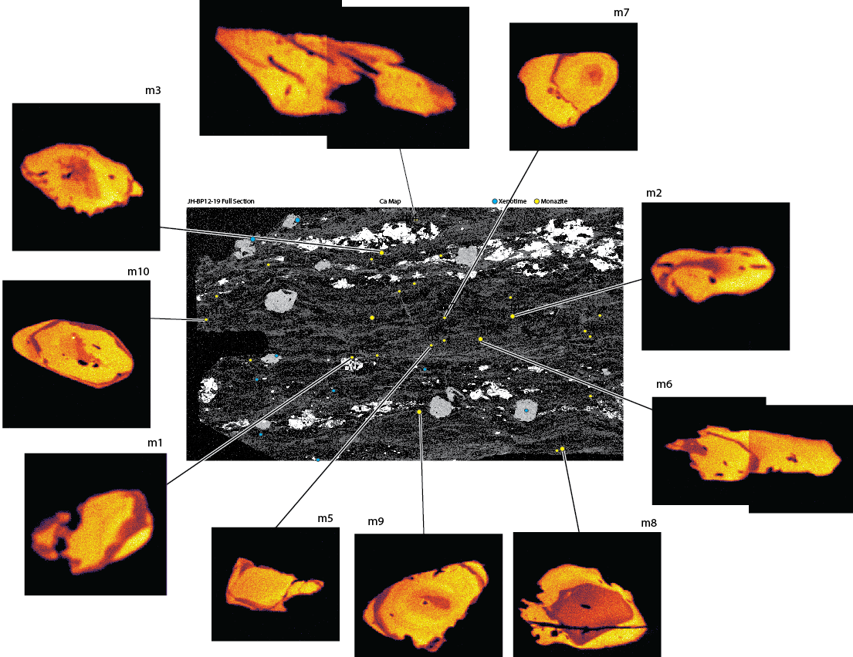
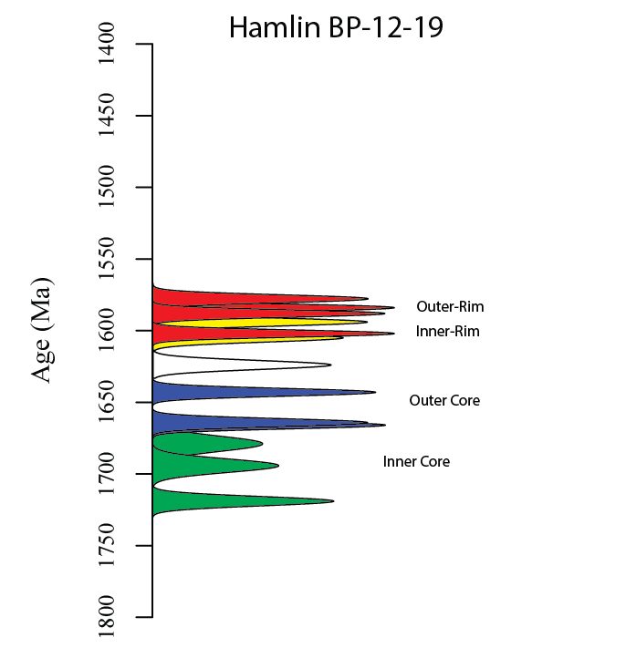
Examples of direct dating of deformation
In situ U-Pb monazite (synkinematic rims)
U-Pb titanite
Green Mt. block
northern Colorado
1562.9+3.5 Ma
1567+5 Ma
Soda Creek-Fish Creek
shear zone, northern CO
Rims at 1610-1560 Ma
Mineral growth at ca. 1.56-1.57 Ga
Notes:
Examples of direct dating of deformation.

Slide 16
Geologic map of Colorado showing shear zones studied for kinematics and timing of deformation
Battle Lake FZ
Buffalo Ridge
Kings Cyn. SZ
Farwell Mt./Lester Mt. SZ
Skin Gulch SZ
Soda Cr./Fish Cr. SZ
Moose Mt. SZ
Williams Fork
Idaho Spgs./Ralston SZ
Homestake SZ
Location of inferred
shear zone
Five Points SZ
Study areas shown by
Study areas with 1.62-1.57 Ga ages designated with

