Slide 1
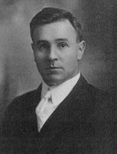
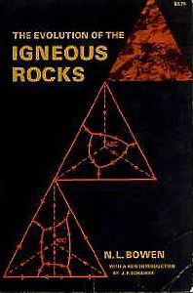
Normal L. Bowen and Experimental Petrology (1)
Phase diagrams –
the last, best hope of
igneous petrology
- N.L. Bowen
Anytime,
Anywhere
“…there may be
times when an
open mind is a
prejudice”
Anatole France
quoted by
Bowen (1928)
RSMAS/MGG
University of Miami
James H. Natland
Bowen in 1909
graduation photo
Notes:
At a constant pressure simple compounds (like ice) melt at a single temperature
More complex compounds (like silicate magmas) have very different melting behavior

Slide 2
Norman L. Bowen and Experimental Petrology (2)
Anyone who can
read can
understand
phase diagrams
- N.L. Bowen
Anytime,
Anywhere
He wrote
declarative
sentences
without
acronyms
and didn’t use
equations.
(1887-1956)
Notes:
At a constant pressure simple compounds (like ice) melt at a single temperature
More complex compounds (like silicate magmas) have very different melting behavior

Slide 3
Norman L. Bowen and Experimental Petrology (3)
…and if you can’t
read, we can
draw pictures.
- N.L. Bowen
Anytime,
Anywhere
He used
phase diagrams.
Prerequisite:
High-school
geometry
Notes:
At a constant pressure simple compounds (like ice) melt at a single temperature
More complex compounds (like silicate magmas) have very different melting behavior

Slide 4
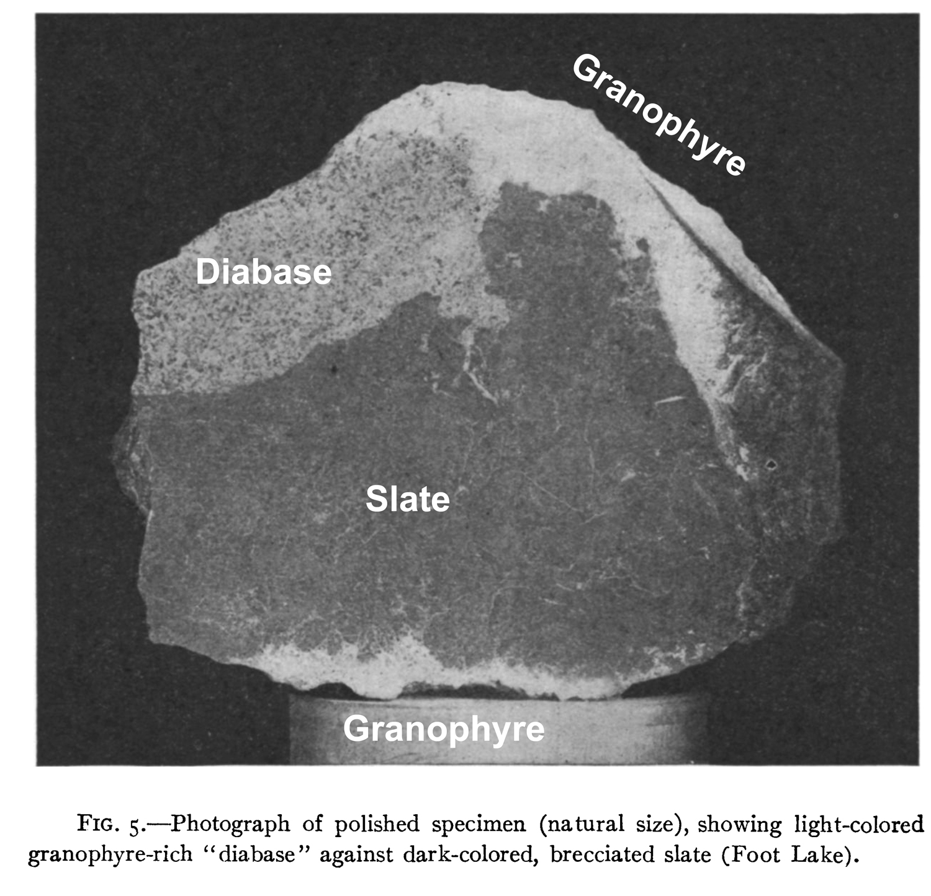
Undergraduate
study of
intrusions at
Gowganda Lake,
Ontario, was
central to much
of Bowen’s
later research.
The critical
role of basalt
Derivation
of granite
Bowen’s
Pet
Rock
Bowen
(1910)
Undergraduate education 1903-1909
– Queen’s University, Kingston, Ontario, Canada
First papers 1909 and 1910 concerned
granophyric diabase intrusive into slate

Slide 5
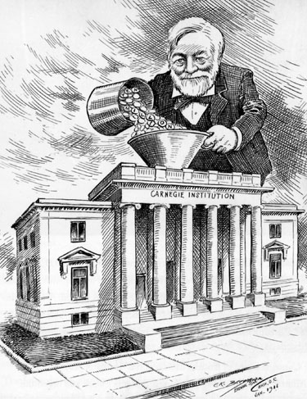
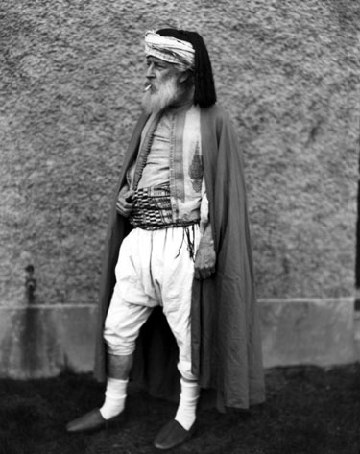
Bowen did his PhD research project at the
Geophysical Lab (1910-1912) via MIT and stayed on
Andrew Carnegie endows
The Carnegie Institution of
Washington in 1902
An early hire:
Henry Stephens Washington (the W in the CIPW Norm)

Slide 6
Guess what?
There was no NSF!
Funding was by endowment
from private sources.
We may be heading in
that direction now.

Slide 7
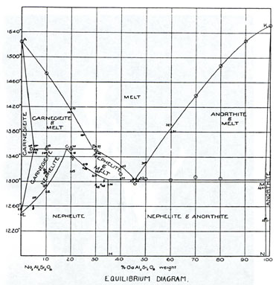
JUST AVAILABLE TO
BOWEN IN 1911!
Schreinemaker’s Rules
for constructing
phase diagrams;
published in German
1892-1909
George W. Morey of the
Geophysical Laboratory
contributed to this theory.
Phase diagrams were in
their infancy!
Bowen’s first phase diagram:
incongruent melting and a binary eutectic
in the system nepheline-anorthite (1912)

Slide 8
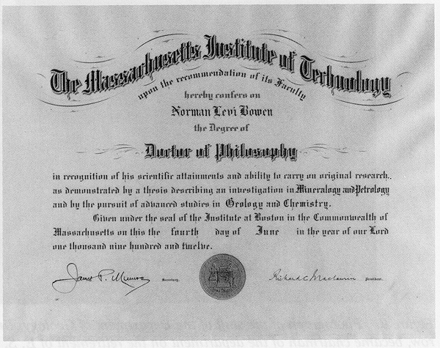
An early influence: R.A. Daly - his first graduate advisor
“Basalt is ubiquitous in time and space.”
“… basalt – the bringer of heat.”
MIT PhD Diploma 1912

Slide 9
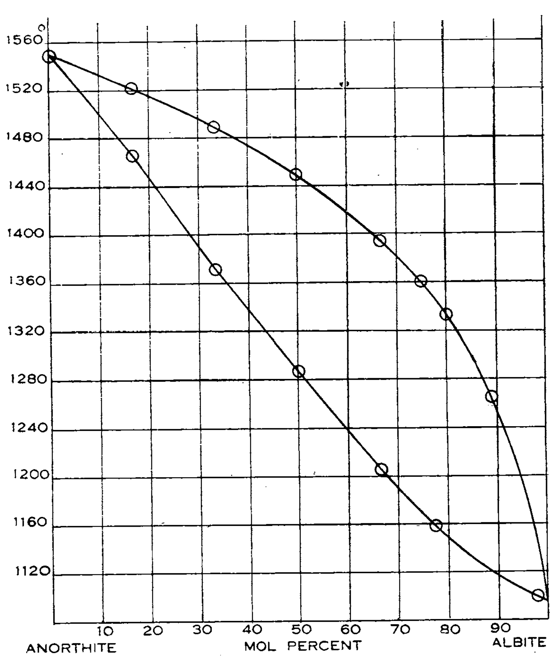
Bowen (1912)
Age 25
First postdoctoral
paper from the
Carnegie Institution
based on Bowen’s
innovative use of the
quench method
“The Melting Phenomena
of the Plagioclase
Feldspars”
(Am. J. Science)
The first famous phase diagram

Slide 10
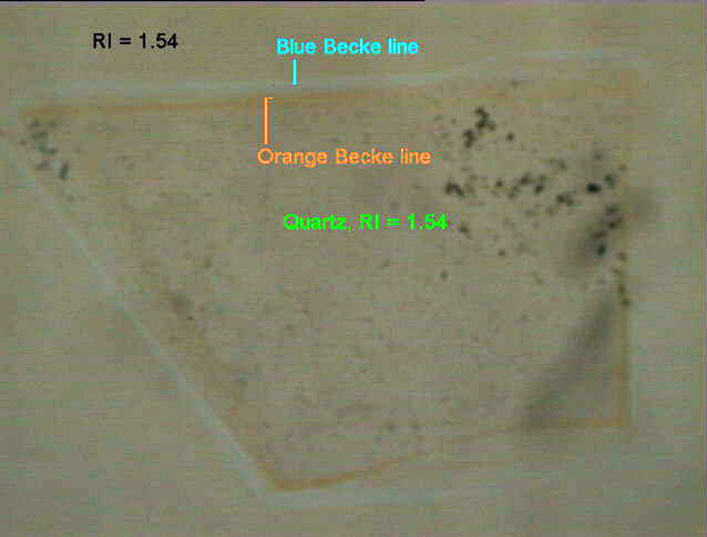
How did Bowen know what he was looking at?
Mineral identification:
Crystal morphology
Cleavage
Indices of refraction
Reflected light
ODP Site 1213 Shatsky Rise
(j. Natland)
Much optical work was done using classical microscope
techniques and reflected light

Slide 11
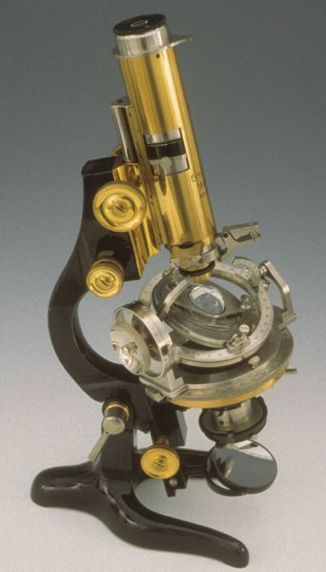
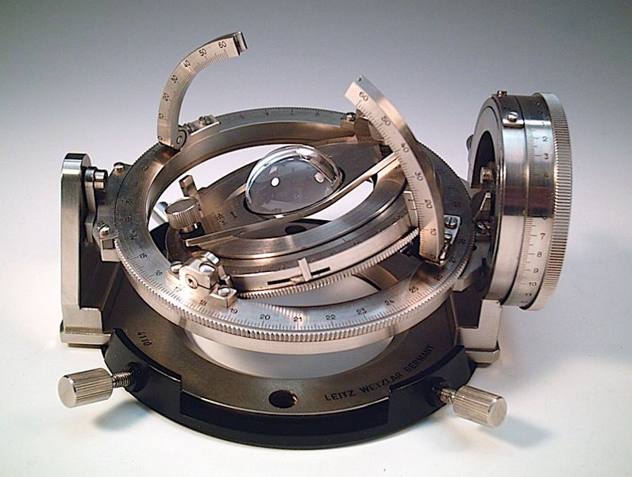
Mineral compositions in
experimental charges were known
from restricted starting compositions;
in rocks they required a
universal stage
No electron microprobes

Slide 12
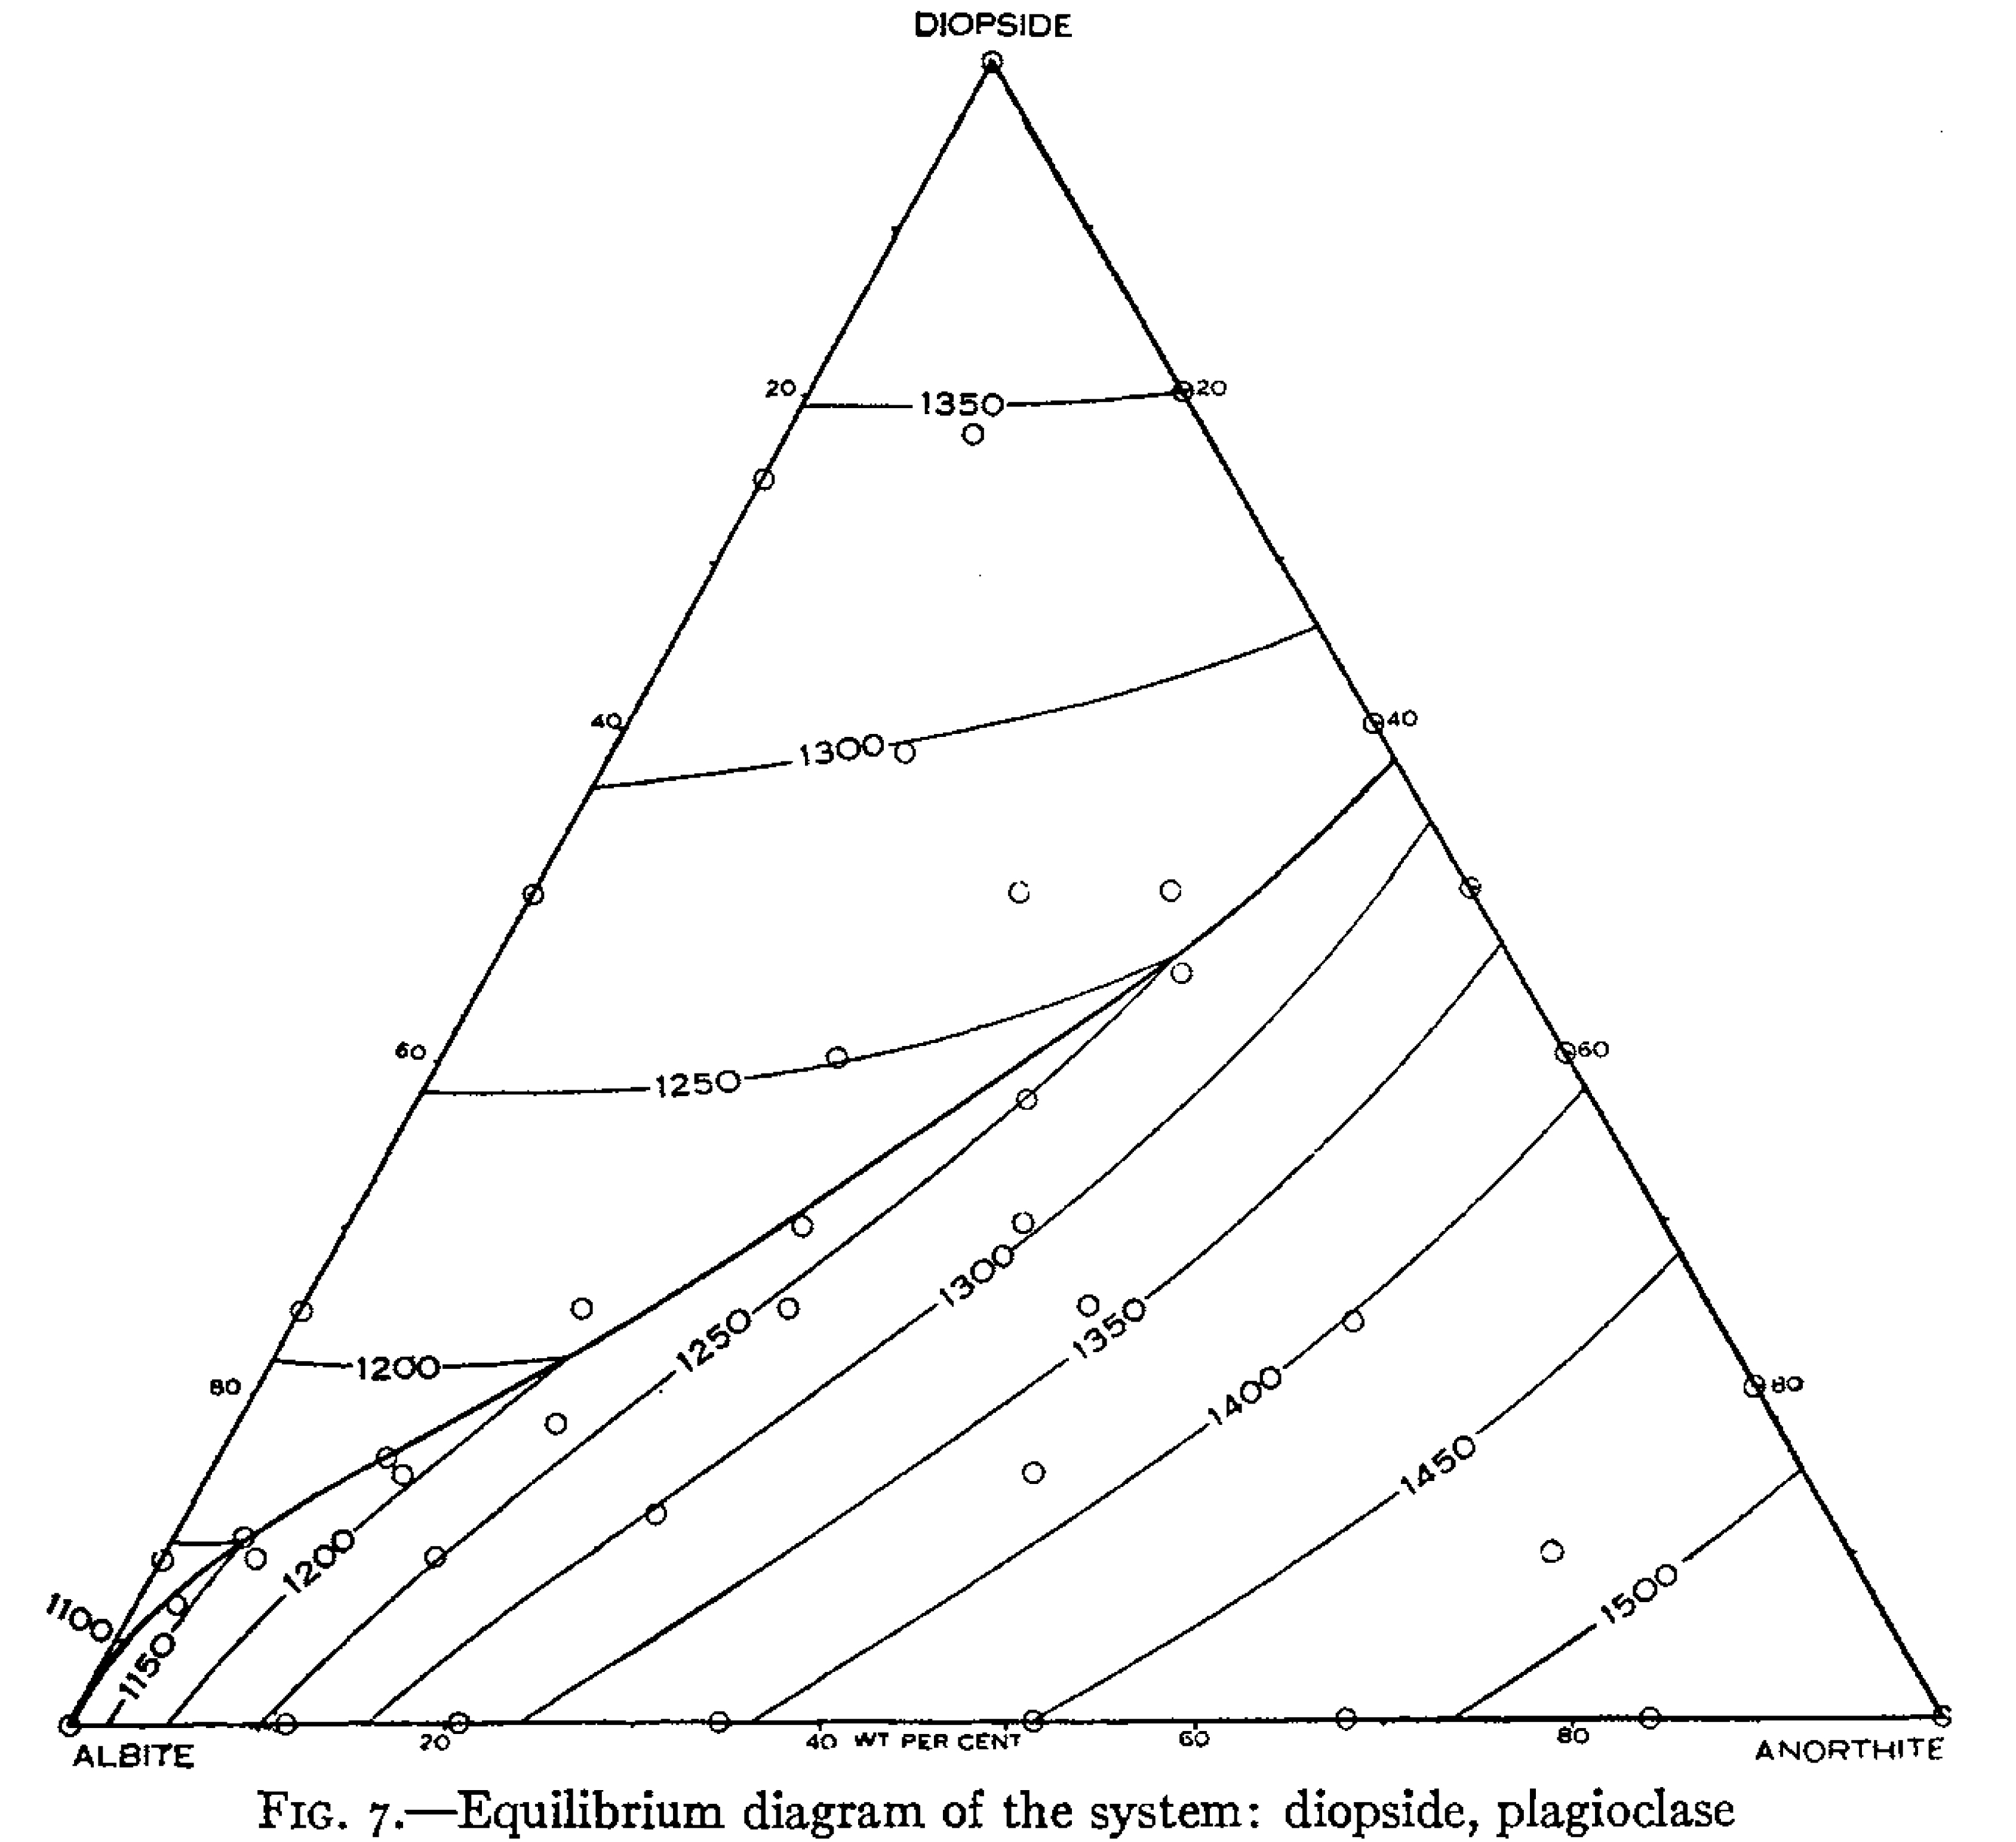
Note:
Petrologists in
general did not
accept Bowen’s
approach for
decades
Questions were
about multi-component
versus simple systems,
field relations and the role of volatiles.
The paradigm shift
in igneous petrology
took 45 years.
The second famous phase diagram
Bowen (1915)
Age 28
Crystallization of haplo*basalts along
the plagioclase-diopside cotectic
* from the Greek απλοσ = simple

Slide 13
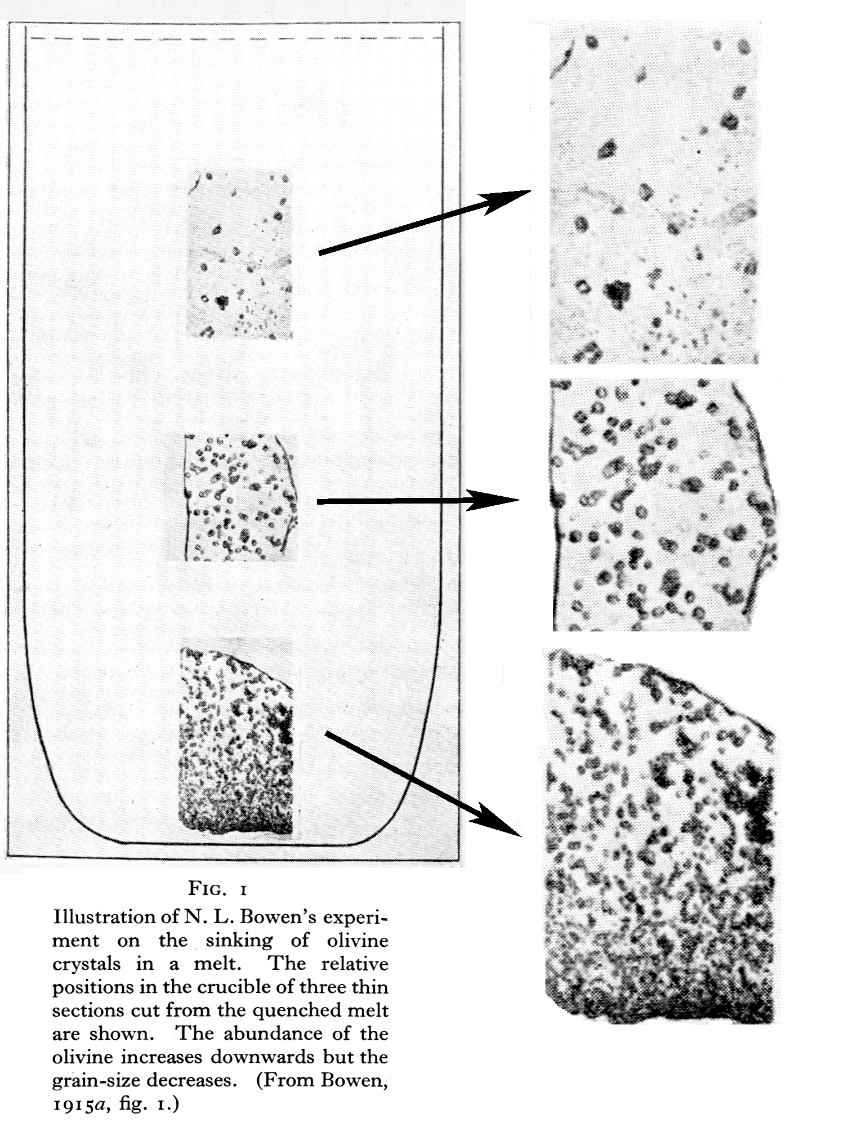
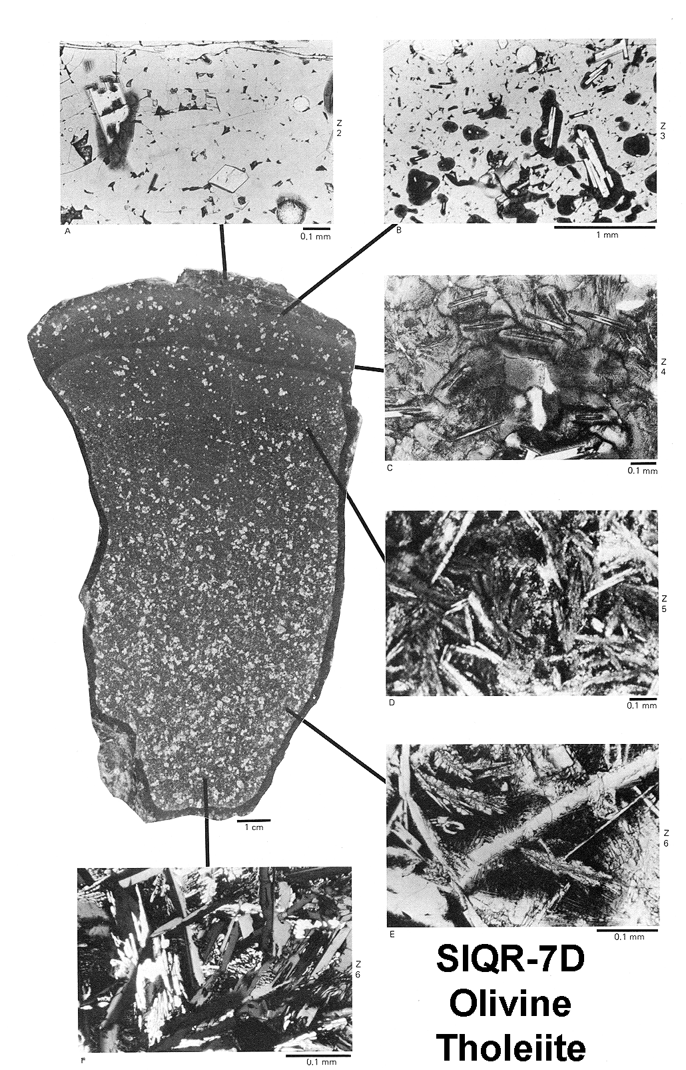
Start simply: The sinking of olivine
Experimental crystallization
of olivine fom basaltic melt
in a gravity field (Bowen, 1915)
Natural crystallization of olivine
and groundmass minerals in an
olivine basalt from the ocean floor,
8.5N East Pacific Rise
Natland’s
Pet
Rock
Natland
(1980)

Slide 14
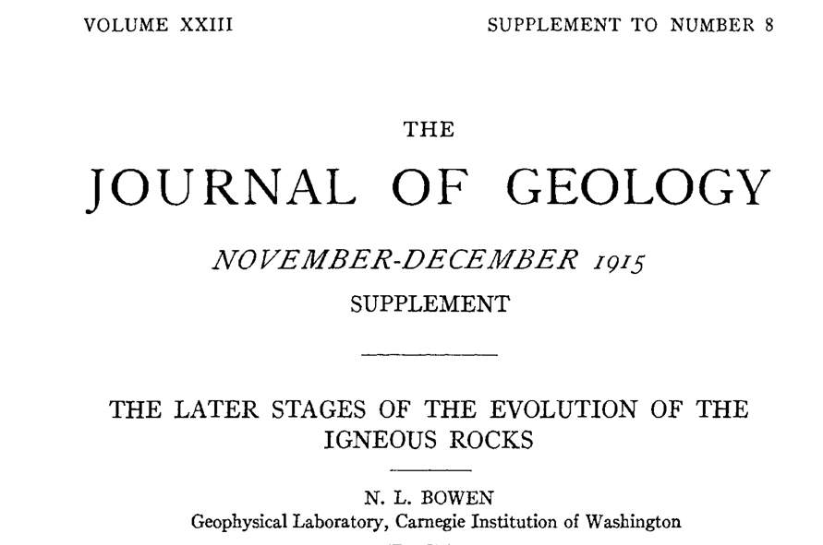
Precursor to Bowen’s book: one entire supplemental
issue of the Journal of Geology (1915)
Age 28

Slide 15
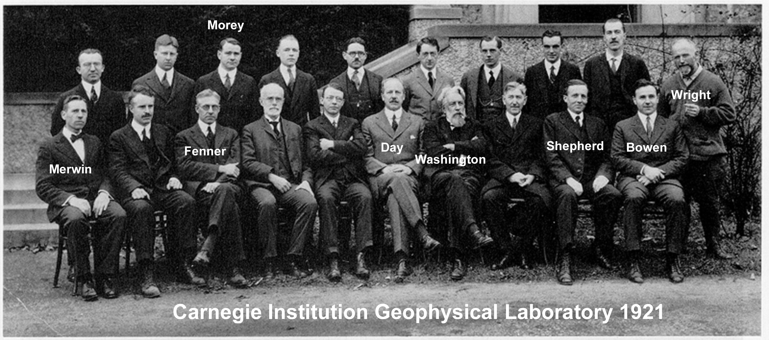
Others
Buddington
Anderson
Rankin
Colleagues and Contenders at the
Geophysical Laboratory
Day - Director
Washington – rock analyses
Everyone else named - Creators of petrological phase diagrams
All phase diagrams in Bowen 1928 were determined
At the Geophysical Laboratory
That’s
Arthur L. Day who
left money for the
GSA Day Medal

Slide 16

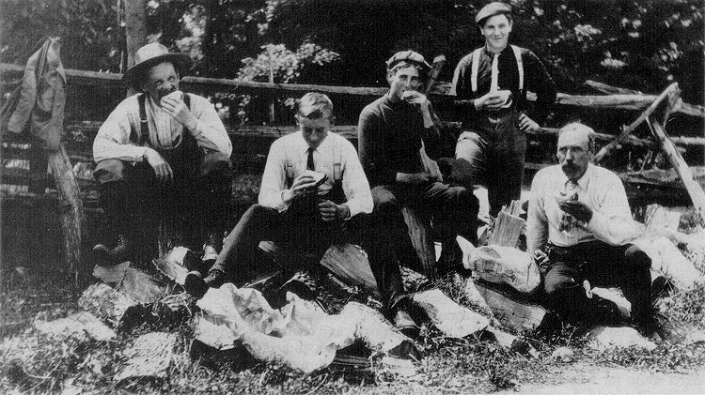
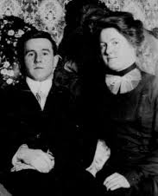
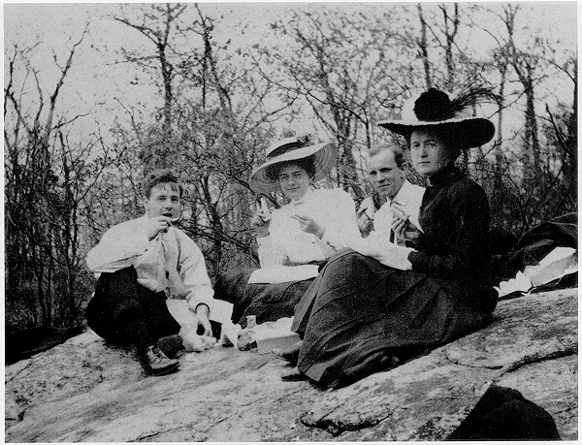
Is he
wearing a
tie?
In the field in Canada 1907-1909
Yes, he is.
With fiancé
Mary Lamont,
later his
wife, in
Boston

Slide 17
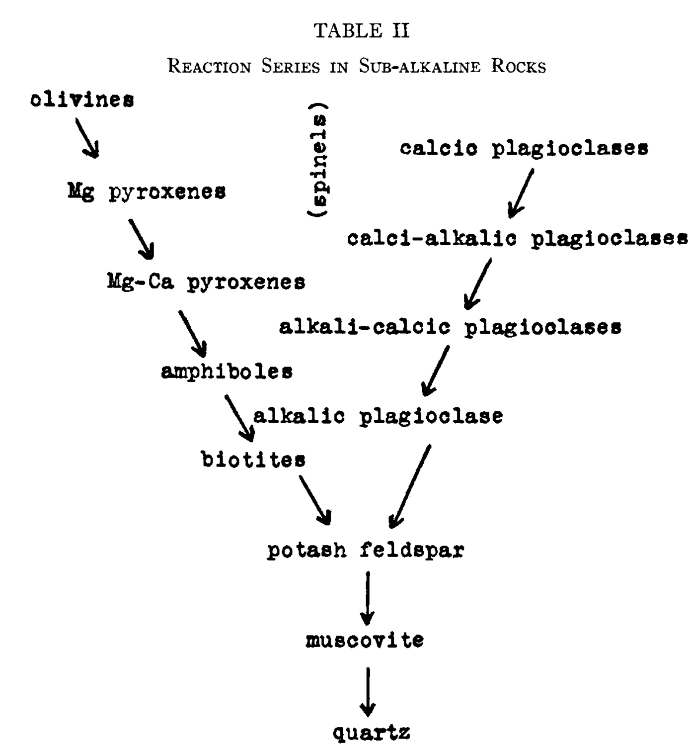
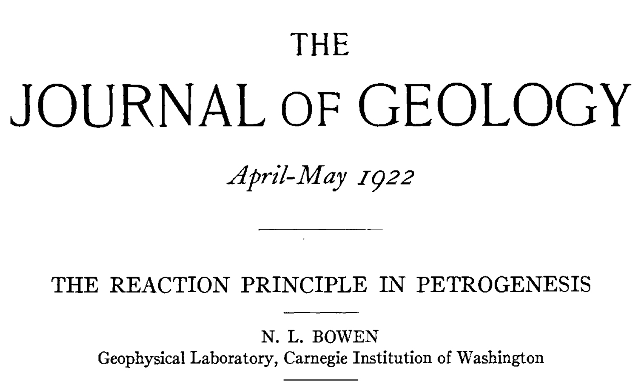
Bowen’s Method:
First write a paper 1922 (age 35)
then incorporate it into the book 1928 (age 41)
Discontinuous and continuous
reaction series and the
common rocks of orogenic
belts and batholiths (island arcs)
Chapter V of
The Evolution of the Igneous Rocks

Slide 18
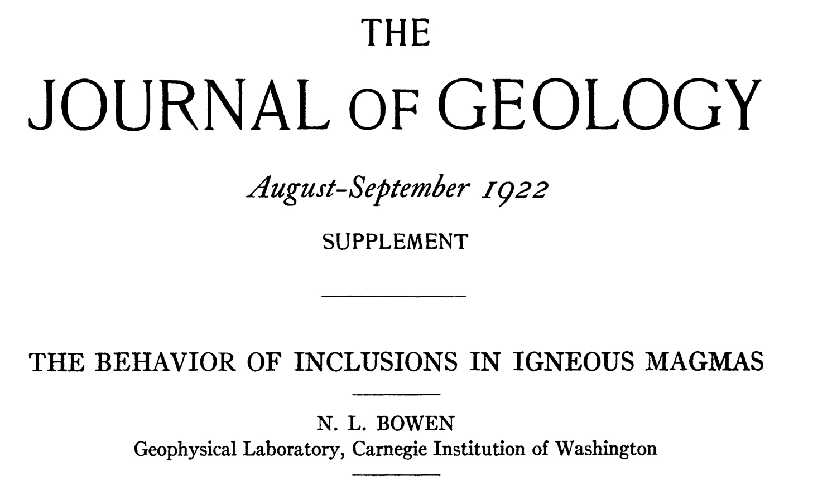
He did it again in the same year
Bowen 1922 Age 35
Precursor to Chapter X of
The Evolution of the Igneous Rocks
Bowen (1928)
“The best thing ever written about assimilation.” – A.E.J. Engel
It pays attention to heats of solution and the limited role of superheat.

Slide 19
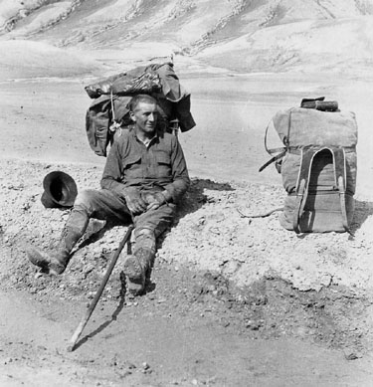
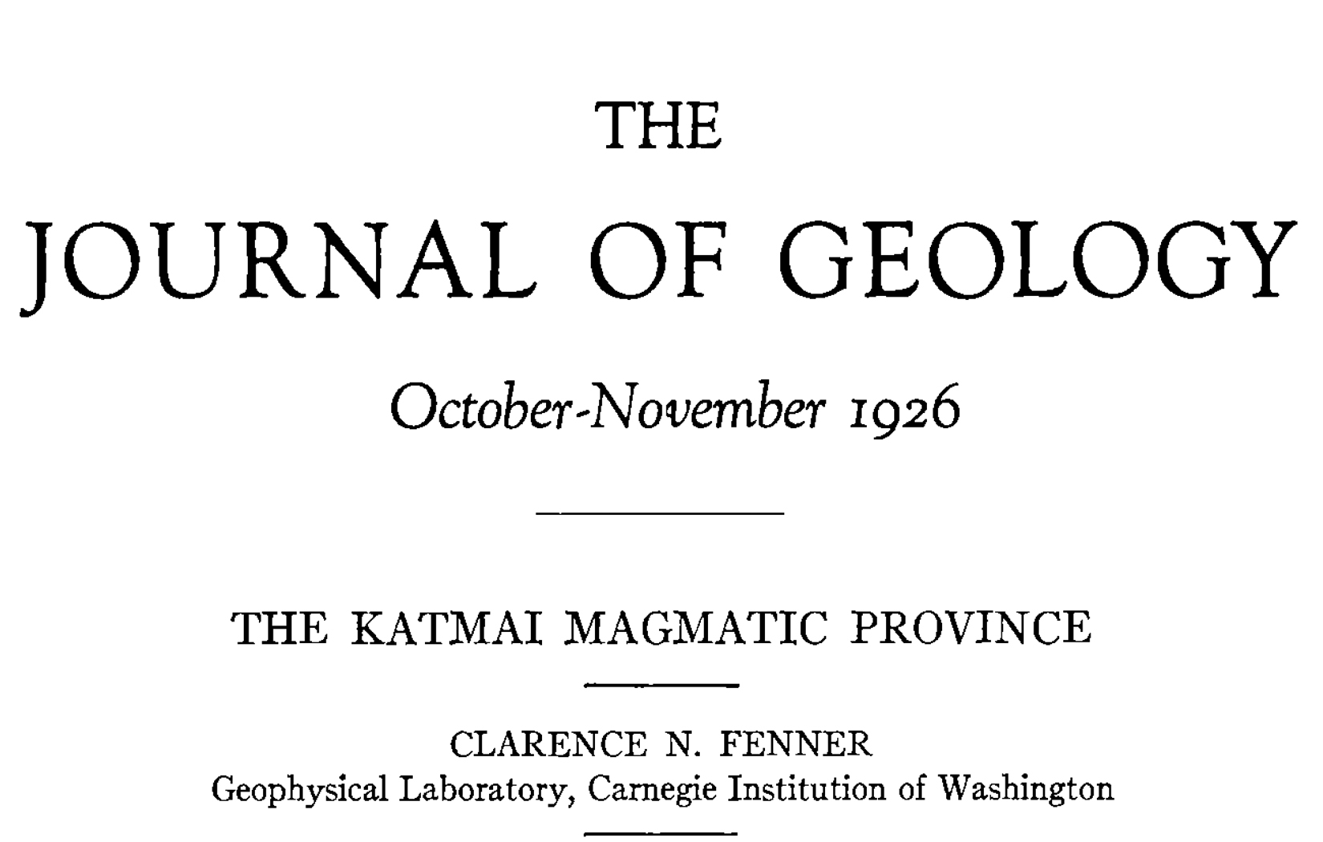
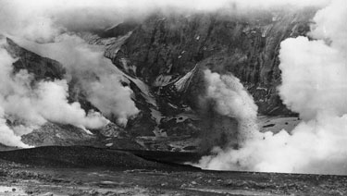
The first of two major
controversies with colleague
Clarence N. Fenner
concerned magma mixing
of lavas at Katmai, Alaska, and
The Valley 0f 10,000 Smokes.
See Chapter VII of
The Evolution of the Igneous Rocks
for Bowen’s rejoinder

Slide 20
The Evolution of the Igneous Rocks (1928)
Chapter IV Crystallization in Silicate Systems
Has 10 single, binary and ternary phase diagrams
pertaining mainly to basalt crystallization.
All were done at the Geophysical Laboratory.
Four of them were by Bowen and coauthors.
It was enough for the book, but the big one on granites took
decades of more research.
This chapter is basically duplicated in all
subsequent textbooks on igneous petrology,
but no one else has done it better.

Slide 21
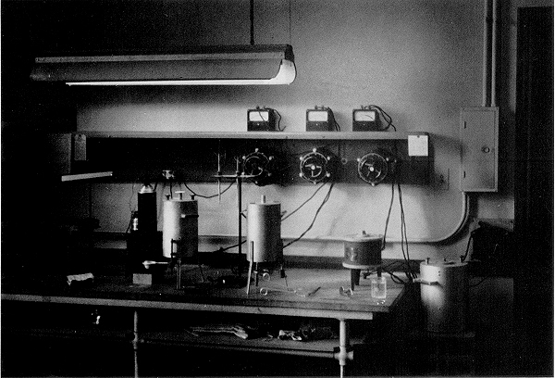
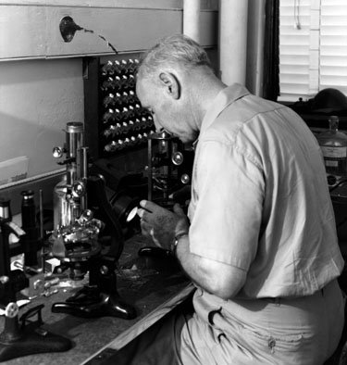
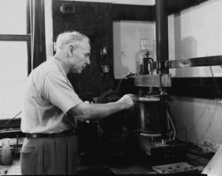
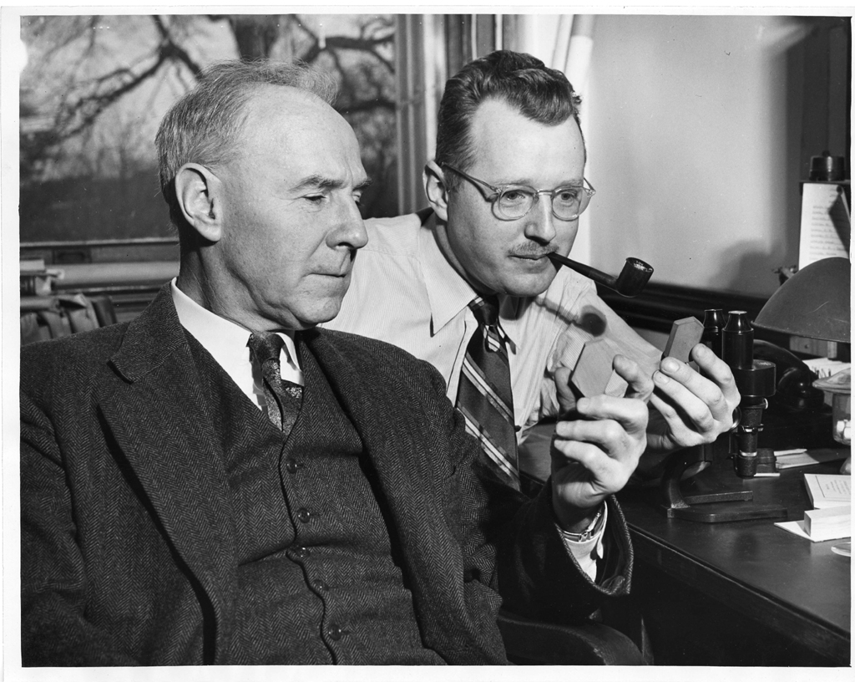
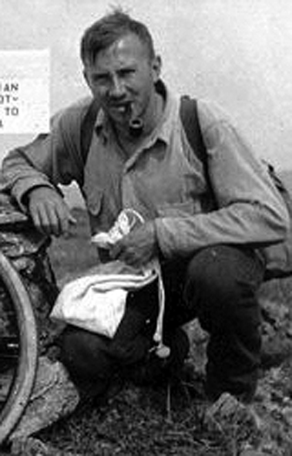
U of Chicago
Geophysical Laboratory
Bowen’s laboratories and closest colleagues
J.Frank
Schairer
With
O.F. Tuttle
(and a tie)
“Where are
you going
to get the
calories
for that?”

Slide 22
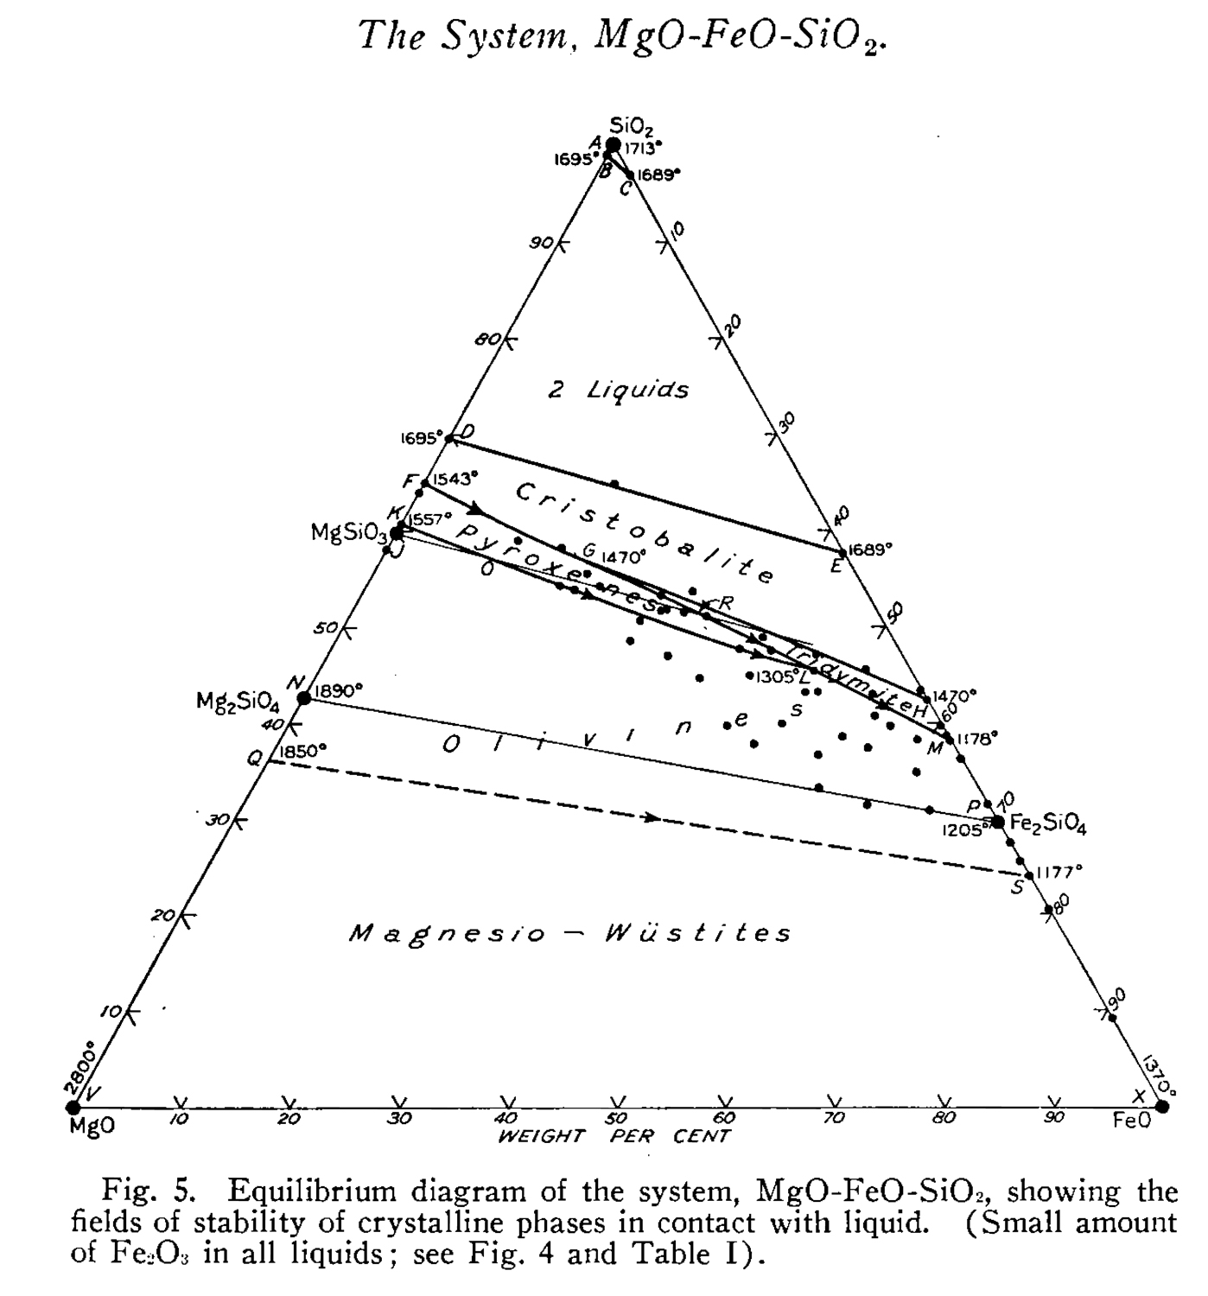
Bowen and
Schairer (1935)
Am. J. Sci.
Age 48
Two intervals
of olivine
crystallization
Second debate
with Fenner:
When people
disagree,
produce a new
phase diagram
The system MgO-FeO-SiO₂:
Explanation for the Skaergaard
iron-enrichment differentiation Trend

Slide 23

Granite is the absence of basalt
and there’s a lot of it.
Bowen’s last great research project with O.F. Tuttle
“Pontiffs versus Soakers” – Bowen (1948 – age 61)

Slide 24
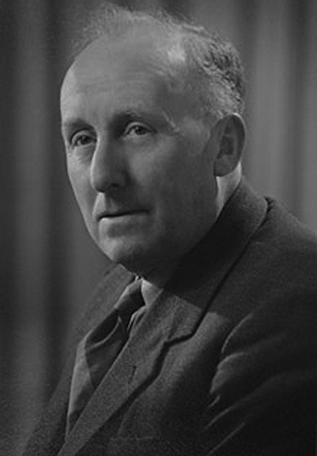
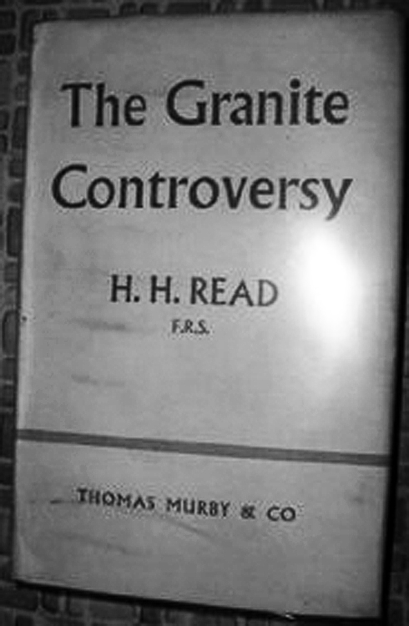
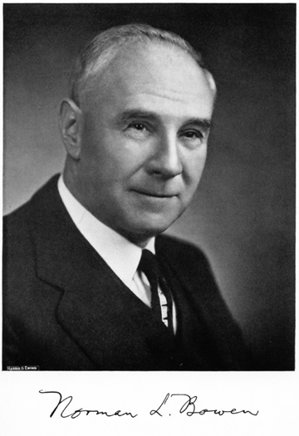
The principal
soaker
(metasomatist)
The principal
pontiff
(magmatist)
and his tie
Migmatites, large-volume batholiths and small-volume granophyres
The last great battle
Are granites metamorphic or igneous?

Slide 25
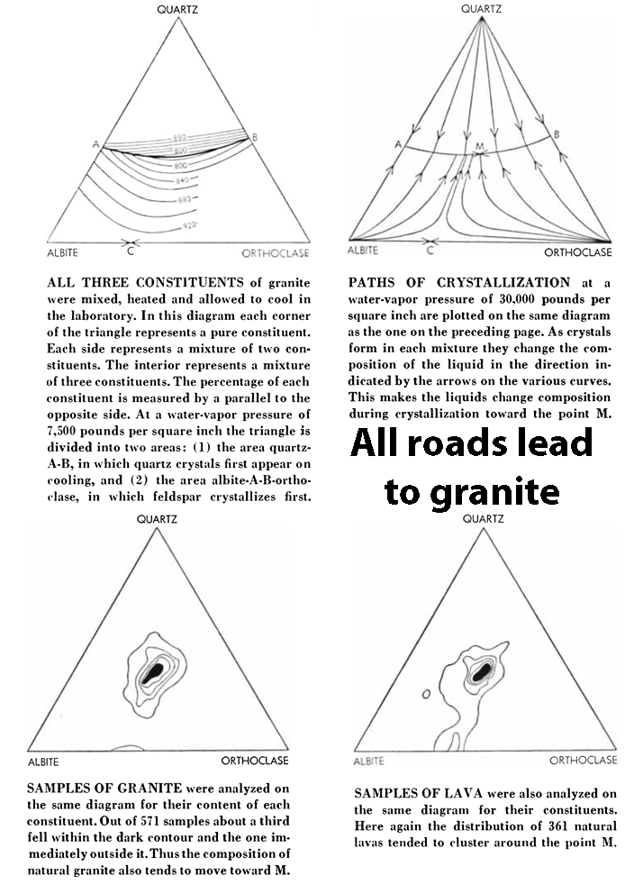
Q-Ab-Or
The granite
ternary
minimum
revealed
This
effectively
ended the
granite
controversy.
All roads lead to ternary-minimum granite
Tuttle and Bowen (1958) age - diseased

Slide 26
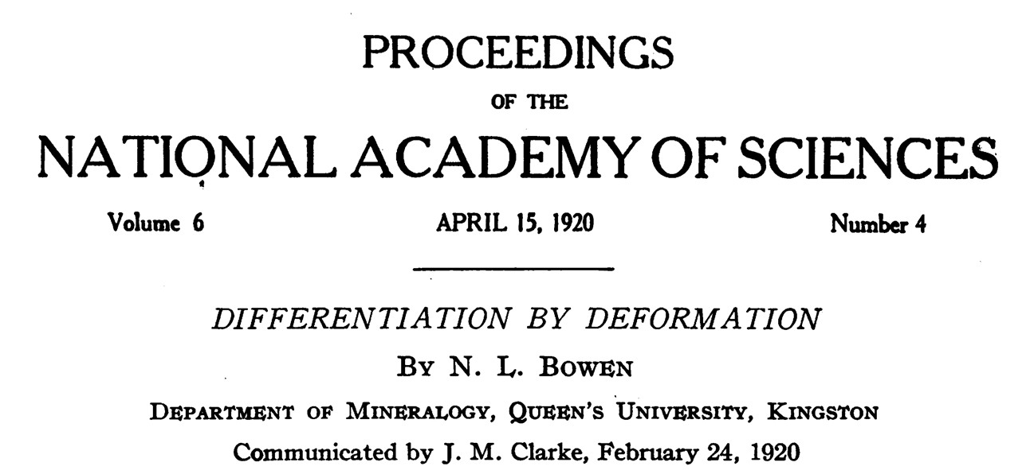
A little-known early paper
Bowen (1920)
Age 33
An overlooked gem of considerable modern significance

Slide 27
Differentiation by squeezing out of intercumulus liquids
from nearly solid rock (Harker’s filter pressing)
Monomineralic rocks of excessive purity
(dunites, anorthosites and adcumulates in general)
2) Sill-like monomineralic rocks (adcumulates)
(Rum intrusion allivalites and peridotites, chromitite seams, basal parts of ophiolites)
3) Complementary dikes
(composite basalt-rhyolite lava flows; Bowen’s Gowganda dikes)
4) Primary banding
(layered intrusions; not necessarily rhythmic layering)
All these are features of the ocean crust, where there is no
seismic evidence for large magma chambers, yet eruptive
rocks experienced 10-90% shallow crustal differentiation
and seismic layer 3 (mainly gabbros) is 2-4 km thick!

Slide 28
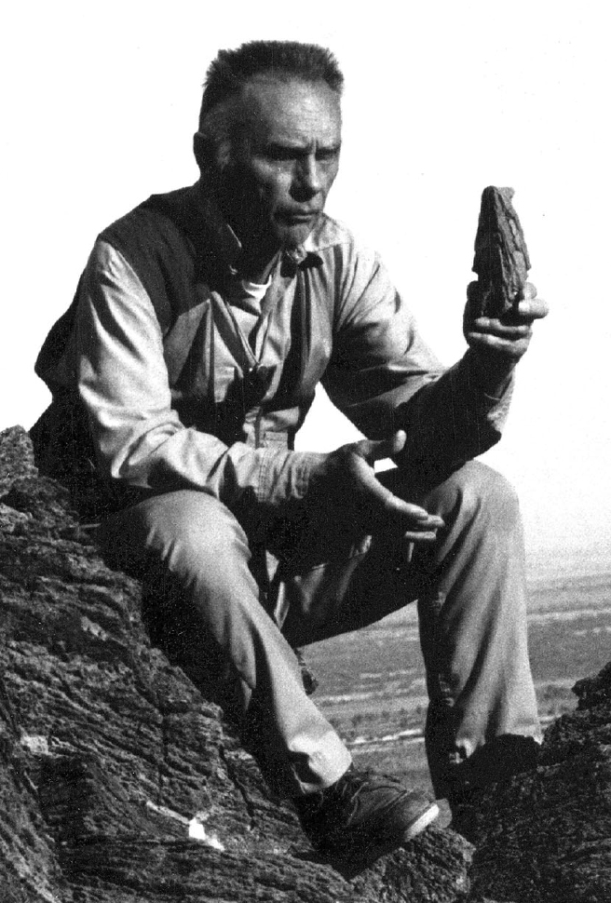
Bowen was a kind of wizard.
“Everything Bowen did turned to gold.”
-Albert E.J. Engel
who attended a reprise of his
lectures at Princeton
Scripps Institution of Oceanography
Personal communication (1970)
My opinion:
Almost any paper he wrote is instructive
and can be read today.
Al Engel at
Anza Borrego,
California

