Slide 1
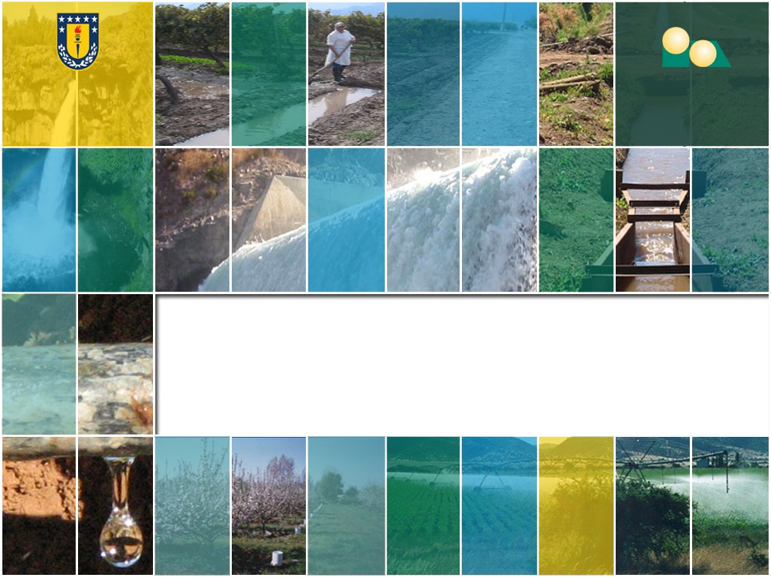
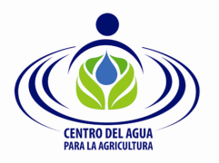
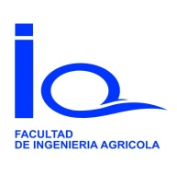
Water availability and quality vulnerability after climate and land-cover changes in an Andean volcanic watershed in south central Chile
José Luis Arumí & Diego Rivera
Water Resources Department
Water Center for Agriculture
University of Concepcion, Chile

Slide 2
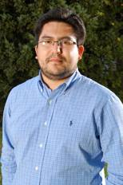
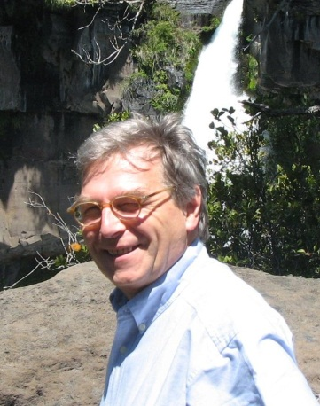
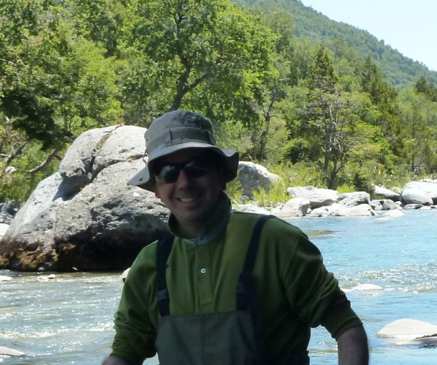
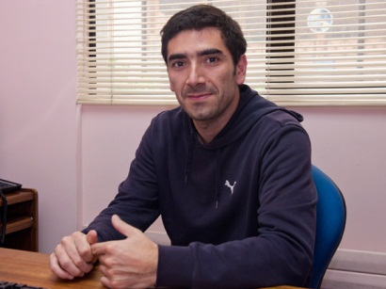
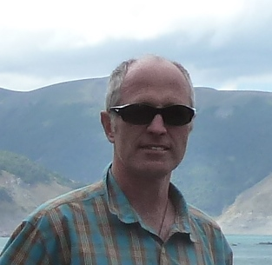
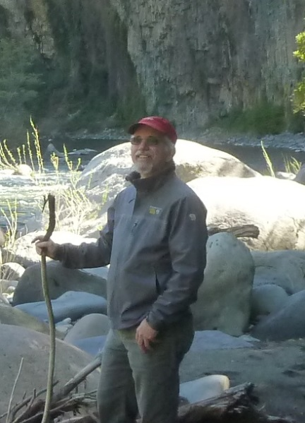
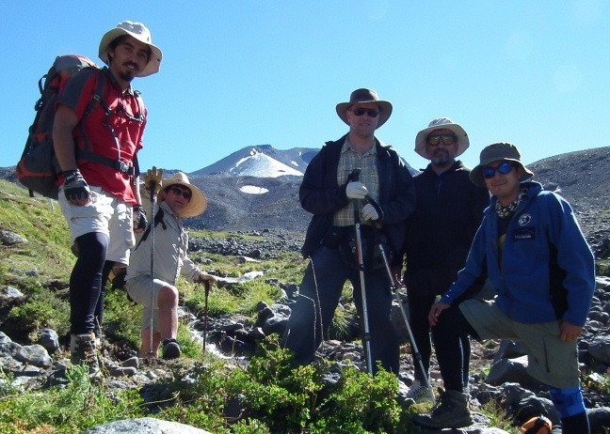
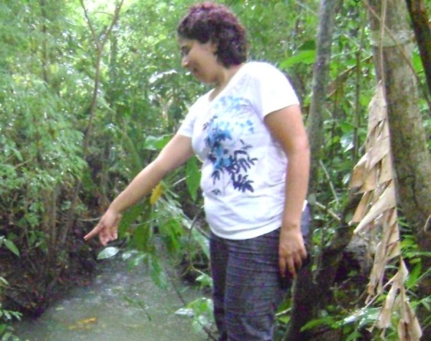
Colaborators

Slide 3
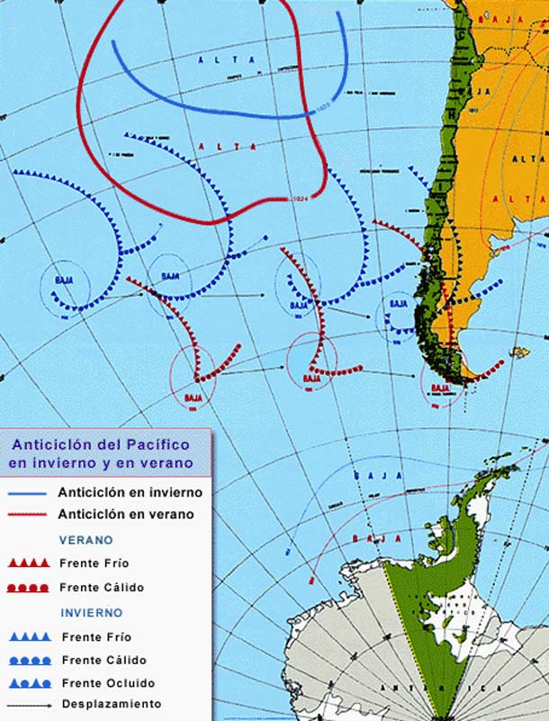
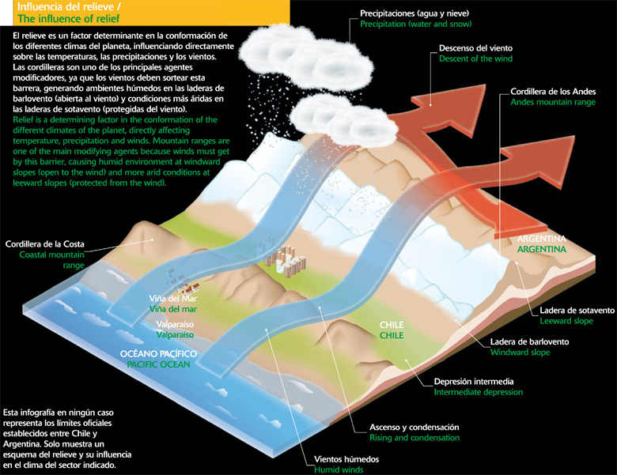
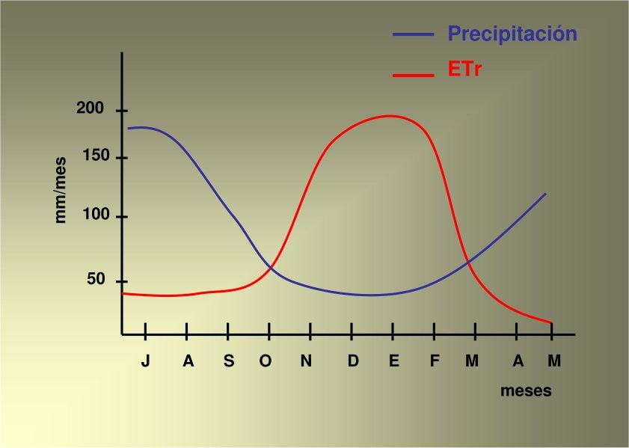
Chile´s Central Valley
Poorly understood Andean hydrology
Economical and social expansion pressure Andean watersheds
Lack of information and understanding regarding ecological services
Potential conflicts between stakeholders

Slide 4
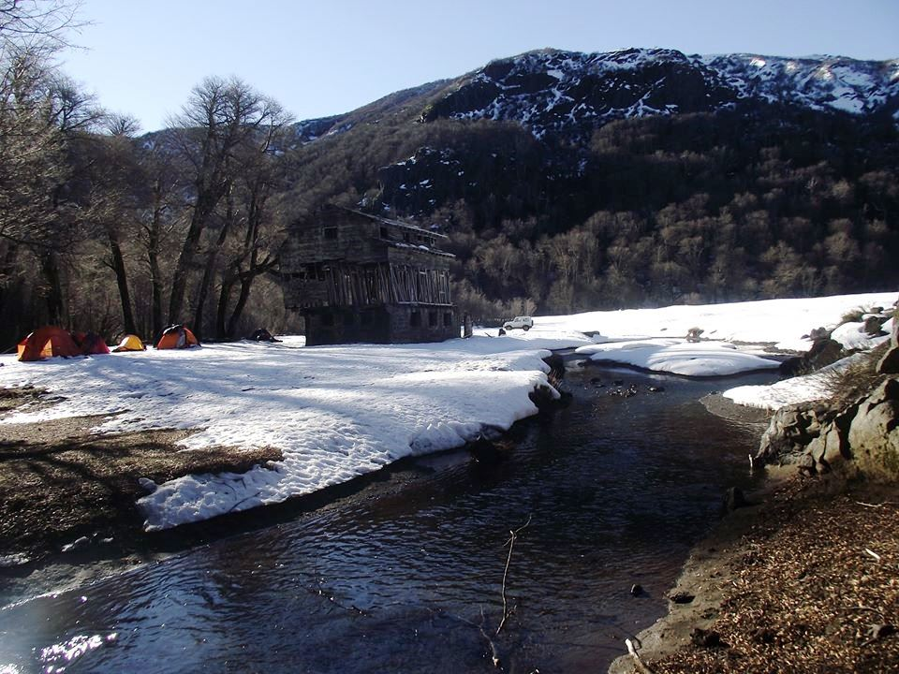
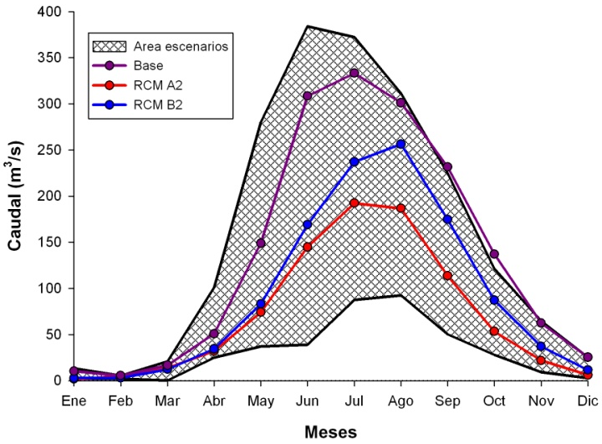
Climate change impact
Andes Mountain snowmelt is the main source of water of Central Chile
Climate Change will Snowmelt will be earlier
Less snowmelt in late summer and early fall
More dependency on groundwater base flow

Slide 5
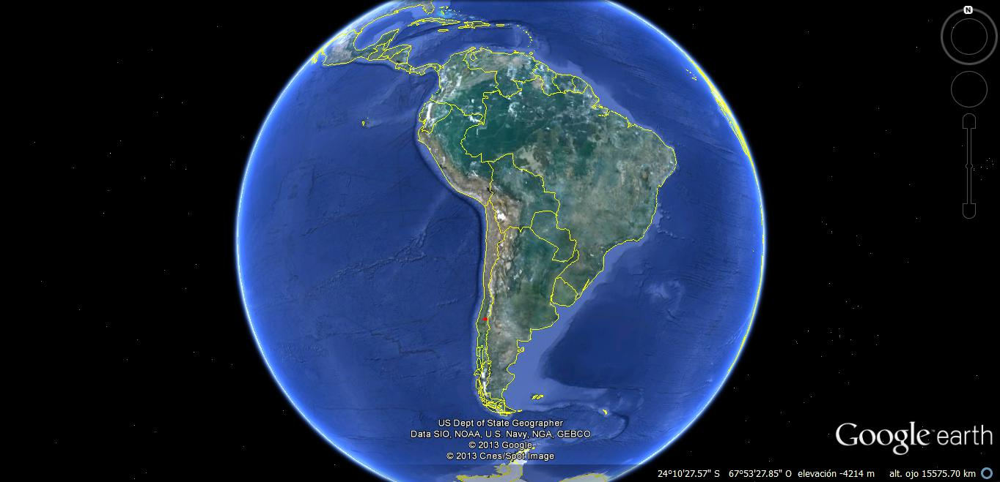
Diguillin watershed

Slide 6
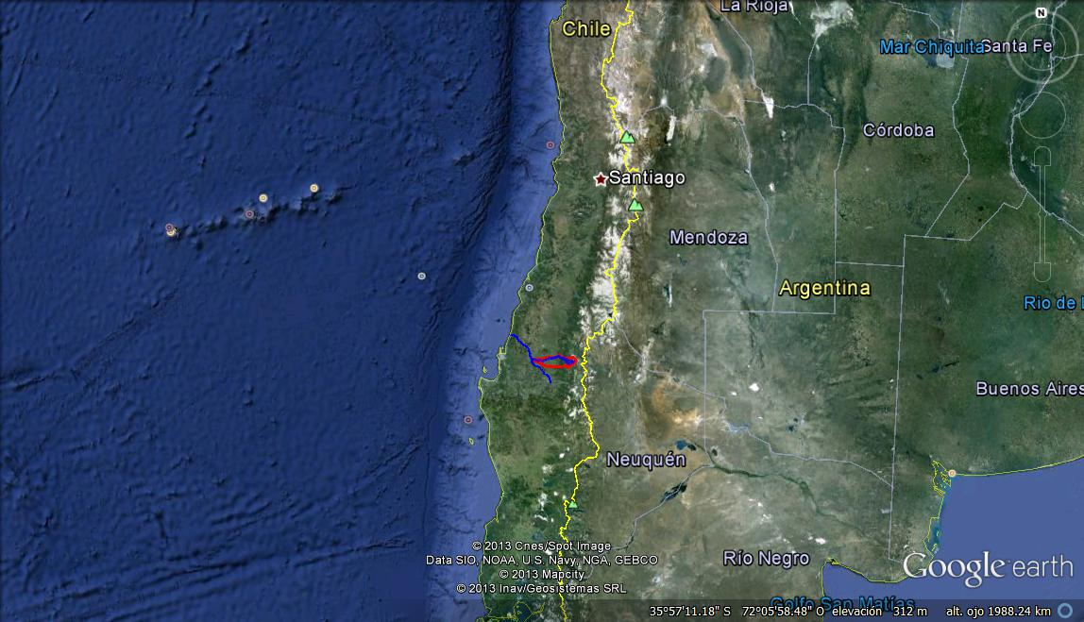
Diguillin watershed

Slide 7
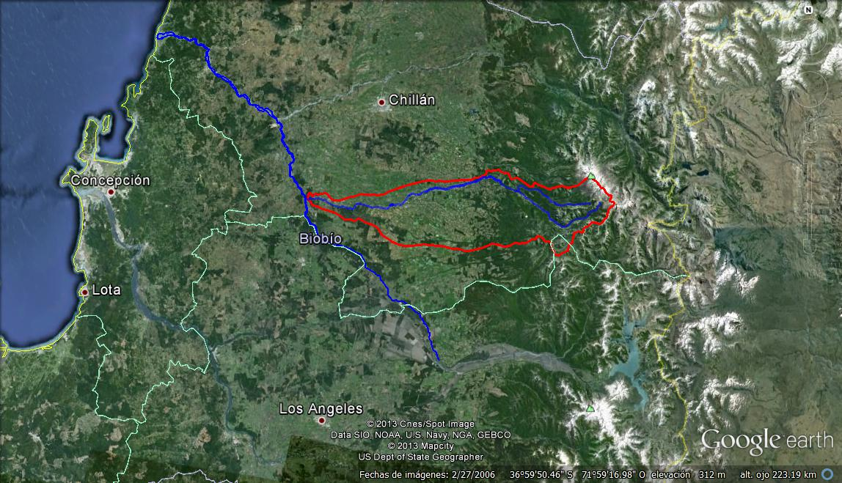
Diguillin watershed

Slide 8
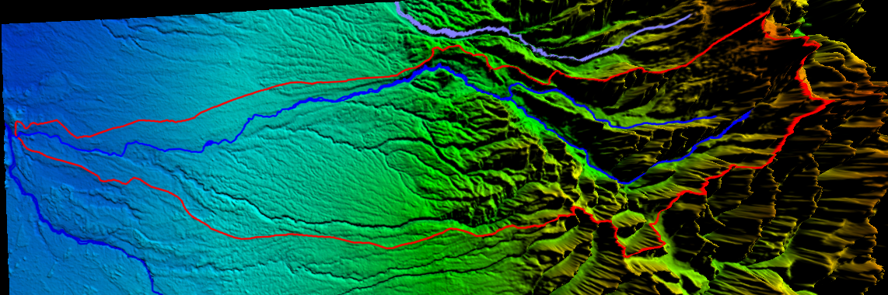
Diguillin watershed
The lower part is an important agriculture area.
The upper part is an important tourist area

Slide 9
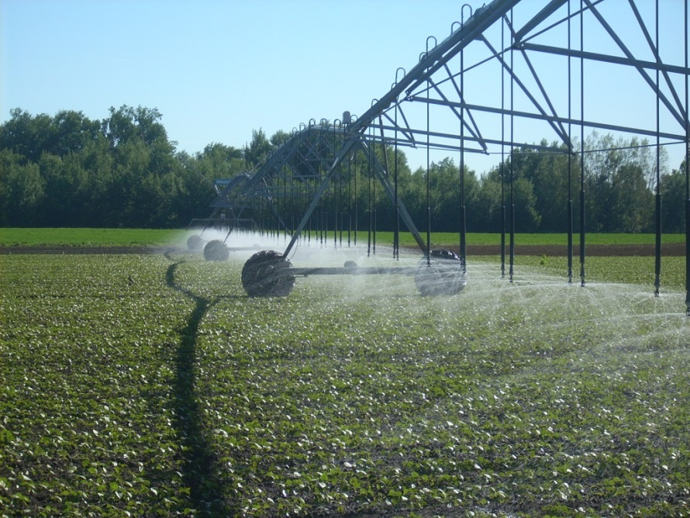
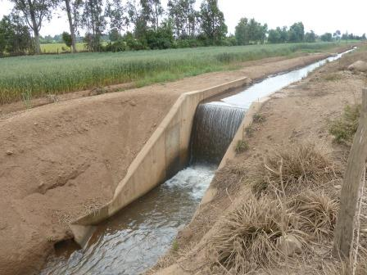
Lower part of the watershed uses water for irrigation
High inversion on agriculture and irrigation
  World's highest yield on Sugar Beat
  Blueberry, wheat, corn and horticultural products
High dependency on water availability and quality.

Slide 10
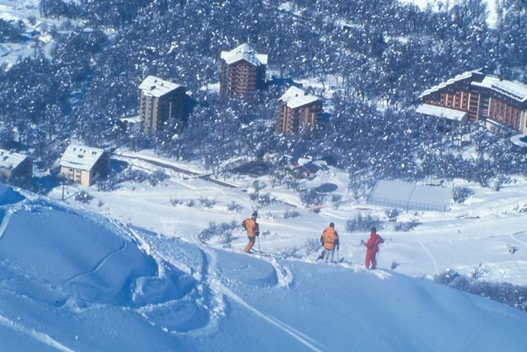
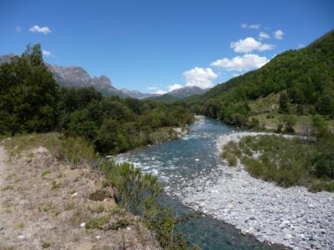
Headwaters
The Renegado creek : tourism (Sky, trekking and thermal baths )
The upper Diguillin river: a natural reserve (Hydropower v/s biodiversity)

Slide 11
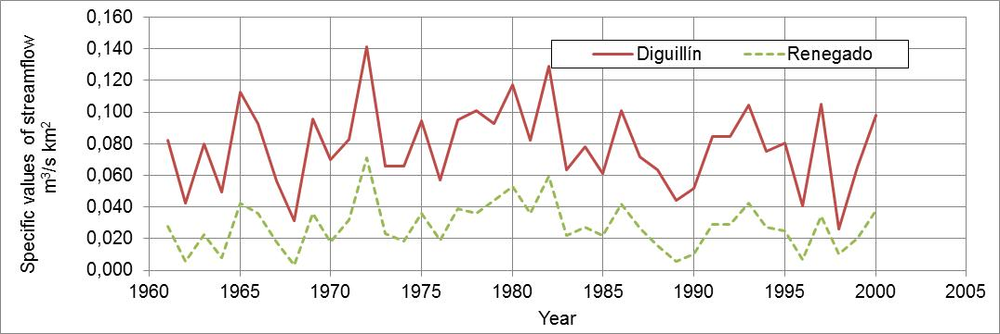
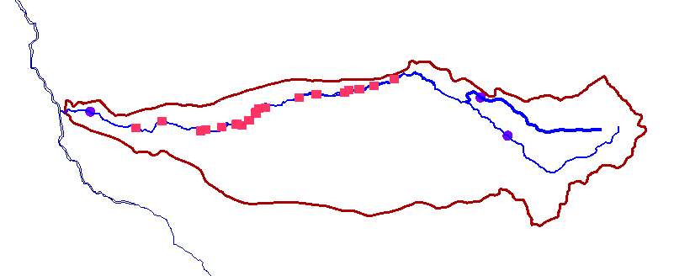
The problem: No closure for the water balance
+ Similar hydrological features implies similar hydrology
+ The Upper Diguillin has more water than the Renegado creek. Why?
+ Do similar hydrological features imply similar hydrology?

Slide 12
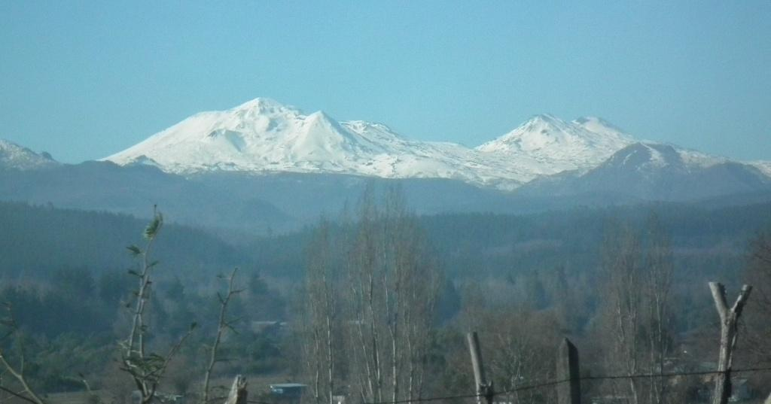
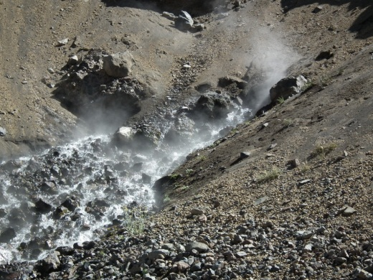
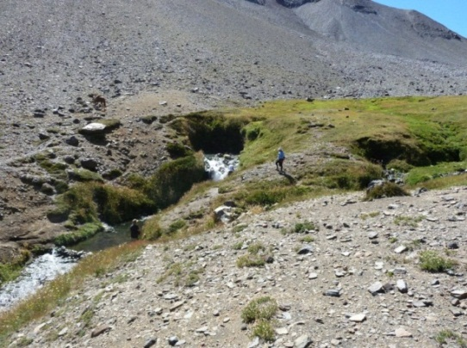
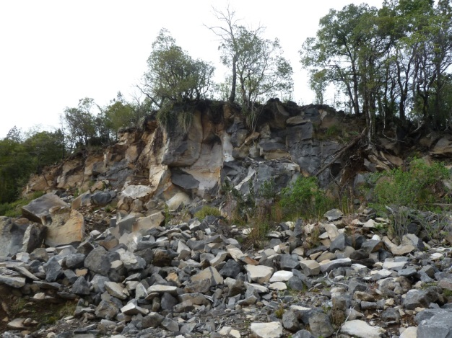
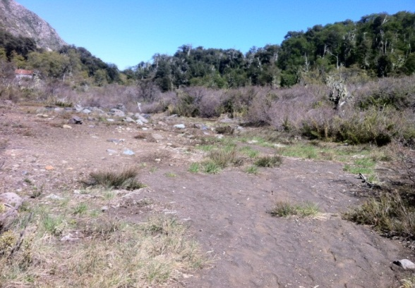
Volcanism controls the hydrology
Nevados del Chillán Complex
The upper Diguillin river drains an aquifer inside the volcanic complex
Renegado´s hydrogeology comes from recent lava deposits ➔ fracture rock system + thick sandy soils ➔ high infiltration

Slide 13

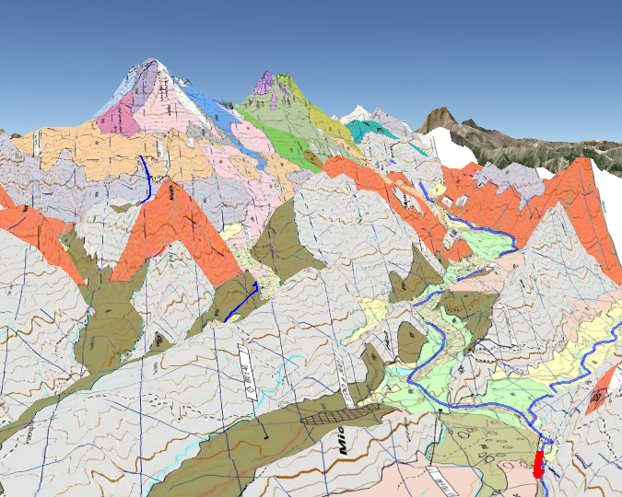
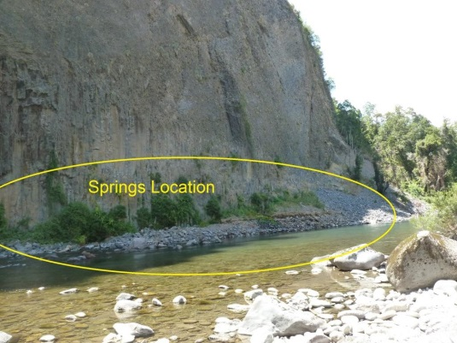
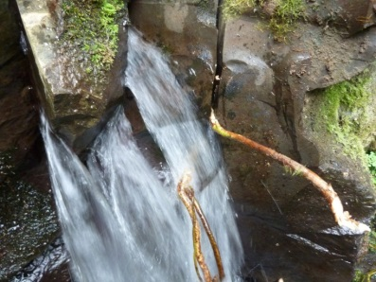

Slide 14
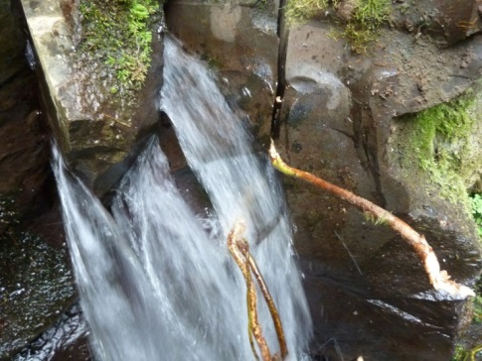
Renegado: Highly permeable soils favors infiltration to the fractures and low surface runoff
Groundwater from the Renegado discharges directly to the Diguillin river.
Discharge keeps a minimum flow at the river during dry years

Slide 15
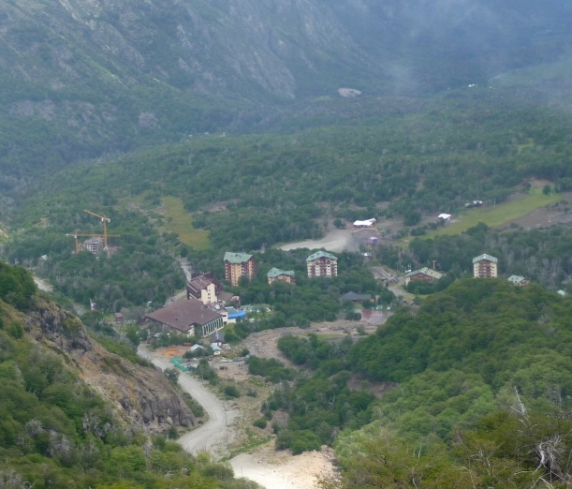
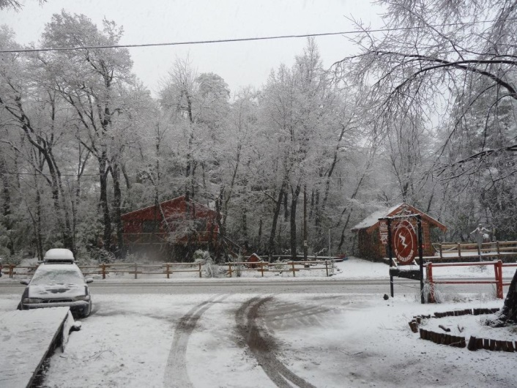
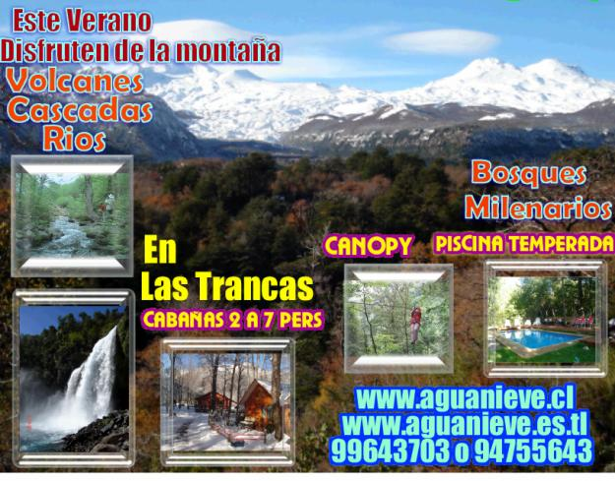
Land cover change
The Renegado Valley is under a strong pressure for second-housing development

Slide 16
The highly permeable soil and the fractured rock system at the Renegado watershed, where there is an important development of tourism and construction of weekend houses, produces questions about the fate of pollutants introduces to the systems by wastewater infiltration from septic tank.
The pathways between pollutant recharge areas and springs discharge are unknown and most be identified to improve the sustainable develop of the whole watershed.

Slide 17
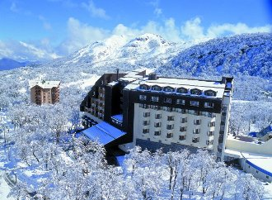
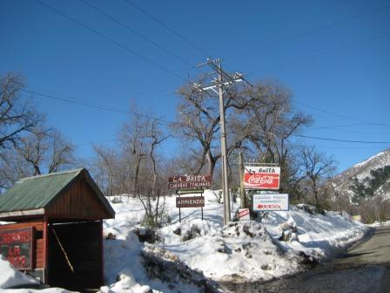
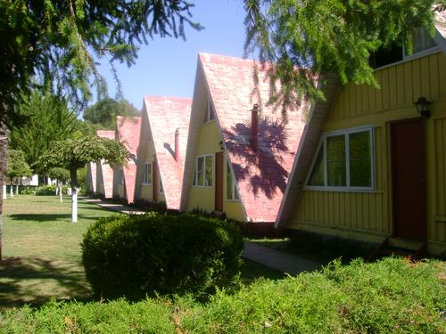
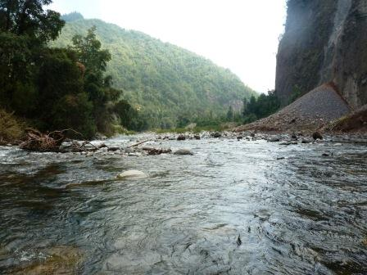
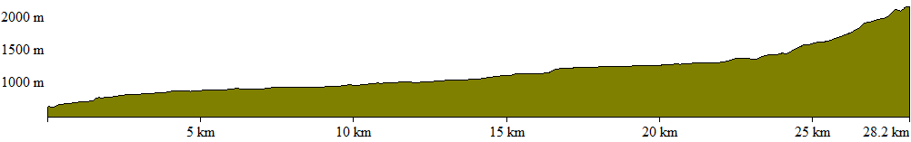
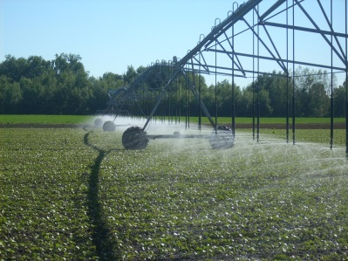
The upper watershed drains to the river
Upper watershed
Lower watershed

Slide 18
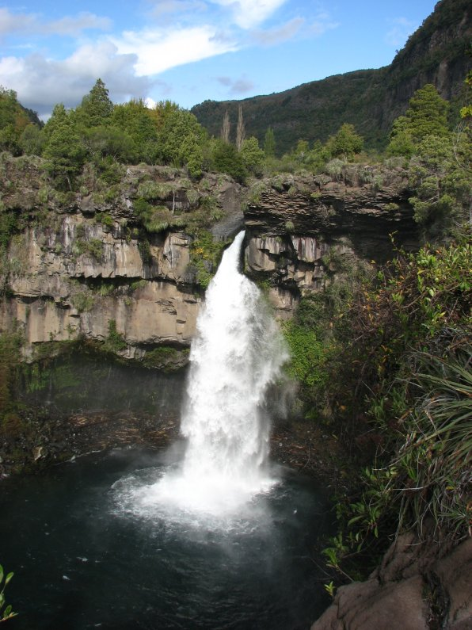
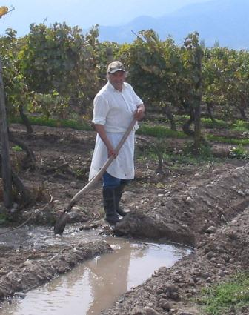
Thanks
José Luis Arumí, Diego Rivera
Water Resources Department
University of Concepcion, Chile

