Slide 1
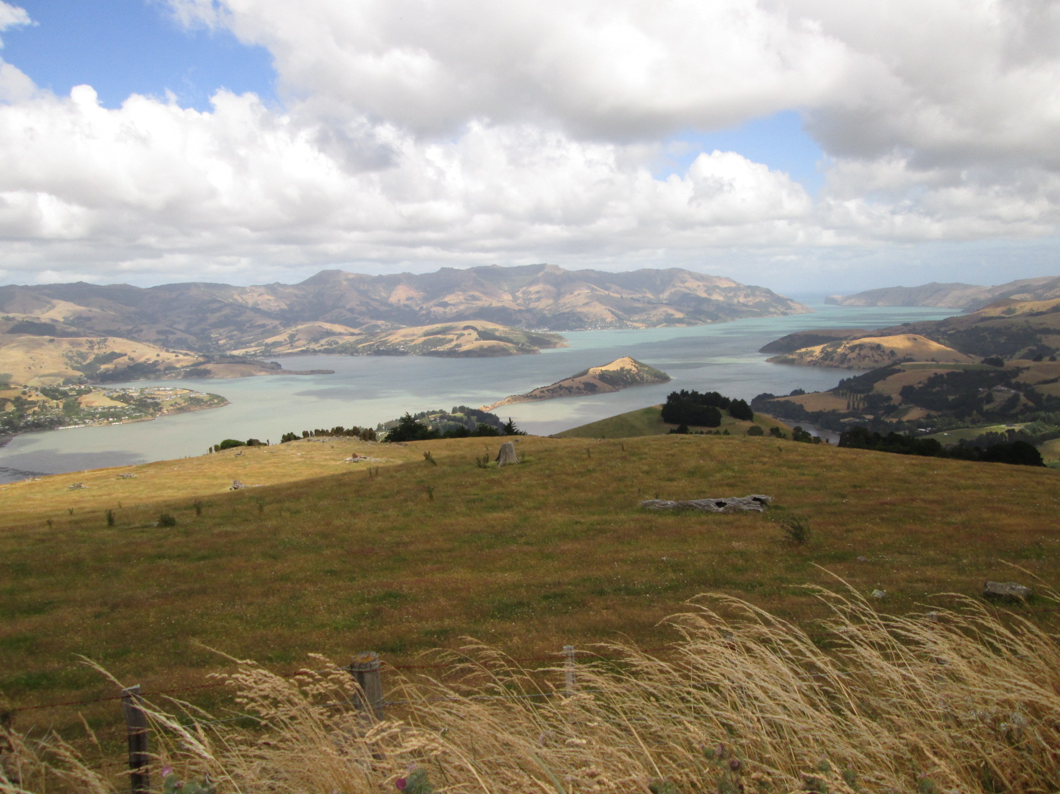



The Stories of Banks Peninsula: Connecting Maori Oral Traditions, European History, and Geological and Ecological Perspectives
Presenter: Camille H. Dwyer
Contributors: Dr. Sam Hampton, Dr. Darren Gravley,
and Ben Chiewphasa
“T14. Geologic Hazards in Archaeological Contexts,”
Wednesday, 30 October 2013, 10:15 AM
Notes:
Smith College is cut off
Make sure that color is good
TRANSITIONS!
Combining all tools. Imperfect record we have to use all the tools on hand
Western/ European History
Slow down
Take a breath
Topic Sentence
Need the root of the story
Can be used for one event
Highlight the tools. Speak slower
Have a topic sentence for each point
In context
More emphaize on the flow of the arugement. Flow of the story
Why am I talking about pas?
More promient
Too much detail and not enough main point

Slide 2
Outline
Introduction to Banks Peninsula and the Maori
Main Question
Methods
Historical, Geological, Archaeological, and Anthropological Evidence Surrounding Tsunamis
Pa Locations
Remaining Questions and Significance
Notes:
What are the main things? What are my objectives?
Have and write an outline slide
Just give an outline: Key Points
Summarize results
Logically

Slide 3
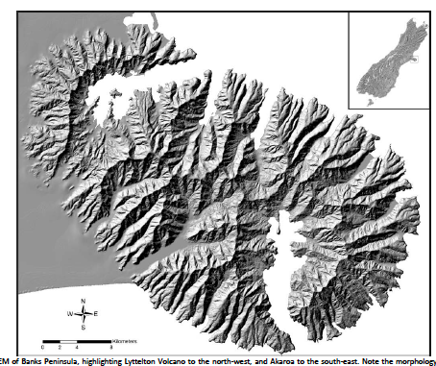
Banks Peninsula, New Zealand
Figure Adapted from Hampton (2012)
Notes:
Photo of all of New Zealand

Slide 4
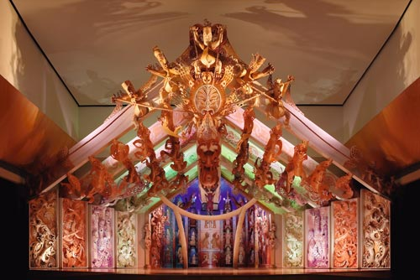
Maori of New Zealand
First inhabitants arrived to North Island ~ 13th century C.E. (Te Ara, 2013).
Banks Peninsula inhabited by 2 iwi (tribe), the Waitaha & Ngati Mamoe ~ 14th to 16th century (Bassett et al. 2004 & Stack, 1893).
Early 1600s, Maori iwi, Ngāi Tahu settled in Banks Peninsula (Te Maire Tau, 2012)
http://www.teara.govt.nz/files/32146-wmu.jpg
Notes:
Have photo of New Zealand
Websites Sited
Check date of Maori arrival

Slide 5
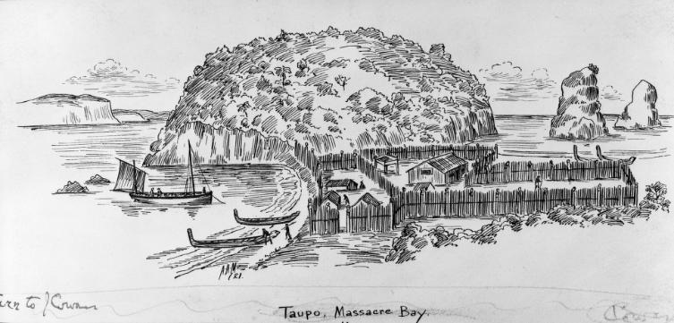
Pa = Fortified Settlement
Photo: http://theprow.org.nz/assets/Maori/Taupo-pa.jpg
Notes:
Picture of Pa
Take advantage of natural
Some of the landscapes are ideal because of volcanic cones- headland around the coast, location cones

Slide 6
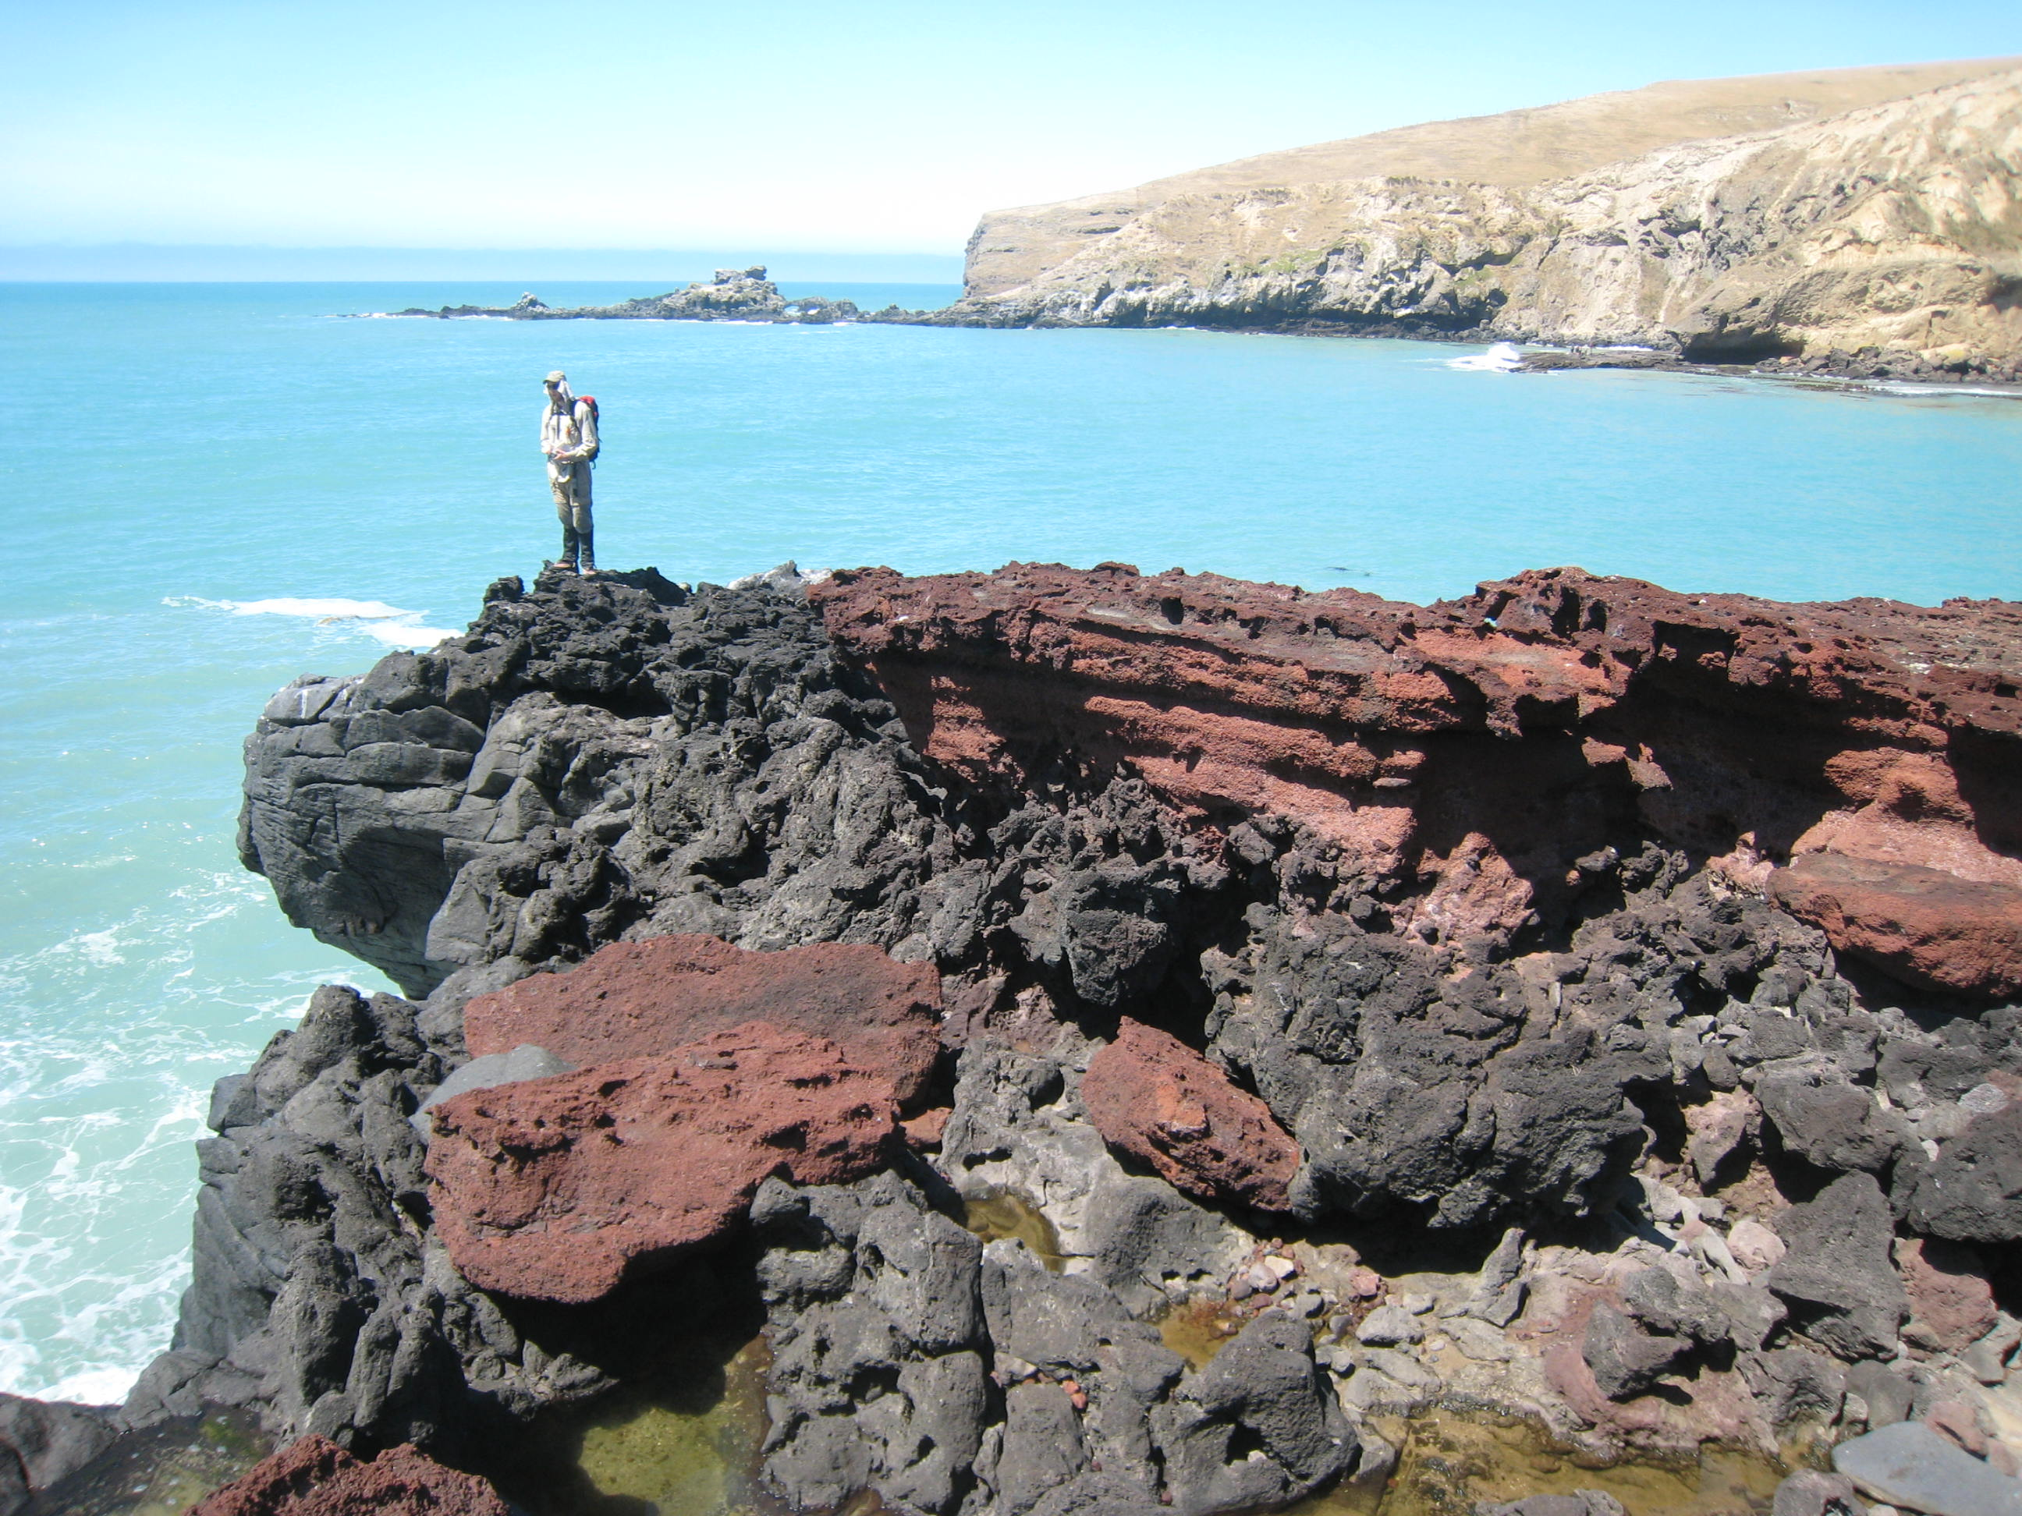
Do Maori settlement patterns on Banks Peninsula reflect an understanding of and response to naturally occurring phenomena such as tsunamis and their associated hazards?
Photo Courtesy of Paula Bürgi- Pa Bay
Notes:
Tsunami as decribed by geological record, oral tradition, and

Slide 7
Methods
Understand the European historical and scientific perspectives
Interpret oral tradition
Historical and Symbolic
Interviews with kaitiaki (guardian/ elder) from Ōnuku Marae in Akaroa Harbour and Maori Resources Librarian, NekenekeiteRangi Paul
Notes:
How to say kaitiaki (?)

Slide 8
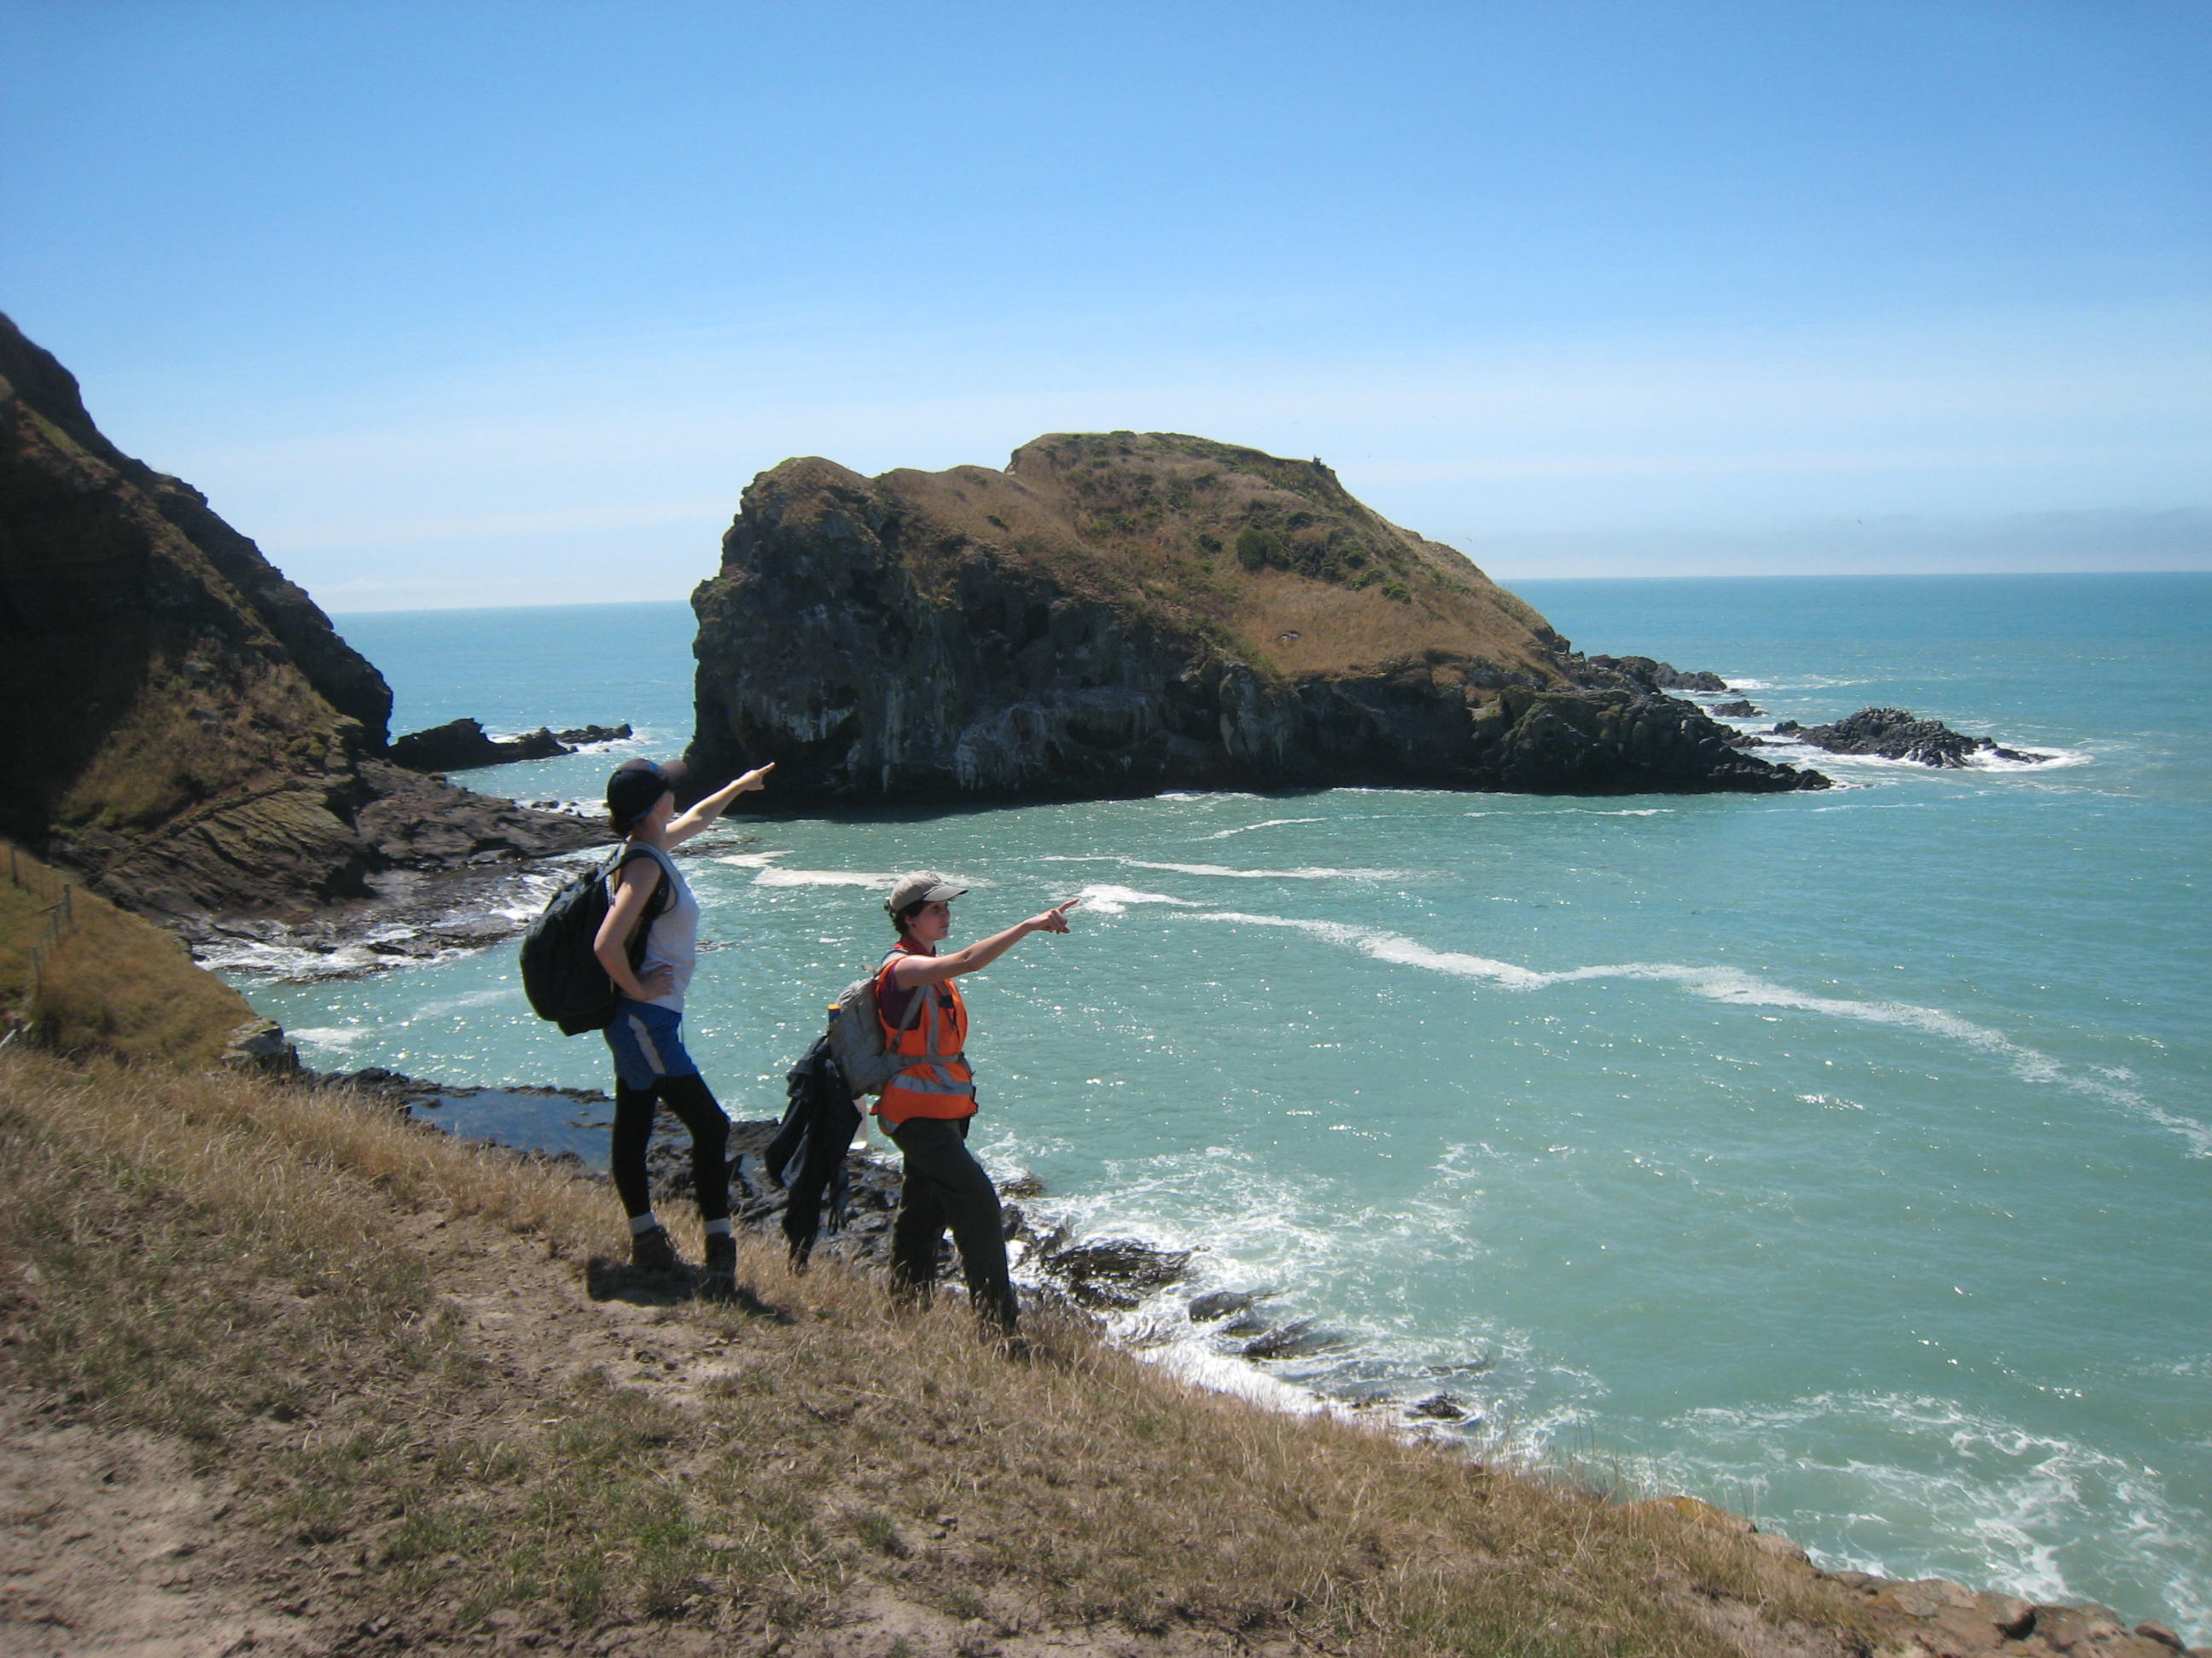
Methods Continued
Maps of pa sites (Taylor, 1894; Challis, 1995)
To understand the geological landscape consulted Google Earth and The Tattooed Land: The Southern Frontiers of the Pa Maori (Brailsford, 1981)
Photo Courtesy of Paula Bürgi- Pa Island

Slide 9
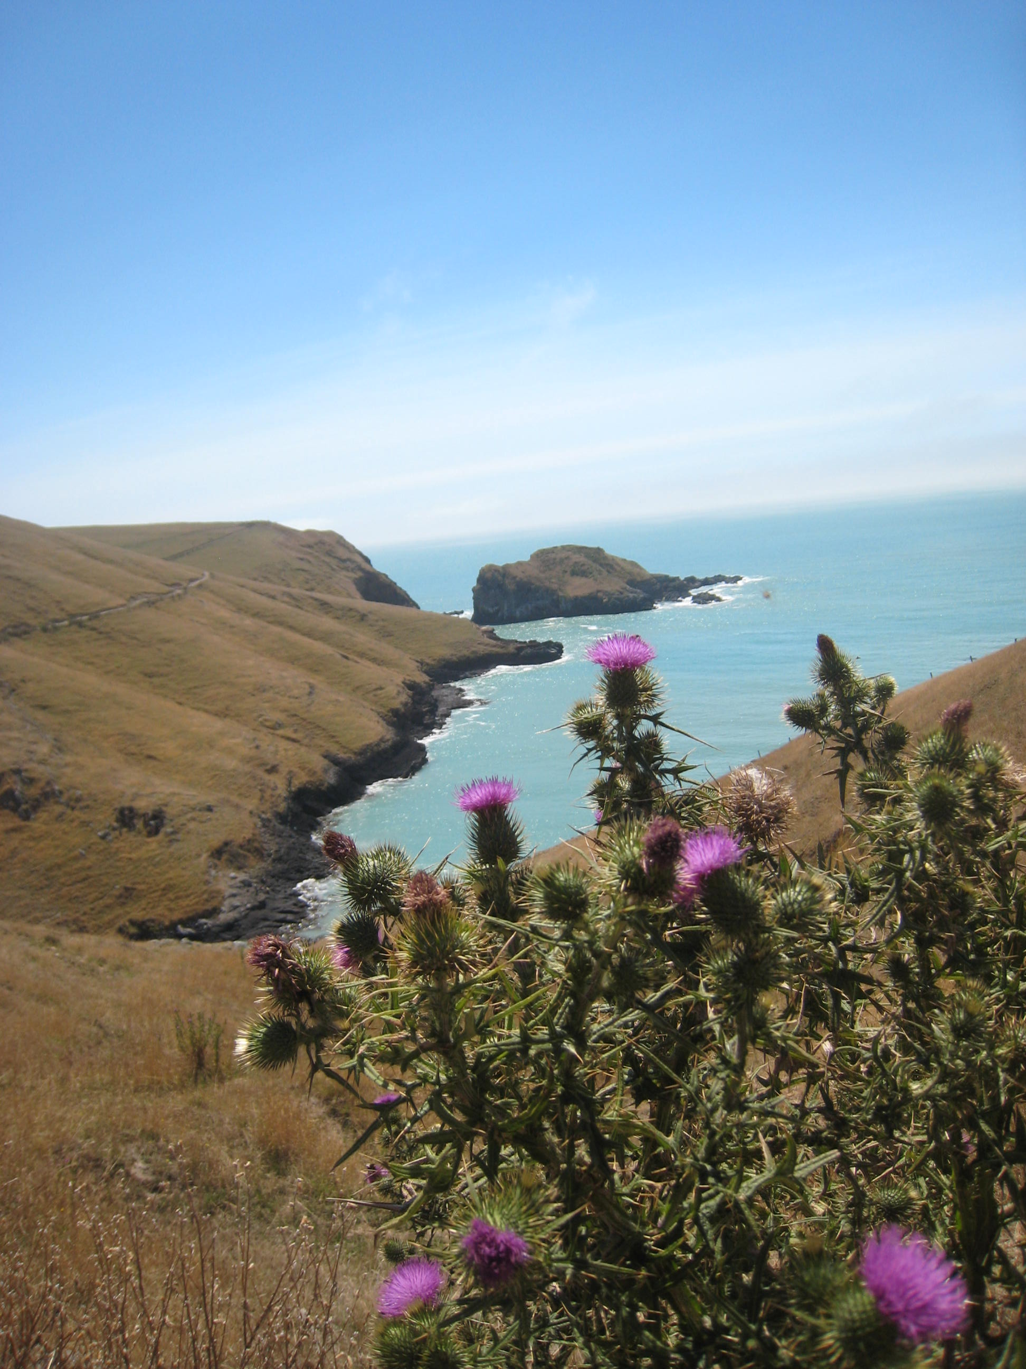
Tsunami Evidence
History
Geology
Archaeology
Oral Tradition:
Taniwha
Pa of Nga-Toko-Ono
Photo Courtesy of Paula Bürgi- Pa Island

Slide 10
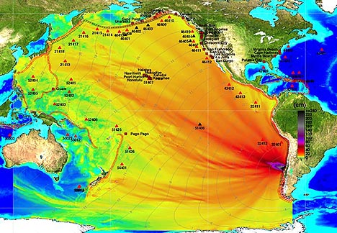
European Historical Evidence
European Historical examples include: 1868 and 1960
http://media.treehugger.com/
Notes:
Transcontinetal Tsunami (?)
This map does not reflect 1896
1960 (?)
Dates:
1896
1960

Slide 11
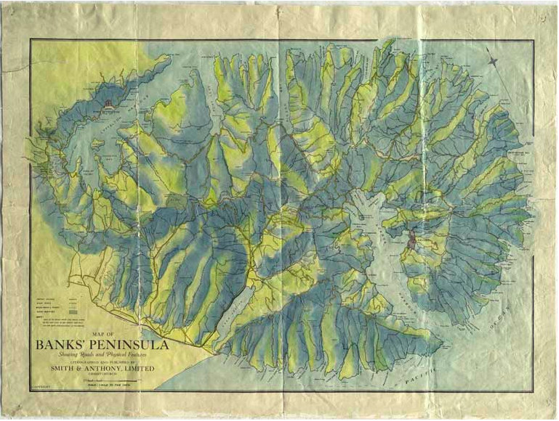
Natural Hazards
1868 Tsunami impact on Okains Bay Bridge
http://christchurchcitylibraries.com/heritage/maps/169109.jpg
Notes:
Is dot right?

Slide 12
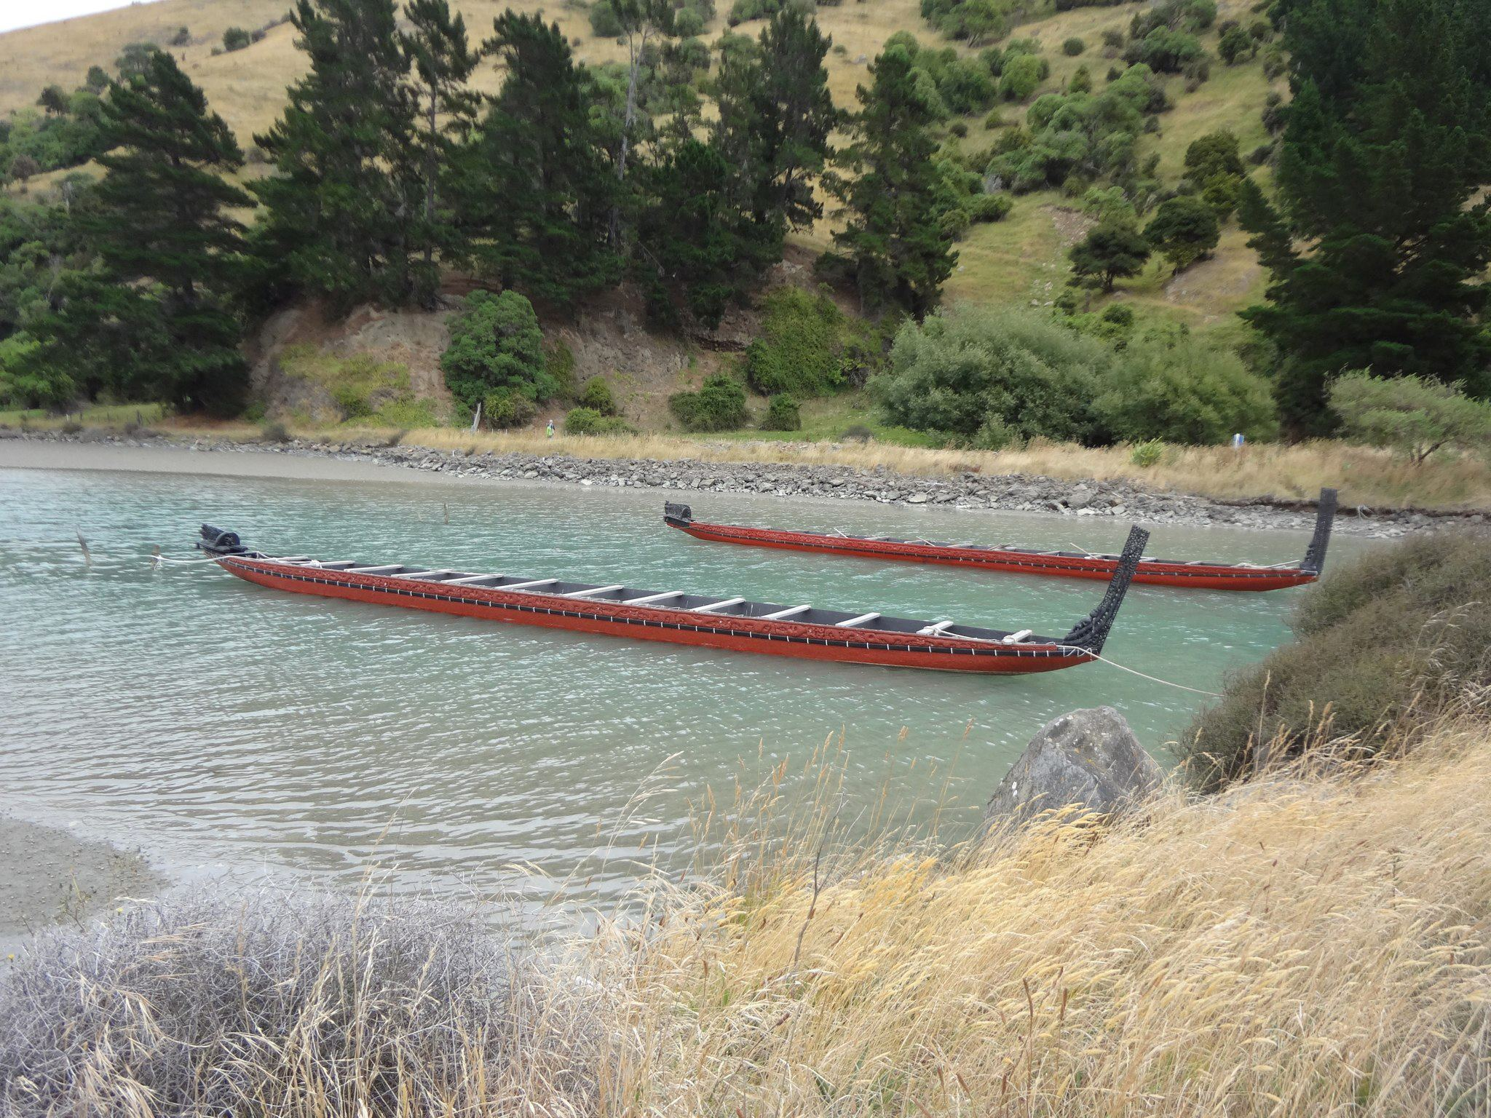
Scientific Evidence
Record of 7 paleotsunamis (Goff & Chagué- Goff, 2012).
Only concerned about 1250 -1350 C.E. and 1604 C.E.
Photo Courtesy of Jane Eisenberg- Waka

Slide 13
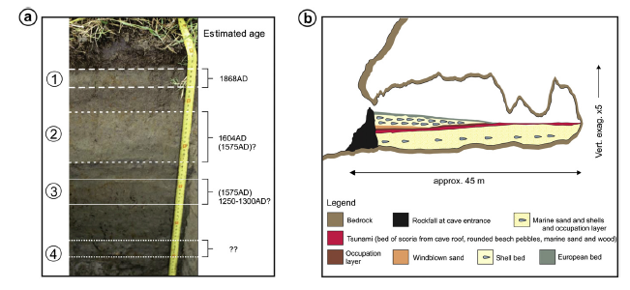
Scientific Evidence
Geological Evidence: Tsunami Deposit Couplets from Okains Bay
Archaeological Evidence: Inhabited Cave
Figure Adopted from Goff and Chagué- Goff (2012)
Notes:
Record of 10? Tsunamis
Stratigraphy
Bridge Example

Slide 14
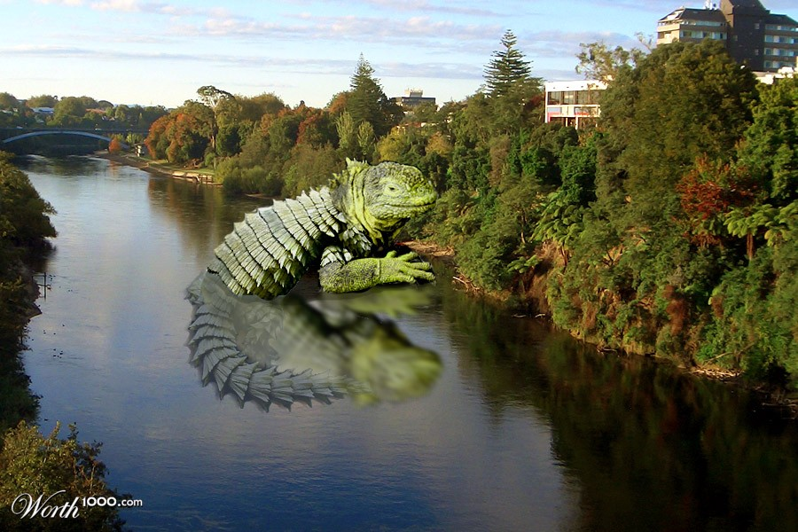
Taniwha = Giant Sea Lizard
http://www.worth1000.com/contests/21347/cryptozoo-8
Notes:
Taniwha- omen
Analogous

Slide 15
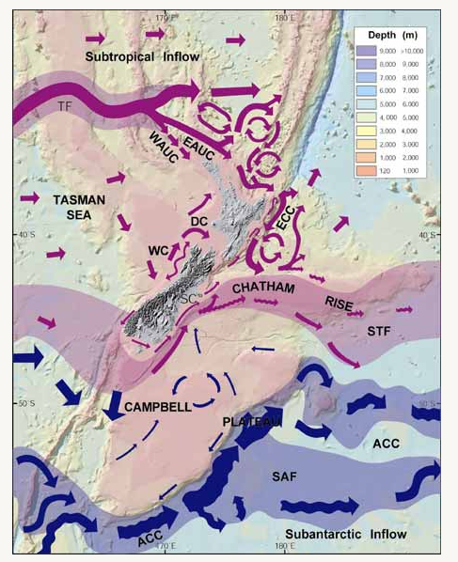
Pa of Nga-Toko-Ono and Chatham Islands
Figure Adopted From Stevens & Chiswell (2012)

Slide 16
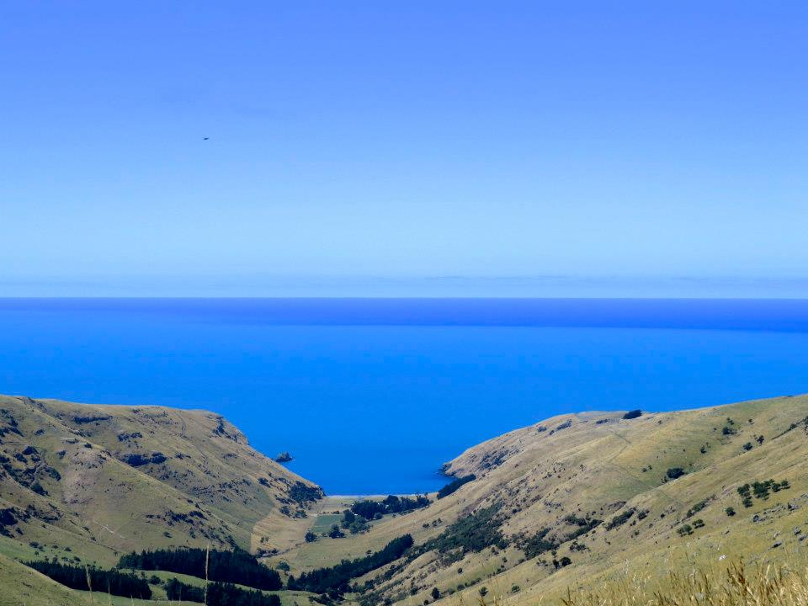
Biggest threat to New Zealand’s east coast are transoceanic tsunamis triggered by high magnitude South American earthquakes.
Tsunami effects are greater on Northern and Eastern Banks Peninsula.
Photo Courtesy of Kyle Metcalfe- Banks Peninsula

Slide 17
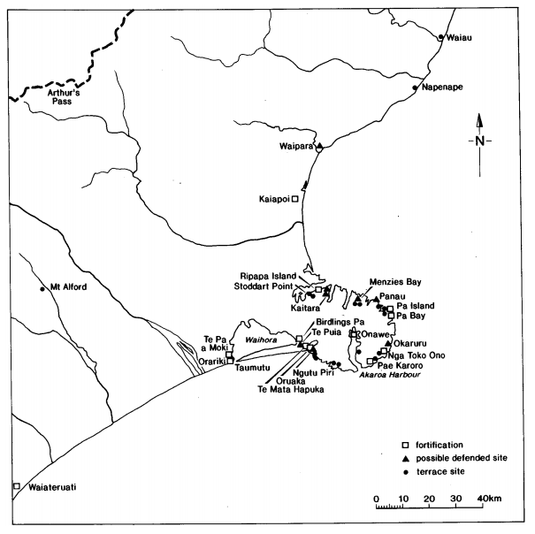
Pas of Banks Peninsula
Elevation: Tsunami Risk
Low Elevation: High
Combination: Medium
High Cliffs: Minimal
Low Elevation: None
Figure Modified from Challis (1995)
Notes:
Could red pa sites be built before 1604?
Most vulnerable parts
Biggest threat
Outline:
Banks Peninsula
Maori
Recongoition of tsunami on Banks Peninsula both historically and th geological record

Slide 18
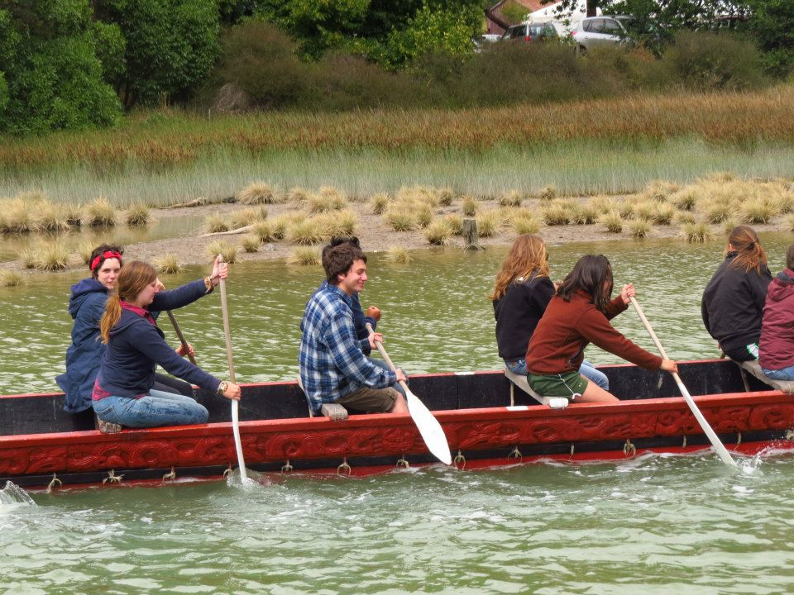
Lingering Questions
Did the Ngāi Tahu move to Banks Peninsula after the 1604 C.E. tsunami to look for more natural resources as well as higher ground to construct pas because of another impending tsunami event?
Photo Courtesy of Kyle Metcalfe- Waitangi Day

Slide 19
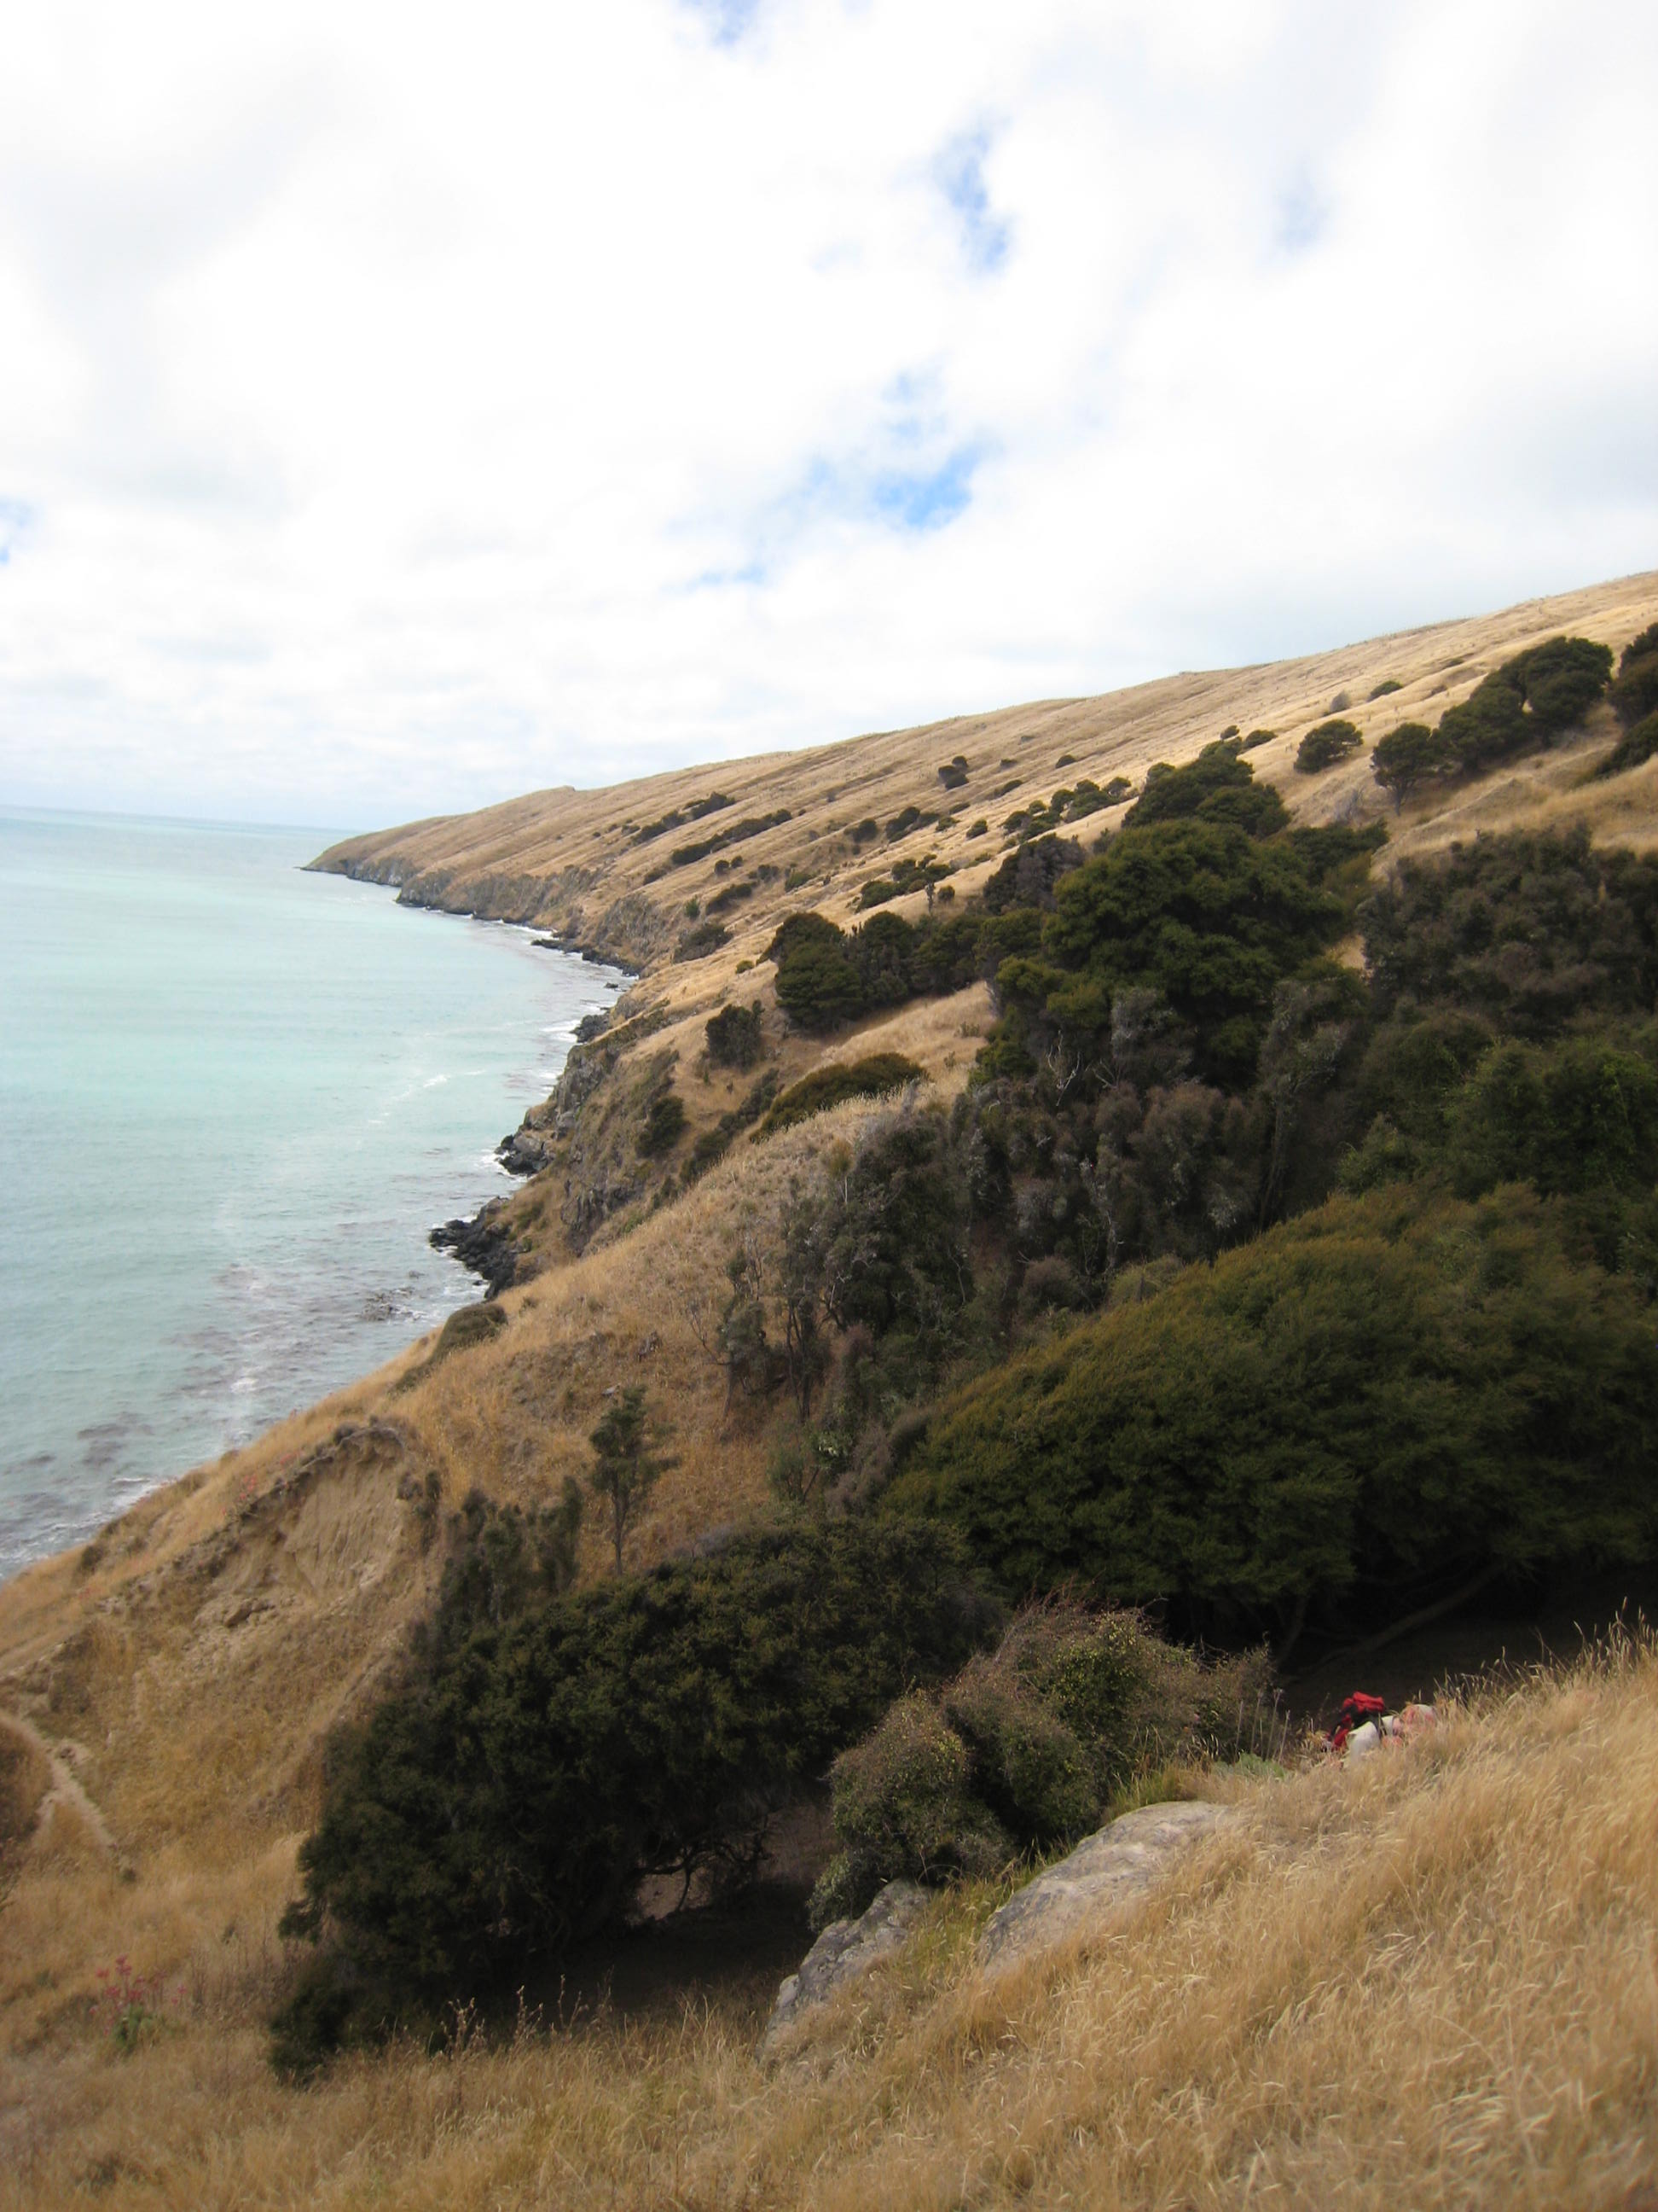
Research Significance
When there is not an obvious geological record, researchers can use oral traditions to supplement and enhance it.
Learning from the past can help modern day Kiwis become aware of transoceanic tsunamis and their associated hazards
Photo Courtesy of Paula Bürgi-East Okains Bay
Notes:
Catalog f information
Targeted look in geological and archeological record
Tsunamis occurred in the past
The oral traditions/ stories: catalog of events that happened in the past. There is not an obvious
Timing of
Patterns reflect where they live based on natural phenomena

Slide 20
Summary
Maori and Banks Peninsula
Main Question
Read articles, interpreted oral traditions, and consulted maps
European perspectives, Geological, Archaeological, and Oral Traditions for tsunami evidence
East coast pas reflect understanding, but north coast pas do not.
Oral Traditions can help to supplement the geological record

Slide 21
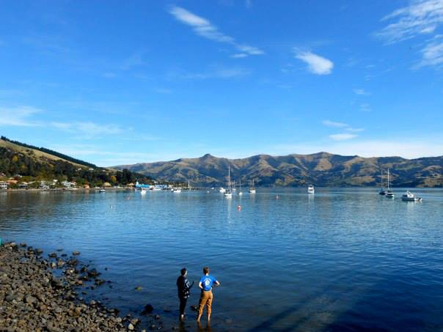
Questions
cdwyer@smith.edu
Photo Courtesy of Alexa Zilberfarb - Akaora Harbour
Notes:
Do some edits and meet up tomorrow

