Slide 1
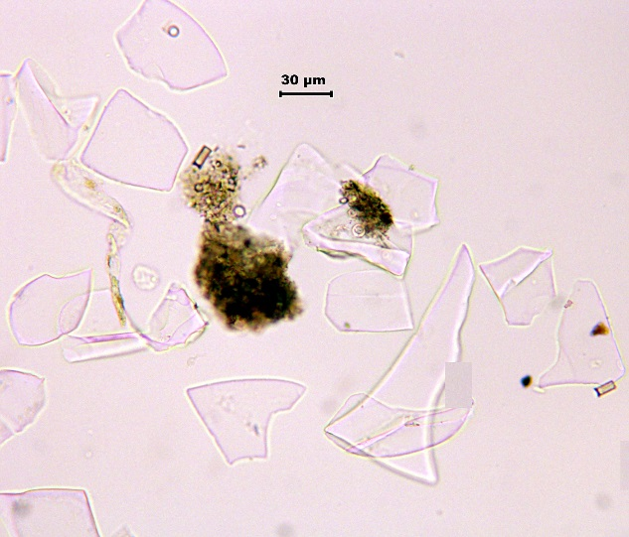


USING CRYPTOTEPHRA TO IMPROVE AGE MODELS OF SEDIMENTARY RECORDS: GEOCHEMICALLY FINGERPRINTING LAKE MALAWI TEPHRA
Ben Chorn
Large Lakes Observatory and Department of Geological Sciences University of Minnesota Duluth

Slide 2
Outline
Background on tephra/cryptotephra
How tephra is useful
Methods (from Lake Malawi cores)
Lake Malawi- a success story

Slide 3
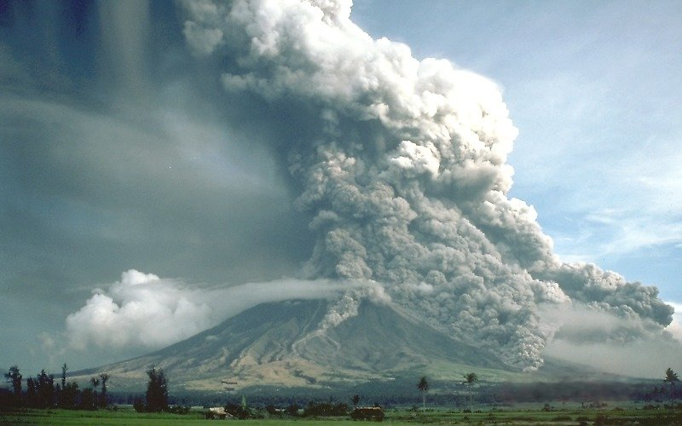
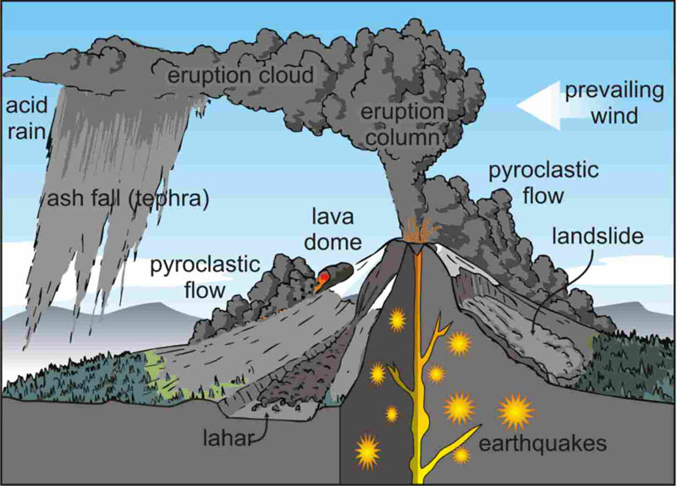
Tephra
“Definition : Pyroclastic materials that fly from an erupting volcano through the air before cooling, and range in size from fine dust to massive blocks.”
http://upload.wikimedia.org/wikipedia/commons/7/73/Pyroclastic_flows_at_Mayon_Volcano.jpg
http://198.103.48.70/volcanoes/images/

Slide 4
Cryptotephra
Invisible to naked eye
From Greek word kryptein, or “to hide”
Preferred over “microtephra”
Notes:
prefix of “micro-” implies information on the size of the particles, or the thickness of the layer

Slide 5
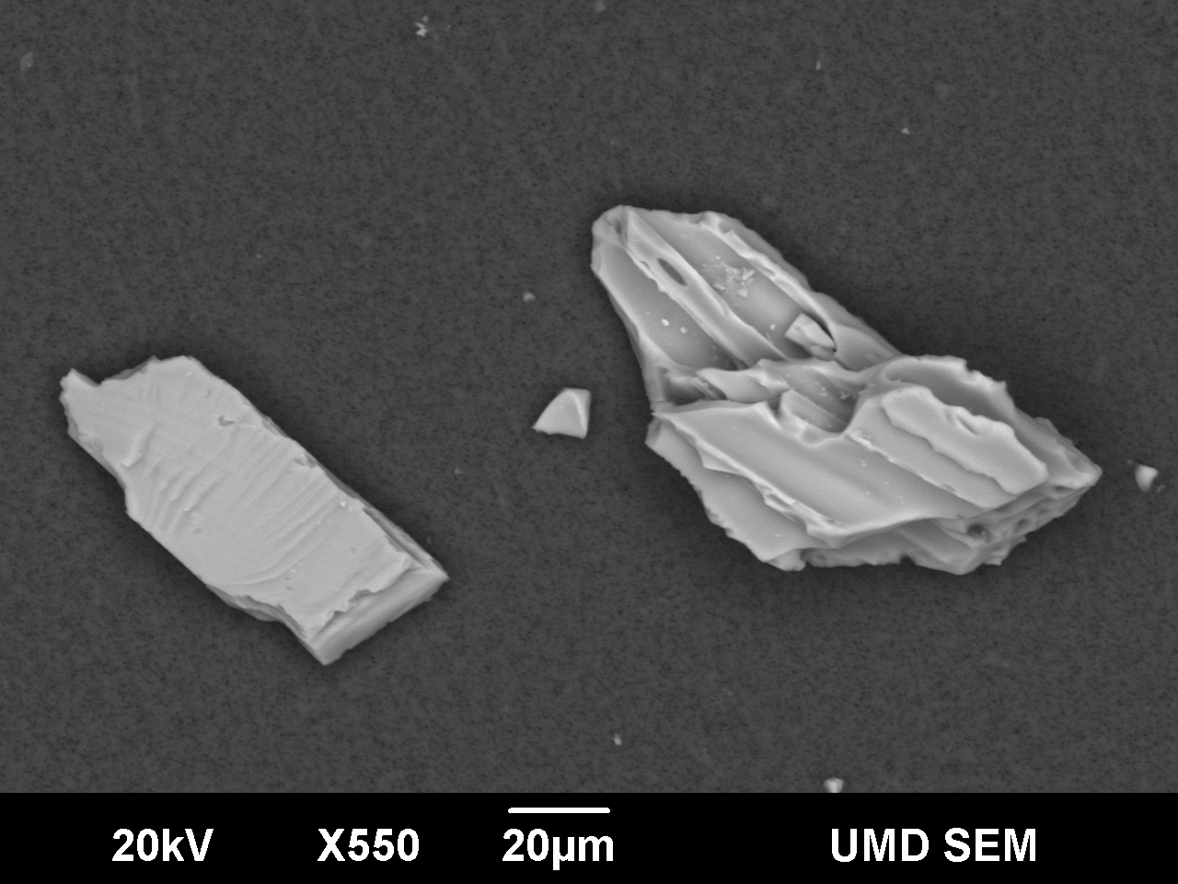
Tephra- How is it useful?
Eruptions
  Eruptive history and extent/volume
  Climate?
  Instantaneous- isochronous markers
Correlations
  Stratigraphic marker (Tephrostratigraphy)
  Large areas (cryptotephra)
Unique properties (density, shape, etc.)
Mineral grain (left) and tephra (right)

Slide 6
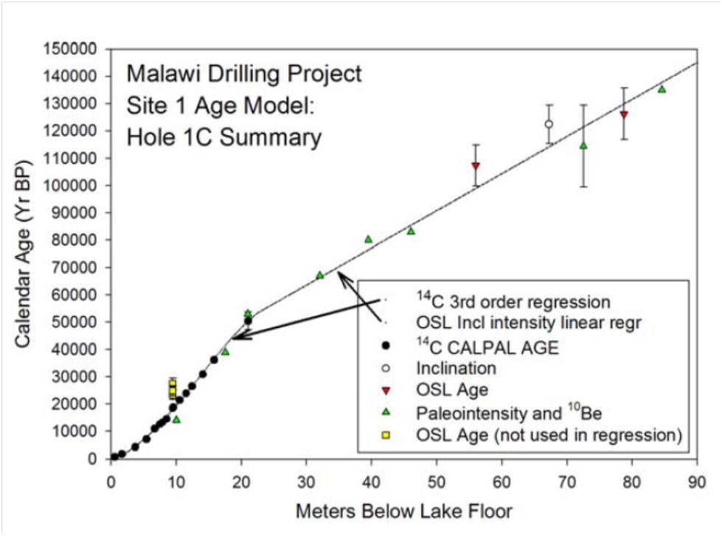
The problem- Lake Malawi age model
Bathymetric map of Lake Malawi with coring locations of site 1 and 2 shown (from Scholz et al., 2007)
Age model for hole 1C using a variety of methods; (from Scholz et al., 2011)

Slide 7
Methods
Cryptotephra layers
  Isolation/concentrate tephra
  Identification
Geochemical fingerprinting
  Energy-dispersive spectrometry using scanning electron microscope (SEM-EDS)
  Electron microprobe analysis with wavelength-dispersive spectrometry (EMPA-WDS)
Notes:
energy-dispersive spectrometry (EDS) , wavelength-dispersive spectrometry, X-ray fluorescence (XRF)

Slide 8
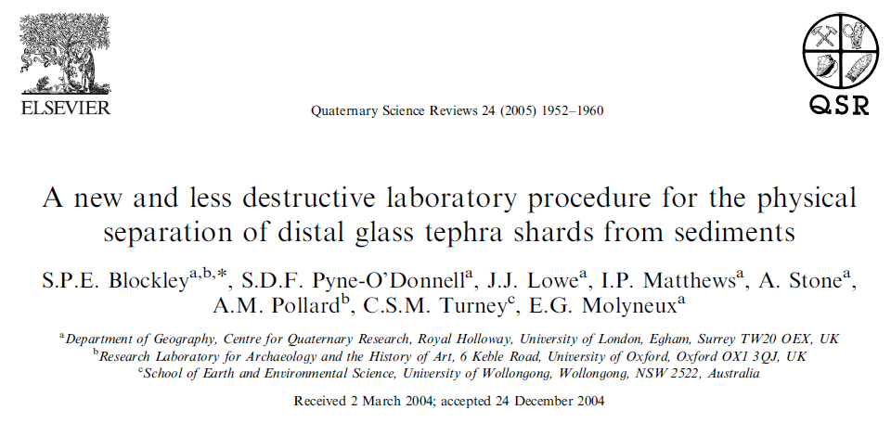
Methods- sampling
Used method from Blockley et al., 2005
Sample in 10 cm intervals, weigh
Isolate/concentrate tephra
Counting/Prep for analyses

Slide 9
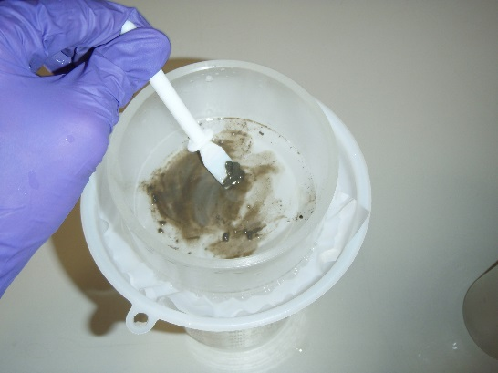
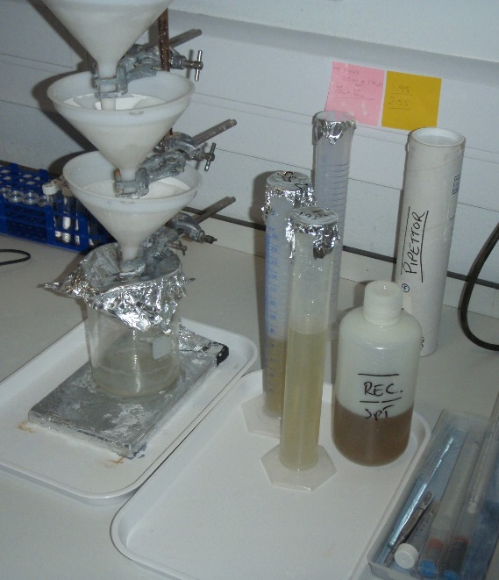
Methods- Isolating tephra
5% HCl wash to remove carbonates
Sieve at 80 µm and 25 µm
Density separation (1.95-2.55 g/cm³)
  Sodium polytungstate (SPT)
  Reuse/recycle SPT
Sieving sediment through 25 µm mesh

Slide 10
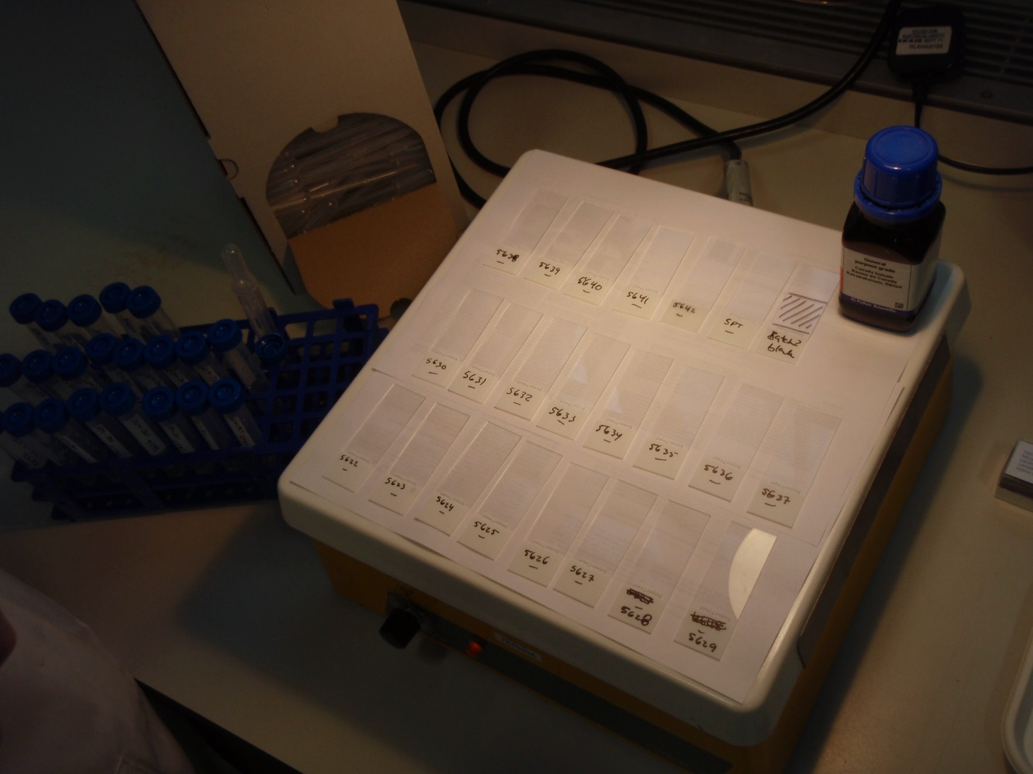
Methods- Counting tephra
Mount material onto slides
Count all tephra shards
Notes:
>16,200 for M151 layer- visible, ~1mm thick

Slide 11
Tephra- Identification
Clear to purple tinge; brownish (more basaltic)
Irregular form with concave-curved sides
Isotropic, extinct in cross polarized light
Tool for Microscopic Identification
  http://tmi.laccore.umn.edu
30 µm

Slide 12
Geochemical Fingerprinting- SEM-EDS
Not reliable
  Can produce alkali migration
    20-25% loss for Sodium
Average range between differences of layers analyzed under the same conditions was 0.33 wt.%
Notes:
size of the electron beam, and also the standards and counting time used.

Slide 13
Geochemical Fingerprinting
EMPA-WDS
Checking instrument conditions against secondary glass standards (SGS)
Considerable discrepancy in results (with and without SGS), particularly for Na₂O, K₂O, SiO₂, and Al₂O₃

Slide 14
Toba ash in Lake Malawi
Adjusted age model; YTT 75 ka
Increased known distal extent of ash fall

Slide 15
Toba ash in Lake Malawi
Adjusted age model- new model places the bottom of hole 1C at an age of ~250 ka (previously ~145 ka)
Increased known distal extent of ash fall
  ~4,400km to 7,300km

Slide 16
Summary
Tephra/cryptotephra can be isolated/concentrated
EMPA-WDS with SGS can be used to geochemically fingerprint
Successful cryptotephrochronology has been used in cores from Lake Malawi

Slide 17





Thanks!

Slide 19
Geochemical Fingerprinting
Total oxide wt.% of 95% as a cut-off value for eliminating poorly collected data while still allowing totals less than 100% The
  5% difference is largely attributed to the water content of tephra, which cannot be detected with EMPA-WDS.
  can be affected by poorly polished surfaces, beam-induced sodium migration, and water content Pollard et al. (2006)
  consistent lower totals (as low as 90%) for tephra included in this study; most data were included for analysis with probable high water content as suggested by Lowe (2011).
SGS
  average difference of 0.53 wt.%.
  SiO₂ 1.15 wt.% higher on average and Na₂O 1.17 wt.% lower

