Slide 1

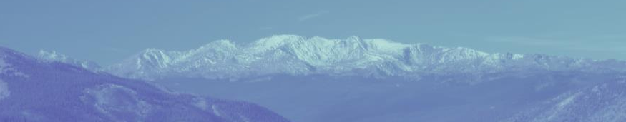
Whither the Rio Grande Rift?
Vincent Matthews
Leadville Geology LLC
Leadville Geology, LLC
Vince Matthews, Principal

Slide 2
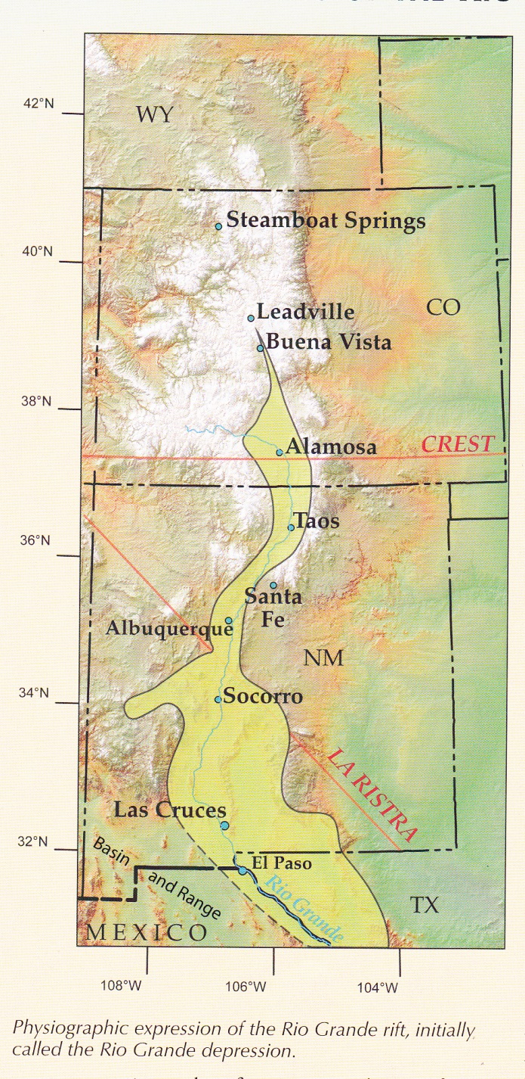
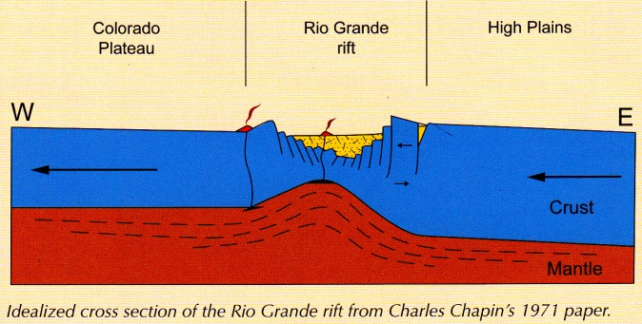
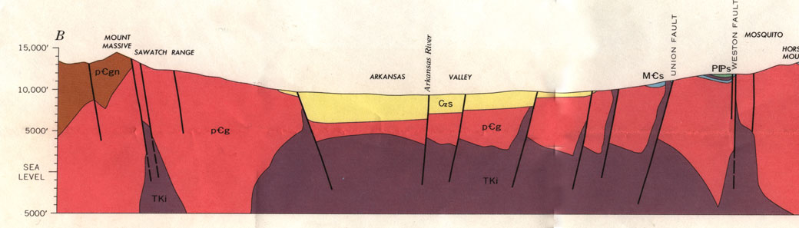
Bryan (1938) Rio Grande Depression
?
Kelley (1940-1970) Tectonic grabens
Chapin (1971) Active continental rift
Tweto (1970s) Extends rift northward
Kelley & Chamberlin, 2012
Leadville Geology, LLC
Vince Matthews, Principal

Slide 3
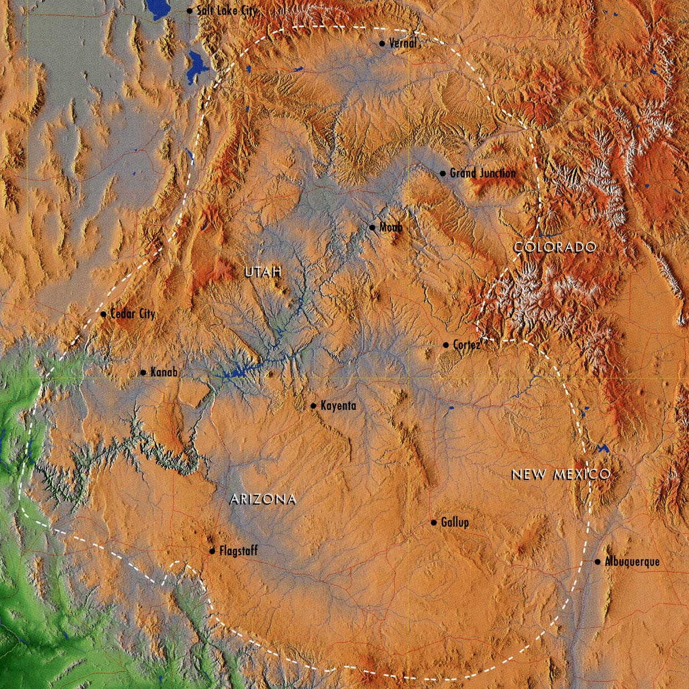
What is the Colorado Plateau?
Is it a Physiographic Province?
Or, Is it a Structural/ Tectonic Province?
Structural style of the Plateau:
Laramide block uplift of Precambrian basement
Monoclinal folding of Phanerozoic strata over block edges
Leadville Geology, LLC
Vince Matthews, Principal

Slide 4
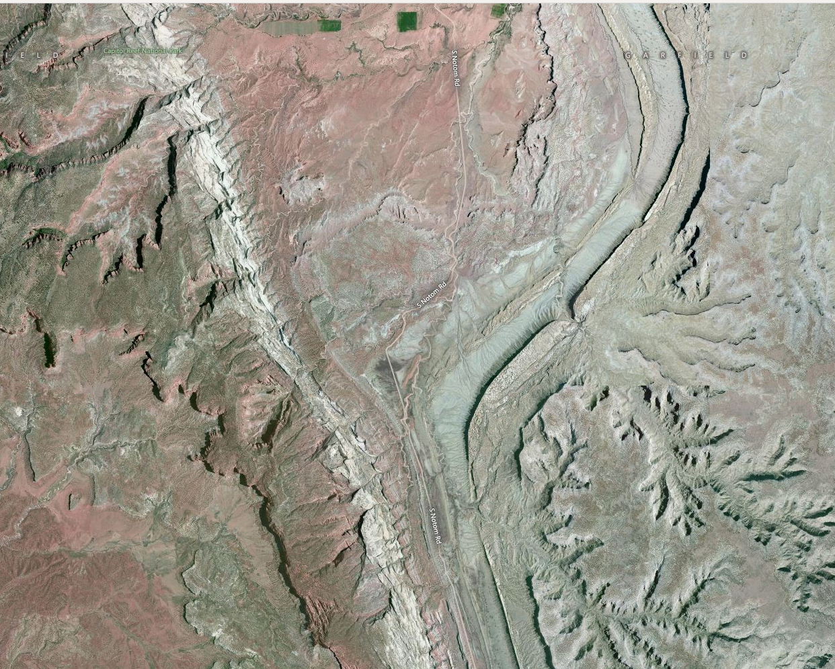
Near Capitol Reef, Utah
D
D
U
U
BLOCK
B
BLOCK
A
D
U
BLOCK
C
D
U
Leadville Geology, LLC
Vince Matthews, Principal

Slide 5
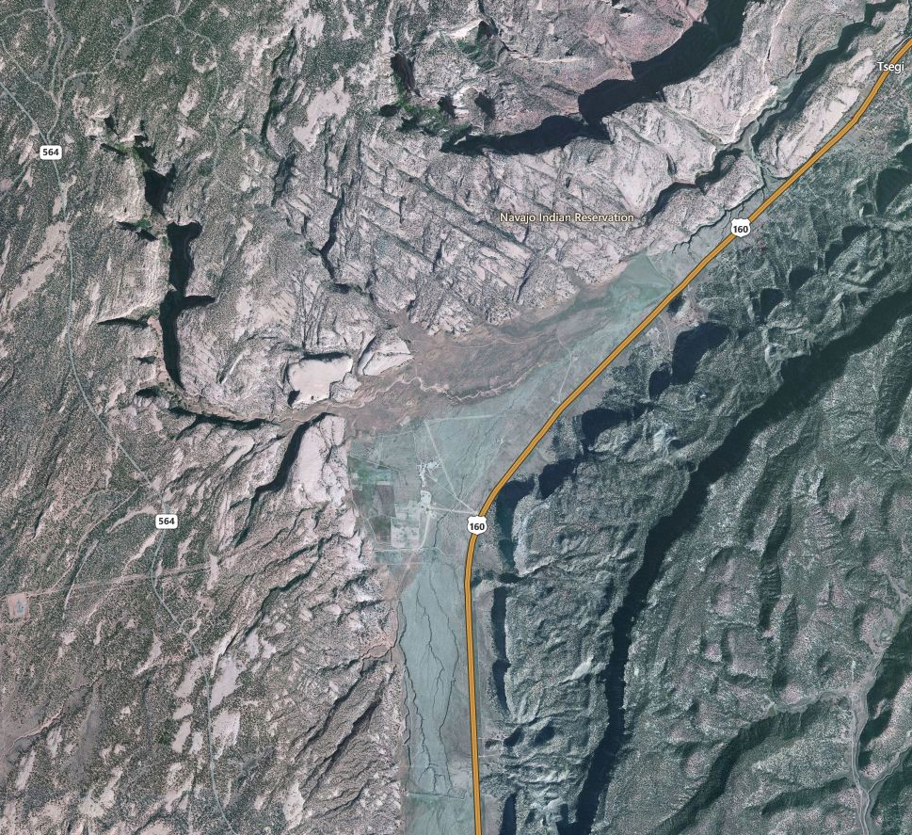
Near Kayenta, Arizona
Leadville Geology, LLC
Vince Matthews, Principal

Slide 6
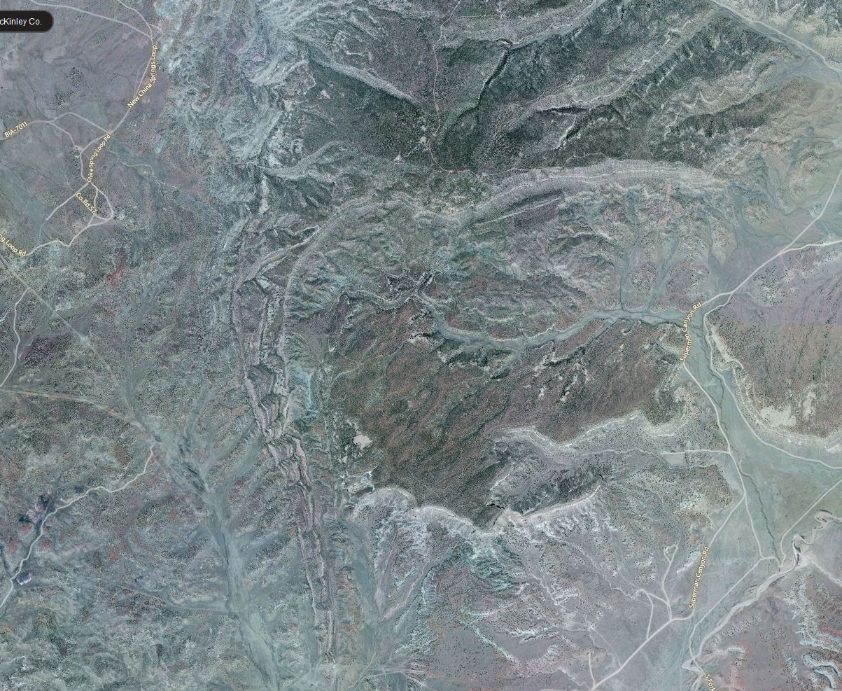
Zuni Uplift (New Mexico)
Leadville Geology, LLC
Vince Matthews, Principal

Slide 7
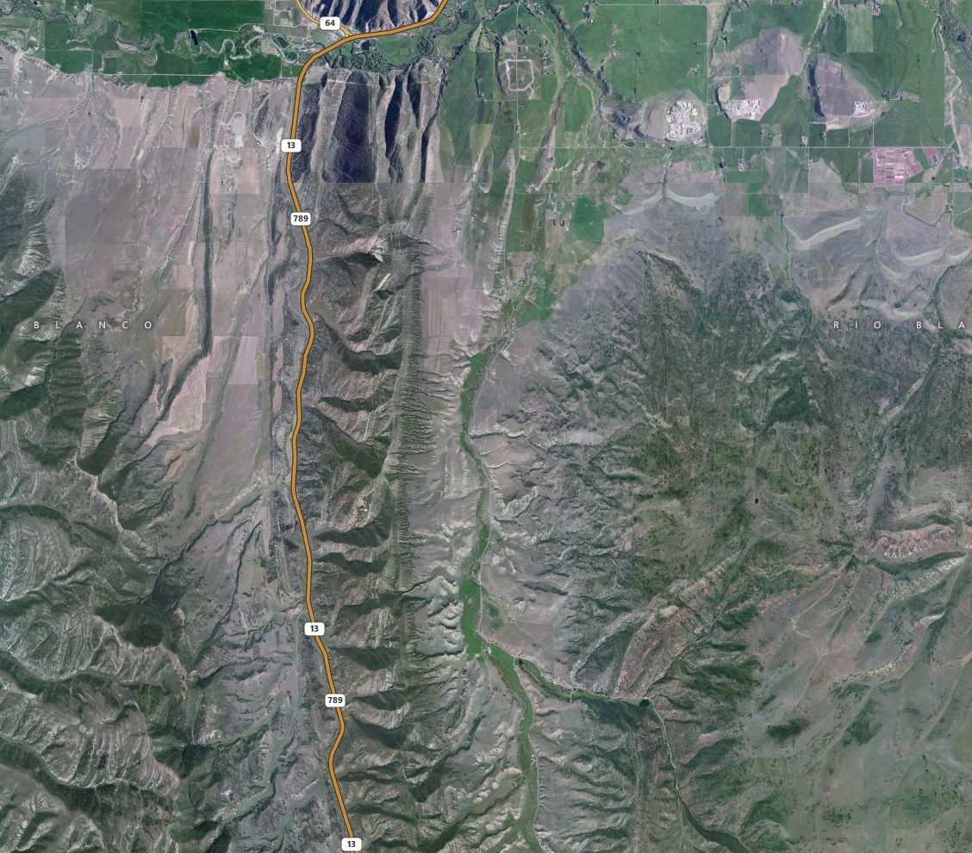
White River Uplift (Colorado)
Leadville Geology, LLC
Vince Matthews, Principal

Slide 8
What is the Colorado Plateau?
You should Specify--
Physiographic Province
Or, Structural/Tectonic Province
Rigid crust
Deformed by Laramide
Bounded by Late Cenozoic Rifting
Leadville Geology, LLC
Vince Matthews, Principal

Slide 9
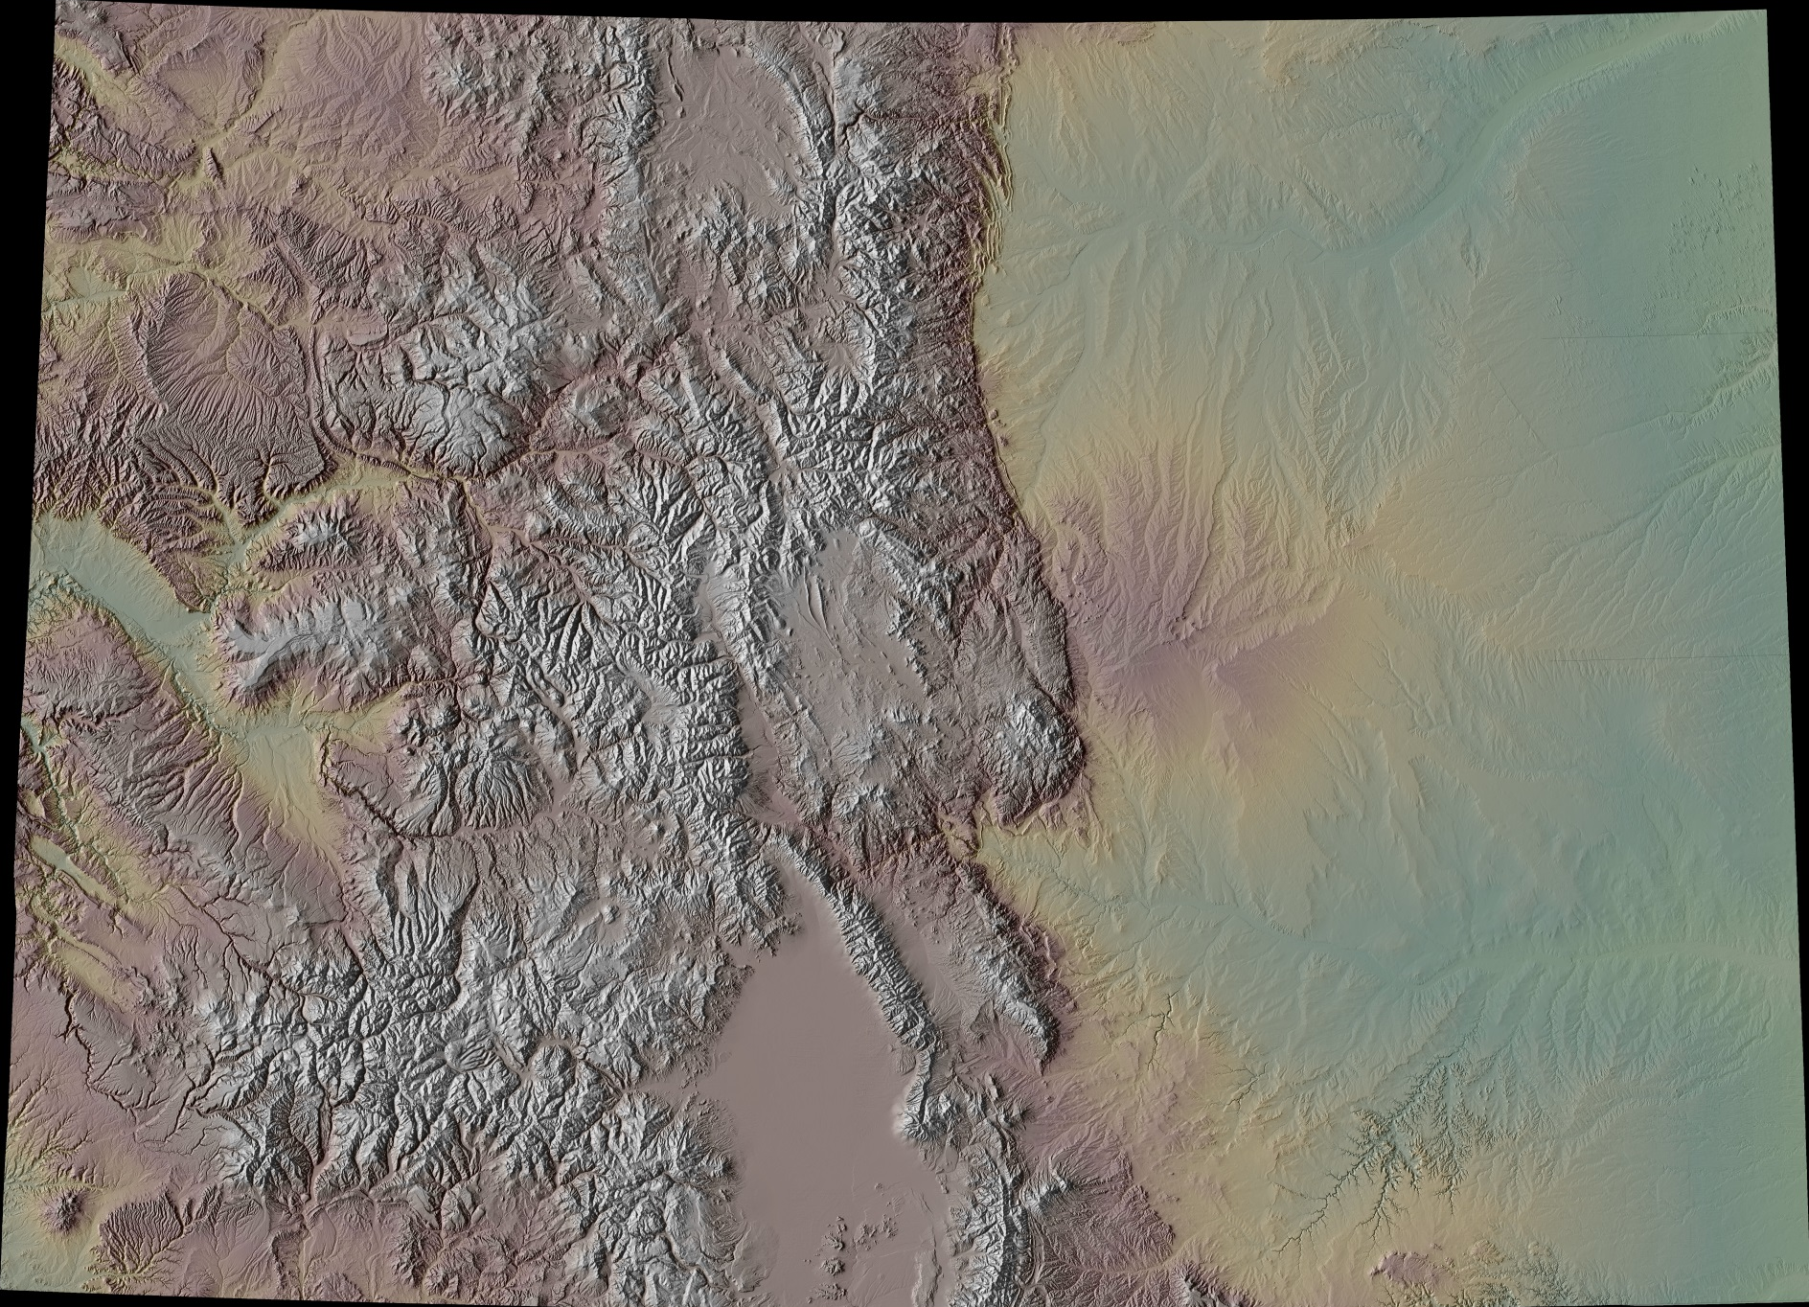
Leadville Geology, LLC
Vince Matthews, Principal

Slide 10
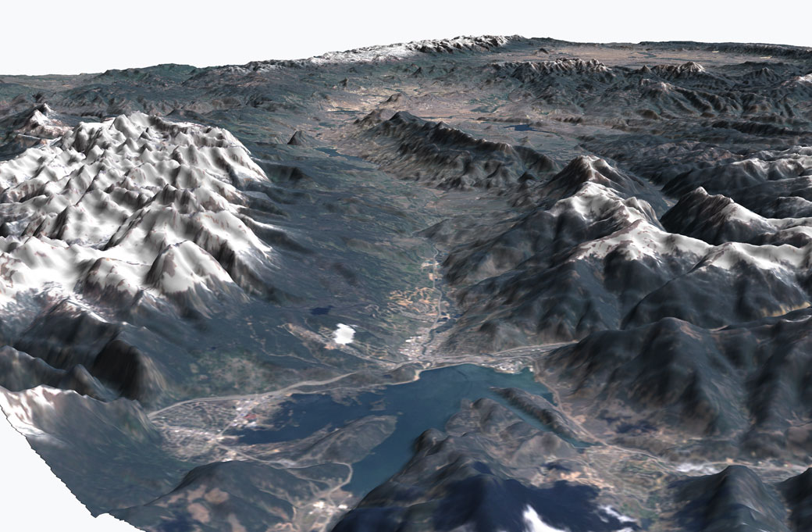
Williams Fork
Valley
Williams Fork Mtns
GORE RANGE
Leadville Geology, LLC
Vince Matthews, Principal

Slide 11
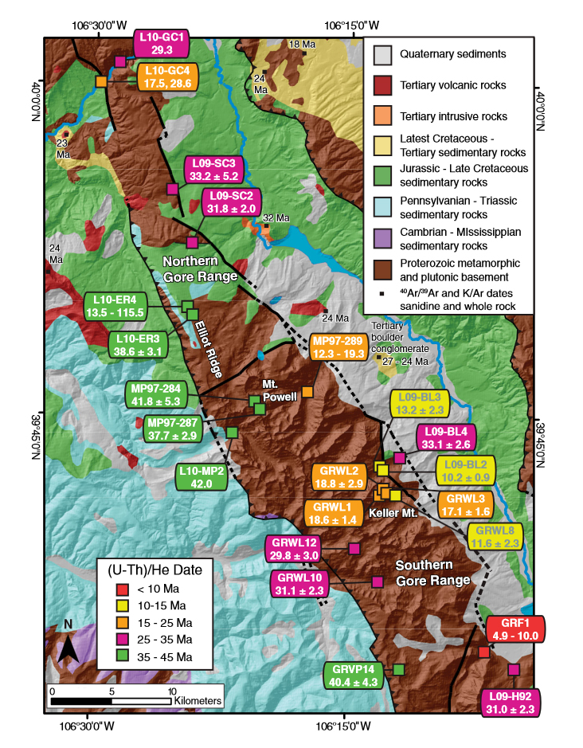
(U-Th)/He Dates
10-15 Ma
15-25 Ma
Landman & Flowers, 2013
Leadville Geology, LLC
Vince Matthews, Principal

Slide 12
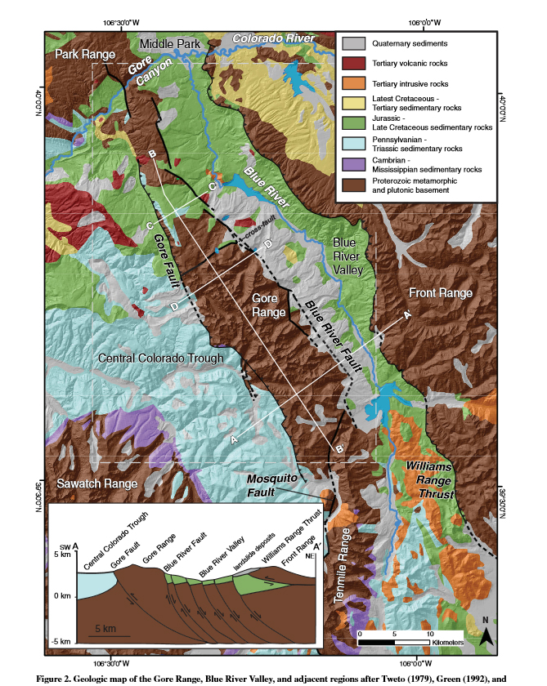
Landman & Flowers, 2013
Leadville Geology, LLC
Vince Matthews, Principal

Slide 13
Leadville Geology, LLC
Vince Matthews, Principal

Slide 14
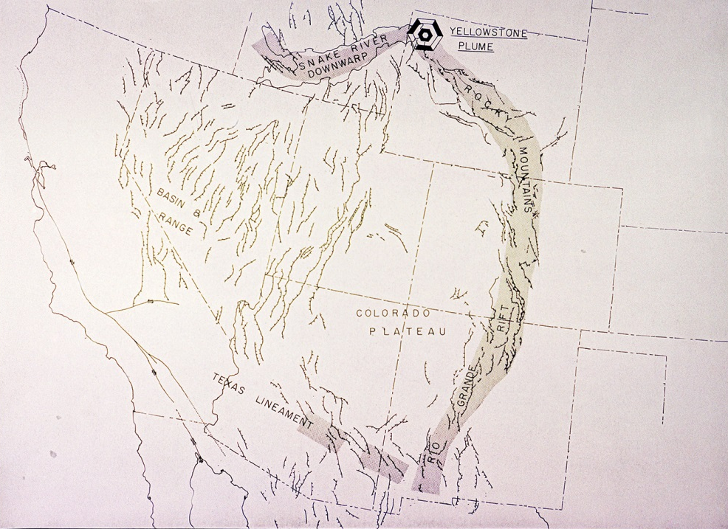
“In pure speculation then, the two systems may be part of an incipient and growing rift in the North American Plate, outlining a segment of some 150,000 square miles”
-- Blackstone, 1971
Matthews & Anderson, Nature, 1973
Leadville Geology, LLC
Vince Matthews, Principal

Slide 15
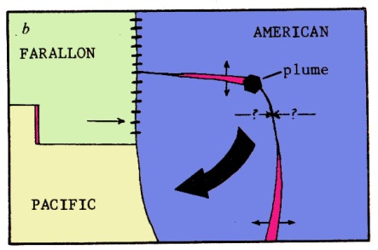
Snake River Plain
Rio Grande Rift
Matthews & Anderson, Nature, 1973
Leadville Geology, LLC
Vince Matthews, Principal

Slide 16
Evidences of Rifting
Extensional Faulting
GPS extensional measurements
Extensional stress indicators
Leadville Geology, LLC
Vince Matthews, Principal

Slide 17
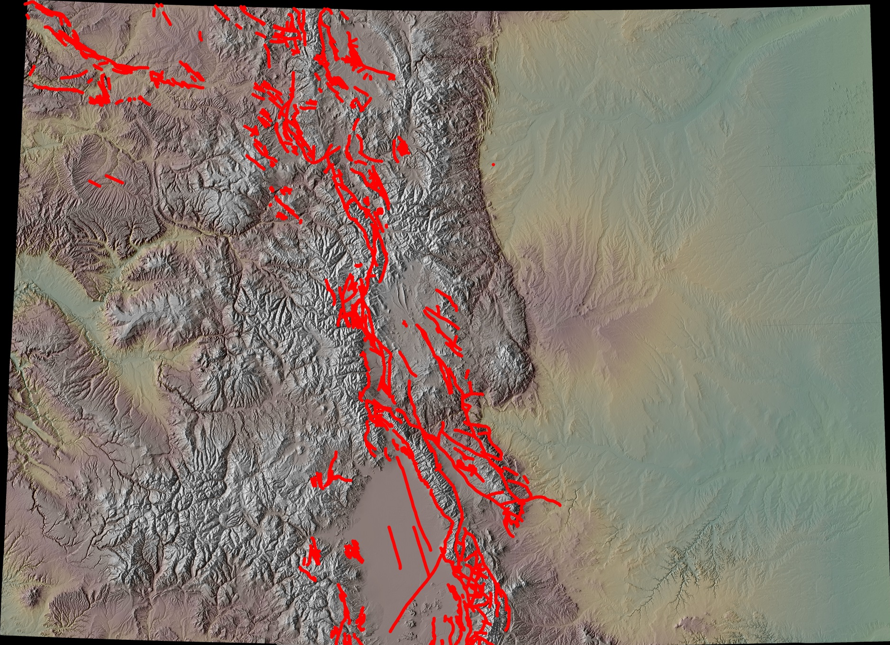
Late Cenozoic Faulting
(Cutting Miocene or Younger Sediments)
Leadville Geology, LLC
Vince Matthews, Principal

Slide 18
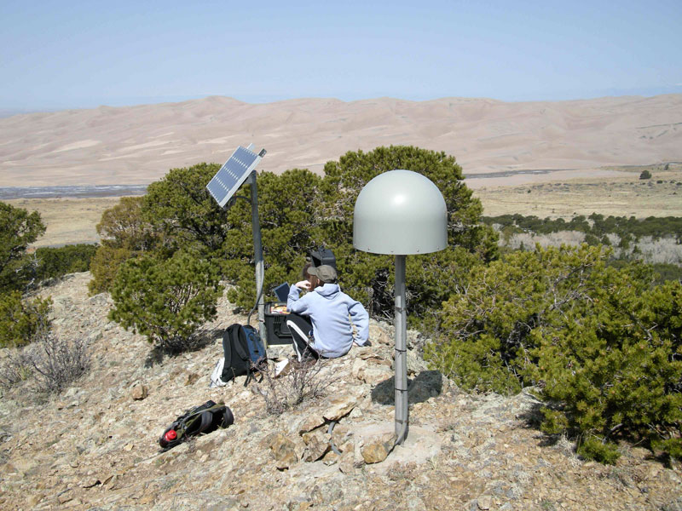
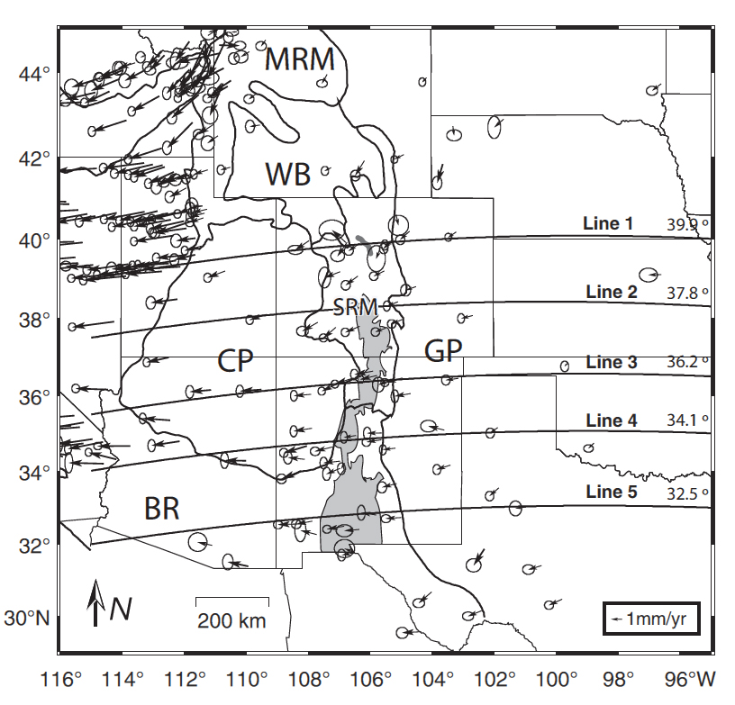
GPS
Image Courtesy: Anne Sheehan
Berglund, et al, 2012
Leadville Geology, LLC
Vince Matthews, Principal

Slide 19
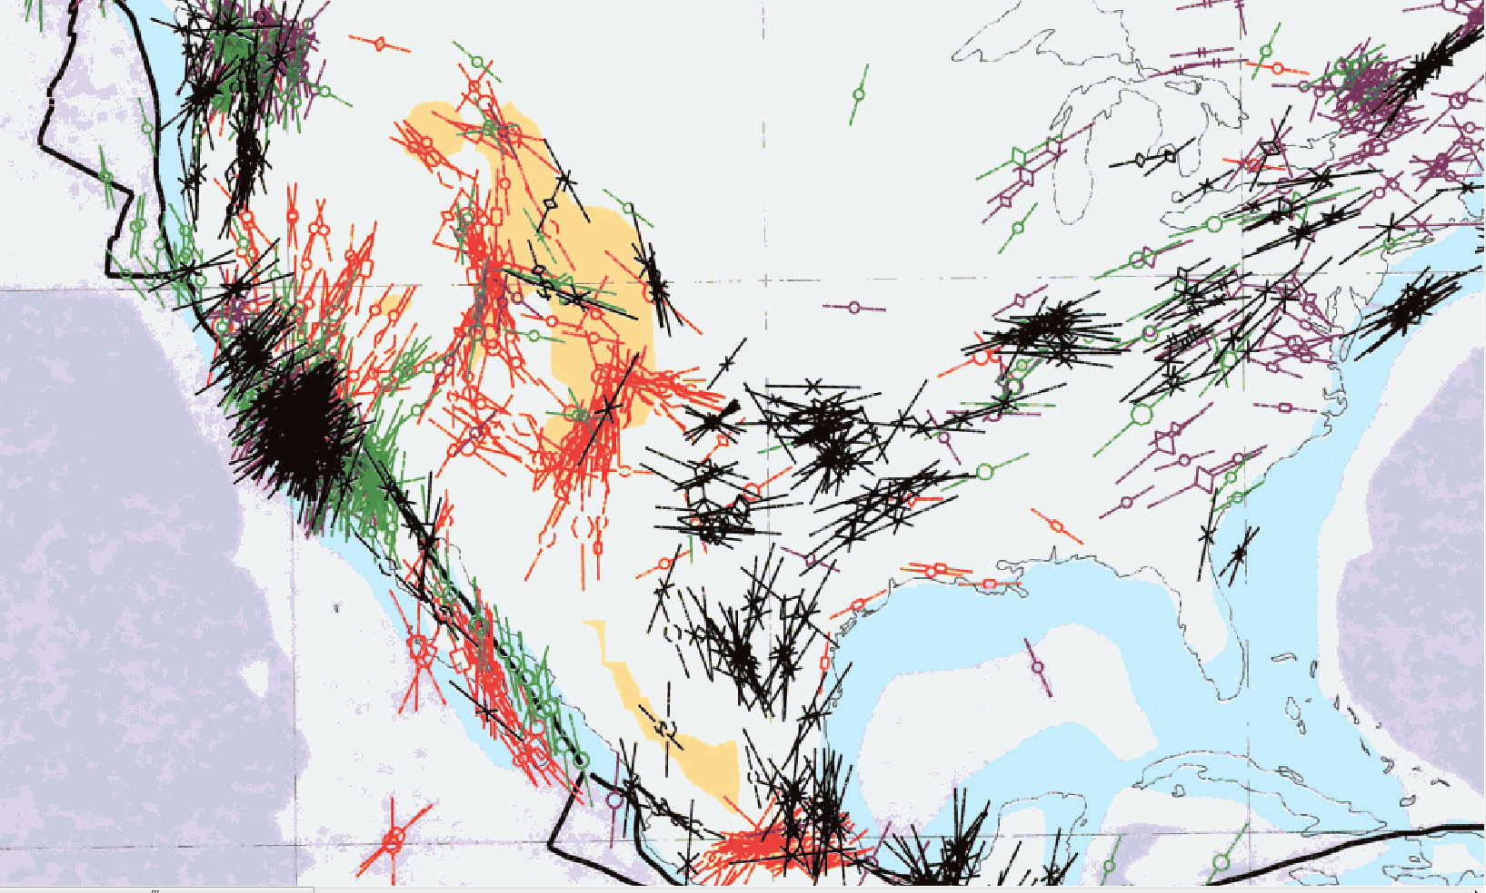
World Stress Map
Leadville Geology, LLC
Vince Matthews, Principal

Slide 20
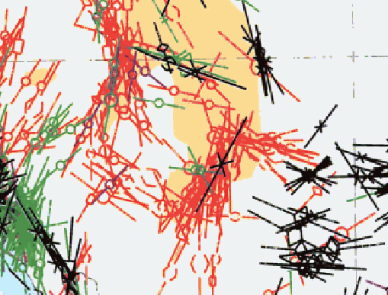
World Stress Map
Leadville Geology, LLC
Vince Matthews, Principal

Slide 21
Consequences of rifting
Basaltic Volcanism
Rift-flank, fault-block uplifts.
Sediment-filled, graben structures
Leadville Geology, LLC
Vince Matthews, Principal

Slide 22
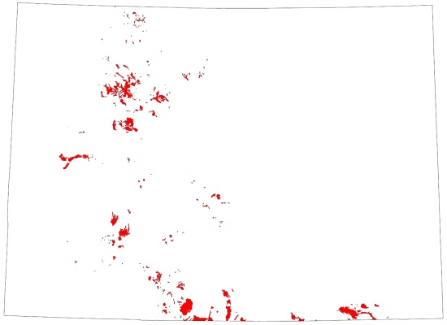
Late Cenozoic Basalts
Leadville Geology, LLC
Vince Matthews, Principal

Slide 23
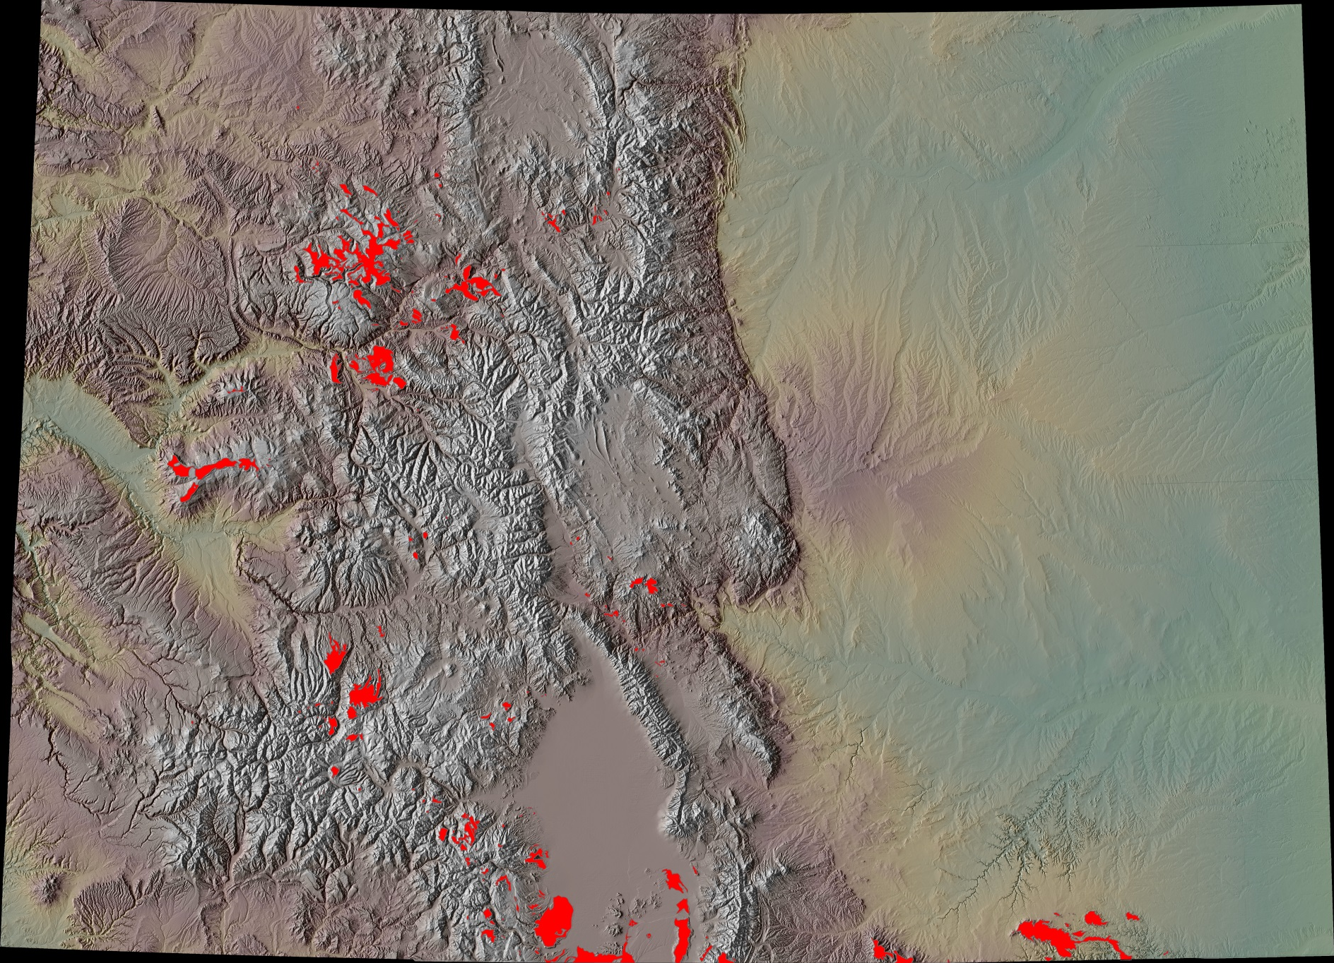
Late Cenozoic Basalts
Leadville Geology, LLC
Vince Matthews, Principal

Slide 24
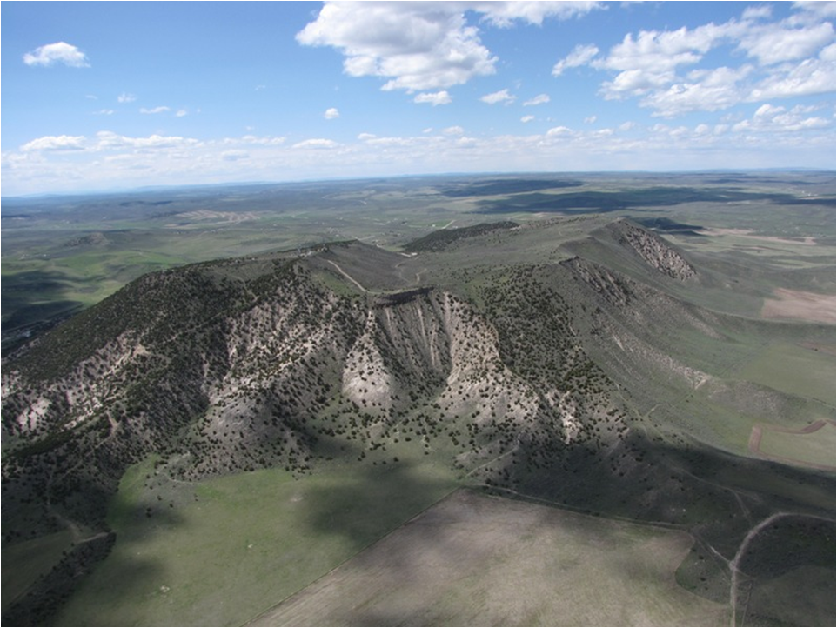
Late Cenozoic Basalt
Leadville Geology, LLC
Vince Matthews, Principal

Slide 25
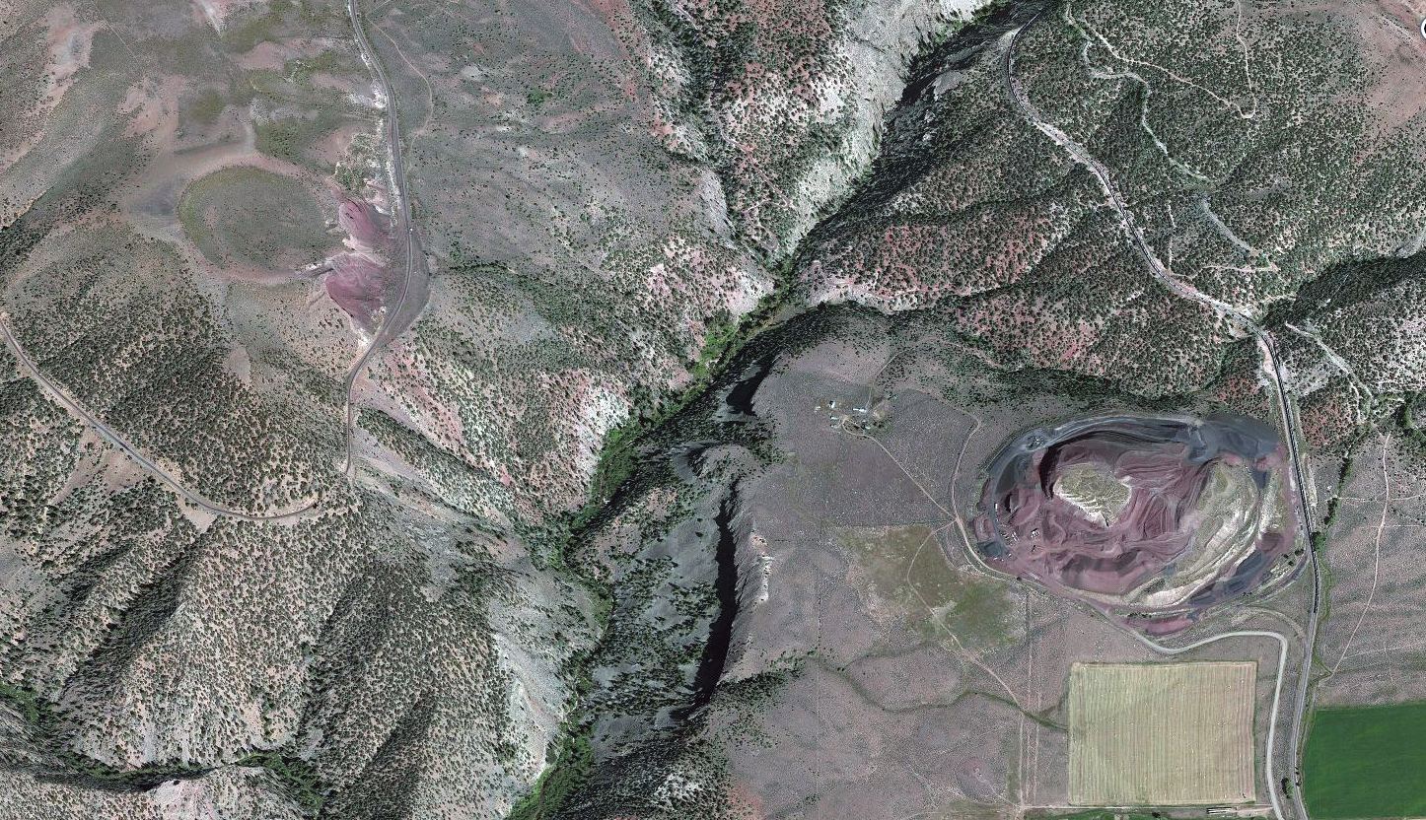
640-thousand-year-old Cinder Cones
Leadville Geology, LLC
Vince Matthews, Principal

Slide 26
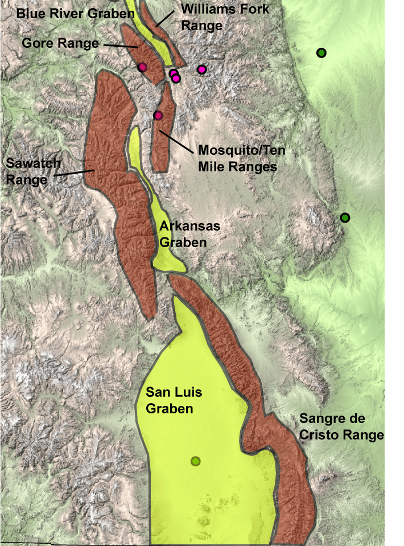
Rift-Bounding Fault Blocks
Leadville Geology, LLC
Vince Matthews, Principal

Slide 27
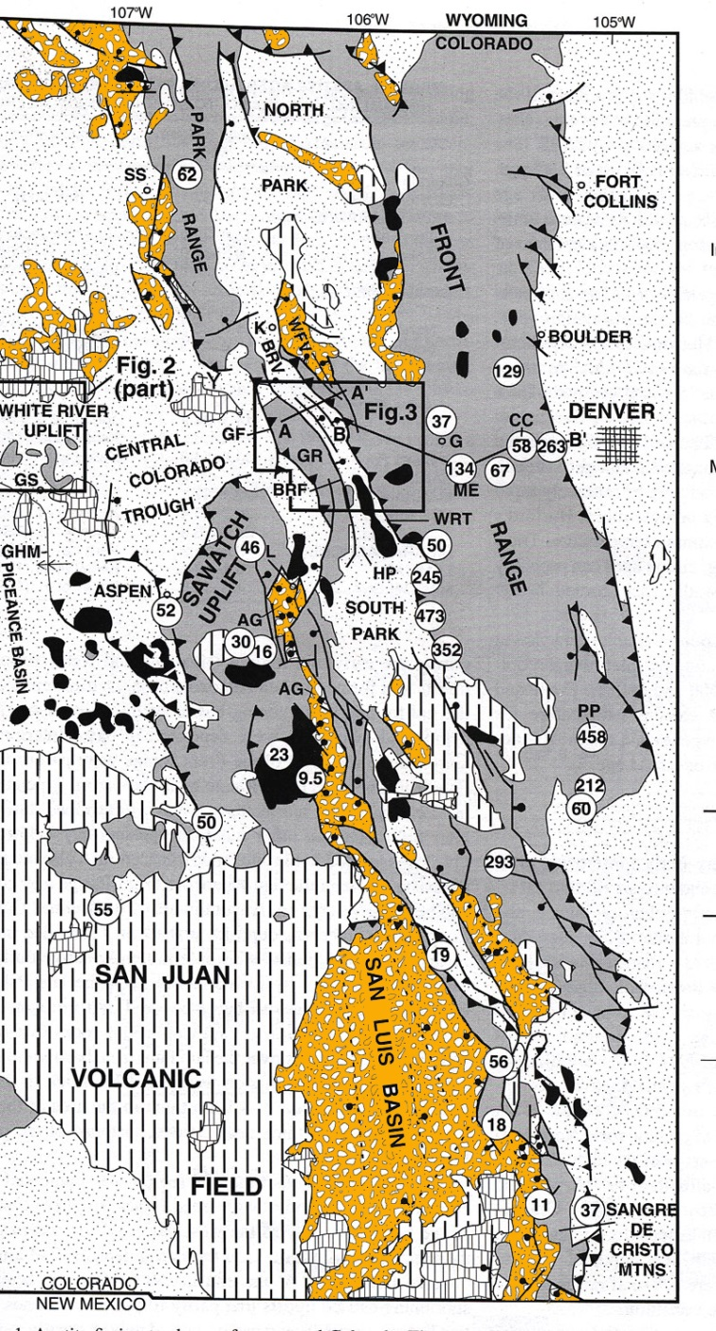
Browns Park formation
Dry Union formation
Santa Fe formation
Naeser, et al, 2002
Leadville Geology, LLC
Vince Matthews, Principal

Slide 28
Browns Park formation
Leadville Geology, LLC
Vince Matthews, Principal

Slide 29
Evidences of Rifting
Extensional Faulting
GPS extensional measurements
Extensional stress indicators
Consequences of rifting
Basaltic Volcanism
Rift-flank, fault-block uplifts.
Sediment-filled, graben structures
Leadville Geology, LLC
Vince Matthews, Principal

Slide 30
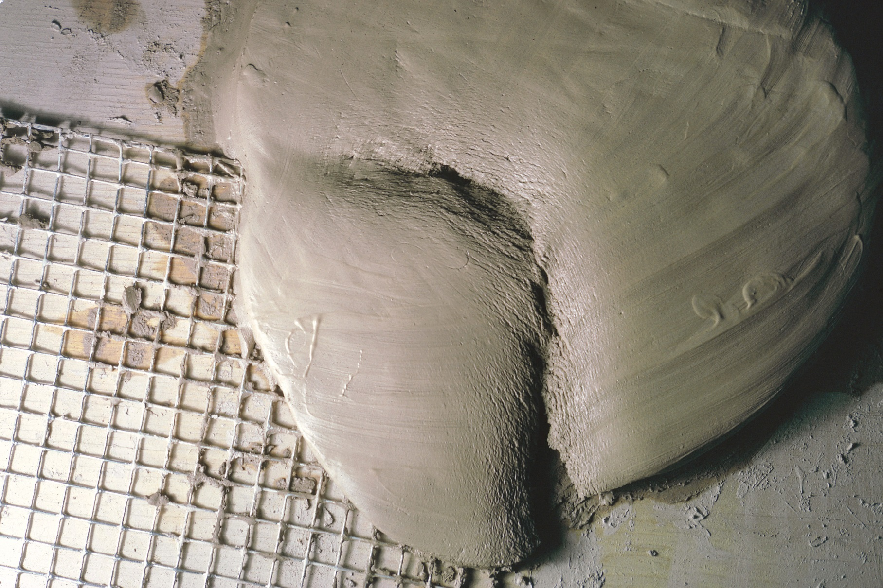
Clay Cake Experiment
Modified from Matthews & Anderson, Nature, 1973
Leadville Geology, LLC
Vince Matthews, Principal

Slide 31
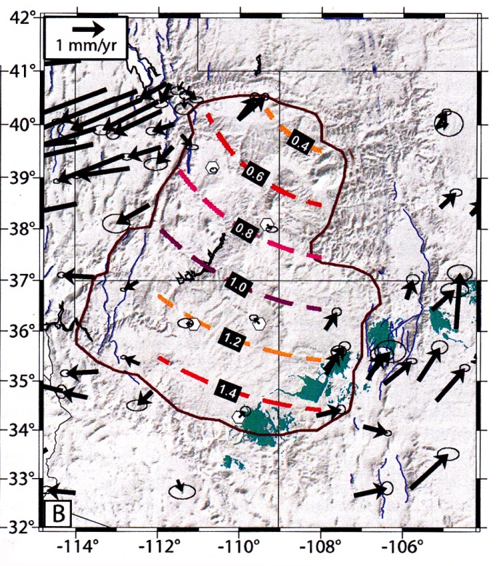
GPS Station Analysis
from Kreemer, et al, 2010
Leadville Geology, LLC
Vince Matthews, Principal

Slide 32

Leadville Geology, LLC
Vince Matthews, Principal

Slide 33
SUMMARY
The Colorado Plateau is merely an area of Laramide deformation with rifting superposed on it, creating structural boundaries to a currently rigid block.
Rotation of the rigid plateau can explain the distribution and orientation of Late Cenozoic normal faulting and volcanism in Colorado.
The structural Colorado Plateau should be considered in tectonic modeling, rather than the physiographic province.
Leadville Geology, LLC
Vince Matthews, Principal

Slide 34
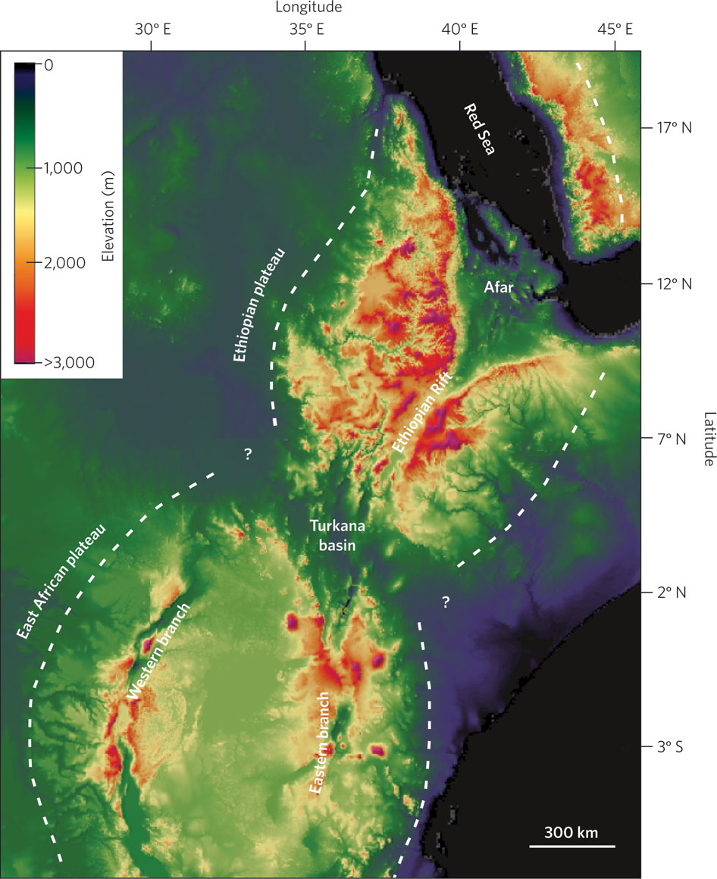
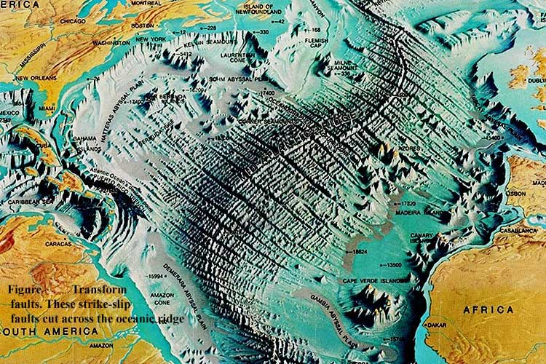
Orogeny or Epeirogeny?
Leadville Geology, LLC
Vince Matthews, Principal

Slide 35
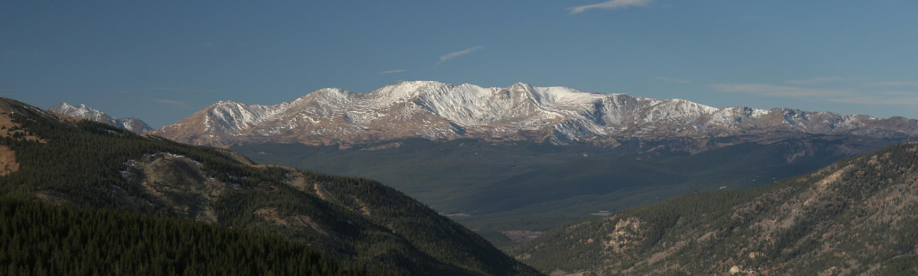
Thank you for being here on Wednesday afternoon!!!
Leadville Geology, LLC
Vince Matthews, Principal

