Slide 1

American Geosciences Institute’s Workforce Program: Past, Present, Future
Carolyn Wilson
Christopher Keane
Heather Houlton
American Geosciences Institute
October 30, 2013

Slide 2

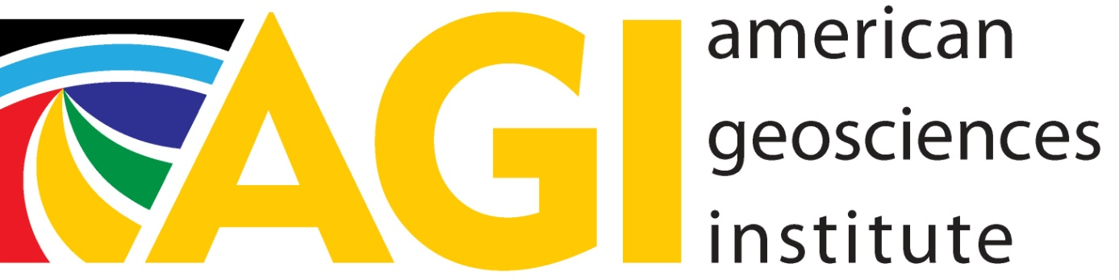
American Geological/Geosciences Institute

Slide 3
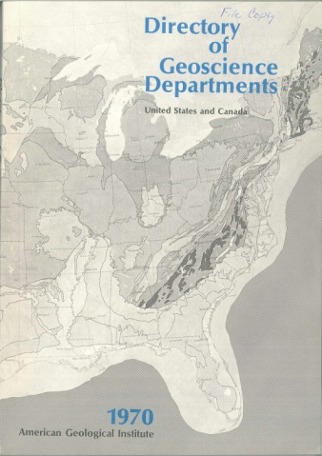
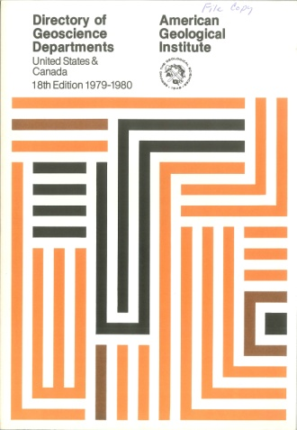
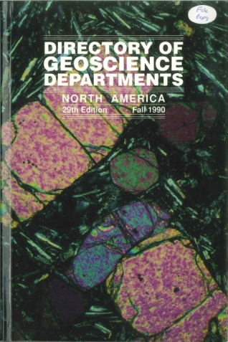
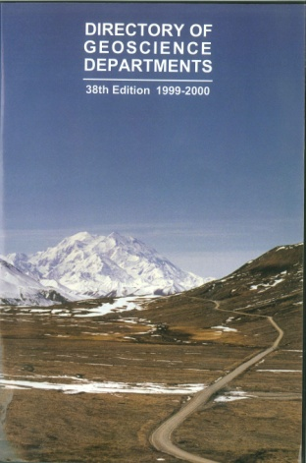
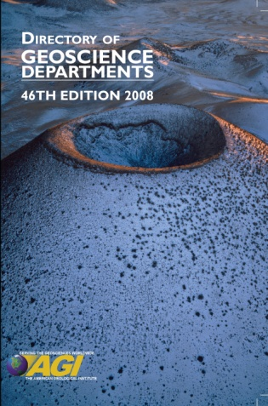
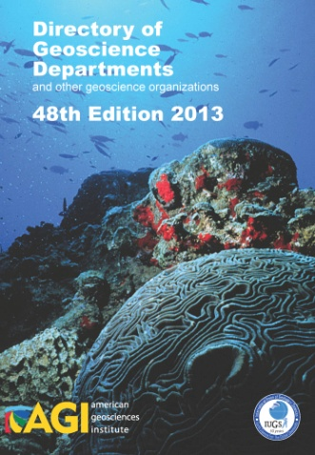
Manpower Program
First iteration of the Workforce Program
Began in 1955
Purpose: Ensuring the community had sufficiently skilled workforce capacity for the economic needs of the time
Began the data collection for the Directory of Geoscience Departments

Slide 4
Workforce Program
Goals
Utilize information, tools, and strategies to support the development of a robust and sustainable geoscience workforce both domestically and globally
Engage in efforts to improve the interface between Academia and the applied sectors, including collaboration on science as well as facilitating the transition of new graduates into the overall geoscience workforce
Design national initiatives in undergraduate career counseling efforts for geoscience majors as a means to bolster student retention, improve success of new graduates, and bolster the professionalism of the geosciences

Slide 5

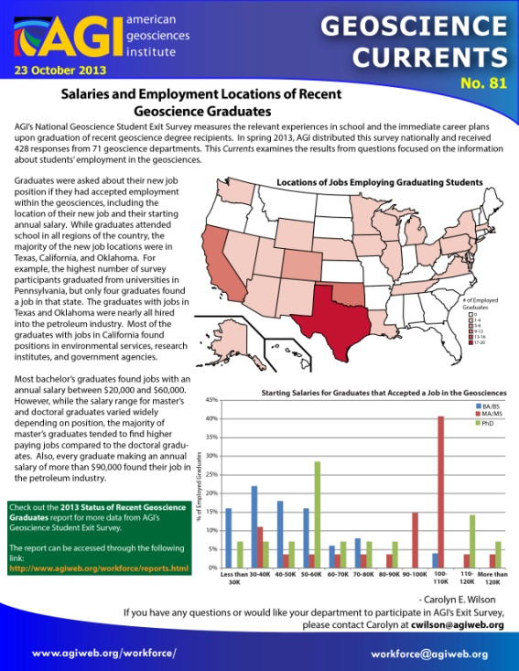
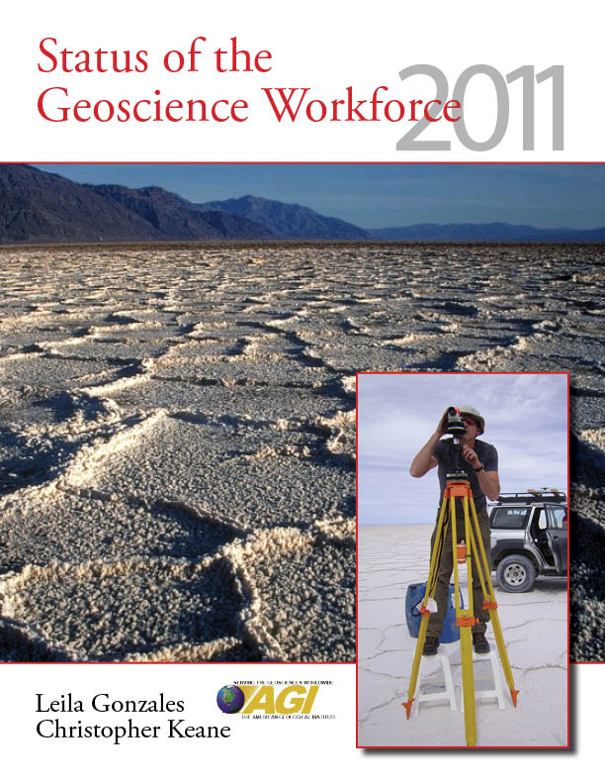

Ongoing Projects
Directory of Geoscience Departments
Updated yearly with self-reported data
Recent changes
International departments
2-year colleges
Student theses
Geoscience Currents
Monthly newsletters highlighting workforce data
Status of the Geoscience Workforce
Compendium of Workforce data
Published every other year
Outreach Initiatives
Career Networking Lunches
Brochure “Careers that Change the World”

Slide 6

Supporting the Student-to-Professional Transition
Preparing Our Workforce Initiative (POW)
Via GOLI – Online courses taught by experts
How to host a Careers Discussion with geo students
Information Literacy – conducting effective literature research
Hosted by GeoRef
Geo Career MaPS: Geoscience Career Master’s Preparation Survey
NSF funded project to align curriculum with workforce competencies
For Master’s programs in geology and geography

Slide 7
Supporting the Student-to-Professional Transition
Developing a Diverse Professoriate Workshop
NSF Funded workshop to support underrepresented minorities succeed in academia
Held in April 2012 – 2.5 days long
Scholarships
Minority Participation Program (MPP)
Longest running diversity scholarship in the geosciences (ended 2012)
Harriet Evelyn Wallace Scholarship (new!)
Offered to female graduate students in geoscience

Slide 8

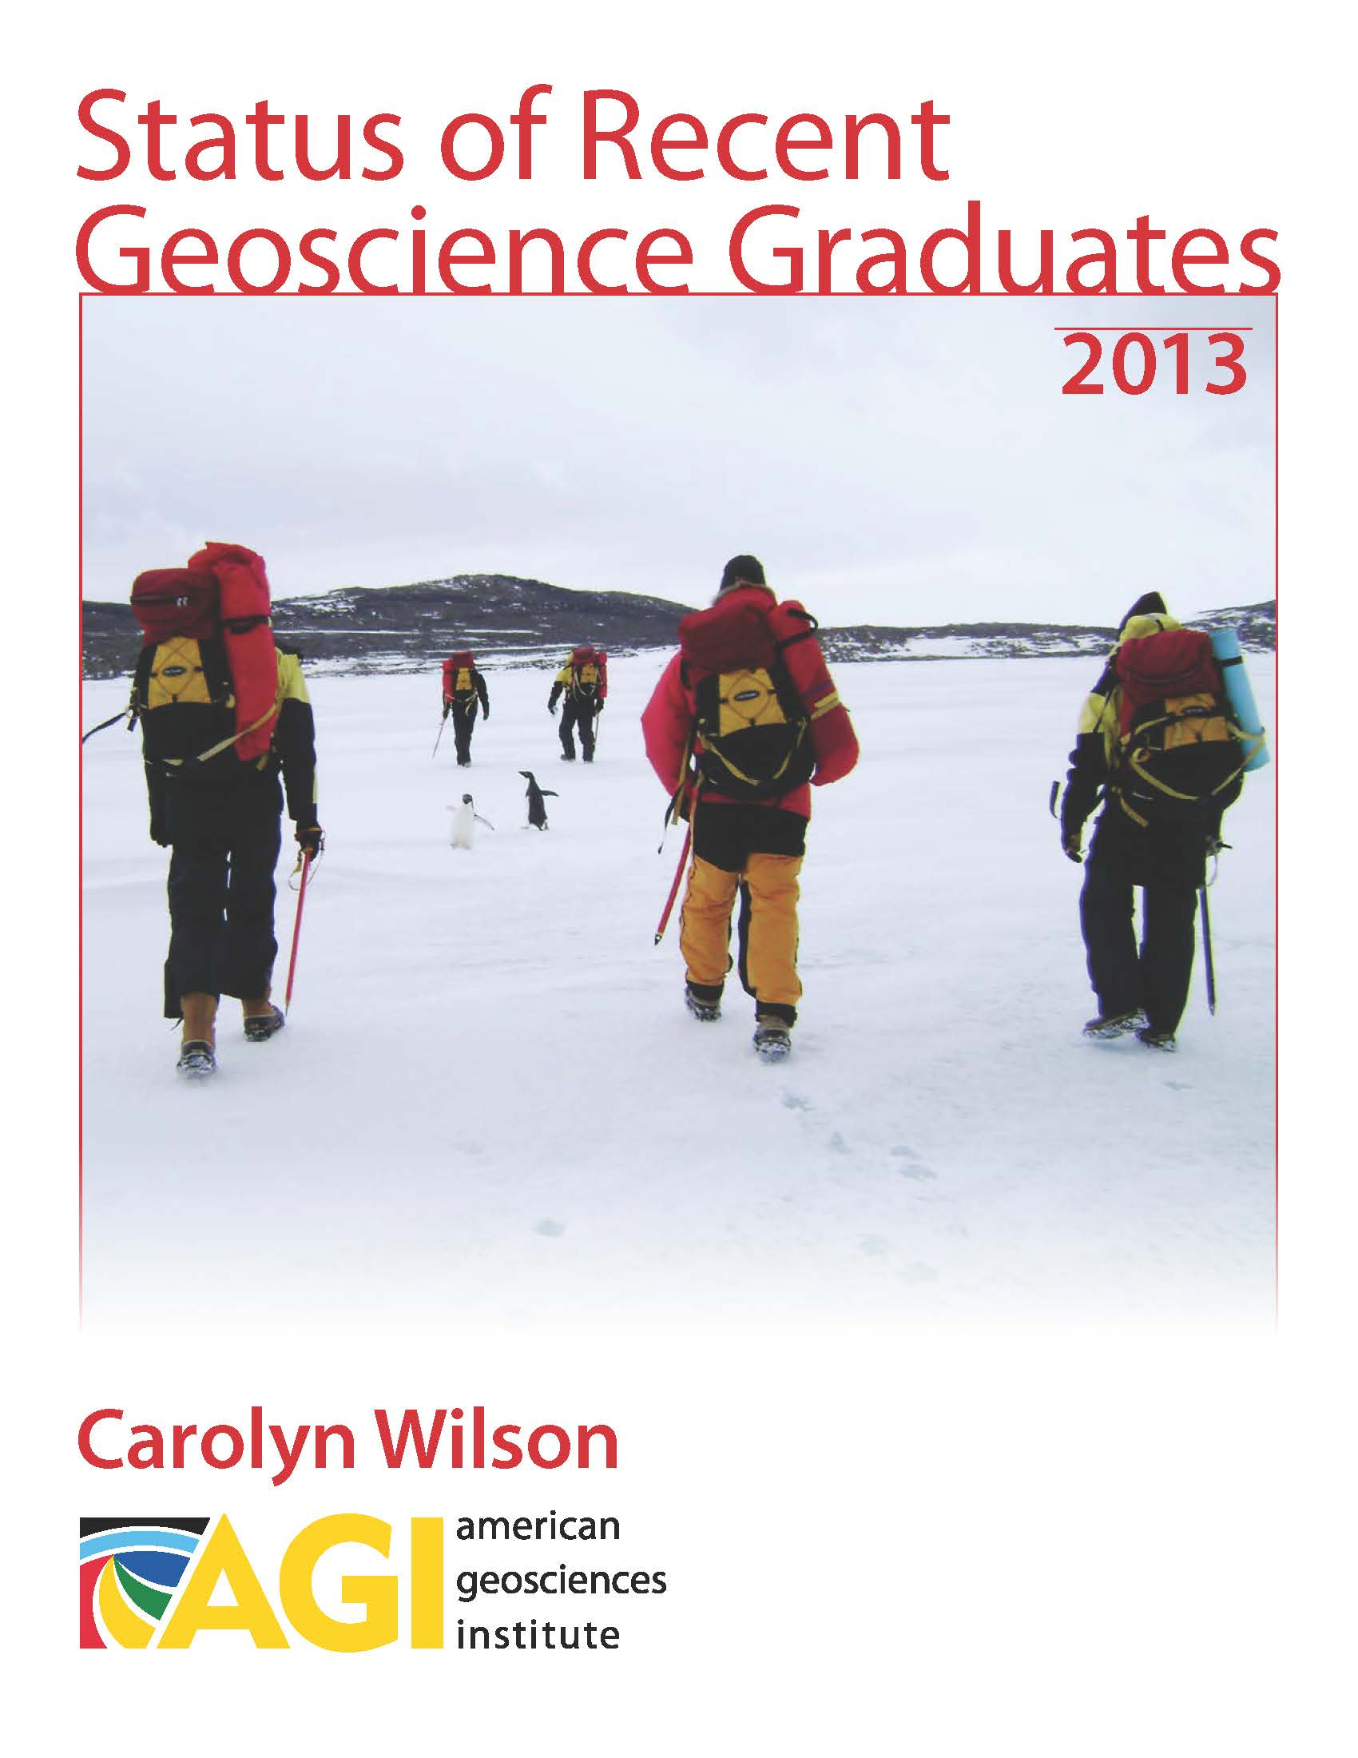
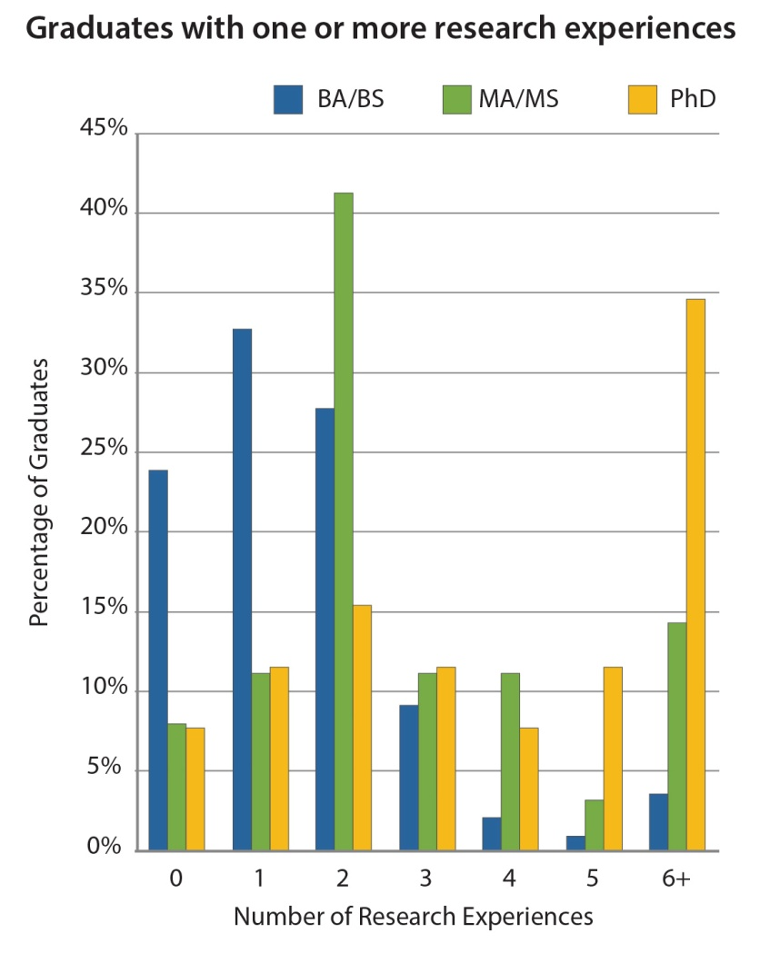
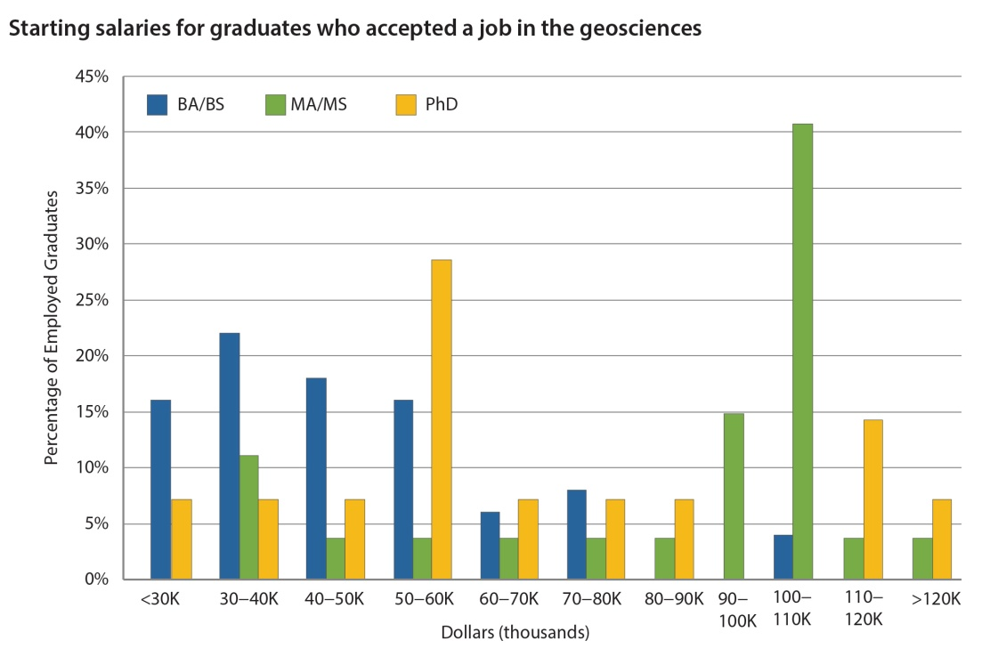
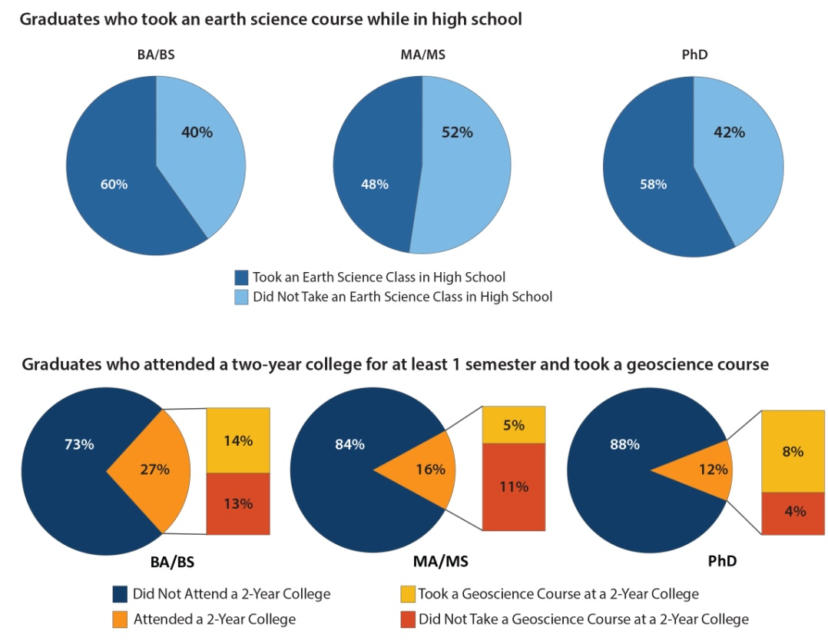
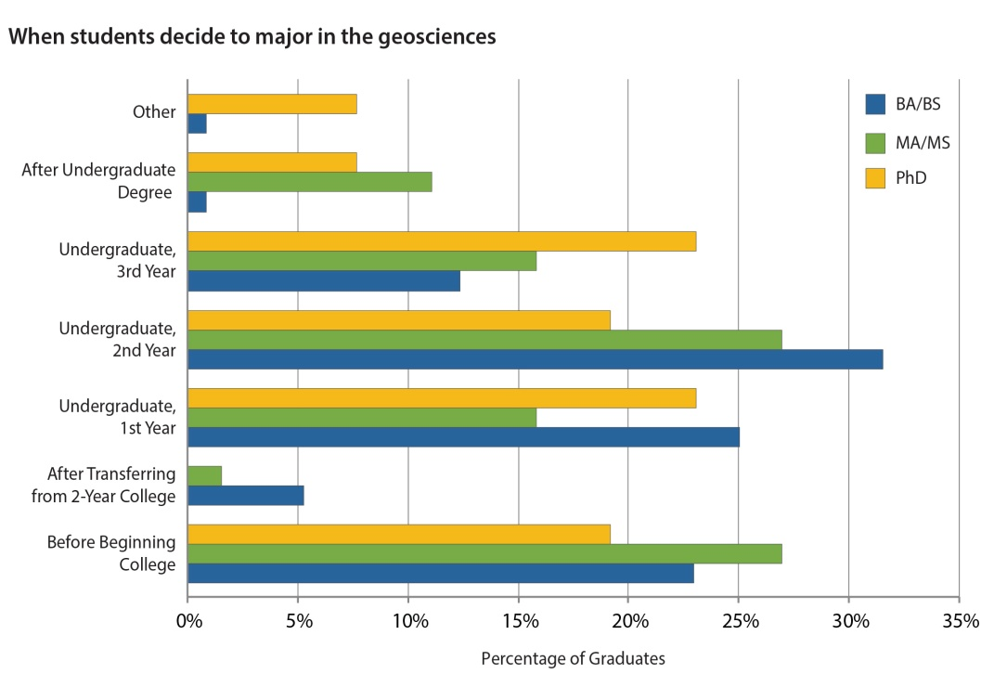
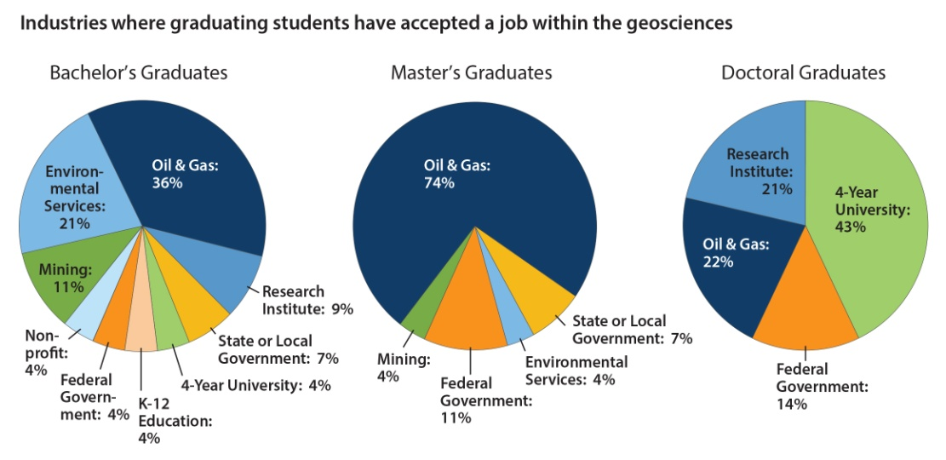
AGI’s Geoscience Student Exit Survey
Objectives
Understand the general pathway of geoscience graduates through their educational career
Identify student decision points for and understand reasons for attrition
Identify the geoscience fields and co-curricular experiences that students pursue in postsecondary school
Identify preferred jobs and industries of graduates
Demonstrate the value of a geoscience degree

Slide 9
National Survey of the Geoscience Workforce
Objectives
Identify the difference geoscience careers and industries hiring the majority of the geoscience workforce
Identify the skills and knowledge gained while in the workforce
Collect information about salary projections as experience and skill level changes
Measure the attrition rate of the trained geoscience workforce
Understand the career pathways from college through the first few years in the workforce

Slide 10
Future Initiatives/Ideas
Highlighting internship opportunities for students
Workforce Skills Development
Developing international collaboration for our surveys
Creating geographical mapping of career pathways
Understanding the 2-year college pathway

Slide 11
Questions? Comments?
Contact Information
Christopher Keane: keane@agiweb.org
Heather Houlton: hrh@agiweb.org
Carolyn Wilson: cwilson@agiweb.org
American Geosciences Institute, Workforce Program
http://www.agiweb.org/workforce
Geoscience Currents: http://www.agiweb.org/workforce/currents.html
Workforce Reports: http://www.agiweb.org/workforce/reports.html
Scholarship Information: http://www.agiweb.org/scholarships/wallace/
POW Initiative registration can be found on our main webpage

