Slide 1







Geoscience Learning for a Sustainable Future: InTeGrate Hurricane Hazards Module
Lisa A. Gilbert, Williams-Mystic and Williams College
Joan Ramage, Lehigh University
Joshua C. Galster, Montclair State University
Mary E. Savina, Carleton College
David McConnell, North Carolina State University

Slide 2
5-year NSF-funded STEP Center
(STEM Talent Expansion Program)
Main goals:
Develop curricula that will increase geoscience literacy of undergraduate students.
Increase geoscience majors able to work on interdisciplinary topics that are societally relevant
More info: http://serc.carleton.edu/integrate

Slide 3
Outline of module development
 | Date | Activity
 | Winter ‘12 | Proposals submitted
 | March ‘12 | Proposal approval
Year 1 | May ‘12 | First meeting
 | Summer-Fall ‘12 | Material development
 | Fall ‘12 | IRB approval
 | Spring ‘13 | Material testing in classrooms
Year 2 | May ‘13 | Second meeting
 | Summer-Fall ‘13 | Material revision
 | Winter ‘14 | Publish materials online
Notes:
Mention proposals, too? I think the timeline is roughly similar that proposals are due in the winter, then 1st meeting is in the Spring
Added Winter ’12 since that’s what I remember

Slide 4
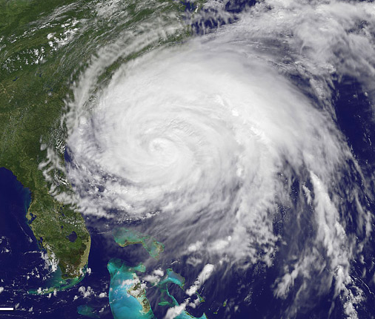
Our hurricane module
Introduces the scientific and societal challenges of hurricanes
Uses systems thinking across the ocean-atmosphere-terrestrial spheres
Incorporates data from historic hurricanes and their tracks
Uses active learning
Is scalable and flexible to different learning environments
Geographically relevant
2 weeks of classroom/lab material
Individual activities also usable on their own
Lecture and laboratory activities
Downloadable, free, and customizable

Slide 5
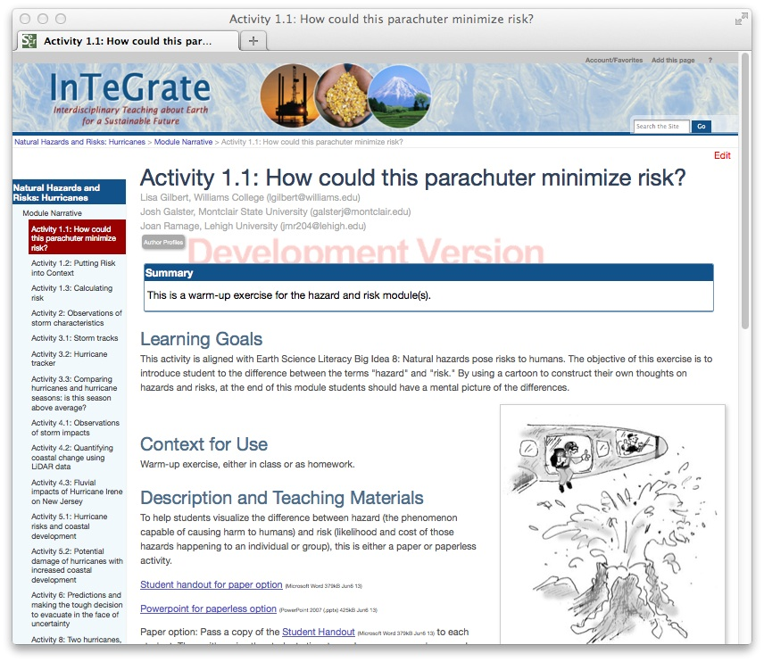
Notes:
To illustrate what one might see coming to the website looking for material:
Learning goals; Context, Description; Teaching Notes; Assessment; References and Resources

Slide 6
Outline of module: Week 1
Activity 1: Risks vs. hazards
Activity 1.1: (5-10 minutes)
Using an image of someone parachuting over a volcano, introduce the difference between hazard & risk. Activity 1.2: (10-20 minutes)
Discussion based on New York Times article about daily risk.
Activity 1.3: (20 minutes)
Calculate risk and insurance costs.
http://www.nhc.noaa.gov/climo/
Notes:
Brief description of each one and an image for each- each image appearing the disappearing

Slide 7
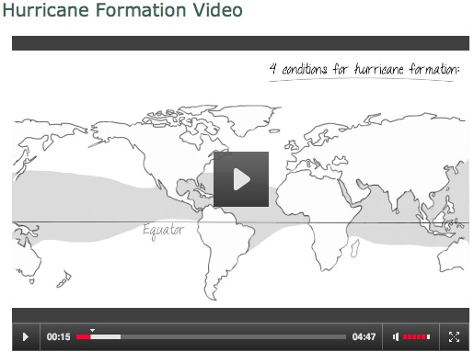
Outline of module: Week 1
Activity 2: Storm characteristics
Notes:
Mention we have images, powerpoints, videos all available for use on the site (video is NOT LINKED)

Slide 8
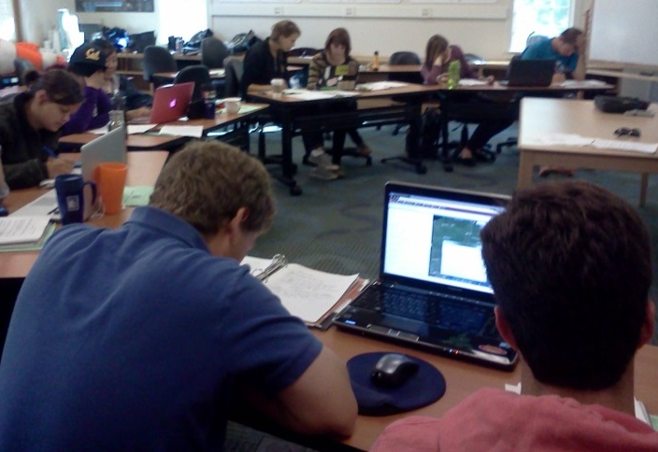
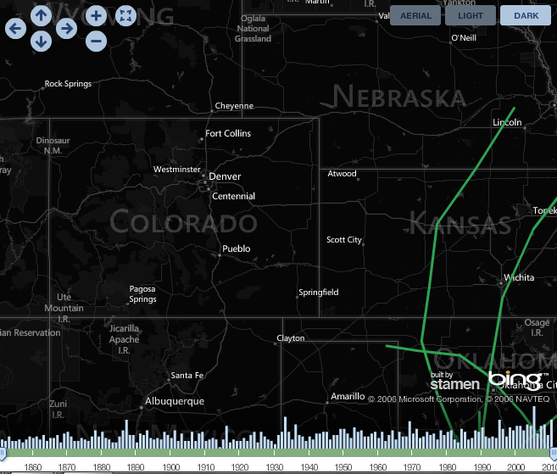
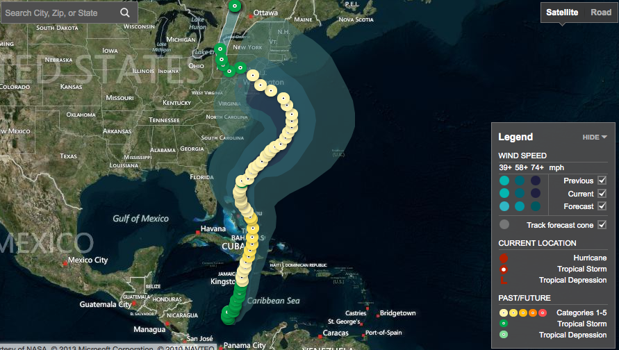
Outline of module: Week 1
Activity 3: Hurricane Tracks
http://www.weather.com/weather/hurricanecentral/tracker-historical
Notes:
We use online tracker tools, too, which allow deep exploration of data by students
I wanted to use Denver here since that’s where I’ll be

Slide 9
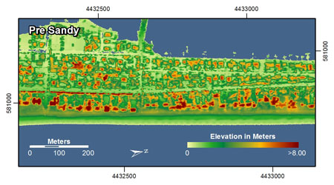
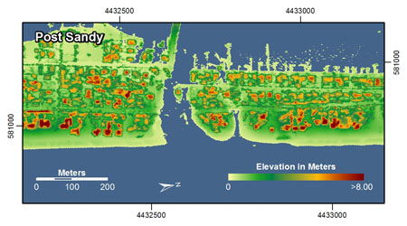
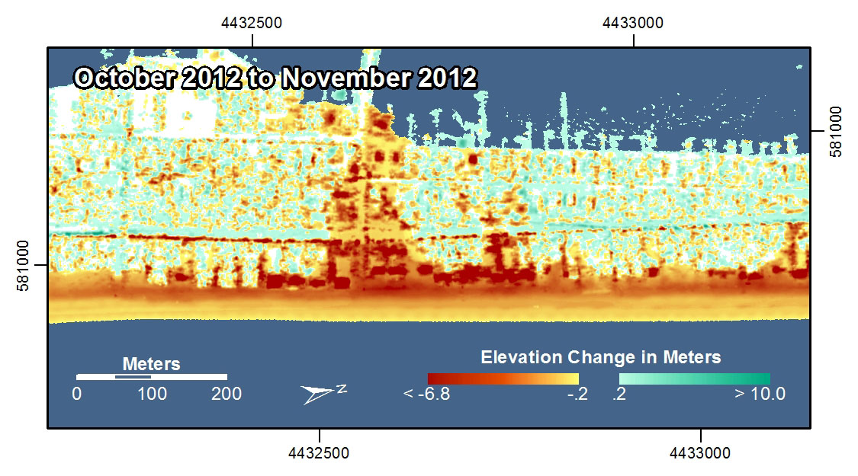
Outline of module: Week 2
Activity 4: Terrestrial storm impacts
USGS St. Petersburg
Coastal and Marine
Science Center
Notes:
Using LiDAR data; linking lithosphere-hydrosphere-atmosphere

Slide 10
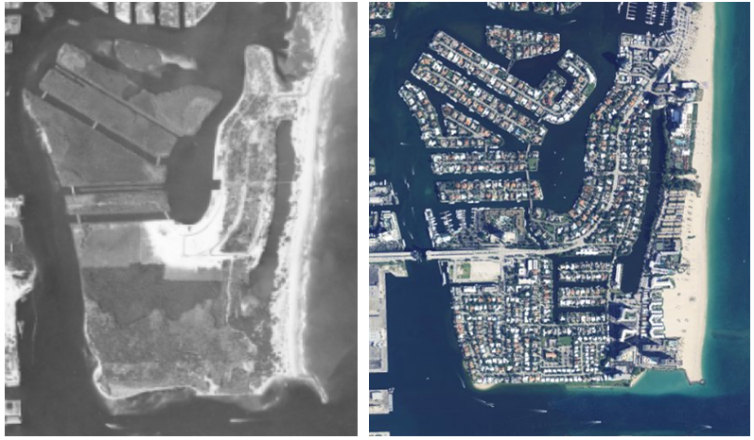
Outline of module: Week 2
Activity 5: Hurricane Risks and Coastal Development
Notes:
Brief description of each one and an image for each- each image appearing the disappearing

Slide 11
Outline of module: Week 2
Activity 6: Predictions, uncertainty, & evacuating
Notes:
Brief description of each one and an image for each- each image appearing the disappearing

Slide 12
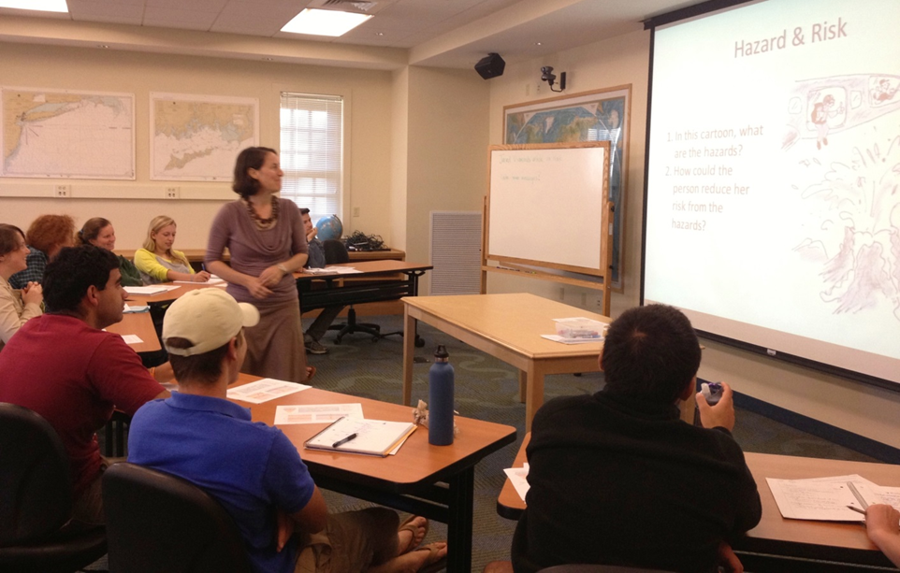
Piloted at different schools
Montclair State: public, master’s granting
24 students, general education Environmental Geology course
Lehigh: private, research university
75 students, non-major introductory Earth Science course
Williams College: private, baccalaureate
12 students, junior-level Oceanography course within an interdisciplinary maritime studies off-campus semester (during and after Hurricane Sandy)
Notes:
Flexible, tested different ways

Slide 13
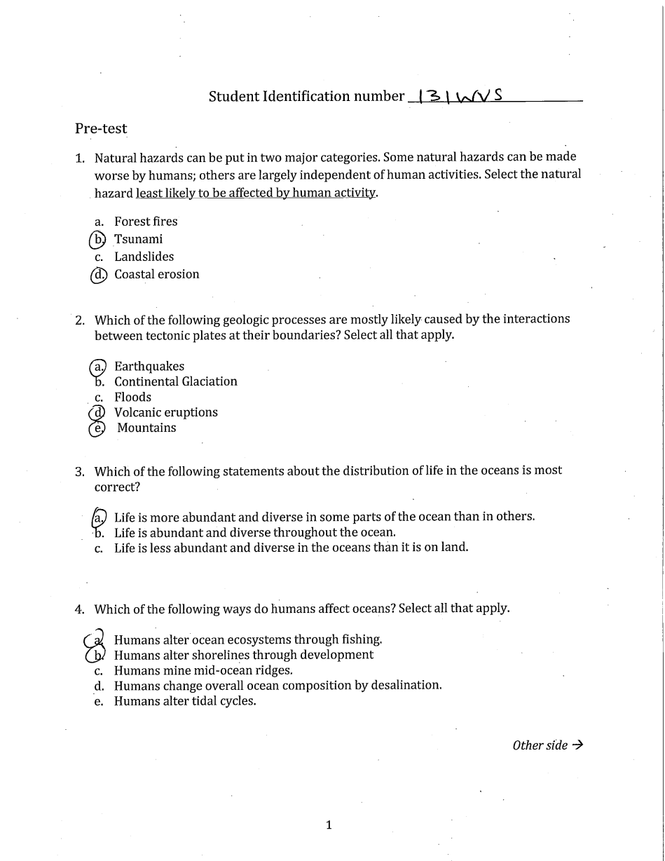
Revisions based on:
Pre- and post-tests and attitudinal surveys
Classroom observations and student interviews
Student written feedback
Rubric-based evaluation by 2 assessors
Weekly discussion between 3 developers
Notes:
Generally positive student feedback

Slide 14
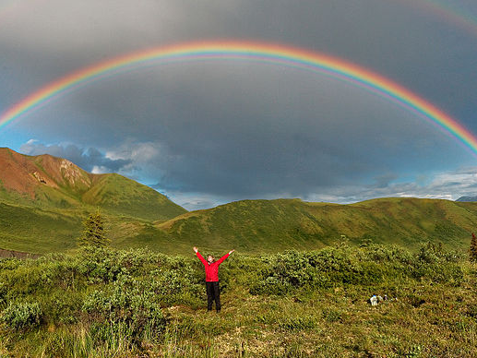
Reflections on collaborative course material development
Good team chemistry
Frequent and effective communication
Only met in-person twice
Skype/Google hangouts and conference calls
Build on researchers’ strengths
Remote sensing, oceanography, geomorphology
Willingness to be flexible and open-minded
Image: Rolph, 2007

Slide 15
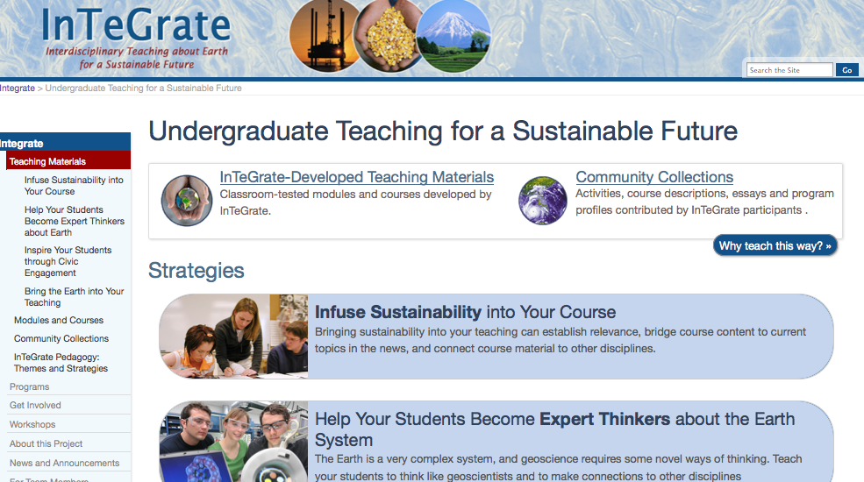
Other modules in development
Climate Change
Earth’s Mineral Resources
Environmental Justice and Freshwater
Launch planned early 2014

Slide 16
Acknowledgements
David Steer, Cathy Manduca, and InTeGrate management team
Monica Bruckner, Sean Fox, and others at SERC for web development and deployment
Laura Lukes (NCSU) for classroom observations and student interviews
Other InTeGrate talks:
Wednesday 9:10 (Room 404) McConnell et al. Integrate: Rethinking Geoscience Instruction with the Development of Free Customizable Resources to Address Earth's Grand Challenges in Introductory Courses
Wednesday 10:00 (Room 405) Walker et al. Promoting Climate Literacy Through Development of Data-Driven Instructional Modules for Undergraduates

