Slide 1
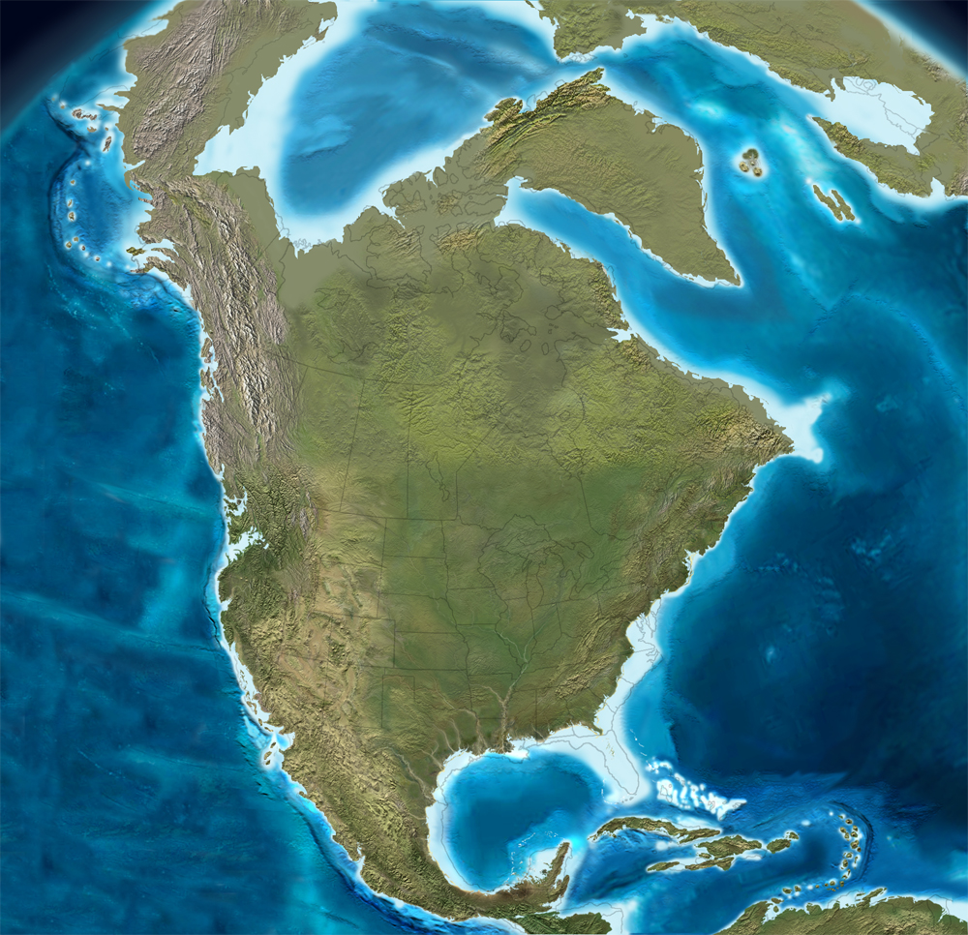
Paleoclimate Reconstructions of Three Mid-Atlantic Miocene Sites
Aly Baumgartner
East Tennessee State University

Slide 2
Purpose
Broaden understanding of Neogene E. North America
Compare/contribute to global knowledge of Neogene climate

Slide 3
Miocene North America
Notes:
~15 mya
Except for the Mid-Miocene Climatic Optimum, overall cooling trend throughout the Neogene

Slide 4
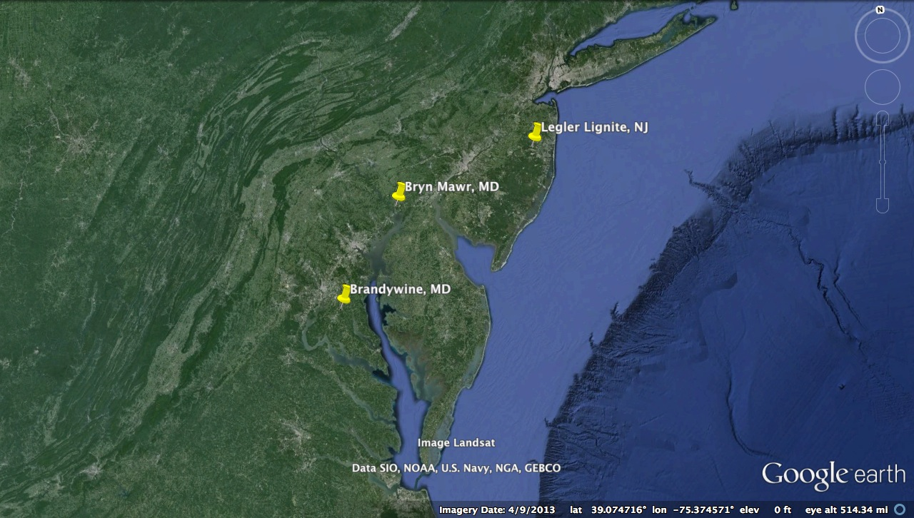
Mid-Atlantic Sites
Notes:
Chosen: close in age (Middle to Late Miocene)
Close in space (~100 km apart)
Floral fossils

Slide 5
Legler Lignite
Middle Miocene (~11 mya)
Cohansey Formation
Exotic taxa: Cyathea, Podocarpus, Engelhardia, Pterocarya
Quercus, Pinus, Carya => climate was warmer, wetter
Notes:
-many fossil taxa still found in coastal New Jersey today -Cyathea and Podocarpus: found in the mountains of Mexico and the Antilles –Engelhardia: found in the mountains of tropical Mexico and Central America –Pterocarya: found in East -climate was likely similar to that of modern southeastern North America, or perhaps warmer due to the presence of taxa that are restricted to tropical and subtropical regions today

Slide 6
Bryn Mawr
Middle/Late Miocene
Bryn Mawr Formation
Exotic taxa: Sciadopitys, Engelhardia, Pterocarya
Quercus, Alnus, Carya, Taxodium, Liquidambar, Juglans, Pinus.
Quercus, Carya, Engelhardia, Symplocos, Cyrilla => warm-temperate/subtropical w/o extended cool periods
Notes:
-many taxa found still present in the region today (Quercus, Carya, Pinus, Ilex and Betula) -Sciadopitys, Engelhardia and Pterocarya: site must be older than Pleistocene -presence of temperate gymnosperm pollen (Tsuga and Picea) suggests a cooler climate w/ more seasonality -Pazzaglia et al: that the middle to late Miocene brought about shift from thermophilic species and Quercus-Carya dominance to more cold-adapted Pinus and Picea

Slide 7
Brandywine
Late Miocene (~11.2-6.5 mya )
Exotic taxa: Alangium, Pterocarya, Zelkova, Trapa
Pinus, Smilax, Myrica and Comptonia => temperate climate (McCartan et al.,1990)
Taxodium, Pterocarya, Liquidambar, Cyrilla => warm-temperate or sub-tropical climate (Groot, 1991)
Taxodium distichum/absence of drought-tolerant taxa => high water table and adequate rainfall
Notes:
-~49 taxa (pollen, seeds, fruit, leaves, and wood from Taxodium) –vegetation dominated by vines & deciduous trees -climate was likely warm-temperate. –only Mneme is now extinct –only four taxa no longer found in North America but still survive in temperate climate -remaining 44 genera, all but two still grow in Maryland: Sophora now grows west of the Appalachian Mountains and Larix only grows as far south as New Jersey. -scarcity of terrestrial herbaceous plants/absence of grass pollen indicates a lack of open space near site

Slide 8
Planera, Clethra, Cyrilla, Cyathea, Fraxinus, Gordonia,
Podocarpus, Plantago
Abies, Tsuga, Myrica, Sequoia, Symplocos, Sciadopitys
Prunus, Vitis,
Taxodium,Gleditsia, Potamogeton, Ptelea,
Smilax, Trapa, Sophora,
Toxicodendron, Cornus, Hamamelis, Euonymus, Larix
Parthenocissus, Nuphar, Liriodendron, Platanus
Ulmus, Nyssa,
Salix, Pterocarya,
Ilex, Quercus,
Carya, Pinus
Liquidambar,
Typha, Alnus,
Fagus
Brandywine
(Late Miocene)
Alangium, Acer,
Betula, Zelkova
Populus
Engelhardia,
Castanea,
Picea,
Tilia
Bryn Mawr
(Mid/Late Miocene)
Legler Lignite
(Late Miocene)

Slide 9
Methods
Nearest Living Relative Approach
  MAT, CMMT, WMMT, MAP, MMaP, MMiP, WMMP
  Range of values
Map with modern intervals
  Median value

Slide 10
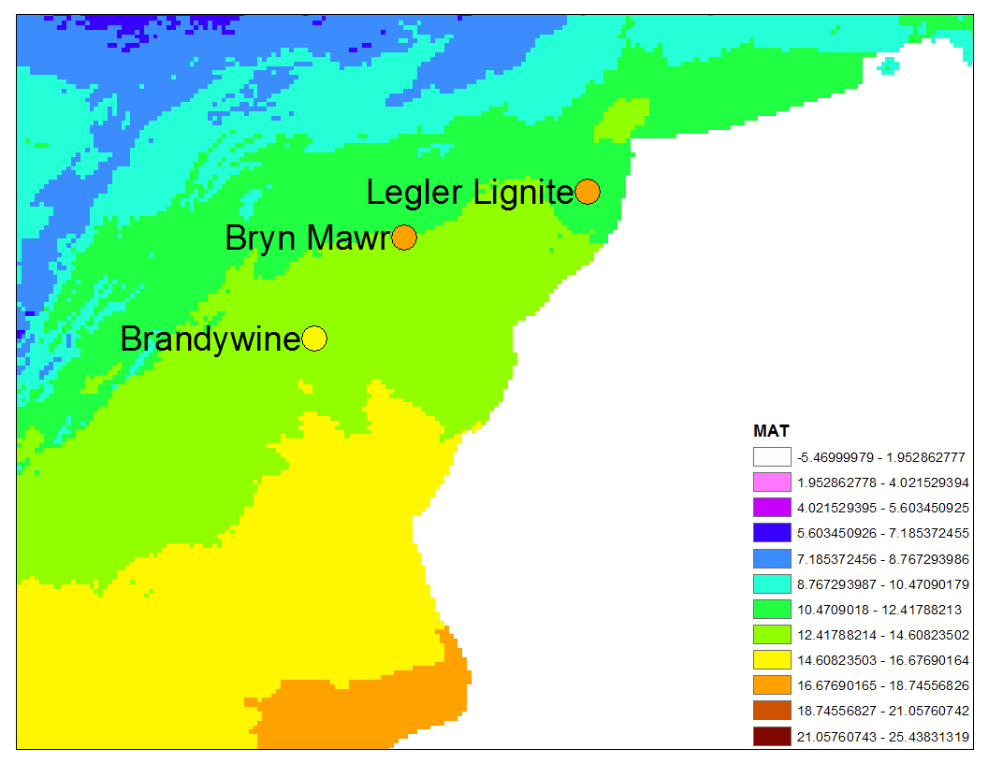
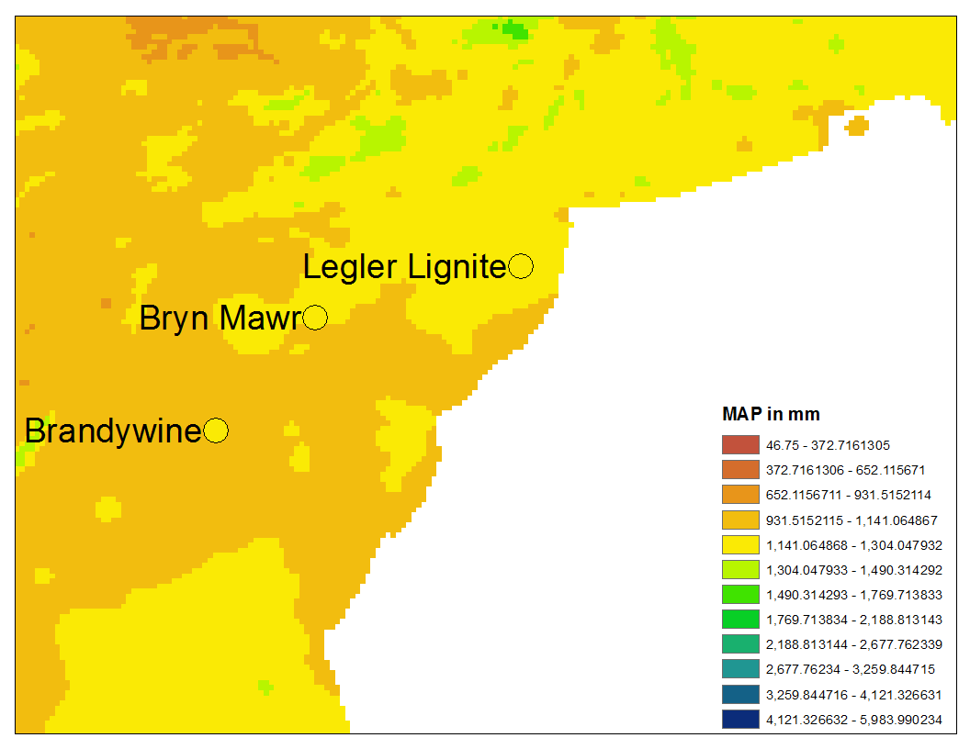
Results
Mean Annual Temperature
Mean Annual Precipitation
Notes:
More intervals -> smaller intervals -> easier to compare fossil sites to similar modern climate

Slide 11
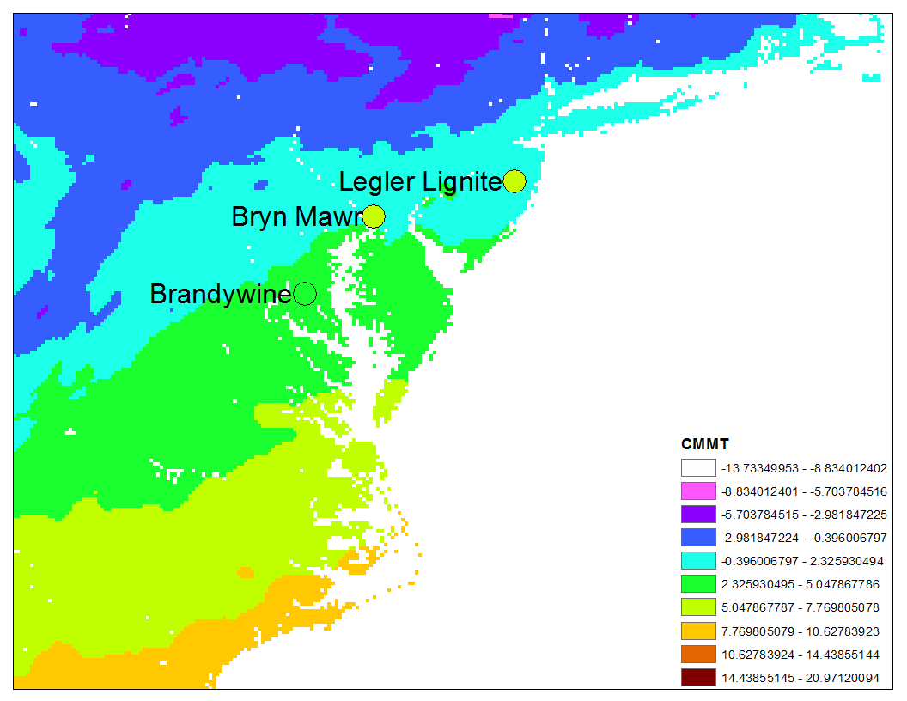
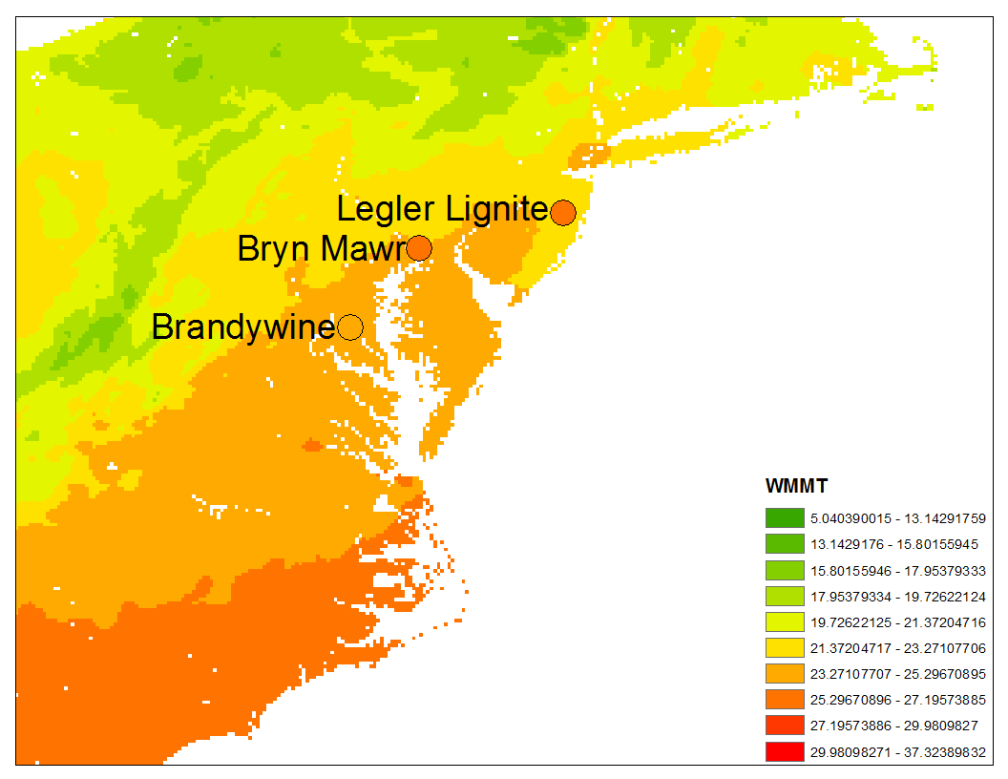
Results
Cold Month Mean Temperature
Warm Month Mean Temperature

Slide 12
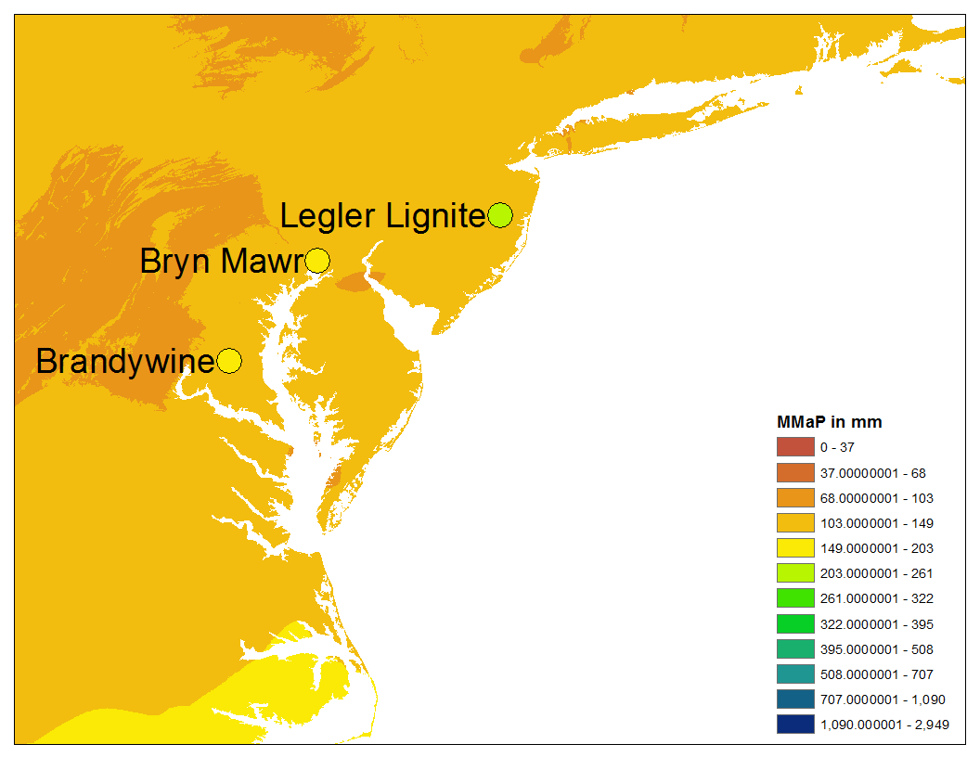
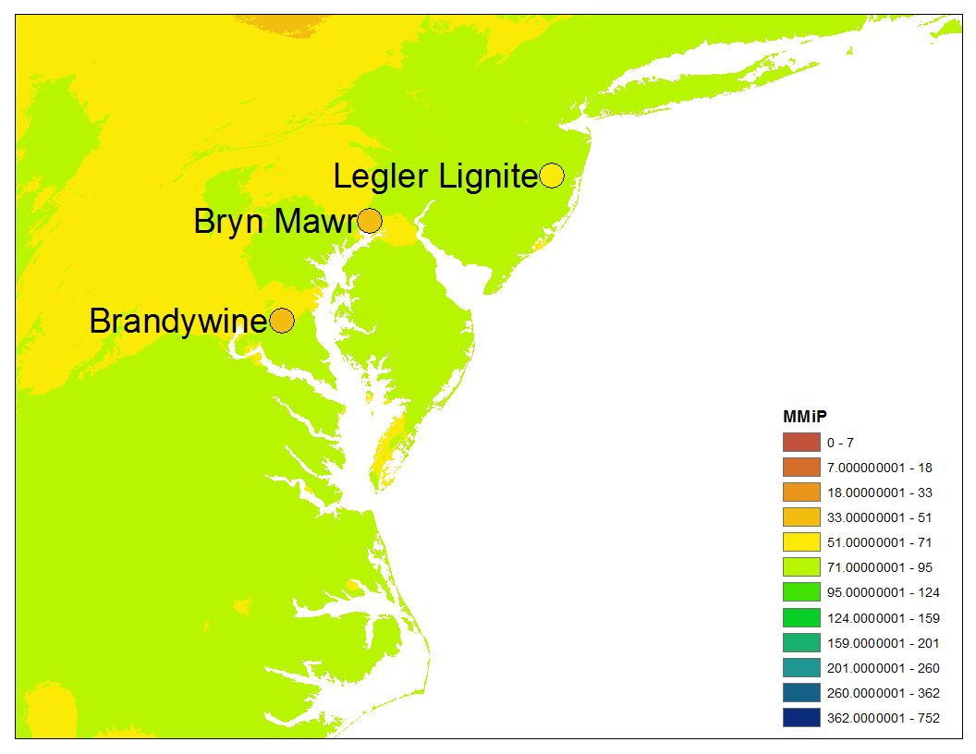
Results
Mean Maximum Precipitation
Mean Minimum Precipitation

Slide 13
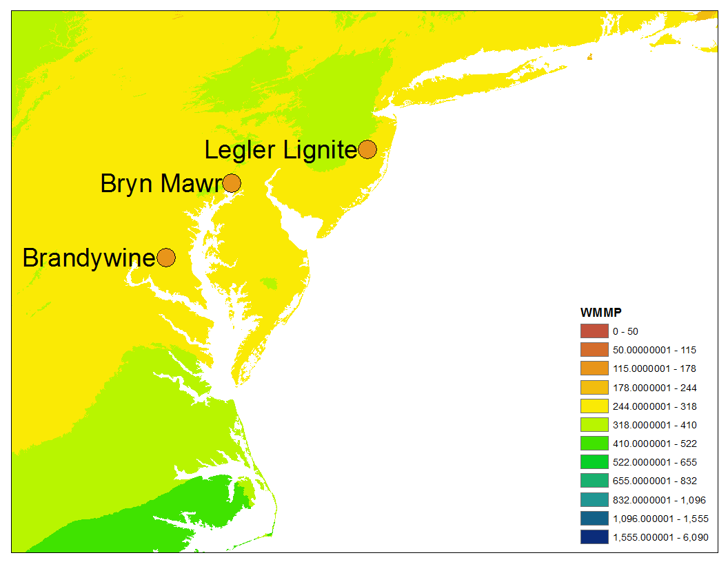
Results
Warm Month Mean Precipitation

Slide 14
Results
 | MAT | CMMT | WMMT | MAP | MMaP | MMiP | WMMP
Bryn Mawr | 13.8-20.8 | 3.1-13.3 | 23.7-27.9 | 823-1613 | 204-245 | 9-59 | 79-180
Brandywine | 13.3-16.1 | -0.1-7.8 | 23-25.6 | 735-1551 | 109-195 | 32-56 | 74-176
Legler Lignite | 14.4-20.8 | 5.2-12.6 | 24-27.9 | 996-1347 | 204-293 | 52-56 | 99-142
Notes:
Rectangles: don’t differ from present on map
Arrows, don’t differ from present on paper
MAT: 13.3
MAP: 1088

Slide 15
Conclusions
All 3 sites differ from today
  MAP exception
Notes:
LL is oldest, should be warmest/wettest/least seasonal (AS EXPECTED)
BW is youngest, should be coolest, driest, more seasonal (AS EXPECTED)
Warmer -> colder through time seen around world, and at LL, BM, BW

Slide 16
Conclusions
All 3 sites differ from today
  MAP exception
Legler Lignite most different

Slide 17
Conclusions
All 3 sites differ from today
  MAP exception
Legler Lignite most different
Brandywine least different

Slide 18

Acknowledgements
My advisor and committee
  Dr. Chris Liu, Dr. Catherine Chen, Dr. Istvan Karsai
The Biology and Geoscience Departments
Financial Support from the National Science Foundation grant to Dr. Liu.

